Slide 1

Open discussion session on synchronisation for quantum communication
Javier Serrano
WR Collaboration / CERN

Slide 2
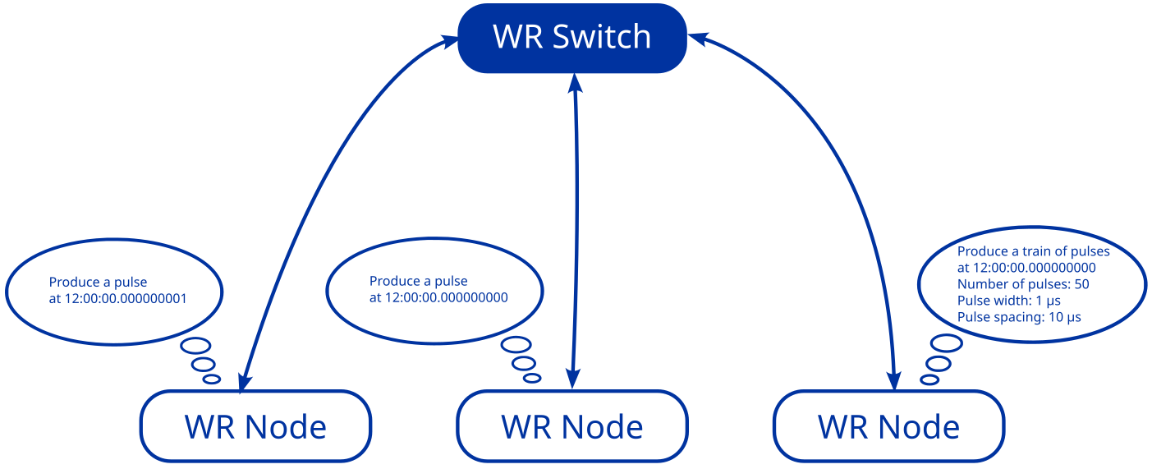
WR-based event system

Slide 3
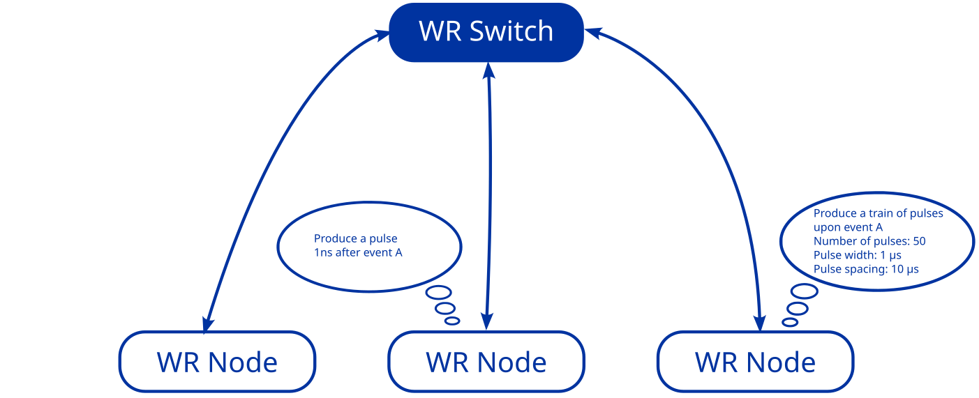
WR-based event system

Slide 4
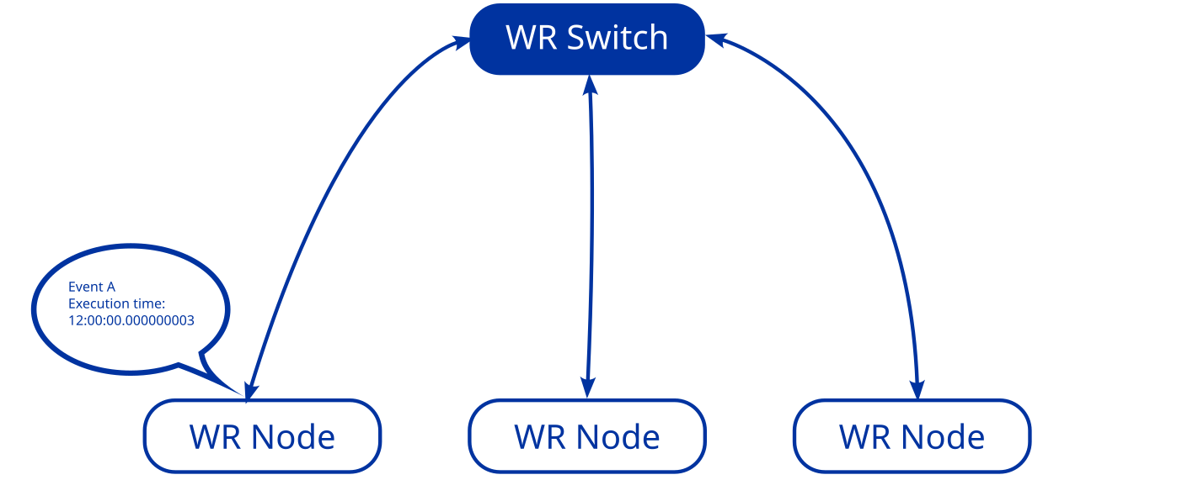
WR-based event system

Slide 5
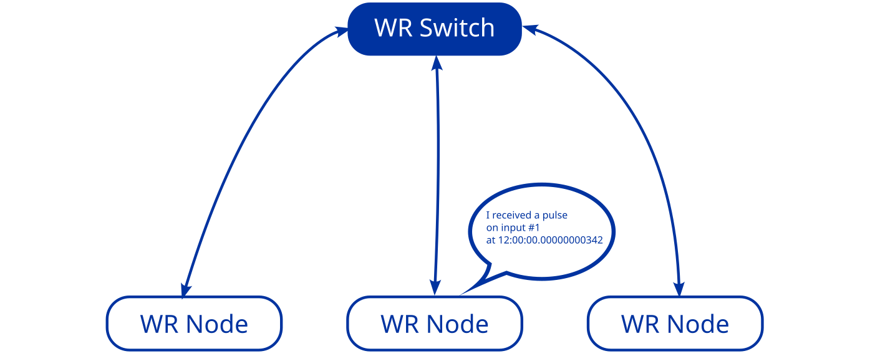
WR-based event system

Slide 6
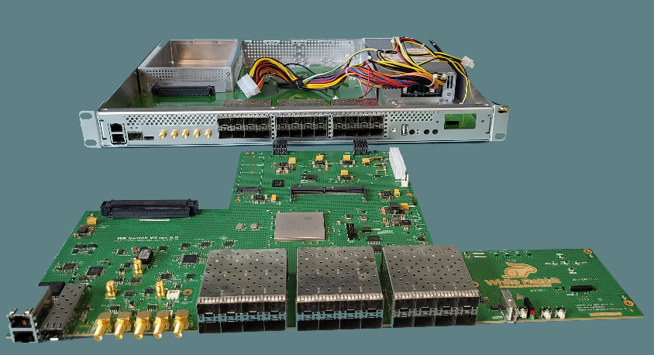
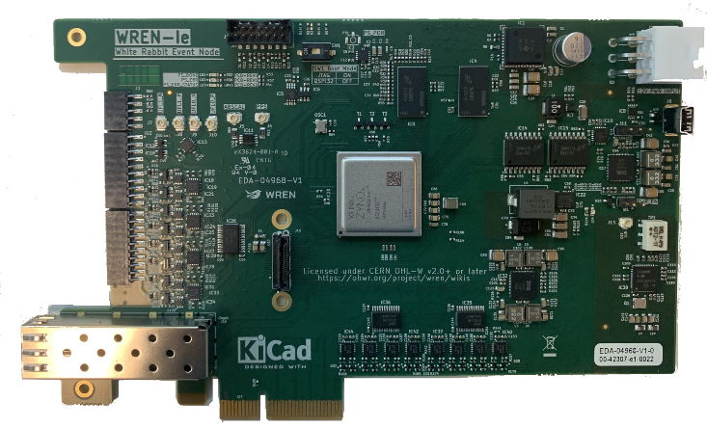
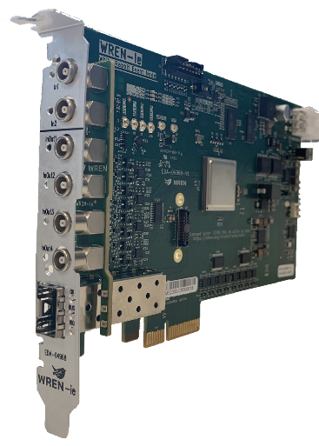
WR-based event system

Slide 7
Points for discussion
What is missing in the domain of synchronisation for quantum
communication?
  Precision/accuracy needs
  User interface: providing and time-stamping pulses, bursts, etc. Controlling times, repetition rates, duty cycles…
  Protocols: TSN? Something simpler?
  Distance requirements
  Combining or not quantum and classical networks in the same fibre: multiplexing in time vs multiplexing in wavelength
  Opportunities for standardisation, formal or de-facto
  Other?
What are your plans for the short and medium term?
Can this event spawn one or more collaborative efforts in this
domain?
PTTI 2025

