Slide 1
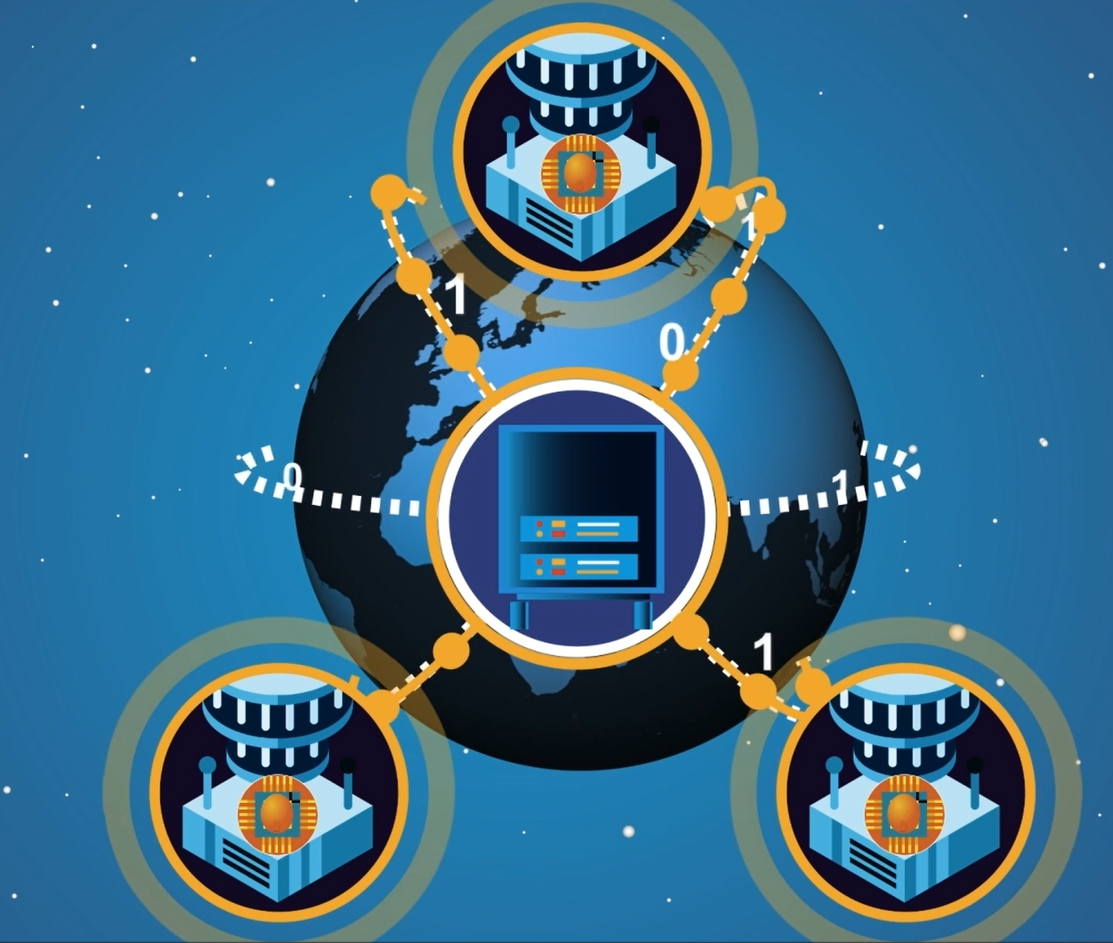
Quantum Internet: Applications, Challenges and Opportunities
Arian stolk – QT4HEP 2025

Slide 2


Slide 3
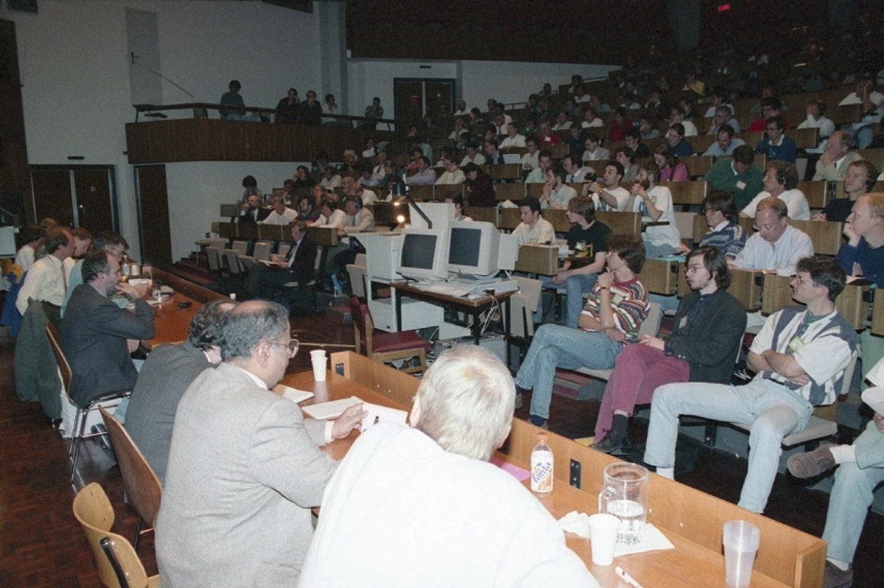

Great history of the Web at CERN
1994: Year of the Web! (W3C)
2025: Year of Quantum Science and Technology
© CERN

Slide 4
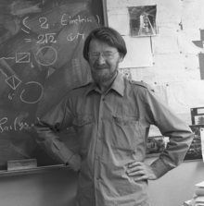
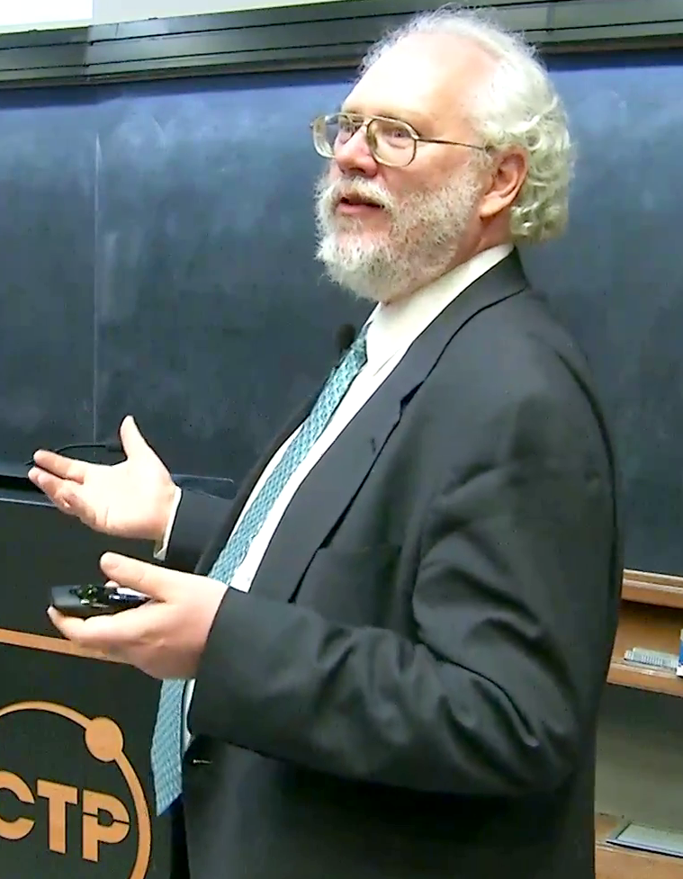
Where was Quantum by 1994?
1964: Bell’s Inequality
1994: Shor’s Algorithm
Quantum States can allow for stronger correlations than any Classical System!
Quantum Algorithms can have an exponential advantage over existing Classical Algorithms!

Slide 5
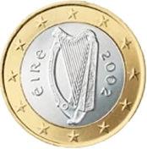
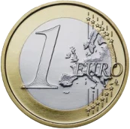


Information in the Quantum world
$$\left.|0\right\rangle$$
$$\left.|1\right\rangle$$

Slide 6


Information in the Quantum world
Superposition of both $\left.|0\right\rangle$ and $\left.|1\right\rangle$

Slide 7

Information in the Quantum world

Slide 8
Information in the Quantum world

Slide 9
Information in the Quantum world

Slide 10
Information in the Quantum world
50%
50%
Random

Slide 11
Core of Quantum: Entanglement
Two qubits in a shared superposition

Slide 12
Core of Quantum: Entanglement
50%
50%
The outcomes of the left qubit are random

Slide 13
Core of Quantum: Entanglement
50%
50%
... And also for the right qubit

Slide 14
Core of Quantum: Entanglement
50%
50%
50%
50%
…but when you compare the outcomes side by side

Slide 15
Core of Quantum: Entanglement
50%
50%
are always the same, even when far apart: non-local!
…but when you compare the outcomes side by side

Slide 16
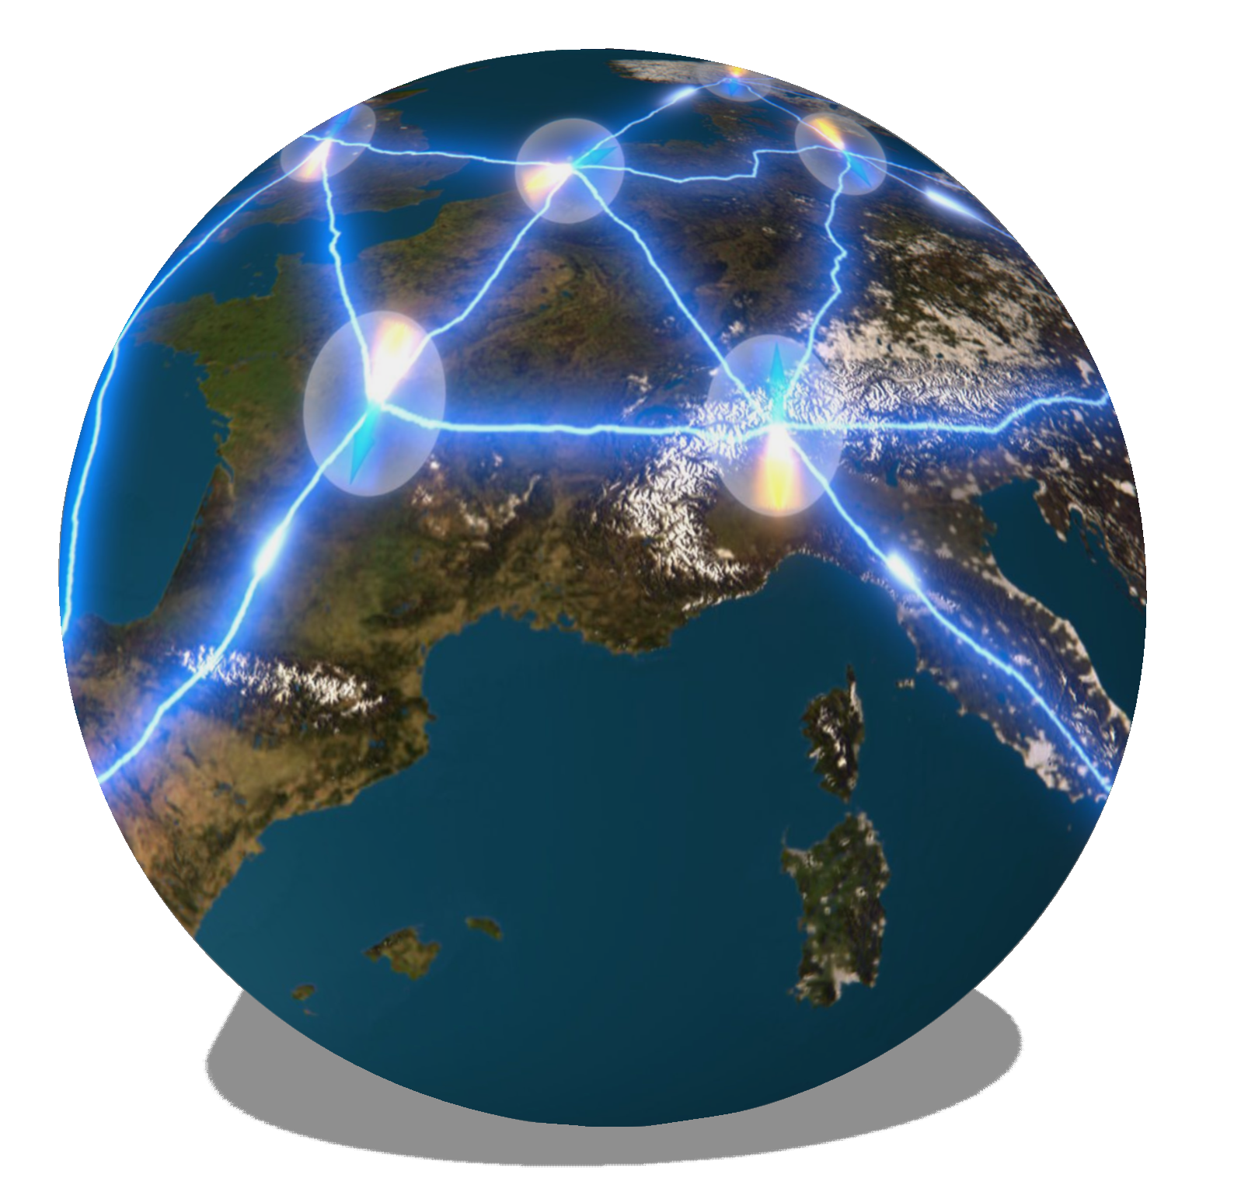
What is the Quantum Internet?
Many quantum nodes…
…connected over large distances…
…reliably exchanging
quantum information and entanglement!

Slide 17
Go through the stages of the Quantum Internet:
-What is already achieved?
-What are the challenges?
-What are the opportunities?
Stephanie Wehner, David Elkouss, Ronald Hanson, Science 2018

Slide 18
Stages of the Quantum Internet
Stephanie Wehner, David Elkouss, Ronald Hanson, Science 2018

Slide 19
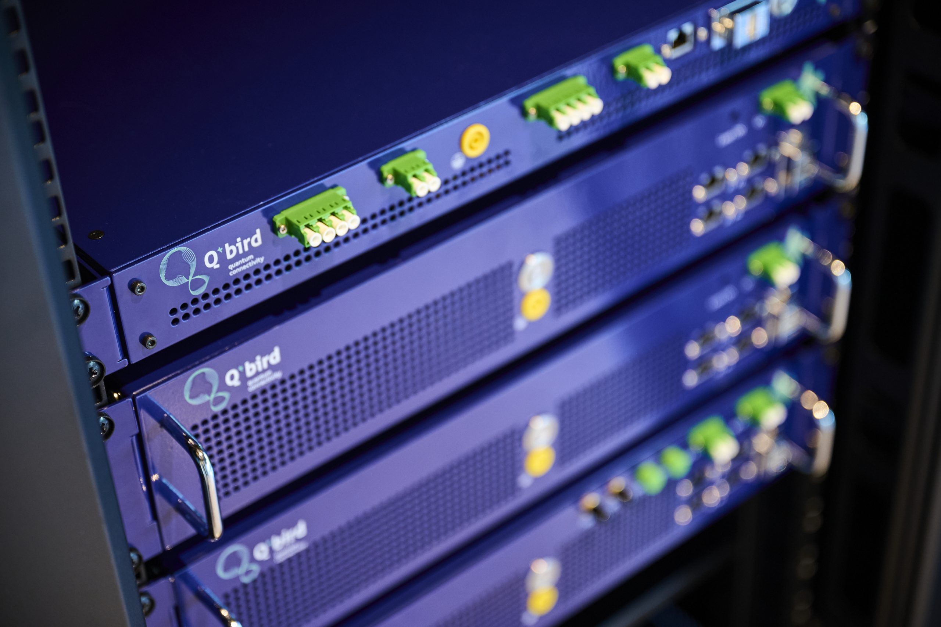
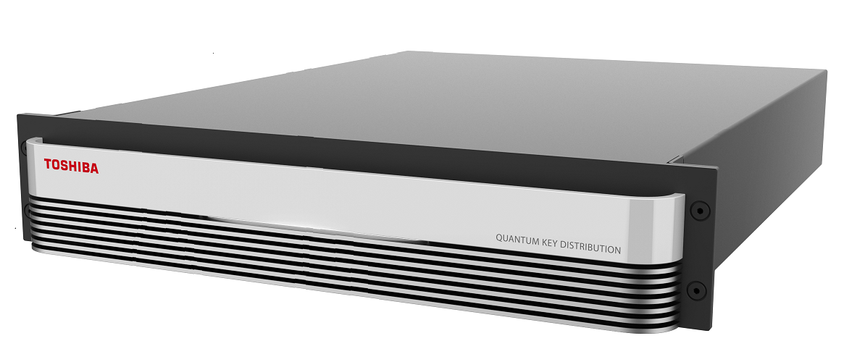
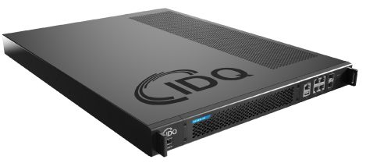
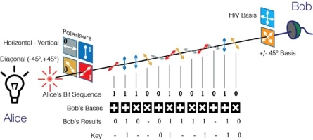
QKD systems
Various hardware vendors: Toshiba, Q*Bird, IDQuantique….

Slide 20
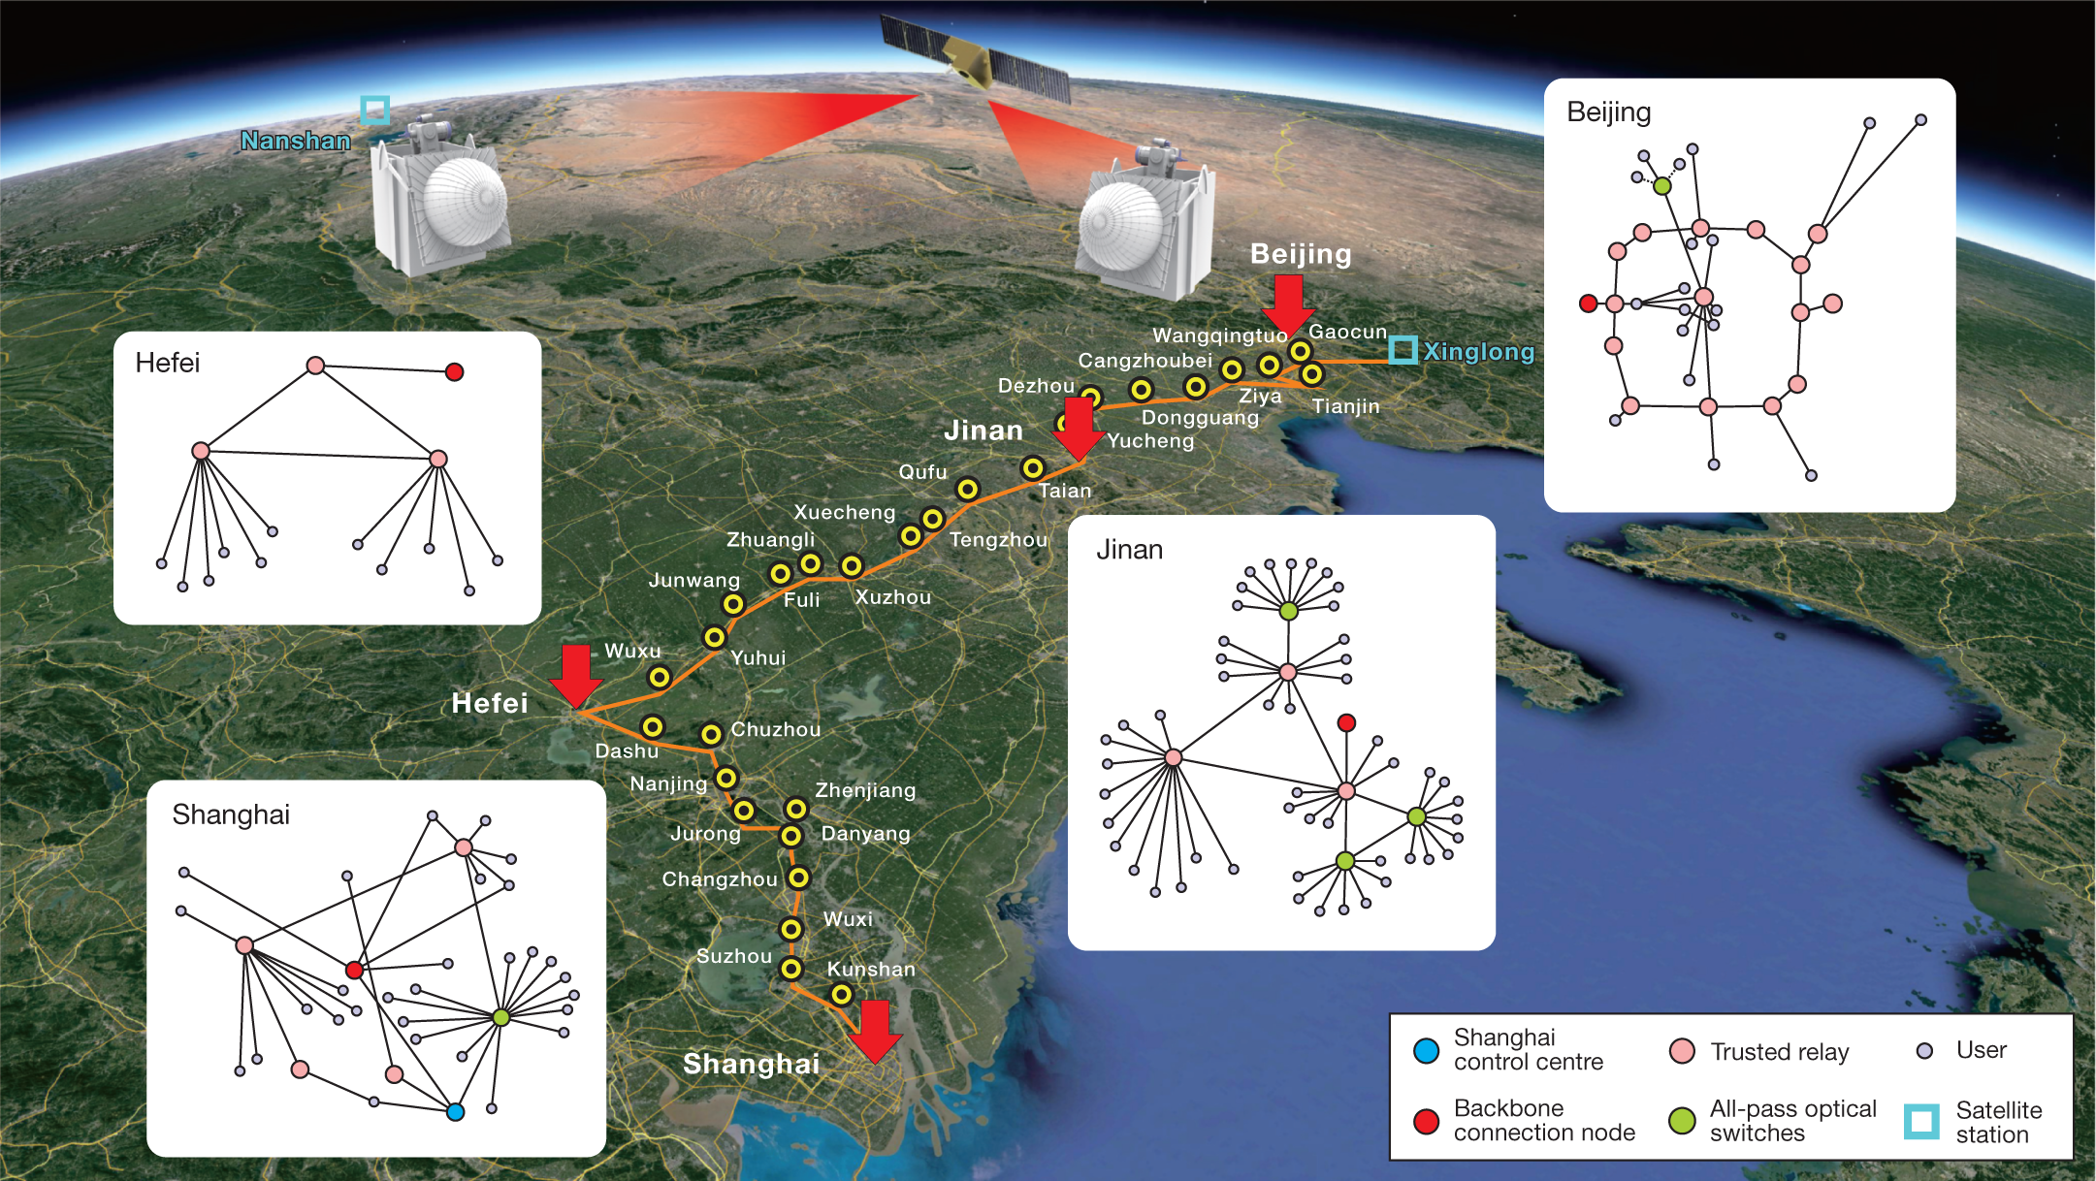
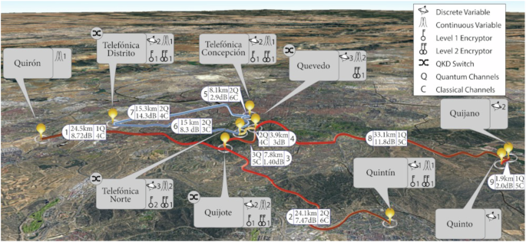
Trusted Repeater
MADQCI: QKD network in Madrid metropolitan area
Chen, YA., Zhang, Q., Chen, TY. et al. Nature 589, 214–219 (2021).
4 Metropolitan networks linked by backbone
Martin, V., Brito, J.P., Ortíz, L. et al. npj Quantum Inf 10, 80 (2024)
Generate random bits between remote parties, useful for encryption!

Slide 21
Prepare and measure
Stephanie Wehner, David Elkouss, Ronald Hanson, Science 2018

Slide 22
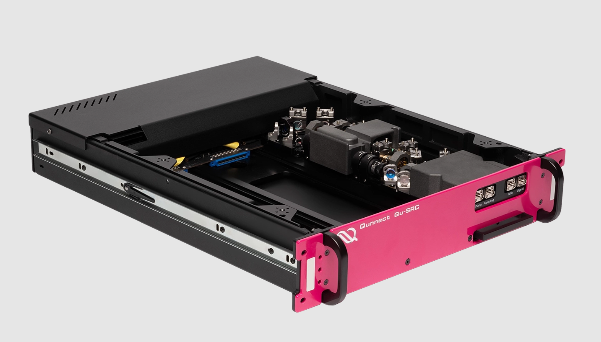
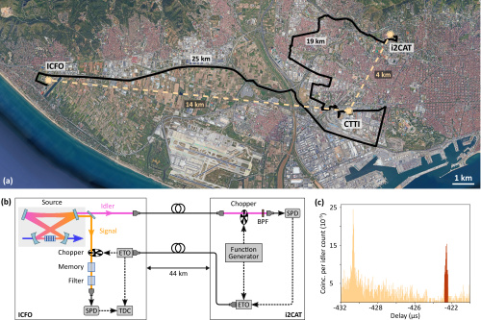

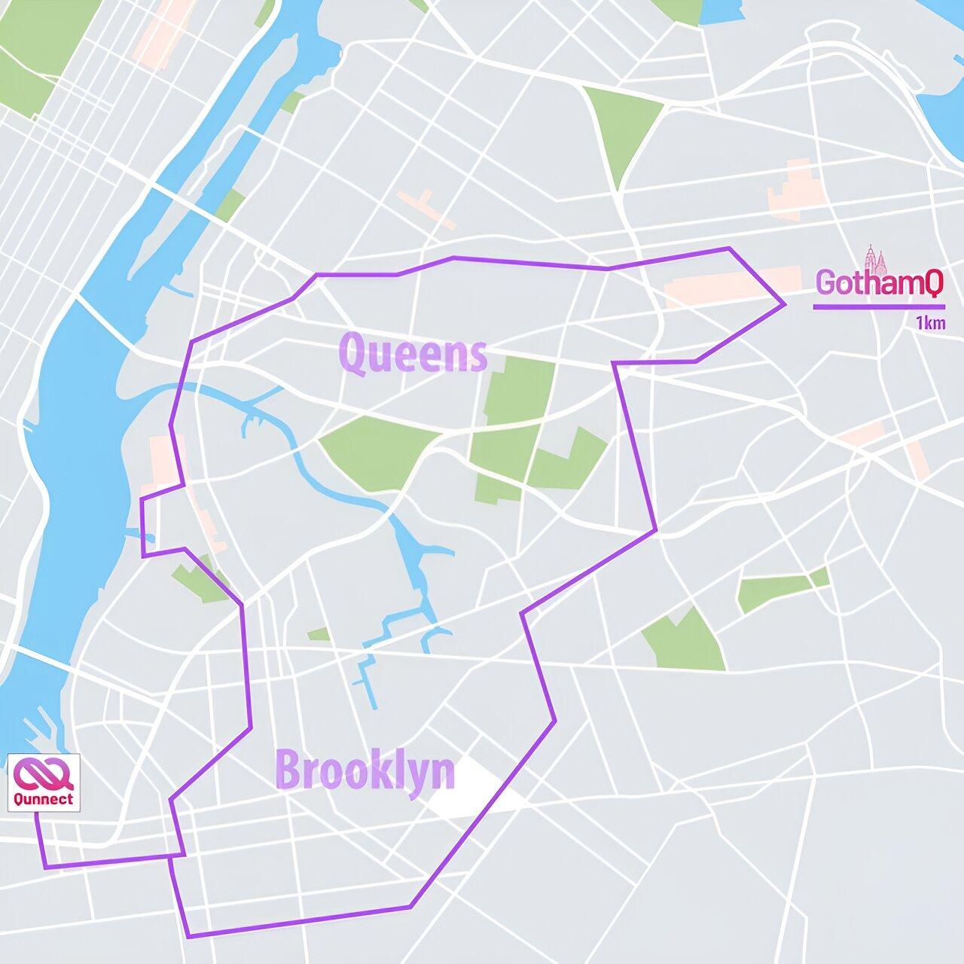
Entanglement distribution with photons
Photon pair generation compatible with telecom fiber propagation (Rb gas, SPDC sources, etc…)
Jelena V. Rakonjac et al, Optica Quantum 1 (2023)
Photons can be stored/retrieved (on demand) from memories probabilistically and lack computing capabilities
Alexander N. Craddock et al.
PRX Quantum 5, 030330 (2024)

Slide 23
Entanglement generation
Stephanie Wehner, David Elkouss, Ronald Hanson, Science 2018

Slide 24
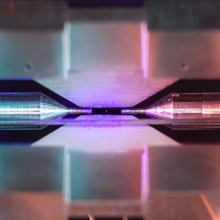
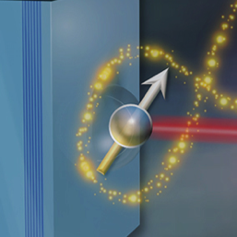
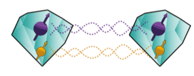

Entangled processing nodes, lots of activity!
Trapped ions
Quantum dots
Moehring et al. "Entanglement of single-atom quantum bits at a distance."
Nature 449, 68 (2007)
Stephenson et al. "High-rate, high-fidelity entanglement of qubits across an elementary quantum network."
PRL 124, 110501 (2020)
Delteil et al. "Generation of heralded entanglement between distant hole spins."
Nature Physics 12, 218 (2016)
Stockill, Robert, et al. "Phase-tuned entangled state generation between distant spin qubits."
PRL119, 010503 (2017)
[David Nadlinger]
[Aymeric Delteil]
Neutral atoms
Color centers in diamond
Hofmann et al. "Heralded entanglement between widely separated atoms."
Science 337, 72 (2012)
Daiss et al. "A quantum-logic gate between distant quantum-network modules."
Science 371, 614 (2021)
Bernien et al. "Heralded entanglement between solid-state qubits separated by three metres."
Nature 497, 86 (2013)
Humphreys et al. "Deterministic delivery of remote entanglement on a quantum network.”
Nature 558, 268 (2018)
Pompili, Hermans, Baier et al., Science 372, 259 (2021)
[Max Planck Institute for Quantum Optics]
[Kalb et al., Science 2017]
Notes:
Same

Slide 25
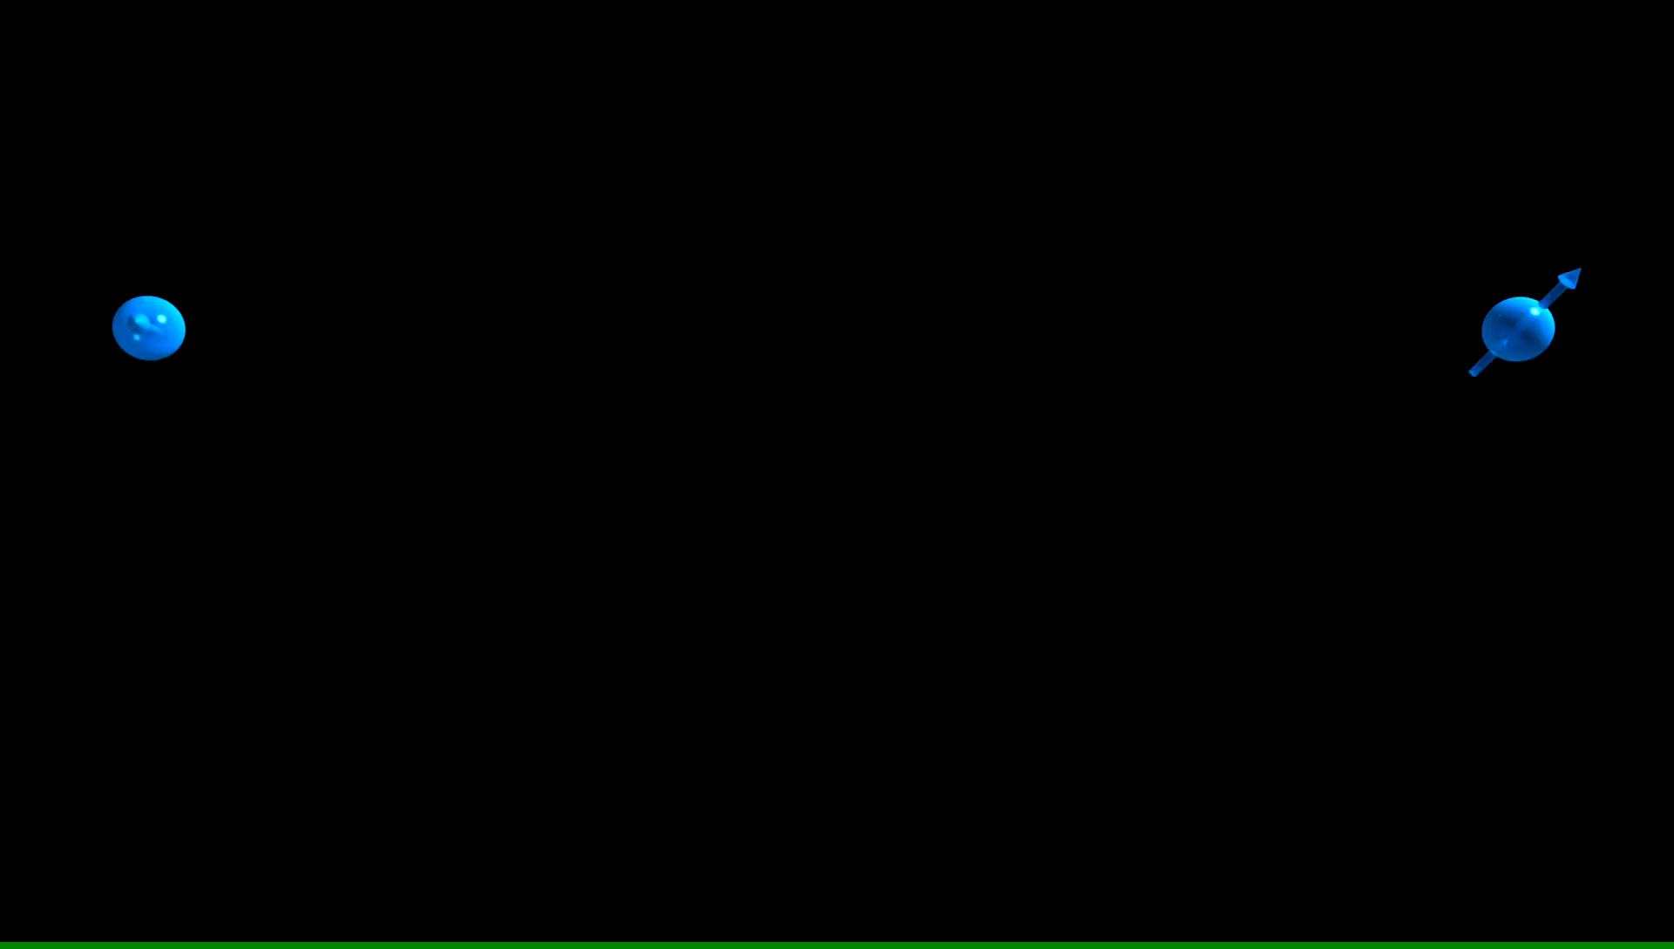
Notes:
Next step is to take these apart and bring them to a large distance but they do remain entangled in their colors. In principle even if we bring them to opposite edges of the universe.

Slide 26
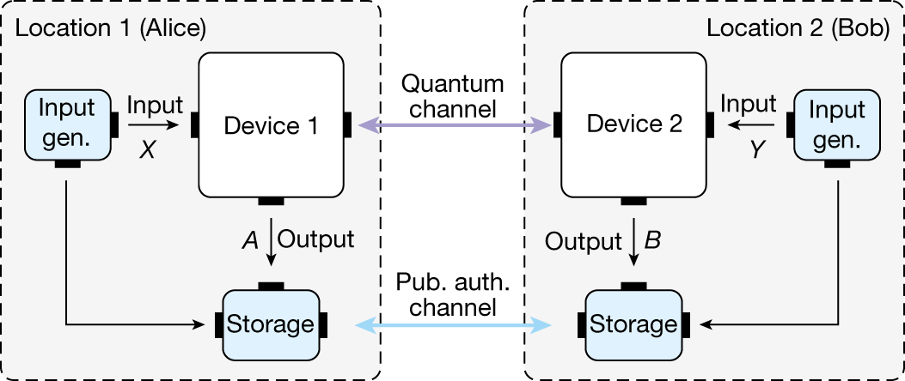

Device Independence via entanglement
Zhang, W., van Leent, T., Redeker, K. et al. Nature 607, (2022)
Fundamental security based on the laws of quantum mechanics

Slide 27
Non-local applications:
Coordination between non-communicating parties
O₁
O₂
Long Comm. Delay (>100us)
O = Observation of changing environment
D = Decision to take an action
Local Program
Local Program
D₁
D₂
Distributed systems (HPC, Content providers), Energy grids, Financial Markets etc…

Slide 28
Non-local applications:
Coordination between non-communicating parties
O₁
O₂
Long Comm. Delay (>100us)
Entanglement assisted program measures M₁
Entanglement assisted program measures M₂
D₁
D₂
Observations inform measurement basis, measurement outcome informs decision
Non-local correlations -> Quantum strategies can beat classical!
For more: Dawei Ding and Liang Jiang, Coordinating Decisions via Quantum Telepathy, arXiv:2407.21723v1

Slide 29
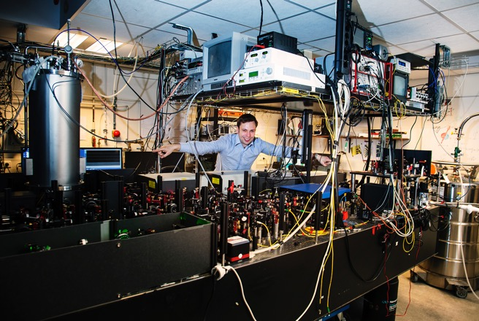
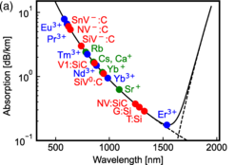
Going to large separation between nodes
Stationary qubit needs to survive the message of the heralding signal:
5us per km!
scale bar
Nature 497, 86 (2013)
A. Reiserer, Rev. Mod. Phys. 94, 041003 (2022)
Independent
2. Photon Loss
3. Coherence

Slide 30
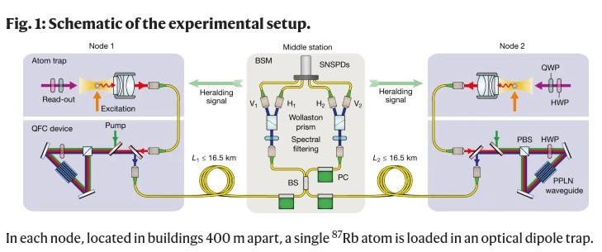
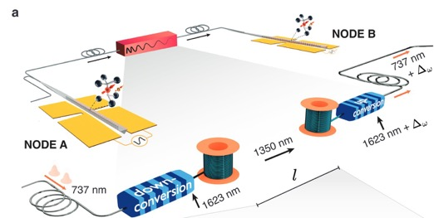
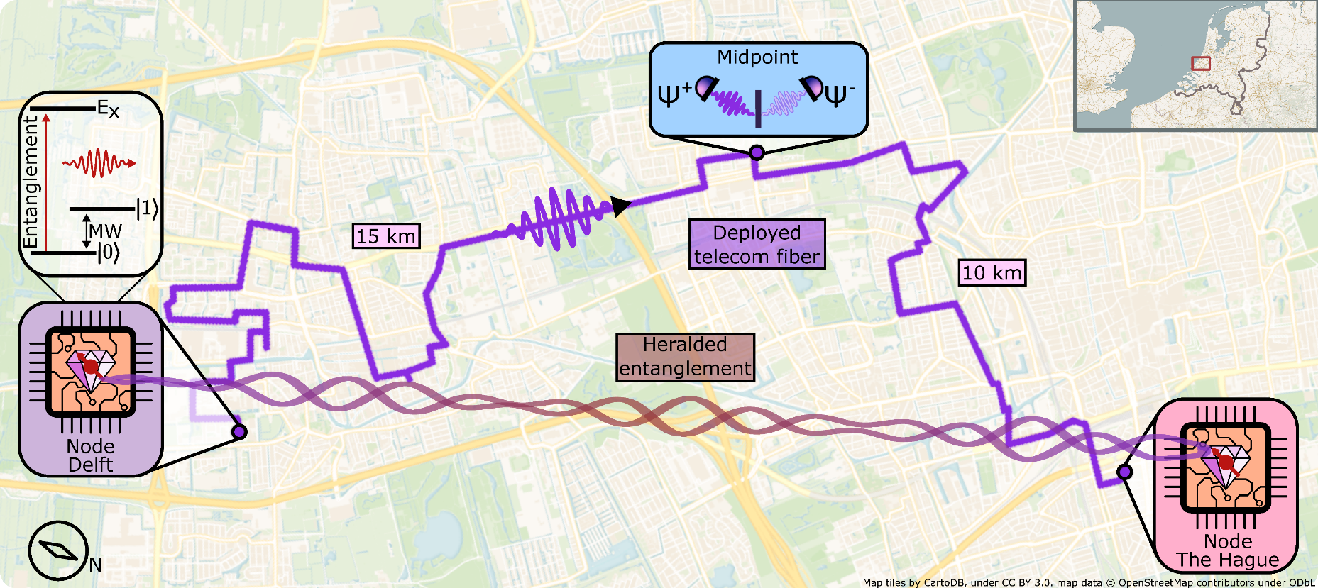
Recent work (towards) metropolitan scale
Leent et al. Nature (2022)
Knaut, C.M., Suleymanzade, A., Wei, YC. et al. Nature 629, (2024).
Heralded entanglement of NV centers with
10km separation between end nodes
A.J. Stolk, K.L. van der Enden et al. Sci.Adv. (2024)
Notes:
30

Slide 31
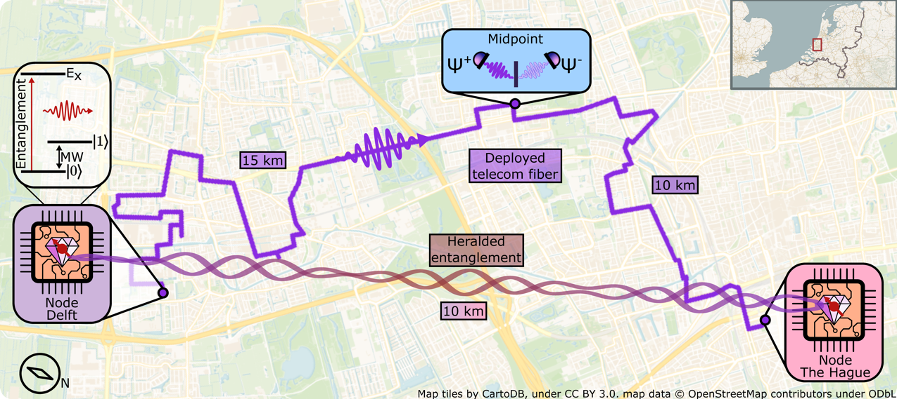
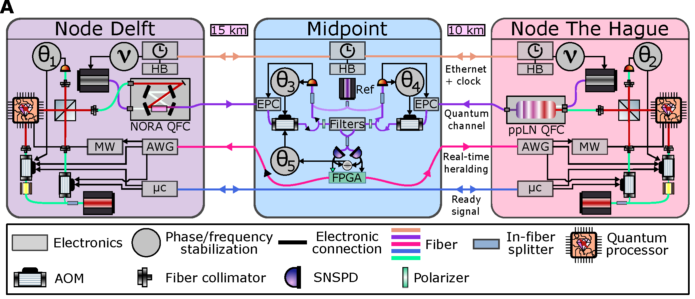
Metropolitan-scale quantum link of solid-state entanglement
arXiv:2408.12464
Independent nodes
Overcome photon loss
Herald within coherence
=> boundary condition to the design
=> QFC and single-photon protocol
=> Real-time heralding and decoupling of qubit
Optical phase stabilization using 5 interferometers
Tracking and compensation of polarization and time-of-arrival drift
Distributed clock (White Rabbit) enables remote sub-nanosecond syncing
Tech paper: A.J. Stolk et al. arXiv:2408.12464 (soon in PRApplied)

Slide 32
Quantum Memory
Stephanie Wehner, David Elkouss, Ronald Hanson, Science 2018

Slide 33
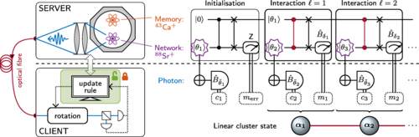
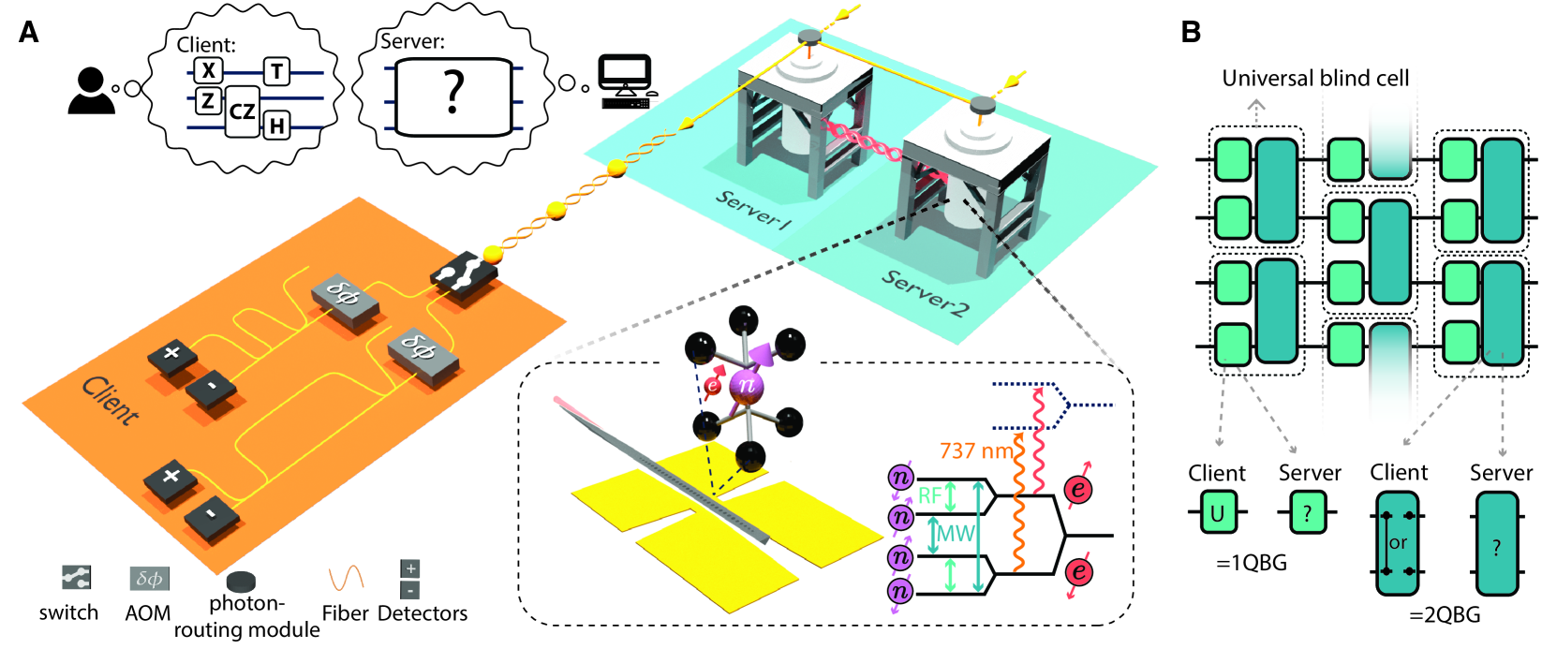
2024: Blind Quantum Computing
Client can perform computations on a remote quantum server.
Server does not know what the computation is. Client gets the correct answer.
P. Drmota et al, Phys. Rev. Lett. 132, 150604 – (2024)
Y.-C. Wei, P.-J. Stas, A. Suleymanzade, G. Baranes ,arXiv:2412.03020v1 (2024)

Slide 34
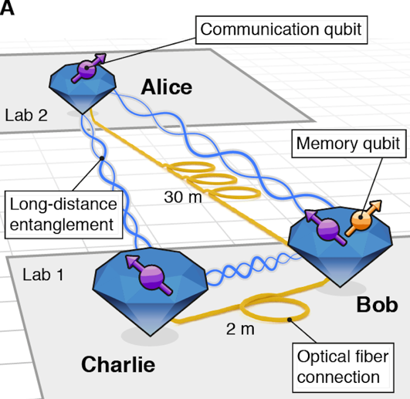
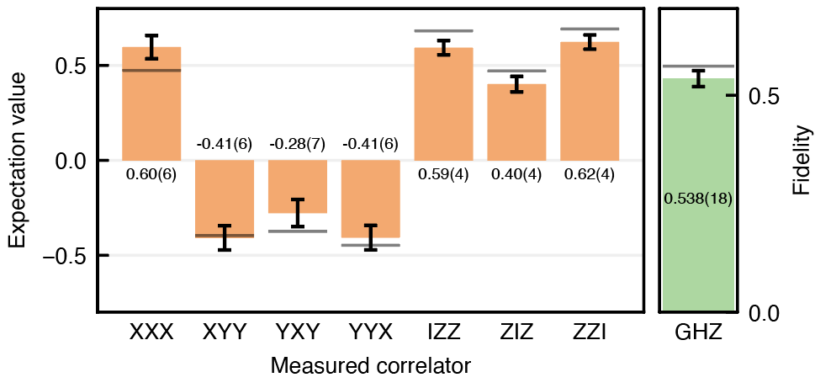
2021: First multi-node network in the lab
Heralded multipartite entanglement distribution
Pompili, Hermans, Baier et al., Science 372, 259 (2021)

Slide 35
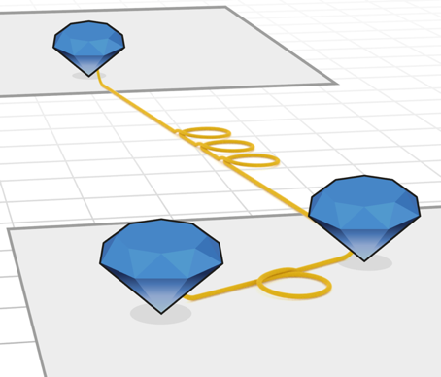
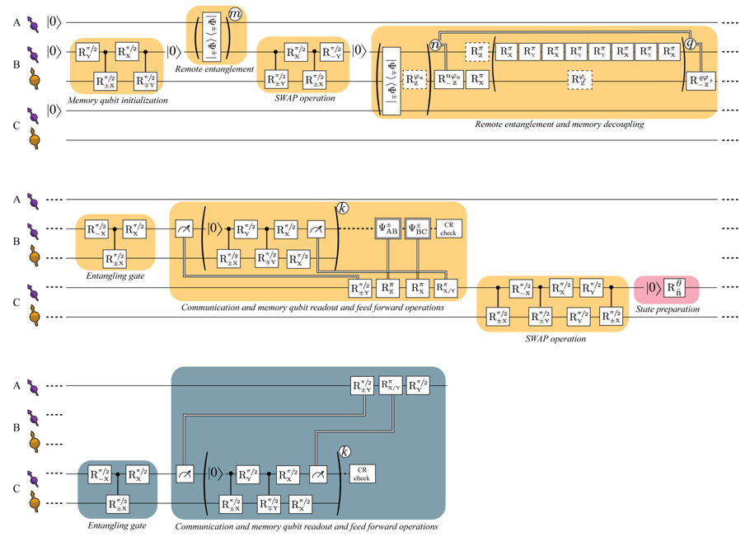

2022: Teleportation beyond nearest neighbors
Alice
Qubit teleportation enables reliable transfer of quantum information across lossy network links
(Bennett et al., PRL 1993)
First demonstrations in 1997 (Popescu, Zeilinger)
$$\left.|Ψ\right\rangle$$
Bob
Charlie
Hermans, Pompili et al., Nature 605, 663 (2022)
Rates limited by probabilistic entanglement generation and qubit decoherence

Slide 36
Challenges beyond proof-of-principle
 | Multi-node Network | Non-nearest neighbour | Metropolitan link
Avg. time for success | 90 seconds | 119 seconds | 50 seconds
Fidelity with ideal state | 0.538 | 0.702 | 0.534
Footprint | 2 optical labs | 2 optical labs | 1 server room, 1 lab, 2 19” racks
Probability of Bell pair per attempt | ~7 * 10⁻⁴ | ~7 * 10⁻⁴ | 7.2 * 10⁻⁶

Slide 37
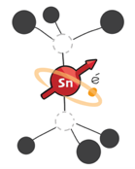
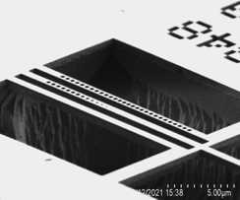
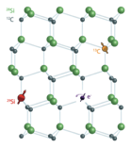
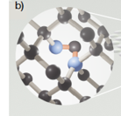

A hardware vision towards large-scale quantum networks
Stable spin qubits with very long quantum lifetimes
Efficient on-chip quantum optical interfaces
Photonic integration
+
+
2 μm
Image: Nature 583, 226 (2020)
Journal of Appl. Phys. 130, 070901 (2021)
On-chip integration: small form factor and better performance
Scalable to small quantum computing units for error correction, routing, …
Large-scale multiplexing (on-chip) for increased rates

Slide 38
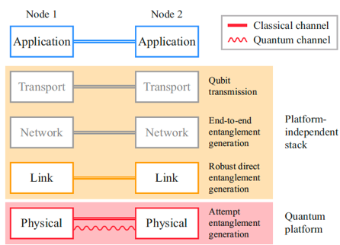
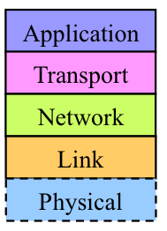
Software for the Quantum Internet
Quantum Network Stack
Internet Protocol Stack
Link layer: NPJ Quantum 8, 121 (2022)

Slide 39

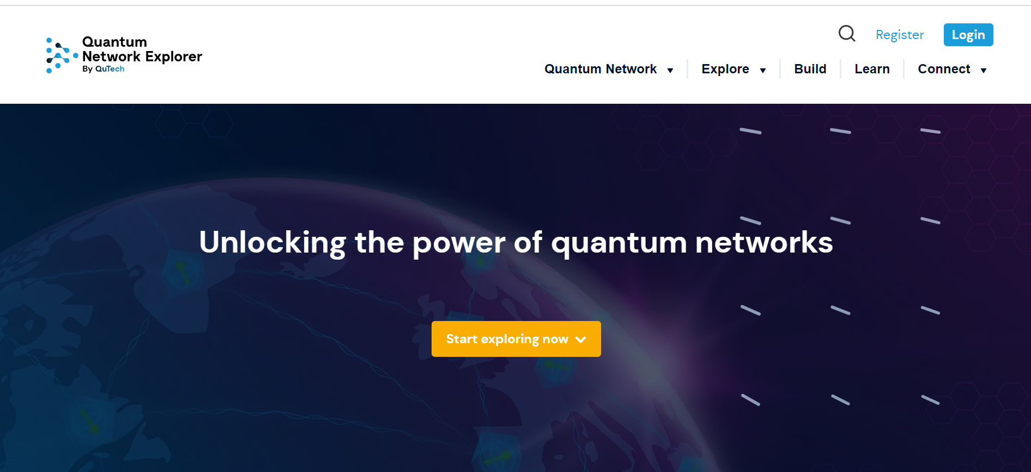
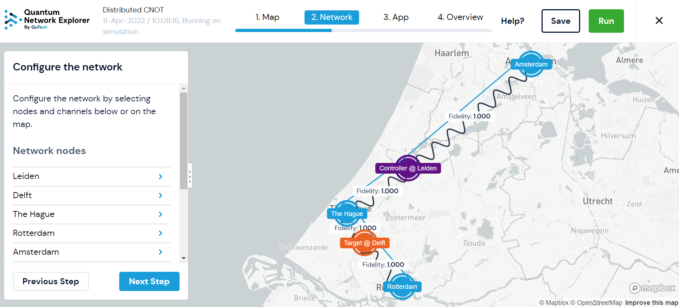
www.quantum-network.com
Explore
Configure and run applications
Learn
Explainers, Knowledge base,
LLM Chatbots
Build
Build new applications using
high-level ADK
Connect
Social media channels
and forums

Slide 40
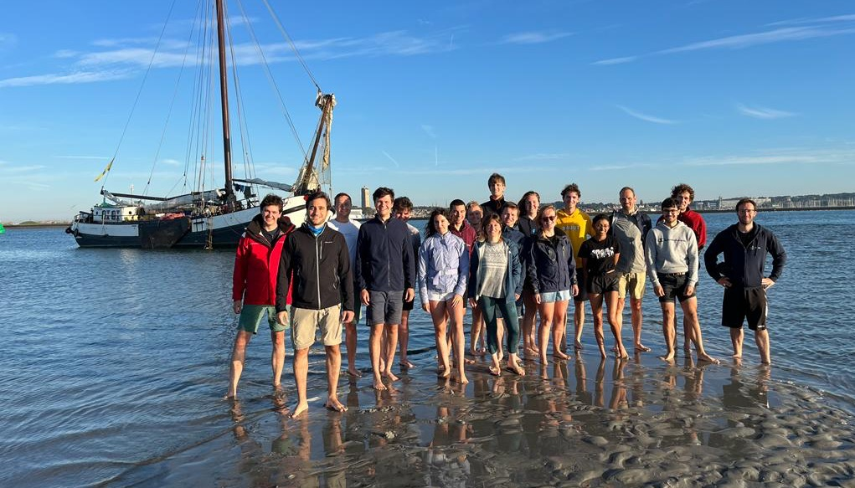


Thanks to:
Hansonlab team
QuTech electronics team
TNO engineering team
Fraunhofer ILT, OPNT, KPN, Holland High-Tech, SURF , Element6, Toptica
Reach out if you want to connect/chat! Arian@qiraffe.nl
Notes:
Thank all the people

Slide 41
The Quantum Internet: Applications, Challenges and Opportunities
Reach out if you want to connect/chat!
Arian@qiraffe.nl

Slide 42
Backup slides

Slide 43
Non-local applications: Coordination between non-communicating parties
O₁
Long Comm. Delay (>100us)
O₂
Entanglement assisted program measures M₁
Entanglement assisted program measures M₂
D₁
D₂
High fidelity entanglement -> Higher advantage over Classical strategies
High entanglement generation rate -> Many decisions per second
Guarantee correlations via heralding
For more: Dawei Ding and Liang Jiang, Coordinating Decisions via Quantum Telepathy, arXiv:2407.21723v1

