Slide 1
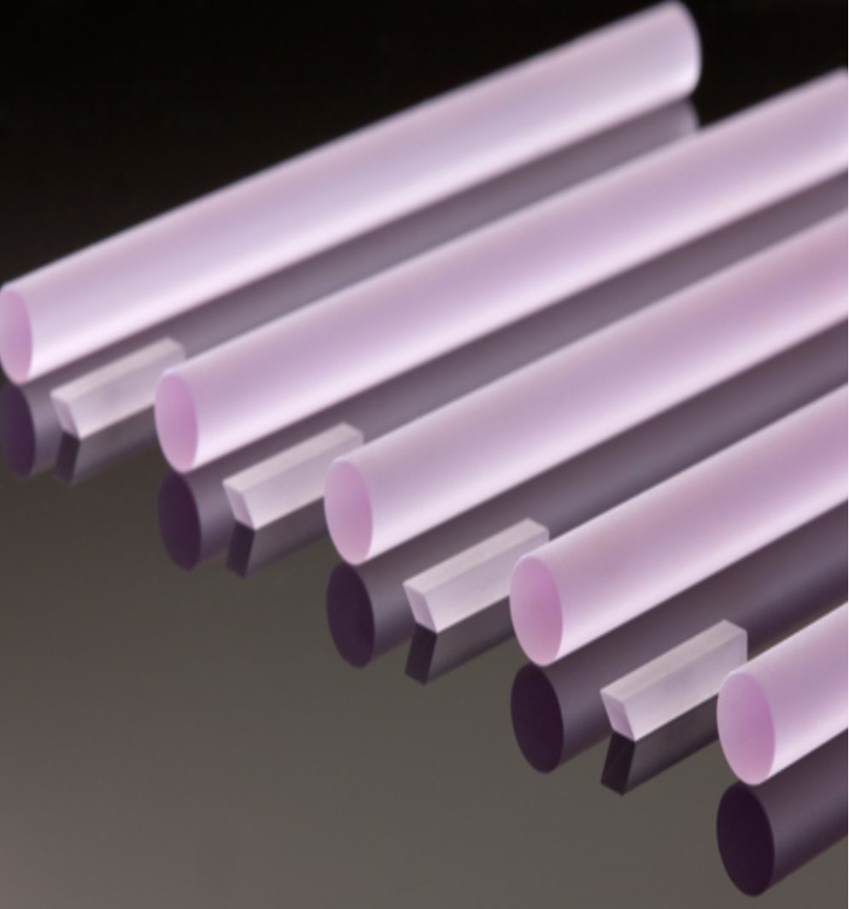


Quantum
network technology
The second life of rare-earth crystals
Wolfgang Tittel
University of Geneva
Constructor Institute of Technology & Constructor University
Notes:
As you certainly all know, the development of the Internet over the past 50 years has revolutionized our lifestyle. There is no day during which we don’t exchange emails, fill out online forms, look up information, or or post information using the latest social media platform.
Interestingly, as we change the unit of information from bits (0 or 1) to qubits, we discover fundamentally more powerful functionalities, including the distribution of secret encryption keys …, the possibility for networked quantum computing, and the possibility for blind quantum computing.
Without surprise, new capabilities require new technology and materials, or, if you are lucky, the use of well-known materials but under new conditions.
In this presentation I will elaborate on how rare-earth doped solid-state materials, here shown are Nd:YAG laser rods, which are at the heart of the well-known 1064 nm laser allow building the required quantum technology when cooled to temperatures of a few Kelvin and with cavity-enhanced coupling to light—often nano-photonic cavitiess.

Slide 2
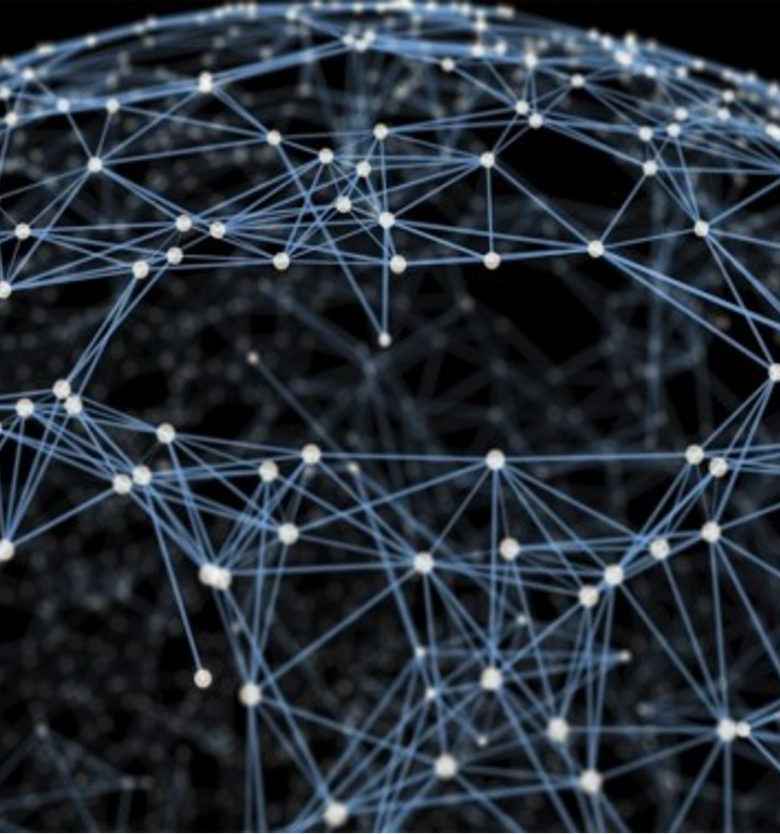
Elements of a quantum network
Interacting centers for matter-based qubits
Individual optical centers for single and entangled photons
Large ensembles for high-capacity, feed-forward-controlled optical quantum memories
For compatibility and scalability, these components should be based on the same type of defect and be on-chip integrable using standard photonics technology.
Notes:
But before I discus the special properties of rare-earth ions, let’s start with the elements we require for building a quantum network. For the sake of this presentation, I will ignore detectors and optical measurements, which are well understood, and limit myself to light-matter interfaces.

Slide 3
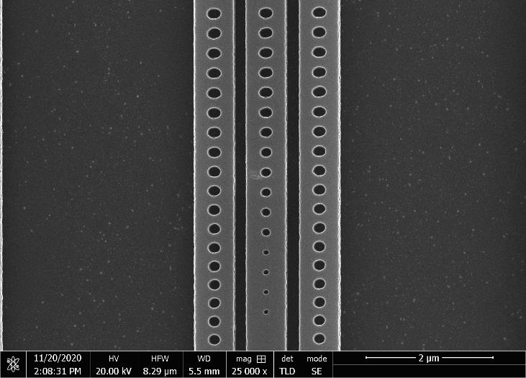
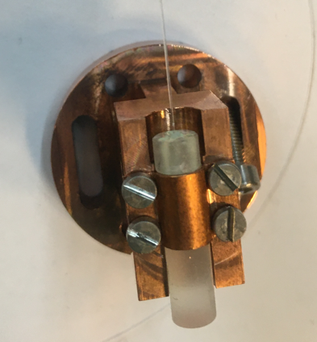
Outline
Rare-earth ion-doped crystals
Single photons based on individual rare-earth ions
Optical quantum memory using ensembles of rare-earth ions
Outlook and conclusion
Notes:
Two key ingredients in view of creating quantum network nodes that allow quantum information processing and photon emission

Slide 4
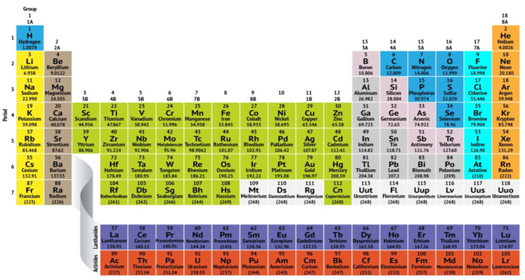
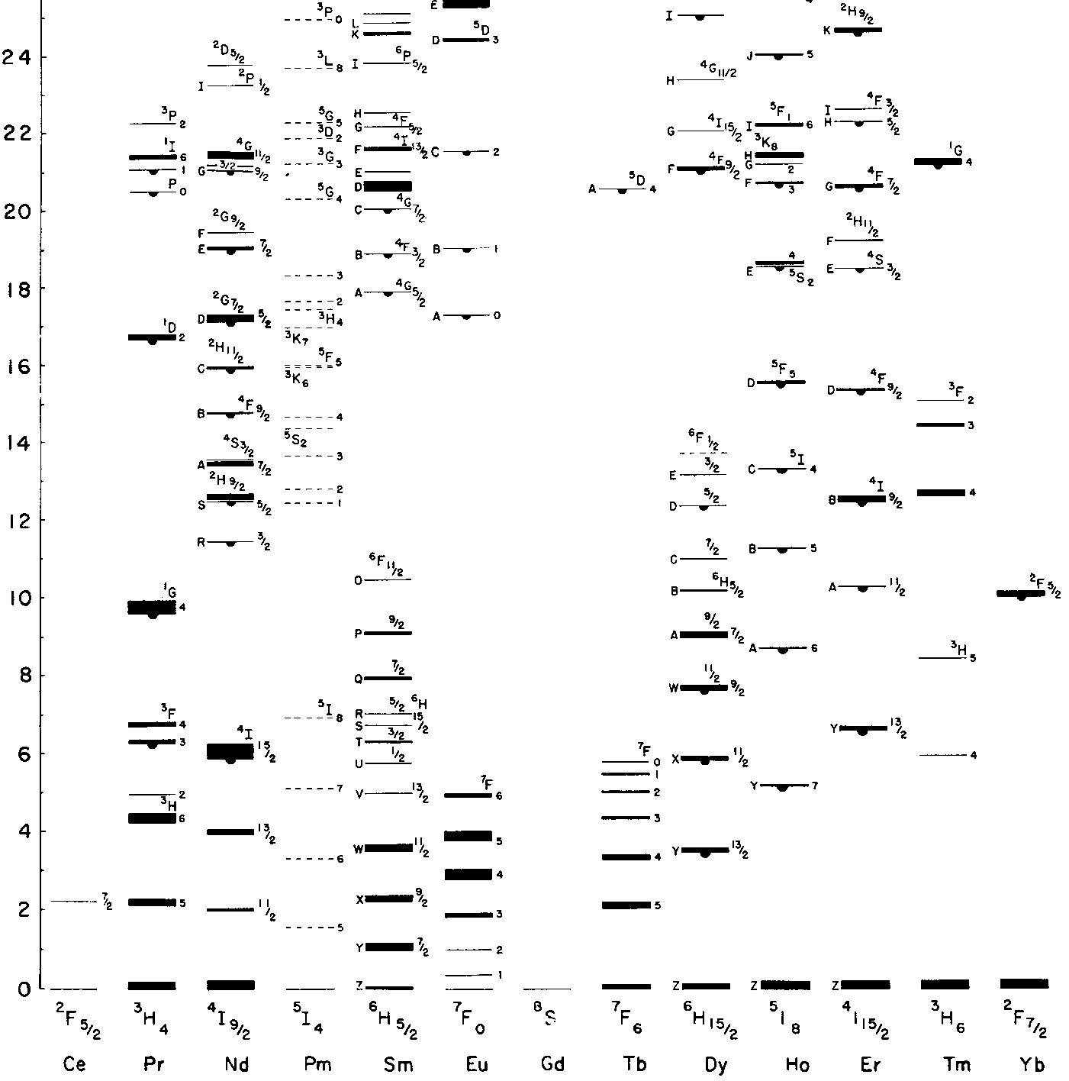
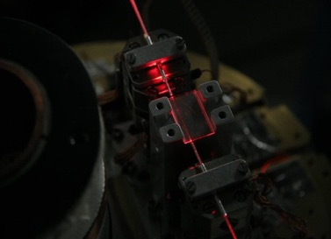
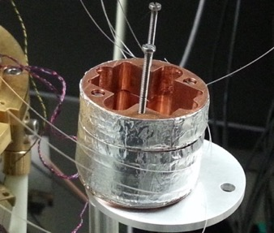
Rare-earth ion-doped crystals
Commercial solid-state lasers
Quantum technology (memories, single emitters)
606 nm
Energy of electronic levels [x10³ cm⁻¹]
580 nm
1064 nm
883 nm
1030 nm
1532 nm
1900 nm
1550 nm
795 nm
2100 nm
Saglamyurek, WT et al., Nature 469, 512-515 (2011).
Saglamyurek, WT et al., Nature Phot. 9, 83 (2015).
G.H. Dieke, Spectra and Energy Levels of Rare Earth Ions in Crystals, Wiley Interscience, New York, 1968.
Notes:
Placed in orbitals that form filled shells. 1s, 2s 2p,…
Free ion levels given by coulomb interaction and spin-orbit coupling ^{2s+1} L _{J} (free ion levels). L=angular momentum. J = total angular momentum
Nd and Tm YAG lasers are used in manufacturing as well as in the medical domain

Slide 5
Rare-earth crystals: a brief introduction
  1) Transitions (zero-phonon lines) in the visible and near infrared -> quantum communication
  2) Γ_{inhom} ≈ 100 MHz – 500 GHz -> broadband quantum memory
  3) Excited states with very long lifetimes (ms)
  -> difficult to observe single-photon emissions
  4) At T< 2 K: Γ_{hom}^{opt} ≈ 50 Hz – 100 kHz -> T₂ = 4 ms -> high-capacity and long-lived quantum memory
  5) At T< 2 K: ground states with long T₁ (d) and long T₂ (h) -> long-lived quantum memory and qubits
  6) Electric dipole-dipole interaction between neighboring ions -> quantum gates
Simplified level structure of Tm³⁺-doped crystals
Promising for optical quantum memory and QIP. But not for single-photon emitters.
Notes:
What makes rare-earth-ion doped crytals so special?
For the specialists here, the transitions of interest are zero-phonon lines
different levels feature permanent electric dipole moments
Optical coherence up to 4 ms <-unique solid-state impurity
Spin coherence up to 6h

Slide 6
How to create a single photon? Spontaneous emission from a single emitter
The long optical lifetimes in rare-earth ions result in very small decay rates
Photons will be emitted into random directions
Tm:YAlO₃
γ
Yb:YVO₄
Single rare-earth ion
Notes:
Isotropic emission

Slide 7
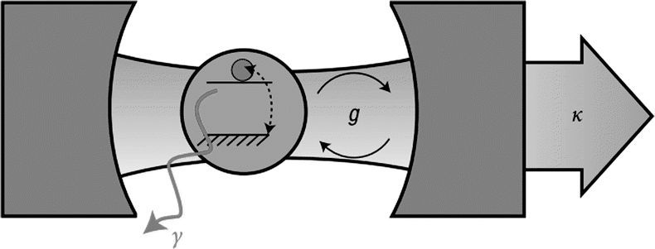
Creating (and observing) single photons
For κ >> g >> γ₀ (weak coupling regime):
Purcell factor
Tm:YAlO₃
κ ∝ L⁻¹
γ₀: vacuum emission rate
# for atom in max field region
∝ (energy loss)⁻¹
Quality factor
Mode volume
₀
Needed: cavity with small V and large Q
Notes:
Effective Purcell factor (which describes the actual increase of emission rate) is smaller by a factor given by the branching ratio. We have observed F_P(effective) of 60.
Behind this development is the so-called Purcell effect, which I will briefly explain on this slide.
Instead of interrogating the emitter in free-space (or, in our case, a crystal), let’s assume we put it inside an optical cavity as sketched here. Now, in addition to the spontaneous decay, we have to consider two more processes: The possibility that the emitter echanges its excitation with the cavity, which is characterized by the coupling constant g. And the possibility that an excitation in the cavity – a photon – escapes in the mode defined by the cavity, gamma. What we want is that, after excitation of the emitter by a laser pulse, the ewxcitation is rapidly transferred to the cavity mode, i.e. g >>gamma, and that it leaks out of the cavity before it can hop back onto the emitter, i.e. gamma >> g. For this scenario one could conclude that this may lead to a rapid and efficient creation of a freely propagating photon, and this intuition is correct.
More precisely, the enhancement of the emission rate—the Purcell factor—is given by the ratio of the cavity quality factor Q, which is related to the time a cavity can store energy, and the mode volume- roughly the integration of the intensity. `this was difficult as it requires cavities with a highly confined mode – note here that it is measured with respect to lambda ^3!
Such cavities can be created using nano-photonic crystals. What you see here is a so-called nano-beams …The holes serve as mirrors—or Bragg reflectors– but the hole pattern is slightly changed in the middle part, allowing a highly confined optical mode to exist. Such a cavity can be placed on top of a rare-earth crystal, and the evanescent field then creates the desired conditions of a neighboring rare earth ion to become a good photon source with 1000-fold increased emission rate.
-------
Q factor describes the storage time of a photon (or classically, of electromagnetic field energy) inside a cavity; the energy stored inside the mode with frequency ω and quality factor Q : W(t) =W0 e^- Qt =W0e−2κt , where κ = 2Q is the cavity field
decay rate.
F_P can also be expressed using g,kappa and Gamma: F_P=4g(r)^2/kappa Gamma (cooperativity), with g= dE/hbar

Slide 8
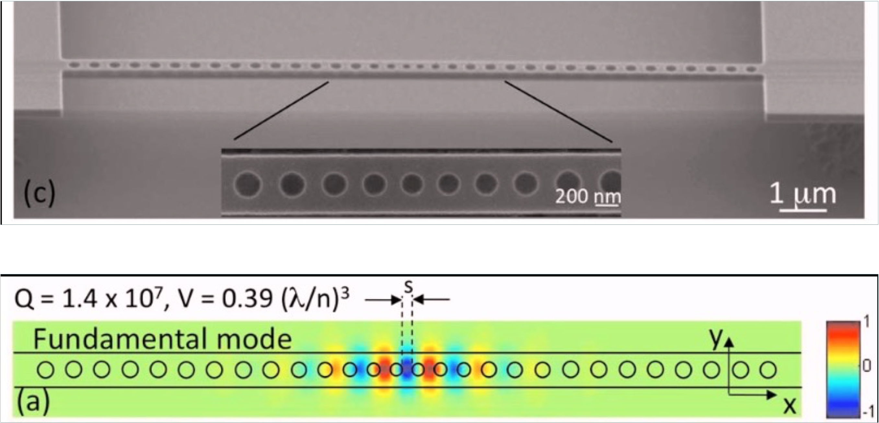
The Purcell effect: atom-light interaction in the weak coupling regime
Nano-photonic crystal cavities
Deotare et al. Appl. Phys. Lett. 94, 121106 (2009)
Notes:
Loncar group at Harvard
Calculated F_P: 2.6M (but there was no absorber included)

Slide 9
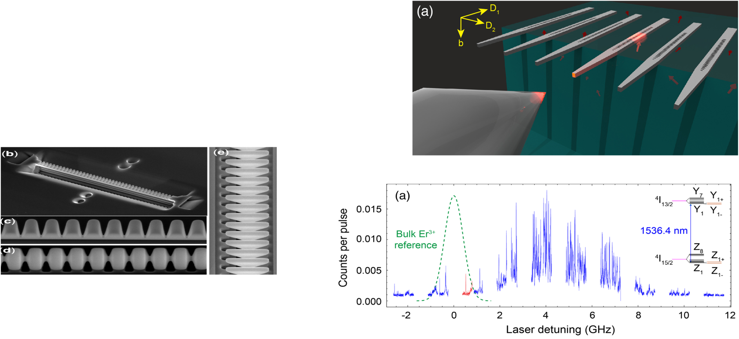
Single photons from individual rare-earth ions
Heterogeneous approach
Purcell-entangled light-matter interaction has enabled the observation of true single photons from individual rare-earth ions coupled to nanocavities.
F_{P}=650
Thompson group: Silicon photonic crystal (nano) cavity stamped on top of Er:YSO (PRL 2018)
Homogeneous approach
F_{P}=110
Faraon group: photonic crystal nano-cavity milled out of Nd:YVO₄ (PRL 2018)
Notes:
Nd Yttrium Orthovanadate
Er:YSO
Spectrum is broadened and shifted compared to bulk due to stress
Both approaches can be modified to other crystals and rare earth—possibly changing from Si to SiN—but the heterogeneous approach enjoys higher precision and, due to Si photonics being a standard procedure, and the possibility for outsourcing into a foundry

Slide 10
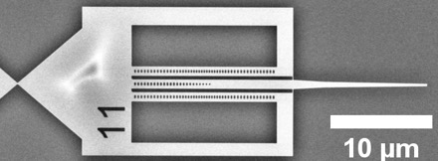
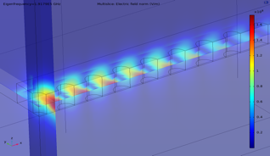
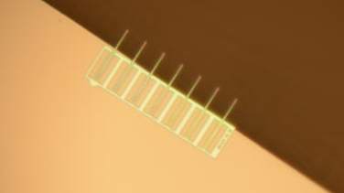
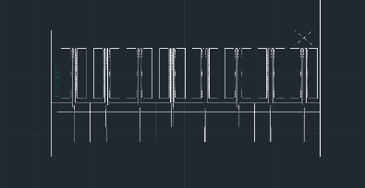
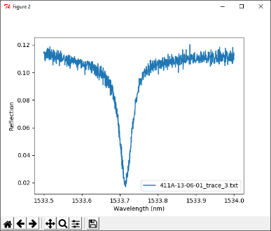
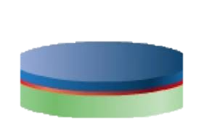
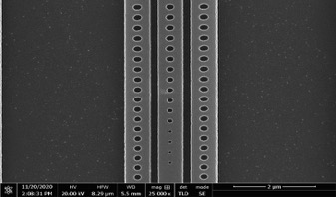
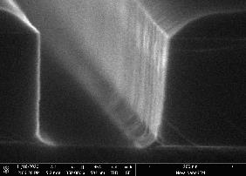
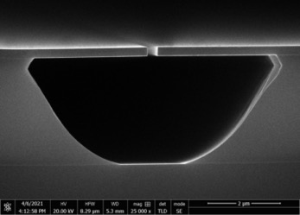
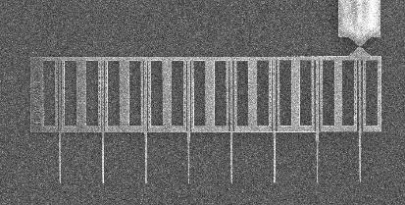
A single-photon source based on Er:LiNbO₃
Design and Simulations
Patterning:
E-beam lithography
Patter transfer:
Reactive ion etching
Under-cutting:
Hydrofluoric acid
Inspection:
Optical microscope & SEM
Optical characterization in air, and after transfer on Er:LiNbO₃, at T=293K and T=4K
Spectra and quality factor
Er:LiNbO₃
Si (250 nm)
Si (0.5 mm)
SiO₂ (3 μm)
Notes:
Er: telecom transition
LNb: electro optic properties, usable for QM (although short storage time).

Slide 11

Design
A “bus” waveguide (with Bragg reflector): couples to 2 nanobeam cavities
Inverse taper coupler: allows coupling light in and out
Photonic crystal cavity
Photonic crystal cavity
Tether: A weak point that can be broken to detach the device
Joint work with Gröblacher group

Slide 12
A single-photon sources based on Er:LiNbO₃
Design and Simulations
Patterning:
E-beam lithography
Patter transfer:
Reactive ion etching
Under-cutting:
Hydrofluoric acid
Inspection:
Optical microscope & SEM
Optical characterization in air, and after transfer on Er:LiNbO₃, at T=293K and T=4K
Spectra and quality factor
Er:LiNbO₃
Si (250 nm)
Si (0.5 mm)
SiO₂ (3 μm)
Notes:
CAESAR 09. A positive reist: wherever the electron beam writes the resist will be removed and during development and the Si will be removed during etcheing

Slide 13
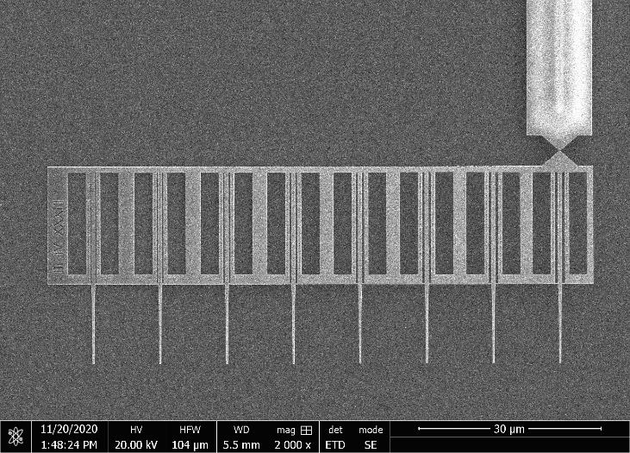
Cavity characterization
Mode volume | calculated | 0.1 μm³
Quality factor (on Er: LiNbO₃) | measured | 50 000
Purcell factor (E=E_{max}, β=1) | predicted | 1 000
Notes:
Our mode volume is 10x larger than that of Deotare. Designed to leak field into the adjacent crystal!
Reftractive index of LiNbO3 at1550 nm is 2.2
Q is smaller than in Deotare because we need evanescent field
Beta =0.22

Slide 14
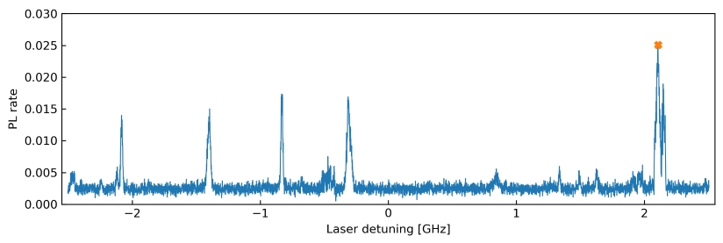
Purcell-enhanced emission
Si cavity on 0.005% Er:LiNbO₃
T approx. 50 mK
Observation of isolated photoluminescence lines off line-center
13-fold(144-fold) reduction of decay constant from 1.8 ms to 134 μs (12.5 μs)
T₁ <10 μsec and radiatively limited emission (T₁=T₂/2) seem possible
-> Fourier-limited photons
Joint work with Gröblacher group, TU Delft
T₁=
Notes:
Calculated F_P assuming beta =0.22 and E =0.54 E_Max: 220
At. 3K and 0.4T, T2 of Er:LiNbO3 is 20 mus

Slide 15
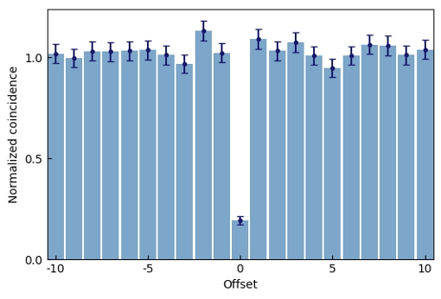
Purcell-enhanced emission
Measurement of auto-correlation coefficient shows non-classical (single-photon) nature of emissions and confirms interaction with individual erbium ions
  -> single-photon source and possibility for qubit read-out
g²(0) = 0.190+-0.02
in₁
out₁
&
out₂
Experimental setup
Detection time difference [bins]
Joint work with Gröblacher group, TU Delft
Notes:
Non-zero g^2 is explainable by detector noise

Slide 16
Purcell-enhanced emission
Energy
Demonstration of Stark tunability of single ion
Single-photon character not affected
Feedback mechanism to counter spectral diffusion
-> indistinguishable single photons
  -> distant spin-spin entanglement
-> heralded entangled photon pairs
Δν=(d_{e}-d_{g})E / h
Joint work with Gröblacher group, TU Delft
Y. Yu et al., Phys. Rev. Lett. 131, 170801 (2023)

Slide 17
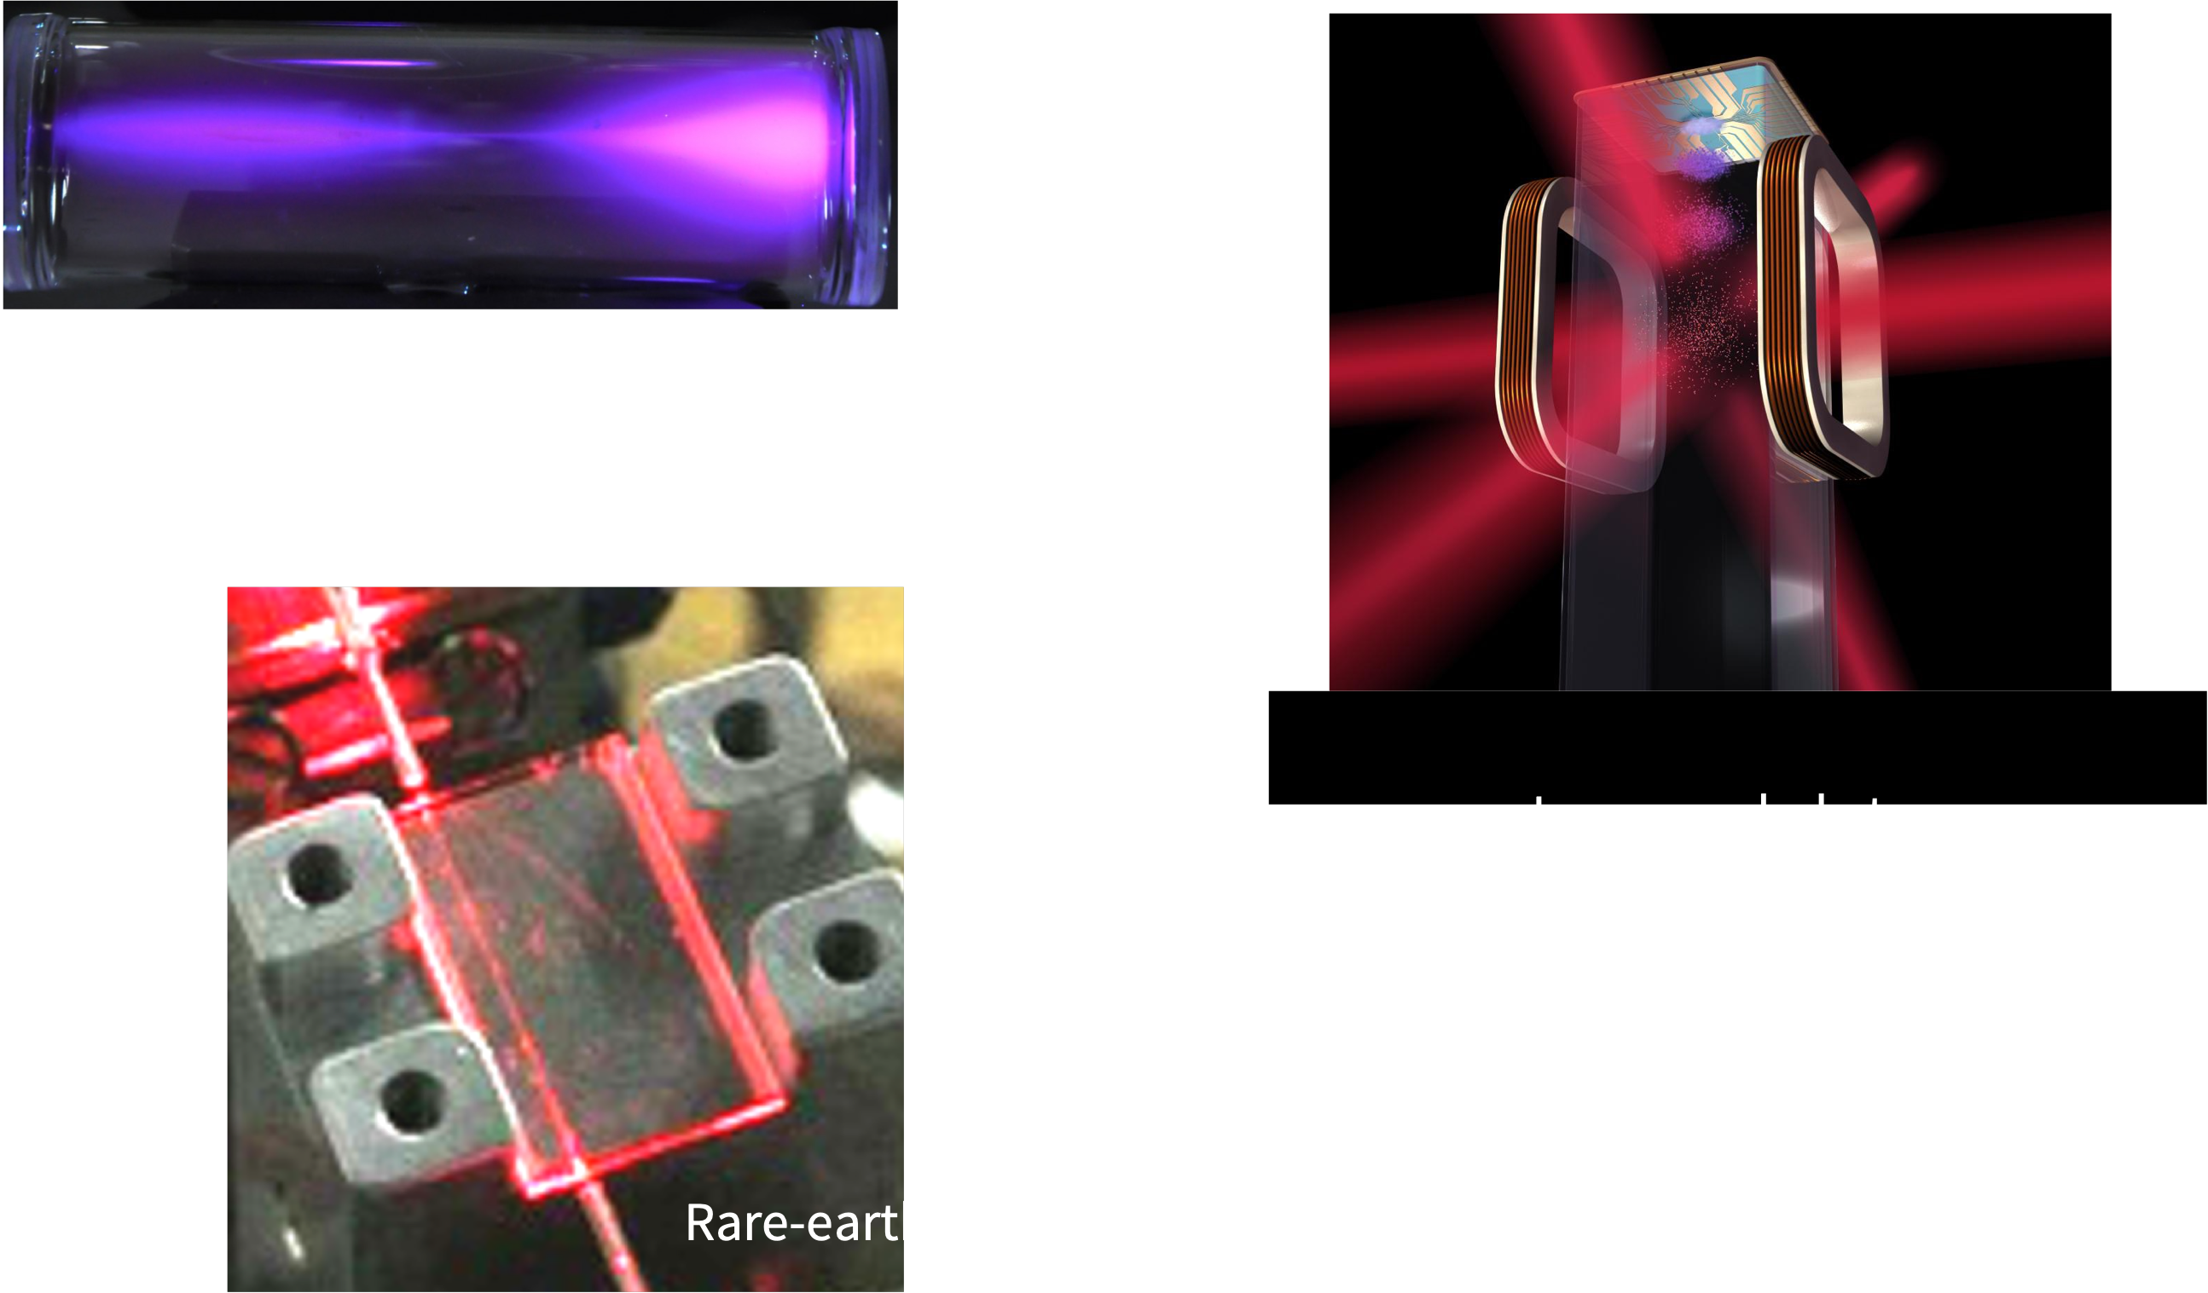
How to store photonic quantum states in a multiplexed manner? Use large ensembles of atoms
In
out

Slide 18
How to store photonic quantum states in a multiplexed manner? Use large ensembles of atoms
In
out

Slide 19
Photon echo quantum memory (AFC)
  1. Preparation of an atomic frequency comb
  2. Absorption of a photon -> fast dephasing
  3. Rephasing at t =1/ν_{comb}: 2πΔ_{j}t=2π(nν_{comb})/ν_{comb} = n 2π
Γ_{hom}
|e>
ν_{comb}
absorption
Ω
|a>
absorption
|g>
|s>
frequency
frequency Δ
Experiments: Geneva, Lund, Paris, Calgary, Delft, Barcelona, Hefei, Caltech
  -> Re-emission of photonic qubits with unity efficiency* and fidelity
  -> Possibility tu use control pulses for on-demand read-out (if needed)
* requires phase matching or cavity
  Needed: inhomogeneously broadened transition, long-lived auxiliary state, narrow homogeneous linewidth
Afzelius et al., PRA (2009); De Riedmatten et al., Nature (2008)
M. Afzelius et al. PRA 79, 052329 (2009)
  -> long storage times require small ν_{comb}, i.e. narrow homogeneous lines
Notes:
-> long storage times require small ν_{comb}, i.e. narrow homogeneous lines

Slide 20
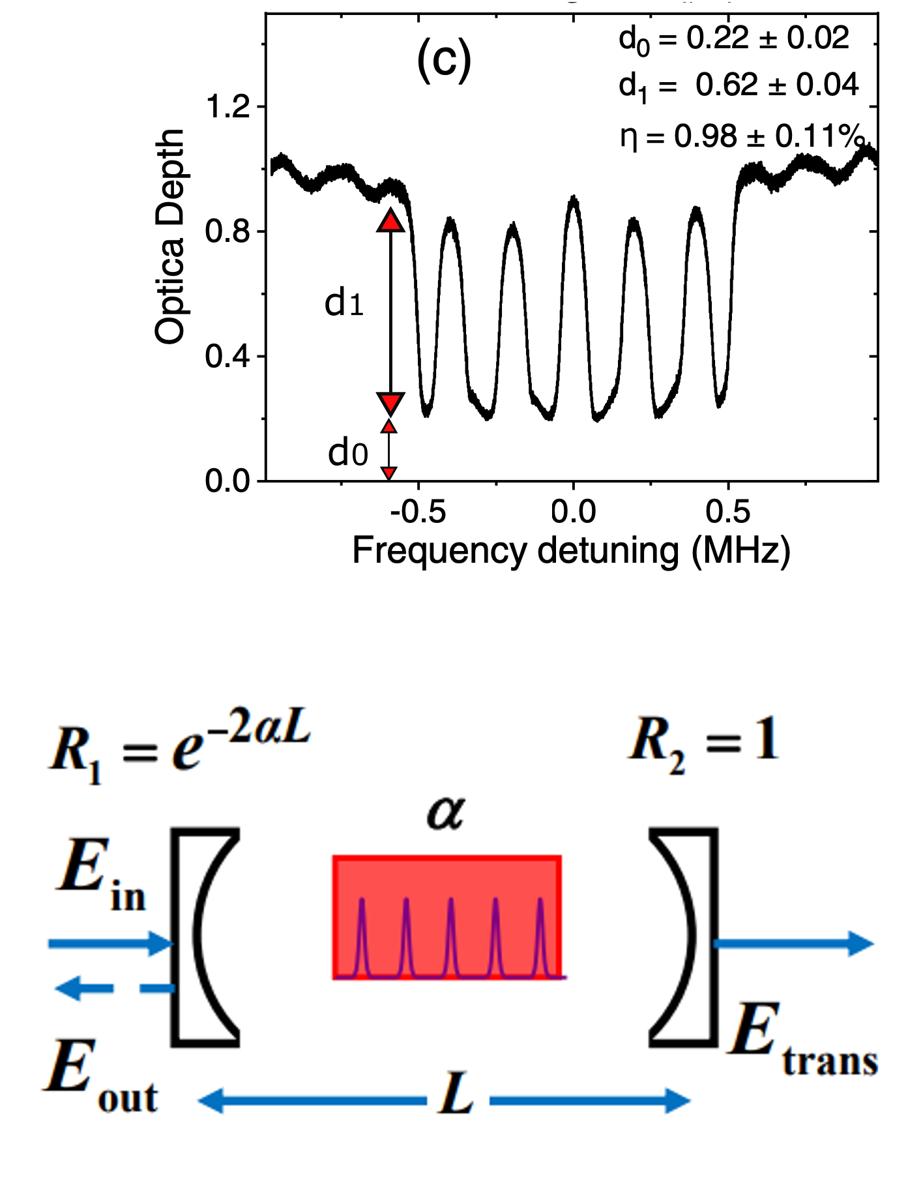
Towards efficient quantum memory
The efficiency of the AFC quantum memory is limited by its optical depth
Using an impedance-matched cavity allows in principle to increase the efficiency to 1 despite small single-pass absorption e^{-αl}
Condition: R₁=e^{-2αl} R₂ with R₂ = 1
M. Afzelius and C. Simon, Phys. Rev. A 82, 022310 (2010)
Notes:
FSR= ~6 GHz @ 795nm, Finesse = ~115
Formula assumes forward recall where eta max =0.54 for d1/F=2

Slide 21
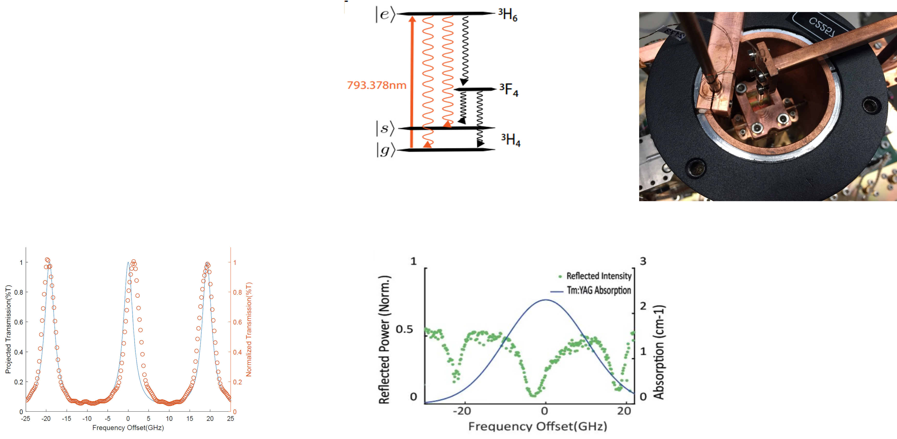
Towards efficient quantum memory
Reflection-coated Tm:Y₃Al₅O₁₂ (YAG) crystal
T₁=1.1 ms
R₁=0.40
R₂=0.99
uncoated
4mm
Cavity transmission spectrum (outside Tm resonance)
Cavity reflection spectrum (within Tm resonance)
FSR~20 GHz, F~7
Approx. impedance matching
J. Davidson, WT et al., PRA 101, 042333 (2020)
Almost impedance-matched!
Notes:
FSR= ~20 GHz @ 795nm, Finesse = ~7
Resonances are broadened due to additional cavity loss due to Tm.
Measurement was done with 4ns long pulses
Note: Appprox impedance matching does not change when creating AFC as F=2, i.e. average OD remains constant

Slide 22
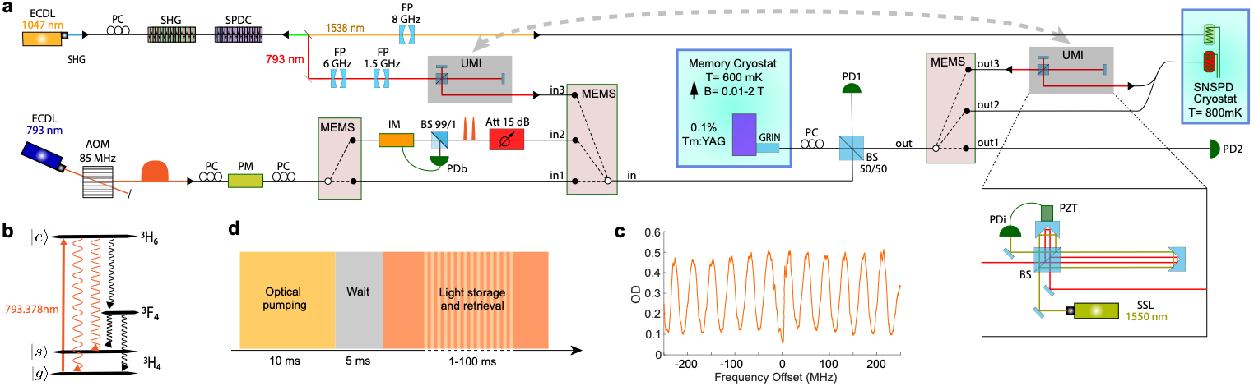
Towards efficient quantum memory
Preparation of light
Quantum memory
detection
Setup allows creating and measuring
the AFC
attenuated laser pulses in time-bin qubit states
time-bin qubits encoded into heralded single photons
|ψ>=α|e>+βe^{iφ}|l>
J. Davidson, WT et al., PRA 101, 042333 (2020)
Notes:
FSR= ~6 GHz @ 795nm, Finesse = ~115
SSL: solid-state laser (I guess Teraxion)

Slide 23
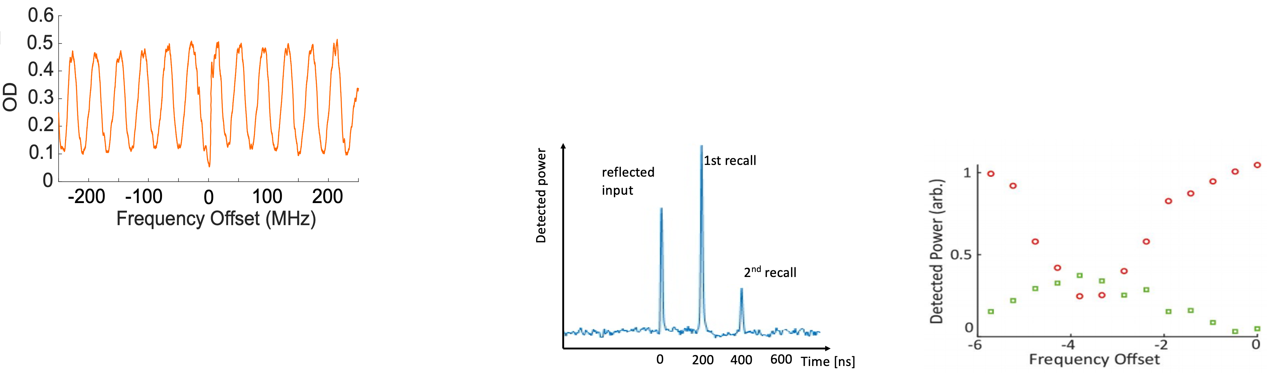
Results
AFC created using the non-coated part of the crystal. η~1%
AFC-based storage of attenuated laser pulses (μ=0.7) using coated part of crystal
back-reflected
η_{max} =27%
Deetected photons
Detected photons [a.u.]
recalled
Imperfect impedance matching
J. Davidson, WT et al., PRA 101, 042333 (2020)
Notes:
Storage time is limited by laser linewidth. T2 should be in excess of 100 mus

Slide 24
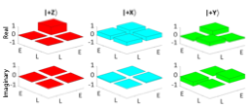
More Results
Quantum process tomography of time-bin qubits encoded into attenuate laser pulses (μ=0.7)
Measurement of non-classical cross-correlations with photon pairs before and after storage:
g⁽²⁾_{before}=61.8 ±3.8, g⁽²⁾_{after} = 9.1 ±1.2
Quantum state tomography of time-bin qubits encoded into heralded single photons
-> F=(85 ± 1)% >> 0.66
J. Davidson, WT et al., PRA 101, 042333 (2020)
Notes:
Kai is complex 4x4 matrix, Kai _mn is a (complex) number
F_classic=2/3

Slide 25
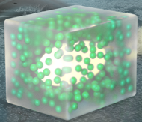
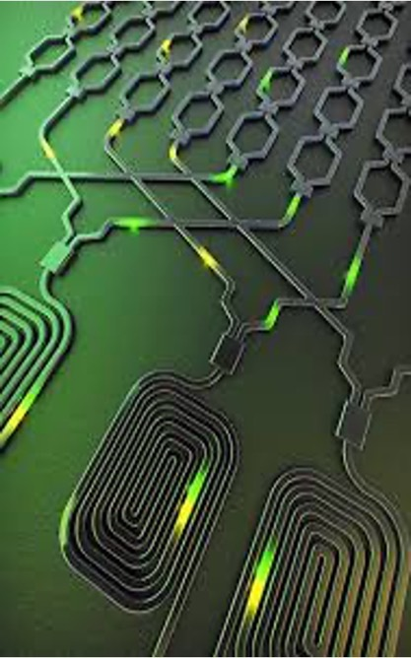

Towards fully quantum-enabled networks based on an integrated platform
Single (and soon? entangled) photons based on Purcell-enhanced emission from single rare-earth ions
Compatible quantum memories based on large ensembles of rare-earth ions
(Quantum computing nodes using interacting rare-earth ions coupled to nano-cavities for readout)
Exploit maturity of Si/SiN/LiNbO₃ photonics (foundries) to create compatible, scalable and integrated quantum network technology
More fundamental research into materials, protocols, applications,…

Slide 26







Thank you!
Tittel lab (UNIGE)
Patrick Remy
Erell Laot
Javier Carrasco
Deeksha Gupta
Archi Gupta
Akshay Karyath
Luozhen Li
Tittel lab (TUD)
Dorian Oser
Sara Marzban
J. Davidson
Gröblacher lab (TU Delft)
Simon Gröblacher
Rob Stockill
Yong Yu
Gaia Da Prato
Emanuele Urbinati
Tittel lab (UofC)
Daniel Oblak
P. Levebfre

Slide 27
Quantum repeater - how to mitigate loss
    Goal: Overcome the exponential scaling of photon transmission over a long (lossy) quantum channel
    Note: multiplexing does not lead to better scaling
    Solution
    1) Break long link into shorter elementary links.
Exponential scaling
Same scaling
    2) Distribute heralded and long-lived entanglement across each elementary link.
    3) Multiplex distribution (any degree of freedom) to make it efficient.
    4) Mode mapping based on feed-forward info allows connecting “good” links using Bell-state measurements.
Better scaling
    No need for photons to travel in one go over the entire link.
N Sinclair, WT et al., Phys. Rev. Lett. 113, 053603 (2014)

Slide 28
Quantum memory requirements
    Large storage efficiency
    Sufficient storage time
    Fidelity ->1
    Feed-forward mode mapping
    High multiplexing capacity
    Wavelength of operation
    Bandwidth per qubit
    Integrability
QM
BSM
QM
Add info about necessary storage efficiency
Notes:
Discuss elementary link
Lots of progress on all fronts.
Here I will focus on the decay of efficiency with storage time

Slide 29
State-of-the-art
Comparing results taken under different conditions… But while not all experiments demonstrate quantum nature, all used a quantum protocol
2-level AFC: not yet better than fiber, but close. Materials with sufficient T₂^{opt} for τ = 1ms exist. Need to reduce technical noise and add cavities.
AFC spin-storage: scaling already better than fiber, but efficiencies still small. Materials with sufficient T₂^{spin} exist. Need to improve efficiency of π-pulses and noise and to add cavities.
Three use cases (assuming sufficient multiplexing)
  Quantum repeaters for fiber networks
  Quantum repeaters for satellite networks
  Physical qubit transport
Physical qubit transport-based networks
Fiber-based networks
Satellite-based networks
Notes:
Additional problems: sources (SPDC), need for integration (-> less loss between components),…

