Slide 1







Quantum Chebyshev generative modeling for Fragmentation functions
based on:
Jorge J. Martinez de Lejarza¹, Hsin-Yu Wu^{3,4}, Andrea Gentile⁴, Germán Rodrigo¹, Oleksandr Kyriienko^{3,4}, Michele Grossi²,
In preparation
¹
²
Speaker:
Jorge Martínez de Lejarza
QT4HEP 2025 – 23/01/2025
³
⁴

Slide 2
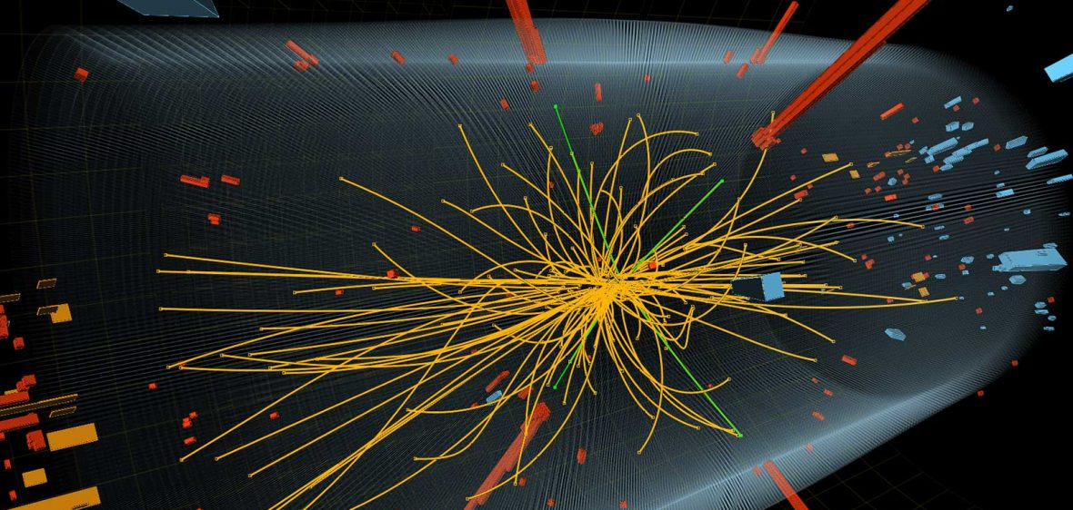
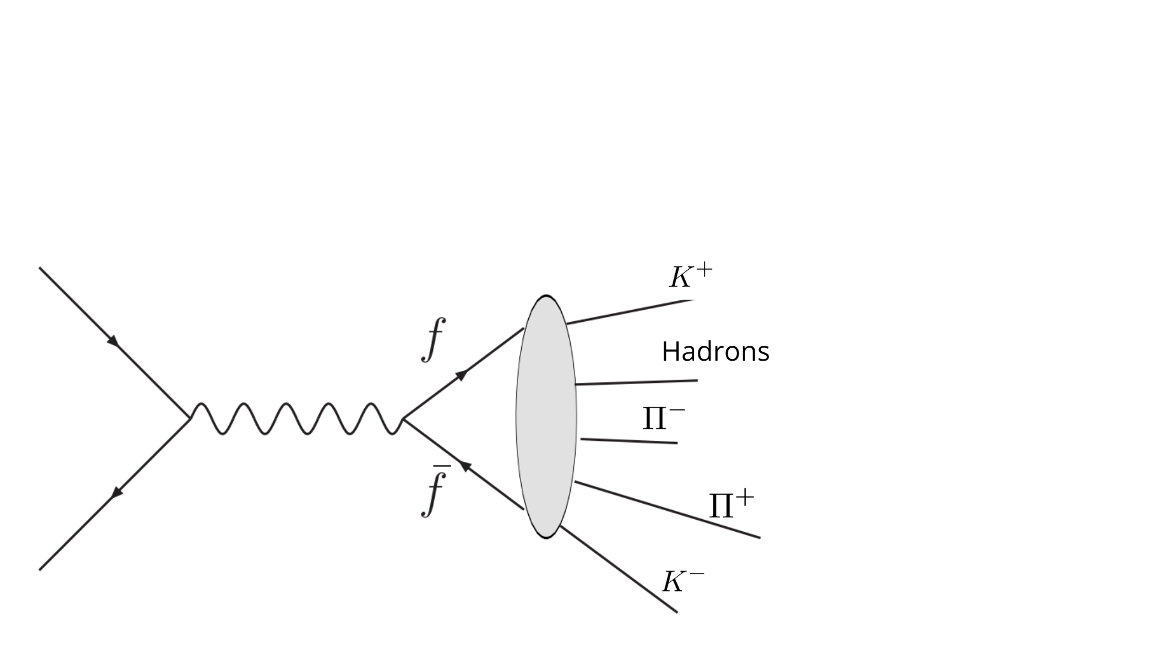
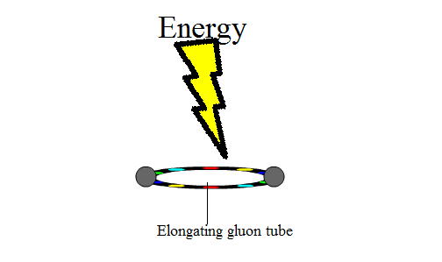
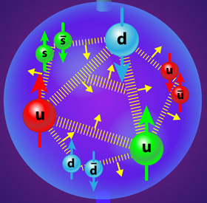

Motivation: Hadronization
Hadronization: Partons $→$ Hadrons
Particle Colliders (LHC)
Partons: quarks and gluons
Proton content
color particles QCD

Slide 3
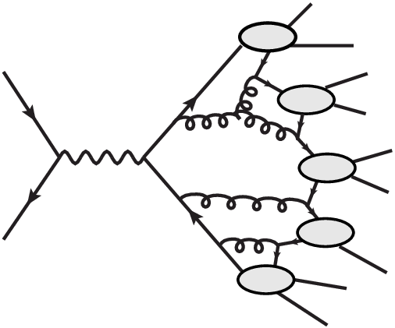
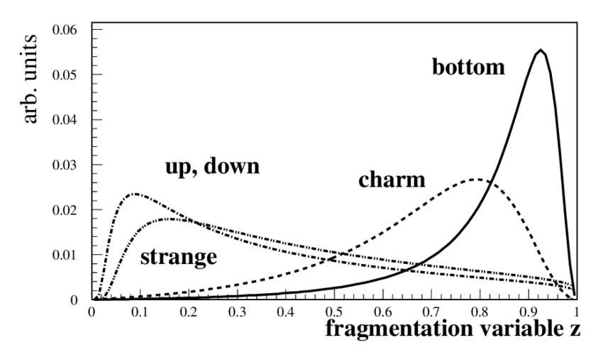
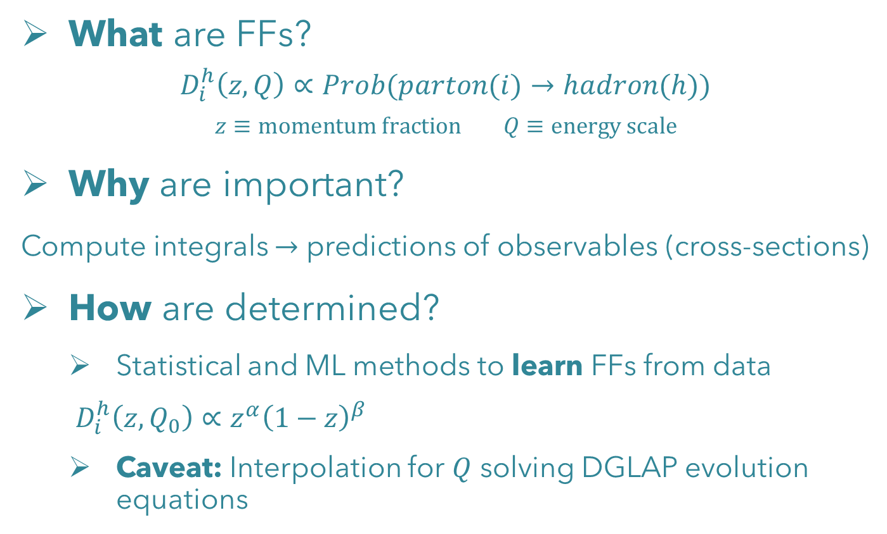
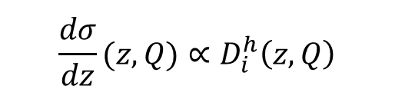
Motivation: Fragmentation functions (FFs)
What are FFs?
$$D_{i}^{h}\left(z,Q\right)∝Prob(parton(i)→hadron(h))$$
$$z≡momentum fraction Q≡energy scale$$
Why are important?
Compute integrals $→$ predictions of observables (cross-sections)
How are determined?
  Statistical and ML methods to learn FFs from data
  $D_{i}^{h}\left(z,Q_{0}\right)∝z^{α}{\left(1−z\right)}^{β}$
  Caveat: Interpolation for $Q$ solving DGLAP evolution equations
$${\frac{dσ}{dz}(z,Q)∝D}_{i}^{h}\left(z,Q\right)$$

Slide 4
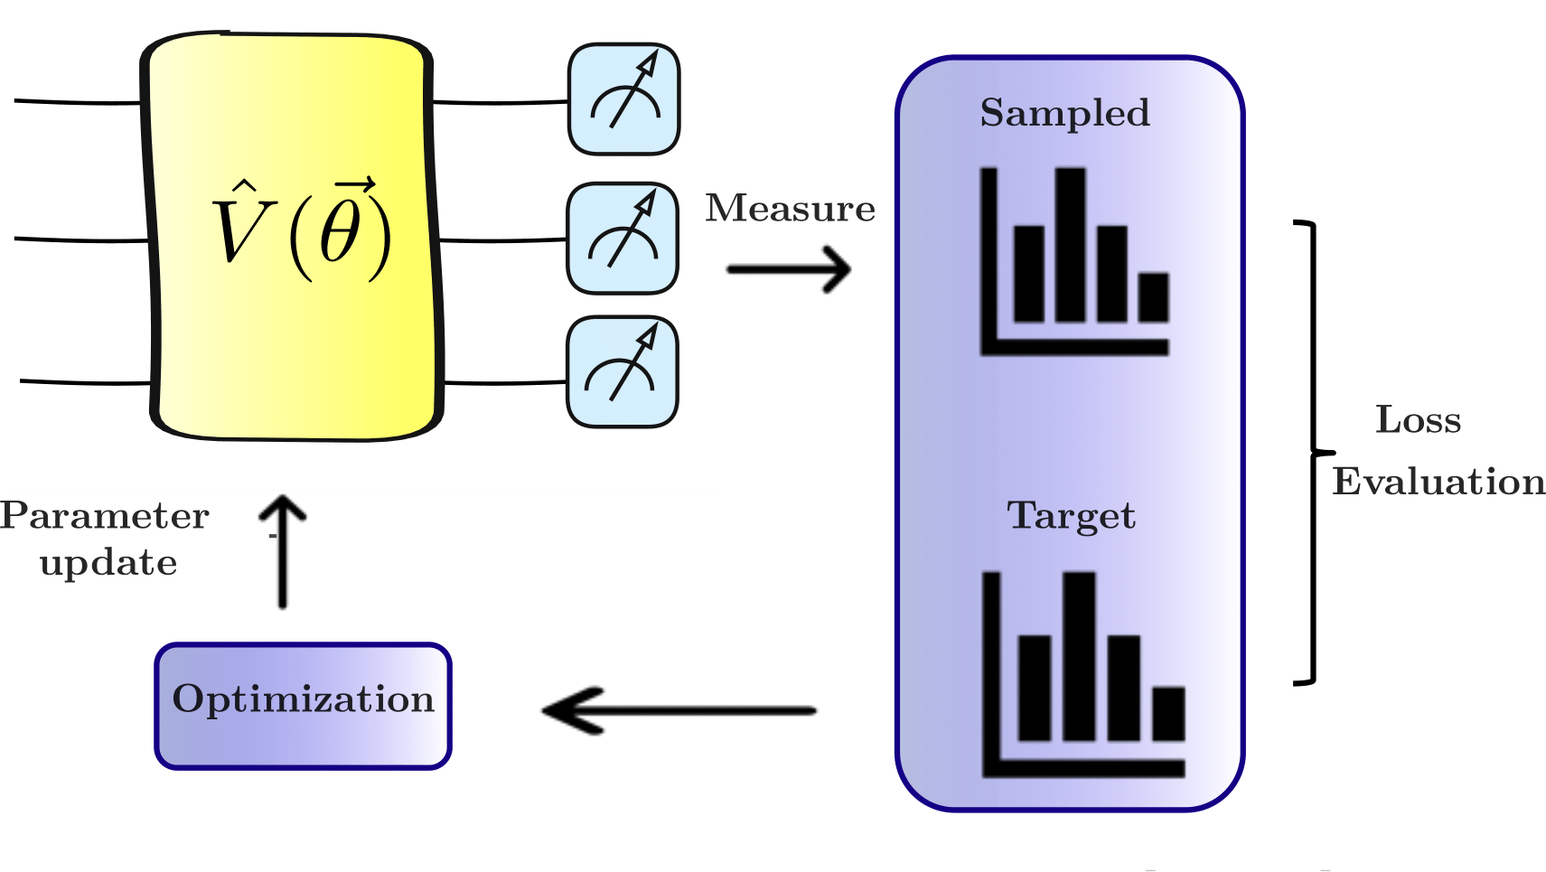


Motivation: Quantum Generative Models (QGM)
1. Learn target distributions
2. Generate new samples
3. Potentially more efficient
QGM
4. Examples: QGANs, QCBM, QAE, QChebGM

Slide 5
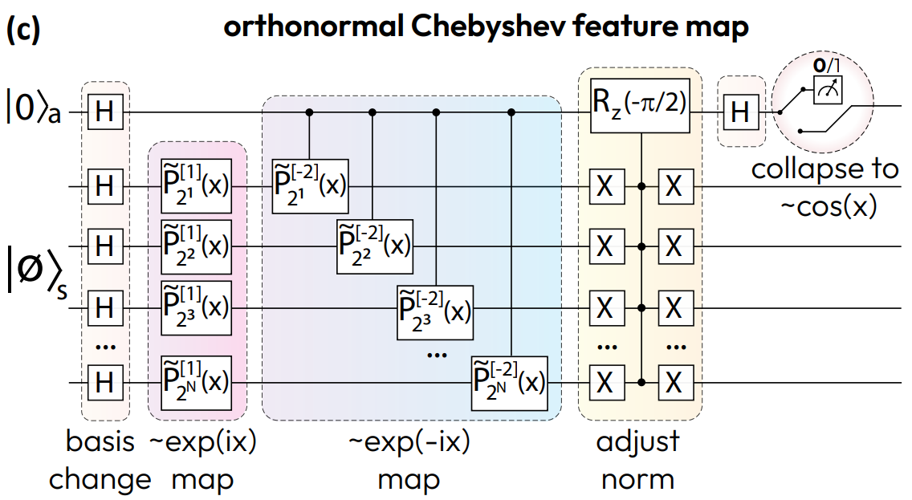


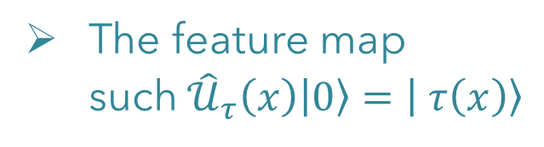

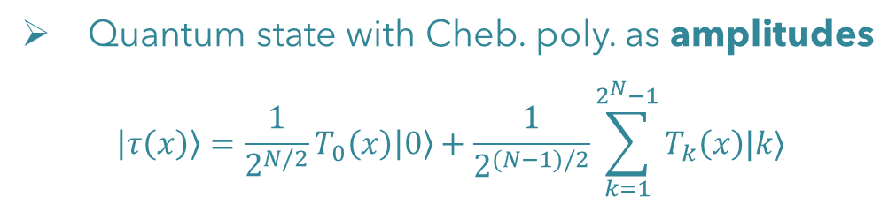

Quantum Chebyshev Generative Models
Quantum Chebyshev Transform: Mapping, Embedding, Learning and Sampling Distributions: Chelsea A. Williams, Annie E. Paine, Hsin-Yu Wu, Vincent E. Elfving, Oleksandr Kyriienko, arXiv:2306.17026
Chebyshev Feature map:
Chebyshev polynomials:
$$T_{k}\left(x\right)≡\cos\left(k arccos\left(x\right)\right)$$
Quantum state with Cheb. poly. as amplitudes
$$\left|τ\left(x\right)\right\rangle =\frac{1}{2^{N/2}}T_{0}\left(x\right)\left|0\right\rangle +\frac{1}{2^{(N−1)/2}}\sum_{k=1}^{2^{N}−1}{T_{k}\left(x\right)|k⟩}$$
$$P_{meas}=\frac{I−Z}{2}$$
The feature map such${ \hat{𝒰}}_{τ}\left(x\right)\left|0\right\rangle =\left| τ\left(x\right)\right\rangle$
$$|τ\left(x\right)⟩$$
Orthogonal at the nodes
$$x_{j}^{Ch}:=\cos{(π/2(2j+1)/2^{N})}$$

Slide 6
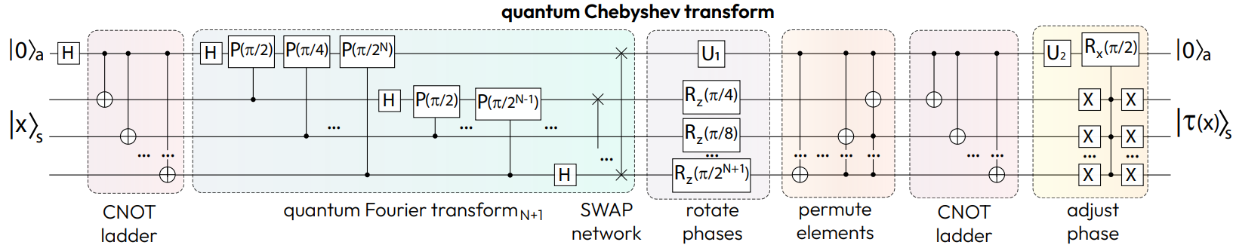
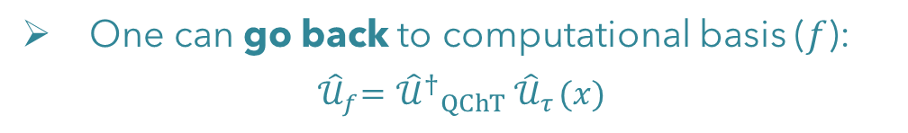
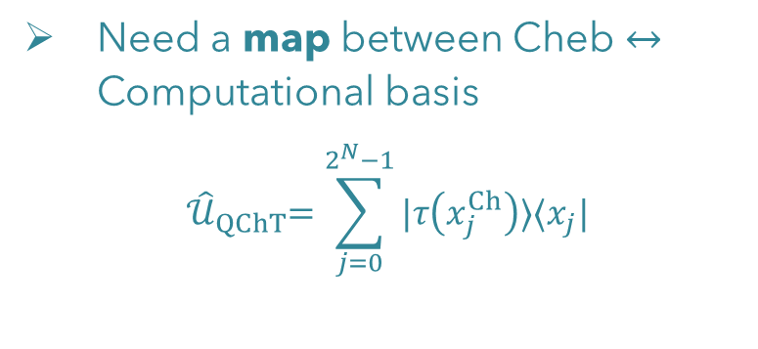
Quantum Chebyshev Generative Models
Quantum Chebyshev Transform: Mapping, Embedding, Learning and Sampling Distributions: Chelsea A. Williams, Annie E. Paine, Hsin-Yu Wu, Vincent E. Elfving, Oleksandr Kyriienko, arXiv:2306.17026
Quantum Chebyshev Transform:
Need a map between Cheb $↔$ Computational basis
$${ \hat{𝒰}}_{QChT}=\sum_{j=0}^{2^{N}−1}{|τ\left(x_{j}^{Ch}\right)⟩⟨x_{j}|}$$
One can go back to computational basis ($f$):
$${ \hat{𝒰}}_{f}={ {\hat{𝒰}}^{†}}_{QChT}{ \hat{𝒰}}_{τ}(x)$$
$$U_{1}=P\left(−π{/2}^{N+1}\right)R_{z}\left(−π\left(2^{N}−1\right)/2^{N+1}\right), U_{2}=P\left(−π/2\right)R_{Y}\left(−π/2\right)$$

Slide 7
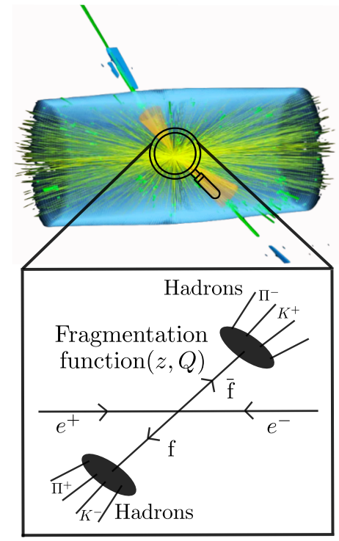
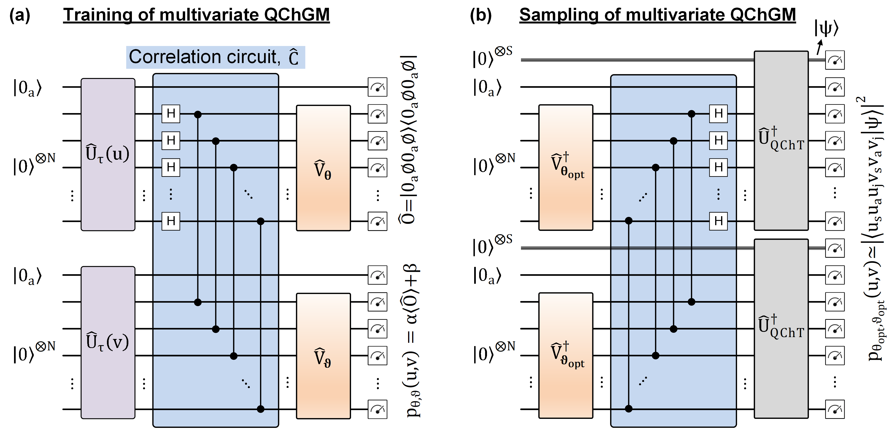
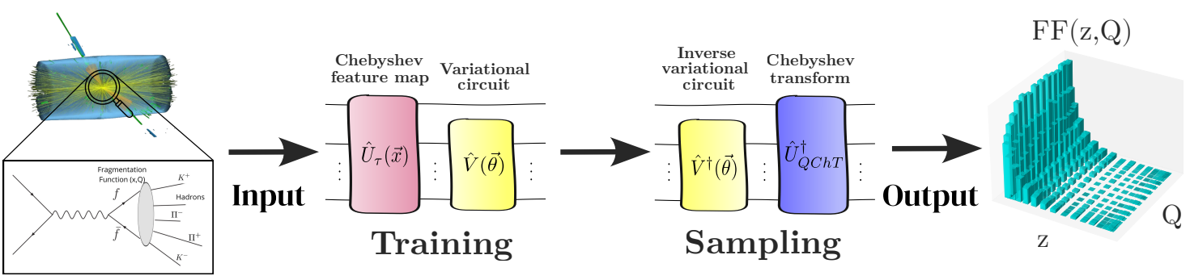
Quantum Chebyshev Generative Models
Workflow of the model:
Training
Sampling

Slide 8


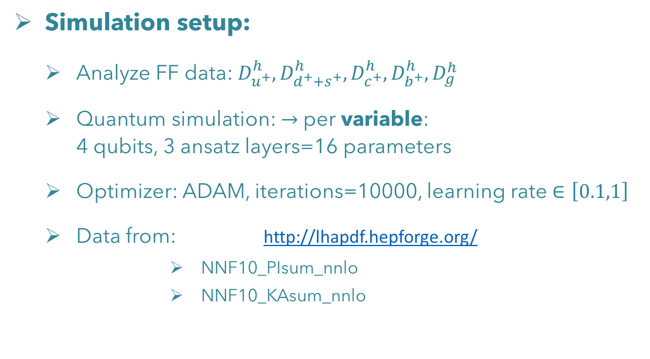
Results: QChGM for FF
Simulation setup:
  Analyze FF data: $D_{u^{+}}^{h}, D_{d^{+}+s^{+}}^{h}, D_{c^{+}}^{h}, D_{b^{+}}^{h}, D_{g}^{h}$
  Quantum simulation:$→$ per variable: 4 qubits, 3 ansatz layers=16 parameters
  Optimizer: ADAM, iterations=10000, learning rate $∈\left[0.1,1\right]$
  Data from: http://lhapdf.hepforge.org/
          NNF10_PIsum_nnlo
          NNF10_KAsum_nnlo
{
with $h=Π^{±}, K^{±}$
for $z∈\left[0.01,1\right], Q∈[1, 10000]$
LHAPDF6: parton density access in the LHC precision era: Andy Buckley, James Ferrando, Stephen Lloyd, Karl Nordstrom, Ben Page, Martin Ruefenacht, Marek Schoenherr, Graeme Watt, Eur.Phys.J.C 75 (2015) 132

Slide 9
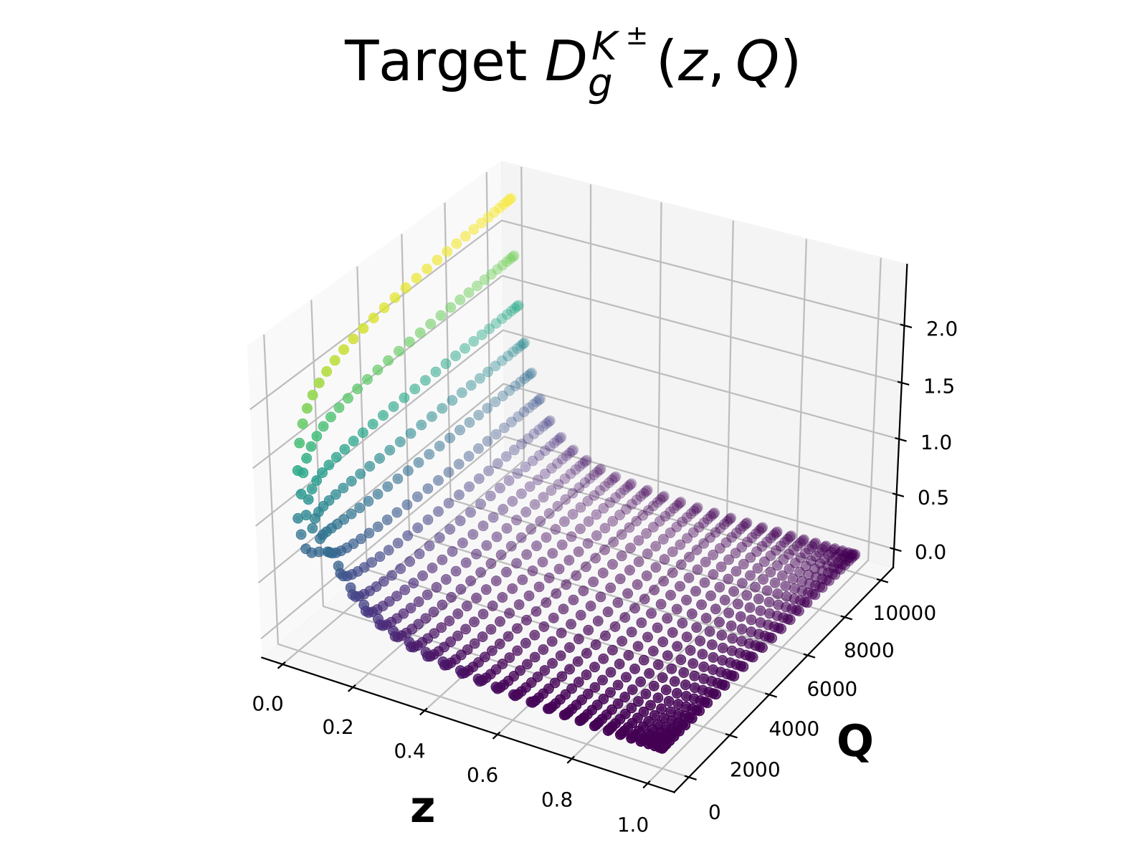
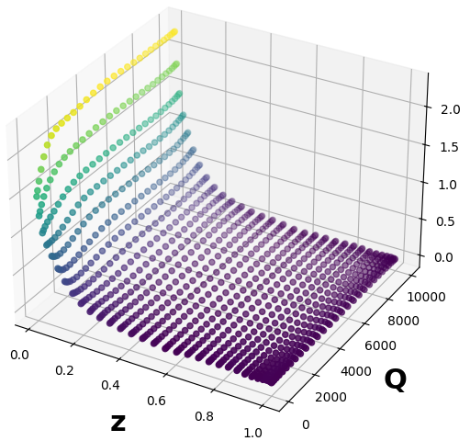


Results: QChGM for FF
Training and sampling:
  Example $D_{g}^{K^{±}}$:
Target:
Predictions: $R^{2}=0.99$

Slide 10
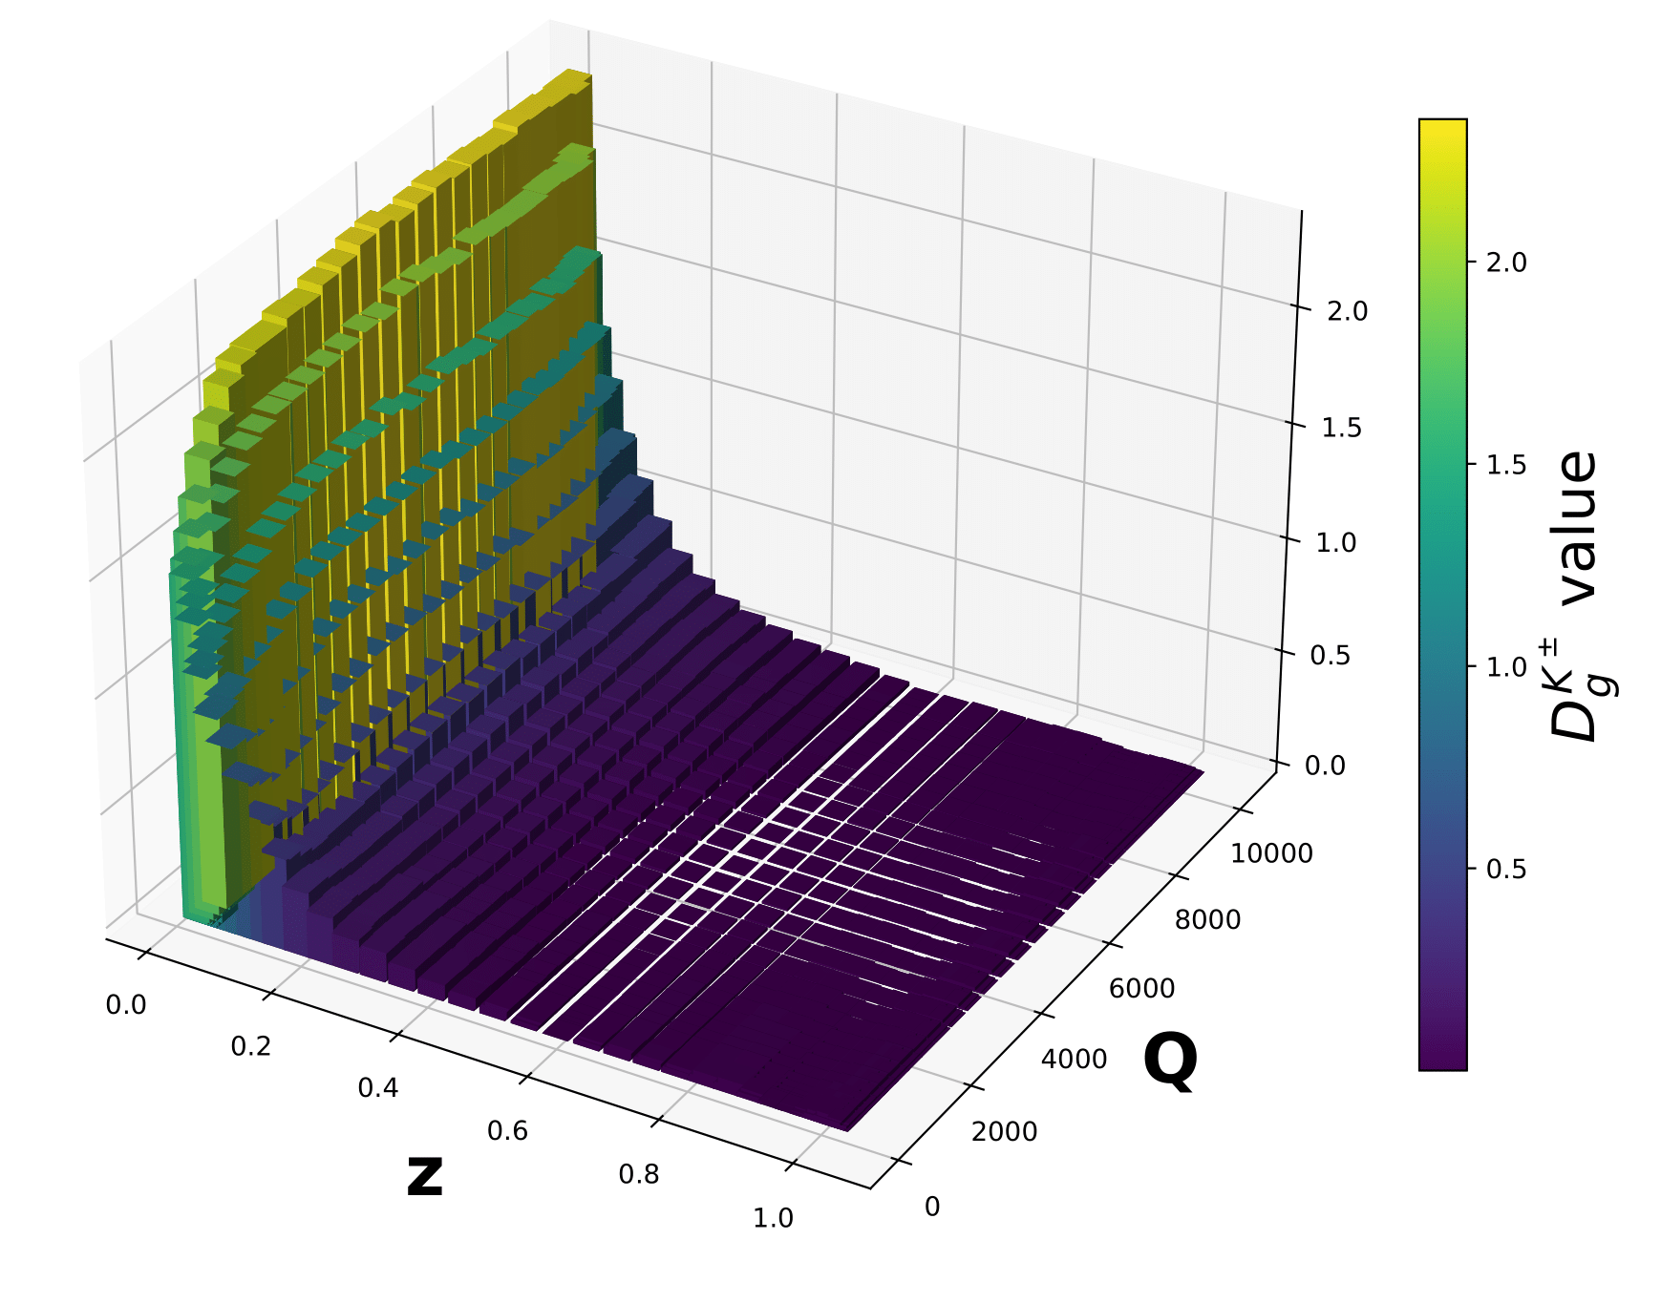
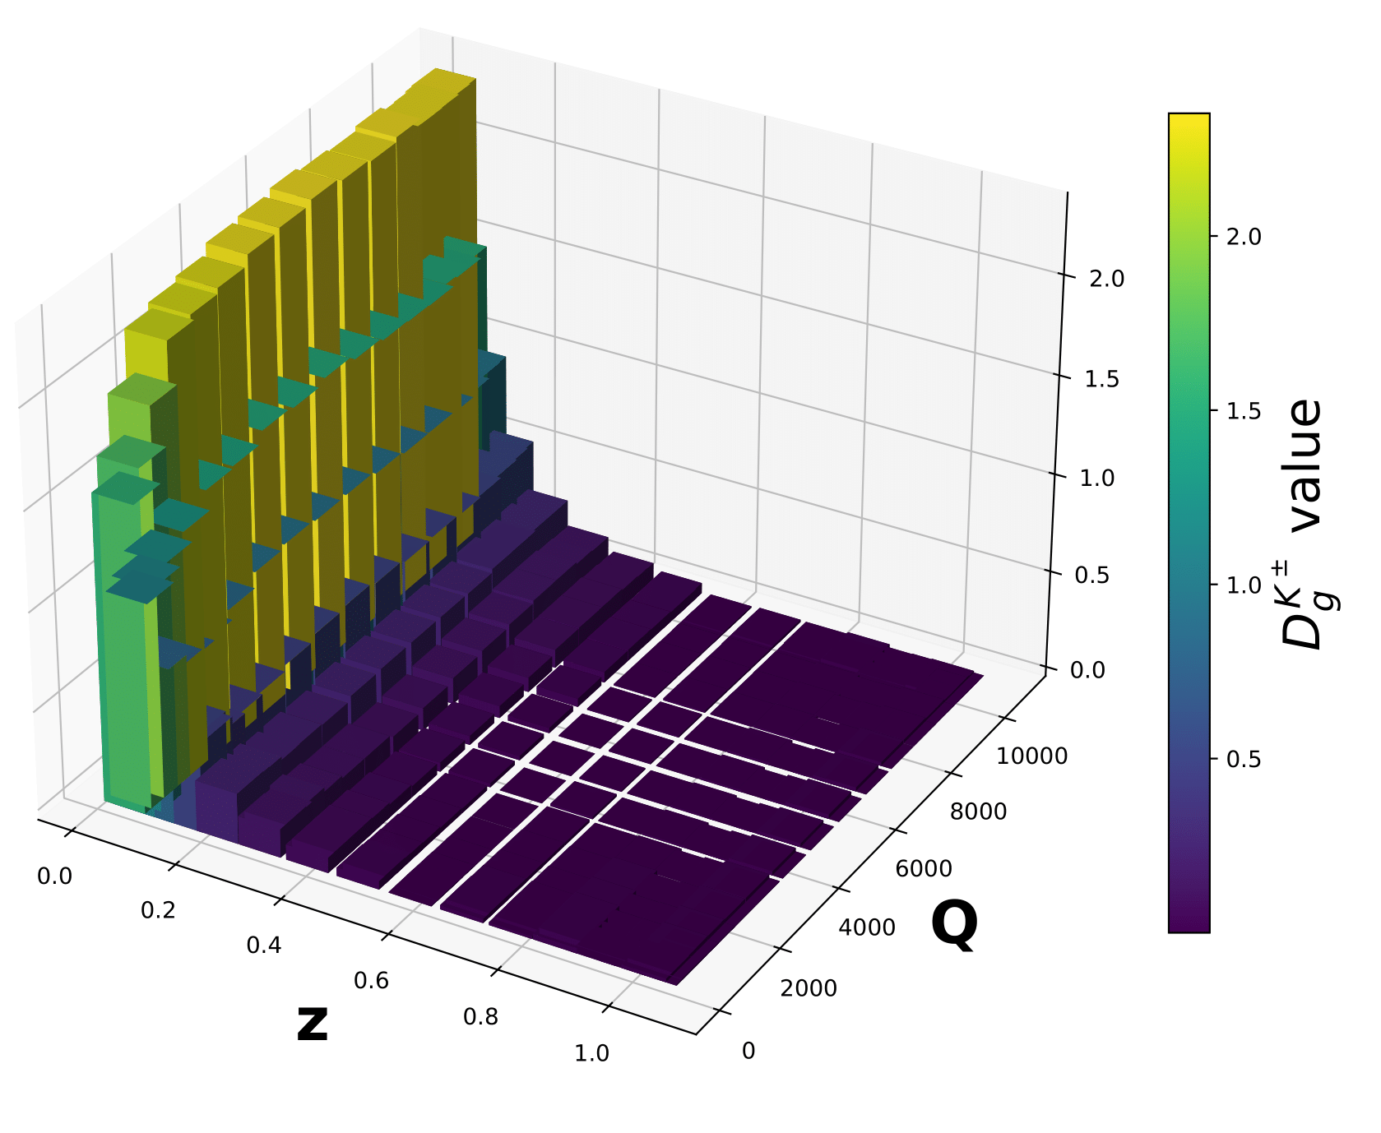
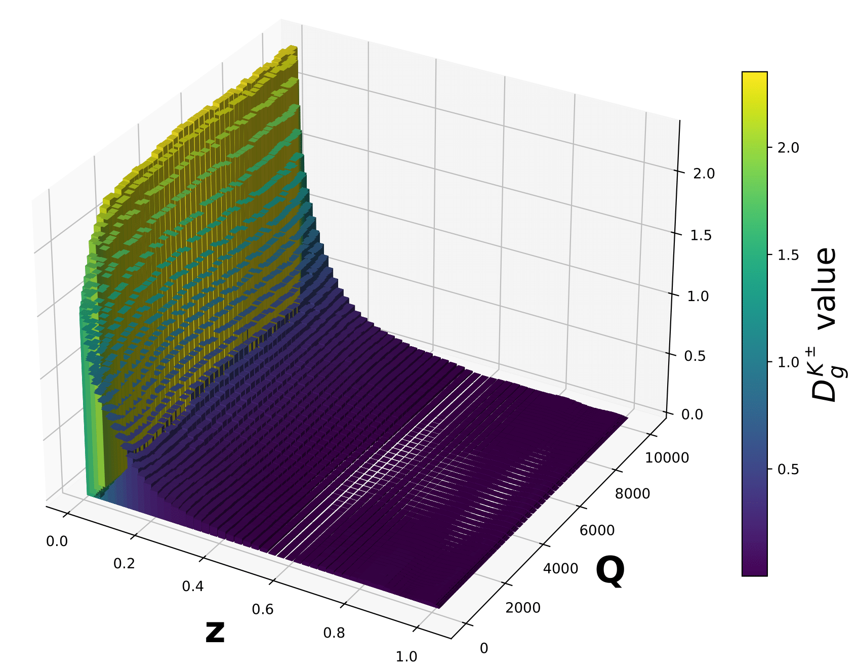
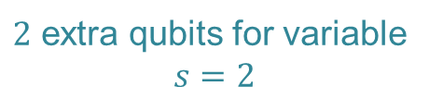
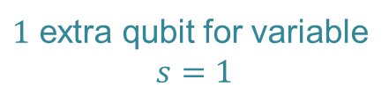
Results: QChGM for FF
$1$ extra qubit for variable
$$s=1$$
Quantum interpolation
Training and sampling:
  Example $D_{g}^{K^{±}}$:
Extended sampling
Target:
Sampling:
(more qubits)
$2$ extra qubits for variable
$$s=2$$

Slide 11
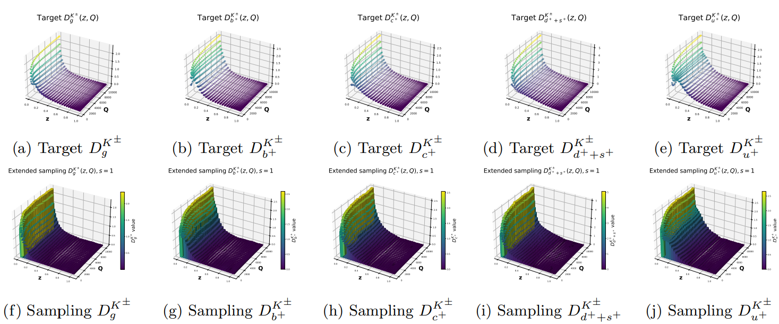
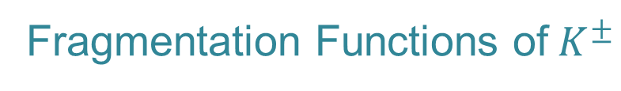
Results: QChGM for FF
All the results:
Fragmentation Functions of$K^{±}$

Slide 12
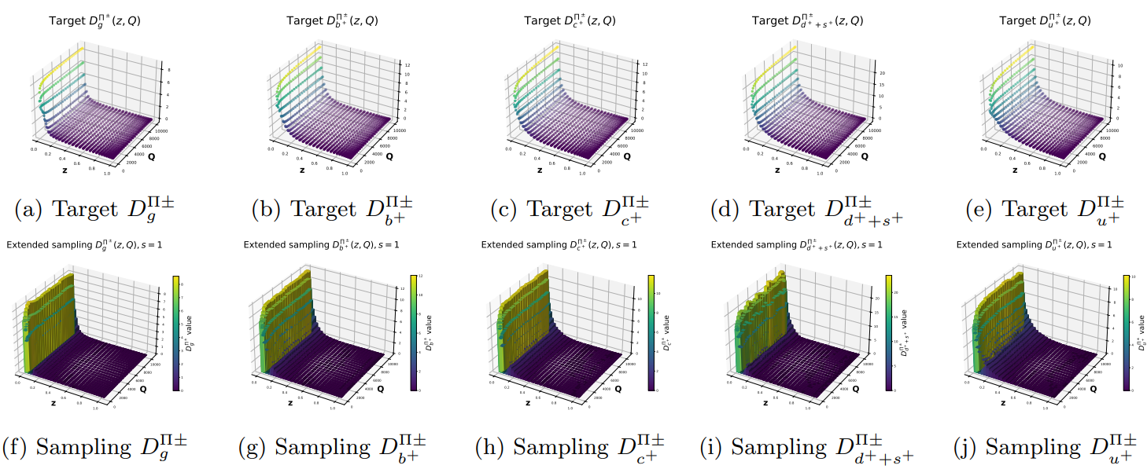
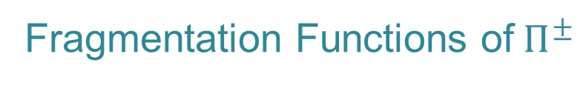
Results: QChGM for FF
All the results:
Fragmentation Functions of$Π^{±}$

Slide 13
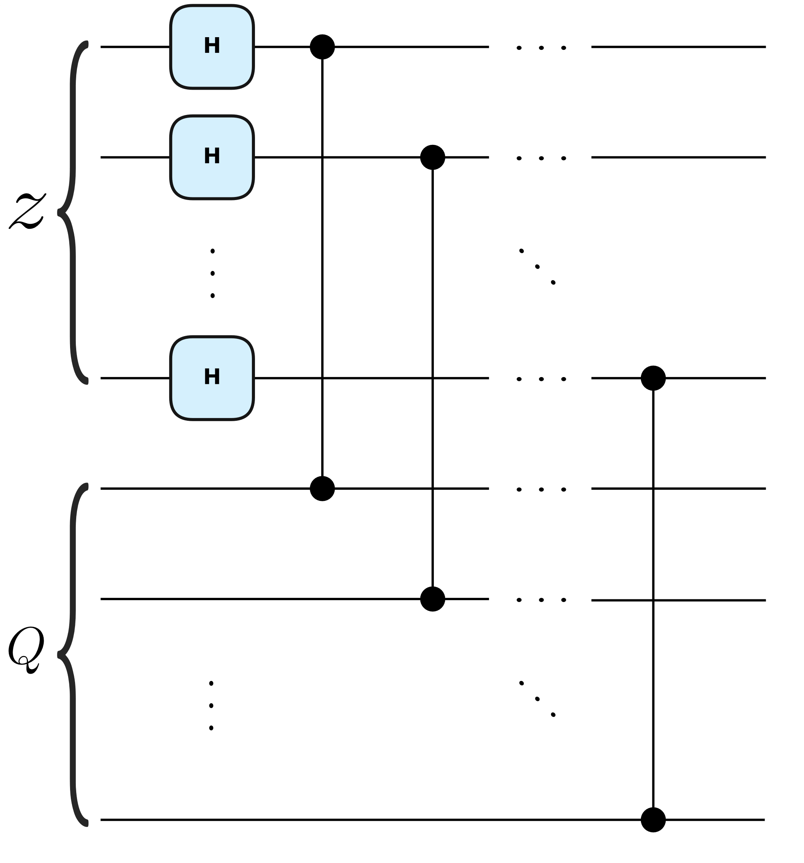
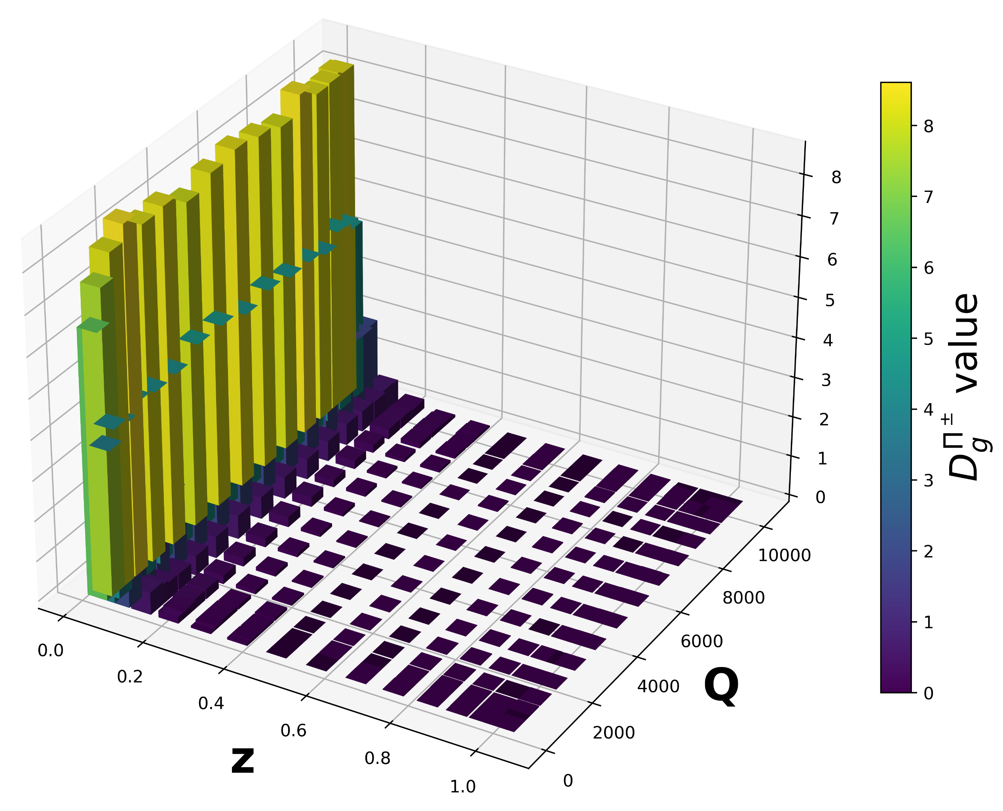
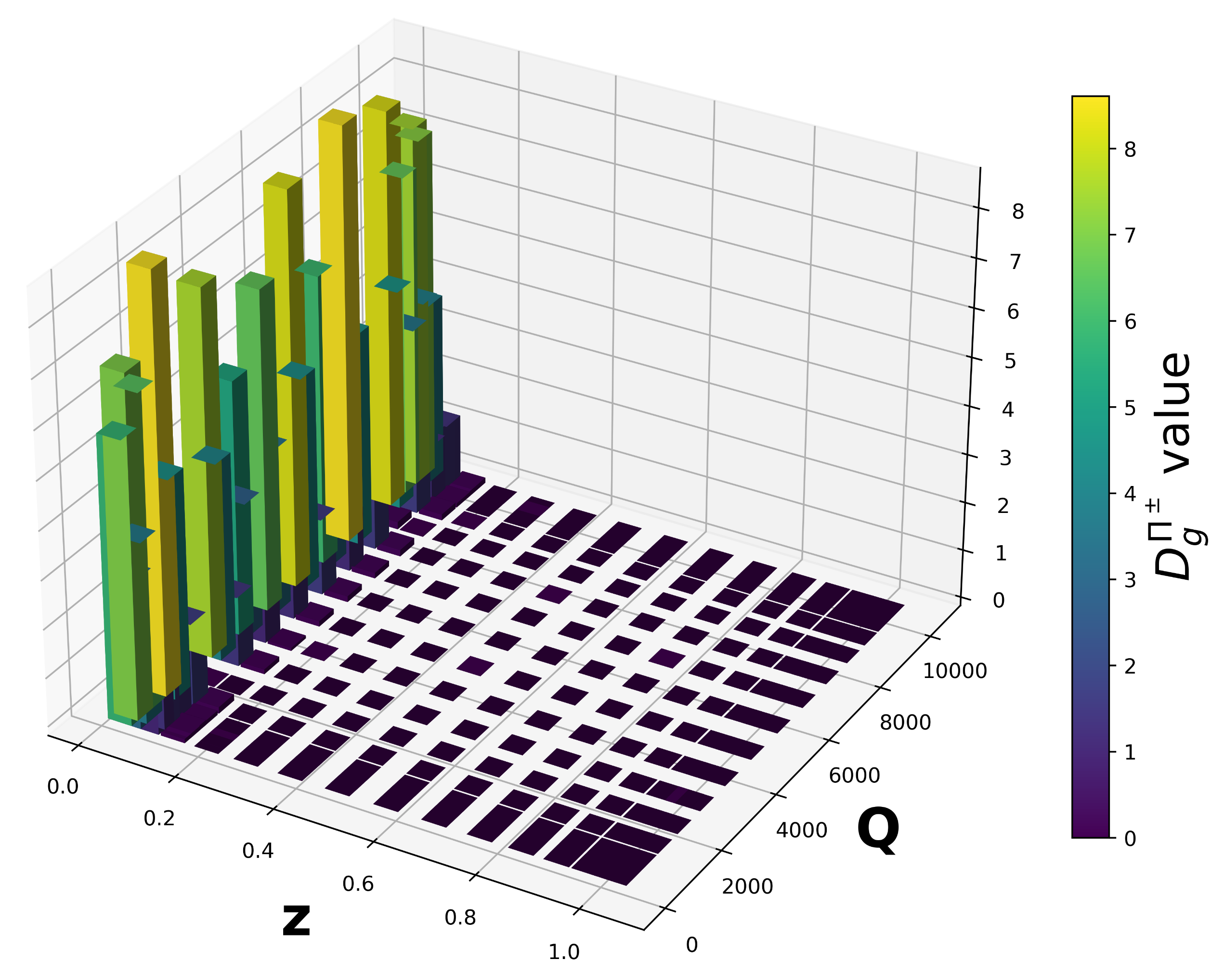


Results: QChGM for FF
Study of correlations:
Correlations circuit
Example $D_{g}^{Π^{±}}$: 4 qubits, 3 layers, 10000 iter., learning rate $∈\left[0.1,1\right]$
W/ CC:
$$R^{2}=0.99$$
W/o CC:
$$R^{2}=0.85$$

Slide 14
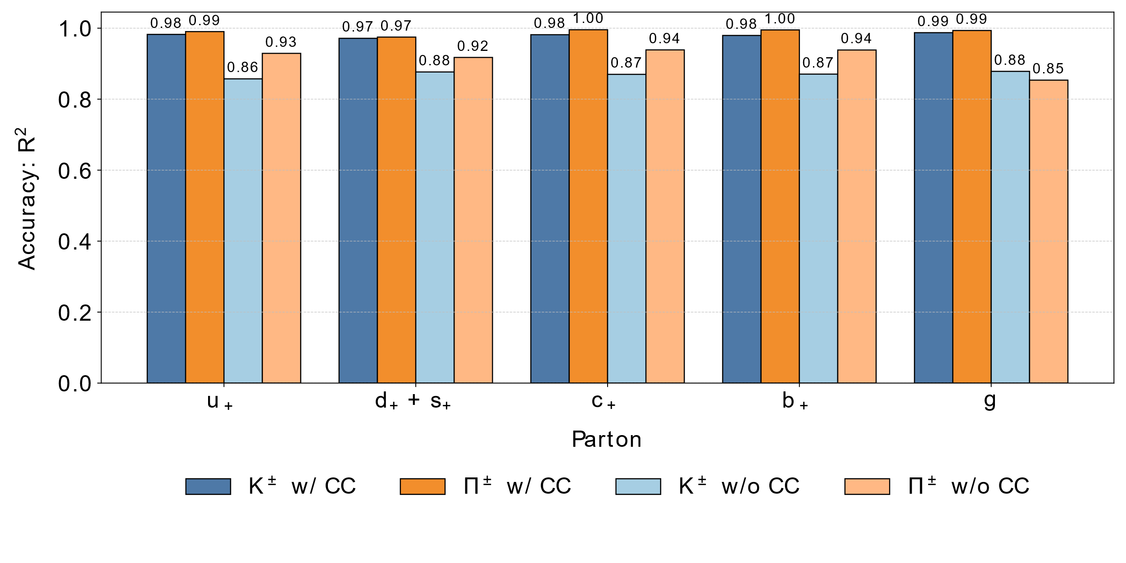
Results: QChGM for FF
Different findings than:
Better than classical? The subtle art of benchmarking quantum machine learning models: Joseph Bowles, Shahnawaz Ahmed, Maria Schuld, arXiv:2403.07059
They: Classical data
We: “Quantum” data
“Quantumness” help the models to learn
Study of correlations:
Similar to: Yacine Haddad’s poster
Comparison all FF
Correlations circuit

Slide 15

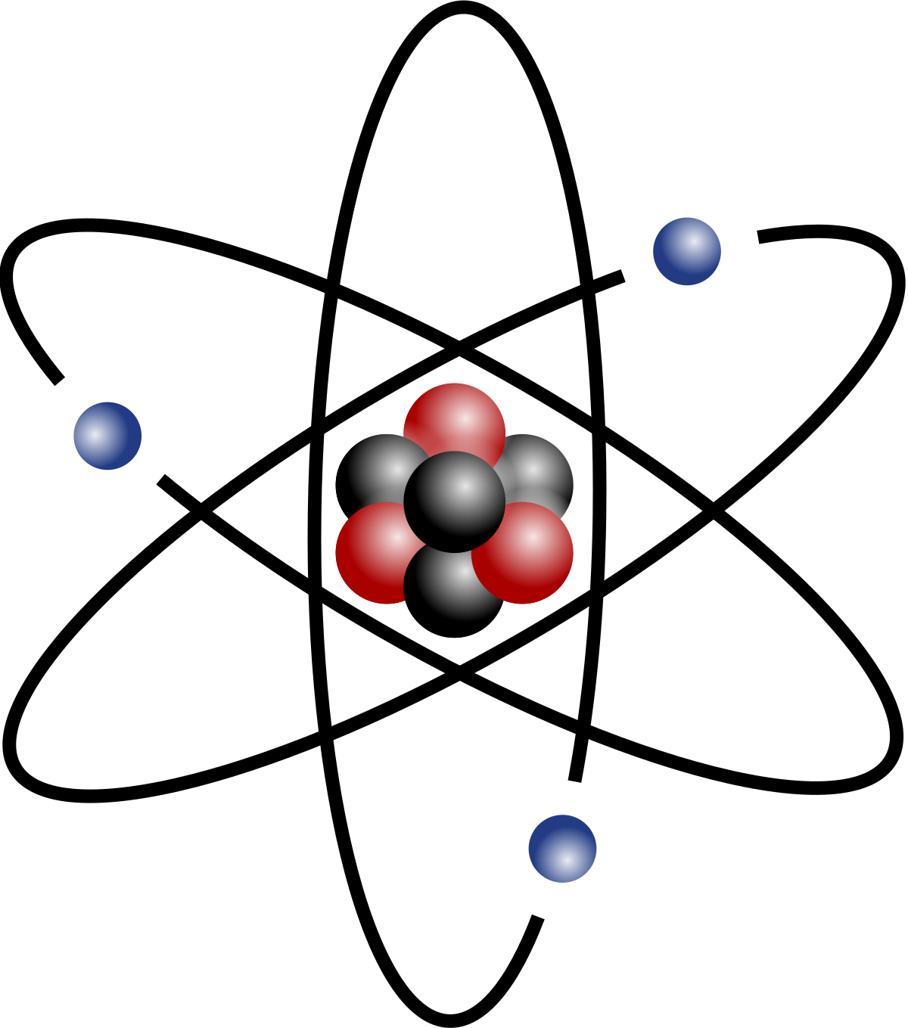
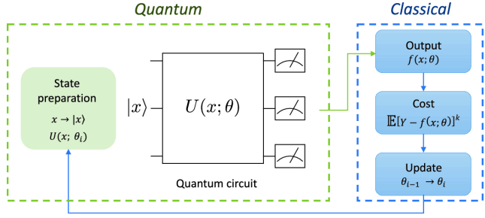
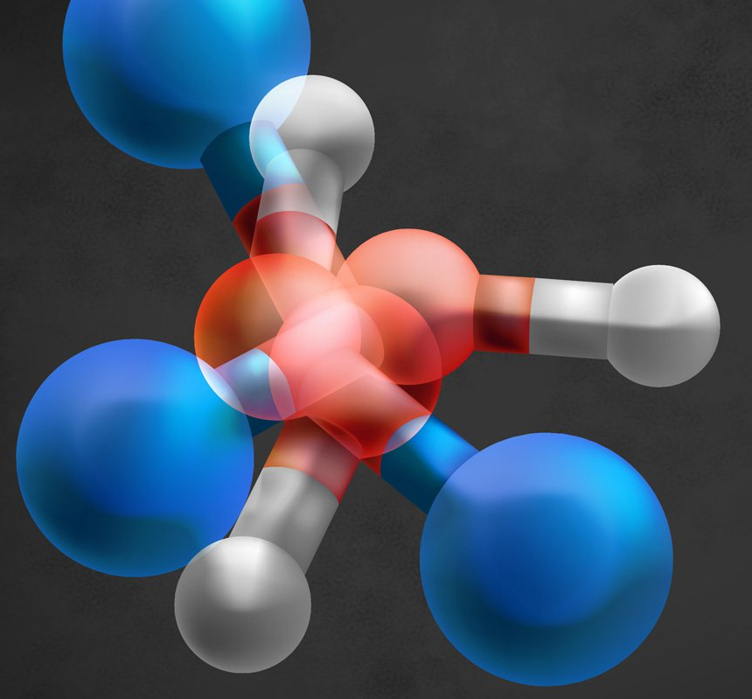

Outlook
+
Succesfully applied QChGM to learn FFs
Efficient sampling with extended register
  Natural quantum interpolation
Correlations help the quantum model to learn
  Apply QML to data that comes from quantum processes
$$→$$

Slide 16
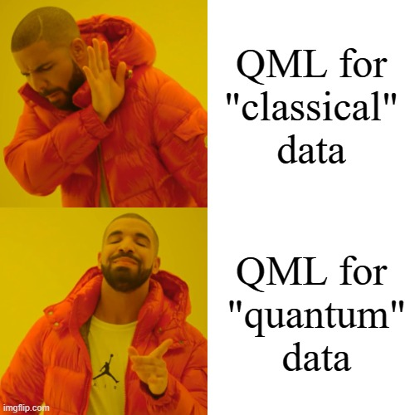
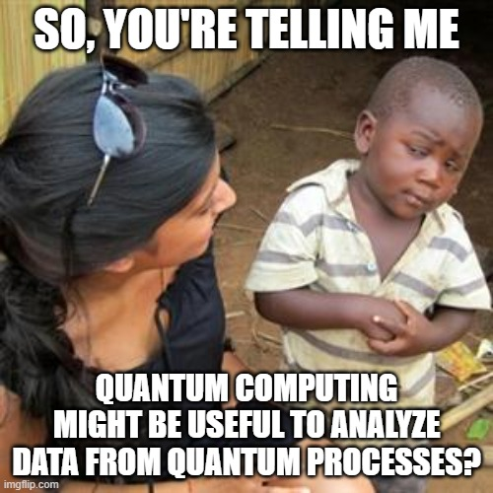

Thank you for your attention!
If questions drop me an email:
jormard@ific.uv.es

