Slide 1
How can we ensure equitable access to quantum technologies?
Dr Marianne Schoerling
Geneva Science and Diplomacy Anticipator (GESDA) Foundation/OQI
QT4HEP, 21 Jan 2025

Slide 2

1
Setting the scene: Science Diplomacy
2
Zooming in: The Open Quantum Institute
3
Activating opportunities: IYQ2025

Slide 3

Setting the scene: Science Diplomacy
Science to accelerate sustainable development
Policymakers to think upstream about the impact of scientific and technological progress on society
Ensure equitable access to the technology and progresses for the benefit of humanity
Anticipation of future developments
Acceleration of the dialogue between science, diplomacy, philanthropy and society
Translation of opportunities into action

Slide 4

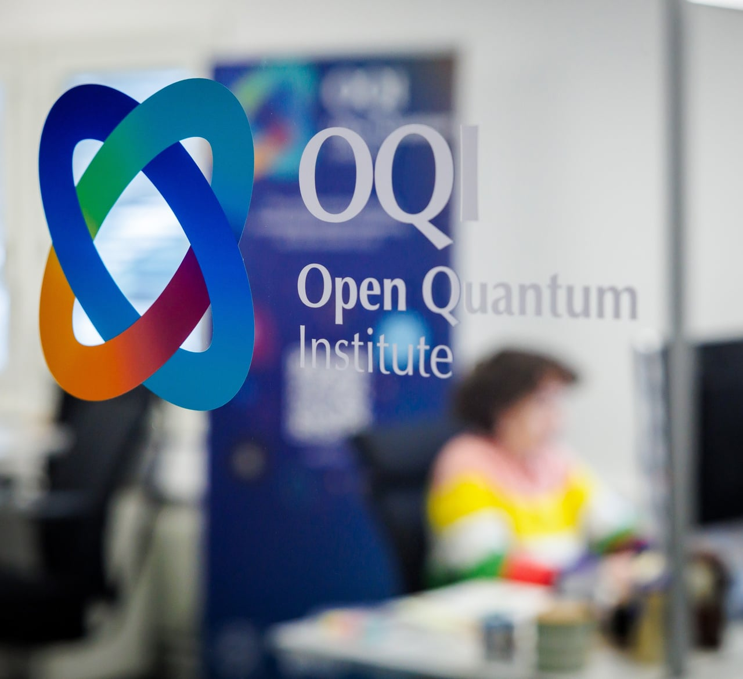
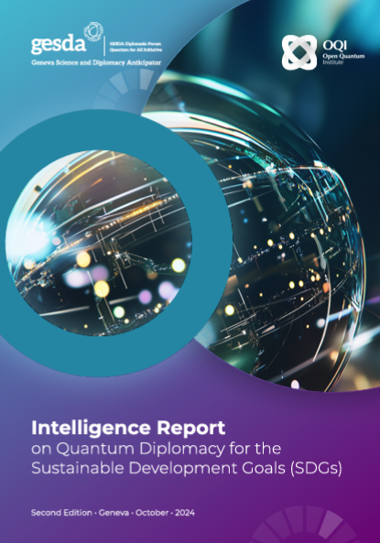
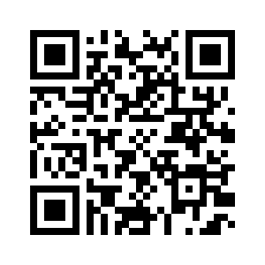
Zooming in: The Open Quantum Institute
proactive

Slide 5




Strategic Pillars of the Open Quantum Institute
A1 Accelerating applications for humanity
A2 Access for all
Realising the full potential of quantum computing by accelerating the use cases geared towards achieving the SDGs, thanks to the combined forces of researchers and developers, entrepreneurs, the United Nations, and large NGOs.
Providing global, inclusive and equitable access to a pool of public and private quantum computers and simulators available via the cloud
A3 Advancing capacity building
A4 Activating multilateral governance for the SDGs
Developing educational tools to enable everyone around the world to contribute to the development of quantum computing and make the most of the technology.
Providing a neutral forum to help shape multilateral governance of quantum computing for the SDGs

Slide 6
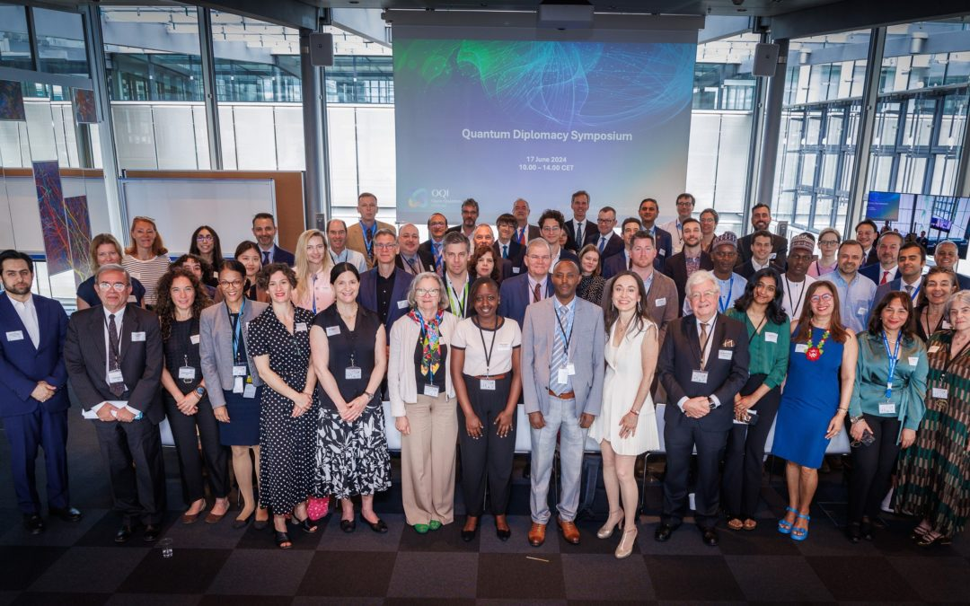
A4 - Activating Multilateral Governance for SDGs
Quantum Diplomacy engagement through informal discussions with 20+ permanent representations in Geneva and in country with input from community of practice (industry and science)
Digital and economic inclusivity
Technology for the SDGs
Global Security
Interoperability
Trade
Environment
Talent
Human Agency

Slide 7

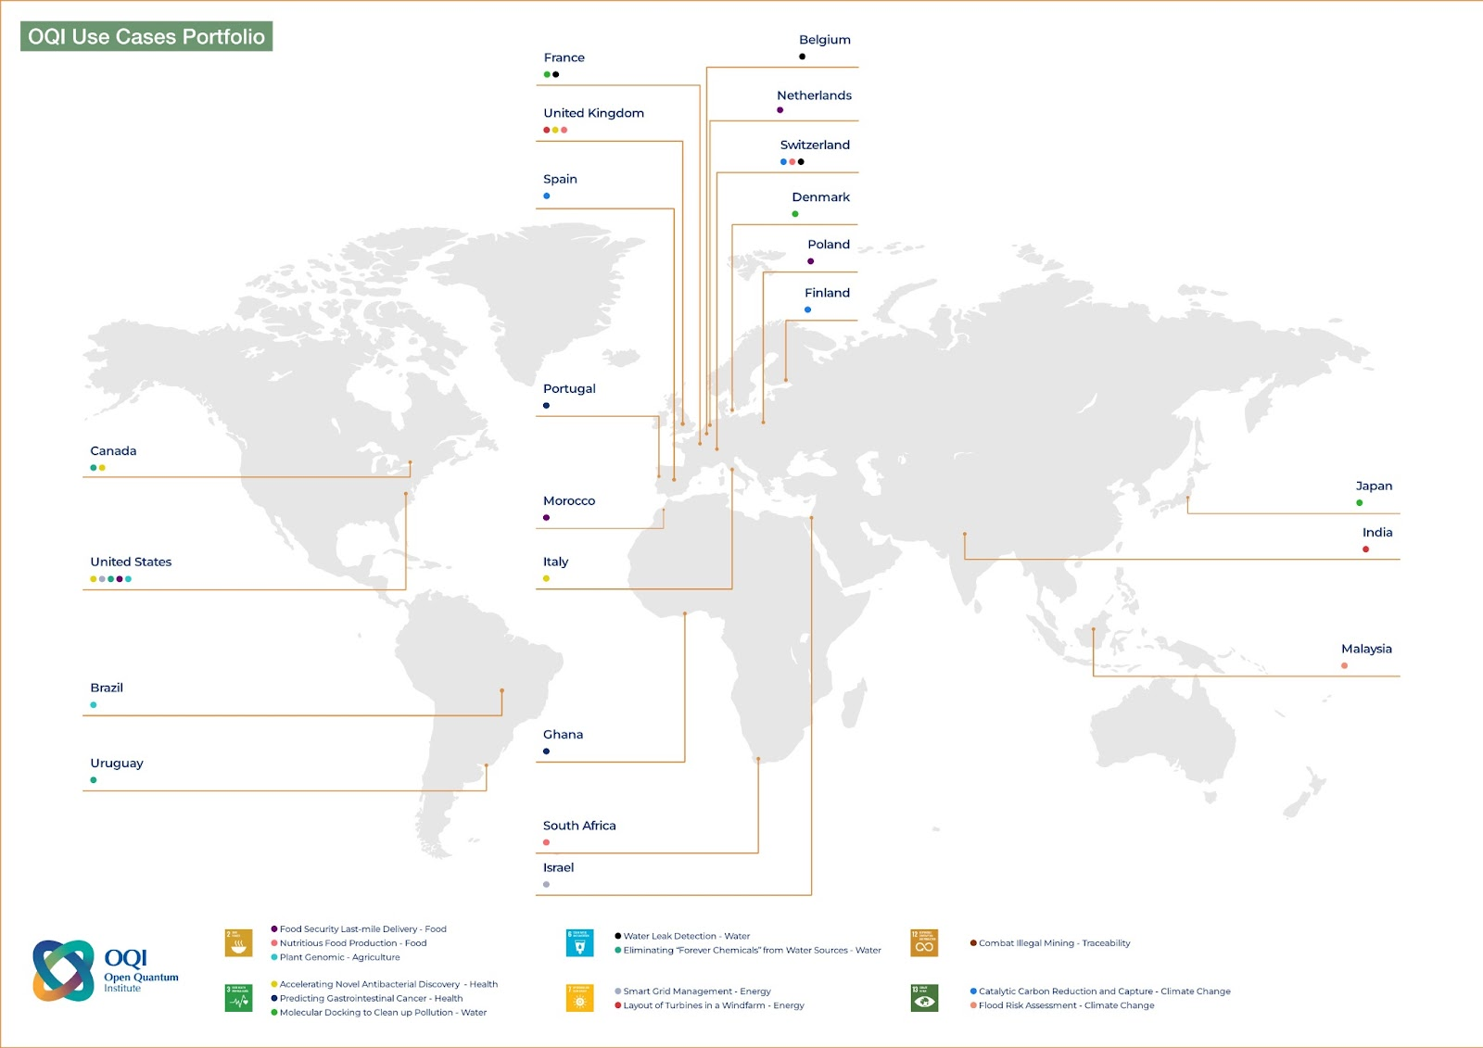





A1 - Accelerating Applications for Humanity
• Nutritious Food production
• Food Security – Last mile food delivery
• Plant Genomics
• Accelerating Novel Antibacterial Discovery
• Molecular Docking
• Predicting Gastro- intestinal Cancer
• Water Leak Detection
• Eliminating forever chemicals from water sources
• Laying out turbines in a windfarm
• Smart grid management
• Carbon Capture
• Flood risk assessment

Slide 8
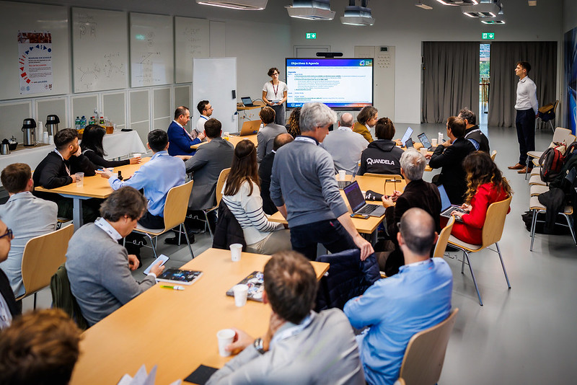
A2 - Access for All
  OQI as the center for expertise on the applications of quantum computing for the SDGs (and their future succeeding framework)

Slide 9
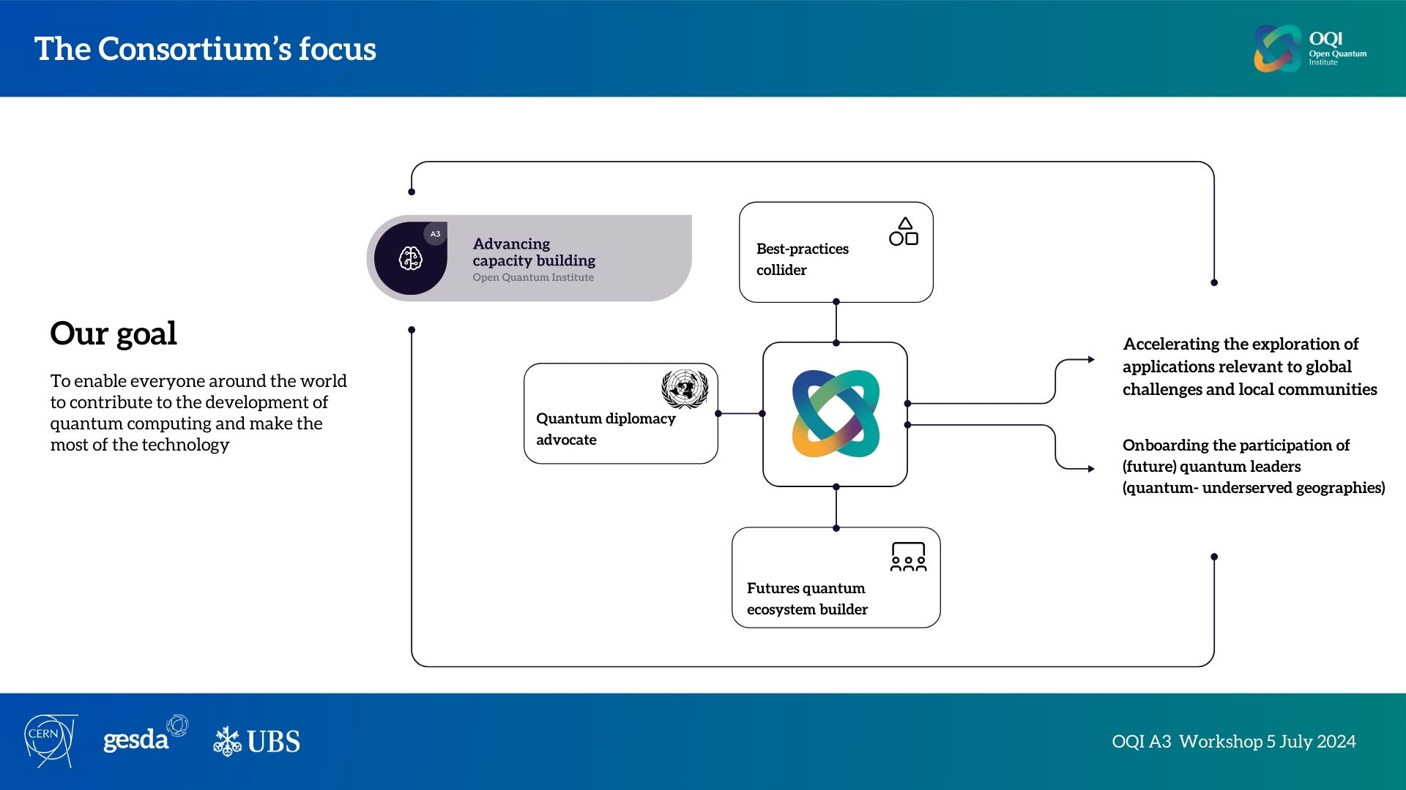
A3 - Advancing capacity building at OQI

Slide 10
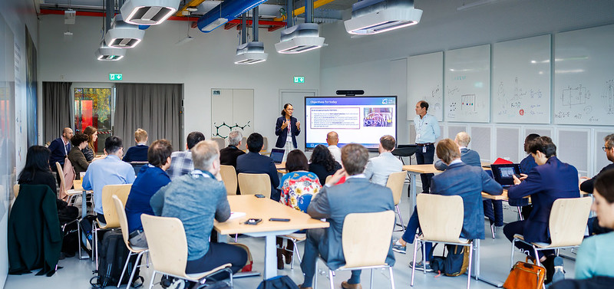
A3 - Advancing capacity building - activities
Educational Consortium Workshops Extended Educational Repository Foundational Trainings
Hackathons Training for host institutions of OQI supported hackathons Pre-hackathon training programme for participants OQI mentorship programme OQI internship programme Regional quantum community events OQI inspired activities
Quantum Diplomacy Game Quantum Diplomacy Game facilitator programme
  Best-practices collider
Educational Consortium
55+ institutions contributing, with 17 official member institutions, and 80 experts involved in the Education Consortium
All activities aligned and relayed as part of the UN Year of Quantum Science and Technology
  Futures quantum ecosystem builder
  Quantum diplomacy advocate

Slide 11
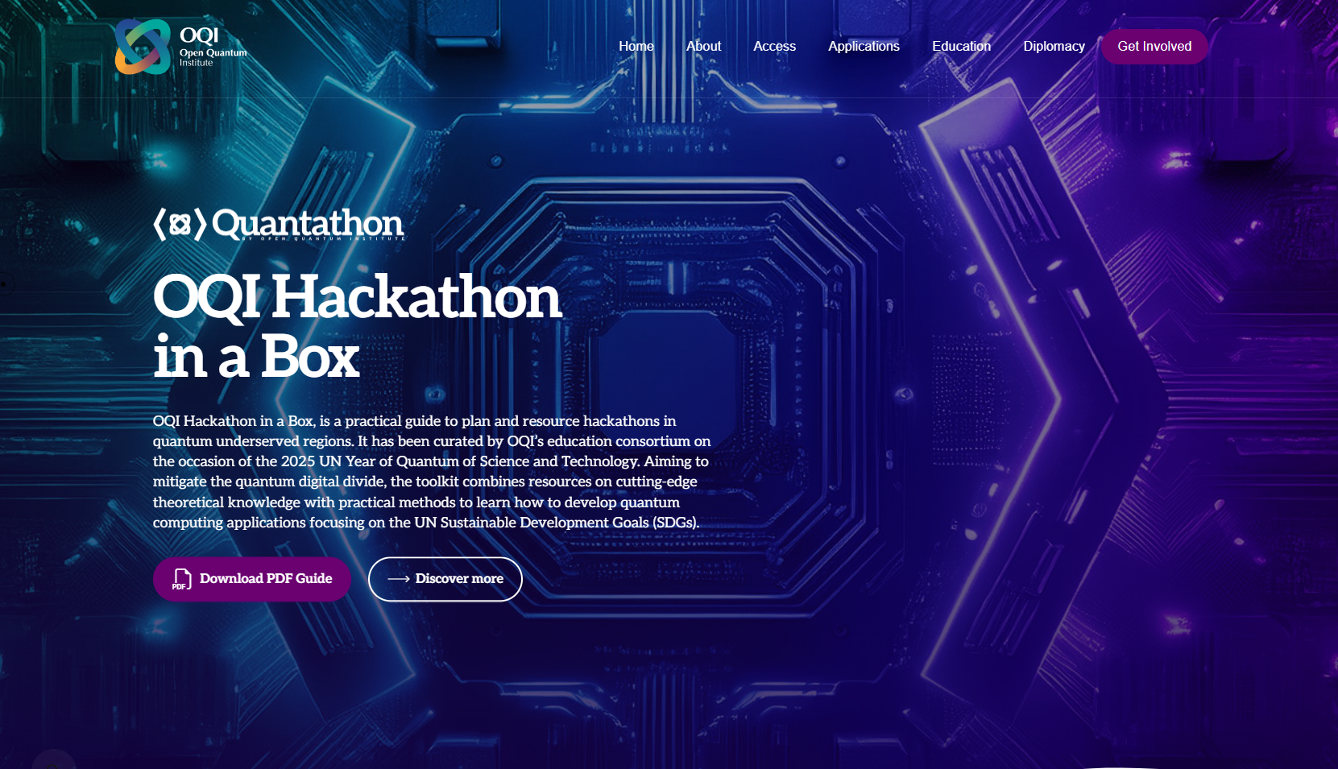
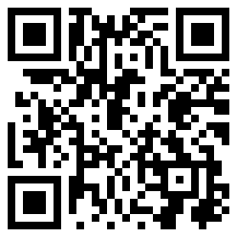
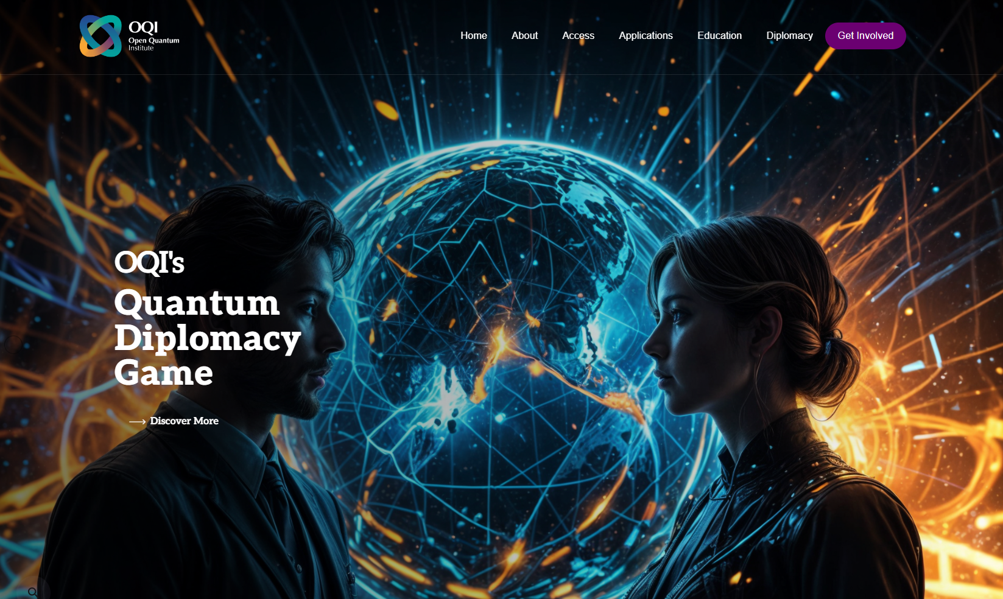
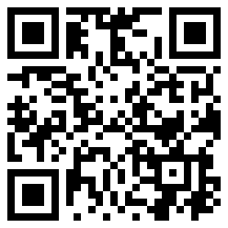
Activating opportunities: IYQ2025
6 Hackathons taking place in all continents
4 Quantum diplomacy Games around the globe,
OQI white Paper on Use Cases and Arxiv Paper on Regime of Quantum Advantage

Slide 12
How can we ensure equitable access ?
Anticipating
Identifying opportunities for SDG use cases on the global quantum landscape
Identifying access and implementation support needs
Accelerating of the dialogue between science, diplomacy, philanthropy and society
Using platforms such the Quantum Diplomacy Symposium to debate across sectors about multilateral efforts required to harness the technology responsibly
Using quantum technologies as tools for equitable innovation rather than instruments of division
Offering support for implementation when providing access to technology
Advocating for capacity-sharing initiatives
Offering open-source educational resources
Implementing collectively best practices for advancing capacity building
Translating opportunities into action

Slide 13
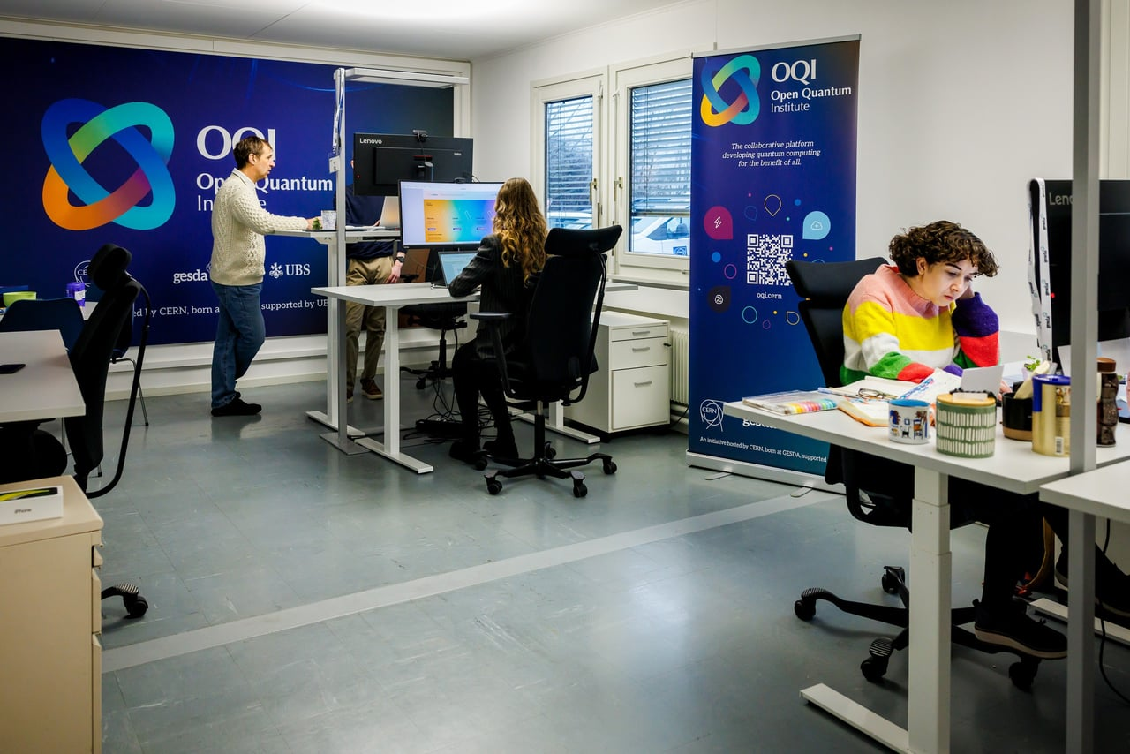
Thank you!
oqi.info@cern.ch

