Slide 1

Long-baseline atom interferometry:
Probing the universe with ultracold atoms
Dr Tiffany Harte
22/01/2025, QT4HEP
th558@cam.ac.uk

Slide 2
Outline
Introduction to atom interferometry
Long-baseline interferometers as detectors
The AION detector: science and detection goals
Wider synergies with cold atom technologies

Slide 3
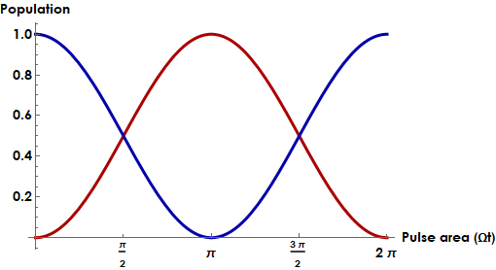

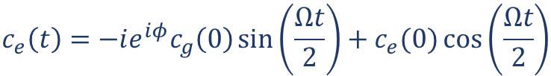

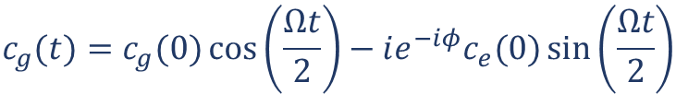


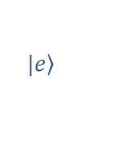
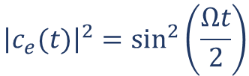


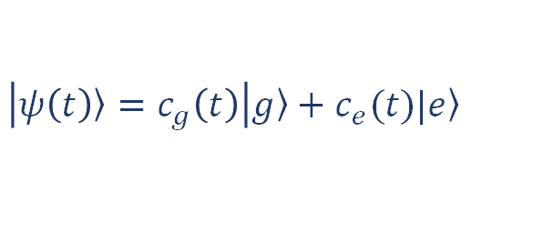
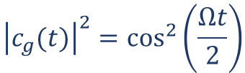
Atom-light interactions
Substitute into Schrödinger equation and ignore rapidly-oscillating terms.
$$|\left.e\right\rangle$$
$$\frac{dc_{g}(t)}{dt}=−i\frac{Ω}{2}e^{−iφ}c_{e}(t)$$
$$\frac{dc_{e}(t)}{dt}=−i\frac{Ω}{2}e^{iφ}c_{g}(t)$$
$$ω_{0}$$
$$|\left.g\right\rangle$$
$$c_{g}(t)=c_{g}(0)\cos\left(\frac{Ωt}{2}\right)−ie^{−iφ}c_{e}(0)\sin\left(\frac{Ωt}{2}\right)$$
$$c_{e}\left(t\right)={−ie^{iφ}c}_{g}\left(0\right)\sin\left(\frac{Ωt}{2}\right)+c_{e}(0)\cos\left(\frac{Ωt}{2}\right)$$
$$H_{int}=er∙E_{0}\cos{(φ−ω_{0}t)}$$
$$Ω=\frac{\left\langle g | er∙E_{0} | e\right\rangle }{ℏ}$$
$${\left|c_{g}(t)\right|}^{2}=\cos^{2}\left(\frac{Ωt}{2}\right)$$
$${\left|c_{e}(t)\right|}^{2}=\sin^{2}\left(\frac{Ωt}{2}\right)$$
$$\left|\left.ψ\left(t\right)\right\rangle =c_{g}\left(t\right)\right|\left.g\right\rangle +c_{e}(t)|\left.e\right\rangle$$
Following C.J. Foot, Atomic Physics

Slide 4

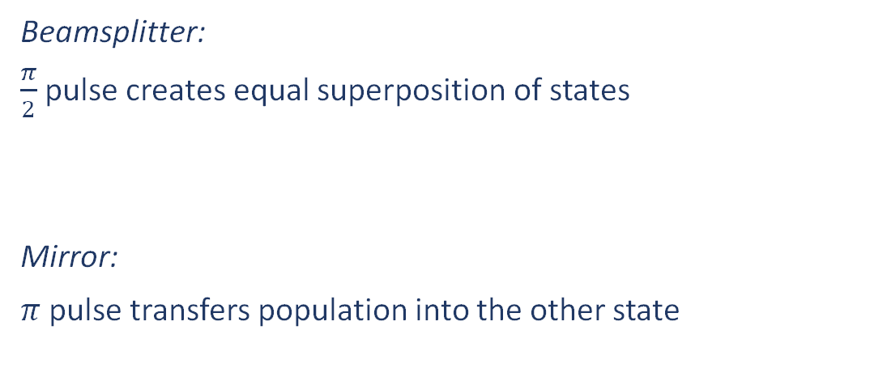
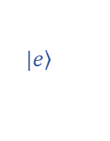


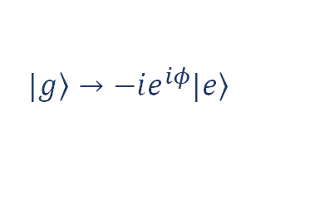
Atom-light interactions
$$|\left.e\right\rangle$$
$$ω_{0}$$
$$|\left.g\right\rangle$$
Beamsplitter:
$\frac{π}{2}$ pulse creates equal superposition of states
Mirror:
$π$pulse transfers population into the other state
$$\left.|g\right\rangle → \frac{1}{\sqrt{2}}\left(\left.|g\right\rangle −ie^{iφ}\left.|e\right\rangle \right)$$
$$\left.|g\right\rangle →−ie^{iφ}\left.|e\right\rangle$$
Recent atom-optics implementation using time-varying potentials: Phys. Rev. Lett. 129, 183202 (2022)

Slide 5

Optical interferometry
Mach-Zehnder interferometer:
$$∆φ$$

Slide 6
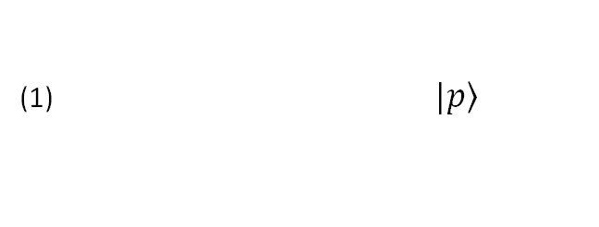

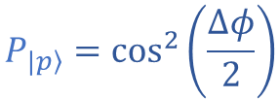
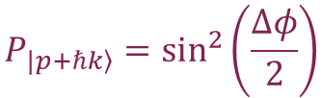
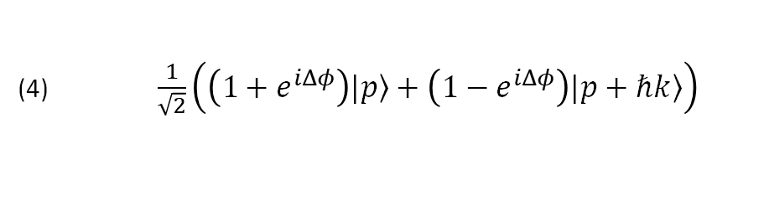

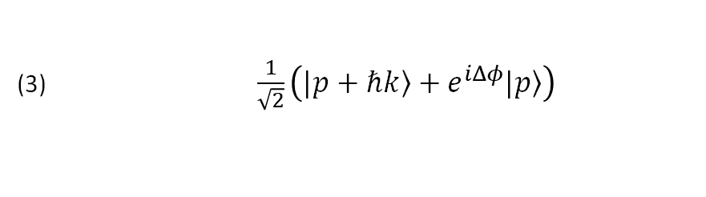

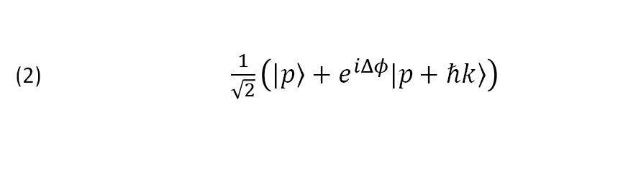
Atom interferometry
(1) $|\left.p\right\rangle$
(2) $\frac{1}{\sqrt{2}}\left(|\left.p\right\rangle +e^{iΔφ}|\left.p+ℏk\right\rangle \right)$
e.g. Mach-Zehnder interferometer:
(3) $\frac{1}{\sqrt{2}}\left(|\left.p+ℏk\right\rangle +e^{iΔφ}|\left.p\right\rangle \right)$
(1)
(2)
(3)
(4)
(4) $\frac{1}{\sqrt{2}}\left(\left(1+e^{iΔφ}\right)|\left.p\right\rangle +\left(1−e^{iΔφ}\right)|\left.p+ℏk\right\rangle \right)$
$$P_{|\left.p\right\rangle }=\cos^{2}\left(\frac{∆φ}{2}\right)$$
$$P_{\left.|p+ℏk\right\rangle }=\sin^{2}\left(\frac{∆φ}{2}\right)$$
${∆φ}_{total} ={∆φ}_{propagation}$ + ${∆φ}_{separation}$+ ${∆φ}_{laser}$
$$\frac{π}{2}$$
$$π$$
$$\frac{π}{2}$$
Time
Note: other interferometer configurations e.g. Ramsey-Bordé can cancel/enhance different phase terms
Useful references:
arXiv:0806.3261 (2008)
Quantum Sci. Technol. 6, 044003 (2021)

Slide 7
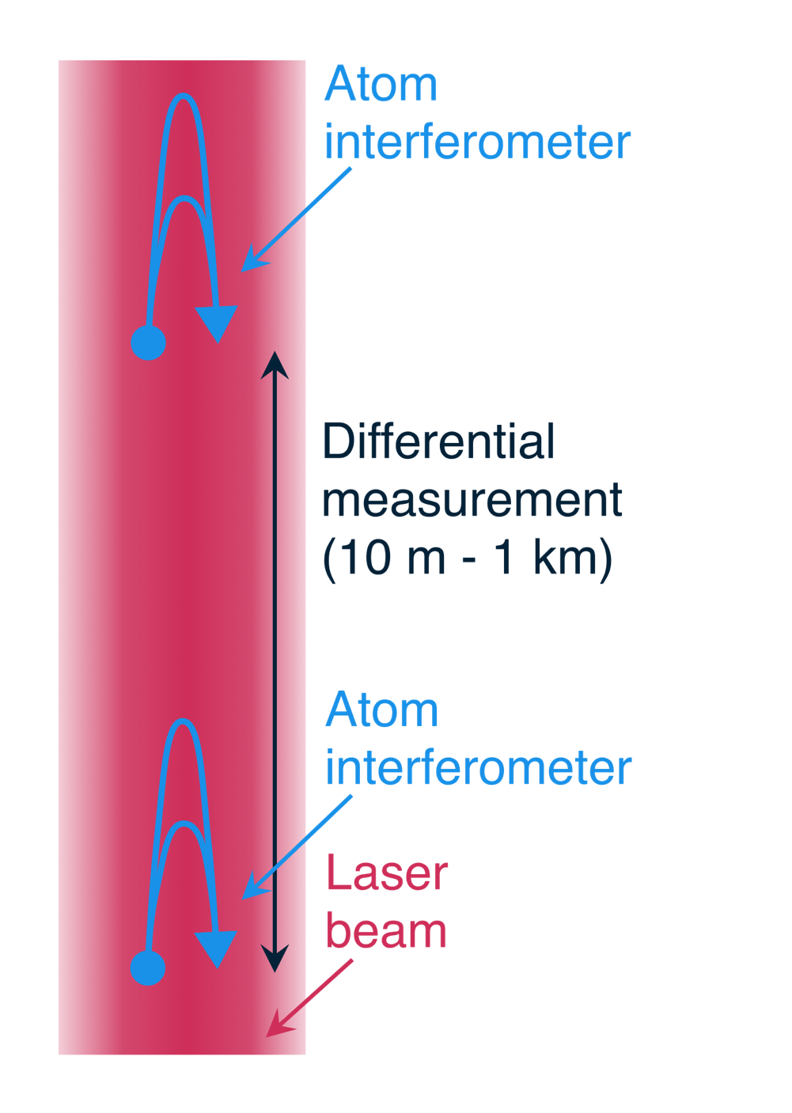
Long-baseline atom interferometry
Single or multiple atom interferometers separated by baseline (horizontal or vertical), addressed by common laser
  Analysis of multi-gradiometer configuration: Phys. Rev. D 107, 055002 (2023)
Differential measurement: fluctuations in relative phase between interferometers
Sensitivity scales with baseline length
Other interferometry configurations also hold great promise for fundamental physics studies – e.g. cavity interferometry in the Müller group Berkeley (Phys. Rev. Lett. 114, 100405 (2015))

Slide 8
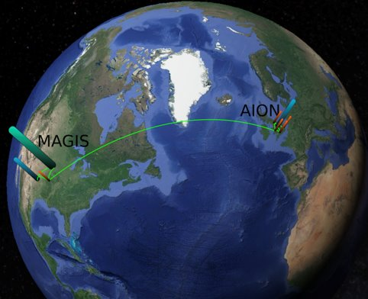
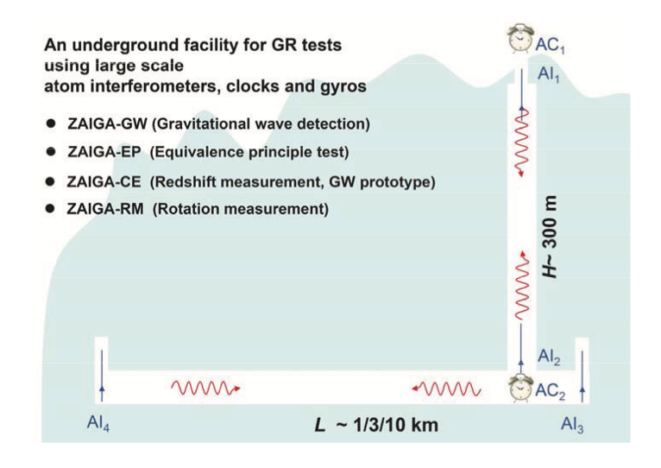
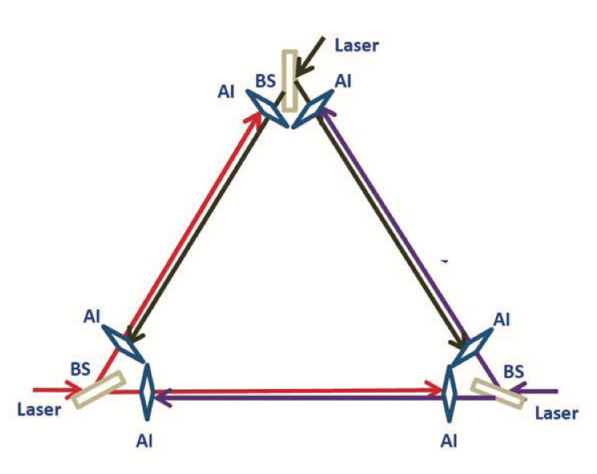
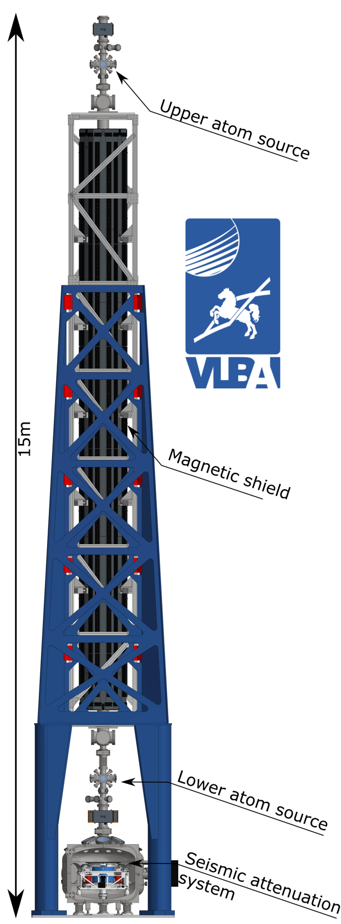
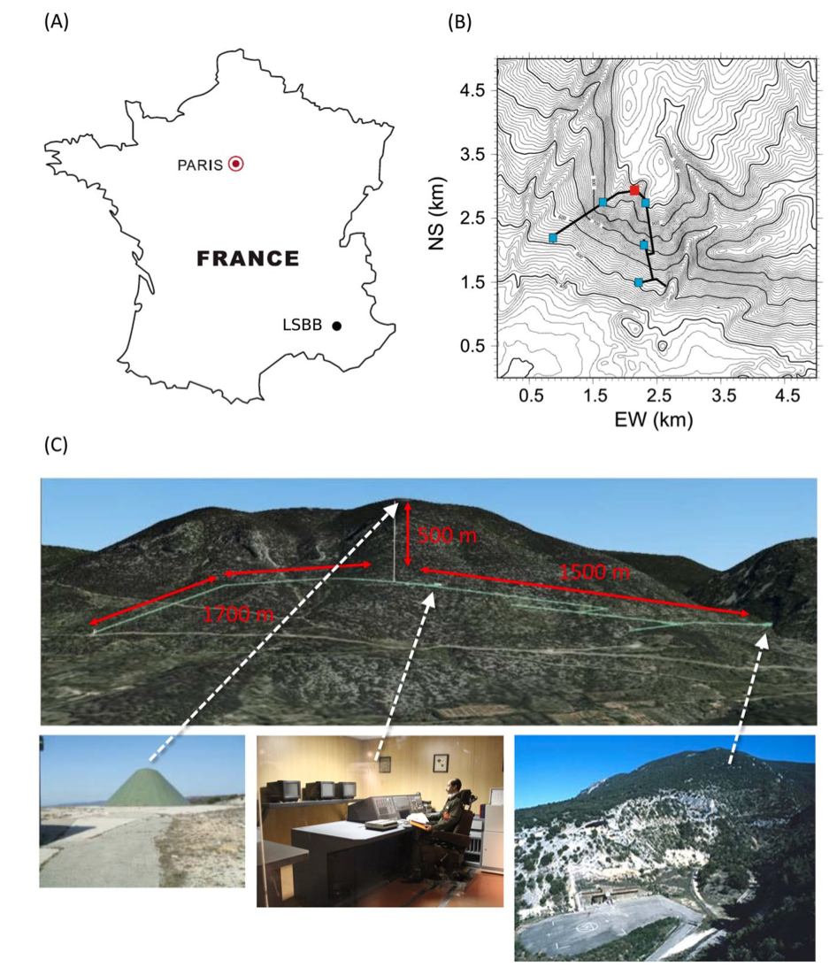
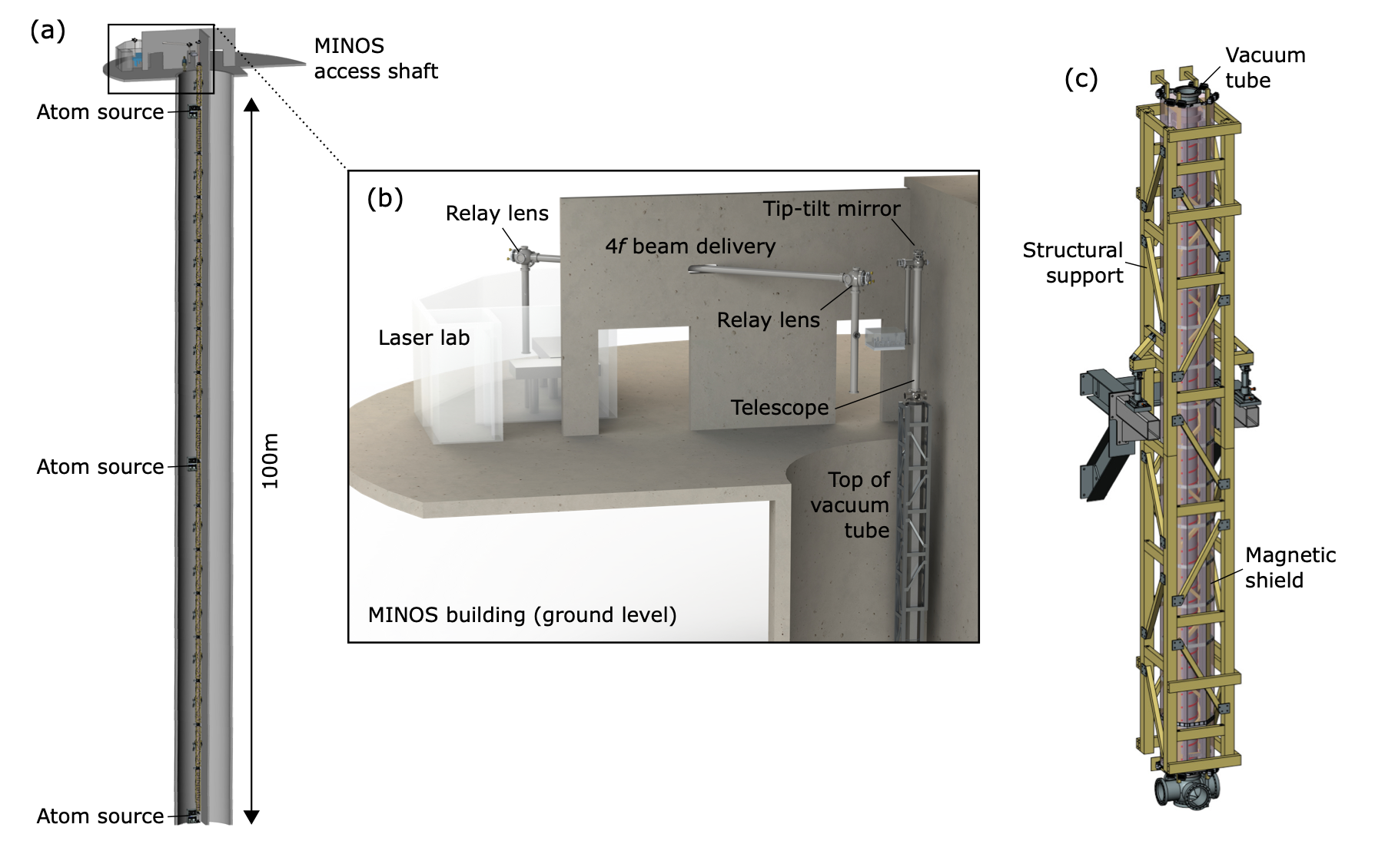
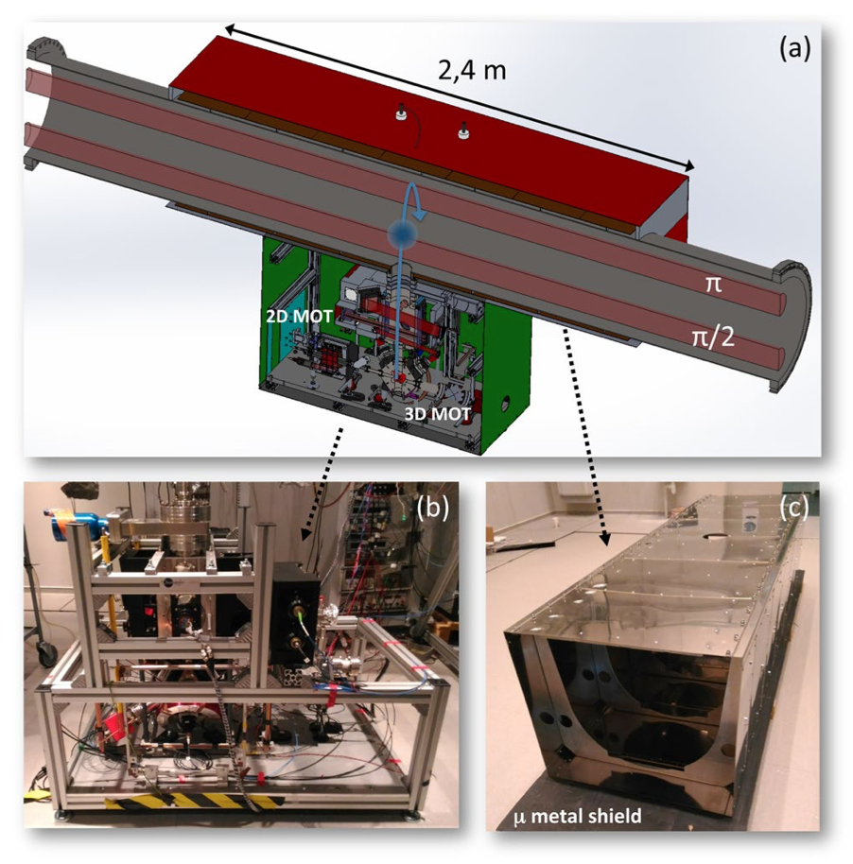
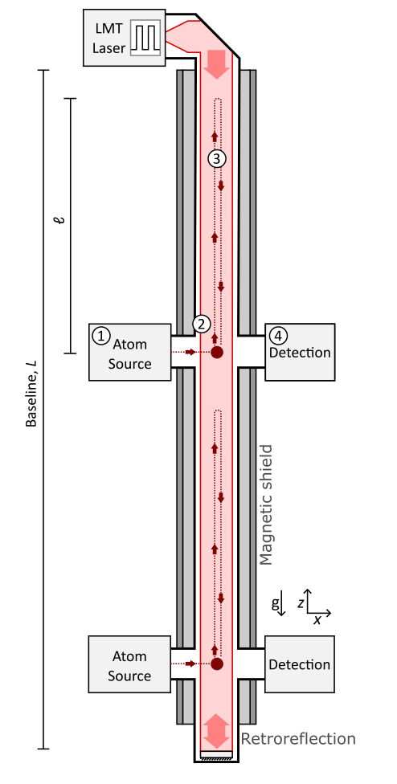
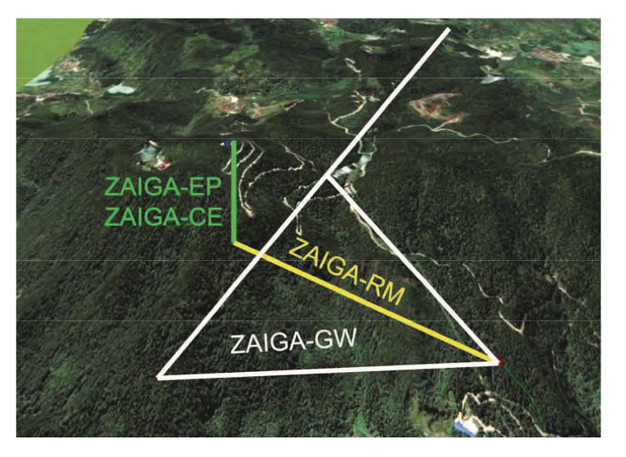
Terrestrial long-baseline atom interferometers
MIGA and ELGAR
ZAIGA (China)
M.-S. Zhan et al. Int. J. Mod. Phys. D 29 1940005 (2020).
VLBAI
AION (UK)
L. Badurina et al. J. Cosmol. Astropart. Physics 5, 011 (2020)
J. Hartwig et al. New J. Phys. 17 035011 (2015)
MAGIS-100 (US)
M. Abe et al, Quantum Sci. Technol. 6 044003 (2021)
B. Canuel et al. Sci. Rep. 8 14064 (2018)

Slide 9
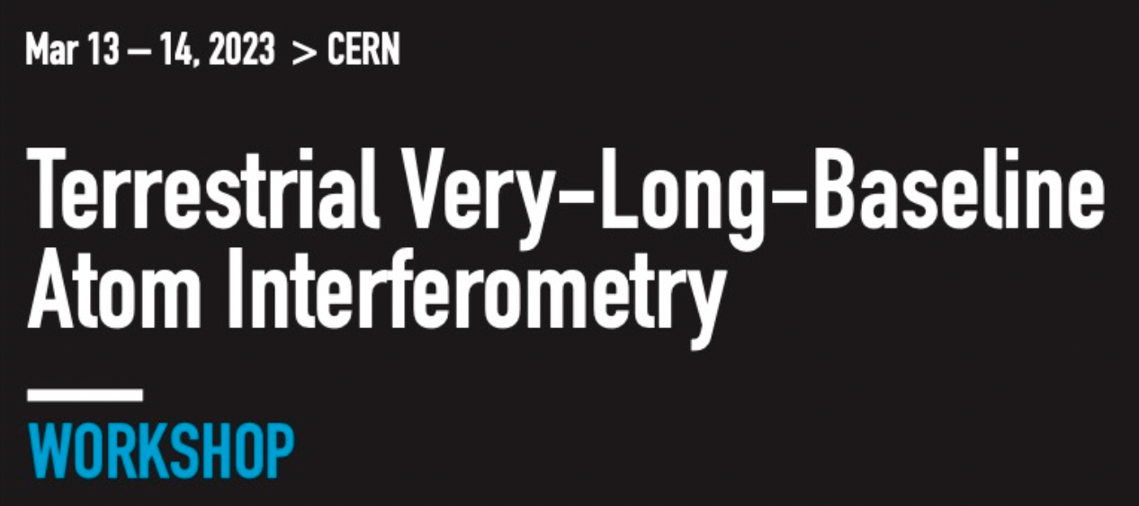
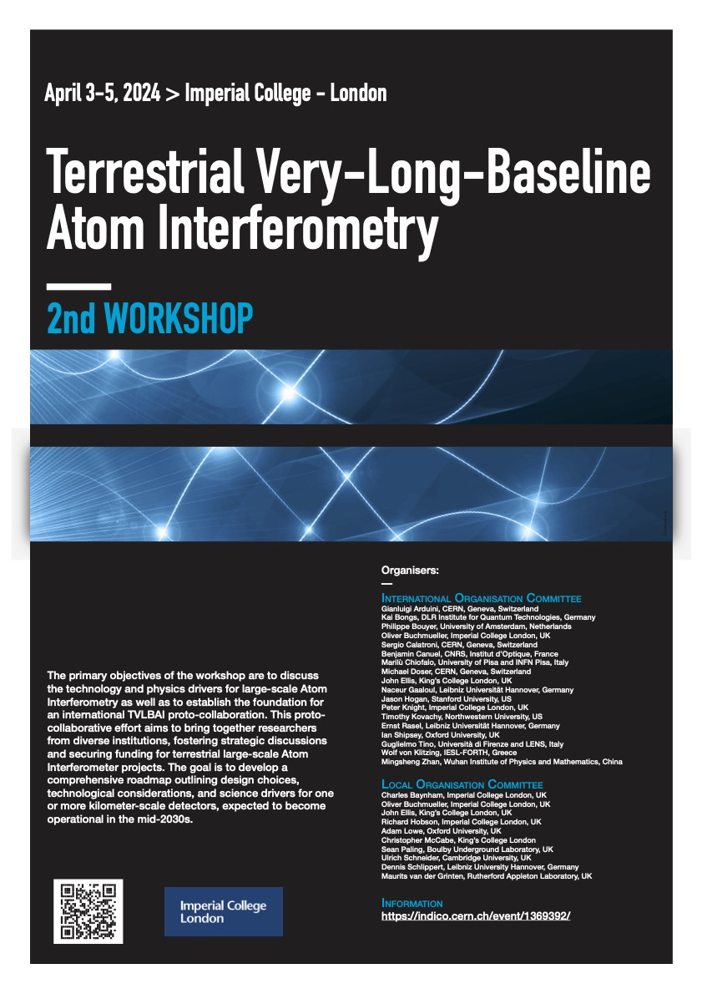
Progressive Expansion of Quantum Detectors
Stage Expansion of Detector Length**
Stage 1: 2024 to 2027
10 m detector protype to be built in Oxford, focus fundamental science and R&D
10–20 m AION “spin-off” from Oxford design & experience at Boulby focus Earth Science applications.
Stage 2: 2028 to 2035
(Multi-)100 m detector: Site options are Boulby or Daresbury (UK), possibly also at CERN (France/Switzerland).
Stage 3: 2035 onwards
km-scale detector: Site options are Boulby and other international sites
AVS Quantum Science 6, 024701 (2024)
https://doi.org/10.1116/5.0185291
arXiv:2412.14960 [hep-ex] (2024)
3rd workshop upcoming in summer 2025 (dates tbc)
** Sensitivity scales with length of detector

Slide 10
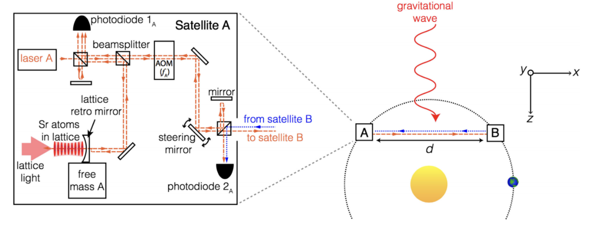
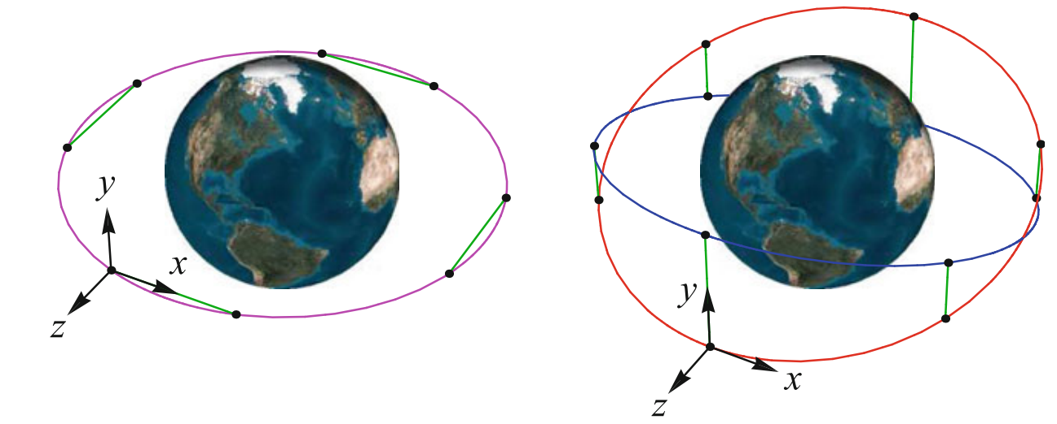
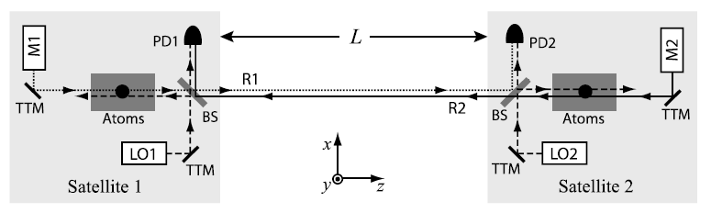
Ultracold observatories in space
Avoid seismic noise
Longer freefall*
AGIS-LEO
Gen Relativ Gravit 43:1953–2009 (2011)
Clock-based GW detector:
Phys. Rev. D 94, 124043 (2016)
*Longer exposure to source masses e.g. dark energy measurements
Phys. Rev. D 94 044051 (2016)
AEDGE
EPJ Quantum Technology 7, 6 (2020)

Slide 11

The atom interferometer observatory and network (AION)
Journal of Cosmology and Astroparticle Physics 5, 011 (2020)
Strontium-87 (fermionic)
  Clock transition
  Single-photon interferometry* [1,2]
Differential measurement (long baseline)
Cold clouds with large atom number, delivered with a fast repetition rate
Large momentum transfer
Quantum enhancements: squeezing
Detector network for fundamental physics
Noise modelling, systematics analsysis, and signal verification [3]
5s6s ³S₁
5s6s ³S₁
707 nm
5s5p ¹P₁
679 nm
461 nm
2π x 30 MHz
J=2
689 nm
2π x 7.5 kHz
J=1
5s5p ³P_{J}
J=0
698 nm
mHz
5s² ¹S₀
[1] P. Graham et al. PRL 110 171102 (2013)
[2] L. Hu et al. PRL 119, 263601 (2017)
[3] J. Mitchell et al. J. Inst. 17, 01 (2022)
* Recent 3-photon excitation of ⁸⁸Sr clock transition: S. Carman et al, arXiv:2406.07902 (2024)

Slide 12
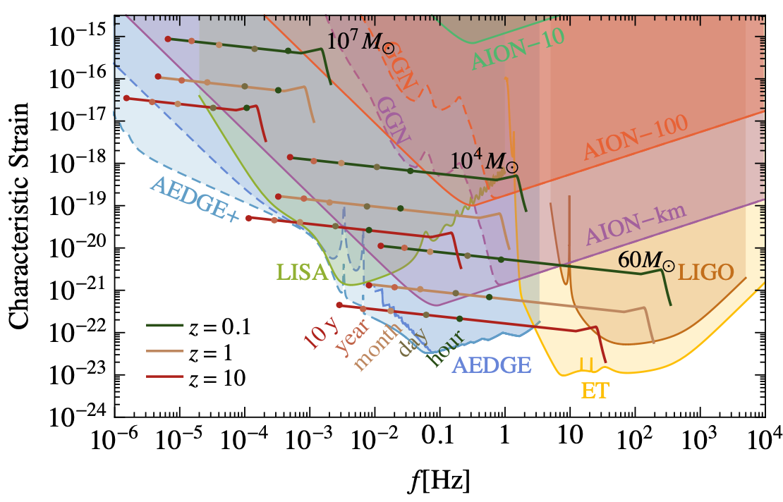


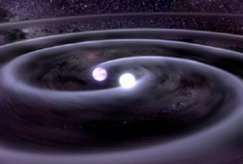
AION detection goals
decihertz range
Decihertz gravitational waves [1]
Fine-structure constant measurements [2]
Probing dark energy models [3]
L. Badurina et al, Phil. Trans. A. Math. Phys. Eng. Sci. 380 20210060 (2021).
[1] P.W. Graham et al. Phys. Rev. Lett. 110, 171102 (2013).
[2] J. Schelfhout et al. Phys. Rev. A 110, 053309 (2024).
[3] B. Elder et al., Phys. Rev. D 94, 044051 (2016).
[4] Y. V. Stadnik and V. V. Flambaum, PRL 114 161301 (2015).
[5] A. Arvanitaki et al. Phys. Rev. D 91 015015 (2015).
[6] L. Badurina, et al. Phys. Rev. D 107, 055002 (2023).
[7] G. Rosi et al. Nat. Commun. 8, 15529 (2017).
[8] P. Asenbaum et al. PRL 125, 191101 (2020).
[9] J. Mitchell et al., J. Inst., 17, 01 (2022).

Slide 13
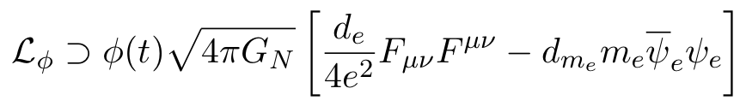
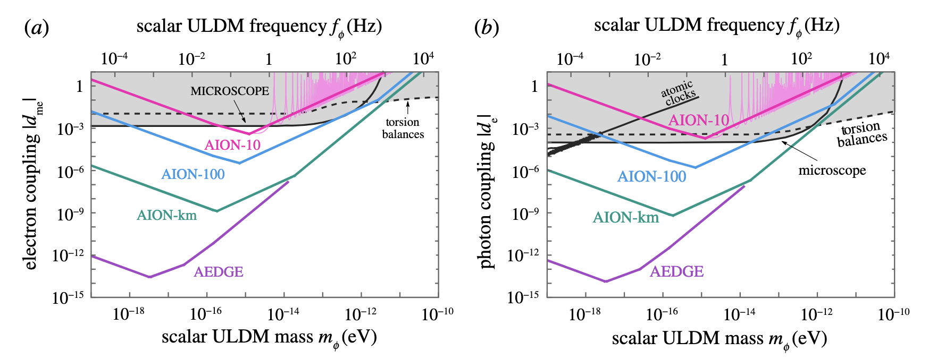
AION detection goals
Ultralight (wavelike) dark matter [4-6]
Decihertz gravitational waves [1]
Photon coupling
Electron mass coupling
Equivalence principle tests
Gradiometer comparison between different states or species [7,8]
Fine-structure constant measurements [2]
Earth science and seismology
Turning noise into signal: gravity fluctuations and gradients [9]
Probing dark energy models [3]
L. Badurina et al, Phil. Trans. A. Math. Phys. Eng. Sci. 380 20210060 (2021).
[1] P.W. Graham et al. Phys. Rev. Lett. 110, 171102 (2013).
[2] J. Schelfhout et al. Phys. Rev. A 110, 053309 (2024).
[3] B. Elder et al., Phys. Rev. D 94, 044051 (2016).
[4] Y. V. Stadnik and V. V. Flambaum, PRL 114 161301 (2015).
[5] A. Arvanitaki et al. Phys. Rev. D 91 015015 (2015).
[6] L. Badurina, et al. Phys. Rev. D 107, 055002 (2023).
[7] G. Rosi et al. Nat. Commun. 8, 15529 (2017).
[8] P. Asenbaum et al. PRL 125, 191101 (2020).
[9] J. Mitchell et al., J. Inst., 17, 01 (2022).

Slide 14
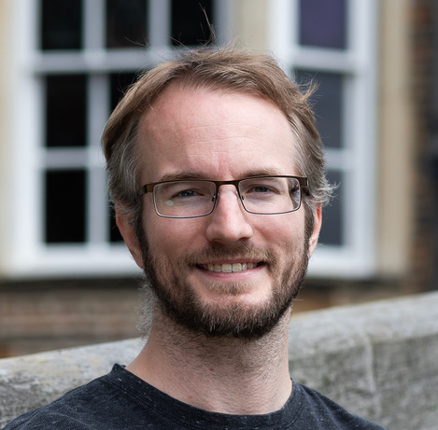
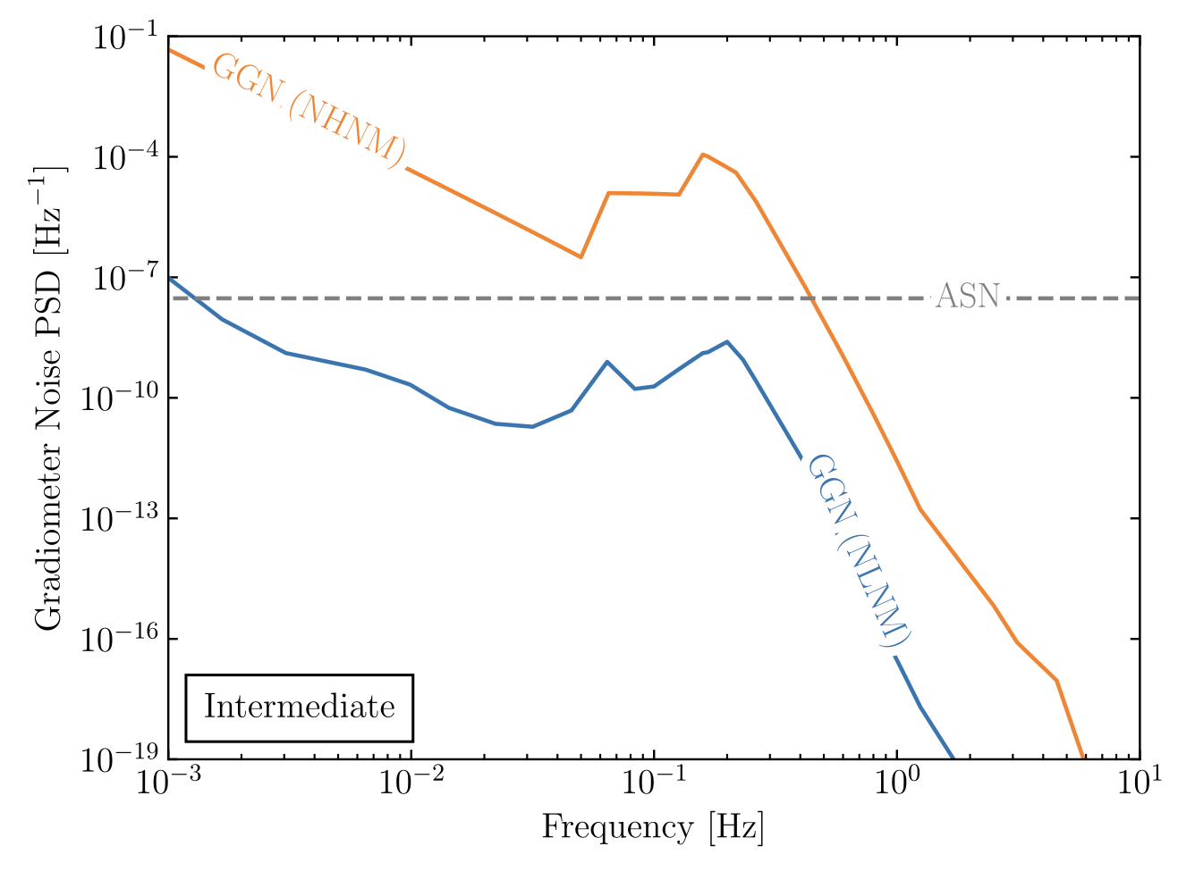
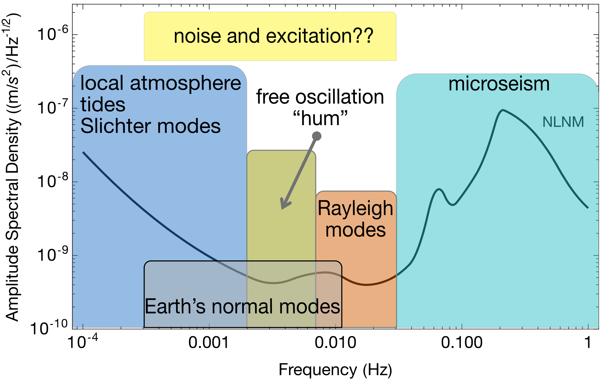
Earth Science applications
Rayleigh seismic waves source gravitational fluctuations
Jeremiah Mitchell (Cambridge)
Terrestrial backgrounds cause gravity gradient noise limiting fundamental physics searches
AION can use gravitational signal channel to answer open questions in Earth science
  Earth’s free oscillation and normal modes
  Low-frequency Earth dynamics
Mitchell et al., J. Inst., 17, 01 (2022)
Seismic Frequency Spectrum
Badurina, et al. Phys. Rev. D 107, 055002 (2023)
Atmospheric infrasound and temperature gradient noise
Carlton et al., arXiv:2412.05379 (2024).

Slide 15
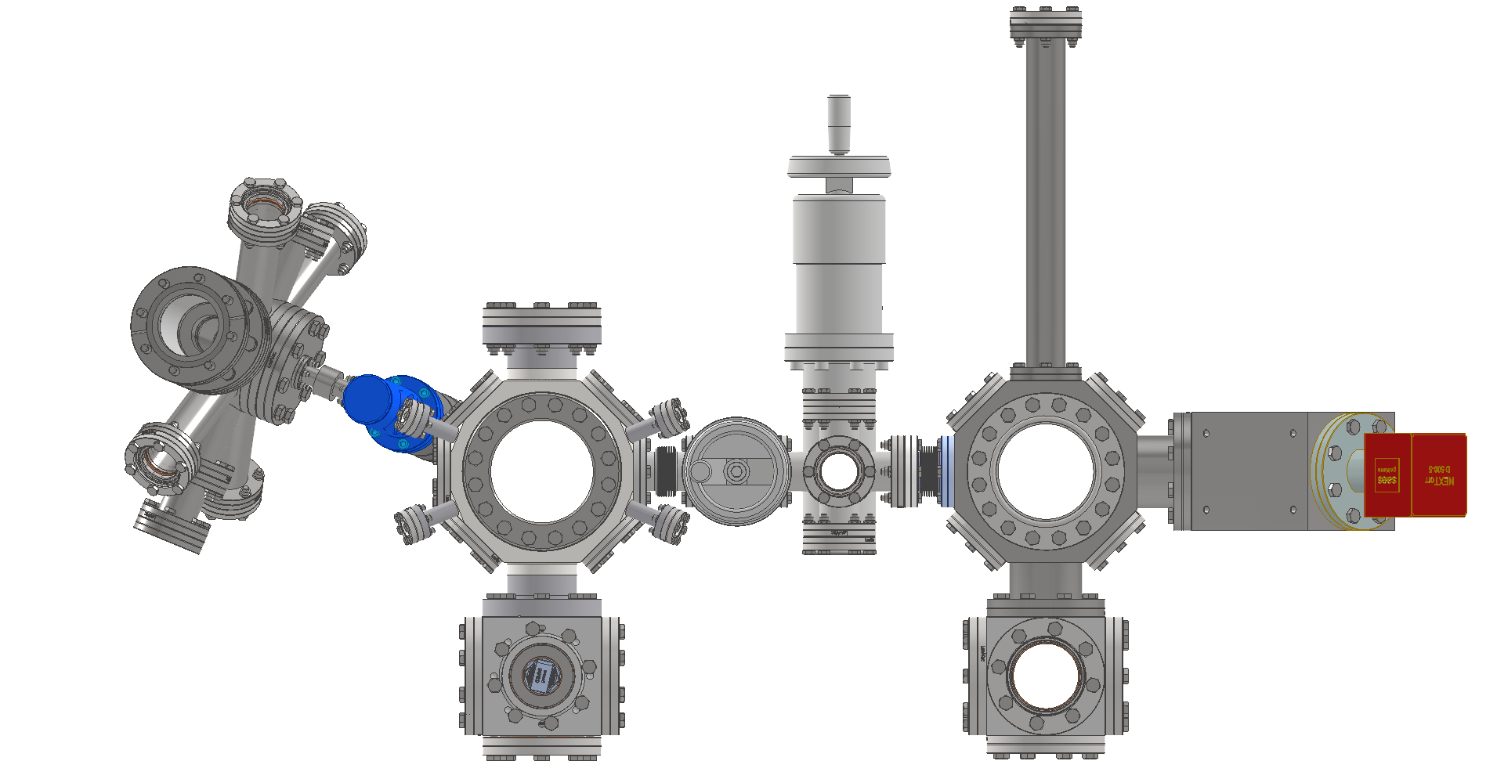

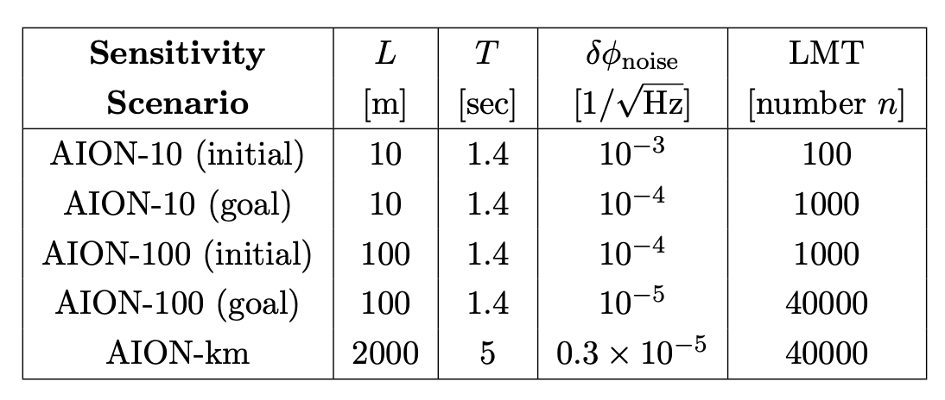
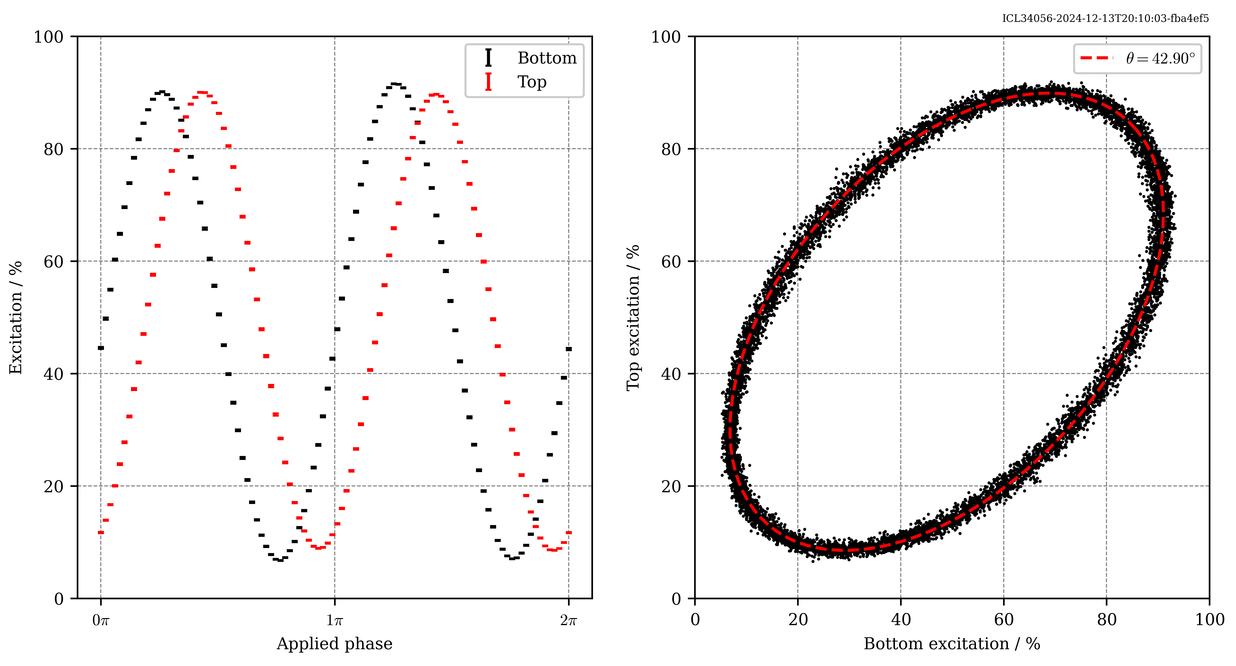
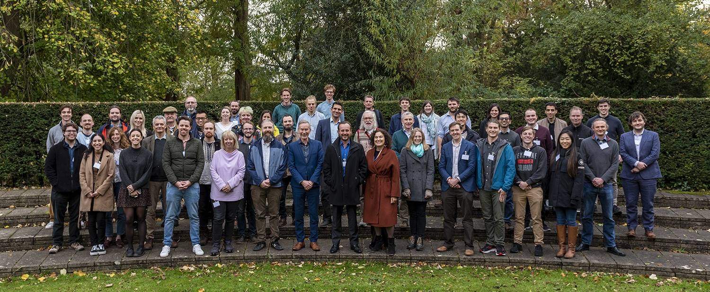
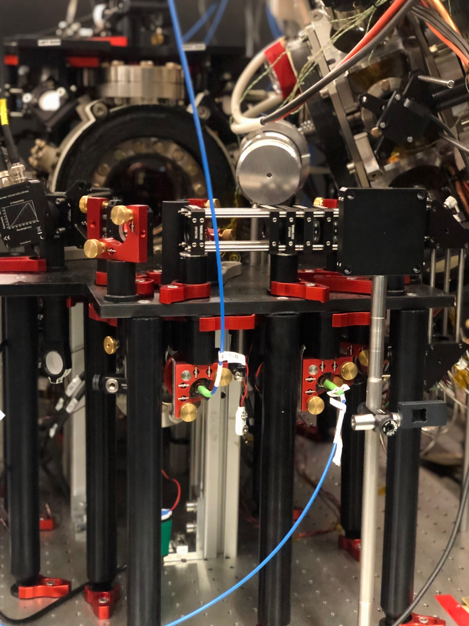
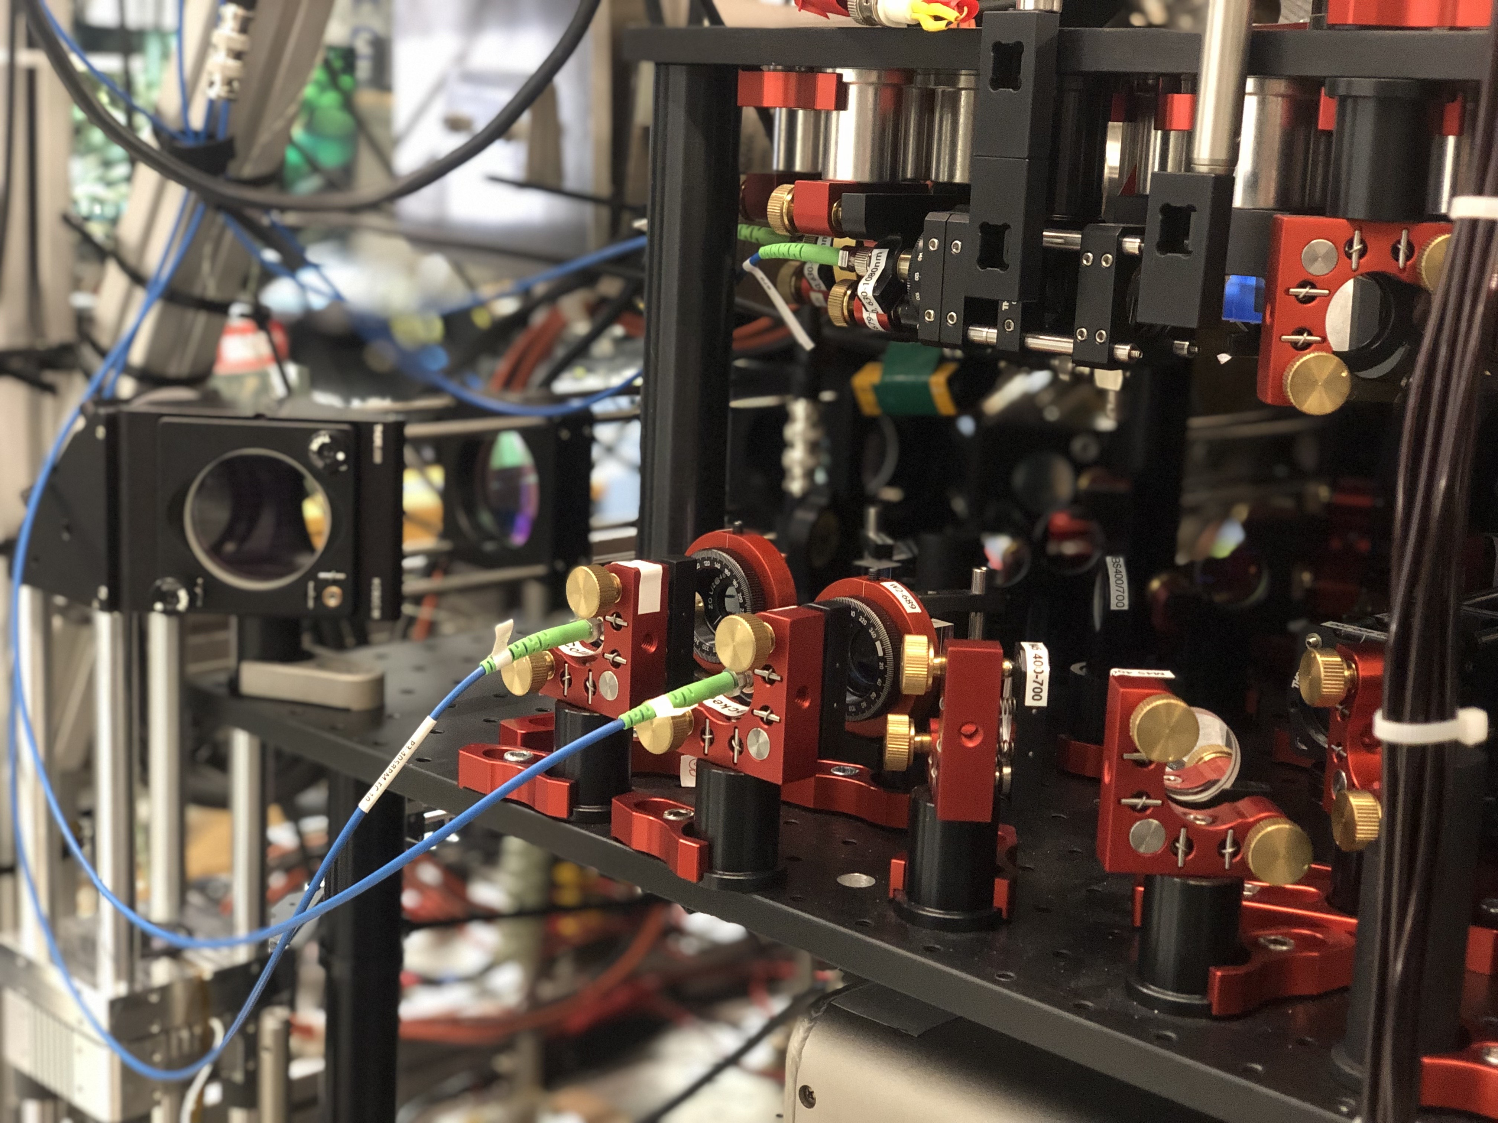
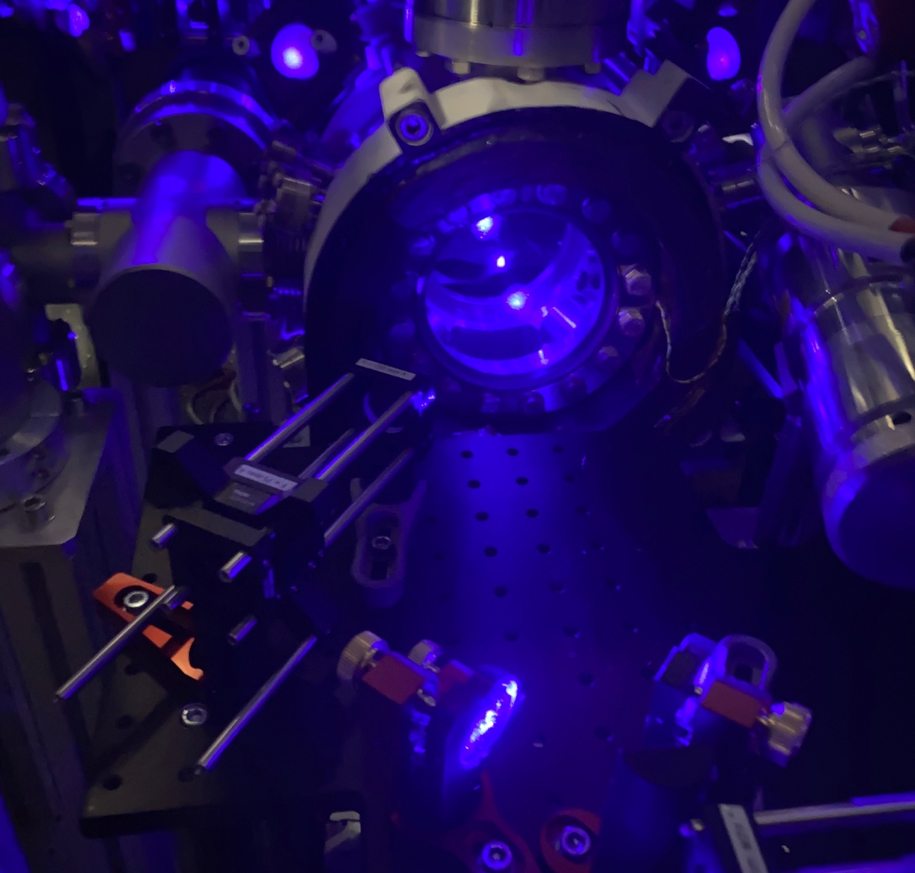
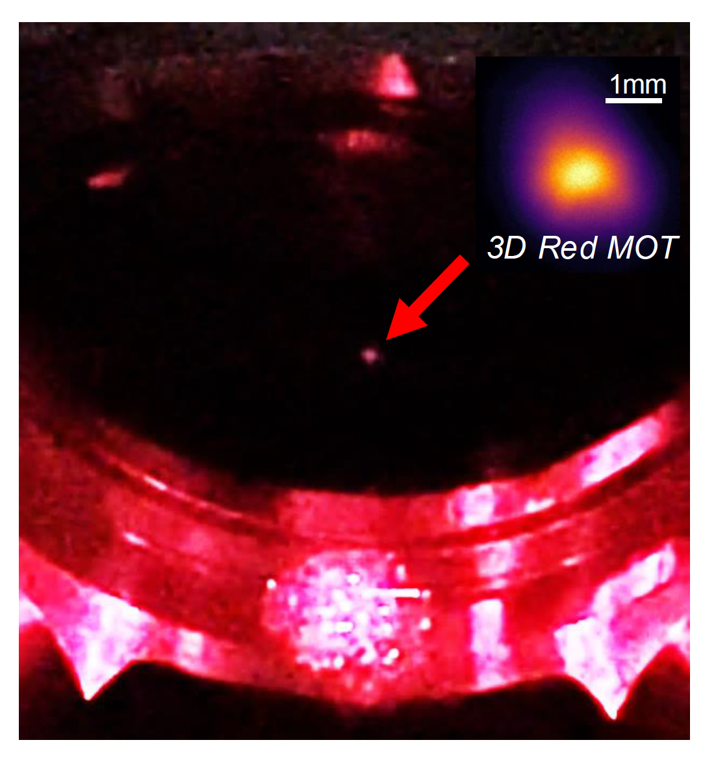
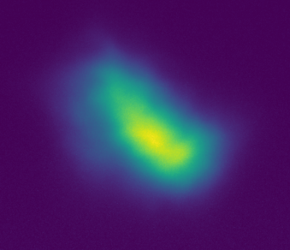
The AION consortium
7 UK institutions
5 ultracold strontium labs following HEP-style collaboration principles [1]
  Parallel production
  Interlinked R&D
  Common control systems and codebase
Phenomenology and noise modelling
Above: schematic of tabletop demonstrator
Below: differential interferometry in Imperial demonstrator
Above: schematic of tabletop demonstrator
Below: tabletop demonstrator in the Cambridge lab
3D blue MOT
Atoms at mK
3D red MOT
Atoms at tens µK
PRELIMINARY
Project executed in national partnership with UK National Quantum Technology Hub in Sensors and Timing, Birmingham, UK,
and international partnership with The MAGIS Collaboration and The Fermi National Laboratory, US
1 mm
[1] AVS Quantum Sci. 6, 014409 (2024)

Slide 16
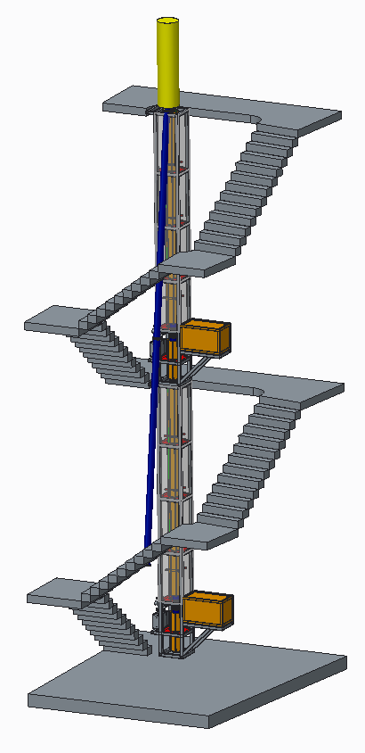
The AION consortium
14.7m
Ground level
7 UK institutions
5 ultracold strontium labs following HEP-style collaboration principles [1]
  Parallel production
  Interlinked R&D
  Common control systems and codebase
Phenomenology and noise modelling
Design and deploy increasing-baseline atom interferometers 10m -> 100m -> 1km
Technology development and network with MAGIS-100 for large-scale science goals
AI-10
10.0m
7.7m
5.0m
Project executed in national partnership with UK National Quantum Technology Hub in Sensors and Timing, Birmingham, UK,
and international partnership with The MAGIS Collaboration and The Fermi National Laboratory, US
Planned AION-10 detector (University of Oxford)
[1] AVS Quantum Sci. 6, 014409 (2024)

Slide 17
Ongoing research avenues
Technical challenges require extreme precision for quantum control
  Atom flux and interferometer repetition rate
  Atom kinematics, temperature, collimation
  Laser frequency, phase, and pointing stability
  Quantum enhancements to measurement: squeezed states
  Interferometer readout
  Temperature, vacuum, stray magnetic fields, and vibrations
  Gravitational static gradients and moving masses
  Subsampling instrument, aliasing L. Badurina, A. Beniwal, and C. McCabe, Phys. Rev. D 108, 083016 (2023)
Exquisite sensitivity to gravity results in environmental noise sources which are harder to mitigate
  Seismic and atmospheric gravity gradient noise L. Badurina et al. Phys. Rev. D 107, 055002 (2023); J. Mitchell et al., J. Inst., 17, 01 (2022)
  Random anthropogenic and synanthropic noise J. Carlton and C. McCabe, Phys. Rev. D 108, 123004 (2023)
Scaling baseline
  High power laser sources
  Optics stability and ruggedisation
  Shaft and environment engineering
Coordinated community effort and opportunities for collaboration

Slide 18
Synergies with wider ultracold quantum technologies
Shared underlying ultracold technologies: opportunity for mutual technology transfer and physics exploitation
UK Quantum Technology Hub: Sensors and Timing
QSNET EPJ Quant.Technol. 9 1, 12 (2022)
  Network of atomic and molecular clocks studying variation in fundamental constants
QSimFP
  Quantum simulation of fundamental physics phenomena
New project: QQQS
  Quantum advantage in quantitative quantum simulators
  Includes intersection of quantum sensing, quantum simulation and many-body physics

Slide 19
Summary
Long-baseline atom interferometry a promising platform for studying a range of fundamental physics – complementary to other technologies
Interdisciplinary community-building: benefits of QT4HEP and HEP4QT!
Many exciting research avenues ahead for both technology development and physics exploitation…
Contact: th558@cam.ac.uk

