Slide 1


Highly Sensitive Optical Quantum Sensors
Young Jin Kim
Leanne Duffy, Igor Savukov
Los Alamos National Laboratory (LANL), USA
January 22, 2025
International Conference on Quantum Technologies for High-Energy Physics
CERN

Slide 2
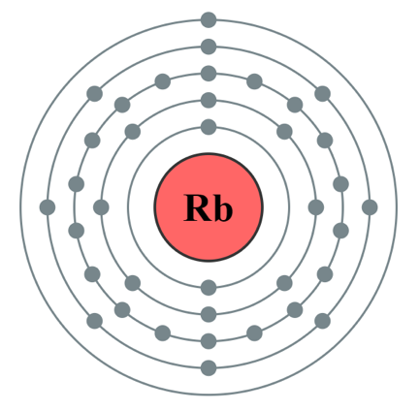
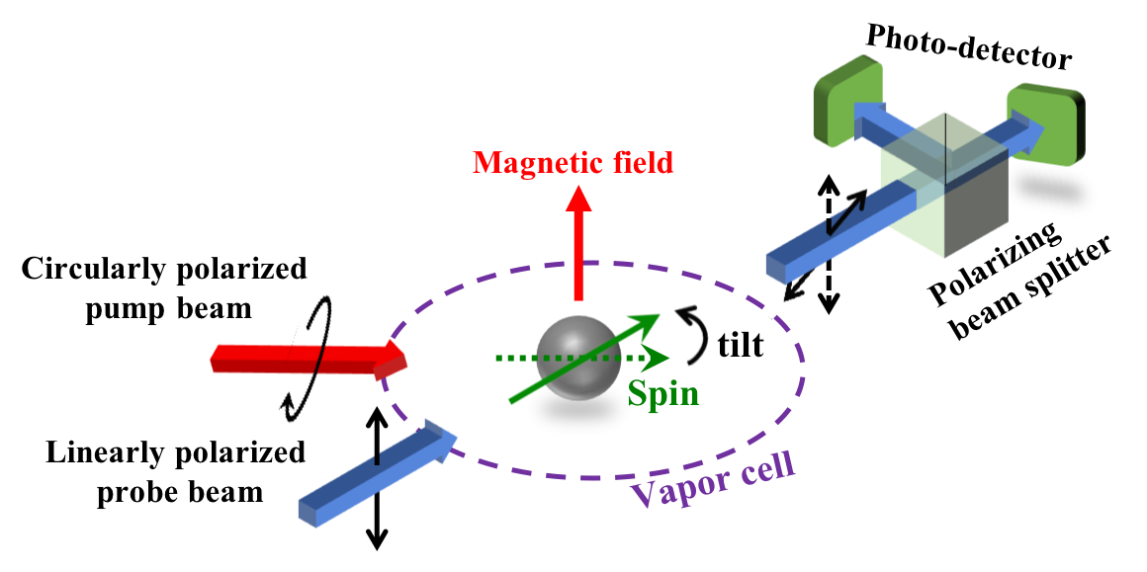

Optical Quantum Sensor (OQS)
Based on lasers (pumping and probing) and alkali-metal (Cs, Rb, K) vapor cells
Manipulate electron spins for magnetic sensing
Manipulate one valence electron
Typical implementation of OQS:
$$θ$$
Cryogen-free sensor!

Slide 3
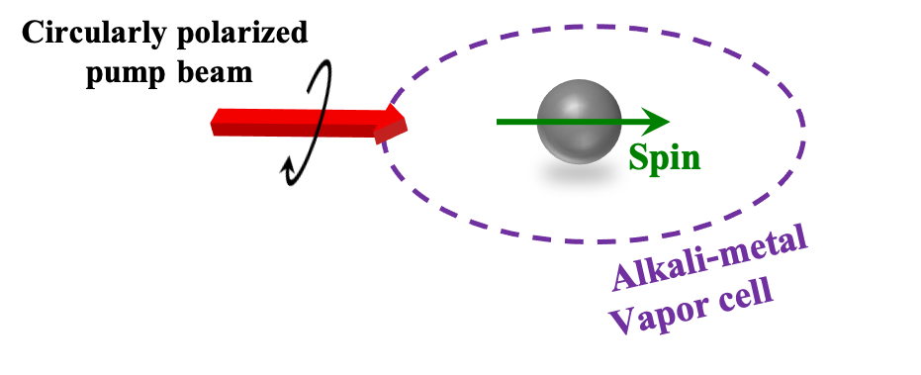
Optical Quantum Sensor (OQS)
Pumping:
Polarize atomic spins

Slide 4
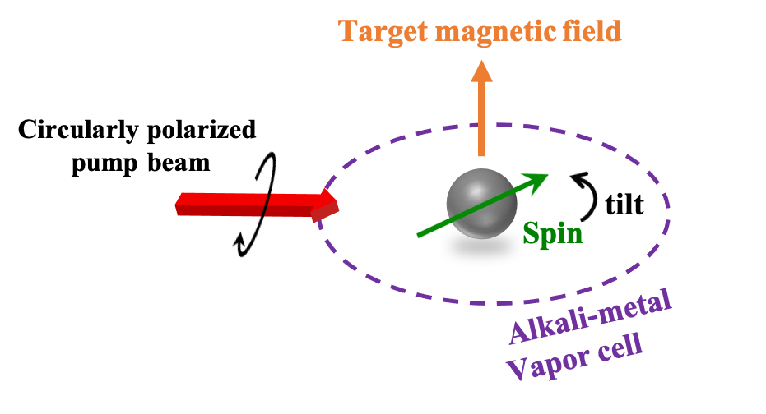
Optical Quantum Sensor (OQS)
Spin tilt:
Spin tilt proportional to field strength

Slide 5
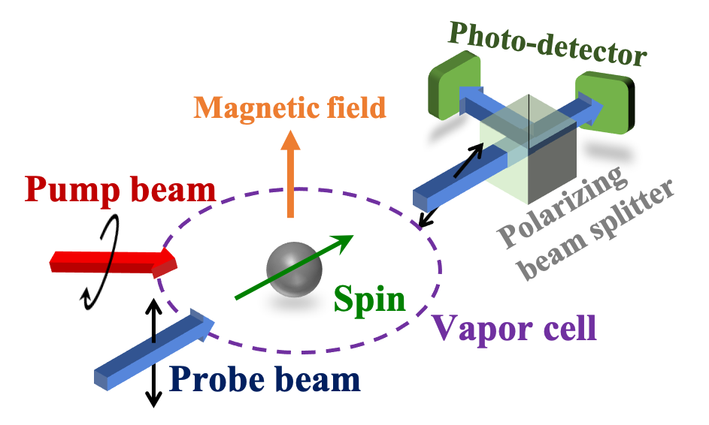


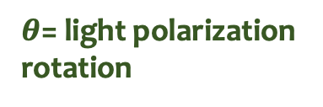

Optical Quantum Sensor (OQS)
$θ$= light polarization rotation
$$θ$$
$$∆θ$$
1 pT
Probing:
$$∆θ$$
1 fT
Detect magnetic field with probe beam

Slide 6
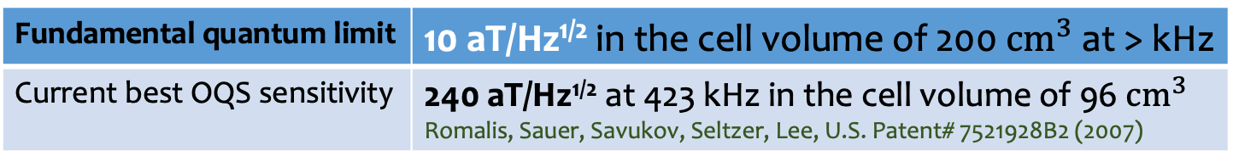
OQS Noise Limit
Fundamental quantum noise limit:
γ = gyromagnetic ratio of alkali-metal atoms
n = density of alkali-metal atoms
V = active measurement vapor cell volume
T₂ = coherence time of electron spins
η = photodiode quantum efficiency in probe beam readout
R_{pr} = absorption rate of probe beam photons
OD = optical depth of the probe beam
Spin noise
Photon shot noise
Light shift noise
Fundamental quantum limit | 10 aT/Hz^{1/2} in the cell volume of 200${ cm}^{3}$ at > kHz
Current best OQS sensitivity | 240 aT/Hz^{1/2} at 423 kHz in the cell volume of 96${ cm}^{3}$ Romalis, Sauer, Savukov, Seltzer, Lee, U.S. Patent# 7521928B2 (2007)

Slide 7
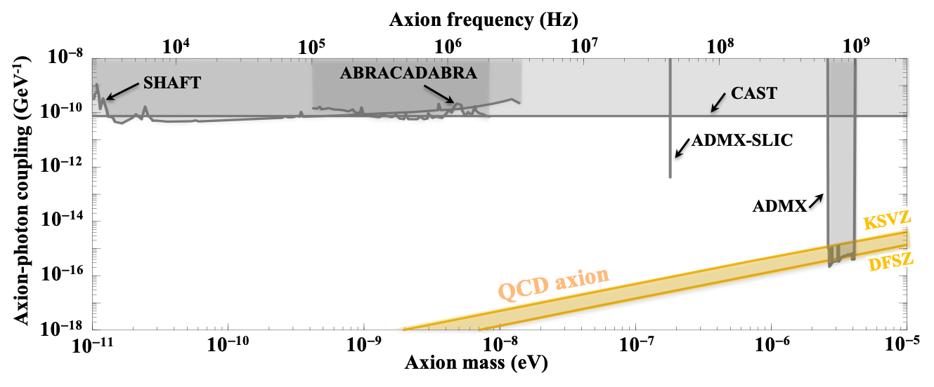
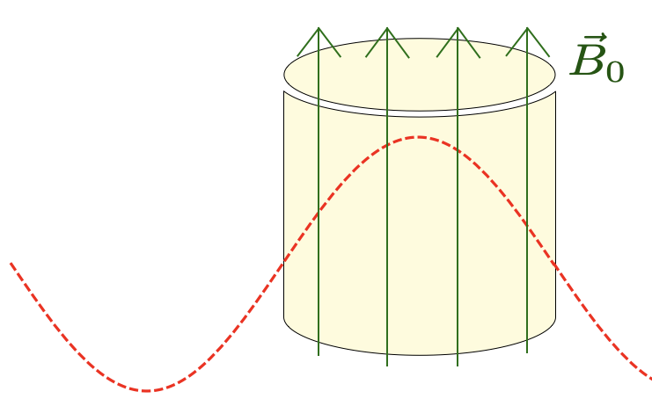
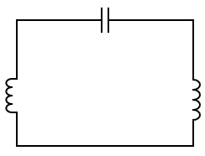
Application: Ultralight Axion Dark Matter Search
Resonant inductor-capacitor (LC) circuit experiment
Resonant Cavity experiment
LANL axion search: New detection concept based on optical quantum sensor
Axion wave
Axion wave
Cavity size >> 1 m
(e.g., 1 km for 10⁻⁹ eV)
ADMX
Cavity size ~ 1 m for ~10⁻⁶ eV

Slide 8
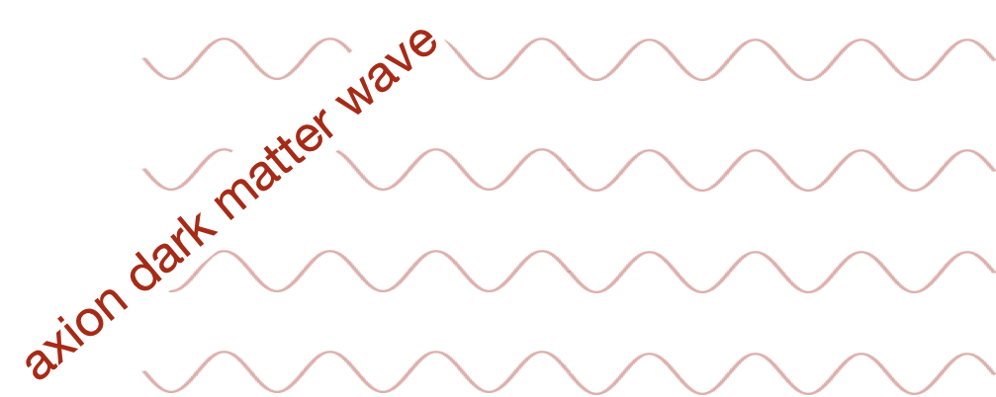
LANL Axion Search: Target Signal
Axion dark matter is “wave-like”: an oscillating field at a frequency of the axion mass (m_{a}) that permeates all of space

Slide 9
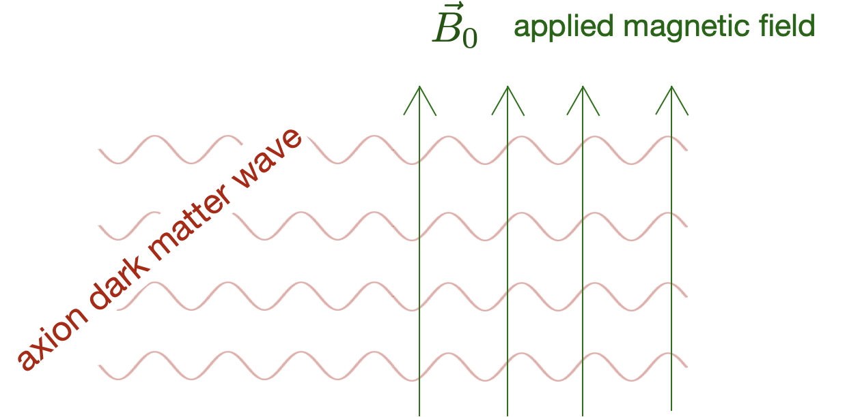
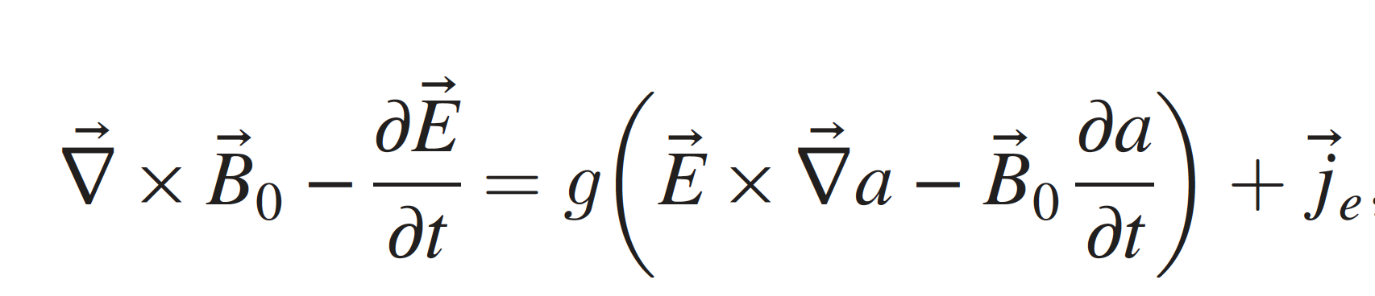
LANL Axion Search: Target Signal
Axion dark matter is “wave-like”: an oscillating field that permeates
all of space and interacts with the electromagnetic field
Axion-photon coupling

Slide 10
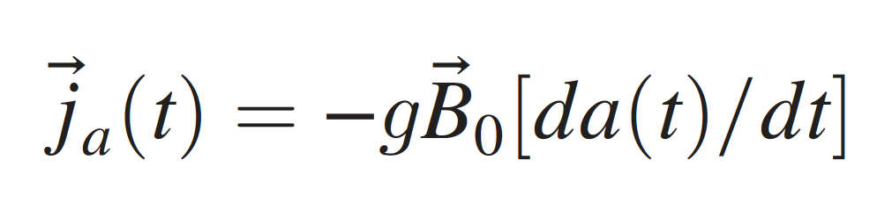

LANL Axion Search: Target Signal
Axion dark matter is “wave-like”: an oscillating field that permeates
all of space and interacts with the electromagnetic field
Axion-photon coupling
$$\vec{j_{a}}$$

Slide 11
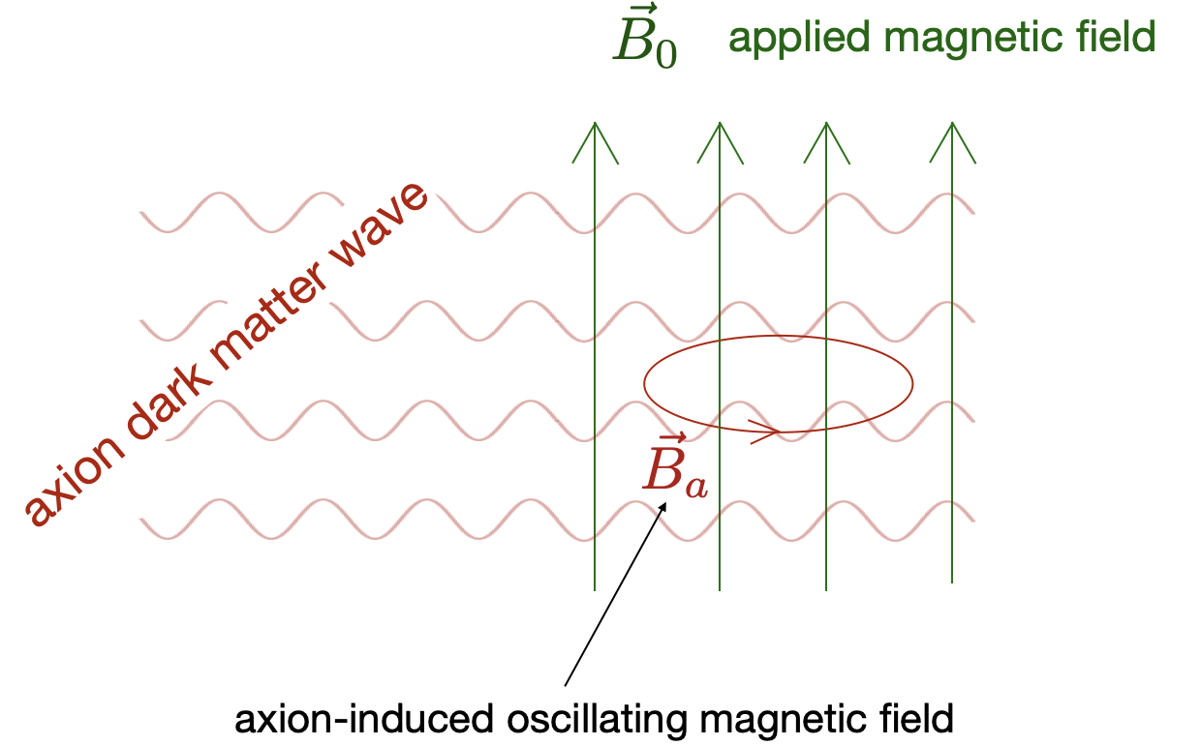

LANL Axion Search: Target Signal
Axion dark matter is “wave-like”: an oscillating field that permeates
all of space and interacts with the electromagnetic field
$$\vec{j_{a}}$$

Slide 12
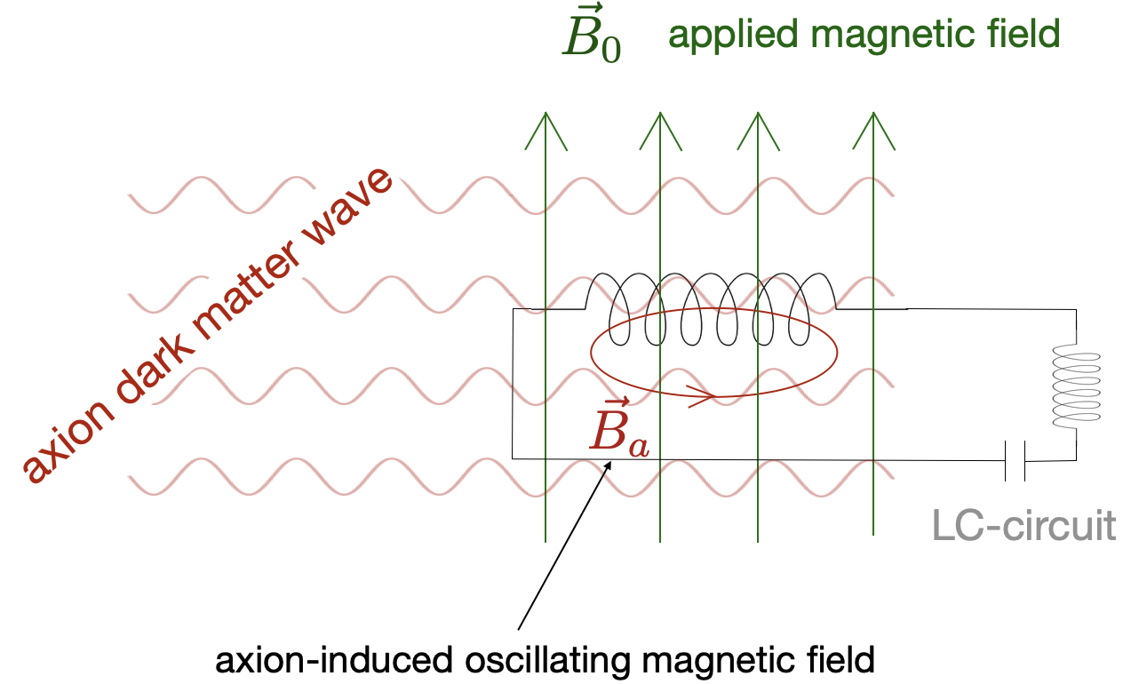
LANL Axion Search: Target Signal
Axion dark matter is “wave-like”: an oscillating field that permeates
all of space and interacts with the electromagnetic field
Resonant circuit

Slide 13
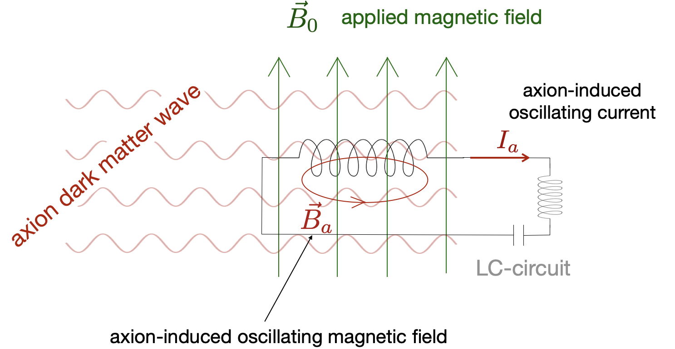
LANL Axion Search: Target Signal
Axion dark matter is “wave-like”: an oscillating field that permeates
all of space and interacts with the electromagnetic field
Resonant circuit

Slide 14
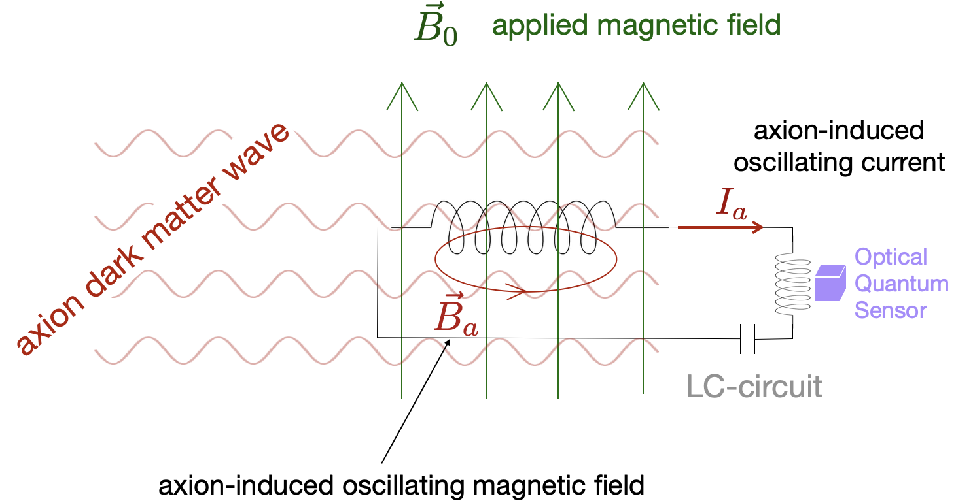

LANL Axion Search: Target Signal
Axion dark matter is “wave-like”: an oscillating field that permeates
all of space and interacts with the electromagnetic field
$$\vec{B_{d}}$$
Resonant circuit

Slide 15
LANL Experiment Layout
  Low temperature resonant LC circuit + quantum limited (10 aT/Hz^{1/2}) OQS

Slide 16
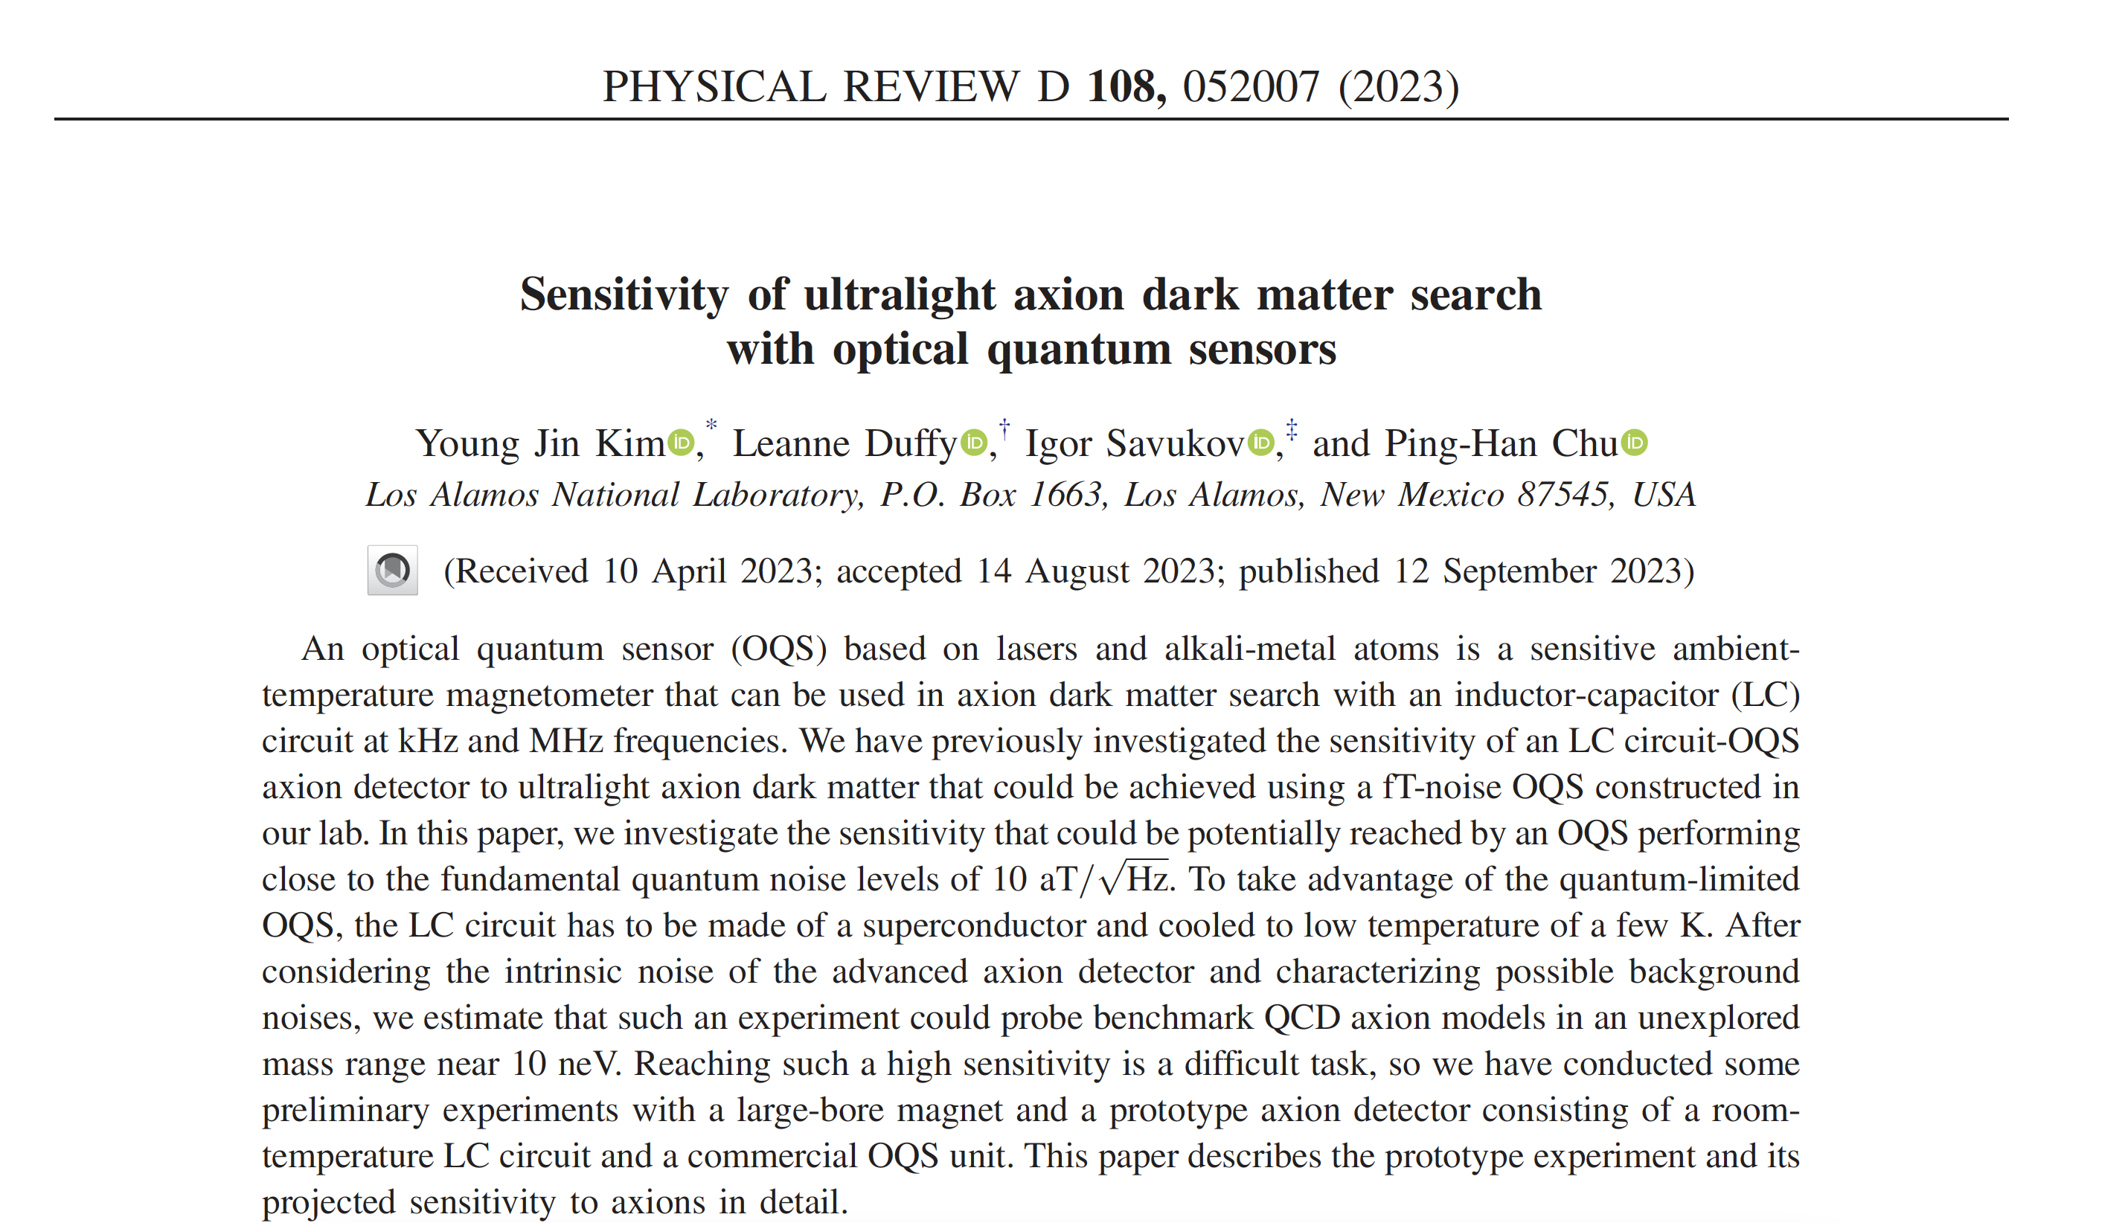
Publication

Slide 17
Intrinsic Noise of Optimized Axion Detector
Intrinsic noise of LANL LC circuit-OQS axion detector:
At MHz target frequency (i.e., neV mass range), axion detector sensitivity is determined by optical quantum sensor noise
OQS noise reduction = key to success of the project!
Target range

Slide 18
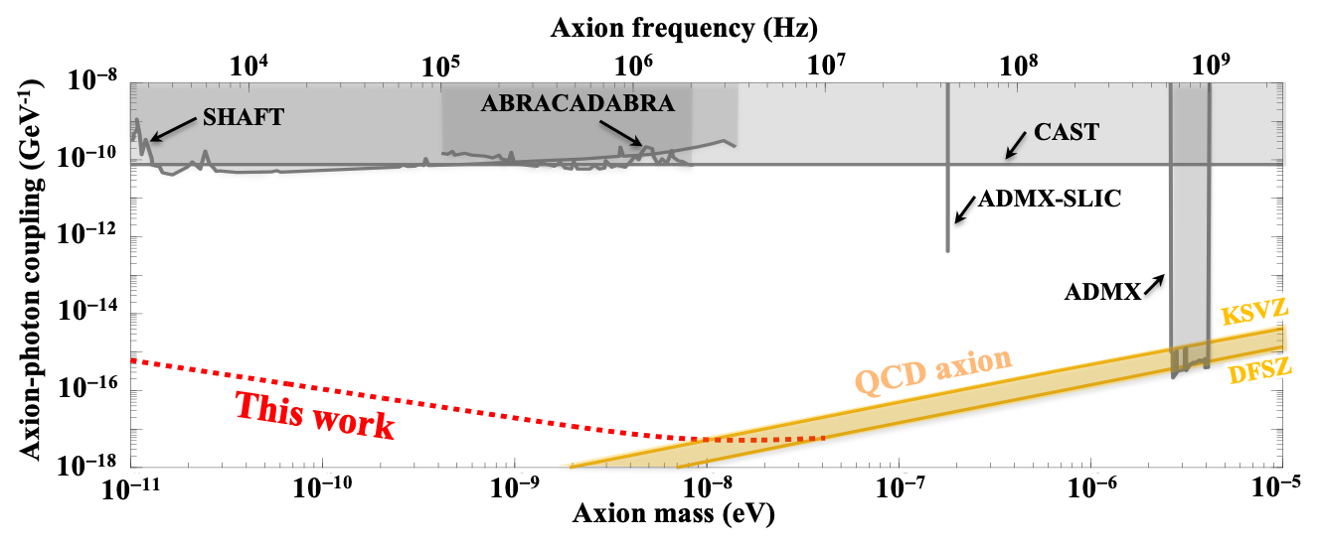
Projected Sensitivity of LANL Axion Search
Unprecedented sensitivity 7 orders of magnitude beyond the current limit
Will probe a completely unexplored axion mass range near 10 neV

Slide 19

Spin Squeezing Method
The Heisenberg’s uncertainty principle:
To reduce spin noise

Slide 20
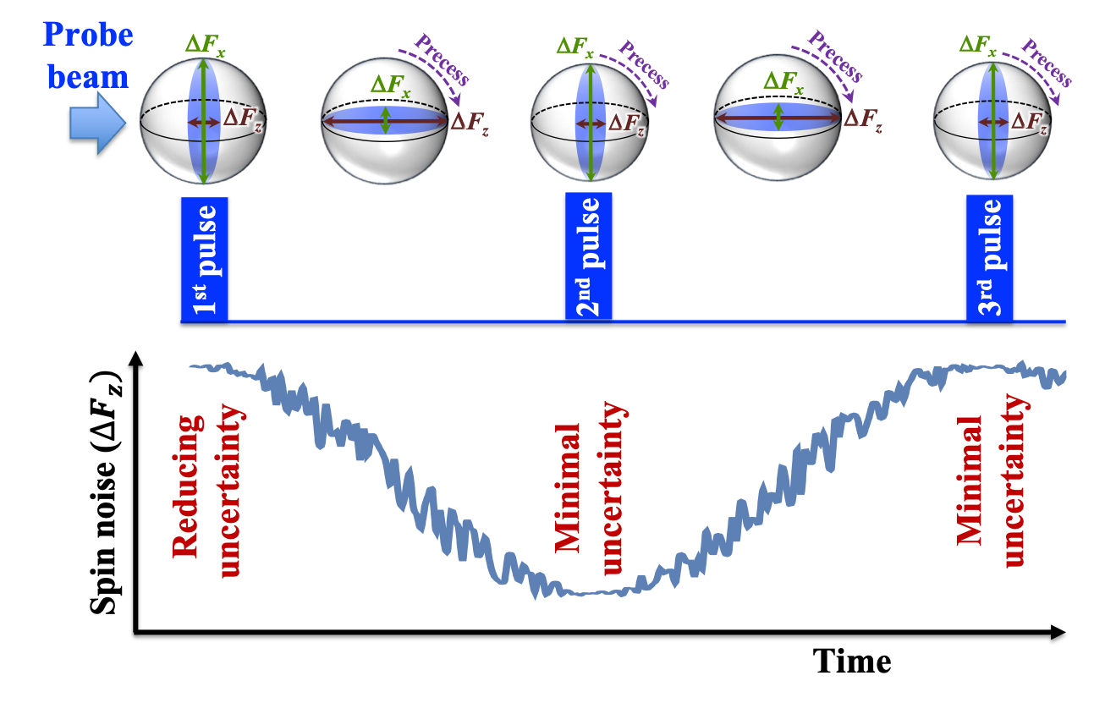
Spin Squeezing Method
Probe pulsing for spin squeezing:
The first pulse squeezes spins
Subsequent pulses readout spin states when the uncertainty is minimal

Slide 21
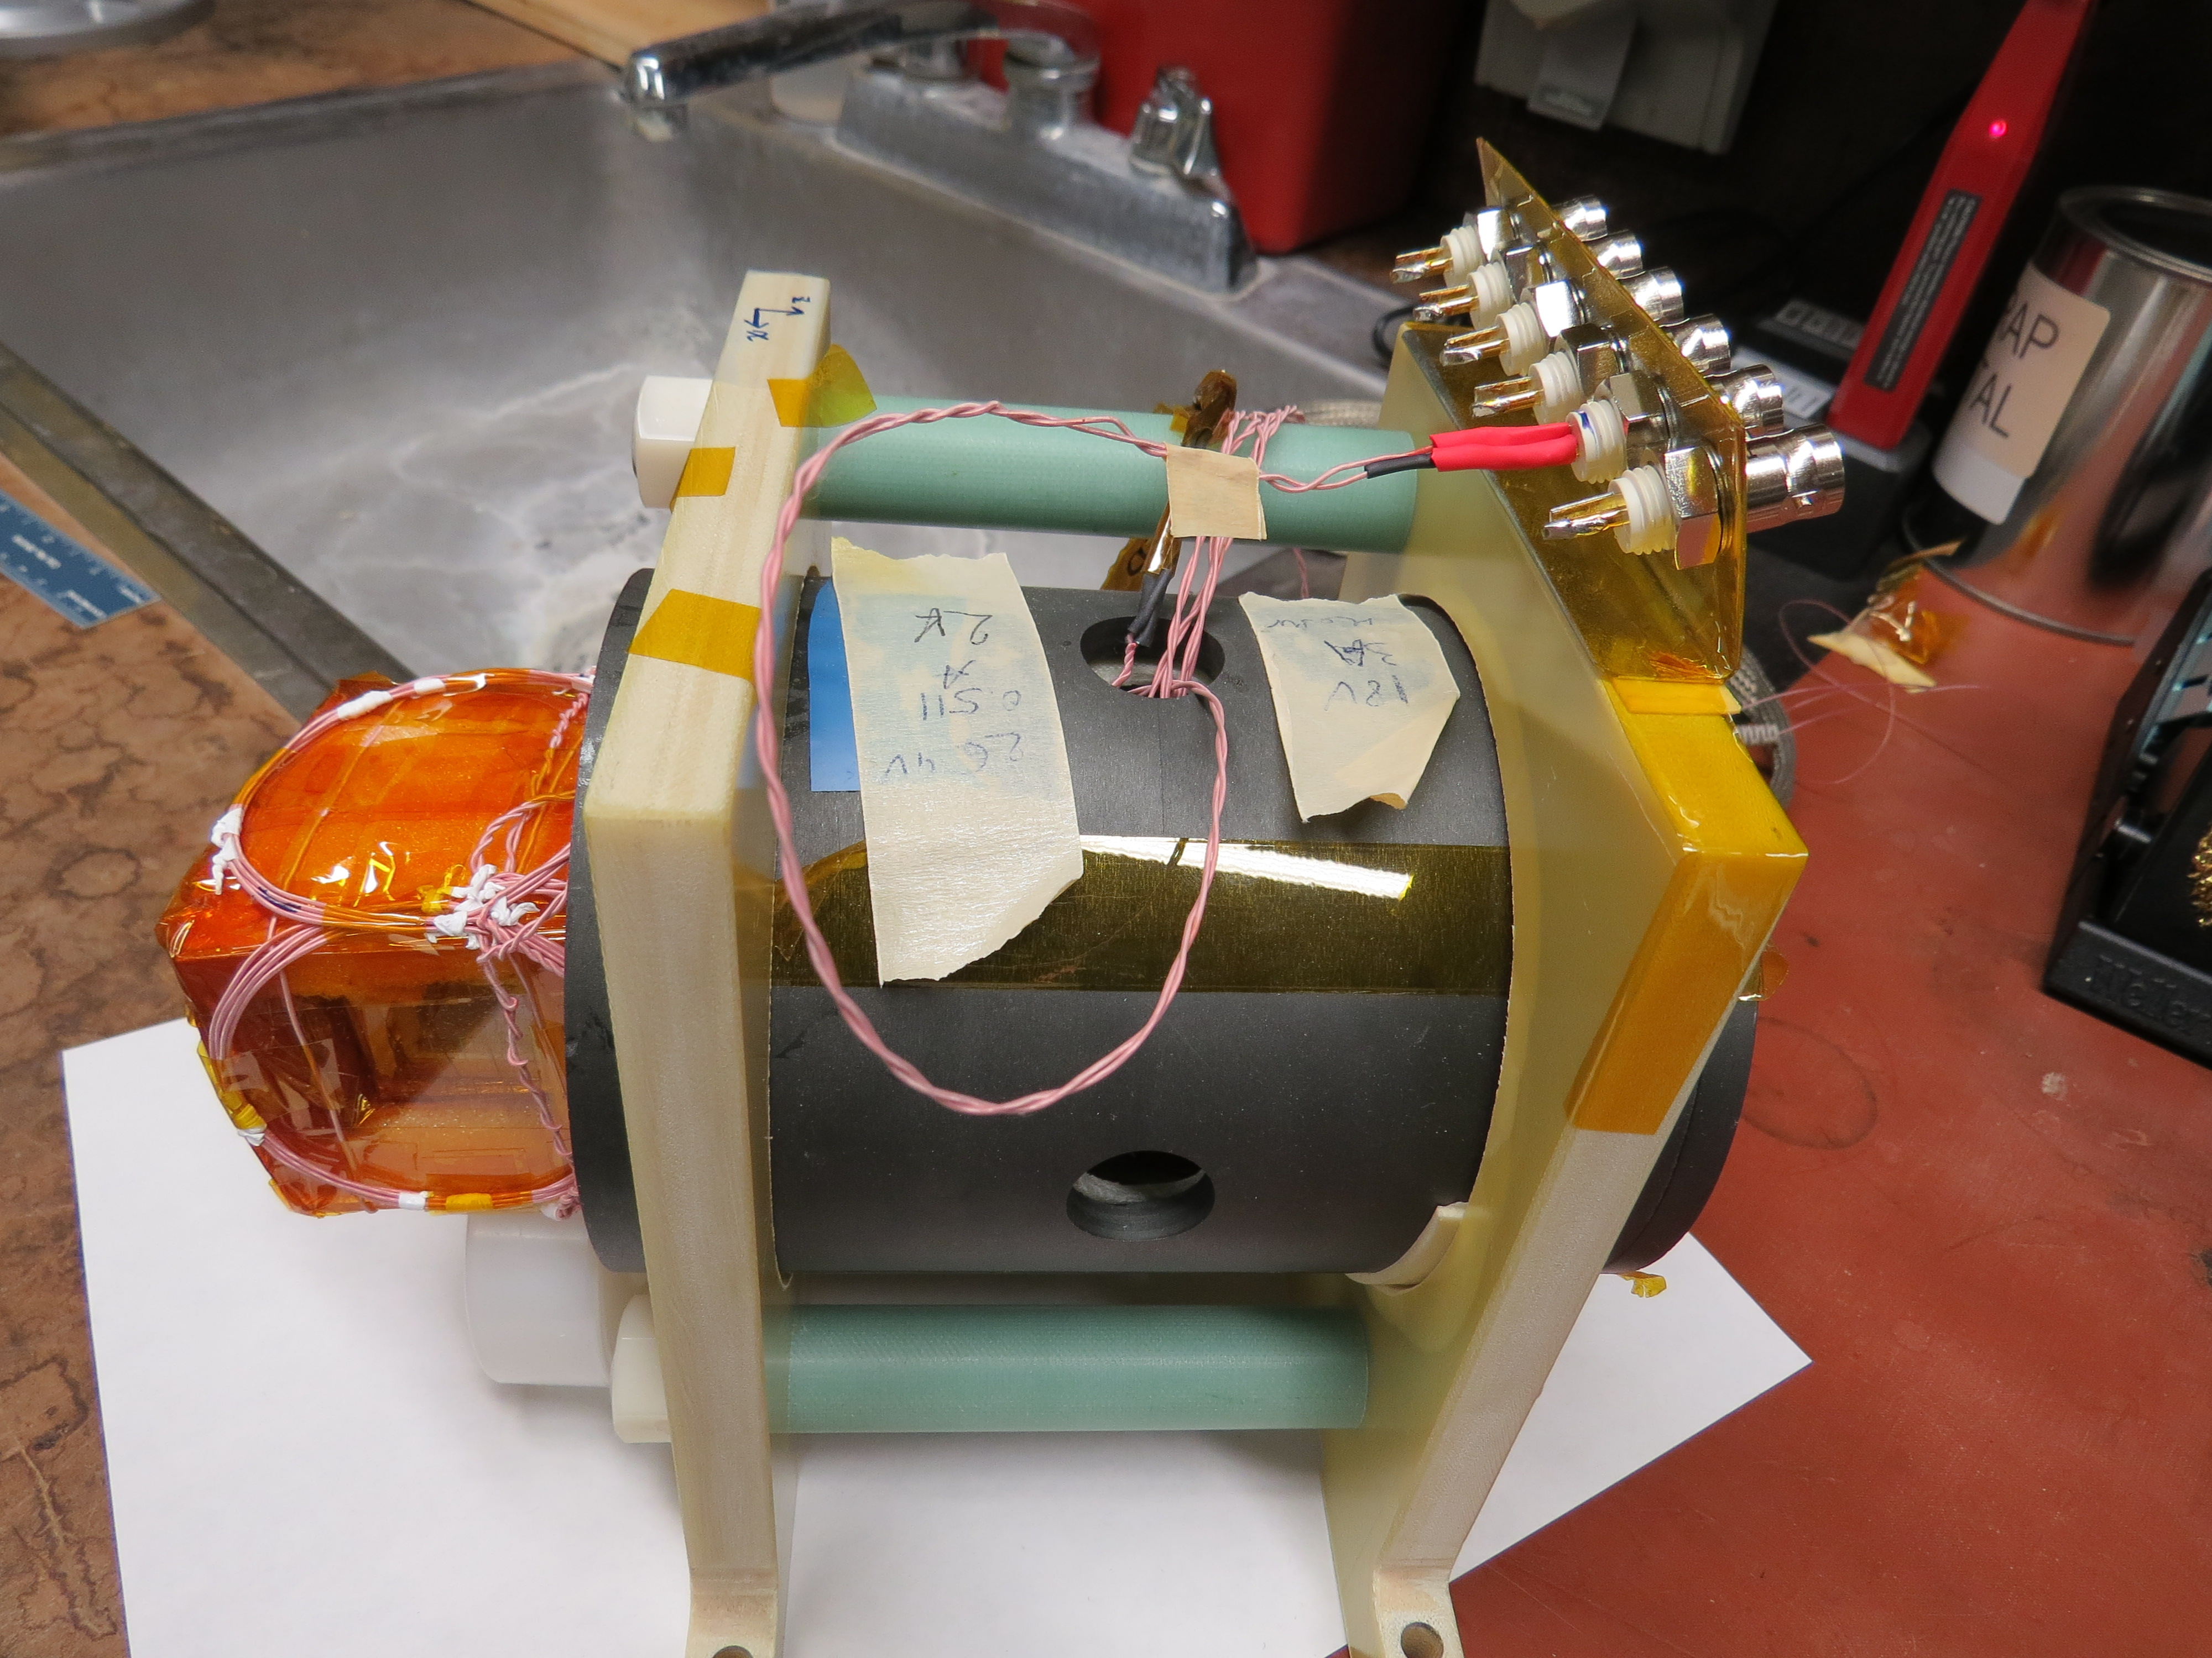
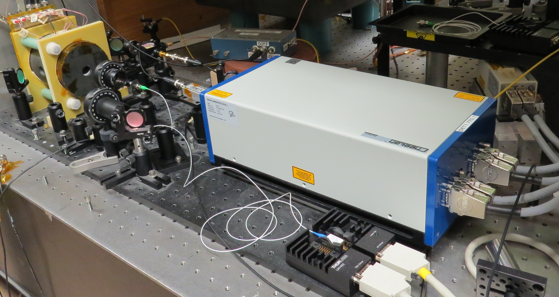
OQS Setup
Potassium vapor cell
(outside the shield for illustration purpose)
Photo-detectors
Probe laser
Pump Laser beam
Magnetic shield with vapor cell
Opening for probe Laser beam
Magnetic shield
Pump laser
  Built an OQS module based on a potassium vapor cell and stable lasers with measured OQS field noise at 10⁻¹⁵ T level

Slide 22
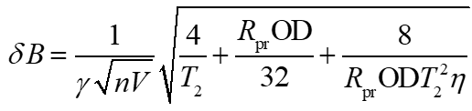
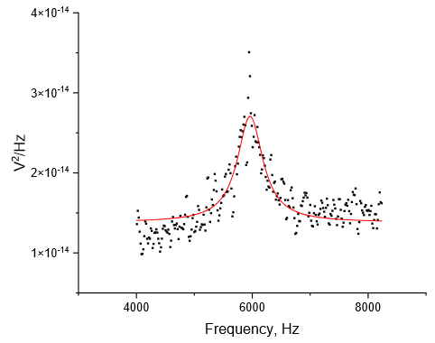



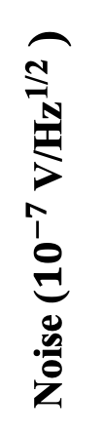
Spin Noise Measurement
$$1.8$$
Spin noise
Noise (${10}^{−7}$ V/Hz^{1/2} )
$$1.4$$
Probe laser noise
$$1.0$$
Photon shot noise
4
6
8
Frequency ( kHz )
  Measured the spin noise term (resonant bump) with continuous probe (i.e., without spin squeezing)

Slide 23
Spin Squeezing with Acousto-optic Modulator (AOM)
AOM
Probe laser
Magnetic shield with vapor cell
Pump laser
  We added an AOM between the probe beam and the vapor cell for probe pulsing.

Slide 24
Protocol for Spin Squeezing
  During the delay time, the spin state is un-squeezed.
  Spin noise in measurement state depends on the delay time.

Slide 25
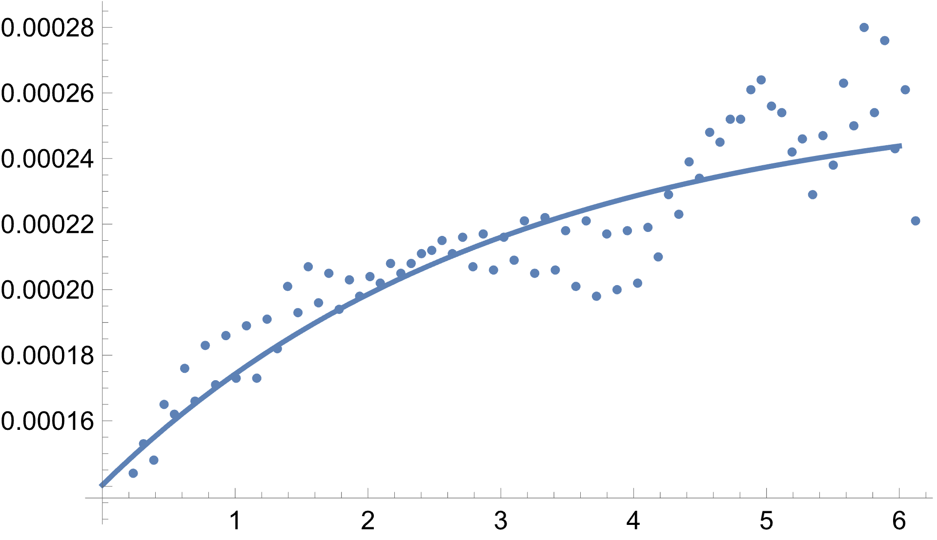
Preliminary Spin Squeezing Verification
Spin noise increases at longer delay time (preliminary Verification of spin squeezing effect!)
Data fluctuation due to ambient magnetic noise
OQS spin noise (a.u.)
Time delay (ms)

Slide 26
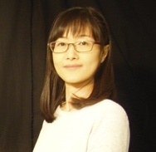
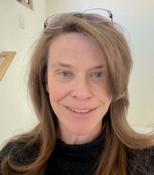
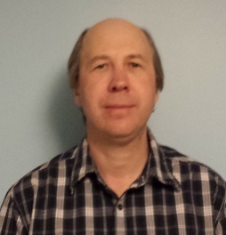

Research Team
Key investigators at Los Alamos National Laboratory:
Young Jin Kim
Leanne Duffy
Igor Savukov
Axion search using OQS recently selected for a QuantISED 2.0 award (Quantum Information Science Enabled Discoveries in High Energy Physics)!
Thank you!

