Slide 1
QT4HEP 2025 :
The Second Day

Slide 2
QT4HEP
Programme
https://indico.cern.ch/event/1433194

Slide 3
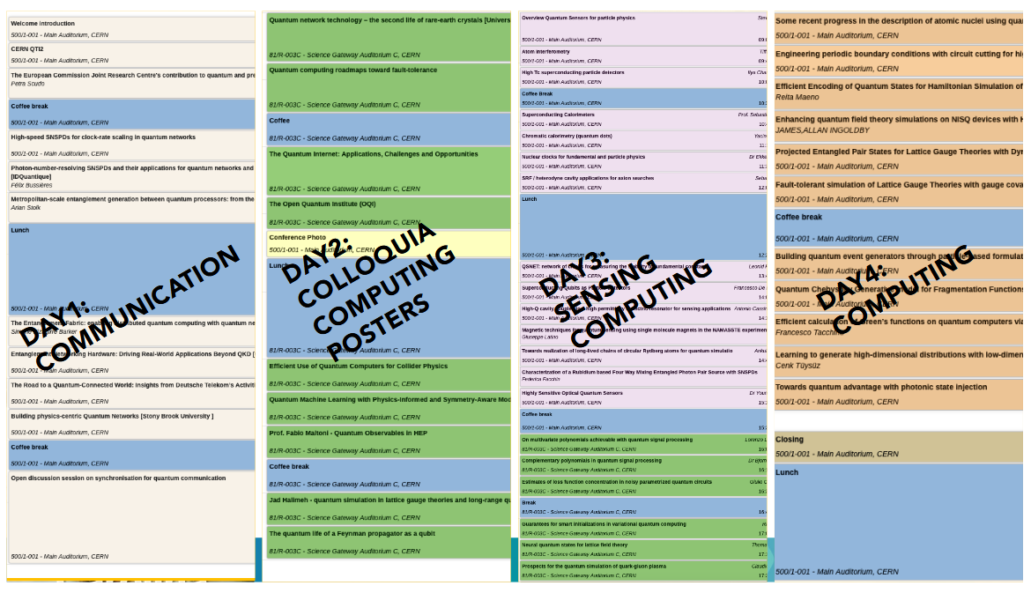

Slide 4
Today we are at the Science Gateway
Coffee breaks are on the ground floor
Lunch is served here
To visit exhibitions use the public entrance.
Conference badge will get you 10% discount at the CERN store
Conference Photo at 1215, before lunch
Poster Session and Conference Cocktail tonight in the Science Gateway
Don’t forget to bring your poster here!

Slide 5
Quantum network technology – the second life of rare-earth crystals
Wolfgang Tittel
Quantum computing roadmaps toward fault-tolerance
Olivier Ezratty
COFFEE !!!
The Quantum Internet: Applications, Challenges and Opportunities
Arian Stolk
The Open Quantum Institute
Marianne Schoerling

