Slide 1
Access to Research Infrastructures for
Nuclear Physics - Accelerator R&D – Particle Physics
HORIZON-INFRA-2021-SERV-01-07
Research Infrastructures Services Advancing Frontier Knowledge
PS-SPS Users Meeting
CERN Meeting, 04.07.2024

Slide 2
Trans-national Access (TA)
User Groups participating in approved test experiments in the
PS-SPS Test beams – IRRAD – and GIF++
facilities, can apply for EURO-LABS Trans-national Access funds for their experiment.
The access can be:
Transnational Access (TA) : when the team visits the infrastructure to make use of it.
Remote Trans-national Access (RA) through the provision of scientific services to the users without a visit to the facility.
  Examples : testing of user equipment sent to the facility, irradiation and/or analysis of material samples, remote access to installed experiments for special data-taking.
The EURO-LABS project funds can be used for:
financial support to the team members during their stay at CERN (TA access): subsistence and travel expenses.
expenses related to the experiment: installation and/or transport of the equipment.
contributing to operating costs: consumables, adaptation of infrastructure.
mainly for test beams
mainly for IRRAD, GIF++

Slide 3
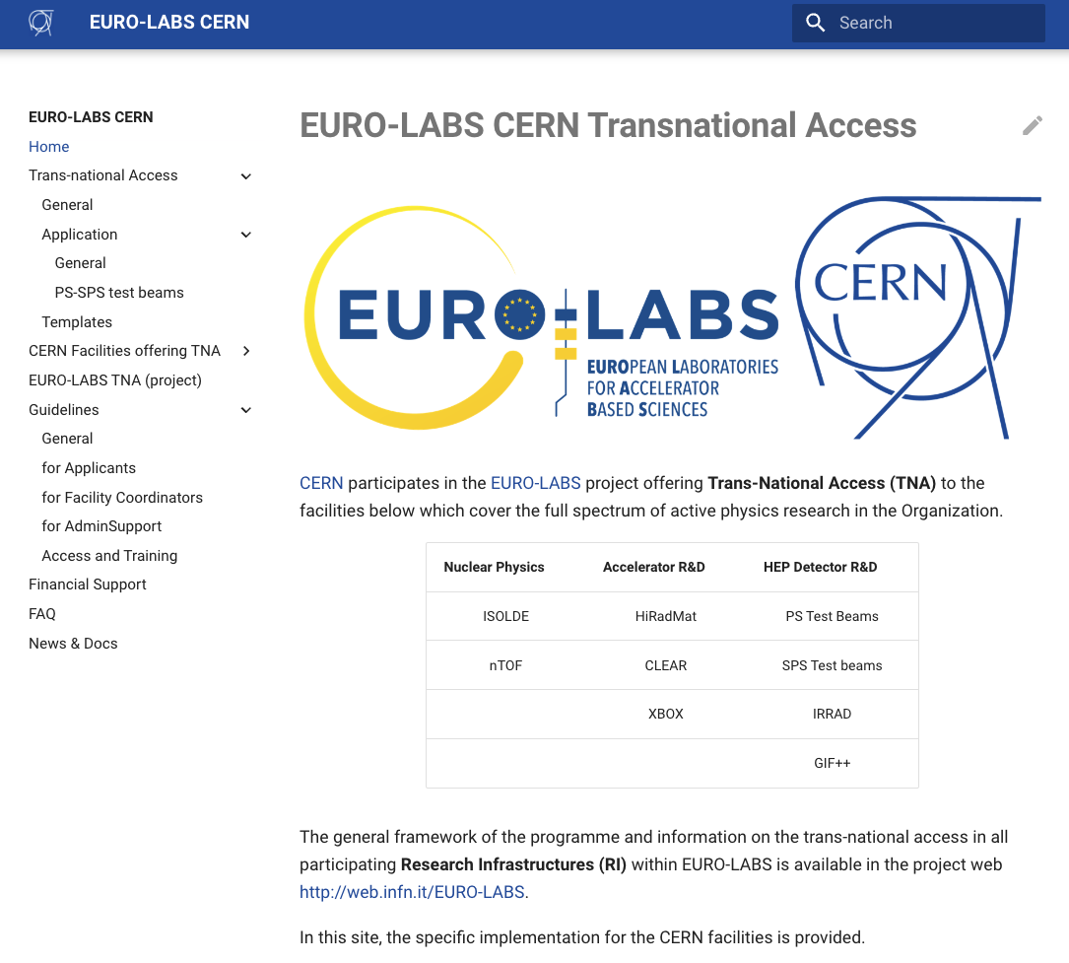
Trans-national Access (TA)
Further information in the project web
https://web.infn.it/EURO-LABS/
..and the CERN specific site :
https://euro-labs-cern-ta.docs.cern.ch/

Slide 4
Application
Declare interest and contact the Coordinators
Eligibility criteria defined in the project web
Application form templated and procedure details available in the CERN EURO-LABS TA web
Deadlines for 2024 :
  15th July : for experiments scheduled and even concluded in the first part of the year
  30th October : for experiments scheduled up to the end of the year

Slide 5
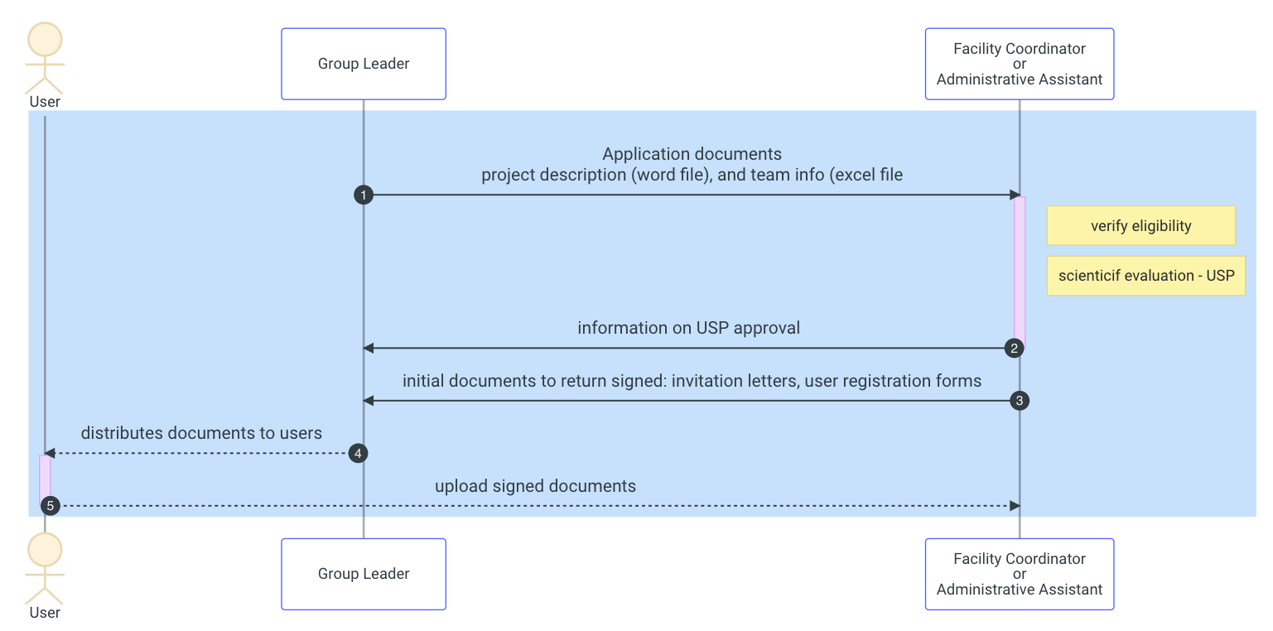
TA Application
Initial phase
Forms to fill: project description (word), user information (excel)
  Templates available

Slide 6
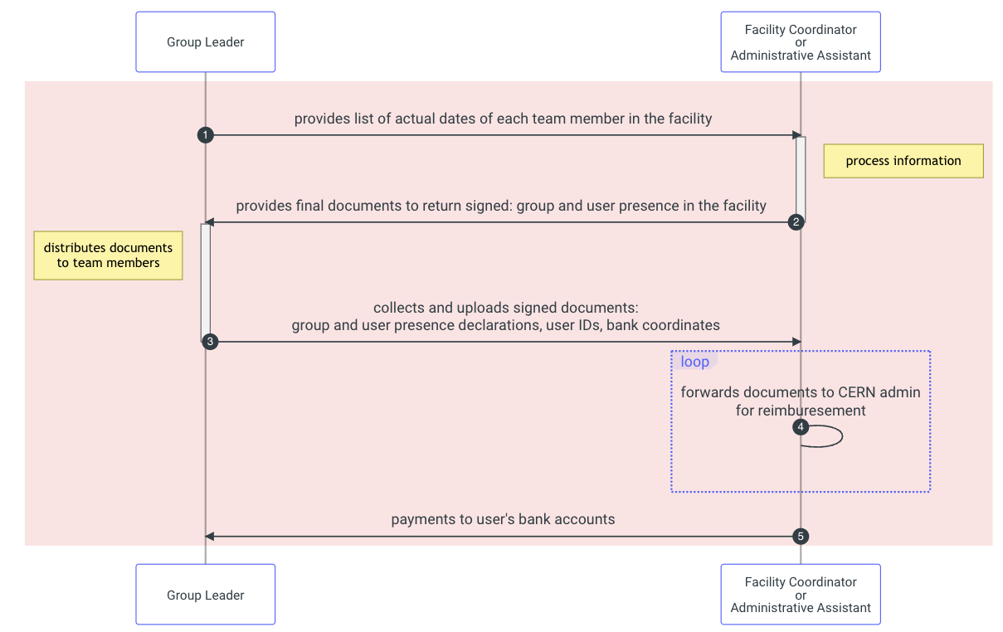
TA Application
Final phase
  at the start or end of experiment
Provide actual dates for the team
Documents to sign:
  declaration of presence for the group by the group leader,
  Declaration of presence for each member
  Proof of travel/stay at CERN, bank coordinates
Within two weeks from the end of the experiment:
  All user documents need to be returned
  The GL must provide a short experiment report
    word template available
  otherwise, the access will be cancelled, and the funds will be distributed to other experiments/users

Slide 7

Publications - Acknowledgement
EURO-LABS needs to be acknowledged in any publication or presentation by the users who received funds

