Slide 1
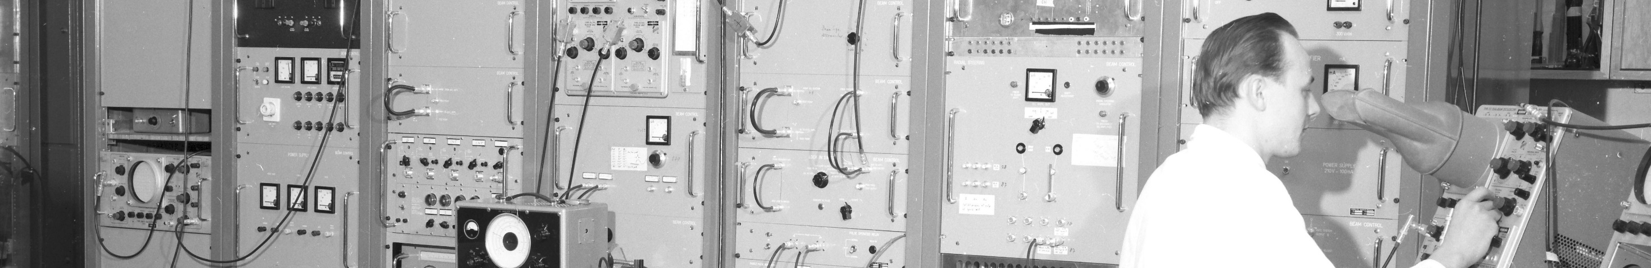
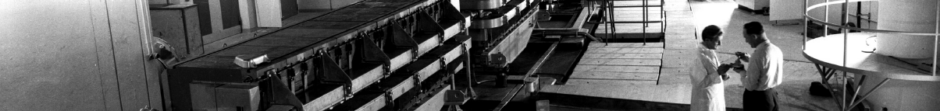
PS Report week 27
Many thanks
to the PS OP and coordination teams as well as all equipment experts and support teams!
A. Lasheen SY-RF-BR
1

Slide 2
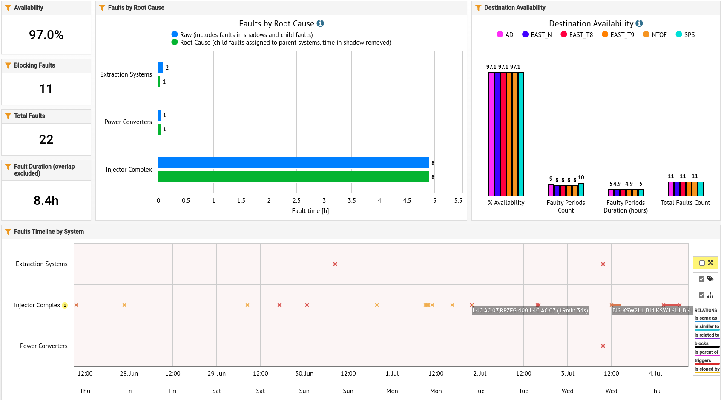
Availability W26/27 (Thu-Thu 09:00)
L4 Solenoid
A. Lasheen SY-RF-BR

Slide 3
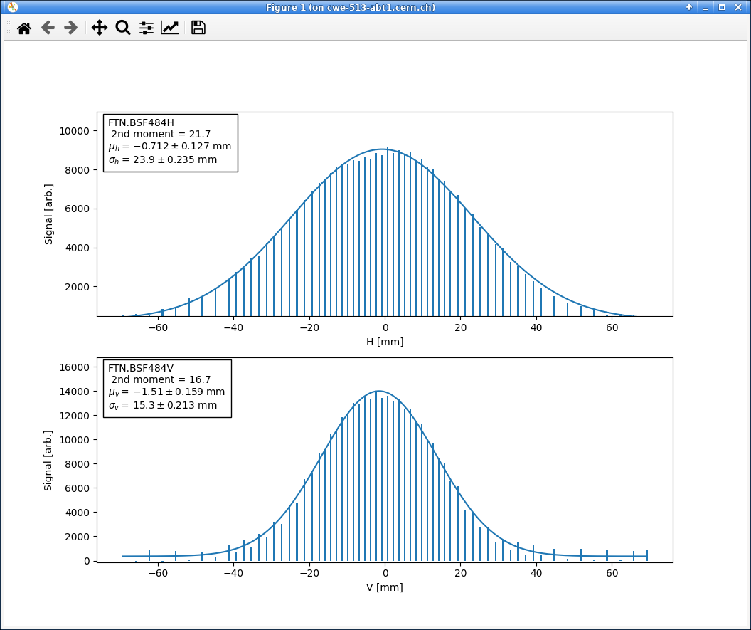
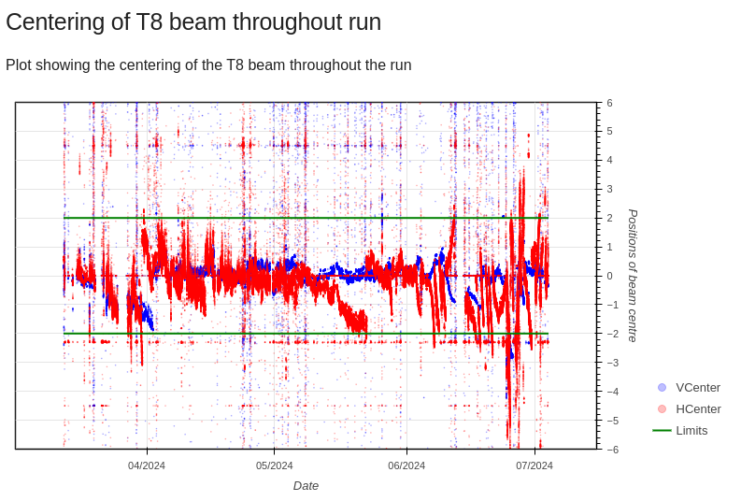
Beam size on target with 44ns extracted bunch length and old optics
Main issues and activities
Excellent availability in W26 and start of W27!
Main fault is Linac4 overnight Wednesday/Thursday (4h downtime)
Adjustments of the optics in transfer line to TOF to increase beam size on target with extracted bunch length of 44ns
  Reloaded optics from previous years (2022-2023), beam size remains a too small in H on target
  Little influence on the losses in ring and transfer
  Will require some further work
  Benefits for bunch rotation with double TOF/EAST to be checked at higher intensities
EAST T8 set back to 80e10 ppp, fluctuations on the beam centering observed, being monitored.
Drifts in radial position of the beam at top energy noticed on all beam. May impact transfer to SPS and efficiency of processes on flat top (e.g. MTE efficiency). Ongoing investigations.
A. Lasheen SY-RF-BR
T8 centering fluctuations

Slide 4
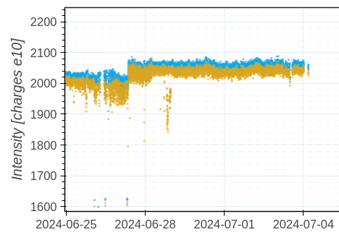
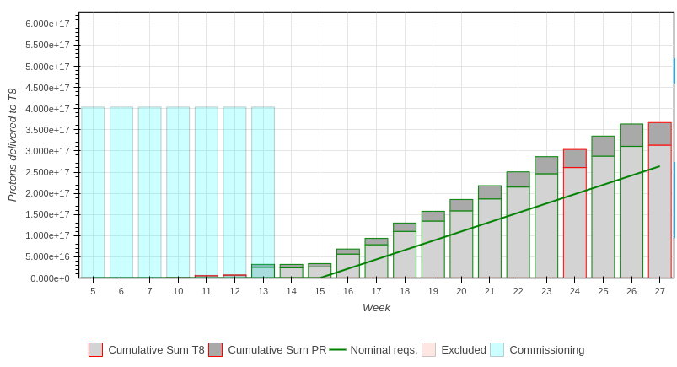
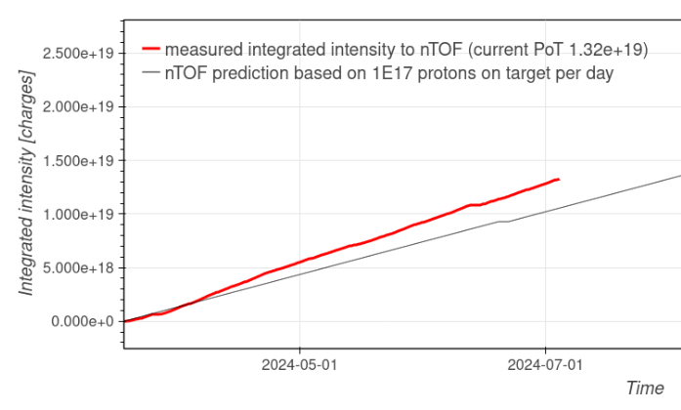
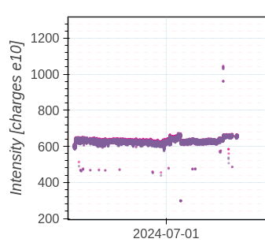
Delivered intensity
AD
EAST T8
SFTPRO
TOF
A. Lasheen SY-RF-BR
https://bpt.web.cern.ch/

Slide 5

Questions and Comments
PS Coordinator for week 27 – Alexandre Lasheen
PS Coordinator for week 28 – Yann Dutheil
9:00 live meeting at the CCC on Wednesday/Friday
Zoom link to follow the meeting on remote: https://cern.zoom.us/j/9372114100?pwd=L29BcmlHUENCdFBRSytXYVcrM1B4Zz09
Meeting ID : 937 211 4100
Passcode: 525463
A. Lasheen SY-RF-BR
4

