Slide 1
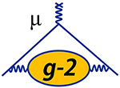





Muon g-2
Masterclasses
IMC SG Meeting, CERN, Nov 25th, 2024
Sean Foster & René Reimann

Slide 2

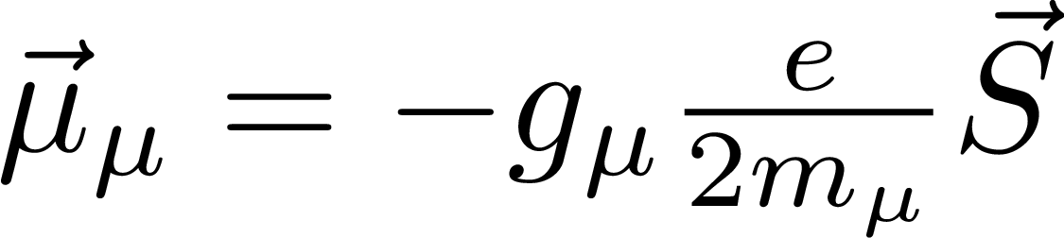
Muon g-2 in a Nutshell
one of the most precise measurement in particle physics
+
high precision theory calculation
=
one of the most stringent tests of SM of PP
proportionality factor between
spin and magnetic moment

Slide 3
Measurement Principle

Slide 4
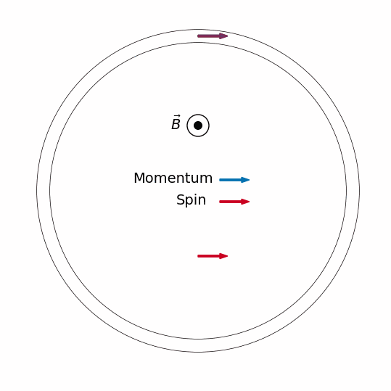
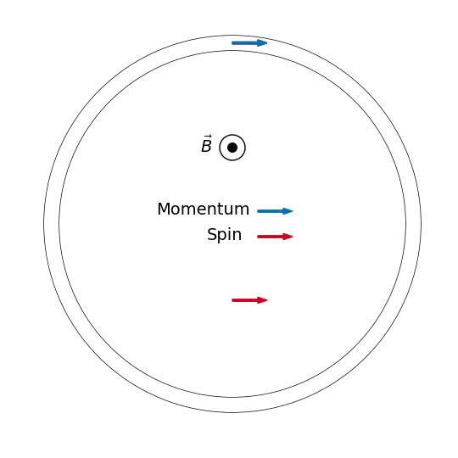
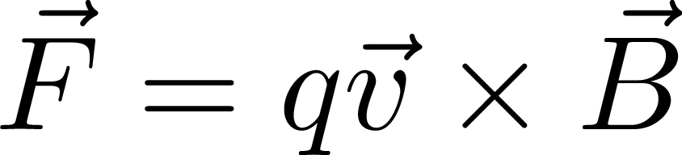

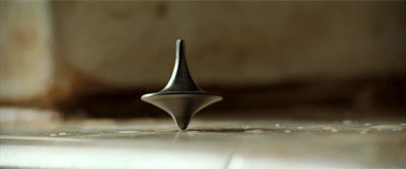
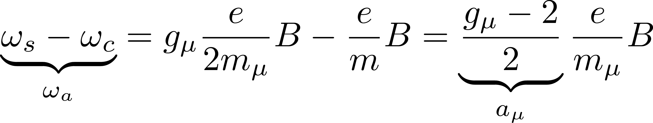
Muon in homogeneous magnetic field
Spin Precession
Cyclotron Motion
torque → precession
perpendicular force → circular orbit
anomalous spin-precession frequency
anomalous magnetic
moment

Slide 5
Event Reconstruction
Task 1

Slide 6
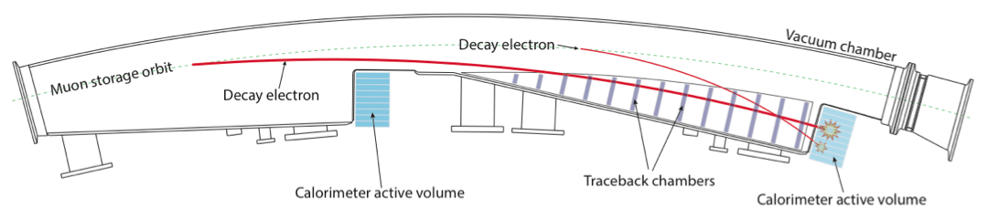
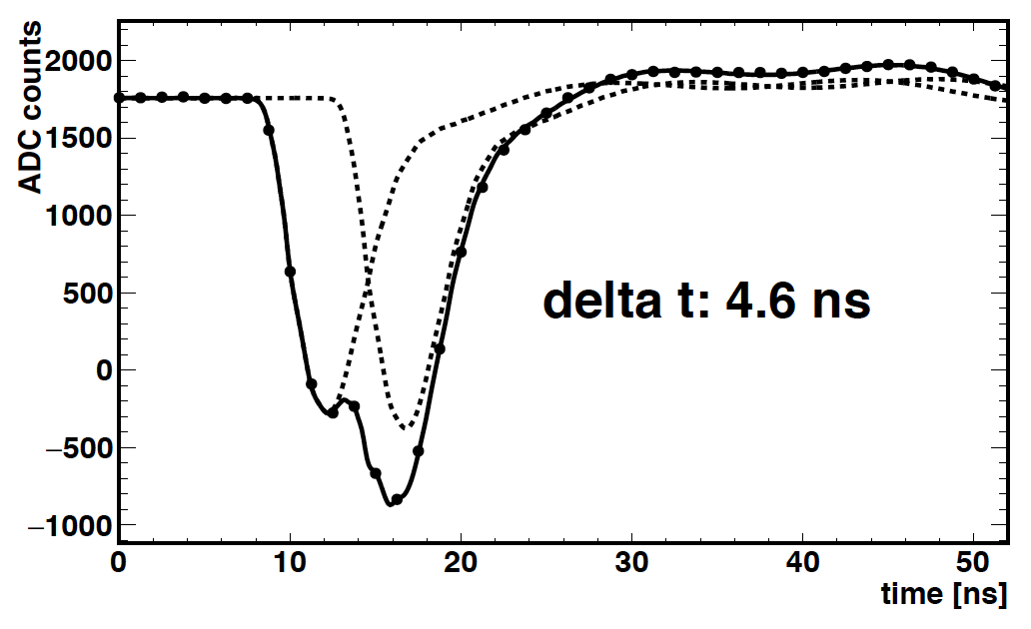
Event Detection
1/12 of the ring
Muon decay → positron
Positrons spiral inwards
Cherenkov light PbF2 crystals
24 calorimeters with 6x9 crystals
Reconstruct Time and Energy

Slide 7
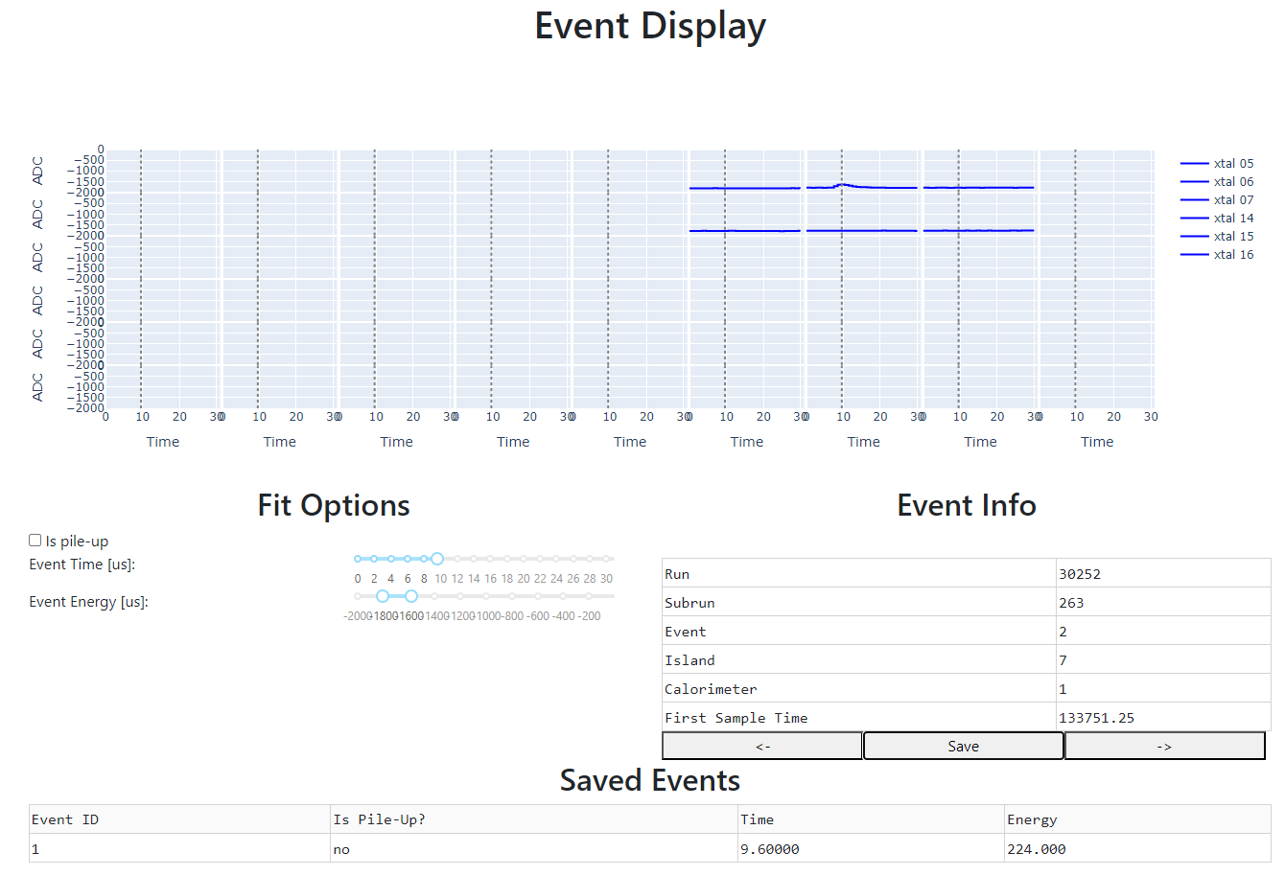
Event Reconstruction
Event Display
Event Navigation
Slider fit
  Event time
  Event amplitude / energy
Pile-up flag
Save event information

Slide 8
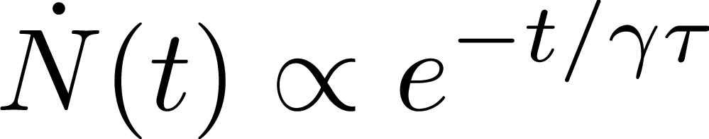
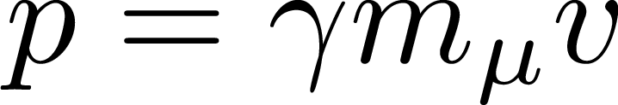
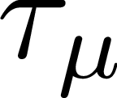
Tasks
Extract positron time and energy from "slider fits" to individual pulses
Identify pile-up events
Determine boosted muon lifetime from exponential decay of time spectrum
Determine muon momentum from energy spectrum end point
Determine muon rest lifetime from boosted lifetime and momentum

Slide 9
Wiggle Plot Fit
Extracting ω_{a}
Task 2

Slide 10
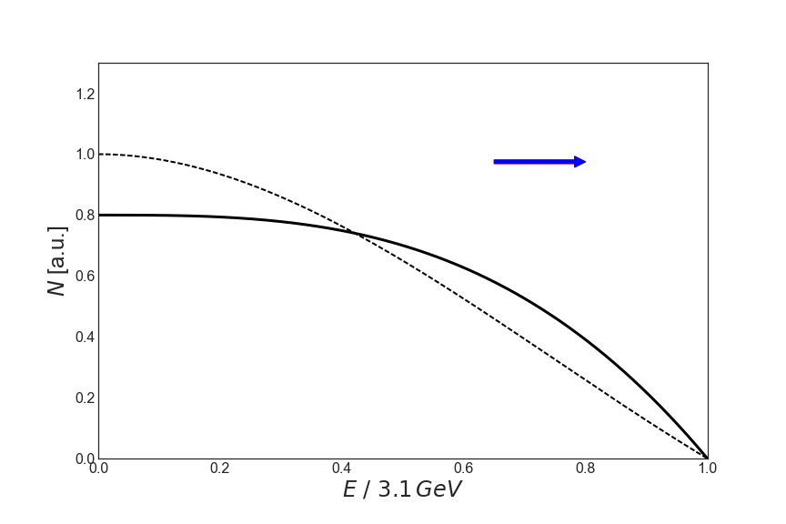
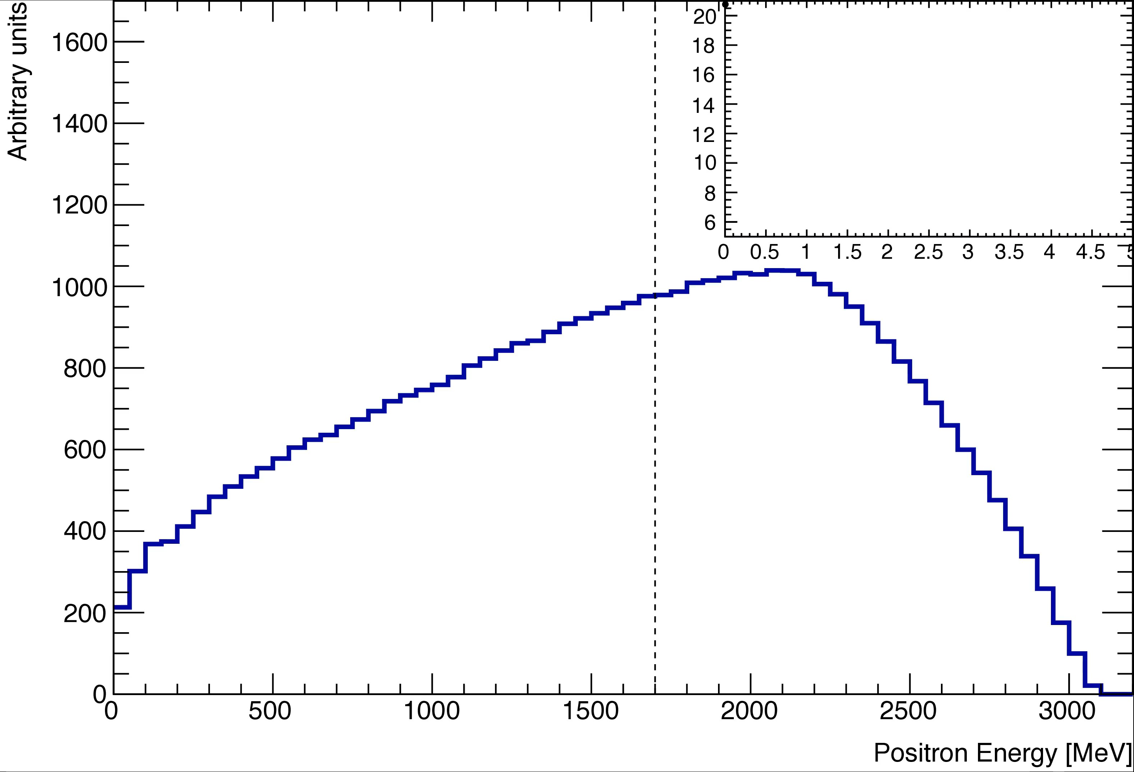
Spin Precession → Positron Energy
Muon Rest Frame
Lab Rest Frame
With detector acceptance
Boost
Weak decay → parity violation
Positron emission in direction of spin
count rate above energy-threshold

Slide 11
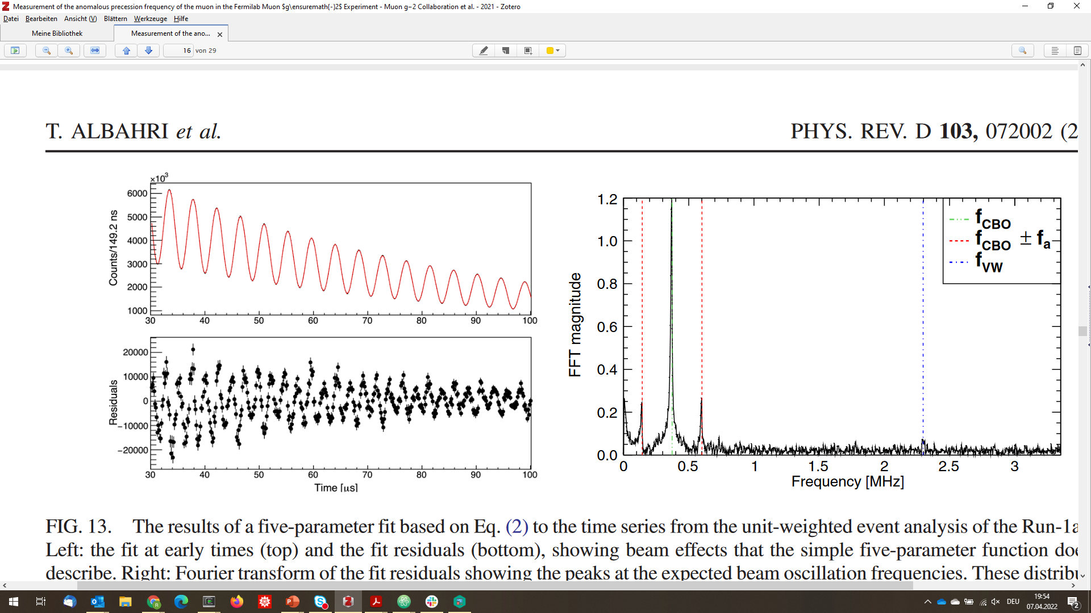
Wiggle Plot
normalization
wiggle phase
muon decay
wiggle frequency
wiggle amplitude
measurement of g-2

Slide 12
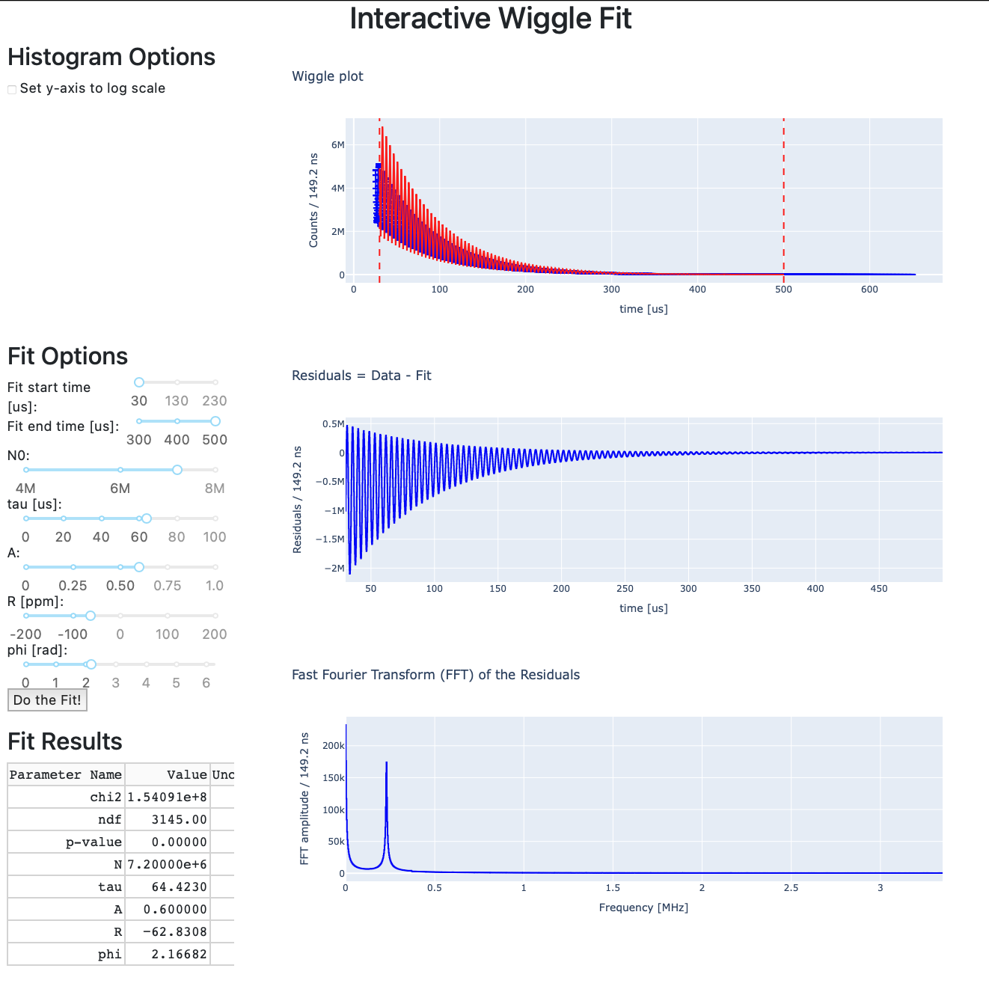
Wiggle Fit
Fraction of data from run 3
Linear & logarithmic representation
5-parameter fit
  sliders
  automatic
Fit result table
Residuals & FFT of residuals
Determine frequency:
  counting wiggles by hand
  slider fits

Slide 13
Combining Results
& Interpretation
Task 3

Slide 14
Calculation of g-2
Provide few different datasets for task 2
Compare results for ω_{a} of different groups
for same dataset
  up to 19 different analysis in Muon g-2 to extract ω_{a}
  estimate uncertainty
Provide magnetic field values per dataset
  → calculate g-2 per dataset
Combine values from different datasets
Unblinding: time given in clock ticks
The 40 MHz clock was really set to:
39 997 844 MHz

Slide 15
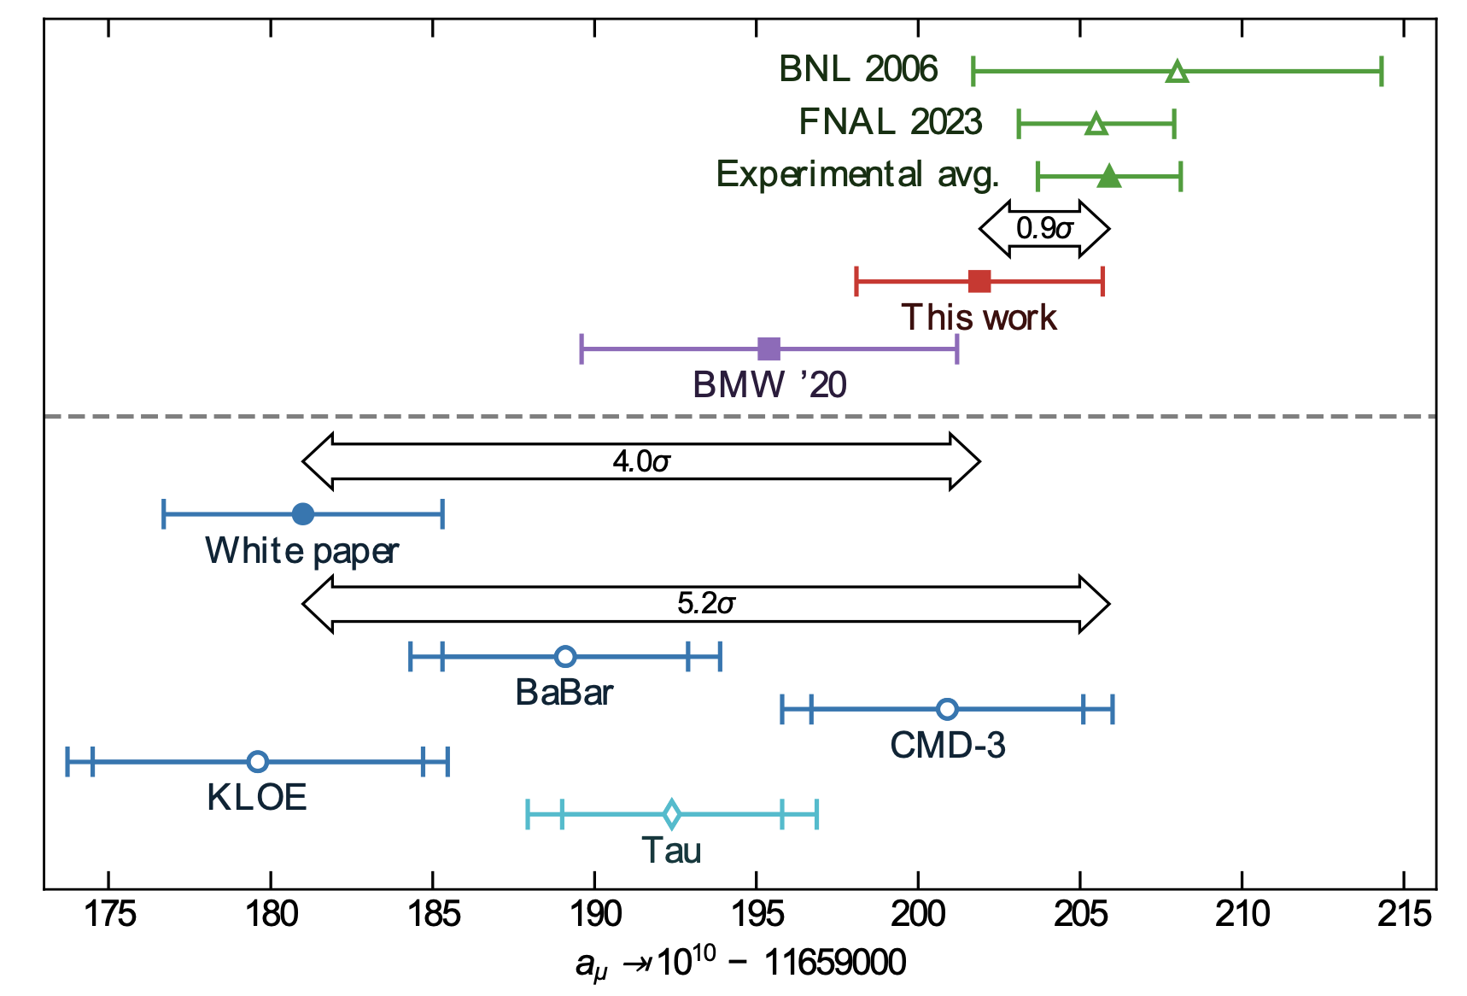
Compare to Theory Prediction
M. Hoferichter, Workshop of TI, Sep 2024 @KEK
Muon g-2 Puzzle
tension between theory (white paper) and experiment
New muon g-2 Puzzle
Inconsistency between
lattice and data-driven approach
different e⁺e⁻ experiments
Experiment
→ improve statistics & systematics
of measurement
BMW ‘24
Your Result

Slide 16
Timeline
Idea presented to collaboration at last Collaboration meeting
  very positive feedback
Prototype interactive wiggle fit & event reconstruction
  running in web-browser (python web-application)
Two meetings with FNAL education section
  very helpful feedback on tools and concept
Outlook:
  Prepare introduction material
  Improve event reconstruction tool (calibration factors, speed)
  Prepare additional datasets
  Test muon lifetime extraction
  Test with few first semester students and other Masterclasses tutors in Mainz in January

Slide 17
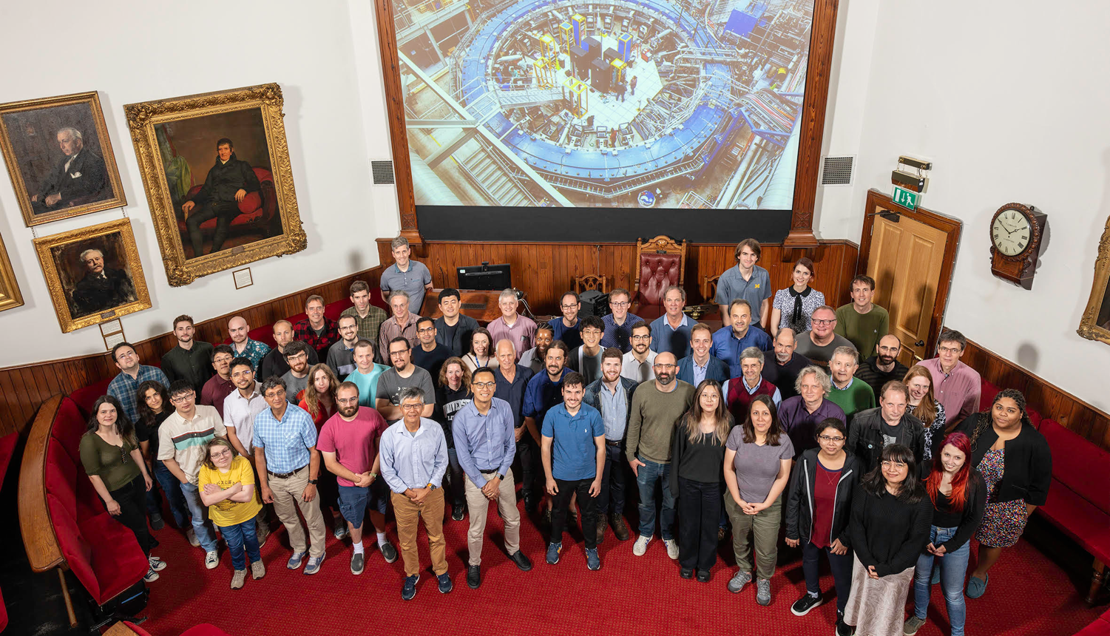
Thank you for your attention
Summer Collaboration meeting at University of Liverpool July 24-28, 2023

Slide 18
Backup

Slide 19
Analysis Tasks
Extract time and energy from calo hits
  classification of pile-up / no pile-up event
  fit amplitude and position of template
  Dataset: ~100 events at most
  Estimate muon lifetime
Fit wiggle plot with 5-parameter fit
  dataset: one run 3 letter datasets per group
  optional: change start/stop time to estimate systematic impact
Combine results from 5-parameter fit of different letter datasets
  magnetic field per data-set to combined result
  calculate weighted mean
  unblinding factor
Event reconstruction
Main Task: ω_{a} extraction
Bonus: group experience

Slide 20
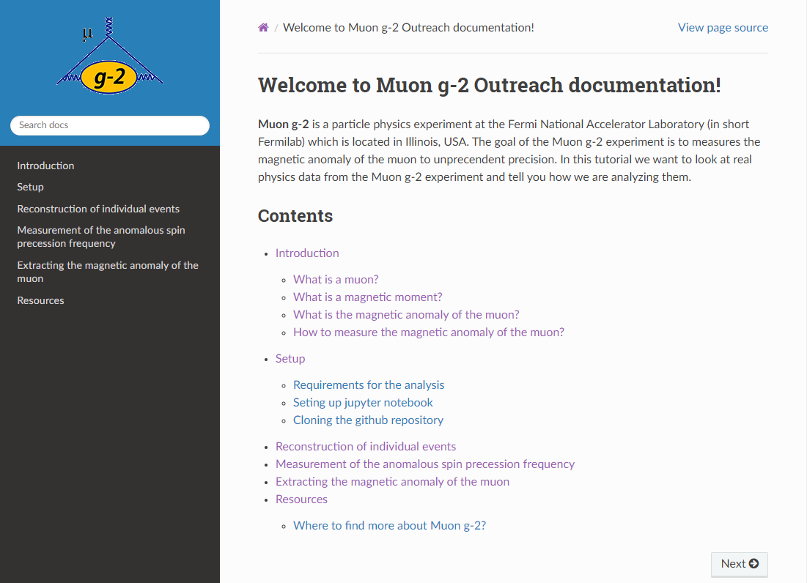
Online Format – Read the Docs
Online tutorial page
Write documentation so students can perform analysis themselves
Setting tutorial up in gm2outreach
using reStructuredText and sphinx
ReadTheDocs can automatically generate and publish documentation from GitHub repositories online
currently compiled offline with sphinx

Slide 21
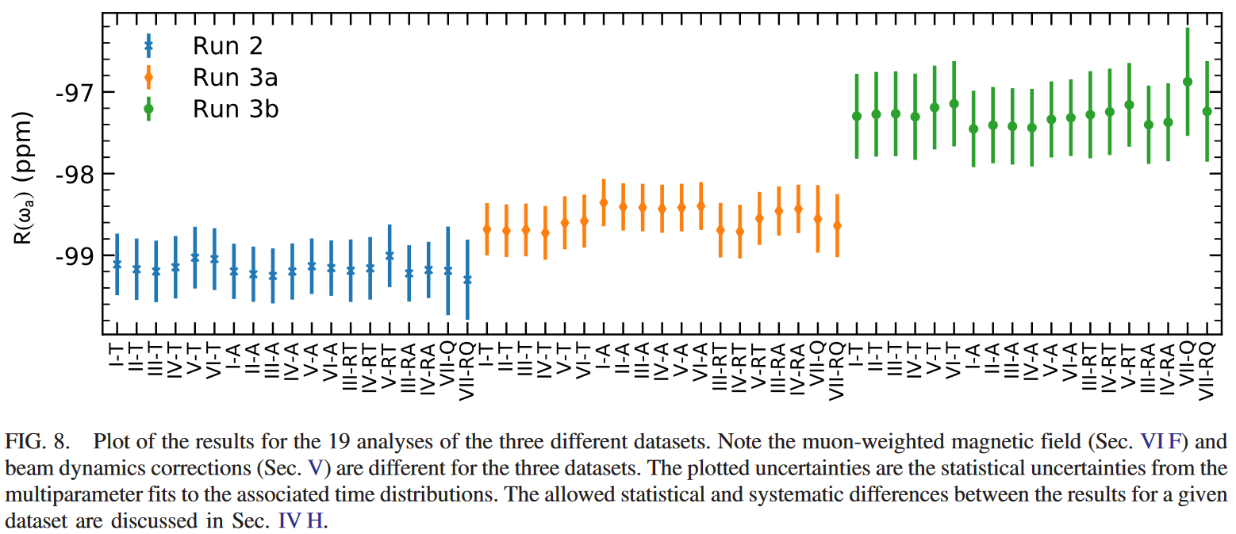

Slide 22
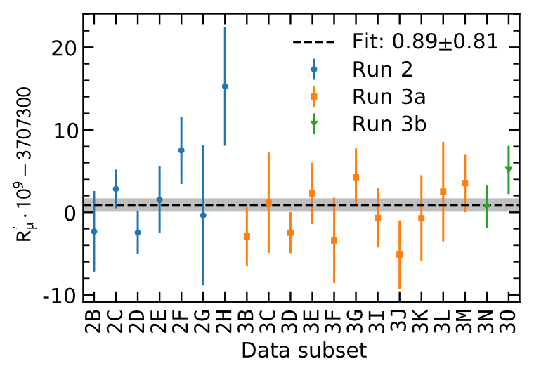
Datasets
published
published
analysis on-going

