Slide 1


Delhi University – Status and Plans
Arun Kumar, Ashutosh Bhardwaj, Namrata Agrawal, Kirti Ranjan*
DU Group
Department of Physics and Astrophysics
University of Delhi, India
DRD3 WG4, 22nd July, 2024

Slide 2
Delhi University – Si Sensors related R&D
1
3
TCAD simulation using SILVACO
Sensor Design and Fabrication
2
Sensor Characterization

Slide 3
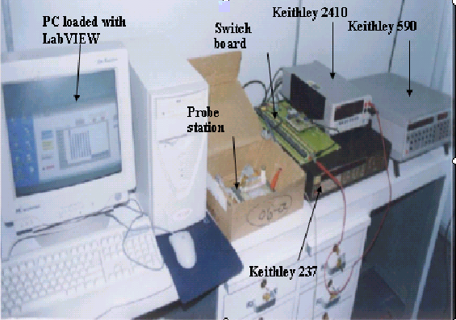
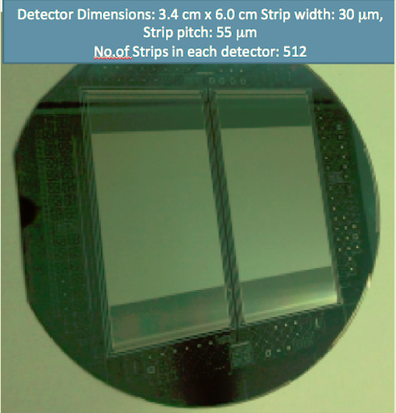
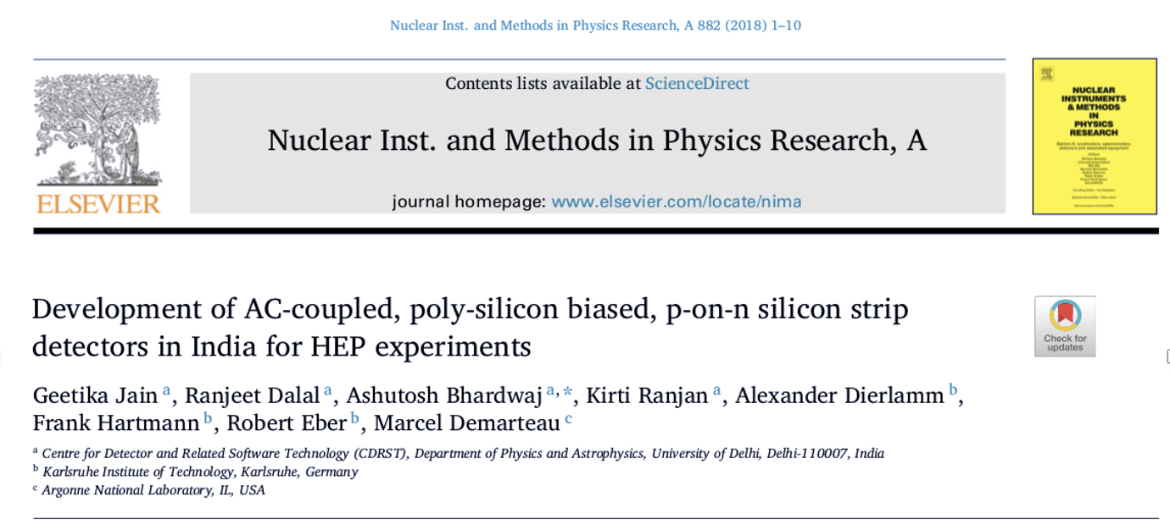
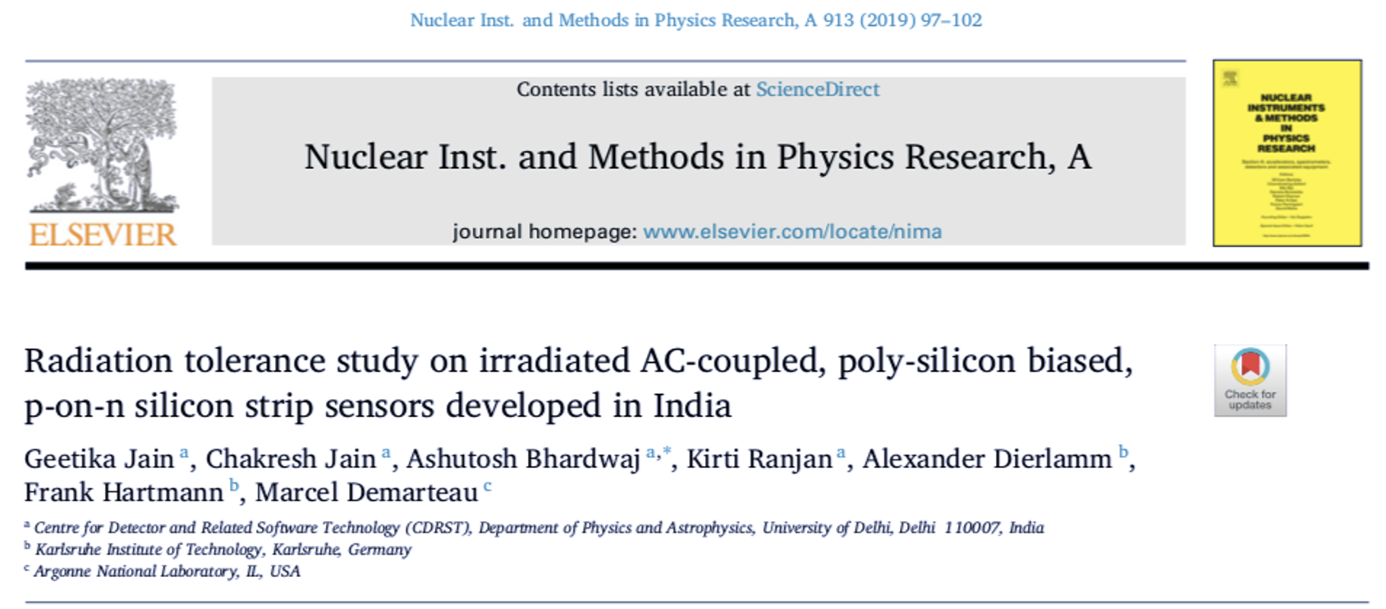
Sensor Design and Fabrication
CMS Preshower Detector (1998-2006)
  Successfully developed ~1000 dc-coupled, Si strip sensors, for first time in India, together with BARC & BEL
Participated in all aspects of Si sensor development
  TCAD Simulation (Pisces & Medici), Characterization (IV, CV), Radiation Hardness
2013-2019: Collaborated with foundary (BEL) to develop ac-coupled p-on-n silicon-strip sensors on 4 inch wafers

Slide 4
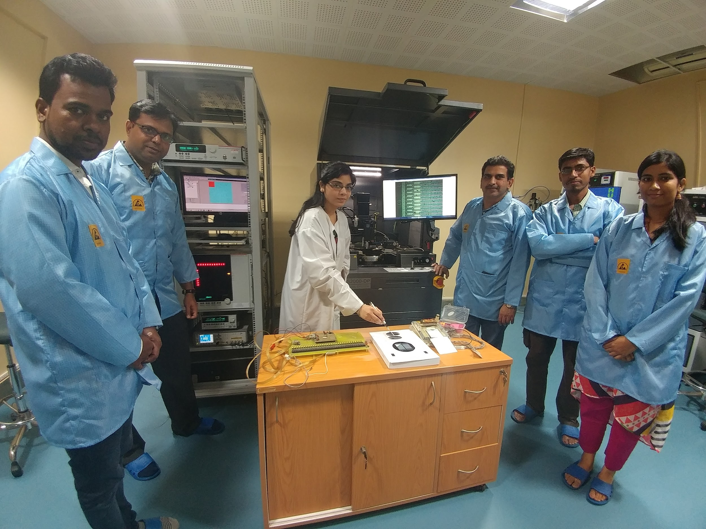
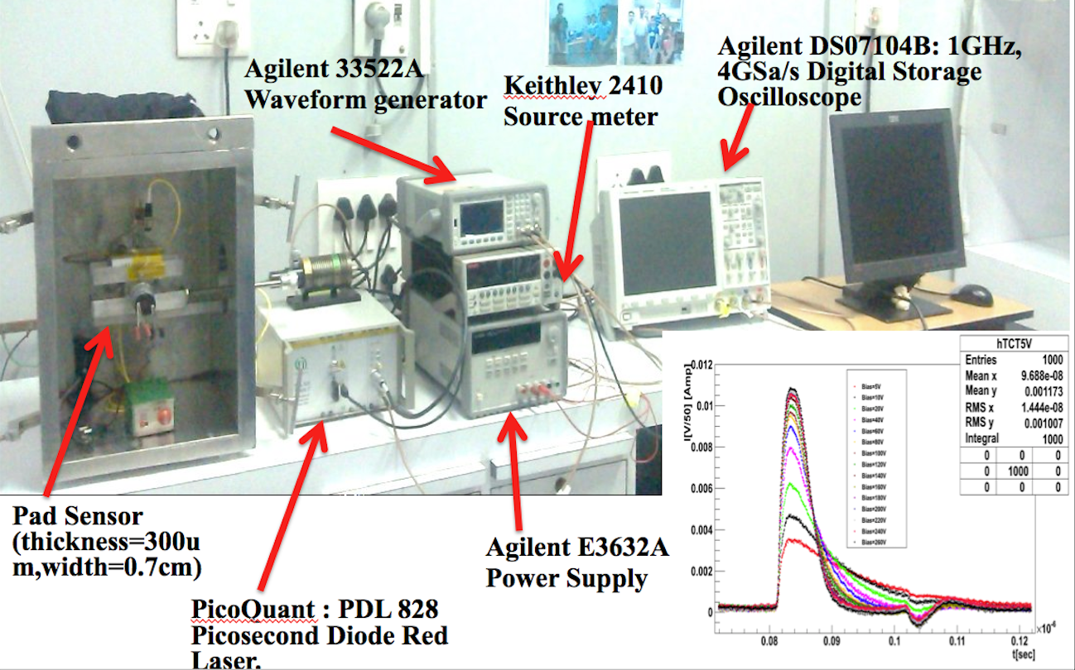
Sensor Characterization
Sensor Qualification Center: One of six such facilities for testing Phase 2 CMS Outer Tracker 2S n-on-p sensors: Automated & programmable characterization system
Red Laser based TCT setup
Alibava Source based Characterisation system

Slide 5
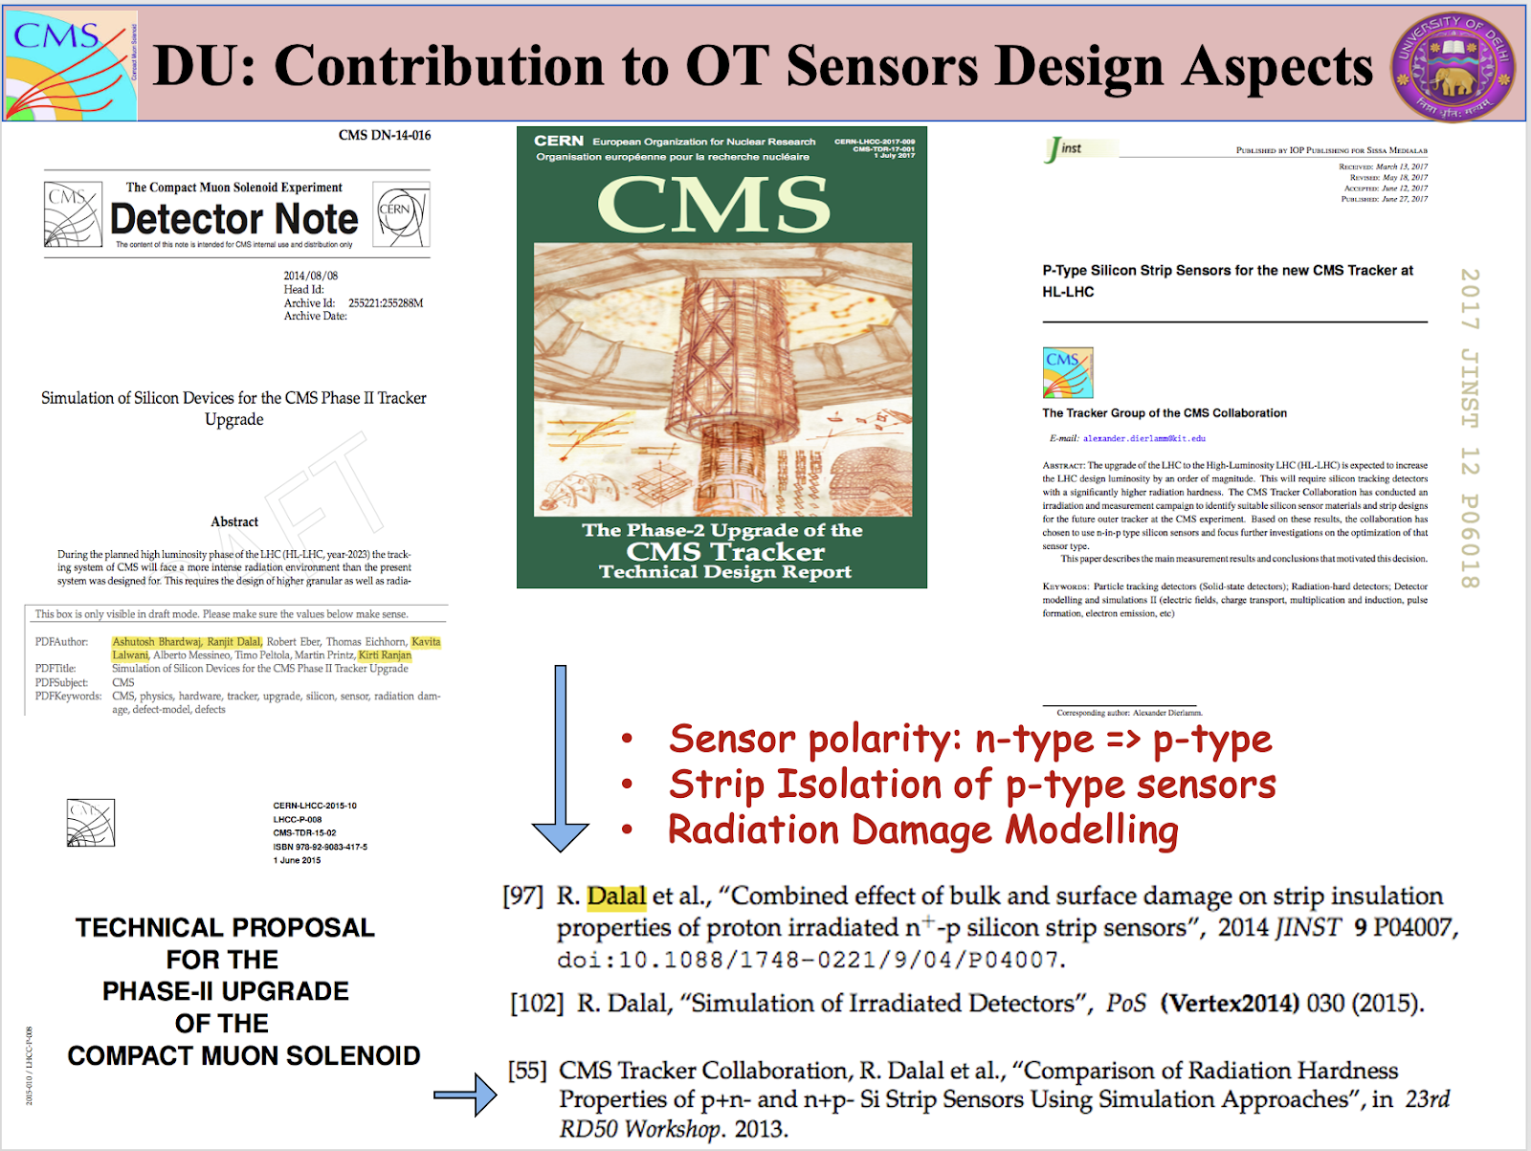
TCAD Simulation: Design and Radiation Hardness
Design (simulation) work included in CMS Phase 2 Tracker upgrade: CMS Detector Note, Technical Proposal, Technical Design Report (TDR) and P-type Tracker paper

Slide 6
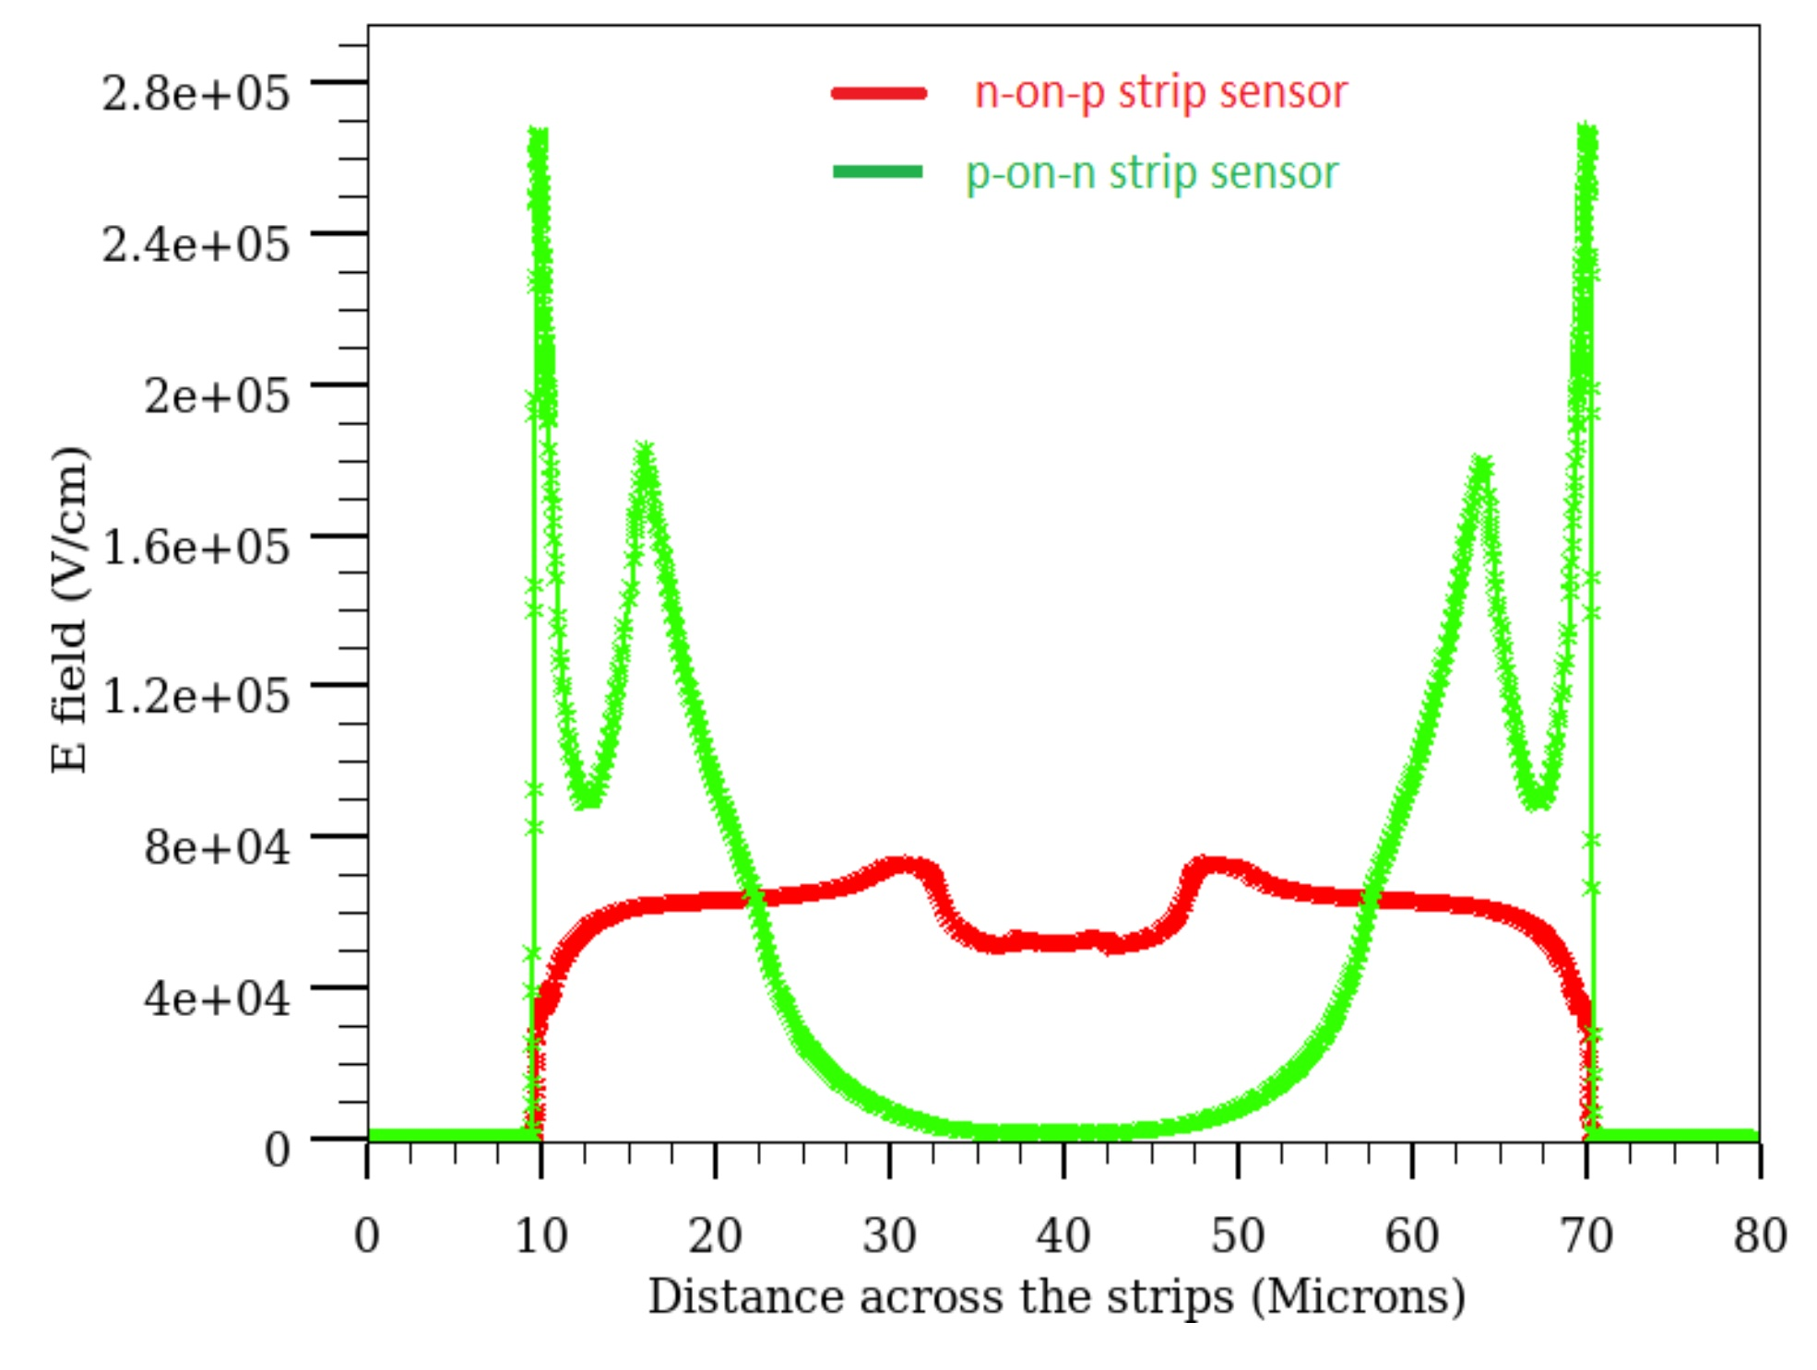
TCAD Simulation: Design and Radiation Hardness
PROTON Damage model:
Initial 5-level bulk model + Surface damage
Modified 2-level bulk damage + Surface damage (Interface traps + Q_{f})
Attempts at LGAD Simulation and Thin and Low resistivity Si simulation
TCAD simulation of Low Gain Avalanche Detectors Ranjeet Dalal, Geetika Jain, Ashutosh Bhardwaj, Kirti Ranjan, NIMA 836, 11, 2016, 113
https://www.sciencedirect.com/science/article/abs/pii/S0168900216308804
Radiation hardness investigation of thin and low resistivity bulk Si detectors
G. Jain, S. Sharma, C. Jain, A. Kumar, A. Bhardwaj, K. Ranjan, NIMA 936, 21, 2019, 693
https://www.sciencedirect.com/science/article/abs/pii/S0168900218312610
Radiation hardness studies of thin and low bulk resistivity LGADs
Geetika Jain, Chakresh Jain, Saumya Saumya, Namrata Agrawal, Ashutosh Bhardwaj and Kirti Ranjan, 2021 Semicond. Sci. Technol. 36 065016
https://iopscience.iop.org/article/10.1088/1361-6641/abfb0f/meta

Slide 7
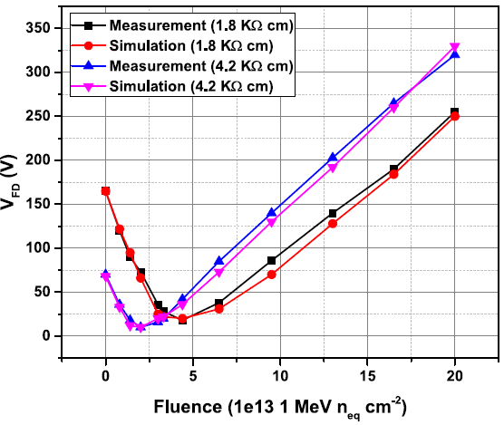
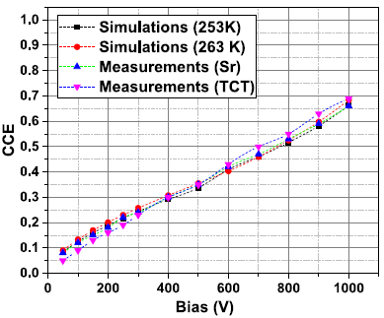
TCAD Simulation: Design and Radiation Hardness
NEUTRON Damage model:
2-level bulk damage
Modeling of neutron radiation-induced defects in silicon particle detectors
Chakresh Jain, Saumya Saumya, Geetika Jain, Ranjeet Dalal, Namrata Agrawal, Ashutosh Bhardwaj and Kirti Ranjan, 2020 Semicond. Sci. Technol. 35 045021
https://iopscience.iop.org/article/10.1088/1361-6641/ab74ea/meta
9 x 10¹⁴ cm⁻²

Slide 8
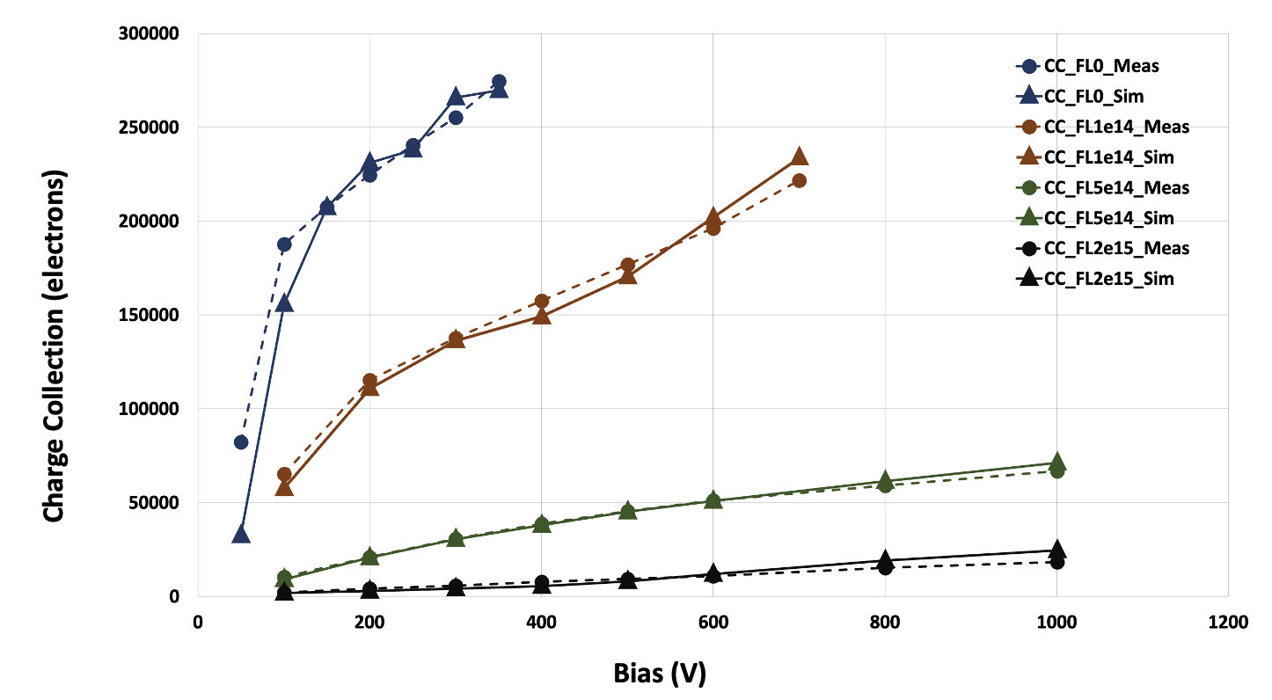
TCAD Simulation: Design and Radiation Hardness
NEUTRON Damage model applied to LGAD (300 micron thick)
2-level bulk damage
Measurement data are taken from: G. Pellegrini et al., Technology developments and first measurements of Low Gain Avalanche Detectors for high energy physics applications. NIM A 765 (2014) 12-16.

Slide 9
TCAD Simulation: Status and Plans
Few (5) licenses of TCAD Silvaco
Manpower:
  4 faculty: Arun Kumar, Ashutosh Bhardwaj, Namrata, Kirti Ranjan,
  1 postdoc (Chakresh Jain)
  few PhD students
Contribute to radiation damage studies of the LGAD designs; Materials like SiC; CMOS designs etc.
Eager to participate in DRD3 - WG4 efforts

Slide 10
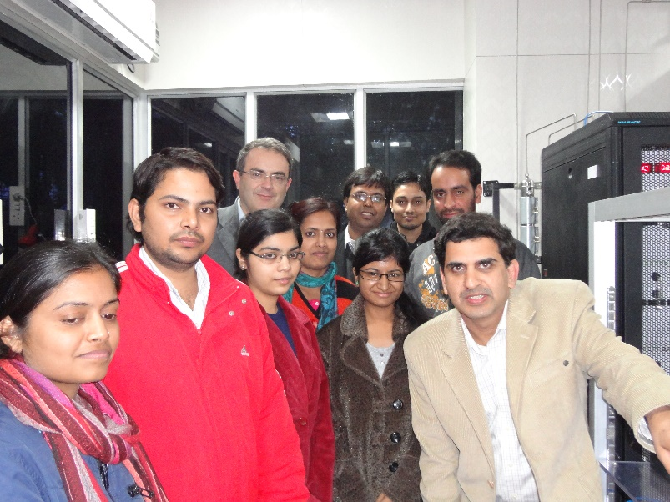
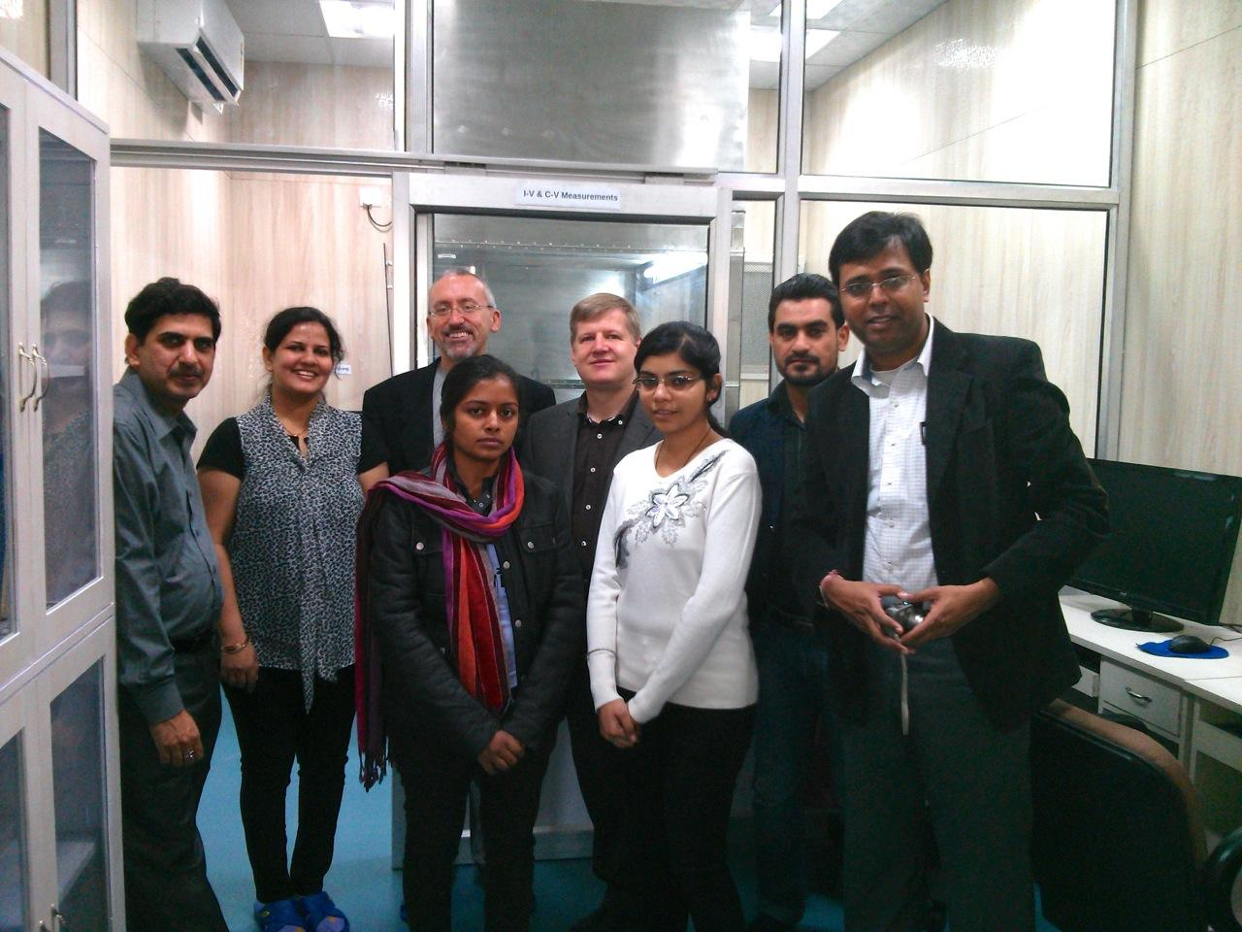
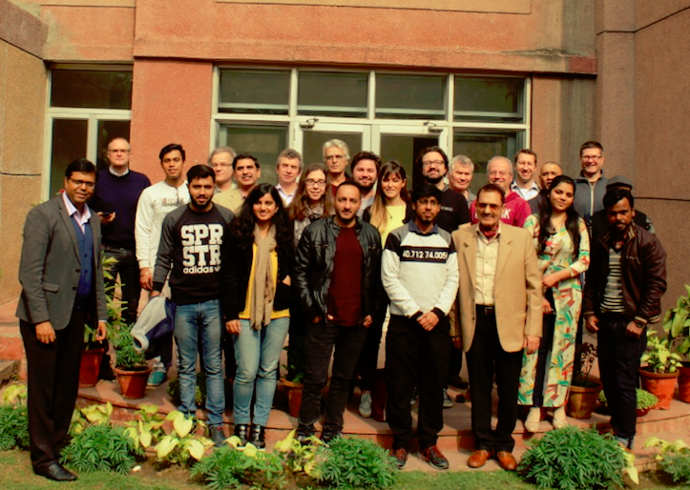
Thank you
3rd Sensor Quality Assurance Workshop, DU 22-24 Jan, 2019

