Slide 1
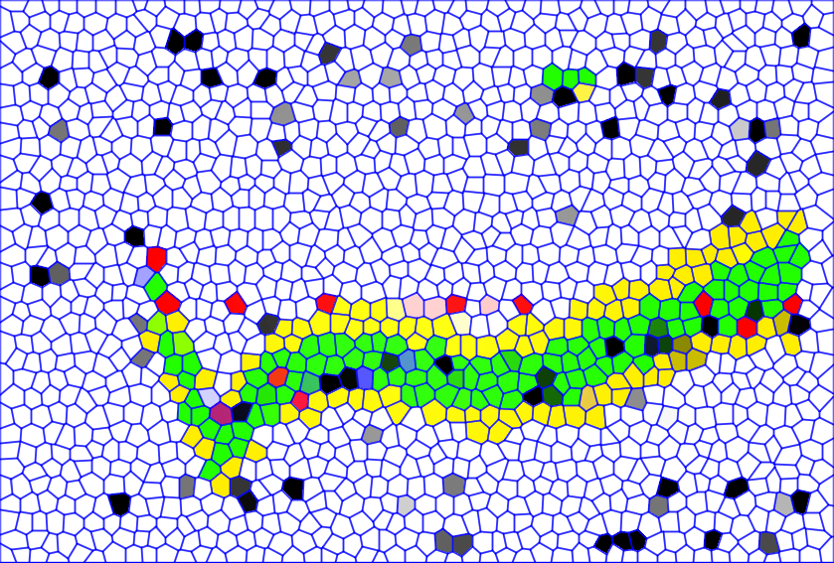
Search For The SM Higgs Boson
With the CMS Detector
Boris Mangano, UC San Diego

Slide 2
Outline
Introduction
Survey of all channels
  High Mass channels
  Both High and Low Mass (workhorse) channels
  Low Mass channels
Combination

Slide 3
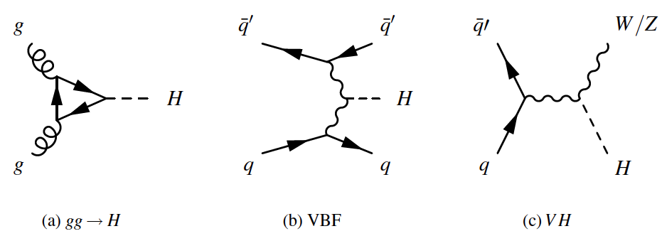
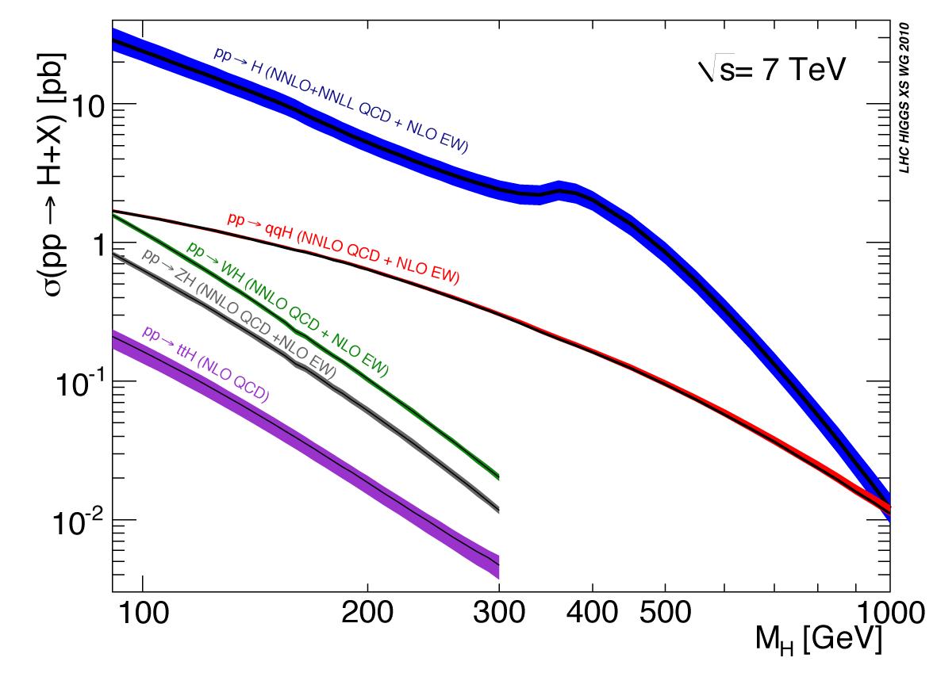
Portrait Of SM Higgs Production and Decay
σ•BR is in the 1fb-1pb ballpark

Slide 4
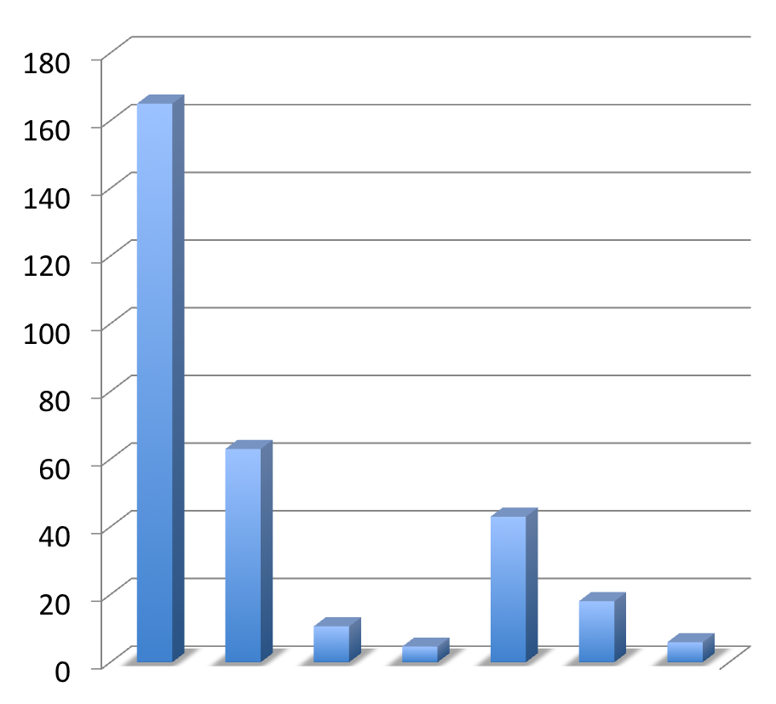
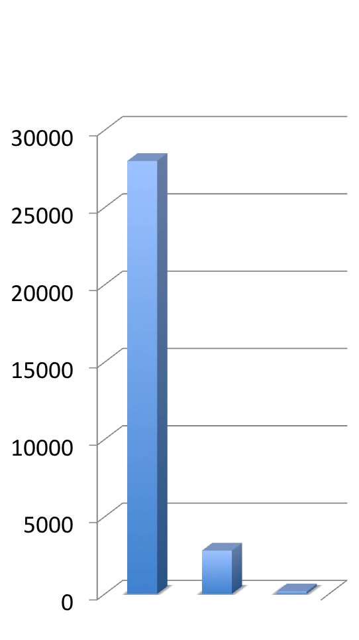
Cross-sections of SM processes
pp at 7 TeV
Strong CMS effort to measure these cross sections

Slide 5
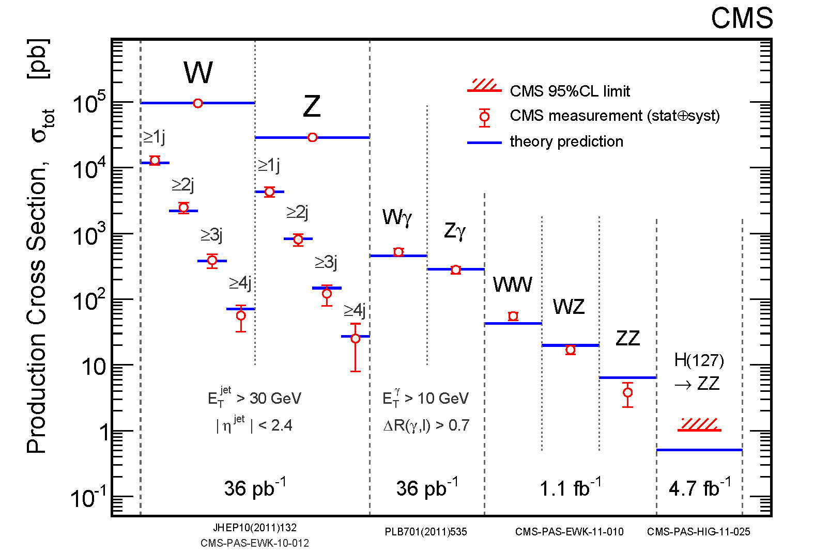
Some Key “Background” Measurements

Slide 6
Search Channels For SM Higgs Boson
Mode | Mass Range | Data Used (fb⁻¹) | Mass resolution | CMS Document
H → γγ | 110-150 | 4.8 | 1-3 % | arXiv:1202.1487
H → bb | 110-135 | 4.7 | 10 % | HIG-11-031 (PAS)
H → ττ | 110-145 | 4.6 | 20 % | HIG-11-029 (PAS)
H →WW →2l 2ν | 110-600 | 4.6 | 20% | arXiv:1202.1489
H → ZZ →4l | 110-600 | 4.7 | 1-2% | arXiv: 1202.1997
H → ZZ →2l2τ | 190-600 | 4.7 | 10-15% | HIG-11-028 (PAS)
H → ZZ →2l2j | 130-165/200-600 | 4.6 | 3% | arXiv: 1202.1416
H → ZZ →2l2ν | 250-600 | 4.6 | 7% | HIG-11-026 (PAS)
5 exclusive final states
9 exclusive final states
5 exclusive final states
5 exclusive final states
3 exclusive final states
8 exclusive final states
6 exclusive final states
2 exclusive final states
m_{H} (GeV)

Slide 7
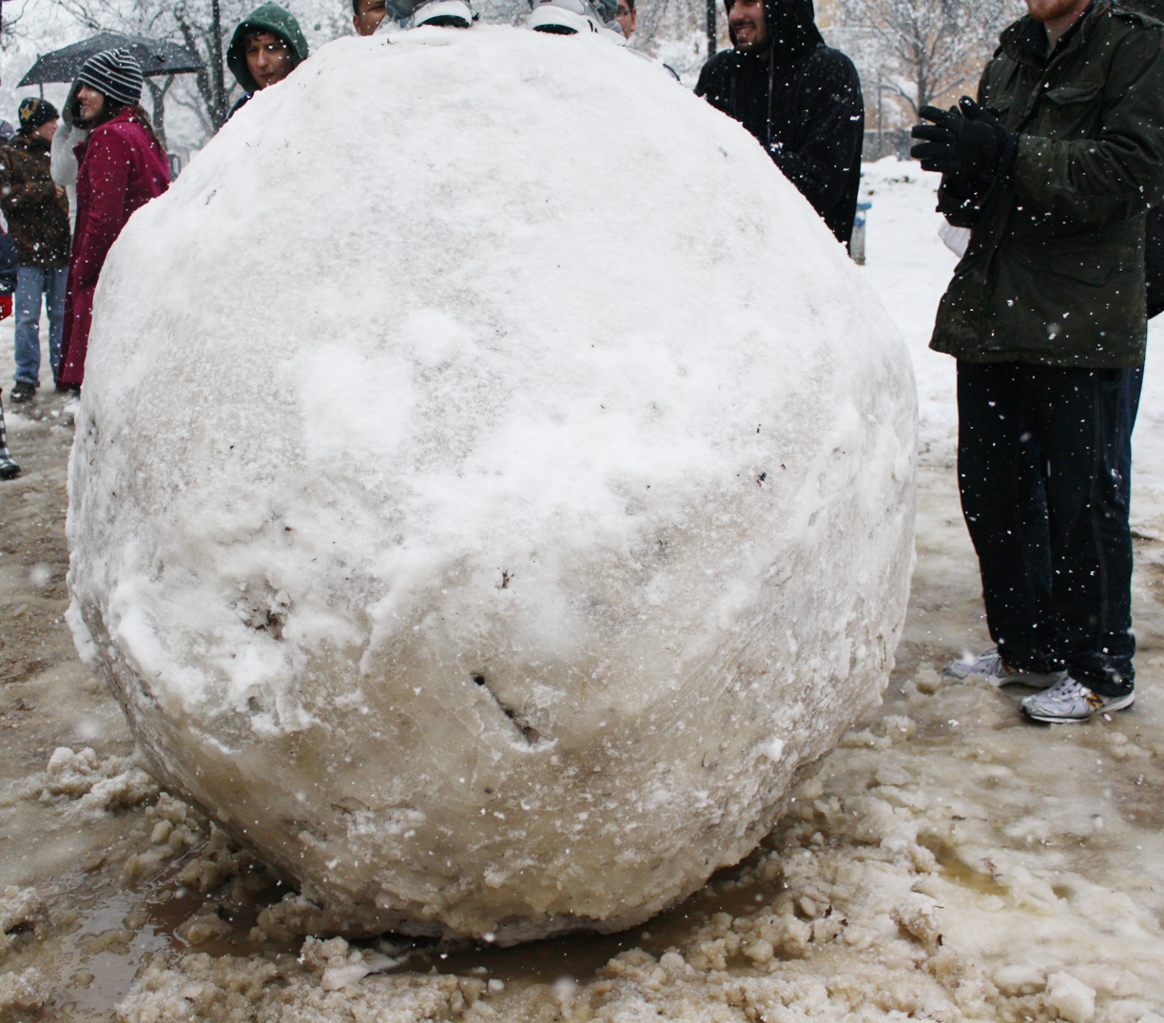
High Mass (m_{H}>200 GeV) channels

Slide 8
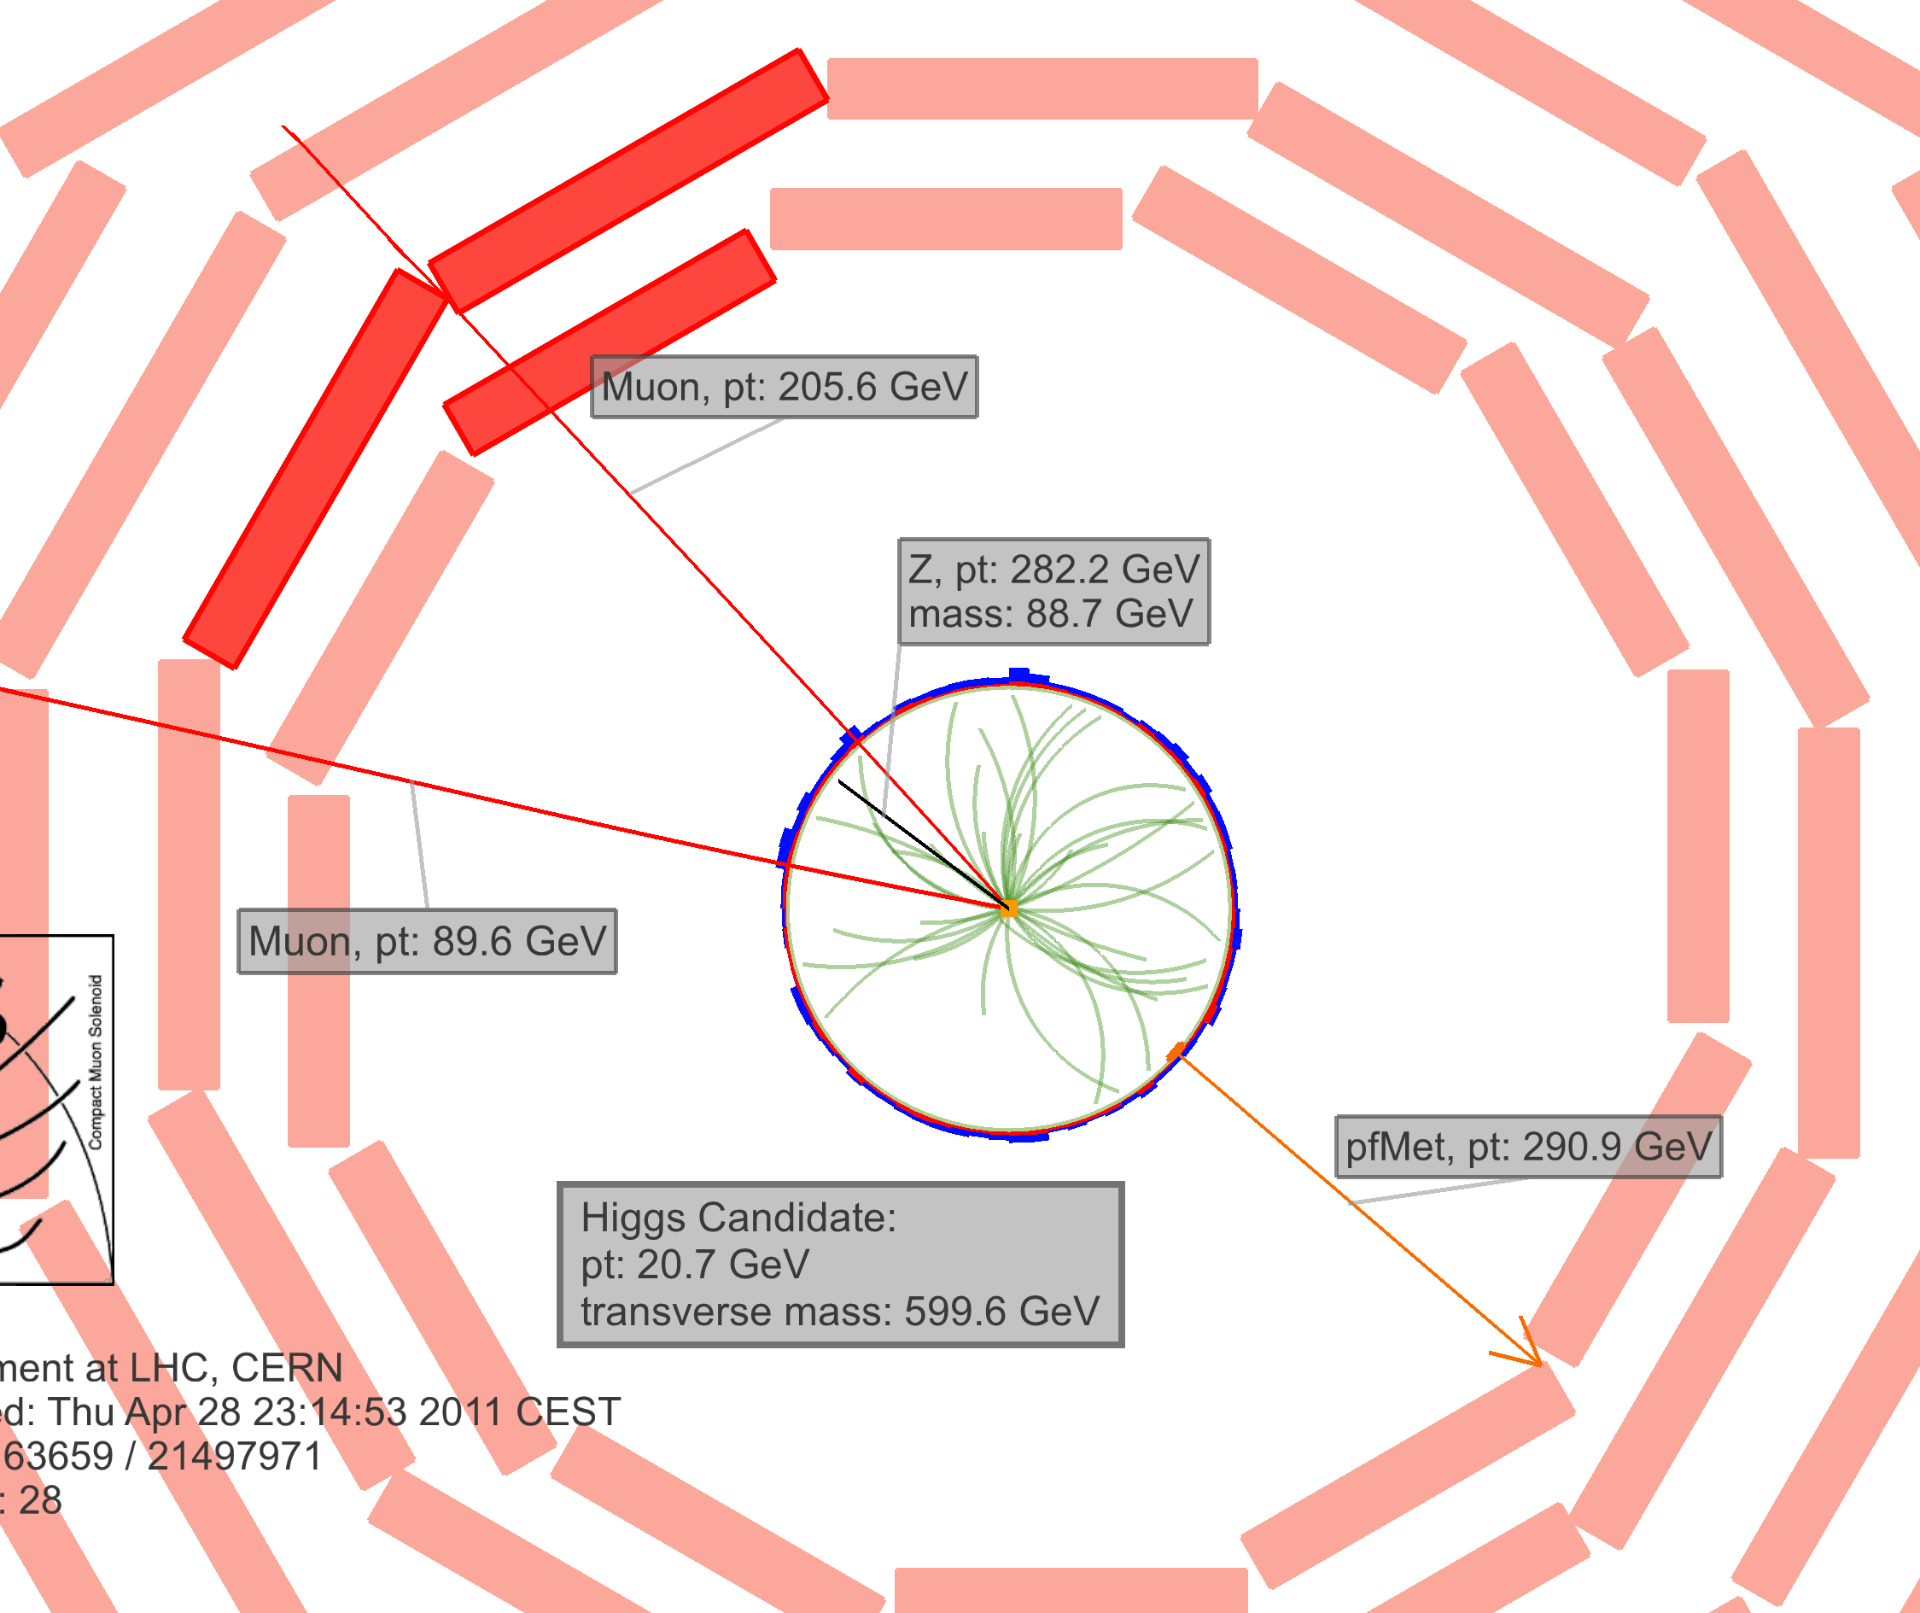
High Mass Higgs: H → ZZ → 2l 2ν
CMS PAS
HIG-11-026

Slide 9
High Mass Higgs: H → ZZ → 2l 2ν
Event Selection:
2 isolated leptons: Z(2e), Z(2μ)
small impact parameter
p_{T}(ll) > 55 GeV (large)
large MET, not aligned with jets or leptons
Final discriminant: M_{T} shape
Main backgrounds:
Z+jets ( S/B = 1/10⁵ ): from data (γ+jets)
tt, WW, Wjets: from data (off Z-peak)
ZZ, WZ: from MC

Slide 10
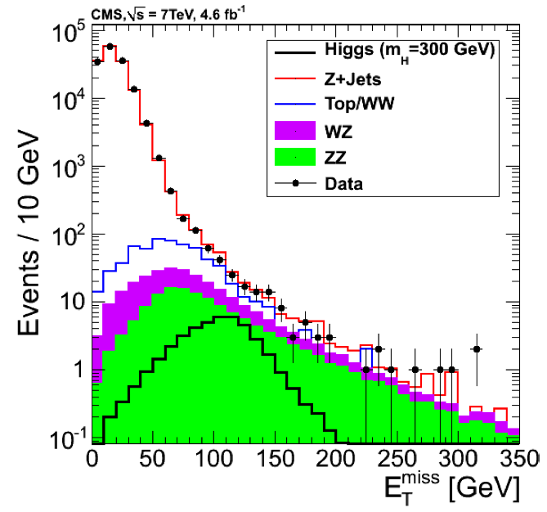
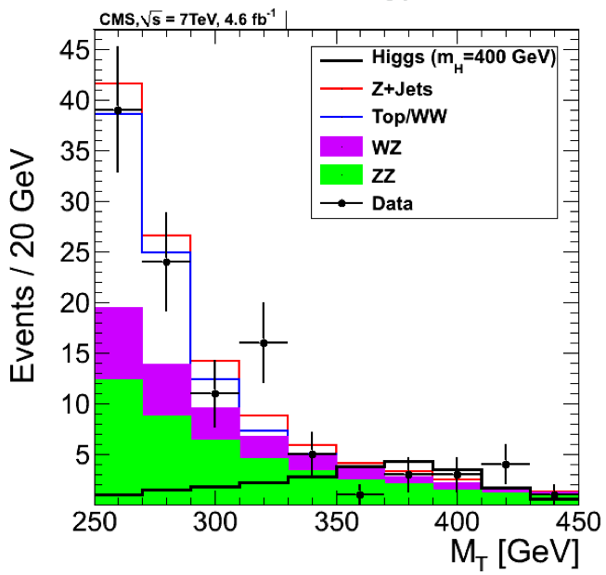
H → ZZ → 2l 2ν: Distributions
Data-driven prediction for Z+jets bkgd, using γ+jets events
Data-driven prediction for tt/WW bkgd, using m_{Z} sideband
After very tight MET cut

Slide 11
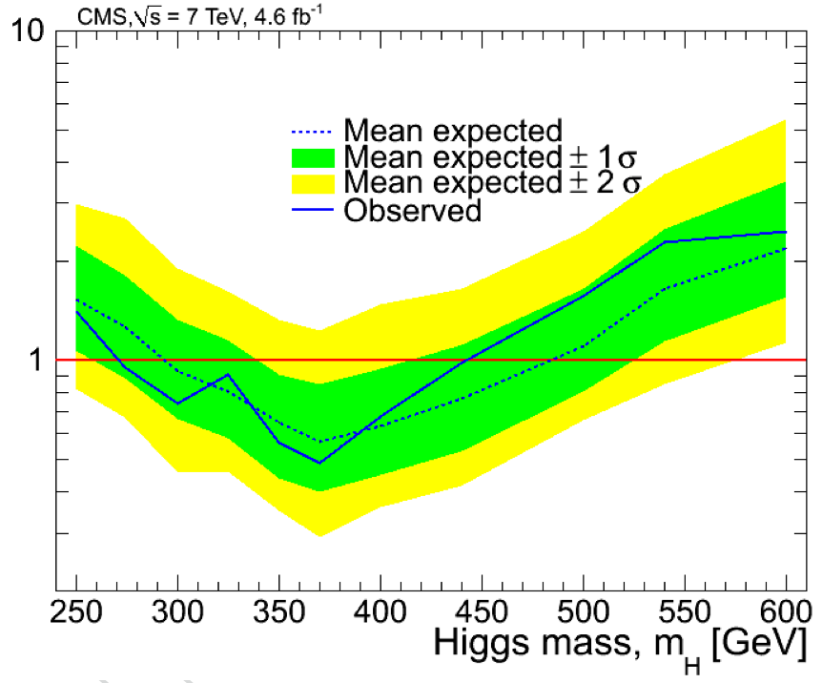
H → ZZ → 2l 2ν: Limits
Dominant Uncertainty:
non-resonant background (mostly TTbar)
it is statistically dominated
Expected limit: 290 < M_{H} < 490 GeV
Observed limit: 270 < M_{H} < 440 GeV

Slide 12
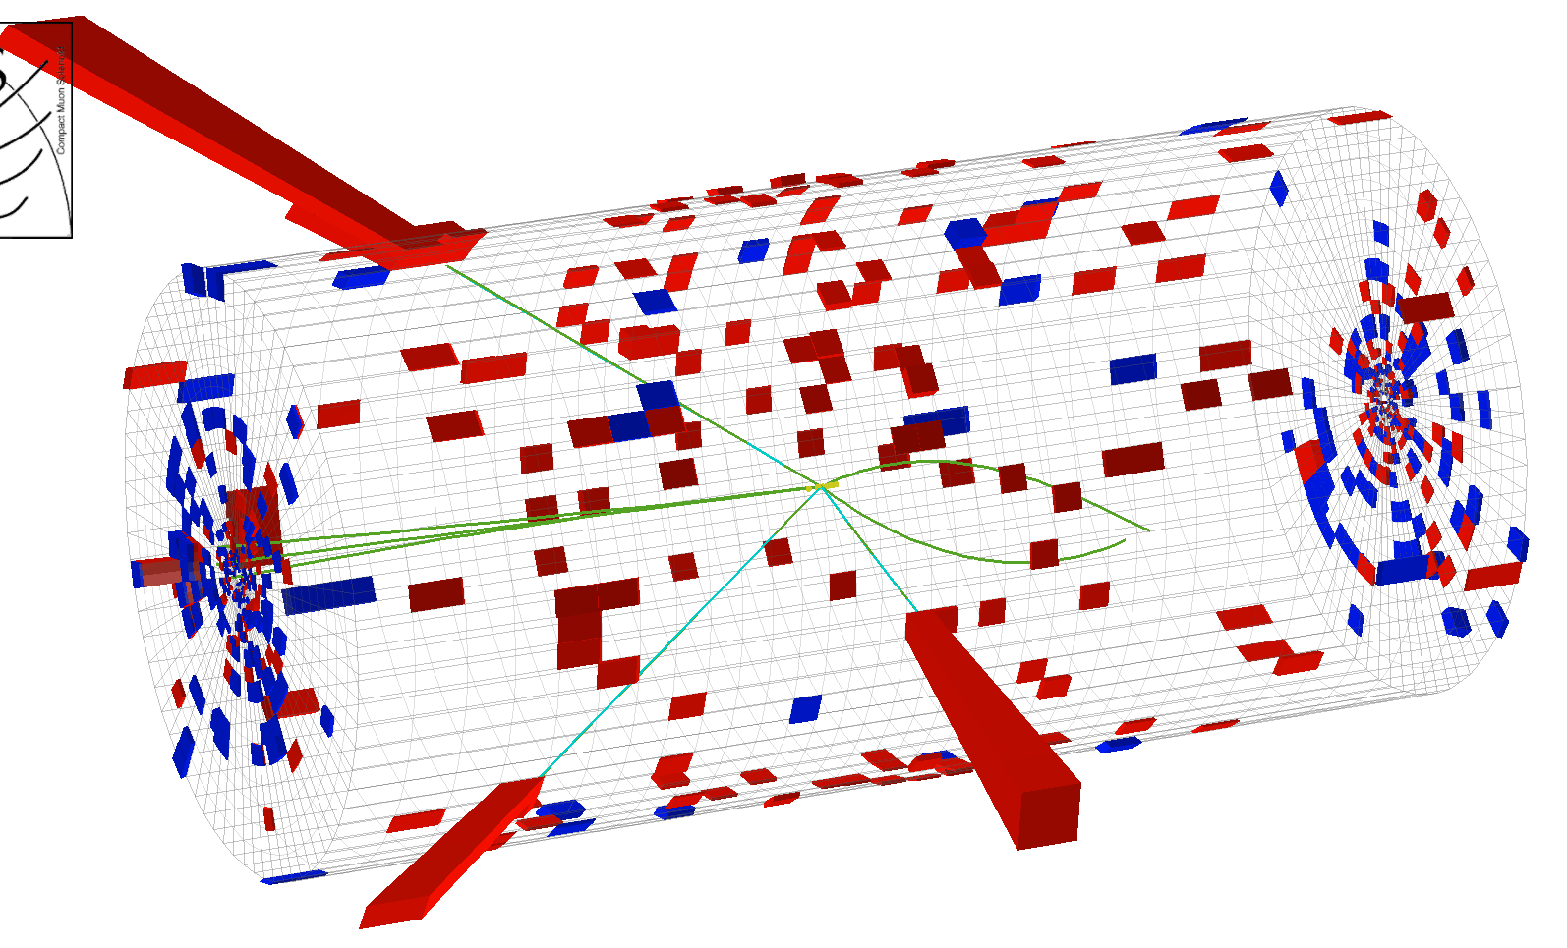
H → ZZ → 2l 2τ
e
H → ZZ→ eeeτ candidate
τ_{had}
e
e
CMS PAS
HIG-11-028

Slide 13
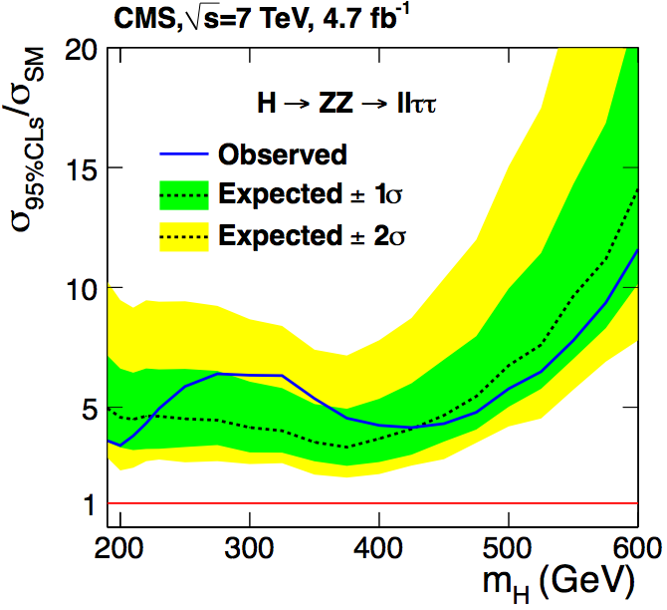
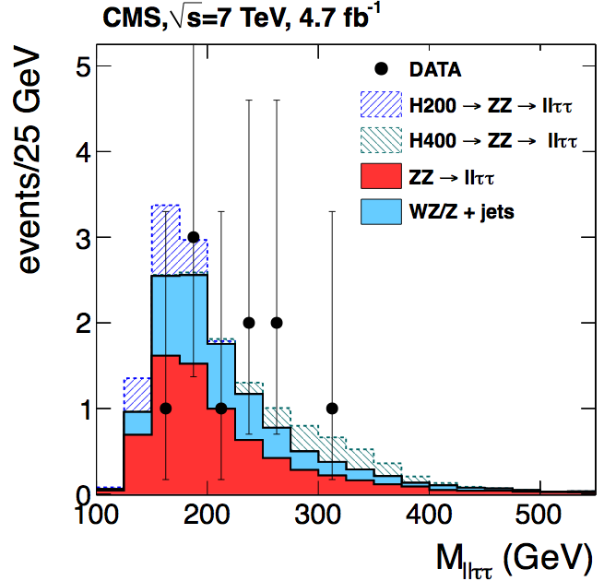
H → ZZ → 2l 2τ
e
H → ZZ→ eeeτ candidate
τ_{had}
e
e
H(200GeV)
A small drop in the Higgs bucket
Shape-based analysis
H(400GeV)

Slide 14
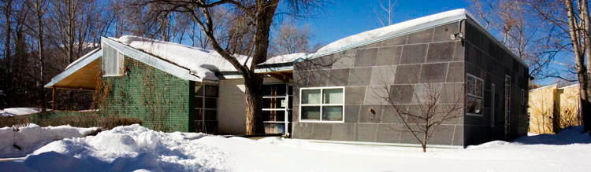
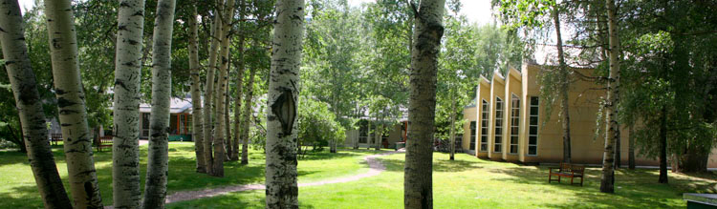
Channels for Both High and Low mass
(good for all seasons)

Slide 15
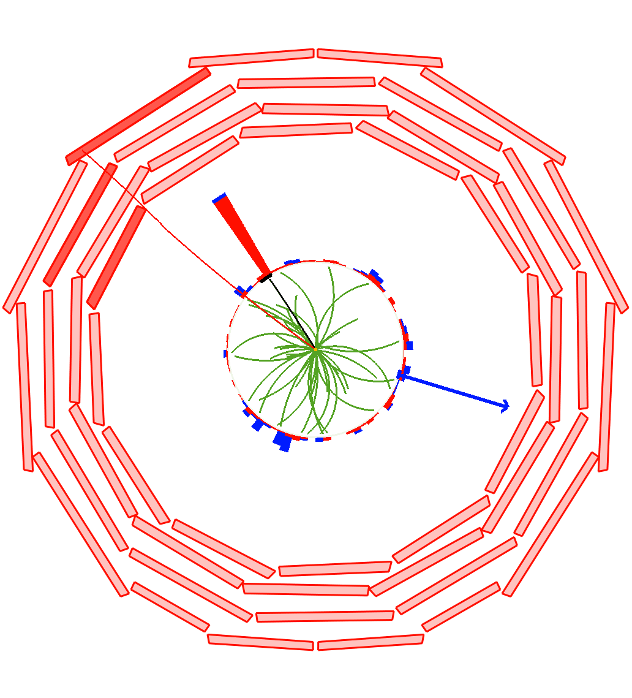
H→ WW → 2l 2ν
μ P_{T}
32 GeV
e P_{T}
34 GeV
ΔΦ
ME_{T}
47 GeV
arXiv 1202.1489
(submitted to Physics Letters B)

Slide 16
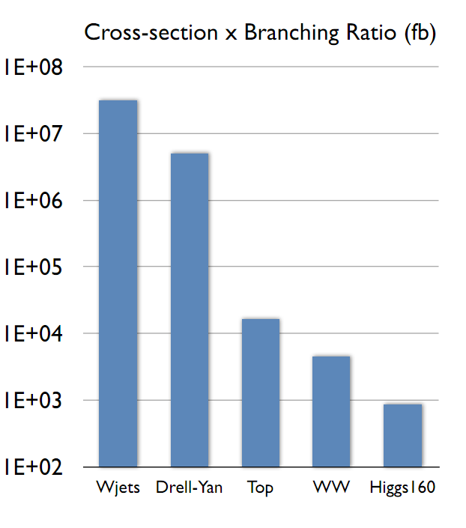
H→ WW → 2l 2ν
No signal mass peak (missing νν )
Challenge is to remove & control large backgrounds
Major requirements:
Lepton P_{t} > 15 GeV, tight ID & Isolation
  removes QCD & W+jets contamination
Large ME_{T} & Z → μμ, ee veto
  removes Drell-Yan contamination
Classification by # of jets (P_{T} > 30 GeV) & b-jet veto
  reduce Top contamination
Kinematic discriminants: M_{ll} & ΔΦ (l⁺l⁻)
  mitigate irreducible pp → ww background
μ P_{T}
32 GeV
e P_{T}
34 GeV
ΔΦ
ME_{T}
47 GeV
Signal characteristics:
  Only 2 opposite sign, isolated leptons
  significant ME_{T}
  No b-jets, no additional low P_{T} μ
  With additional 0, 1 or 2 jets (VBF)
  Small ΔΦ (l⁺l⁻) ← Higgs scalarity

Slide 17
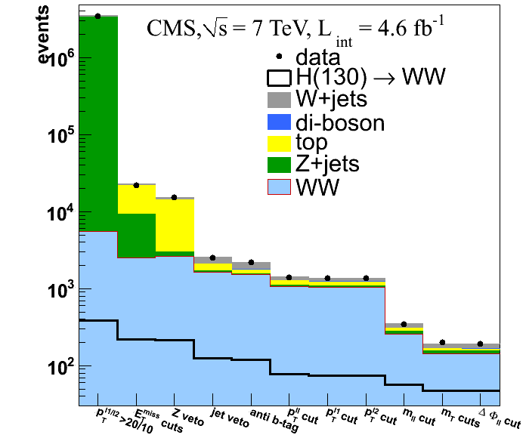
Cut Flow Evolution (0-jet Bin As an Example)
Predicted Vs Observed Yield Vs Cut
Higgs signal
~200 events
Higgs selection
WW selection
~40 H events
Data describes predicted background well

Slide 18
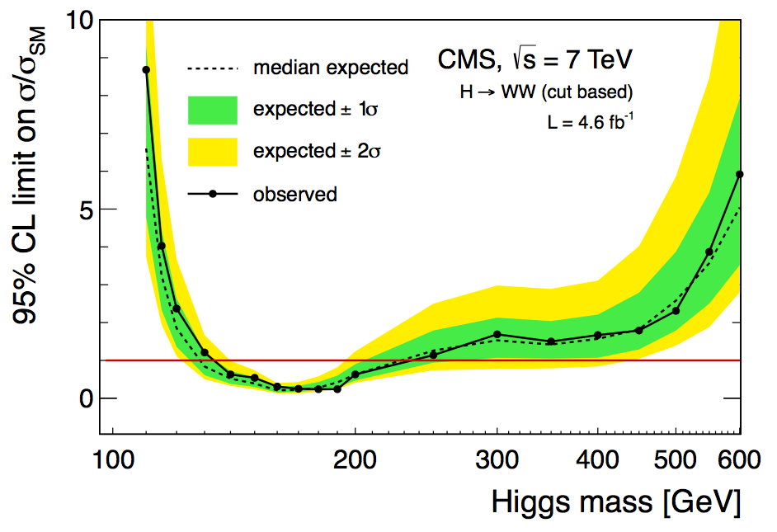
Limits From H→ WW → 2l 2ν: Cut Based
Expected 95% CL limit: 129 < M_{H} < 236 GeV
Observed 95% CL limit: 132< M_{H} < 238 GeV

Slide 19
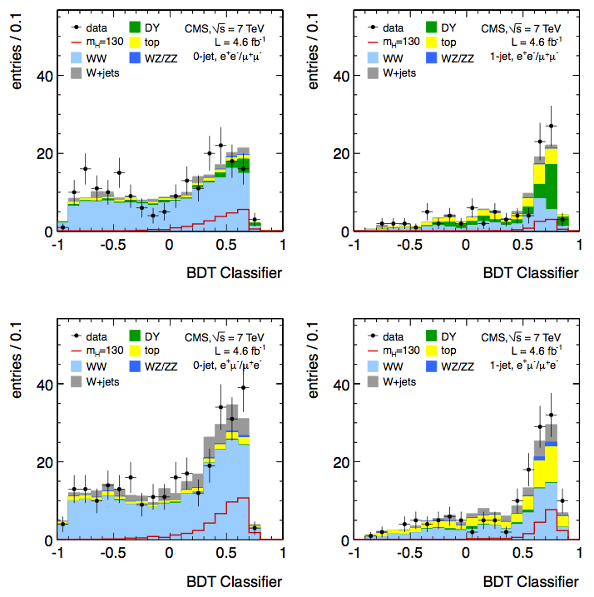
Multivariate (BDT) Classifier
0 jets
1 jet
same flavor
ee +μμ
opposite flavor
eμ
0 jets
1 jet

Slide 20
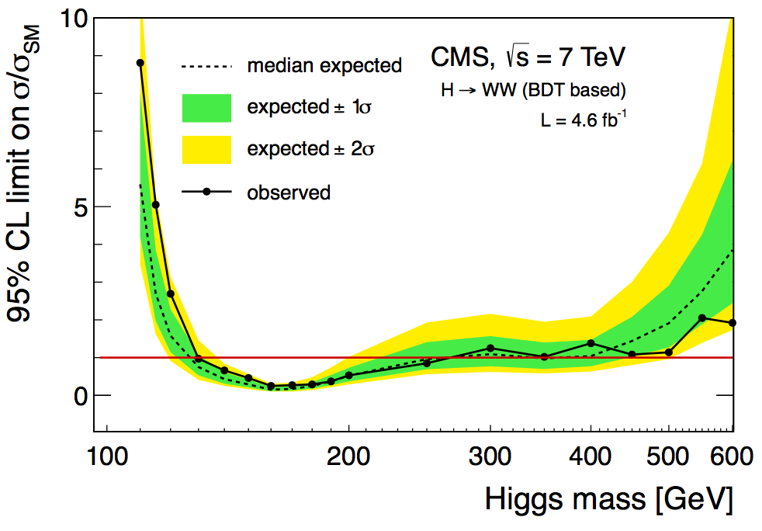
Limits From H→ WW → 2l 2ν: BDT Analysis
Dominant Uncertainties:
Theoretical uncertainty on signal.
Uncertainty on WW (stat.)
Uncertainty on Top (stat.)
Expected limit: 127 < M_{H} < 270 GeV
Observed limit: 129< M_{H} < 270 GeV

Slide 21
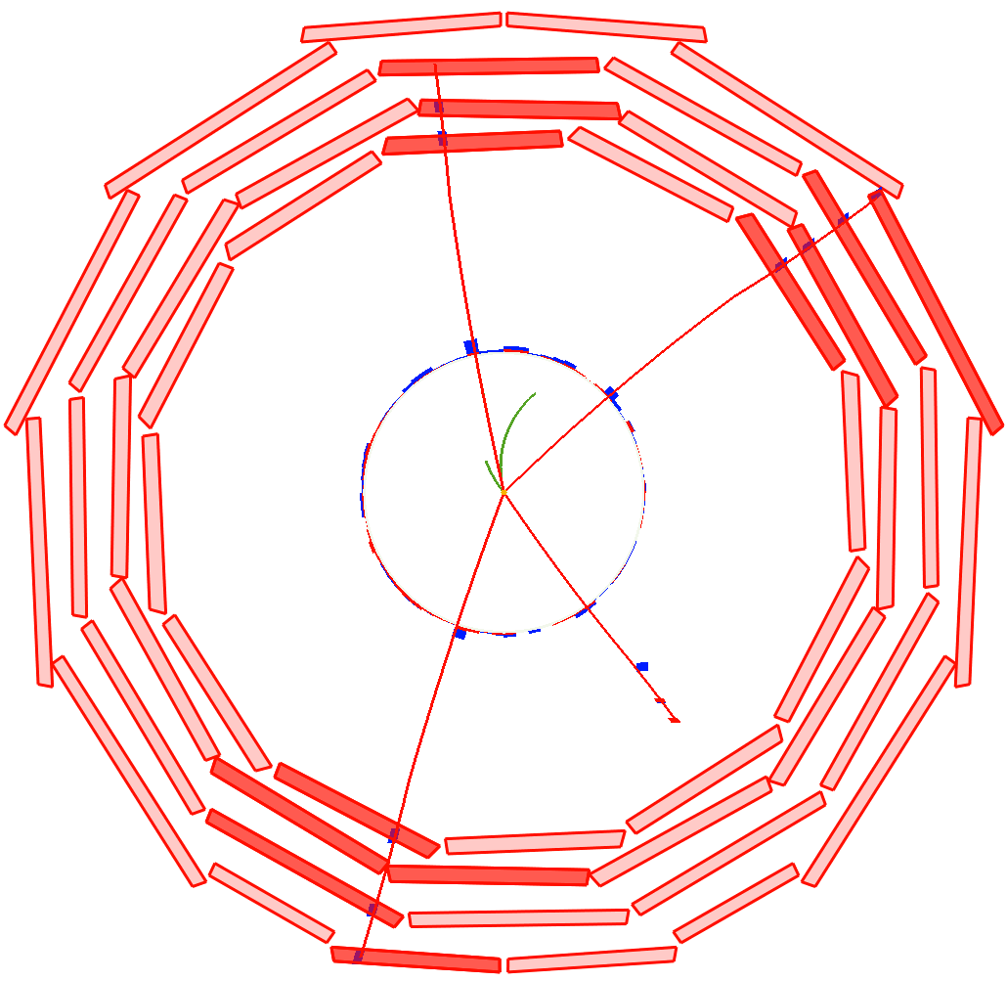
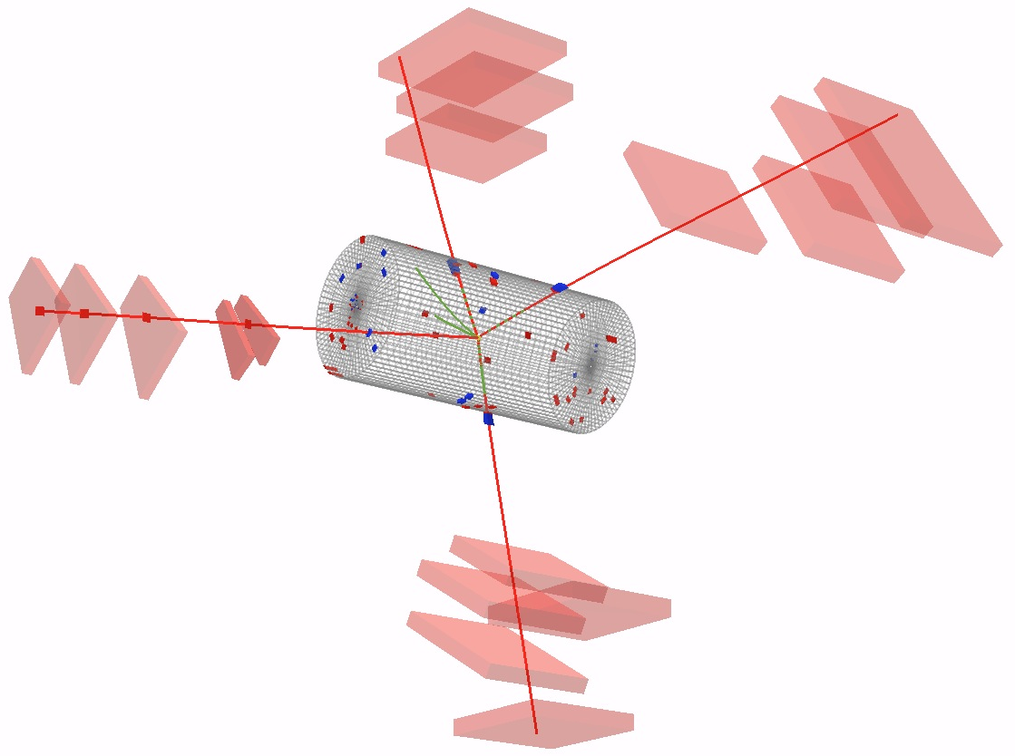
H → ZZ → 4e, 4μ or 2e 2μ
(The Golden Channels)
P_{T}
43 GeV
P_{T}
26 GeV
P_{T}
20 GeV
P_{T}
48 GeV
arXiv 1202.1997
(submitted to Physical Review Letters)

Slide 22
H → ZZ → 4e, 4μ or 2e 2μ
(The Golden Channel)
Signal: 4 isolated leptons from common vertex
Fully reconstructed mass with resolution ~ 1%
Reducible backgrounds:
  ttbar → 2l2υ2b ; Z+bb
  Removed by Isolation & Impact parameter requirements
Reducible background contribution measured from data
Irreducible background: pp → ZZ Continuum
ZZ Continuum:
  Shape and yield known at NLO, corrected for gg → ZZ →4l evaluated with MCFM
  Cross-check: event rate obtained from Z yield in data & theoretical prediction for ratio of ZZ to Z cross sections
P_{T}
43 GeV
P_{T}
26 GeV
P_{T}
20 GeV
P_{T}
48 GeV

Slide 23
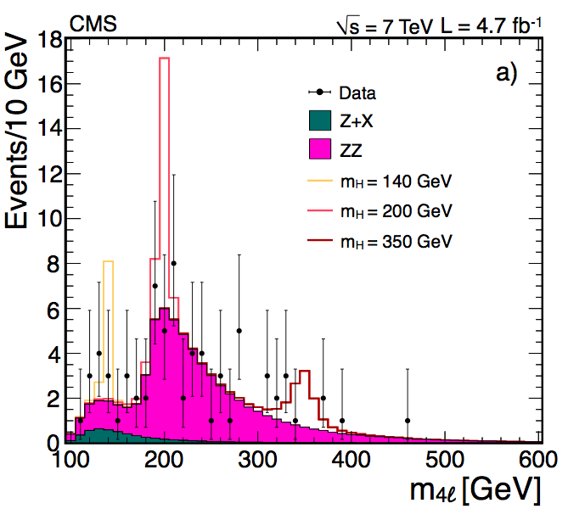
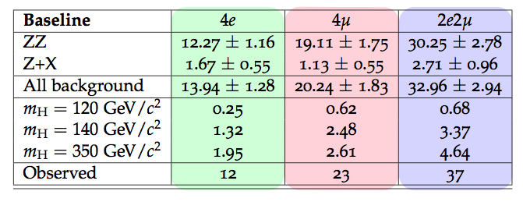
H → ZZ → 4l : Expected & Observed Yields
M4l > 100 GeV/c²
Observed events: 72
Expected events: 67.1 ± 6.0

Slide 24
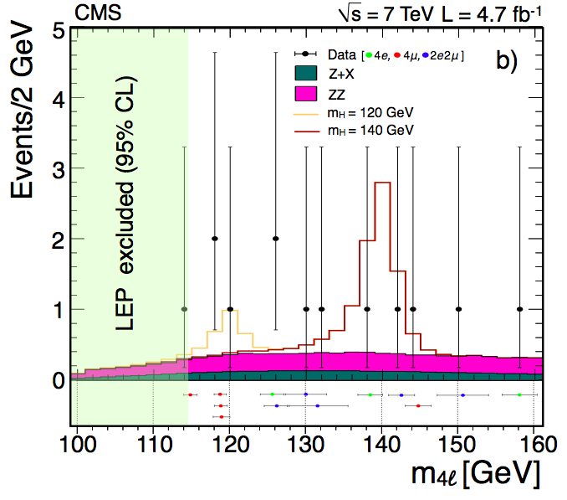
H → ZZ → 4l : Zoom Of Low Mass Range
100 < M4l < 160 GeV/c²
Obs. events: 13
Exp. events: 9.5 ± 1.3
Final state: 4e 4μ 2e2μ
Obs. events: 3 5 5
Exp. events: 1.7 3.3 4.5
Note:
unbinned events in the bottom panel
4e, 4μ, 2e2μ
Event-by-event mass error (bars)

Slide 25
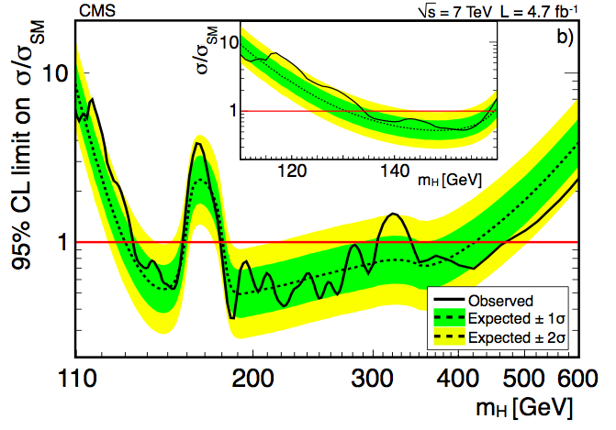
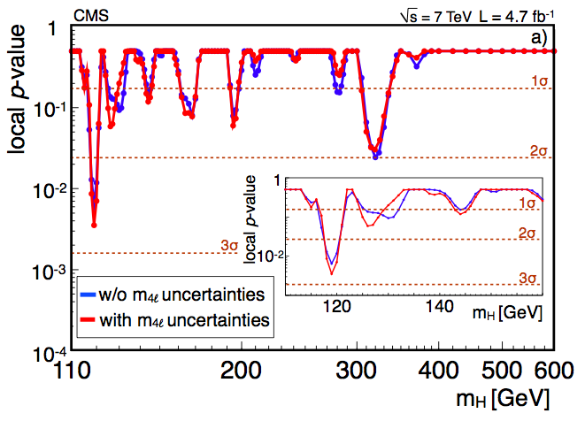
H → ZZ → 4l : Results
Observed limit:
Largest excess: 2.5σ at 119 GeV (1.6σ after LEE in 110-160 GeV)
Also, local p value = 1.5σ at 126 GeV and ~2σ at 320 GeV

Slide 26
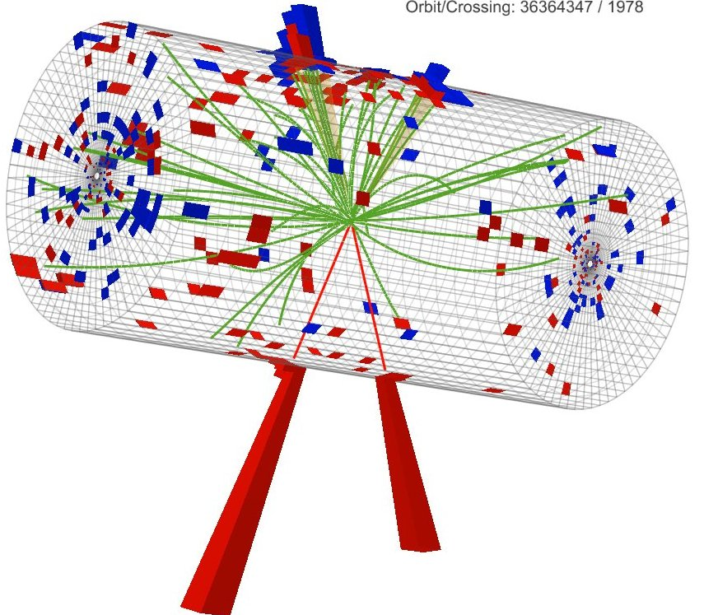
H → ZZ → 2l 2jets
Jet: 207 GeV
Jet: 114 GeV
e: 177 GeV
e: 114 GeV
arXiv 1202.1416
(submitted to JHEP)
M_{2l2j} = 580 GeV

Slide 27
H → ZZ → 2l 2jets
Selection:
2 isolated prompt leptons making Z→2e, Z→2μ
two jets: Z(jj) with 0, 1, 2 b-tags
most of sensitivity from 2 b-tag category
no MET
cut on angular topology (ME-based) for high mass search
Final discriminant: m_{lljj} mass distribution
Mass resolution: 3%
Main backgrounds from m_{jj} sidebands
  Z+jets ( including heavy flavor jets )
  WZ, ZZ
  ttbar, WW
Jet: 207 GeV
Jet: 114 GeV
e: 177 GeV
e: 114 GeV
M_{2l2j} = 580 GeV

Slide 28
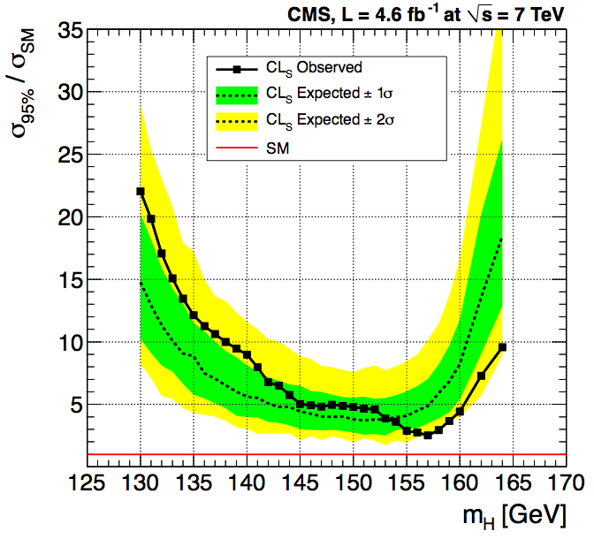
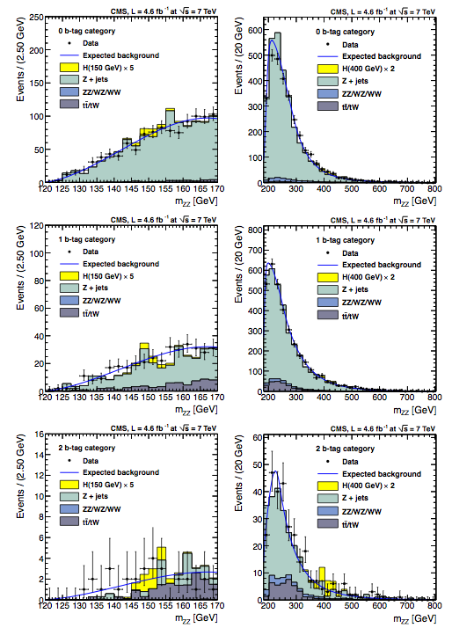
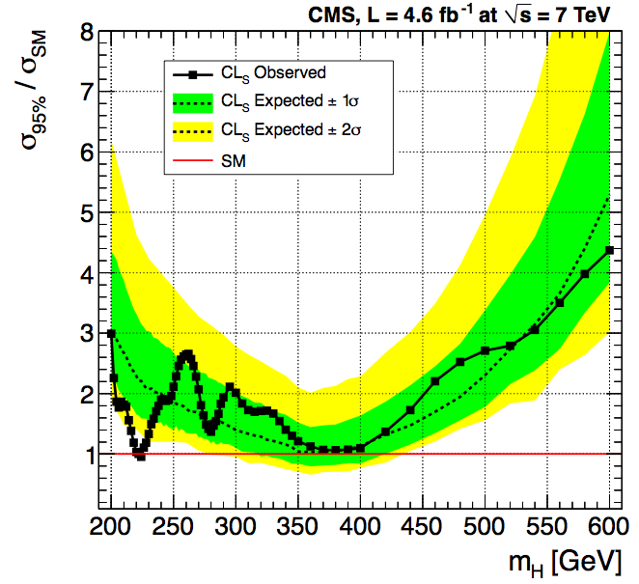
H → ZZ → 2l 2jets : Distributions & Limits
5xH(150 GeV)
2xH(400 GeV)
0 btag category
Low mass range
1 btag category
High mass range
2 btag category

Slide 29

Low Mass (m_{H}< 150 GeV) channels

Slide 30
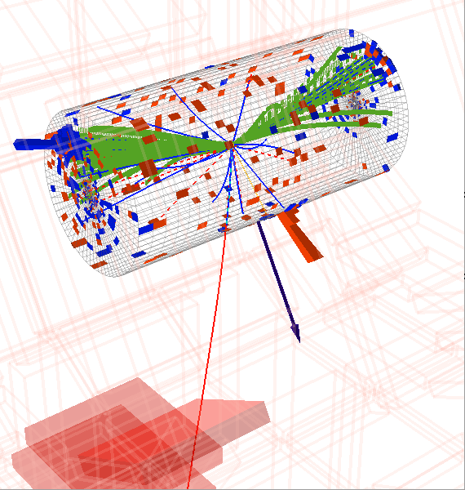
H→ τau τau
Jet₂ E_{T} =46 GeV
Jet₁ E_{T} = 177 GeV
→ π⁺π⁰ ν
τ P_{T}^{vis} = 70 GeV
μ P_{T} =20 GeV
Missing E_{T} = 97 GeV
_{Visible Mass(ττ) = 75 GeV}
_{Mass ( jj ) = 580 GeV}
_{Δη (jj) = 3.5}
CMS PAS
HIG-11-029

Slide 31
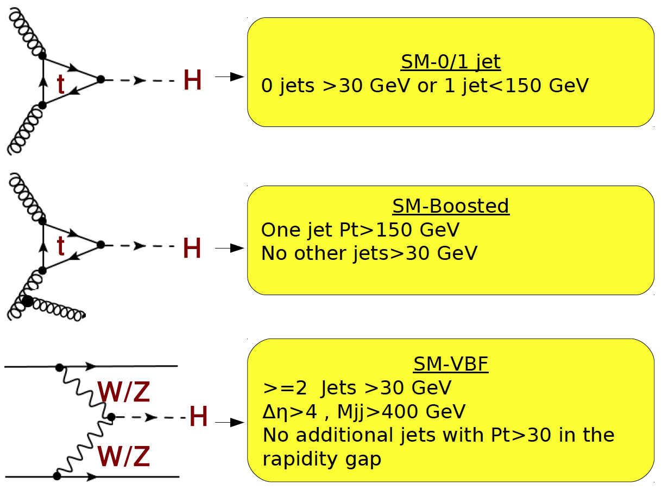
H→ τau τau
Jet₂ E_{T} =46 GeV
Jet₁ E_{T} = 177 GeV
→ π⁺π⁰ ν
increasing sensitivity
τ P_{T}^{vis} = 70 GeV
μ P_{T} =20 GeV
Missing E_{T} = 97 GeV
_{Visible Mass(ττ) = 75 GeV}
_{Mass ( jj ) = 580 GeV}
_{Δη (jj) = 3.5}
ττ selection: μ+τ_{had} , μ+τ_{had ,} μ+e
Main background Z→ ττ, estimated with tau embedding technique
VBF mode is the cleanest and most sensitive

Slide 32
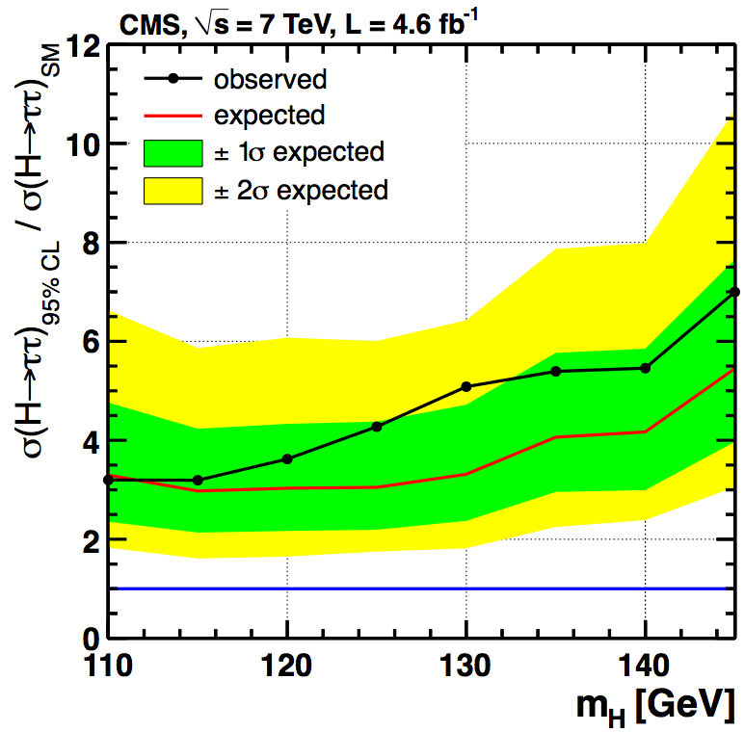
H→ ττ : Limits Becoming Interesting
Final discriminator is tau-pair invariant mass
Maximum likelihood technique used to improve mass resolution: from 24% to 21%
At M_{H}=125 GeV : Expected= 3.1xσ_{SM}, Observed = 4.3xσ_{SM}

Slide 33
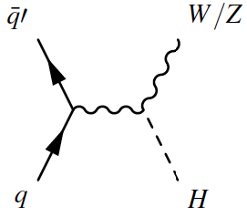
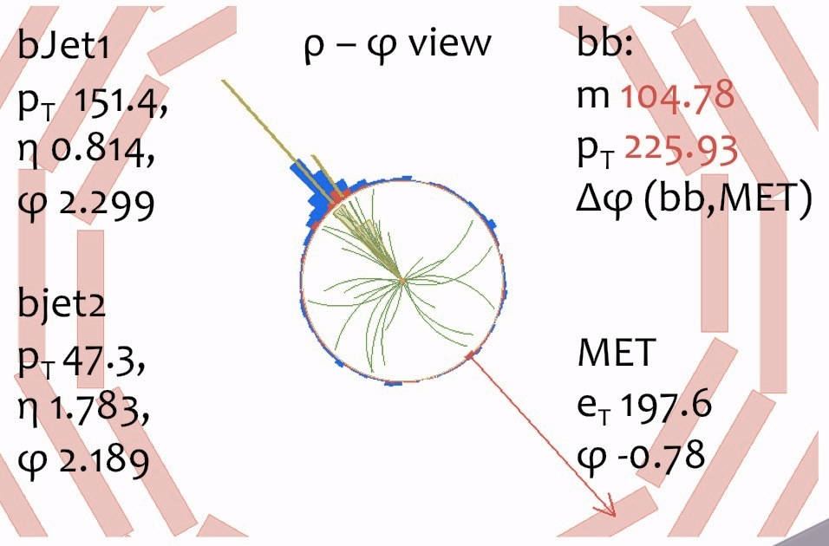
H→ b b
CMS PAS
HIG-11-031

Slide 34
W/Z H→ b b
Selection:
  5 channels: W→lν, Z→ll, Z→νν
  high MET quality for W→lν and Z→νν
  two jets with tight b-tags
  V+H(bb) topology: back-to-back
  p_{T}(bb)> 100-160 GeV (but not super boosted)
  Final discriminant is BDT output shape
bb mass resolution: 10%
(aided by the boost of bbbar system)
Main backgrounds:
  Vbb: from data (invert p_{T}(bb) boost)
  V+jets: from data (invert b-tag)
  tt: from data (require extra jet, enfore b-tag)
  W+Z(bb) and Z+Z(bb): from MC
  QCD background for Z(→νν)Η from data using ABCD method

Slide 35
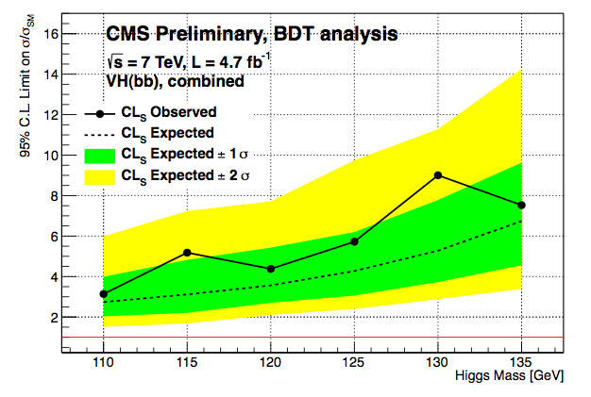
H→ b b
BDT cut&count analysis for m_{H}=125 GeV
Sensitivity ≈ 4.3 ✕ σ_{SM}
Observed ≈ 5.7 ✕ σ_{SM}

Slide 36
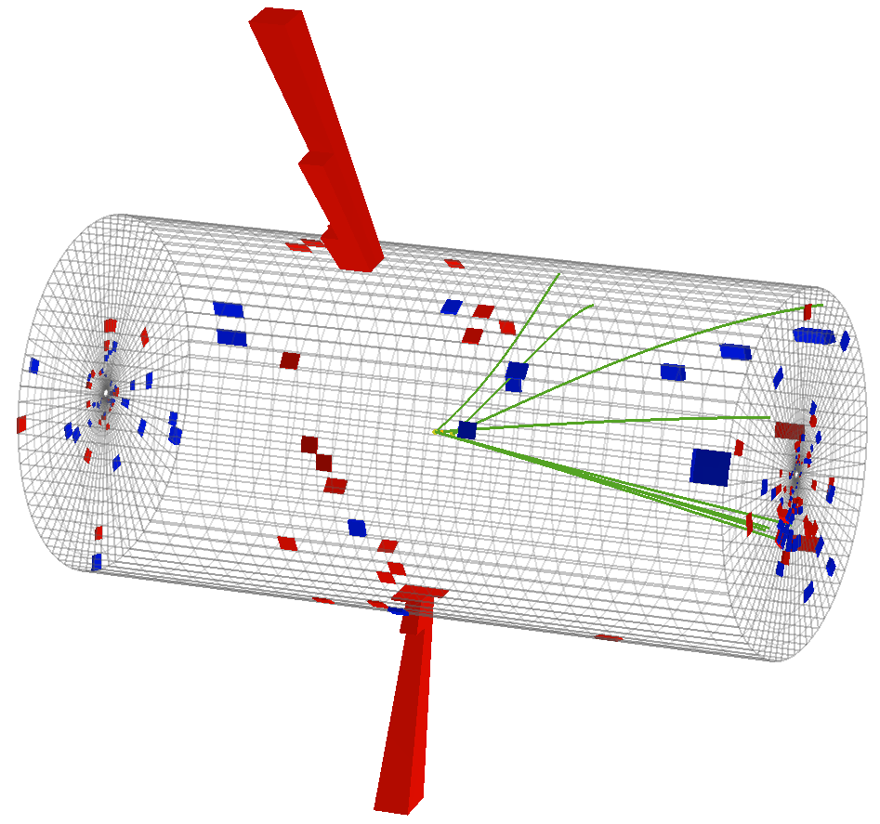
H→ γγ
γ₁= 86 GeV
γ₂=56 GeV
arXiv 1202.1487
(submitted to Physics Letters B)

Slide 37
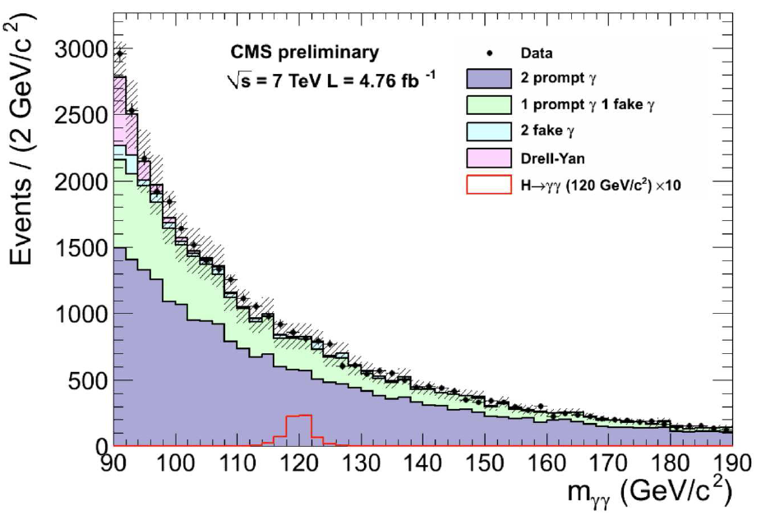
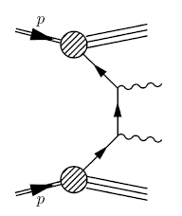
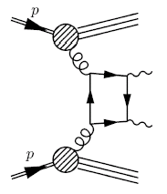
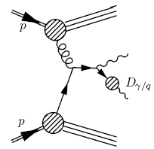
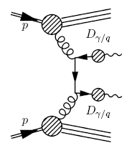
H→ γγ
γ₁= 86 GeV
Non prompt γγ ≈ 30%
γ₂=56 GeV
Signature: 2 energetic,
isolated γ, narrow mass peak
Background: Large & partly irreducible QCD. Measured from M_{γγ} sidebands in data
Data divided in 4+1 categories depending on γγ mass resolution and production mechanism
Background shape fitted by a 5th order polynomial constrained to be positive
  Several other forms also tried
Signal shape : Sum of 3 Gaussians, parameters determined from Z → ee data

Slide 38
H →γγ Event Vertex Determination
~10

Slide 39
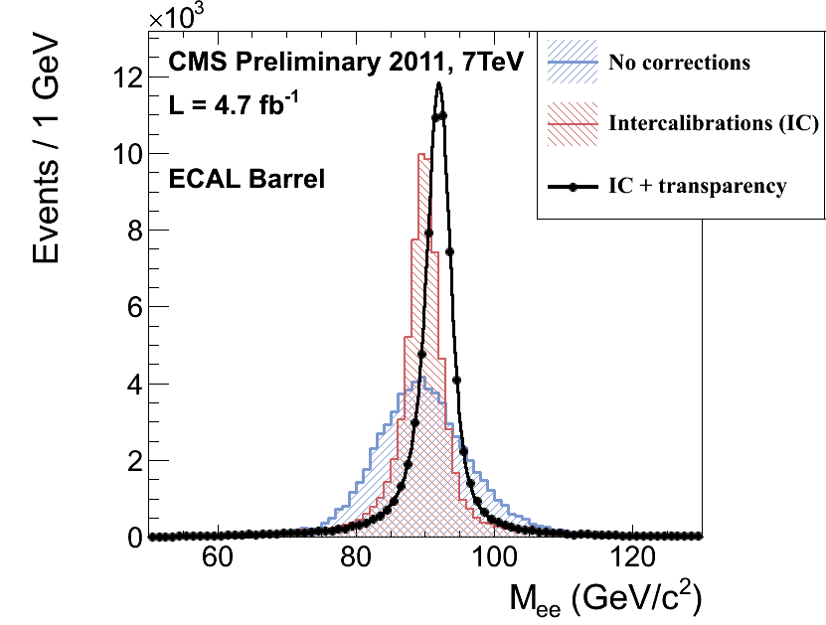
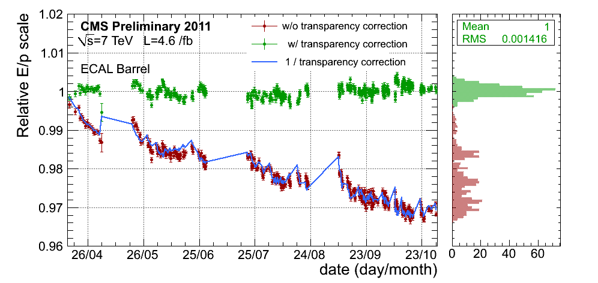
Photon Energy Scale & Resolution
Energy resolution studied with Z →ee, W →eν , πº inter-calibrations and laser signals for transparency corrections
Resolution in data improves typically by 10% in barrel ( |η|<1, R9>0.94 ) w.r.t LP’11 data
Instrumental resolution in the best Barrel category = 0.99 ±0.01 GeV
Energy scale for W→eν and Z→ee stable throughout 2011 at the level of 0.2% in barrel and 0.7% in endcap

Slide 40
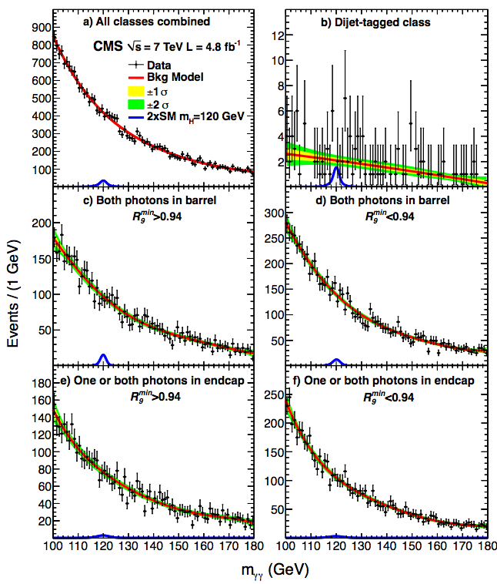
H→ γγ Search Categories
Both photons of high quality?
Both photons in barrel?
new VBF channel has better S/B than other 4 channels.
However, penalized by statistics.
1 | 1
Important:
M_{γγ} resolutions
S/B ratios
Categorization
helps with both
0 | 1
1 | 1
0 | 0
1 | 0

Slide 41
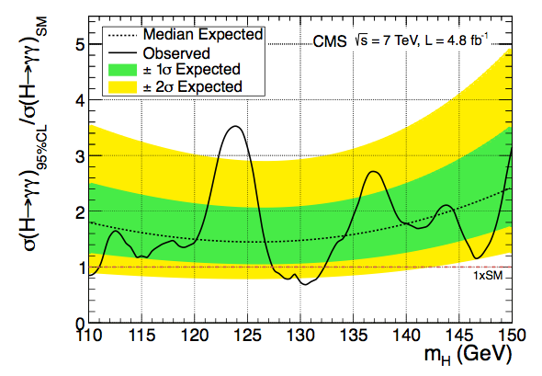
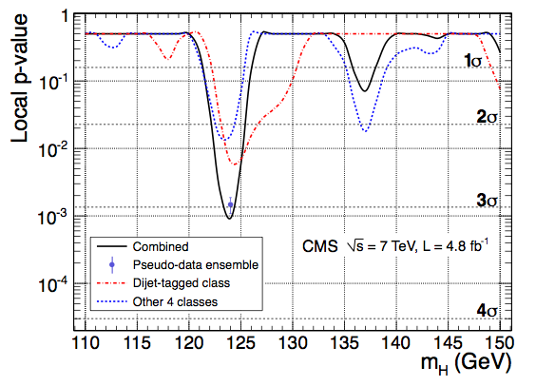
H→ γγ : Results
Expected exclusion limits between 1.4 and 2.4 times the SM cross-section in the mass range of interest.
Observed excess at ~124 GeV has a local significance of 3.1s .
Accounting of Look-Elsewhere-Effect (LEE) over the range 110-150, the excess is estimated to be 1.8s .
Signal Strength σ/σ_{SM}~ 2.1 at M_{γγ}=124 GeV

Slide 42

Combination Of CMS SM Higgs Searches
arXiv 1202.1488
(submitted to Physics Letters B)

Slide 43

Expected Sensitivity with 4.7 fb⁻¹
95% CL expected sensitivity: 117—543 GeV

Slide 44

Exclusion Limits on μ = σ/σ_{SM}
95% CL expected limits: 118—543 GeV
95% CL observed limits: 127—600 GeV

Slide 45

By High & Low Mass Resolution Channels
High mass resolution channels: γγ + 4l
Poor mass resolution channels: WW + ττ + bb
The two sets have nearly identical sensitivity
The γγ+4l group shows a localized excess >2σ around m_{H}=121-125 GeV
The WW+ττ+bb group shows a broad excess, reaching 2σ around 115-125 GeV

Slide 46

Quantifying The Low Mass Excess
Largest observed excess
Z_{max}=3.1 (p_{min}=0.1%) for m_{H}=124 GeV
After LEE in 110-600 (110-145), excess reduces to 1.5σ (2.1σ)
Observed excess at 124
not inconsistent (±1σ)
with SM Higgs

Slide 47

Observed Rate Of Excesses at M_{H}= 119.5, 124 GeV

Slide 48

Summary Of CMS 2011 Higgs Searches
?
SM HIGGS NOT HERE
NOT HERE
114.4
127
Remaining corridor of uncertainty

Slide 49
What 2012 LHC Run Will Tell Us
Expect ≈ 20 fb⁻¹ data in 2012
If SM Higgs exists, it will be discovered this year
Else it will be ruled out over the 114-600 GeV mass range

Slide 50
Summary Of CMS Higgs Boson Search
CMS has searched for SM Higgs in 8 distinct Higgs boson decay channels with up to 4.8 fb⁻¹ data
The Higgs search mass range spans 110-600 GeV
Expected 95% CL exclusion range, in absence of Higgs, is 117-543 GeV
Observed 95% CL exclusion range is: 127-600 GeV
An excess in the low mass range seen
More data are required to determine the source of this excess.
Hopefully the Hunt for the SM Higgs will come to a decisive end in this year...

Slide 51


Comparison between Atlas and CMS
CMS
ATLAS

Slide 52
Comparison between Atlas and CMS

Slide 53
Backup Slides

Slide 54

LHC And CMS Performance
>5 fb⁻¹delivered !
LHC target for 2011 was 1 fb⁻¹ per exp.
CMS
Max luminosity
L = 3.5 x 10³³ cm⁻² s⁻¹
Rapid increase in instantaneous luminosity: April (L=2x10³² cm⁻²s⁻¹) – October (3.5x10³³ cm⁻²s⁻¹)
1 day in October’11 = more data than 4 x (entire 2010 run)
The challenge of trigger budget & pileup successfully met

Slide 55
Backup Slides for HWW

Slide 56

Major Background: ttbar
Reduced by requiring b-Jet (Jet) Veto in |η| <2.5 (4.5)
^{μ-}
35 GeV
Jet
56 GeV
Jet
42 GeV
Simulation
^{μ+}
39 GeV
MET
88 GeV

Slide 57

Major Background: Drell-Yan
Drastically reduced by requiring MET in the event
^{μ-}
21.1 GeV
Simulation
MET
6.9 GeV
^{μ+}
22.7 GeV

Slide 58

pp → WW Is The Major Irreducible Background
too large ΔΦ_{ll}
too large ΔΦ_{ll}
Data

Slide 59






Distributions At WW Selection level
M_{T}
0-jet
1-jet
2-jet
Δϕ
0-jet
1-jet
2-jet
M_{ll}
0-jet
1-jet
2-jet

Slide 60

Event Yield Tally For Cut Based Analysis

Slide 61
Cross Check: Single Variable (M_{ll}) Shape Analysis
0-jet OF
0-jet SF
1-jet OF
1-jet SF
Result consistent
With BDT
Expected range: 126 < M_{H} < 230 GeV
Observed range: 132 < M_{H} < 238 GeV

Slide 62

H→ WW → 2l 2ν: What To Expect For M_{H}=124
Inject a SM like Higgs signal over predicted backgrounds
Bkgd + Signal @ M_{H}=124
2011 Data

Slide 63





H->WW->lvlv: Evolution of Search Limits
EPS’11
MVA-based analysis
2011 data set
MVA-based analysis
x
EPS’11
Cut-based analysis
LP’11
Cut-based analysis
2011 data set
Cut-based analysis

Slide 64
Backup Slides for HZZ

Slide 65


Along The Way: Observation of Z → 4l
CMS Preliminary
Di-lepton mass cut relaxed to 4 GeV
Standard Candle for H→ZZ→4l search:
direct calibration of M_{4l} scale
direct measurement of M_{4l} resolution
M_{4l}=91.3±0.6 GeV (stat)

Slide 66
Backup Slides for Hbb

Slide 67



H→ b b : Data Driven Way of Dealing With Bkgnd
Reducible backgrounds
QCD, V+udscg
ttbar and single top
Definition of Control Regions (CR) crucial element of the analysis
Define several CR enriched in different background components:
Control regions cuts as close as possible to the signal region
Example: Zee control region definition
Irreducible backgrounds
V+bb @ high p_{T}
ZZ(bb), W(lν)Z(bb)

Slide 68



Low Mass Higgs Search : H→ b b
Systematic errors are
a persistent challenge as
the integrated lumi increases
Signal ✕ 1
Signal ✕ 1
Signal ✕ 1
Signal ✕ 1
Signal ✕ 1

Slide 69

Backup Slides for H → tau tau

Slide 70
Backup Slides for Hγγ

Slide 71

Best-fit results

Slide 72



M_{γγ} Resolution In Four Catagories
1 | 1
0 | 0

Slide 73

H→ γγ : Systematic Uncertainties

Slide 74



H→γγ:Evolution Of Search Limits
EPS’11 LP’11 2011
2011 data with VBF channel

Slide 75
H →γγ : Studies of Background Model
The distribution of background events in M_{γγ} is assumed to behave as a continuous function. Since no prior knowledge is assumed of the specific form of this function we choose a parameterization which is demonstrably flexible enough to describe any reasonable form without introducing a bias. Studied several test functional forms all of which provide good fits to MC and data.
Choose some functional form as truth model (used here 2nd Order polynomial, double exponential, double power law and 4-term “partial Laurent series")
Fit chosen truth form to background MC scaled to 5fb⁻¹ and throw background only toys.
Fit test functional form + signal model and evaluate signal strength μ (in units of σ_{SM})
Bias defined as mean value of signal strength μ, should be 0 for background only toys

Slide 76
Backup Slides for Combination

Slide 77


Observed Exclusion Confidence Levels
95% CL observed limits: 127—600 GeV
99% CL observed limits: 128 —525 GeV

Slide 78

Expected & Observed Limit : Channel By Channel

Slide 79


Evolution Of CMS Higgs Combination in 2011
EPS’11
LP’11
2011 data
2011 data with VBF channel

