Slide 1
QCD Results from LHC
Vasundhara Chetluru (FNAL)
“Hard Scattering” Component
“Underlying Event”
Cartoon by Rick Feilds

Slide 2
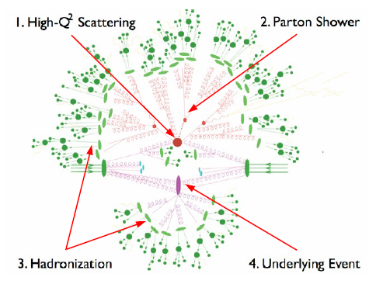
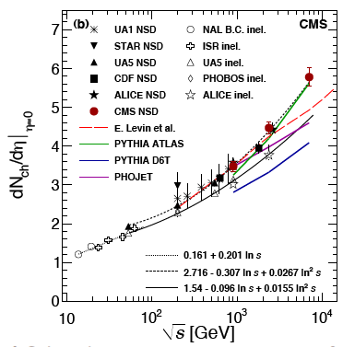
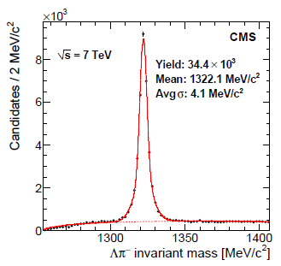
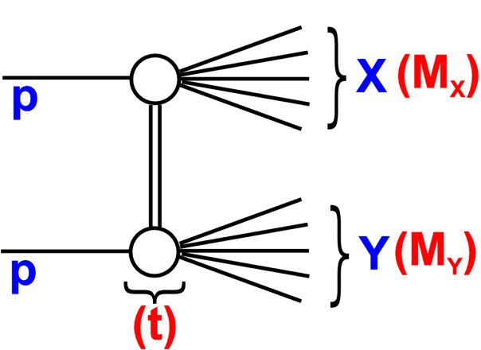
Soft physics
Particle multiplicities
Underlying event
Rapidity Gap cross sections
Strangeness production
Long range correlations

Slide 3
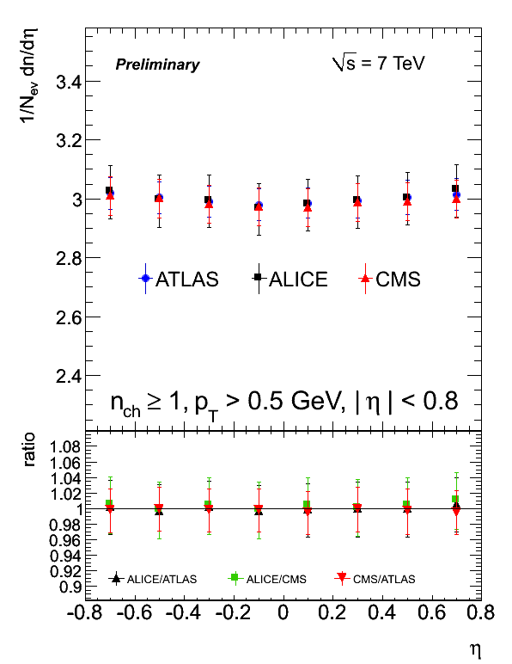
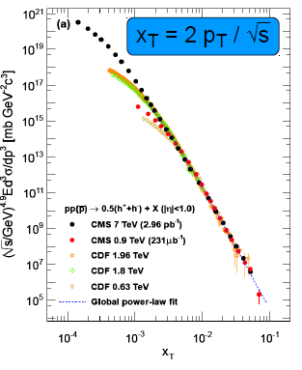
Charged particle distributions
Very high particle production at increasing energy
Simple x_{T} scaling allows to derive pt spectrum at 2.76TeV
  useful for Heavy Ion analysis.

Slide 4
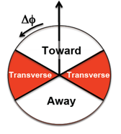
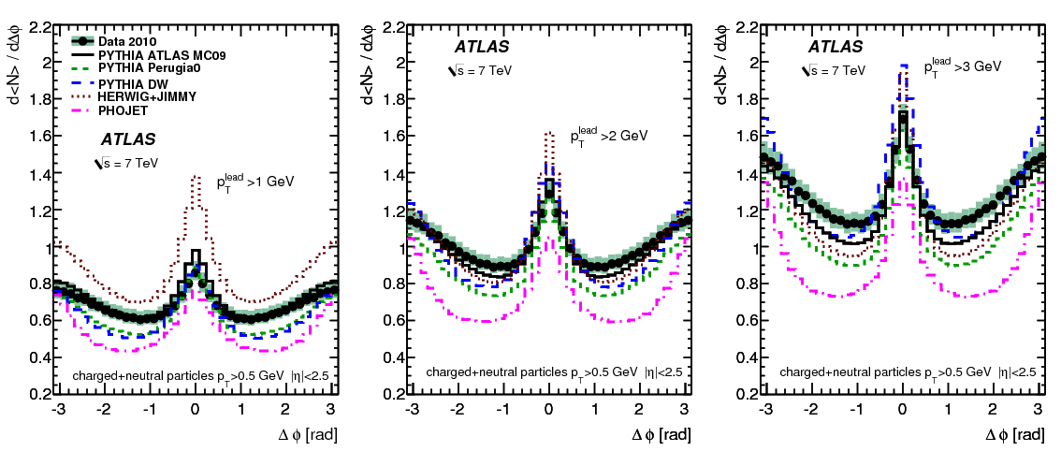
Underlying event
Leading cluster or track jet
Clusters of tracks, “track jet”, or the clusters of colorimeter cells with the largest p_{T} are called the leading object. These are expected to reflect the direction of the parton in the hard scattering.
Three topological directions defined are
  Towards , Away, Transverse
Transverse region is expected to be sensitive to underlying event

Slide 5
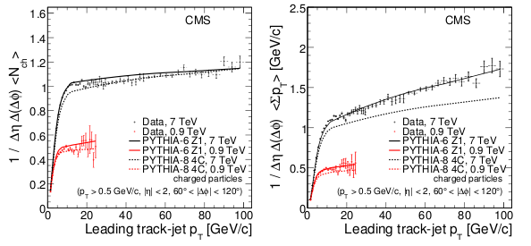
Underlying event
Fast rise for pT < 8 GeV/c (4 GeV/c), attributed mainly to the increase of MPI activity, followed by a Plateau-like region with ≈ constant average number of selected particles and a slow increase of ∑pT, in a saturation regime.
Increase of the activity with √s also corroborates MPIs.

Slide 6
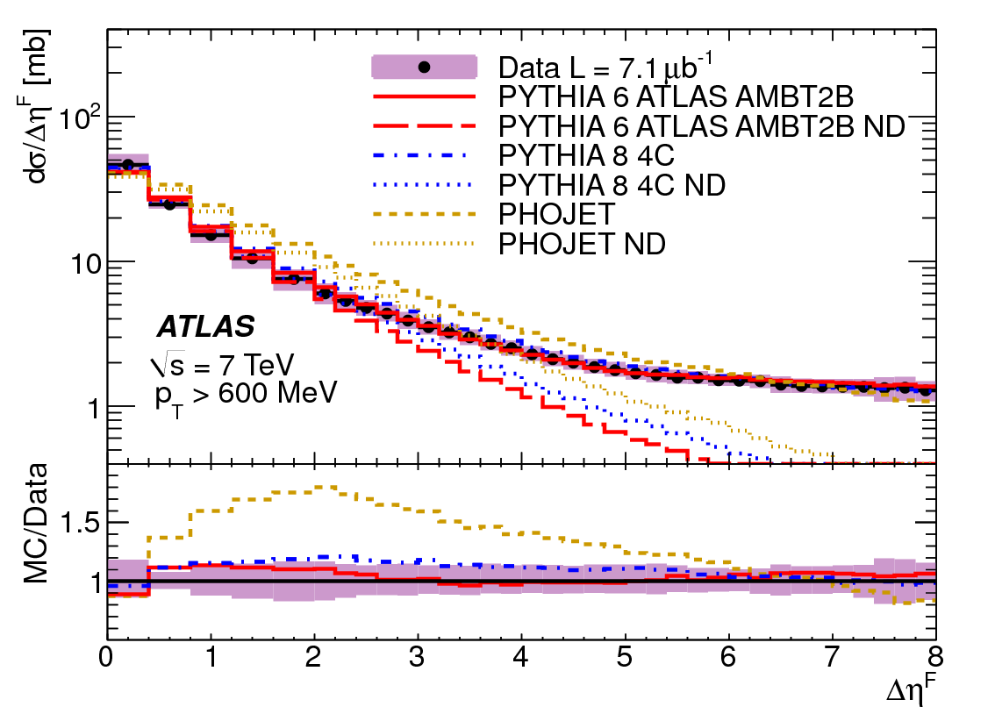
Rapidity Gap Cross Sections
Diffractive events have large rapidity gaps
The MC does not describe the data well
Inelastic cross section excluding diffractive processes obtained by integration of the differential cross section from gap sizes of zero to a variable maximum
arXiv:1201.2808
Δη^{F} the larger of the two ‘forward’ psuedorapidity regions extending to at least = ±4.9 in which no particles are produced with p_{T} > p^{cut}_{T} , where p^{cut}_{T} is varied between 200 MeV and 800 MeV

Slide 7
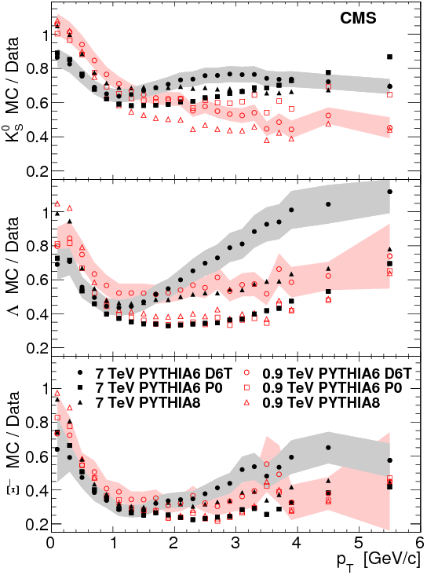
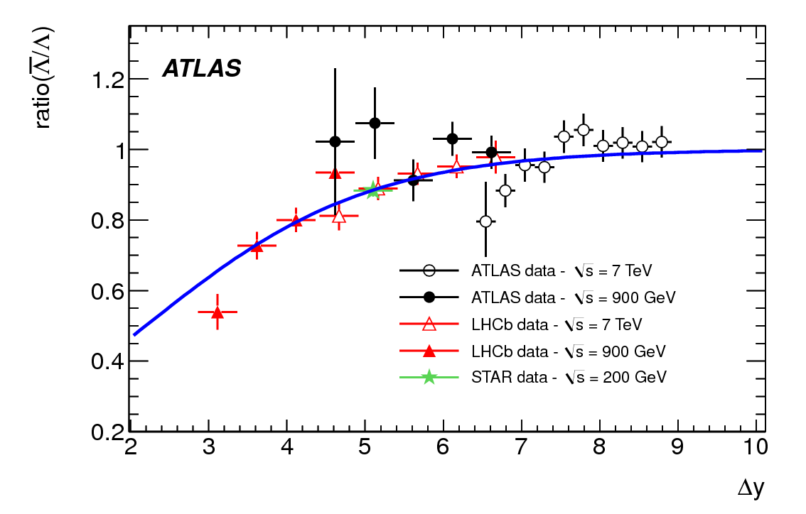
Strangeness production
Various tunes of PYTHIA show variations as a function of pT for various strange particle productions
The Lambda/Lambda-bar ratio is close to unity
  Agrees with Baryon Transport
Phys.Rev.D 85 (2012) 012001
JHEP 05 (2011) 064

Slide 8
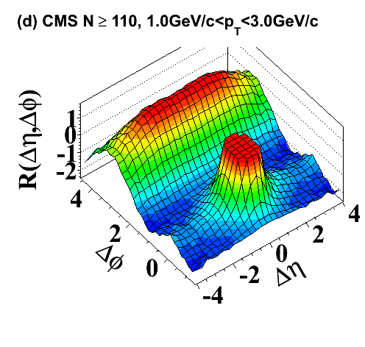
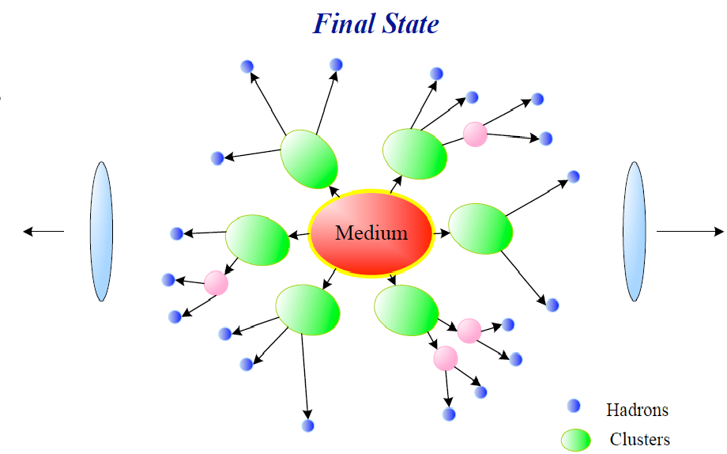



Long range particle correlations
Two particle angular correlation (R) is obtained using the charged tracks pT > 1.0 GeV/c
  Signal distribution (S) is obtained from the tracks with in the same event
  Background distribution (B) is obtained using the tracks from different events (mixing).
Near-side long range correlations observed

Slide 9
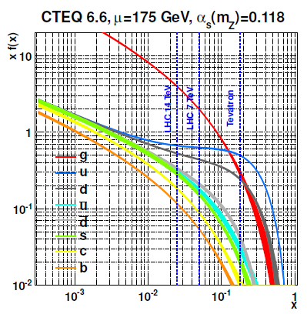
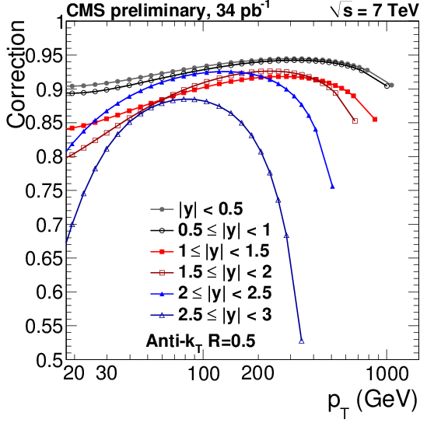
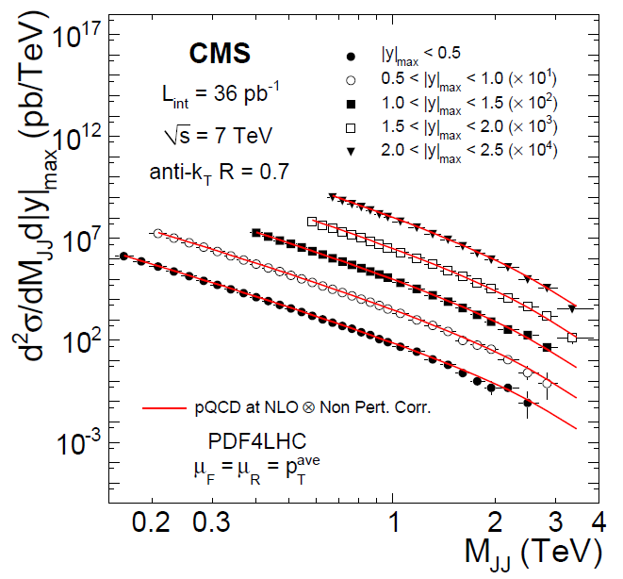
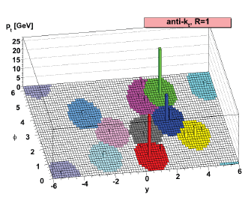
Jets
Inclusive jet cross-section
  Comparison with NLO calculation
Dijet χ
Dijets with a central jet veto

Slide 10
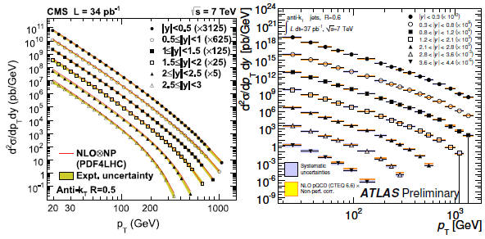
Inclusive jet cross section
One of the first measurements made with the 7 TeV data
Comparison to NLO prediction using NLO++

Slide 11
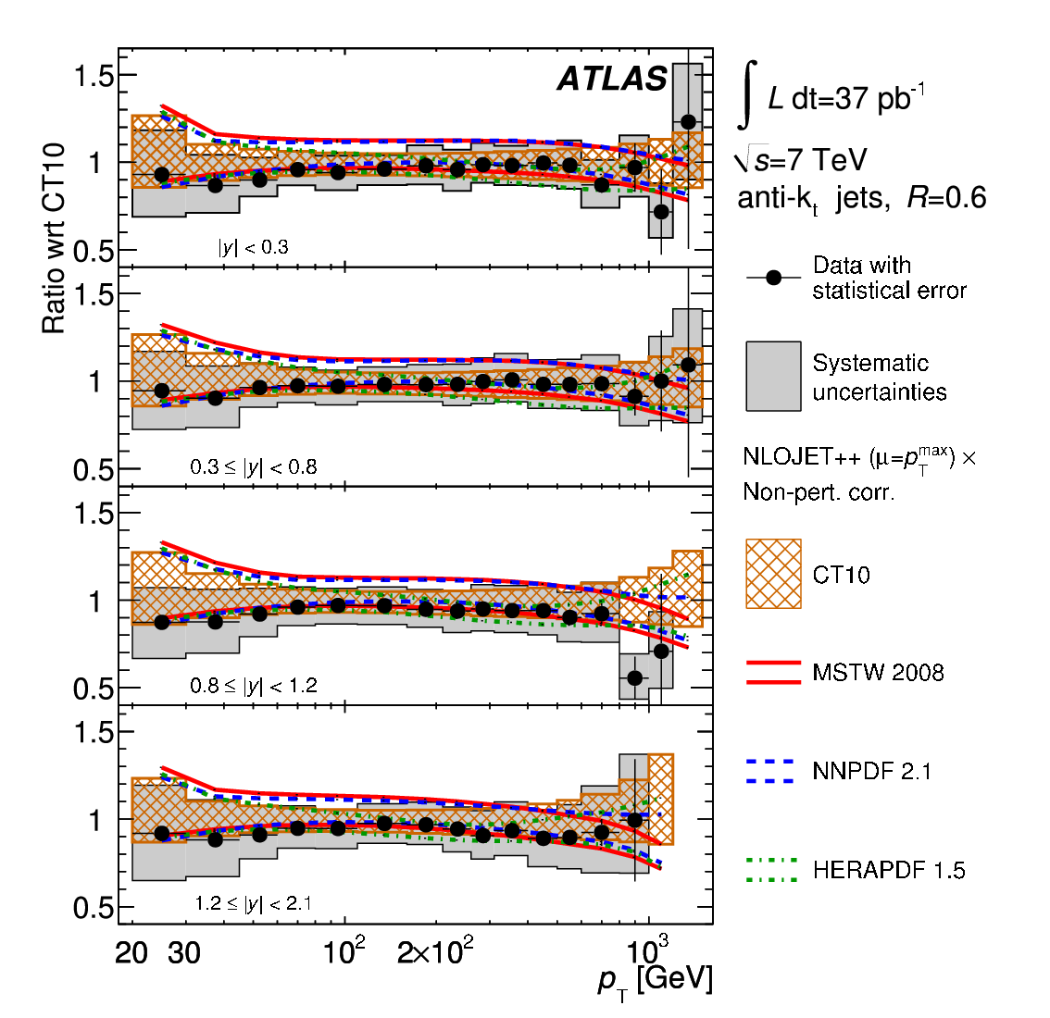
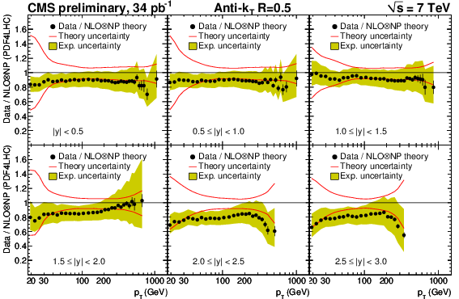
Inclusive cross-section (Data/Theory)
Perturbative corrections are applied to theoretical predictions
The data is systematically lower than the prediction, still within the theoretical uncertainty

Slide 12
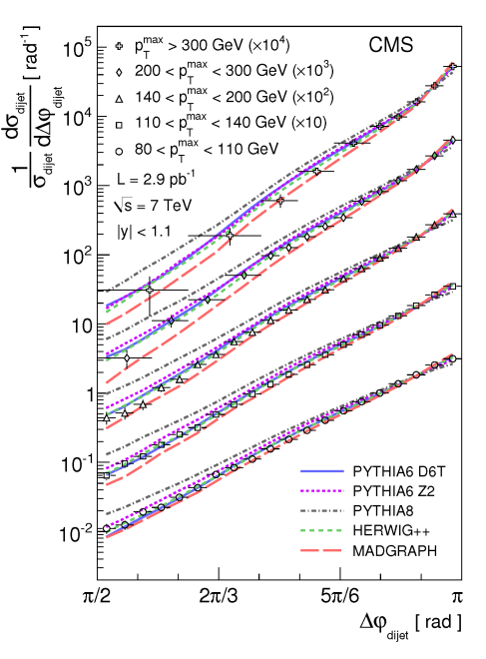
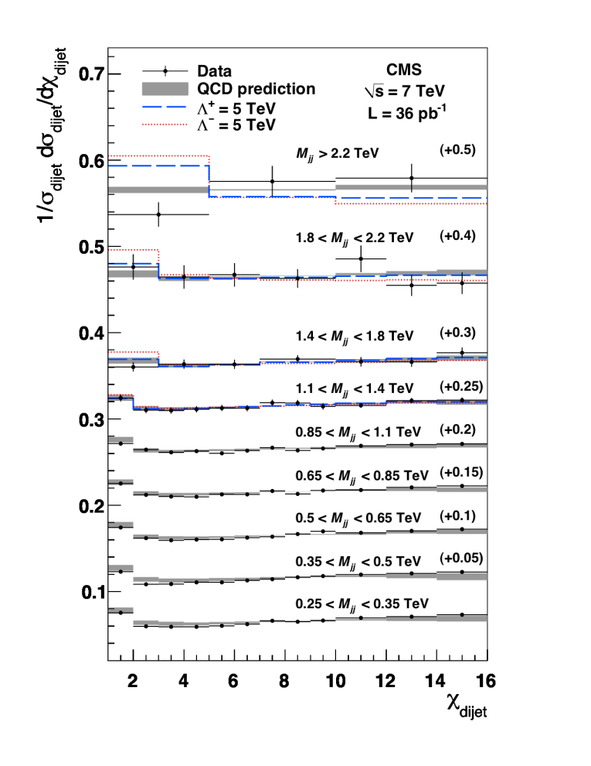
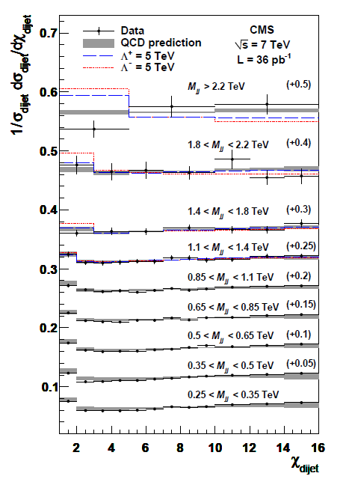

Dijet Angular Properties
The dijet angular distributions do not strongly depend on the details of the parton distribution functions (PDFs)
It also allows signatures of new physics that might have a more isotropic angular distribution than QCD (e.g. quark compositeness) to be more easily examined
  QCD is almost flat in (in good agreement with NLO) , while new physics (compositeness) might peak at lower values Event

Slide 13
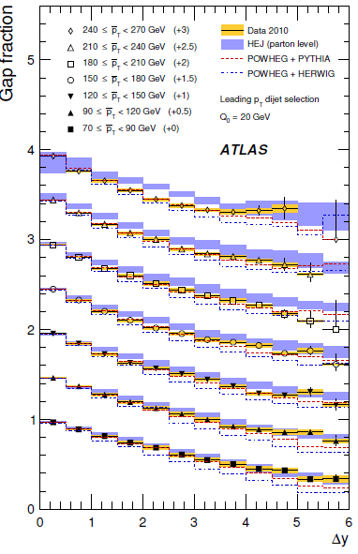
Dijets with a central jet veto
Look at the activity inside the rapidity gap between a di-jet system defined by
  either the two leading jets in pT
  or the two jets with the largest rapidity gap y
Gap fraction is the fraction of events without additional jet activity in the rapidity interval between the jets
plot to the right shows gap fraction for leading jets in p_{T} as function of ΔY for various p_{T} ranges (ATLAS)
1201.4932

Slide 14
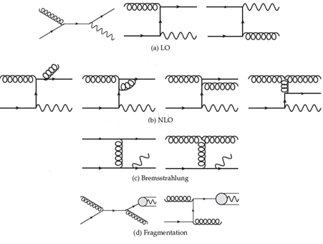
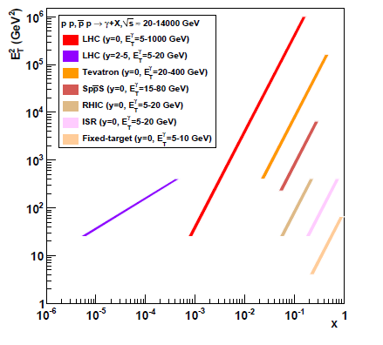
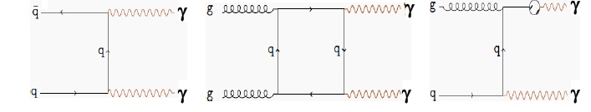
Photons
Inclusive isolated photon cross section
Di-photon cross-section

Slide 15
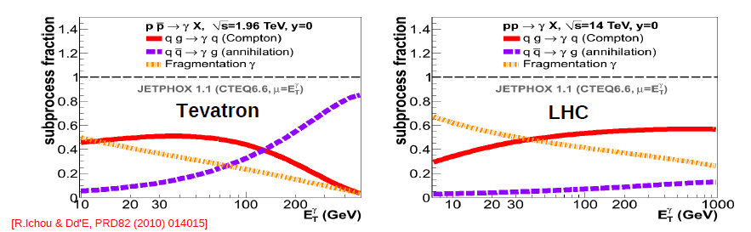
Inclusive Photons
Relative sub-process in NLO, comparing Tevatron and LHC
Long standing disagreement between NLO pQCD and inclusive photon data at fixed target
  Not solved by (N)NNL soft-gluon threshold & recoil resummations
Photons removed from global PDF fits
  (used to constrain high-x gluon) since MRST99
@ LHC Compton scattering is more dominant

Slide 16
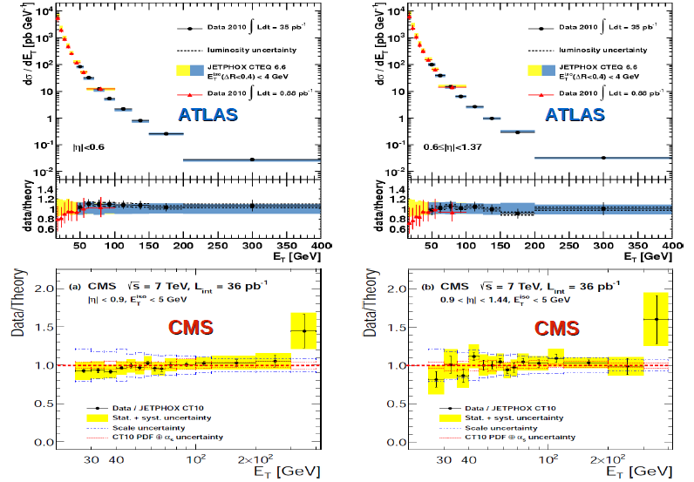
Isolated Photons @ LHC
The NLO prediction using JetPHOX
The disagreement at Low pT still exists

Slide 17
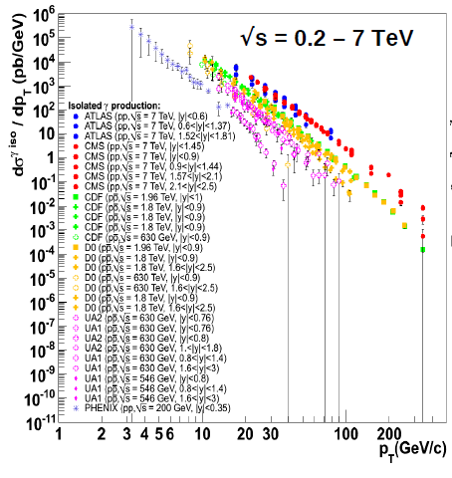
Isolated Gamma – World data

Slide 18
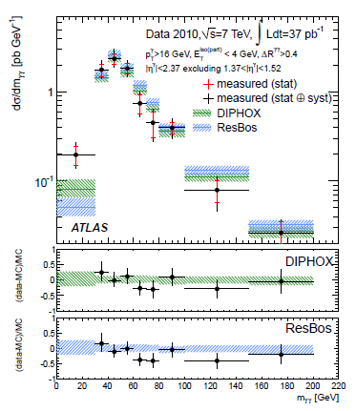
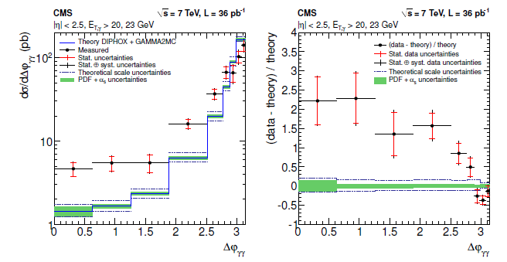
Isolated Di-photons
The experimental results are compared with NLO predictions obtained with DIPHOX+GAMMA2MC and ResBos.
The theory underestimates the cross section in regions of the phase space where the two photons have an azimuthal angle difference Δφ < 2.8

Slide 19
Summary
Soft particle production
  Particle multiplicities, Underlying event, rapidity gap cross section, strangeness production
  Pre LHC tunes do not describe the data well
  Tuning is a work in progress
Jet production
  Inclusive cross-sections, dijet properties
  NLO predictions agree with data reasonably (data is systematically lower but with in theoretical uncertainty)
Photons
  Inclusive isolated photon cross-section, agrees reasonably with NLO predictions (disagreement observed at low pt, different xT range from Tevatron)
  Di-photon angular distributions are significantly broader in data compared to NLO predictions
Future : 8TeV?

Slide 20
Backup

Slide 21
Link to documentation
https://twiki.cern.ch/twiki/bin/view/CMSPublic/PhysicsResultsQCD
https://twiki.cern.ch/twiki/bin/view/AtlasPublic/StandardModelPublicResults

Slide 22
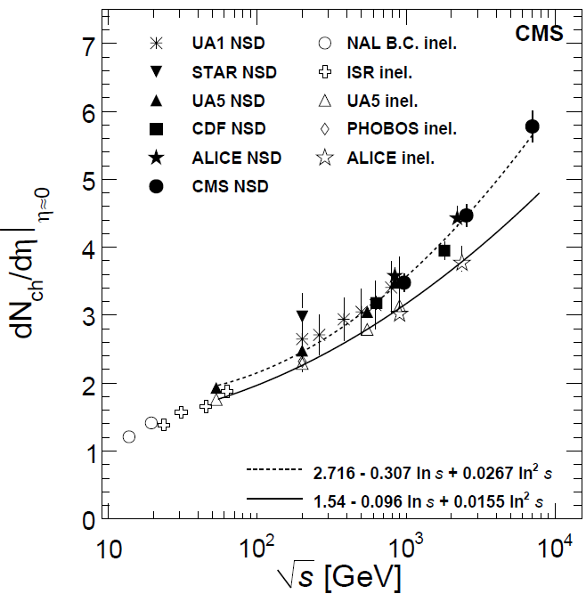
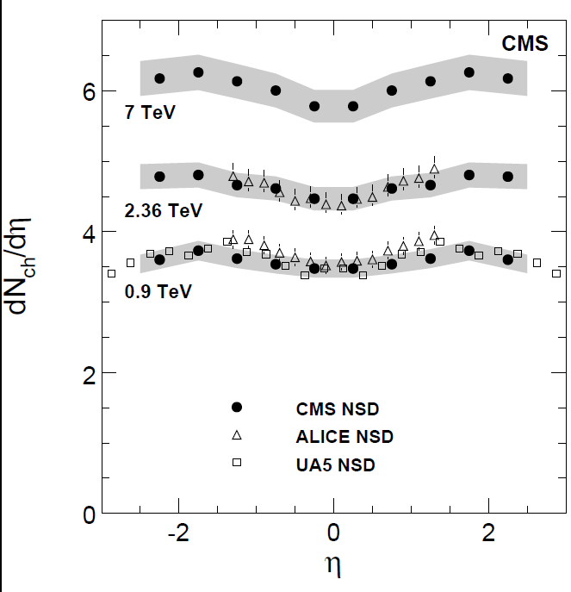
Charged particle Psuedorapidity distributions

Slide 23
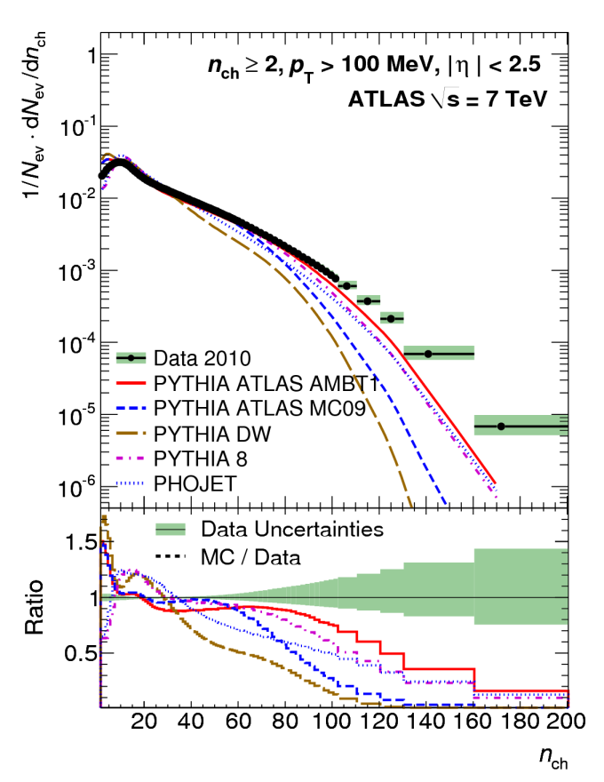
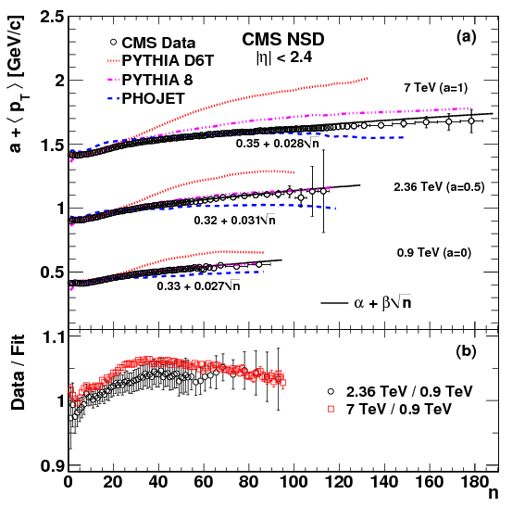
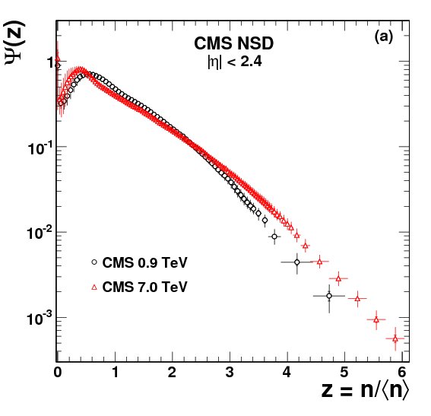
Particle Multiplicities
J. High Energy Phys. 01 (2011) 079
New J.Phys.13:053033,2011
Large multiplicity tail observed at 7 TeV (cf. dN/dh)
MCs can't describe all multiplicities at all energies
A strong violation of KNO (Koba, Nielsen, and Olesen ) scaling for large pseudo-rapidity interval of |η|<2.4 is observed

Slide 24
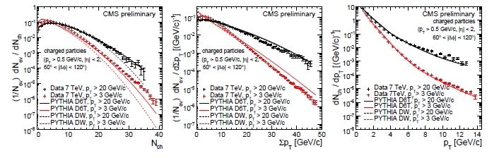
Particle densities in transverse region
PAS QCD-10-001
Normalized distributions for multiplicity, ∑p_{T} and p_{T} are presented for leading track jet of p_{T} >3 & 20 GeV/c
The distributions get harder upon on the selection of harder scale indicating the increase in the UE as the hard scale increases
The observation of 10 GeV/c in p_{T} indicates the presence of hard component in the transverse region

Slide 25
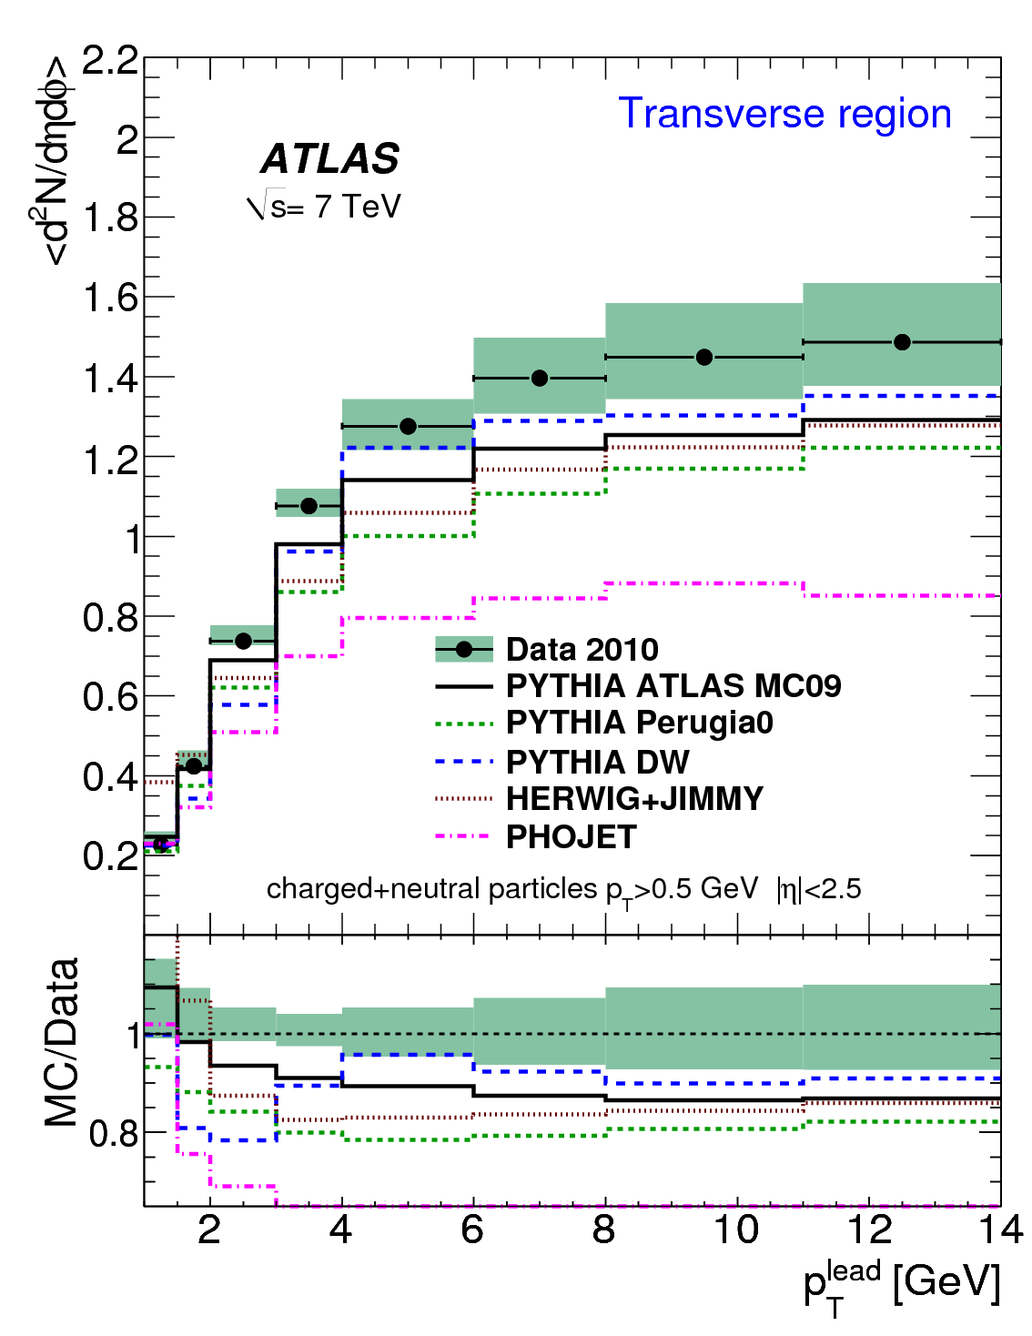
Underlying event
The Monte Carlo generators typically predict a lower particle density in the transverse region (|Δφ| π/2), while in the toward region (Δφ 0), the PYTHIA DW and HERWIG+JIMMY generators both overestimate the densities.
PHOJET significantly fails for the √s = 7 TeV data.
The discrepancies between the data and MonteCarlo generators agree with those observed for charged particles

Slide 26
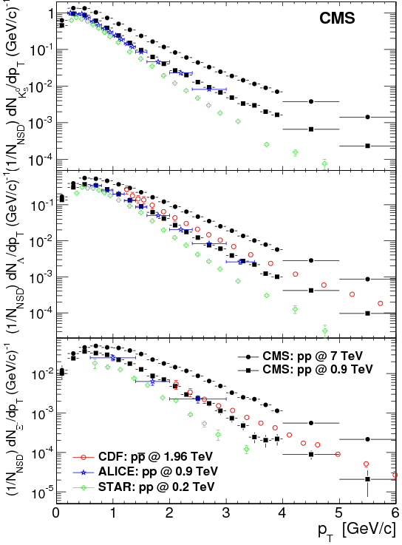
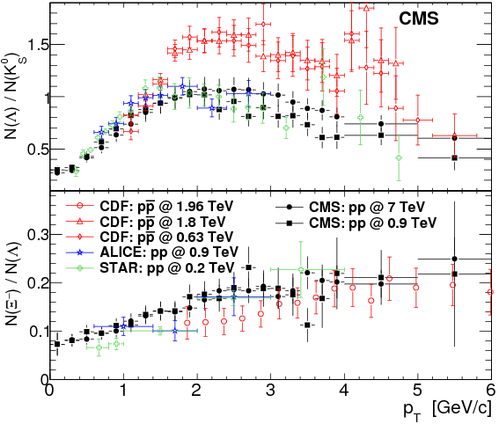
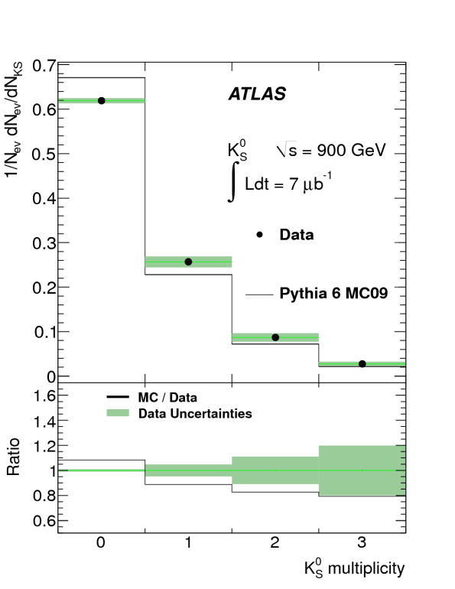
Strangeness production

Slide 27
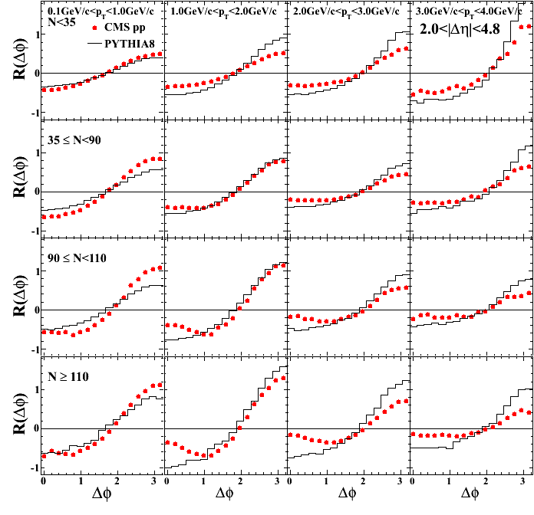
Two particle correlations

Slide 28
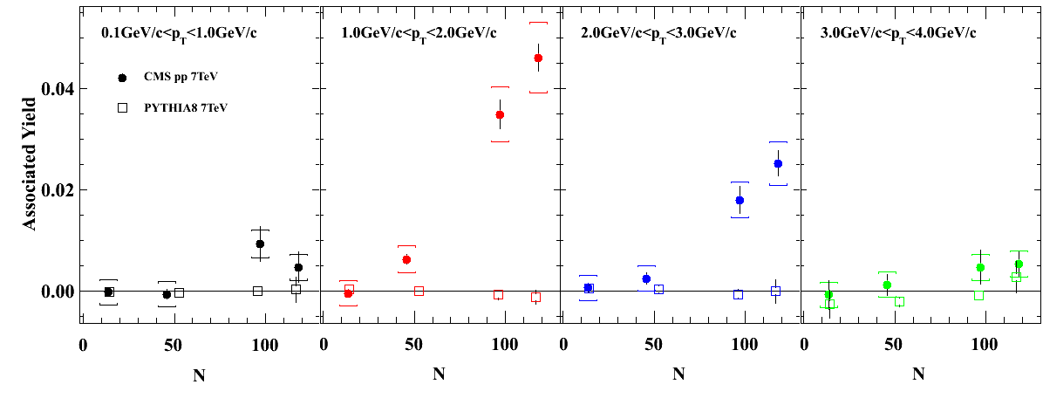
Associated yield

Slide 29
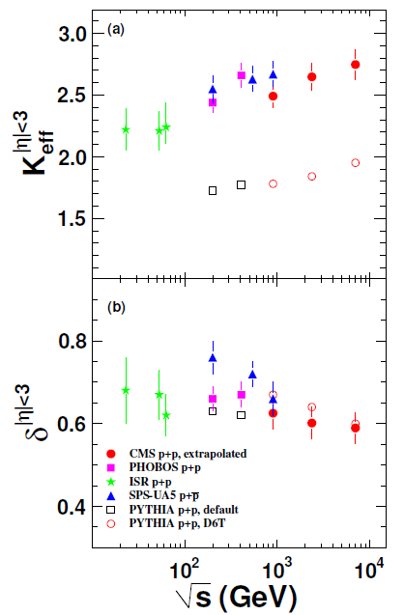
Two particle correlations
The effective cluster size and decay width are extracted from the two-particle pseudo-rapidity correlation function
Effective “cluster size” increases with collisions energy
PYTHIA describes the correlation data poorly

Slide 30
Jets @ LHC
Both ATLAS and CMS (after a considering a wide variety of algorithms) close anti-Kt as the algorithm of choice
  Unlike the kT (x=1) algorithm the, the anti-KT (x=-1) algorithm treats the highest pT object first
  anti-KT leads to much more regular shaped jets and does not get effected from vacuum cleaner effect
  CMS uses R = 0:5 (incl.) and R = 0:7 (di-jet), while ATLAS uses R = 0:4 and R = 0:6 (both)
Measured spectrum is corrected bin-by-bin for migration effects in pT by
  Gaussian smearing with p? resolution of modified power-law spectrum obtained by fit to data (CMS)
  y correction factors obtained from full detector simulations including also detector inefficiencies (ATLAS)
NLO pQCD predictions
  NLOJet++ 4.1.2 with CTEQ 6.6 NLO PDFs as baseline (ATLAS)
  NLOJet++ 2.0.1 with average of CT10, MSTW2008NLO, NNPDF2.0 NLO PDFs as baseline (CMS)
CMS uses Particle Flow jets : Particles flow algorithm uses the information from all the sub-systems to reconstruct the particle. These reconstructed “particles” are then clustered in to jets

Slide 31
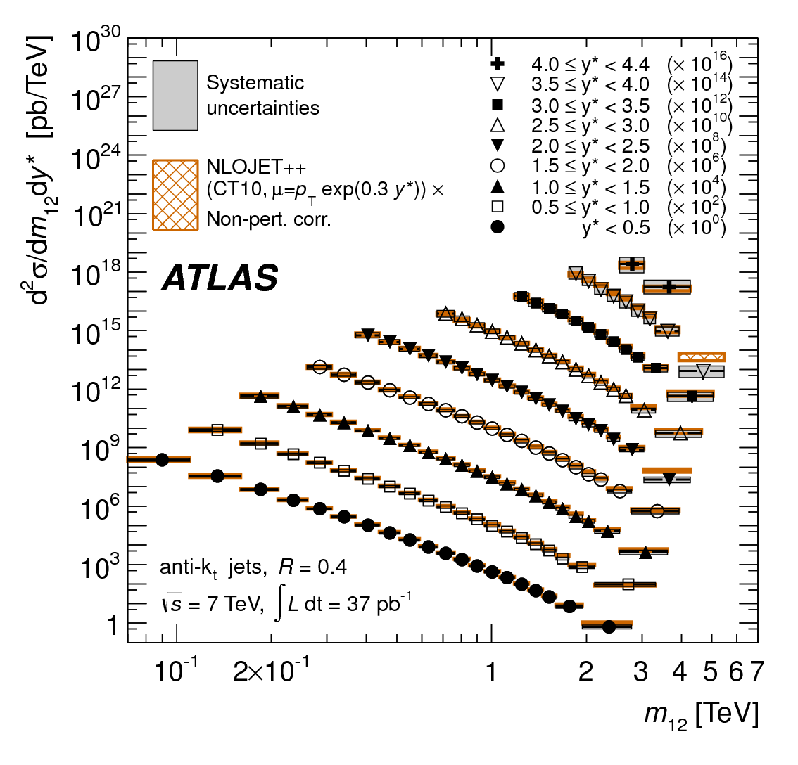
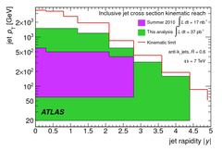
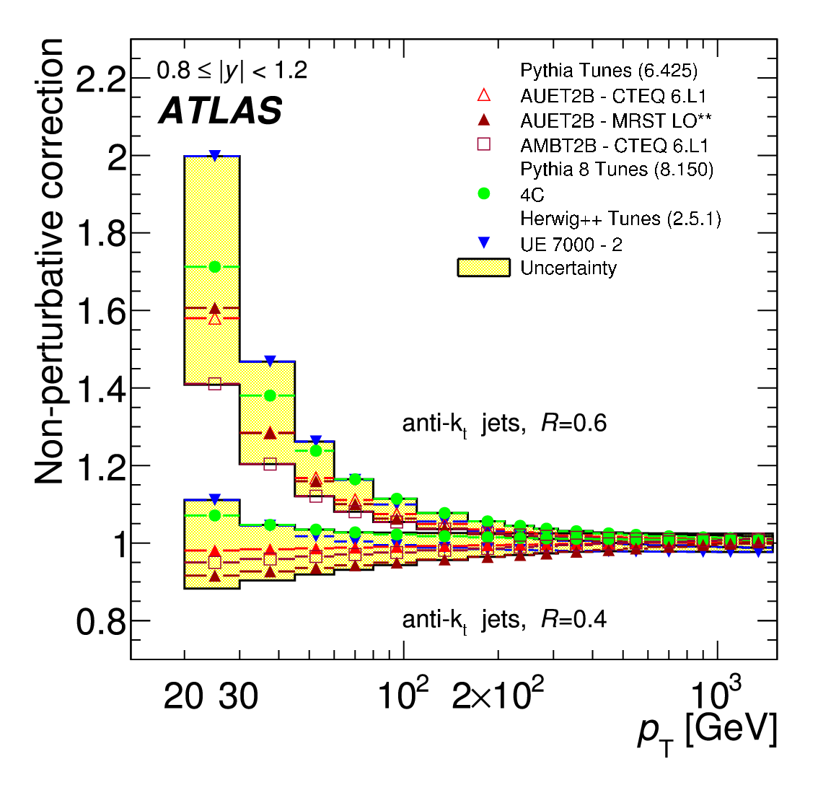
Jets @ LHC

Slide 32
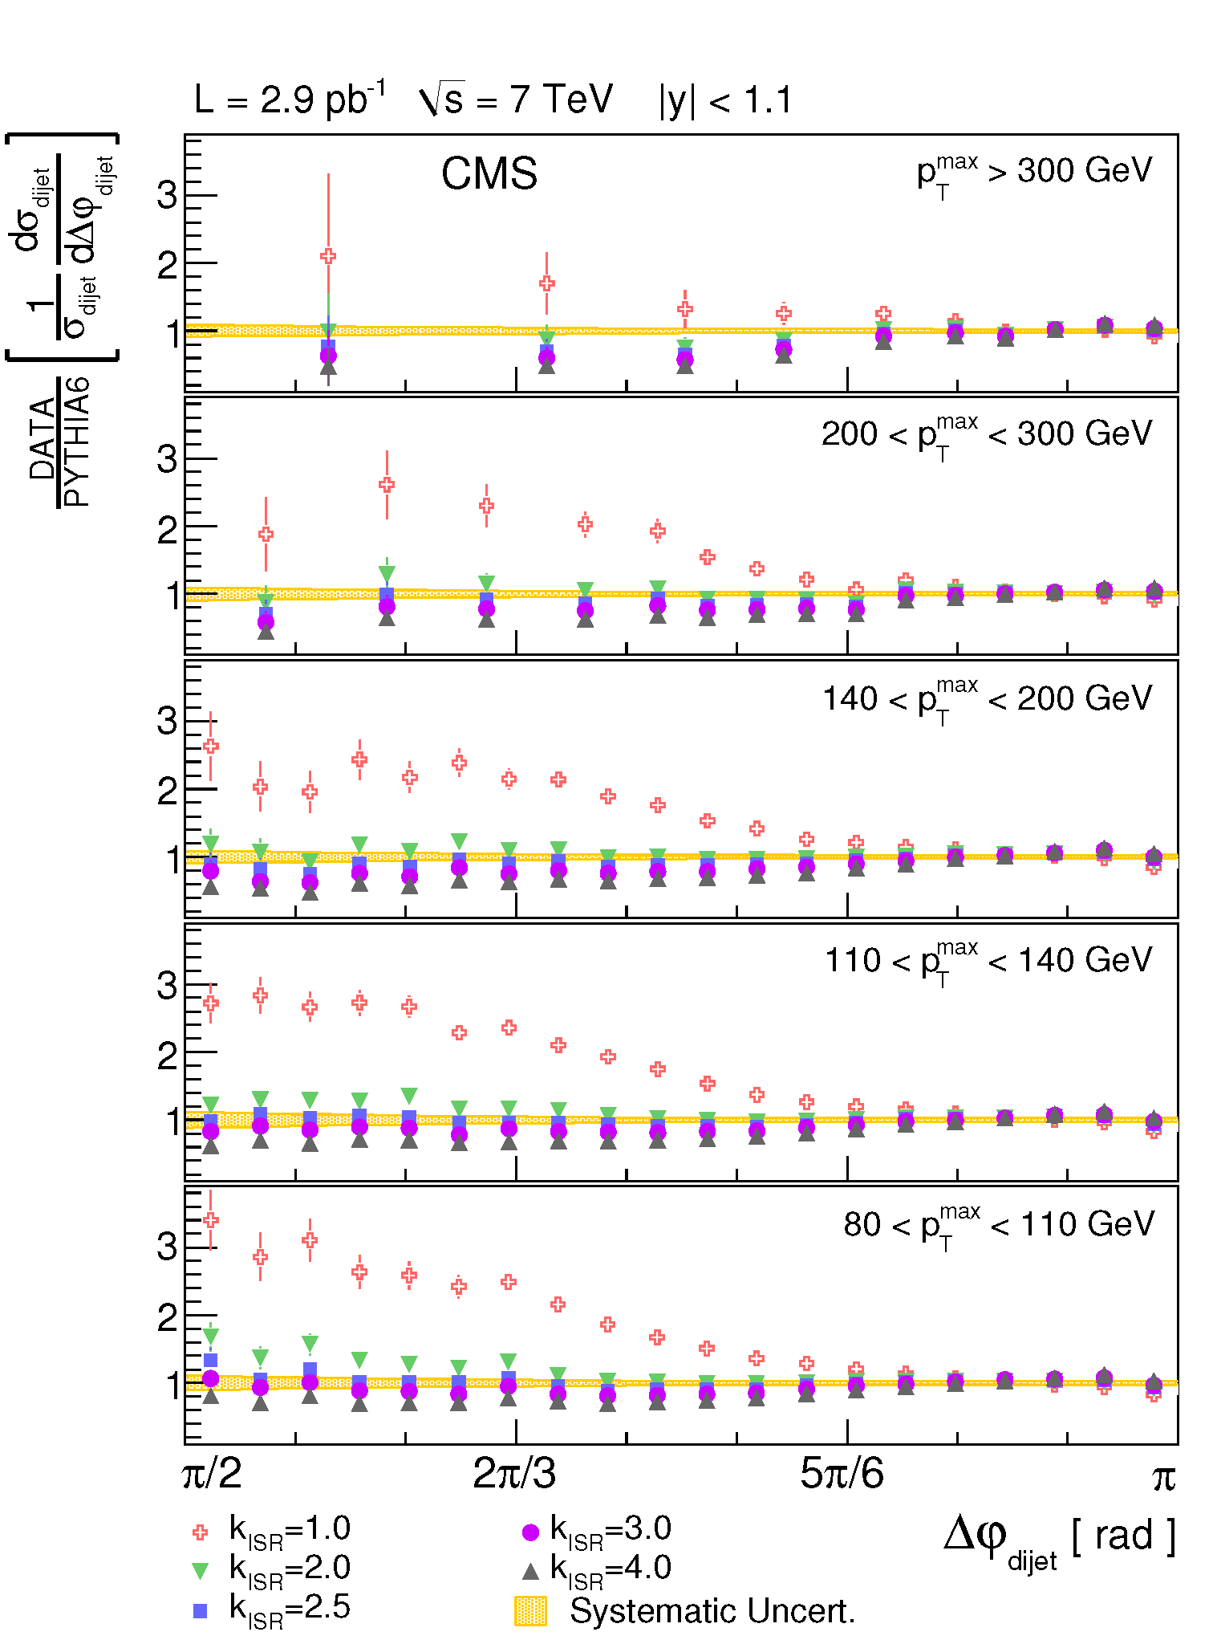
Jets @ LHC

Slide 33


Multijets
ALPGEN, PYTHIA and SHERPA seems to agree well with data
Systematic due to jet energy correction and luminosity is minimal in the ratios
The overall multiplicative correction factor to the data is within ±5% of unity
The ratio plateaus at value of about 0.8 in agreement with predictions of PYTHIA and MadGraph MC calculations

Slide 34
Diphoton cross-sections
The asymmetric thresholds on the photon transverse momenta avoid the infrared sensitivity affecting the fixed-order calculations and simplify the comparison of the measurements with the theoretical predictions.
  ET1 > 23
  ET2 > 20
  Delta R > 0.45
Contributions from the quark-antiquark annihilation process and the single- and double-fragmentation processes are calculated up to order α² with the DIPHOX
The contributions from the gluon fusion process, includingthe one-loop box diagram of order α²_{s} α², the interference between the one- and two-loop box diagrams, and the real emission one-loop “pentagon” gg -> ggg, both of order α³_{s} α², are calculated with the GAMMA2MC
Although they are higher-order processes, the gluon fusion contributions are quantitatively comparable to those from quark-antiquark annihilation in the diphoton mass range of interest, due to the significant gluon luminosity in this mass range at the LHC.
The three theoretical scales, renormalisation, initial factorisation, and fragmentation, are set to the diphoton mass value.

Slide 35



Diphotons

Slide 36


Diphotons

