Slide 1






Introduction to semiconductor for High Energy Physic using
EASY: Educational Alibava System
Carmen García
IFIC (CSIC-Univeridad de Valencia)
Alibava systems

Slide 2
EASY
Basic principles of silicon strips sensors
The experimental setup (EASY system)
Data acquisition and monitoring
Data analysis:
  Exercise 1: Charge collection and depletion voltage
  Exercise 2: Strip structure and charge sharing
For the exercises you need your google drive account
Two windows: one for zoom and other for your google account

Slide 3
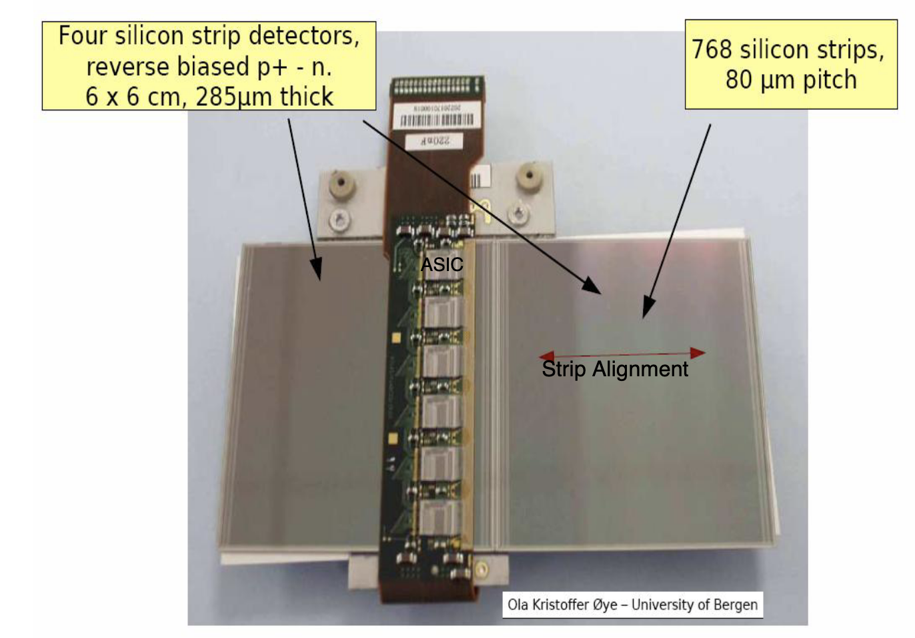
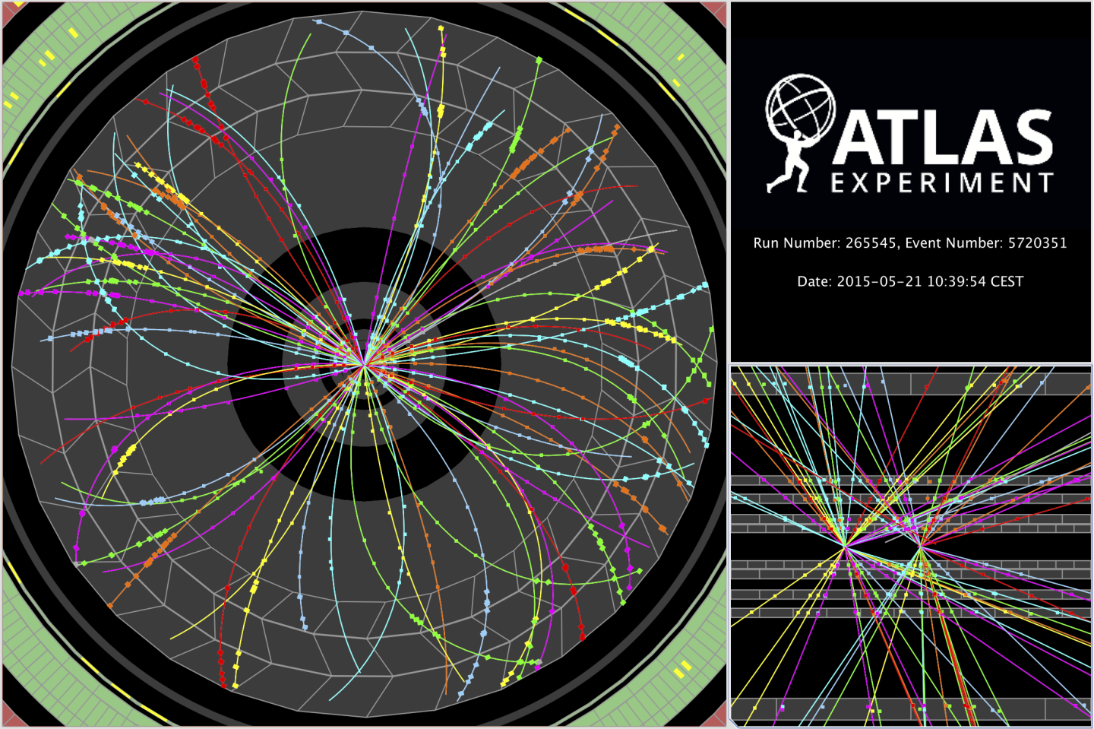
EASY
Basic principle
Silicon strip sensors are used to track the pass of charge particles in high energy physics detectors.
The ATLAS example
Inner Tracker ATLAS
Inner Tracker ATLAS event
ATLAS SCT module
Notes:
Our divice consist of an 300 microns thick n type bulk. and thin layer of strips of p type silicon,. The abrupt junctions are formed between the strips and the bulk silicon. The depletion zone grows from the strips to the backplane so that, the device can operate partially depleted.
We nned amplification and shaping for full processing

Slide 4
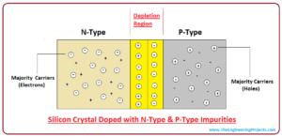
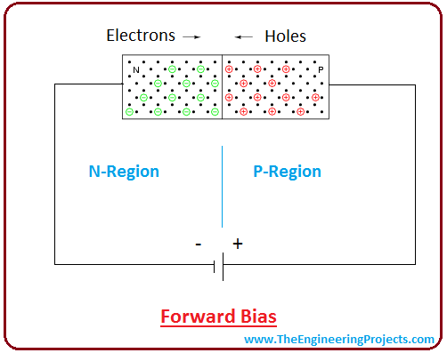
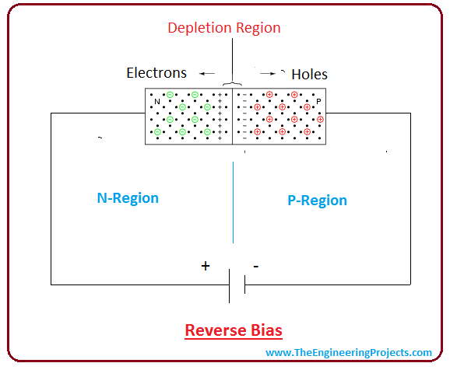
EASY
Basic principle: p-n junction
The holes present in the P region are diffuse into the N-region, leaving behind the negative charge in the P region . Electrons present at the N-region diffuse into the P-region leaving behind the positive.
As the junction is formed, each region of silicon crystal becomes depleted from major charge carriers around the junction.
The electrons present in the N-region will push toward the P-region. Holes in the P-region will continue to diffuse into the N-region as long as the forward bias voltage is applied across the junction.
The width of depletion region behaves in proportion with the reverse bias voltage applied across the junction.
Stops the current flow between the junction.
In this condition, PN junction behaves as an insulator.
Notes:
Our divice consist of an 300 microns thick n type bulk. and thin layer of strips of p type silicon,. The abrupt junctions are formed between the strips and the bulk silicon. The depletion zone grows from the strips to the backplane so that, the device can operate partially depleted.
We nned amplification and shaping for full processing

Slide 5
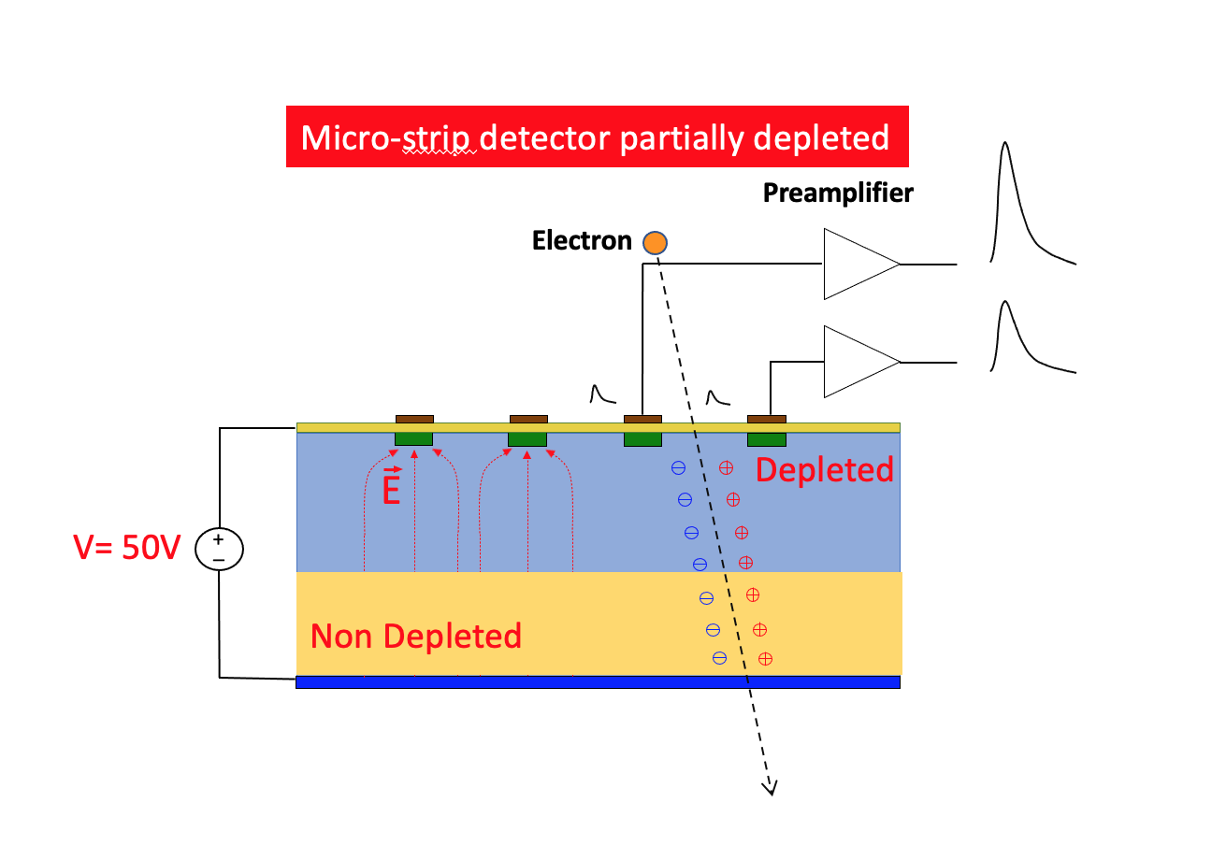
EASY
Basic principle
Exercise 1
Charge collected is proportional to the depletion area
Notes:
Our divice consist of an 300 microns thick n type bulk. and thin layer of strips of p type silicon,. The abrupt junctions are formed between the strips and the bulk silicon. The depletion zone grows from the strips to the backplane so that, the device can operate partially depleted.
We nned amplification and shaping for full processing

Slide 6
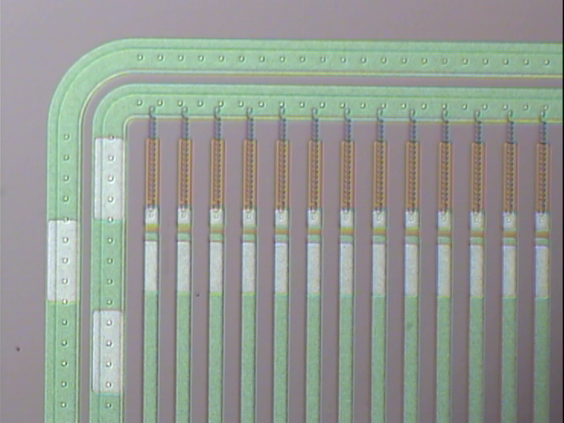
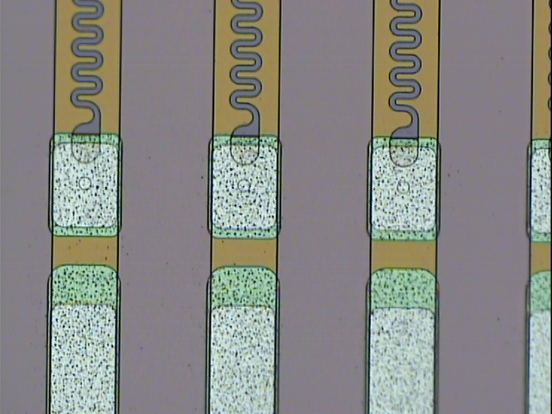
EASY
Basic principle
EASY sensor
Notes:
Our divice consist of an 300 microns thick n type bulk. and thin layer of strips of p type silicon,. The abrupt junctions are formed between the strips and the bulk silicon. The depletion zone grows from the strips to the backplane so that, the device can operate partially depleted.
We nned amplification and shaping for full processing

Slide 7
EASY
Basic principle
Steps of 10µm
Laser
Exercise 2
Notes:
Our divice consist of an 300 microns thick n type bulk. and thin layer of strips of p type silicon,. The abrupt junctions are formed between the strips and the bulk silicon. The depletion zone grows from the strips to the backplane so that, the device can operate partially depleted.
We nned amplification and shaping for full processing

Slide 8
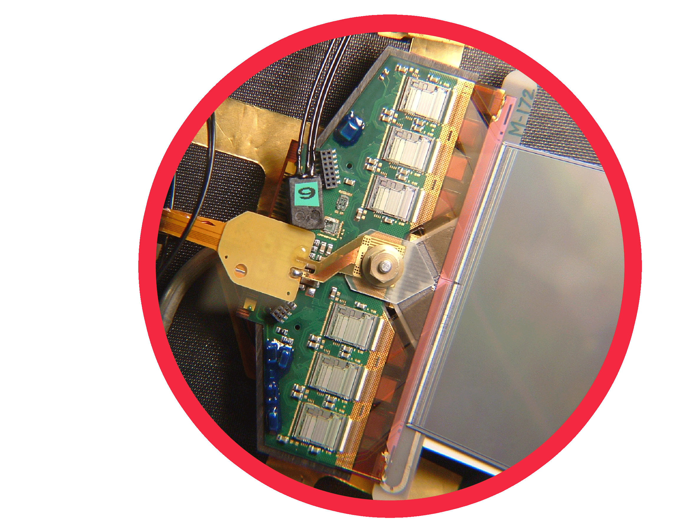
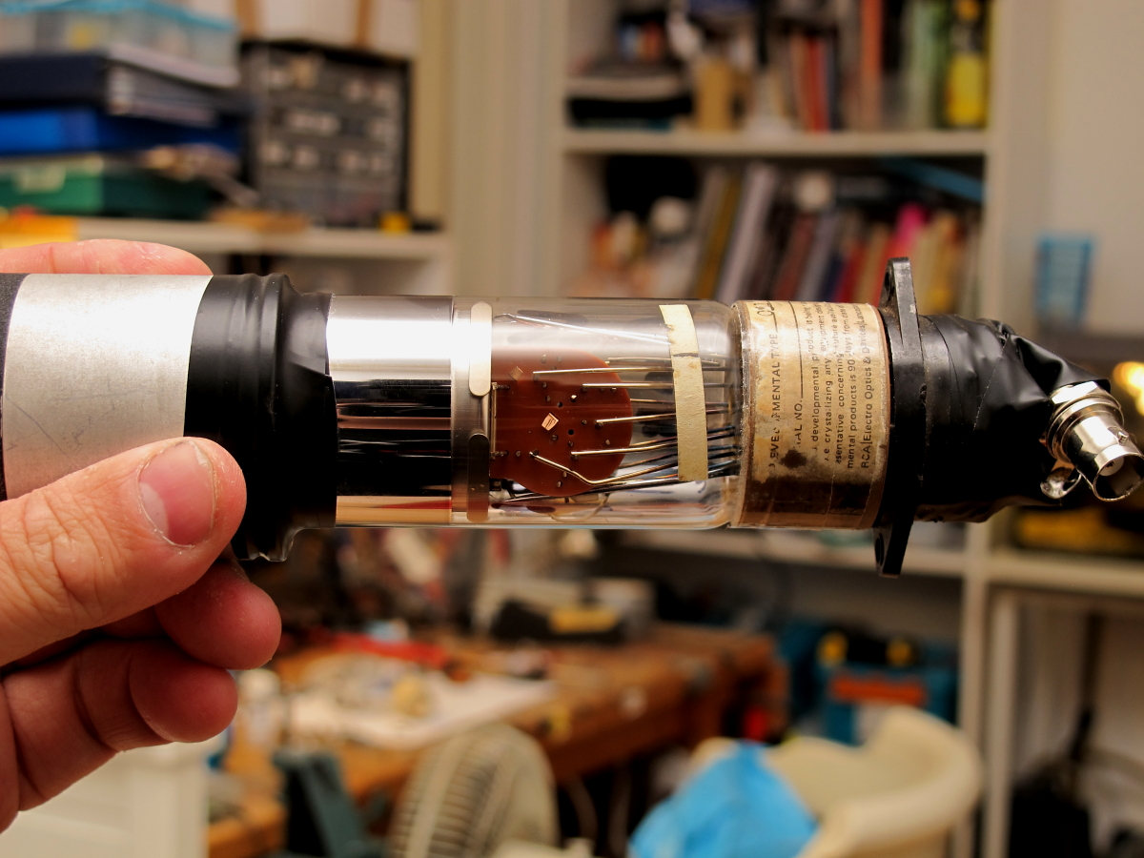
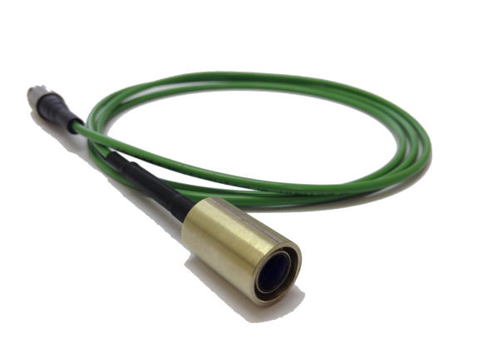

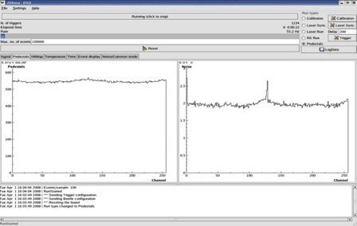

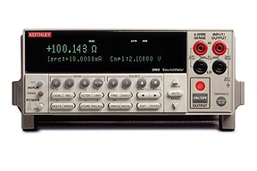
EASY
Setup components @ Lab.
Components of a silicon microstrip detectors
Source of particle
Trigger
Laser
Sensor + ASIC
Radioactive source
Control unit
Data acquisition and monitoring
HV power supply

Slide 9
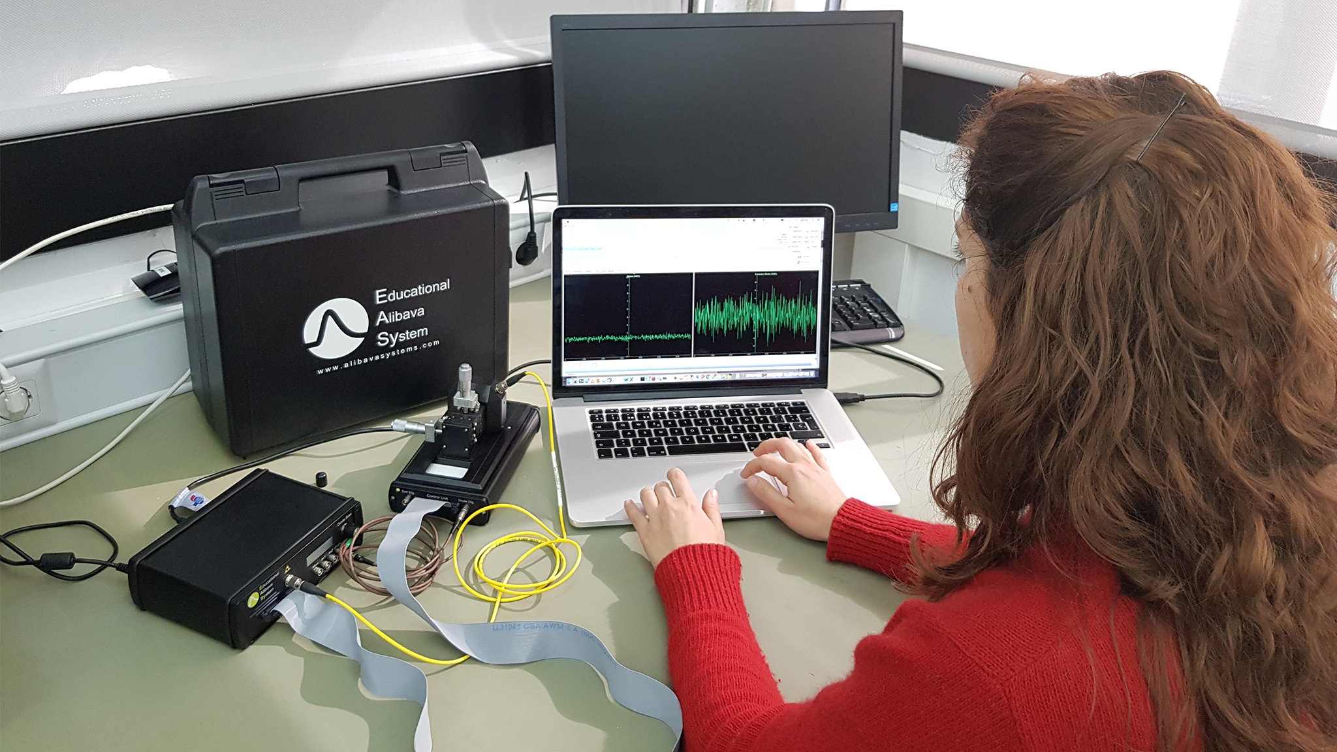
EASY
EASY system
EASY is a portable, compact and complete system for microstrip ideal complex experiments with silicon microstrip detectors.
EASY SYSTEM

Slide 10
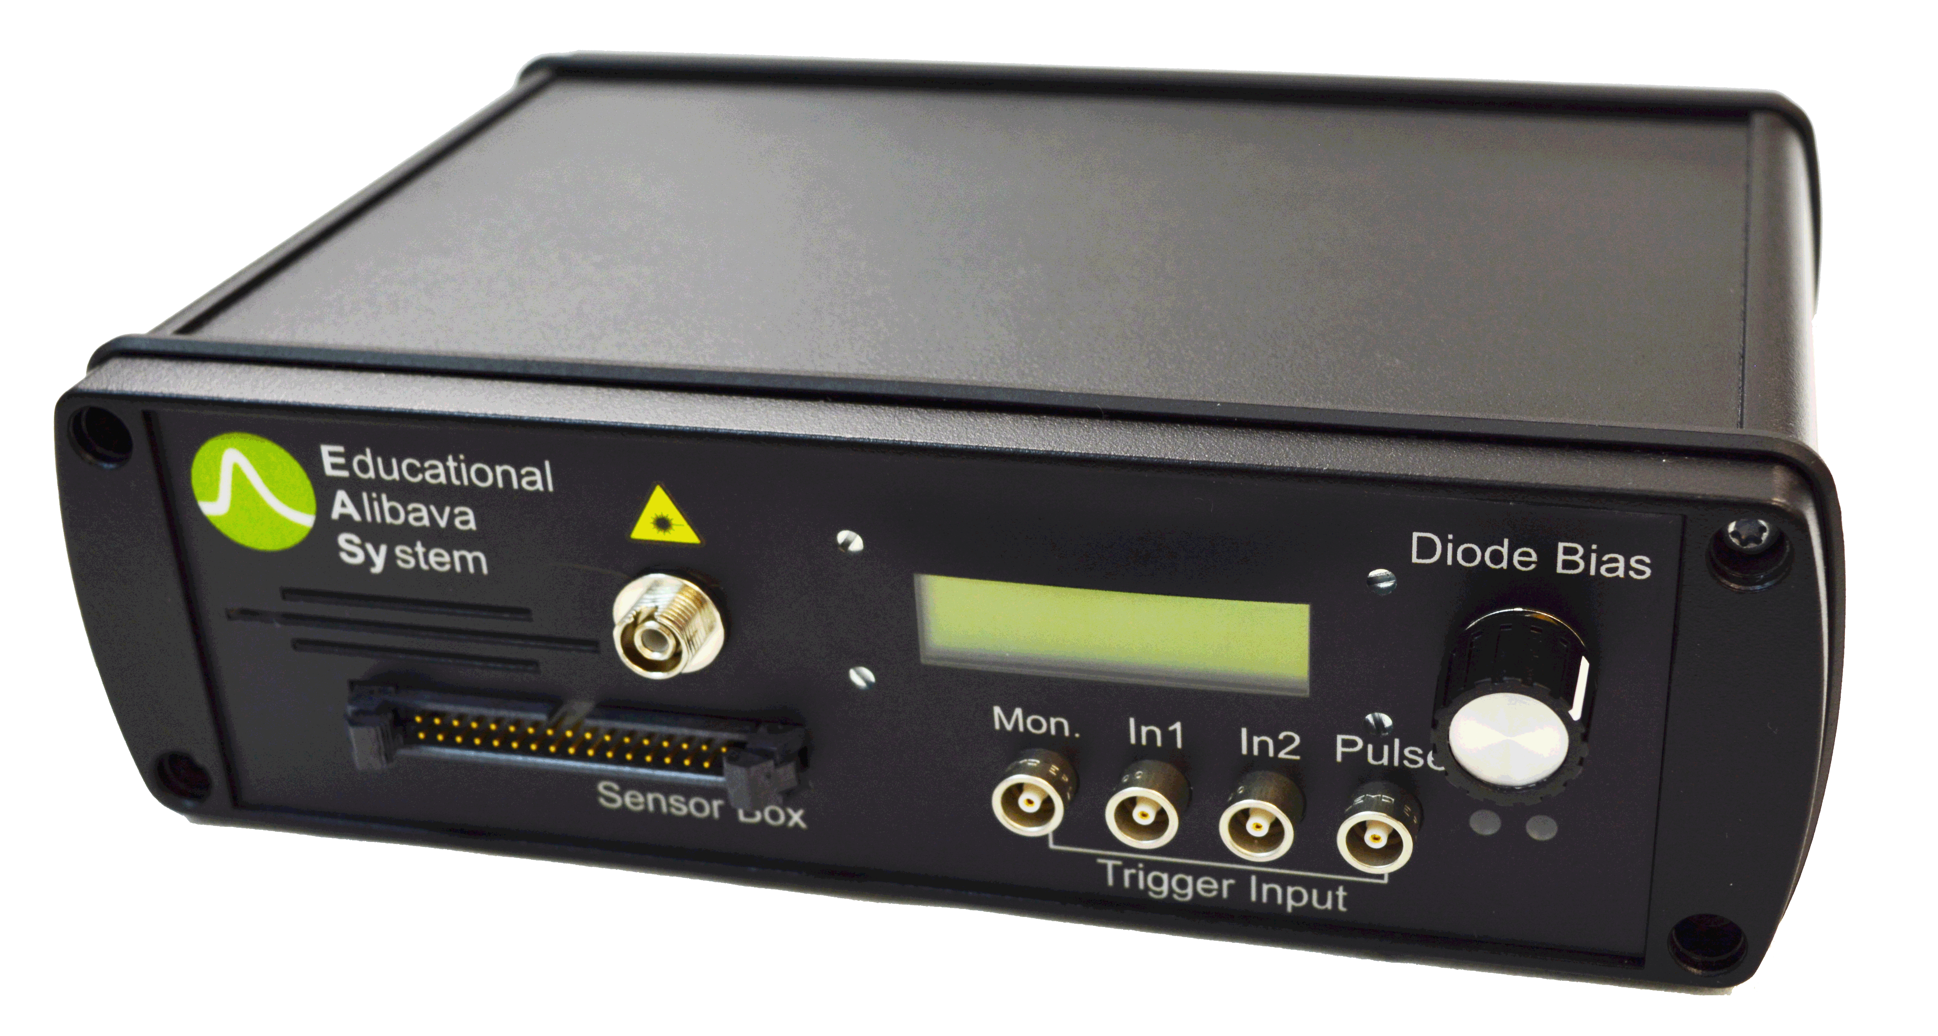
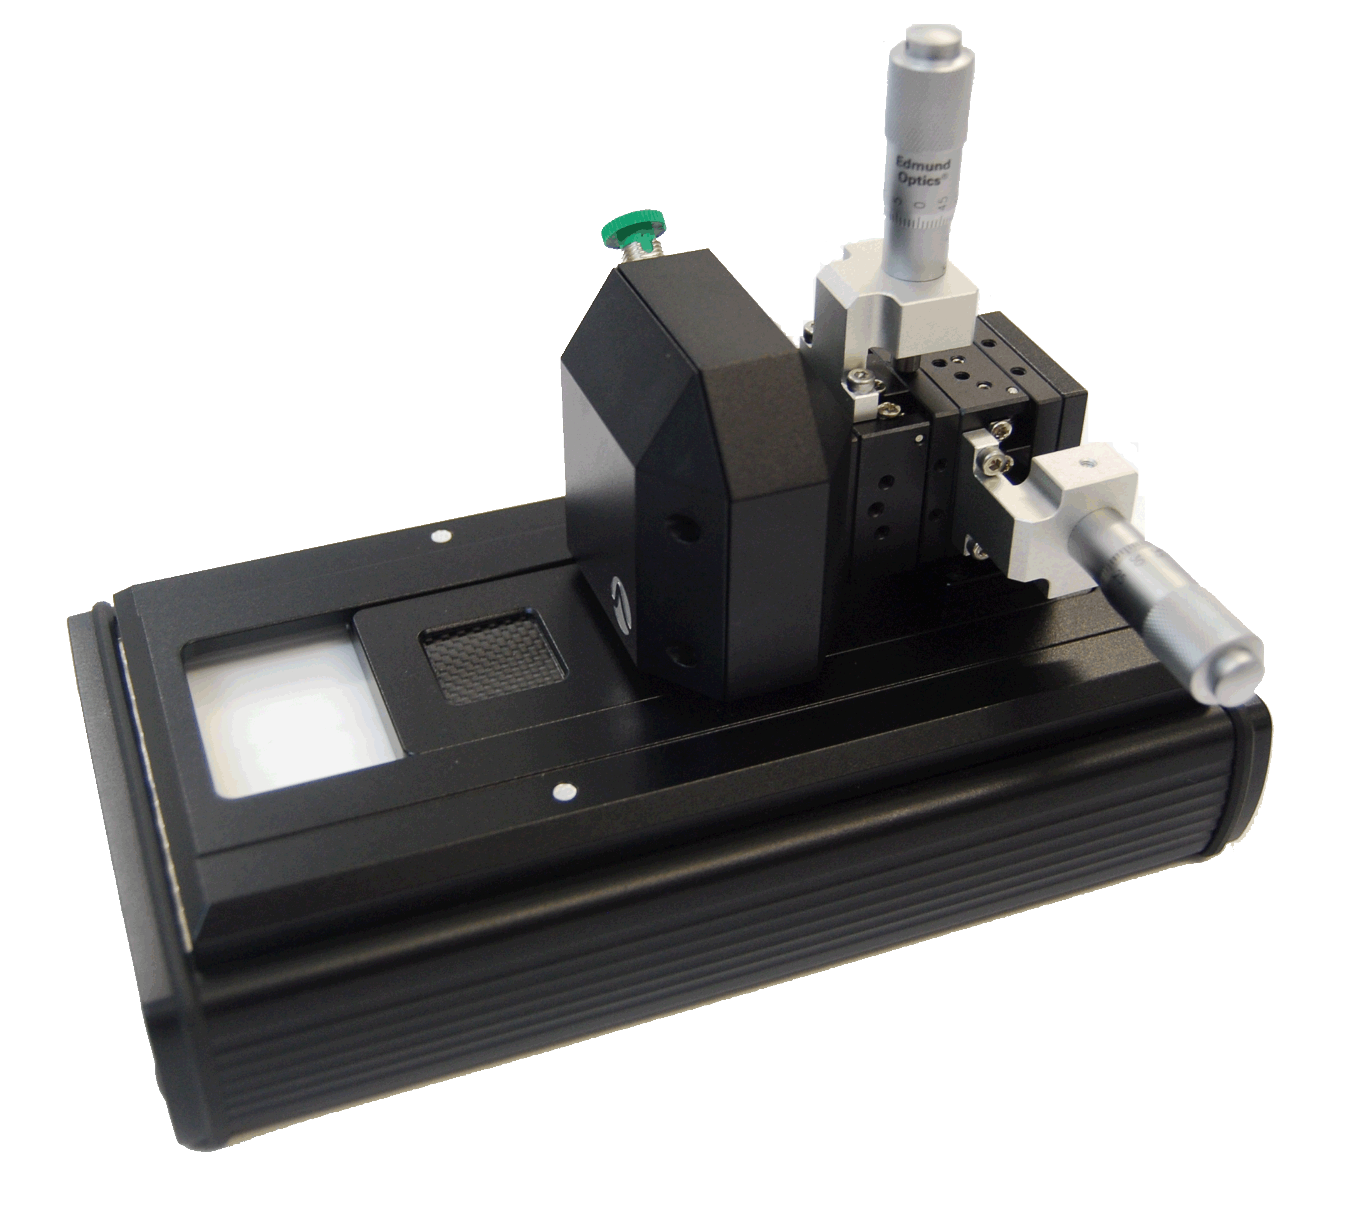
EASY
EASY system
Control unit
Data Acquisition Control.
Processing of the sensor and trigger data
Adjustable HV unit for microstrip sensor bias, with voltage and current display.
Include the laser source
Communication with computer software via USB
Sensor unit
Silicon microstrip sensor and the Beetle chip.
Opaque carbon fibre window to place radioactive source.
Laser micropositioner and focus system.
A diode placed under the detector provides a trigger signal.

Slide 11
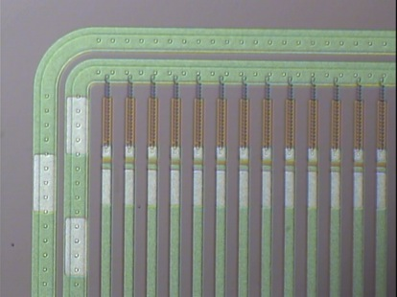
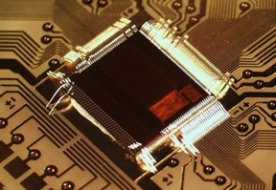
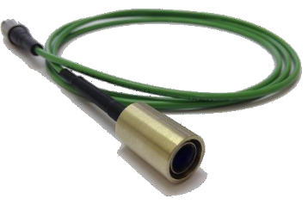

EASY
EASY system
Silicon microstrip
P-on-N Detector
Size: 20x20 mm2
Thickness: 300 µm
Channels: 128
Interstrip pitch: 160 μm
Beetle Characteristics
Low noise ASIC developed for CERN/LHC experiments
128 channels
Laser source
Wavelength: 980nm
Pulse width: 5 ns
Laser Spot: 20 μm
Micropositioner resolution: 10 μm

Slide 12
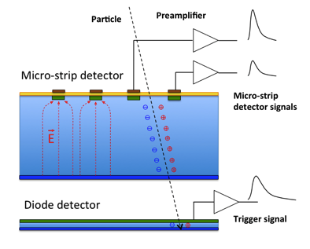
EASY
Trigger
Tigger modes:
  External: provided by the diode, for particles crossing the sensor.
  Synchronised trigger: to trigger the laser source.

Slide 13
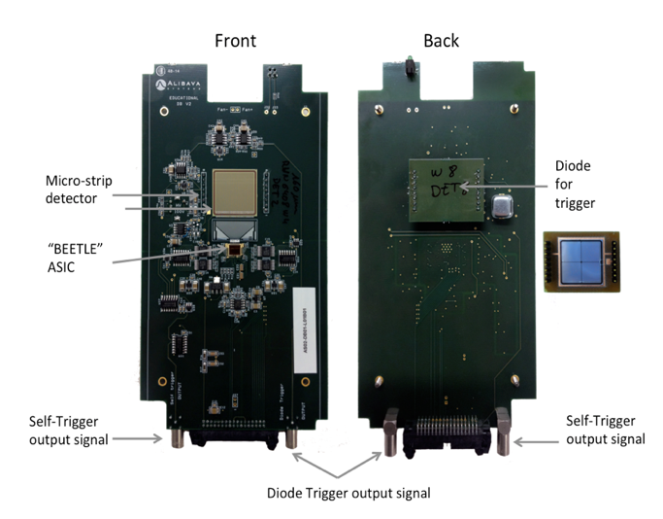
EASY
Trigger

Slide 14
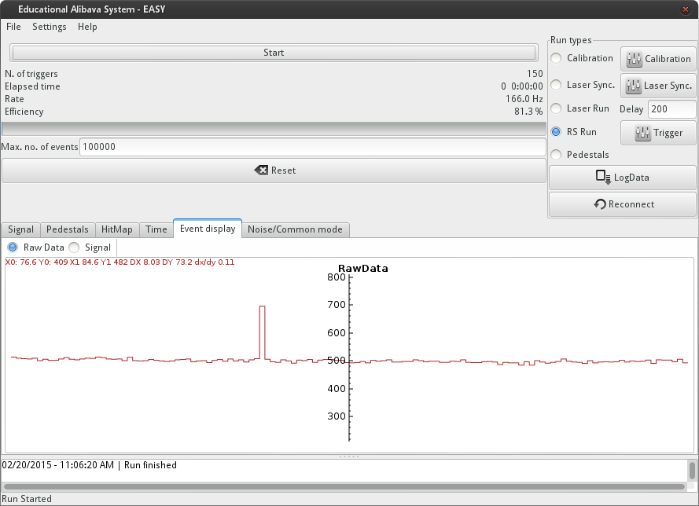
EASY
Charge collection
Strip i , Event k
ADC (i,k)
TDC (i,k)
Beetle chip
Sampling
Charge
time

Slide 15
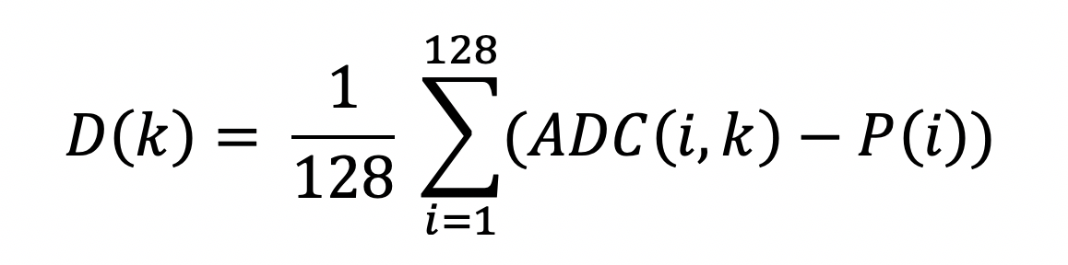
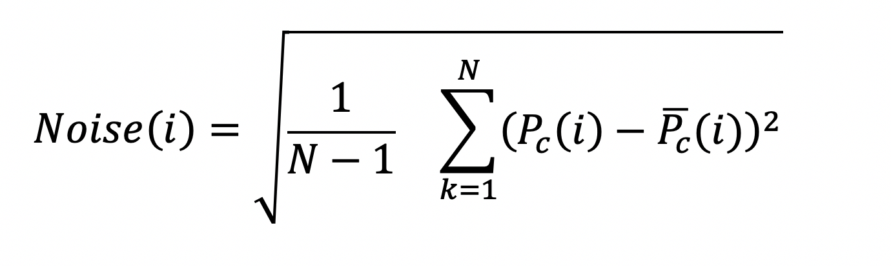
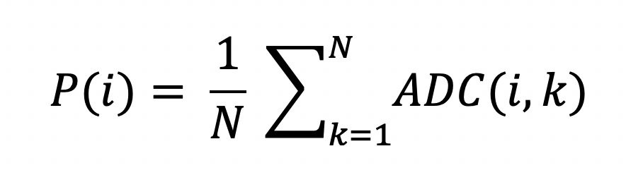
EASY
Charge collection
Strip i , Event k
ADC(i,k)= Offset (i)+ Common Noise (k)+ Electronic Noise (i) + Charge (i,k)
N events
128 channels

Slide 16
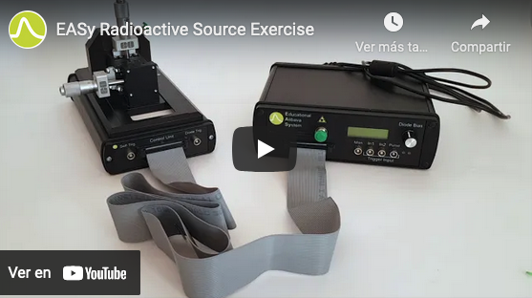
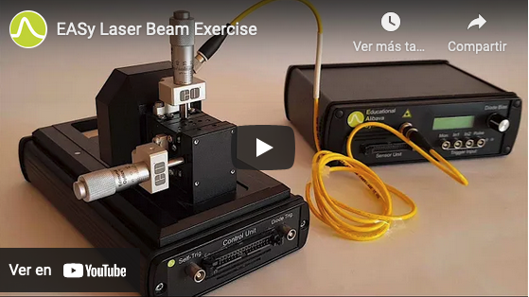
EASY
More information
https://www.alibavasystems.com/ Alibava System youtube
Exercise 1
Exercise 2

Slide 17
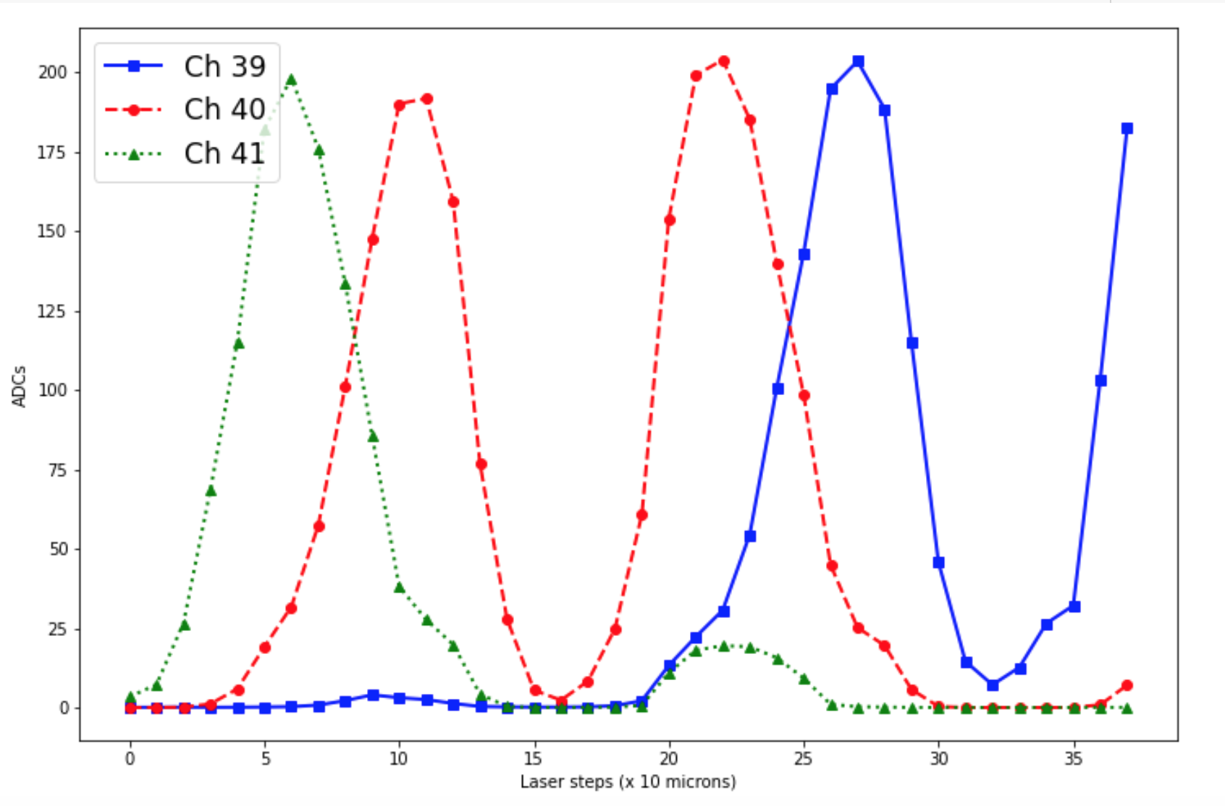
EASY
Strips exercise
LASER

Slide 18
EASY
Strips exercise
LASER

Slide 19
EASY
Strips exercise
LASER

Slide 20
EASY
Strips exercise
LASER

Slide 21
EASY
Strips exercise
LASER

Slide 22
EASY
Strips exercise
LASER
Laser beam Spot
Pich
Strip width

