Slide 2



DIRAC@JINR
DIRAC Users’ Workshop 2025, Sep 17-20
Status 2025
Igor Pelevanyuk

Slide 3
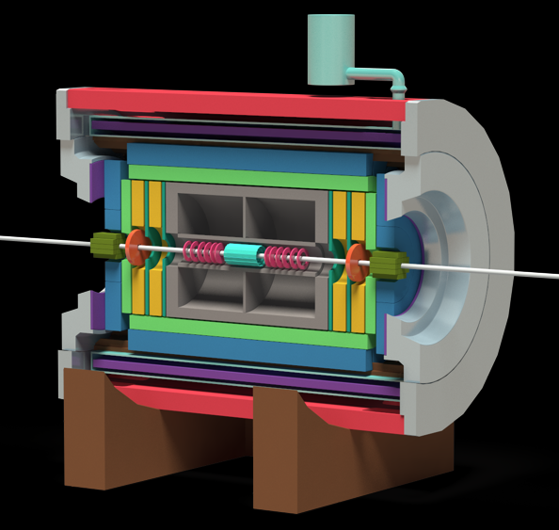
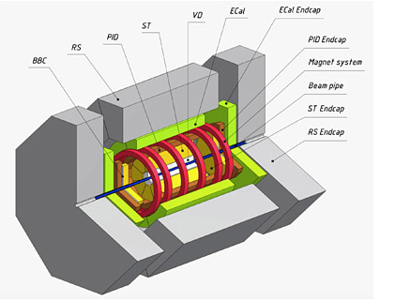




Experiments that we support
Operational Monte-Carlo, Analysis, Experimental data
Last data taking: 436 TB
Operational Monte-Carlo, Analysis,
Biggest resources consumer
Suspended
Monte-Carlo, Analysis
VOMS been disabled
Suspended
Monte-Carlo
HTCondor disabled X509 certs

Slide 4


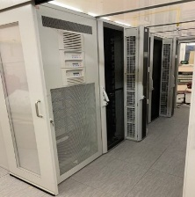




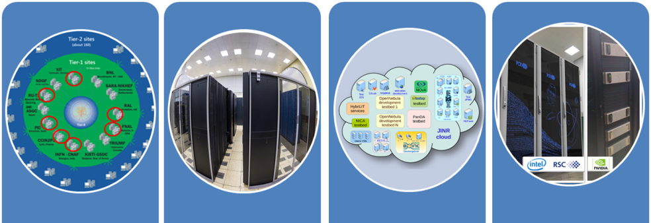

















Resources integrated in DIRAC@JINR
LHEP resources
MLIT MICC basic facility
DDC cluster
NICA cluster
MLIT EOS
DAQ computing
farm
MLIT CTA
Other/Collaboration resources
JINR Cloud
Tier-1
Tier-2
Govorun
UNAM
MEPHI
Lustre
Ultra-fast storage
Clouds
INP
MSC
Polytech
IMDT
NOSU
ASRT
IPANAS
PRUE
INP
SU
INRNE
INP

Slide 5
DIRAC Hardware
DIRAC server:
CPU: 2x Intel Xeon E5-2660 v4 (2 x 14 physical cores)
RAM: 128 GB
Disk: 1 TB
DIRAC monitoring server:
CPU: 2x Intel Xeon Gold 5317 (2 x 12 physical cores)
RAM: 256 GB
Disk: 2 TB

Slide 6
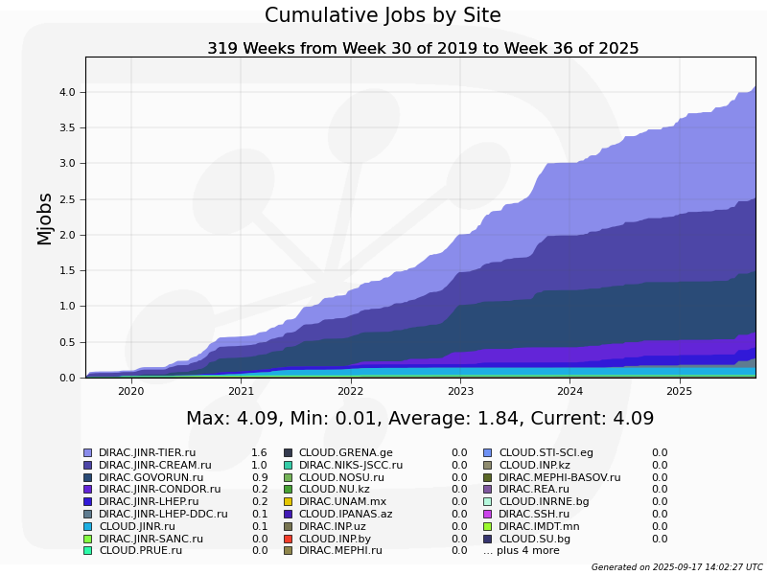
Total successful jobs
> 4 million jobs

Slide 7
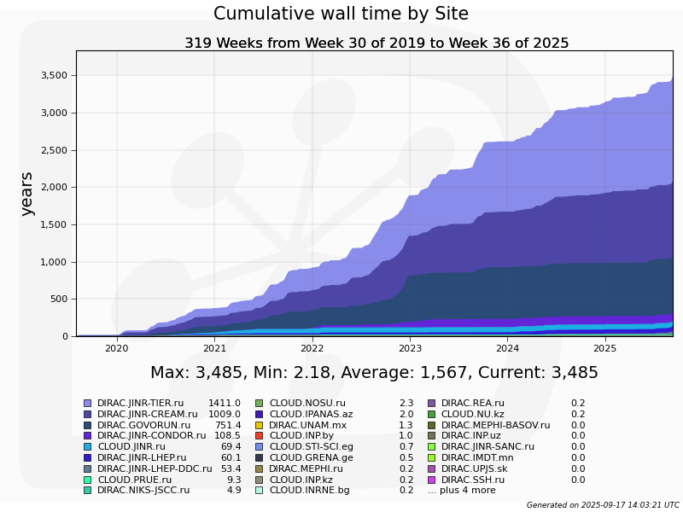
Total walltime
~ 3500 Years of wall time

Slide 8
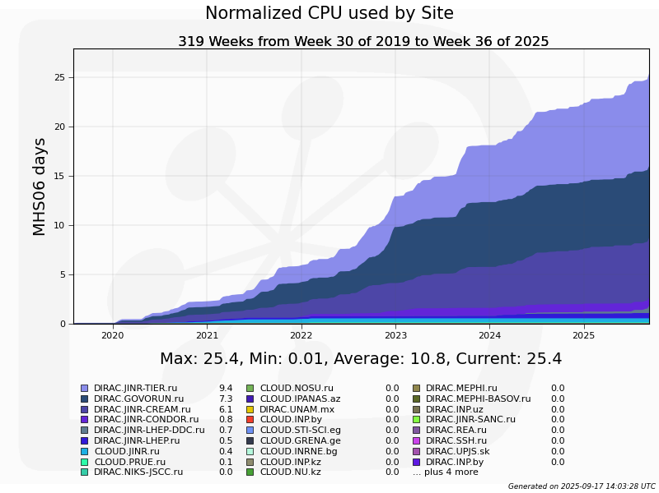
Total walltime
25 MHS06/days

Slide 9




1. User job monitoring
Pilot
Grafana
userscript.sh
Monitoring DB (InfluxDB)
./job_monitoring
root script
root -b -q -l "/cvmfs/proc.C(
input.root
)" > log.txt 2>&1 &
ROOT_PID=$!
load_dirac_envs
python job_monitoring $ROOT_PID
child processes
Дочерние процессы
Дочерние процессы

Slide 10
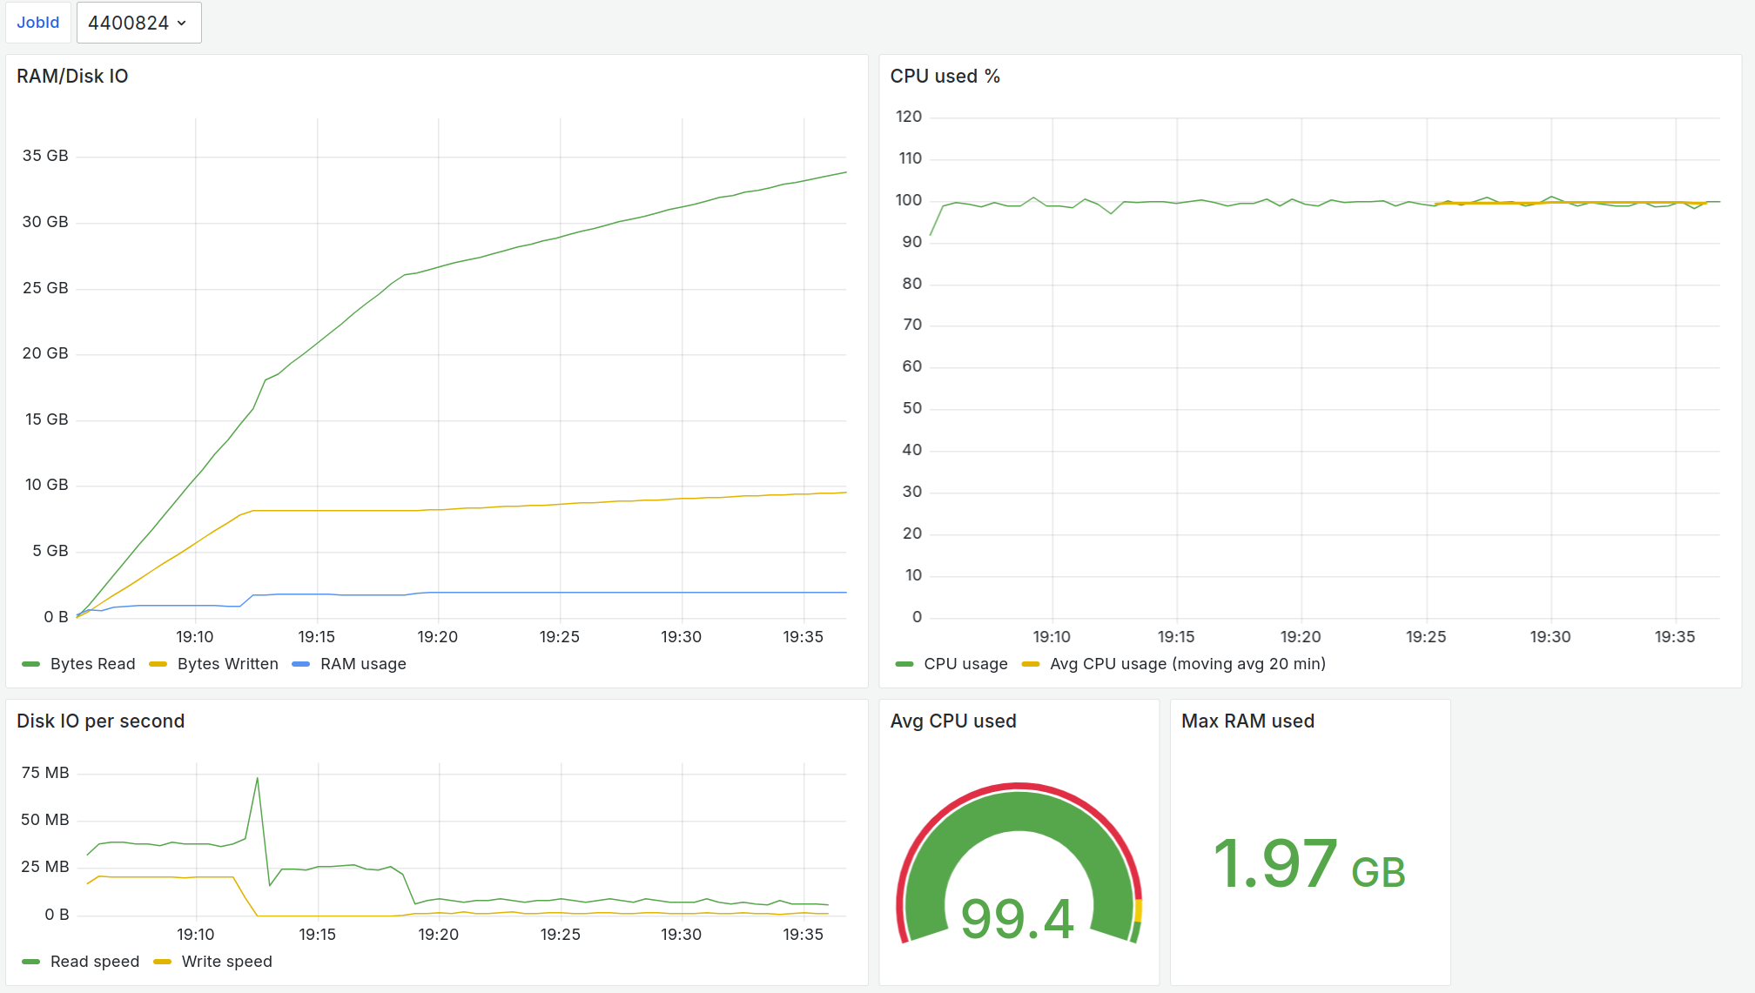
1. User job monitoring
Bytes read
RAM usage
Bytes written
CPU usage
(sliding avg 20min)
CPU usage
(momentarily)
Disk read speed
Disk read speed
Avg CPU usage
Max RAM usage

Slide 11
2. Transfer monitoring
Cluster
Grafana
Worknode
3
userscript.sh
jinr-get-file
1
Monitoring DB (InfluxDB)
dirac-dms-get-file
2
jinr-add-file
1
dirac-dms-add-file

Slide 12
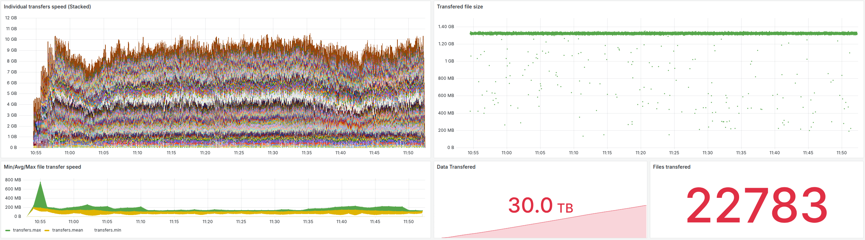
2. Transfer monitoring
Momentarily transfer speed
Max / Min transfer speed

Slide 13
2. Transfer monitoring
Size of transferred data
Size of files
Amount of files

Slide 14
3. Jobs visualization and analysis
See Anna’s talk: https://indico.cern.ch/event/1433941/contributions/6650526/

Slide 15
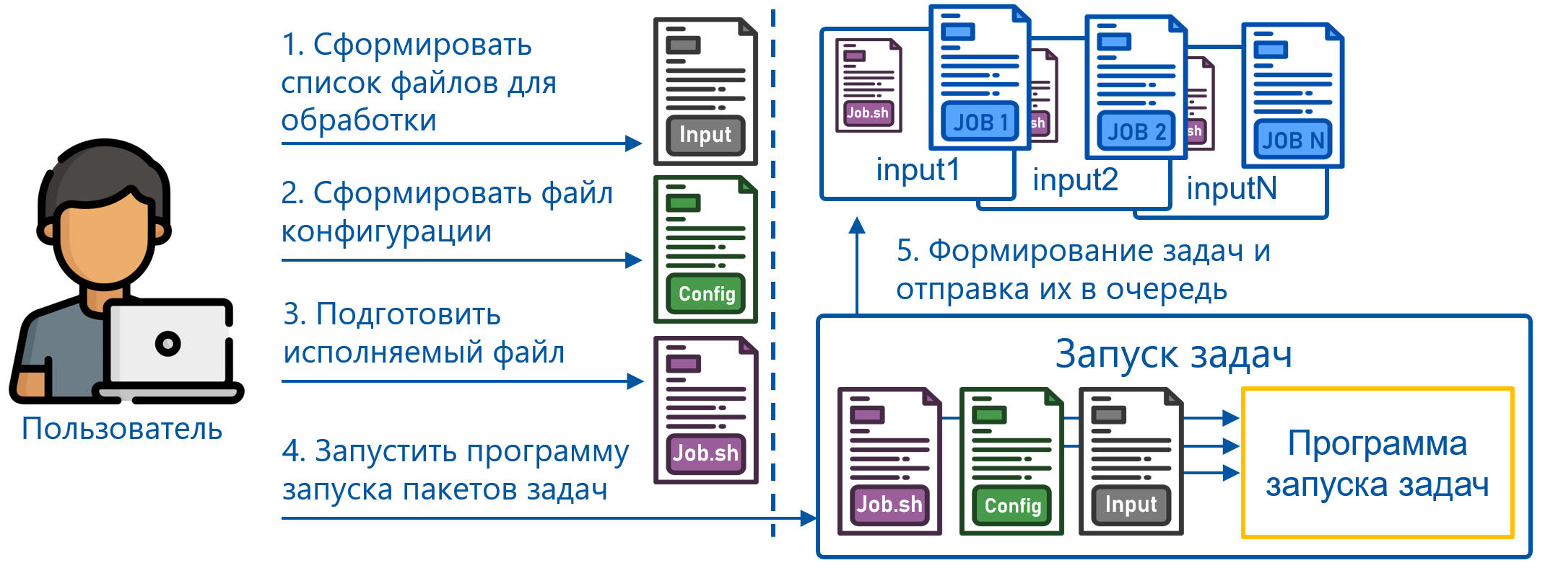
4. Job launch tool
1. Form list of LFNs
2. Edit config.json
3. Edit executable.sh
Job launching
User
4. Run launch.py
launch.py
config.json content:
"job_name": "RawToDigi_v24:",
"job_type": "RawToDigi",
"input_files": "input.lfns",
"sites": ["DIRAC.JINR-TIER.ru"]
"destination_path": "/bmn/vo/digi",
"output_se": "JINR-EOS-BMN",
"input_ext": ".data",
"output_ext": ".root",
"executable": "RawToDigi.sh"
./submit –D # Dry run
./submit –T # Single job for each allowed site
./submit # Submit jobs
# Script will analyze currently Running and Waiting jobs to avoid second submission

Slide 16
5. Data transfer tool
1. Form list of LFNs to transfer
2. Edit config.json
Job launching
User
4. Run launch.py
launch.py
config.json content:
"transfers_list": "input_files.lfns",
"transfers_done": "done.txt",
"base_path": "/bmn.nica.jinr/exp/dst/run8/24.12.0",
"destination_path": "/eos/nica/bmn/exp/dst/run8/24.12.0",
"sites": ["DIRAC.JINR-LHEP.ru"],
"se_name": "Change if adding to SE",
"jobs": 50
Allow transfers ”To” and “From” local storages!

Slide 17



6. Simulation system
JobQueue
Monitoring
Parameters
Simulation system
Results
Controller
Written in Python to predict CPU, RAM, network and disk load.
All configuration is in python code.
It is used to check the behavior of hypothetical workload in real infrastructure.
Simulation is done every second, but period may be increased for speeding up simulation.
InfluxDB is used for results storage. Grafana – for visualization.
Storage
Cluster
Worknode
Job
Task

Slide 18
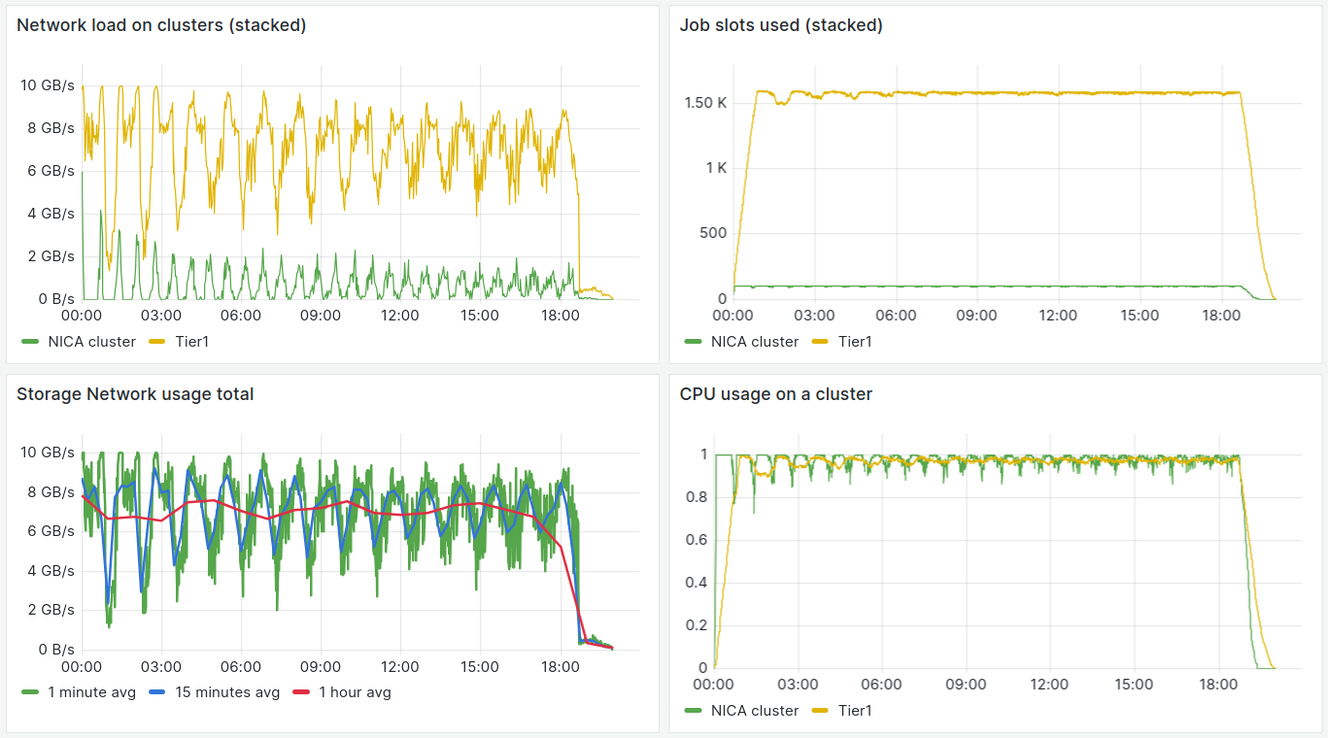
BM@N RawToDigi simulation
Standard schema of resources. Tier1 – 1500, pilot submission – 30/m

Slide 19
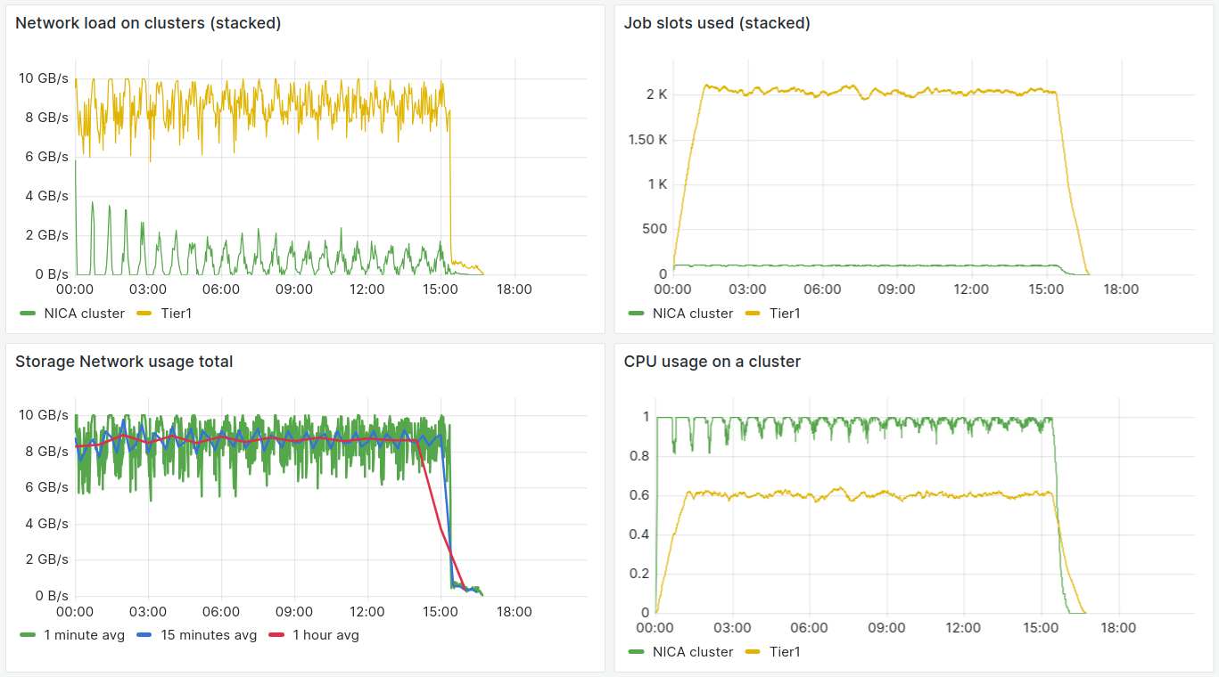
BM@N RawToDigi simulation
Tier1 3000 cores, pilot submission – 30/m

Slide 20
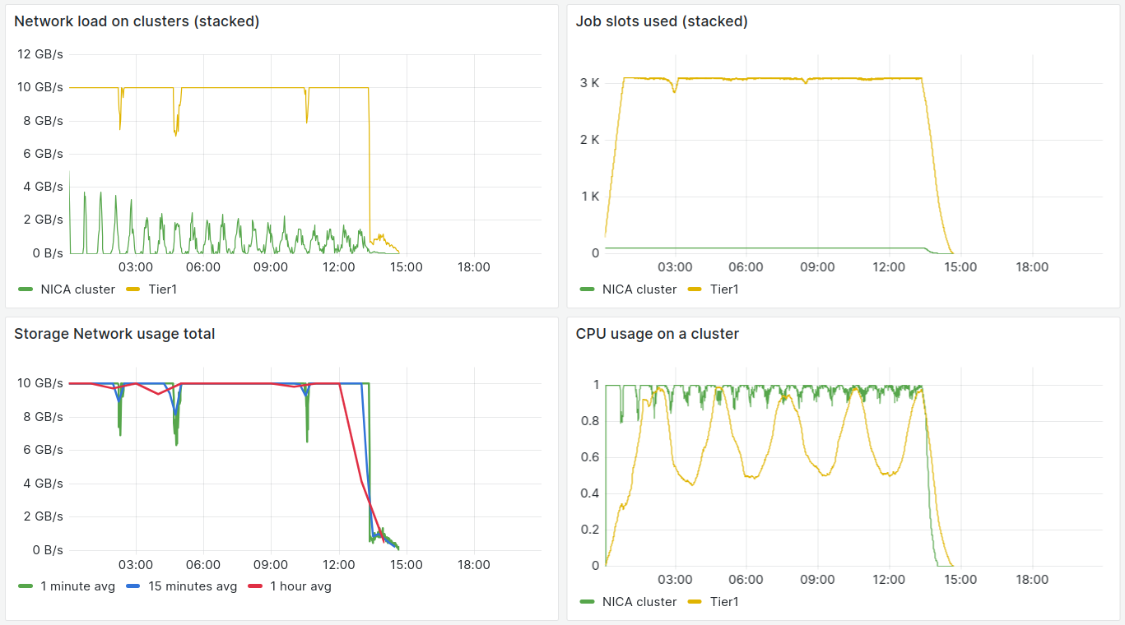
BM@N RawToDigi simulation
Tier1 3000 cores, pilot submission – 60/m

Slide 21
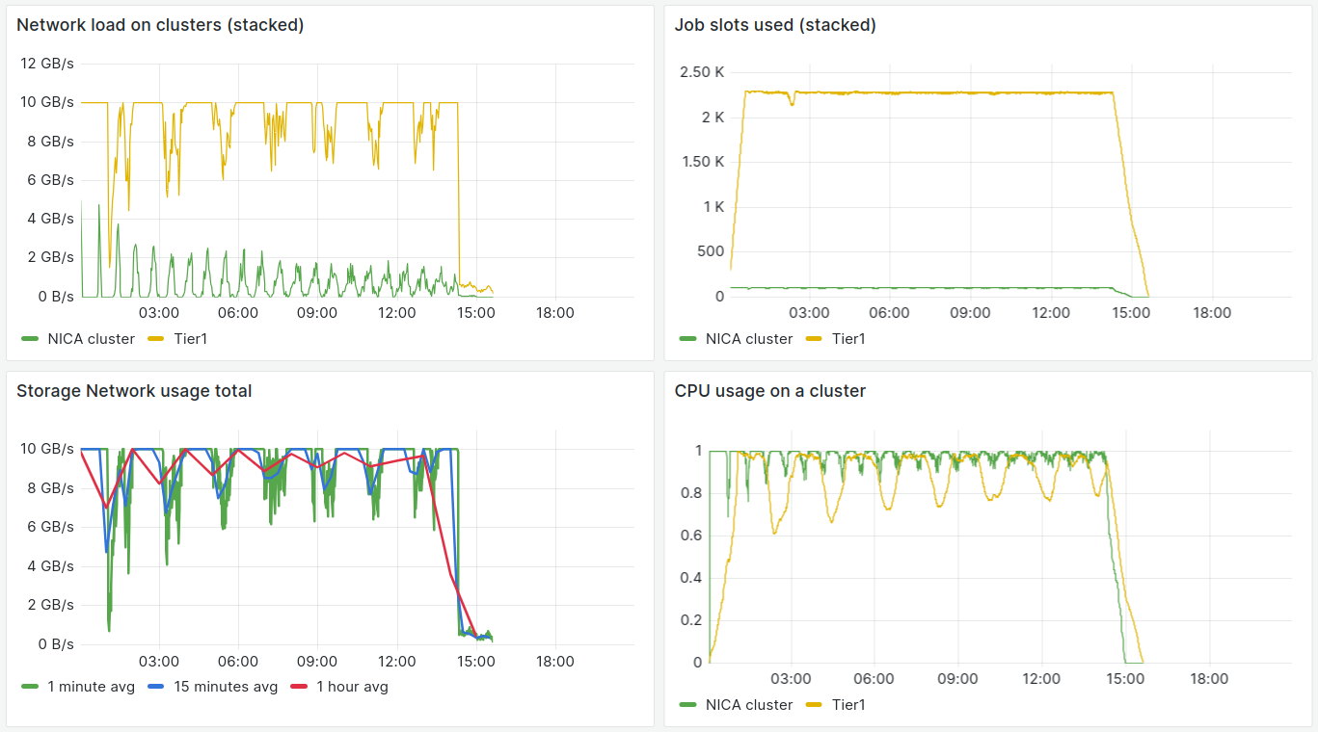
BM@N RawToDigi simulation
Tier1 optimal: ~2200 cores, pilot submission – 60/m

Slide 22
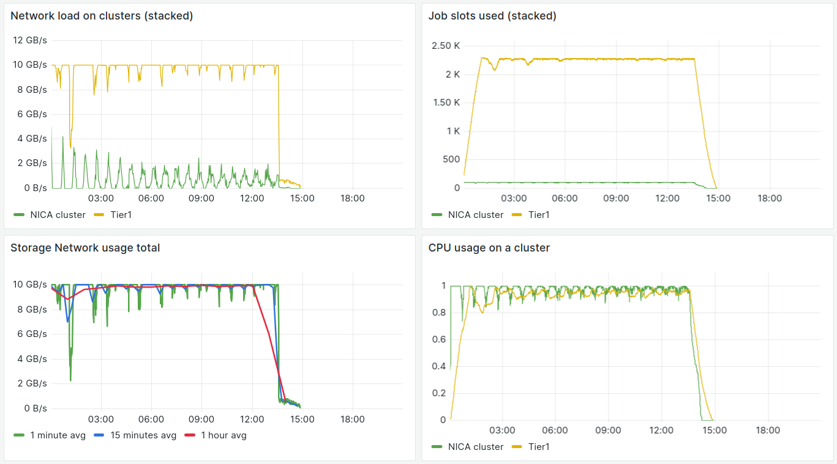
BM@N RawToDigi simulation
Tier1 optimal: ~2200 cores, pilot submission – 37/m

Slide 23

Automation
Detection of a new files rely on the files meta data
RawToDigi query: {type=raw, run_number=9}
DigiToDst query: {type=digi, run_number=9}
For 1 file – 1 job is started
DIRAC FileCatalog
EOS NCX
1
MLIT CTA
MLIT EOS
2
DIGI
3
DST
New raw file discovery
RawToDigi
New digi file discovery
DigiToDst

Slide 24


General schema of DIRAC@JINR
Authentication
X509 (RDIG)
Authorization
VOMS
Common services and systems
Etc
Configuration
WebApp
Storage systems
Accounting
Computing resources
WMS
DMS
TS
RMS
1. User jobs monitoring
4. Job launcher
3. Job visualization
2. Transfer monitoring
5. Data transfer tool
6. Simulation system
Grafana
User/Admin

Slide 25
Why DIRAC?
1. Enough performance for job and data management.
No need to use a sledge-hammer to crack a nut.
But with possibility to become a sledge-hummer.
2. Simplicity of installation, support and development.
1 FTE (which could be initially a greenhorn) is enough
3. Single solution for all: jobs, data, user groups, rights, automation, etc.
No need to learn and keep in mind different systems and features of interactions between them.
4. Open and active community of developers, admins and users.
Yearly meetings, active github.
5. Multi-VO support.
It saves time for current groups and encourage new groups to experiment with DIRAC.
Thanks to DIRAC Developers, Administrators, Users for help !!!

Slide 26
DIRAC documentation is much better!
but still, DIRAC always lacks
”Best” or even “Good enough practices” recommendations.
It's not a complaint! But rather a statement of fact.

Slide 27
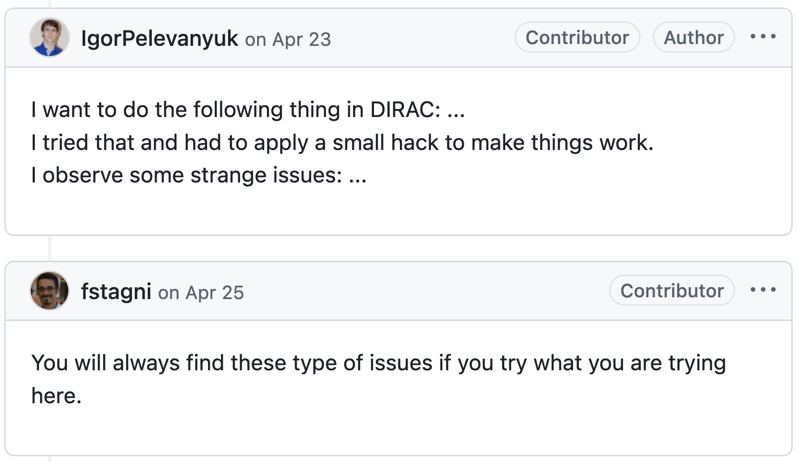
Thank you for attention!

Slide 29
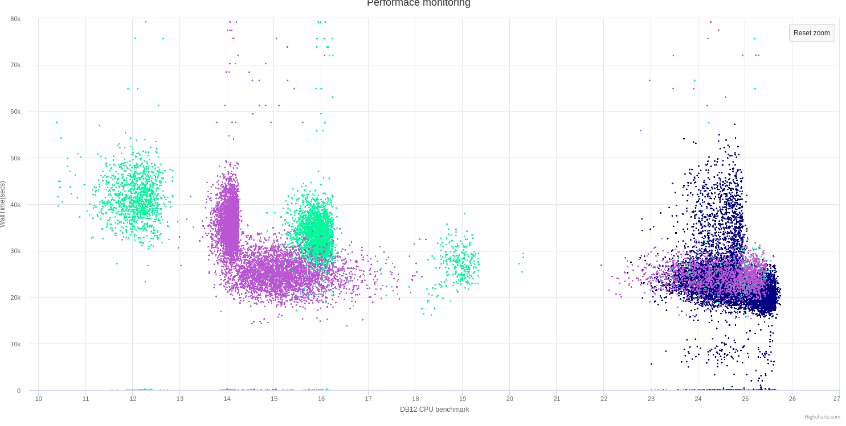
Issue with DB12
AMD estimation problem by DB12
Walltime
DB12 benchmark

