Slide 1
Week 27:
R134a with z5 material
Presenter: Amin Bouzaiene, Maria Cristina Arena, Hsuan-Chu Chen

Slide 2
Experimental design
Conditions
  Flowrate: 1-100 L/hr (conversion factor ~3) at room temp with gas supply pressure 3 barg
Procedures (with cycles)
  Using vacuum pump to keep the cartridge nearly vacuum (-0.92 barg)
  Insert R134a with gas cylinder
  As the pressure of the cartridge increases to 0 barg, stop inserting gas, and turn on the vacuum pump

Slide 3
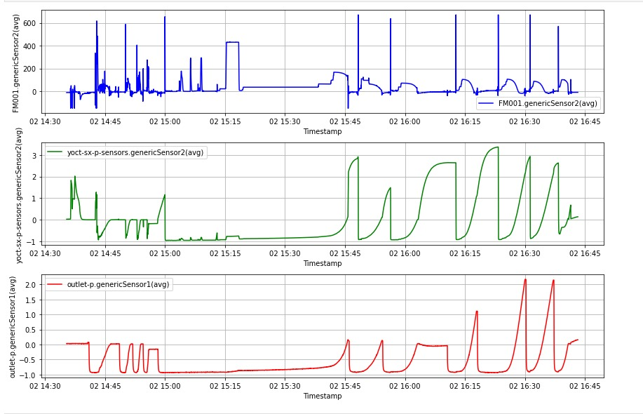
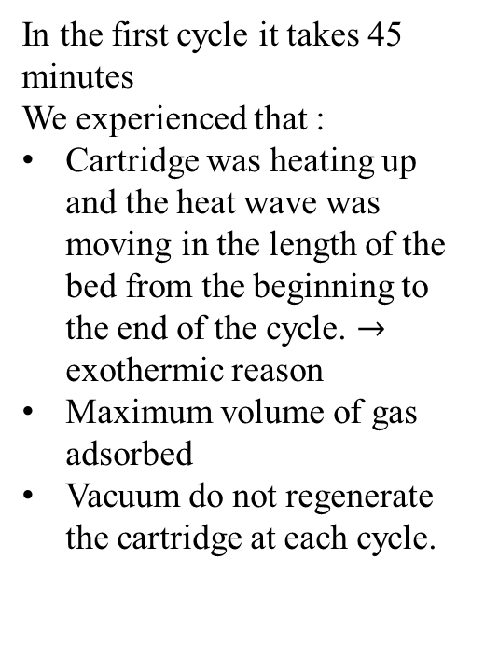
R134a PSA cycles
In the first cycle it takes 45 minutes
We experienced that :
Cartridge was heating up and the heat wave was moving in the length of the bed from the beginning to the end of the cycle. $→$ exothermic reason
Maximum volume of gas adsorbed
Vacuum do not regenerate the cartridge at each cycle.

Slide 4
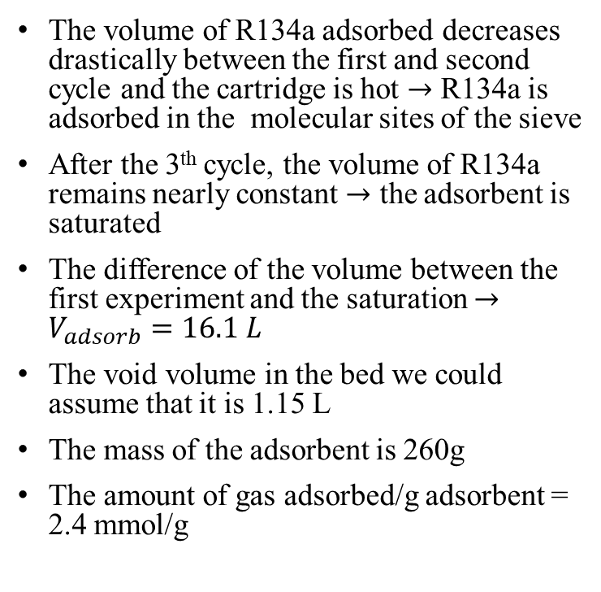
Results (z5 experiments)
The volume of R134a adsorbed decreases drastically between the first and second cycle and the cartridge is hot $→$ R134a is adsorbed in the molecular sites of the sieve
After the 3th cycle, the volume of R134a remains nearly constant $→$ the adsorbent is saturated
The difference of the volume between the first experiment and the saturation $→$ $V_{adsorb}=16.1 L$
The void volume in the bed we could assume that it is 1.15 L
The mass of the adsorbent is 260g
The amount of gas adsorbed/g adsorbent = 2.4 mmol/g
Converted volume = Volume measured by the flowmeter calibrated in air/ conversion factor

Slide 5
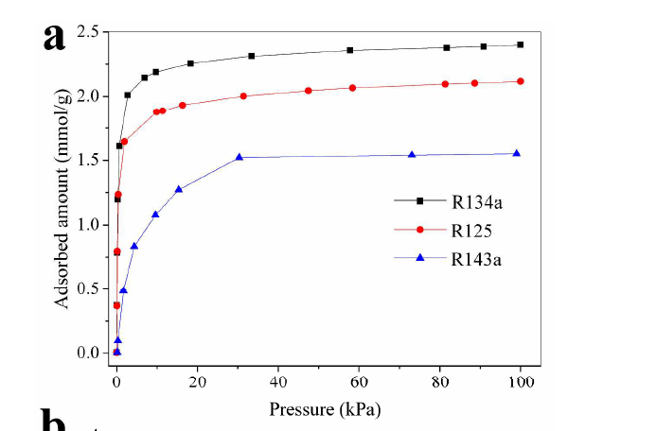
R134a literature compared with experimental results
260 g of adsorbent material and 16 liters of gas adsorbed
The amount of gas adsorbed/g adsorbent = 2.51 mmol/g at a pressure of 1 bar it is comparable with literature findings

Slide 6
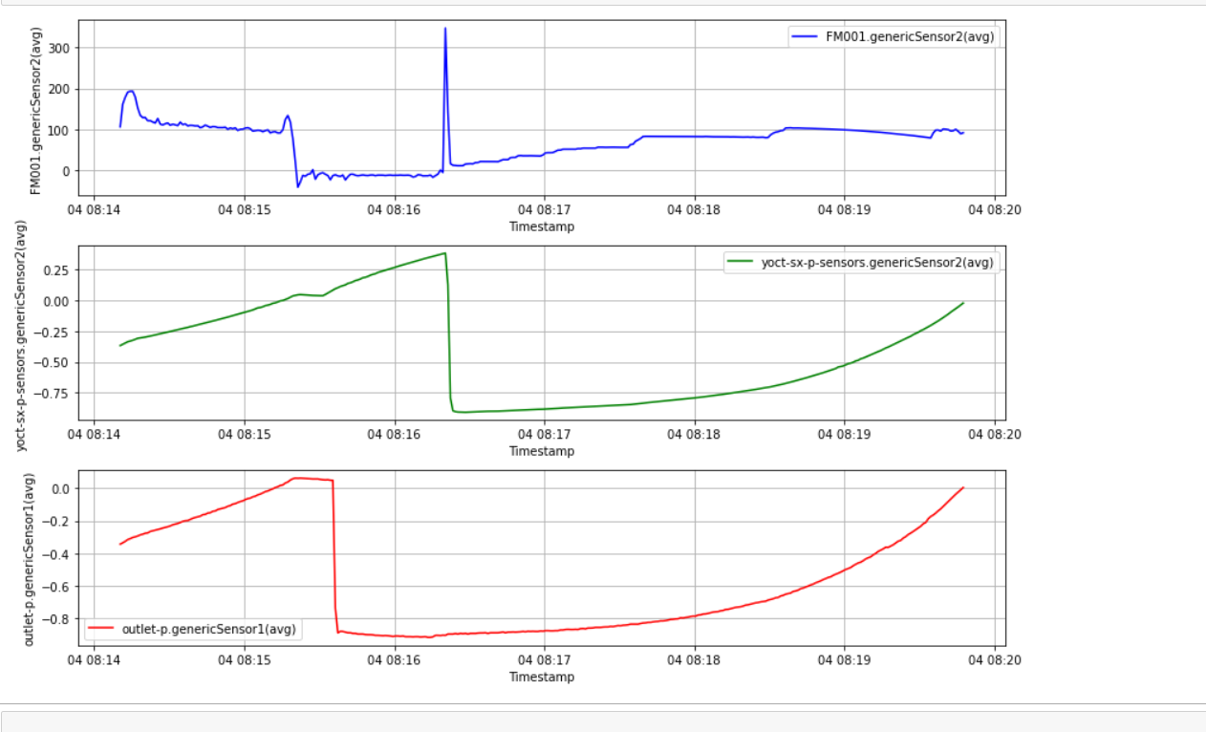
Regeneration with vacuum for 45 minutes
GOAL : try to see if keeping under vacuum the cartridge for a time equal to the time of adsorption of the first cycle, the regeneration takes place or not.
1st cycle after thermal regeneration volume of gas adsorbed was 16.1 L
After vacuum for 45 minutes volume adsorbed is 0.7 L
RESULT: the regeneration with vacuum pressure is NOT effective.

