Slide 1


UPDATE CMS
D. Galassi – 27/06/24

Slide 2
THE GOAL
PART 1
CMS TESTS

Slide 3
MAY TESTS
SO?
Before the modification of the FGR system we noticed that:
There is an interesting correlation between quality and extraction time has for C1 and C4. Moreover, C2 and C3 are rarely able to discharge solely. Thus, reducing the quality of their output
Data shows that C3 and C4 perform better in terms of quality with respect to C1 and C2
In most of cases C1 and C2 are responsible for peaks in iC4 concentration
We can observe that:
1. We modified the plant to connect the output pipes directly to the before pump buffer
2. Since Column 1 & 2 are the responsible for producing a “dirtier” product we tried to reduce the extraction flowrate
re extracted as triplets the quality drops
3. The best performers are C3 and C4
The data for the tests have been merged (vertical concatenation) to visualize the behavior of different columns and column combinations.
Column | Avg. ppm iC4
C1 | 7000
C2 | 9400
C3 | 4070
C4 | 4100

Slide 4
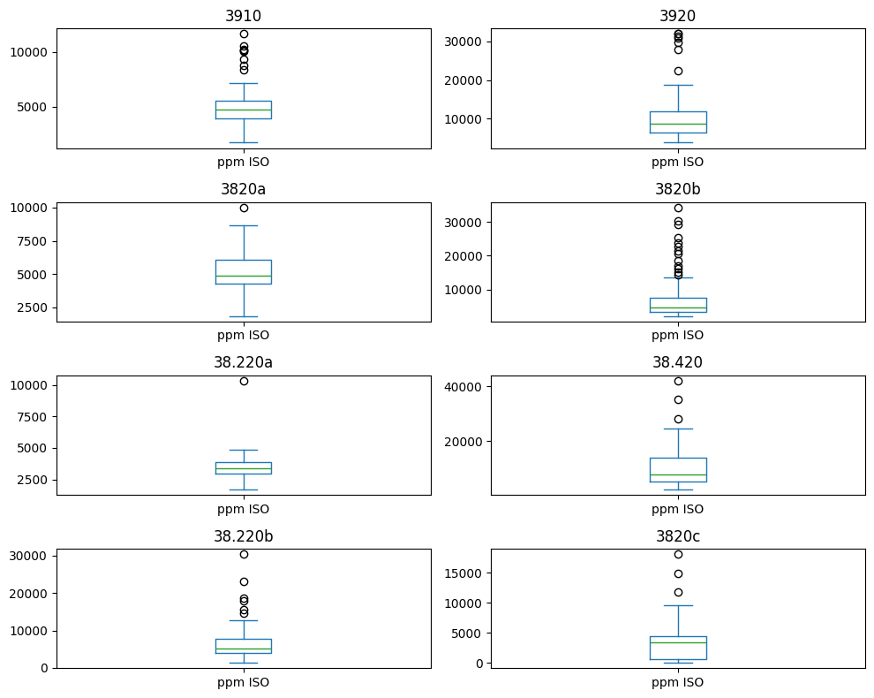
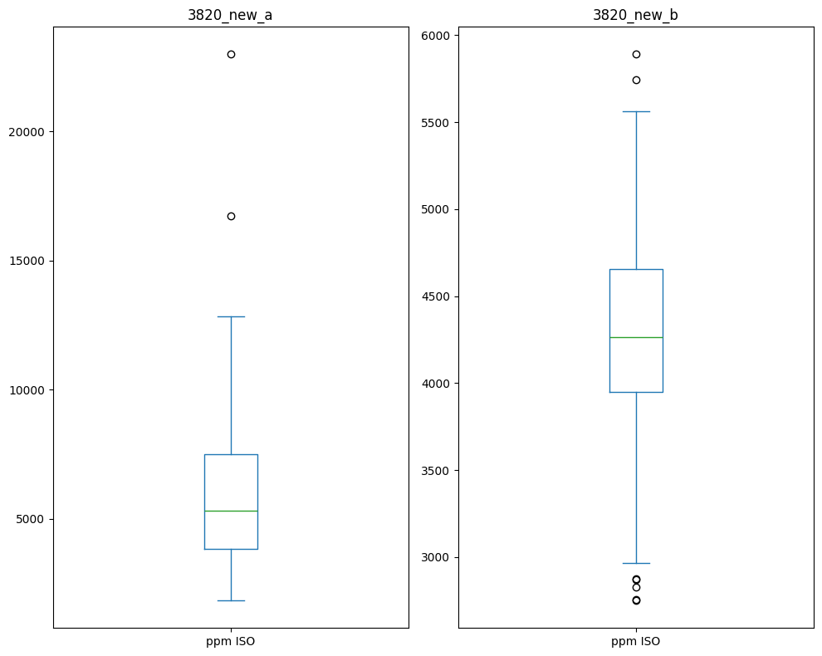
BOX PLOTS: MAY
BOX PLOTS: JUNE
- When analyzing the statistics of the samples (by test analysis). We note a high variability due to the influence of temperature, pressure, and column geometry.
- This means that during the tests the quality varies along the columns.
The modification of the extraction tubes does not solve the high variance of the system which still present high peaks in isobutane (3820_new_a)
The reduction of the extraction flux from 650 l/h to 450 l/h promotes a more stabile recovery (3820-new_b)

Slide 5
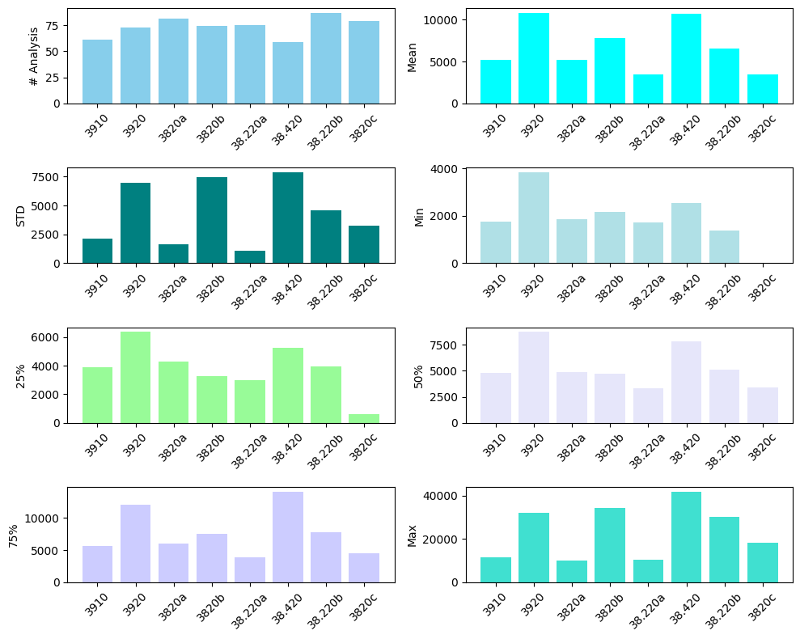
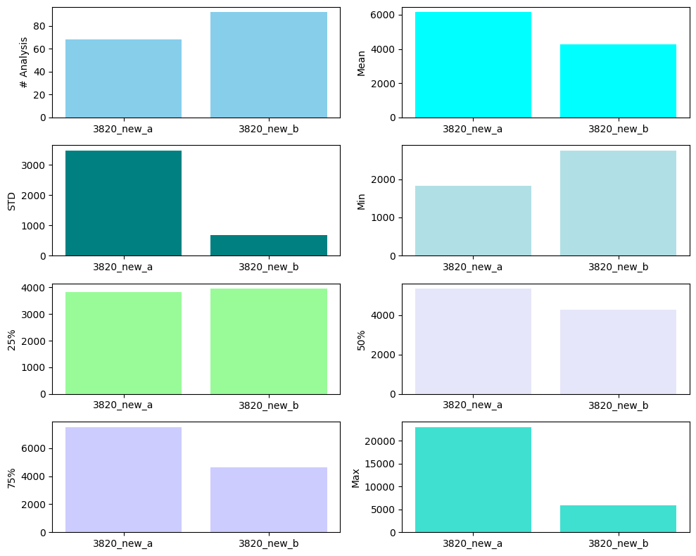
MAIN STATS: MAY
MAIN STATS: JUNE
The following plots report the main statistics in terms of PPM of isobutane measured during the tests
Here we report the same plot. What we can notice is that the reduction of extraction flux influences strongly the gas quality

Slide 6
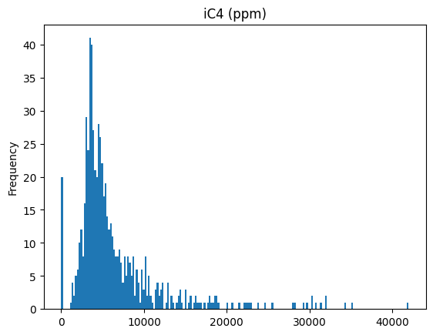
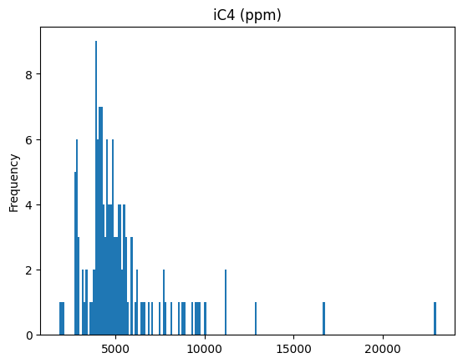
BY COLUMN ANALYSIS
MAY
JUNE
Average ppm iC4
6450
Average ppm iC4
5209
Standard Dev ppm iC4
5515
Standard Dev ppm iC4
2670
AVG ppm Reduction
20%
STD Reduction
51%

Slide 7
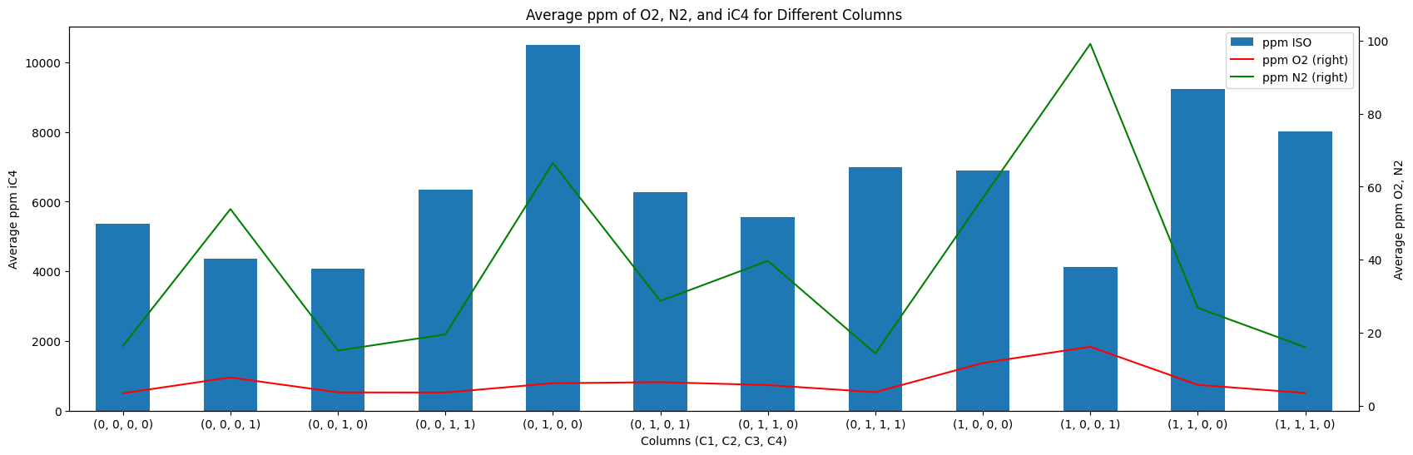
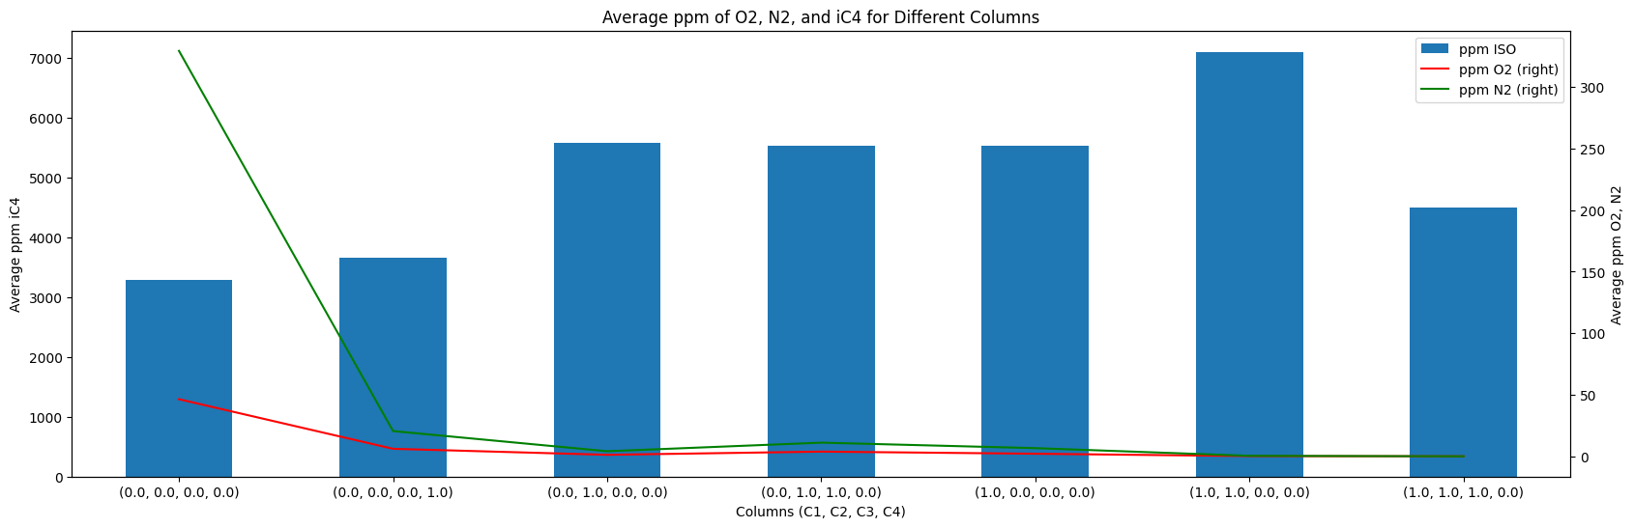
BY COLUMN ANALYSIS
The data for the tests have been merged (vertical concatenation) to visualize the behavior of different columns and column combinations.
In May we observed that:
1. Column C2 is the worst performer
2. When columns are extracted as triplets the quality drops a lot!
3. The best performers are C3 and C4
In June we are noticing that:
1. After the modifications we observe similar behaviors but the amount of iC4 and AIR is strongly reduced
2. Only two tests have been done, hence more data is required to confirm these results

Slide 8
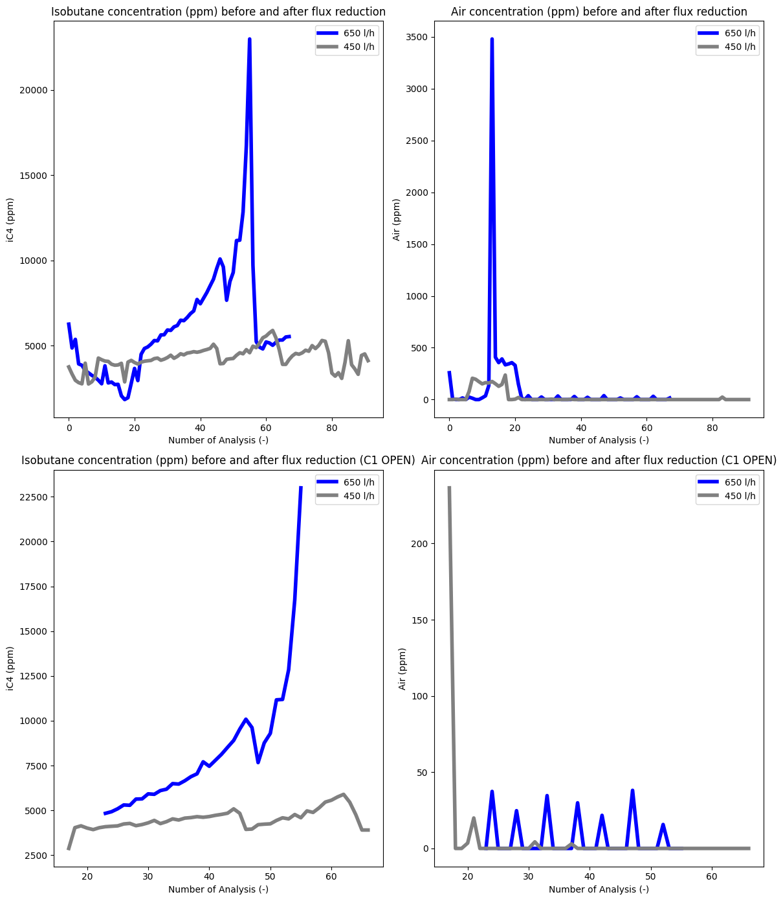
FLUX REDUCTION

