Slide 1
wakis:
3D Electromagnetic Time- Domain
Wake and Impedance Solver
ABP-CEI Meeting, 25th April 2024
Elena de la Fuente, Lorenzo Giacomel, Giovanni Iadarola, Carlo Zannini, Manuel Cotelo (UPM)
☺ Special thanks to: Chiara Antuono, Giovanni Rumolo, Benoit Salvant, Leonardo Sito, Jean Luc Vay (Berkeley Lab) and yet again to Lorenzo Giacomel

Slide 2
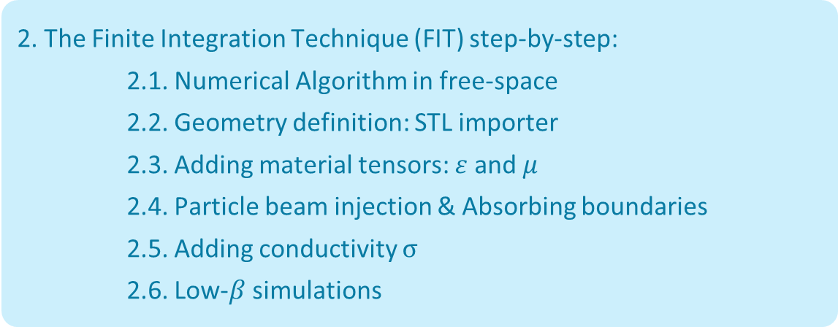
Outline
1. Introduction to Beam-Coupling Impedance simulations & Motivation
Slides 4 - 11
2. The Finite Integration Technique (FIT) step-by-step:
2.1. Numerical Algorithm in free-space
2.2. Geometry definition: STL importer
2.3. Adding material tensors: $ε$ and $μ$
2.4. Particle beam injection & Absorbing boundaries
2.5. Adding conductivity $σ$
2.6. Low-$β$ simulations
Slides 13 - 38
3. Conclusions, Challenges & Future work
Slides 40 - 42

Slide 3
Outline
1. Introduction to Beam-Coupling Impedance simulations & Motivation
Slides 4 - 11
2. The Finite Integration Technique (FIT) step-by-step:
2.1. Numerical Algorithm in free-space
2.2. Geometry definition: STL importer
2.3. Adding material tensors: $ε$ and $μ$
2.4. Particle beam injection & Absorbing boundaries
2.5. Adding conductivity $σ$
2.6. Low-$β$ simulations
Slides 13 - 38
3. Conclusions, Challenges & Future work
Slides 40 - 42

Slide 4
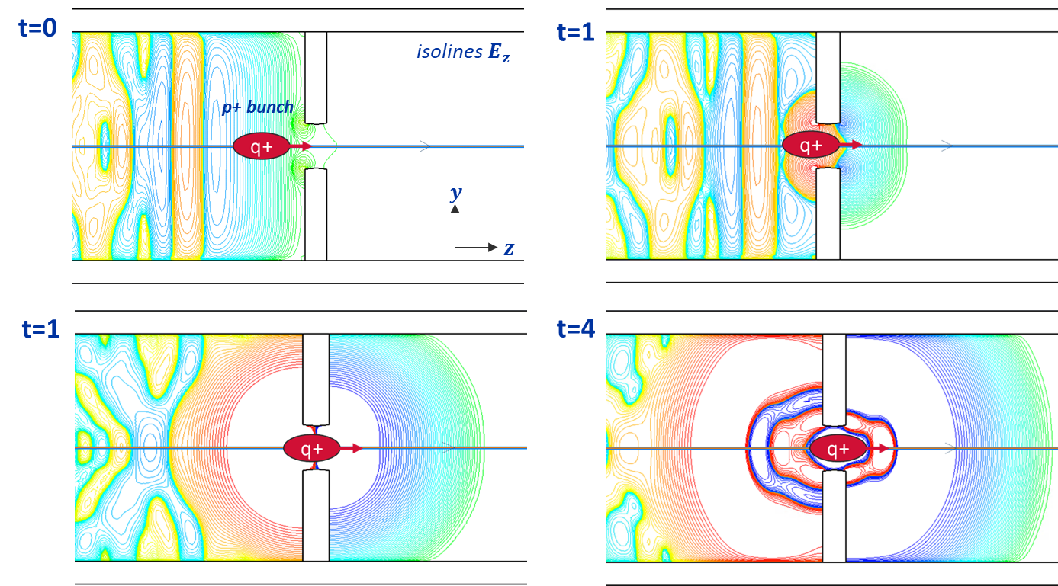
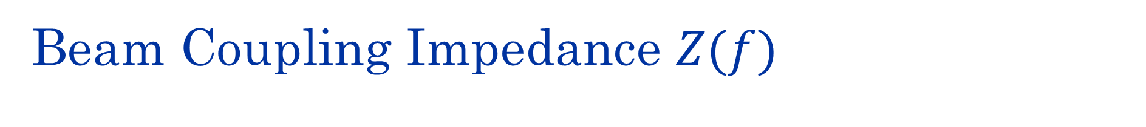
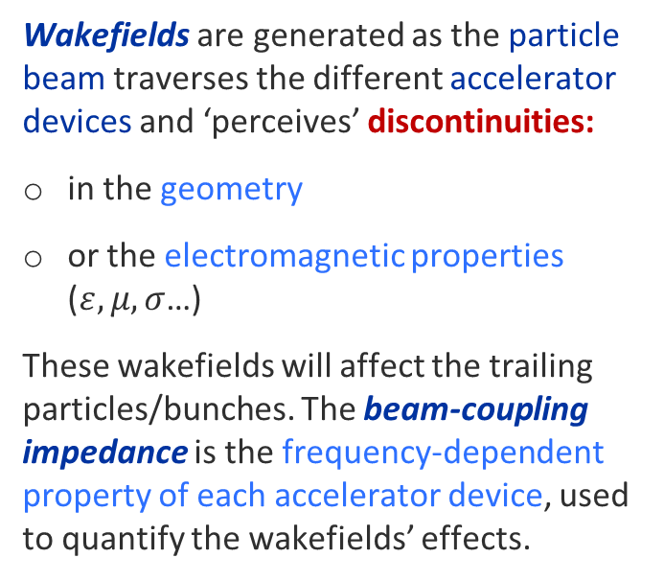
Beam Coupling Impedance $Z(f)$
Wakefields are generated as the particle beam traverses the different accelerator devices and ‘perceives’ discontinuities:
in the geometry
or the electromagnetic properties ($ε, μ, σ$…)
These wakefields will affect the trailing particles/bunches. The beam-coupling impedance is the frequency-dependent property of each accelerator device, used to quantify the wakefields’ effects.
Fig: 3D Time domain simulation of a smooth pipe with obstacle with a passing proton beam (1-4) with CST®

Slide 5
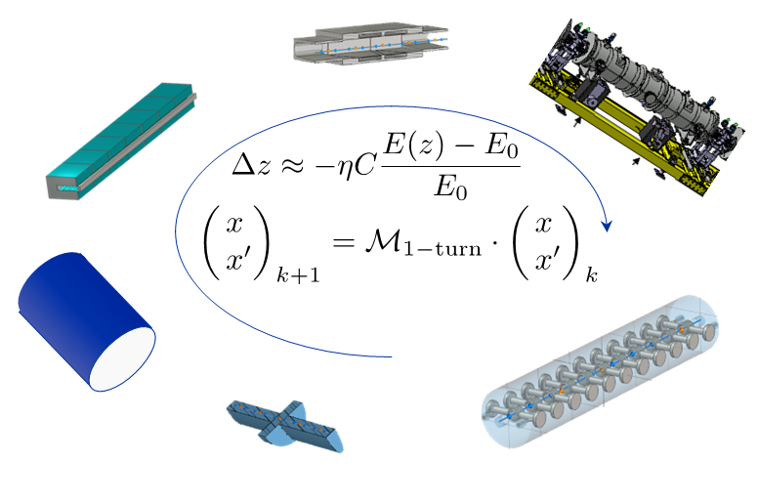
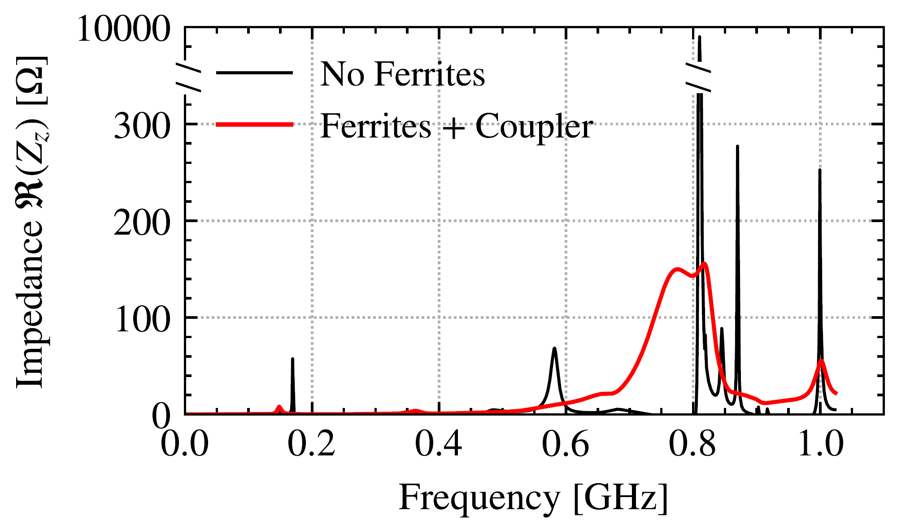
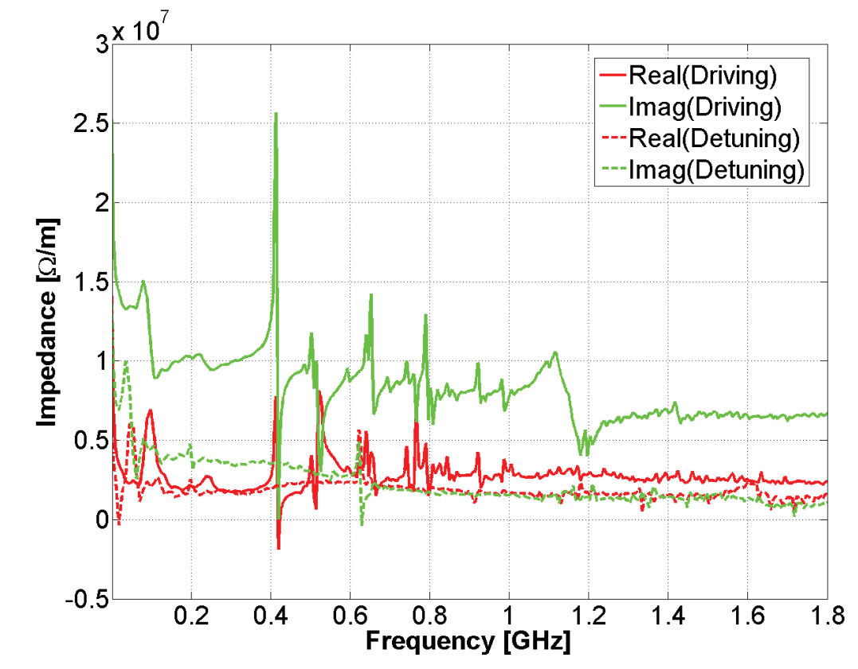
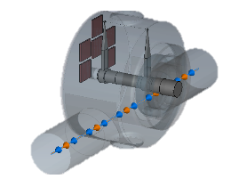
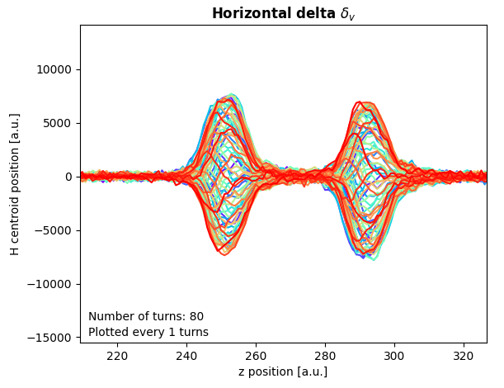
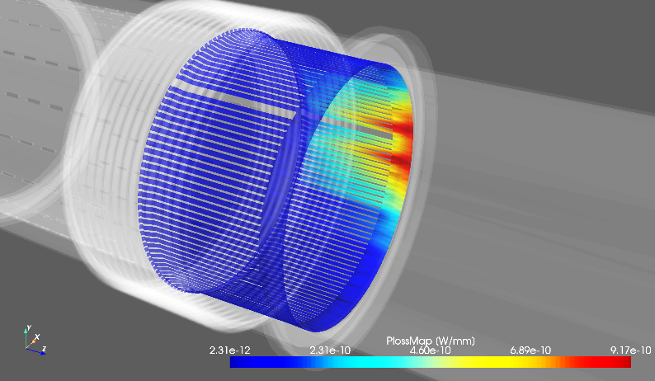
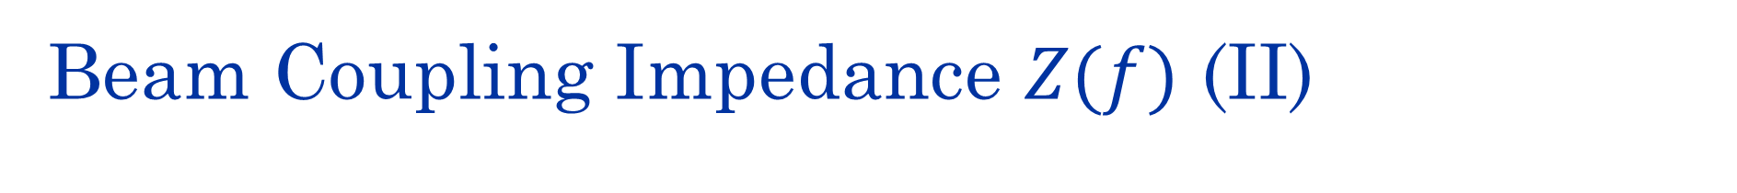
Beam Coupling Impedance $Z(f)$ (II)
The impedance of all relevant accelerator components is gathered in each accelerator's impedance model
And used in beam-dynamics codes (pyHeadTail, Xsuite) to predict beam behaviour
Or assess beam-induced heating of individual accelerator components and propose mitigation solutions
[2] PyHEADTAIL concept schematic.
K. Li & G. Rumolo
[4] SPS BWS mitigation solution (2023)
[3] Simulated Head-Tail
mode-zero instability
[5] Warm Vacuum modules Power lost map (2023)
[1] SPS Transverse vertical impedance model.
C. Zannini

Slide 6
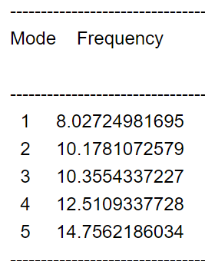
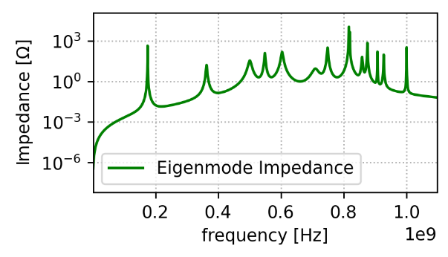
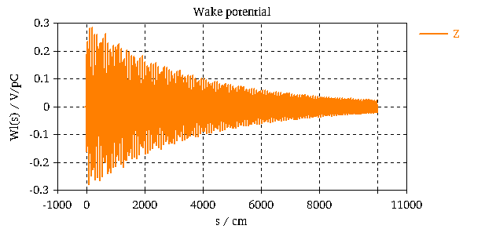
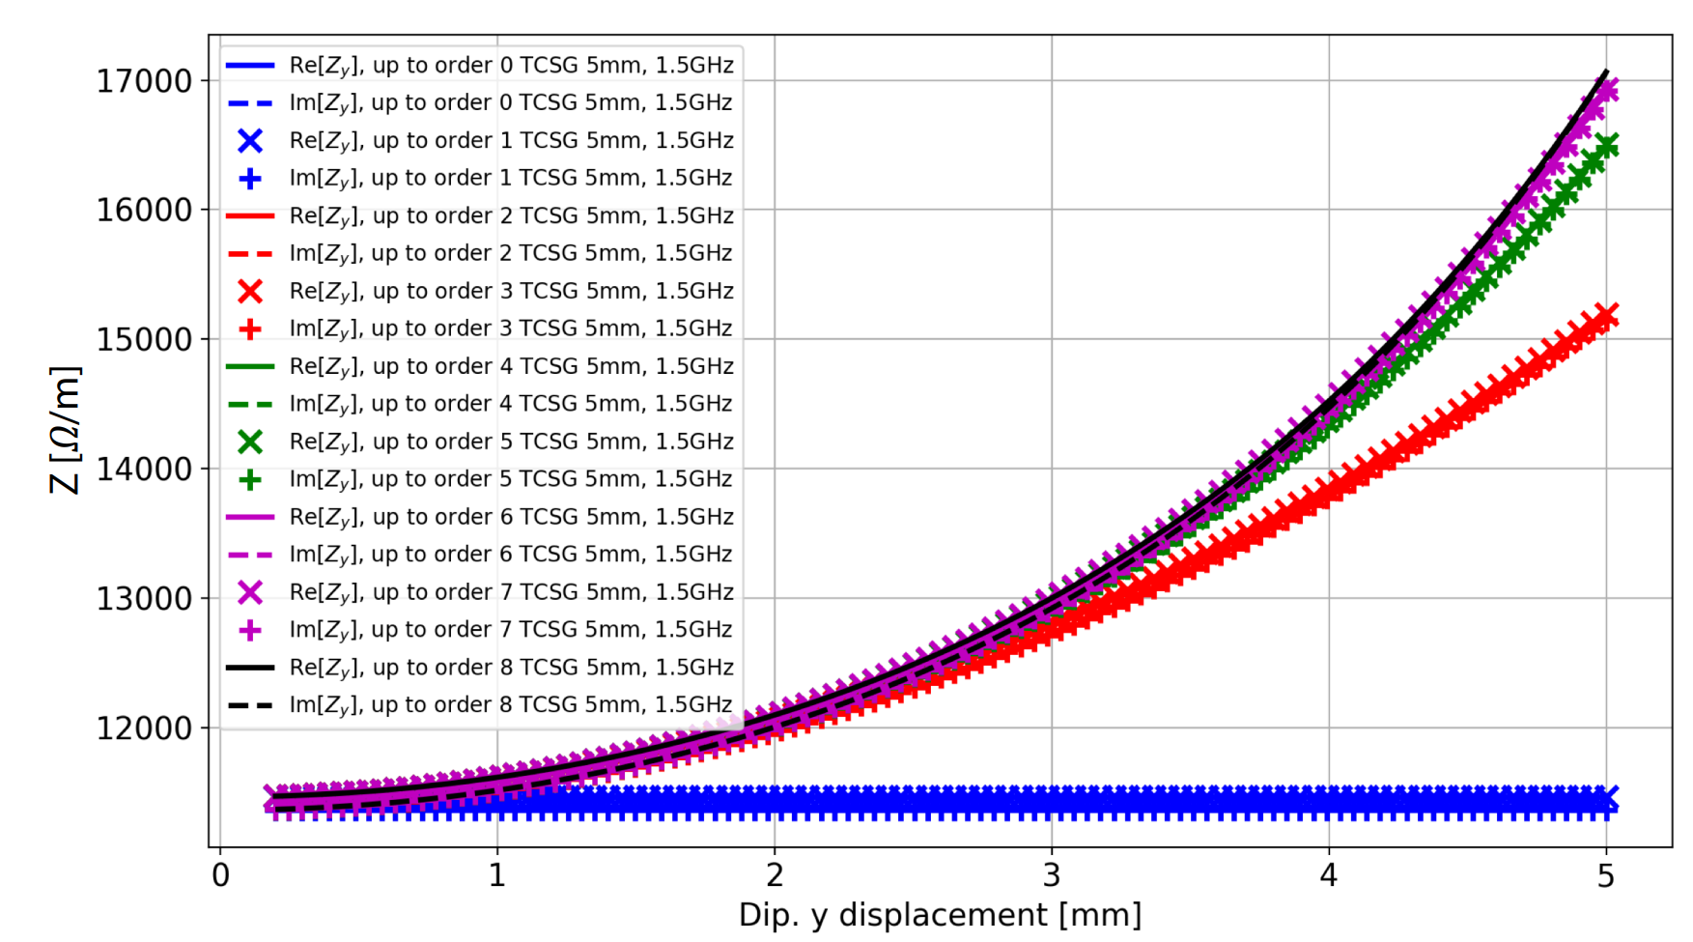
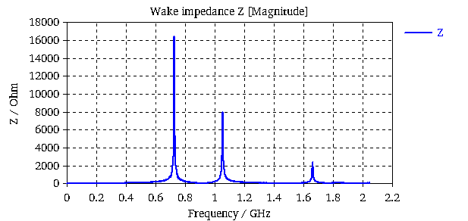



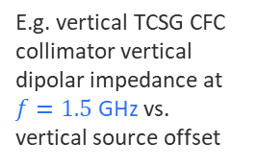



How to obtain $Z(f)$?
Directly in frequency domain (FD)
From the time domain (TD)
Eigenmode solver (CST®):
Wakefield solver (CST®):
Reconstructed $Z(f)$
Wake Potential $W(s)$
$$f, R_{s}, Q$$
Resistive wall impedance: (IW2D)
[1]
$$Z(f=1.5 GHz)$$
E.g. vertical TCSG CFC collimator vertical dipolar impedance at $f=1.5$ GHz vs. vertical source offset
Impedance $Z(f)$
[2]
E.g. simulation of lossy pillbox cavity with CST®
[1] N. Mounet. The LHC Transverse Coupled-Bunch Instability, PhD thesis 5305 (EPFL, 2012)
[2] N. Mounet. ImpedanceWake2D BE-ABP-CEI 22/04/2021

Slide 7
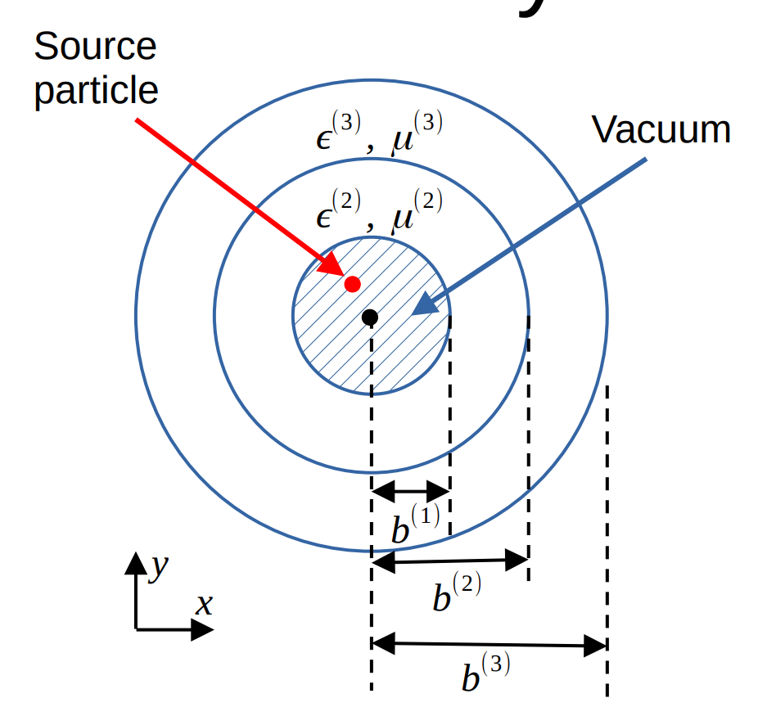
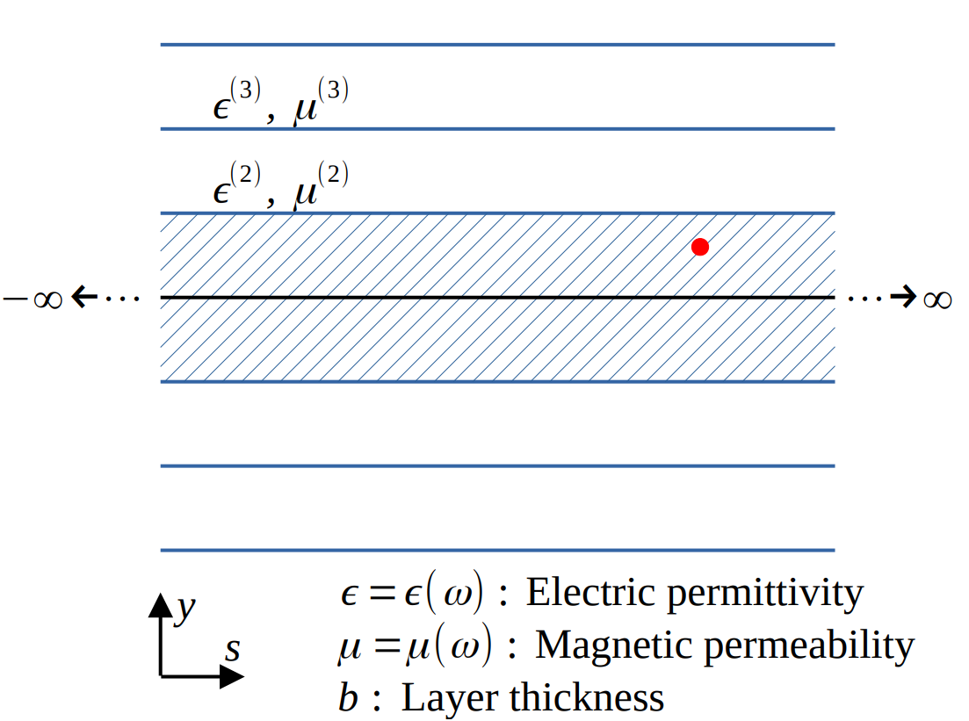
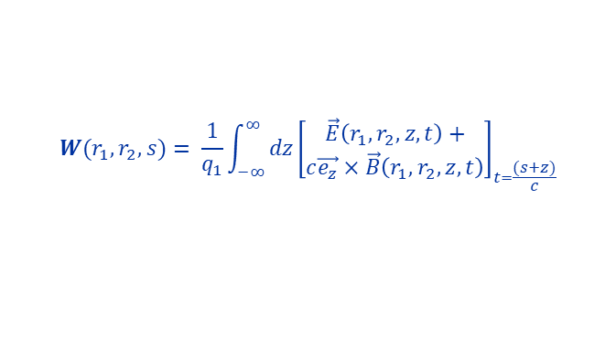
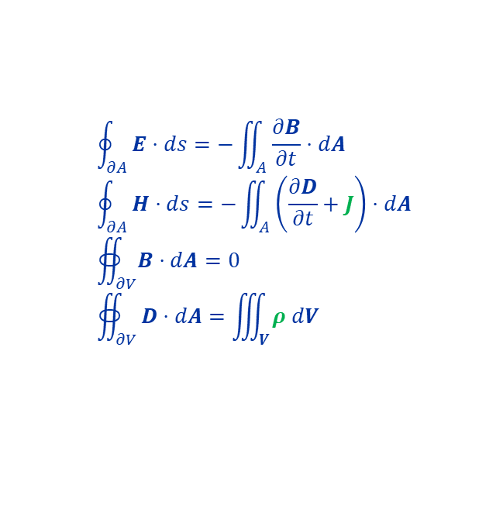

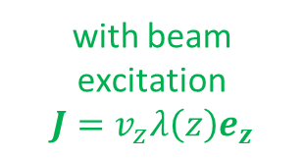

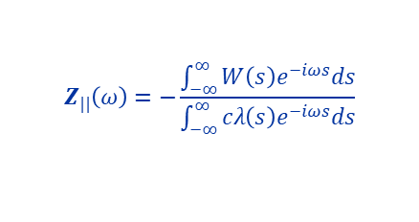
How to obtain $Z(f)$?
Commercial /
not open-source codes
Directly in frequency domain (FD)
From the time domain (TD)
Eigenmode solver (CST®):
Wakefield solver (CST®):
$$rot \vec{E}=jωμ\vec{H}$$
$$rot \vec{H}=jω\left(ε+\frac{σ}{jω}\right)\vec{E}$$
Eigenvalue problem
3D time domain Maxwell equations (integral form)
$$rot \frac{1}{\underline{\underline{μ}}}rot \vec{E}={\underline{\underline{ε}}ω}^{2}\vec{E}$$
$$\oint_{∂A}^{ }{E⋅ds=−\iint_{A}^{ }{\frac{∂B}{∂t}⋅dA}}$$
$$\oint_{∂A}^{ }{H⋅ds=−\iint_{A}^{ }{\left(\frac{∂D}{∂t}+J\right)⋅dA}}$$
$$∯_{∂V}^{ }{B⋅dA}=0$$
$$∯_{∂V}^{ }{D⋅dA=\iiint_{V}^{ }{ρ dV}}$$
Fundamental EM modes of 3D loss-less resonant structures without excitation + Q-factor postprocessing
with beam excitation
$$J=v_{z}λ\left(z\right)e_{z}$$
Resistive wall impedance: (IW2D@CERN)
[1]
+ wake potential and impedance computation:
$$W(r_{1},r_{2},s)= \frac{1}{q_{1}}\int_{−∞}^{∞}{dz{\left[\begin{aligned}\vec{E}\left(r_{1}, r_{2}, z, t\right)+ \\ c\vec{e_{z}}×\vec{B}\left(r_{1}, r_{2}, z, t\right)\end{aligned}\right]}_{t=\frac{(s+z)}{c}}}$$
$$Z_{||}\left(ω\right)=−\frac{\int_{−∞}^{∞}{W_{ }\left(s\right)e^{−iωs}ds}}{\int_{−∞}^{∞}{cλ\left(s\right)e^{−iωs}ds}}$$
(FT + deconvolution)
[1] N. Mounet. The LHC Transverse Coupled-Bunch Instability, PhD thesis 5305 (EPFL, 2012)

Slide 8

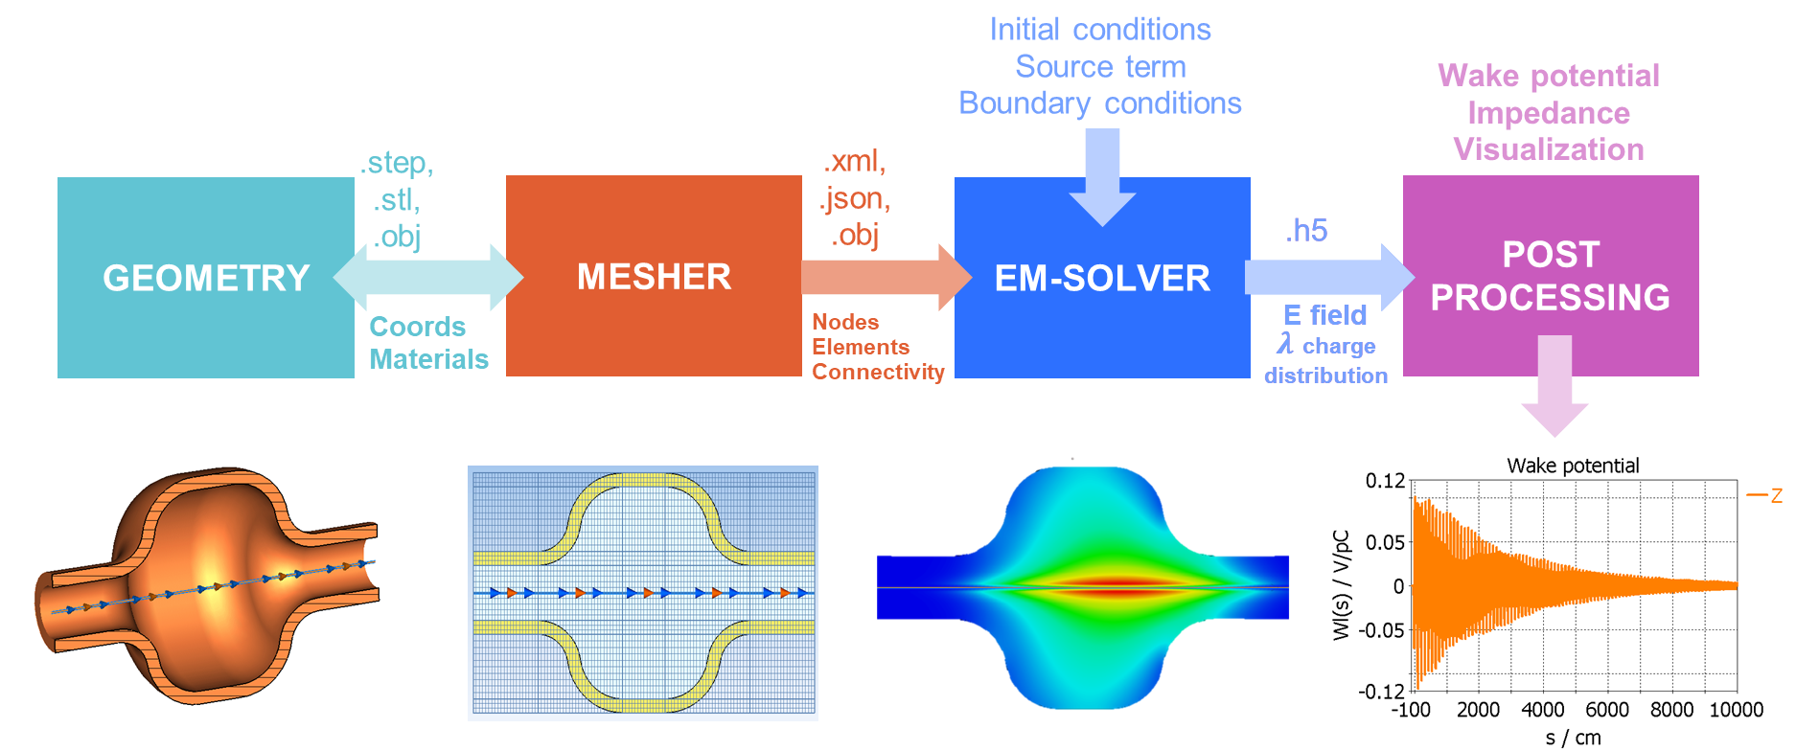
Project objective
Develop an open-source Wakefield Solver (i.e., 3D electromagnetic time-domain) at CERN
WAKE SOLVER WORKFLOW

Slide 9
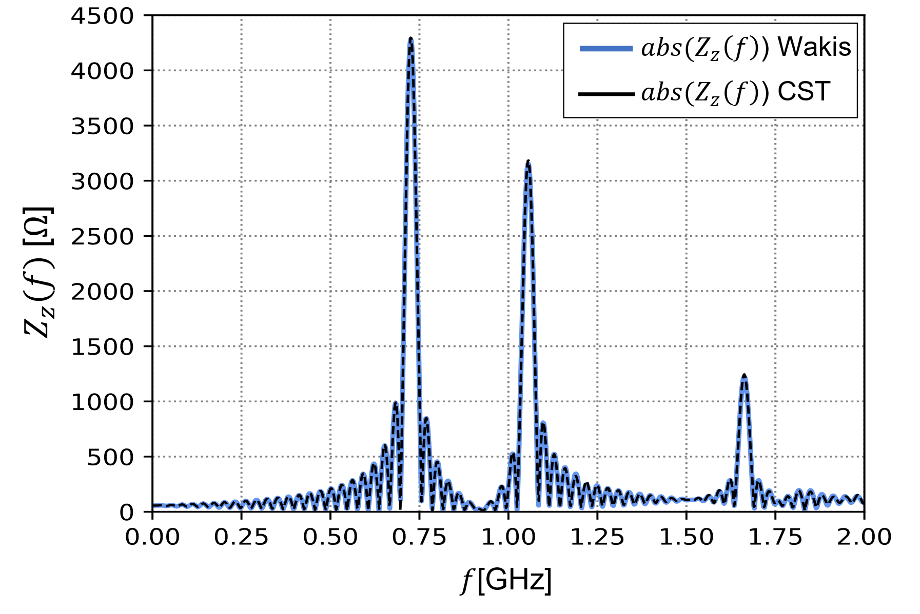
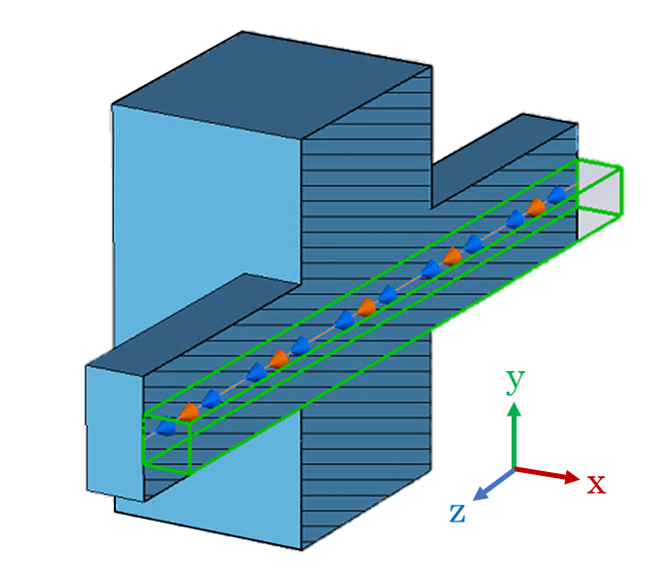
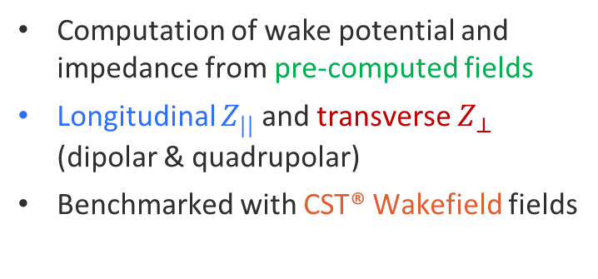
PhD motivation
Trainee
PhD
1st year
2nd year
1st year
2nd year
3rd year
(v0.1) Developed wakis package:
Computation of wake potential and impedance from pre-computed fields
Longitudinal $Z_{||}$ and transverse $Z_{⊥}$ (dipolar & quadrupolar)
Benchmarked with CST® Wakefield fields
[1] Progress and challenges of an in-house wake/impedance solver. ABP information meeting, 28th April 2022. https://indico.cern.ch/event/1154158/

Slide 10
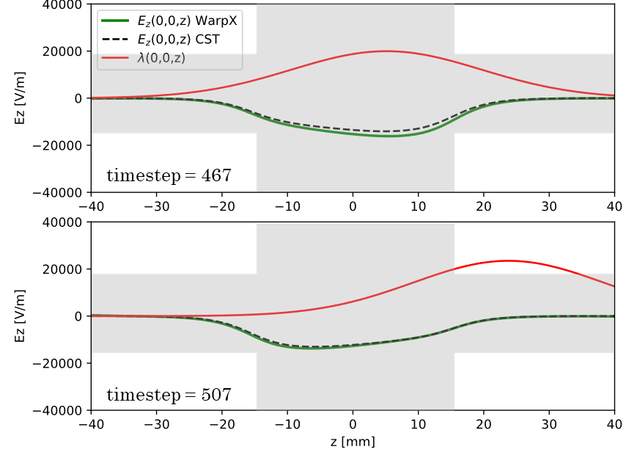
PhD motivation (II)
Trainee
PhD
1st year
2nd year
1st year
2nd year
3rd year
(v0.2) Explored open-source EM solvers to couple with wakis:
WarpX was the most promissing option: PIC+FDTD, mesh refinement (AMR), PML boundaries, python API
Found very good agreement for pillbox cavity, AMReX developed importer for more complex geometries
WarpX at the time, did not include material tensors other than vacuum/PEC. Found limitations in beam injection & PML behaviour too, C++ core, complexity…
[2] Progress on in-house wake solver “wakis”. ABP-CEI meeting, 3rd August 2023. https://indico.cern.ch/event/1283485/

Slide 11











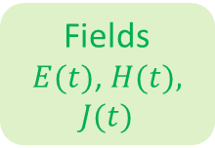

PhD status
(v.0.3) Decided to explore CST®’s numerical method, the Finite Integration Technique (FIT) in a python mockup ☺
Trainee
PhD
1st year
2nd year
1st year
2nd year
3rd year
wakis (v0.3)
Geometry importer
Boundary conditions
Time stepping scheme
CAD Geometry
(.stl)
Simulation
parameters
Visualization
& post-proc
S$ource f(t)$
Fields
$E(t)$, $H(t),$ $J(t)$
Mesh
$$G, \tilde{G}$$
Operators $C, D_{A}, D_{s},{\tilde{D}}_{A}, {\tilde{D}}_{s}$
Wake solve
$$W, Z$$
Materials $M_{ε}, M_{μ}, M_{σ}$
100%
https://github.com/ImpedanCEI/FITwakis

Slide 12
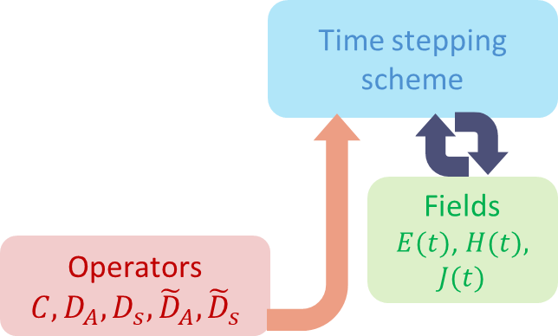
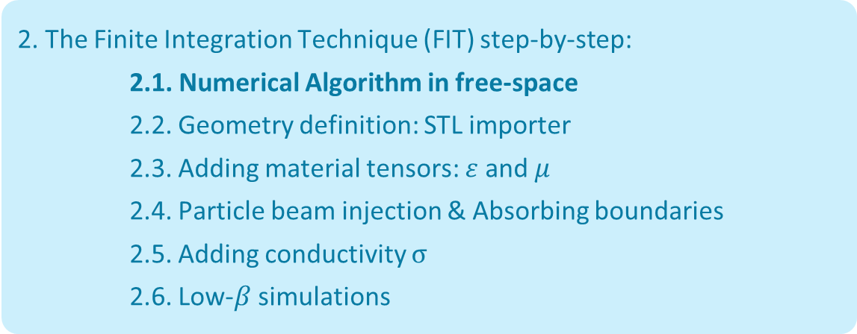
Outline
1. Introduction to Beam-Coupling Impedance simulations & Motivation
Slides 4 - 11
2. The Finite Integration Technique (FIT) step-by-step:
2.1. Numerical Algorithm in free-space
2.2. Geometry definition: STL importer
2.3. Adding material tensors: $ε$ and $μ$
2.4. Particle beam injection & Absorbing boundaries
2.5. Adding conductivity $σ$
2.6. Low-$β$ simulations
Slides 13 - 38
3. Conclusions, Challenges & Future work
Slides 40 - 42

Slide 13
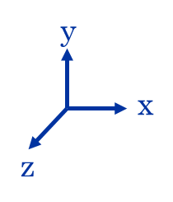
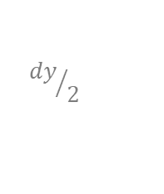
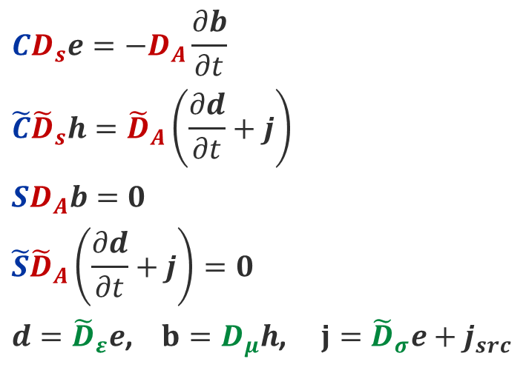

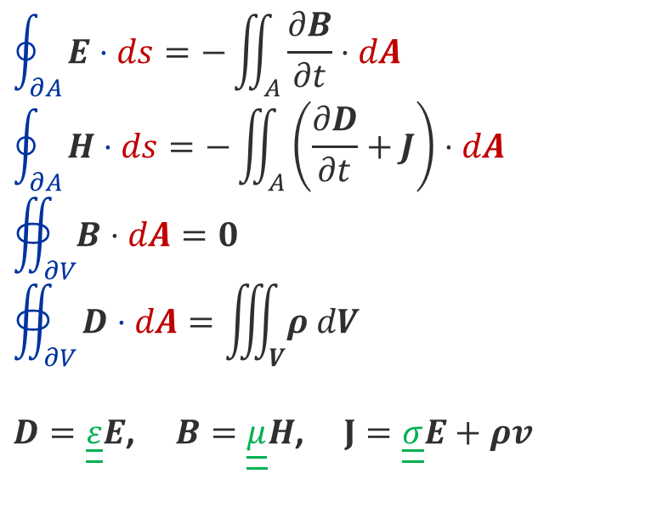


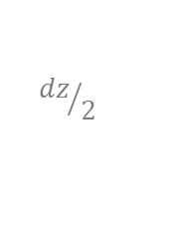
Finite Integration Technique
1st approximation
Maxwell Equations (Integral form)
Domain discretization
$$dx, dy, dz$$
Maxwell Grid Equations*
$$CD_{s}e=−D_{A}\frac{∂b}{∂t}$$
$$\tilde{C}{\tilde{D}}_{s}h={\tilde{D}}_{A}\left(\frac{∂d}{∂t}+j\right)$$
$$SD_{A}b=0$$
$${\tilde{S}\tilde{D}}_{A}\left(\frac{∂d}{∂t}+j\right)=0$$
$d={\tilde{D}}_{ε}e$, $b=D_{μ}h$, $j={\tilde{D}}_{σ}e+j_{src}$
$$\oint_{∂A}^{ }{E⋅ds=−\iint_{A}^{ }{\frac{∂B}{∂t}⋅dA}}$$
$$\oint_{∂A}^{ }{H⋅ds=−\iint_{A}^{ }{\left(\frac{∂D}{∂t}+J\right)⋅dA}}$$
$$∯_{∂V}^{ }{B⋅dA}=0$$
$$∯_{∂V}^{ }{D⋅dA=\iiint_{V}^{ }{ρ dV}}$$
$D=\underline{\underline{ε}}E$, $B=\underline{\underline{μ}}H$, $J=\underline{\underline{σ}}E+ρv$
$N_{cells}=N_{x}N_{y}N_{z}$
y
$${dy}/2$$
Operators
Grid areas and lengths
Materials
$${dz}/2$$
$${dx}/2$$
x
*Formulation by T. Weiland: Wakefields and Impedances , 1991
z

Slide 14
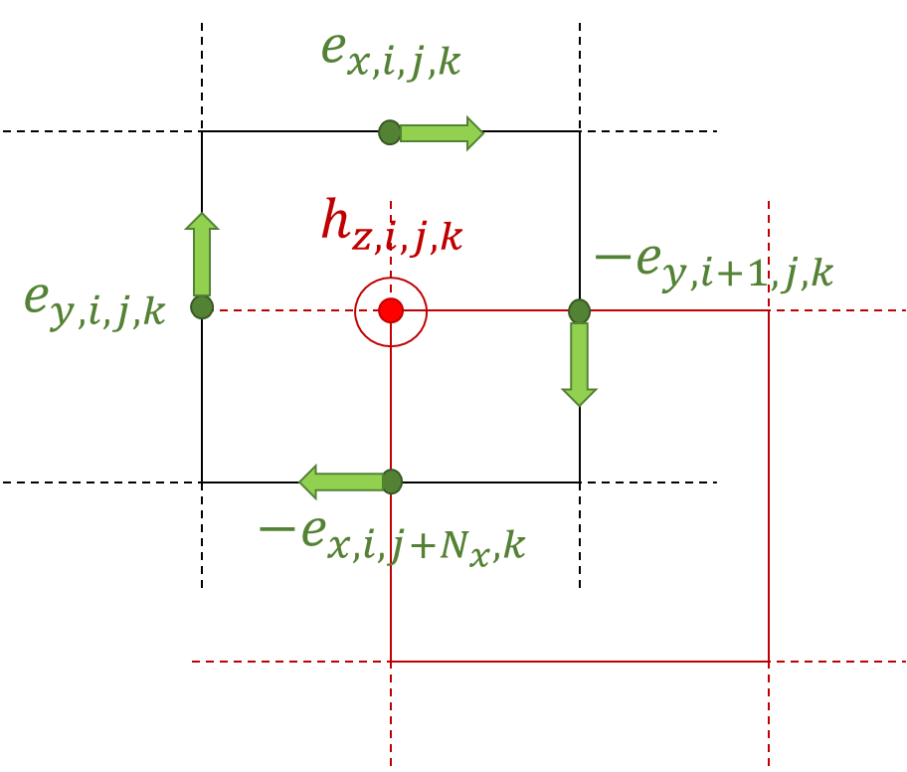

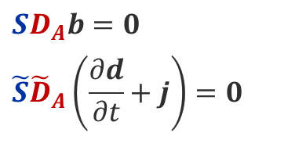

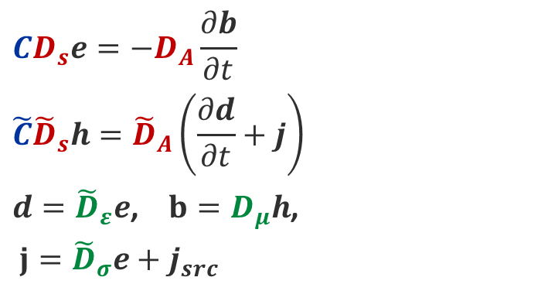
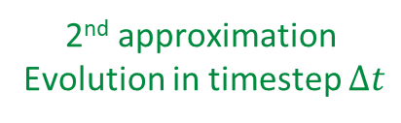
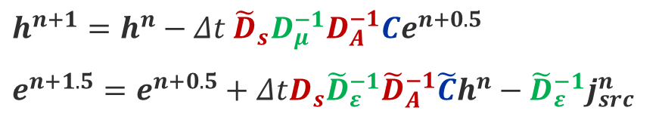
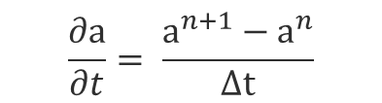
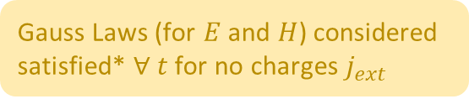
Finite Integration Technique (II)
2nd approximation
Evolution in timestep $Δt$
Maxwell Grid Equations
Time-stepping scheme (leapfrog)
$$CD_{s}e=−D_{A}\frac{∂b}{∂t}$$
$$\tilde{C}{\tilde{D}}_{s}h={\tilde{D}}_{A}\left(\frac{∂d}{∂t}+j\right)$$
$d={\tilde{D}}_{ε}e$, $b=D_{μ}h$,
$j={\tilde{D}}_{σ}e+j_{src}$
$$\frac{∂a}{∂t}= \frac{a^{n+1}−a^{n}}{Δt}$$
$$h^{n+1}=h^{n}−Δt{ {\tilde{D}}_{s}D_{μ}^{−1}D}_{A}^{−1}Ce^{n+0.5}$$
$$e^{n+1.5}=e^{n+0.5}+ΔtD_{s}{\tilde{D}}_{ε}^{−1}{\tilde{D}}_{A}^{−1}\tilde{C}h^{n}−{\tilde{D}}_{ε}^{−1}j_{src}^{n}$$
Domain discretization
With Yee grid
2nd order convergence in time
Can pre-compute most of the quantities → speed 🚀
$$SD_{A}b=0$$
$${\tilde{S}\tilde{D}}_{A}\left(\frac{∂d}{∂t}+j\right)=0$$
No matrix inversion needed during time loop
Dual Grid $\tilde{G}$
Gauss Laws (for $E$ and $H$) considered satisfied* $∀ t$ for no charges $j_{ext}$
Primal grid $G$
*Raymond Rumpf, Electromagnetic and Photonic Simulation for the Beginner, Artech, 2022.

Slide 15




















FIT (III): Operators $C, \tilde{C}$
Time-stepping scheme in vacuum
The curl operator $C$ on primal grid and $\tilde{C}$ on the dual grid, with $\tilde{C}=C^{t}$ is a $3N_{cells}×3N_{cells}$ sparse matrix made of bands of $+1$ and $−1$
By modifying the columns or rows of C, one can add boundary conditions:
Perfect Electric Conductor (PEC): columns to zero at $ijk$ of boundary cells
Perfect Magnetic Conductor (PMC): rows to zero at $ijk$ of boundary cells
$$h^{n+1}=h^{n}−Δt{μ_{0}^{−1}{\tilde{D}}_{s}D}_{A}^{−1}Ce^{n+0.5}$$
$$e^{n+1.5}=e^{n+0.5}+Δtε_{0}^{−1}D_{s}{\tilde{D}}_{A}^{−1}\tilde{C}h^{n}−ε_{0}^{−1}j^{n}$$
$$+1$$
$$N_{x}N_{y}$$
$$N_{x}$$
primal
$$E_{x,0,0,0}$$
Sparcity of C
$$x$$
$$+1$$
$$−1$$
$$E_{x,N_{x},N_{y},N_{z}}$$
$$E_{y,0,0,0}$$
$$y$$
$$E_{y,N_{x},N_{y},N_{z}}$$
$$E_{z,0,0,0}$$
$$z$$
$$−1$$
$$E_{z,N_{x},N_{y},N_{z}}$$
dual
Size: $3N_{cells}×3N_{cells}$
Lexicographic
indexation
Notes:
PEC Tangential electric field to zero at boundary
PMC Tangential magnetic field to zero

Slide 16









FIT (IV): Diagonal matrices $D_{A}, D_{s}, {\tilde{D}}_{A}, {\tilde{D}}_{s}$
Time-stepping scheme vacuum
The diagonal matrices contain the grid information:
$D_{A}^{−1} = diag\left\{A_{x, 0.0,0}^{−1}, …, A_{x, N_{x}.N_{y},N_{z}}^{−1}, A_{y, 0.0,0}^{−1}, …, A_{y, N_{x}.N_{y},N_{z}}^{−1},A_{z, 0.0,0}^{−1}, …, A_{z, N_{x}.N_{y},N_{z}}^{−1}\right\}$
$D_{s} = diag\{l_{x, 0.0,0}, …, l_{x, N_{x}.N_{y},N_{z}}, l_{y, 0.0,0}, …, l_{y, N_{x}.N_{y},N_{z}},l_{z, 0.0,0}, …, l_{z, N_{x}.N_{y},N_{z}}\}$
$$h^{n+1}=h^{n}−Δt{μ_{0}^{−1}{\tilde{D}}_{s}D}_{A}^{−1}Ce^{n+0.5}$$
$$e^{n+1.5}=e^{n+0.5}+Δtε_{0}^{−1}D_{s}{\tilde{D}}_{A}^{−1}\tilde{C}h^{n}−ε_{0}^{−1}j^{n}$$
Where (i.e. x-direction):
  $l_{x, i.j,k}=x_{i+1.j,k}−x_{i,j,k}$
  $A_{x, i.j,k}=l_{y i.j,k}×l_{z i.j,k}$
$${\tilde{D}}_{s}$$
${\tilde{D}}_{A}$and ${\tilde{D}}_{s}$ are analogous for the dual grid. Due to the Yee staggering, some of the components are zero:
If not set to zero, but equal to $D_{A}$ and $D_{s}$ at the opposite end $→$ Periodic boundary conditions
$${\tilde{D}}_{A}$$
*generated with wakis built-in 3D plotting

Slide 17













FIT (V): Fields $E, H, J$
Time-stepping scheme vacuum
The fields are stored in memory as 3 ($x,y,z$) 3d numpy matrices np.zeros$(N_{x}, N_{y}, N_{z})$. In the time-stepping, they must be converted to 1d arrays with lexicographic indexing:
$n = 1 + (i−1) + (j−1)N_{x} + (k−1)N_{x}N_{y}$
$$h^{n+1}=h^{n}−Δt{μ_{0}^{−1}{\tilde{D}}_{s}D}_{A}^{−1}Ce^{n+0.5}$$
$$e^{n+1.5}=e^{n+0.5}+Δtε_{0}^{−1}D_{s}{\tilde{D}}_{A}^{−1}\tilde{C}h^{n}−ε_{0}^{−1}j^{n}$$
Class Field has custom magic methods (__getitem__, __setitem__, __mul__, …) to handle 3d to collapsed conversion, operations and built-in visualization methods (inspect(), inspect3d())
$$E_{x,0,0,0}$$
$$x$$
field.py
class Field:
$$E_{x,N_{x},N_{y},N_{z}}$$
$$E_{y,0,0,0}$$
$$y$$
$$E_{y,N_{x},N_{y},N_{z}}$$
$$E_{z,0,0,0}$$
$$z$$
$$E_{z,N_{x},N_{y},N_{z}}$$
Lexicographic
indexation
*E.g., E field in a coarse-meshed cube resonator generated with wakis built-in 3D plotting solver.E.inspect3d()

Slide 18



Example: Perturbation in free-space with BC
Vacuum
Perturbation
Plotting
plane XY
$E_{z}$ Perturbation at $\frac{3}{4}N_{x}$, $\frac{3}{4}N_{y}$, $\frac{1}{2}N_{z}$
examples/script_noeb_fit.py
A static field perturbation in $E_{z}$ generates a spheric wavefront that is reflected for PEC BCs or re-enters the domain for Periodic BCs

Slide 19

Example: Perturbation in free-space with BC
Boundary conditions (BCs): All Periodic
Vacuum
Perturbation
Plotting
plane XY
$E_{z}$ Perturbation at $\frac{3}{4}N_{x}$, $\frac{3}{4}N_{y}$, $\frac{1}{2}N_{z}$
examples/script_noeb_fit.py
A static field perturbation in $E_{z}$ generates a spheric wavefront that is reflected for PEC BCs or re-enters the domain for Periodic BCs

Slide 20

Example: Perturbation in free-space with BC
Boundary conditions (BCs): All Periodic
Vacuum
Perturbation
Plotting
plane XY
$E_{z}$ Perturbation at $\frac{3}{4}N_{x}$, $\frac{3}{4}N_{y}$, $\frac{1}{2}N_{z}$
Boundary conditions (BCs): all PEC
examples/script_noeb_fit.py
A static field perturbation in $E_{z}$ generates a spheric wavefront that is reflected for PEC BCs or re-enters the domain for Periodic BCs

Slide 21



Outline
1. Introduction to Beam-Coupling Impedance simulations & Motivation
Slides 4 - 11
2. The Finite Integration Technique (FIT) step-by-step:
2.1. Numerical Algorithm in free-space
2.2. Geometry definition: STL importer
2.3. Adding material tensors: $ε$ and $μ$
2.4. Particle beam injection & Absorbing boundaries
2.5. Adding conductivity $σ$
2.6. Low-$β$ simulations
Slides 13 - 38
3. Conclusions, Challenges & Future work
Slides 40 - 42

Slide 22





Importing geometry with
Using PyVista capabilities, wakis can:
Import CAD geometry: stl= pv.read(stl_file)
Generate a grid: grid = pv.StructuredGrid(X, Y, Z)
Find the cells that are inside the geometry with advanced collision filters* $→$ mask for material properties
State-of-the-art interactive 3d plotting
wakis interactive grid.inspect() method
https://github.com/pyvista/pyvista
https://docs.pyvista.org/version/stable/
Cells inside the goniometer** shown in blue
*Pyvista extract_cells_inside_surface filter
** Simplified goniometer geometry by C. Antuono

Slide 23




Example: Perturbation with imported STL
y
Vacuum
z
x
BCs:
all PEC
PEC $ε_{r}=∞$
Plotting
plane YZ
Perturbation moving at $z=ct$
examples/script_letters_fit.py
A field perturbation in $E_{z}$ moving at $z=ct$ excites the field in the vacuum domain revealing the PEC imported geometry
*STL files generated with online tool: https://text2stl.mestres.fr/

Slide 24

Example: Perturbation with imported STL
y
Vacuum
z
x
BCs:
all PEC
PEC $ε_{r}=∞$
Plotting
plane YZ
Perturbation moving at $z=ct$
examples/script_letters_fit.py
A field perturbation in $E_{z}$ moving at $z=ct$ excites the field in the vacuum domain revealing the PEC imported geometry
*STL files generated with online tool: https://text2stl.mestres.fr/

Slide 25


Outline
1. Introduction to Beam-Coupling Impedance simulations & Motivation
Slides 4 - 11
2. The Finite Integration Technique (FIT) step-by-step:
2.1. Numerical Algorithm in free-space
2.2. Geometry definition: STL importer
2.3. Adding material tensors: $ε$ and $μ$
2.4. Particle beam injection & Absorbing boundaries
2.5. Adding conductivity $σ$
2.6. Low-$β$ simulations
Slides 13 - 38
3. Conclusions, Challenges & Future work
Slides 40 - 42

Slide 26










Material tensors for $ε, μ$
Time-stepping scheme with 𝜀, 𝜇
The material matrices are considered diagonal* tensors:
User can specify relative permitivity/permeability: $ε_{r}=ε/{ε_{0}}$
The matrix will be built with a background material $ε_{r, bg}, μ_{r,bg}$
The material associated with each imported stl geometry will overwrite the background material in the tensor (numpy + pyvista)
User can also specify anisotropic materials by defining $ε_{r,x}$, $ε_{r,y},ε_{r,z}$, …
$$h^{n+1}=h^{n}−Δt{ {\tilde{D}}_{s}D_{μ}^{−1}D}_{A}^{−1}Ce^{n+0.5}$$
$$e^{n+1.5}=e^{n+0.5}+ΔtD_{s}{\tilde{D}}_{ε}^{−1}{\tilde{D}}_{A}^{−1}\tilde{C}h^{n}−{\tilde{D}}_{ε}^{−1}j^{n}$$
$$D_{ε}^{−1} = diag\left\{ε_{x, 0.0,0}^{−1}, …, ε_{x, N_{x}.N_{y},N_{z}}^{−1}, ε_{y, 0.0,0}^{−1}, …, ε_{y, N_{x}.N_{y},N_{z}}^{−1},ε_{z, 0.0,0}^{−1}, …, ε_{z, N_{x}.N_{y},N_{z}}^{−1}\right\}$$
$$3×N_{cells}$$
$$D_{μ}^{−1} = diag\left\{μ_{x, 0.0,0}^{−1}, …, μ_{x, N_{x}.N_{y},N_{z}}^{−1}, μ_{y, 0.0,0}^{−1}, …, μ_{y, N_{x}.N_{y},N_{z}}^{−1},μ_{z, 0.0,0}^{−1}, …, μ_{z, N_{x}.N_{y},N_{z}}^{−1}\right\}$$
$$3×N_{cells}$$
$$ε_{x}^{−1}$$
$$ε_{y}^{−1}$$
$$ε_{z}^{−1}$$
examples/test/test_materials.py
A PEC sphere $ε^{−1}=0$and a Dielectric sphere $ε^{−1}={\left(5ε_{0}\right)}^{−1}$ imported in a vacuum background $ε^{−1}=ε_{0}^{−1}$.
User can inspect the material tensors by: solver.ieps.inspect(plane=‘YZ’)
*This approximation is only not valid for Gyrotropic materials

Slide 27



Example: Planewave interacting with sphere
examples/script_planewave_fit.py
Vacuum
BCs:
Periodic x-/x+
Periodic y-/y+
PEC z-/z+
Plane
wave
port
PEC $ε_{r}=∞$
Plane YZ
Special thanks to Prof. M. Cotelo (UPM) for the help with the planewave port setup and validation
Vacuum
BCs:
Periodic x-/x+
Periodic y-/y+
PEC z-/z+
Plane
wave
port
Dielectric $ε_{r}=10$
Plane YZ

Slide 28

Example: Planewave interacting with sphere
examples/script_planewave_fit.py
Vacuum
BCs:
Periodic x-/x+
Periodic y-/y+
PEC z-/z+
*wakis built-in 2d plotting solver.plot2d(**kwargs)
Plane
wave
port
PEC $ε_{r}=∞$
Plane YZ
Special thanks to Prof. M. Cotelo (UPM) for the help with the planewave port setup and validation
Vacuum
BCs:
Periodic x-/x+
Periodic y-/y+
PEC z-/z+
Plane
wave
port
Dielectric $ε_{r}=10$
Plane YZ

Slide 29
Example: Planewave interacting with sphere
examples/script_planewave_fit.py
Vacuum
BCs:
Periodic x-/x+
Periodic y-/y+
PEC z-/z+
*wakis built-in 2d plotting solver.plot2d(**kwargs)
Plane
wave
port
PEC $ε_{r}=∞$
Plane YZ
Special thanks to Prof. M. Cotelo (UPM) for the help with the planewave port setup and validation
Vacuum
BCs:
Periodic x-/x+
Periodic y-/y+
PEC z-/z+
Plane
wave
port
Dielectric $ε_{r}=10$
Plane YZ

Slide 30

Example: Planewave interacting with sphere
examples/script_planewave_fit.py
Vacuum
BCs:
Periodic x-/x+
Periodic y-/y+
PEC z-/z+
Generated with wakis built-in 3d plotting solver.plot3d(**kwargs)
based on pyVista
Plane
wave
port
PEC $ε_{r}=∞$
Plane YZ
Special thanks to Prof. M. Cotelo (UPM) for the help with the planewave port setup and validation
Vacuum
BCs:
Periodic x-/x+
Periodic y-/y+
PEC z-/z+
Plane
wave
port
Dielectric $ε_{r}=10$
Plane YZ

Slide 31


Outline
1. Introduction to Beam-Coupling Impedance simulations & Motivation
Slides 4 - 11
2. The Finite Integration Technique (FIT) step-by-step:
2.1. Numerical Algorithm in free-space
2.2. Geometry definition: STL importer
2.3. Adding material tensors: $ε$ and $μ$
2.4. Particle beam injection & Absorbing boundaries
2.5. Adding conductivity $σ$
2.6. Low-$β$ simulations
Slides 13 - 38
3. Conclusions, Challenges & Future work
Slides 40 - 42

Slide 32





Beam injection as current $J_{z}$
Sources ($E, H, J$) are managed in a dedicated class inside sources.py
Each source should have a source.update(t) method that will be called every timestep $dt$ in the simulation loop.
For the case of a particle beam, the source is a current in $J_{z},$ applied at $x_{s}, y_{s} ∀ z$ with a gaussian time profile.
  $q$ is the charge in [C], typically $≈{10}^{−9}$ C
  $σ_{z}$ is the beam size [m]
  $β$ is the ratio of the beam speed $v$ to the speed of light $c$
$$J_{z}(x_{s}, y_{s},z) = \frac{qβc}{\sqrt{2πσ_{z}}}e^{\frac{−{\left(s−s_{0}\right)}^{2}}{2σ_{z}^{2}}}$$
$$s=z −βct ;$$
$$s_{0}=z_{min} −βct$$

Slide 33


Beam injection as current $J_{z}$
Sources ($E, H, J$) are managed in a dedicated class inside sources.py
Each source should have a source.update(t) method that will be called every timestep $dt$ in the simulation loop.
For the case of a particle beam, the source is a current in $J_{z},$ applied at $x_{s}, y_{s} ∀ z$ with a gaussian time profile.
  $q$ is the charge in [C], typically $≈{10}^{−9}$ C
  $σ_{z}$ is the beam size [m]
  $β$ is the ratio of the beam speed $v$ to the speed of light $c$
$$J_{z}(x_{s}, y_{s},z) = \frac{qβc}{\sqrt{2πσ_{z}}}e^{\frac{−{\left(s−s_{0}\right)}^{2}}{2σ_{z}^{2}}}$$
$$s=z −βct ;$$
$$s_{0}=z_{min} −βct$$

Slide 34
Minimizing injection perturbation: ABC
The perturbation appears due to the violation of the continuity law ${\tilde{S}\tilde{D}}_{A}\left(\frac{∂d}{∂t}+j\right)=0$
We can mitigate it with boundary conditions: 1st attempt was the FOEXTRAP* absorbing boundary condition (ABC)
*FOEXTRAP: First Order Extrapolation (backup slides)

Slide 35


Minimizing injection perturbation: ABC
The perturbation appears due to the violation of the continuity law ${\tilde{S}\tilde{D}}_{A}\left(\frac{∂d}{∂t}+j\right)=0$
We can mitigate it with boundary conditions: 1st attempt was the FOEXTRAP* absorbing boundary condition (ABC)
Thanks to Prof. M. Cotelo (UPM) for the ABC idea
ABC
PEC
*FOEXTRAP: First Order Extrapolation (backup slides)

Slide 36






Example: PEC cubic cavity
benchmarks/cubcavitymm/
Geometry:
$L_{cav}$= 30 mm
$h_{cav}$= 50 mm
$w_{cav}$ = 50 mm
$L_{pipe}$ = 100 mm
$h_{pipe}$= 15 mm
$w_{pipe}$ = 15 mm
Beam:
$σ_{z}$ = 18.5 mm (5 GHz)
q = 1e-9 C
Simulation time: for 1m wakelength (8760 timesteps):
CST: 42s, 16 threads, in `abpimp60g01`
Wakis: 3m40s , single core in `abpimp60g01`
WarpX: 12m, single core, #MP 1e6, in `abpimp60g01`
Mesh:
nx, ny, nz = 50, 50, 150
total: 375000 cells
Cutoff frequency: $\sim 10$ GHz
BCs:
wakis: ABC*
WarpX: PML*
CST: CPML
Remarks
Very good agreement
WarpX shows a non-vanishing injection perturbation while in wakis it disappears
Some phase error comes from the CST field monitor extraction (very close to simulation’s timestep)

Slide 37

Example: PEC cubic cavity
benchmarks/cubcavitymm/
Geometry:
$L_{cav}$= 30 mm
$h_{cav}$= 50 mm
$w_{cav}$ = 50 mm
$L_{pipe}$ = 100 mm
$h_{pipe}$= 15 mm
$w_{pipe}$ = 15 mm
Beam:
$σ_{z}$ = 18.5 mm (5 GHz)
q = 1e-9 C
Simulation time: for 1m wakelength (8760 timesteps):
CST: 42s, 16 threads, in `abpimp60g01`
Wakis: 3m40s , single core in `abpimp60g01`
WarpX: 12m, single core, #MP 1e6, in `abpimp60g01`
Mesh:
nx, ny, nz = 50, 50, 150
total: 375000 cells
Cutoff frequency: $\sim 10$ GHz
Simulation wakis vs WarpX vs CST: (keeping same mesh)
BCs:
wakis: ABC*
WarpX: PML*
CST: CPML
DC component from non-vanishing injection perturbation in WarpX
*last 10 cells in z- and z+ were removed for the wake calculation to mitigate injection perturbation

Slide 38

Outline
1. Introduction to Beam-Coupling Impedance simulations & Motivation
Slides 4 - 11
2. The Finite Integration Technique (FIT) step-by-step:
2.1. Numerical Algorithm in free-space
2.2. Geometry definition: STL importer
2.3. Adding material tensors: $ε$ and $μ$
2.4. Particle beam injection & Absorbing boundaries
2.5. Adding conductivity $σ$
2.6. Low-$β$ simulations
Slides 13 - 38
3. Conclusions, Challenges & Future work
Slides 40 - 42

Slide 39




Conductivity in time domain
Relative permittivity is often a frequency-dependent, complex quantity:
$$ε_{r}\left(ω\right)={ε′}_{r}\left(ω\right)−{jε}_{r}′′\left(ω\right)$$
The simple model for a metal with broadband conductivity $σ$ is:
$$ε_{r}\left(ω\right)=ε_{r}−j\frac{σ}{ωε_{0}}$$
Time-stepping scheme:
$$h^{n+1}=h^{n}−Δt{ {\tilde{D}}_{s}D_{μ}^{−1}D}_{A}^{−1}Ce^{n+0.5}$$
$$e^{n+1.5}=e^{n+0.5}+ΔtD_{s}{\tilde{D}}_{ε}^{−1}{\tilde{D}}_{A}^{−1}\tilde{C}h^{n}−{\tilde{D}}_{ε}^{−1}j_{beam}^{n}$$
How to implement this in a time domain (TD) simulations?
In TD, fields are purely real $ℜ$ $→$ all matrix elements should be real
Introducing frequency dependence involves a de-convolution… (computationally expensive 💲 💲)

Slide 40




Conductivity in time domain
Relative permittivity is often a frequency-dependent, complex quantity:
$$ε_{r}\left(ω\right)={ε′}_{r}\left(ω\right)−{jε}_{r}′′\left(ω\right)$$
The simple model for a metal with broadband conductivity $σ$ is:
$$ε_{r}\left(ω\right)=ε_{r}−j\frac{σ}{ωε_{0}}$$
Time-stepping scheme:
$$h^{n+1}=h^{n}−Δt{ {\tilde{D}}_{s}D_{μ}^{−1}D}_{A}^{−1}Ce^{n+0.5}$$
$$e^{n+1.5}=e^{n+0.5}+ΔtD_{s}{\tilde{D}}_{ε}^{−1}{\tilde{D}}_{A}^{−1}\tilde{C}h^{n}−{\tilde{D}}_{ε}^{−1}j_{beam}^{n}$$
From the Frequency domain Maxwell equations:
Ampere’s law: $∇×H=J_{beam}+jωD=J_{beam}+jωεE;$
$$∇×H\left(ω\right)=J_{beam}+jωε_{0}\left(ε_{r}+\frac{σ}{jωε_{0}}\right)E\left(ω\right);$$
$$∇×H\left(ω\right)=J_{beam}+jωε′E(ω)+σE(ω)$$
To convert to TD: $jω↔ d/{dt}, A\left(ω\right)↔A(t)$*
$∇×H(t)$ = $J_{beam}+\frac{d(ε^{′}E(t))}{dt}+σE(t)$
Time-stepping scheme with $σ$:
$$h^{n+1}=h^{n}−Δt{ {\tilde{D}}_{s}D_{μ}^{−1}D}_{A}^{−1}Ce^{n+0.5}$$
$$e^{n+1.5}=e^{n+0.5}+ΔtD_{s}{\tilde{D}}_{ε}^{−1}{\tilde{D}}_{A}^{−1}\tilde{C}h^{n}−{\tilde{D}}_{ε}^{−1}j_{beam}^{n}$$
$−{\tilde{D}}_{ε}^{−1}$ ${\tilde{D}}_{σ}^{ }$ $e^{n+0.5}$
+ constitutive relation for $J$
$$J\left(t\right)=σE\left(t\right)+J_{beam}(t)$$
*Raymond Rumpf, Electromagnetic and Photonic Simulation for the Beginner, Artech, 2022.

Slide 41



Example: lossy cubic cavity
Conductivity: 10 S/m
Skin-Depth: $δ=\sqrt{\frac{1}{πfμσ}}≈2 mm$
$N_{cells}$: 542754
Runtime: 4’, 30’’ , single core in `abpimp60g01`
$Δ_{cell}$: 0.5 mm > 3$δ$
Remarks:
To match CST results, we had to remove 10 cells z-/z+ and increase the mesh by 20%
Low conductivity was chosen to have a fast decaying wake
benchmarks/condcubcavitymm/

Slide 42






Example: lossy fancy-shaped* cavity
*CST’s Default Acc. Cavity model
$L_{pipe}$ = 80 cm
Conductivity: 1000 S/m
Skin-Depth: $δ=\sqrt{\frac{1}{πfμσ}}≈0.5mm$
$N_{cells}$: 271600,
Wakelength: 100 m
$Δ_{cell}$: 1.5 mm < 3$δ$
Runtime: 20’ 40’’ single core in `abpimp60g01`
$r_{pipe}$ = 12 cm
Remarks:
Staircased grid can induce the frequency shift at 800 MHz
Skin Depth** is not well modelled → difference in shunt impedance
**for $σ>100 S/m$, CST uses surface impedance model (Leontovich)
Shows the need for Surface impedance model for good conductors
Simulation is stable even for very long wakes
benchmarks/condcylcavity/

Slide 43


Outline
1. Introduction to Beam-Coupling Impedance simulations & Motivation
Slides 4 - 11
2. The Finite Integration Technique (FIT) step-by-step:
2.1. Numerical Algorithm in free-space
2.2. Geometry definition: STL importer
2.3. Adding material tensors: $ε$ and $μ$
2.4. Particle beam injection & Absorbing boundaries
2.5. Adding conductivity $σ$
2.6. Low-$β$ simulations
Slides 13 - 38
3. Conclusions, Challenges & Future work
Slides 40 - 42

Slide 44




Simulation script example
from wakis import GridFIT3D, SolverFIT3D, WakeSolver
import pyvista as pv
# ---------- Domain and Grid setup ---------
# Number of mesh cells
Nx = 57
Ny = 57
Nz = 109
#dt = 5.707829241e-12
# Geometry Import
stl_cavity = 'cavity.stl'
stl_pipe = 'beampipe.stl'
stl_solids = {'cavity': stl_cavity, 'pipe': stl_pipe}
# Materials
stl_materials = {'cavity': 'vacuum', 'pipe': 'vacuum'}
background = [1.0, 1.0, 100] # lossy metal [ε_r, µ_r, σ]
# Domain bounds (from stl)
surf = pv.read(stl_cavity) + pv.read(stl_pipe)
xmin, xmax, ymin, ymax, zmin, zmax = surf.bounds
# Set grid and geometry
grid = GridFIT3D(xmin, xmax, ymin, ymax, zmin, zmax, Nx, Ny, Nz,
stl_solids=stl_solids,
stl_materials=stl_materials)
#grid.inspect()
# ------------ Beam source ----------------
# Beam parameters and wake obj.
beta = 0.8 # beam relativistic beta
sigmaz = beta*6e-2 # [m] -> multiplied by beta to have f_max cte
q = 1e-9 # [C]
xs = 0. # x source position [m]
ys = 0. # y source position [m]
xt = 0. # x test position [m]
yt = 0. # y test position [m]
# tinj = 8.53*sigmaz/(beta*c) # injection time offset [s]
wake = WakeSolver(q=q, sigmaz=sigmaz, beta=beta,
xsource=xs, ysource=ys, xtest=xt, ytest=yt,
save=True, logfile=True)
# ----------- Solver & Simulation ----------
# boundary conditions and solver obj.
bc_low=['pec', 'pec', 'pec']
bc_high=['pec', 'pec', 'pec']
solver = SolverFIT3D(grid, wake,
bc_low=bc_low, bc_high=bc_high,
use_stl=True, bg=background)
# Run wakefield time-domain simulation
wakelength = 5. #[m]
add_space = 10 # no. cells to remove for the wake calculation
solver.wakesolve(wakelength=wakelength, add_space=add_space,
plot=True, plot_every=30, save_J=True,
**plotkw)

Slide 45





Example: results for different $β$
benchmarks/betacavity/
Work in progress!
1st attempt shows some agreement, but mesh needs to be optimized
The behaviour with $β$ is consistent
Simulation of a cylindrical pillbox* below cut-off for different relativistic $β$ values
*Model by Elena Macchia

Slide 46
Outline
1. Introduction to Beam-Coupling Impedance simulations & Motivation
Slides 4 - 11
2. The Finite Integration Technique (FIT) step-by-step:
2.1. Numerical Algorithm in free-space
2.2. Geometry definition: STL importer
2.3. Adding material tensors: $ε$ and $μ$
2.4. Particle beam injection & Absorbing boundaries
2.5. Adding conductivity $σ$
2.6. Low-$β$ simulations
Slides 13 - 38
3. Conclusions, Challenges & Future work
Slides 40 - 42

Slide 47




Challenges: Simulations above cut-off $f$
When the bunches are short, they excite to higher frequencies: $f_{max}= \frac{βc}{3σ_{z}}$
When $f_{max}>f_{cutoff}$ of the pipe, some modes are in propagation and reach the boundaries
wakis does not show good agreement above cut-off (yet)
Perfect matching layers (PML) BCs are needed to simulate propagating modes
Cutoff frequency: $\sim 1.25$ GHz
benchmarks/cubcavitycm/

Slide 48



Challenges: Simulations above cut-off $f$
This becomes more evident in a non-resonant structure, like a transition (i.e., Step-out)
All modes should propagate, but in wakis they are reflected back. To simulate propagating modes, we need the PML boundary conditions
Cutoff frequency: $\sim 0.8$ GHz
benchmarks/taperout/

Slide 49



More challenges for the near future
PML & Simulations above cutoff
Staircased grid
Numerical dispersion
GPU acceleration
Surface impedance
Wake extrapolation (genetic algorithm)
Frequency dependent (dispersive) materials
Frequency domain monitors
Staircased grid with curved geometry generates artifacts and difficulties convergence
For some optic applications, the code shows numerical dispersión
examples/script_wavepacket_fit.py
Acceleration should be possible with cupy since it supports scipy.sparse

Slide 50



Conclusions
Developed a 3D Electromagnetic and Wake Solver in time domain, 100% in python: wakis
  Uses the Finite Integration Technique and scipy.sparse matrices, allowing for fast computations, extendable to GPU
  Different boundary conditions: PEC, PMC, Periodic, ABC
  Importing CAD geometry with pyvista
  Simulate materials with $ε, μ, σ$ with diagonal tensors. Possibility of anisotropic properties.
  Simulate several sources: Planewave, gaussian wave packet, and the particle beam for different $β$
  Several on the fly built-in plotting capabilities in 1d, 2d, 3d
  Interactive visualization methods to inspect the grid and the geometry
  +10 examples and benchmark simulations (⏳~2’ to 20’) already available on GitHub.
wakis solver has been benchmarked with CST Wakefield Solver® with pillbox cavities of different materials and geometries, below cut-off.
It is built also as a general-purpose 3D TD EM code, capable of simulating optical lenses, diffraction gratings and much more.
However, many challenges need to be investigated: simulations above cutoff with PML boundaries, advanced mesh generation, GPU acceleration, numerical dispersion correction, surface impedance condition… That will be addressed during the PhD!
https://github.com/ImpedanCEI/FITwakis

Slide 51
Thank you ☺ !!!
wakis:
3D Electromagnetic Time- Domain
Wake and Impedance Solver
Elena de la Fuente García (BE–ABP–CEI)

Slide 52

Bibliography used
Wakefields and Impedances [T. Weiland, 1991]
TE/TM FIT for accelerators [I. Zarg, 2005]
Open boundaries for FIT [MC. Balk, 2005]
2D expansion [I. Zarg, 2015]
2D freq. domain [R. SChumann, 2000]
Frequency domain FIT and FEM Uwe Niedermayer PhD thesis [2015]
Eigenmode + MPI + Gyrotropic materials Klaus Klopfer PhD thesis [2014]
EMcLAW: An unsplit Godunov method for Maxwell ’s Equations. (UPM) Moreno, José A. PhD Thesis [2020]

Slide 53



Absorbing boundary condition (ABC)
A first attempt to reduce the perturbation of the $E_{z}$ field when the beam current enters/exits it to use absorbing boundary conditions (ABC)
Since PML formulation is complex, the simplest ABC, the FOEXTRAP, was tested first. This is a first order extrapolation that mimics a continuous field at the boundary cells
It has to be updated every timestep
Same for all 6 boundaries (low and high, x, y, z)

Slide 54

Challenges: Simulations above cut-off $f$
The agreement is okay when we use PEC boundaries In both wakis and CST®
Cutoff frequency: $\sim 0.8$ GHz
benchmarks/taperout/

Slide 55



Optimizing results with wakis
If we remove the last 8 cells in z-/z+ with the add_space parameter
Conductivity: 10 S/m
Skin-Depth: $δ=\sqrt{\frac{1}{πfμσ}}≈2 mm$
$N_{cells}$: 542754
Runtime: 4’, 30’’ ,
single core in `abpimp60g01`
$Δ_{cell}$: 0.5 mm > 3$δ$

Slide 56
Optimizing results with wakis
Then, if we increase the mesh resolution by 15%
Conductivity: 10 S/m
Skin-Depth: $δ=\sqrt{\frac{1}{πfμσ}}≈2 mm$
$N_{cells}$: 542754
Runtime: 4’, 30’’ ,
single core in `abpimp60g01`
$Δ_{cell}$: 0.5 mm > 3$δ$

Slide 57


FITwakis GitHub overview
Benchmarks vs CST, WarpX …
Examples & university tests:
Plane wave propagation
Gaussian wavepacket propagation
Cubic Resonator
Field class to manage matrix formulation
$E, H, J, ε, μ$ are instances of this class
FIT EM Solver
GridFIT3D class in charge of STL importer and grid definition
Pre-defined materials library (vacuum, dielectric, PEC)
FDTD EM solver
by Lorenzo
SolverFIT3D class that solves Maxwell equations
Wake Solver
Wakis(v0.2) code is refactored into class WakeSolver

Slide 58




SolverFIT3D development (I): memory optimization
Deletes from memory the matrices that will not be used for the timestepping routine:
Improves memory allocation by 60%
Increases speed performance by 5%

Slide 59


SolverFIT3D development (II): 1D, 2D, 3D plotting
Using PyVista (vtk based) functions.
Plots can also be interactive:
clip_volume or clip_normal flags when off_screen =True
Plot3D example:
examples/script_planewave_fit.py
A planewave interacting with a dielectric sphere (University test)

Slide 60




SolverFIT3D development (II): 1D, 2D, 3D plotting
Matplotlib based coutourf (2D) and line plot (1D)
Plot2D and 1D example:
examples/script_planewave_fit.py
A planewave propagating through vacuum being repflected at the PEC boundary

Slide 61

SolverFIT3D development (IV): EM solve
Runs Electromagnetic time domain simulation given an initial condition or source
EM solve example:
examples/script_wavepacket_fit.py
A gaussian wavepacket propagating through vacuum domain (University test)

Slide 62


SolverFIT3D development (V): Wake solve
Runs Wakefield time domain simulation given a wakelength.
Beam source injected is defined by WakeSolver object.
Computes wake potential and impedance by saving Ez field every timestep and using the routines in WakeSolver class (needs h5py)
Wake solve example:
examples/script_cubcavity_fit.py
A gaussian beam traversing a PEC cubic pillbox cavity

