Slide 1
Modeling of coasting beams in Xsuite
G. Iadarola
Acknowledgements:
H. Bartosik, R. De Maria, S.Lopaciuk, K. Paraschou

Slide 2
Outline
Introduction
  Particle slippage
  Implications for collective effects
Simulation method description
  Reference speed β_{sim}
  From turns to frames
  Algorithm step bu step
Mathematical description
  Propositions on time time of arrivals
  Justification of the method
  Generalization of ζ coordinate
  ζ update at start turn
  ζ update on frame jump
Numerical tests
2

Slide 3
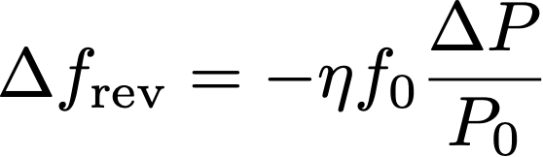
Particle slippage
In a ring the particles revolution frequency depends on the on the particle energy.
To first order, this dependence is described by the slip factor:
In bunched beams, the momentum of the particles oscillates around the equilibrium momentum:
The average revolution period (over a synchrotron period) is the same for all particles
The differences in time of arrival among particles never exceeds one revolution period
Over a given time interval, all particles make the same number of turns
  → The turn index can be used as independent variable in the simulation
3

Slide 4
Particle slippage
In a ring the particles revolution frequency depends on the on the particle energy.
To first order, this dependence is described by the slip factor:
In coasting beams, there is no RF focusing:
Particles keep their momentum deviation indefinitely
Hence, differences in revolution frequency are also kept indefinitely
Over a given time interval, different particles perform a different number of turns
4

Slide 5
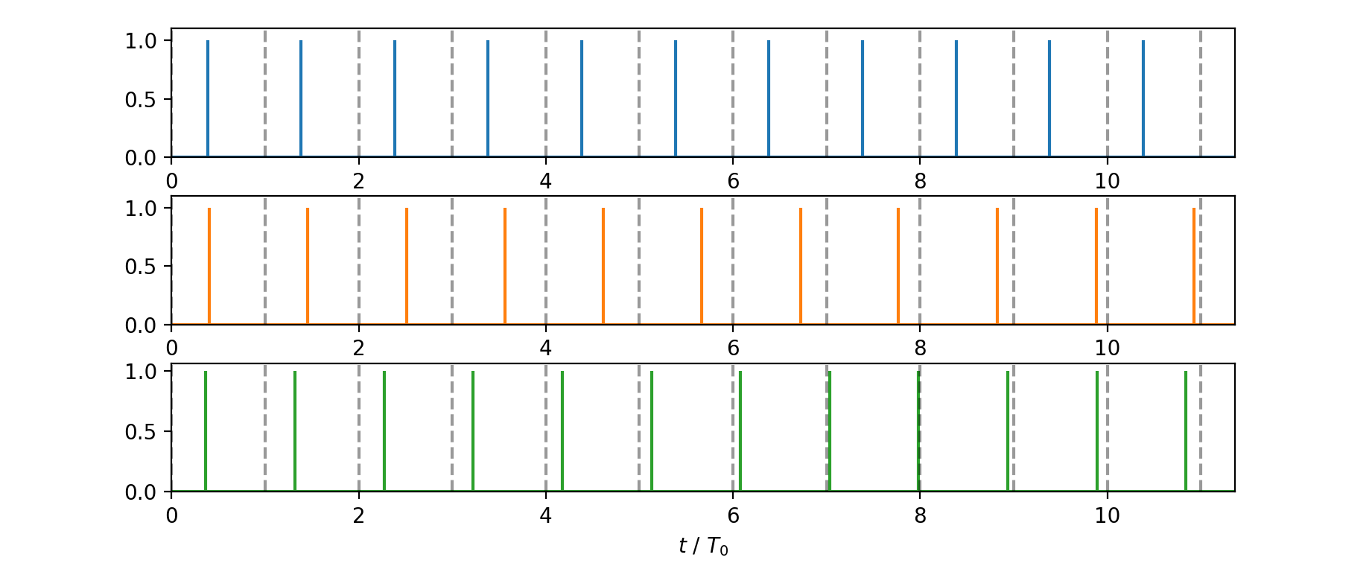
Particle slippage
To visualize this effect, in the case of a coasting beam, we compare three particles having three different revolution frequencies by marking the times at which they are detected at a given location of the ring
Δf_{rev} = 0
Δf_{rev} < 0
Δf_{rev} > 0

Slide 6
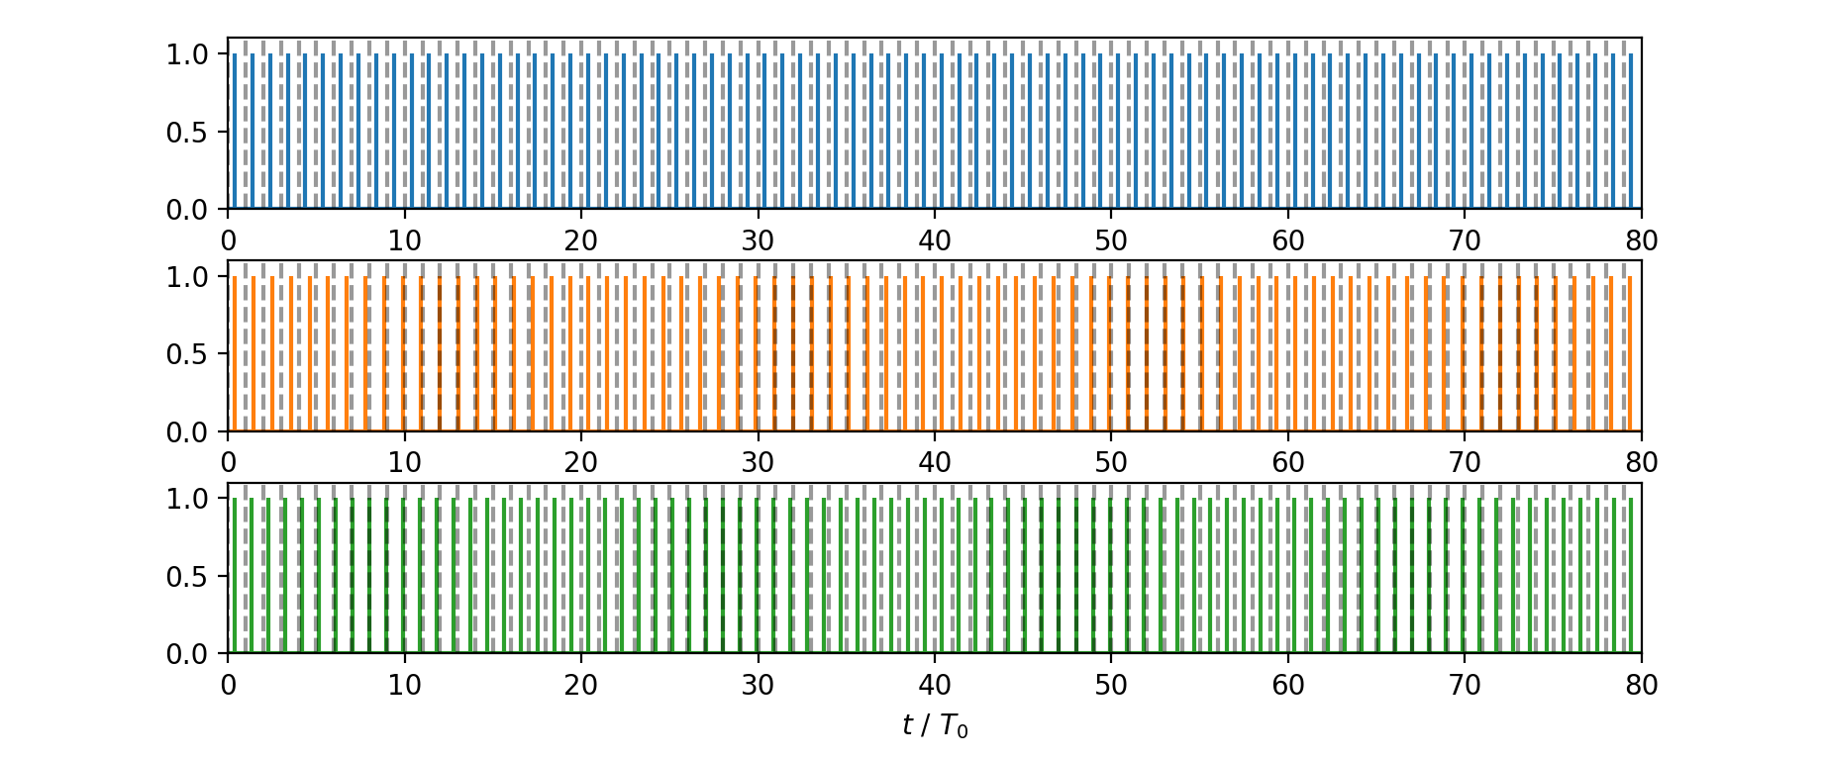
Particle slippage
To visualize this effect, in the case of a coasting beam, we compare three particles having three different revolution frequencies by marking the times at which they are detected at a given location of the ring
  Over a given time interval, the three particles perform a different number of revolutions
Δf_{rev} = 0
80 revolutions
Δf_{rev} < 0
76 revolutions
Δf_{rev} > 0
84 revolutions

Slide 7
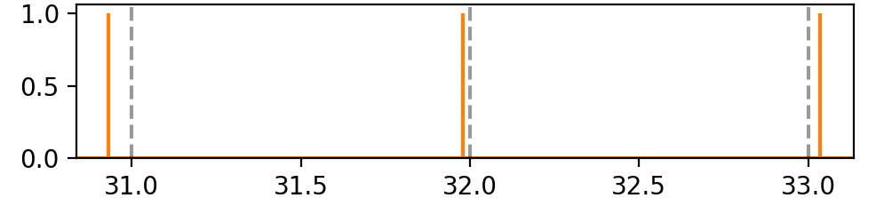
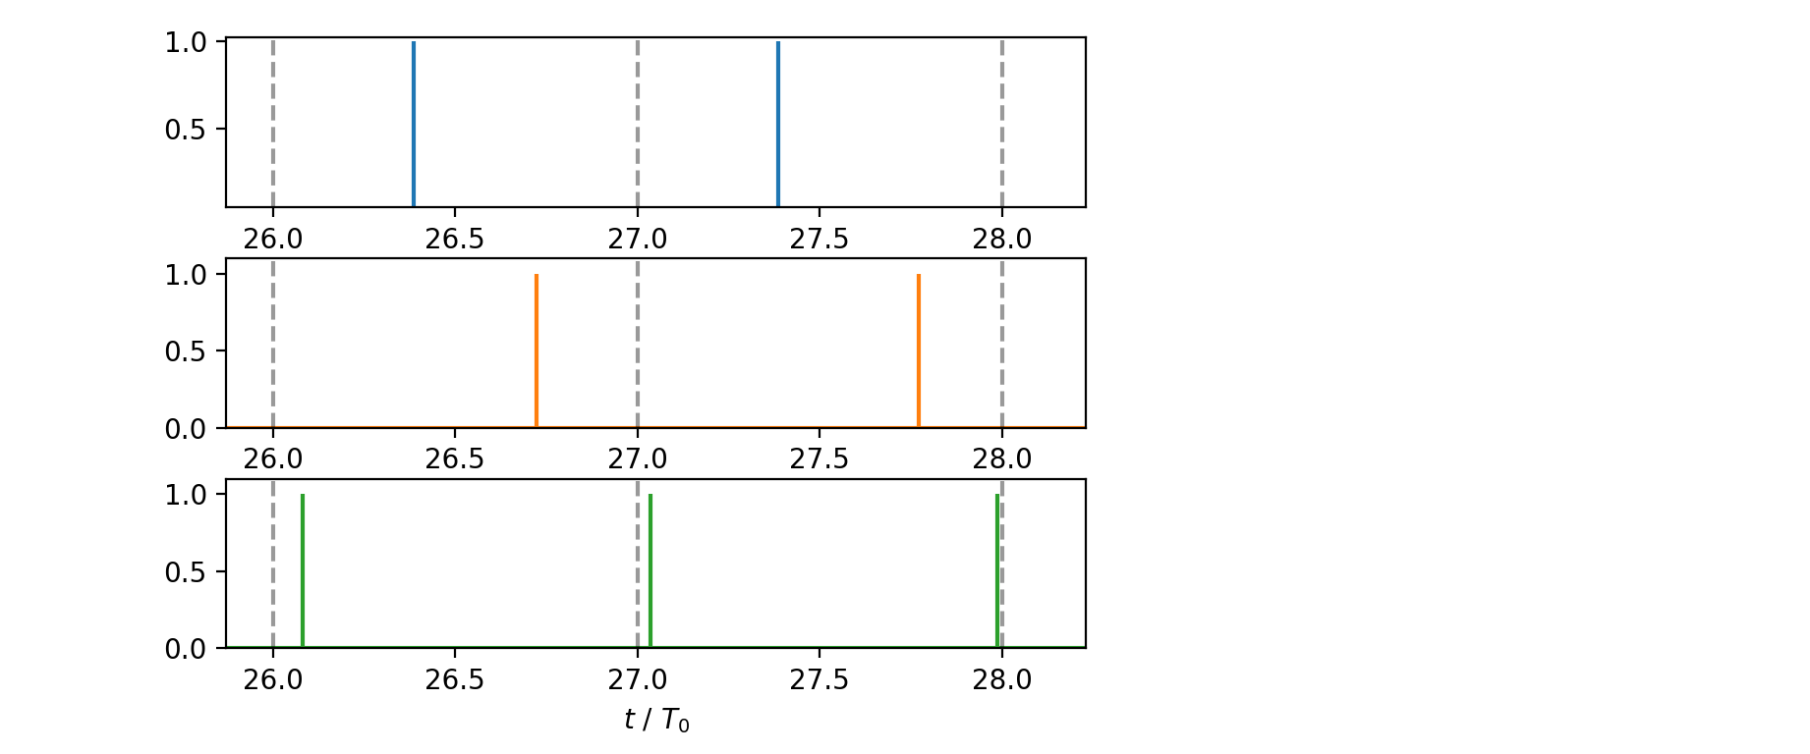
Particle slippage
To visualize this effect, in the case of a coasting beam, we compare three particles having three different revolution frequencies by marking the times at which they are detected at a given location of the ring
  Over a given time interval, the three particles perform a different number of revolutions
The slow particle “skips” some turns!
Δf_{rev} = 0
80 revolutions
Δf_{rev} < 0
76 revolutions
The fast particle can be seen twice in the same turn!
Δf_{rev} > 0
84 revolutions

Slide 8
Particle slippage
In conventional tracking simulations we use the longitudinal coordinate s and the turn number as independent variables of our simulations
At a given simulation stage all particles have travelled the same distance, but in the case of coasting beams their arrival time can be several turns apart
This creates an issue for the simulation of collective effects.
For example, to compute space charge forces on a particle we need to know the position of all the other particles at the same time. Same for getting distribution moments in wakefield simulations.
Δf_{rev} = 0
80 revolutions
Δf_{rev} < 0
76 revolutions
Δf_{rev} > 0
84 revolutions

Slide 9
Particle slippage
In conventional tracking simulations we use the longitudinal coordinate s and the turn number as independent variables of our simulations
At a given simulation stage all particles have travelled the same distance, but in the case of coasting beams their arrival time can be several turns apart
This creates an issue for the simulation of collective effects.
For example, to compute space charge forces on a particle we need to know the position of all the other particles at the same time. Same for getting distribution moments in wakefield simulations.
One radical solution to this problem would be to change simulation approach and use time as independent variable:
While conceptually simple, it would extremely heavy in terms of development effort and very expensive in terms of follow-up and maintenance (it’s basically another code)
Instead, we have devised a method allowing us to reuse without changes our conventional simulation modules (tracking elements, space-charge, wakefields, etc.) while achieving the required synchronization for collective effects
  The implementation turns out to be quite simple and confined in a dedicated module (great advantage to preserve Xsuite extendibility and maintainability)
  The derivation is a bit cumbersome, so bear with me…
Δf_{rev} = 0
80 revolutions
Δf_{rev} < 0
76 revolutions
Δf_{rev} > 0
84 revolutions

Slide 10
Outline
Introduction
  Particle slippage
  Implications for collective effects
Simulation method description
  Reference speed β_{sim}
  From turns to frames
  Algorithm step bu step
Mathematical description
  Propositions on time time of arrivals
  Justification of the method
  Generalization of ζ coordinate
  ζ update at start turn
  ζ update on frame jump
Numerical tests
10

Slide 11
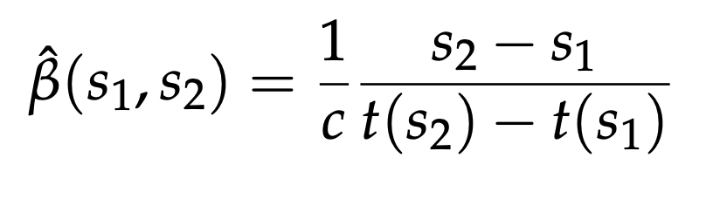
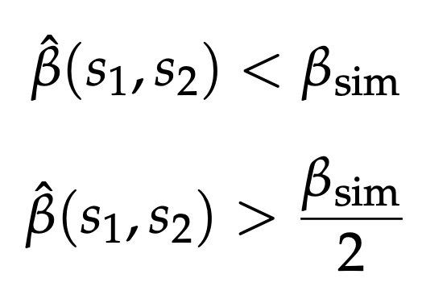
Reference simulation speed
We define for each particles:
Speed measured on the reference trajectory
Then we choose a ”reference speed” β_{sim} such that for all particles
i. e. No particle moves faster than β_{sim}
i. e. No particle moves slower β_{sim} / 2
Easy to find: β_{sim} = 1.1 β₀ works practically for any storage ring
In a nutshell, what we will do in the following is to use β_{sim} as reference velocity
→ Particles can be too slow (skip a turn) but not too fast (arrive twice in a turn)
Note that in the following of this presentation, if we replace β_{sim} with β₀ we get back the definitions and relations used for bunched beams.

Slide 12
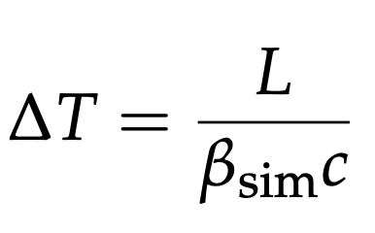
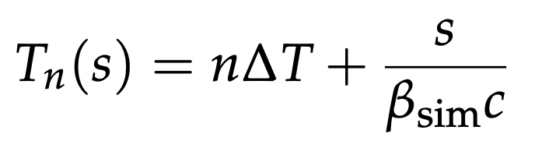
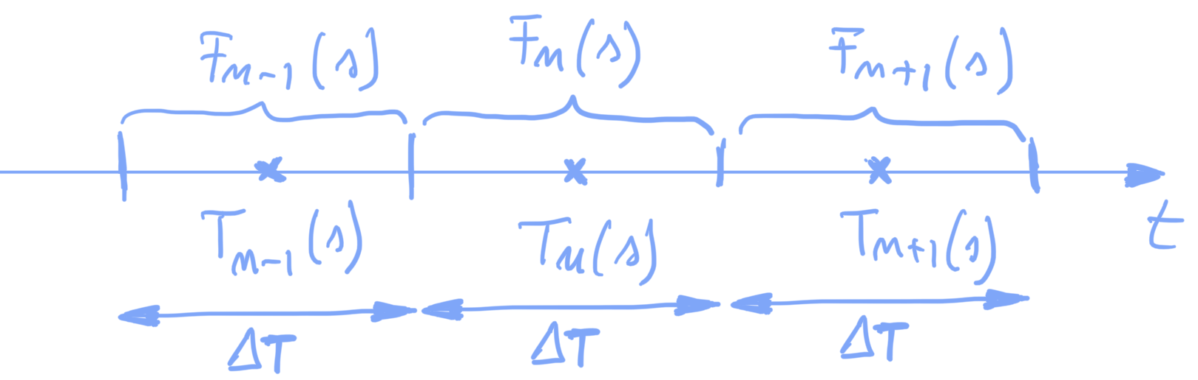
From turns to time frames
We use a “virtual particle” moving at the “reference speed” β_{sim} on the reference trajectory to generalize the concept of turn:
We call frame a time interval of length:
The mid point of each frame depends on the s position and is defined by the passage of the virtual particle at the given s:
.

Slide 13
Method
s=0
The time frames act as the turns of the bunched beam case:
  For each frame we track particles around the ring
  We compute forces due to collective effects only for the present frame
We need to ensure that at each collective interaction we pass to the collective elements all particles arriving during the present time frame (independently of their number of performed revolutions)
For this purpose, we install in front of each collective element, a “SyncTime” element
  The SyncTime takes care of disabling particles that fall out of the current time frame (arrive too late) and re-enabling them at the following frame
Collective
element
SyncTime
SyncTime
Collective
element

Slide 14
Method
s=0
We start by simulating frame F₀(s):
We track particles from the start of the ring to the first SyncTime elements
Collective
element
SyncTime
Frame n = 0
SyncTime
Collective
element

Slide 15
Method
s=0
We start by simulating frame F₀(s):
We track particles from the start of the ring to the first SyncTime elements
Collective
element
SyncTime
Frame n = 0
SyncTime
Collective
element

Slide 16
Method
s=0
We start by simulating frame F₀(s):
We track particles from the start of the ring to the first SyncTime elements
Some particles are found to arrive too late, outside F₀(s)
  → these particles are deactivated
Collective
element
SyncTime
Frame n = 0
SyncTime
Collective
element

Slide 17
Method
s=0
We start by simulating frame F₀(s):
We track particles from the start of the ring to the first SyncTime elements
Some particles are found to arrive too late, outside F₀(s)
  → these particles are deactivated
The active particles are taken into account by the collective element
Collective
element
SyncTime
Frame n = 0
SyncTime
Collective
element

Slide 18
Method
s=0
We start by simulating frame F₀(s):
We track particles from the start of the ring to the first SyncTime elements
Some particles are found to arrive too late, outside F₀(s)
  → these particles are deactivated
The active particles are taken into account by the collective element
The active particles are tracked to the next collective location where the same procedure takes place
Collective
element
SyncTime
Frame n = 0
SyncTime
Collective
element

Slide 19
Method
s=0
We start by simulating frame F₀(s):
We track particles from the start of the ring to the first SyncTime elements
Some particles are found to arrive too late, outside F₀(s)
  → these particles are deactivated
The active particles are taken into account by the collective element
The active particles are tracked to the next collective location where the same procedure takes place
Collective
element
SyncTime
Frame n = 0
SyncTime
Collective
element

Slide 20
Method
s=0
We start by simulating frame F₀(s):
We track particles from the start of the ring to the first SyncTime elements
Some particles are found to arrive too late, outside F₀(s)
  → these particles are deactivated
The active particles are taken into account by the collective element
The active particles are tracked to the next collective location where the same procedure takes place
Tracking continues to the end of the ring
Collective
element
SyncTime
Frame n = 0
SyncTime
Collective
element

Slide 21
Method
s=0
We start by simulating frame F₀(s):
We track particles from the start of the ring to the first SyncTime elements
Some particles are found to arrive too late, outside F₀(s)
  → these particles are deactivated
The active particles are taken into account by the collective element
The active particles are tracked to the next collective location where the same procedure takes place
Tracking continues to the end of the ring
Collective
element
SyncTime
Frame n = 0
SyncTime
Collective
element

Slide 22
Method
s=L
We start by simulating frame F₀(s):
We track particles from the start of the ring to the first SyncTime elements
Some particles are found to arrive too late, outside F₀(s)
  → these particles are deactivated
The active particles are taken into account by the collective element
The active particles are tracked to the next collective location where the same procedure takes place
Tracking continues to the end of the ring
Collective
element
SyncTime
Frame n = 0
SyncTime
Collective
element

Slide 23
Method
s=0
Simuation of frame F₁(s):
At the start of each turn the ζ coordinate needs to be updated (see later)
We track active partilces to the first SyncTime element
Collective
element
SyncTime
Frame n = 1
SyncTime
Collective
element

Slide 24
Method
s=0
Simuation of frame F₁(s):
At the start of each turn the ζ coordinate needs to be updated (see later)
We track active partilces to the first SyncTime element
Collective
element
SyncTime
Frame n = 1
SyncTime
Collective
element

Slide 25
Method
s=0
Simuation of frame F₁(s):
At the start of each turn the ζ coordinate needs to be updated (see later)
We track active partilces to the first SyncTime element
  Particles that arrived too late in F₀(s) are now reactivated for F₁(s) → ζ needs to be updated (see later)
Collective
element
SyncTime
Frame n = 1
SyncTime
Collective
element

Slide 26
Method
s=0
Simuation of frame F₁(s):
At the start of each turn the ζ coordinate needs to be updated (see later)
We track active partilces to the first SyncTime element
  Particles that arrived too late in F₀(s) are now reactivated for F₁(s) → ζ needs to be updated (see later)
  Particles arriving too late for F₁(s) are deactivated
Collective
element
SyncTime
Frame n = 1
SyncTime
Collective
element

Slide 27
Method
s=0
Simuation of frame F₁(s):
At the start of each turn the ζ coordinate needs to be updated (see later)
We track active partilces to the first SyncTime element
  Particles that arrived too late in F₀(s) are now reactivated for F₁(s) → ζ needs to be updated (see later)
  Particles arriving too late for F₁(s) are deactivated
And so on…
Collective
element
SyncTime
Frame n = 1
SyncTime
Collective
element

Slide 28
Method
s=0
Simuation of frame F₁(s):
At the start of each turn the ζ coordinate needs to be updated (see later)
We track active partilces to the first SyncTime element
  Particles that arrived too late in F₀(s) are now reactivated for F₁(s) → ζ needs to be updated (see later)
  Particles arriving too late for F₁(s) are deactivated
And so on…
Collective
element
SyncTime
Frame n = 1
SyncTime
Collective
element

Slide 29
Outline
Introduction
  Particle slippage
  Implications for collective effects
Simulation method description
  Reference speed β_{sim}
  From turns to frames
  Algorithm step bu step
Mathematical description
  Propositions on time time of arrivals
  Justification of the method
  Generalization of ζ coordinate
  ζ update at start turn
  ζ update on frame jump
Numerical tests
29

Slide 30
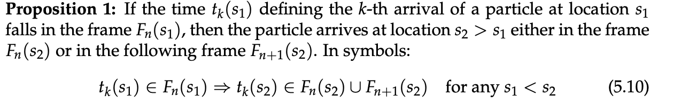
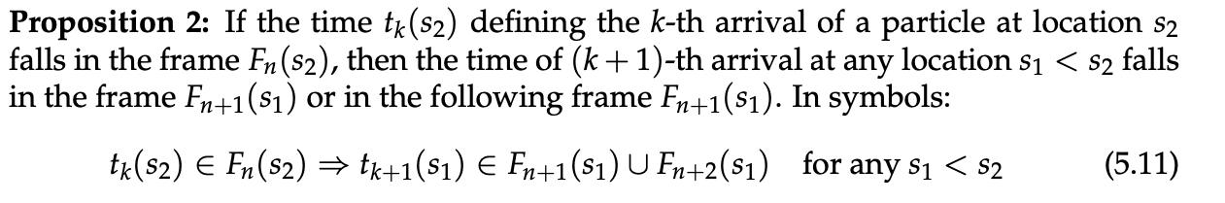
Propositions on particles arrival times
The procedure illustrated so far can be rigorously justified mathematically. Full derivation available in the Xsuite Physics Guide.
A central role is played by the following two propositions:
In the following I give you a glimpse of the proof…

Slide 31
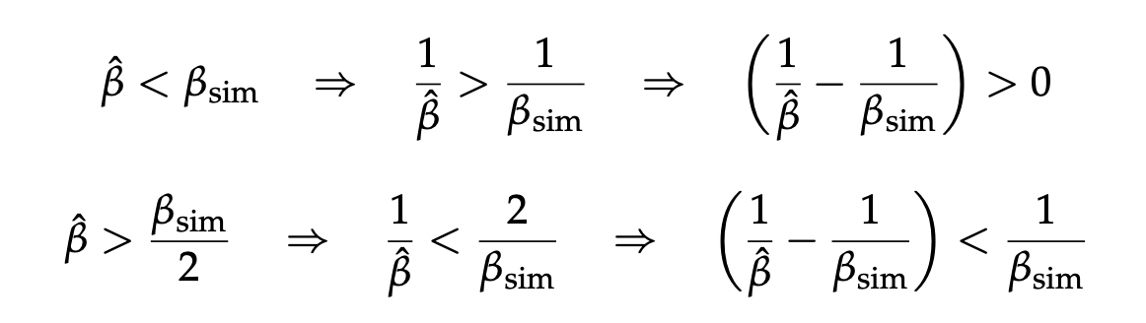
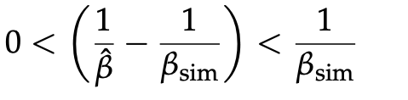
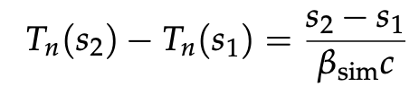
Proof of proposition 1
Reminders:
We prove an auxiliary result:
Cobining the two:
Another relation that we will use:

Slide 32
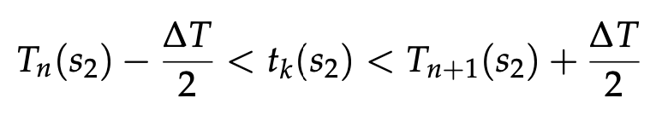
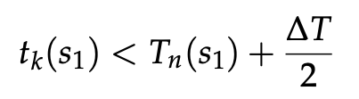
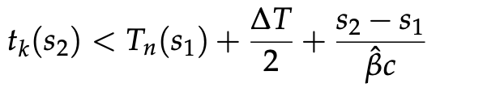

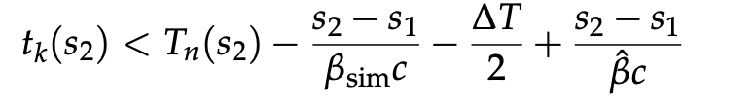
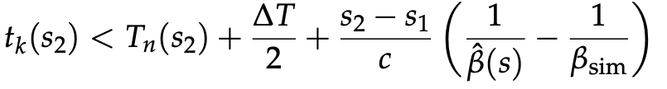
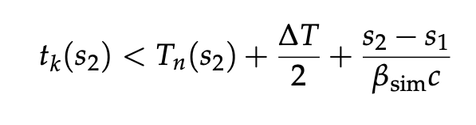
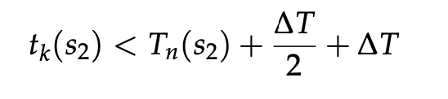

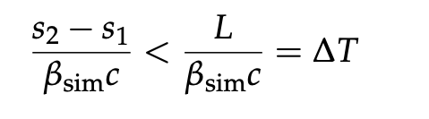
Proof of proposition 1
Reminders:
We want to prove:
or equivalently:
This proves the upper bound.

Slide 33

Proof of proposition 1
Reminders:
We want to prove:
or equivalently:
The proof for the lower bound is very similar and can be found on the Xsuite Physics Manual
This proves the upper bound.

Slide 34



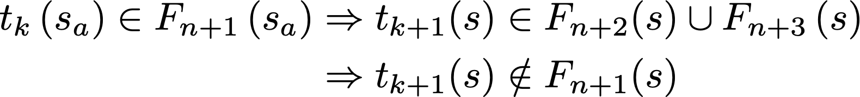
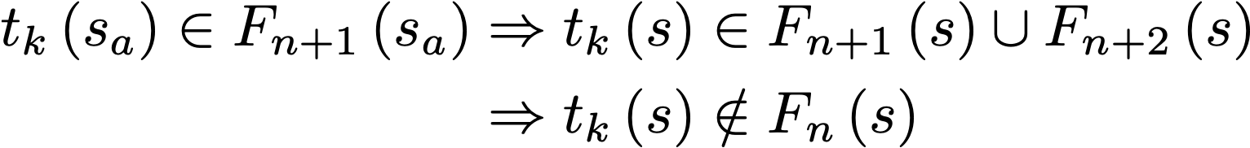
How these proofs justify the simulation procedure
Prop. 1:
Prop. 2:
s=L
s=0
Frame (n+1)
We detect that the particle is not in the current frame F_{n}(s) at s=s_{a}
We know from Prop. 1 that the particles is already in the next frame
We know from Prop. 1 that for s > s_{a}:
Frame n
s_{a}
Frame jump!
Frame n
We know from Prop. 2 for s < s_{a}:
Frame (n+1)
This is exacty what we do in the simulator!

Slide 35
Outline
Introduction
  Particle slippage
  Implications for collective effects
Simulation method description
  Reference speed β_{sim}
  From turns to frames
  Algorithm step bu step
Mathematical description
  Propositions on time time of arrivals
  Justification of the method
  Generalization of ζ coordinate
  ζ update at start turn
  ζ update on frame jump
Numerical tests
35

Slide 36


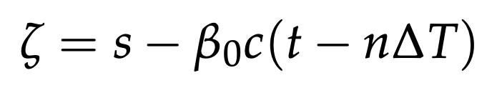
Generalization of the zeta coordinate
Reminder on usual definitions (bunched beams)
In Xsuite (as in all beam dynamics codes) we don’t use t to track the particle arrival time. We instead use ζ defined as:
where S is the total traveled length on the reference trajectory:
Combining the relations above we obtain:
Time within the turn
Generalization to coasting beams:
For coasting beam we define ζ as:
Reminder
Time within the frame

Slide 37
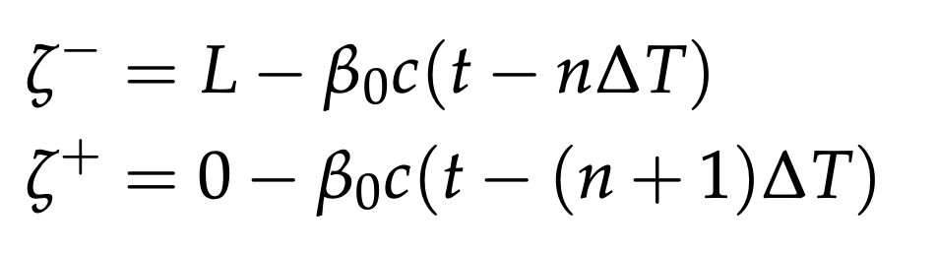
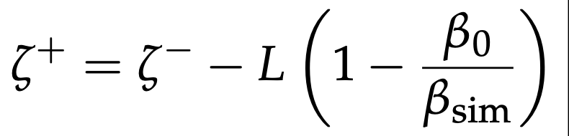
Zeta update at start of turn
Reminder:
One of the implications of our definition of ζ is that we need to update ζ at the start of each turn:
End of turn n (s=L):
Start of turn n+1 (s=0):
Subtracting one from the other we obtain the update equation:

Slide 38
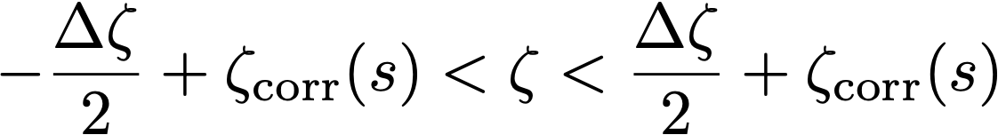
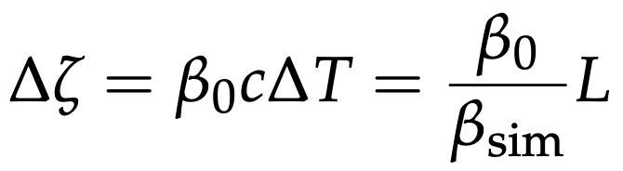
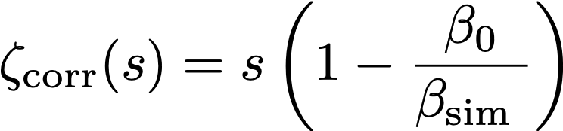

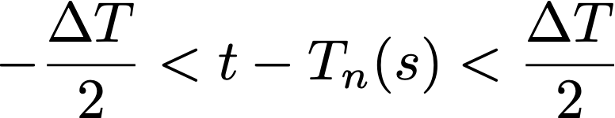

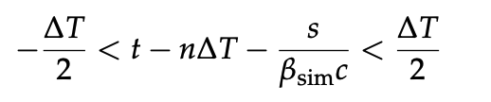

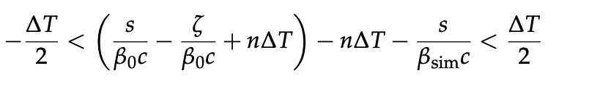
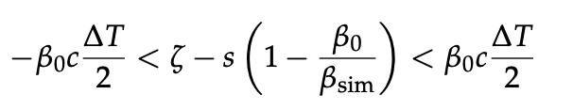
Conditions on zeta for arrival time in the current frame
We can prove⁽¹⁾ the following condition for the arrival time of a particle to be in the current frame F_{n}(s):
where:
⁽¹⁾ Proof:
Reminder:

Slide 39
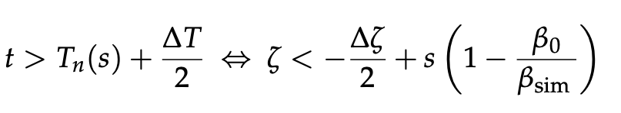
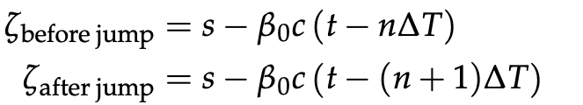
Zeta update on frame jump
Reminder:
where:
Particles arrive out of the current frame (arrive too late) and jump to the next when:
As discussed, the particle is stopped, and its tracking is resumed when handling frame (n+1)
When this happens the ζ coordinates needs to be updated:
Subtracting one from the other we obtain the update equation:

Slide 40
Outline
Introduction
  Particle slippage
  Implications for collective effects
Simulation method description
  Reference speed β_{sim}
  From turns to frames
  Algorithm step bu step
Mathematical description
  Propositions on time time of arrivals
  Justification of the method
  Generalization of ζ coordinate
  ζ update at start turn
  ζ update on frame jump
Numerical tests
40

Slide 41
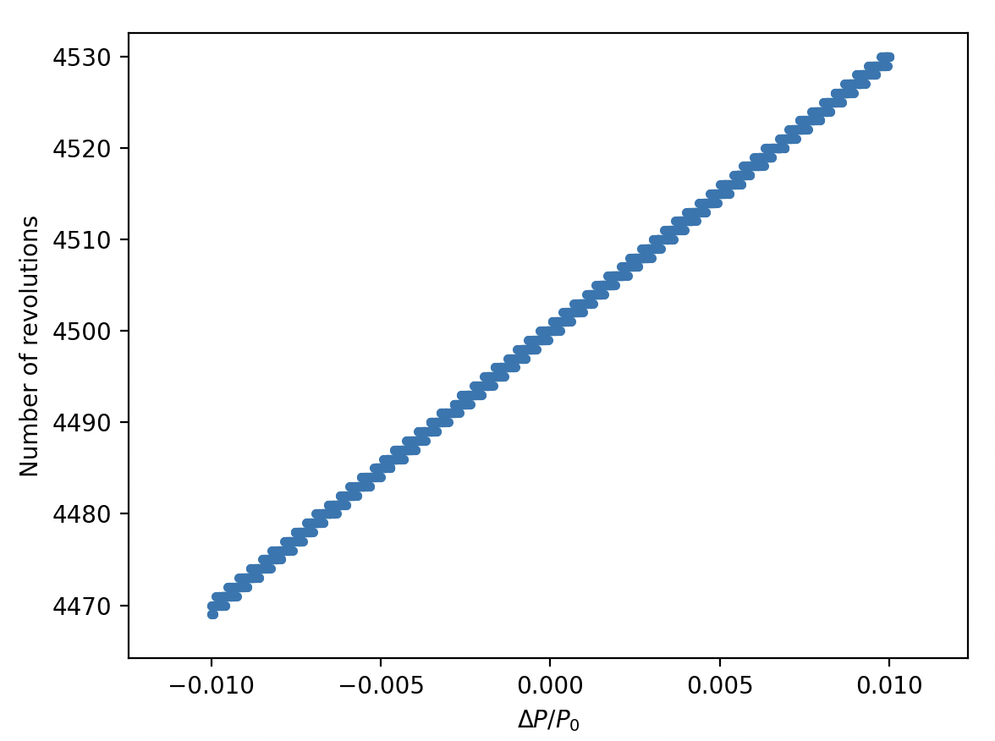
Test simulations
CERN PS Booster
Full lattice
E_{kin} = 160 MeV
RF off
Test case:
Tracking a beam with an artificially large momentum spread we can clearly see that different particles perform a different number of revolution over the simulated time.

Slide 42
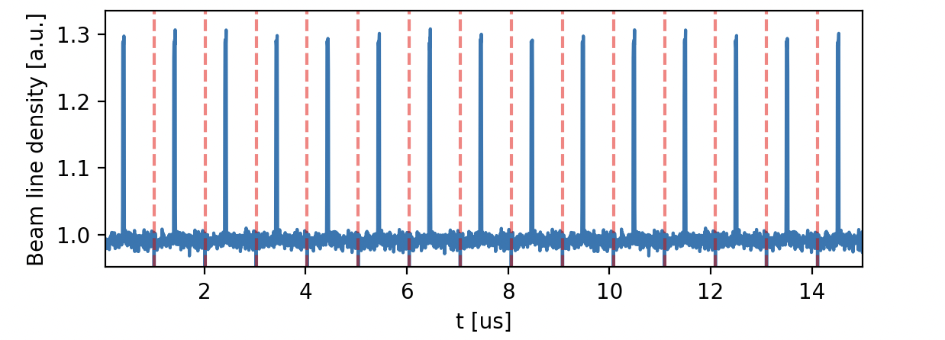
Test simulations – measuring the revolution frequency
We track a beam with no momentum spread, and we introduce a perturbation on the beam line density.
As there is no slippage, the perturbation is observed at each turn
It is possible to measure the revolution frequency by extracting the main Fourier component of the longitudinal profile (using nafflib)
The beam is generated with δ = 0
f_nominal (on momentum): 991.96599 kHz
f_measured (off momentum): 991.96599 Hz

Slide 43
Test simulations – measuring the revolution frequency
We track a beam with no momentum spread, and we introduce a perturbation on the beam line density.
As there is no slippage, the perturbation is observed at each turn
It is possible to measure the revolution frequency by extracting the main Fourier component of the longitudinal profile (using nafflib)
The beam is generated with δ = -0.01
f_nominal (on momentum): 991.966 kHz
f_expected (off momentum): 985.271 kHz
f_measured (off momentum): 985.271 kHz

Slide 44
Test simulations – measuring the revolution frequency
We track a beam with no momentum spread, and we introduce a perturbation on the beam line density.
As there is no slippage, the perturbation is observed at each turn
It is possible to measure the revolution frequency by extracting the main Fourier component of the longitudinal profile (using nafflib)
The beam is generated with δ = +0.01
f_nominal (on momentum): 991.966 kHz
f_expected (off momentum): 998.580 kHz
f_measured (off momentum): 998.581 kHz
Frequency obtained from the line density agrees very well with expected one ☺

Slide 45
Summary and outlook
A method has been devised to simulate coasting beams with tracking codes that use the reference path length s as independent variable
The different revolution frequency among particles is accurately modeled
The method has been implemented in Xsuite:
No modifications in the conventional tracking elements
Time synchronization of particles is achieved by installing dedicated SyncTime elements in front of the collective elements (e.g. space charge, impedances)
Planned applications include:
PSB with space charge (benchmark of coasting beam experiments)
Fermilab IOTA ring with space charge
ISIS-2 stability studies

Slide 46
Thanks for your attention!

Slide 47
