Slide 1
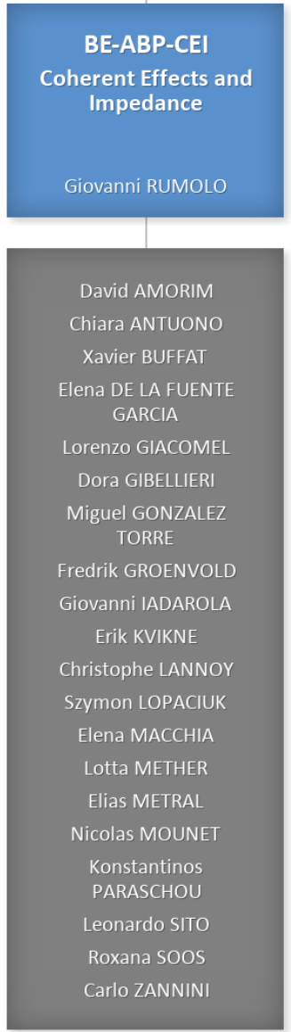
Coherent Effects and Impedances section (CEI) – general information
Giovanni Rumolo
CEI Section Meeting, 08/08/2024
Scientific secretary: Chiara Antuono
https://indico.cern.ch/event/1434653/
Notes:
02

Slide 2
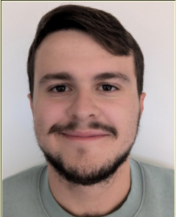
New arrivals
Bernardo Abreu Figueiredo, welcome!
Doctoral student with Giovanni Iadarola, will work on Xsuite,
in particular “Development of computing techniques for
accelerator physics in the Xsuite framework”
  Optimisation techniques for accelerator physics problems
  Performance speed-up of beam dynamics simulations
  Application of automatic differentiation techniques to accelerator physics

Slide 3
New arrivals … and departures ☹
Bernardo Abreu Figueiredo, welcome!
Doctoral student with Giovanni Iadarola, will work on Xsuite,
in particular “Development of computing techniques for
accelerator physics in the Xsuite framework”
  Optimisation techniques for accelerator physics problems
  Performance speed-up of beam dynamics simulations
  Application of automatic differentiation techniques to accelerator physics
Josephine will be leaving CERN next week (15 August 2024) and will move to a new phase of her career evolution – all the very best for the next challenges!

Slide 4
Arising matters
CERN Announcements for the Locks and Keys service and the Main Reception (email from Stéphanie)
  The Locks and Keys service is moving to Building 73 (link)
    The Locks and Keys service will be located in Building 73 (73/R‑002), next to the CERN Stores. The opening hours will remain unchanged (7.30 a.m. to 12.00 noon and 1.00 p.m. to 4.30 p.m., Mondays to Fridays).
  The new CERN Community Support Centre (link)
    The area in Building 33 that was formerly occupied by the Main Reception has undergone a complete transformation in order to house the new CERN Community Support Centre (CCSC), which will open on 1 August 2024.
    The CCSC will be operated by the CERN Service Desk team from 7.00 am to 6.30 pm, Monday to Friday. It will be the first line of support for all CERN services and activities that were previously housed in Building 55: contractor registration, delivery of access cards and professional visitor cards, biometry registration and dosimeter distribution, delivery of Swiss legitimation and French MAE cards, online training stations and general online and on-site assistance. These services will all be centralised on the ground floor of Building 33.

Slide 5
IPP meeting last Friday 2 August
SPS recovery after magnet exchange (Kostas)
  Scrubbing and performance recovery has been analysed by Kostas for the cases of magnet exchange in the SPS (4 times in 2024)
  Dynamic pressure rise is higher in the region of the exchanged magnet when it is an MBA (non-coated spare) than when it is an MBB (coated spare). However, we know that MBA scrubs faster (higher SEY threshold for e-cloud build-up)
  In all cases, pressure and beam conditions can be efficiently recovered in about half a day, especially if pressure interlock thresholds are temporarily relaxed around the region of the exchanged magnet to allow for faster scrubbing

Slide 6
IPP meeting last Friday 2 August
BCMS beams (Foteini, Sofia)
  Low emittance
    BCMS beam highly optimized along the injector chain to produce the lowest possible emittance at a given intensity, space charge in the SPS is important for this beam – as expected
    20% decrease of emittance seen at LHC injection when comparing standard and BCMS variants (as expected), the gap however reduces to 15% by the end of the injection process and to 10% at the beginning of stable beams. This results in 5% gain in integrated luminosity
    The emittance growth on the injection plateau has a part that has a clear e-cloud shape and a part that equally affects all bunches (consistent with IBS globally, but the model would expect only in H while it is observed shared in H and V)
  Low tail
    A low-tail version has been used for LHC physics production, in which tails have been made more Gaussian by using scraping in the PSB and optimizing PS transition crossing (tails appear to come also from Linac4)
    Lower q-values are indeed measurable at LHC injection
    The impact of tails on losses at collision seems to be evident both in MDs and in operation

Slide 7
2024 injectors schedule v2.1
No dedicated nor long parallel SPS MDs for three weeks due to HiRadMat run and then LHC MDs
Vacuum problem in Sectors 1 and 4 appeared when no FT beam in the SPS supercycle, still there?

Slide 8
High intensity beams in the SPS
Following the 938 MHz HOM coupler breakage in cavity 3 of the 200 MHz system in the SPS, a limit to 2e11 p/b for LHC beams was temporarily enforced in the SPS
Following discussion at and after the LMC last week, it was decided that
  The beams for the LHC MDs (2x 48b with 2.3e11 p/b) are much below the LIU beam specs (33% of intensity in 33% shorter trains) and can be considered ‘safe’. They will be therefore prepared in the injectors
  HiRadMat has accepted to run with 1.9-2.0e11 p/b this week and the next one, therefore stays within the current limit
  LIU MDs can take place at the end of August with the full LIU beam (4x 72b with 2.6e11 p/b injected) but without acceleration to 450 GeV
  Full-blown LIU MDs including acceleration will gently resume after the week of the Jeûne Genovois, when it is expected that more information on the post-mortem analysis and miscellaneous inspections will be available and the RF team will be also available in case of further failures of this type

Slide 9
2024 LHC schedule v2.0
Physics production with very good availability

Slide 10
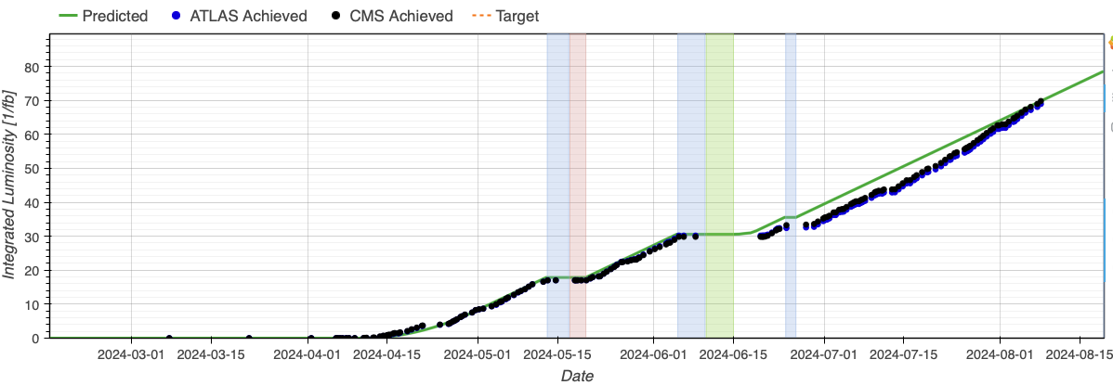
LHC Lumi
LHC integrated lumi finally back on target following a very good production period with high availability and large fraction in stable beams (>60%)

Slide 11
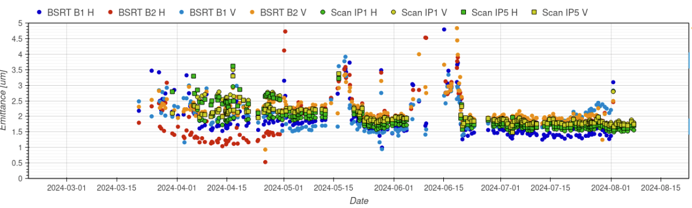
LHC beam parameters
Nice emittance at the beginning of stable beams (~1.7 um) and now great agreement between BSRT and lumi from experiments after BSRT calibration!

