Slide 1


Simulating and Analysing Crystal Channelling in the Large Hadron Collider
Francie Wharton
Skidmore College
CERN Summer Student Programme

Slide 2
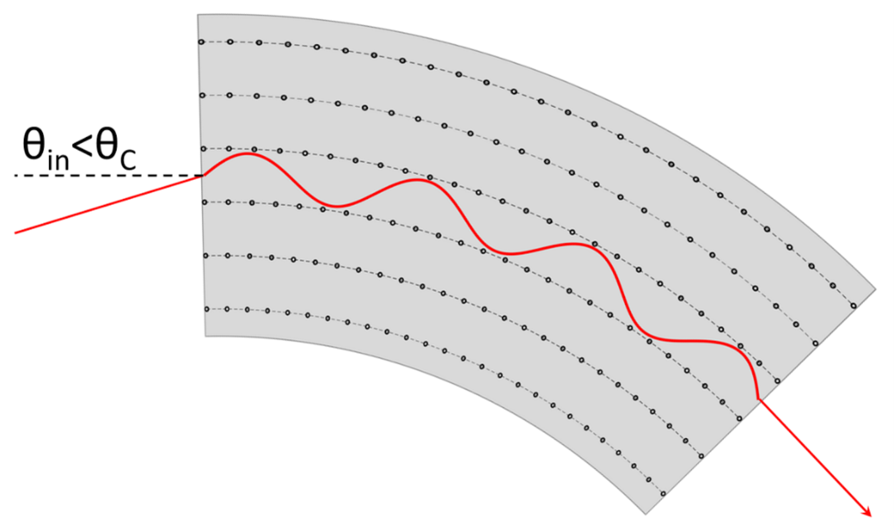
What is Crystal Collimation?
A type of advanced beam cleaning that uses bent silicon crystals to steer beam halo particles toward an absorber
When charged particles interact with a crystal at the right impact conditions, they become trapped and oscillate in the potential well generated by neighboring crystalline planes.
This phenomenon is called “channeling.”

Slide 3
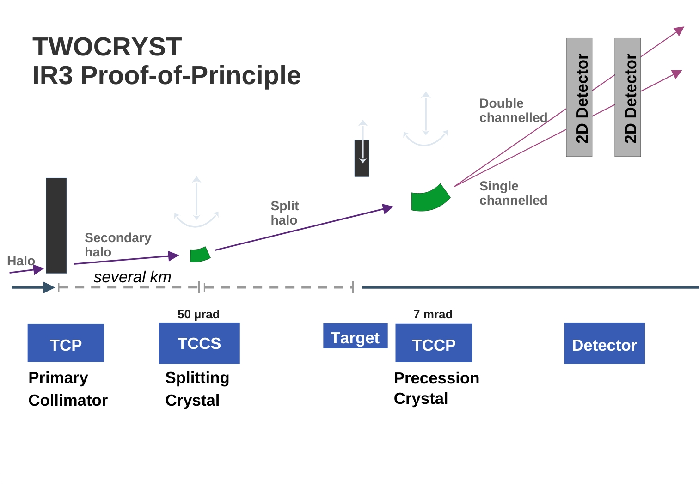
What is Crystal Collimation?
The Non-linear Dynamics and Collimation (NDC) section uses bent silicon crystals to channel beam halo particles in the Large Hadron Collider
Particularly useful for channeling lead ion beams–the crystal applies the same steering angle for intact lead ions and fragments.
  This is why crystal collimation is being implemented for the High Luminosity-LHC project to improve the ion collimation cleaning efficiency!

Slide 4
What I am doing: a change since the first talk!
For my project, I am using the simulation program SixTrack to simulate the results of a recent Machine Development (MD) study in the LHC from May 15th, 2024, which focused on testing and arrangement of the collimator/crystal hierarchy.
First step: develop and test an analysis algorithm, which calculates the channeling efficiency, or the percent of particles channeled by the crystal.
HALO
TCP.D
TCP.C
TCPC
TCSG
TCSPM

Slide 5
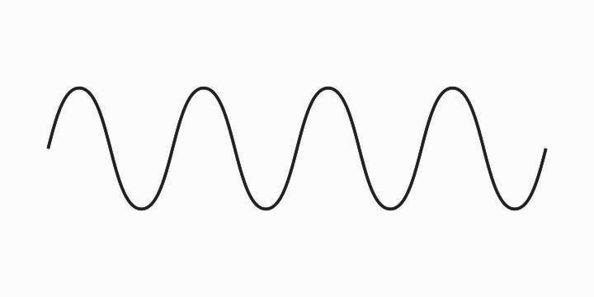
Phenomena from Crystal Particle Interactions
Unchannelled Particle
Channelling
Volume Reflection
Volume Capture
Channelling

Slide 6
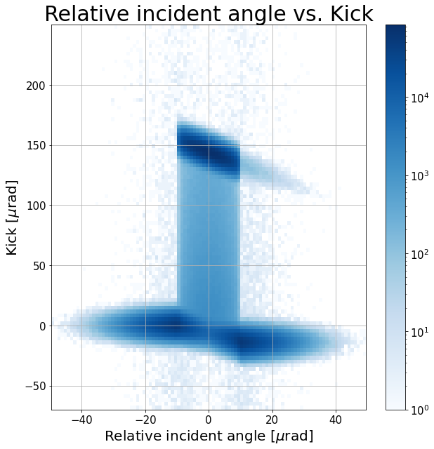
Recognizing Phenomena
Channelling
Volume Capture
Dechannelling
Amorphous
Volume Reflection

Slide 7
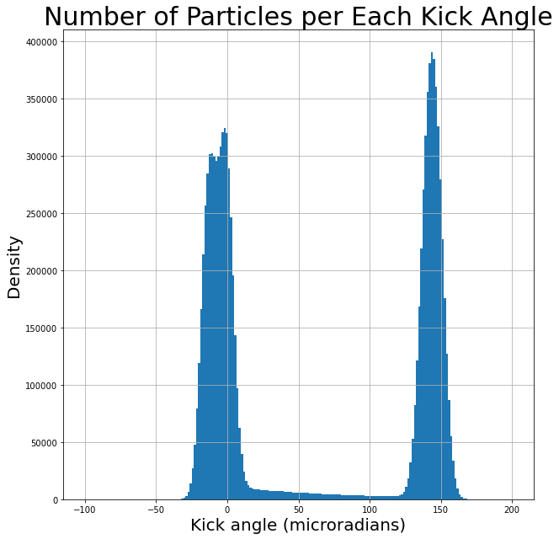
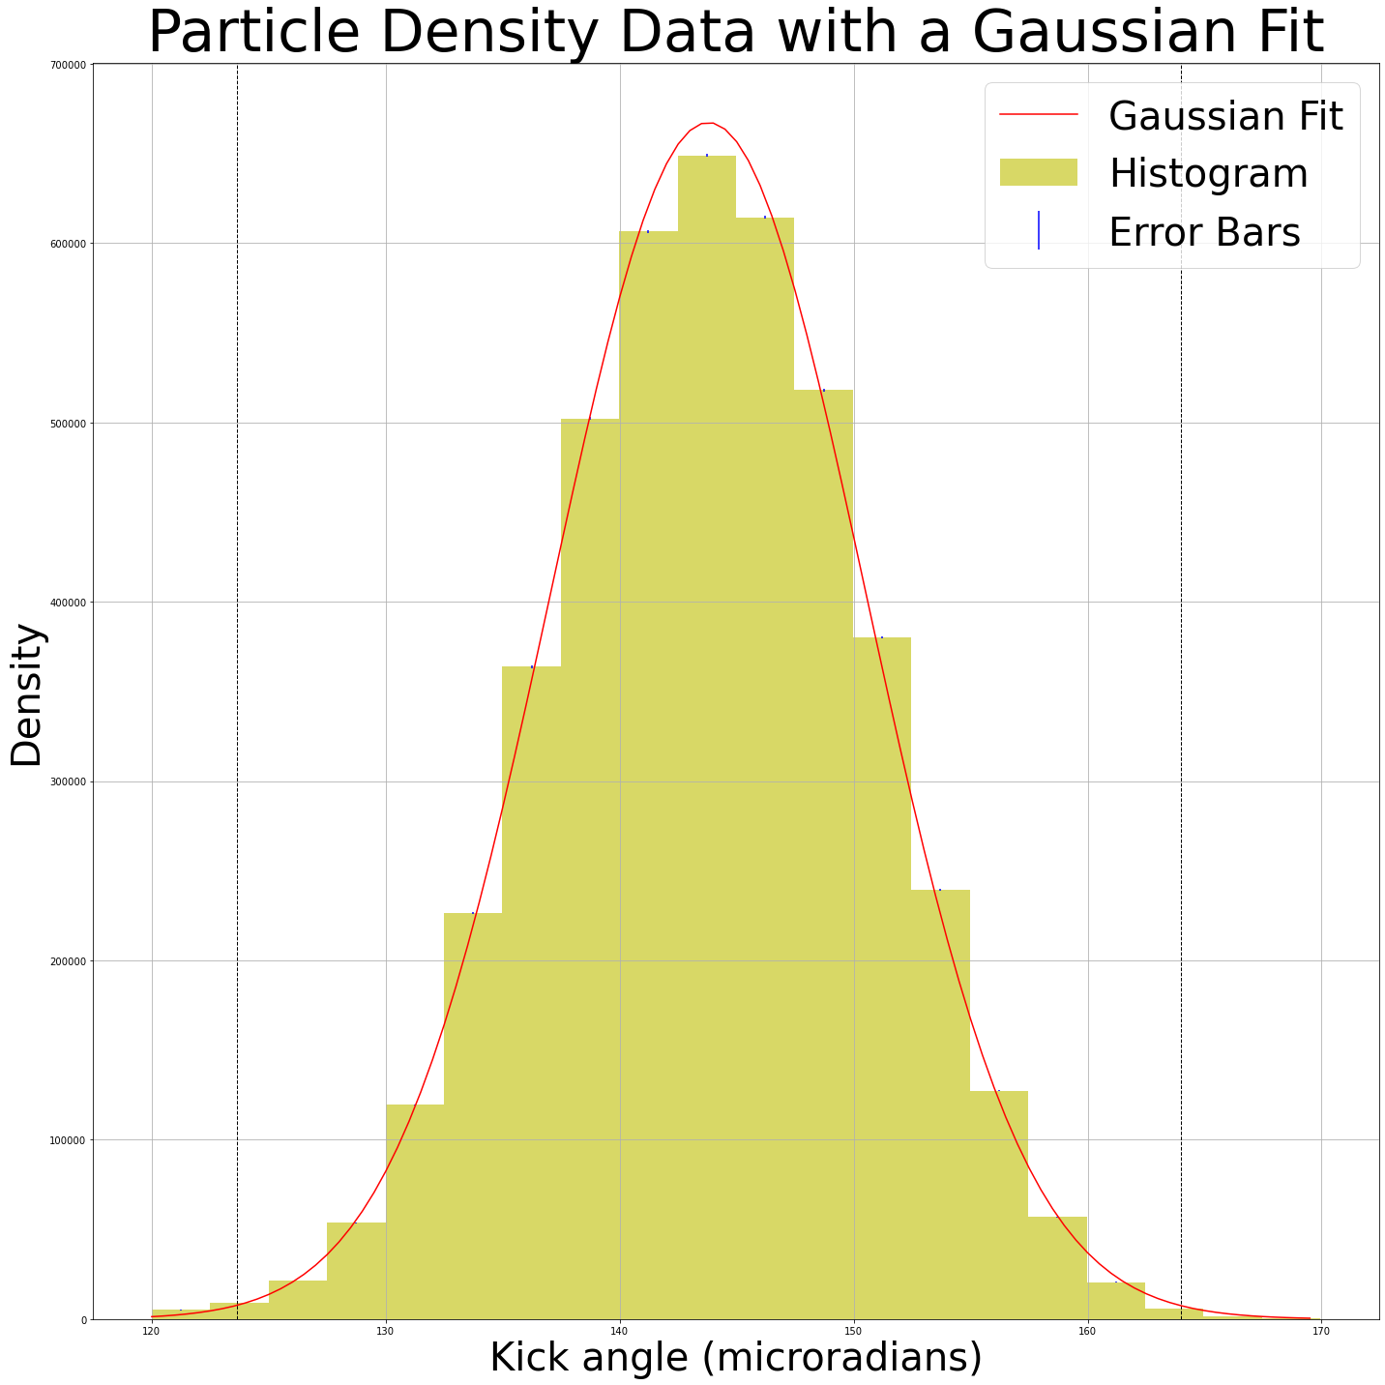
Finding the Channelling Efficiency
±10 μrad cut on the proton incident angle is applied
Channelling
Volume Capture
Total number of particles in the cut: 6,824,780
Number of particles within ±3σ: 4,509,501
Channelling Efficiency: 66.1%

Slide 8
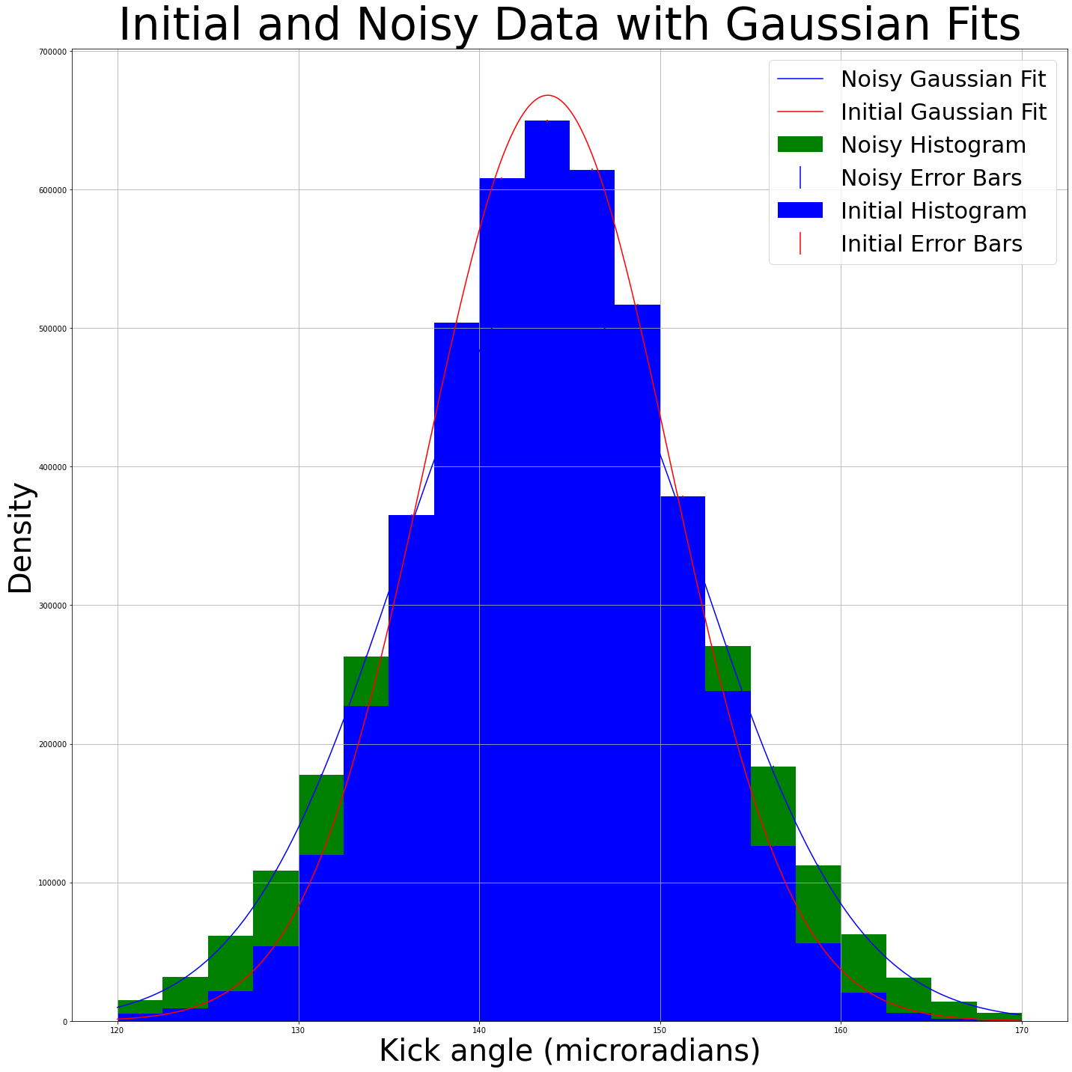
Including Resolution
I added an experimental resolution by adding random gaussian noise to the simulated deflections at the same level that noise occurs in the experiment.
You can see the added resolution in green!
Total number of particles in the cut: 6,824,780
Number of particles within ±3σ: 4520869
Channelling Efficiency: 66.2%

Slide 9
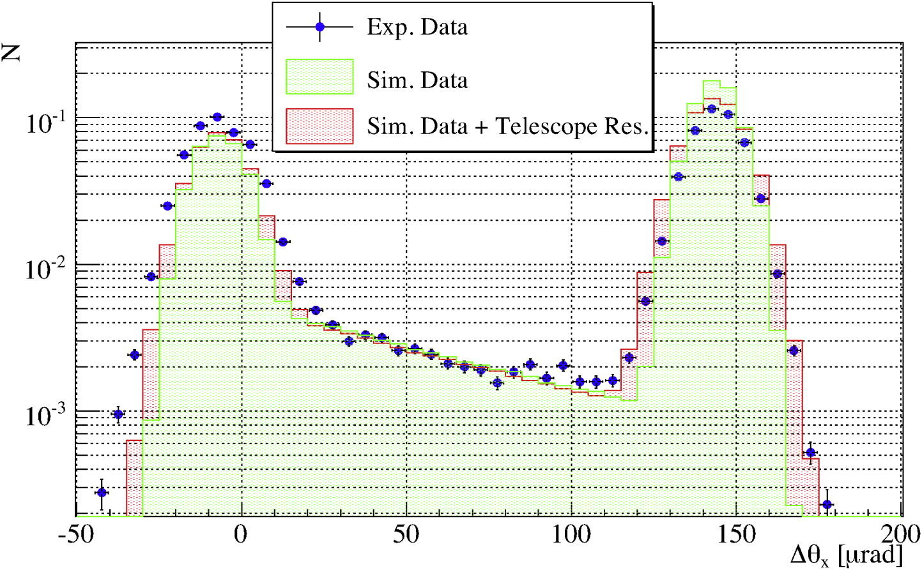
Conclusions
I found that the results of my simulation analysis match up well with results from a corresponding NDC paper, which validates this simulation tool and my analysis script for this MD.

Slide 10
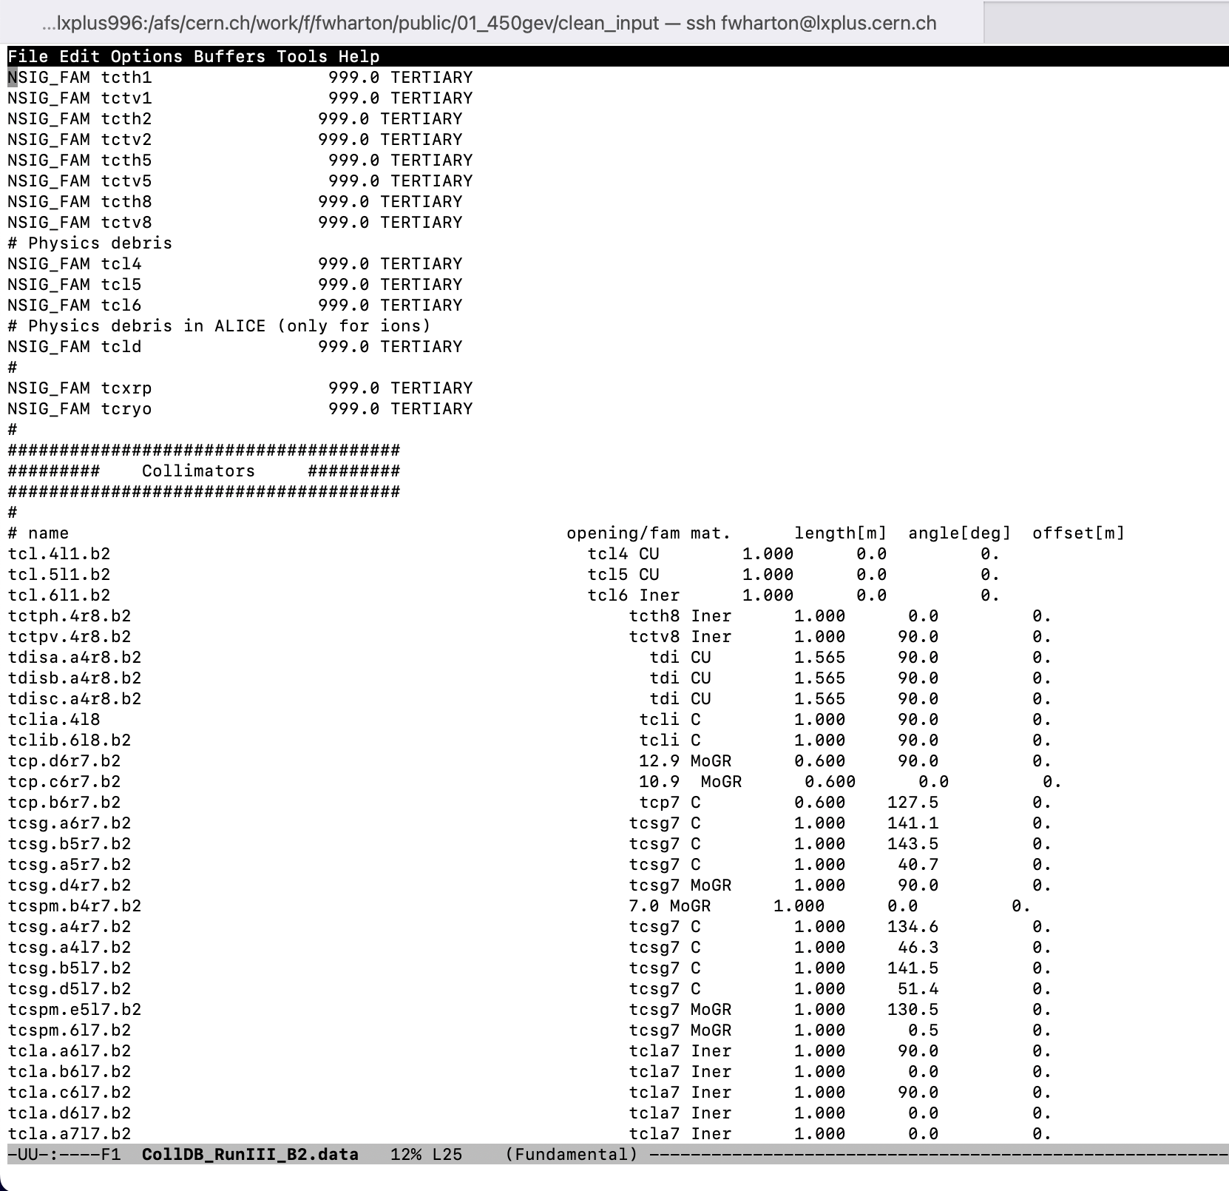
Next Steps
I am currently using SixTrack to simulate a test of a TCPC crystal in the LHC.
  I have completed the first simulation using particles at 450 GeV and will repeat the process considering crystal channeling at higher energies of 1 TeV, 3 TeV, and 5 TeV.
Using the analysis script described here to find the channeling efficiency at each energy, so it can be compared to the collected data from the MD measurements.

Slide 11
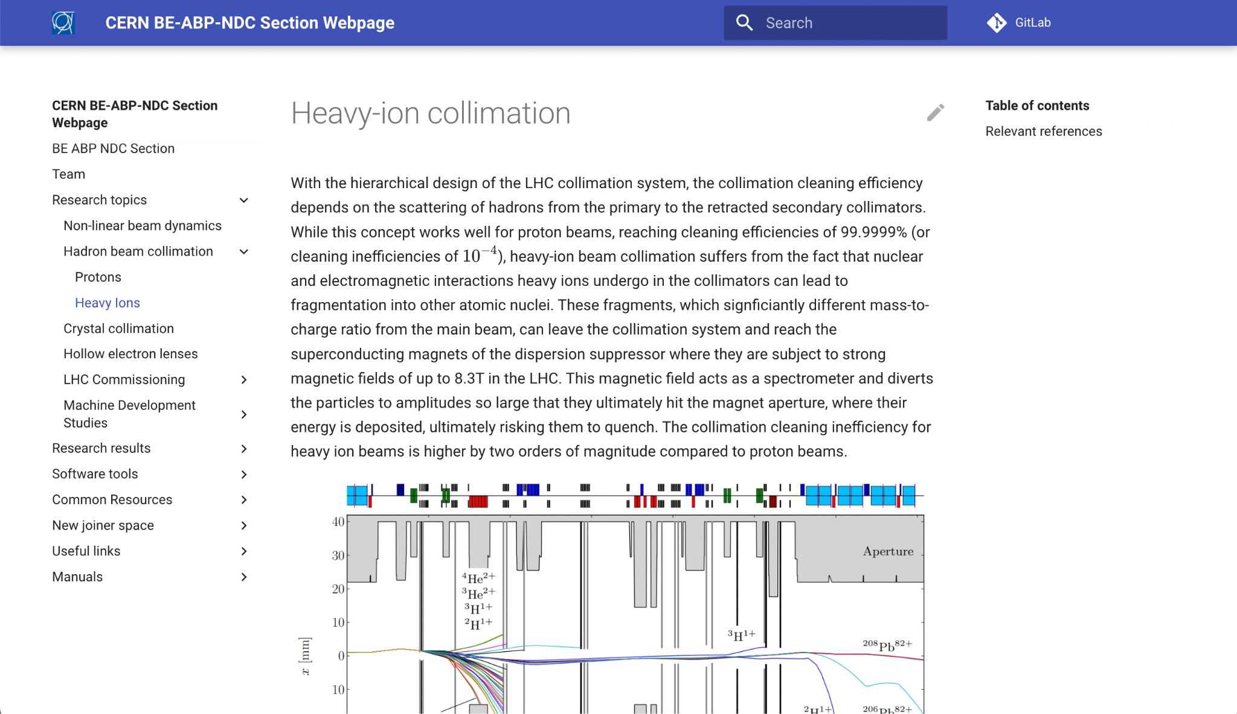
Updates to the NDC section website

Slide 12









