Slide 1


Analysis Sensitivity Test for Novel Asymmetric Leptoquark Pair Production Mechanism
Casey Hampson, André Sopczak
25.07.2024

Slide 2
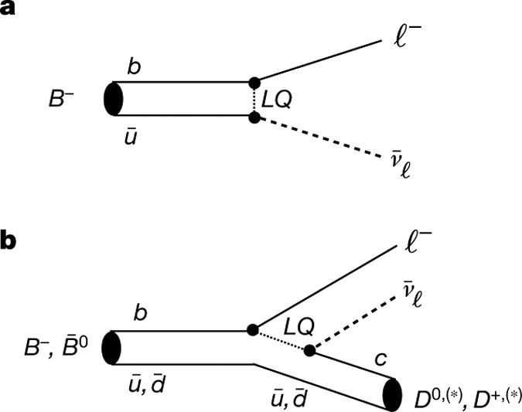
Introduction
LQ’s are hypothesized BSM particles that have both baryon and lepton number, so they can couple to both quarks and leptons
Can help to explain strange behaviors with B-meson decays, as well as explain neutrino masses
The search for LQ’s have revived in recent years due to higher energy events at the LHC
Lots of studies are being done to constrain the parameter space

Slide 3
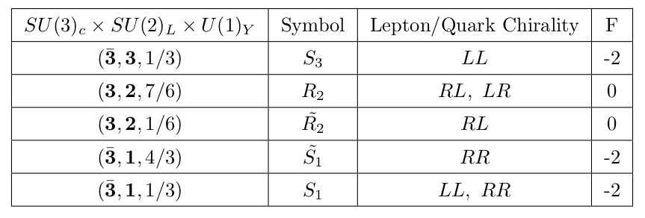
Scalar Leptoquarks
There are both scalar and vector leptoquarks proposed, but we focus on the scalar leptoquarks

Slide 4
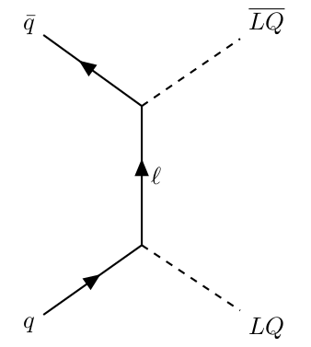
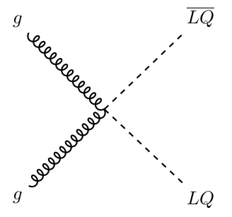
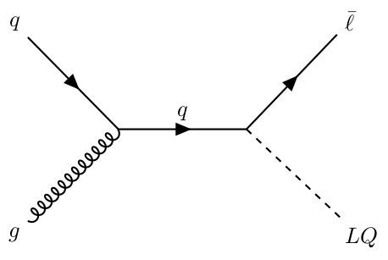
Current/Conventional Production

Slide 5
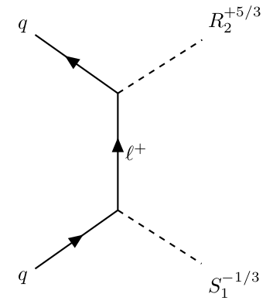
Novel Asymmetric Production Method
Recently, a novel method has been proposed for pair producing LQ’s that are not charge conjugates of each other and have a different fermion number
Added benefit of a quark-quark initial state, which is desirable at the LHC
Requires the LQ’s to couple to a lepton of the same flavor and chirality; we can turn on the relevant Yukawa couplings and this asymmetric production automatically happens

Slide 6

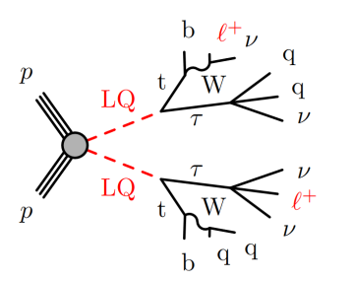
Analysis Channel
Our group focuses on the channel/signature: two same sign leptons plus a hadronically decaying tau
Existing analyses in this channel have proved fruitful, such as that for Higgs production or previous LQ production
We look to apply this existing analysis to this novel production method to test sensitivity

Slide 7
Challenges
The analysis uses machine learning to try and separate signal from background based on a variety of different features
My background/signal uses release 22 ntuples; very different from the previous release 21 ntuples!
I am missing 2/3 of the background ntuples; specifically, I am missing the campaigns mc20a and mc20e
Code I was provided is relatively poorly organized; makes doing the substitutions for the different features/ntuples very challenging

Slide 8
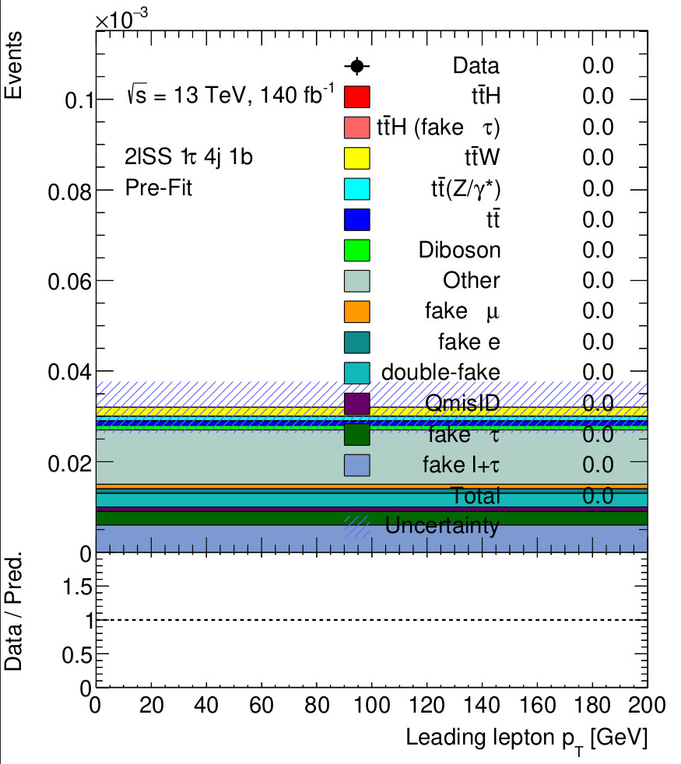
Next Steps
Work with others to try and get the features/ntuples sorted out as fast as possible, so I can train the model and generate some predictions
Run some statistical analysis with TRExFitter
Start working on the report

