Slide 1
H6 Modification – Smaller Beam Spot
Luke Weaver
Supervisors: Dr. Laurie Nevay & Dr. Fabian Metzger
15 - July - 2024

Slide 2
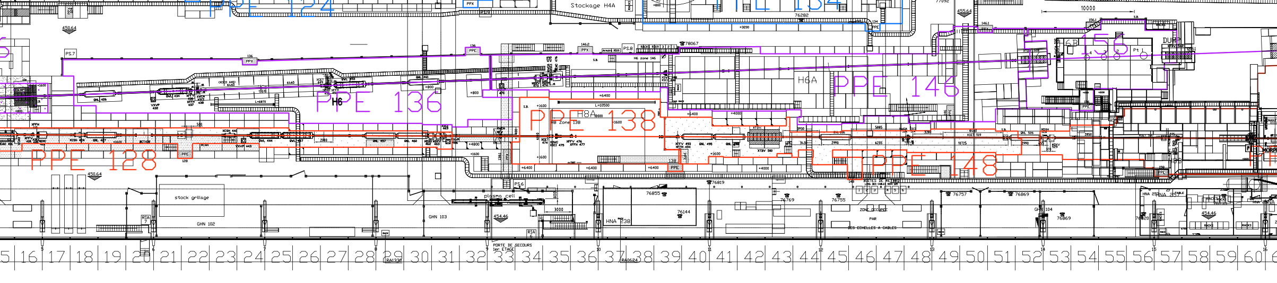
A Brief Recap
R&D silicon groups testing small silicon sensors which require smaller beam size for sufficient rate (already at RP safety limit)
Investigate possible configurations of quadrupoles to minimize beam spot
Accurately predict beam size taking into account filtering of secondary beam and multiple scattering in air
Free Area for Quadrupoles
Last doublet of quadrupoles
beam

Slide 3
Work Thus Far
Final focus study
Determine acceptance
Application of Twiss parameters and R-Matrices to model beam optics
Utilize MAD-X to evaluate different configurations of quadrupoles varying:
  Position
  Separation
  Quadrupole number
Compared focus size at different positions in user zones PPE146 and PPE156
Free Area for Quadrupoles
492.5 (m)
L
536.5 (m)
485 (m)
500 (m)
533 (m)
540 (m)
PPE146 Foci
PPE156 Foci
Quads

Slide 4
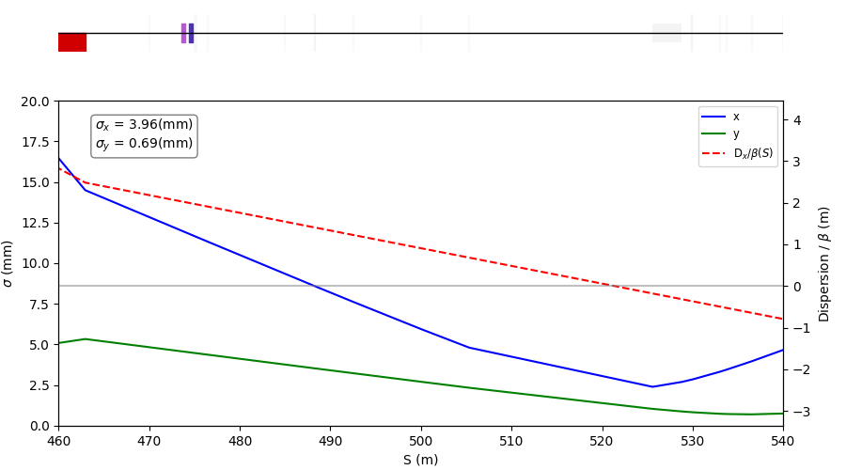
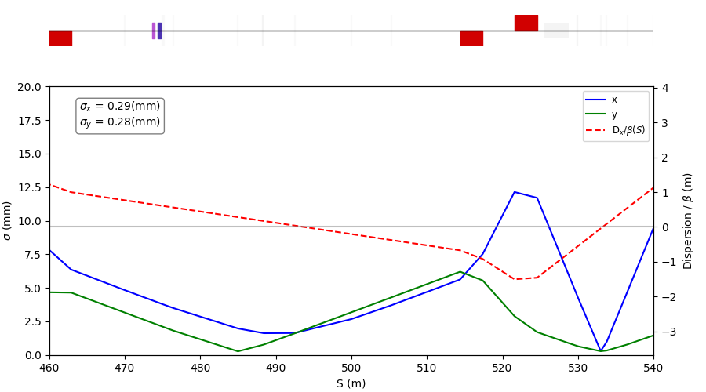
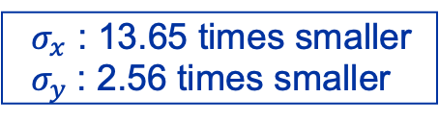
Optimal Setup
Doublet Solution – makes sense as previous focus comes from a Doublet
Quads as far downstream as possible – larger beam focuses to smaller spot size
Separation of 4.2 (m) – determined from varying separation distances in MAD-X
$σ_{x}$ : 13.65 times smaller
$σ_{y}$: 2.56 times smaller
With no Doublet
With Doublet

Slide 5
Multiple Scattering
End of beamline has ~40 m of air
Monte Carlo simulation of multiple scattering in air from reference beam

Slide 6
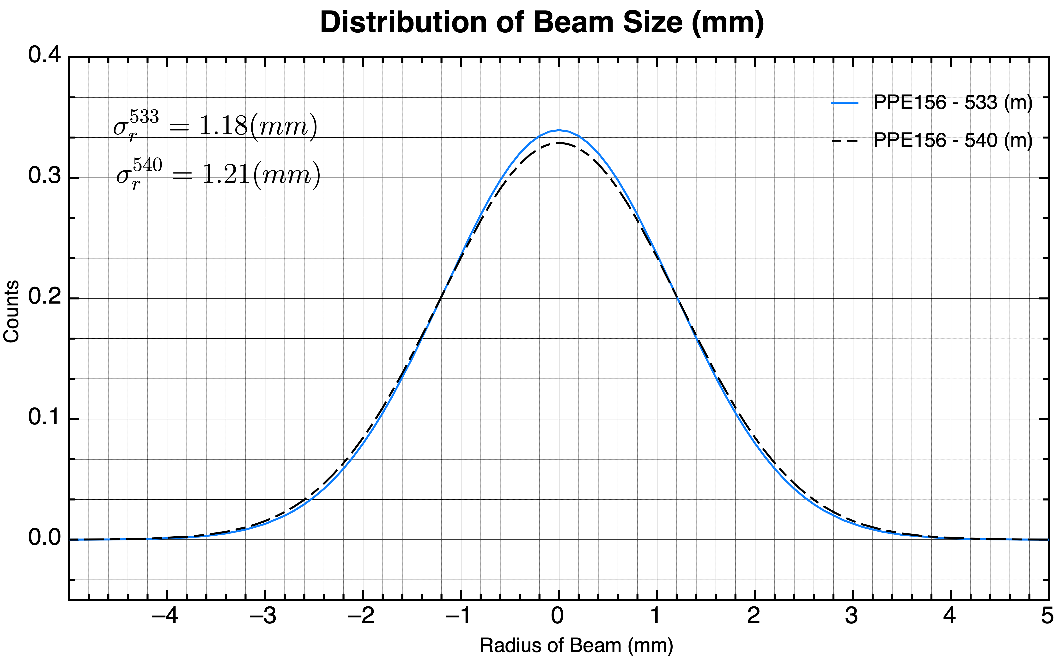
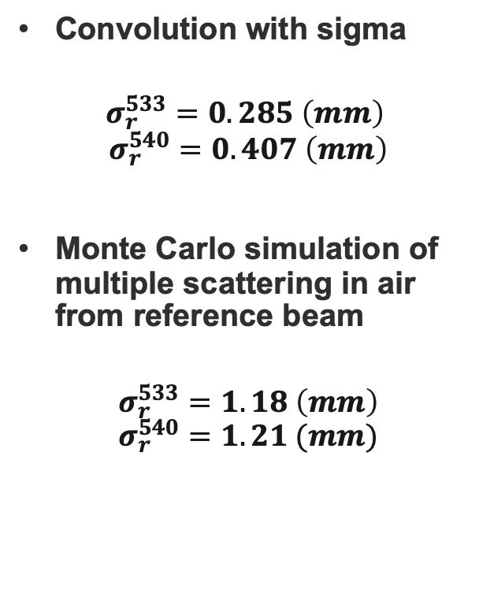
Multiple Scattering
Convolution with sigma
$$σ_{r}^{533}=0.285 \left(mm\right)$$
$$σ_{r}^{540}=0.407 \left(mm\right)$$
Monte Carlo simulation of multiple scattering in air from reference beam
$$σ_{r}^{533}=1.18 \left(mm\right)$$
$$σ_{r}^{540}=1.21 (mm)$$
Relative Frequence of X (normalized)

Slide 7
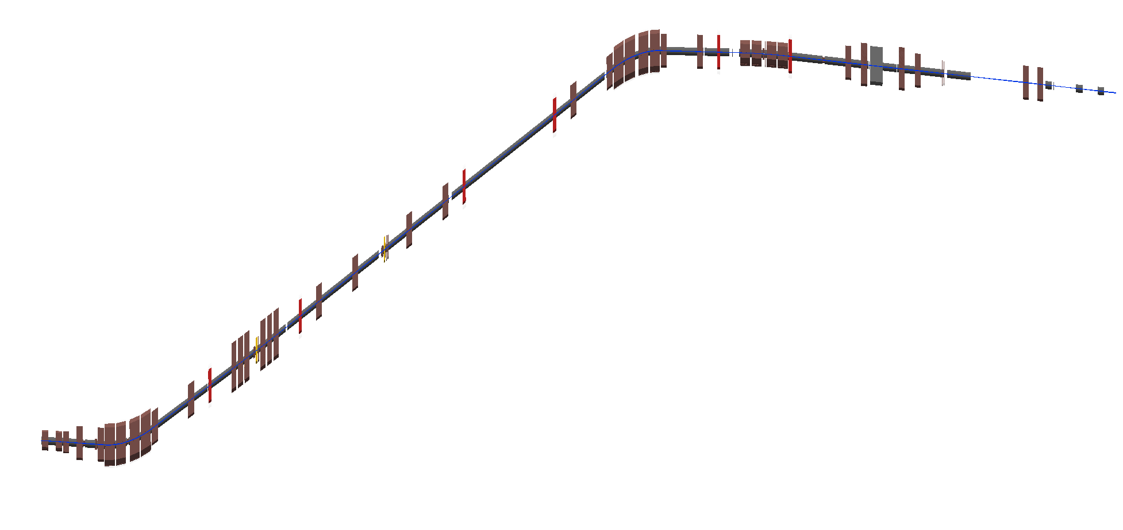
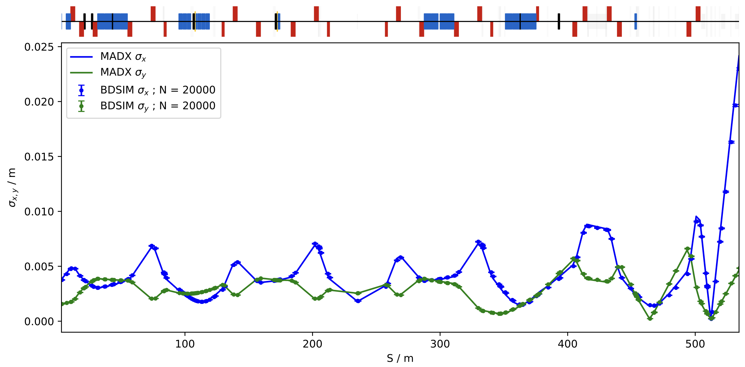
Beamline Model BDSIM
Added vacuum begin and end statements that were missing in the previous model
Added new quadrupoles
Verified the optics
New Quadrupoles

Slide 8
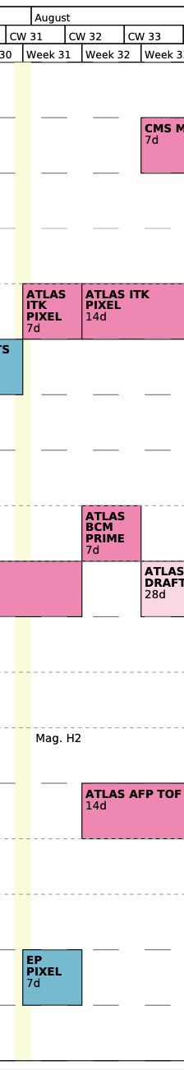
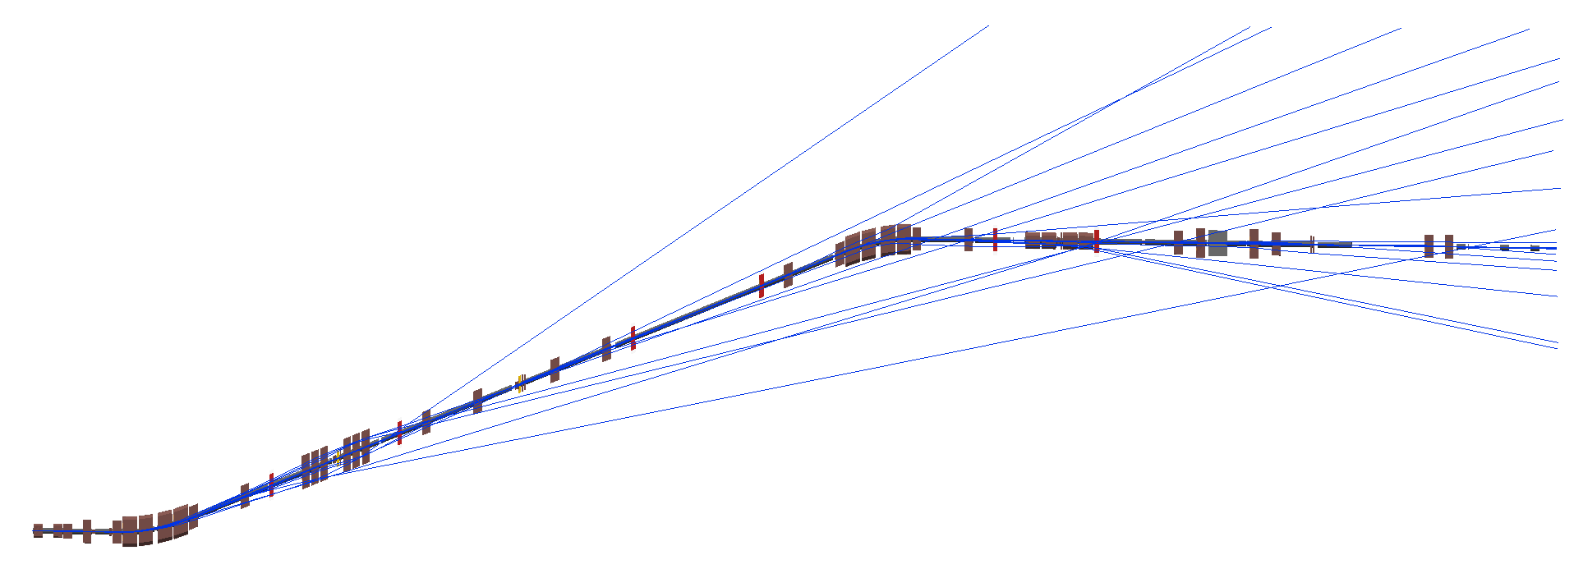
Next Steps
Simulate whole beamline start to finish in BDSIM (with physics on)
  Determine multi-species distribution of beam
Compare to measurements during first week of August
(Preliminary Results)

