Slide 1
Developing a Zenodo Jupyter Lab Extension
Michael Zengel
25-07-2024

Slide 2
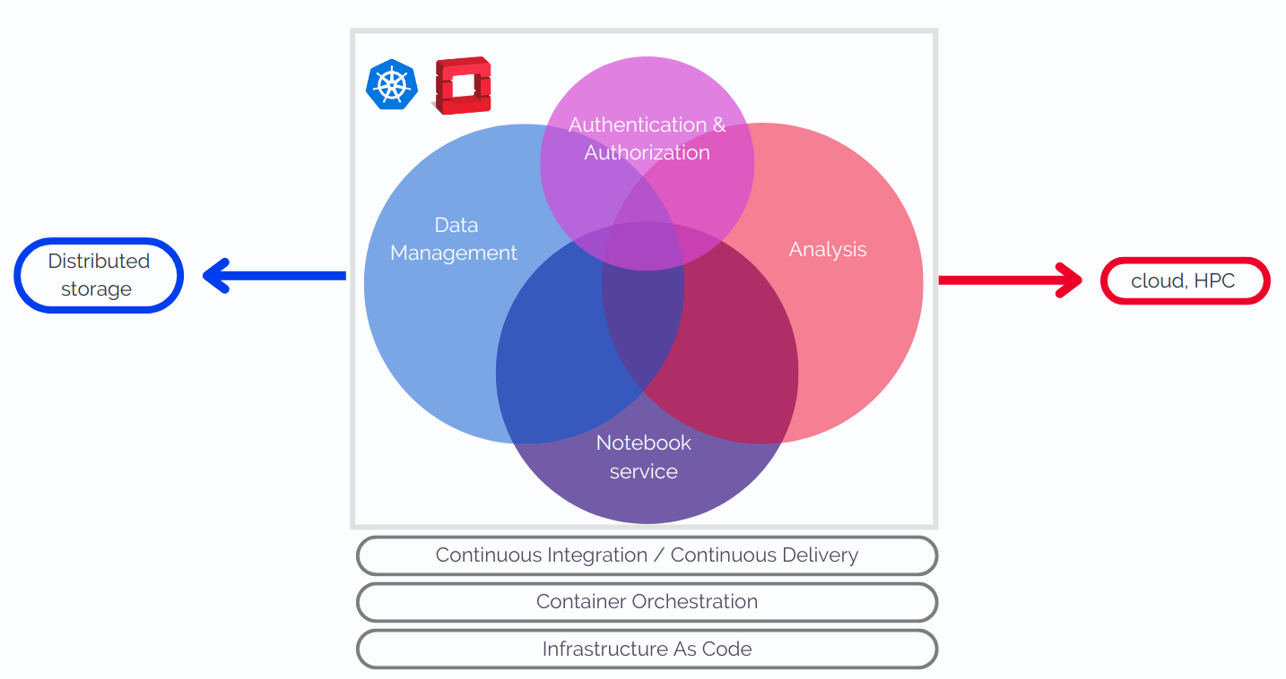

Motivation
Grand Purpose of VRE
  Virtual Research Environment (VRE): simplify life for physicists by combining software in one place
This Project
  Zenodo: Open-source database software for sharing results/code
  Goal: Incorporate into Jupyter Lab (widely used coding software)
    Increases speed and ease of downloading and uploading data
    Removes need to separately access Zenodo via either web client or command line interface (CLI)

Slide 3
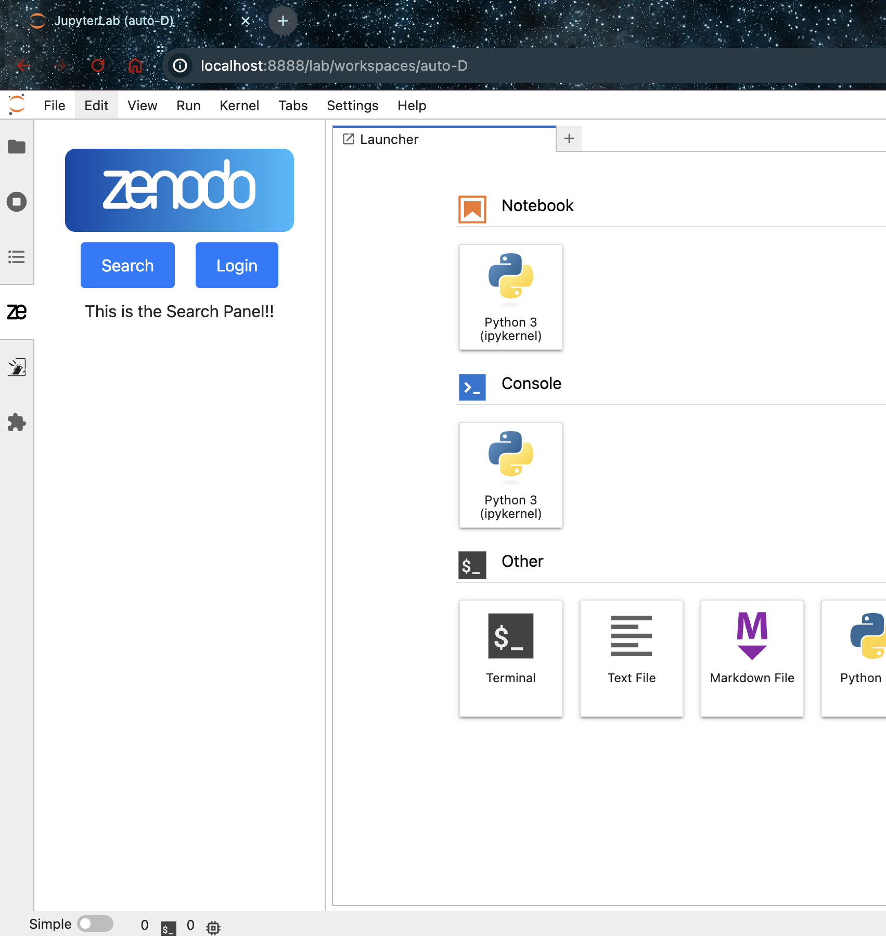
Jupyter Lab Interface
Initial Design (Last Presentation
  Side panel design with separate screens for logging in to Zenodo API and for searching records

Slide 4
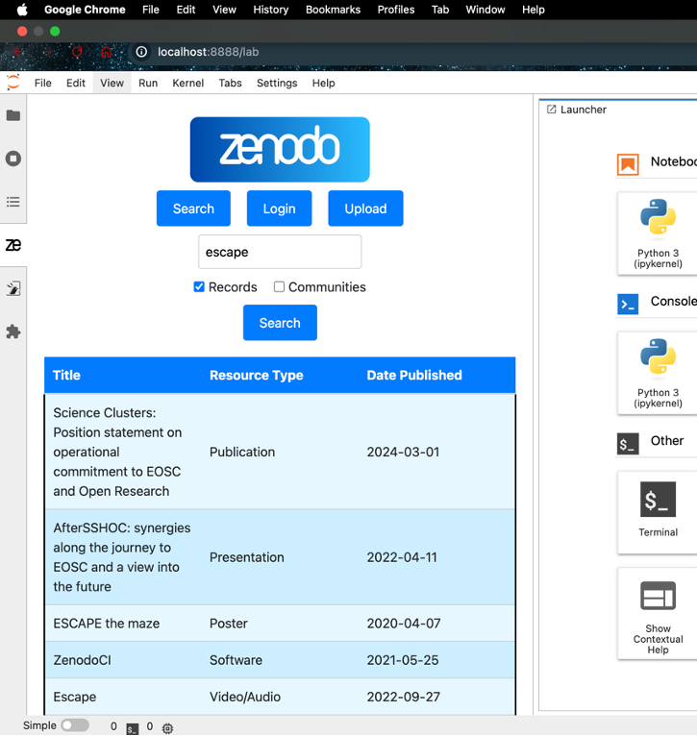
Jupyter Lab Interface
Initial Design (Last Presentation)
  Side panel design with separate screens for logging in to Zenodo API and for searching records
  Search Feature (Since Last Presentation)
  Search Functionality of records

Slide 5
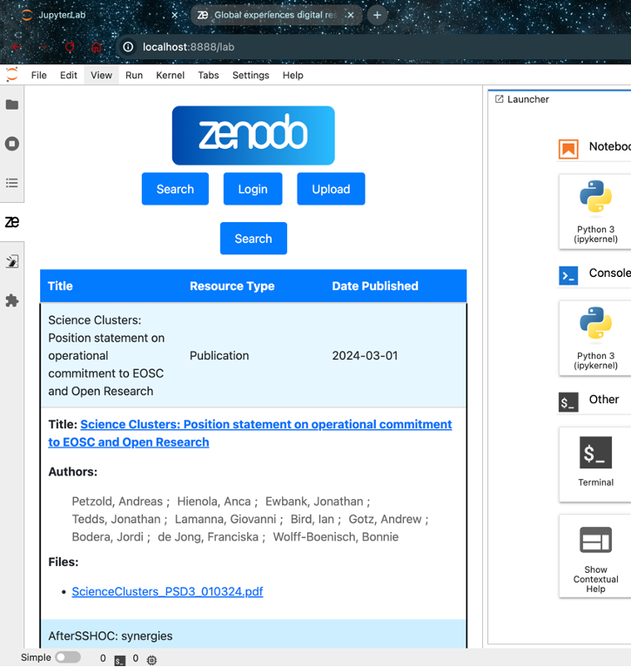
Jupyter Lab Interface
Initial Design (Last Presentation)
  Side panel design with separate screens for logging in to Zenodo API and for searching records
  Search Feature (Since Last Presentation)
  Search Functionality of records
  Record Information Display

Slide 6
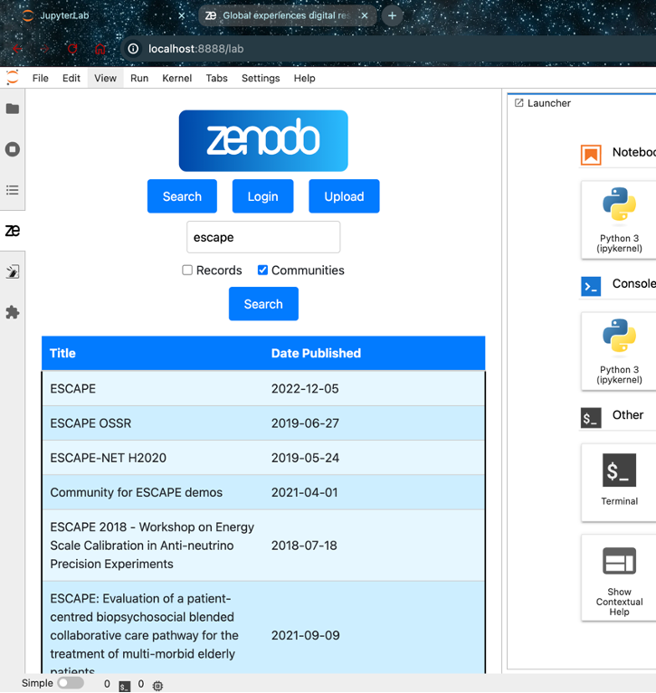
Jupyter Lab Interface
Initial Design (Last Presentation)
  Side panel design with separate screens for logging in to Zenodo API and for searching records
  Search Feature (Since Last Presentation)
  Search Functionality of records
  Record Information Display
  Searchable Communities

Slide 7
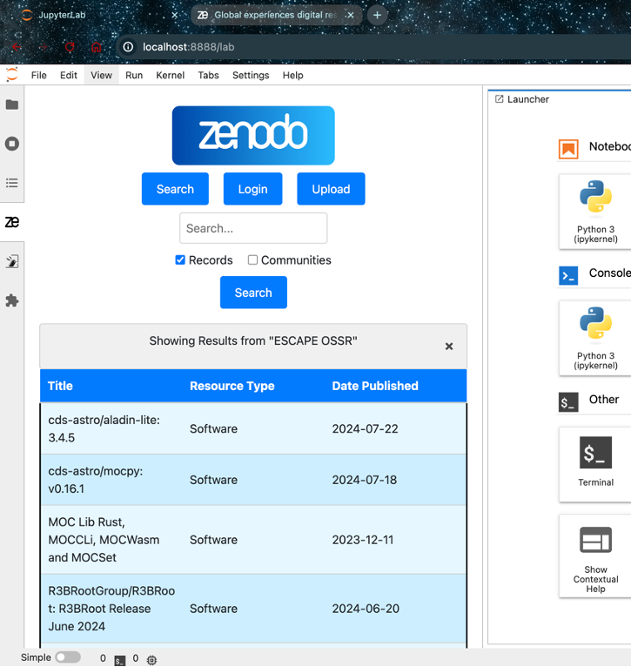
Jupyter Lab Interface
Initial Design (Last Presentation)
  Side panel design with separate screens for logging in to Zenodo API and for searching records
  Search Feature (Since Last Presentation)
  Search Functionality of records
  Record Information Display
  Searchable Communities
  Search Records within communities

Slide 8
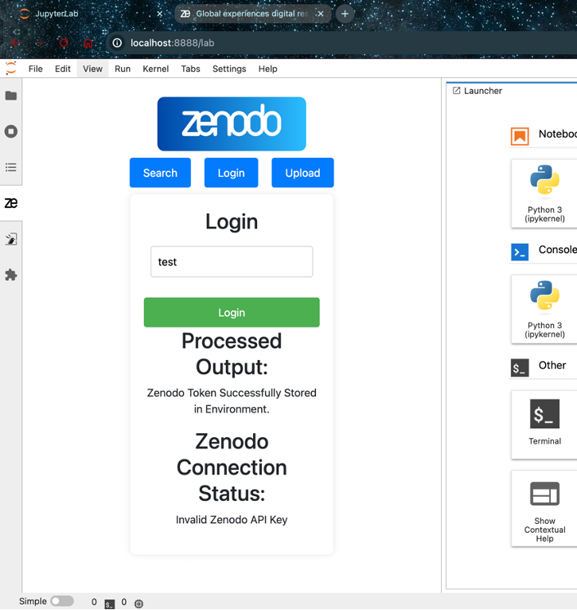
Jupyter Lab Interface
Initial Design (Last Presentation)
  Side panel design with separate screens for logging in to Zenodo API and for searching records
  Search Feature (Since Last Presentation)
  Search Functionality of records
  Record Information Display
  Searchable Communities
  Search Records within communities
  Login Feature (Since Last Presentation)
  Login screen that stores Zenodo API token in environment and test validity

Slide 9
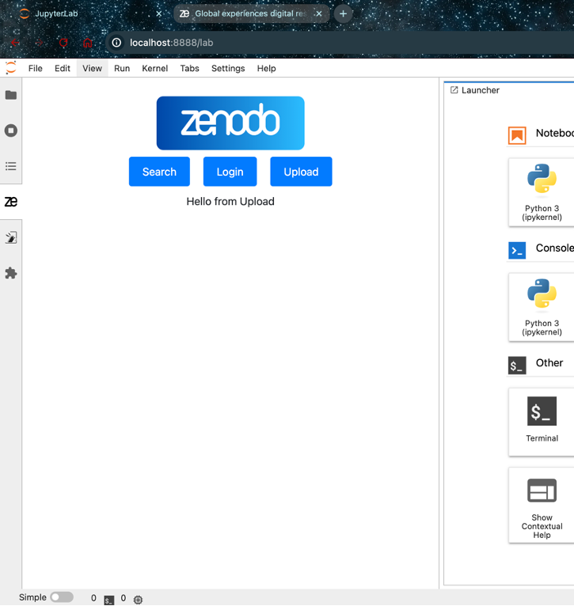
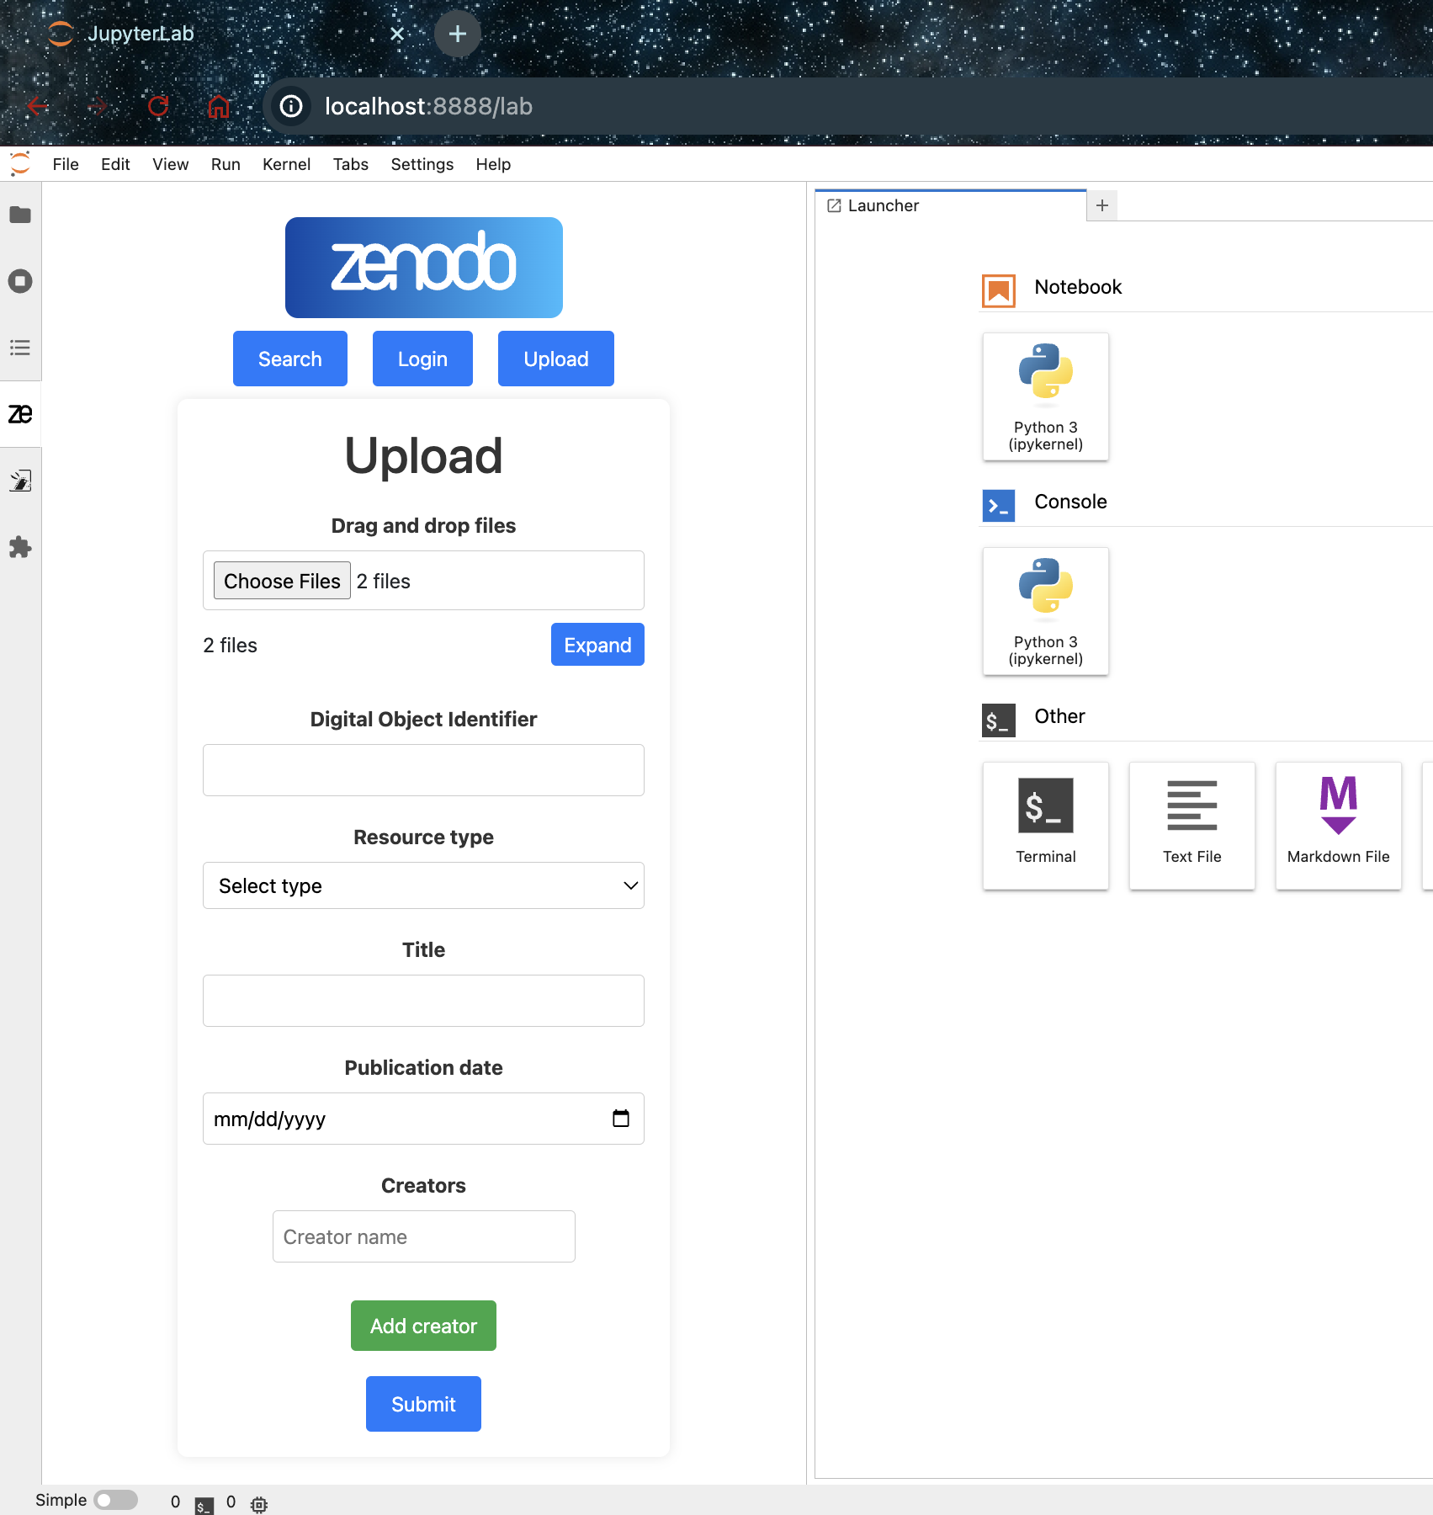
Jupyter Lab Interface
Initial Design (Last Presentation)
  Side panel design with separate screens for logging in to Zenodo API and for searching records
  Search Feature (Since Last Presentation)
  Search Functionality of records
  Record Information Display
  Searchable Communities
  Search Records within communities
  Login Feature (Since Last Presentation)
  Login screen that stores Zenodo API token in environment and test validity
  Upload Feature (TBD)

Slide 10
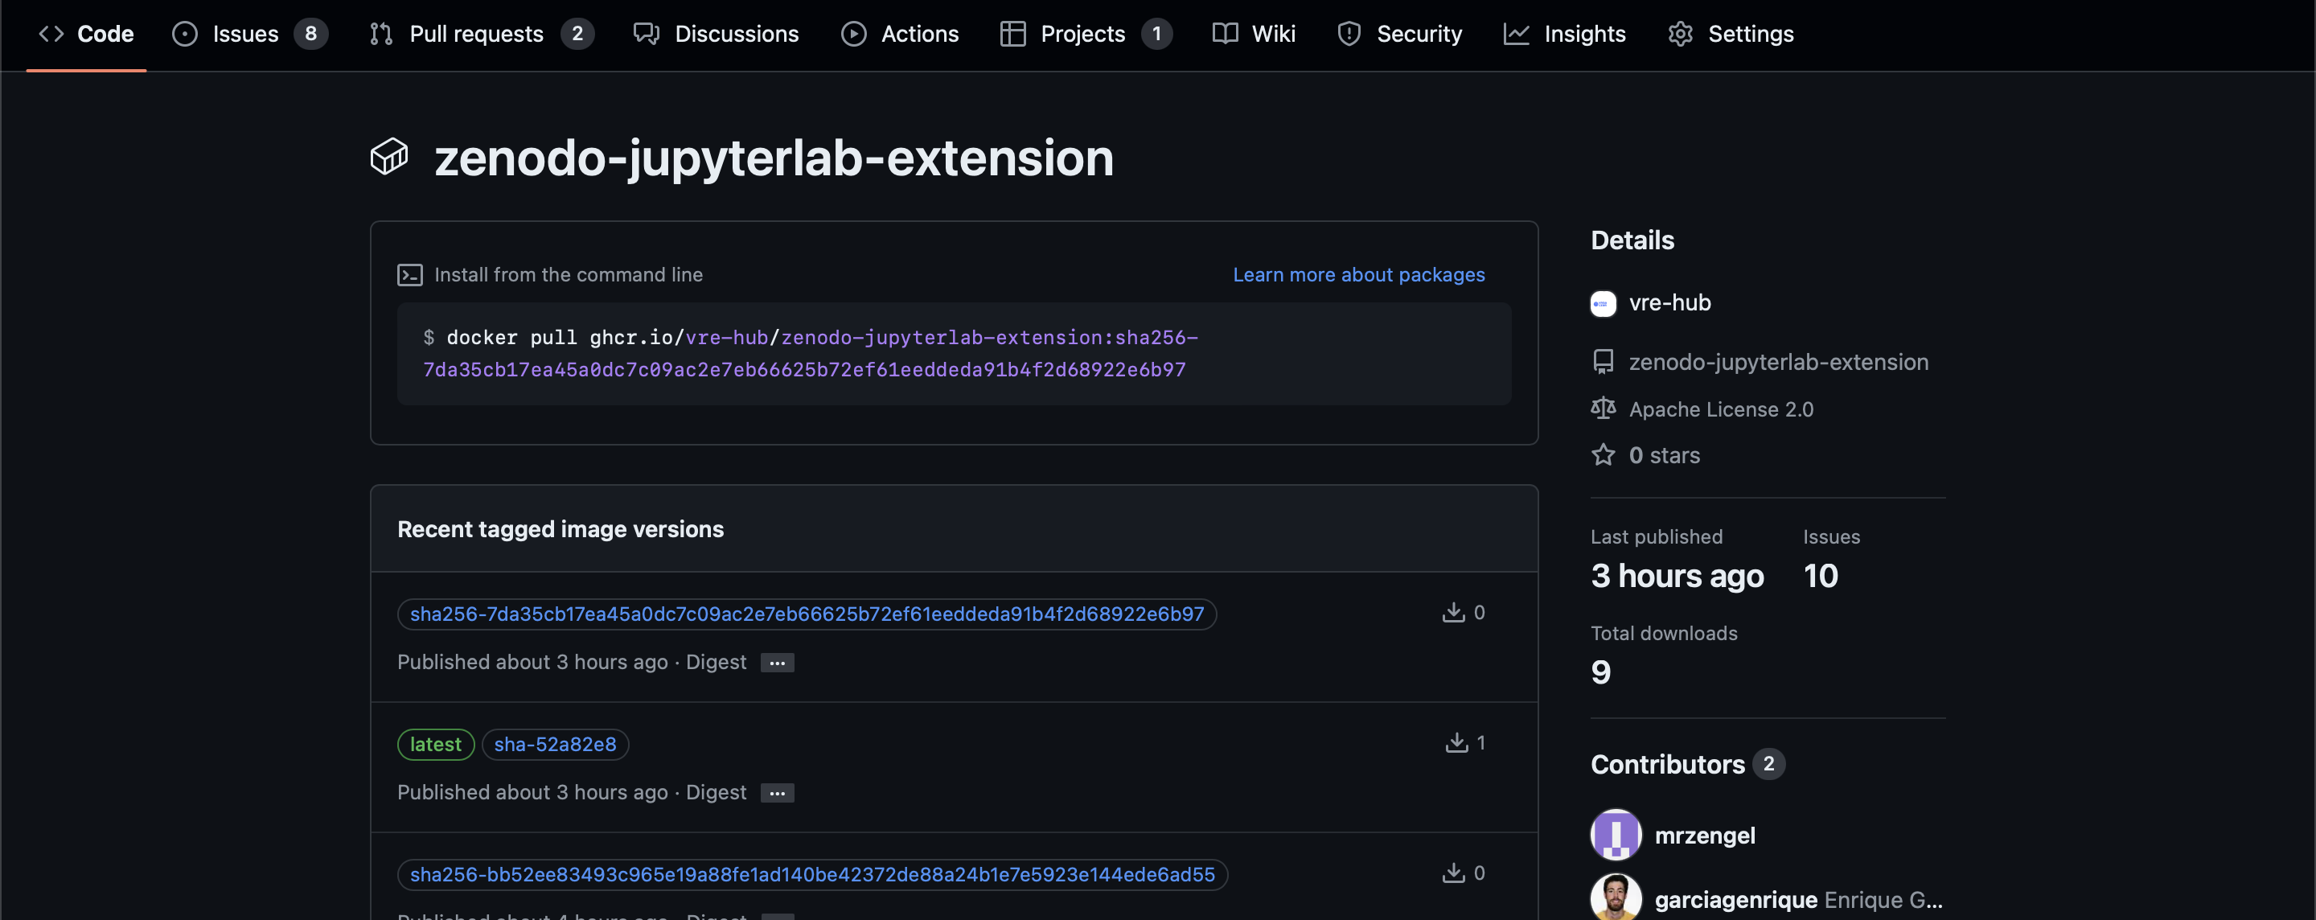
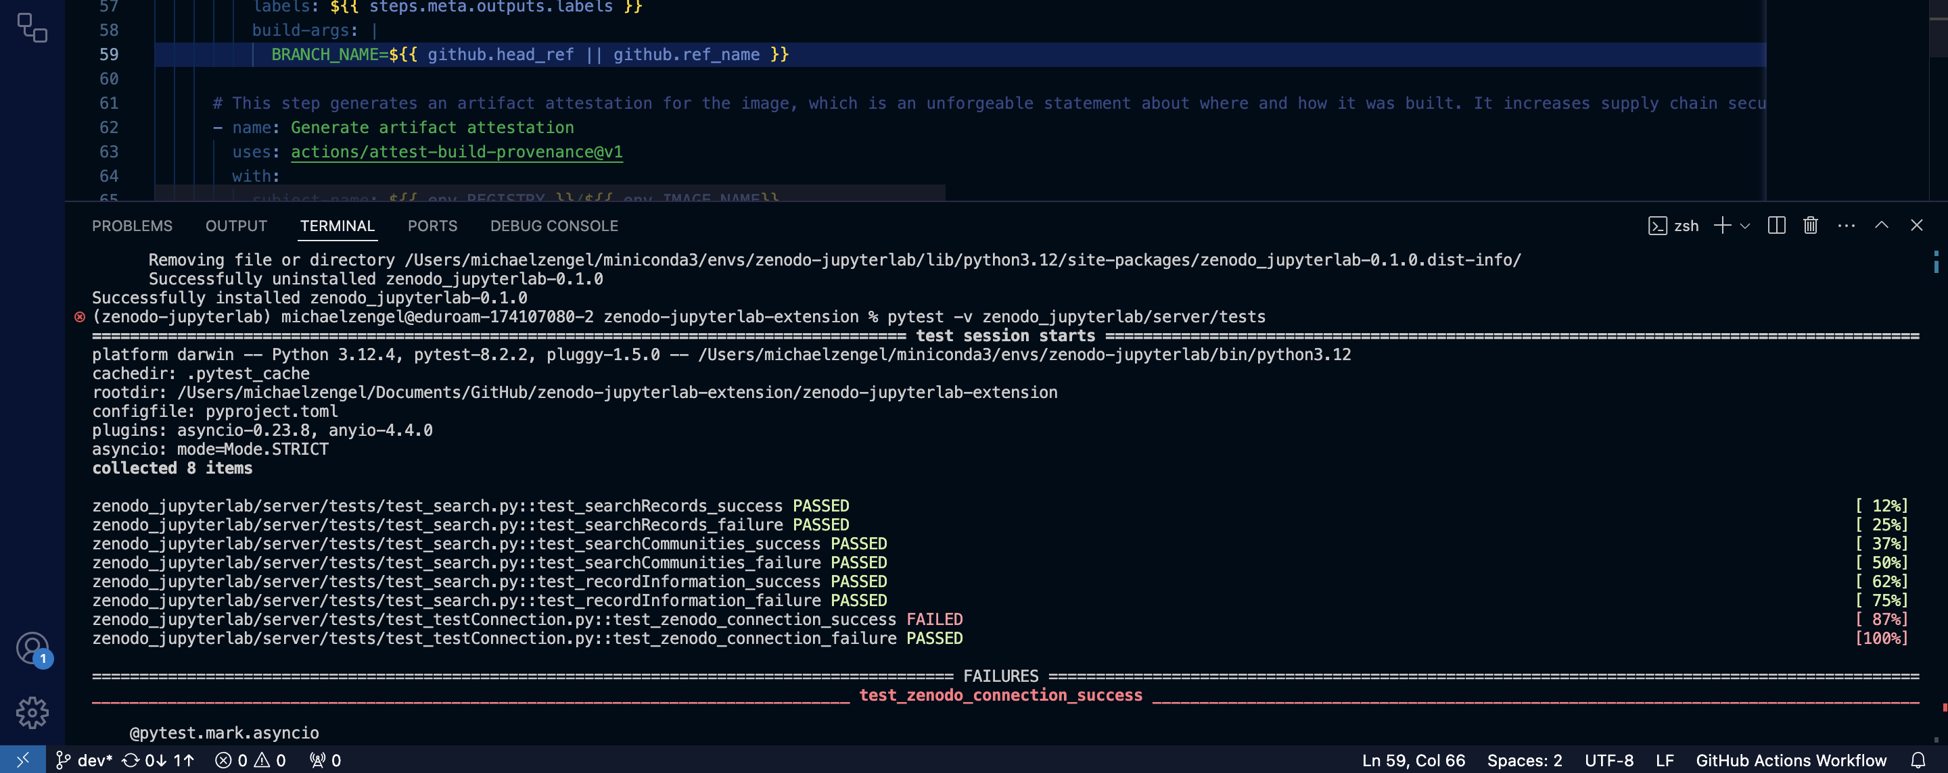
Other Cool Features
Packaging
  Easy install packaging with Docker
  Future Plans:
    Downloadable Python Package
    Hosted on VRE Jupyter Hub
Unit Testing
  Tests individual functions in python backend
  Jupyter Server Extension
  Uses Jupyter Server extension to run python API connection

Slide 11

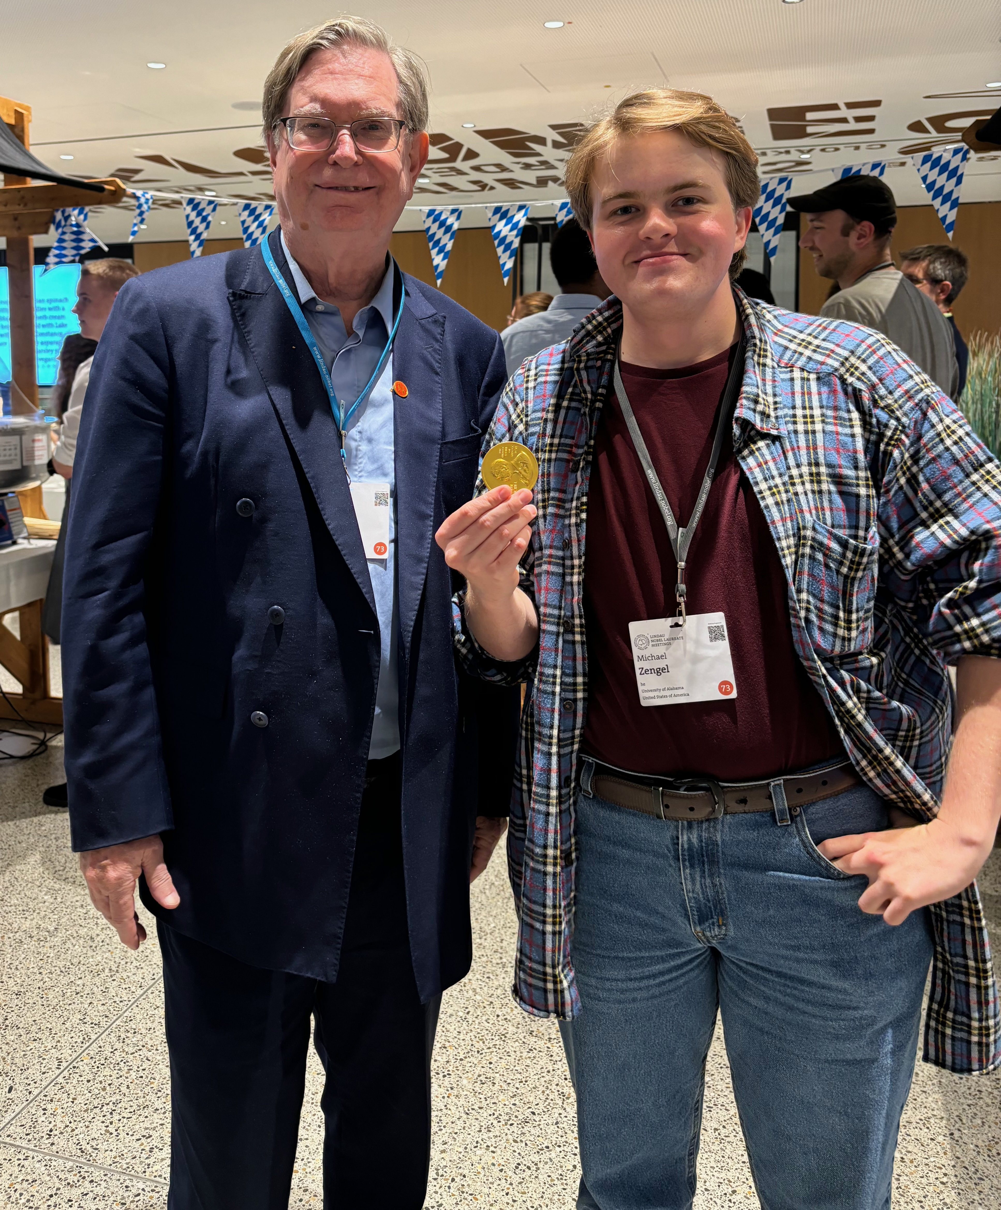
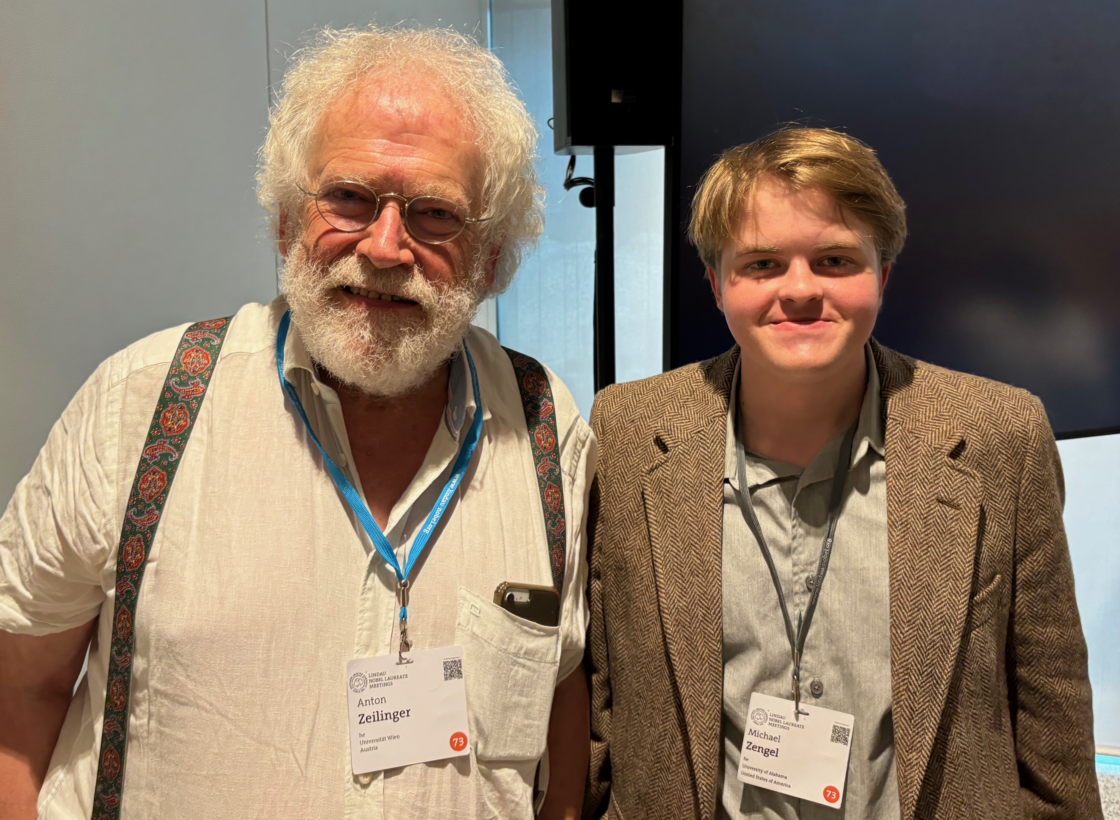
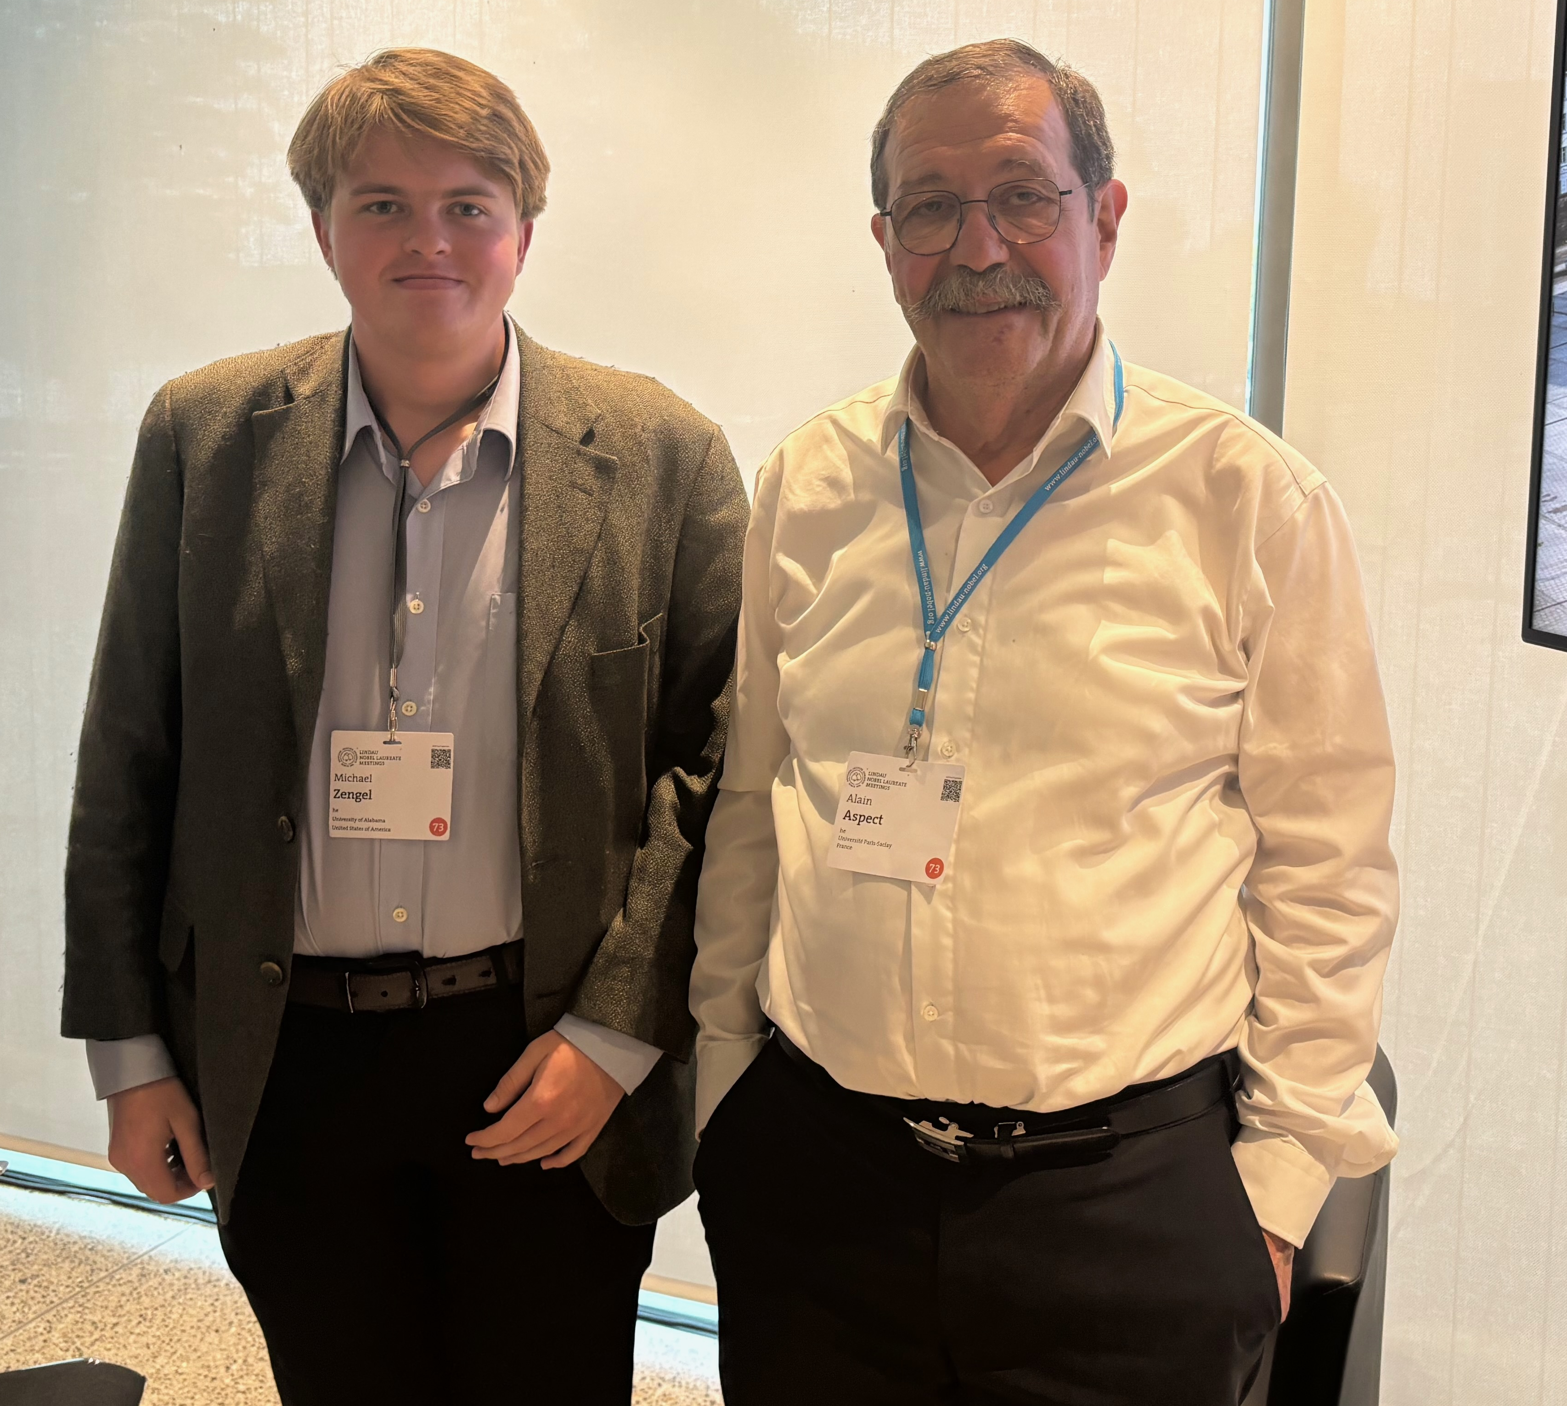
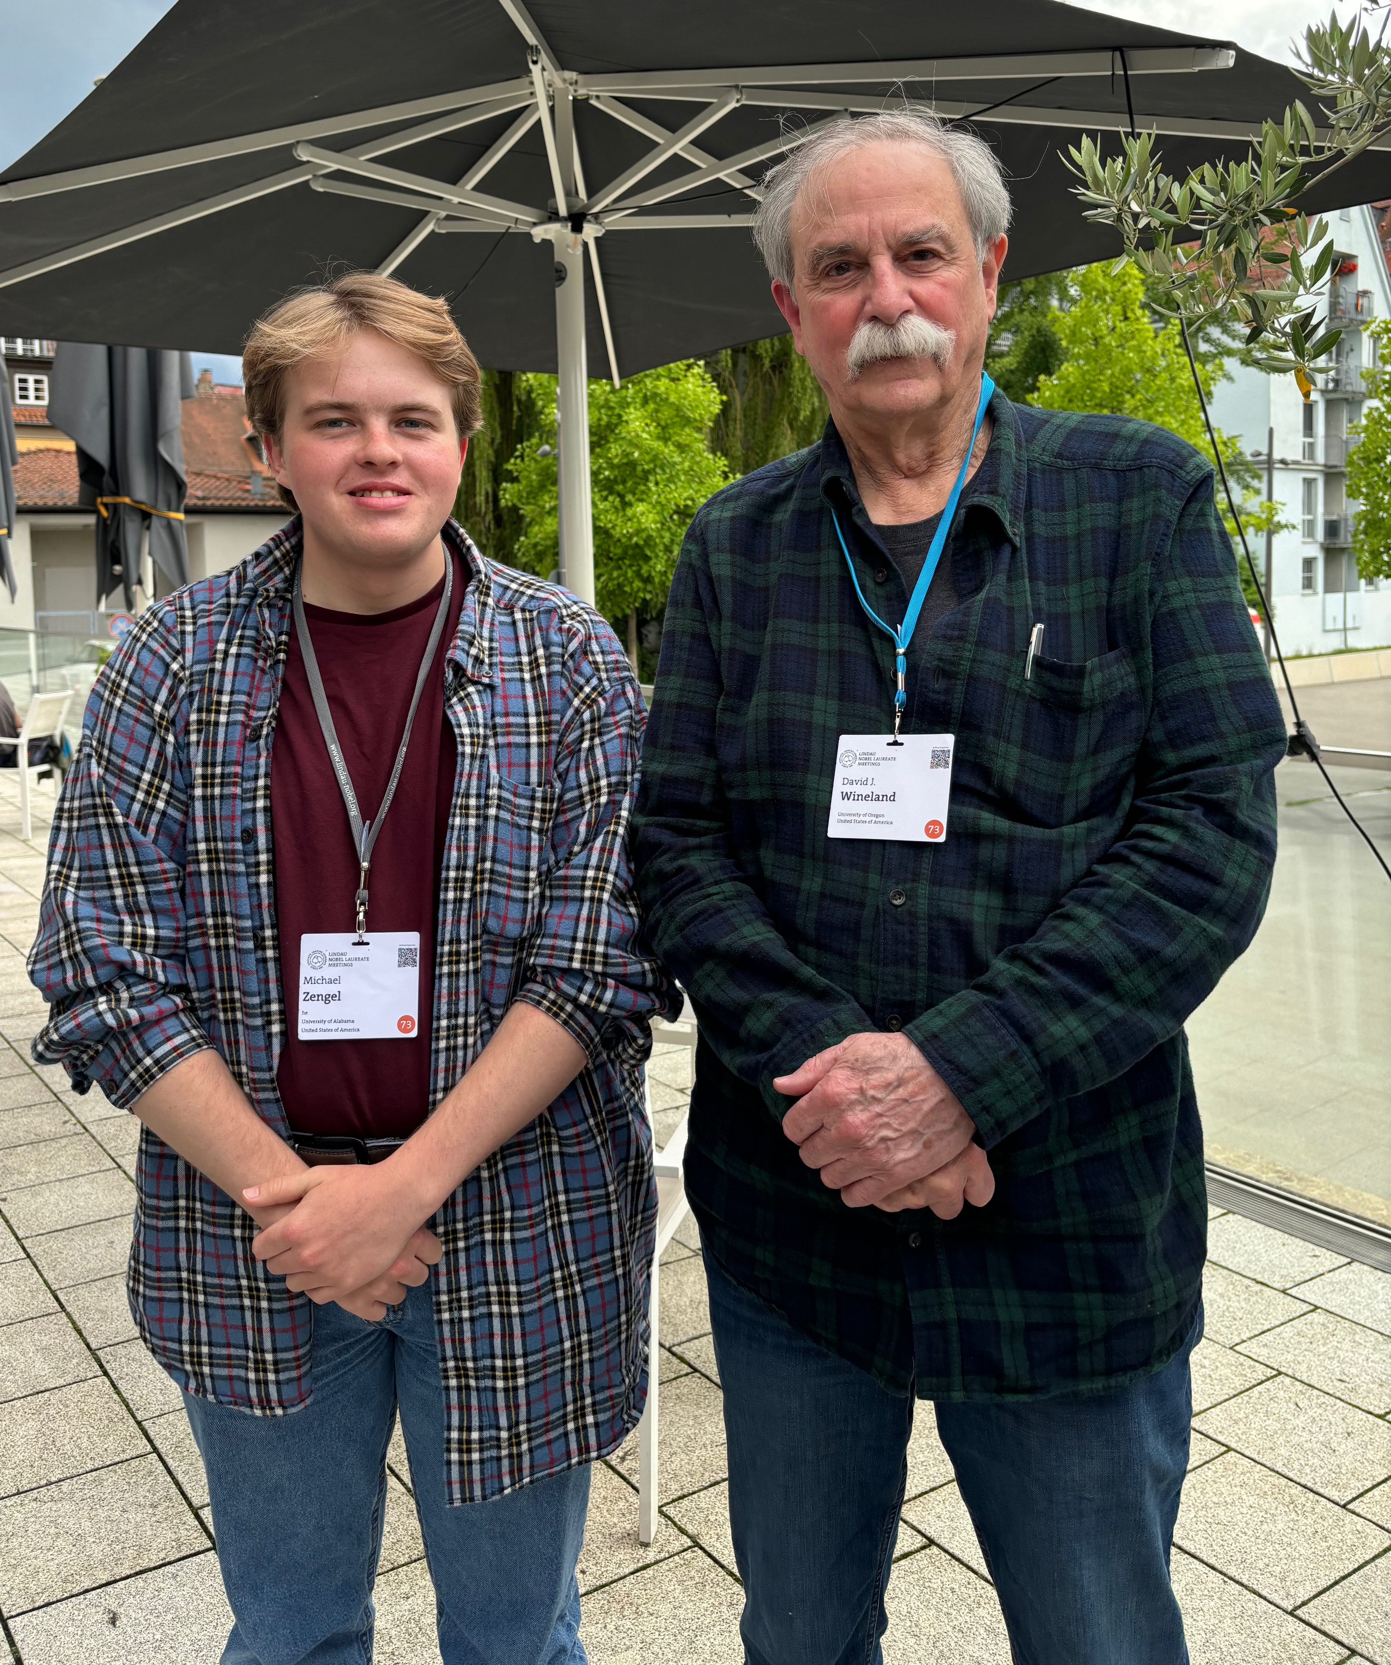

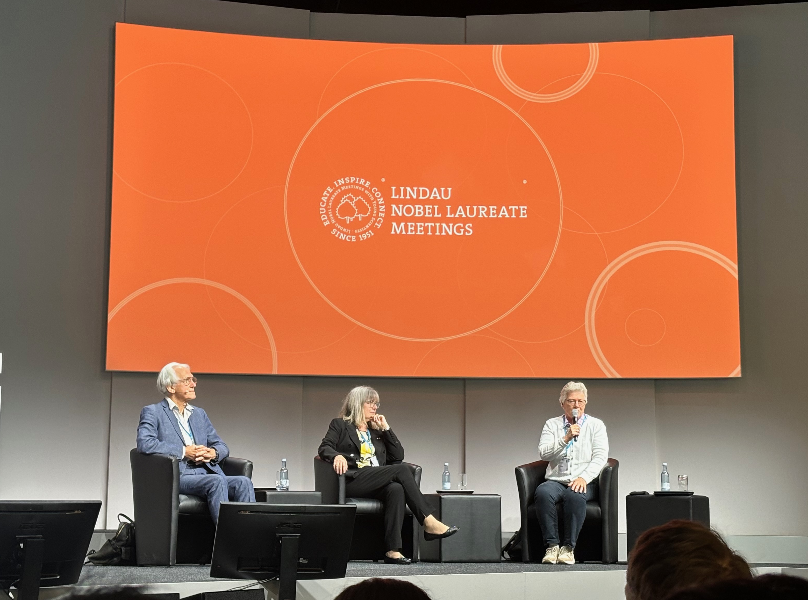
Why I was gone for a week

