Slide 1
TWOCRYST:
Preparing Proof of Principle Experiment for future Charm Physics
Myrra Small

Slide 2
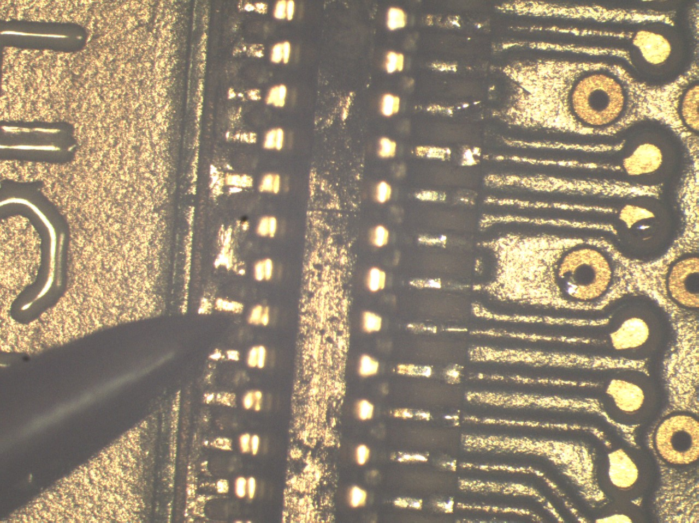
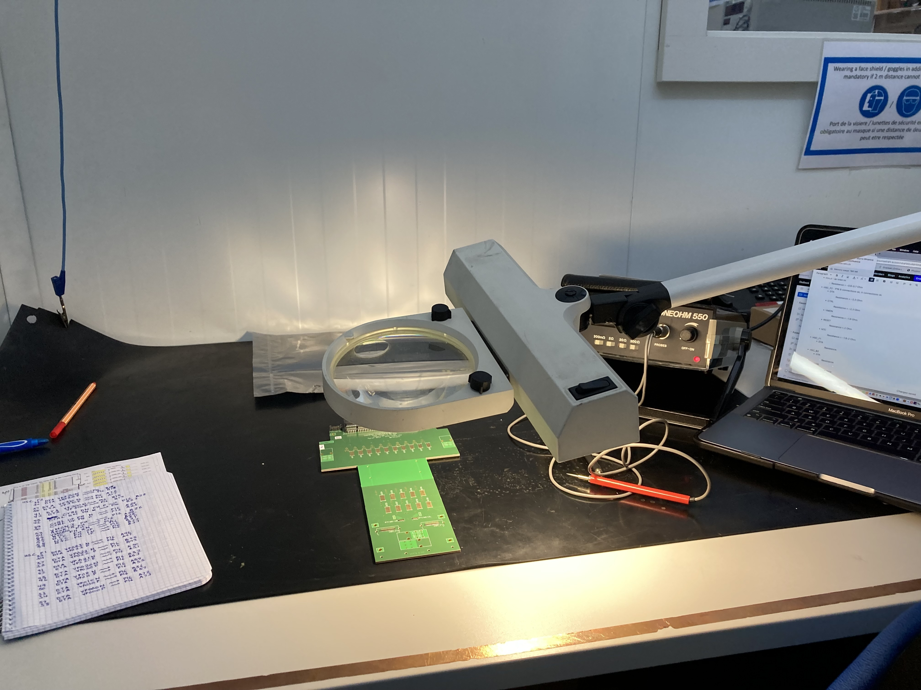
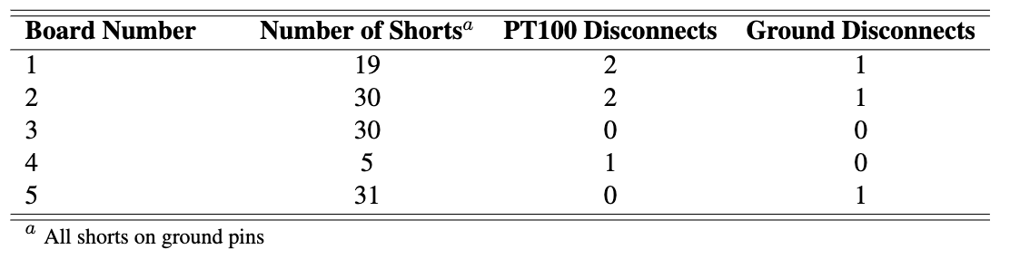
PCB Inspection: Results
Week 3: Wrote up board inspection report
  No major issues
11 ground pins resoldered on board 2

Slide 3
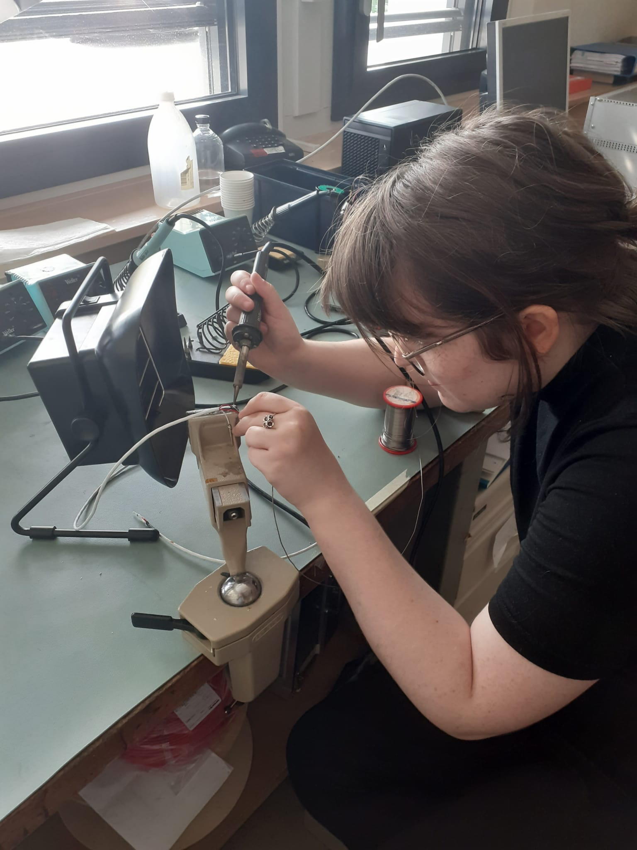
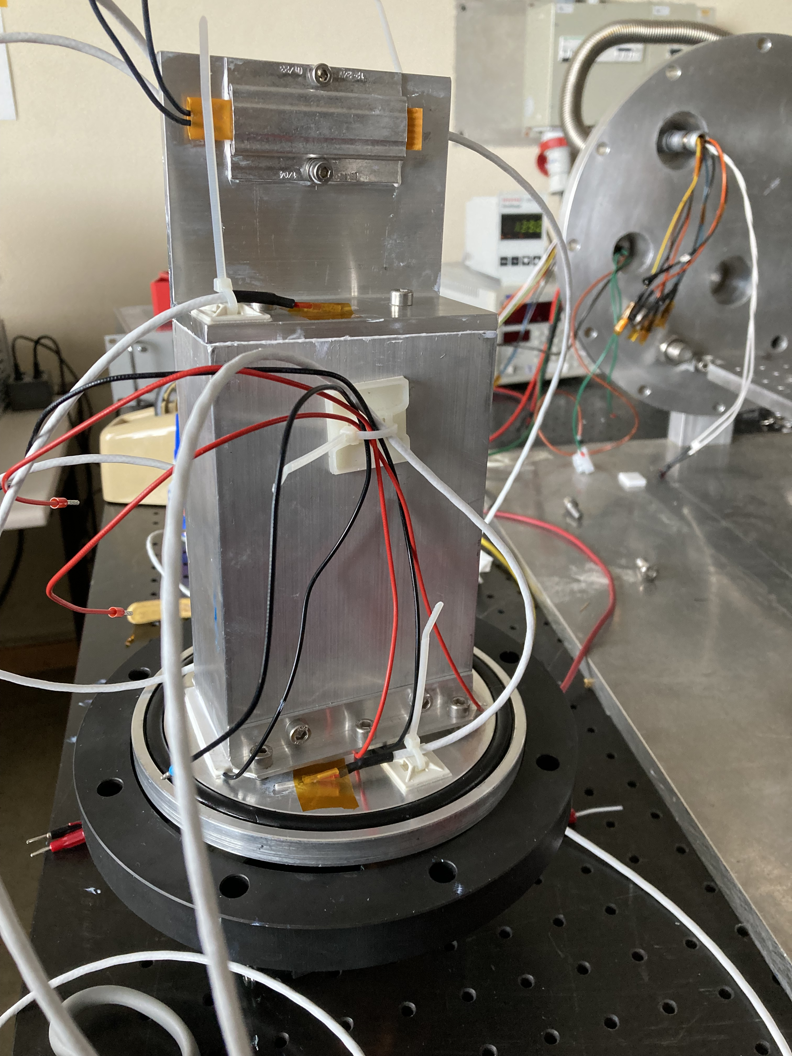
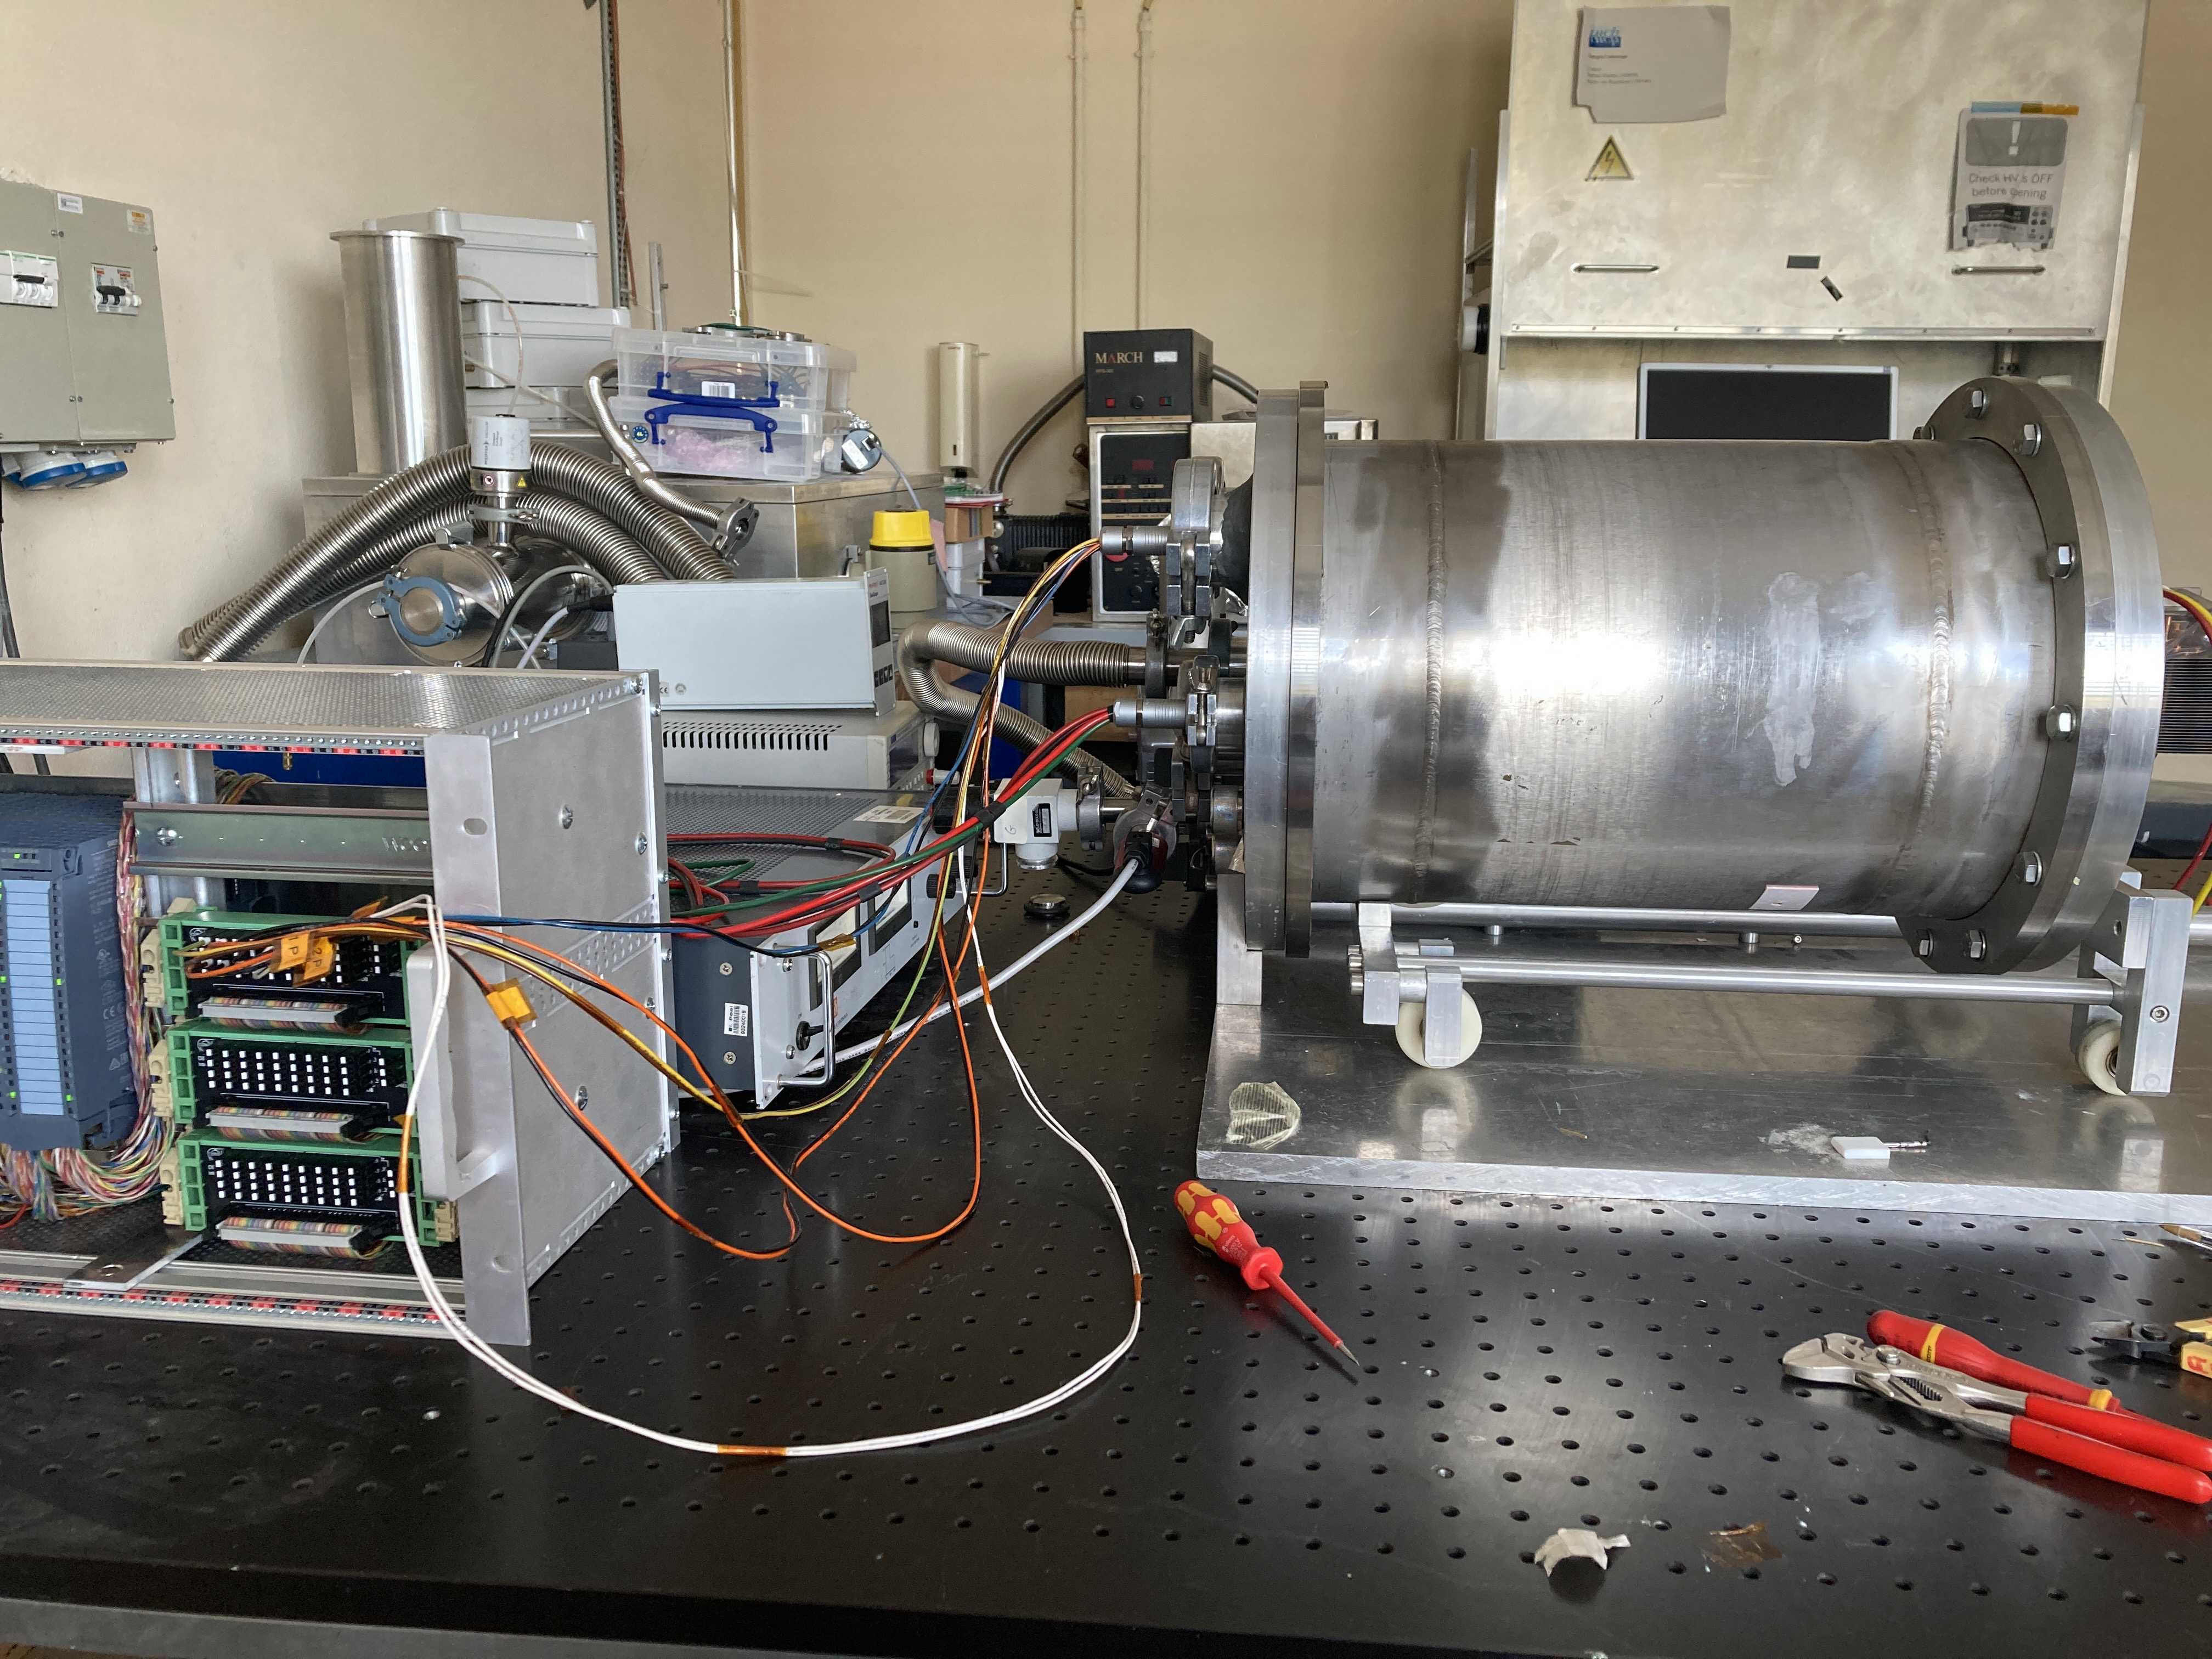
Hardware
Soldered many cables
Used a reasonable amount of superglue and cable ties
Rigged up experimental set-up

Slide 4
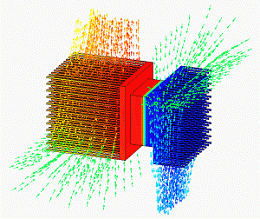
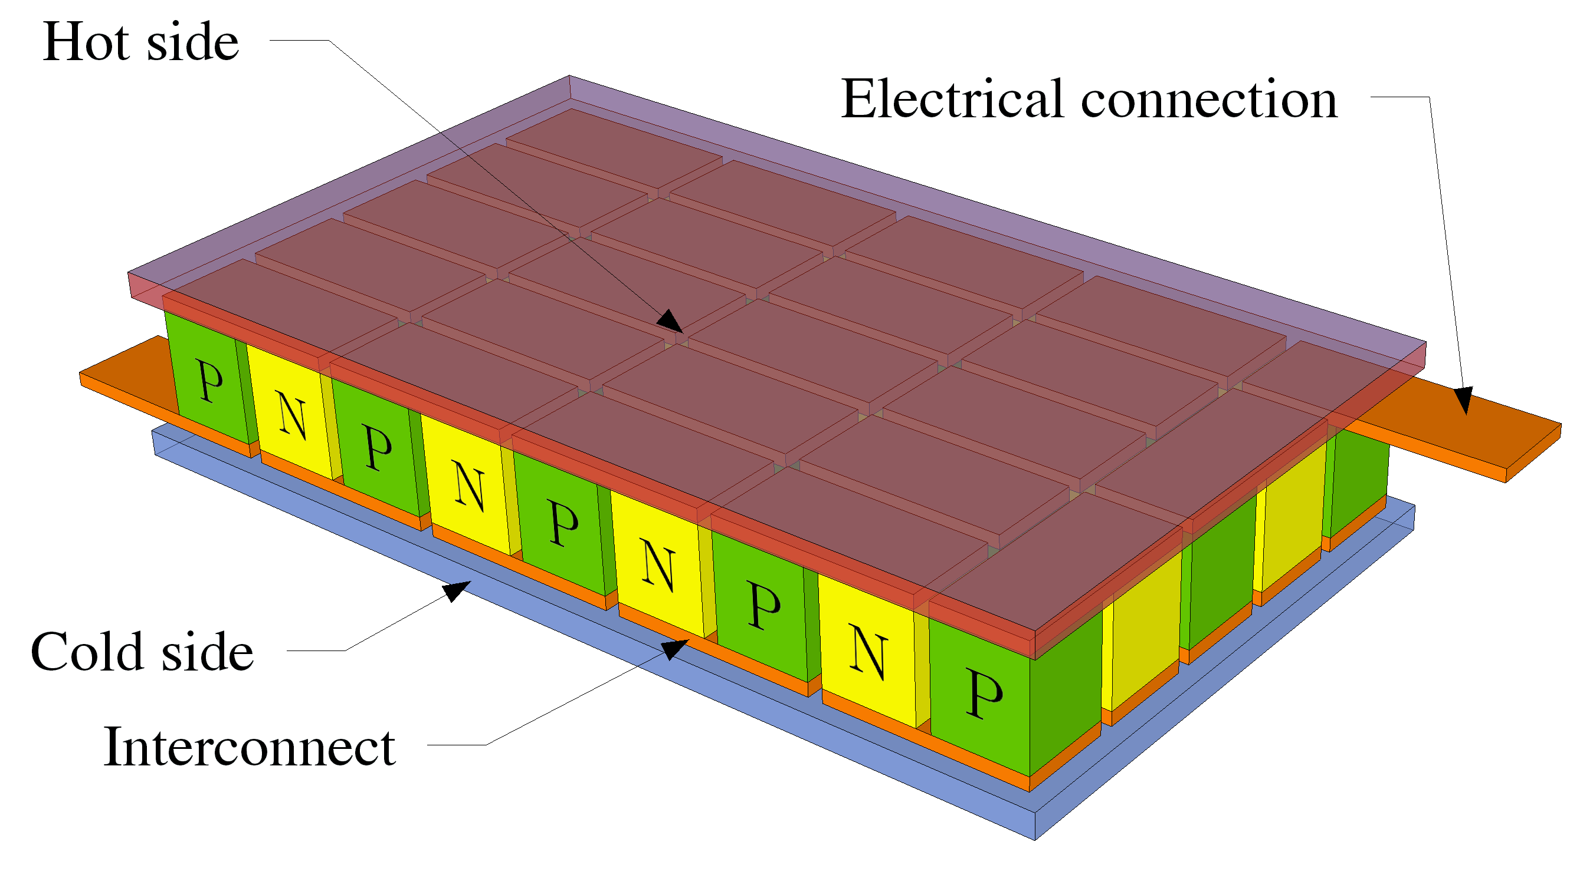
Peltier Cooling – A Crash Course
Thermoelectric effect
  Charge carriers are heat carriers
Driving current drives heat flow
  Inefficient
Credit: Wikimedia Commons
Credit: Wikipedia (MichBich)

Slide 5
Experimenting with Peltier Cooling
DISCLAIMER: MANY PEST VARIABLES (OOPS)
Main Phases:
  Characterize Peltier
  Investigate external fan-cooling
  Investigate external water-cooling

Slide 6
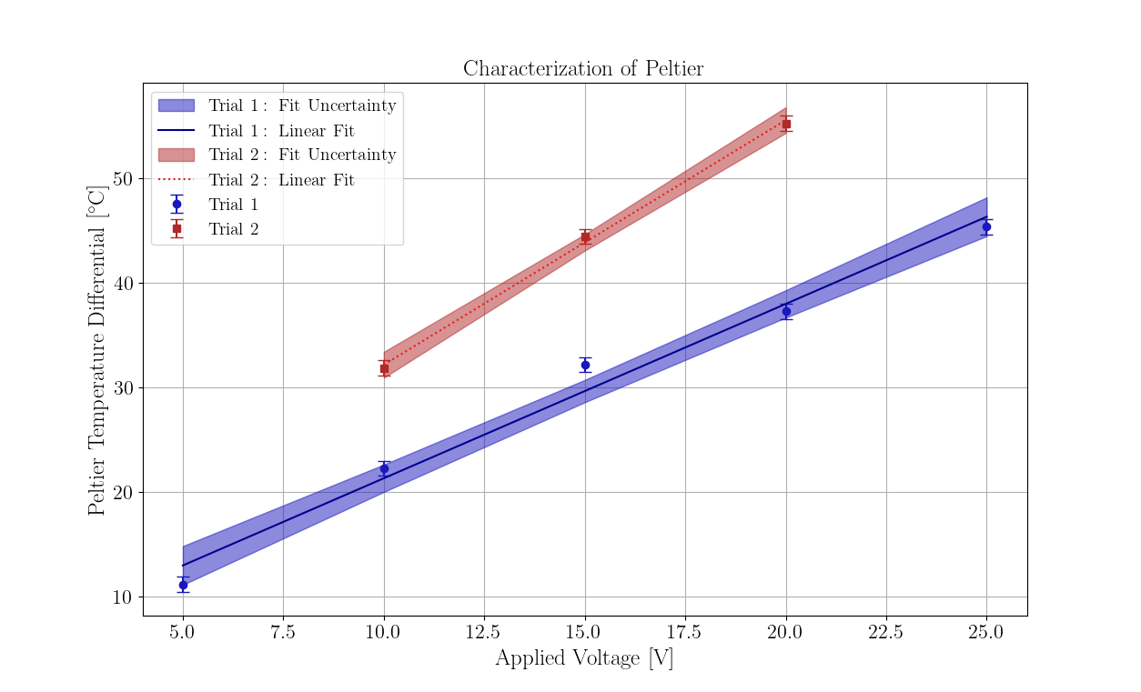
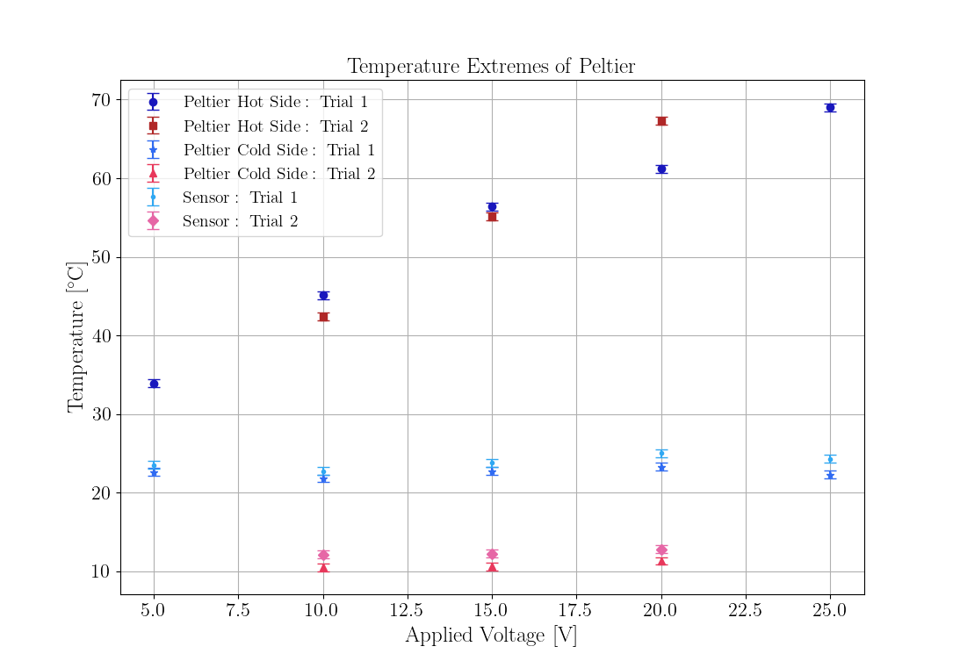
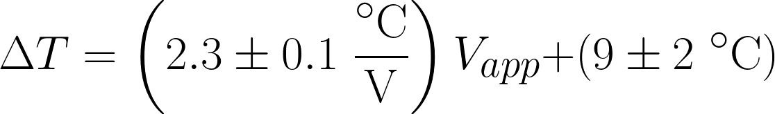
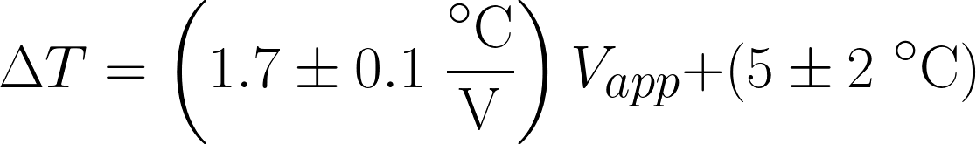
Peltier Characterization

Slide 7
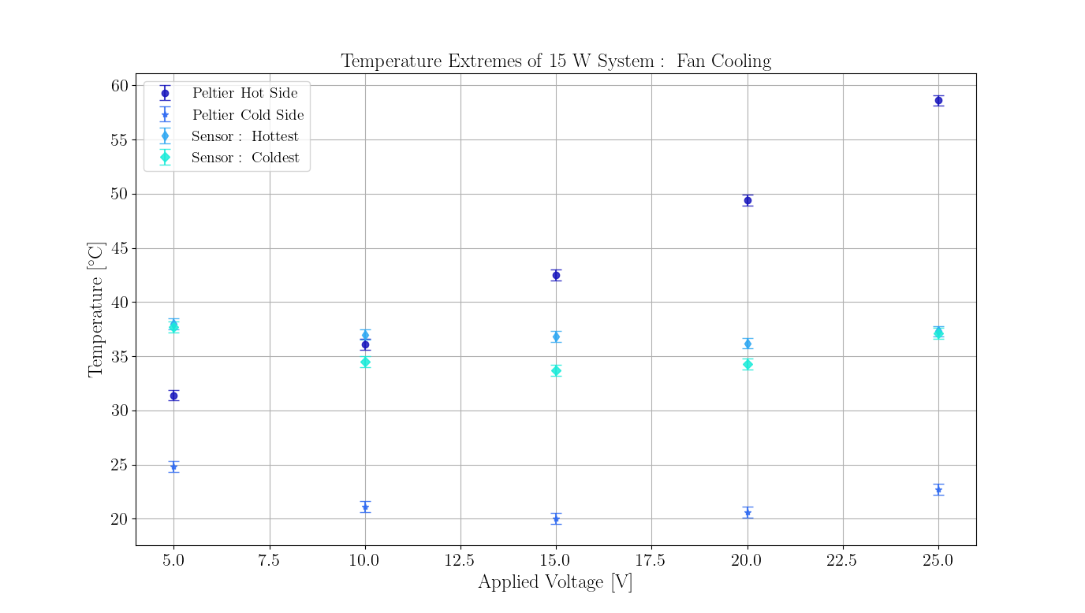
Fan Cooling

Slide 8
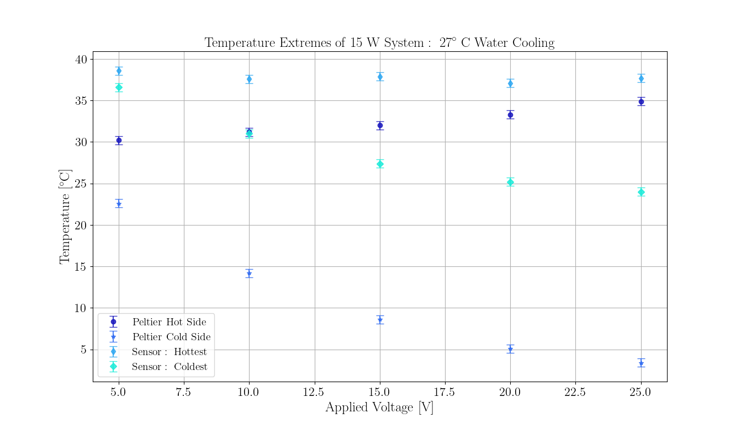
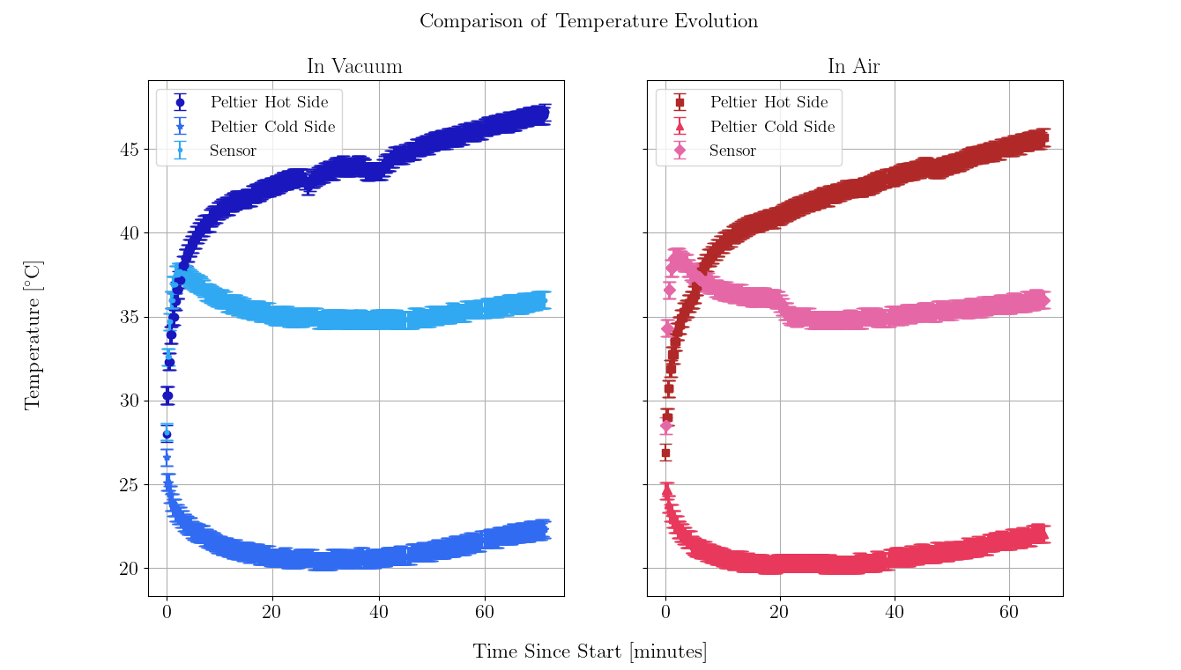
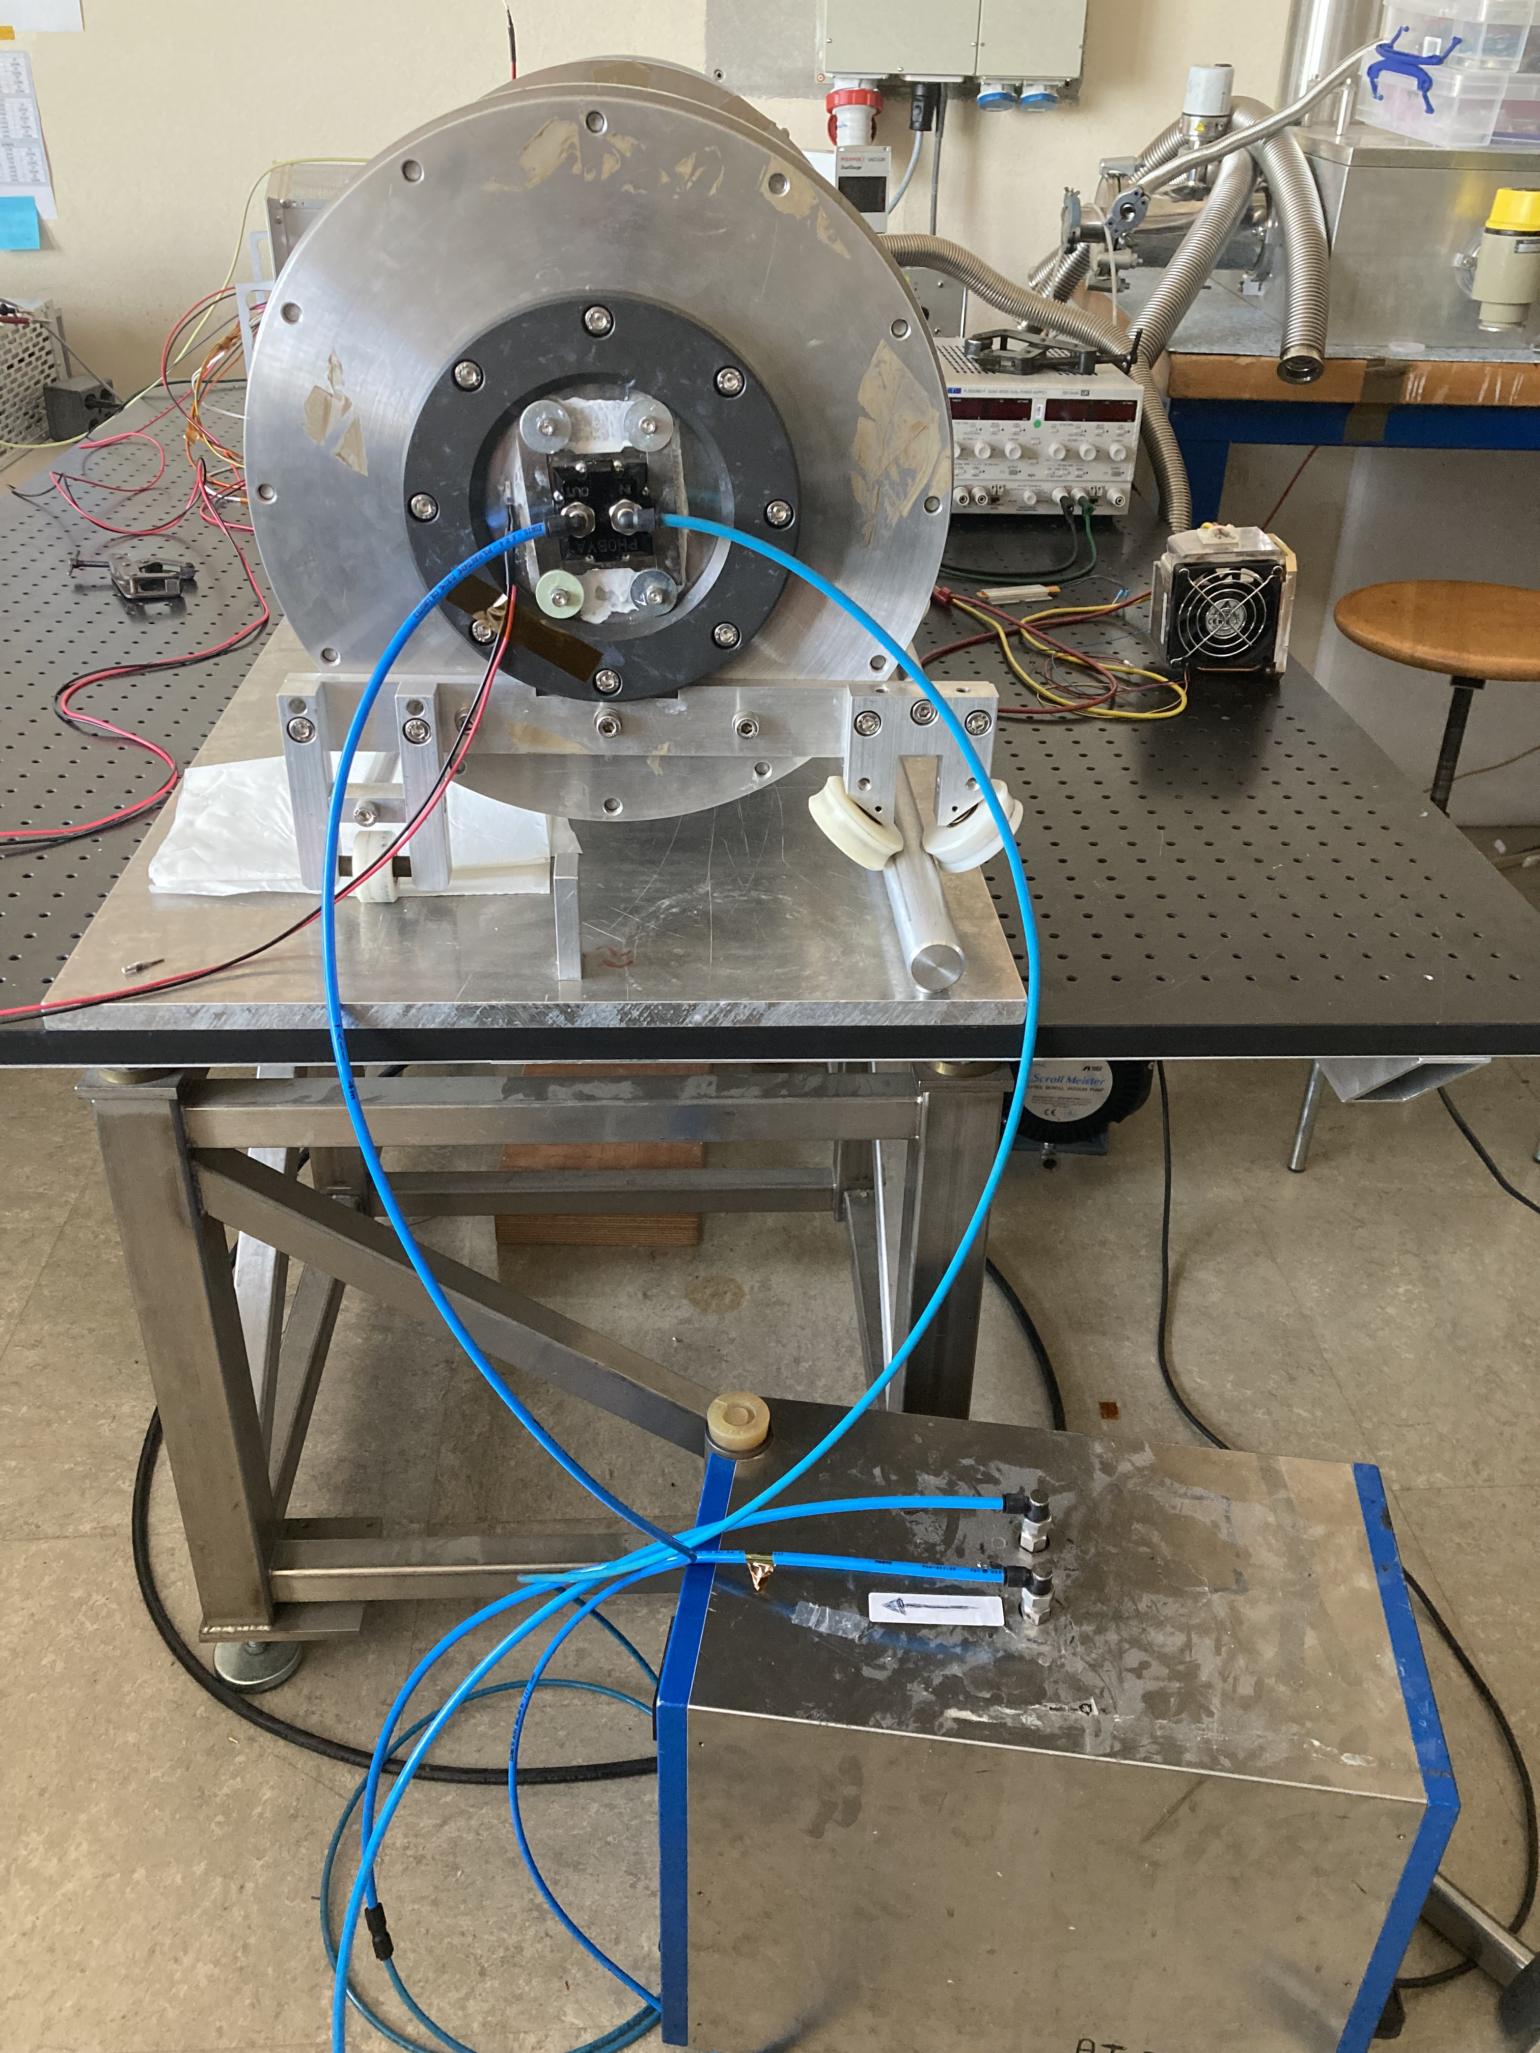
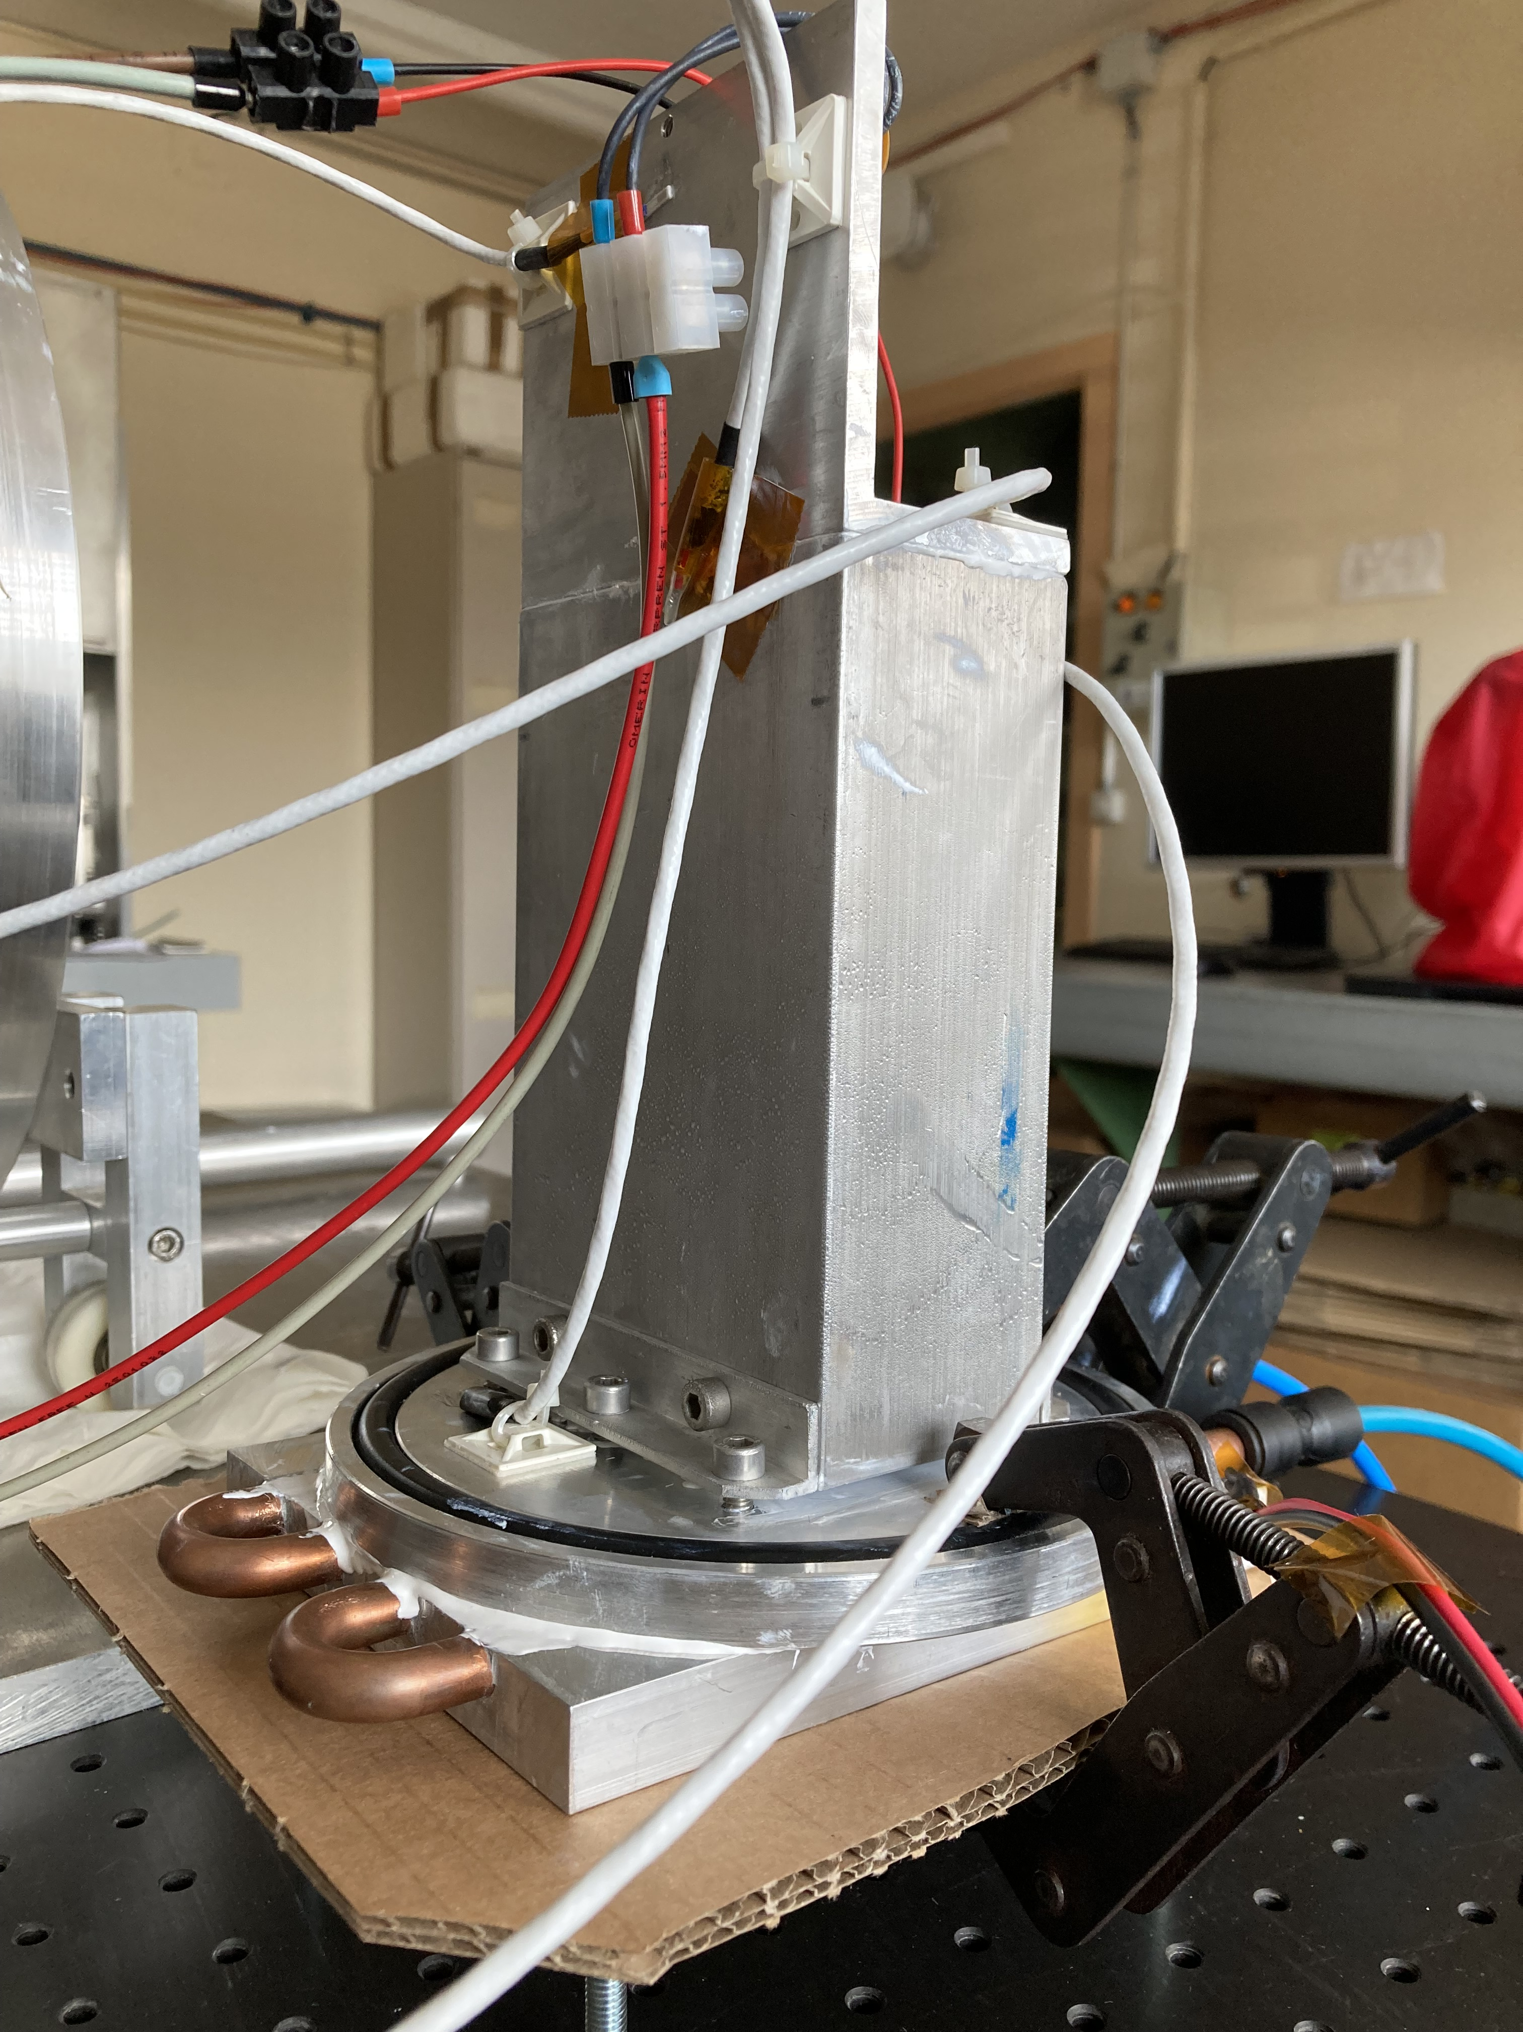
Water Cooling

Slide 9
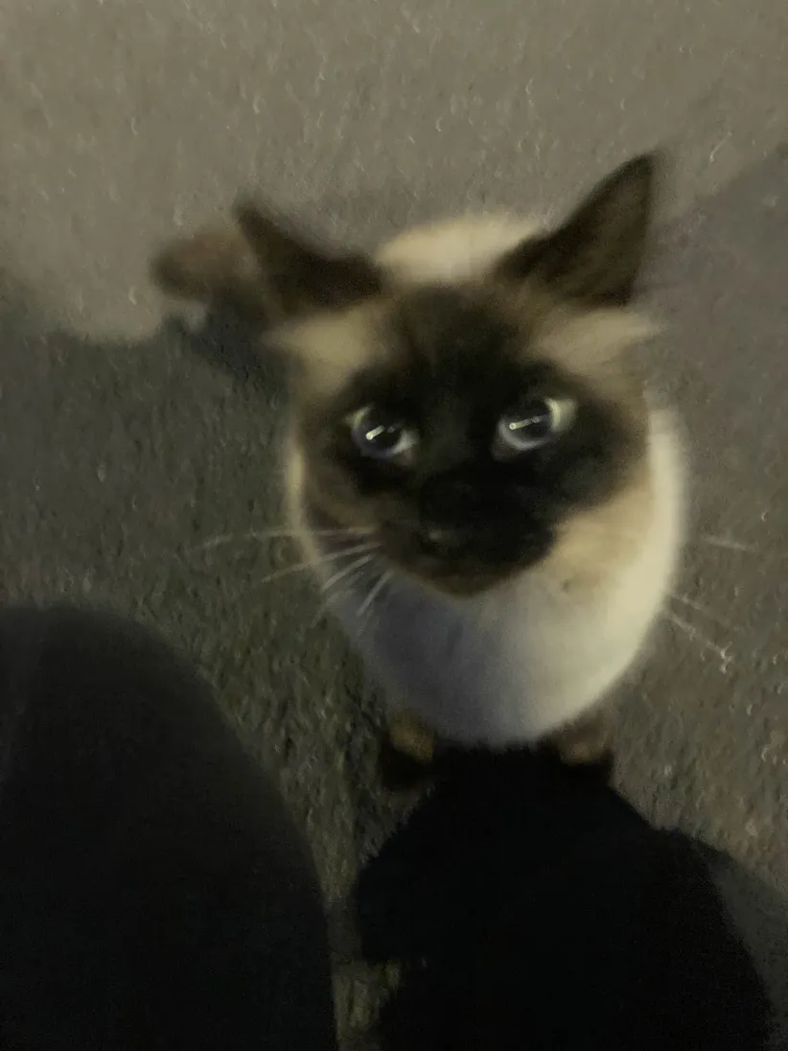
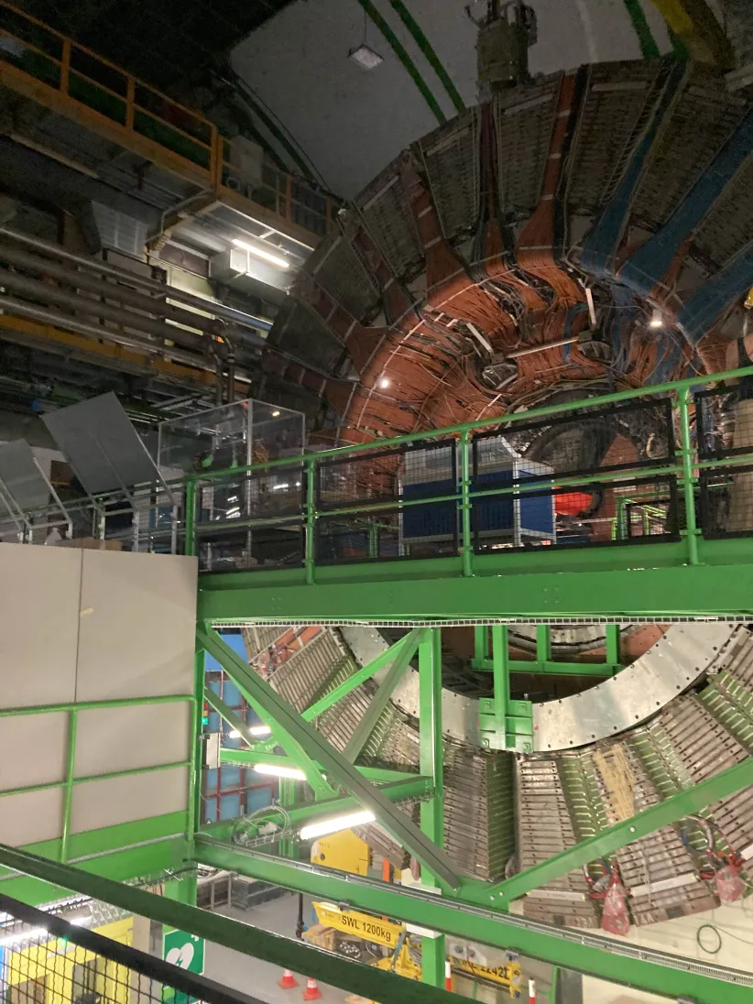
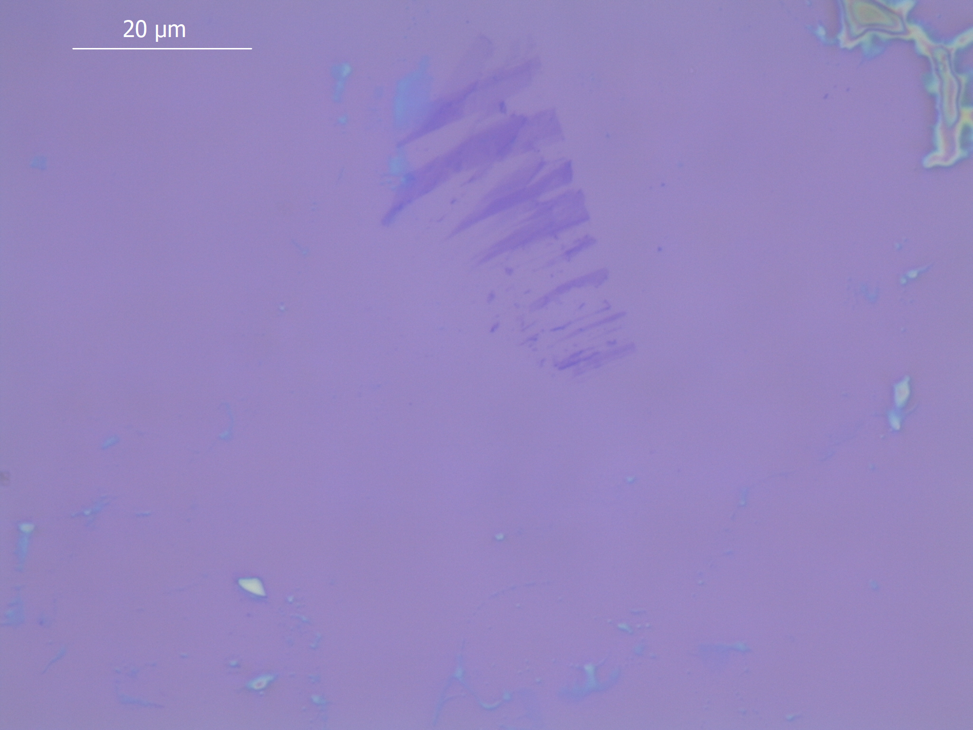
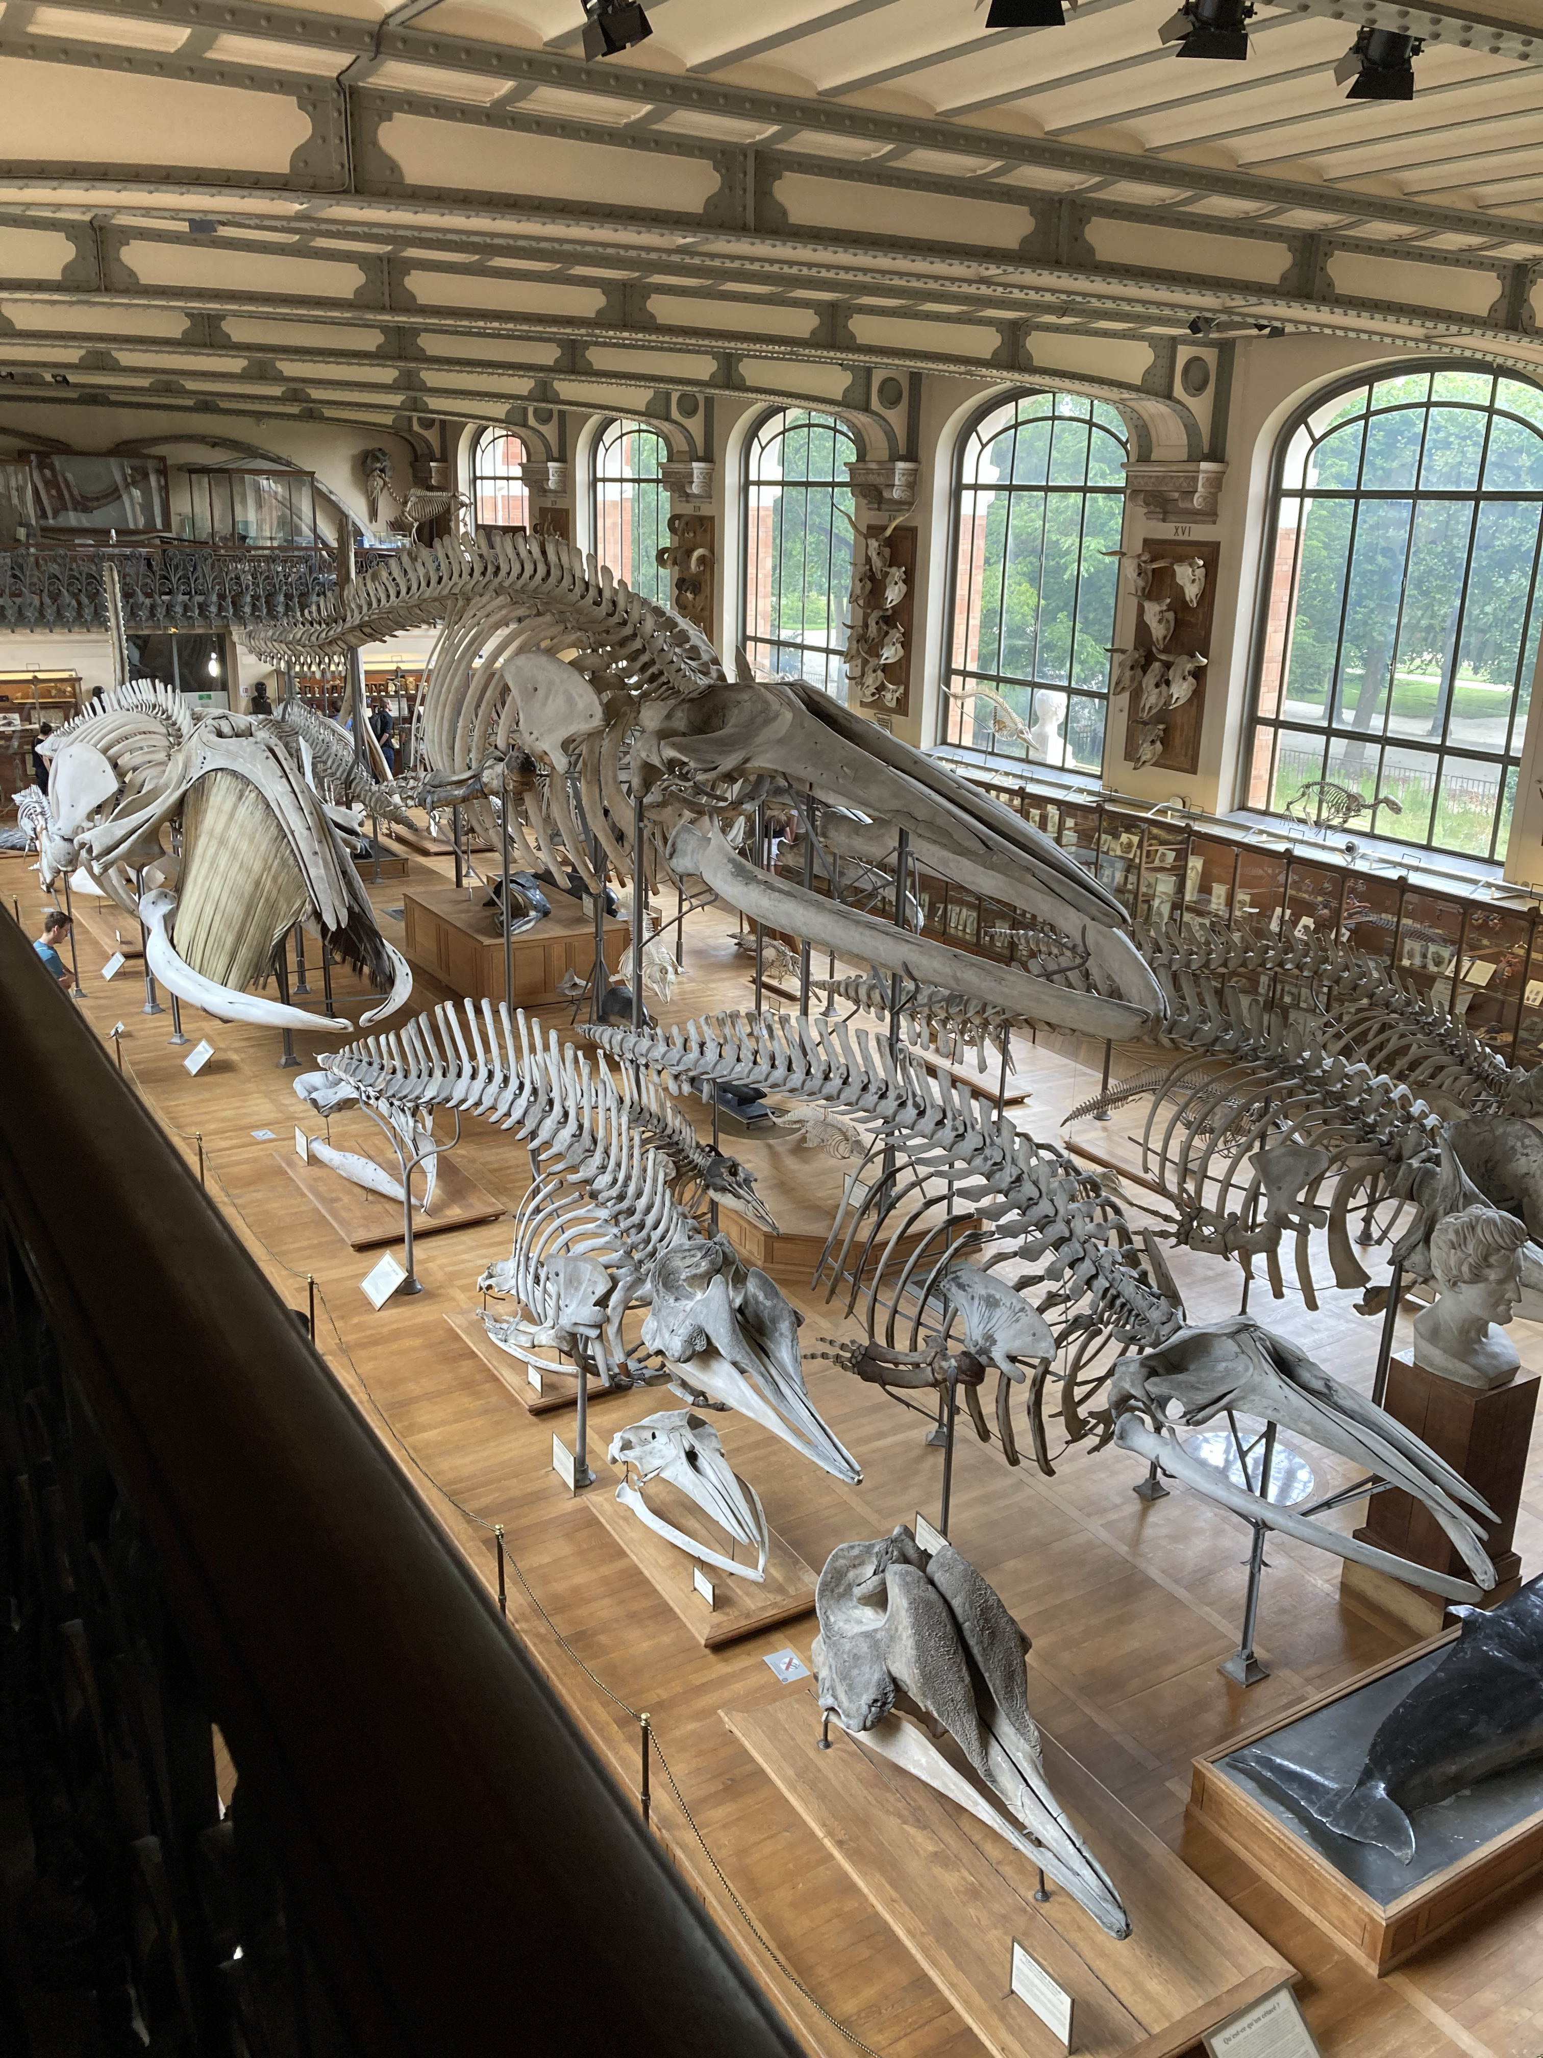
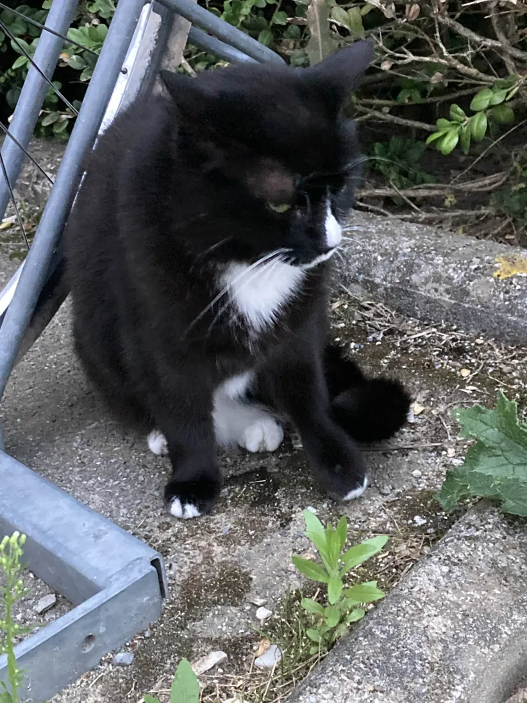
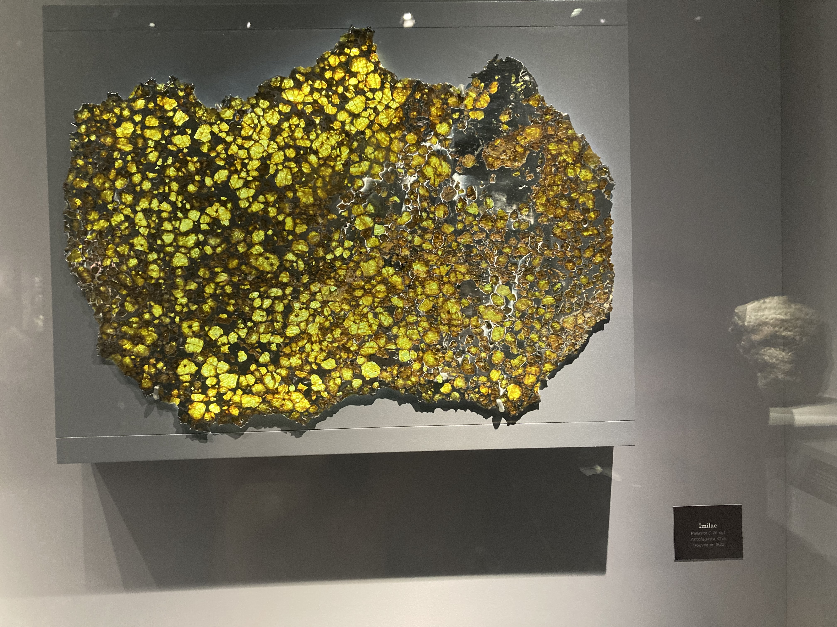
Non–Work Things

