Slide 1




LHCb Jet Flavour Classification with Graph Neural Networks
Gabriella Pesticci
July 25, 2024

Slide 2
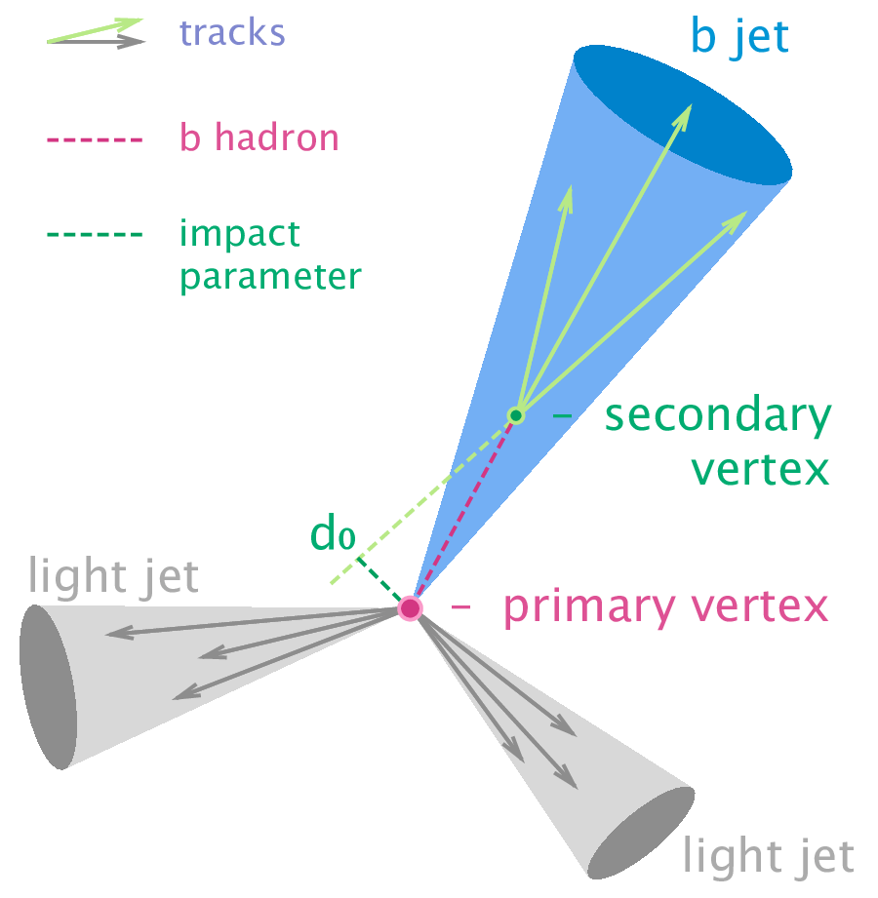
Motivation
Jet Hadronization
  p-p collisions at LHC produce quarks and gluons which hadronize due to QCD confinement
  b-quarks are heavy quarks with longer lifetimes, so there is a characteristic delay before hadronization
  We need to reconstruct the event and identify the original particle
Goal:
  Binary classification: identify if jets are produced by b-quarks or not
  Utilize deep learning to accurately classify the jets in our data
  Apply this to classifier to identify c-jets and fat-jets
Notes:
www.particlebites.com/?p=4007

Slide 3
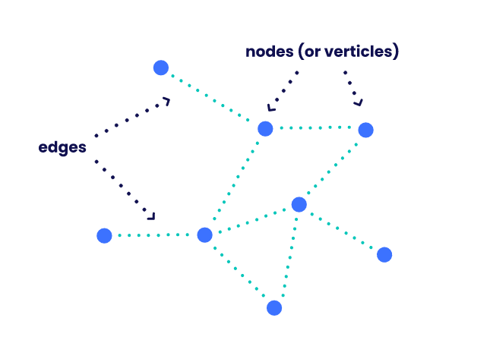
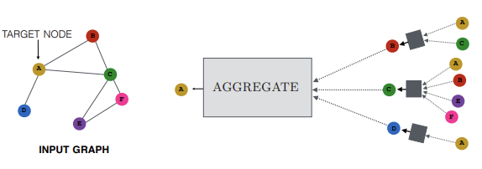
Deep Learning with Graph Neural Networks
  Deep learning
    Multiple hidden layers
  GNN
    Represent data as graphical structures
    Able to handle complex datasets and capture relationships
    Message passing allows for information to be passed between nodes
Notes:
https://medium.com/the-modern-scientist/graph-neural-networks-series-part-4-the-gnns-message-passing-over-smoothing-e77ffee523cc

Slide 4
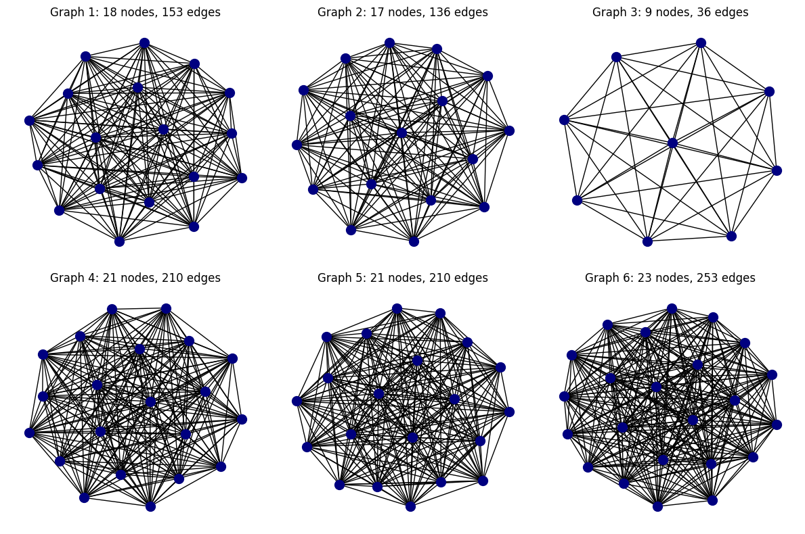
Graphical Representations of Data
Dijet Sample:
  Leading jet
  Each graph represents one jet
  Each node = one daughter
  Fully connected edges
  Features: jet-level and daughter-level
  Assign truth labels for each jet after truth matching and applying cuts to jet features

Slide 5
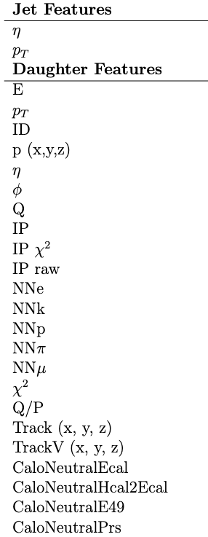
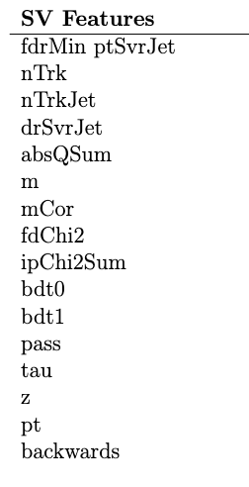
Data Preparation
Truth Matching
  For all data:
    MC Match = 1
  Signal data:
    MC Jet EfB > 0.6
  Background data:
    MC Jet EfB < 0.6
    MC Jet EfD < 0.6
Jet Selection
  pT > 20 GeV
  2.2 < η < 4.4
Jet Features
  Describes overall jet kinematics
  Shared by all daughters in the jet
Daughter Features
  Unique kinematics for each daughter in the jet
SV Features
  SV tagging
  Jet-level features

Slide 6
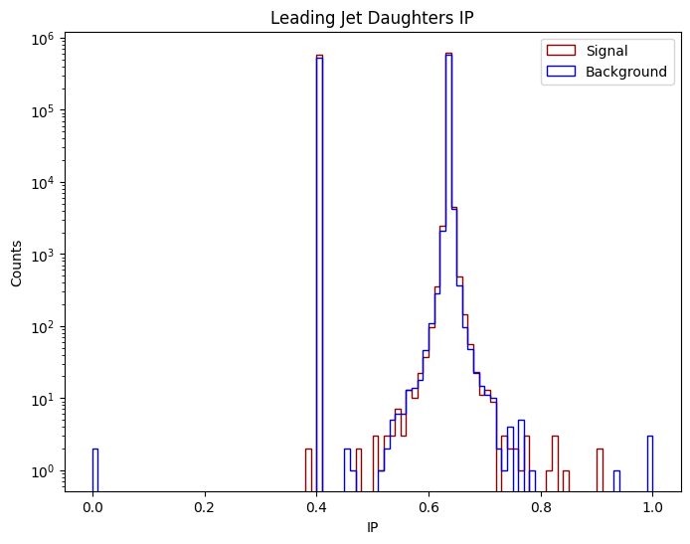
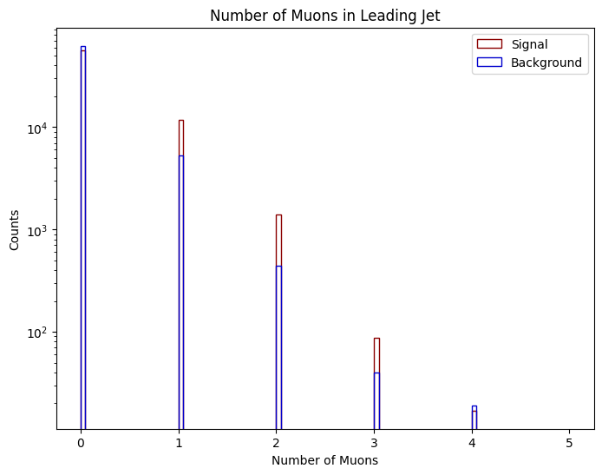
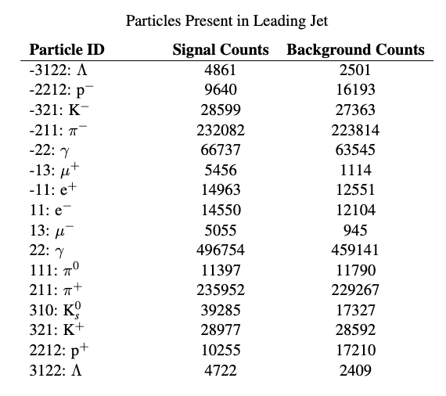
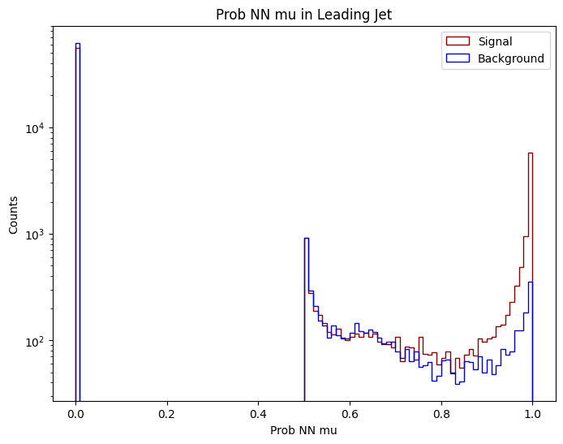
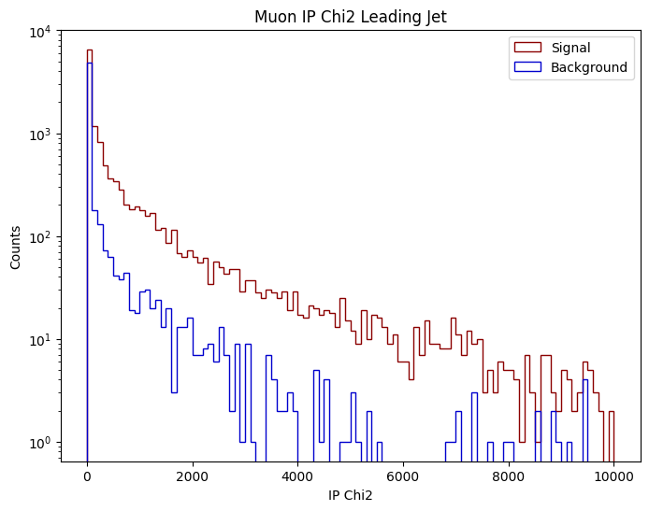
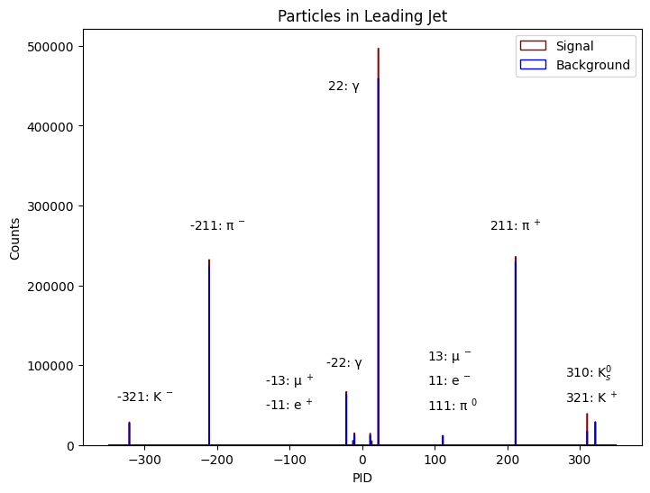
Graph Features

Slide 7
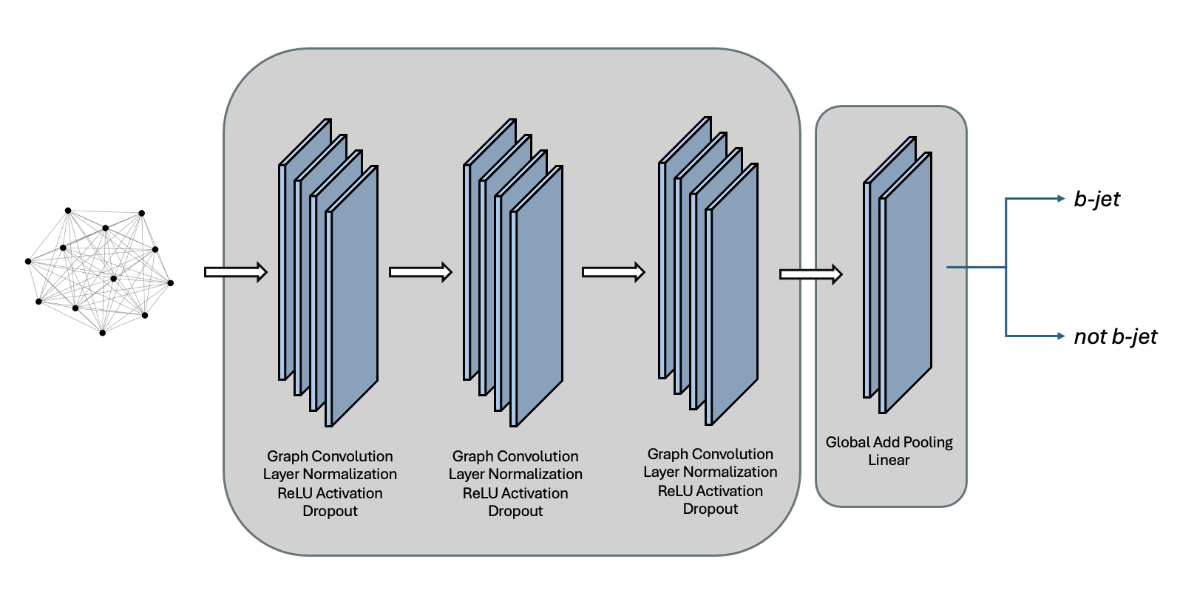
GNN Architecture

Slide 8
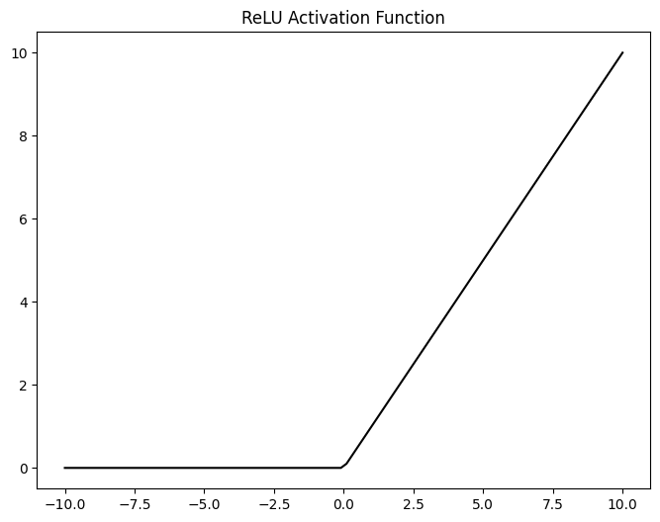
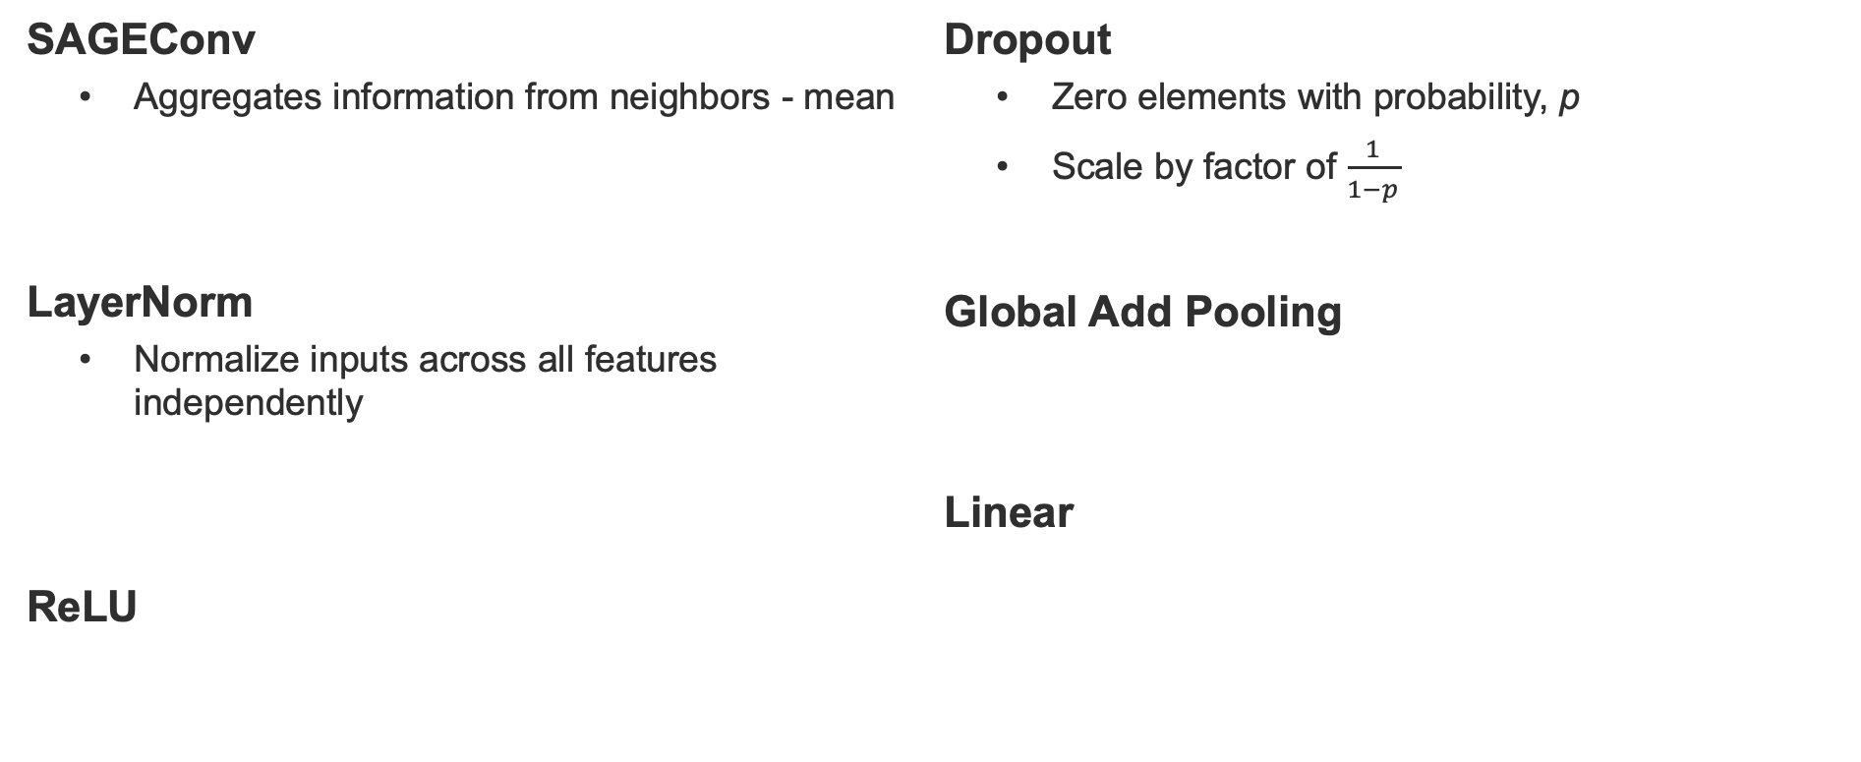
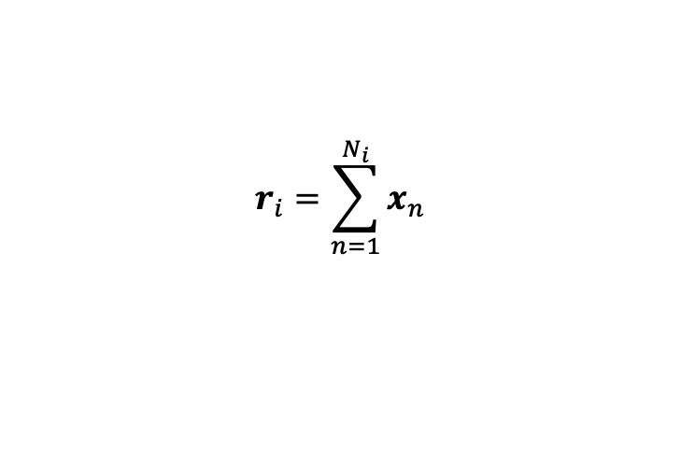

GNN Layers Functions
SAGEConv
  Aggregates information from neighbors - mean
LayerNorm
  Normalize inputs across all features independently
ReLU
Dropout
  Zero elements with probability, p
  Scale by factor of $\frac{1}{1−p}$
Global Add Pooling
Linear
$$x_{i}^{′}=W_{1}x_{1}+W_{2}∙{mean}_{j∈𝒩(i)}x_{j}$$
$$r_{i}=\sum_{n=1}^{N_{i}}{x_{n}}$$
$$y= \frac{x −E[x]}{\sqrt{Var\left[x\right]+ ε}} ∗ γ+ β$$
$$y=xA^{T}+b$$
$$R\left(z\right)=max⁡(0,z)$$

Slide 9
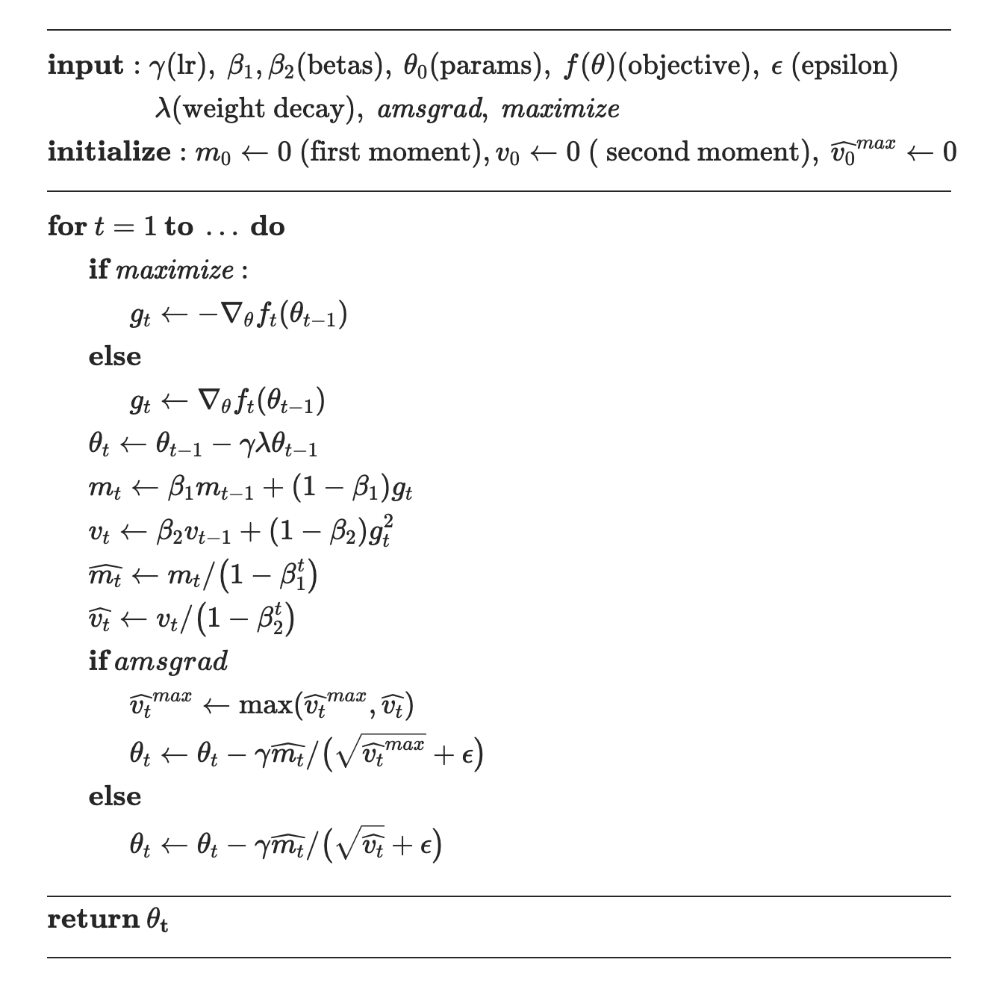
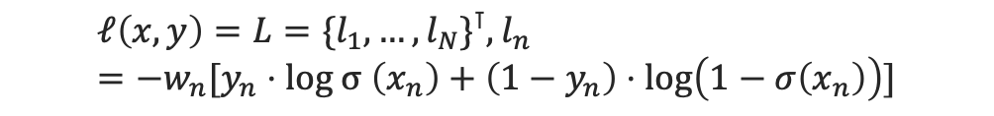
Loss and Optimization
Binary Cross Entropy Loss
AdamW
  Stochastic gradient descent method
  Separates weight decay from gradients
  Better regularization than Adam
$$ℓ\left(x,y\right)=L=\{l_{1},…,l_{N}\}^{⊺}, l_{n}=−w_{n}[y_{n}⋅log σ \left(x_{n}\right)+\left(1−y_{n}\right)⋅log\left(1−σ\left(x_{n}\right)\right)]$$

Slide 10
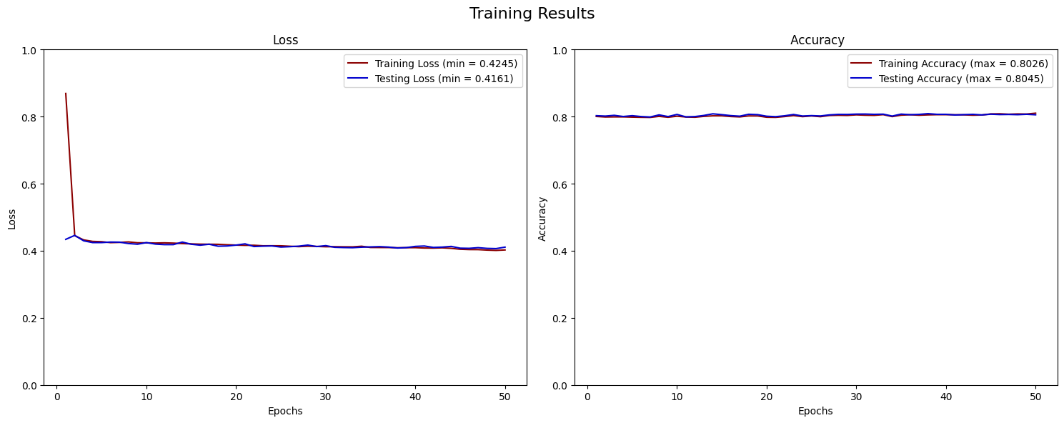
Results

Slide 11
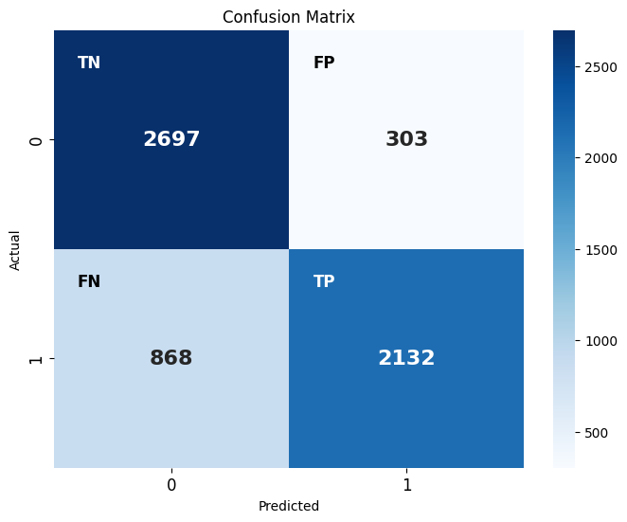
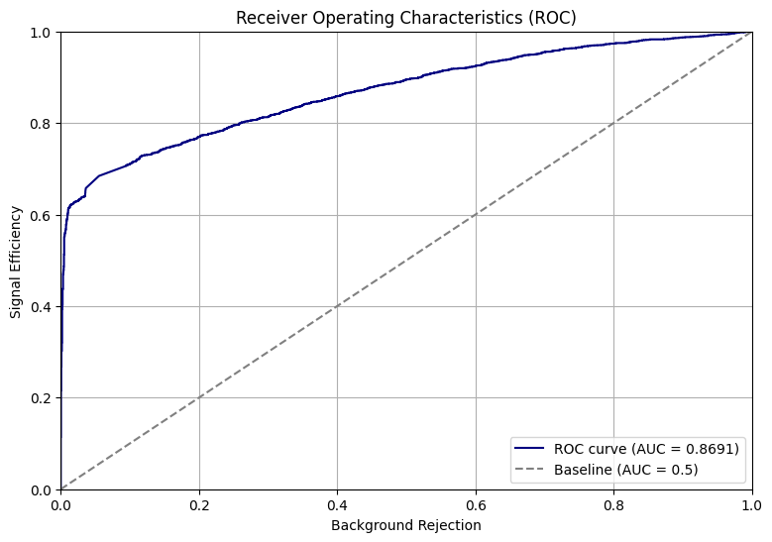
Results

Slide 12
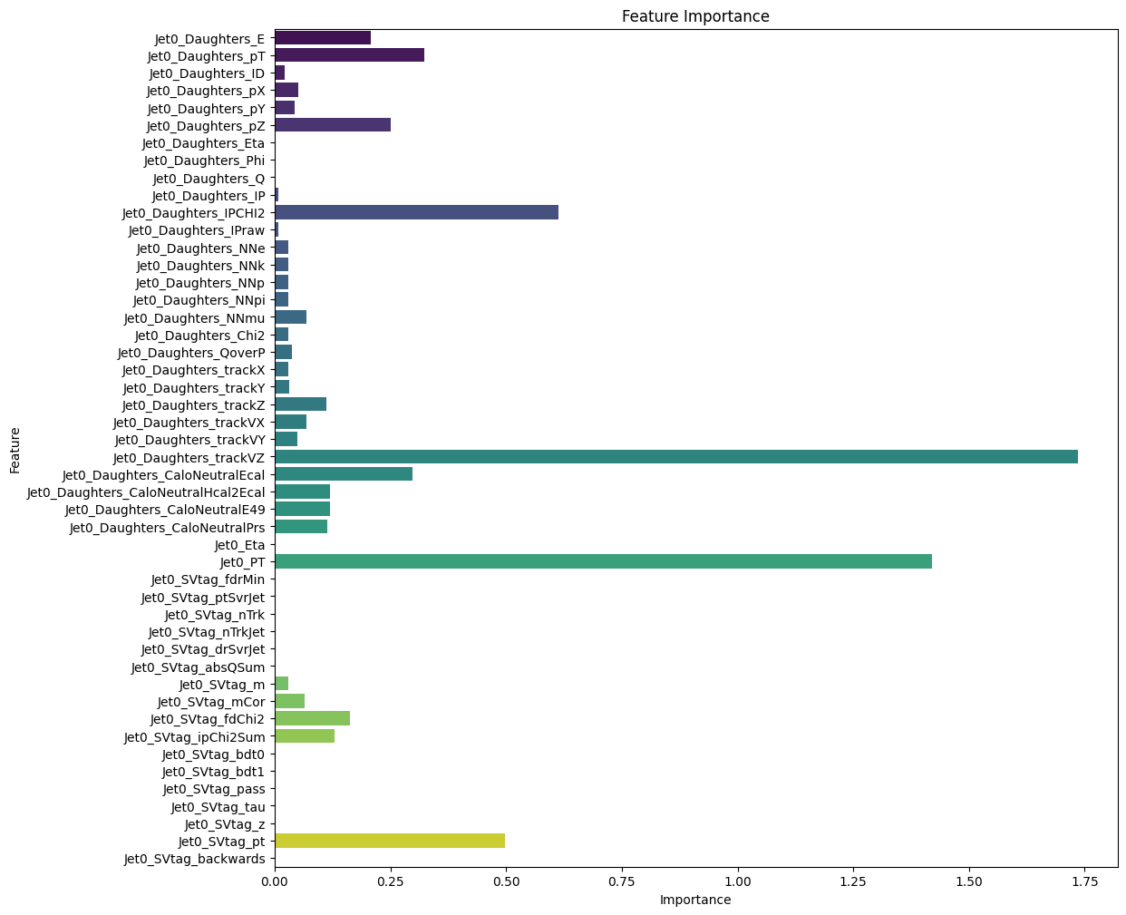
Results
Feature Ablation:
  Remove one feature at a time and compare predictions
Next steps:
  Hyperparameter tuning and optimization
  Complete documentation
  Apply for c-jet and fat jet classification

Slide 13









