Slide 1




Noise Reduction in ALPHA-g Magnet Control System
Sara Sawford
Supervisor: Dr. William Bertsche
25 July 2024

Slide 2
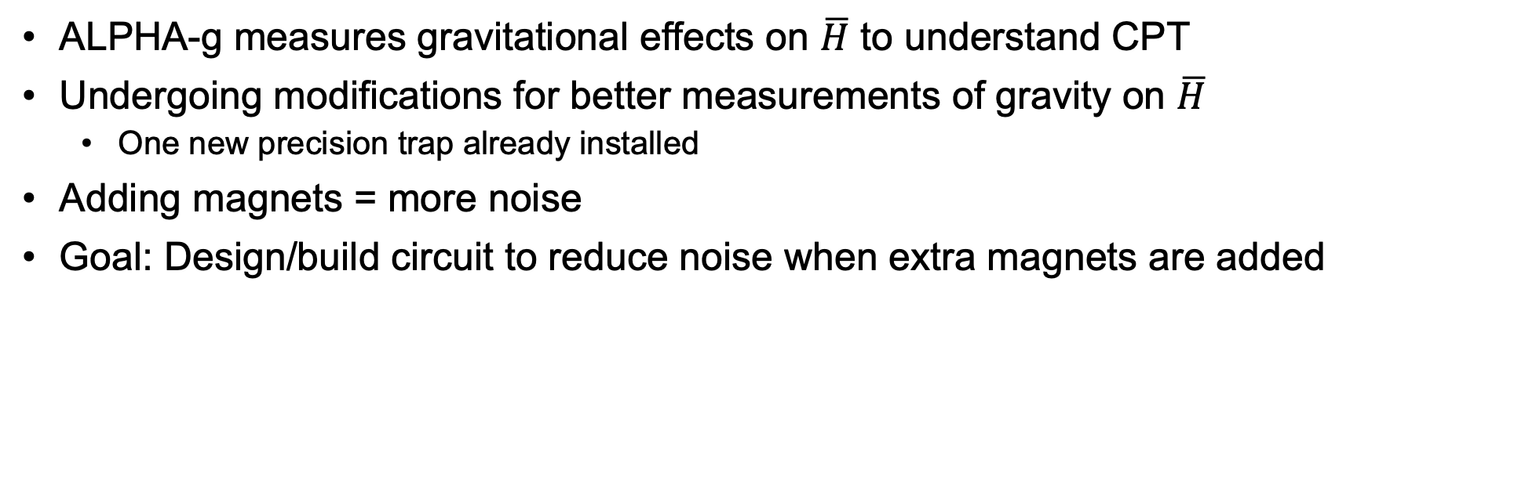
Background
ALPHA-g measures gravitational effects on $\overline{H}$ to understand CPT
Undergoing modifications for better measurements of gravity on $\overline{H}$
  One new precision trap already installed
Adding magnets = more noise
Goal: Design/build circuit to reduce noise when extra magnets are added

Slide 3
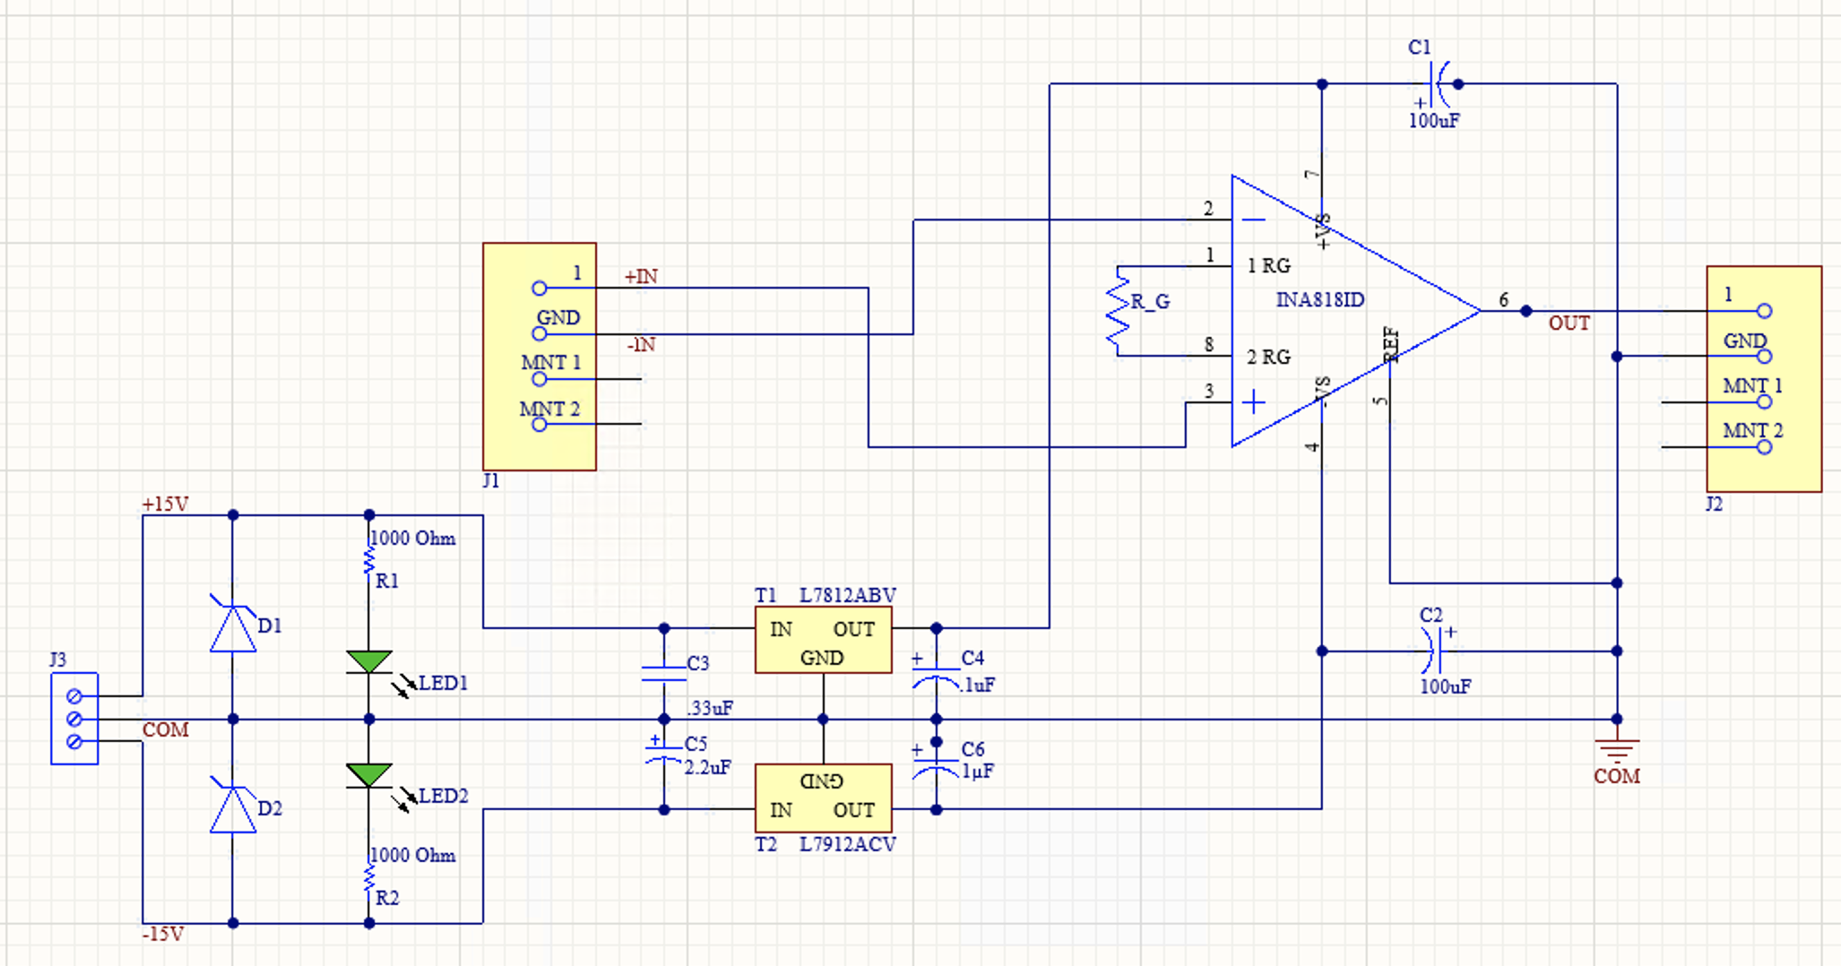
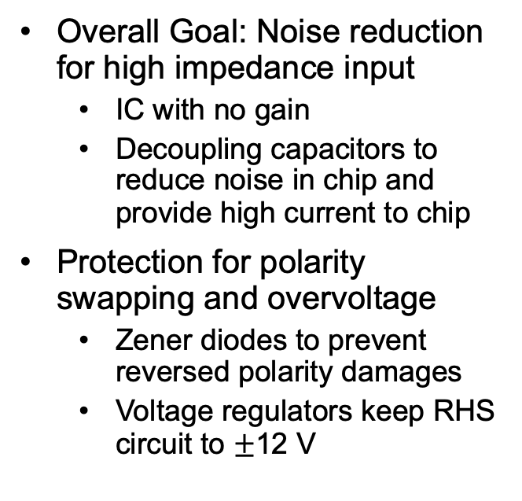
Design Specifications
Overall Goal: Noise reduction for high impedance input
  IC with no gain
  Decoupling capacitors to reduce noise in chip and provide high current to chip
Protection for polarity swapping and overvoltage
  Zener diodes to prevent reversed polarity damages
  Voltage regulators keep RHS circuit to $±$12 V

Slide 4
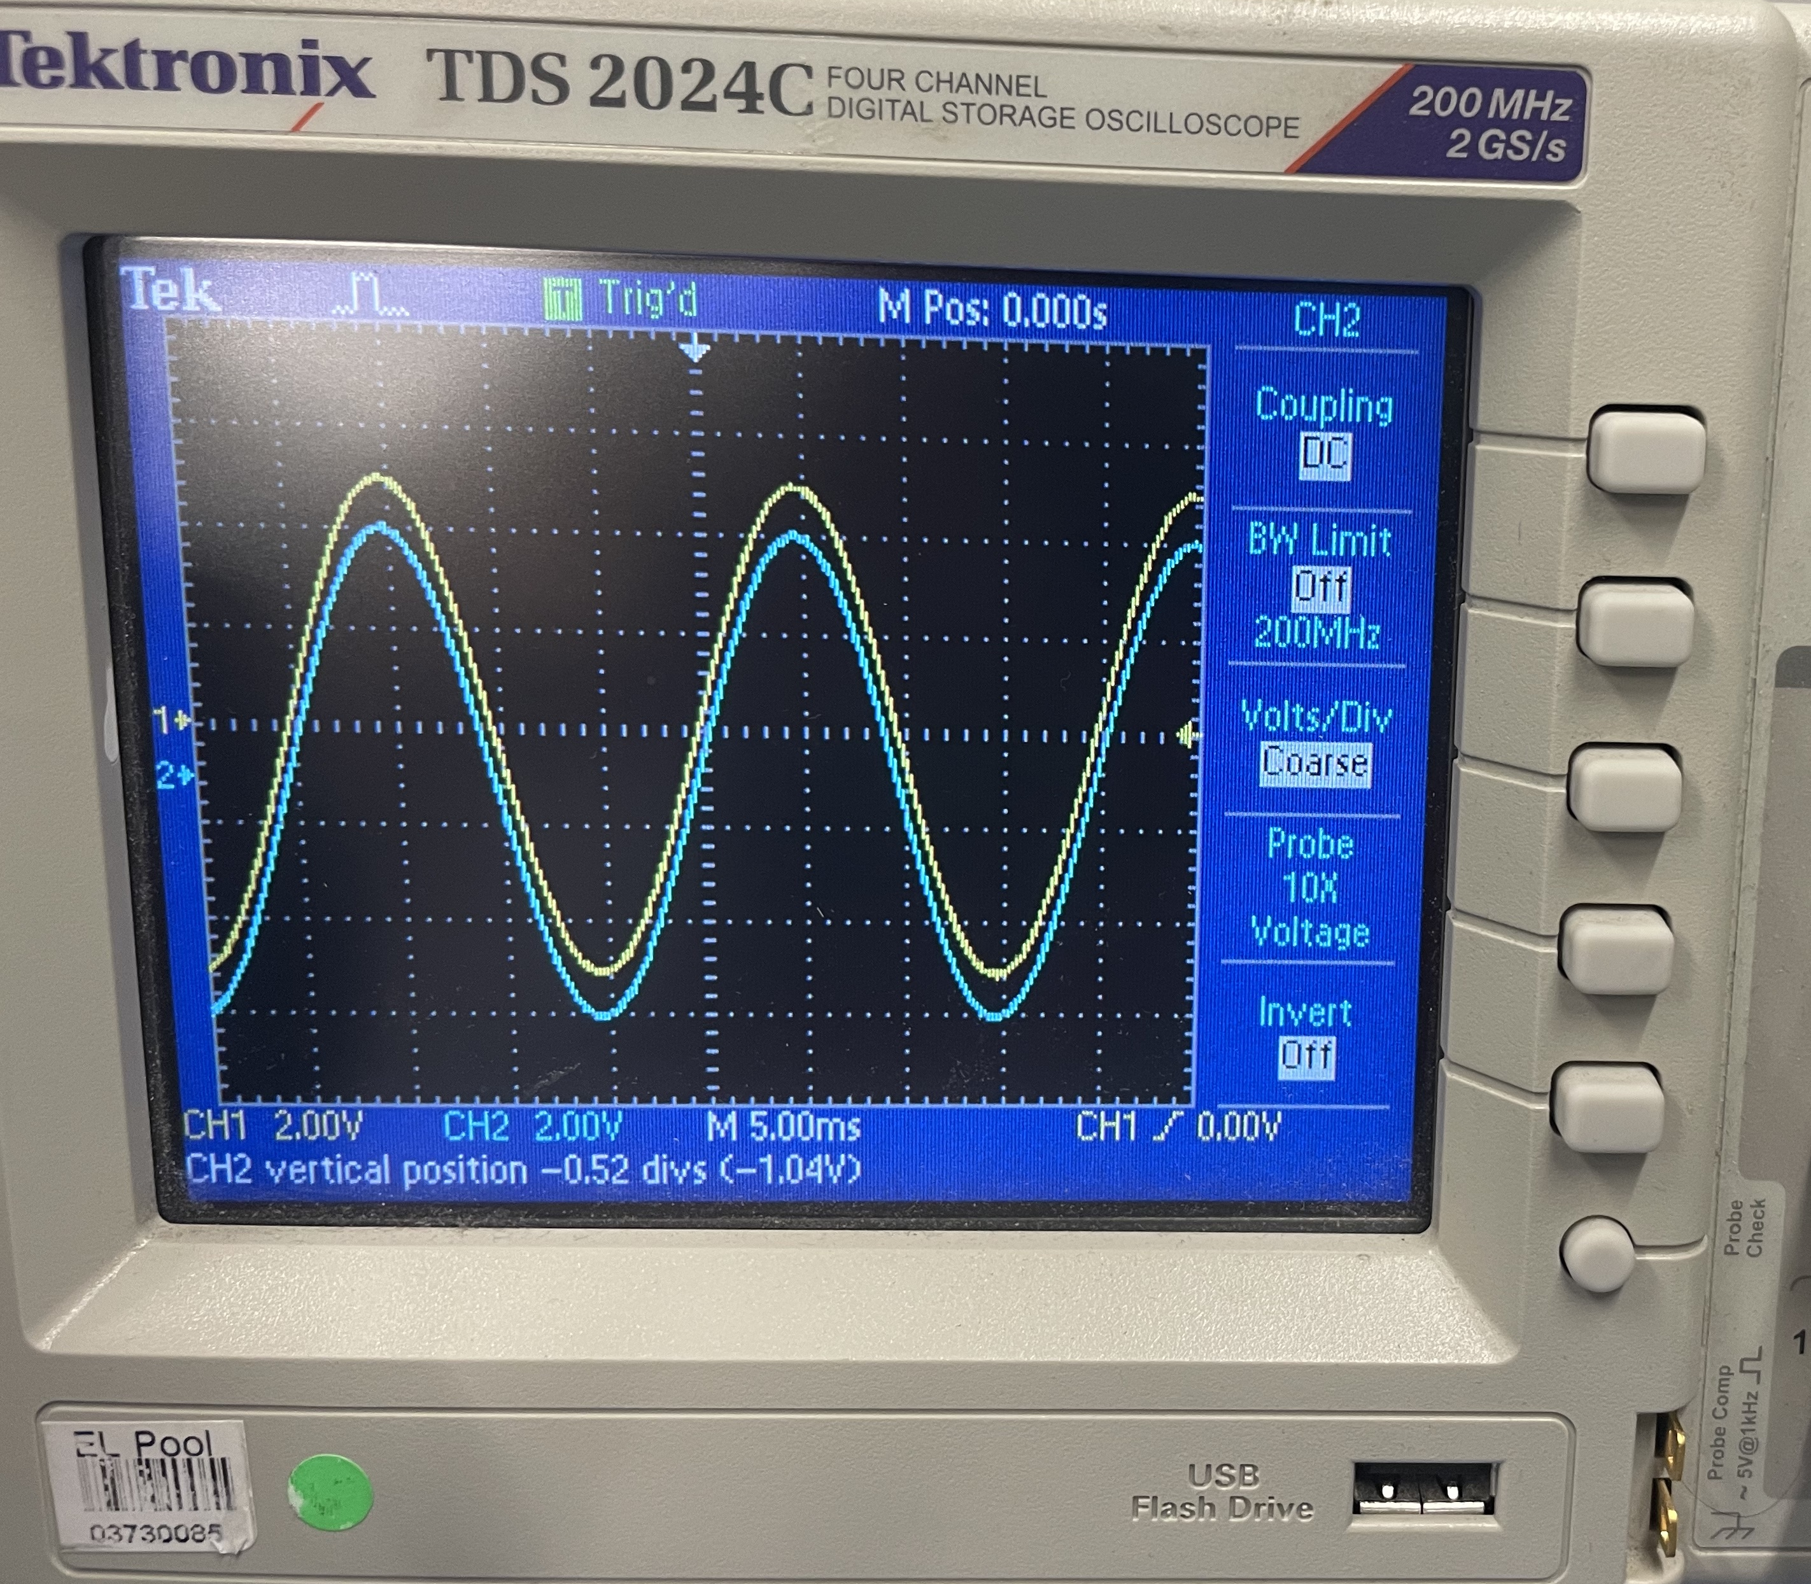
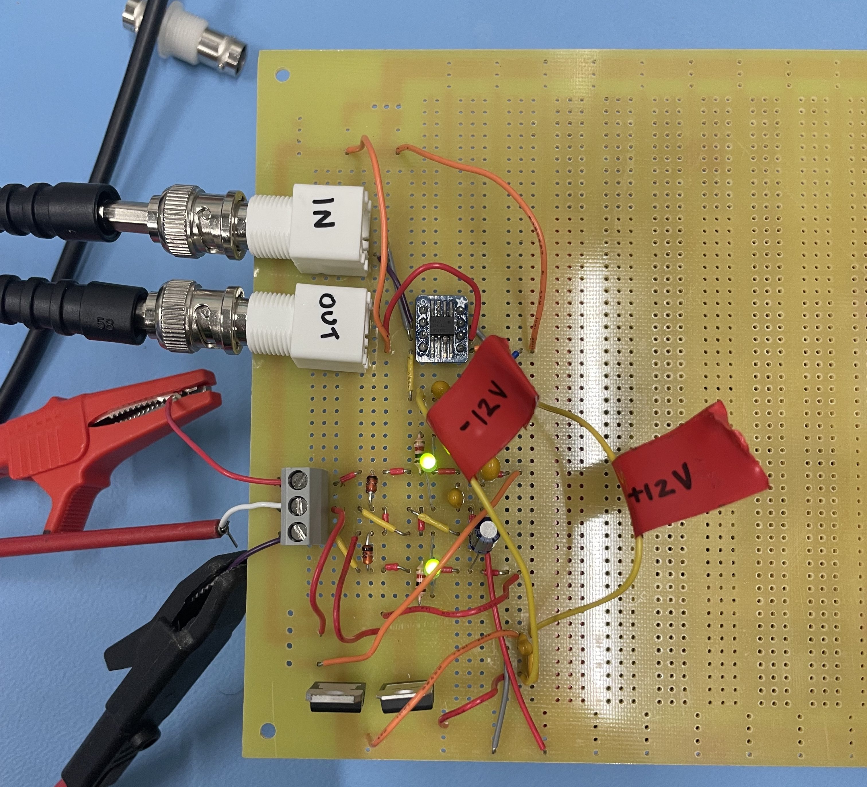
Prototype Circuit
Soldered parts onto perf board
First tested LHS from previous slide, then added RHS
  LEDs indicate circuit behaves correctly
Scope output shows signal was not distorted through circuit
  Traces offset because perfectly overlap
Input = Yellow
Output = Blue

Slide 5
Next Steps
Testing the prototype
  Signal comes from direct current-current transformer (DCCT) connected to magnet
  Collect data with/without circuit to compare noise in system output
Design/print PCB for implementation to ALPHA-g
  3D print holding box for PCB for safe installation to hardware shelves

Slide 6
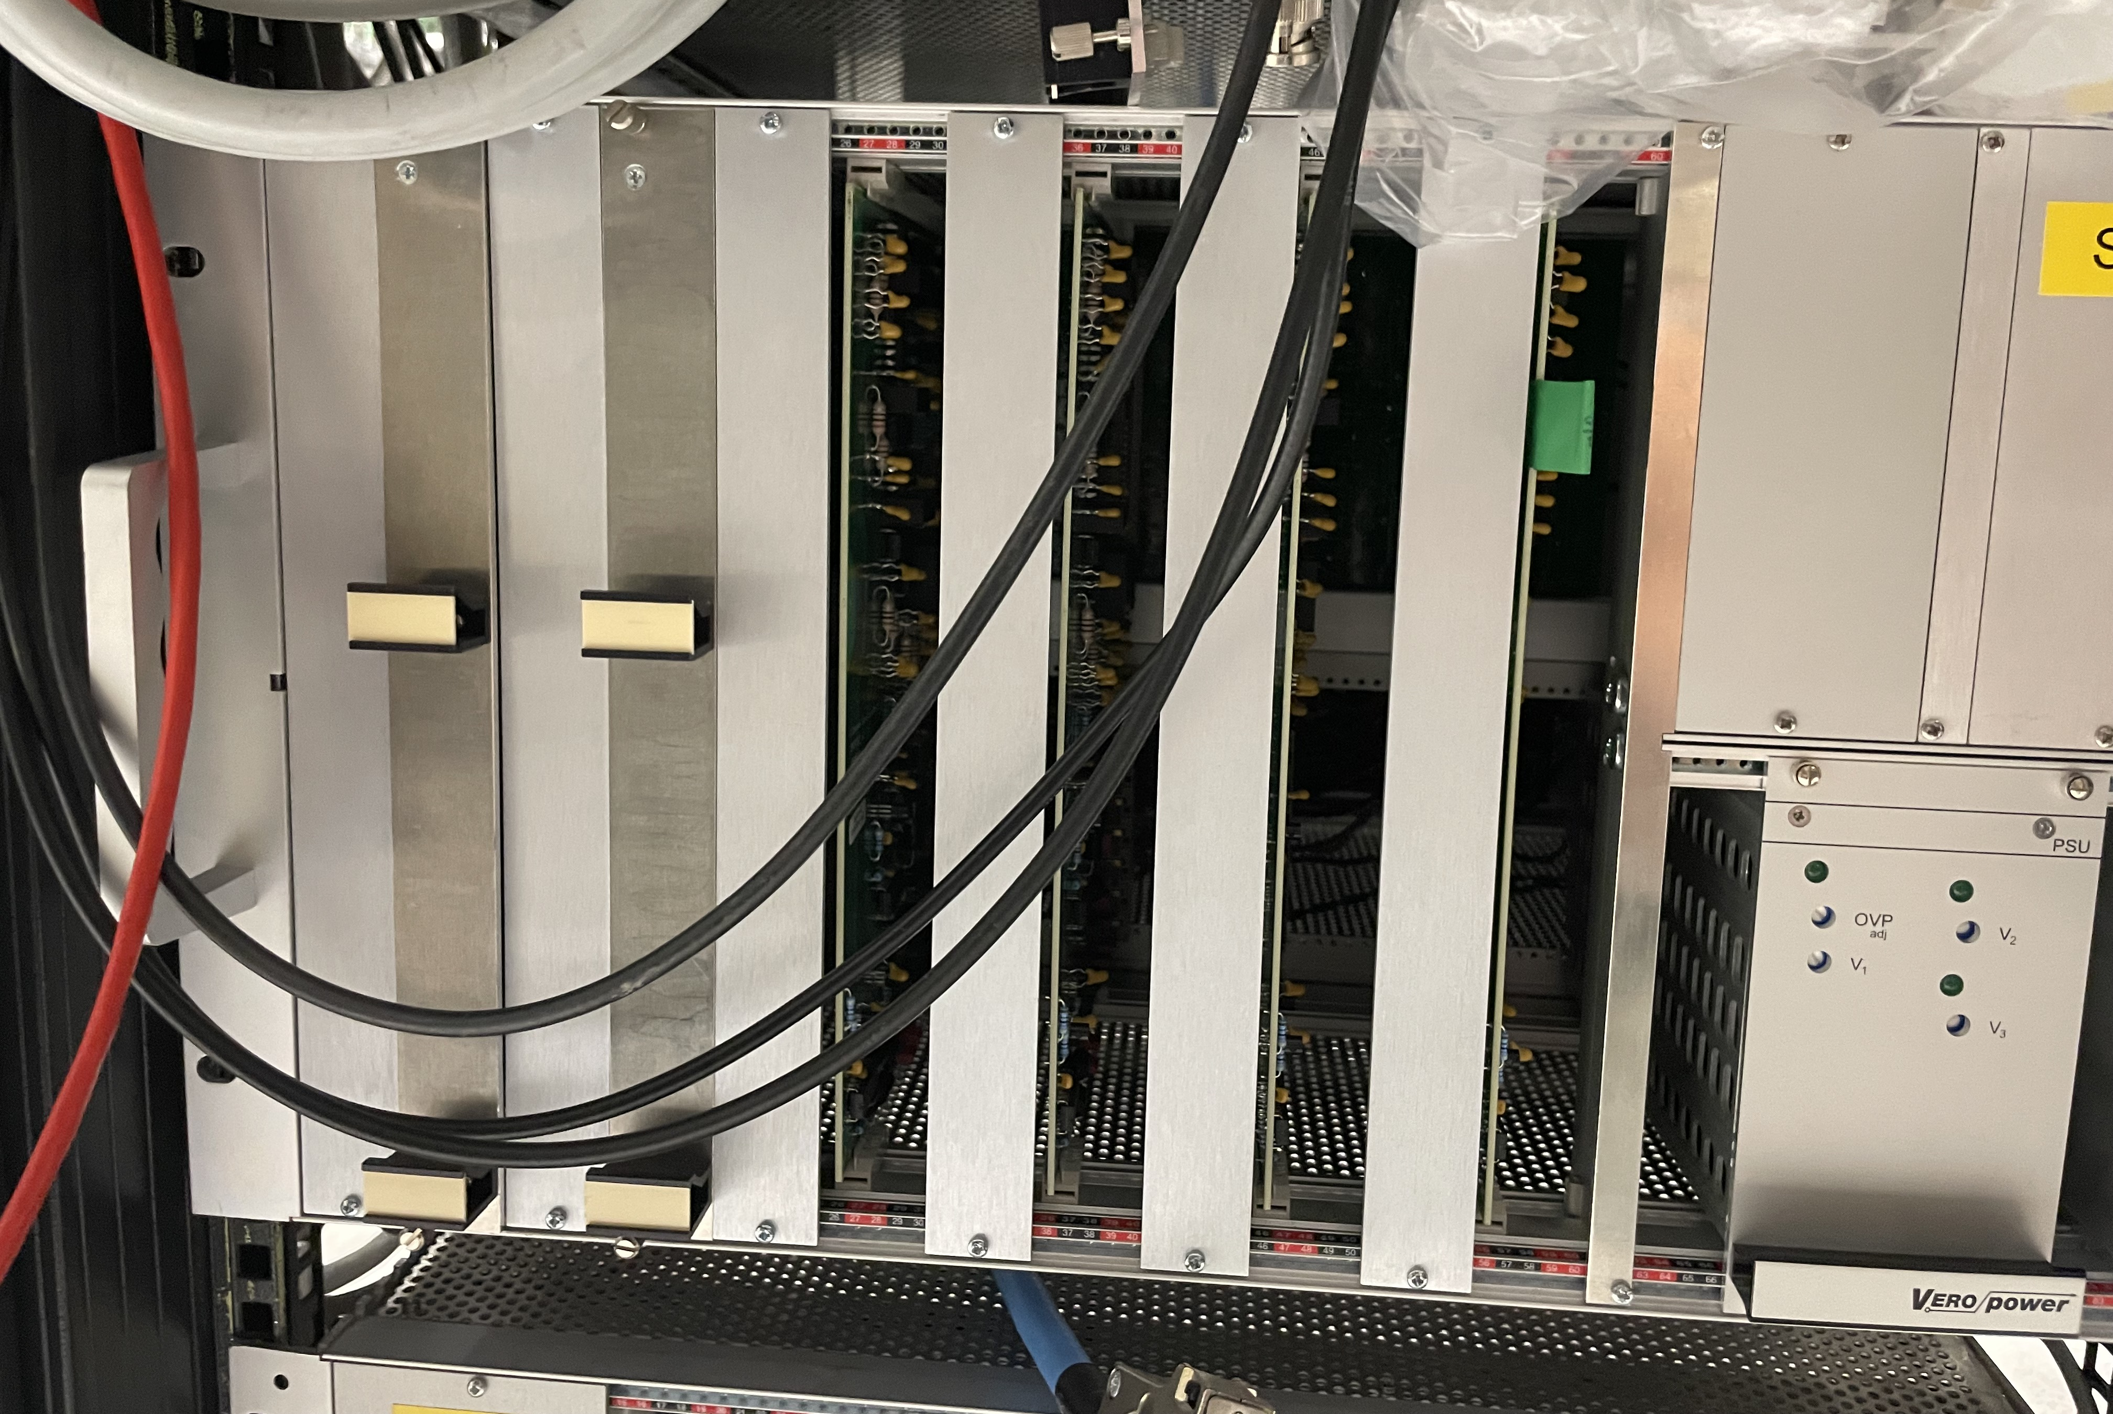
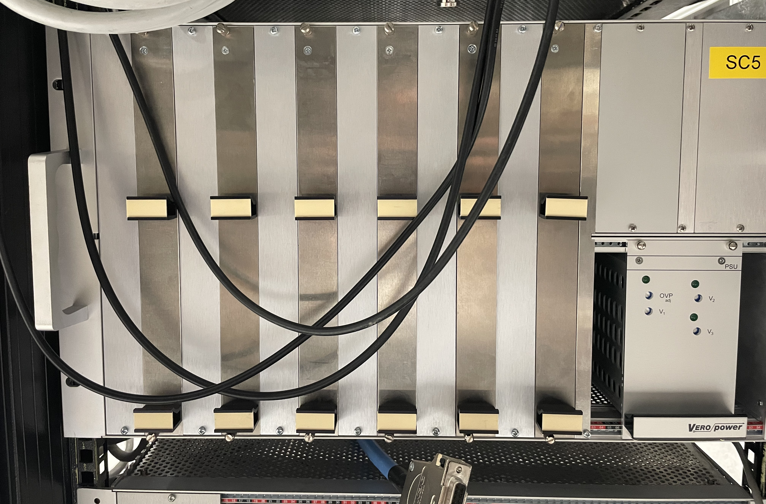
Other Hardware Projects
Side projects with Dr. Álvaro Nunes De Oliveira
Adding panels to clean up chassis for new ALPHA-g hardware
Designing and prototyping circuit to install new power supply to for QPS

Slide 7

