Slide 1
Processing and Analysis of HiRadMat Beam Line Data
Julia White
7/25/2024

Slide 2
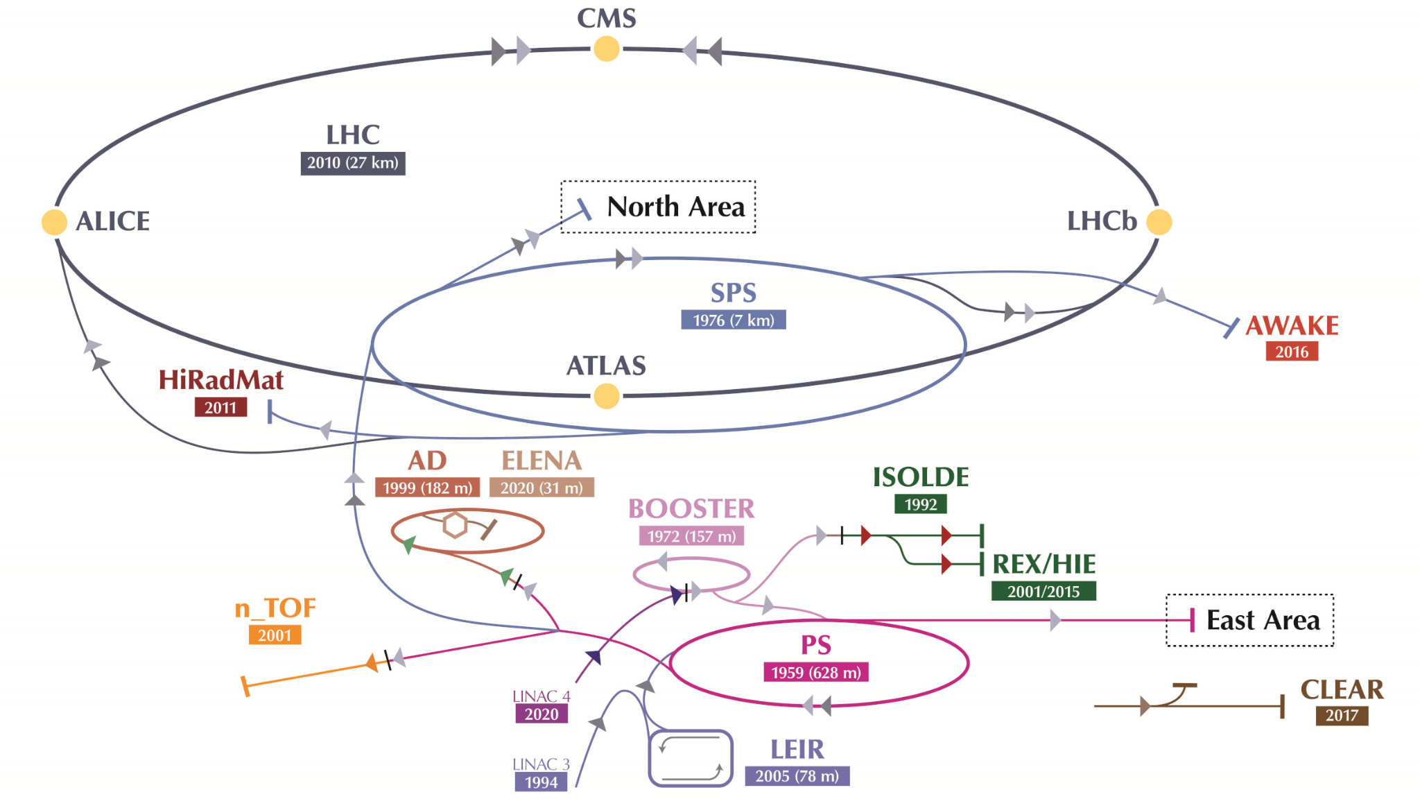
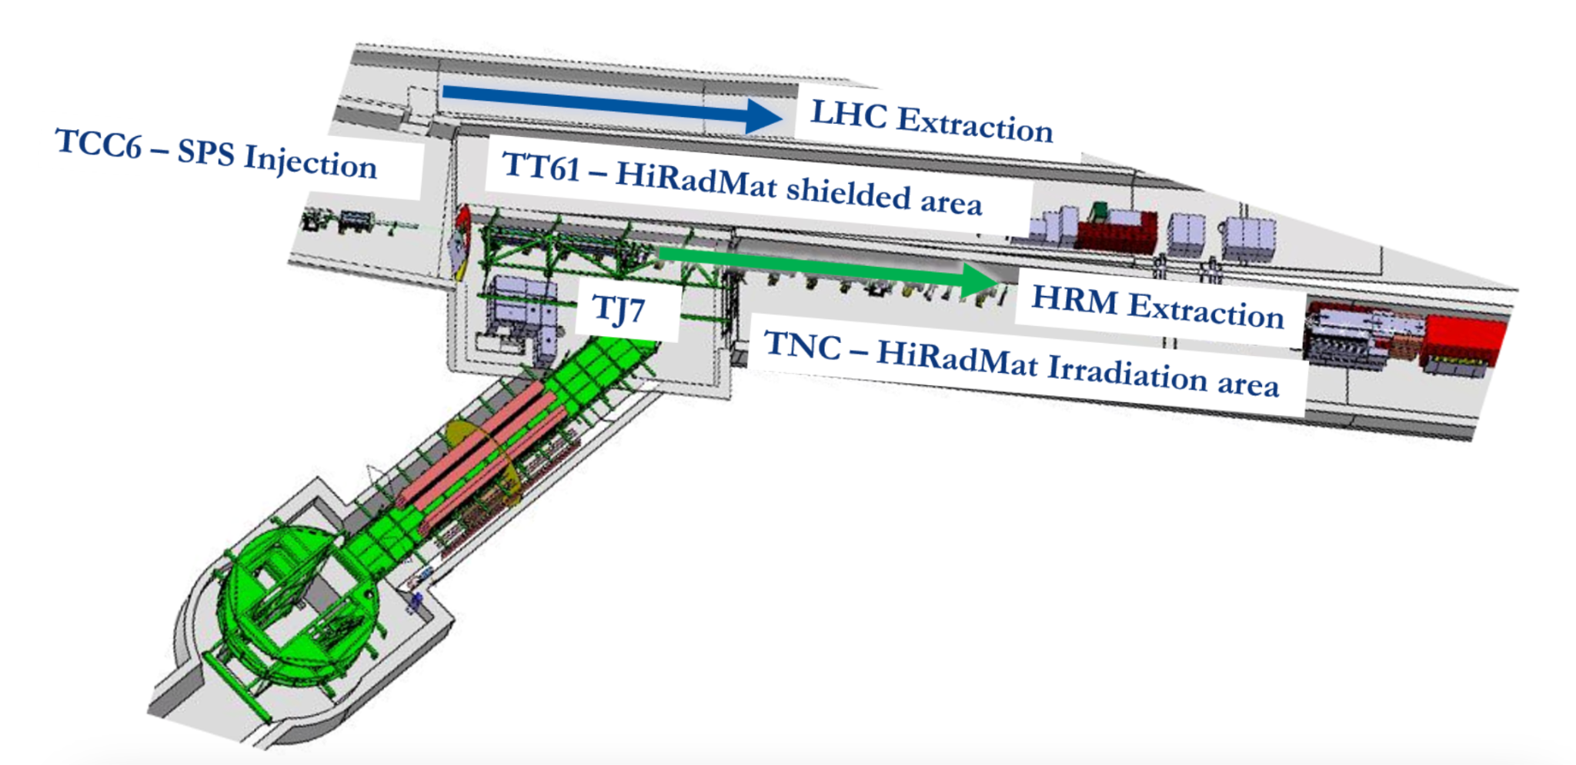
HiRadMat
High Intensity Radiation to Materials
Test the effects of short beam pulses on materials and accelerator components
Julia White | Processing and Analysis of HiRadMat Beam TV Data
25 July 2024
‹#›

Slide 3
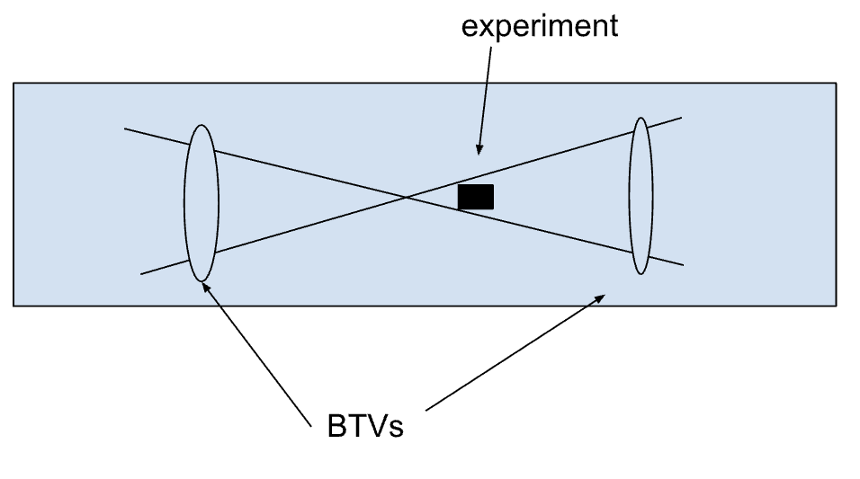
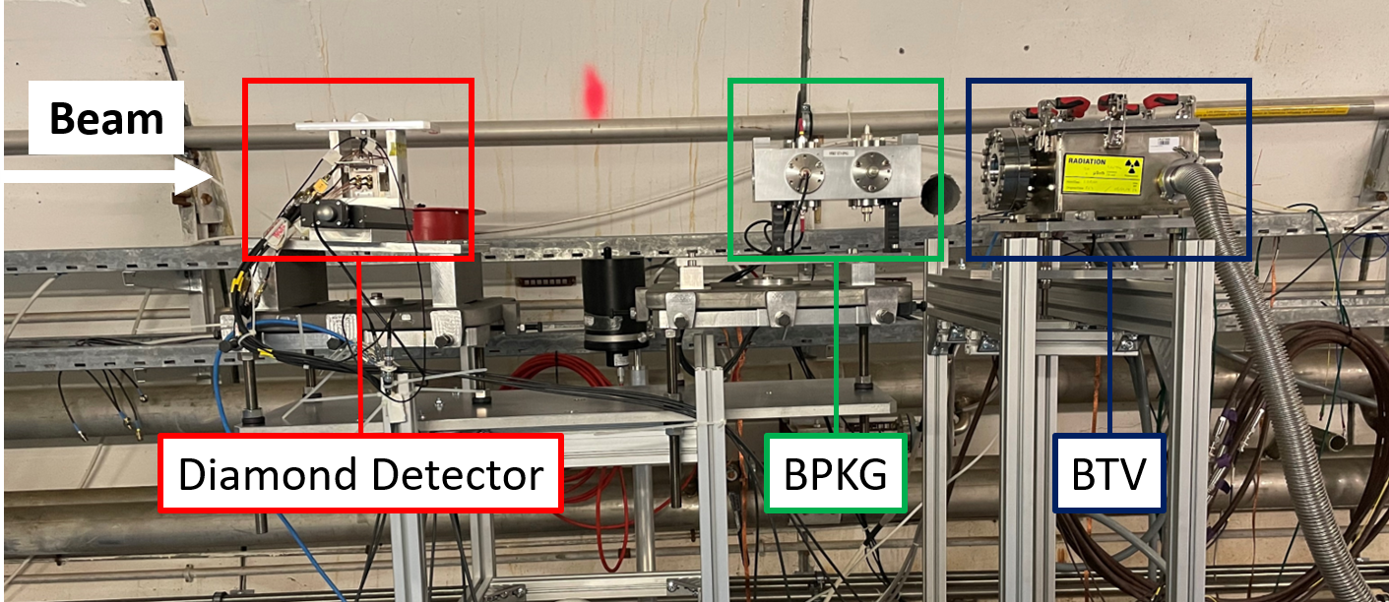
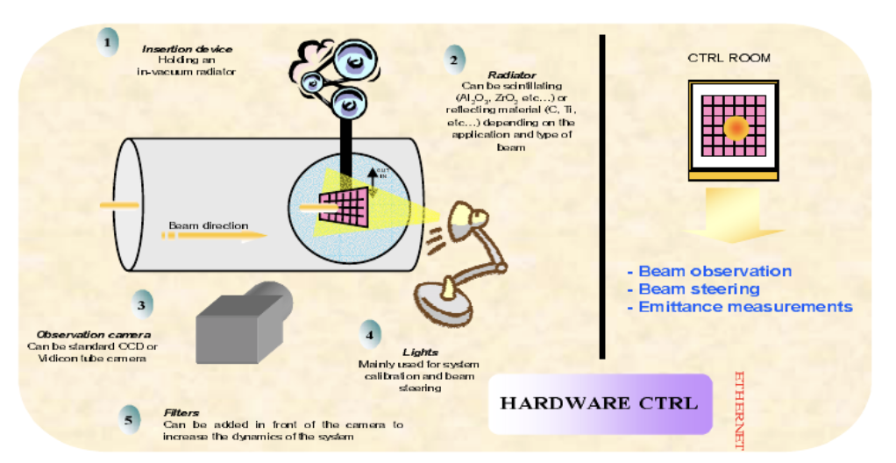
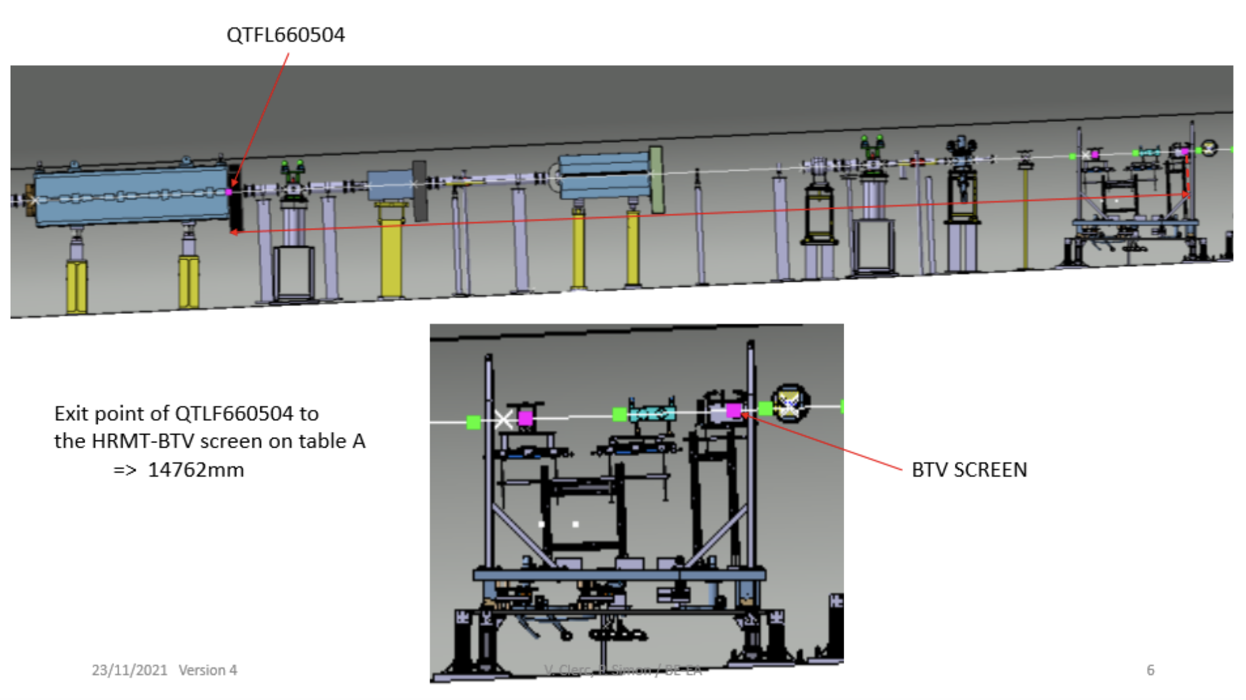
V. Clerc and P. Simon
S. Berger
Julia White | Processing and Analysis of HiRadMat Beam TV Data
25 July 2024
‹#›

Slide 4
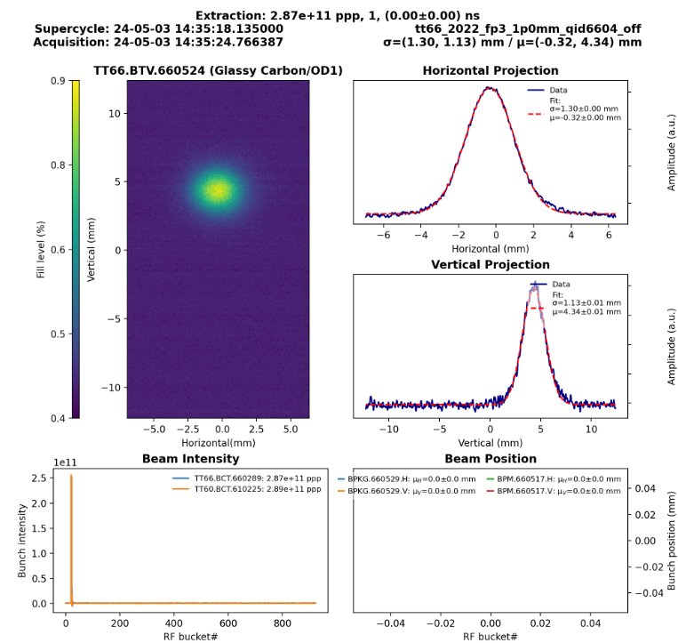
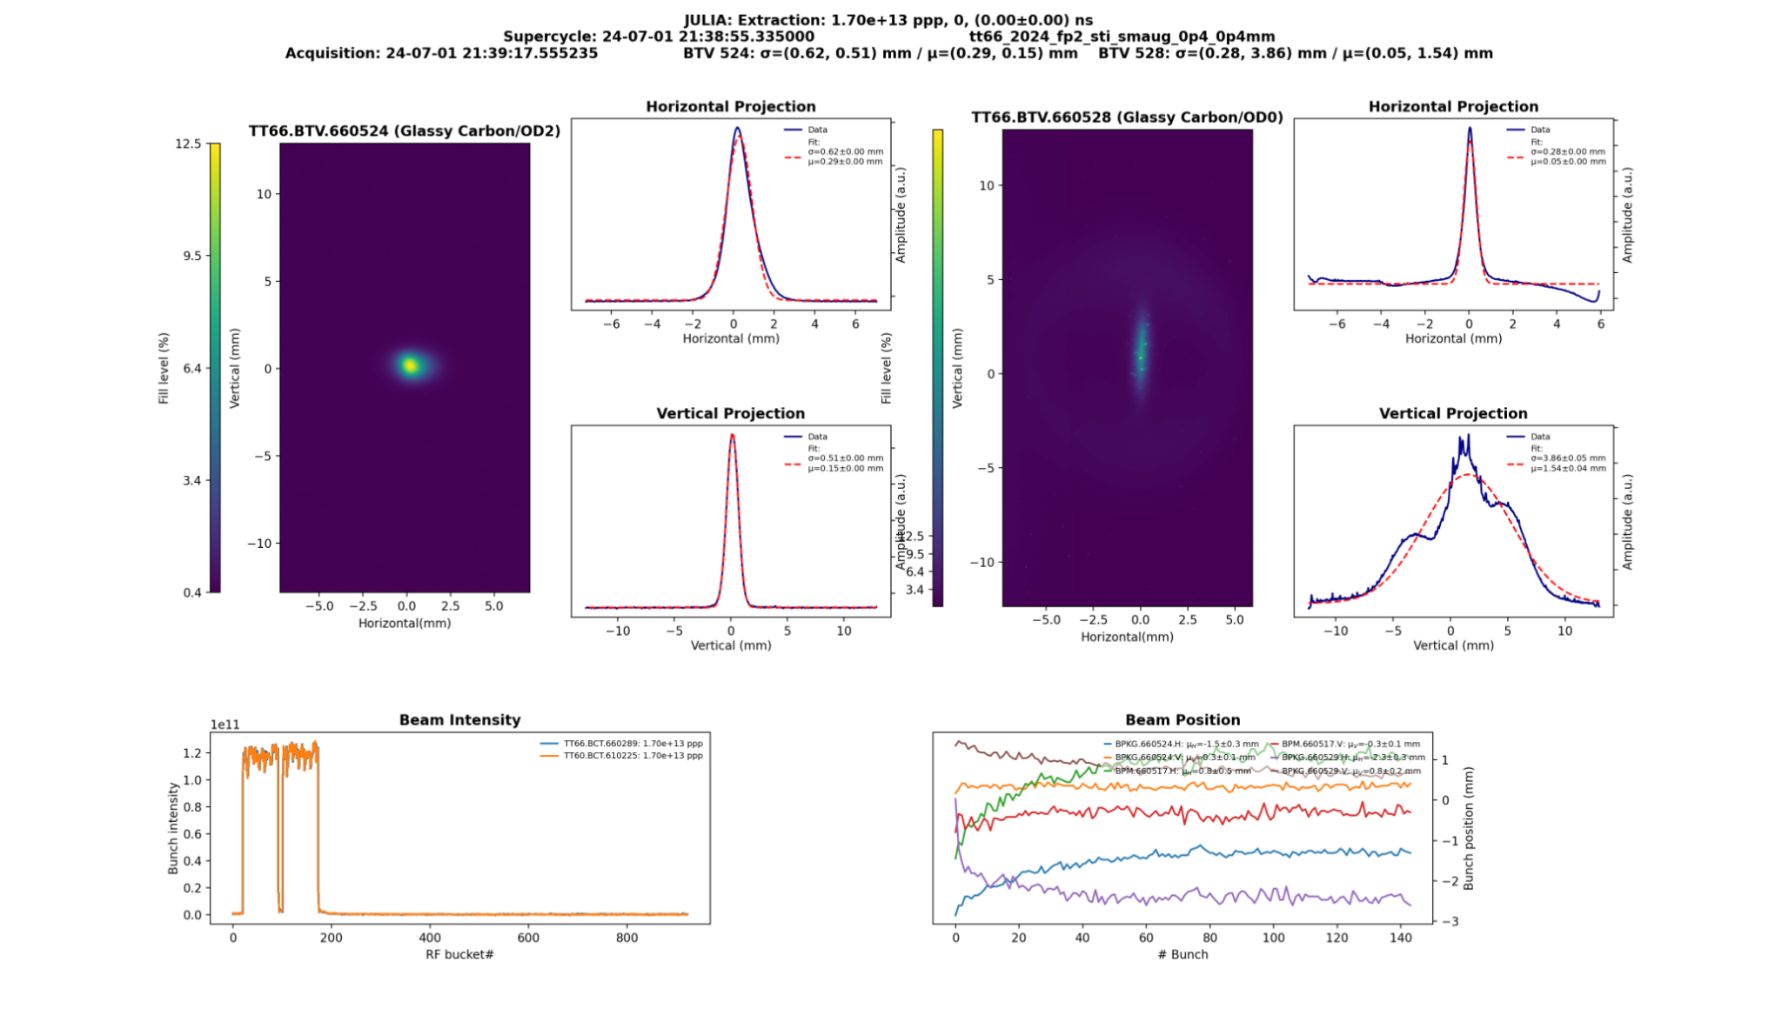
Real-Time BTV Script
Julia White | Processing and Analysis of HiRadMat Beam TV Data
25 July 2024
‹#›

Slide 5
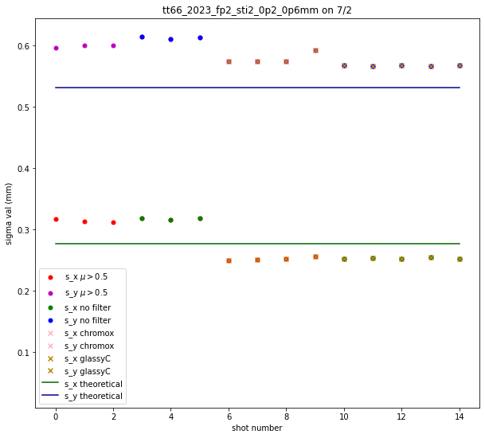
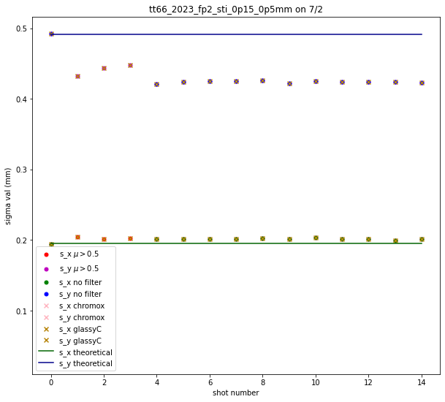
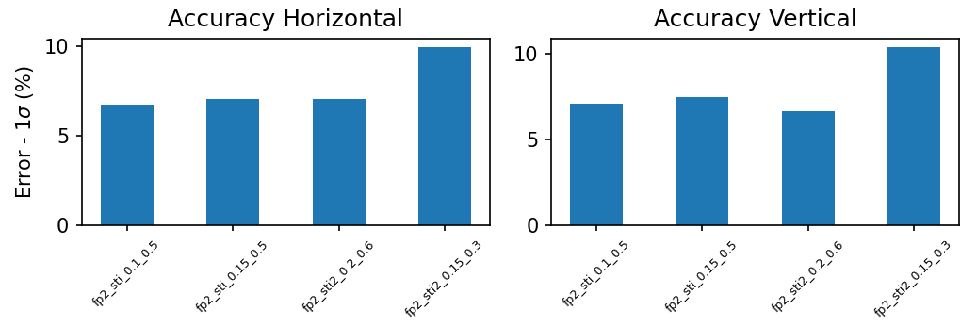
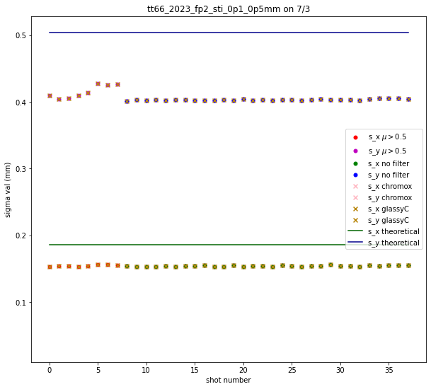
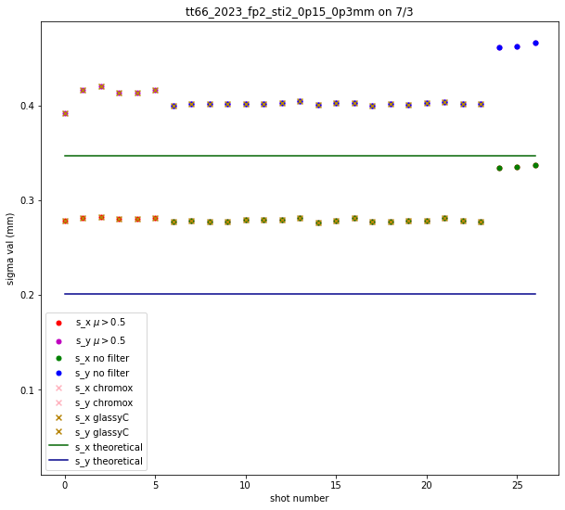
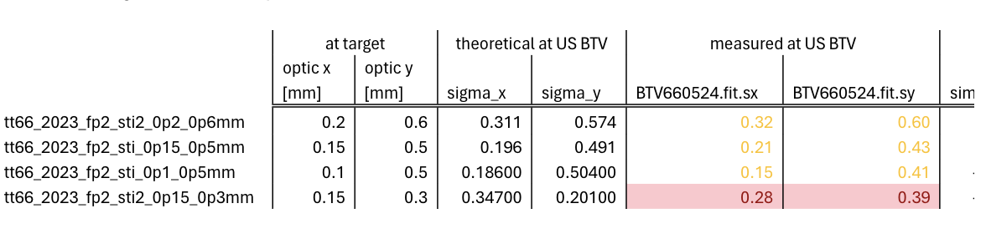
Results From July 2 and 3
s_x : ~8%
s_y : ~6%
s_x : ~4%
s_y : ~15%
F. Velotti
s_x : ~20%
s_y : ~70%
s_x : ~18%
s_y : ~23%
s_x : ~20%
s_y : ~70%
G. Banks
Julia White | Processing and Analysis of HiRadMat Beam TV Data
25 July 2024
‹#›

Slide 6
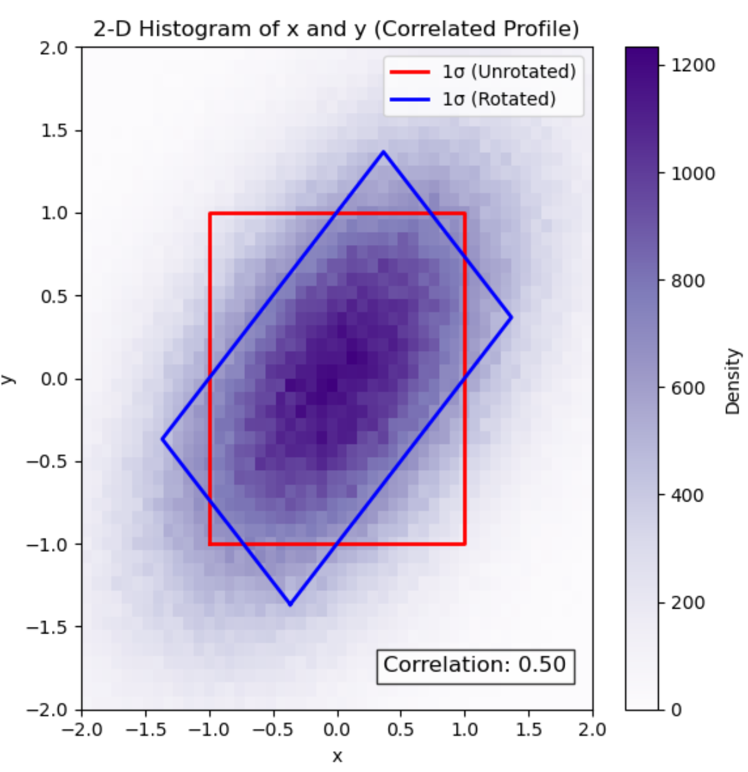
N. Charitonidis
Julia White | Processing and Analysis of HiRadMat Beam TV Data
25 July 2024
‹#›

Slide 7
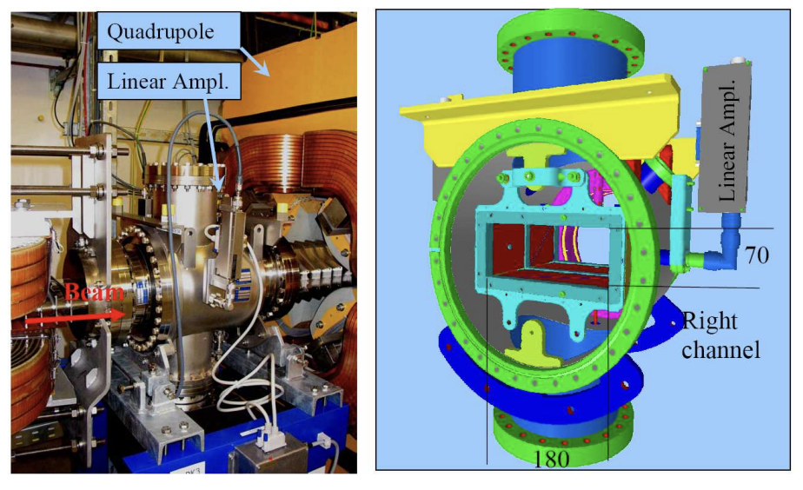
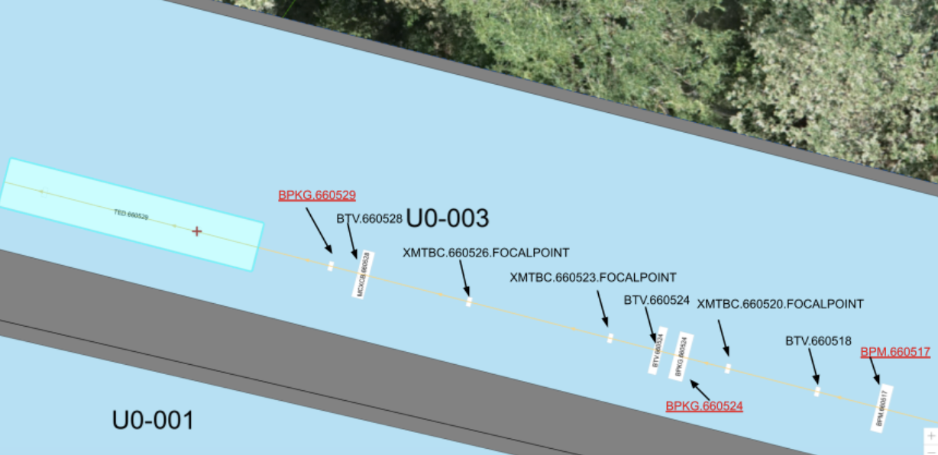
BPM / BPKG
Beam position monitors give the center of mass of the beam and the ‘longitudinal bunch shape’
No magnets between the BPMs and BPKGs being analyzed
P. Forck, P. Kowina, and D. Liakin
s_x : ~20%
s_y : ~70%
Julia White | Processing and Analysis of HiRadMat Beam TV Data
25 July 2024
‹#›

Slide 8
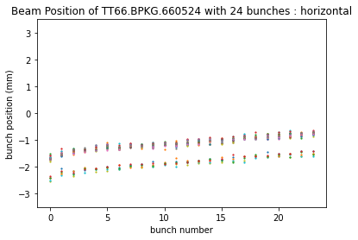
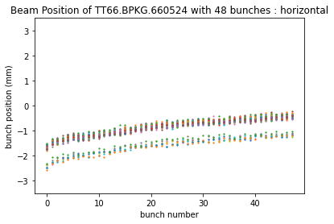
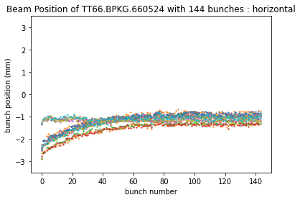
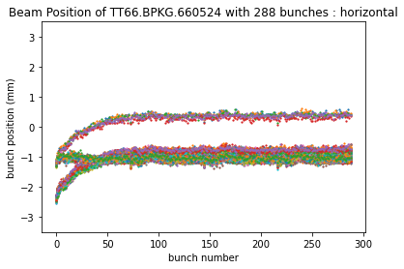
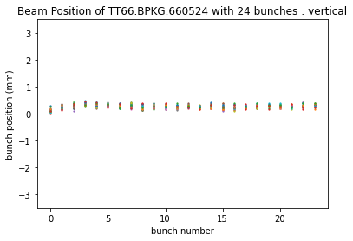
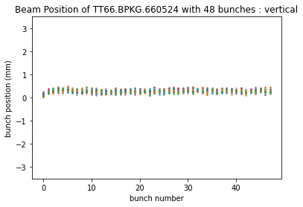
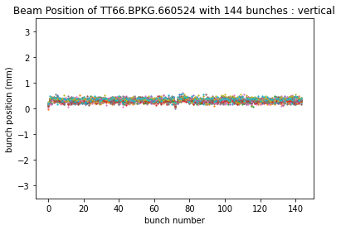
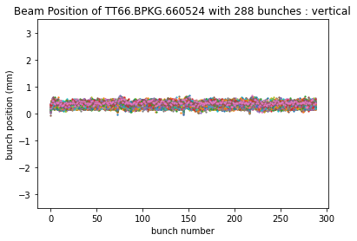
BPKG 660524 Results
‹#›

Slide 9
Next Steps
Calculate the true area of the beam so its density can be used by the STI group in August.
  Connect to Beam Size Monitor tool and obtain a direct size estimation of the beam in each direction.
Learn more about beam position monitors and meet with experts on the extraction beam line to figure out why we are seeing the drift in the BPMs.
Analyze vistar script performance and optics results from STI pre commissioning (7/25) to prepare for their experiment in August.
‹#›

Slide 10





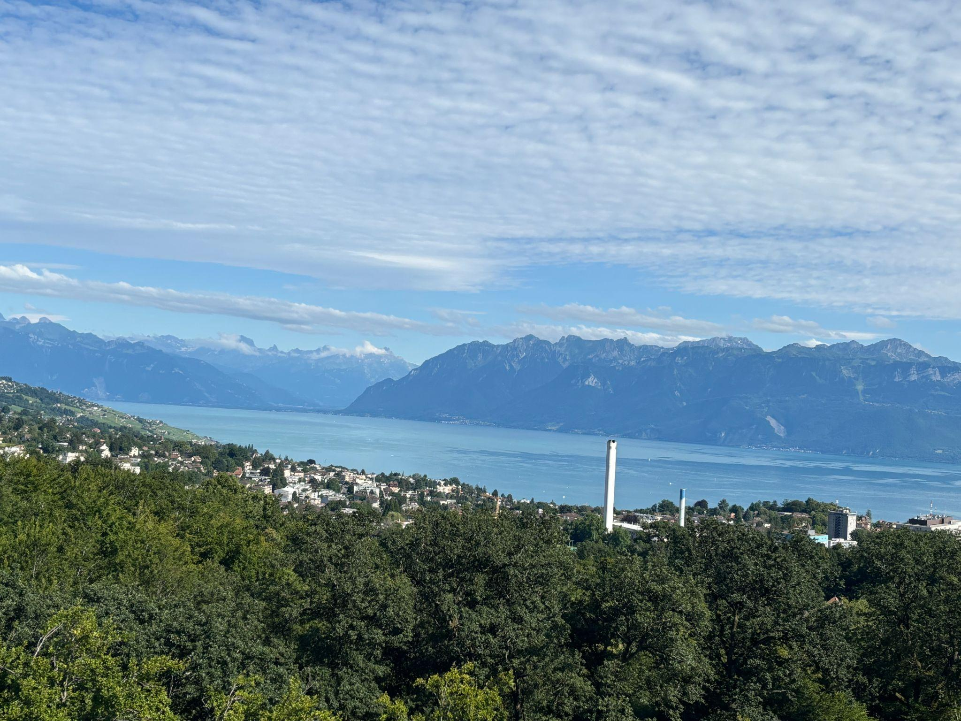



Julia White | Processing and Analysis of HiRadMat Beam TV Data
25 July 2024
‹#›

