Slide 1
Running CI jobs with GitHub Actions on Perlmutter
Atlas
Pengfei Ding
Data Science Engagement Group
Sep 20th, 2024

Slide 2
The question – which tool and where to run?
Many Continuous Integration tools/solutions:
  GitHub Action; Travis CI; GitLab CI; Jenkins; …
  GitHub Action is a popular choice for GitHub-hosted repositories.
CI jobs often need to be run on platforms other than (free) GitHub cloud servers;
  Constraint on hardware
    CPU – matters less since you may use emulators on GitHub cloud runners;
    GPU –
    Other accelerators, special network etc.
  Constraint on scale and use case
    Integration test – needs to be done in the deployment environment (or similar);
    need to test in scale with multi-nodes jobs;
  Constraint on software environment
    Proprietary software which is licensed on servers in your own institution.

Slide 3
The challenge – how to run?
The simplest setup:
  a self-hosted runner instance
  running on a server, e.g. Perlmutter login node
  Listening/polling on CI jobs triggered in a GitHub repository;
Issues with this setup:
  Self-hosted runner instance need to be kept alive (or installed as a system service);
  For public repositories, many users and events can trigger the CI workflow.
    The worst case – someone forked the repository, make malicious changes to the code or workflow, e.g. doing Bitcoin mining in a hidden job step, and submitted a pull request to the upstream repo, which triggered a CI workflow on a supercomputer.
    Can easily violate many HPC facilities’ use policy – only users with accounts/allocations at the facility can use the computing resources.

Slide 4
The solution
What’s needed:
  A gateway to admit/reject CI jobs;
    GitHub sends a message to the gateway when a CI job is triggered;
    The gateway checks if the CI job is:
      triggered in an allowed repository and branch;
      triggered by a GitHub user who already has an account with the HPC facility;
    The gateway sends the job to the supercomputer:
      Start a self-hosted runner remotely on the supercomputer;
      Self-hosted runner takes only the admitted CI job, and tear itself down immediately after job completion.

Slide 5
The solution (cont’d)
An API server running in on-prim cloud at NERSC
What’s needed:
  A gateway to admit/reject CI jobs;
    GitHub sends a message to the gateway when a CI job is triggered;
    The gateway checks if the CI job is:
      triggered in an allowed repository and branch;
      triggered by a GitHub user who already has an account with the HPC facility;
    The gateway sends the job to the supercomputer:
      Start a self-hosted runner remotely on the supercomputer;
      Self-hosted runner takes only the admitted CI job, and tear itself down immediately after job completion.
GitHub webhooks triggered by workflow events
Predefined list of repos/users etc checked by the API server
Use “ephemeral” runners which only takes one CI job
Use NERSC’s Superfacility API to execute scripts/running jobs on Perlmutter

Slide 6
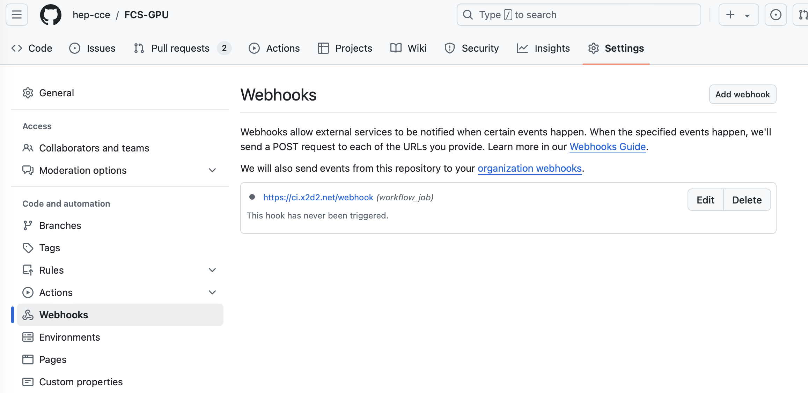
GitHub Webhook (I)

Slide 7
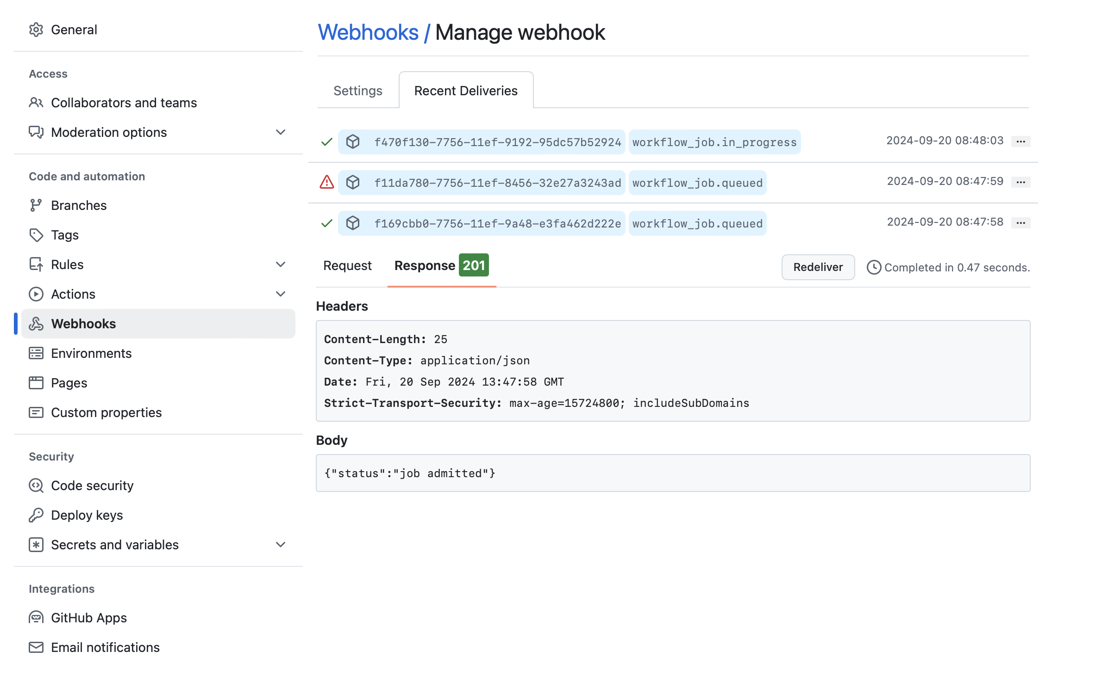
GitHub Webhook (II)

Slide 8
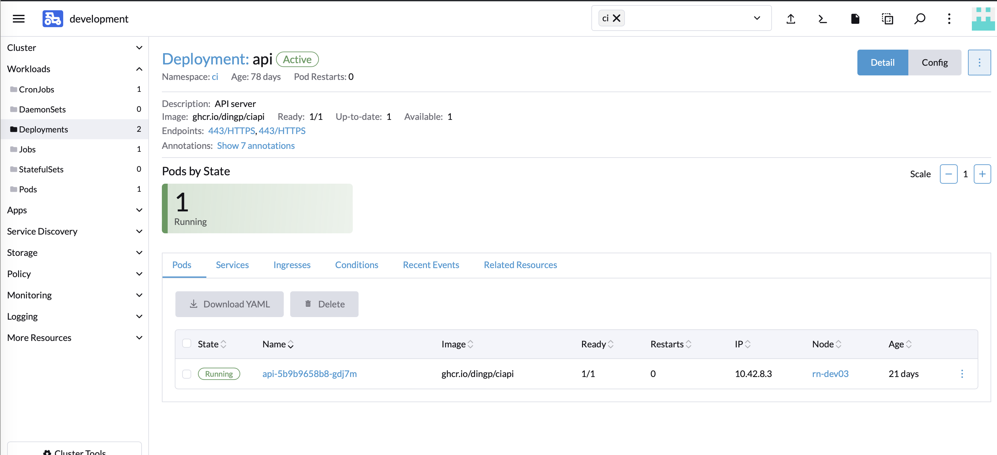
API server

Slide 9
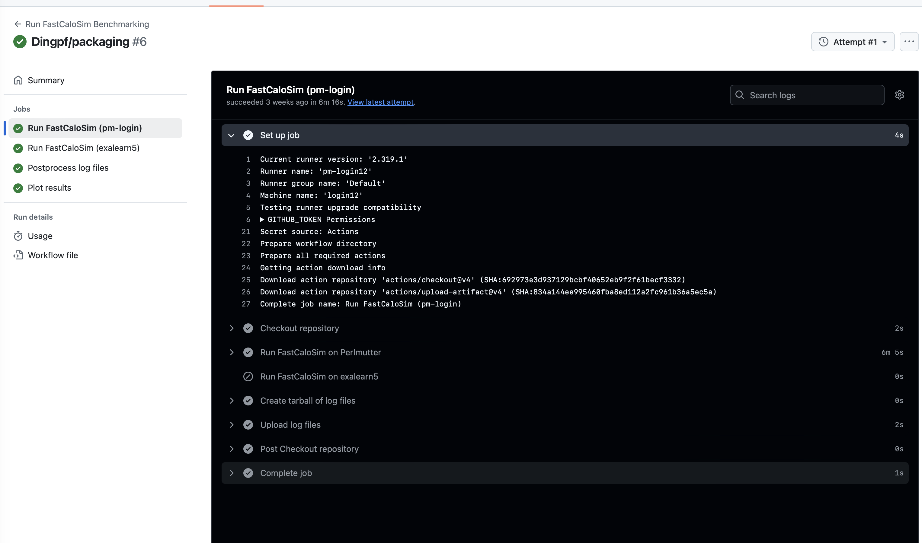
GitHub Action triggered workflow runs

Slide 10
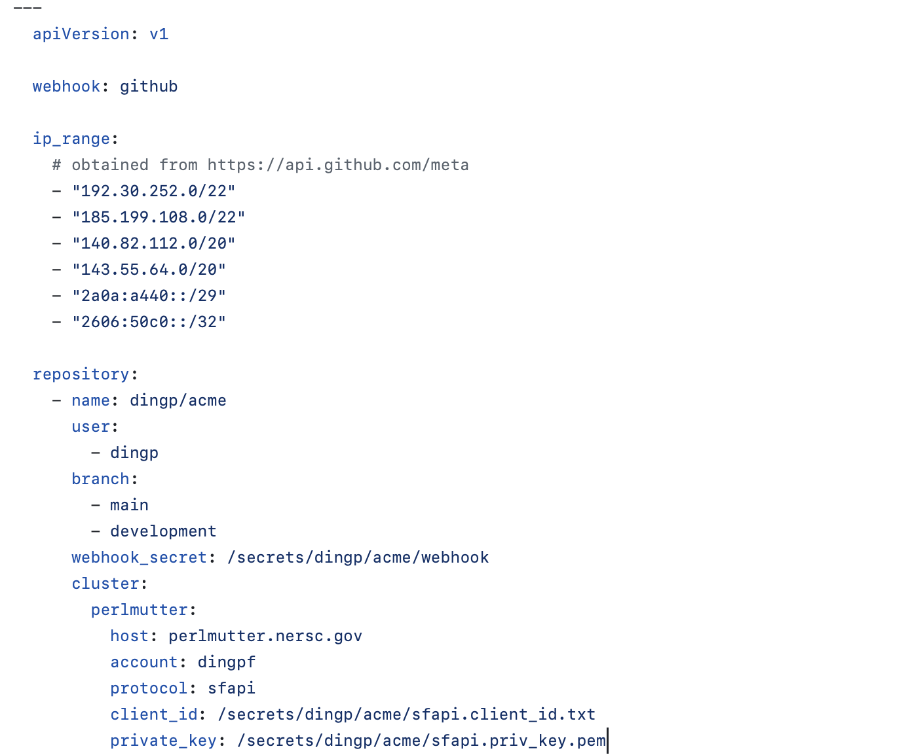
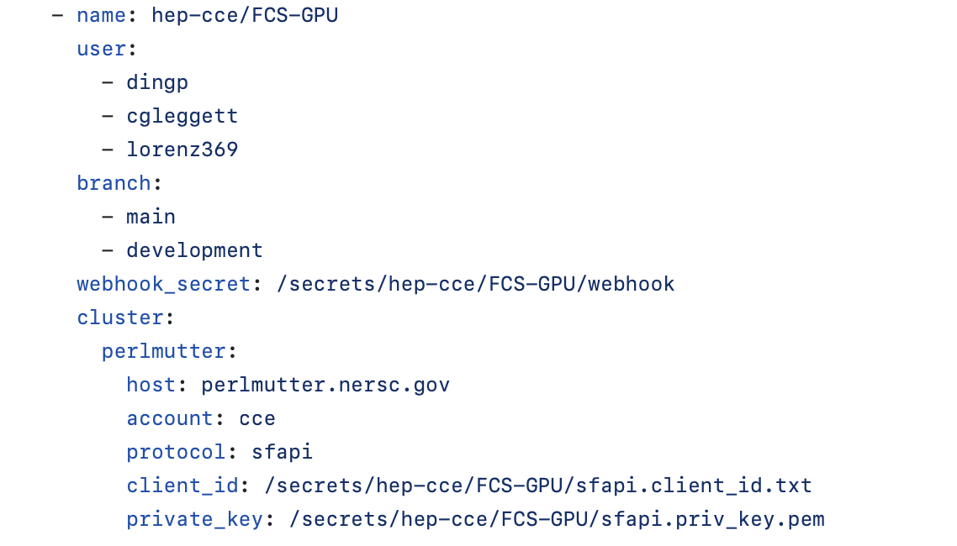
The code - https://github.com/dingp/ciapi
admission.yaml
  https://github.com/dingp/ciapi/blob/main/configs/admission.yaml

Slide 11
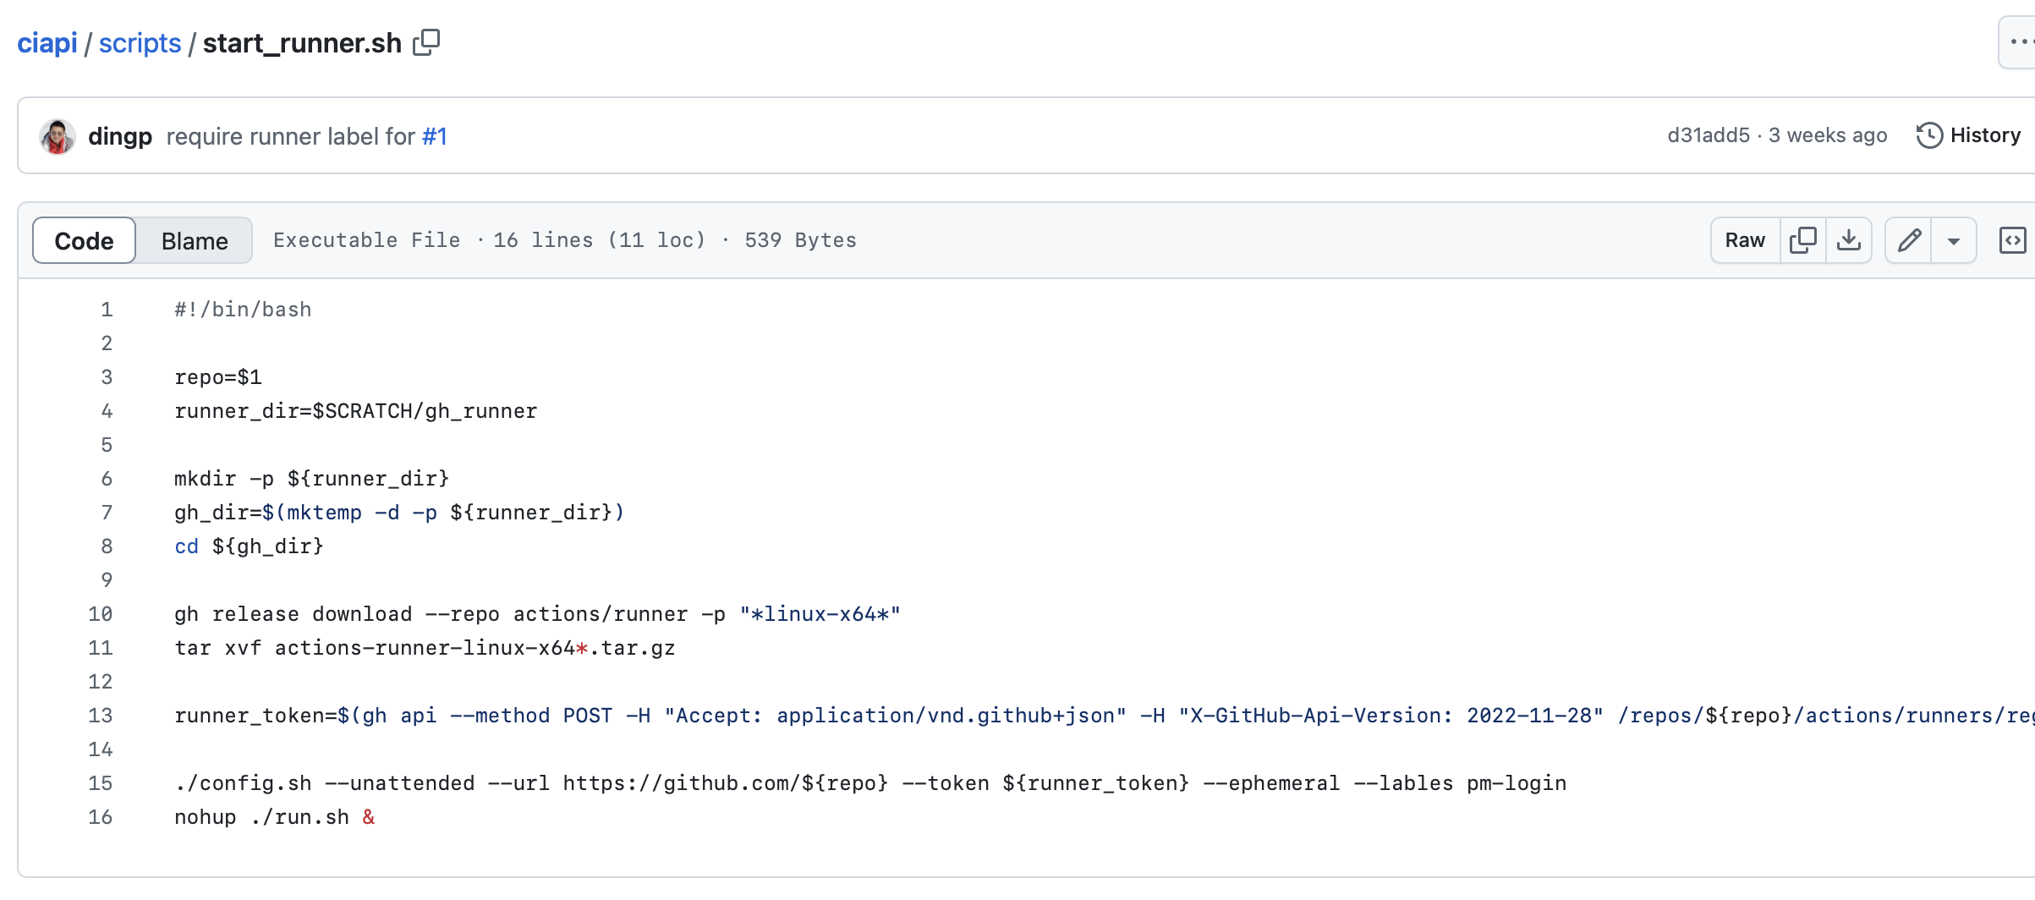
Script to start the ephemeral runner
https://github.com/dingp/ciapi/blob/main/scripts/start_runner.sh

Slide 12
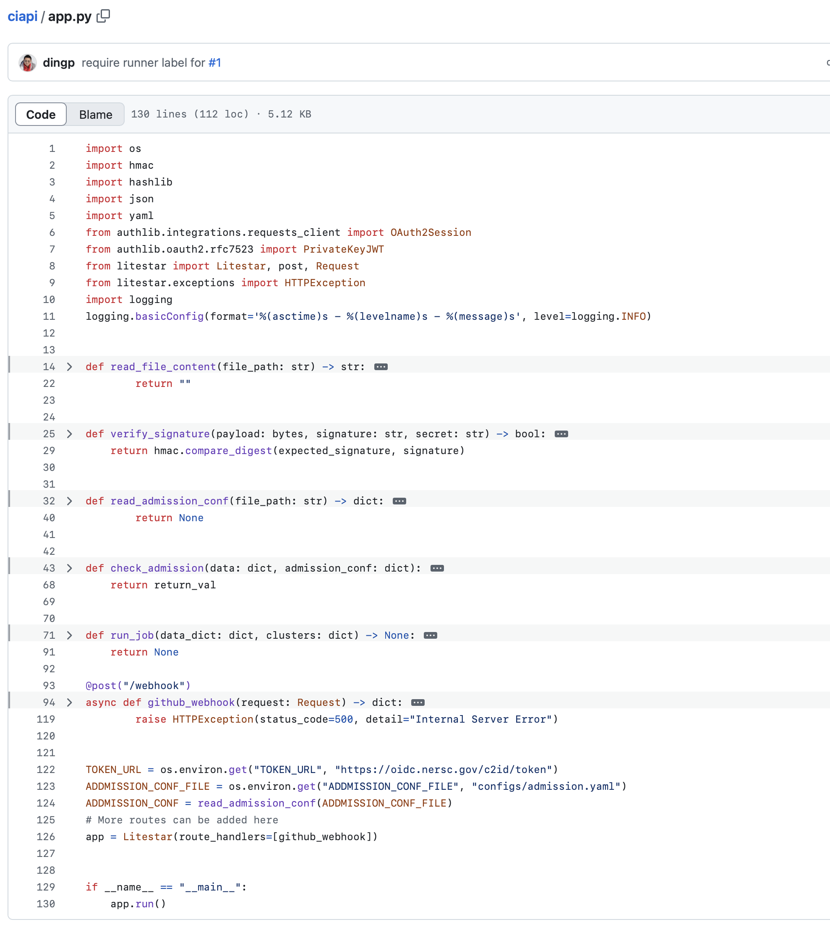
The API server itself
https://github.com/dingp/ciapi/blob/main/app.py
Using “litestar”
130 lines of code

Slide 13
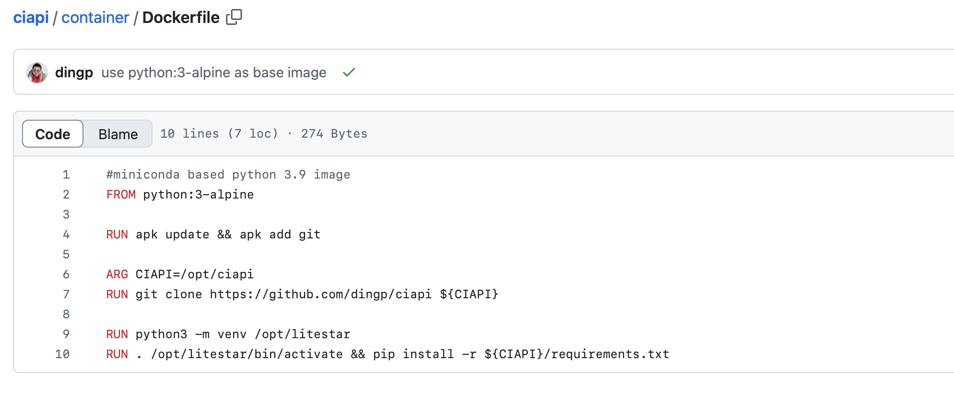
Container image for the API server
https://github.com/dingp/ciapi/blob/main/container/Dockerfile

Slide 14
Helm chart for the API server deployment
To be developed…

Slide 15
Next steps
Pass NERSC’s security review to have extended SF API token;
Helm-chart for deployment;
Support GitLab and other CI tools.

Slide 16
Backup

