Slide 1

DPPS Interfaces and Calibration Pipeline status and plans
Mykhailo Dalchenko on behalf of UniGE/DPNC DPPS group
CTAO-CH Collaboration Meeting, 08/10/2024

Slide 2
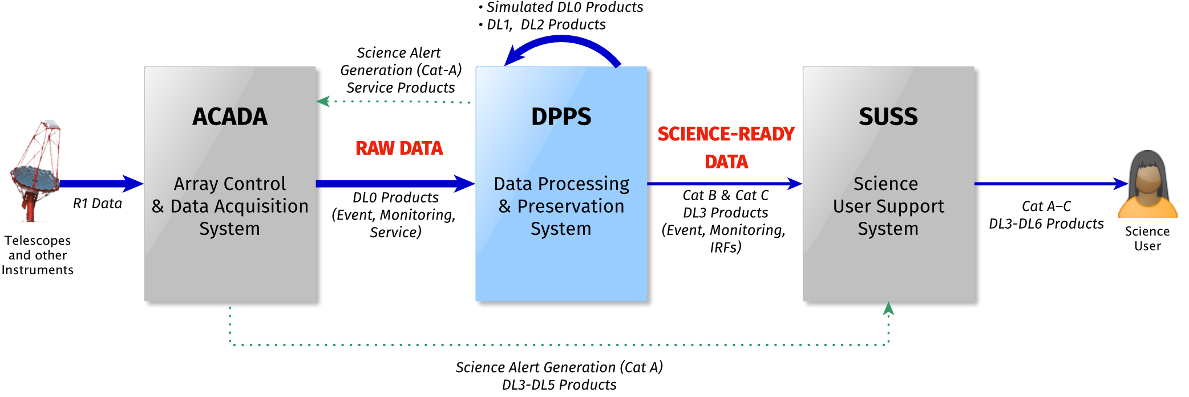
DPPS within the CTAO

Slide 3
DPPS within the CTAO

Slide 4
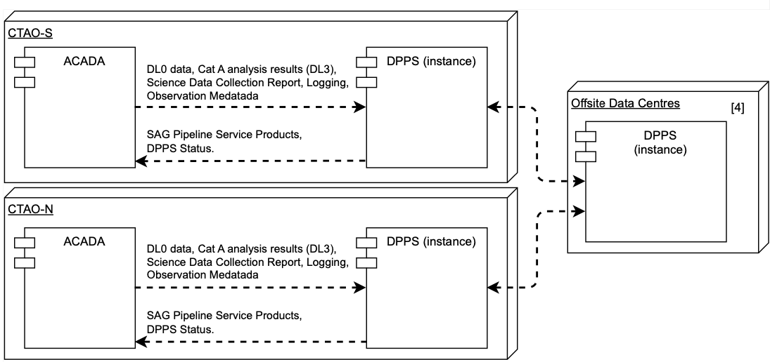
ACADA-DPPS interface (repository)
Data exchange happens in the Onsite ICT

Slide 5
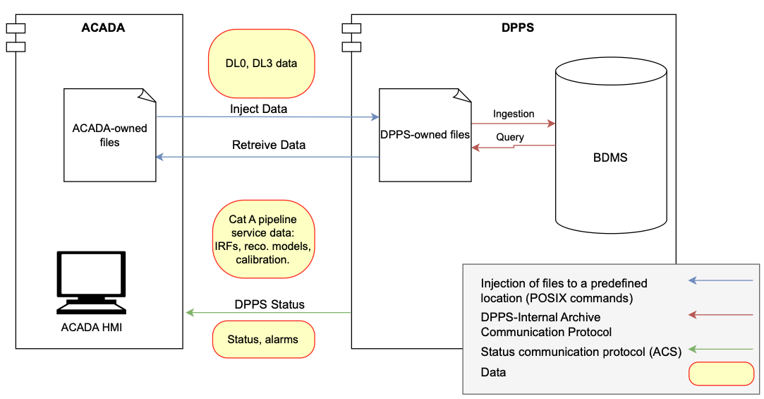
ACADA-DPPS interface (repository)
Data exchange happens in the Onsite ICT
Transaction types:
  File exchange
    POSIX
  Status messages
    ACS

Slide 6
DPPS context view

Slide 7
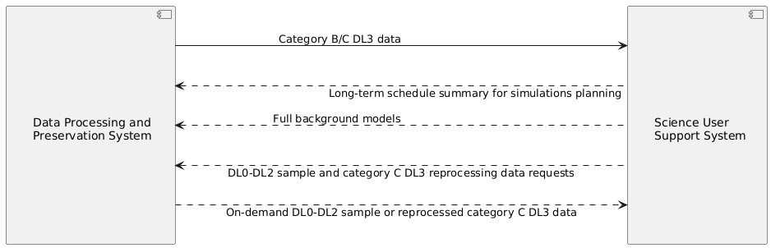
DPPS-SUSS interface (repository)
File and messages exchange
Data rate: O(1GB)/day
  Use CERN’s FTS
Message exchange protocol:
  HTTP (ReST API)
regular interactions
on-demand interactions

Slide 8
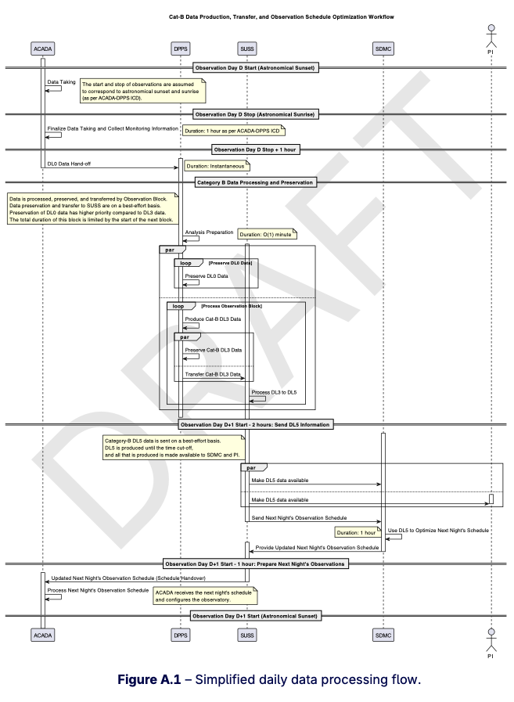
DPPS-SUSS interface (repository)
Design flow:
  Start with the overall scenario

Slide 9
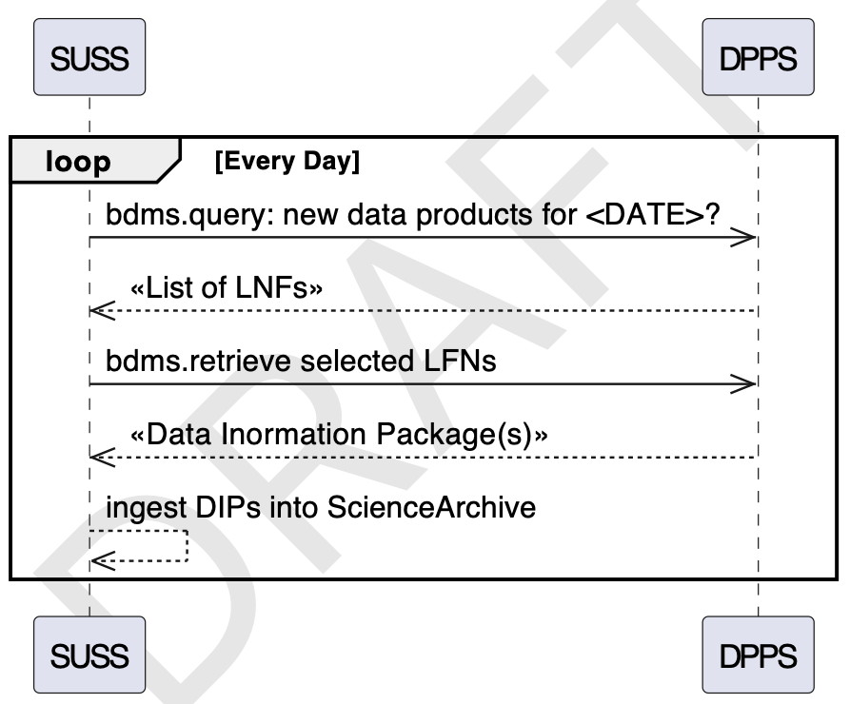
DPPS-SUSS interface (repository)
Design flow:
  Start with the overall scenario
  Detail the interaction

Slide 10
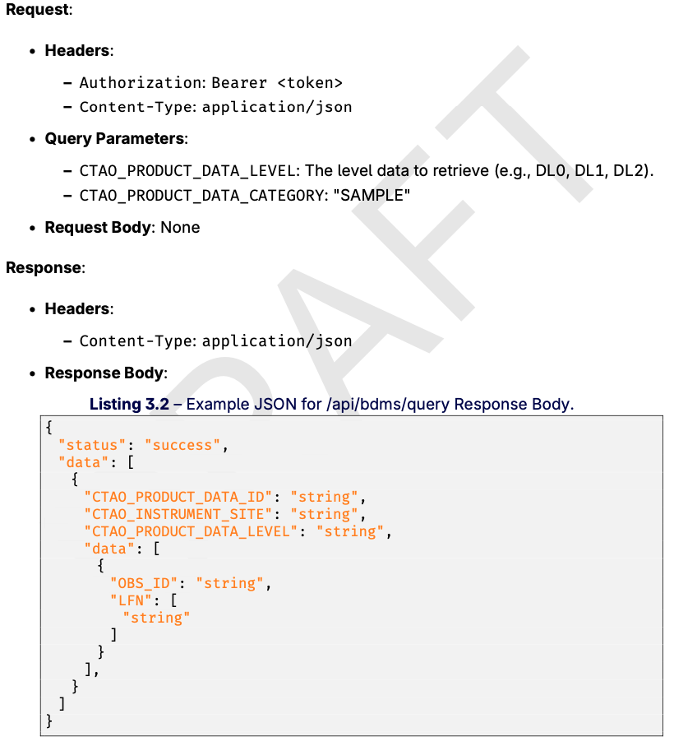
DPPS-SUSS interface (repository)
Design flow:
  Start with the overall scenario
  Detail the interaction
  Design the API specification

Slide 11
DPPS context view

Slide 12
DPPS-SOSS/TOSS/AAI interfaces
Preliminary discussions started
  Establishing precise product definition
    Required to identify the exact borders between the systems
  Priority list:
    SOSS
    TOSS
    AAI

Slide 13
DPPS context view

Slide 14
DPPS-ECDS (honorable mention)

Slide 15
DPPS-ECDS (honorable mention)
Use two meteorological data assimilation systems
  GDAS: low latency (3h), low accuracy, for Cat. B data processing
    Self-maintained python client (fork of RDA client)
  ECMWF: high latency (5d), high accuracy, for Cat. C data processing
    ECMWF-provided climate data store API client
API description will be provided in lieu of ICD

Slide 16
DPPS context view

Slide 17
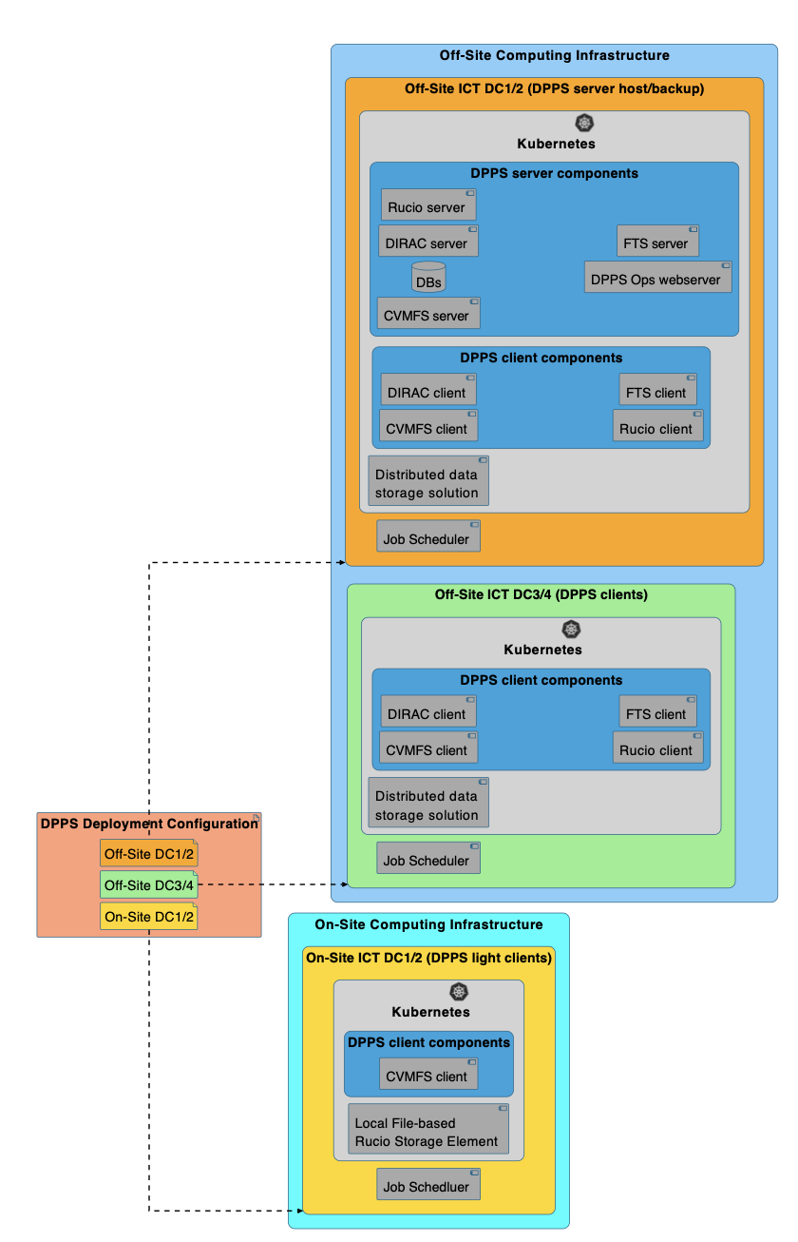
DPPS-ICT interface (repository)
Draft deployment diagram
  Introduce DevOps
Need to agree on provided services and resources
  K8s, DBs, ARC, etc.

Slide 18
External interfaces summary
Minimal deliverables
  ACADA-DPPS: ver. 1a already released!
  DPPS-SUSS: draft (WIP)
  DPPS-ICT: draft (WIP)
  DPPS-ECDS: API documentation
Next steps
  SOSS/TOSS
  AAI
  UI

Slide 19
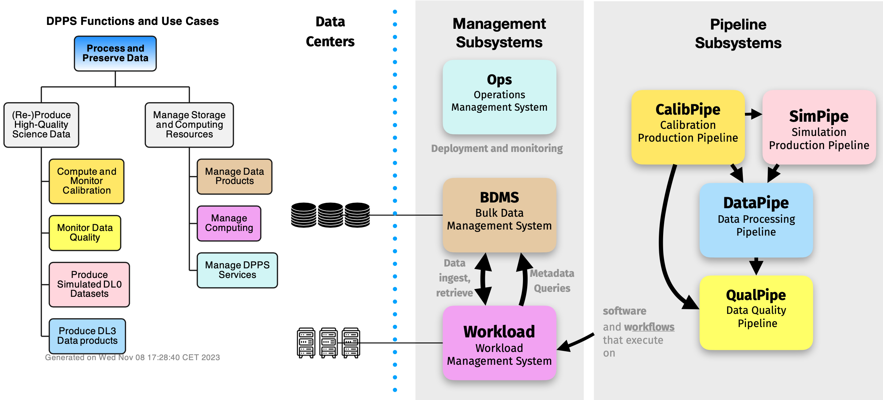
DPPS functional decomposition

Slide 20
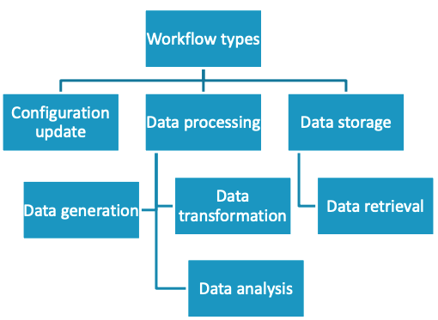

DPPS Workload-Pipeline interface
A workflow is a minimal independent action which ingests configuration and input data and outputs transformed data and/or new system state

Slide 21
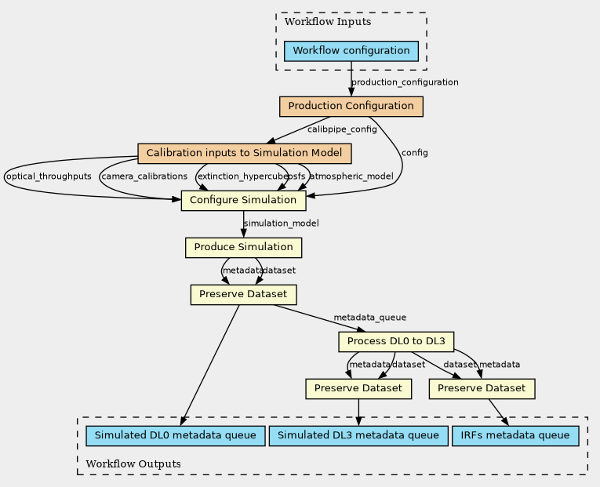
DPPS workflow example
Common Workflow Language (CWL)
  Open standard for workflow descriptions
  Partially supported by CTADIRAC
    Porting to vanilla DIRAC is
    in progress
Workflows can be nested

Slide 22
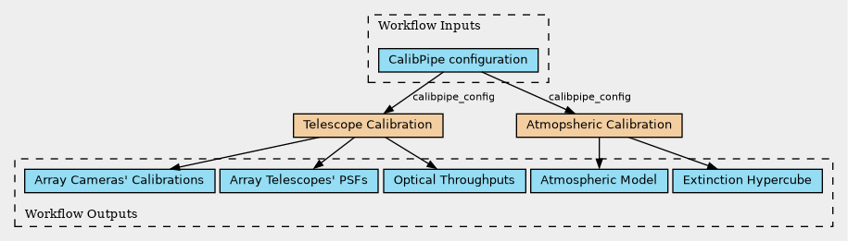
DPPS workflow example
Common Workflow Language (CWL)
  Open standard for workflow descriptions
  Partially supported by CTADIRAC
    Porting to vanilla DIRAC is
    in progress
Workflows can be nested

Slide 23
DPPS workflow example
Common Workflow Language (CWL)
  Open standard for workflow descriptions
  Partially supported by CTADIRAC
    Porting to vanilla DIRAC is
    in progress
Workflows can be nested
Need to define (meta)data models
  Schema verification can be implemented in CWL

Slide 24
Internal interfaces summary
Generic Workload-Pipelines ICD draft is ready
Define the set of workflows and data models for Rel. 0.1
  And subsequently for Rel. 1
Prepare schemas for metadata and data
  Follow the prescriptions from the Top-level Data Model doc
Compose ICDs as collections of
  Workflows (interface use scenarios)
  (Meta)data schemas
  Agreed data formats

Slide 25
DPPS functional decomposition

Slide 26
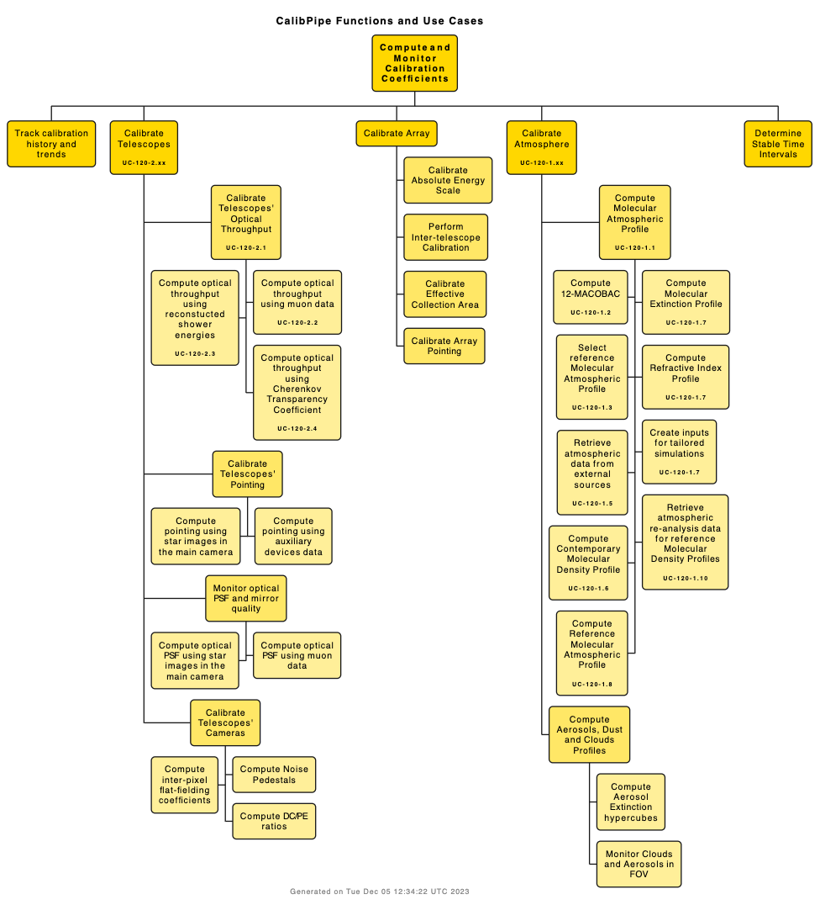
Calibration Pipeline functional view
Main functions:
  Compute instrument and atmospheric calibration coefficients
  Determine the selection of IRFs
  Derive specific parts of the simulation model tailored to observations

Slide 27
Calibration Pipeline Status in Dec. 2023
The Calibration Pipeline is ready for DPPS Rel.0
Towards Rel.0.1:
  All functional code is ready
  Atmospheric Data Models are ready
  Integration with WMS is ready
Towards Rel.1:
  Aerosol atmosphere calibration suite
    Prototype code can analyze FRAM data and produce clouds
  Optical throughput with muon rings
    Double-mirror support and realistic shadowing to be added
  Telescope pointing and PSF monitoring
    Porting star tracking code
  Cherenkov Camera calibration suite
    Data model design and code integration

Slide 28
DPPS Rel.0.1 (integration) status
Use Cases documentation: done
Relevant functionality implementation: done
Data Models and DB integration: done
Workflows for integration with WMS: done
CI/CD automation:
  Prototype CI/CD done
  Adjustment to the AIV prescription in progress

Slide 29
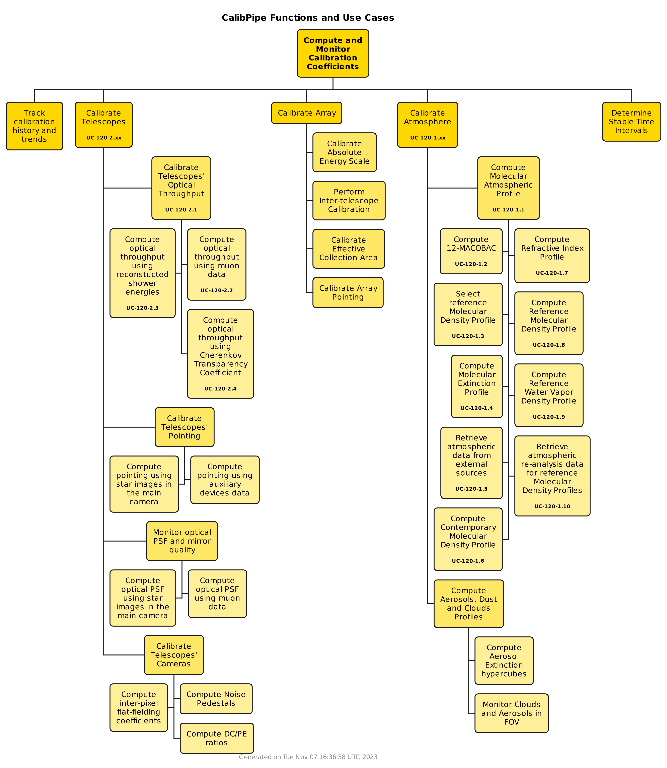
Towards DPPS Rel.1
Rel.0.1
Rel.1
Fast atmospheric component
  FRAM and LIDAR data analysis
Optical Throughput calculation
  Muon reconstruction
  Inter- and cross-calibration
Telescope pointing and PSF
  Star tracking and AUX devices
Cherenkov camera calibration
  Pedestal, FF, DC/p.e., timing

Slide 30
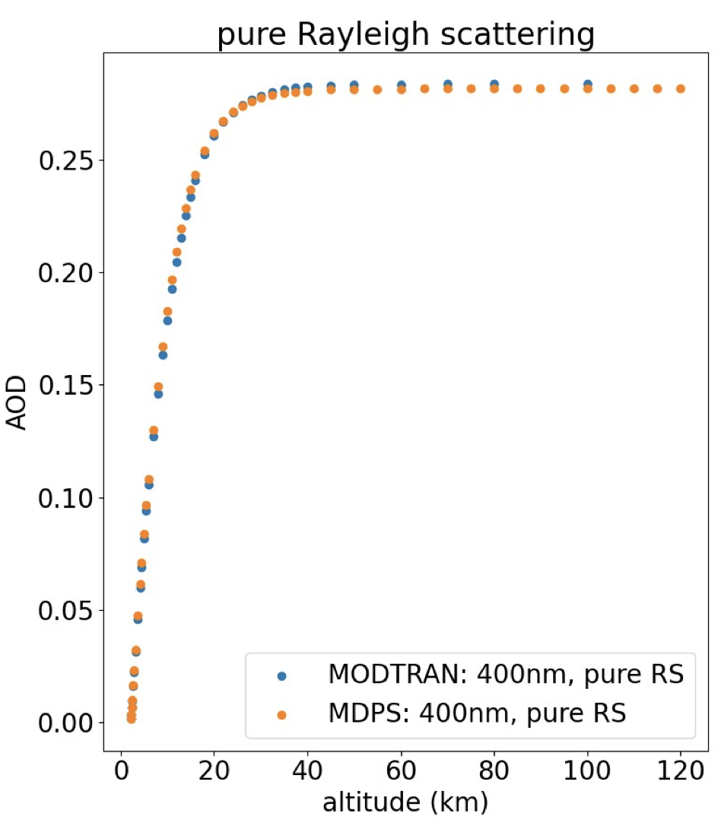
Towards DPPS Rel.1
Fast atmospheric component
  FRAM and LIDAR data analysis
Development status
  Use Cases: ready (drafts)
  Inputs – test FRAM and LIDAR data + climatological historical data: in progress
    Effect on array performance under the study
  Product (extinction hypercube): in progress
    extinction hypercubes prototyped
    cloud models prototyped
    fast/slow components separation studies ongoing
  Integration with Calibration DB: in progress
  Integration with SimPipe and DataPipe: todo
G. Voutsinas

Slide 31
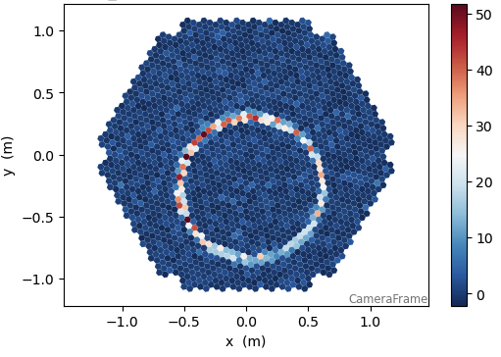
Towards DPPS Rel.1
Optical Throughput calculation
  Muon reconstruction and CTC
V. Voitsekhovskyi
Development status
  Use Cases: ready (drafts)
  Muon reconstruction code: in progress
    Complete for single-mirror telescopes
  Alternative algorithms: in progress
    Inter- and cross-calibrations
      with G. Voutsinas
  Integration with Calibration DB: ready
    Reference metadata has been implemented
  Integration with SimPipe: todo
Example of muon ring in LST

Slide 32
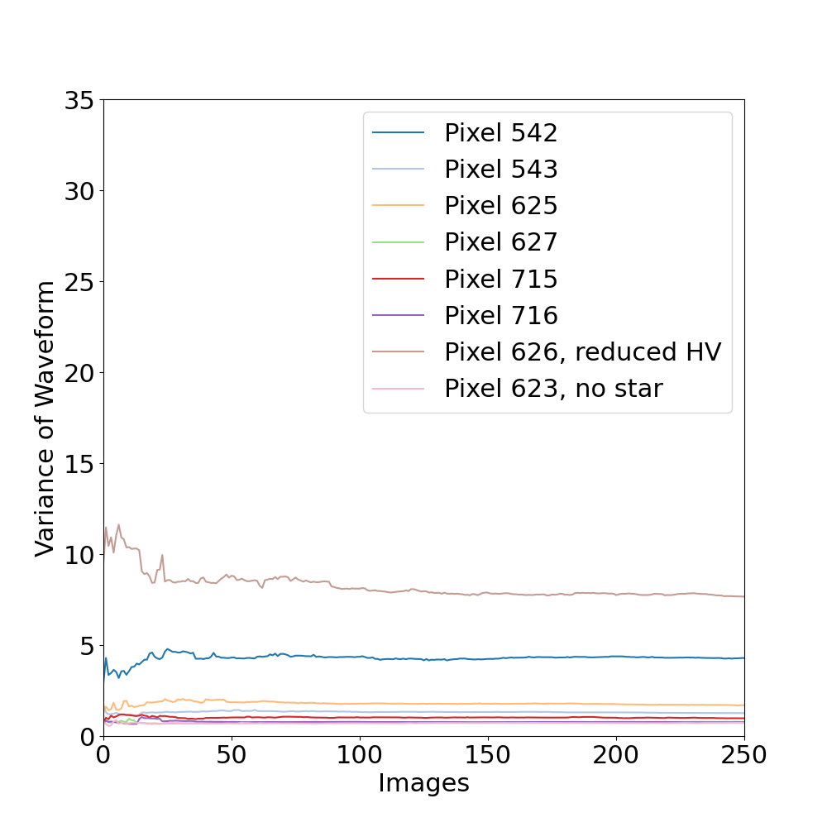
Towards DPPS Rel.1
Telescope pointing and PSF
  Star tracking and AUX devices
Development status
  Use Cases: in progress
  Star tracking code: in progress (50%)
    Interleaved calibration is implemented
      pixels with reduced HV are recovered
    Variance extraction from pedestal events implemented
    Star trajectory fitting is implemented
  AUX devices integration: in progress
  Integration with Calibration DB: todo
  Integration with SimPipe: todo
  Integration with DataPipe: in progress
C. Toennis

Slide 33
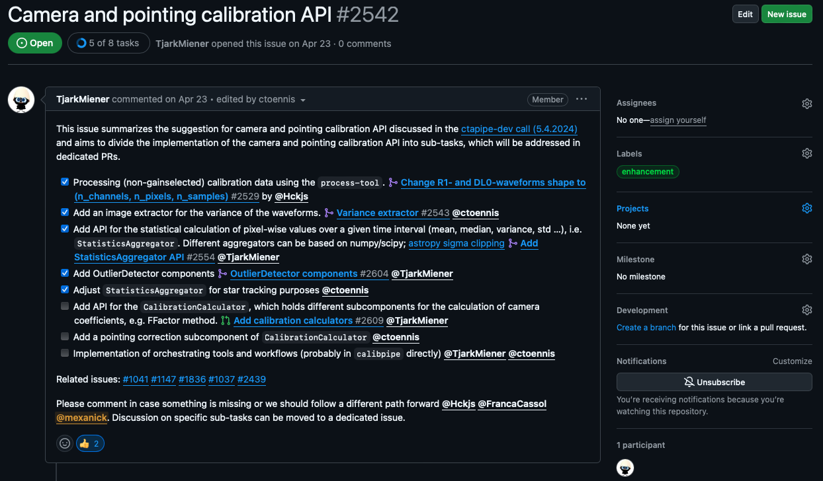
Towards DPPS Rel.1
Cherenkov camera calibration
  Pedestal, FF, DC/p.e., timing
Development status
  Use Cases: ready
  Calibration code: in progress (75% done)
    Restructure the code to optimize the processing
    Implemented new API to aggregate the statistics of the calibration events
      Used to detect outliers and extract the calibration coefficients
      Can be applied to any kind of monitoring data (e.g. for DQM)
  Calibration data model: in progress (almost ready)
  Integration with Calibration DB: todo
  Integration with SimPipe: todo
  Integration with DataPipe: in progress
T. Miener

Slide 34
Calibration Pipeline Summary
DPPS Rel.0: ready
Towards Rel.0.1:
  All functional code is ready
  Documentation and examples are ready
  Atmospheric Data Models are ready
  Integration with WMS is ready
  Release AIV automation is in progress
    Prototype CI/CD is ready
    Wait for final instructions from the DPPS AIV team to finalize the integration
Towards Rel.1:
  Reference metadata implemented
  Aerosol atmosphere calibration suite: in progress (25%)
    Prototype code can analyze FRAM data and produce clouds
    A lot of studies related to uncertainties propagation have been performed
    Code validation vs MODTRAN ongoing
  Optical throughput with muon rings: in progress (75%)
    First functionality that fully includes metadata and a complete interface to the DB
    Double-mirror support and realistic shadowing are to be added
  Telescope inter- and cross-calibrations: in progress (10%)
    Working on the draft implementation
  Telescope pointing and PSF monitoring with stars: in progress (50%)
    Porting star tracking code ongoing
    Variance extraction from the pedestal events and pixel re-calibration is implemented
  PSF monitoring with muon rings: in progress (5%)
    Gathering algorithms and overall concept
  Cherenkov Camera calibration suite: in progress (75%)
    Core code implementation is ready

Slide 35
Calibration Pipeline Plans
CalibPipe WBS Item | 2025 | 2026 | 2027 | 2028 | Total
Calibration Pipeline System Coordination | 0.25 | 0.25 | 0.25 | 0.25 | 1
Produce Calibration Framework and Associated Libraries | 0.5 | 0.5 | 0 | 0 | 1
Produce Data Calibration Algorithms and Tools | 0.5 | 0.5 | 0.25 | 0.25 | 1.5
Produce Data Calibration Workflows and Configurations | 0.25 | 0.25 | 0.25 | 0.25 | 1
Produce the Data Calibration Pipeline Validation Reports | 0.25 | 0.25 | 0.25 | 0.25 | 1
Produce Calibration Database Structure | 0.25 | 0.25 | 0 | 0 | 0.5
Calibration History and Trends Tracker & Stable Time Interval Finder (0.5 FTE)
Aerosol and Clouds Calibration (0.5 FTE)
Optical Throughput Calibration Secondary Algorithms (0.75 FTE)
PSF and Mirror Quality Monitoring Tools (0.5 FTE)
Telescope Pointing Calibration Finalization (0.25 FTE)
MST and SST Camera Calibration Integration (0.5 FTE)
Telescope Inter- and Cross-calibrations (0.5 FTE)
Remaining Array Calibration Algorithms (0.5 FTE)
Coordination & Delivery Preparation (2 FTE)

Slide 36
BACKUP

Slide 37
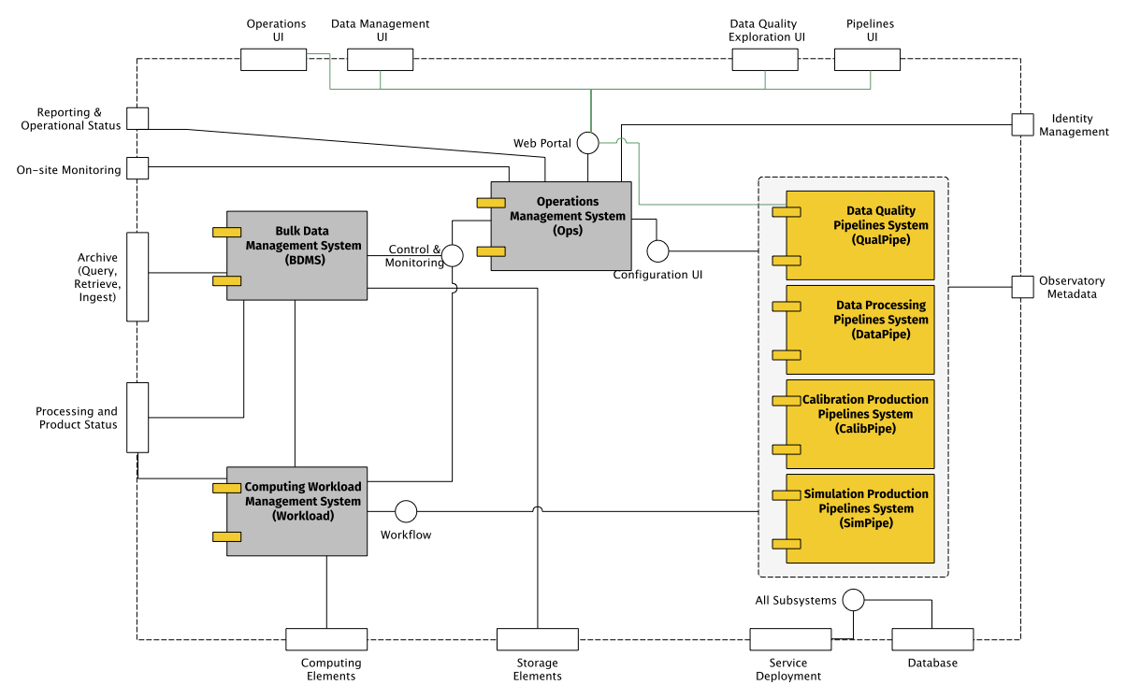
DPPS logical view

Slide 38
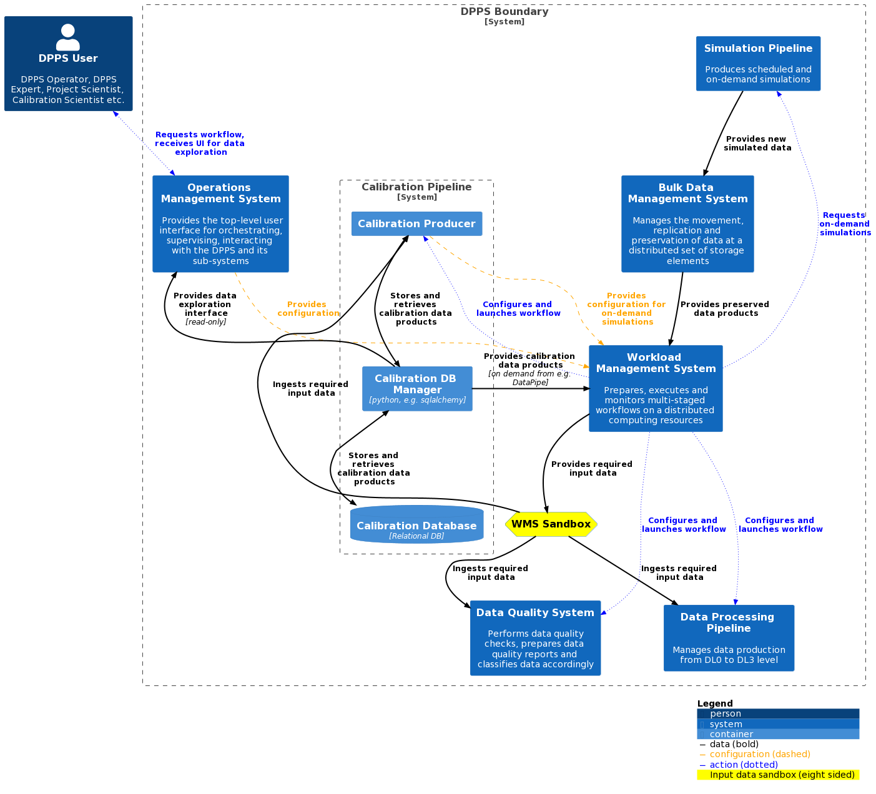
DPPS Calibration Pipeline

Slide 40
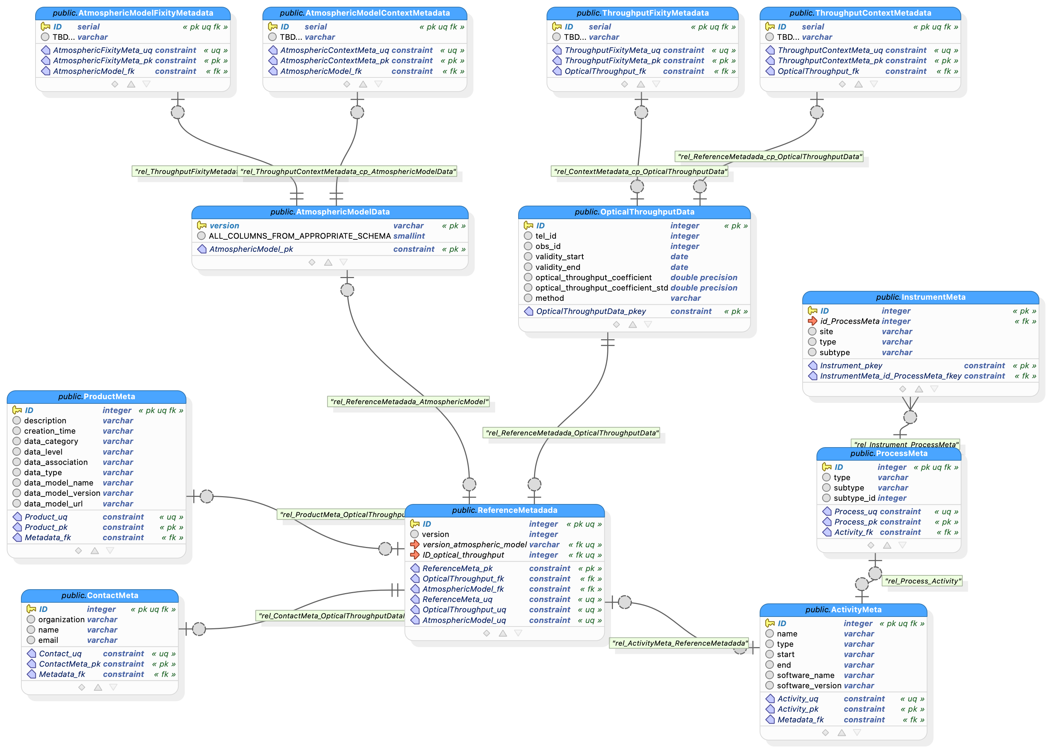

Slide 41
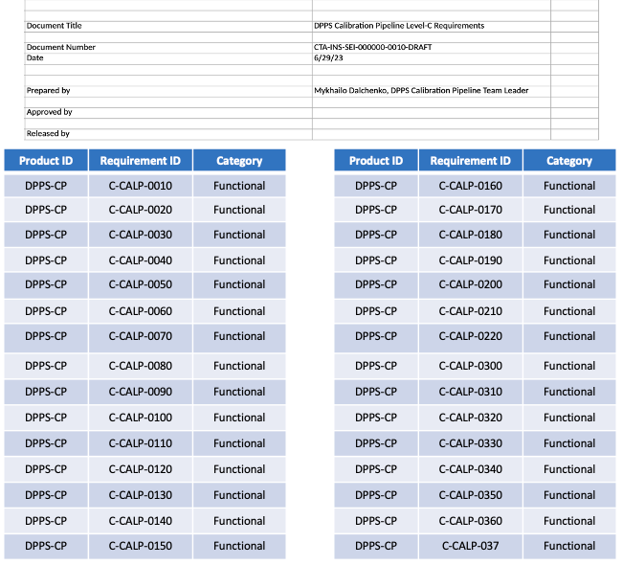
DPPS Rel.0 (documentation) status
Product definition is ready
Selected Use Cases are ready
Relevant level-C requirements are derived
All documents converted to CTAO templates and ready to be uploaded to JAMA

Slide 42
DPPS Rel.0.1 (integration) status

Slide 43
DPPS Rel.0.1 (integration) status

Slide 44
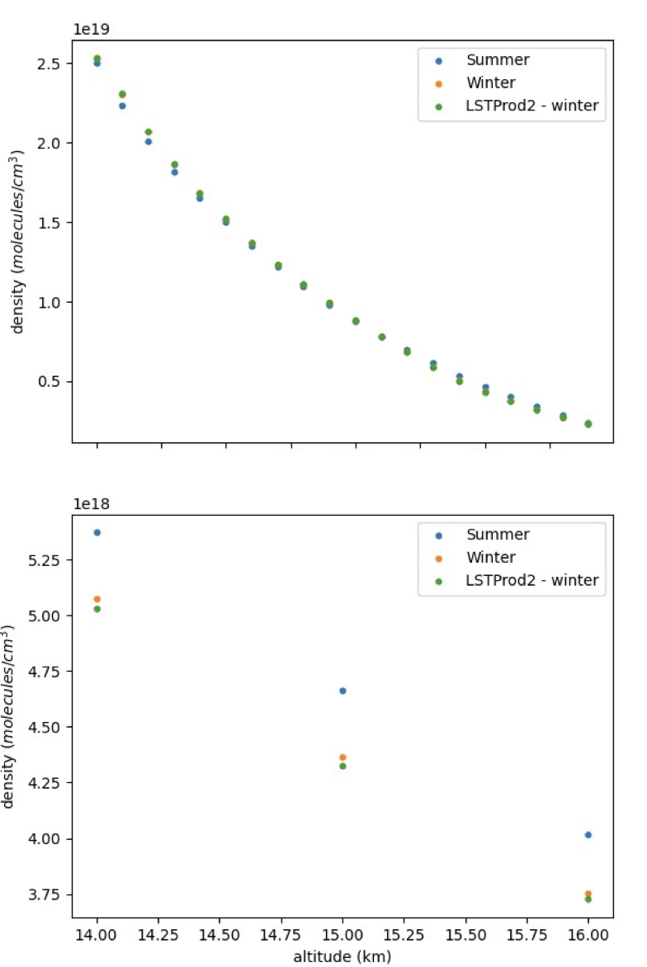
DPPS Rel.0.1 (integration) status
Provide molecular atmosphere calibration
  Implement interfaces to external meteorological data sources
    GDAS, ECMWF, and Keeling Curve
  Implement meteorological data analysis
  Design atmospheric calibration data and metadata models
  Implement Calibration DB
  Implement interfaces to the Workload Management System and Simulation Pipeline

Slide 45
Towards DPPS Rel.1

Slide 46
Towards DPPS Rel.1
Rel.0.1
Rel.1
Fast atmospheric component
  FRAM and LIDAR data analysis
Optical Throughput calculation
  Muon reconstruction and CTC
Telescope pointing and PSF
  Star tracking and AUX devices
Cherenkov camera calibration
  Pedestal, FF, DC/p.e., timing

Slide 47
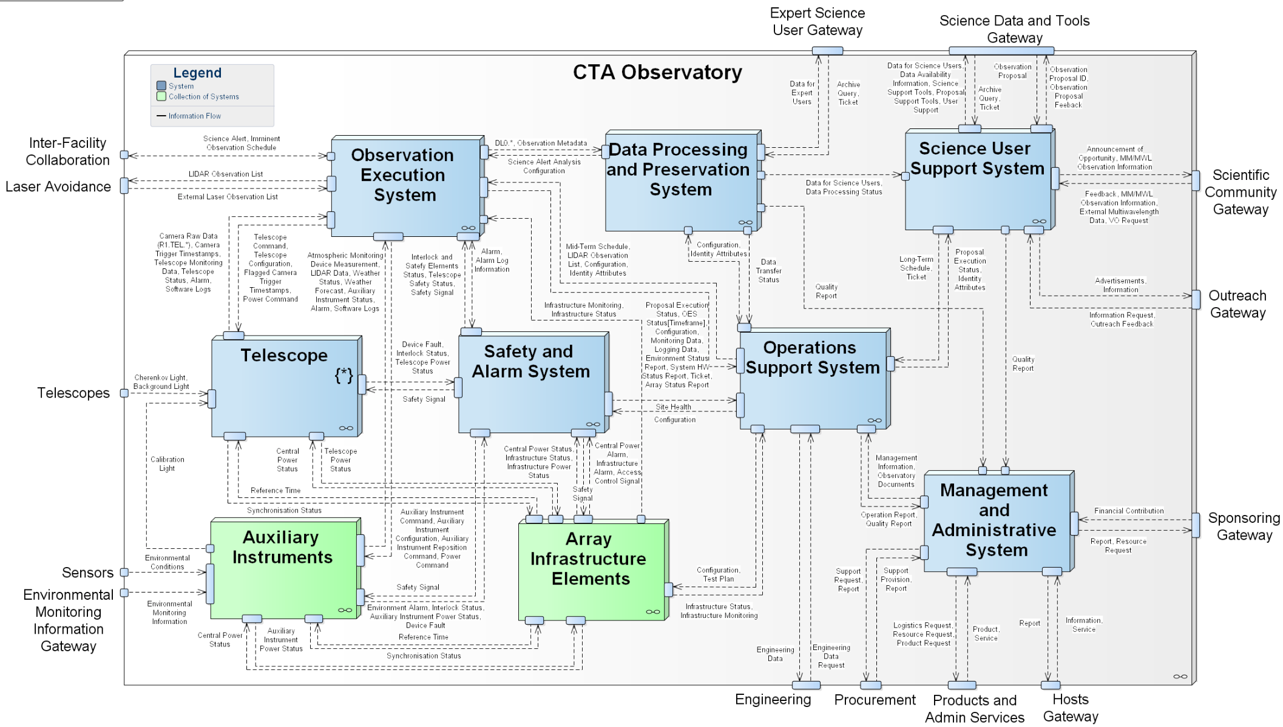
CTAO architecture

Slide 48
CTAO architecture

Slide 49
DPPS context view

Slide 50
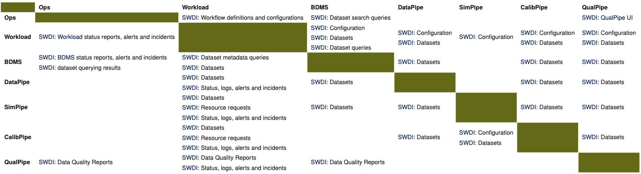
Identified internal interfaces

