Slide 1
Frontend ASIC development for the advanced SiPM camera
Luca Giangrande, Matthieu Heller
FACULTÉ DES SCIENCES
SECTION DPNC

Slide 2
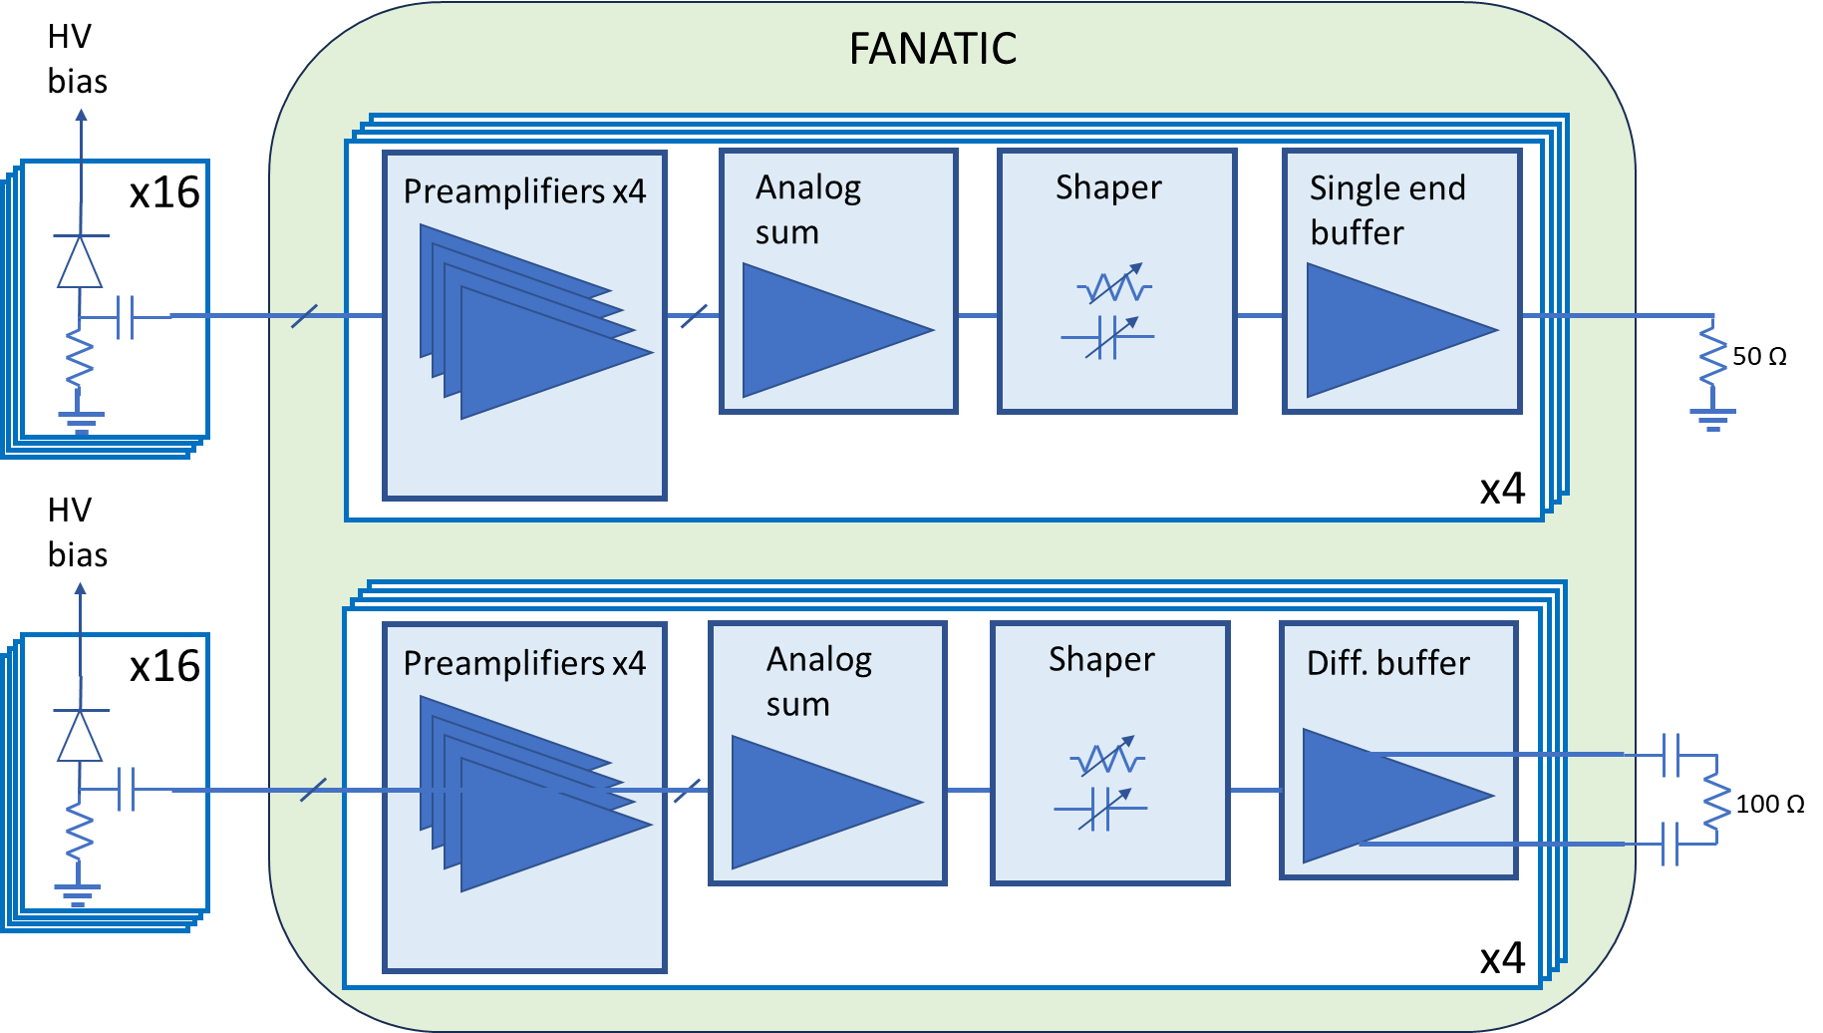
ASIC features
Design requirements:
Linear charge transfer in the range [1:250] photons
SNR ≥ 5
FWHM ≤ 3 ns
Recovery time < 30 ns
Power consumption per pixel < 40 mW
Output load: capacitive ≤ 5 pF plus resistive 50 Ω (impedance matching)
Technology node 65nm CMOS
Test features:
Adjustable channel gain, bandwidth and pulse shape
Multiple test points along the channel
FACULTÉ DES SCIENCES
SECTION DPNC

Slide 3
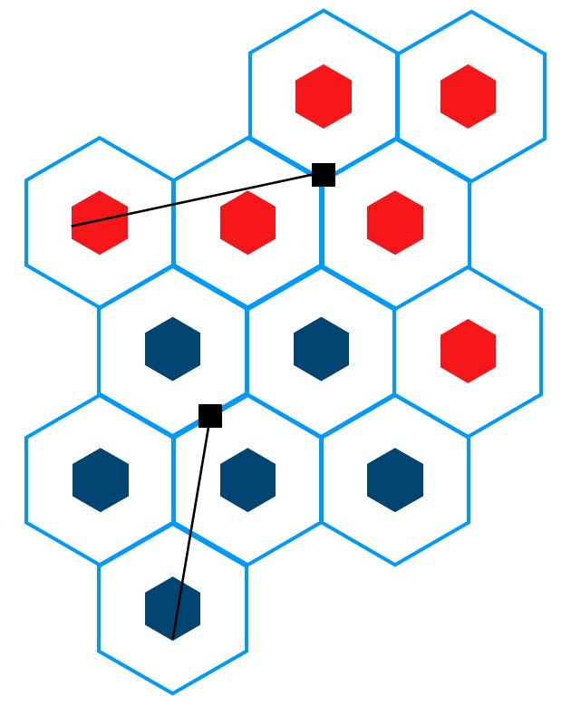
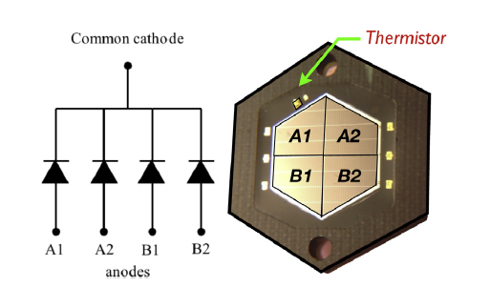

Silicon Photo Multiplier
Pixel
Two modules
Group A
Group B
ASIC
$$9.53mm$$
36.9mm
44.2mm
Hamamatsu LCT5-UVE hexagonal shape with 75x75 μm² micro cell.
Pixel divided into 4 quarters (each with ~4093 μ-cells).
Each quarter is readout by a dedicated pre-amplifier then the 4 signals are actively added together
Pixels organized in modules of 6 (max distance between frontend and sensor of ~ 4.5 cm).
FACULTÉ DES SCIENCES
SECTION DPNC

Slide 4
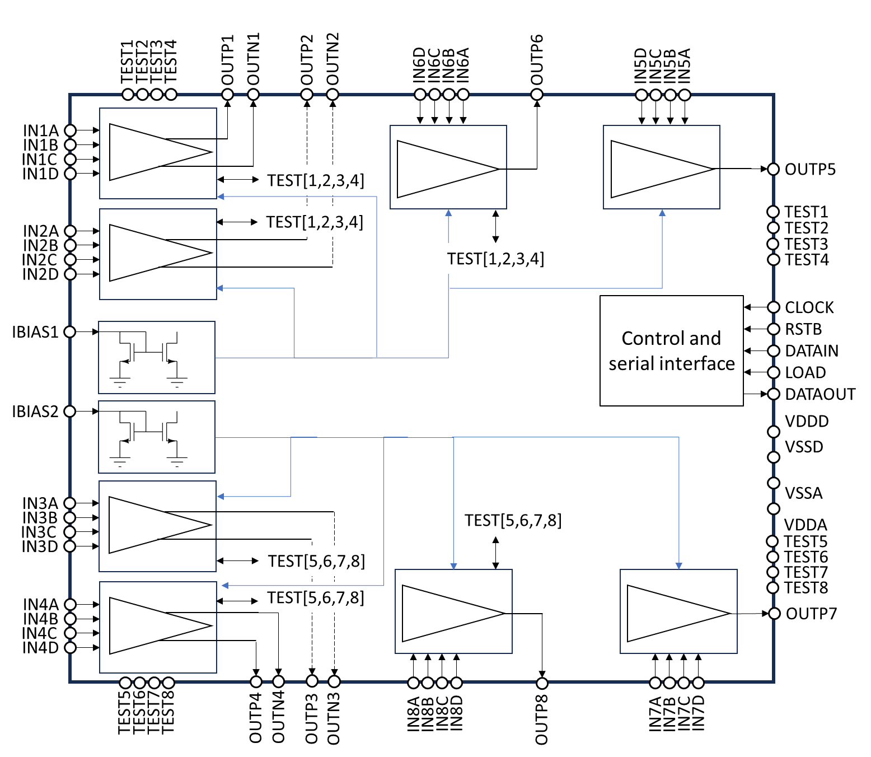
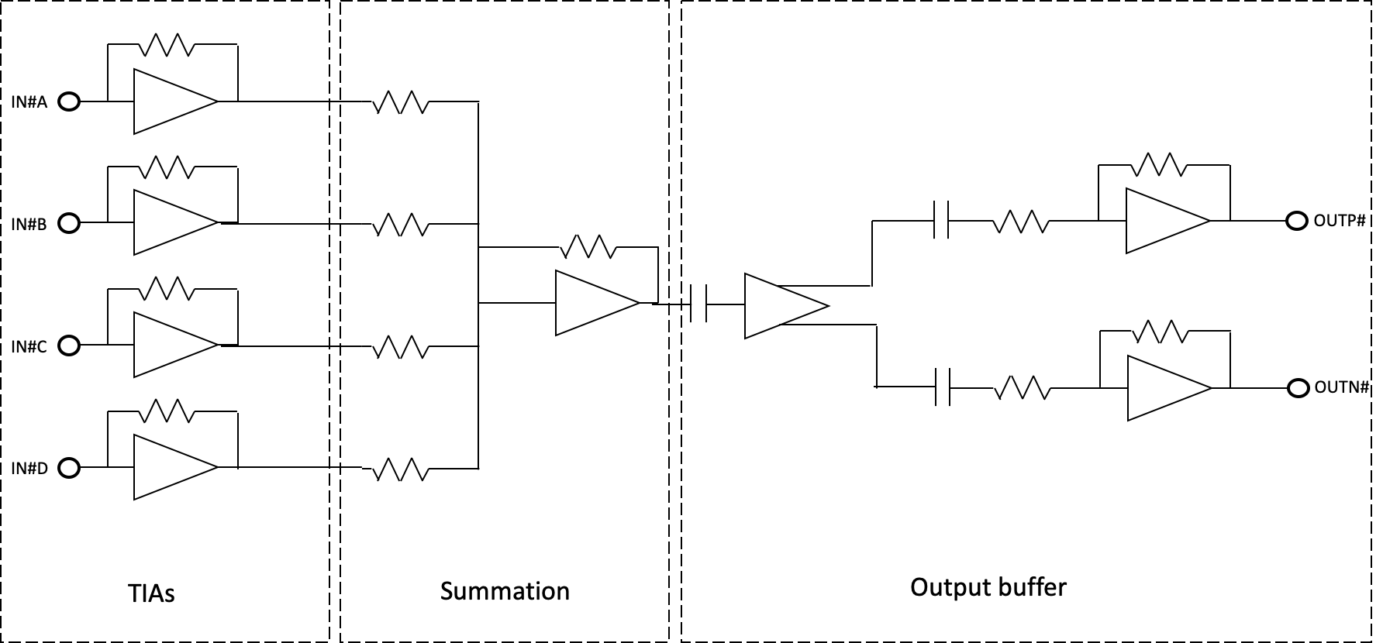
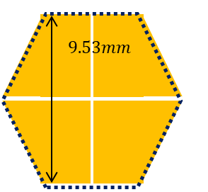
FANATIC architecture
Fast ANAlog Transimpedance amplifier Integrated Circuit:
ASIC readout for 8 pixels:
  4 analog inputs per output channel
  Active summation performed in voltage mode
  1 analog output per pixel: 4 channels with single-ended and 4 channels with pseudo-differential outputs
  Adjustable AC coupling capacitors for output pulse shaping
SiPM
FACULTÉ DES SCIENCES
SECTION DPNC

Slide 5
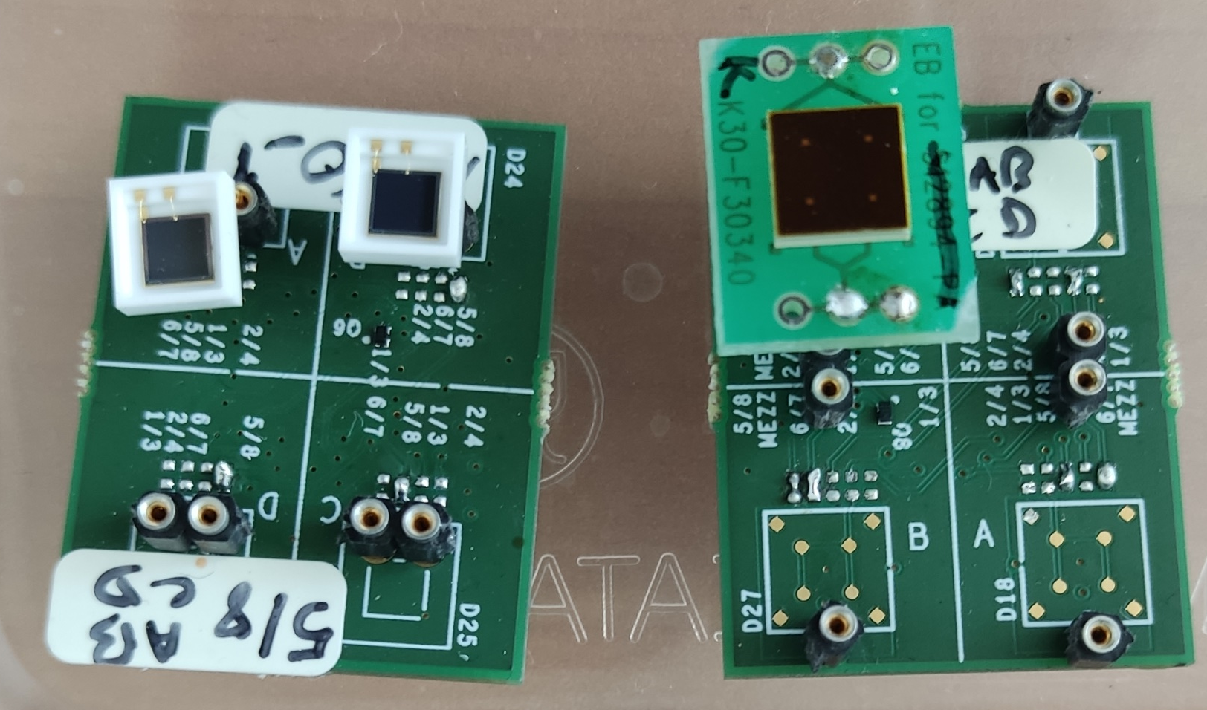
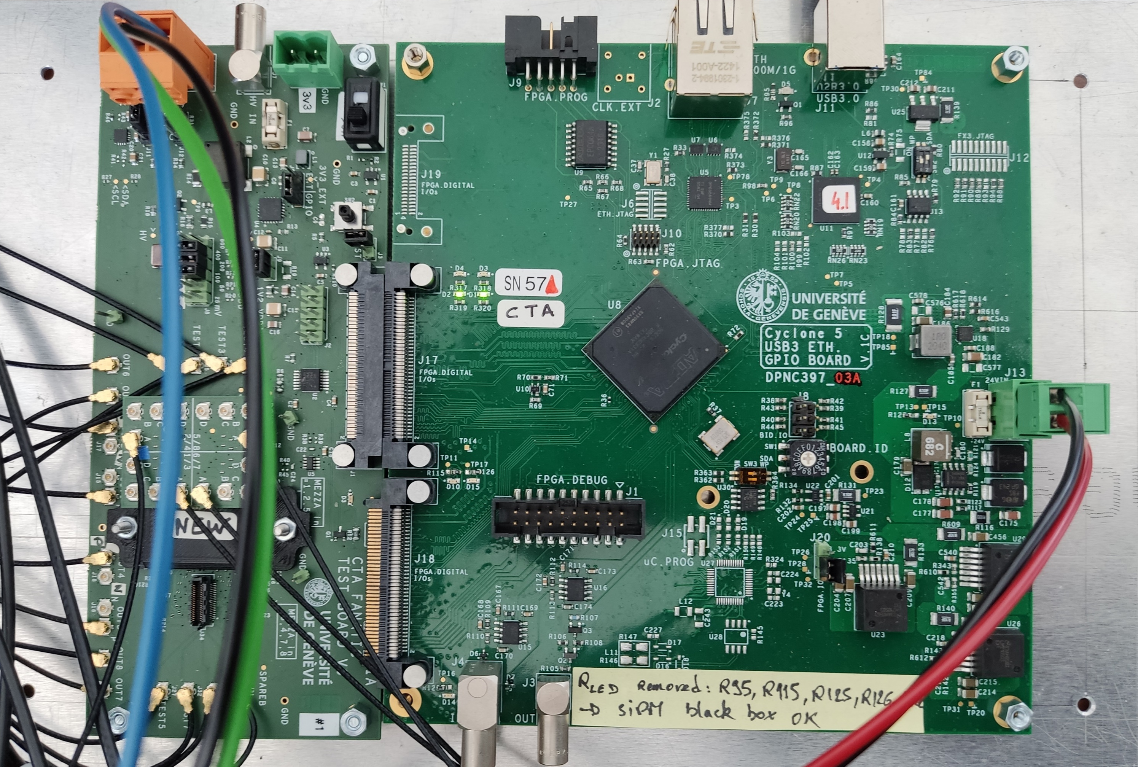
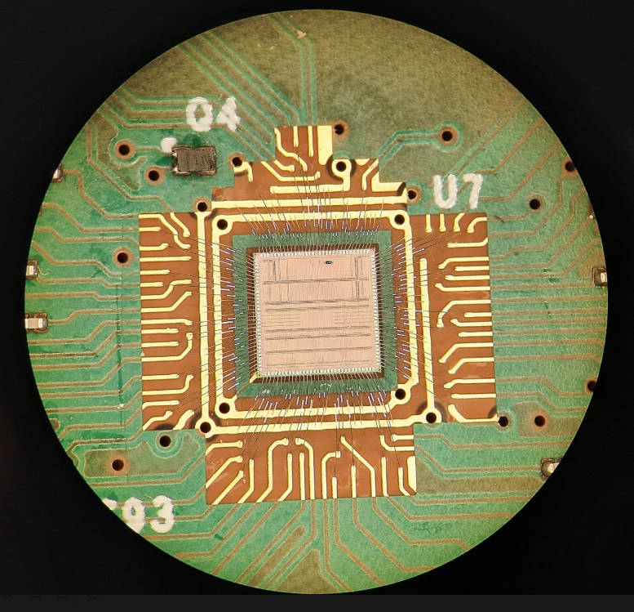
FANATIC SiPM-test PCBs
LCT5 UVE
LVR3
FANATIC PCB
GPIO - FPGA PCB
FACULTÉ DES SCIENCES
SECTION DPNC

Slide 6
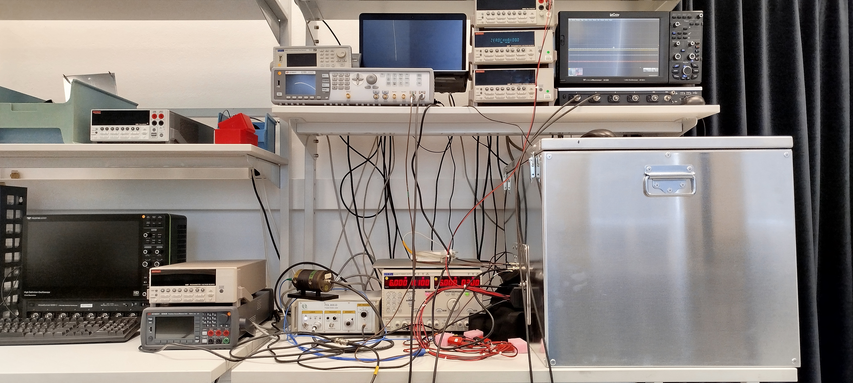
FANATIC Measurement setup
FACULTÉ DES SCIENCES
SECTION DPNC

Slide 7
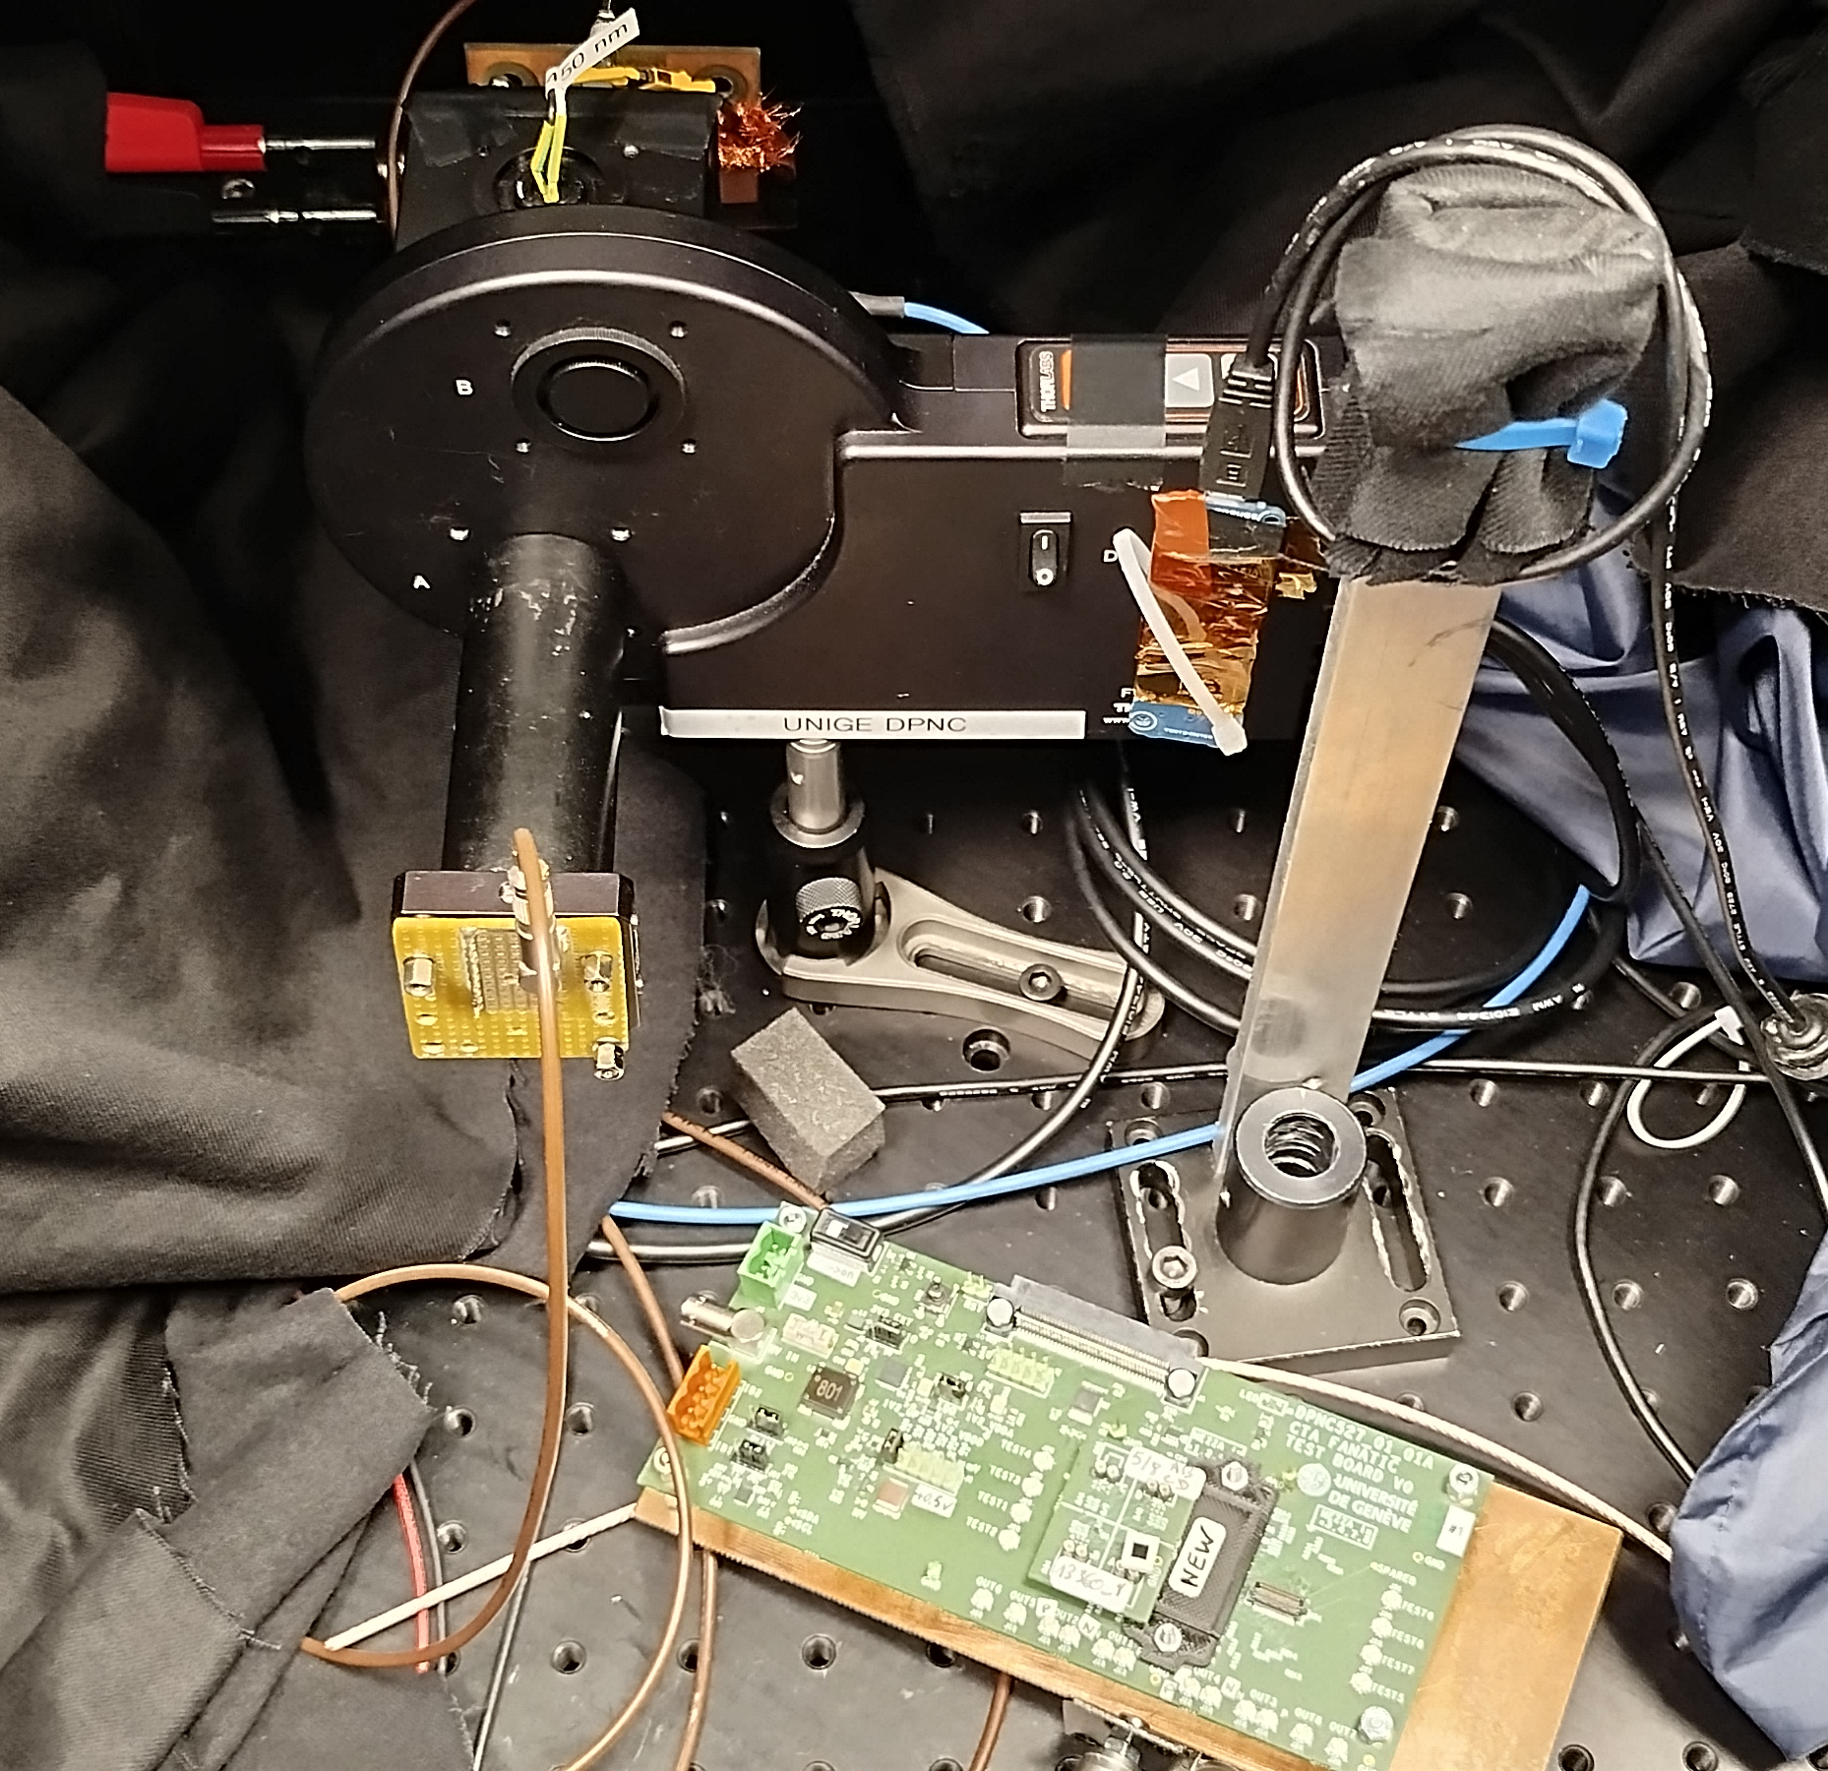
Neutral density filters calibration
Laser source 375 nm: PicoQuant PDL 800-D
Photodiode: Hamamatsu S1337-1010BQ
Motorized filter wheel: Thorlabs FW212C
Neutral density filters: Thorlabs FW212CNEB
Thorlabs integrating sphere
FACULTÉ DES SCIENCES
SECTION DPNC

Slide 8
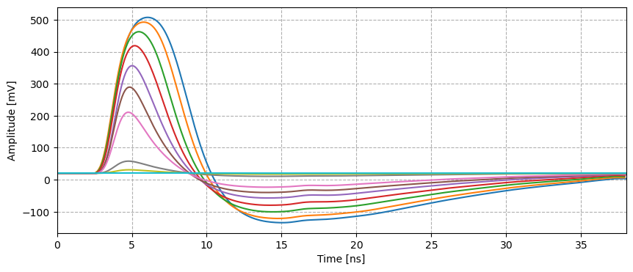
Measured pulse
Averaged pulse with laser source
Peak gain: 2.2 mV/p.e.
Peak to peak gain:
3.14 mV/p.e.
Pulse integral (6 ns) gain: 7.7 V*ns/p.e.
Peaking time: 1.1ns
FWHM: 2.9 ns
Recovery: 30.5 ns
FACULTÉ DES SCIENCES
SECTION DPNC

Slide 9
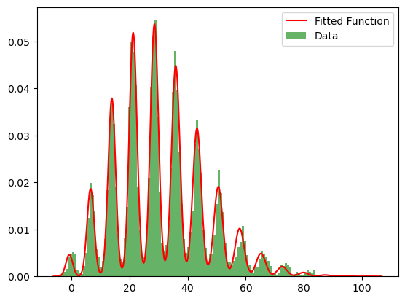
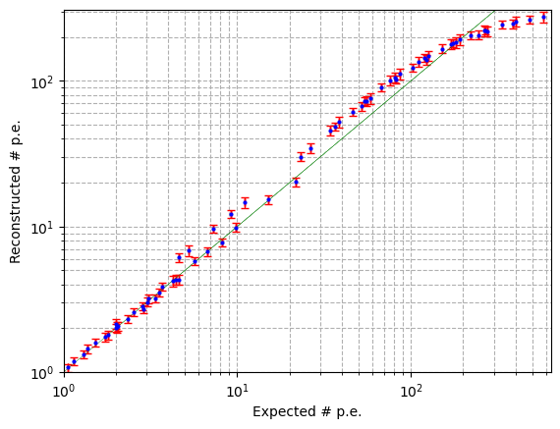
Data Analysis
Low intensity histogram fit with a generalized Poisson distribution function. Pulse integral over a fixed window 6ns. Transfer characteristics from multiple data sets employing different laser intensities.
FACULTÉ DES SCIENCES
SECTION DPNC

Slide 10
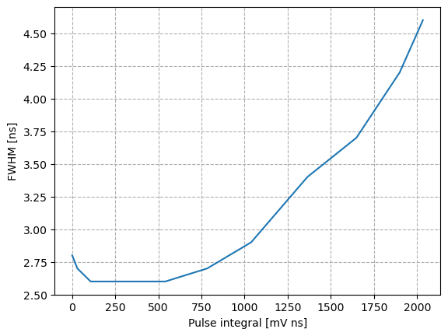
Measurements summary
Single ended channel performance with 3x3 mm² LCT5 UVE and 375nm laser source
Linear characteristic (pulse intergral) up to 200 p.e.
Dynamic range 1000 p.e.
 | Pulse Integral 6ns | Pulse peak | Pulse peak2peak
1 p.e. signal | 7.7 mV*nS | 2.2 mV | 3.14 mV
Noise | 1.5 mV*ns | 0.4 mV rms | 0.4 mV rms
SNR | 5.1 | 5.5 | 7.85
FACULTÉ DES SCIENCES
SECTION DPNC

Slide 11
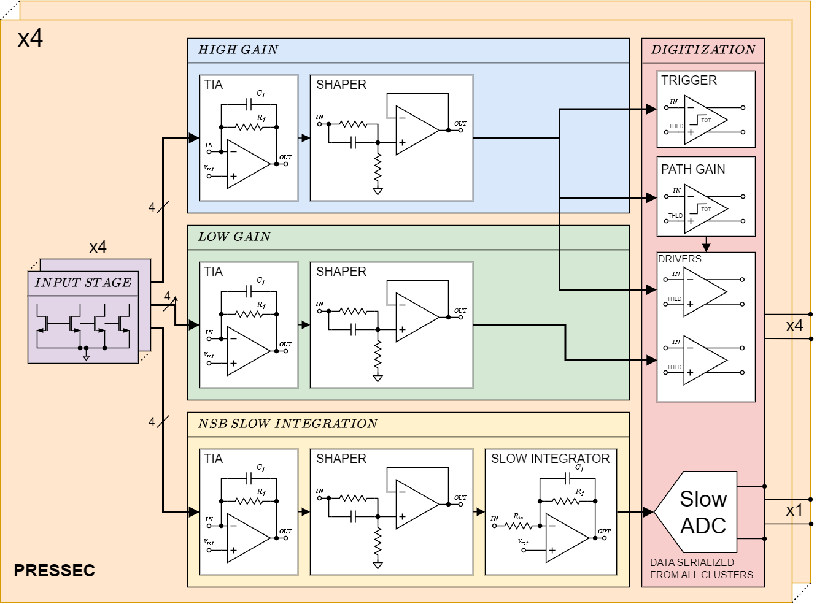

PRESSEC pre-amplifier ASIC (UB-Unige-UPC)
Preamplifier Readout Electronics for Summing SiPMs Enhanced Circuit
Prototype readout for 4 pixels:
  4 current mode analog inputs per pixel
  3 signal processing channels per pixel: high-gain, low-gain and NSB integration
  1 analog output per pixel (high gain or low gain path)
  1 digital output per ASIC providing the NSB serialized data of all pixels
FACULTÉ DES SCIENCES
SECTION DPNC

Slide 12
Further developments
Complete the test campaign:
  Acquisition and analysis of differential output to be done, but no major performance difference is expected
  Measurement campaign with larger pixel (LVR 3 6x6 mm²), to be completed. Expected degradation in FWHM and noise from preliminary results
  Temperature and supply voltage dependence
Adapt the buffer designs for PRESSEC (ASIC designed together with UB and UPC)
Technical paper in preparation
FACULTÉ DES SCIENCES
SECTION DPNC

Slide 13
Backup slides
FACULTÉ DES SCIENCES
SECTION DPNC

Slide 14
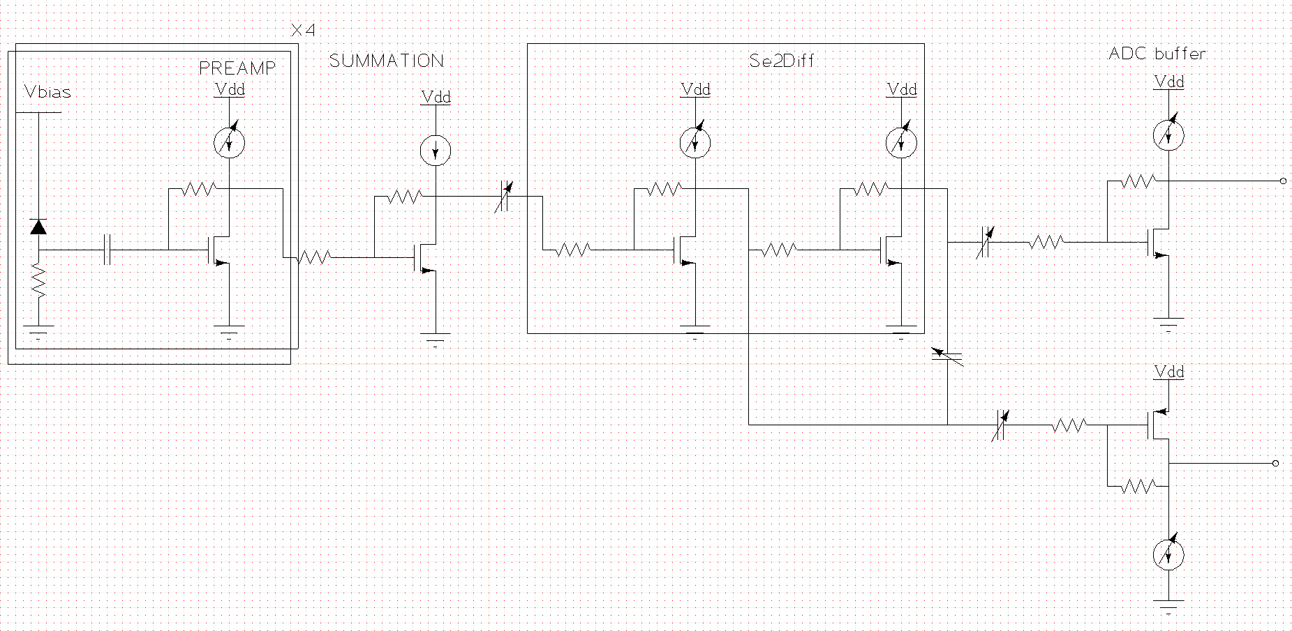
Pseudo-differential frontend schematic
1.3mA
1.4mA
4.4mA
4.4mA
2.2mA
873 Ω
8.8 kΩ
950 Ω
950 Ω
4 kΩ
700 pF
873 Ω
350 Ω
20 Ω
800 Ω
800 Ω
700 Ω
3.2 kΩ
PCB ASIC
2.2mA
FACULTÉ DES SCIENCES
SECTION DPNC

Slide 15
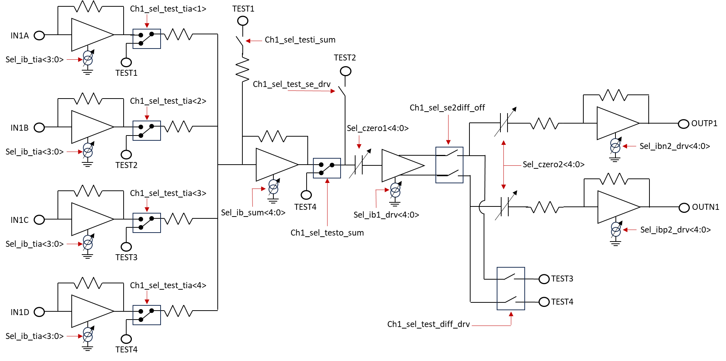
Pseudo-differential frontend schematic
FACULTÉ DES SCIENCES
SECTION DPNC

Slide 16
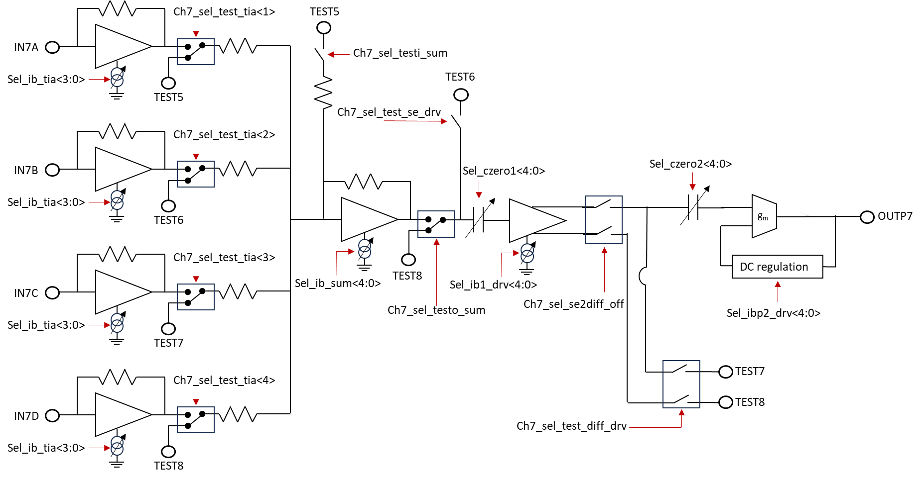
Single-ended frontend schematic
FACULTÉ DES SCIENCES
SECTION DPNC

Slide 17
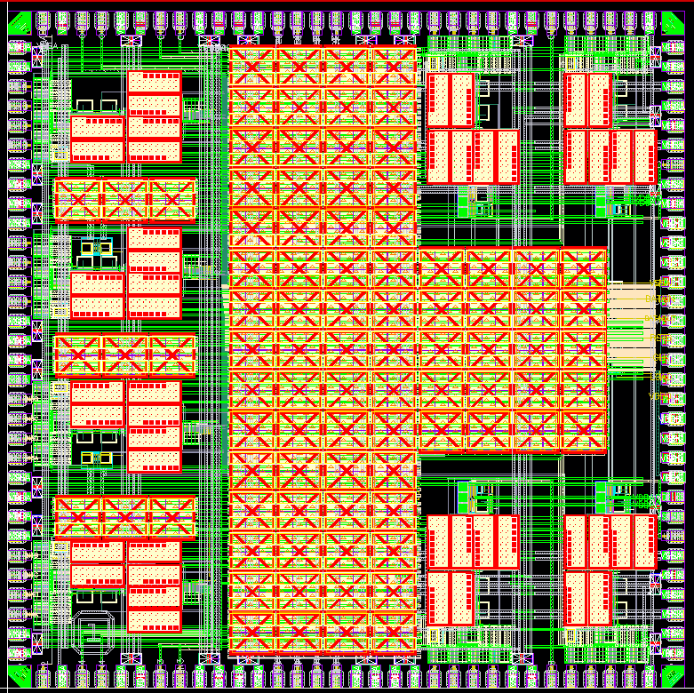
FANATIC layout
3.58 mm
Differential channels
Single ended channels
Digital state registers
FACULTÉ DES SCIENCES
SECTION DPNC

Slide 18
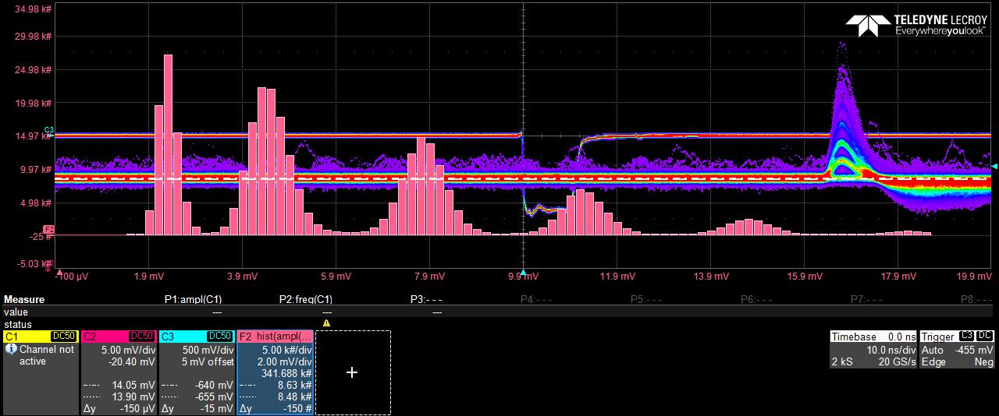
FANATIC measurements with SiPM
Finger plot of single ended channel with laser source and 2x LCT5-UVE 3x3 mm²
^{Noise: 260 uV rms}
^{FWHM: 3 ns}
FACULTÉ DES SCIENCES
SECTION DPNC

