Slide 1
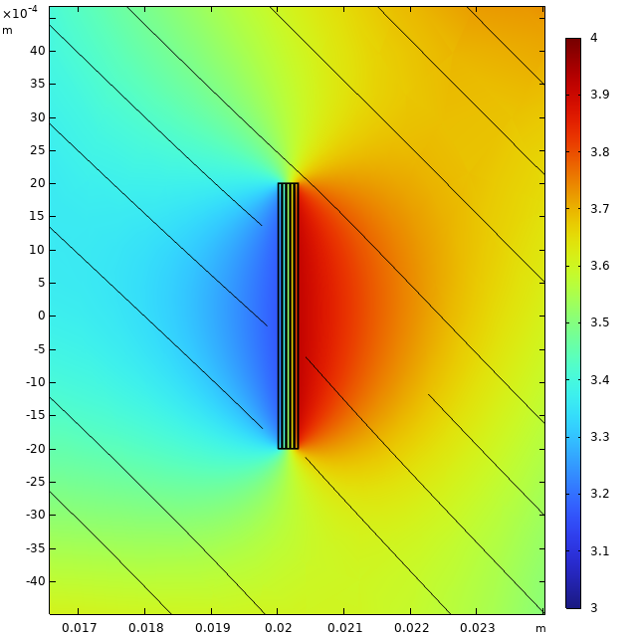
FEM modelling benchmark of ReBCO cables for HTS HFM
HTS straight soldered stack
B. Auchmann, D. M. Araujo, D. Sotnikov, et al.
PSI, 25 July 2024

Slide 2
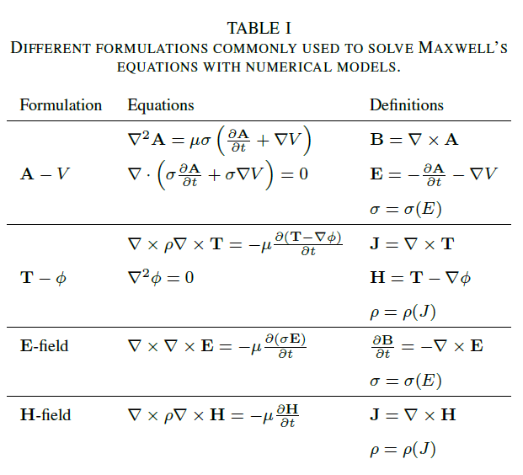
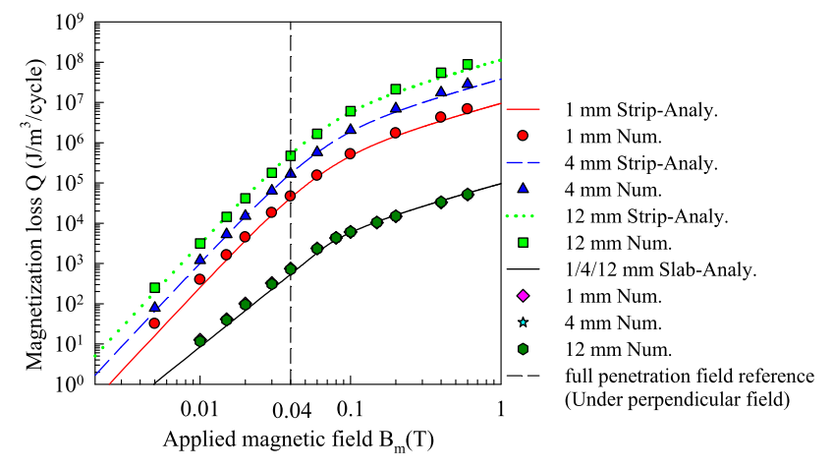
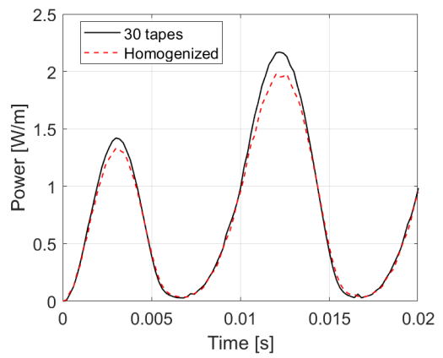
Introduction
Many methods described in presentations and papers about FEM modelling of HTS large-scale applications. But anyway, there is no direct solution for even such simple case as HTS straight soldered stack that perfectly fits to 2D geometry modelling. The quickest way for solving with the same AC losses is using homogenized model.
F. Grilli, Numerical Modeling of HTS Applications, Invited keynote presentation 3A-LS-O1.2 given at EUCAS 2015; Lyon, France, September 6 – 10, 2015.
Fei Gu et al., Numerical Study on Magnetization Losses in Soldered-Stacked-Square (3S) HTS Wires With 1 mm Width, IEEE TRANSACTIONS ON APPLIED SUPERCONDUCTIVITY, VOL. 29, NO. 2, MARCH 2019
ANDREA ZAPPATORE et al., Impact of hysteresis losses in hybrid (HTS-LTS) coils for fusion applications, DOI 10.1109/ACCESS.2023.3315600

Slide 3
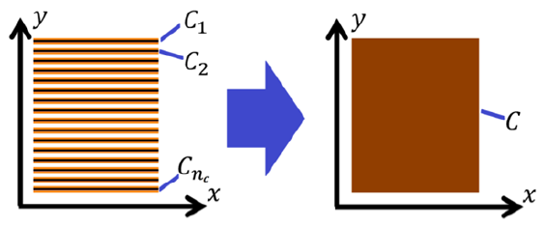
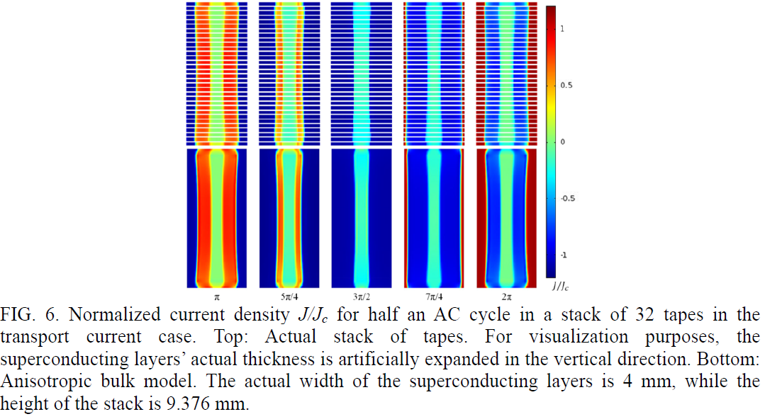
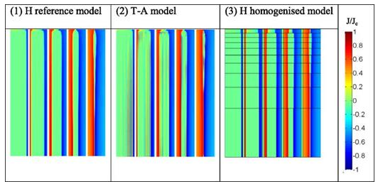
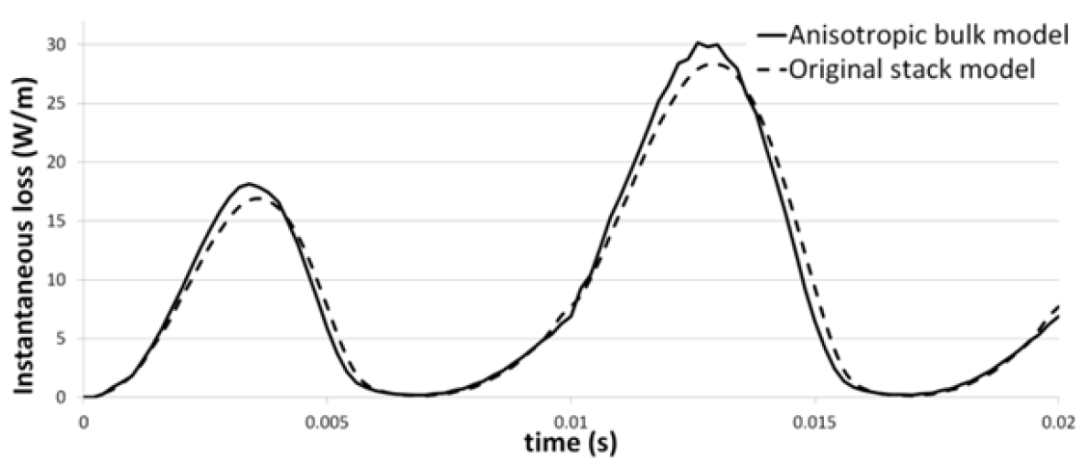
Introduction
Declared simplification of models could be result of specific properties of the selected by authors models like symmetric geometry, or low magnetic field gradient, or low amount of tapes, or others.
Victor M. R. Zermeno et al., Calculation of AC losses in stacks and coils made of second generation high temperature superconducting tapes for large scale applications
Fei Liang et al., A finite element model for simulating second generation high temperature superconducting coils/stacks with large number of turns, J. Appl. Phys. 122, 043903 (2017)

Slide 4
Agenda
Parameters and criteria
Material properties
Models
  Detailed
  Homogenized
    Tape homogenization
    Stack homogenization
  Slit / strip
  network

Slide 5
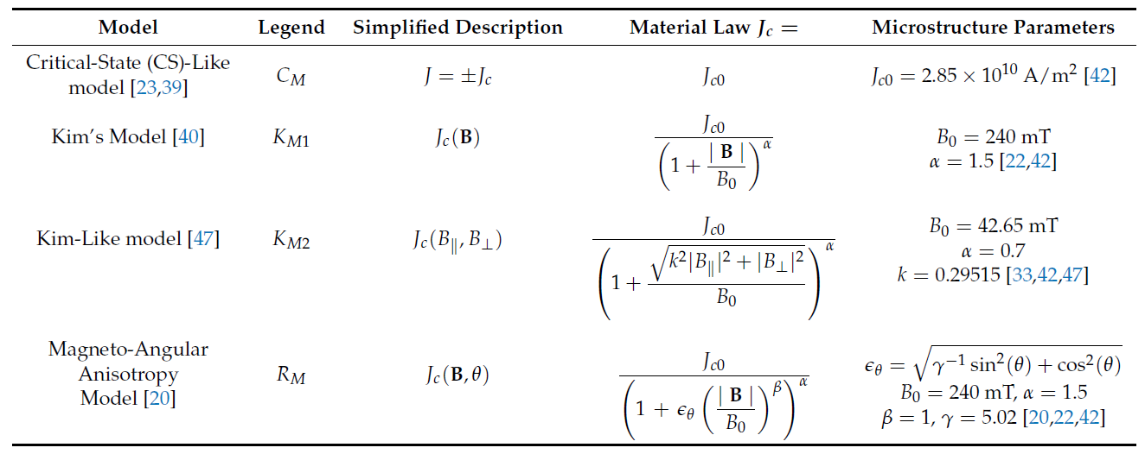
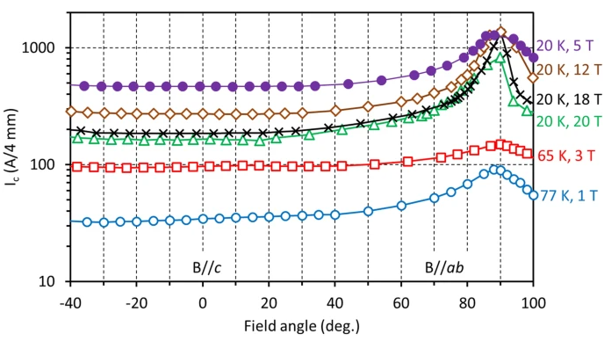
Parameters overview
Temperature: 20 K (because we have measured Ic dependent from angle)
Magnetic field: self-field (SF), 5 T, 14 T, 20 T
Applied current: AC sinusoidal (for wide benchmark with literature), trapezoidal
Adiabatic, no heating
Ic(B): Kim’s model, interpolation data
Bright Chimezie Robert et al., How to Choose the Superconducting Material Law for the Modelling of 2G-HTS Coils, Materials 2019, 12, 2679
A. Molodyk et al., Development and large volume production of extremely high current density YBa2Cu3O7 superconducting wires for fusion, Scientific Reports volume 11, Article number: 2084 (2021)

Slide 6
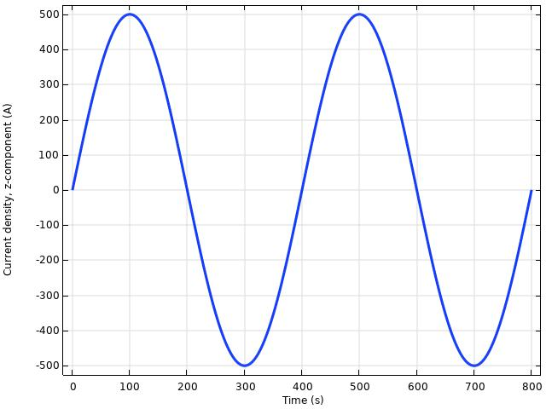
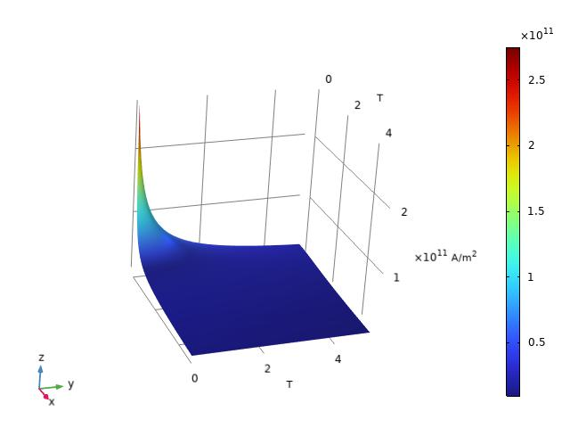
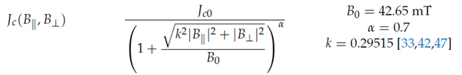
Selected parameters for first benchmark
Temperature: 20 K
Magnetic field: self-field (SF), 5 T
Applied current: AC sinusoidal
Adiabatic, no heating
Ic(B): Kim’s model
Tape width: 4 mm
Tape producer: FFJ
Number of tapes: 5
Sinusoidal:
Peak is 500 A (below than transfer to normal state)
Period 400 s (corresponds to 5 A/s)

Slide 7
Material properties – list of materials
Materials taken from literature for 20 K temperature
# | Name | Property | Resistivity, ohm*m
1 | Copper | RRR13 [1], Bext = 0 T | 1.319e-09 [2]
2 | Silver |  | 3.571e-11 [3]
3 | Hastelloy | C-276 | 1.228e-06 [4]
4 | ReBCO | YBCO, n = 30
5 | Solder | Pb60Sn40 | 2.545e-09 [6]
6 | Kapton |  | 1e13 or 1
7 | Air |  | 1
[1] Bonura M. et al., High-field thermal transports properties of REBCO coated conductors, Conference/Workshop Paper, 05 December 2014
[2] M. Apollonio et al., MEASUREMENT OF THE RESIDUAL RESISTIVITY RATIO OF THE BUS
BARS COPPER STABILIZER OF THE 13 kA CIRCUITS OF THE LHC, Proceedings of IPAC2012, New Orleans, Louisiana, USA
[3] R. A. Matula, Electrical Resistivity of Copper, Gold, Palladium and Silver, 1979
[4] J. Lu et al., Physical properties of Hastelloy C-276TM at cryogenic temperatures, 2008
[5] https://htsdb.wimbush.eu/dataset/13708690
[6] A. Eiling, J.S. Schilling, Pressure and temperature dependence of electrical resistivity of Pb and Sn from 1-300K and 0-10 GPa-use as continuous resistive pressure monitor accurate over wide temperature range; superconductivity under pressure in Pb, Sn and In, 1980
Jc(0T, 20 K) = 6000 [A/cm]/2[um] = 3e11 [A/m^2] [5]

Slide 8
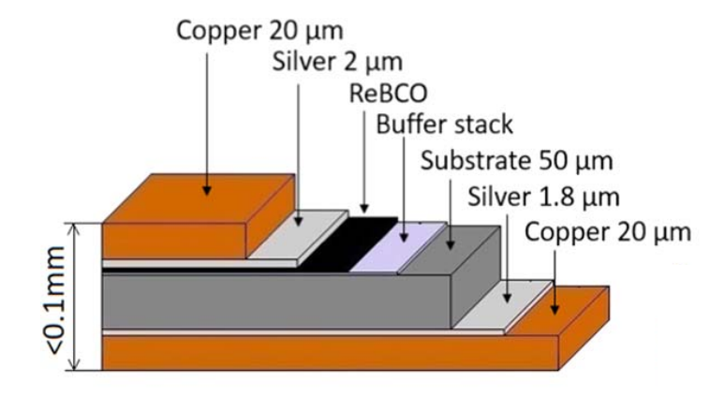
Material properties – HTS tape / stack structure
Data from producer
Solder / Kapton
# | Name | Property | Thickness, um | Width, mm
1 | Copper | Shell around | 5 | 4.01
2 | Silver | Top and bottom | 2 (each) | 4
3 | Hastelloy |  | 40 | 4
4 | ReBCO |  | 2 | 4
5 | Solder | Shell around | 10 | 4.03
6 | Kapton | Same as Solder | 10 | 4.03
Hastelloy
Copper
Silver
Copper
YBCO
Silver
Marek Búran et al., Impact of a REBCO coated conductor stabilization layer on the fault current limiting functionality, Superconductor Science and Technology, Volume 32, Number 9, 2019

Slide 9
Models for benchmark
5T-INS-SF (5 tapes INSulated stack in Self-Field)
5T-NI-SF (5 tapes Non-Insulated stack in Self-Field)
5T-INS-BF1 (5 tapes INSulated stack in homogeneous dipolar background field 0 – 45 – 90 deg)
5T-NI-BF1 (5 tapes Non-Insulated stack in homogeneous dipolar background field 0 – 45 – 90 deg)
5T-INS-BF2 (5 tapes INSulated stack in inhomogeneous quadrupolar background field 0 – 45 – 90 deg)
5T-NI-BF2 (5 tapes Non-Insulated stack in inhomogeneous quadrupolar background field 0 – 45 – 90 deg)

Slide 10
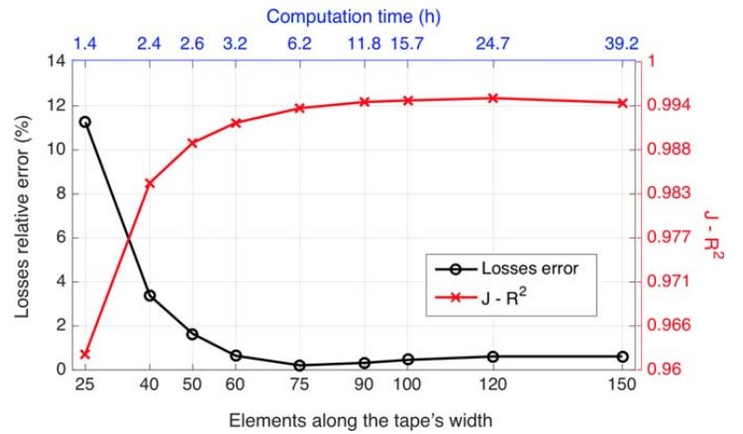
Different meshes
Analysis of mesh quality is important step due to significant difference of results.
Edgar Berrospe-Juarez et al., Real-time simulation of large-scale HTS systems: multi-scale and homogeneous models using the T–A formulation, Supercond. Sci. Technol. 32 (2019) 065003 (14pp)

Slide 11
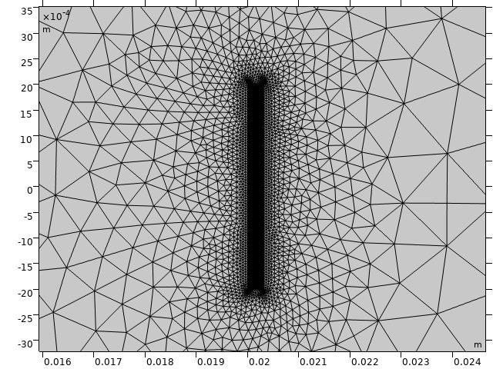
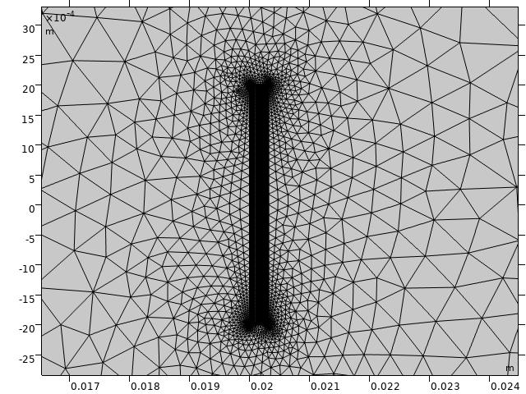
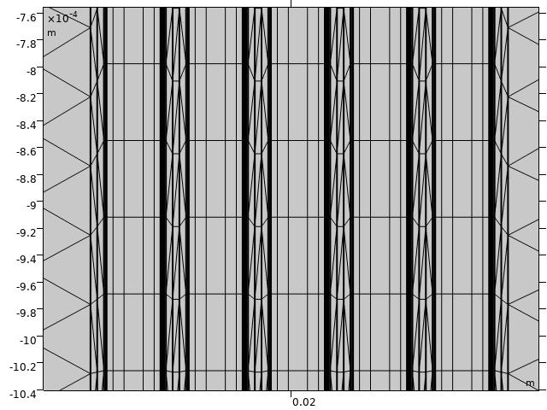
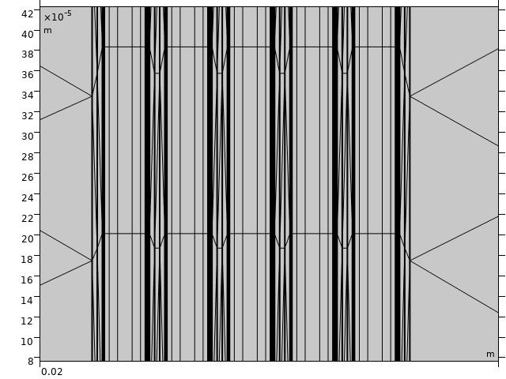
Mesh distribution selection (first results)
The first step is to get a mesh of detailed FEM model with reproducible results. For this, we used selected 5 tapes stack (insulated and non-insulated) in self-field. For ReBCO layer we used rectangular mesh. The goal is to get the minimal numbers of elements by width and thickness of ReBCO layer when AC losses are the same. We used H-A formulation in Comsol.

Slide 12
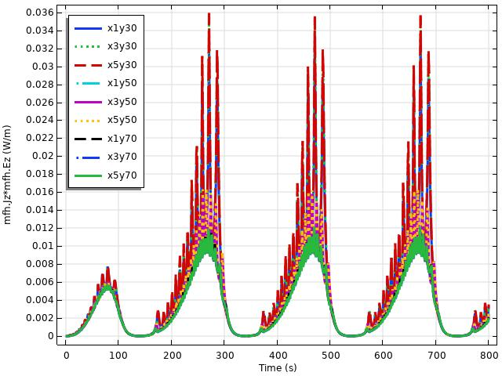
5T-INS-SF_different meshes
# | meshX | meshY | AC losses, J/m | Relative Error, %
1 | 1 | 30 | 2.368 | 62.4
2 | 3 | 30 | 2.531 | 73.6
3 | 5 | 30 | 2.563 | 75.8
4 | 1 | 50 | 1.643 | 12.7
5 | 3 | 50 | 1.687 | 15.7
6 | 5 | 50 | 1.709 | 17.2
7 | 1 | 70 | 1.457 | 0
8 | 3 | 70 | 1.442 | 1.1
9 | 5 | 70 | 1.458 | 0
meshX – number of elements by thickness
meshY – number of elements by width
AC losses computed for the second cycle (from 400 s to 800 s)

Slide 13
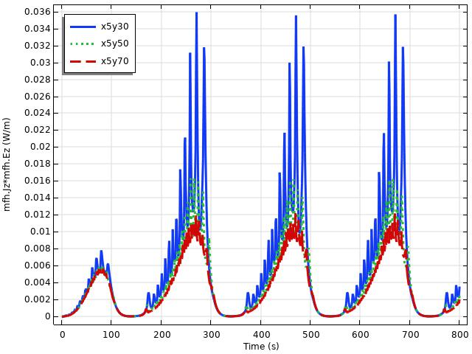
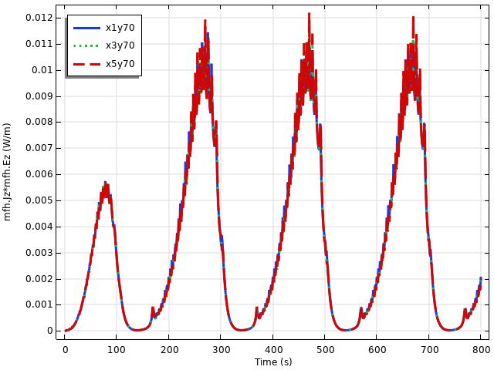
5T-INS-SF_difference meshes
Different distribution by width of ReBCO layer
As low distribution as high deviation
High error with less than 70 elements by width
Different distribution by thickness of ReBCO layer
No difference of losses

Slide 14
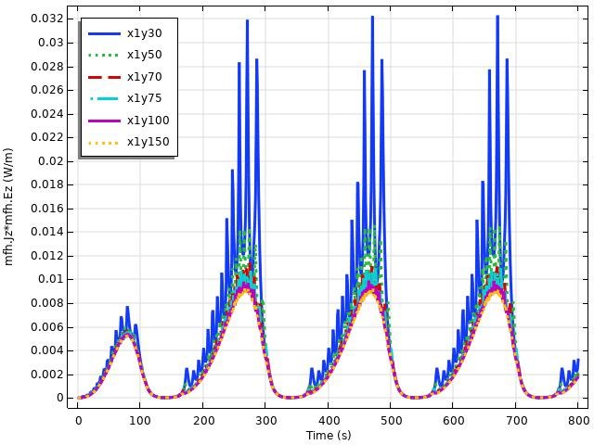
5T-INS-SF_difference meshes
# | meshX | meshY | AC losses, J/m | Relative Error, %
1 | 1 | 30 | 2.368 | 79.3
2 | 1 | 50 | 1.643 | 24.4
3 | 1 | 70 | 1.457 | 10.3
4 | 1 | 75 | 1.434 | 8.5
5 | 1 | 100 | 1.687 | 1.3
6 | 1 | 150 | 1.321 | 0
AC losses computed for the second cycle (from 400 s to 800 s)

Slide 15
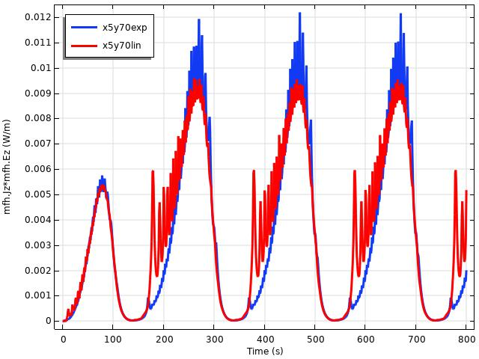
5T-INS-SF_exponential distribution vs linear distribution
# | meshX | meshY | AC losses, J/m | Relative Error, %
1 | 1 | 70exp | 1.457 | 0
2 | 3 | 70exp | 1.442 | 1.1
3 | 5 | 70exp | 1.458 | 0
4 | 1 | 70lin | 1.560 | 7.0
5 | 3 | 70lin | 1.561 | 7.0
6 | 5 | 70lin | 1.580 | 8.4
AC losses computed for the second cycle (from 400 s to 800 s)

Slide 16
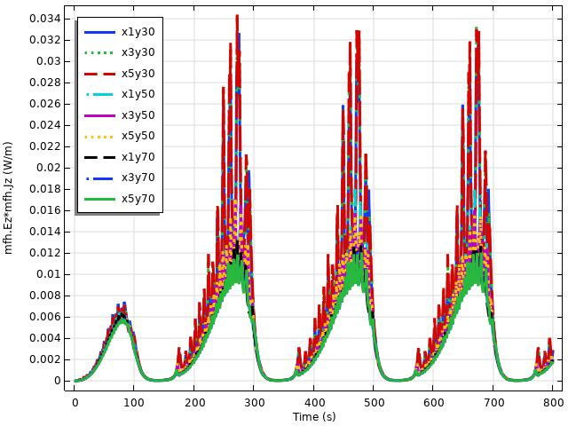
5T-NI-SF_difference meshes
# | meshX | meshY | AC losses, J/m | Relative Error, %
1 | 1 | 30 | 2.603 | 71.8
2 | 3 | 30 | 2.711 | 79.0
3 | 5 | 30 | 2.736 | 80.6
4 | 1 | 50 | 1.771 | 16.8
5 | 3 | 50 | 1.772 | 16.9
6 | 5 | 50 | 1.785 | 17.8
7 | 1 | 70 | 1.568 | 3.5
8 | 3 | 70 | 1.509 | 0.5
9 | 5 | 70 | 1.515 | 0

Slide 17
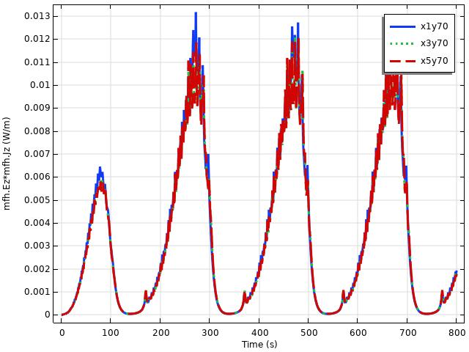
5T-NI-SF_difference meshes
Different distribution by width of ReBCO layer
As low distribution as high deviation
High error with less than 70 elements by width
Different distribution by thickness of ReBCO layer
A bit difference between x1 and others

Slide 18
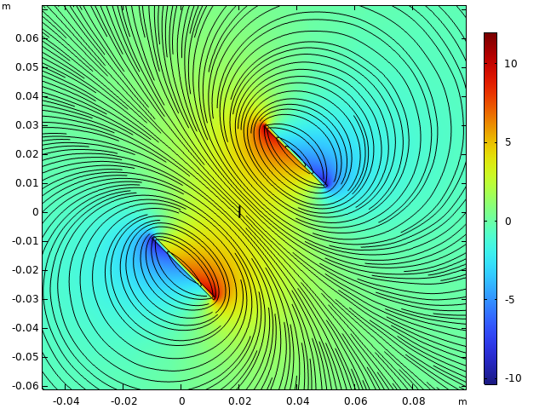
5T-INS-BF1 and 5T-NI-BF1
Required lower peak current
Could be applied in several directions (at least 0, 45 and 90 deg)
First step is 5 T

