Slide 1
FCC Polarimeter
Running modes
Specifications
25 July / EPOL_FCC meeting
Robert Kieffer, on behalf of the EPOL working group and of the CERN BI group.

Slide 2
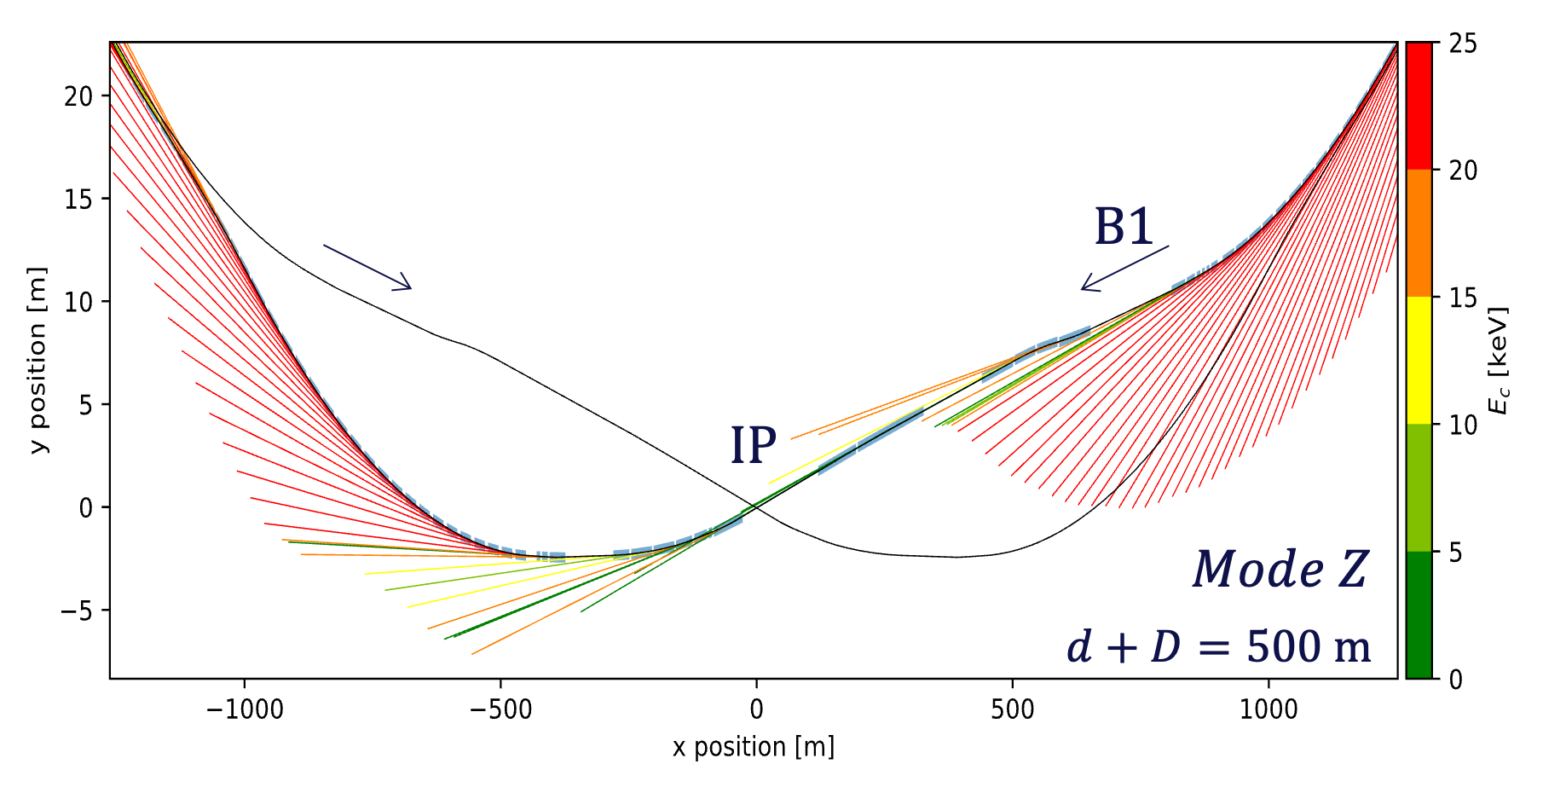
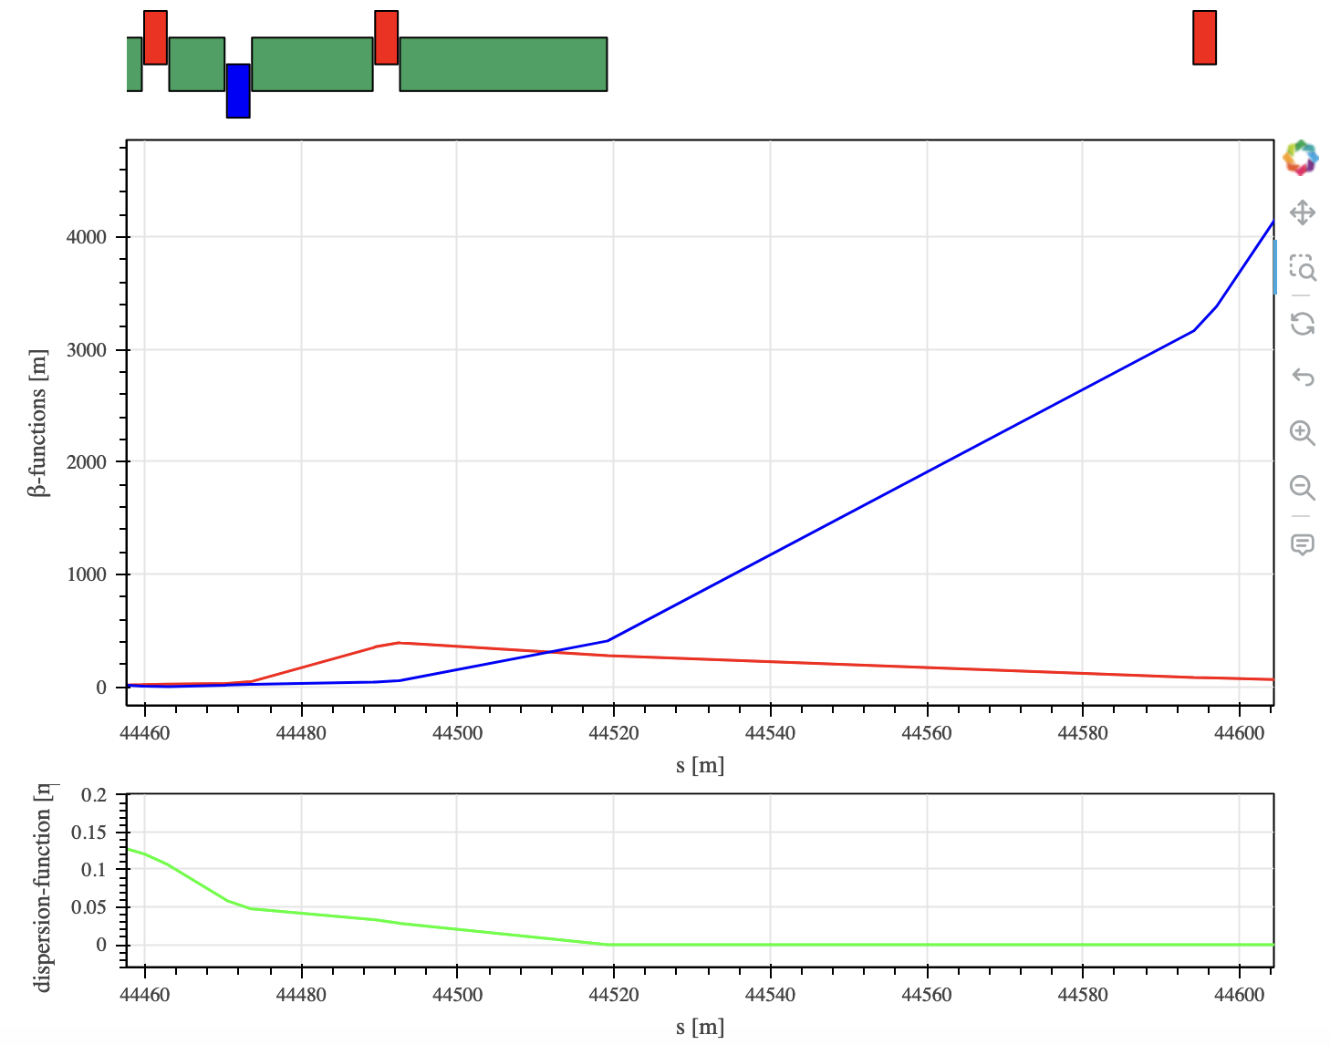
FCCee Polarimeters baseline in Experimental IP A
25 July / EPOL_FCC meeting
Robert Kieffer
BL1.4
Polarimeter
Survey plot from Daniele Butti
Laser IP
Laser IP
Laser IP
GHC optics is used. The polarimeter is not yet tested in the LCC optics.
Synchrotron Radiation fan shows a potentially strong contamination from SR in the compton gammas extraction line.

Slide 3
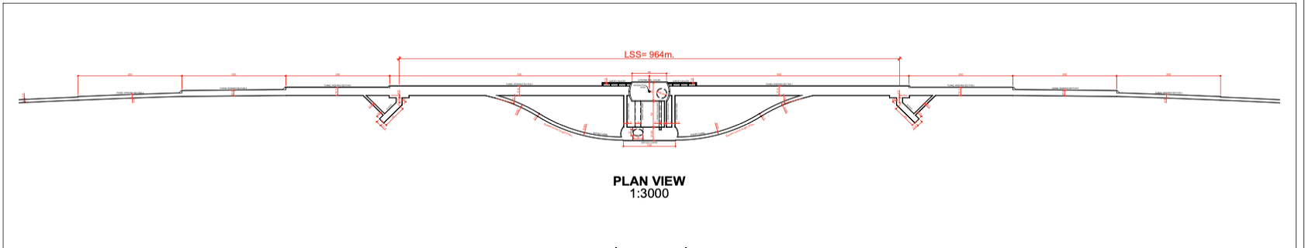
FCCee Polarimeters baseline in Experimental IP A
25 July / EPOL_FCC meeting
Robert Kieffer
Laser IP
830m from IP
Laser IP
830m from IP
300m
300m
Laser hutch
Accessible 24h/7d
Laser hutch
Accessible 24h/7d
Extra tunnel to Laser Hutch
Extra tunnel to Laser Hutch
New bypass tunnel elongated to reach after the BS dump
New bypass tunnel elongated to reach after the BS dump
The base line is to use the magnet BL1.4 as spectrometer on each beam, followed by 75m of free beam propagation to separate the compton photons and compton electrons from the main beam.
In order to insure full time availlabilty of the RDP energy calibration the Laser hutch need to be accessible 24h/7days while close to the Laser IP (50m max). As few mirror folds and view ports as possible to maintain a good laser circular polarisation.
UPDATE from L. Bromiley and T. Watson (after the FCC week)
Cost estimate for the two full lenght 830m tunnels 33MCHF
Cost estimate for the two 300m extra tunnels connected to the extended bypass 12MCHF

Slide 4
25 July / EPOL_FCC meeting
Robert Kieffer
Global specifications for the polarimeter: 95% availability
Such an availability have never been reached for any polarimeter worldwide
Only one polarimeter per beam, both are installed in point A ( no full instrument redundancy)
Critical aspect: The laser room must be accessible 24h/7d to aim required instrument availability.
Laser source duplicated in each hutch to be able to fold back remotely to a second laser in case of failure. The failing laser could then be repaired meanwhile the second one is in use.
An extended description on the laser hutch is available on the following Integration Indico page: https://indico.cern.ch/event/1429622/
Detector design and sensors identification is ongoing, rad-hard system are expected to show near full time availability. To be confirmed.

Slide 5
25 July / EPOL_FCC meeting
Robert Kieffer
Resonant Depolarization Energy Calibration Z and WW modes
BASELINE
RDP energy measurement on 1 pilot bunch every 15 min (~100 keV resolution)
Injection Pilots Bunches
Polarization buildup
Wigglers ON for 2h
Goal reach 10% pol.
Beam
Dump
Injection of physics bunches, collisions and frequent toping-up
Time
POLARIZED PILOTS
RDP energy measurement on 1 pilot bunch every 15 min (~100 keV resolution)
Injection of polarized Pilots Bunches
Beam
Dump
Injection of physics bunches, collisions and frequent toping-up
For ZH and TTbar the resonant depolarization cannot be performed due to beam energy spread crossing the depolarization resonance lines (No polarization buildup).

Slide 6
25 July / EPOL_FCC meeting
Robert Kieffer
3D Polarization measurement on physics bunches
The pilot bunches stay very long (polarisation buildup for RDP) the colliding physics bunches have a lifetime of 5min and will be constantly topped up with fresh (unpolarised electrons).
Objective: insure no longitudinal polarisation buildup on physics bunches for Z
Regularly target a few representative bunches out of the physics bunch train with the laser.
Record and fit precisely the compton electron pattern to extract the transverse and longitudinal polarizations (many turns needed for sufficient statistics).
Aim: Zero longitudinal polarization with a precision down to ~E-5 on physics bunches. Translate into zero transverse polarization with a precision down to ~E-3
Mostly needed for the Z studies (Not necessary for WW ? ZH? TTbar?)

Slide 7
25 July / EPOL_FCC meeting
Robert Kieffer
Z-pole calibration runs, as sides of the ZH and TTbar
If there any statement on the periodicity of the Z-pole calibration runs ? Daily? Monthly?
We need to make sure that the changes in optics and RF will still allow Z-pole calibration.
Ideally the polarimeter will be exactly the same for these calibration runs. Hopefully we can have thes same charge and laser power to get the same stat as for Z mode runs.

Slide 8
25 July / EPOL_FCC meeting
Robert Kieffer
Energy calibration for the ZH ?
Is it possible to perform RDP energy calibration for ZH ?
If we inject polarised pilots? What is the time scale of natural depolarisation (lifetime)?
Can we regularly dump and re-inject only the polarised pilot bunches while the rest of the physics bunch are topped up?
Does it make sense to aim for RDP at the ZH energy ?

Slide 9
25 July / EPOL_FCC meeting
Robert Kieffer
Direct Energy measurement ?
Using the centroid of the Compton photons pattern and the Compton electron pattern, we could potentially obtain a direct energy measurment.
It is much less precise than RDP but could be used for the monitoring of physics bunches.
The main difficulty is the alignement knowledge of both detectors (10um needed)
If this measurement could be made availlable, what would be the scenario?
Do we aim to target physics bunch constantly to monitor energy variation over time?
Should we mention this technique in the coming Feasibilty Study Report?

Slide 10
25 July / EPOL_FCC meeting
Robert Kieffer
Polarimetry for injectors?
In case the beams are polarised at the injectors level.
Do we need to design polarimeters for the injectors too?

Slide 11
25 July / EPOL_FCC meeting
Robert Kieffer
Outlook
The polarimeter aim to perform measurement at Z and WW energies (45.6GeV - 80GeV)
RDP energy calibration on polarised pilot bunches
3D Polarisation on physics bunches (expected to be unpolarized)
The polarimeter is not designed for ZH and TTbar beam energies (120GeV - 182.5GeV)
Since the polarimeter is a spectrometer. It is difficult to cover the full range of energies with the same instrument design (45.6 - 182.5GeV)
Still the polarimeter need to be accessible for dedicated Z energy calibration runs on the side of ZH and TTbar mode runs.

Slide 12
25 July / EPOL_FCC meeting
Robert Kieffer
Feasibilty Study Report (dead line coming soon)
Mostly based on the Mid term report input
Is there any major changes we want to make for the Feasibility Study Report?
Do we introduce the polarized beam injection scheme?
An update on the simulation studies of the polarimeter instrument will be added.
The civil engineering related to the polarimeter will also be added (tunnel and laser hutch).
The whole report is will be based on baseline GHC optics (Oide San).

Slide 13
Thank you for your attention.
25 July / EPOL_FCC meeting
Robert Kieffer
13

Slide 14
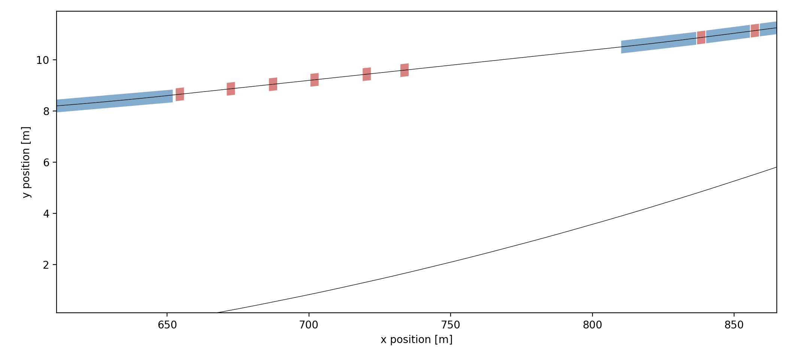
FCCee Polarimeters baseline in Experimental IP A
25 July / EPOL_FCC meeting
Robert Kieffer
Robert Kieffer
Electrons
BL1.4
Photons
100 m propagation distance
Laser IP
7m between beams

