Slide 1
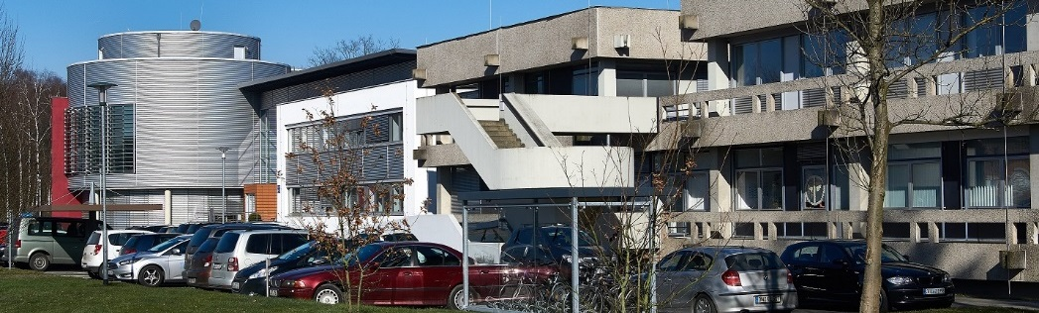
Jülich Supercomputing Centre current status and future directions
05 September 2024

Slide 2

JUPITER – high-level Architecture
Parallel
High Bandwidth
Flash Module
Parallel
High Capacity
Data System
High Capacity Backup/Archive System
Universal Cluster
GPU
Booster
Quantum
Module
Core
Configuration
Future Call
Modules
Interactive
Computation
and Visualization
Neuromorphic
Module
EU-Technology
Enabling Module

Slide 3



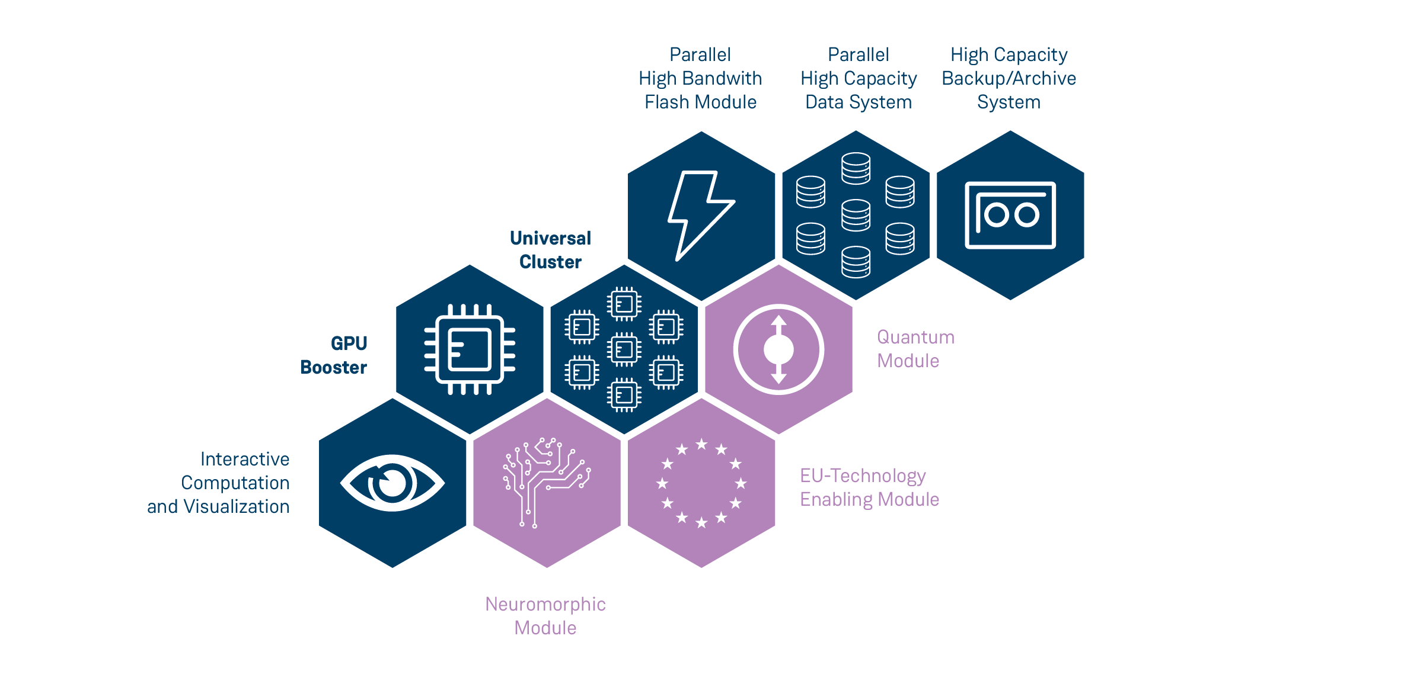







JUPITER – high-level Architecture
>1 ExaFLOP/s FP64 HPL
          >70 ExaFLOP/s FP8 AI
~6000 Nodes
  ~24000 NVIDIA
  Grace-Hopper
  NVIDIA Mellanox NDR
  BullSequana XH3000
JUPITER Management Stack
          Modular System Architecture
          ParTec ParaStation Modulo
          Eviden SMC xScale
Scheduler: Slurm
Scientific Software: EasyBuild
Jobreporting: LLview
>5 PetaFLOP/s FP64 HPL
~1300 Nodes
~2600 SiPearl Rhea1
BullSequana XH3000
21 PB useable Flash
~2,5 TB/s
20* IBM SSS6000
210 PB useable SAS
~1,5 TB/s
22* IBM SSS6000
23 Login Nodes
NVIDIA Hopper/A40
200 Gbit/s connectivity
Core Configuration
Future Call Modules

Slide 4



JUPITER – The 1st European Exascale System
JUPITER - JU Pioneer for Innovative and Transformative Exascale Research
  Selected on June 14, 2022 as the 1st EuroHPC Exascale system
  Installation and first operation in Jülich in 2024
  Test system JEDI #1 on Green500 May 2024! modular data centre is being built
  500 Mio. € Total Costs, equally shared between EuroHPC and Germany (federal and state of North Rhine-Westfalia funding)
JUPITER Access
  50% of resources allocated via GCS processes in Germany: peer reviewed, free of charge
  50% of resources allocated by a similar process governed by EuroHPC

