Slide 1


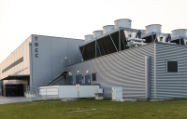


Introducing Jules Verne, toward a common French and European (post)Exascale ambition
GENCI
March 2024

Slide 2


JULES VERNE : the 2nd Exascale consortium
Organization of Jules Verne consortium
GENCI Hosting Entity
CEA Hosting Site at TGCC
SURF (NL) as member of consortium
Full TCO over 5 years : 542 M€ (50% EuroHPC, 50% consortium)
  French public contribution
  French research institutions
  NL public contribution
Seeking more partners in the consortium
  International partners
  French research institutions
  French industrial partners (as end users)

Slide 3
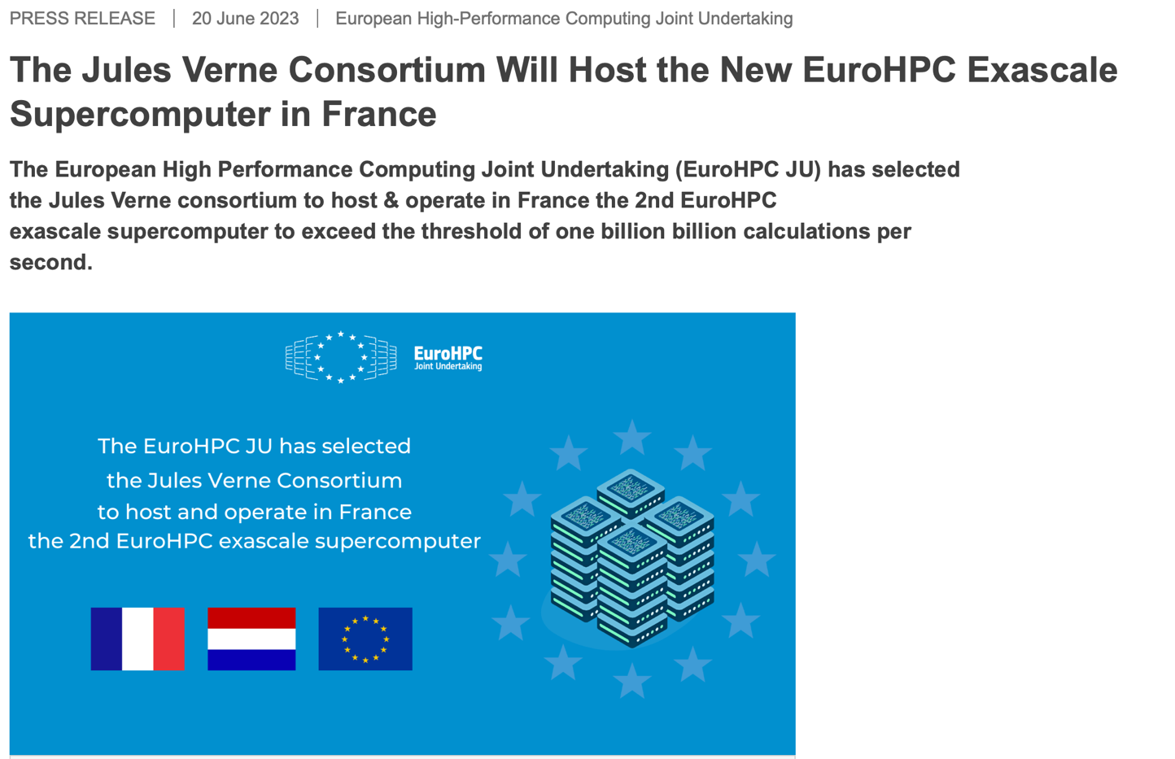



JULES VERNE : the 2nd Exascale consortium
With LoS from

Slide 4

Our vision for an European Exascale machine called ALICE RECOQUE
Addressing societal and scientific challenges (such as universe sciences, climate change, health, new energy, innovative materials or smart cities/systems) via large scale numerical simulations and massive data analysis using artificial intelligence
An accelerator of European Science and Innovation
  open to all scientific and industrial collaborations, supporting new services including Cloud based interactive supercomputing / visualisation, containerisation and urgent computing for fast decision making
A converged HPC/HPDA/AI system with a modular and balanced architecture
  based on accelerated, scalar and HPDA partitions within a tiered data centric infrastructure
  integrating state-of-the-art post-exascale quantum accelerators and related services for specific workloads
A system fully embedded inside the digital continuum
  ready for secured end-to-end workflows from instruments / edge devices to long term sovereign storage
A system with European Technology and Skills
  integrating European hardware and software technologies in terms of computing, storage, network, cooling and infrastructure monitoring, applications with global support of AST to engage/support communities.
A system ready to harness European technologies and the best breed
of opensource software in a highly secure environment
Link with scientific instruments
#NextGenerationEU

Slide 5

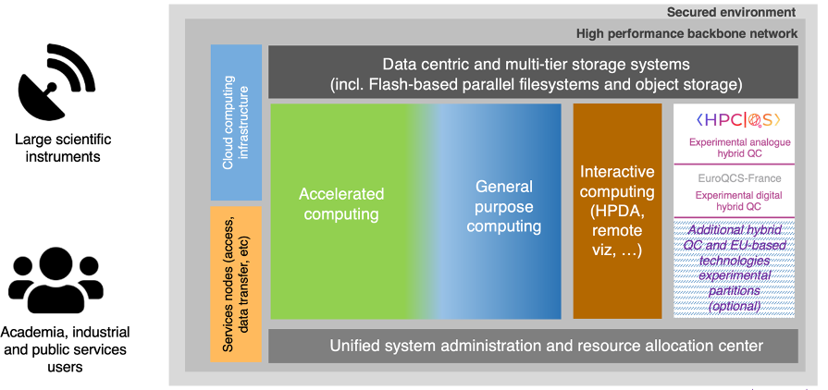
Exascale system architecture overview
Possible reference designs for Alice Recoque
RISC-V ?
Cryo/ neuromorphic computing ?
Immersive cooling ?
Photonics ?
DNA storage ?
>1000 qubits or pre LSQ ?
HPC and AI

Slide 6
Alice recoque planning
Preparation of the application
- Answer to the CEI (Feb 2023)
- Hearing (May 2023)
- Adaptation of TGCC
- Specifications
- Call for tender
- Procurement by EuroHPC
(2024-2025)
- Supercomputer installation
- Early operation (2025+)
Selection of Jules Verne consortium to host and operate the second EuroHPC exascale
15 June 2023
Publication call for tender S2 2024
Procurement -> S2 2025
5 years operation 2026-2030

Slide 7



Let’s foster science and innovation together 🚀

