Slide 1
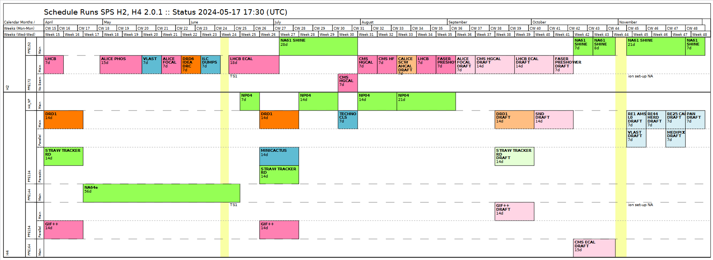
DRD1 H4(PPE134) 2024 Test Beam​
Eraldo Oliveri: +41754116126
Yorgos Tsipolitis: +41754118992
Karl Floethner : +41754110839
Generic and Application driven R&D
  Technologies: Micromegas, uRWELL, uRGroove, GEM
  Application: High Rate, Timing, Calorimetry
  Readout: Capacitive Coupling, Resistive Sharing
Project driven R&D
FCC-muons uRWELL/TIGER
Detector Commissioning
  MPGDHCAL
FE electronics and DAQ
  Straw, VMM3a and TPC
Wed. 26/06/2024 – Wed. 10/07/2024
E. Oliveri, K.J.Floethner, Y. Tsipolitis

Slide 2
Beam Conditions
Muon Beam Purity: perfectly satisfying our needs (no showers produced by our detectors)
Pion: >10e+7/spill
Muon/Pion Rate: Very Satisfied. Huge thanks to Nikos, Bastien and Frederic (Aberle, RP) for helping optimize beam intensity and RP alarms. DAQ rate doubled in some setup. Very important and really appreciated.

Slide 3
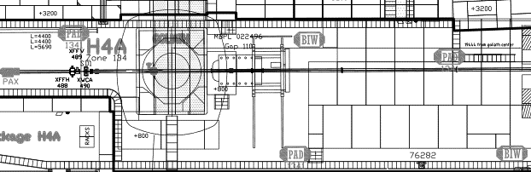
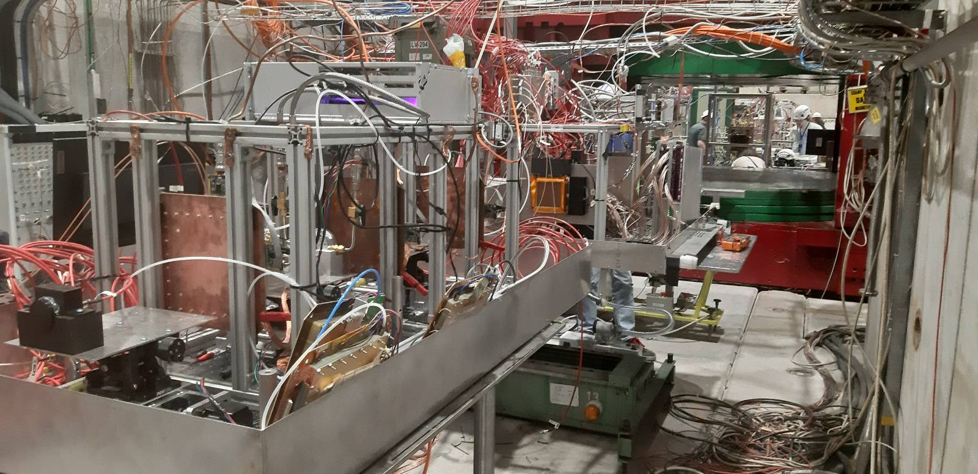
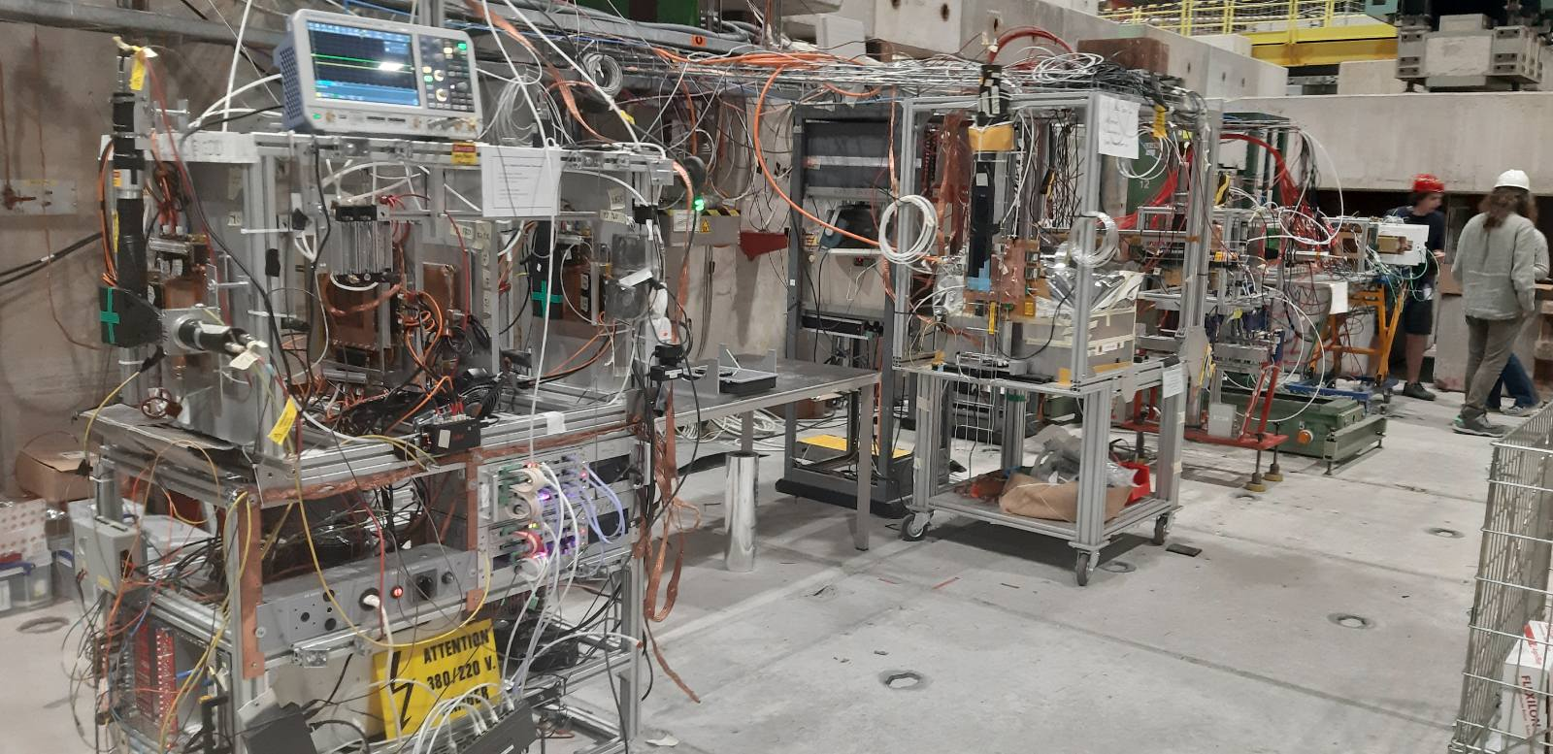
Setups (8)
SETUP
A
SETUP
B
SETUP
C
SETUP
D
SETUP
E
SETUP
F
SETUP
G
SETUP
H
PICOSEC
PICOSEC
MINICACTUS
STRAW
GDD/
DRD1
Tracker
USTC
MPGD HCAL
FCC-muons

Slide 4
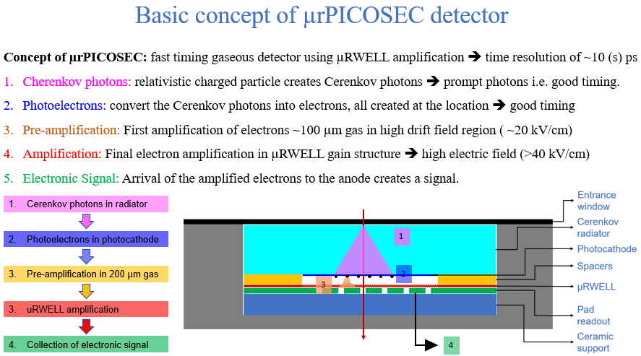


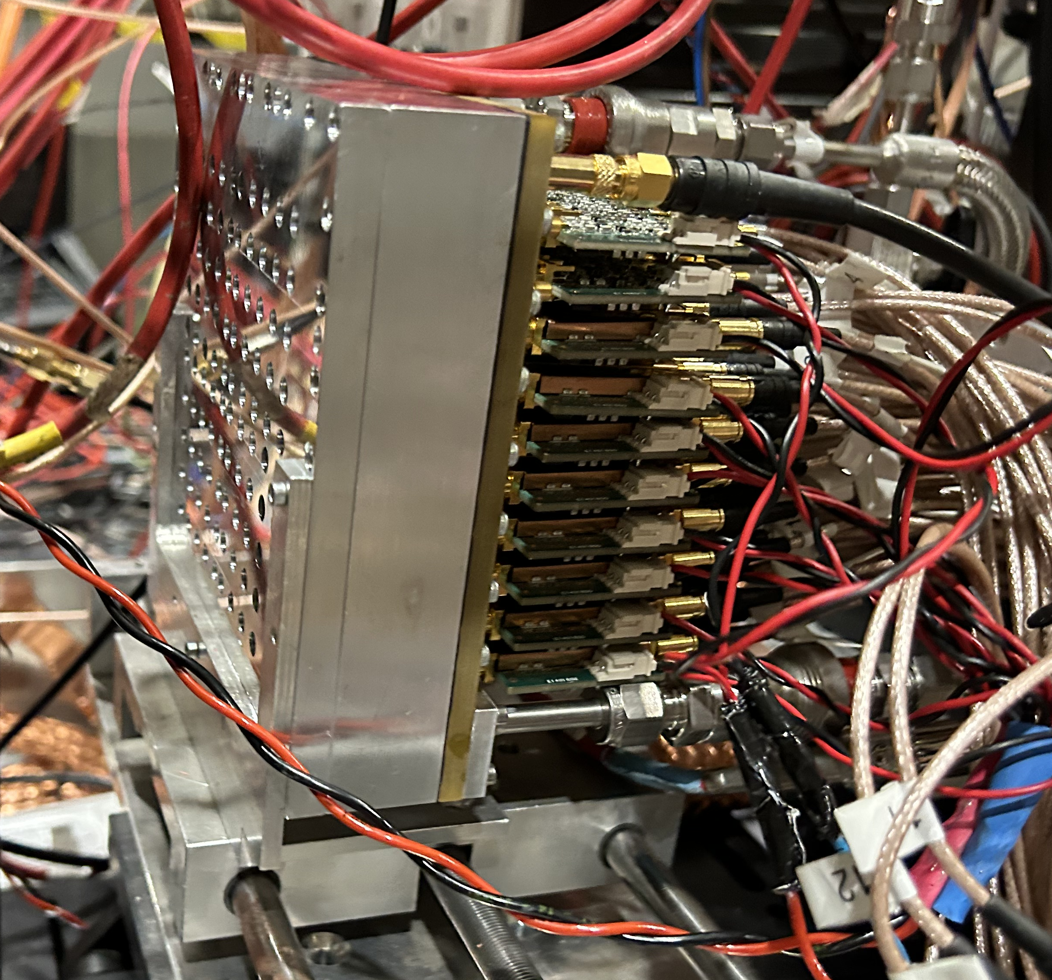
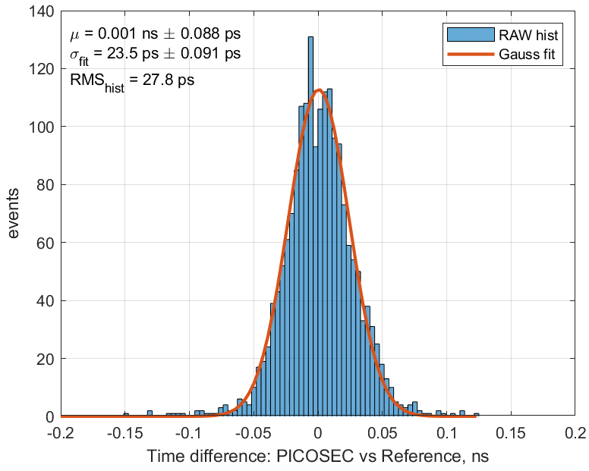
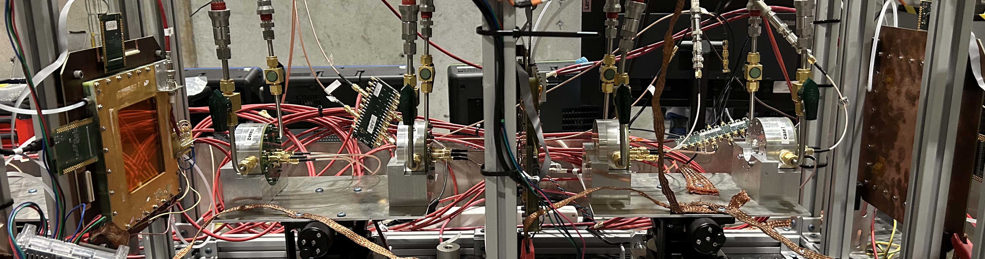
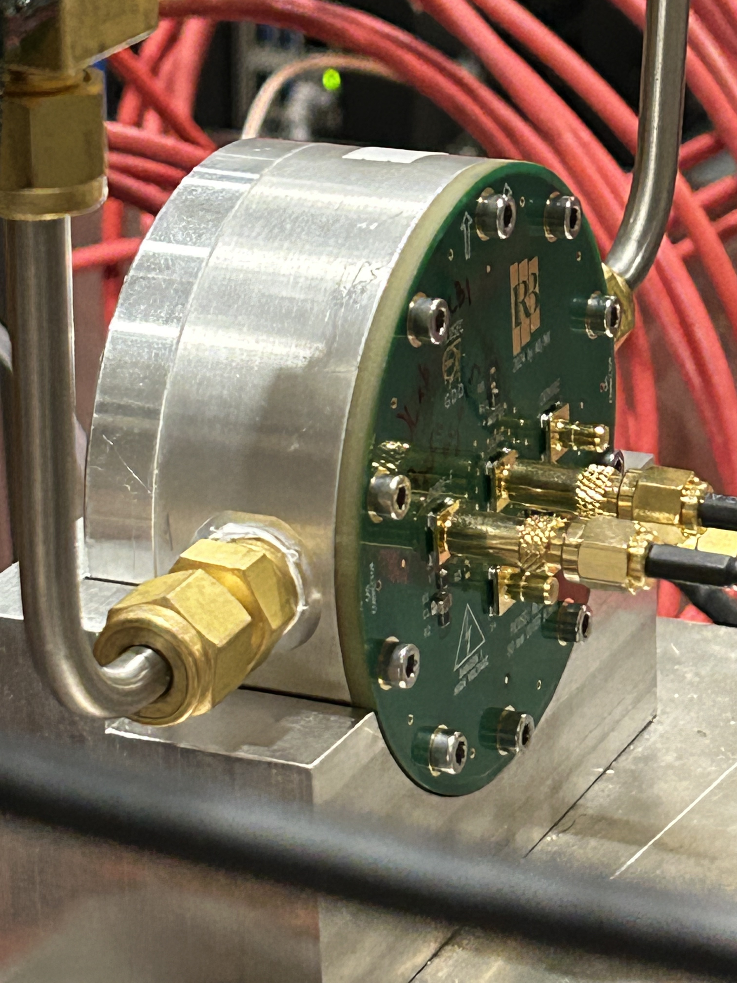
K. Gnanvo, N. Shankman
10x10-channel 𝜇-RWELL PICOSEC detector prototype
June 2024 JLab PICOSEC Telescope
GEM 2
GEM 3
GEM 1
Beam
MCP-PMT (out of frame)
PICOSEC 1
PICOSEC 2
PICOSEC 3
PICOSEC 4

Slide 5
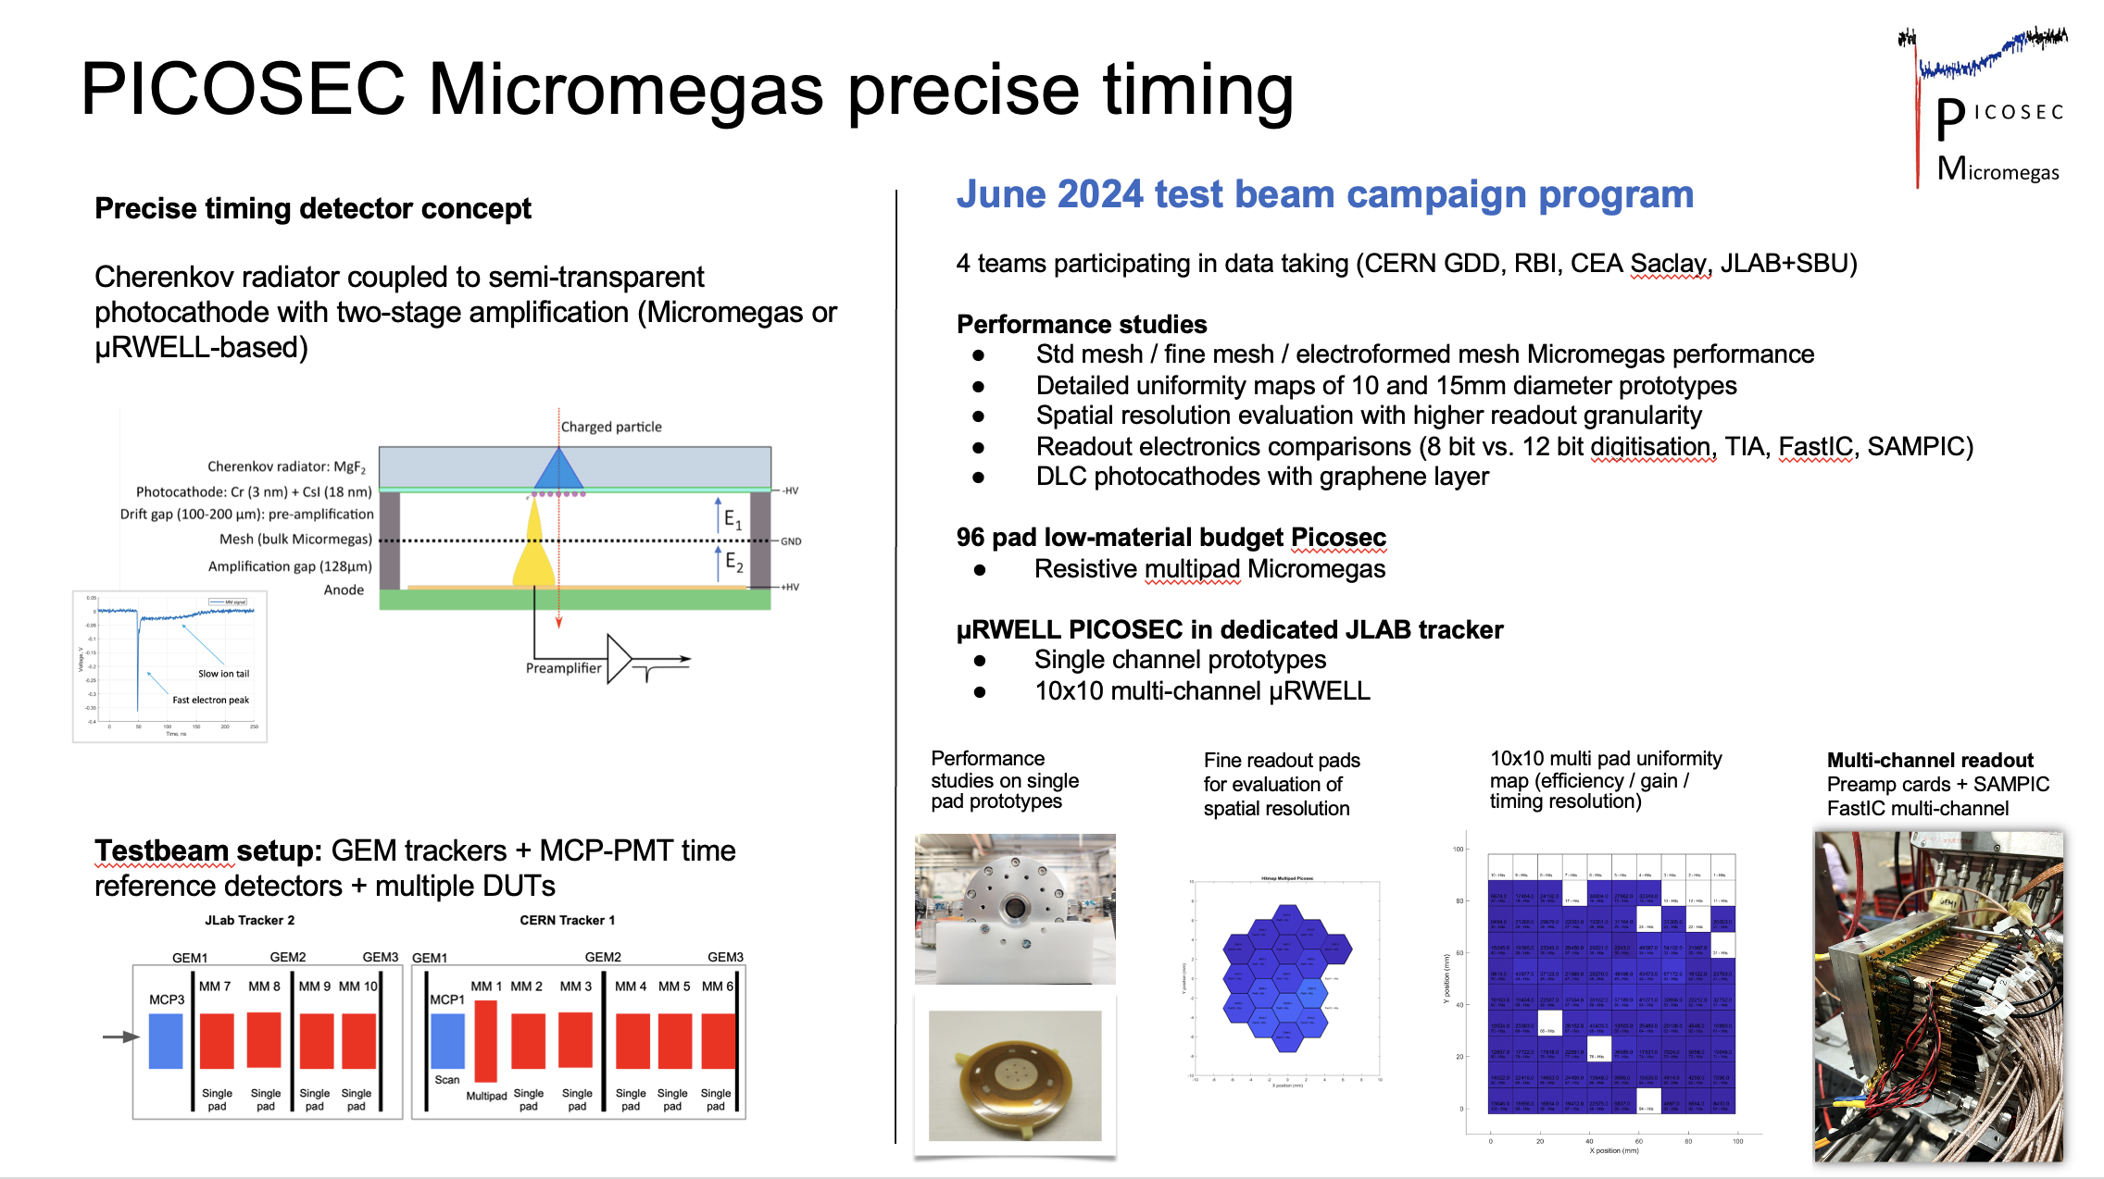

Slide 7
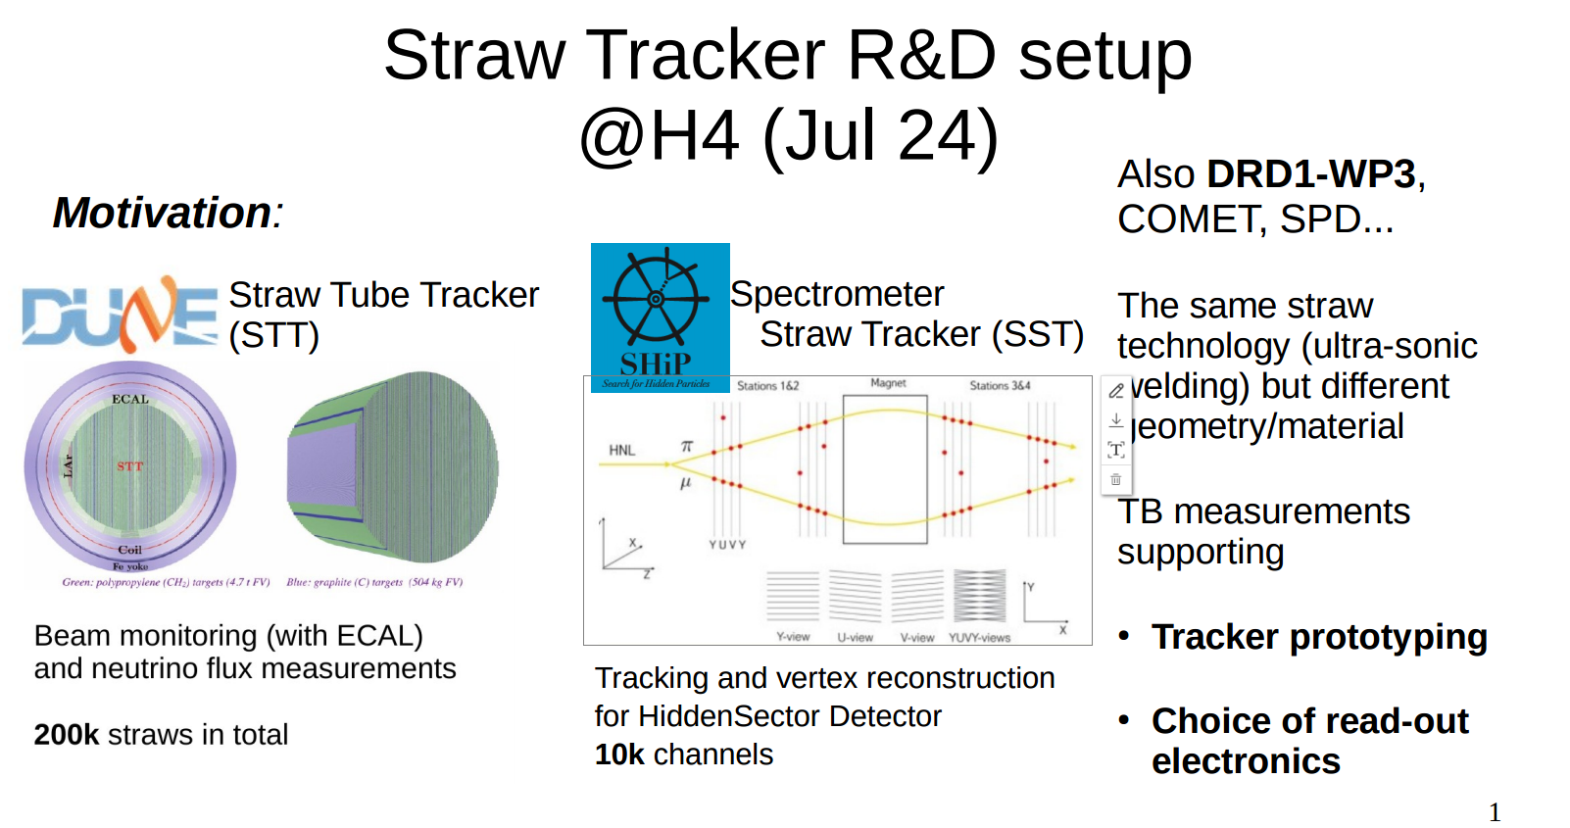
STRAWS

Slide 8
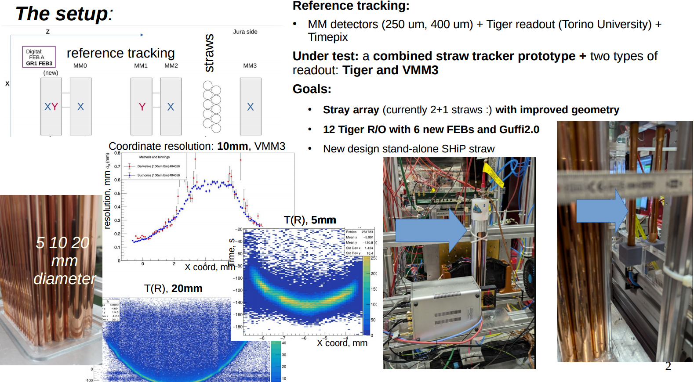
STRAWS

Slide 9
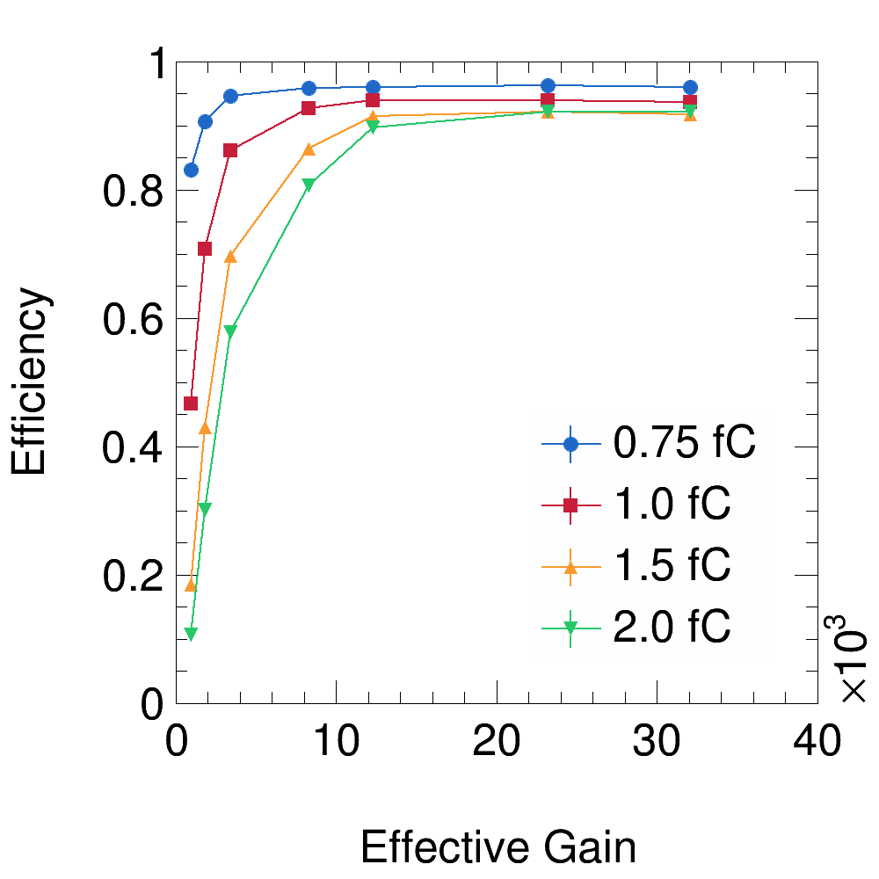
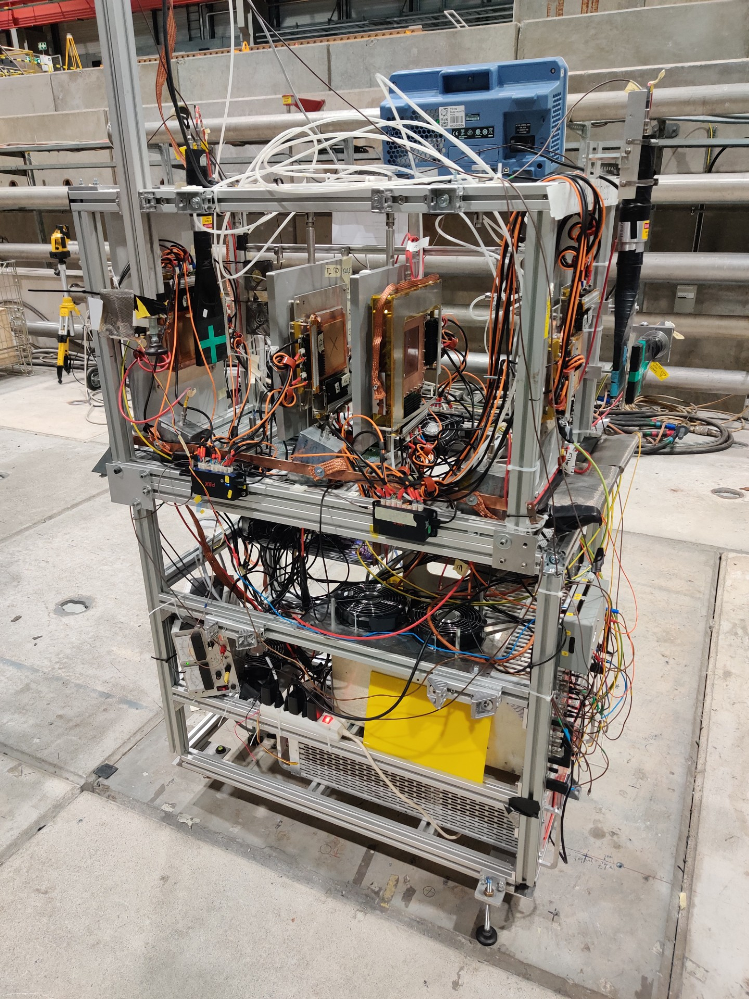
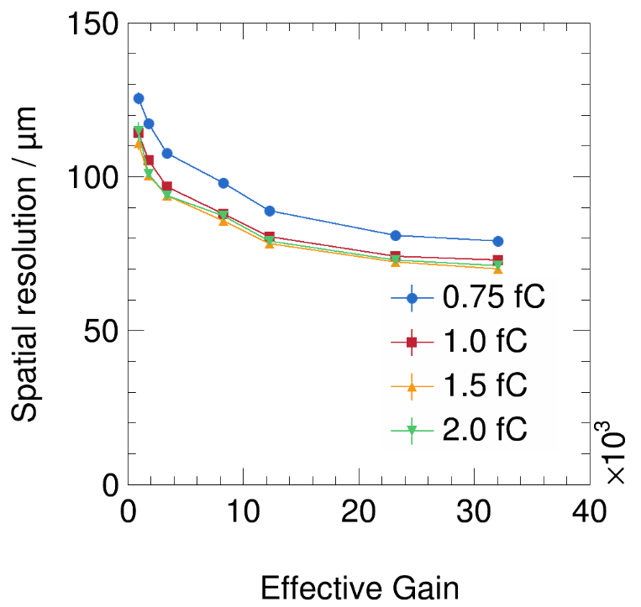
RD51/DRD1 VMM3a/SRS telescope
T1
T2
T3
In addition to continuous self-triggered readout mode, VMM3a/SRS now also contains an externally triggered readout mode.
Goal of this test beam: performance characterisation of triggered mode
→ Useful for integration of front-end electronics with other telescopes and experiments
Measurements and results so far:
→ Externally triggered mode allows operation at lower thresholds (1 fC THL instead of typically 1.5 to 2.0 fC in the self-triggered mode)
→ Operation at high rates possible (> 100 kHz trigger rate), but detailed analysis still ongoing.
Thanks a lot to Bastien and Nikos for the excellent beam quality, especially the pion beam for the rate tests of the triggered mode
7/11/2024
E. Oliveri, K.J.Floethner, Y. Tsipolitis

Slide 10
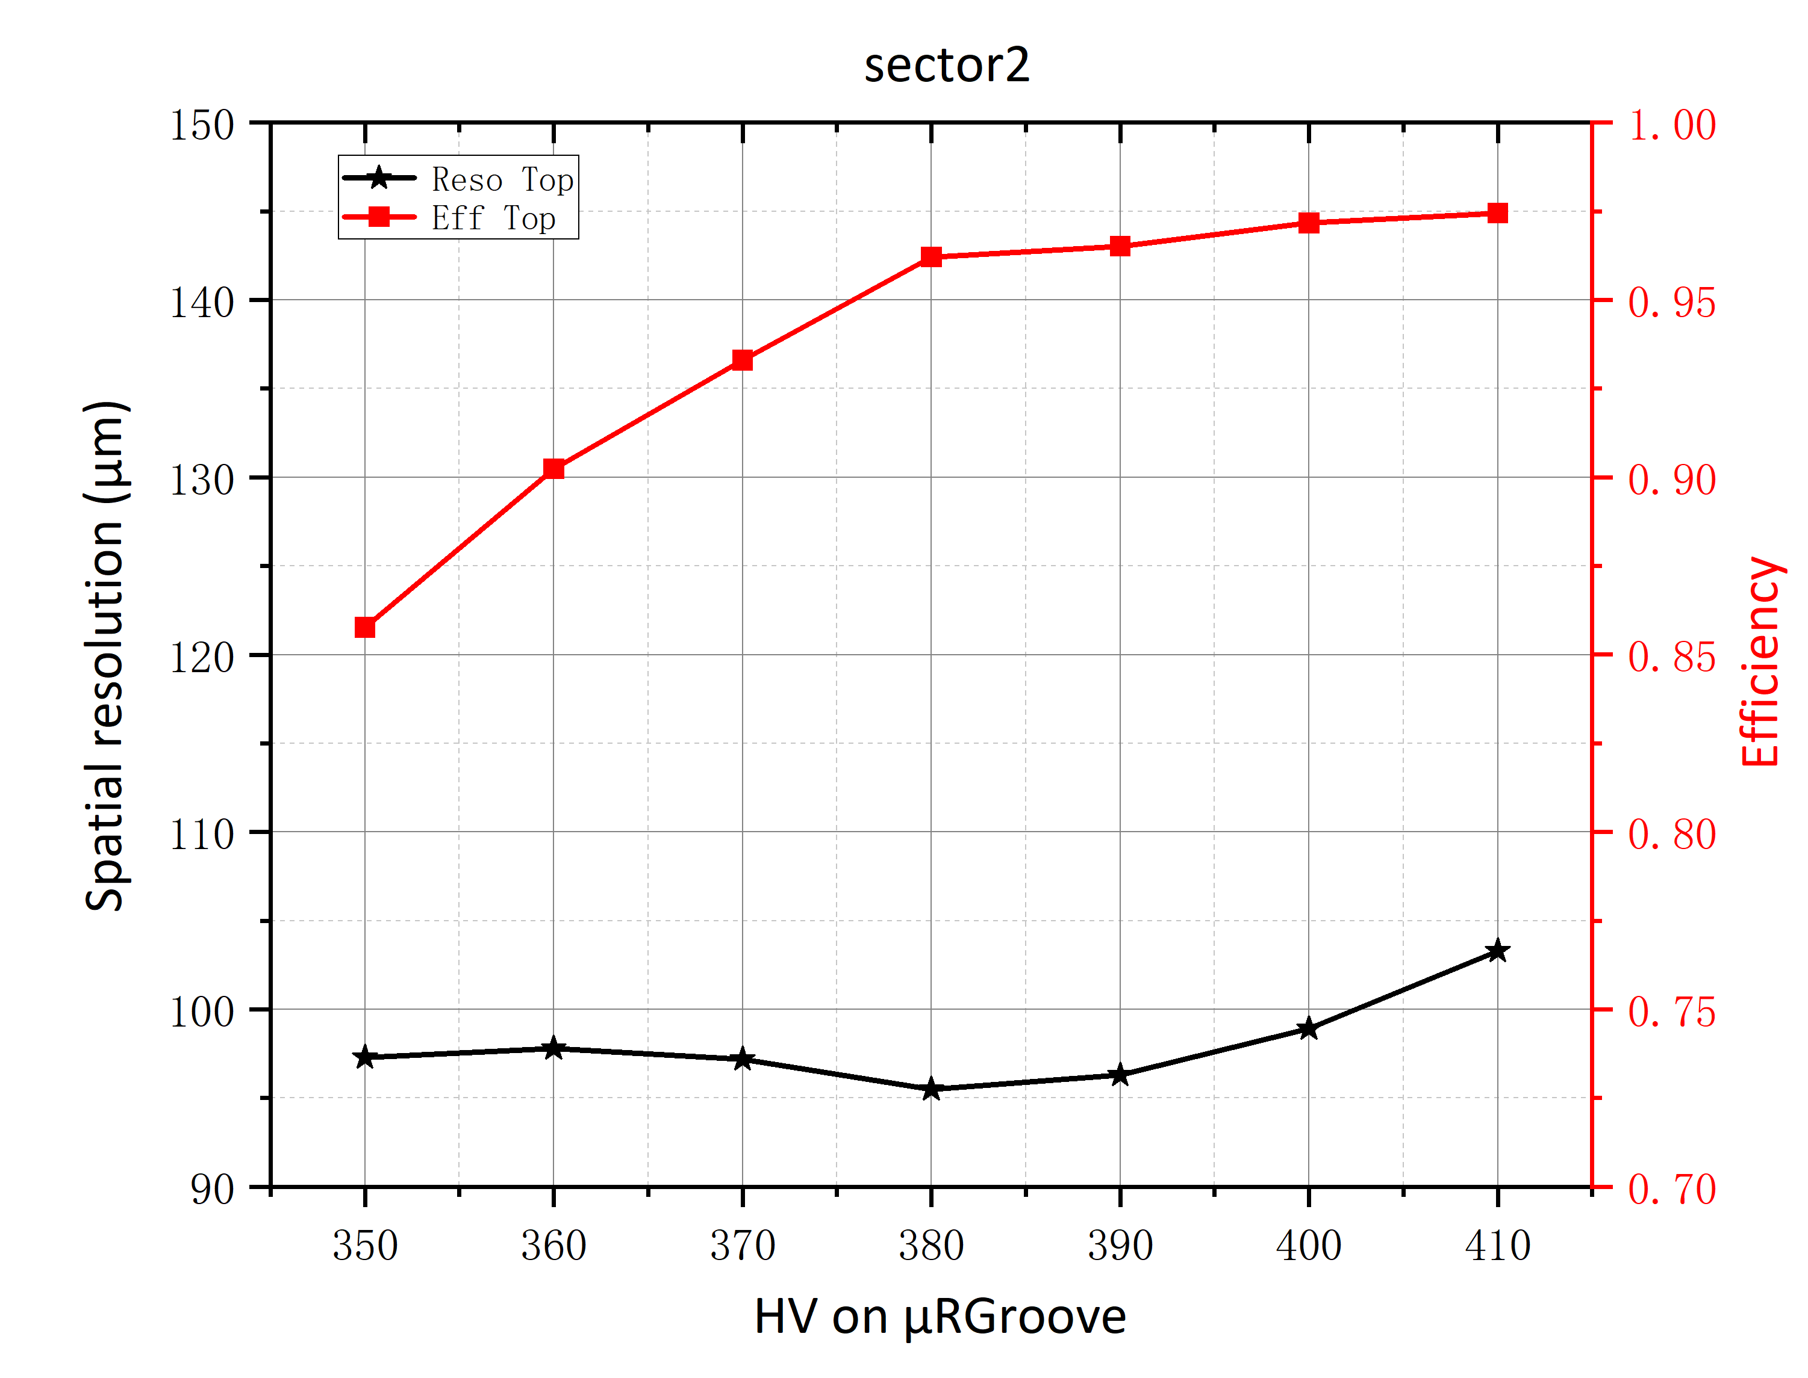
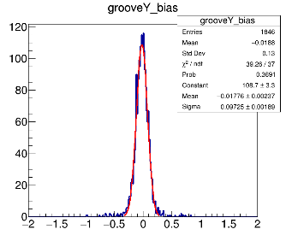
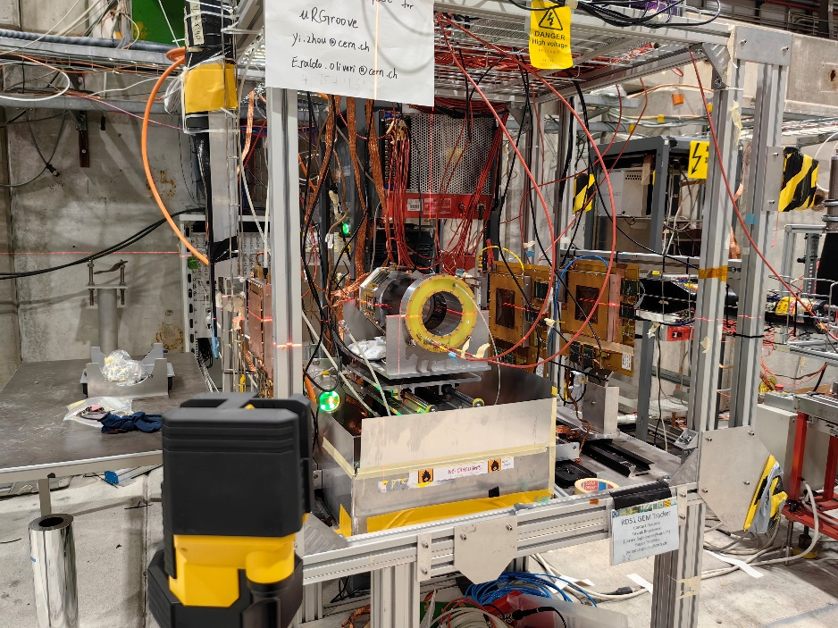
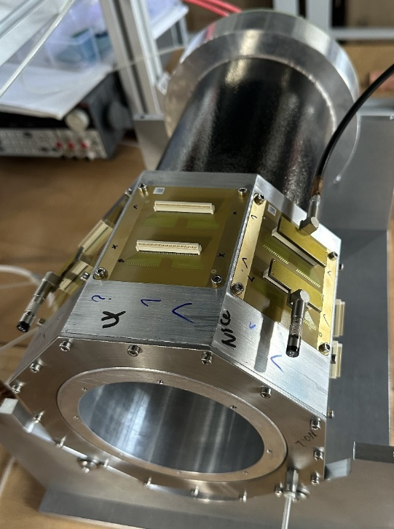
USTC beam test: Cylindrical μRGroove
CC result
Setup：
  Gas: Ar/iC₄H₁₀(95:5) and Ar/CO₂/CF₄(45/15/40)
  Beam: 150GeV/c muon
  Readout from X-strip(top), V-strip grounded
  3×MM Tracker+APV25+SRS+mmDAQ
  CC for the perpendicular and μTPC for the oblique track
USTC Group: Yi Zhou, Siqi He
Spatial resolution by CC：90~100μm
Detection efficiency >95%;
Preliminary results of μTPC：~150μm
7/11/2024
E. Oliveri, K.J.Floethner, Y. Tsipolitis
10

Slide 11
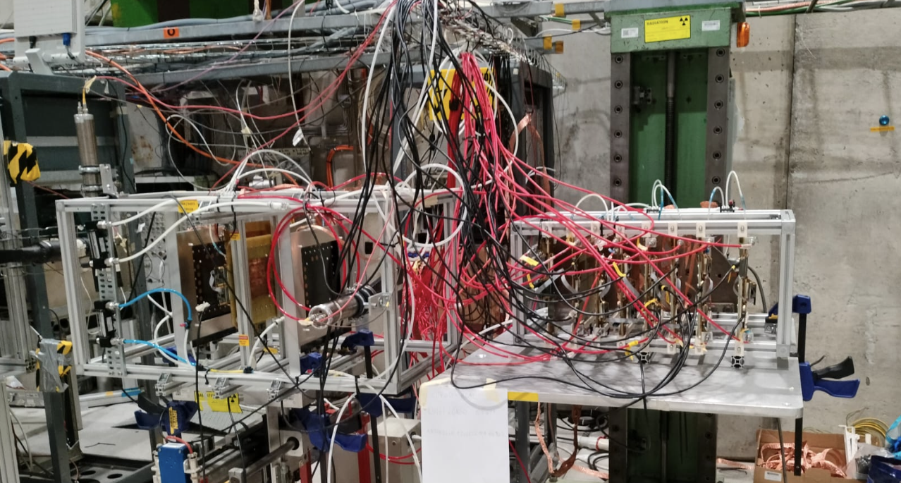
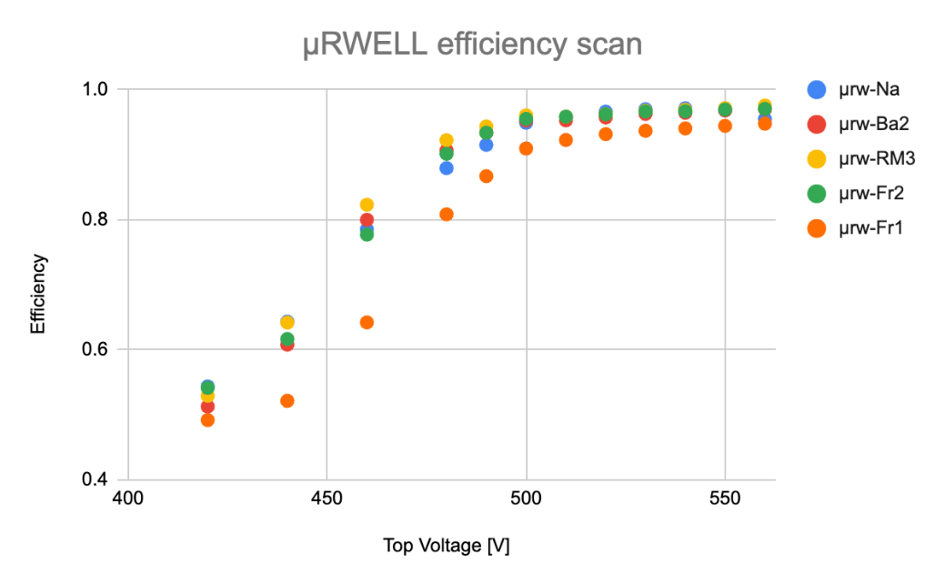
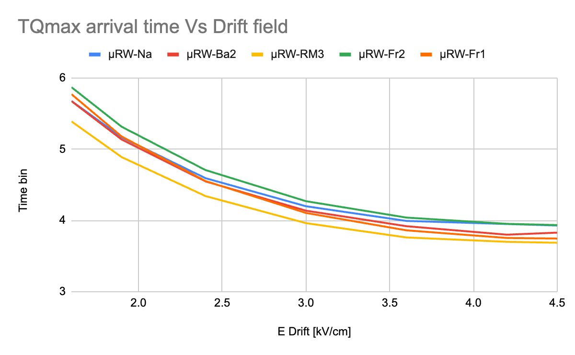
MPGDHCAL
Setup:
Tracker made of:
  2 Micromegas Tmm
  1 GEM with double readout
  2 Scintillators
Calo structure:
  all pad chambers with pad size of 1x1cm2
  3 Micromegas
  5 µRWELL
Tracker
Calo chambers
Measurements:
muons beam:
  HV top/mesh scan
  Drift scan
  X&Y scan
pions beam:
  rate capability
7/11/2024
E. Oliveri, K.J.Floethner, Y. Tsipolitis
11

Slide 12
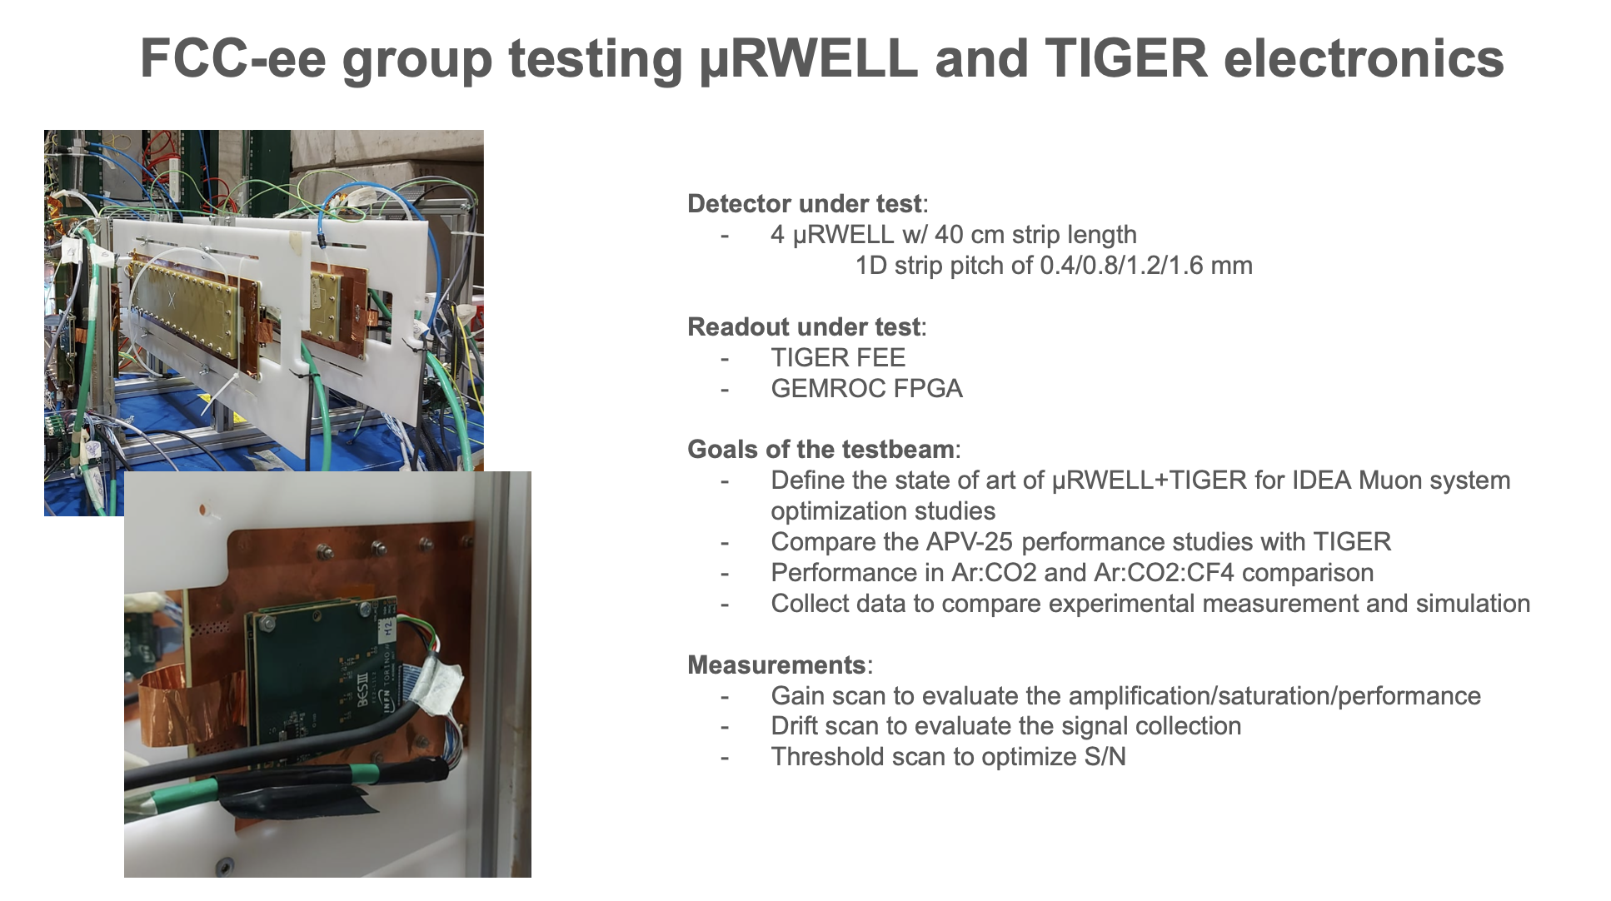
7/11/2024
E. Oliveri, K.J.Floethner, Y. Tsipolitis
12

