Slide 1
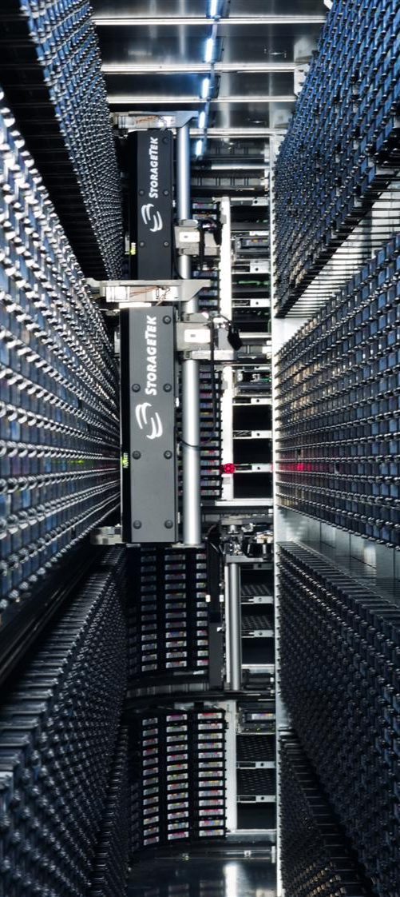
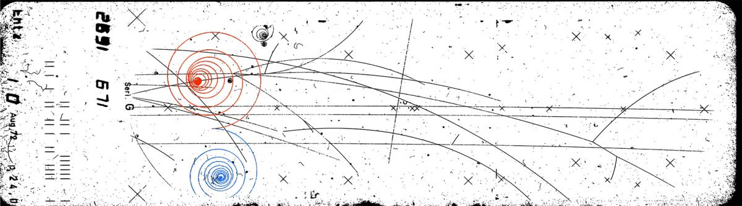

Computing at CERN
0
|
Maite Barroso Lopez CERN IT department

Slide 2
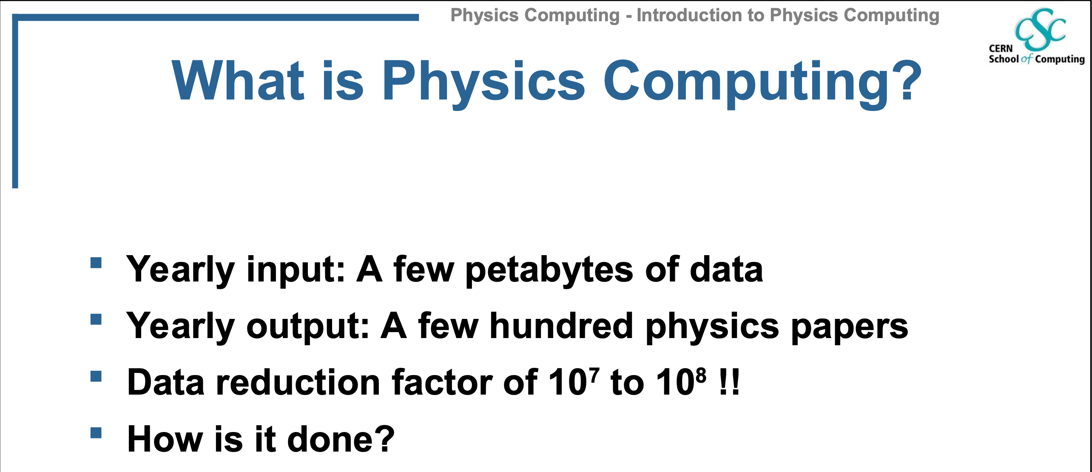

Slide 3
What do we need?
Millions of lines of code (C++,Python, …)
Large infrastructure
  Customized hardware
  PC farms
  Database and storage systems, data management systems
  Distributed analysis facilities
  The grid

Slide 4
What happens to the data?:
Event filtering, tagging and storage
Calibration, alignment
Event reconstruction
Storage
Event simulation
Physics analysis

Slide 5


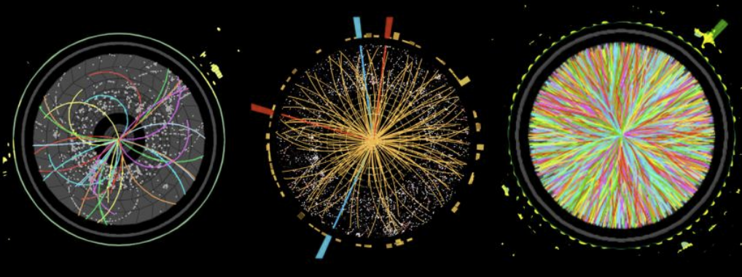
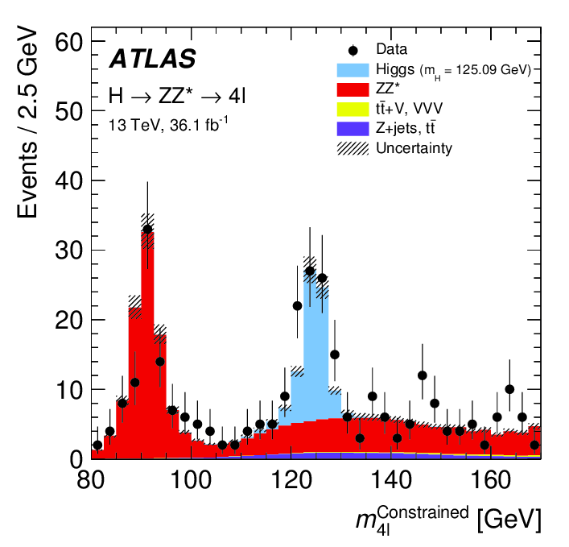

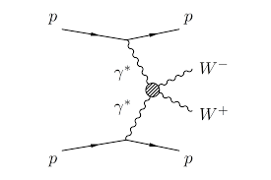




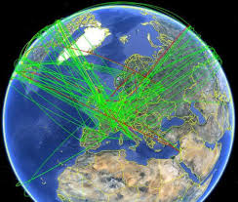





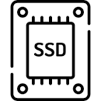
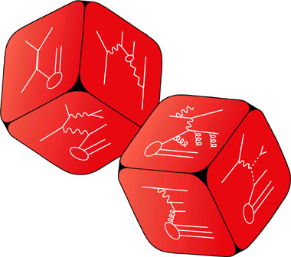
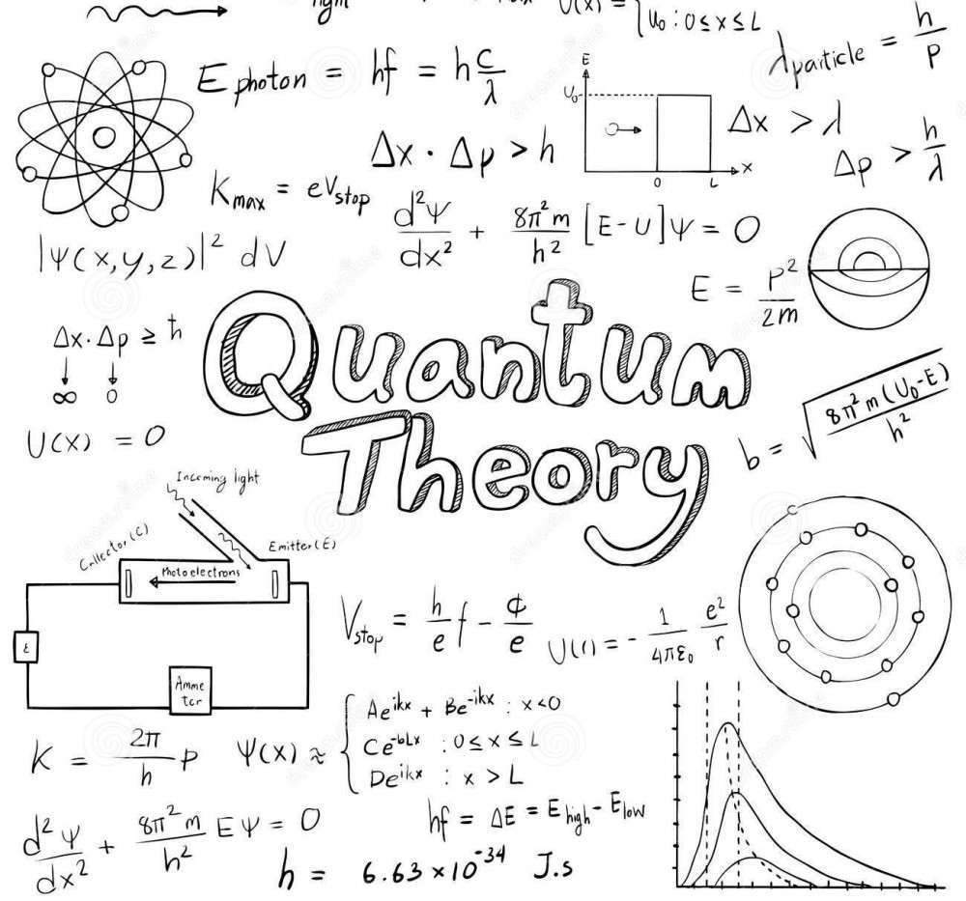

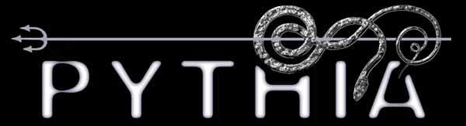

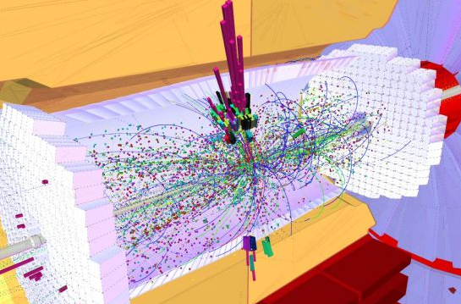






Computing at CERN: the big picture
Data Recording and Archive
Data Acquisition
(trigger)
Detector Data
Data Reconstruction
and Derivation
Data
Analysis
Event Generation^{(part. inter.)} Simulation^{(int. w/ det.)}
Digitization^{(simul detector resp)}
Preservation: Data and Analysis
Simulated Data
HPCs
Computing at CERN - International Teachers Programme - xavier.espinal@cern.ch

Slide 6
Step by step
Each step involves some data reduction
  data are discarded (online)
  data are compressed (offline)
In each step the data get closer to be interpretable in
physical terms
Some steps are repeated many times until the output is
satisfactory (offline reprocessing)

Slide 7
Our Data Generators
Experimental physics is about DATA!
CERN experiments transfer all data to the Computing Center
Data is stored and ready to be processed, analyzed and shared

Slide 8
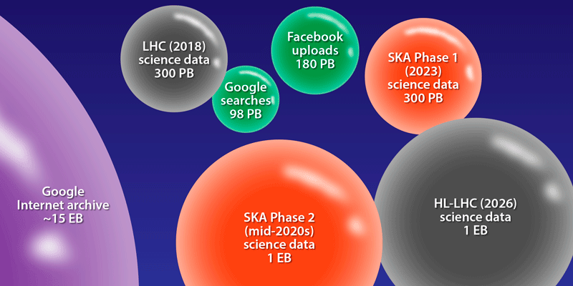
A comparison of the yearly data volumes of current and future projects:
Credits: APS/Alan Stonebraker and V. Gülzow/DESY

Slide 9

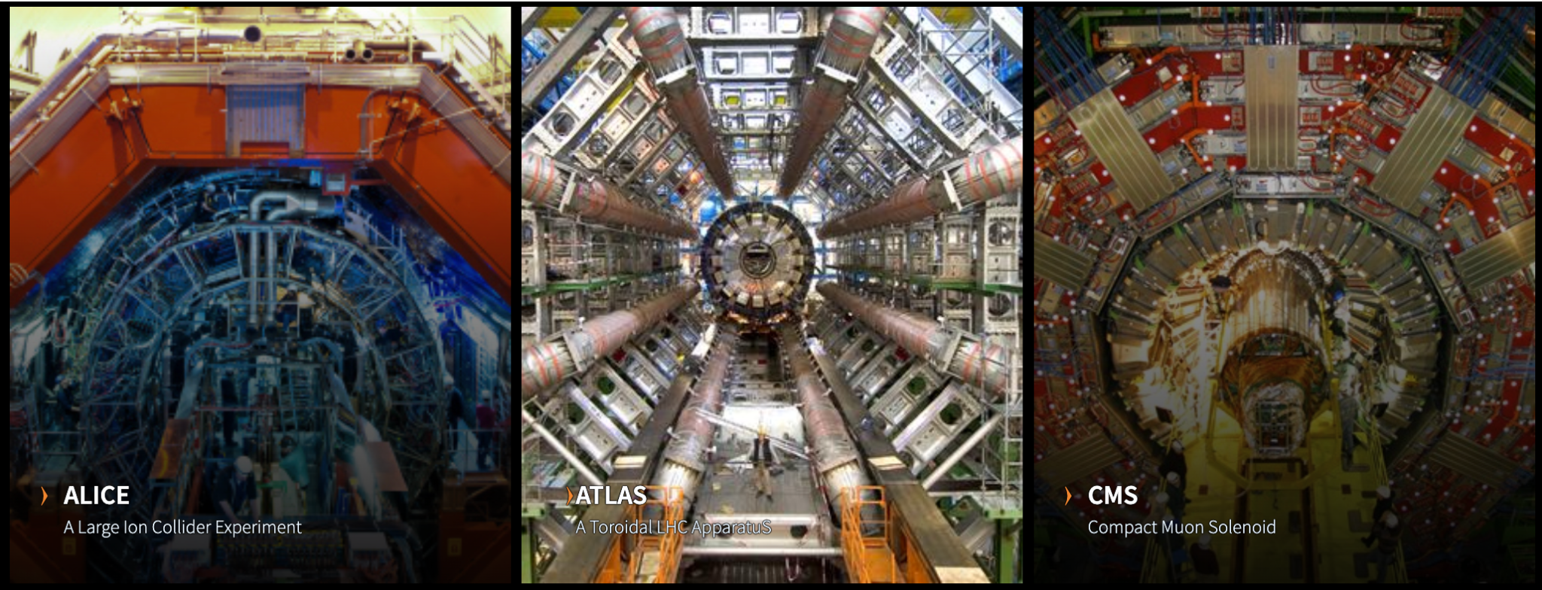
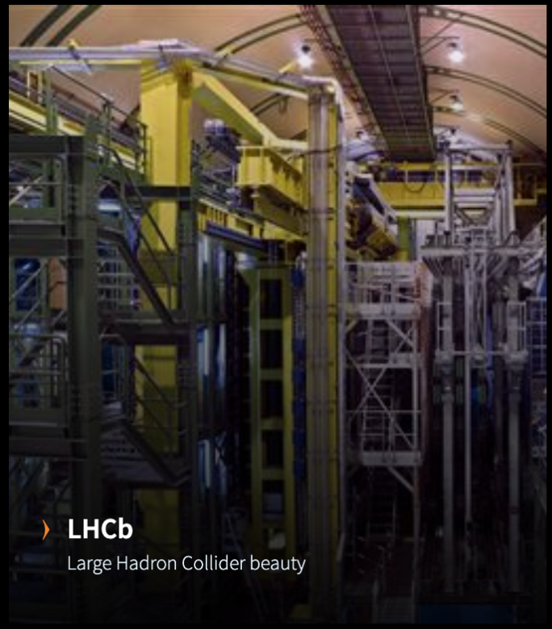
LHC Experiments: the big 4
heavy-ion physics, strongly interacting matter at extreme energy densities (quark-gluon plasma)
General-purpose:Higgs boson, extra dimensions, dark matter
General-purpose:Higgs boson, extra dimensions, dark matter
CP violation in the interactions of b-hadrons: matter-antimatter asymmetry of the Universe.
A computing perspective: O(10-100) Pb/year, 0.5M running jobs (continuous), fat and long-haul networks

Slide 10
Plus more experimets
Fix target (COMPASS, CLOUD, NA64, etc)
Antimatter (AEGIS, ALPHA, etc)
Non-accelerator (AMS, CAST, OSCAR)
Experimental facilities (ISOLDE, Medicis, n_TOF, Neutrino platform)

Slide 11

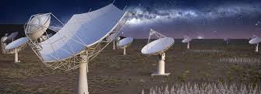
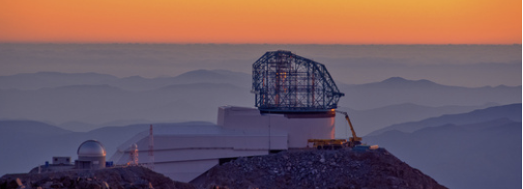


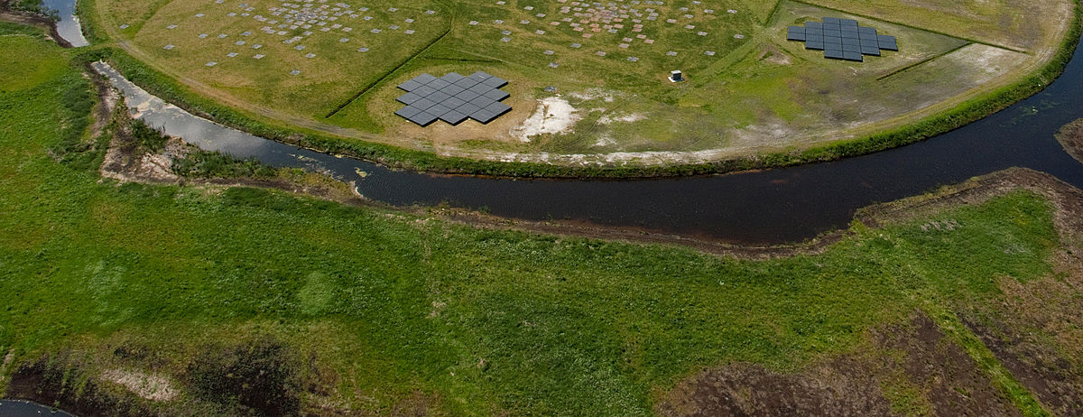
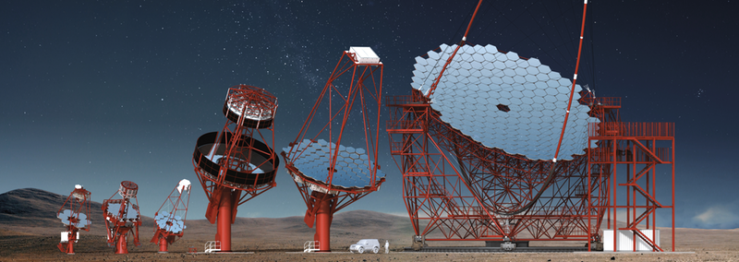


Astroparticle Physics and Radio Astronomy
Knowledge transfer and expertise sharing among large ESFRIs on scientific computing
Data Recording from remote sources

Slide 12
Computing at CERN: the big picture
Data Recording and Archive
Data Acquisition
(trigger)
Detector Data
Data Reconstruction
and Derivation
Data
Analysis
Event Generation^{(part. inter.)} Simulation^{(int. w/ det.)}
Digitization^{(simul detector resp)}
Preservation: Data and Analysis
Simulated Data
HPCs
Computing at CERN - International Teachers Programme - xavier.espinal@cern.ch

Slide 13
Online versus offline
Online
  In real time, fast!
  Decisions are irreversible
  Data cannot be recovered
Offline
  From almost real time to long delays
  Decisions can be reconsidered
  Data can be reprocessed

Slide 14
Online processing
Overall guideline in designing trigger system: what are the essential features of interesting physics in the detectors?
Trigger: event selection
Primary (design) collision rate: 40 MHz
Recording rate: a few hundred Hz to kHz
How is this achieved?
          Multi-level trigger – chain of yes/no decisions
      Very fast first level: (Programmable) hardware
      Slower higher level(s): Software on specialized or
      commodity processors
Has to be reliable
Rejected data are lost forever
Continuous monitoring
Do not lose new physics!
Must therefore be open to many different signatures of potentially new physics in the detector system
Data Recording and Archive
Data Acquisition
(trigger)
Detector Data
Data Reconstruction
and Derivation
Data
Analysis
Event Generation^{(part. inter.)} Simulation^{(int. w/ det.)}
Digitization^{(simul detector resp)}
Preservation: Data and Analysis
Simulated Data
HPCs
Computing at CERN - International Teachers Programme - xavier.espinal@cern.ch

Slide 15
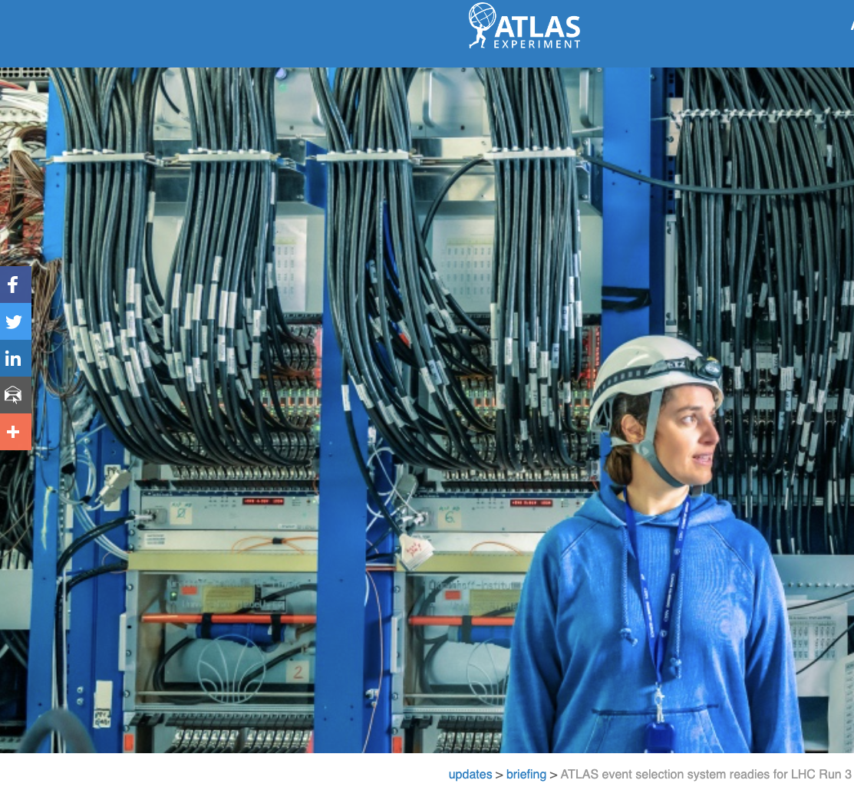
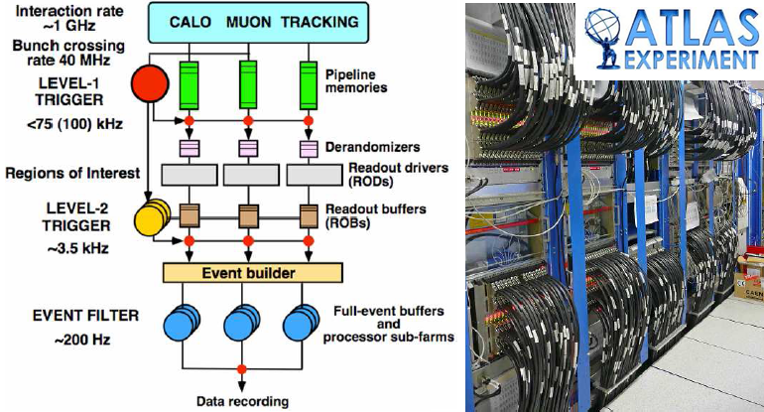
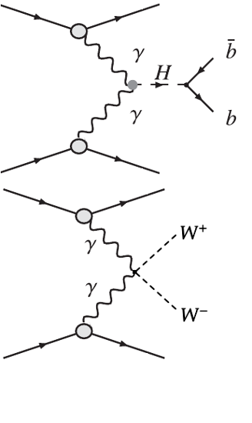
Online processing
Data Recording and Archive
Data Acquisition
(trigger)
Detector Data
Data Reconstruction
and Derivation
Data
Analysis
Event Generation^{(part. inter.)} Simulation^{(int. w/ det.)}
Digitization^{(simul detector resp)}
Preservation: Data and Analysis
Simulated Data
HPCs
Computing at CERN - International Teachers Programme - xavier.espinal@cern.ch

Slide 16
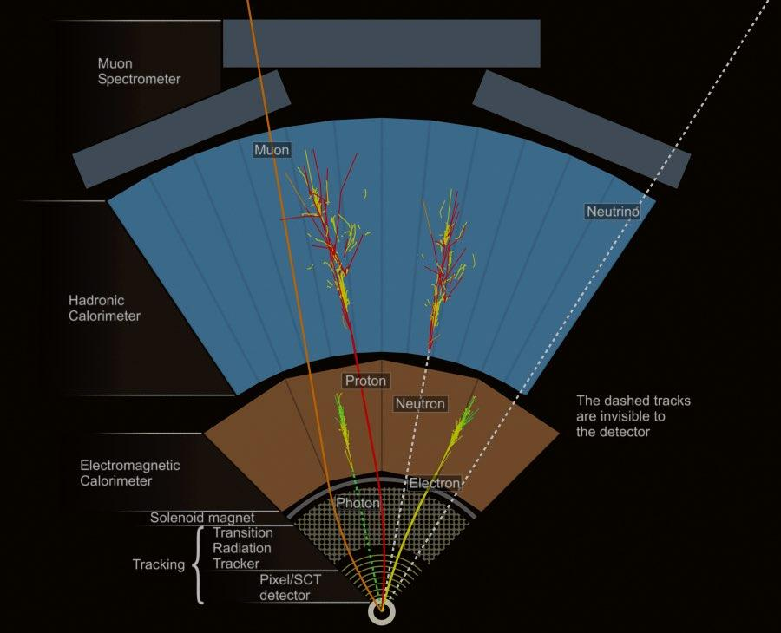
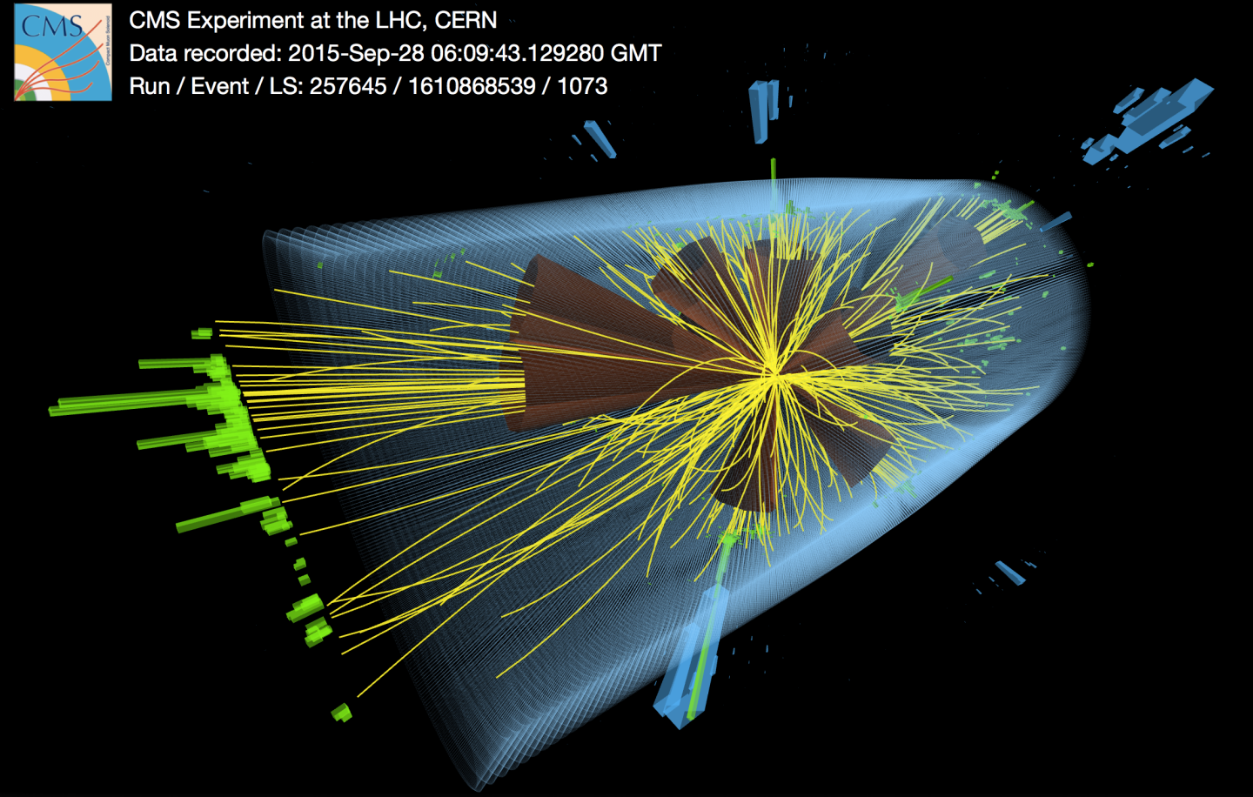
From the Hit to the Bit: DAQ
  100 million channels
  40 million pictures a second
  Synchronised signals from all detector parts

Slide 17
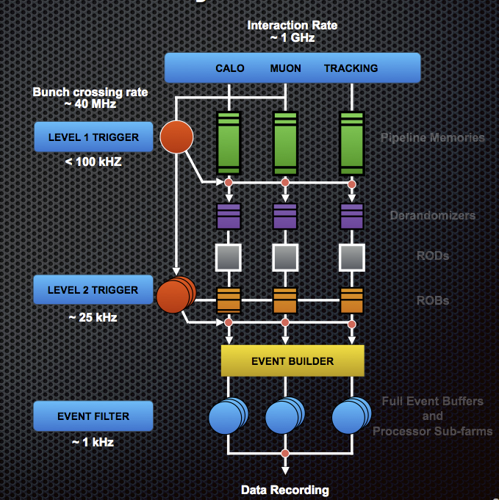
From the Hit to the Bit: event filtering
L1: 40 million events per second
  Fast, simple information
  Hardware trigger in a few microseconds
L2: 100 thousand events per second
  Fast algorithms in local computer farm
  Software trigger in <1 second
EF: Few 100 per second recorded for study

Slide 18
From the Hit to the Bit: event filtering
L1: 40 million events per second
  Fast, simple information
  Hardware trigger in a few microseconds
L2: 100 thousand events per second
  Fast algorithms in local computer farm
  Software trigger in <1 second
EF: Few 100 per second recorded for study
1PB/s: few hundred trillion euros/yr !!!
From 40 MHZ to 100kHz

Slide 19
From the Hit to the Bit: event filtering
L1: 40 million events per second
  Fast, simple information
  Hardware trigger in a few microseconds
L2: 100 thousand events per second
  Fast algorithms in local computer farm
  Software trigger in <1 second
EF: Few 100 per second recorded for study
1PB/s: few hundred trillion euros/yr !!!
From 40 MHZ to 100kHz
We keep ~1 event in a million
From 100 kHZ to 25kHz

Slide 20
From the Hit to the Bit: event filtering
L1: 40 million events per second
  Fast, simple information
  Hardware trigger in a few microseconds
L2: 100 thousand events per second
  Fast algorithms in local computer farm
  Software trigger in <1 second
EF: Few 100 per second recorded for study
1PB/s: few hundred trillion euros/yr !!!
From 40 MHZ to 100kHz
We keep ~1 event in a million
From 100 kHZ to 25kHz
From 25 kHZ to few kHz
Final data rates ~10 GB/s

Slide 21
Offline computing
Data Recording and Archive
Tier-0 processing (CERN)
Archive raw data on mass storage
First event reconstruction without or with a small delay
Archive reconstructed data on mass storage
A few hundred kByte/event, depending on physics
Reconstructed objects (hits/clusters, tracks, vertices, jets,
electrons, muons)
Send raw and processed data to LHC Grid for analysis
Data Acquisition
(trigger)
Detector Data
Data Reconstruction
and Derivation
Data
Analysis
Event Generation^{(part. inter.)} Simulation^{(int. w/ det.)}
Digitization^{(simul detector resp)}
Preservation: Data and Analysis
Simulated Data
HPCs
Computing at CERN - International Teachers Programme - xavier.espinal@cern.ch

Slide 22
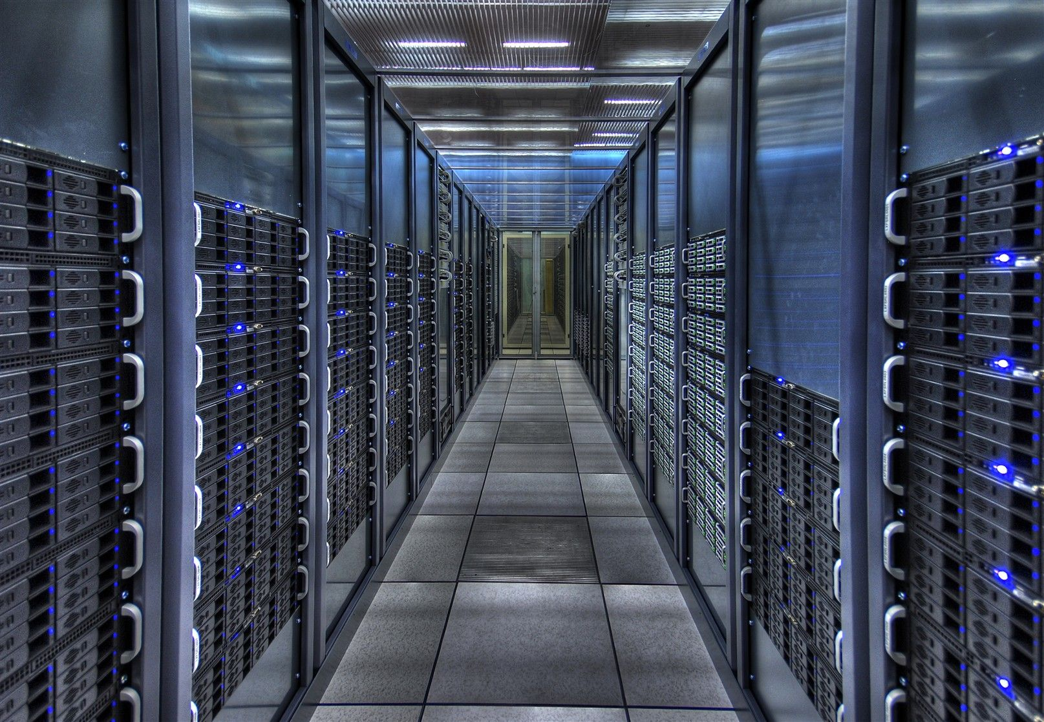
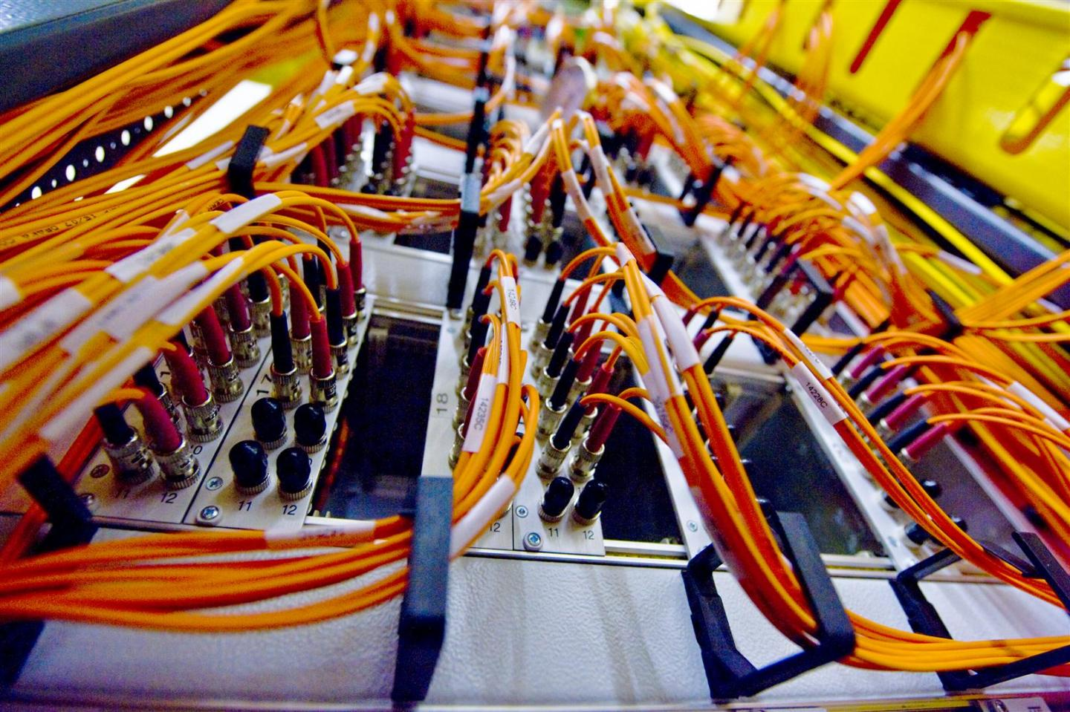
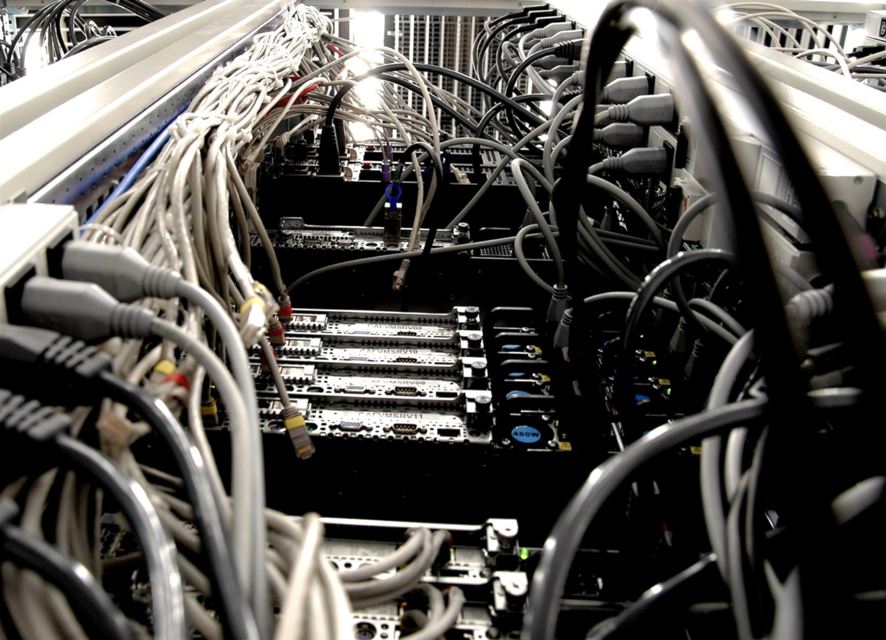

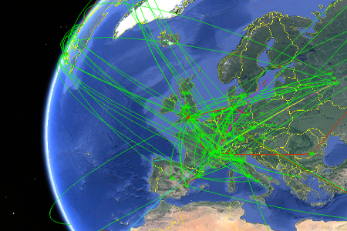

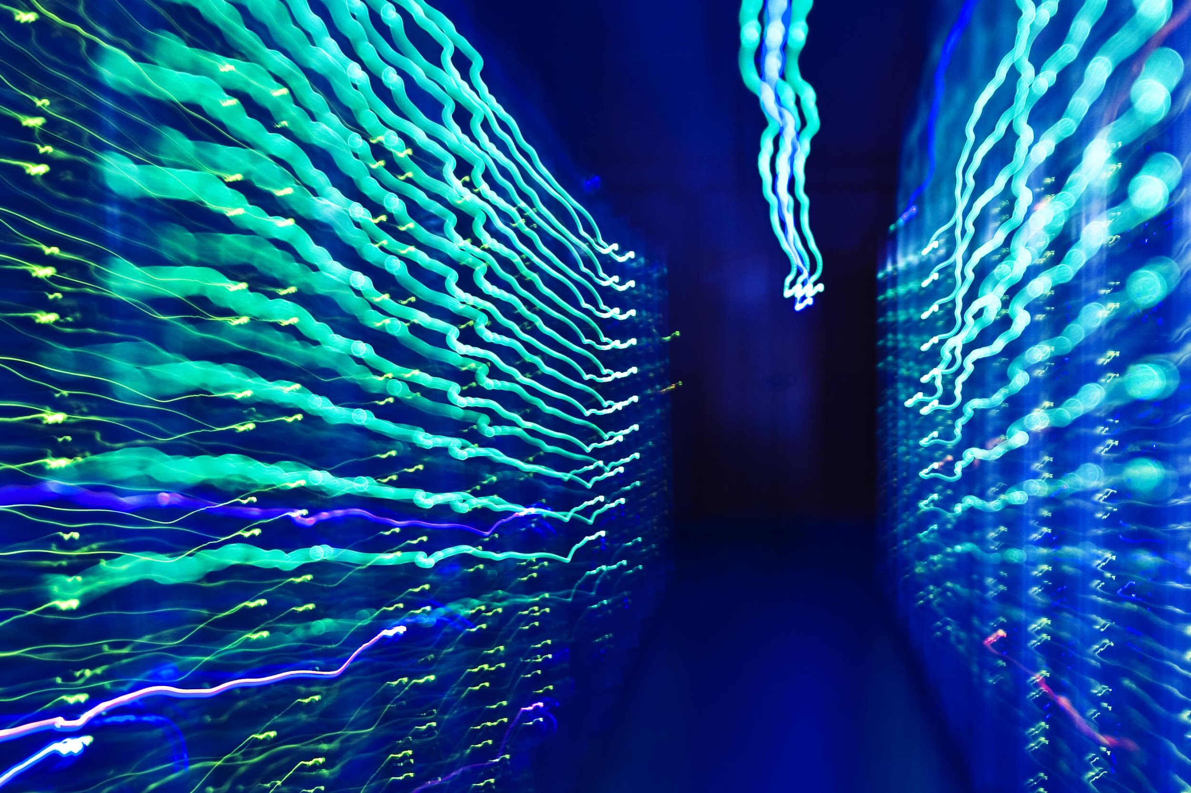
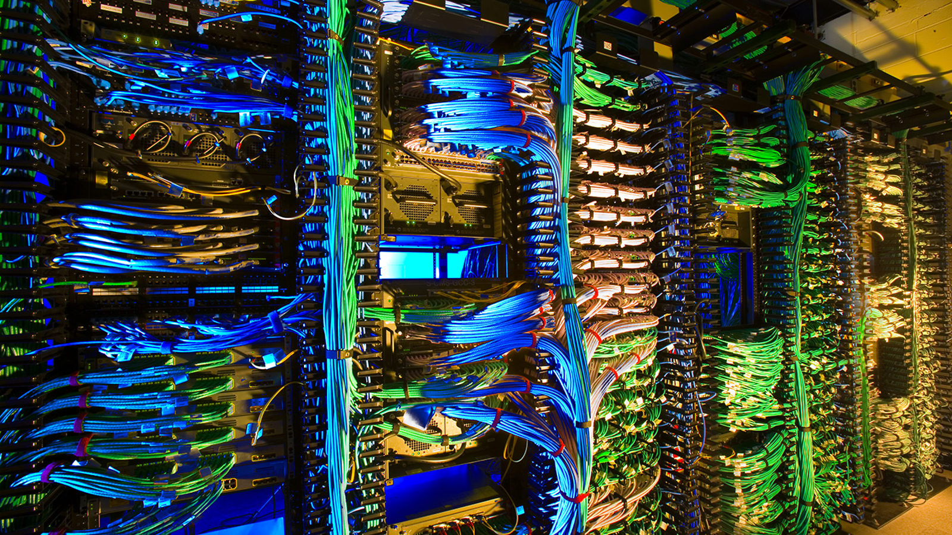
CERN IT Department
Facilities
Network
Data Processing
Data Storage
CERN IT Department
Distributed Computing
Applications and devices
DataBases

Slide 23
Offline computing
Calibration: Convert raw data to physical quantities
Alignment: Find out precise detector positions
Event reconstruction:
  Reconstruct particle tracks and vertices (interaction points)
  Identify particle types and decays
Simulation:
  Generate artificial events resembling real data as closely as possible
  Needed for background studies, corrections, error estimation, …

Slide 24
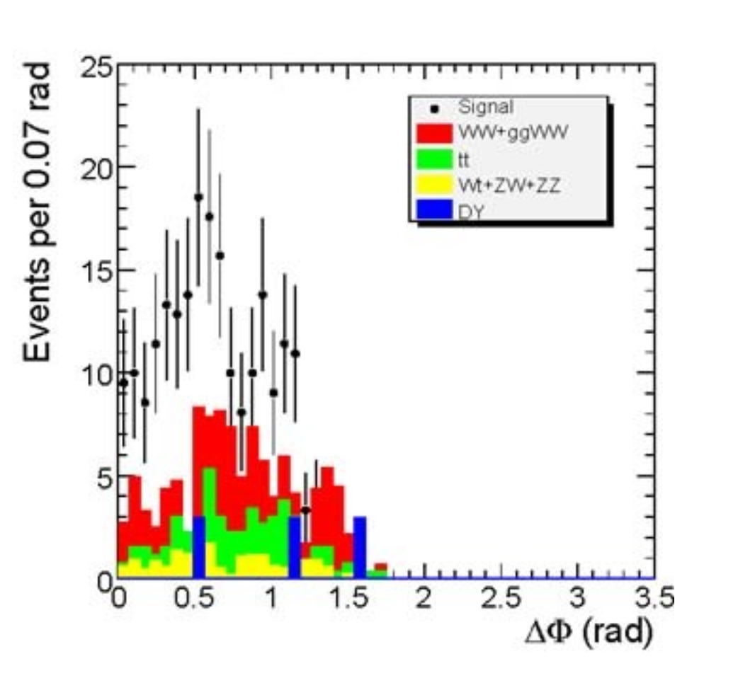
Offline: data analysis
Extract physics signals from
background
  Compute masses, cross-sections, branching ratios, discovery limits, …
Requires sophisticated multivariate techniques
Distributed: Physics analysis takes place in many labs all over the world

Slide 25

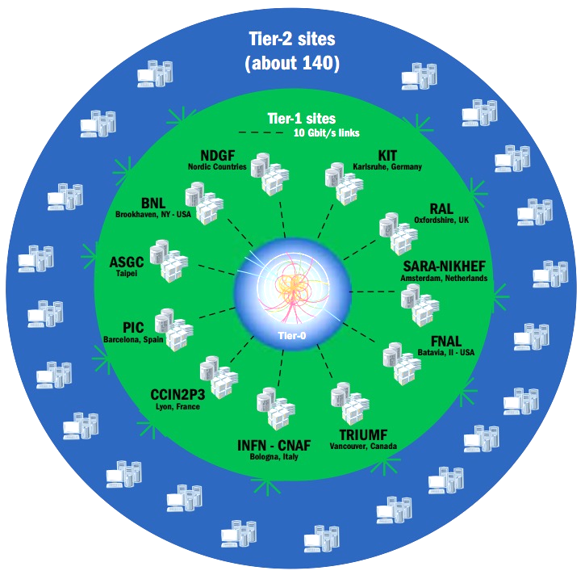
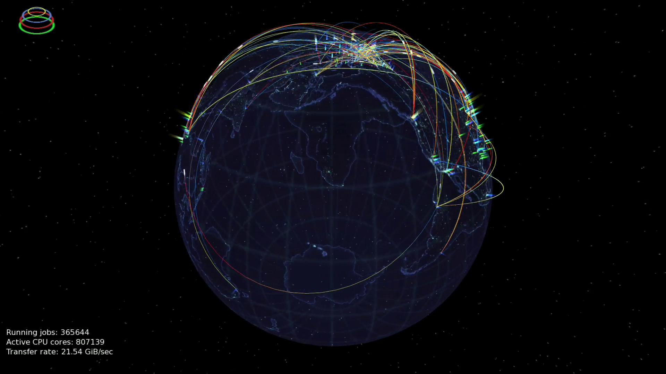
The Worldwide LHC Computing Grid
WLCG provides global computing resources to store, distribute and analyse the LHC data

Slide 26
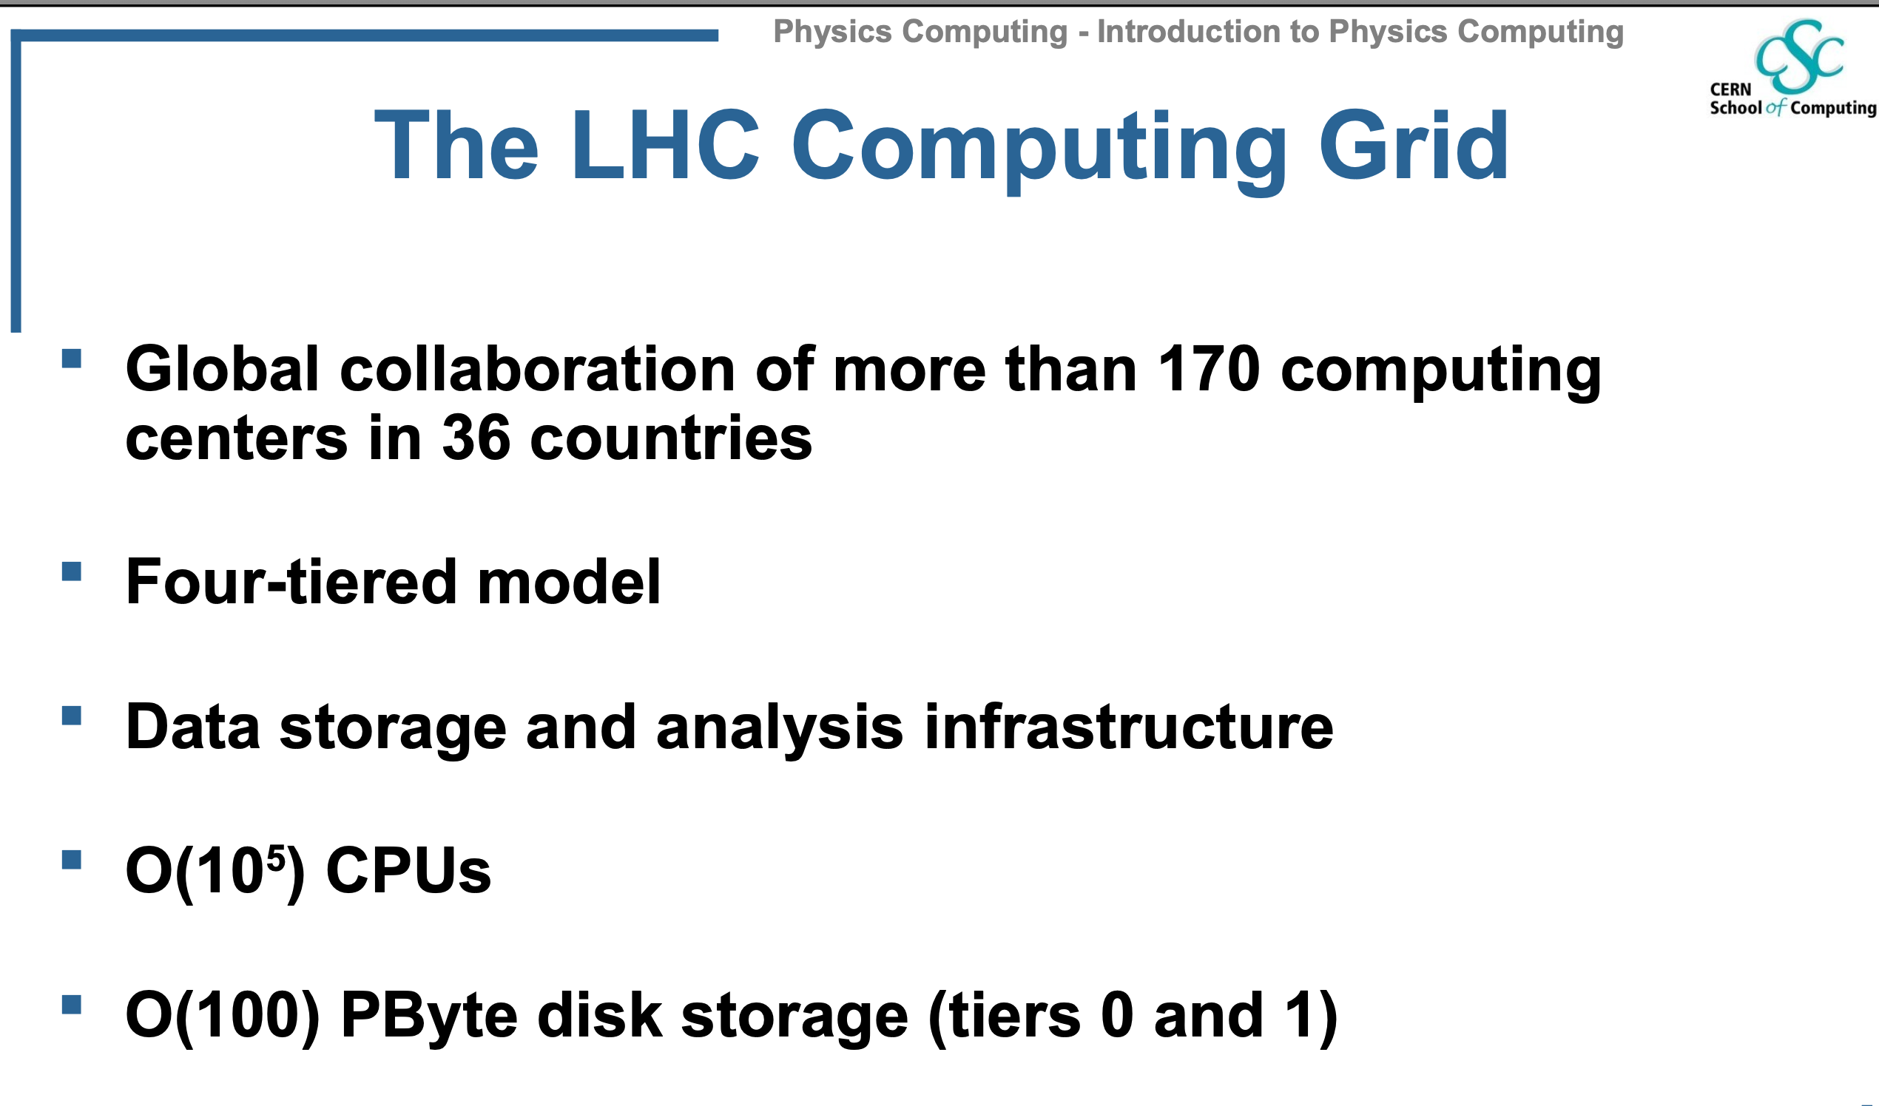

Slide 27
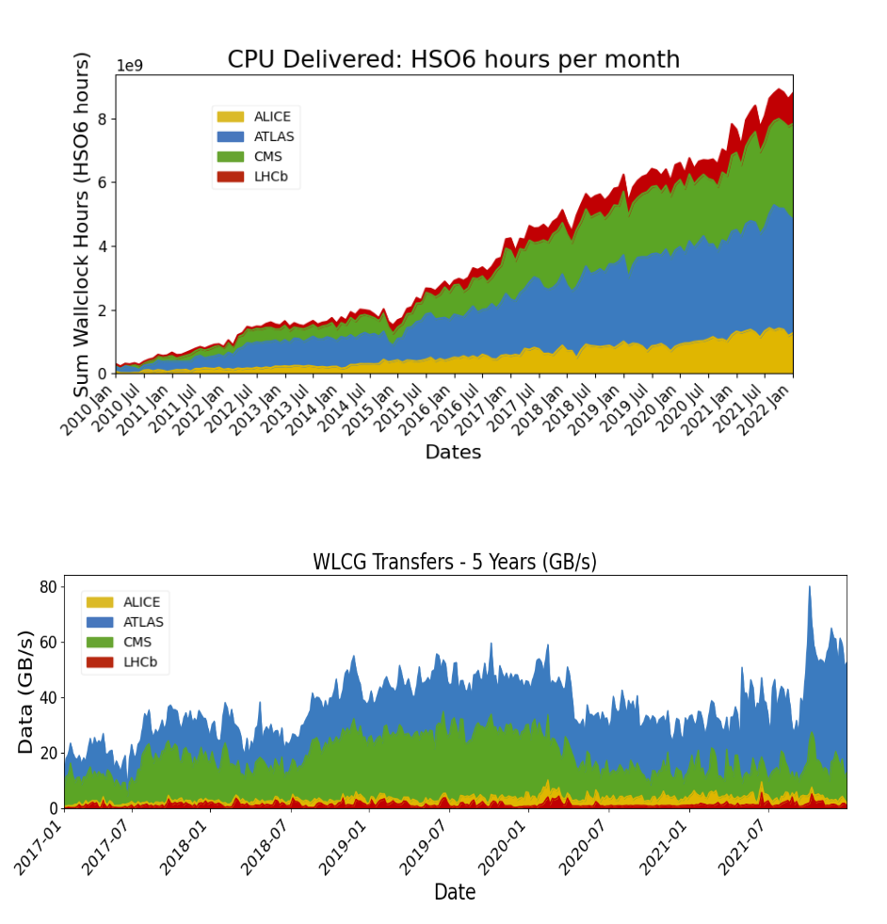
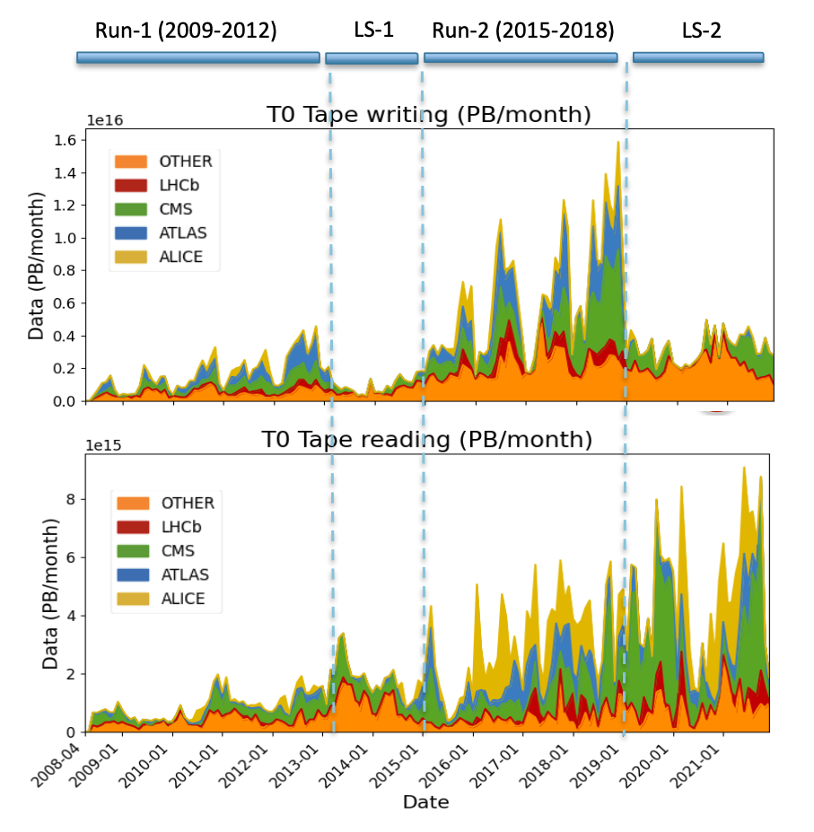
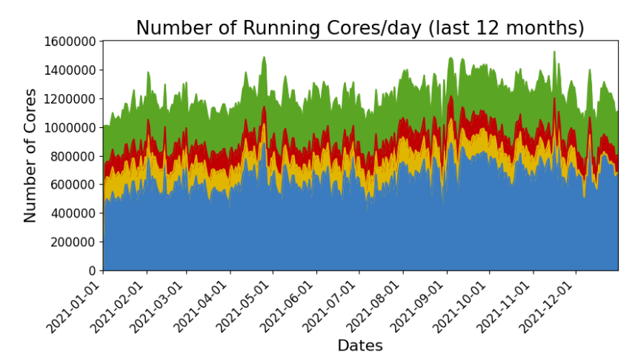
The Worldwide LHC Computing Grid
(10PB)
Data Archive Only (tapes)
(1PB)

Slide 28
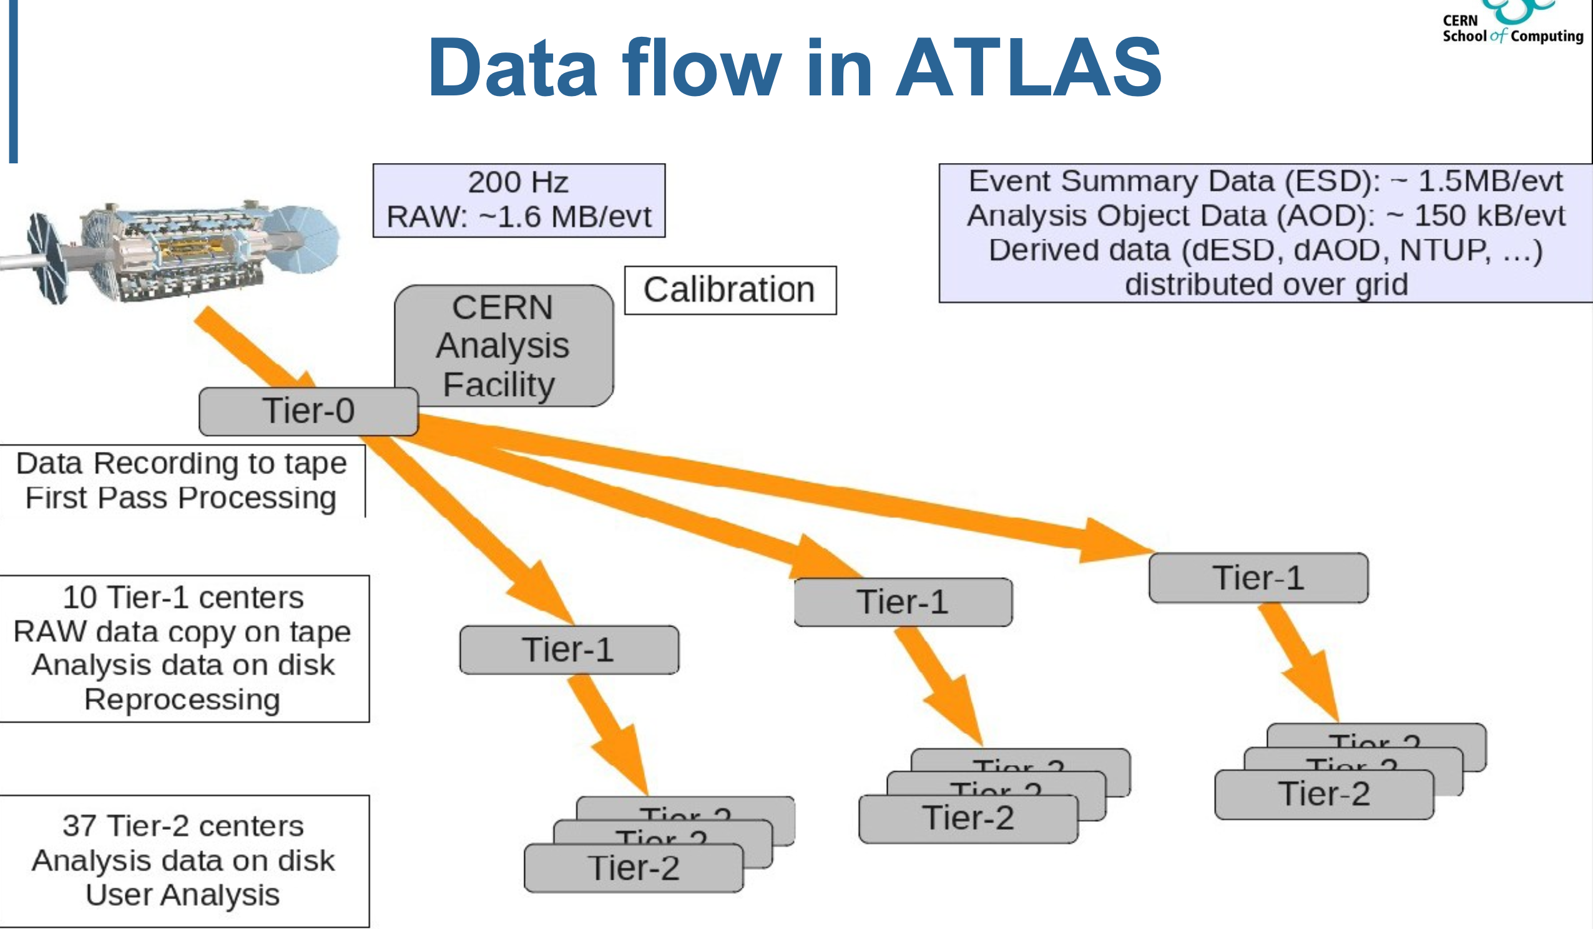

Slide 29
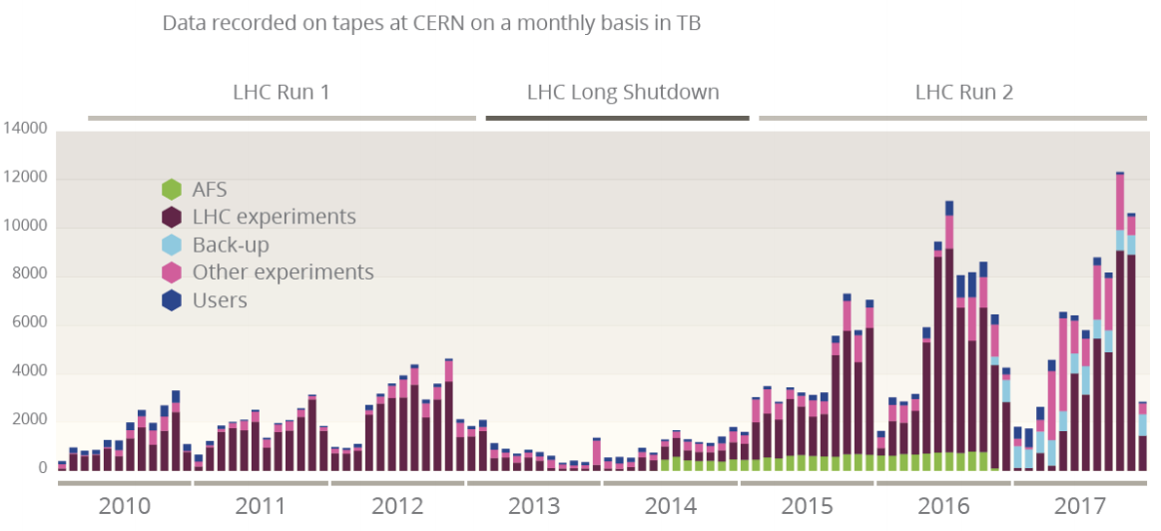
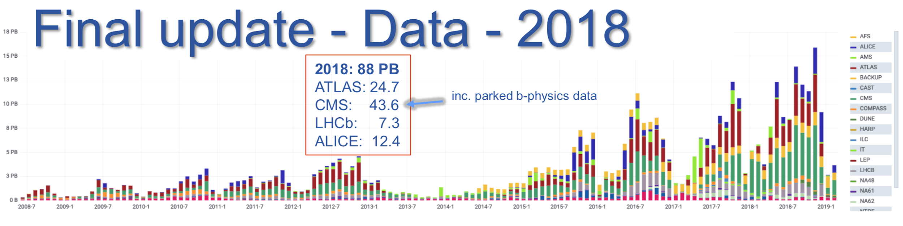
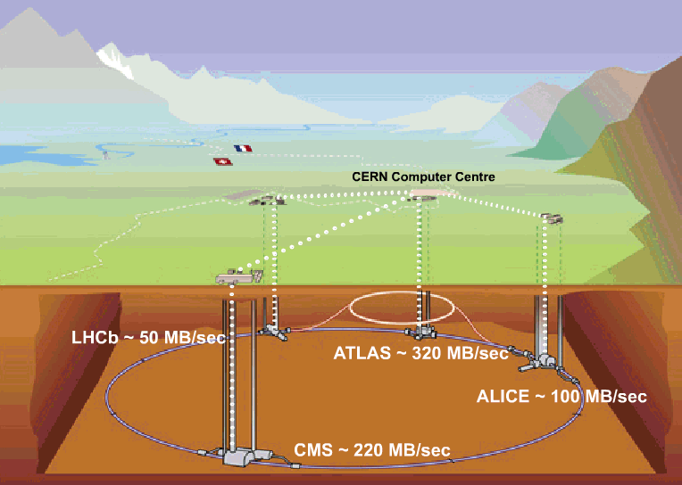
The last LHC Run: data recording
LHC Experiments recorded 88 Petabytes of data in 2018 (15.8PB only in November)
The LHC data is aggregated at the CERN data centre to be stored, processed and distributed
Ian Bird@WLCG-OB
~0.5GB/s
~3GB/s
~ 4GB/s (Heavy Ion Run)
~3GB/s

Slide 30
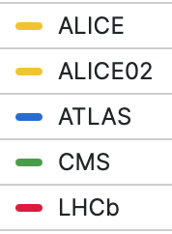
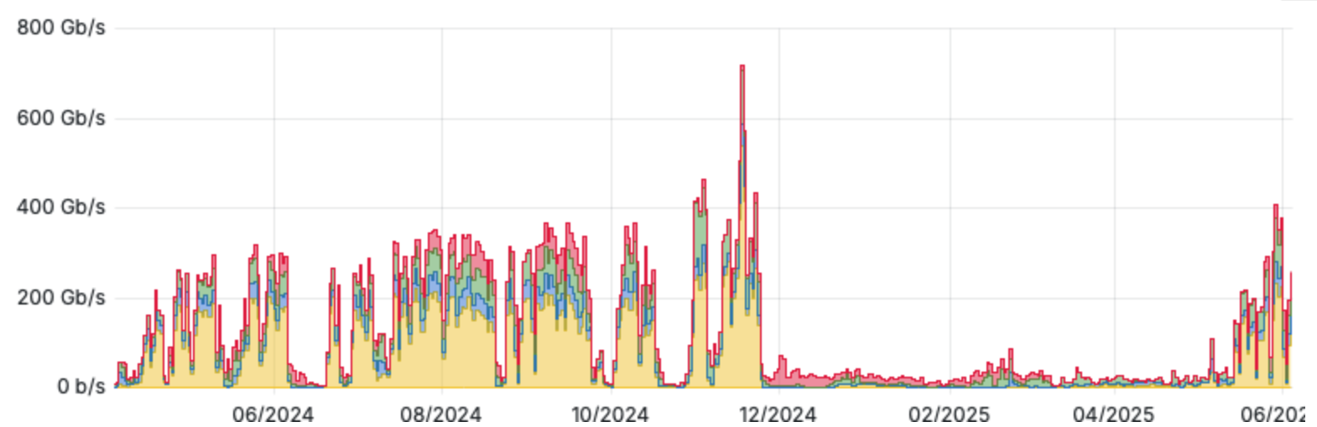
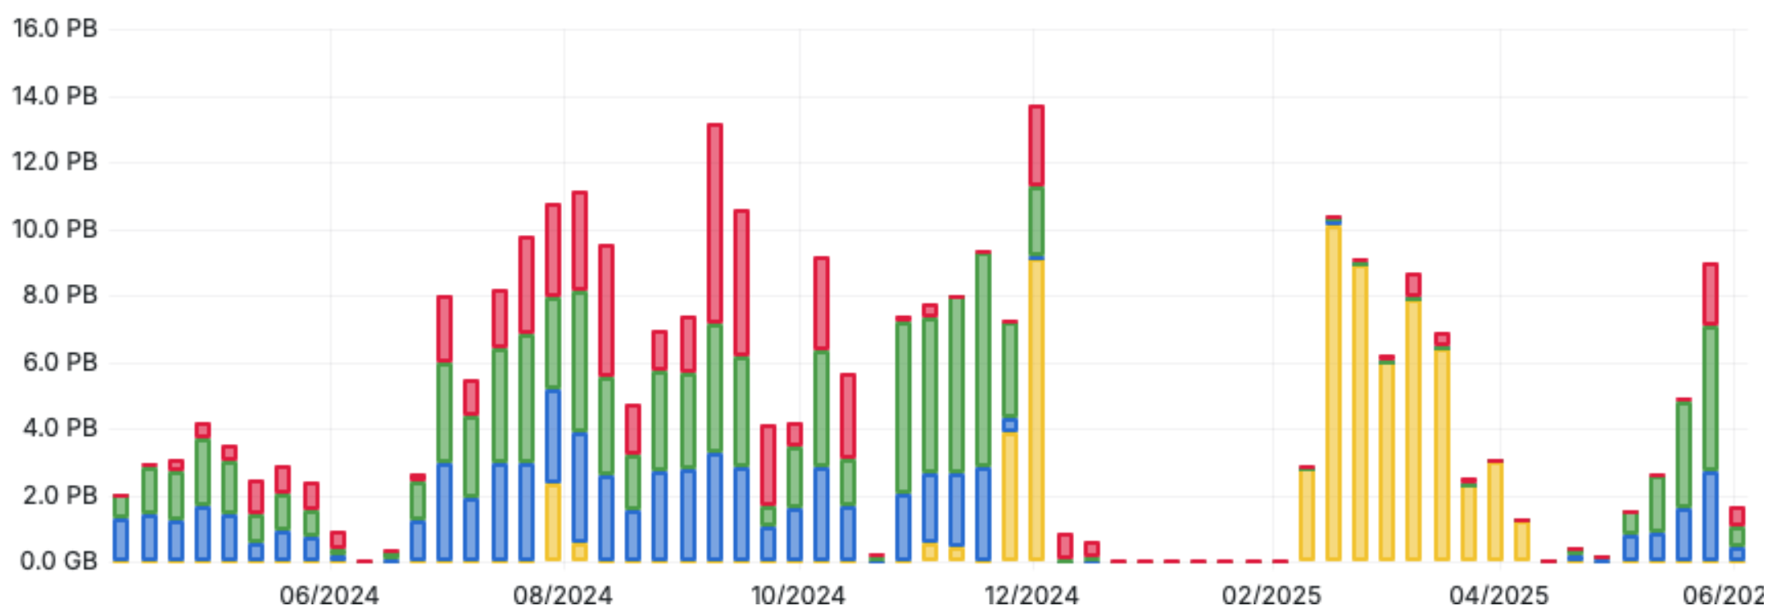
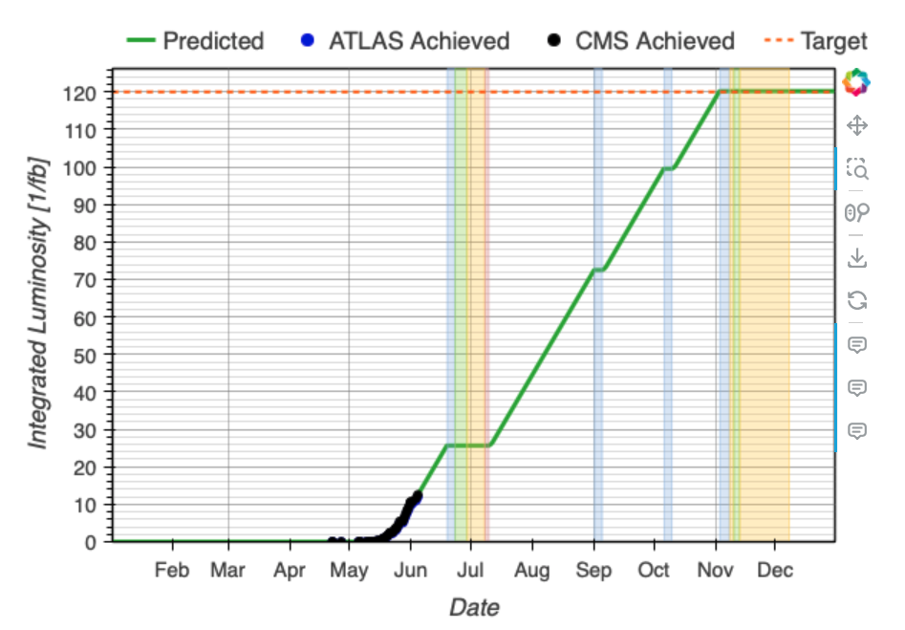
2025 LHC Data Taking
Daily average data rate from experiments to T0 (Gb/s)
The 2025 LHC data taking started
Data rates higher than in 2024 for the same period, inline with expectations
CERN and generally WLCG services running smoothly
2024 HI
2025 pp
2024 pp
EYETS
Recorded data into the CERN tape archive (PB/week)

Slide 31
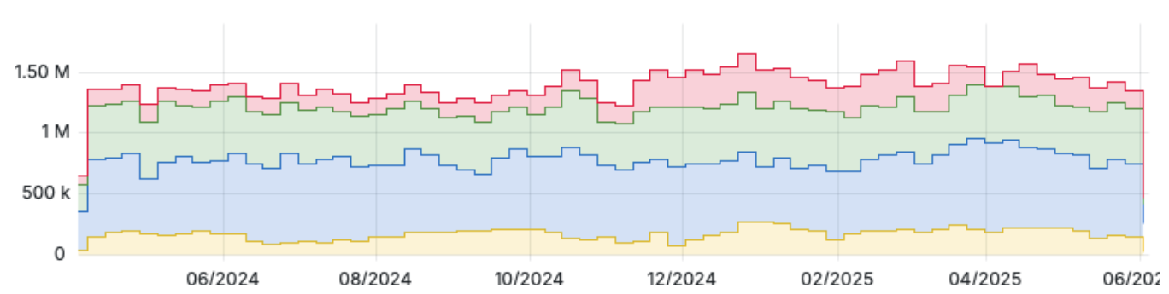
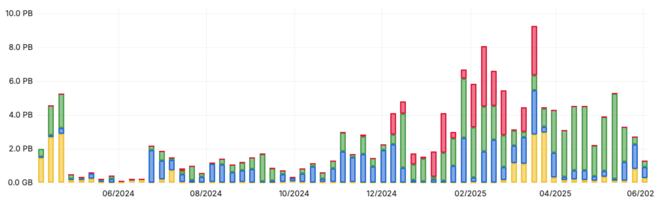
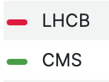
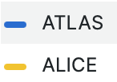
LHC data processing
Number of cores in use (WLCG pledge + opportunistic)
Experiments leveraging all WLCG available cores …
… plus ~50% extra opportunistic capacity (including HLTs and HPCs)
pledge
2024 LHC Run
EYETS
2025 LHC Run
Intense reprocessing campaigns during EYETS recalling data from tape systems
Volume of data recalled from CERN tape (PB/week)

Slide 32

HL-LHC: a computing challenge

Slide 33


Slide 34


Slide 35


Slide 36
CERN Data Center
Built in the 70s on the CERN site (Meyrin,Geneva)
  3.5 MW for equipment
Hardware generally based on commodity
  10,000 servers, providing 500,000 processor cores (14.000 VMs)
  120,000 disk drives providing 0.6EB disk space (1EB=1000PB)
  40,000 tapes drives, providing 0.5EB capacity (1EB=1000PB)

Slide 37

Green IT
PUE
3.0
2.0
1.0
Achievable w/best practices
and efficient equipment
Less efficient
More efficient
DCiE
33%
50%
100%
Power Usage Effectiveness (PUE): Total Facility Energy / IT Facility Energy

Slide 38
Take-away (1)
Computing is instrumental for science. Detectors and sensors evolving: growing IT demands.
  LHC raw data rates are PB/s scale but lowered to GB/s after data filtering
CERN remains largest scientific repository in the world
Scientific data already at the Exabyte scale:
  1EB = 1.000PB = 1.000.000 TB = 1.000.000.000 GB
(1TB is your computer)
(100 GB is your smartphone)

Slide 39
Take-away (2)
A bright future of HEP ahead of us: many questions to answer, discoveries made accessible thanks to the HL-LHC program
More events, more complex, at a finer granularity
  Processing and analysing them is a challenge for us
  To be faced with a constantly evolving hardware landscape
Two elements which help succeeding: parallelism and heterogeneity
Interesting times for motivated scientists-engineers!
A lot has been achieved, but a lot still needs to be done

Slide 40
Credits
Xavier Espinal (material from previous years)
Danilo Pipparo (tCSC 2024)
Simone Campana (WLCG material)
Arnulf Quadt (CERN School of Computing 2024)

