Slide 1
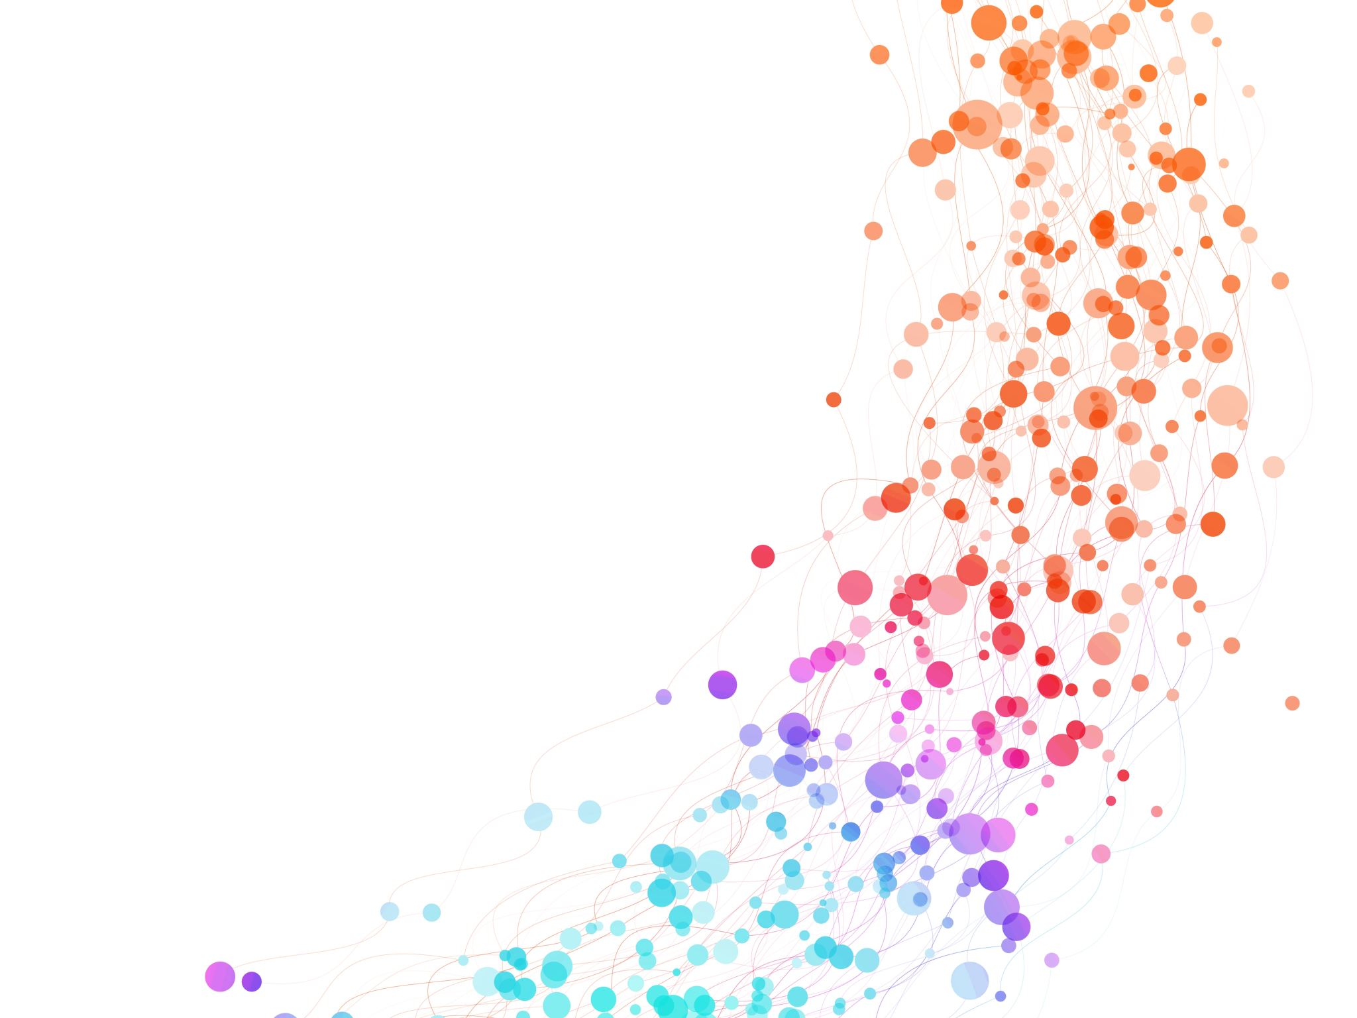


Concept Maps
Session 1
Milena Vujanović
University of Leeds (UK) & CERN (Switzerland)
International High School Teacher Programme 2025
7th July 2025

Slide 2
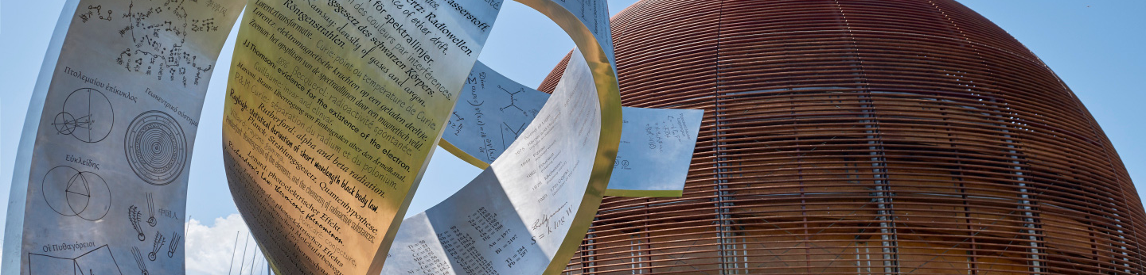

Introduction to Concept Maps
Graphic organisers of knowledge
Need to answer a focus question
Consist of key concepts and links

Slide 3
Introduction to Concept Maps
Connected!
Consists of key concepts and links
Consists of key concepts and links
Consists of key concepts and links
Consists of key concepts and links
Milena loves CERN.
Milena loves CERN.
Milena loves CERN.
Hierarchical Structure!

Slide 4
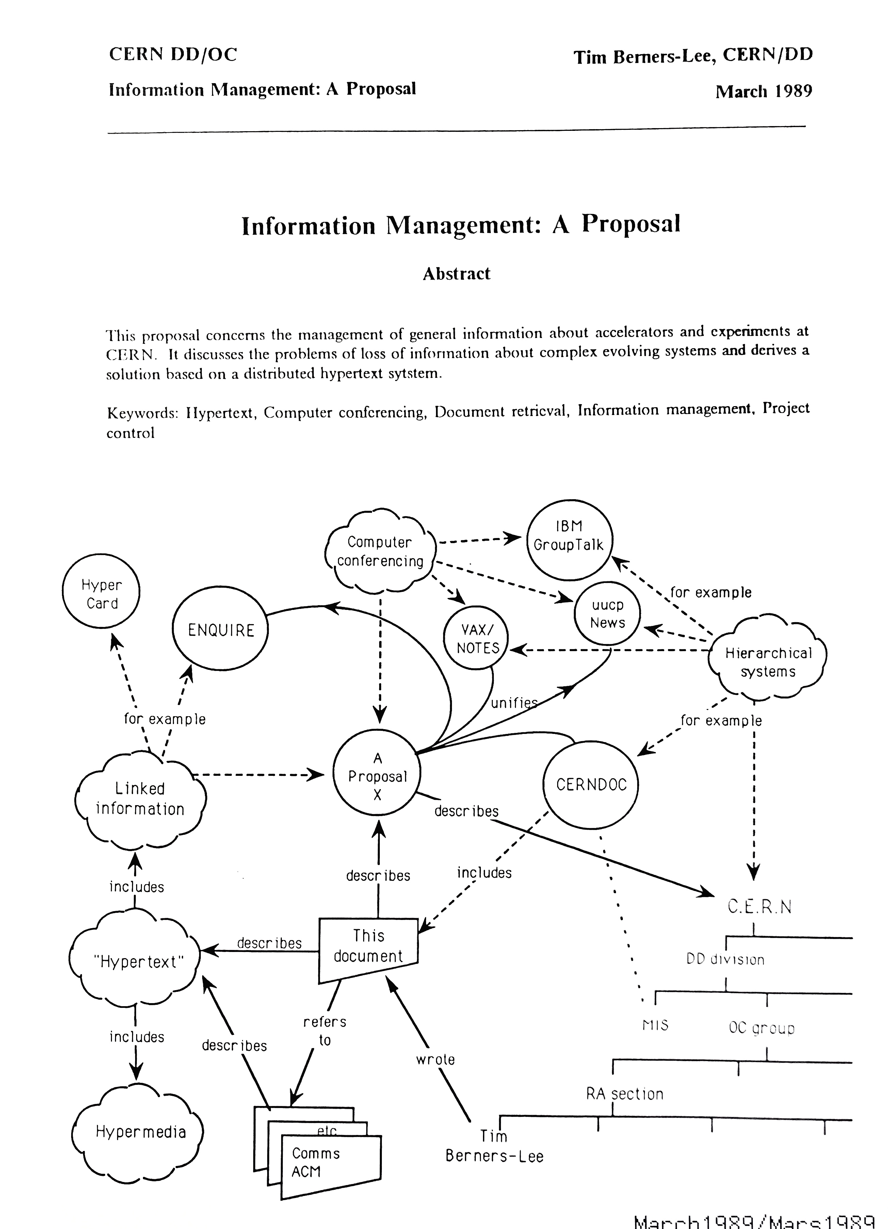
Milena loves to read.
Milena loves to read.
Milena loves to read.

Slide 5
Motivation – Why do we do this?
It is benefticial to you, because:
this will help you organise your knowledge
you will learn how to use concept maps in your classroom
It is benefticial to me, because:
I will get my PhD! ☺

Slide 6
How do you construct a concept map?
Focus question
What do you know about Hogwarts?
2) Stop and think!
Choose a starting concept and 2-5 key concepts

Slide 7
What do you know about Hogwarts?
2-5 key concepts
Link
School for magic
Students
Hogwarts
7

Slide 8
What do you know about Hogwarts?
2-5 key concepts
Link and use ARROWS
School for magic
Students
Hogwarts
8

Slide 9
What do you know about Hogwarts?
2-5 key concepts
Link and use ARROWS and LINKING WORDS !!!
School for magic
Students
is a
Hogwarts
has
VERY IMPORTANT!
9

Slide 10
What do you know about Hogwarts?
2-5 key concepts
Link and use ARROWS and LINKING WORDS !!!
Expand
SECRET TIP !!!
… and expand some more
attend
School for magic
Students
has
is a
Hogwarts
has
has many
are sorted in
attend
Secret Rooms
has
Four houses
Classes
e.g.
Gryffindor
Chamber of Secrets
e.g.
are
e.g.
Hufflepuff
Flying
e.g.
Potions
created
Ravenclaw
was opened by
Slytherin
Transfiguration
is heir of
USE EXAMPLES !!!
Voldemort
was a
10

Slide 11
Now, it is your turn!

Slide 12
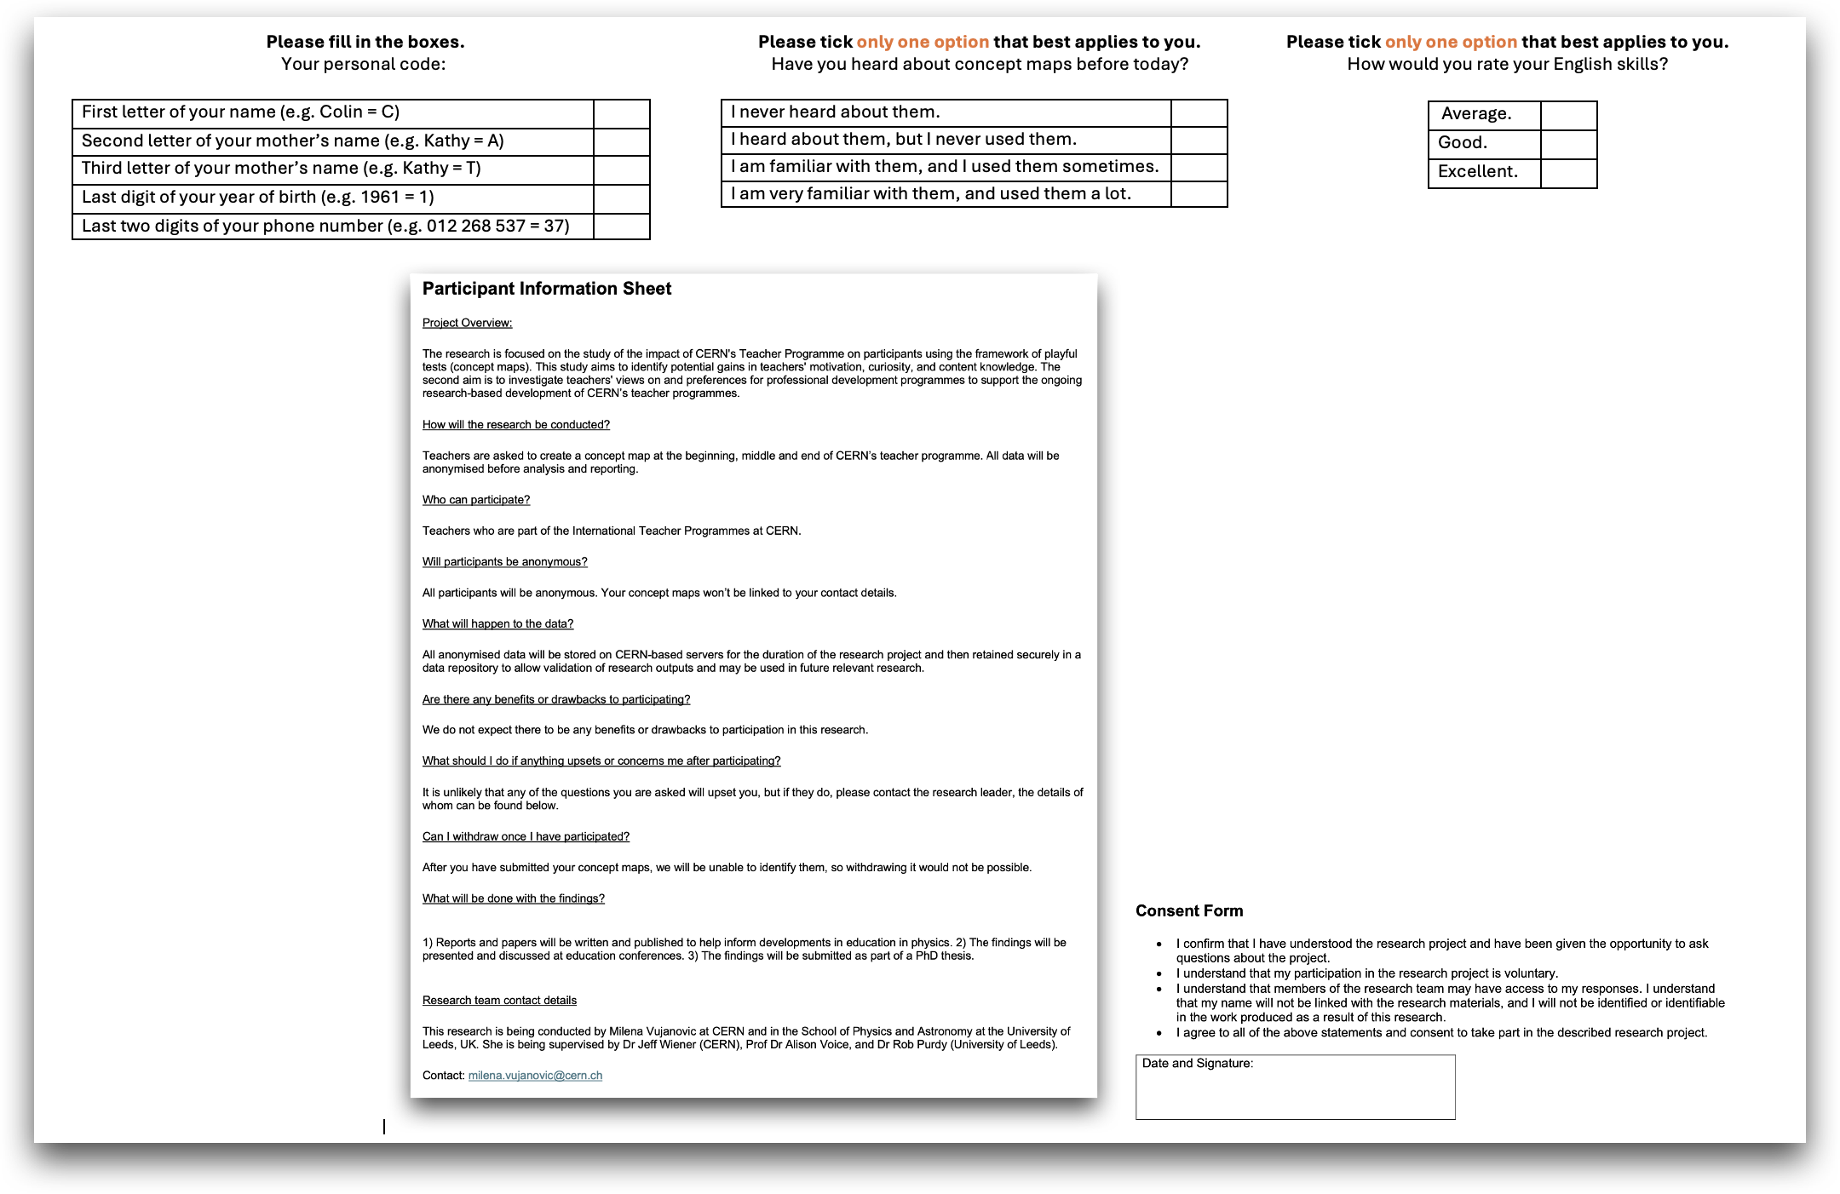

Slide 13
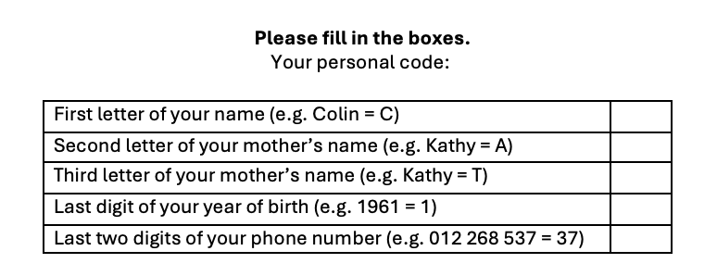
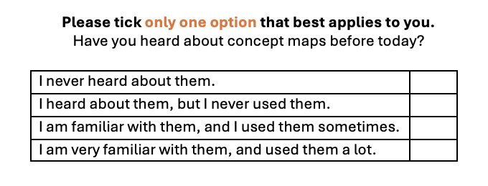
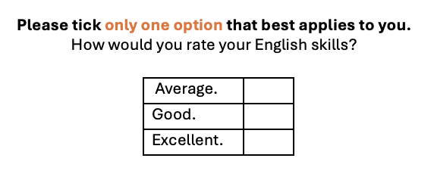

Slide 14
What would you like your students to know about PARTICLE PHYSICS and CERN?

Slide 16
What would you like your students to know about PARTICLE PHYSICS and CERN?
Stop and think about the focus question
2. Chose your starting concept
3. Then chose 2 – 5 key concepts to start your map
4. Connect concepts with arrowed lines and linking words
5. Expand
QUESTIONS?
15 minutes

Slide 17
Time to write the code and sign the consent form!

Slide 18
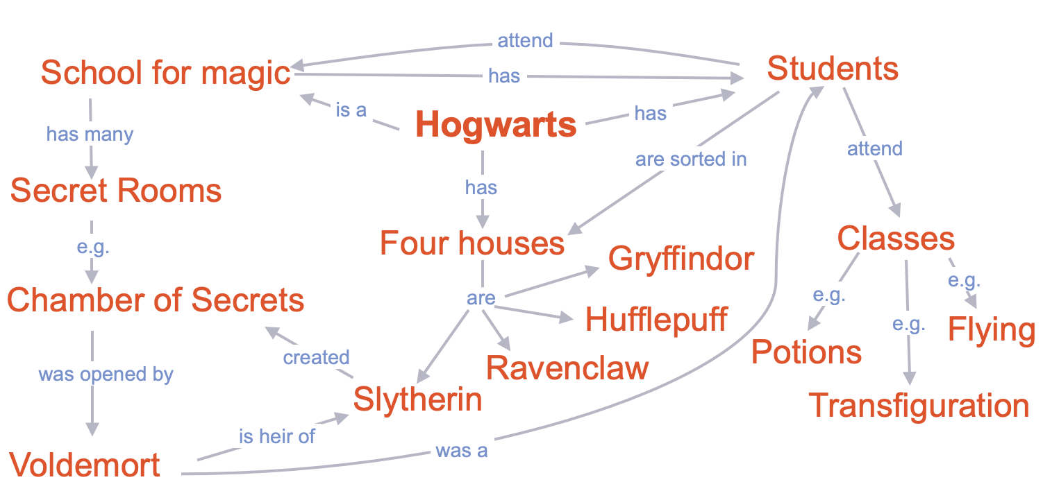
What would you like your students to know about PARTICLE PHYSICS and CERN?
Stop and think about the focus question
2. Chose your starting concept
3. Then chose 2 – 5 key concepts to start your map
4. Connect concepts with arrowed lines and linking words
5. Expand

Slide 19
Pens down!
It’s time to talk ☺

Slide 20
Thank you for your participation!

