Slide 1
Introduction to Particle Accelerators
Simon Albright
Accelerator Physicist
19/02/2025

Slide 2
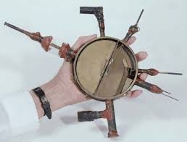
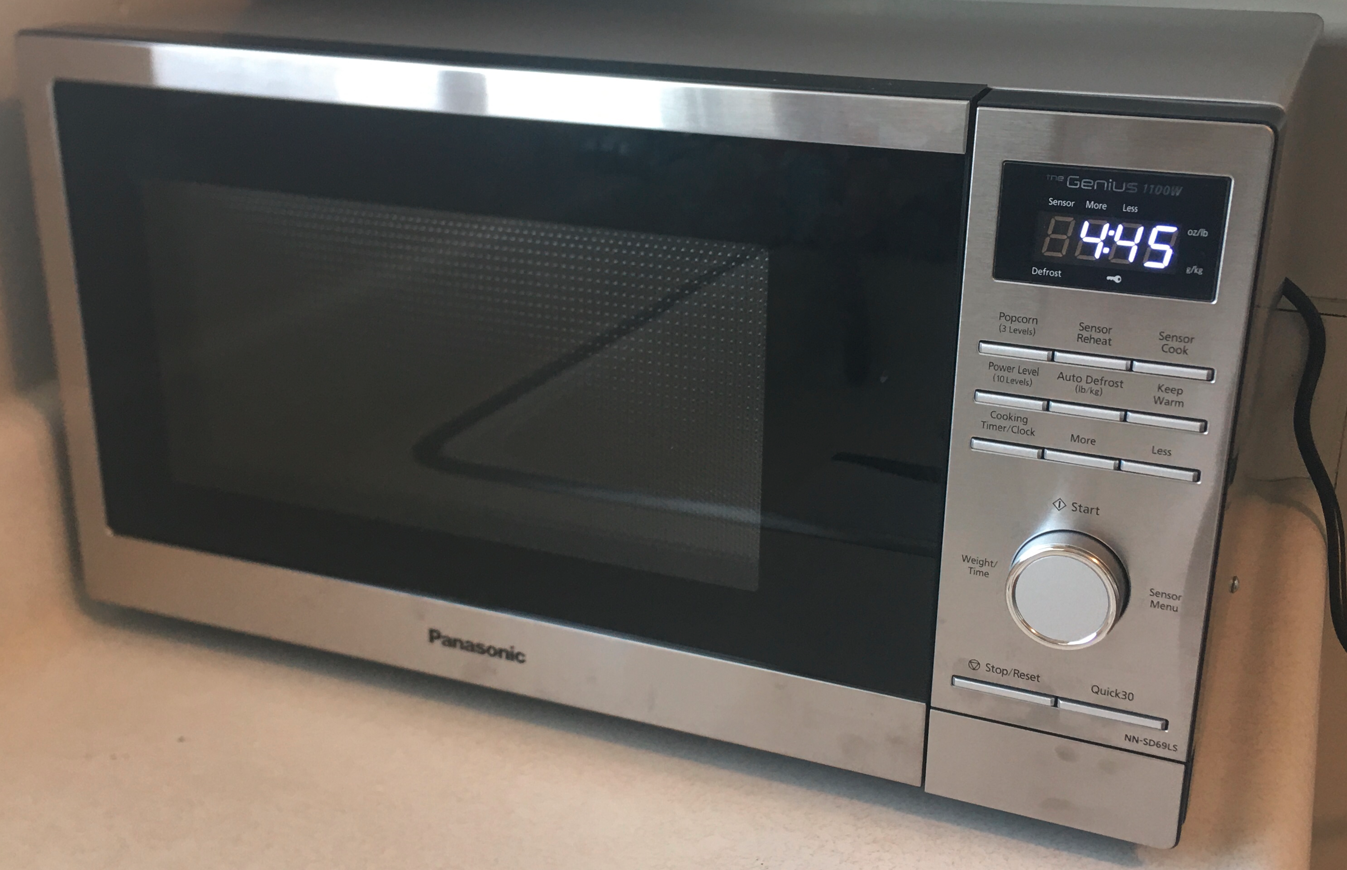
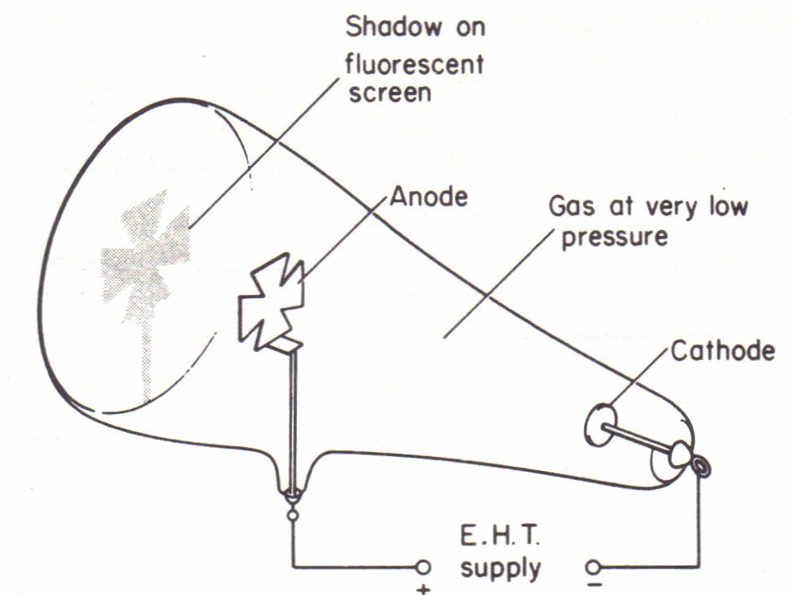
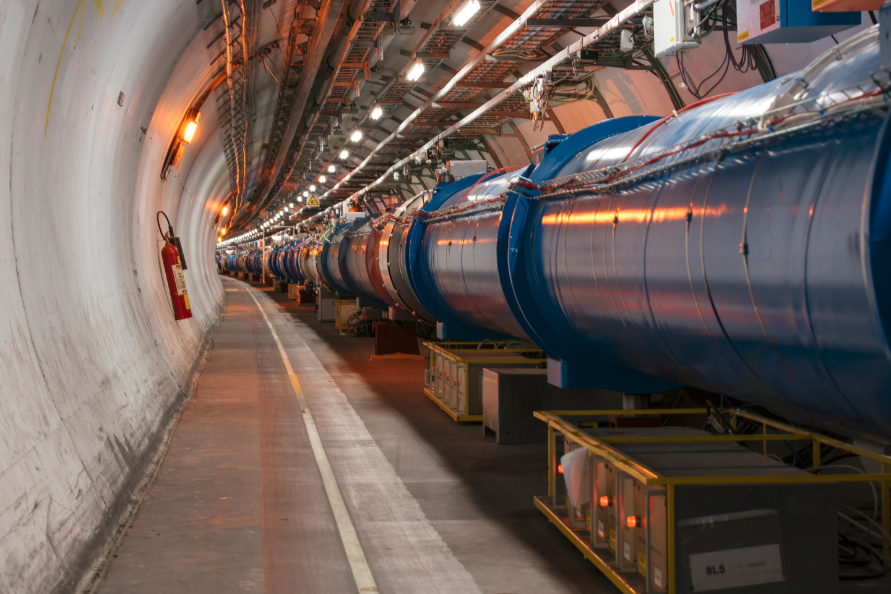
What is a Particle Accelerator?

Slide 3
According to Wikipedia:
A particle accelerator is a machine that uses electromagnetic fields to propel charged particles to very high speeds and energies to contain them in well-defined beams.

Slide 4
A particle accelerator is a machine that uses electromagnetic fields to propel charged particles to very high speeds and energies to contain them in well-defined beams.
Maltese cross
Electric field
Cathode ray
(electron beam)
Electron source

Slide 5
A particle accelerator is a machine that uses electromagnetic fields to propel charged particles to very high speeds and energies to contain them in well-defined beams.
Magnetron
Electric field
Magnetic field
Electron source
Electron beam

Slide 6
A particle accelerator is a machine that uses electromagnetic fields to propel charged particles to very high speeds and energies to contain them in well-defined beams.
Cyclotron
Hydrogen
Electromagnetic field
Proton beam
Magnet
Proton source

Slide 7
A particle accelerator is a machine that uses electromagnetic fields to propel charged particles to very high speeds and energies to contain them in well-defined beams.
Proton/ion beams
Magnets
Large Hadron Collider

Slide 8
Particle Accelerators:
Can be almost any size
Use electromagnetic fields to manipulate beams of charged particles
Range from household appliances to multi-national research facilities, and everything in between

Slide 9

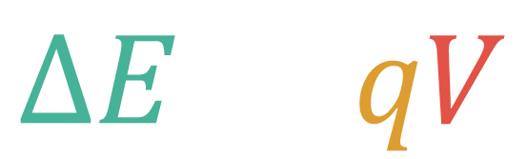

Electrostatic Acceleration
Negative particle:
e⁻, H⁻, anti-proton, …
-
+
Positive particle:
e⁺, H⁺, Pb⁸²⁺, …
A charged particle in an electric field will experience a force, and therefore accelerate
An electron crossing a potential difference of 1 Volt gains 1 electron-Volt (eV) of energy (1.6x10⁻¹⁹ J)
$$ΔE=qV$$
Change of energy
$$=$$
$$×$$
Potential difference
Charge

Slide 10
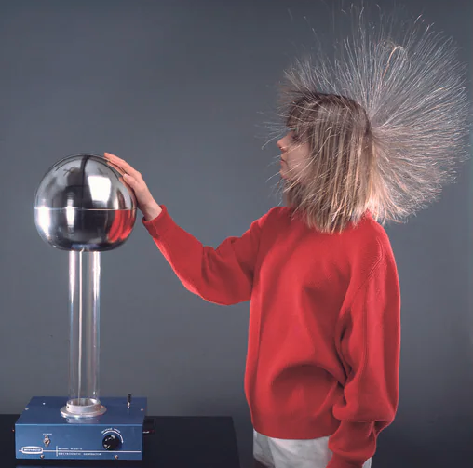

Slide 11
Van de Graaf Accelerator
+
+
+
+
H. V.
+
+
+
+
+
+
+
+
+
+
+
+
+
+
+
Particle beam
+
+
+
+
Positive ion
source
+
+
Ion source raised to Van de Graaf (VdG) potential
Ions accelerated towards ground

Slide 12
Tandem Van de Graaf Accelerator
+
+
+
+
H. V.
+
+
+
+
+
+
+
+
+
+
+
+
+
Positive particle
beam(e.g. H⁺)
+
Negative particle
beam (e.g. H⁻)
+
+
+
+
Negative ion
source
+
+
Charge stripper
Negative ions accelerated from ground towards the VdG
Excess electron(s) removed by a charge stripper
Positive ions accelerated from VdG towards ground

Slide 13
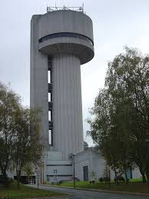
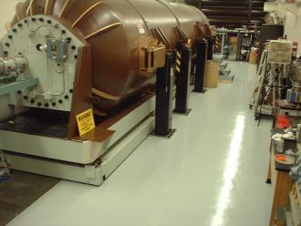
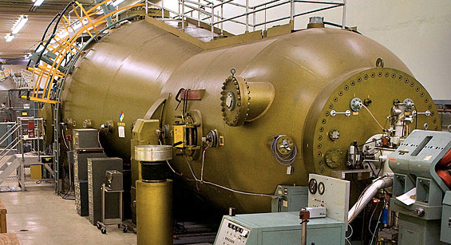
The limits of Electrostatic Acceleration
Brookhaven National Laboratory: 15 MV
Daresbury Laboratory: 20-30 MV
Western Michigan University: 6 MV

Slide 14

Several methods to generate high electrostatic voltage exist (Van de Graaf, Cockroft-Walton, Pelletron, …)
Limited by maximum field to the Mega-Volt scale, typically 10s – 100s kV
Need Tera-Volts for the LHC

Slide 15



From DC to AC
$$ΔE=+eqV$$
$$ΔE=−eqV$$
$$ΔE=+eqV$$
+
-
+
-
Crossing multiple electrostatic gaps does not allow further acceleration
Electric field points in the “wrong” direction between the gaps
Need to change the direction of the electric field

Slide 16



From DC to AC
$$ΔE=+eqV$$
$$ΔE=−eqV$$
$$ΔE=+eqV$$
$$ΔE=−eqV$$
$$ΔE=+eqV$$
$$ΔE=−eqV$$
+
-
+
-
+
-
+
-
Crossing multiple electrostatic gaps does not allow further acceleration
Electric field points in the “wrong” direction between the gaps
Need to change the direction of the electric field

Slide 17
Radiofrequency Acceleration
Confine radio frequency (kHz – GHz) electromagnetic fields in a cavity
Pass bunched beams through either a line of cavities or the same cavity multiple times
Accumulate many small steps in energy, no need for extreme static fields

Slide 18




Radiofrequency Acceleration
The voltage experienced depends on the phase (time) of arrival at the cavity
Particles must cross at the phase that gives the correct voltage
Requires precise synchronisation
Amplitude
Phase
$$ΔE=qVsin(φ)$$
Change of energy
$$=$$
$$×$$
Potential difference
$$×$$
Particle phase
Charge

Slide 19
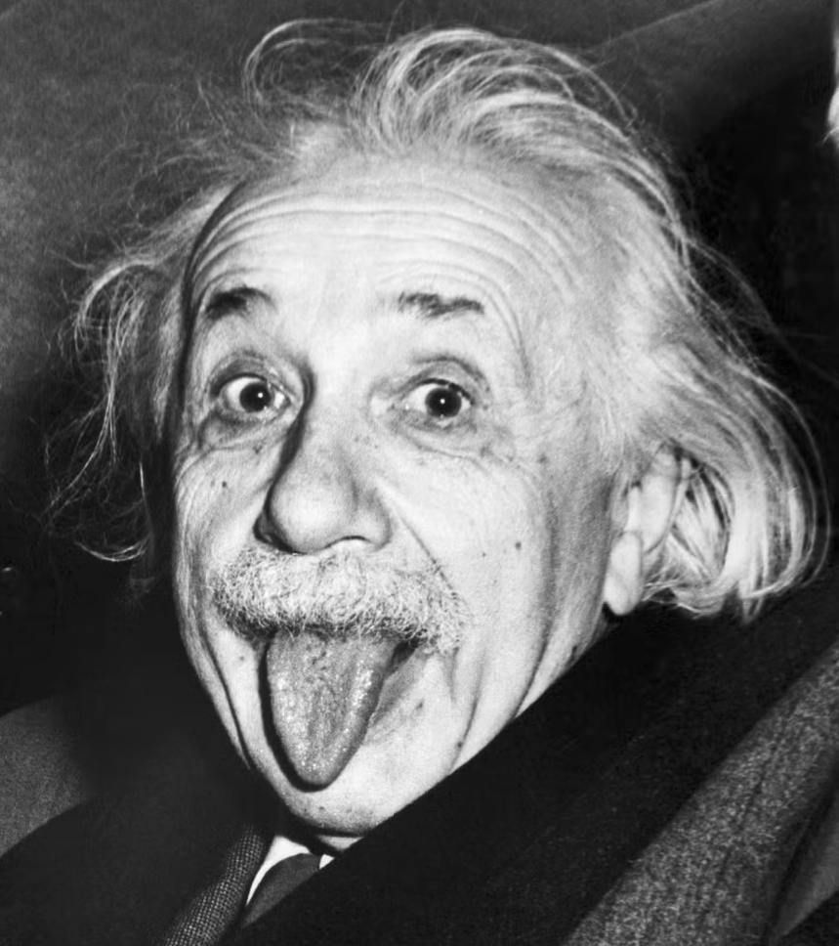

Slide 20
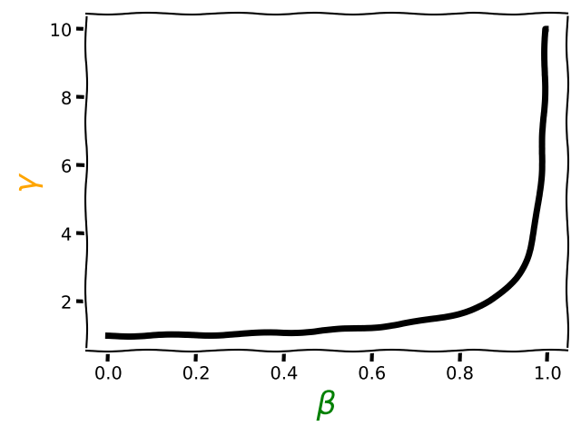


A Light Tour of relativity
c
$$γ= \frac{1}{\sqrt{1−β^{2}}}$$
$$β= \frac{v}{c}$$
When this approaches 1
This approaches infinity
Einstein
Newton

Slide 21
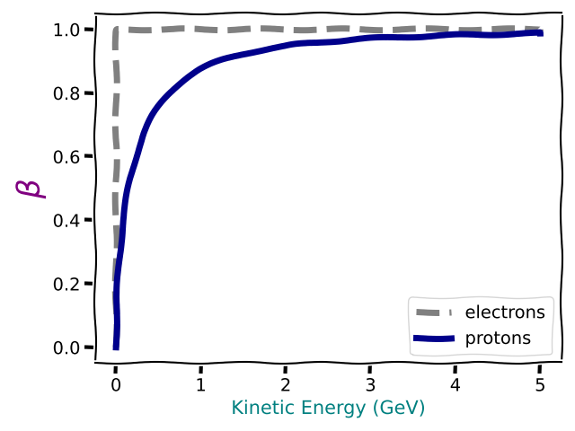

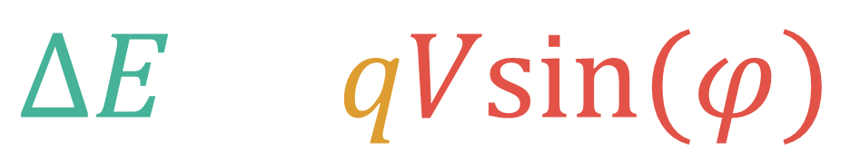

Impact on Acceleration and Energy Gain
$$ΔE=qVsin(φ)$$
The electric field adds kinetic energy to the particles
$$KE= \frac{1}{2}mv^{2}$$
$$KE=(γ−1)m_{0}c^{2}$$
From Newton to Einstein
c
Newton
Einstein

Slide 22
Change of Speed vs Change of Energy
At high energy, speed is almost constant
At low energy, increased kinetic energy means increased speed
Light particles (electrons) become relativistic very quickly
Heavier particles (protons) require a lot more energy to become relativistic

Slide 23
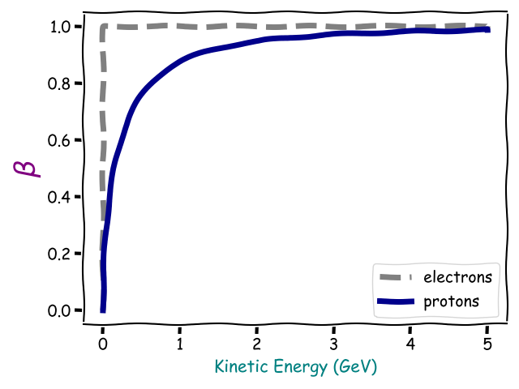
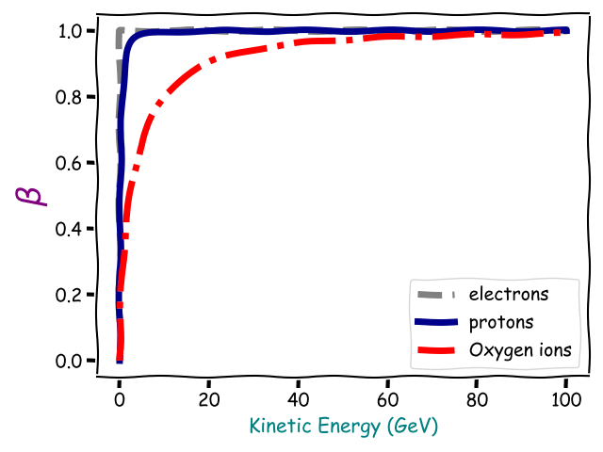
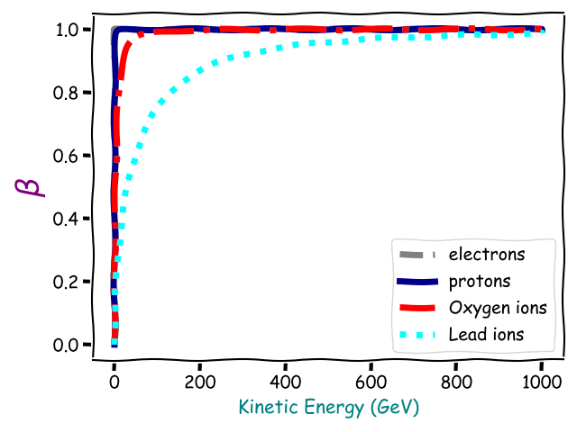
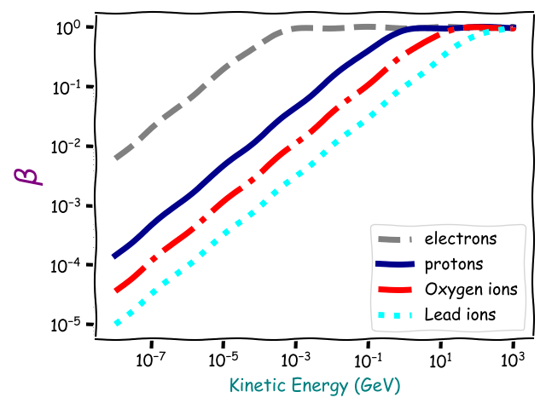
Change of Speed vs Change of Energy – Increasing Mass

Slide 24
Drift Tube Linac
Drift tubes
Beam is accelerated in the gaps between the drift tubes
And shielded from the field in the “wrong” direction in the drift tubes
The drift tubes get longer because the particles get faster (low energy)

Slide 25
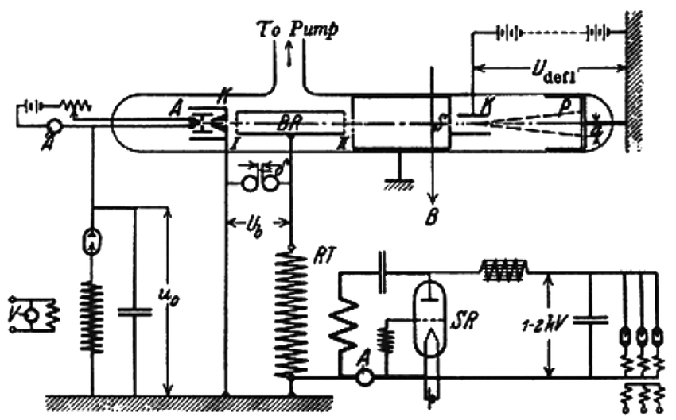
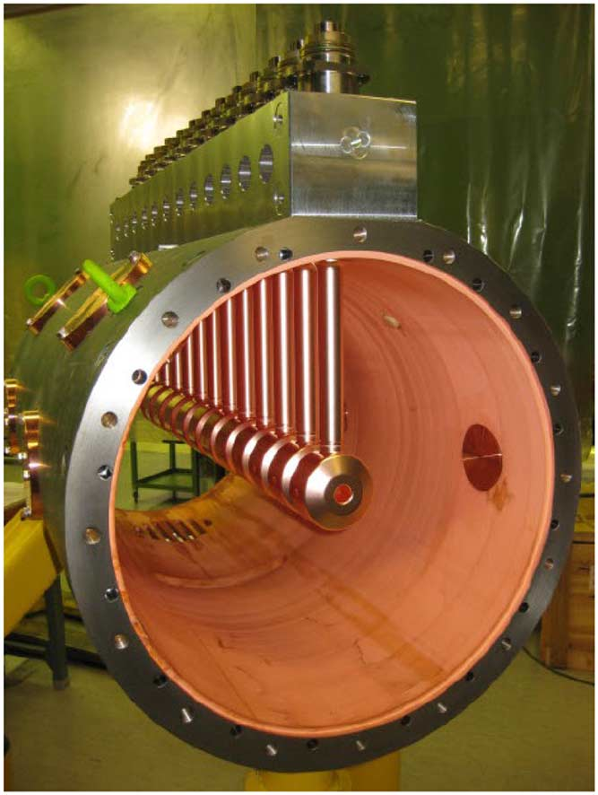
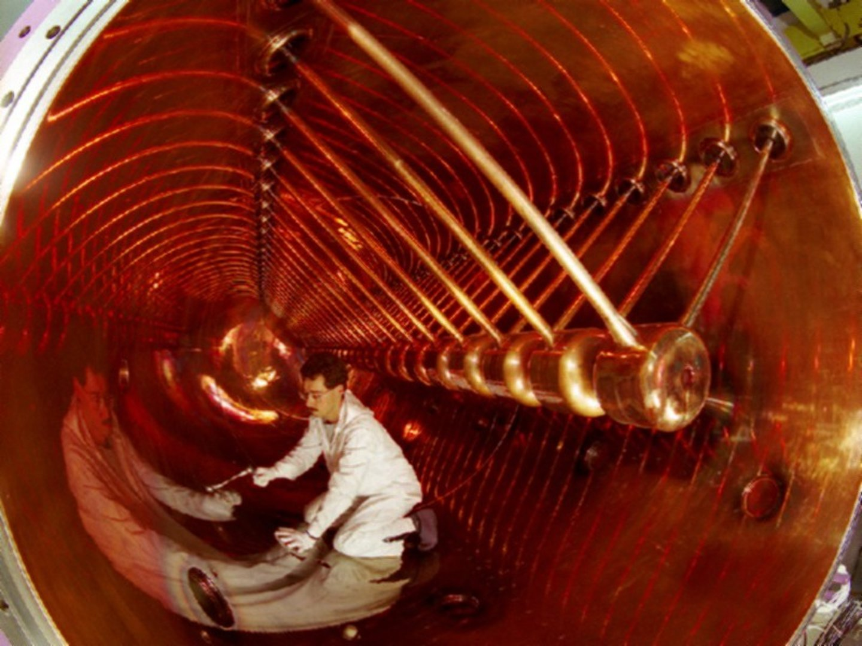
Widerøe Linac
(PhD Thesis 1927)
CERN: Linac4
GSI: UNILAC
Gaps
Drift tubes

Slide 26
Instead of going in a straight line and using lots of accelerating gaps
Go in a circle and use the same gap lots of times

Slide 27
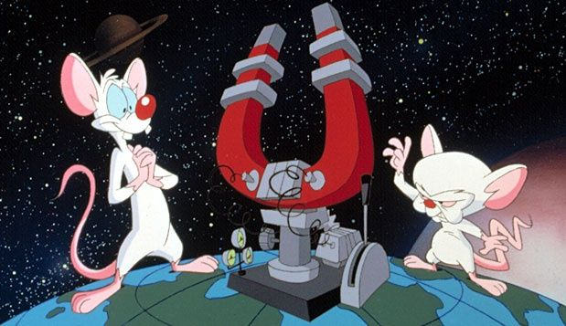

Slide 28




Bending Magnets - Dipoles
Fumb = Force
N
Index = fIeld
S
$$\vec{F}=q\vec{v}×\vec{B}$$
seCond = Current
Force applied
$$=$$
$$×$$
Magnetic field
Current

Slide 29
The Cyclotron
Moving charge follows a curved path in the Dee
On each crossing of the gap, energy and path radius increase
Increased path length and increased speed cancel out, fixed time between crossings
Dee
(magnet)
Dee
(magnet)
RF Cavity

Slide 30


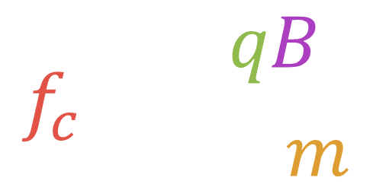



The Cyclotron
$$f_{c}= \frac{qB}{2πm}$$
Magnetic field
Charge
$$×$$
Cyclotron frequency
$$=$$
$$2π$$
$$×$$
Mass
Particle revolution frequency (cyclotron frequency) independent of radius
Excite the RF cavity at $f_{c}$
Increment the particle energy at each crossing of the cavity
Dee
(magnet)
Dee
(magnet)
RF Cavity

Slide 31

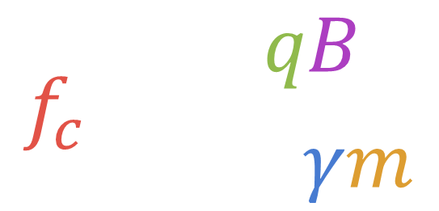


The Cyclotron - Limits
$$f_{c}= \frac{qB}{2πγm}$$
Magnetic field
Charge
$$×$$
Cyclotron frequency
$$=$$
Relativistic gamma
$$2π$$
$$×$$
$$×$$
Mass
As the energy increases, relativity starts to matter
By a few tens of MeV, protons become a too relativistic and the frequency drops
Lose synchronism, acceleration stops
Dee
(magnet)
Dee
(magnet)
RF Cavity

Slide 32
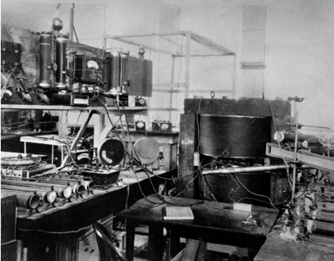
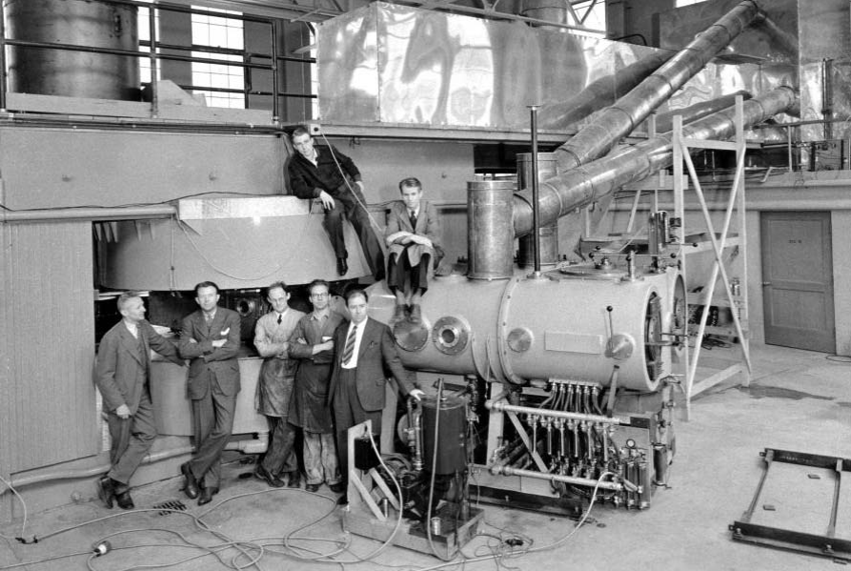
Some Lawrence (et al) Cyclotrons
4-inch Cyclotron
80 keV protons
11-inch Cyclotron
1.2 MeV protons
60-inch Cyclotron
16 MeV deuterium

Slide 33
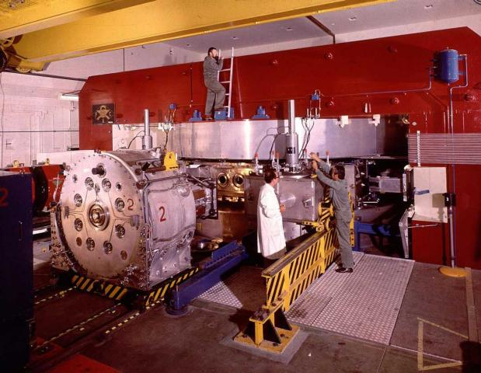
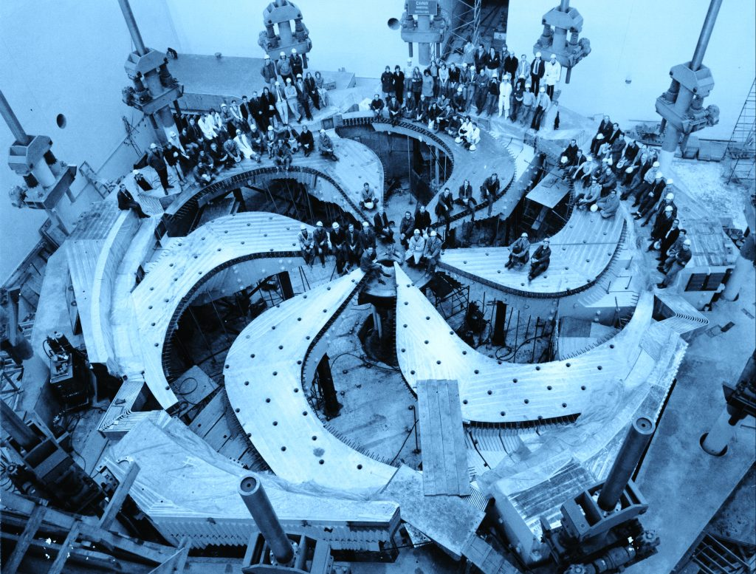
Fancy Cyclotrons
CERN (1957-1990)
600 MeV protons
TRIUMF (1974-Present)
520 MeV protons
Synchrocyclotrons:
Adapt the RF frequency to compensate for relativistic effects
Sector cyclotrons:
Non-uniform magnetic field reshapes the orbit to maintain frequency for longer

Slide 34


Slide 35
Beyond the Cyclotron
Classical cyclotrons are limited to around 20 MeV
With further developments, energies pushing 1 GeV can be reached
Need an accelerator that can operate through to the ultra-relativistic regime
Synchrotrons:
Constant orbital radius
Magnetic field varies with time
RF frequency changes synchronously with the magnetic field

Slide 36






Dipole Magnetic Field And Momentum
Magnetic
field
(B)
Bending
radius
($ρ$)
$$P=cqBρ$$
$$=$$
Speed of light
$$×$$
$$×$$
Magnetic field
$$×$$
Bending radius
Momentum
Charge

Slide 37
Create a Synchrotron
Create a ring of dipoles to define the path for a given energy/momentum

Slide 38
Create a Synchrotron
The momentum defines the speed, add one or more RF cavities with a frequency at an integer multiple of the revolution frequency.
Increase magnetic field and RF frequency synchronously: Synchrotron

Slide 39
Focusing
Particle beams are never perfectly laminar
Like-charges repel each other
Lenses are used to focus the beam

Slide 40
Focusing Magnets - Quadrupoles
S
N
N
S
N
S
S
N
Focusing quadrupole:
Focuses in the horizontal plane
Defocuses in the vertical plane
Defocusing quadrupole:
Defocuses in the horizontal plane
Focuses in the vertical plane

Slide 41
Focusing Channel
F
D
F
D
F
D
F
Horizontal
Vertical

Slide 42
Add quadrupoles around the ring to keep the beam focused

Slide 43
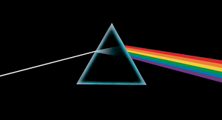

Slide 44
Dispersion
Dipole
The particles have a range of energies (momenta)
For a given magnetic field, high momentum particles bend less than low momentum particles, causing the beam to spread out

Slide 45
Chromaticity
F
High energy particles are focused less
Low energy particles are focused more
For correct focusing, another magnet is added

Slide 46
Chromaticity Correction - Sextupole
F
F
S
N
N
D
S
S
N
This side focuses
This side defocuses

Slide 47
Add sextupoles to correct for chromaticity

Slide 48
Beam Instrumentation
Beam Position Monitors:
Measure the beam’s horizontal/vertical offset
Beam Loss Monitors:
Localise and quantify lost beam
Beam profile measurement
Measure the beam distribution in 3D

Slide 49
Add beam instrumentation

Slide 50

Vacuum

Slide 51
Add vacuum systems

Slide 52
Anything Else?
Injection and extraction systems
  Fast pulsing magnets to get beam in and out of the accelerator
Collimators
  Absorb lost beam in a controlled way at predefined locations
Higher order magnets
  Correct additional errors and influence more beam parameters
Additional RF systems
  Manipulate the longitudinal beam parameters
Feedbacks
  Identify and correct errors that might degrade the beam
…..

Slide 53

Plasma Wakefield Accelerator
Synchrotrons
Linacs

Slide 54
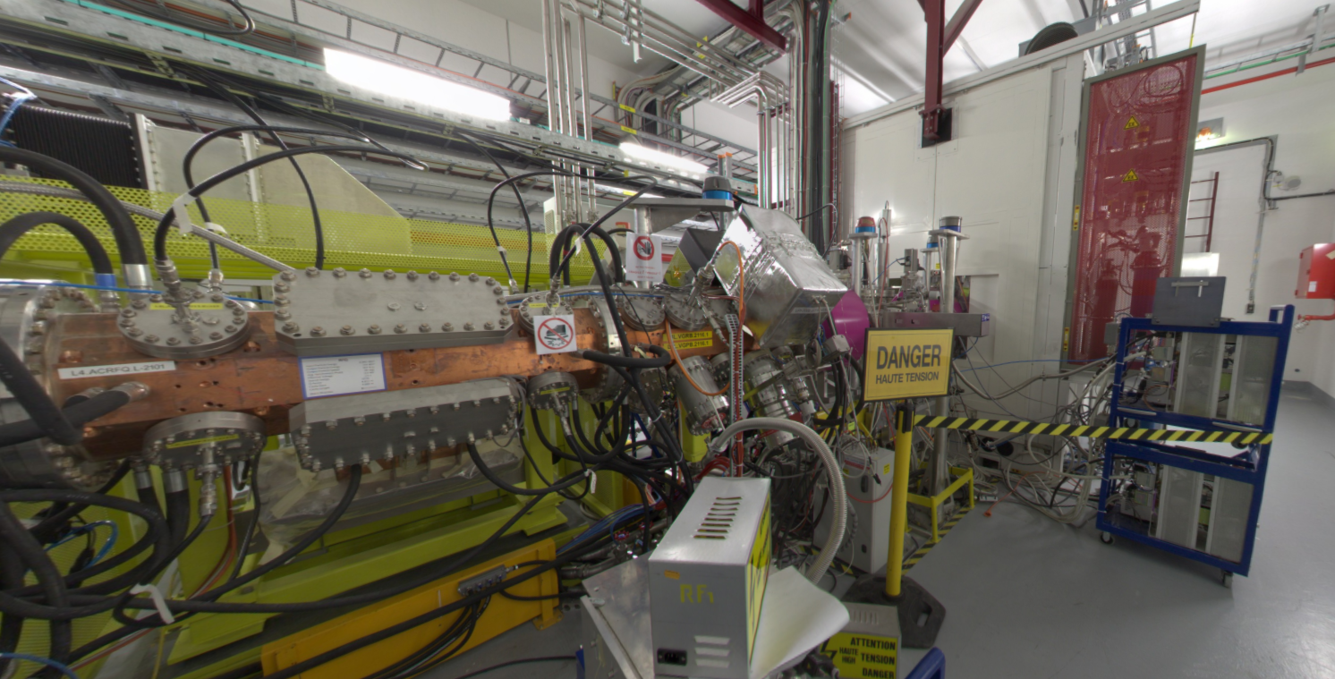
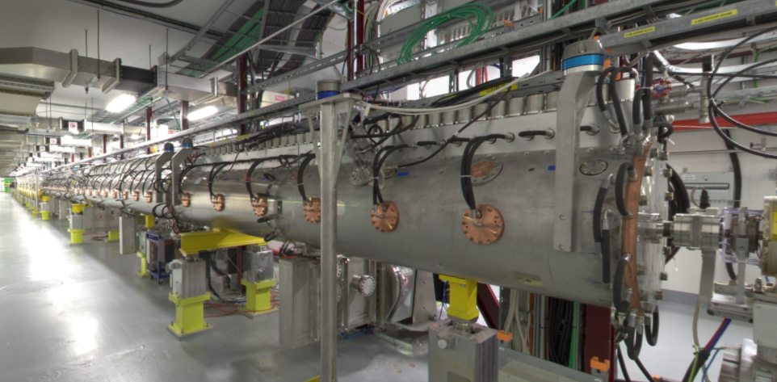
Linac4
High voltage platform:
H⁻ ion source
Electrostatic acceleration
Drift Tube Linac (DTL)
Radiofrequency Quadrupole (RFQ):
Structure that both accelerates and focuses at the same time

Slide 55
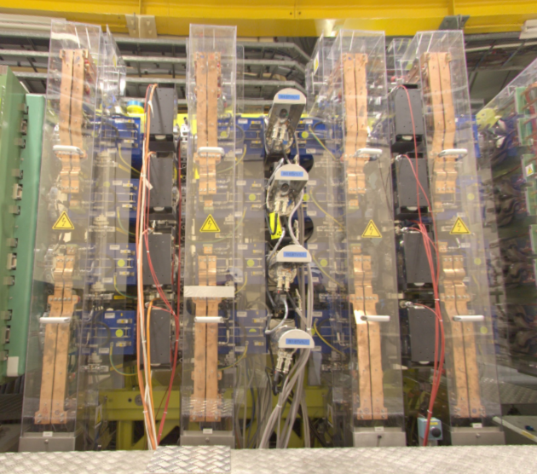
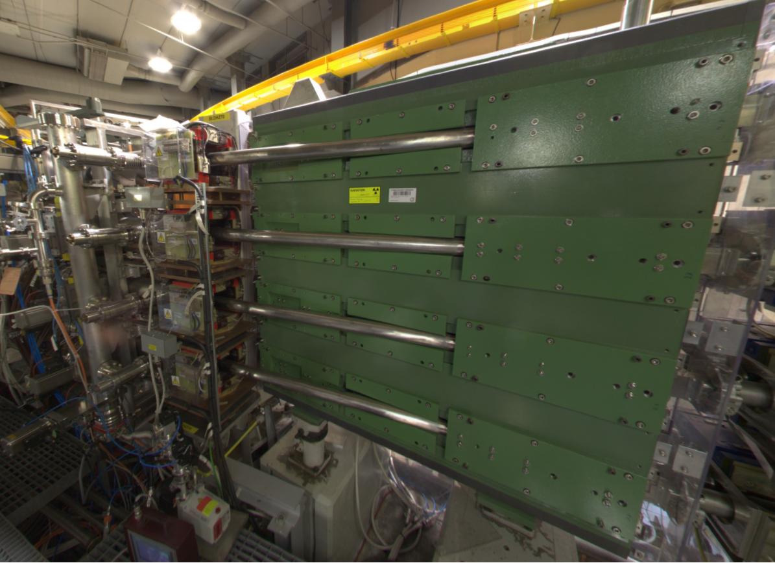
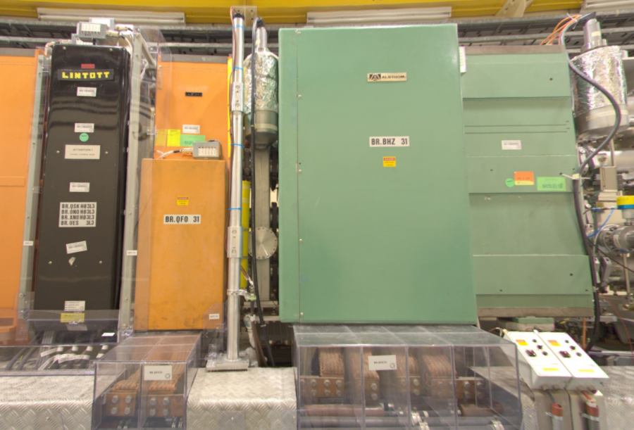
PS Booster
H⁻
Sextupole
Charge strippers
Dipole
H⁺
H⁻ from Linac4
Quadrupole

Slide 56
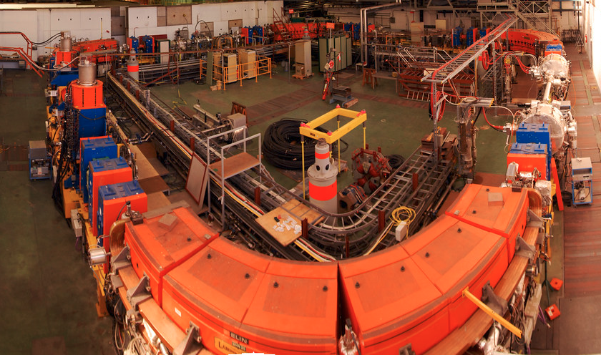
Low Energy Ion Ring
Dipole
Quadrupoles
Quadrupoles
Dipole
Dipole
Quadrupoles
Injection system
RF Cavities
Extraction system
Electron cooling
Quadrupoles
Quadrupoles
Dipole

Slide 57
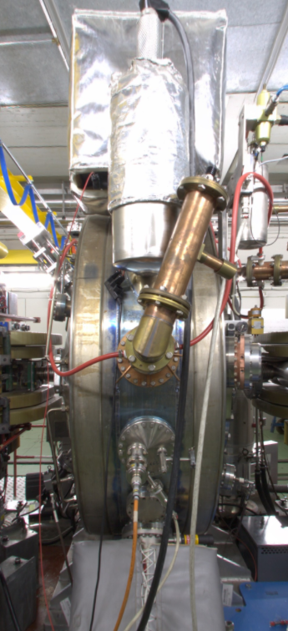
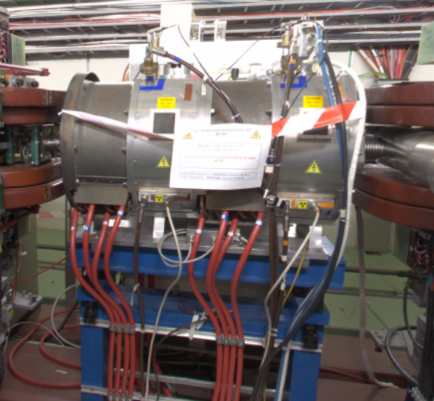
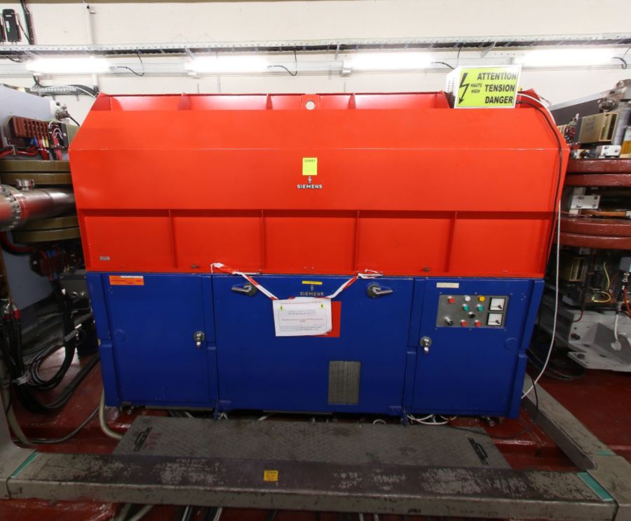
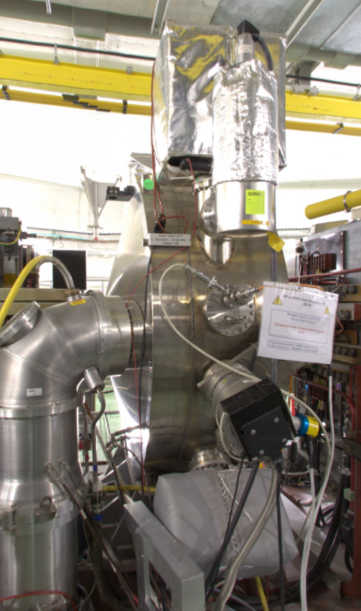
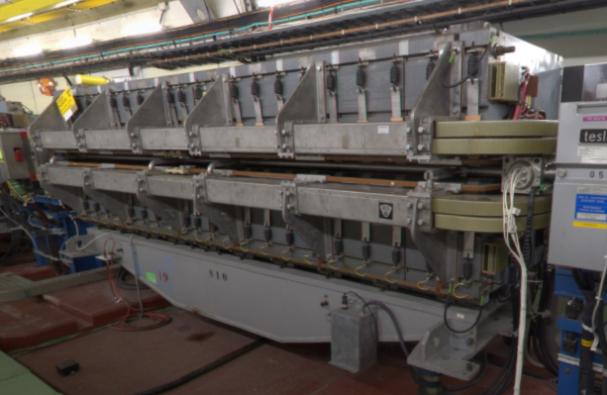
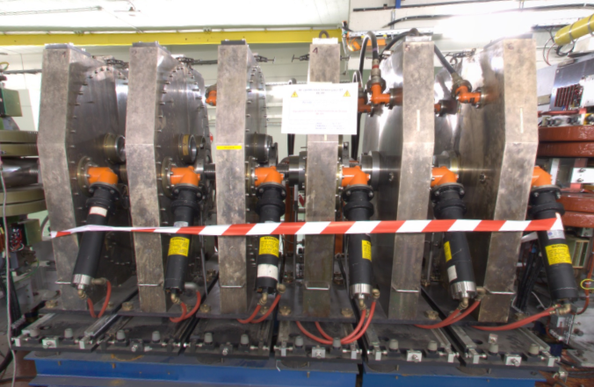
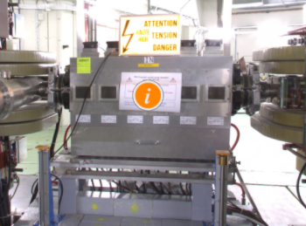
Proton Synchrotron
Variable frequency (~10MHz) cavity
80 MHz cavity
20 MHz cavity
40 MHz cavity
200 MHz cavity
Combined function magnet:
Both a dipole and a quadrupole
Multi-frequency cavity

Slide 58
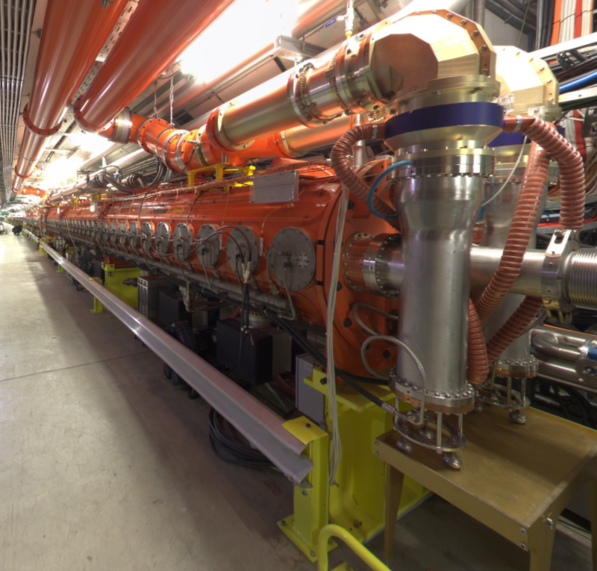
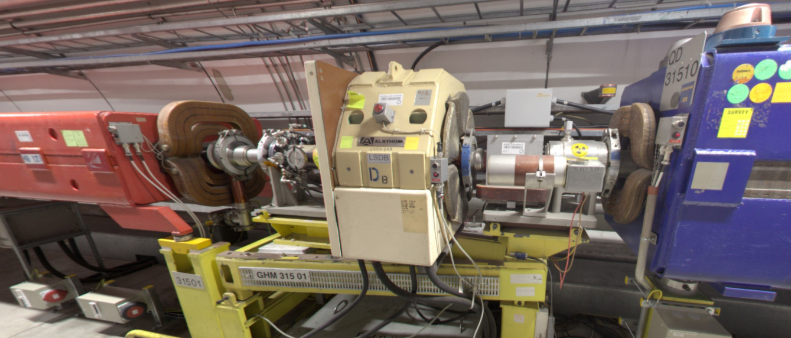
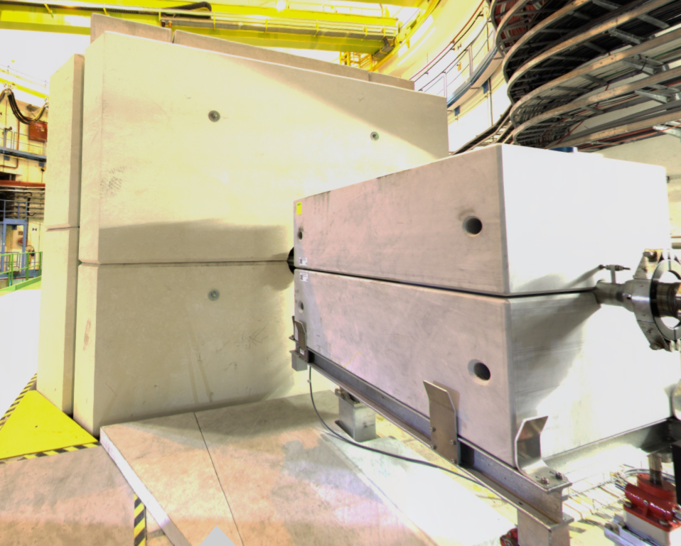
Super Proton Synchrotron
Sextupole
Beam dump
Dipole
Quadrupole
200 MHz Cavity
(Travelling Wave Structure)

Slide 59
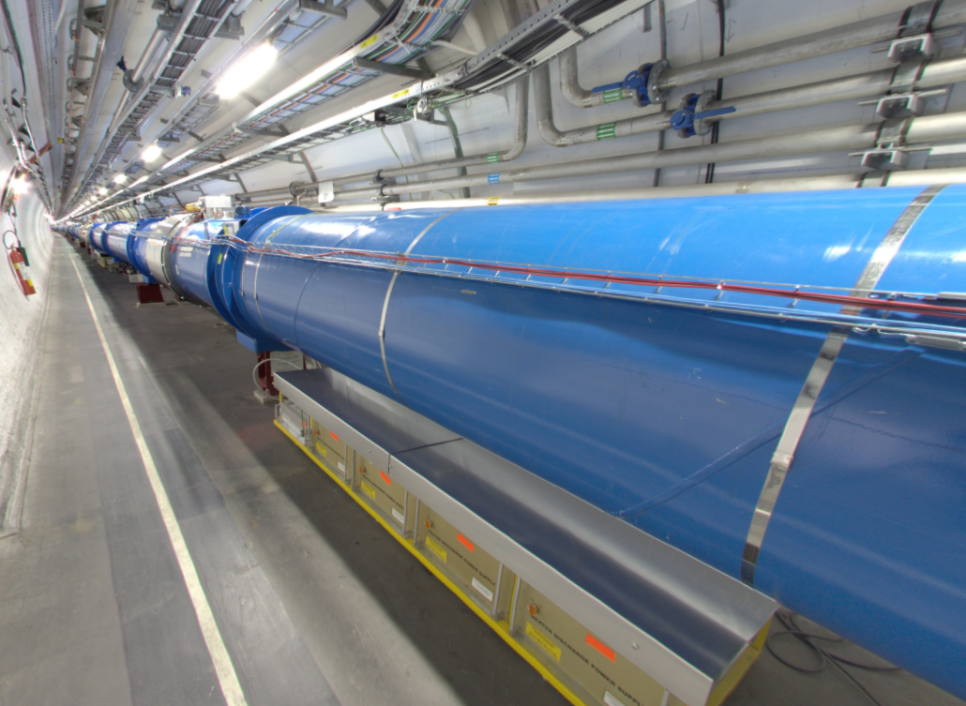
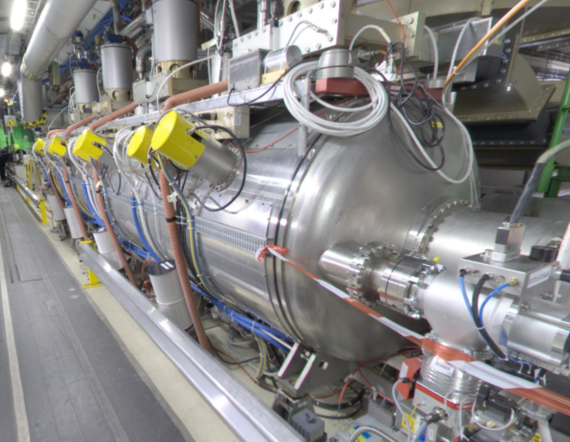
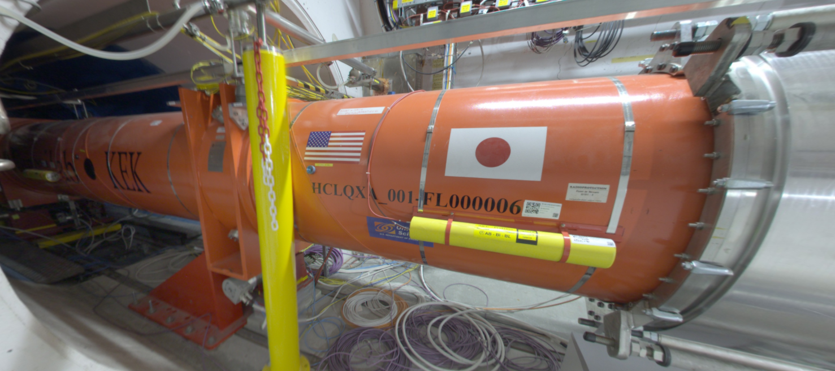
Large Hadron Collider
Dipole
Quadrupole
Beam loss monitor
400 MHz RF cavities

Slide 60
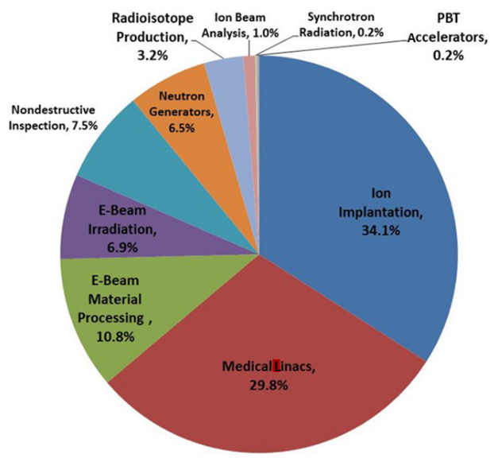
Industrial Applications
Many thousands of accelerators in the world
The vast majority are used in industry and medicine
The underlying physics and engineering requirements are universal, the rest is a matter of context
The future of Industrial Accelerators and Applications, B. Doyle et al, Reviews of Accelerator Science and Technology Vol. 10 (2019)

Slide 61

Linear
Circular
Very flexible (no need for synchronism)
Energy limited by electric field strength
DC
Cyclotron
Synchrotron
Cavity design depends on $β$, varies along the linac
Increasing energy requires more RF cavities
Very fast acceleration
Fixed frequency and field (usually)
Large magnets and vacuum vessels
Energy limited by relativity and size
Magnetic field and RF frequency ramp synchronously
Energy limited by magnet strength and ring size
AC

Slide 62
Other types of accelerator
Betatron: Magnetic field for steering and accelerating
Plasma wakefield: Particles accelerated in bubbles of plasma
Induction: Magnetic induction accelerates the beam
Laser radiation pressure: High powered laser pushes particles
Fixed field accelerator: Best bits of cyclotrons and synchrotrons
…

Slide 63
Summary
Particle accelerators can be small (fit in a microwave), very very large (27 km) and anything in between
Electric fields add energy to the beam, magnetic fields steer and focus the beam (with exceptions)
Electrostatic accelerators can accelerate “anything” but are limited to a few MV, typically 10s-100s kV
Radiofrequency cavities allow many sequential energy increments in linear or circular accelerators
Only a small fraction of accelerators are used for fundamental research, most are tools for industry and medicine

