Slide 1

Fields: Design Challenge
Notes:
DONE

Slide 2
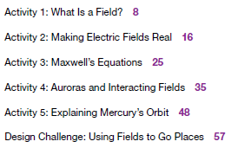

Fields

Slide 3
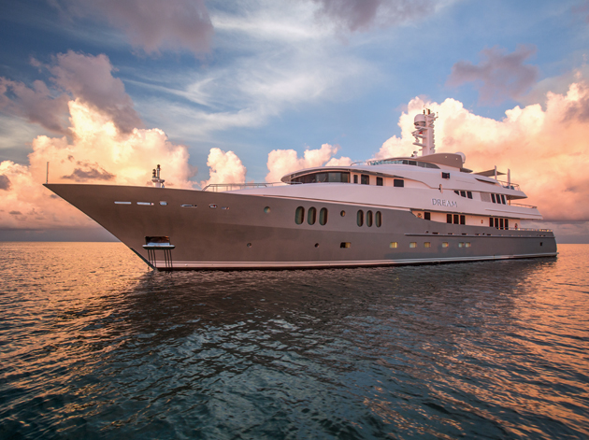
Propellers are a problem
Boats and submarines use motors to turn propellers to move through water.
  Motors are noisy
  The moving parts suffer from wear & tear
  Motors require significant maintenance

Slide 4
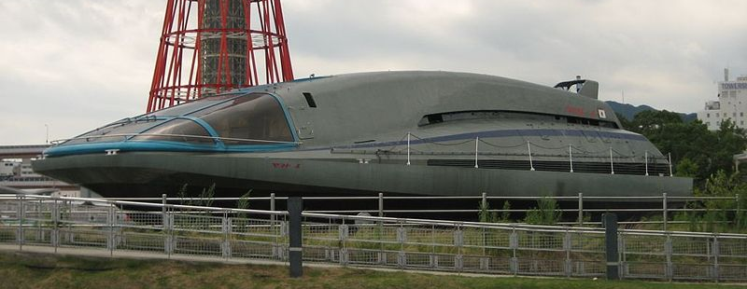
Magnetohydrodynamic Drive (MHD) is a solution
Method of propelling vehicles using electric and magnetic fields through a conductive medium.
Yamato 1 on display in Japan
Notes:
You can mention “Hunt for Red October” movie. MHD is featured in super-secret submarine.

Slide 5
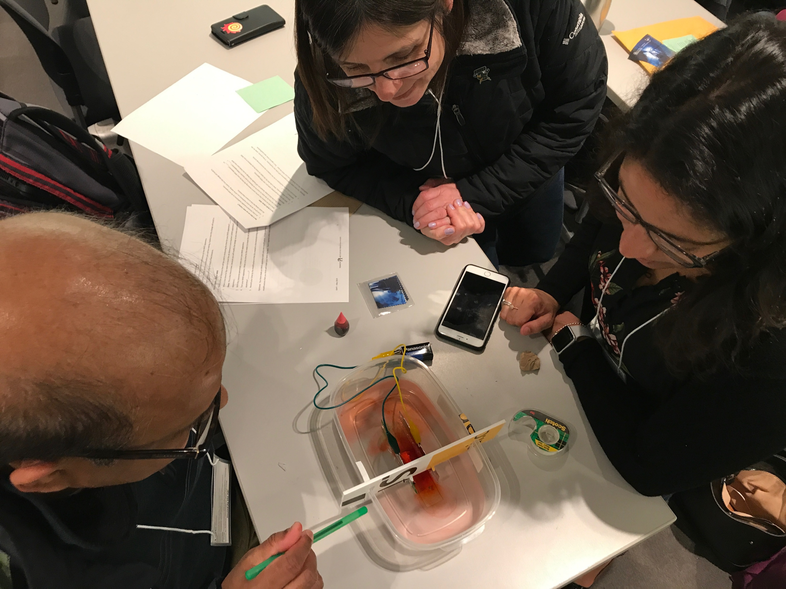
MHD Design Challenge
Learning Goal:
  To apply electric & magnetic field interactions and hand rules to predict net force
Notes:
  we’re not building an actual propulsion system
  we’re looking at the physics

Slide 6
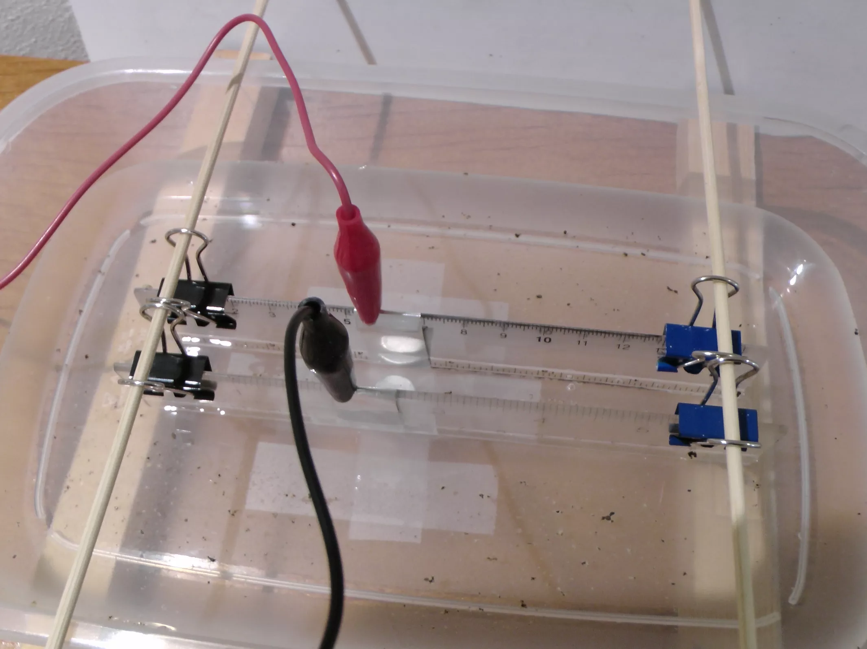

Slide 7
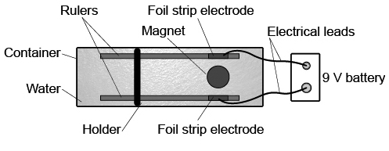

Slide 8

Draw the parallel plates connected to the battery.
Label the polarity of the battery—the positively charged plate and the negatively charged plate.
Add one labelled arrow to show the direction of the uniform electric field between the electrodes.
$$\vec{ε}$$
+
-

Slide 9
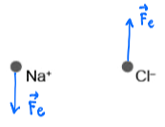

The water contains table salt (NaCl). Add one Na⁺ and one Cl⁻ ion to your diagram.
Use an arrow to show the direction of electric force acting on an ion of sodium, Na⁺, and on an ion of chlorine, Cl–. Justify the directions you have indicated.
$$\vec{ε}$$
+
-

Slide 10

Now add a magnetic field coming out of the page.
Use a hand rule to determine the direction of the magnetic force on the ions moving perpendicular to the magnetic field.
Show the direction of motion of the Na⁺ ion and the Cl– ion in the magnetic field. Use a labelled arrow to show the direction of the force on each ion.
$$\vec{ε}$$
+
F_{b}
F_{b}
-
$$\vec{B}$$

Slide 11
PEOE
Predict what will happen when the electrodes are connected to the battery. Explain your prediction.

Slide 12
PEOE
Observe what happens when the electrodes are connected to the battery. Compare your prediction and observation. Explain any differences and adjust your understanding if necessary.

Slide 13
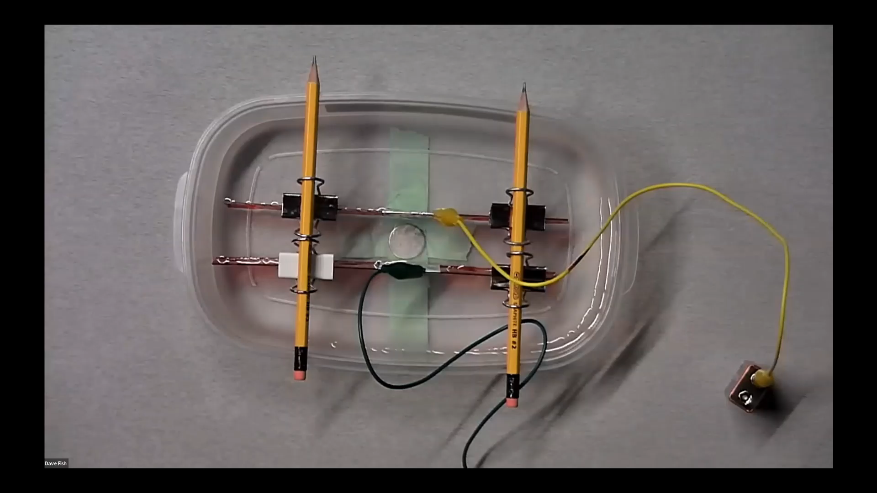

Slide 14
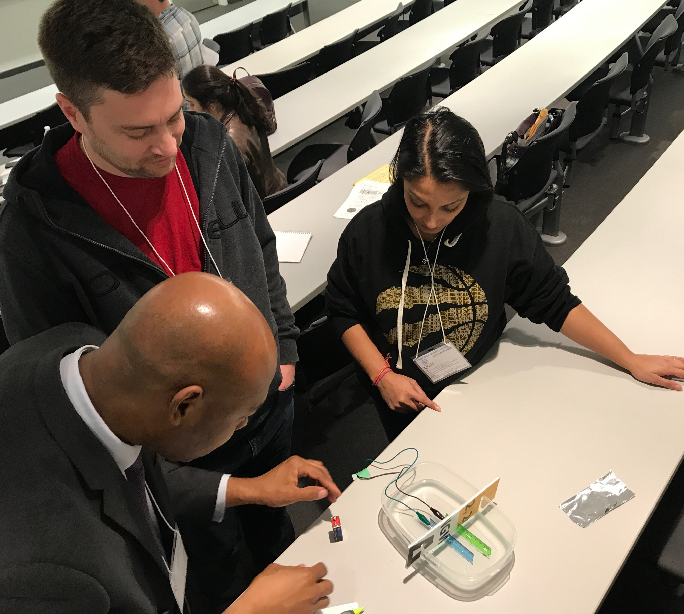

Building Time!
Put the theory into practice!
Build your MHD.
Calculate the flow rate.
  Use the time taken for water to travel 10 cm.
Notes:
Do the brainstorm on the chalkboard in the space room.

Slide 15
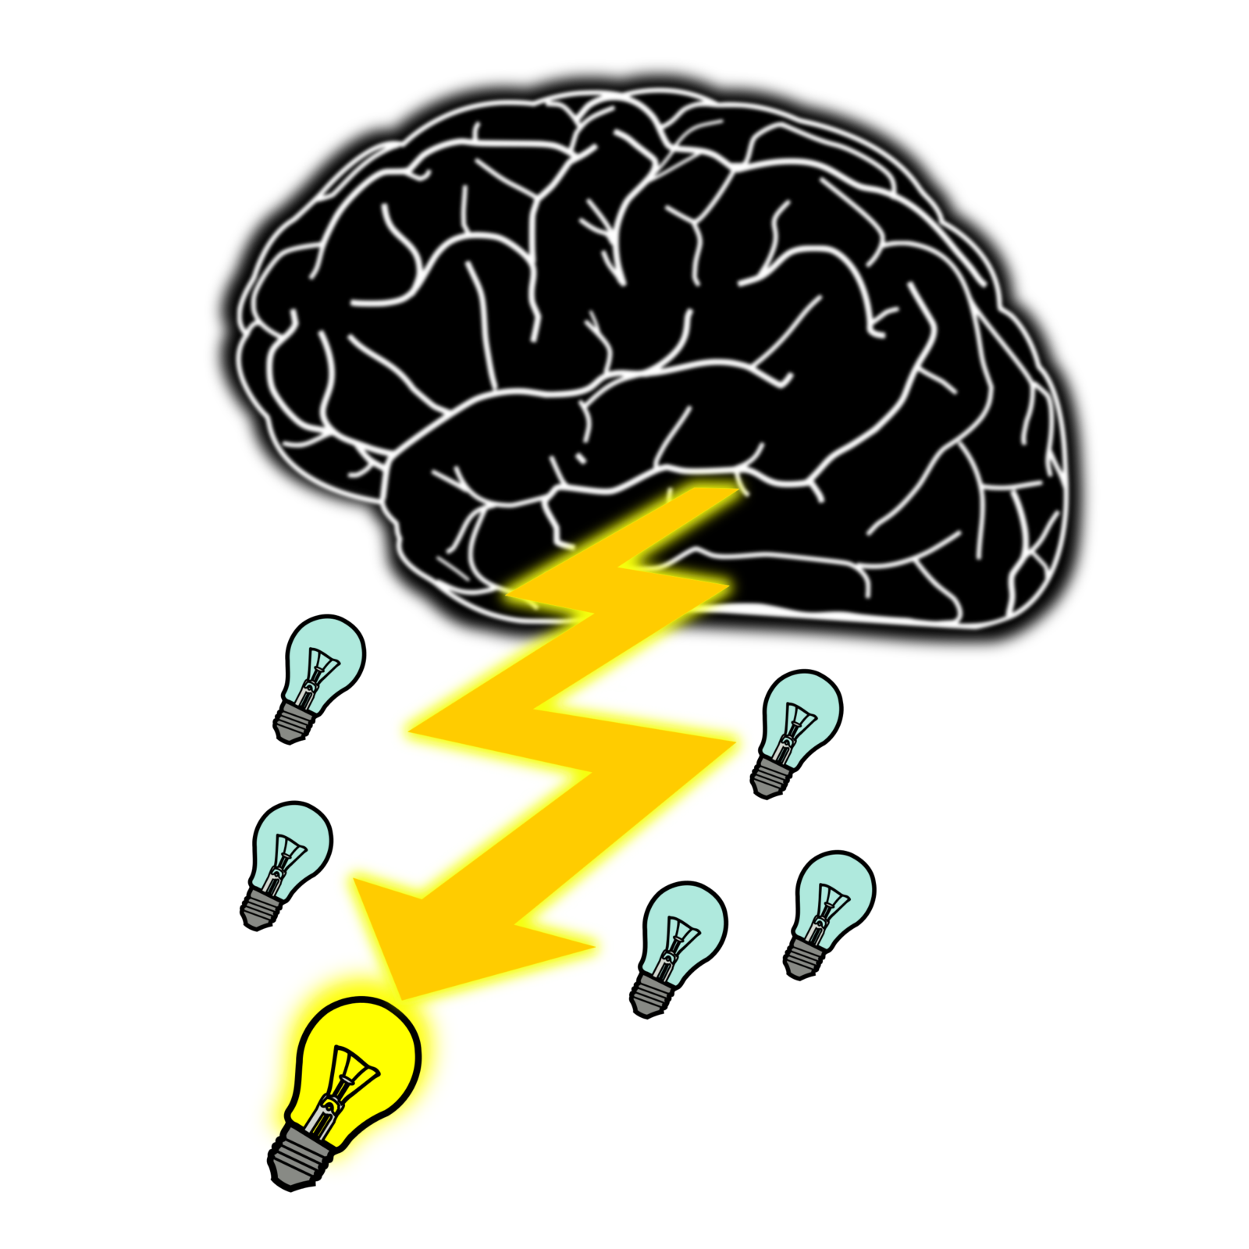
Making it Better
Brainstorm any modifications TO THE APPARATUS (not to the physics)
Every group choses one, different modification
Compare the results from each of the modifications.

Slide 16
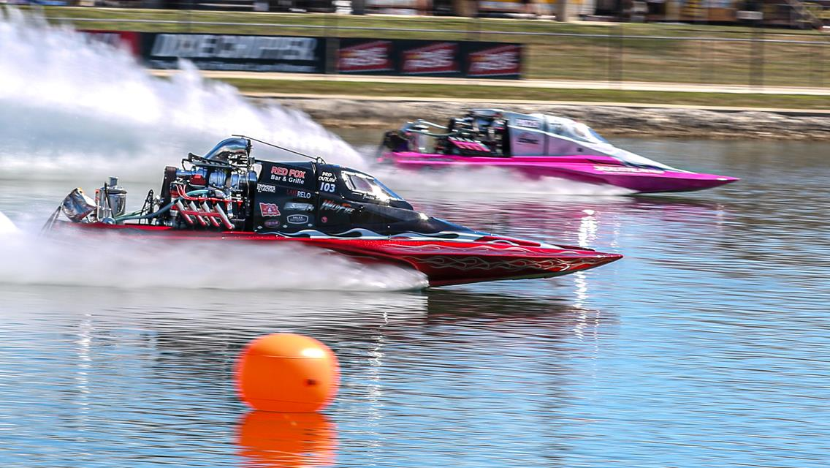
Making it Better
If time permits, make ALL the modifications that you think will make your MHD the best.
Have a contest!

Slide 17


resources.perimeterinstitute.ca

Slide 18
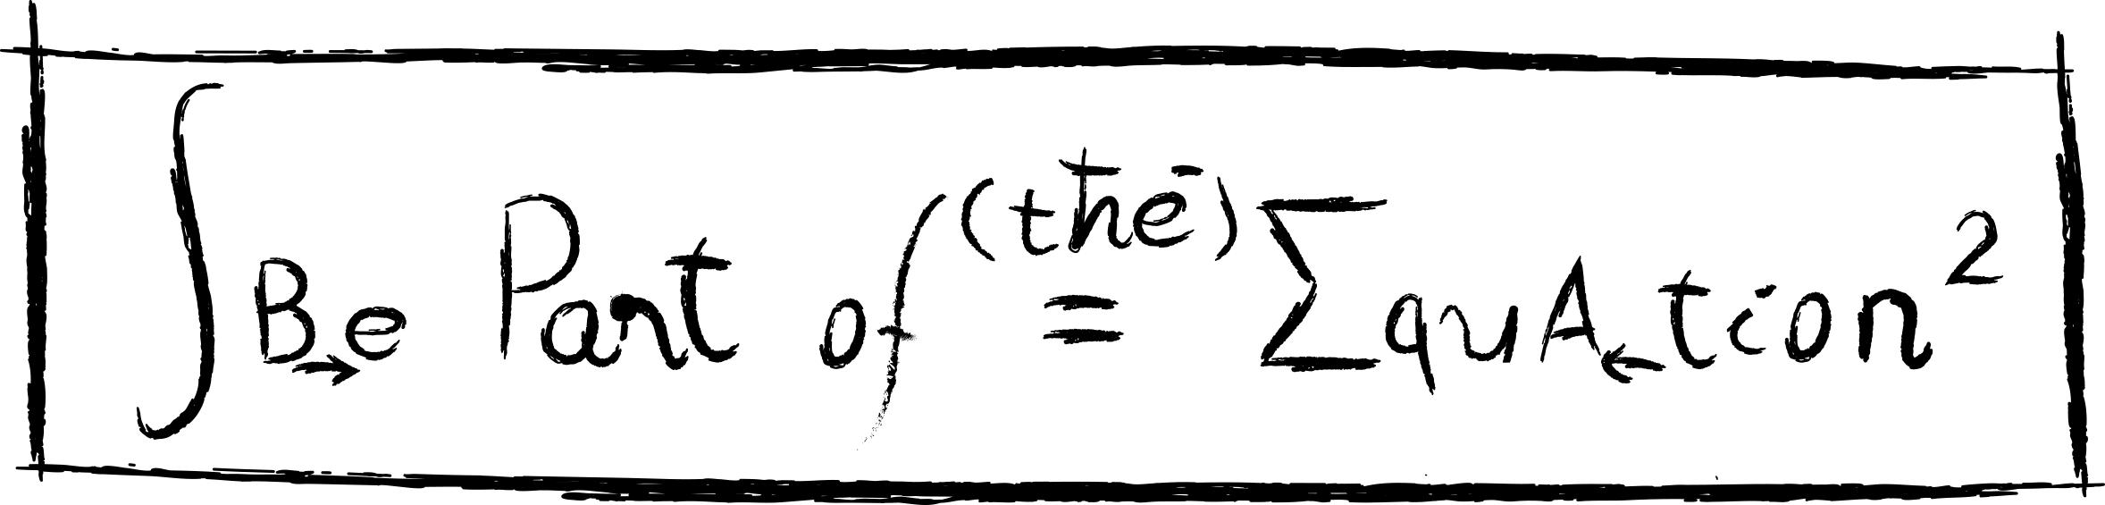


Fields
Ashley McCarl Palmer
amccarl-palmer@perimeterinstitute.ca
Dave Fish
dfish@perimeterinstitute.ca
resources.perimeterinstitute.ca

