Slide 1

Finding Patterns:
Electron Microscopes
CERN HST 2025
Notes:
It is a 75 minute workshop

Slide 2
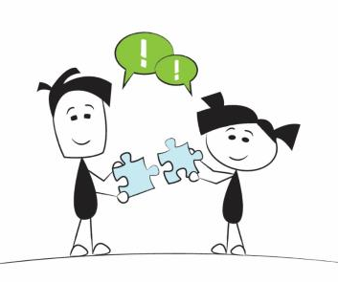

How Do Scientists Think?
Scientists Look for Patterns
Notes:
Humans are innately skilled at finding patterns. Scientists make observations and then sort their data to look for patterns. We are going to work in groups now to see if we can solve the pattern!

Slide 3
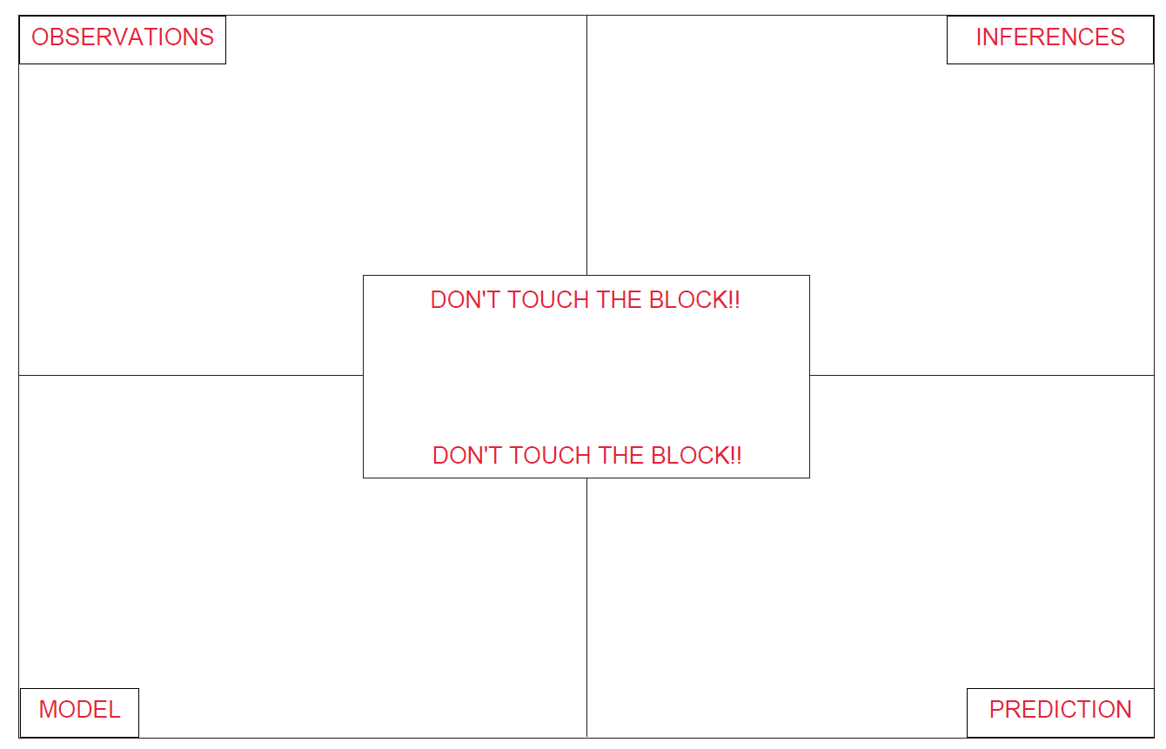
What is on the hidden face?

Slide 4
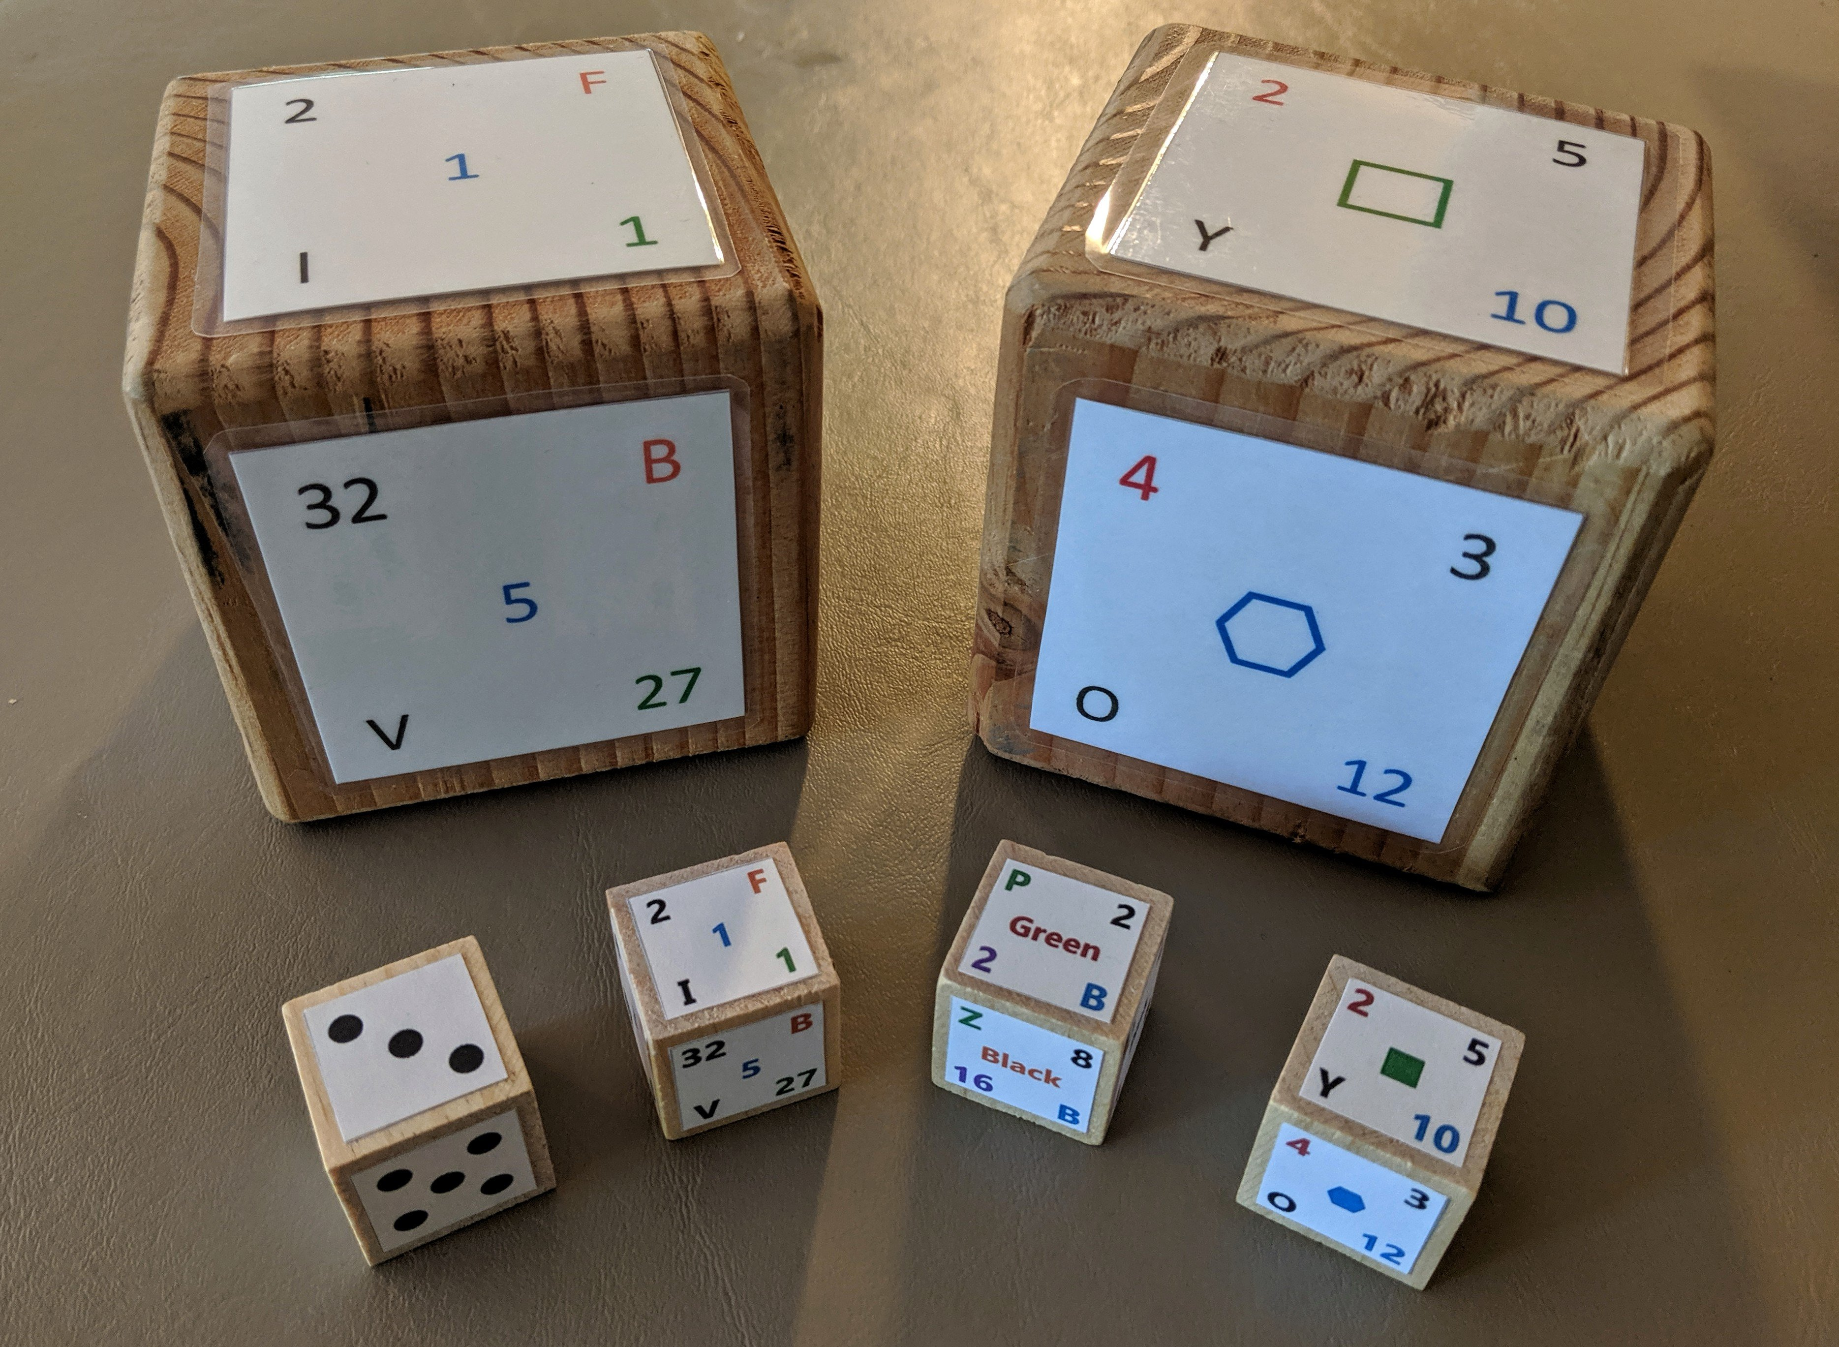
Finding Patterns to Build Models
In your groups try to find the patterns.
Use these patterns to make a prediction of what is on the bottom of the cube!
Image courtesy of Joe Cosette
Notes:
Kelly
Pick a tool and lead a discussion about how it could be used (model what you want them to do in their groups)
For example, this is an example of a HOOK.
Describe the black box and elicit suggestions about ways it can be used.
Breakout rooms using https://docs.google.com/presentation/d/1ehfdbEoXc_DH3T8TQntMjcNNjhJyIcPsVkm4JcvBU5g/edit?usp=sharing
Discuss how it can be used in each of the four stages:
ACTIVATING – draws students in and gets them thinking
ESTABLISHING – teaching about how to build models
DEEPENING – comparing models (peer review) gives insight into multiple models
REFLECTING – shaking the box makes them reflect on their model

Slide 5

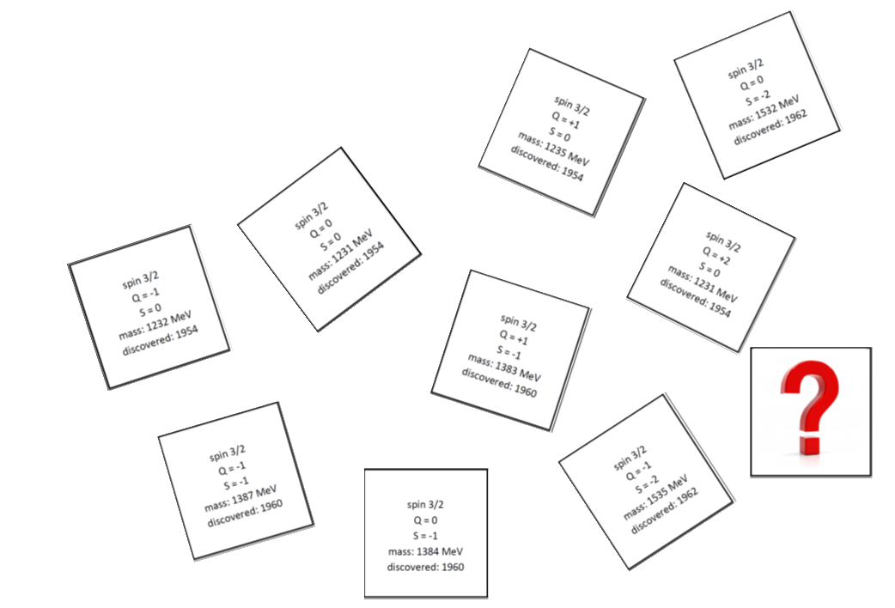
Can we use these patterns?
Put on your student hat
Organize the cards
Find the patterns to make a prediction!
Notes:
Humans are innately skilled at finding patterns. Scientists make observations and then sort their data to look for patterns. We are going to work in groups now to see if we can solve the pattern!

Slide 6
Finding Patterns
Column:
Same Charge
Increasing Mass
Row:
Same Strangeness

Slide 7
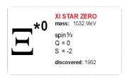
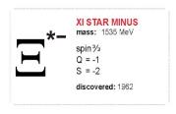
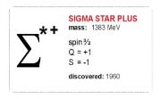
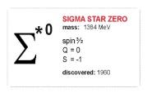
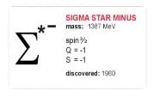
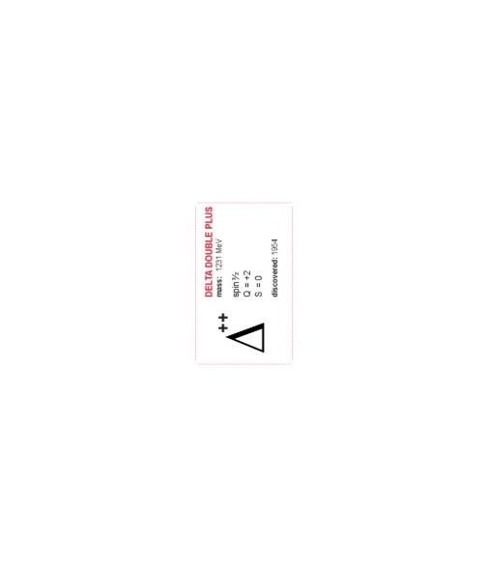
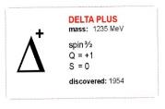
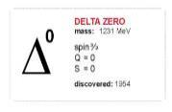
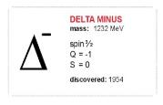
Finding Patterns
?
Column:
Same Charge
Increasing Mass
Row:
Same Strangeness

Slide 8
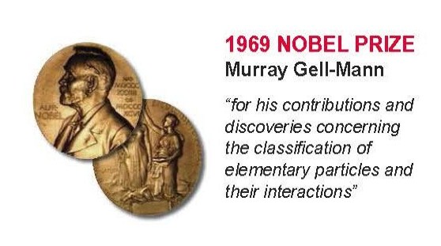
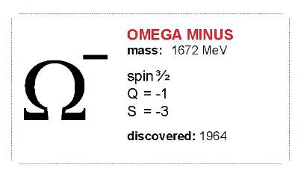
Making a Prediction
spin 3/2
charge = -1
strangeness = -3
mass ≈ 1680 MeV
Notes:
Predicting particles

Slide 9

What is a Particle Anyway ?
If I asked your students to describe or draw a particle,
what would they say?
Notes:
Then have them share with each other and then go to the next slide.

Slide 10


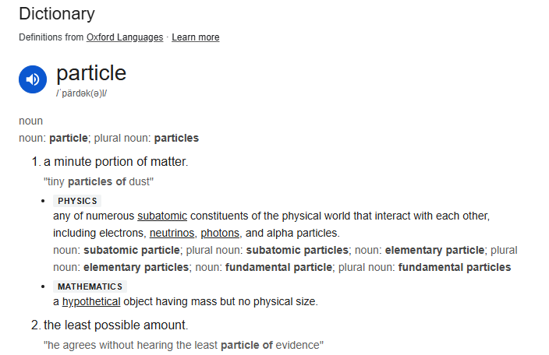
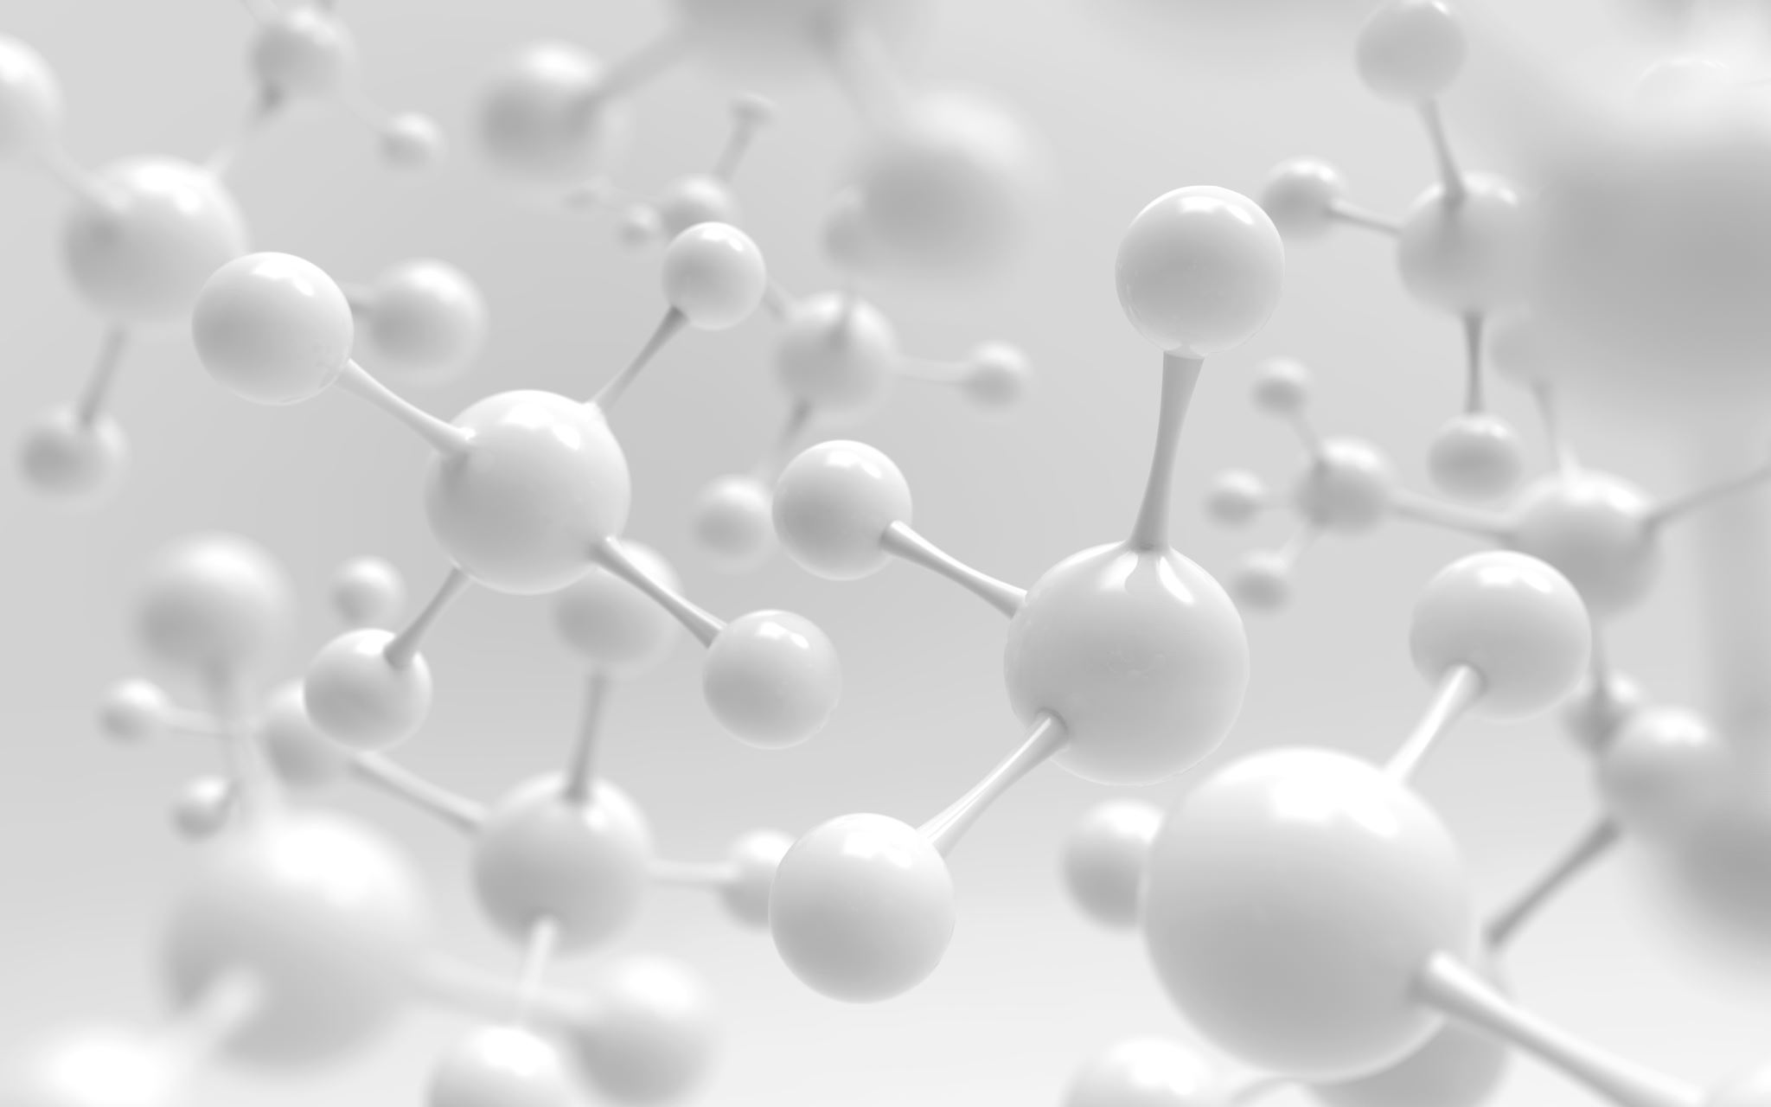
“Officially”
Notes:
I Googled electron & these are some of the things I found. This is the definition from Merriam-Webster.

Slide 11

But what does that mean???
Notes:
I Googled electron & these are some of the things I found. This is the definition from Merriam-Webster.

Slide 12
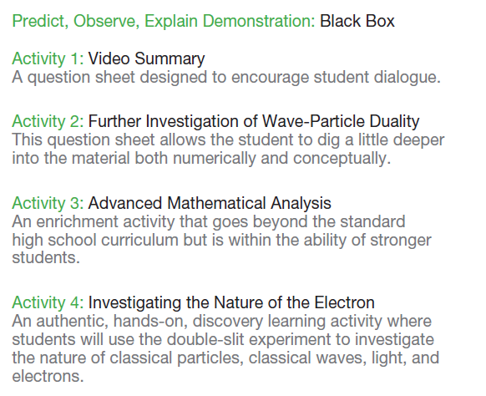
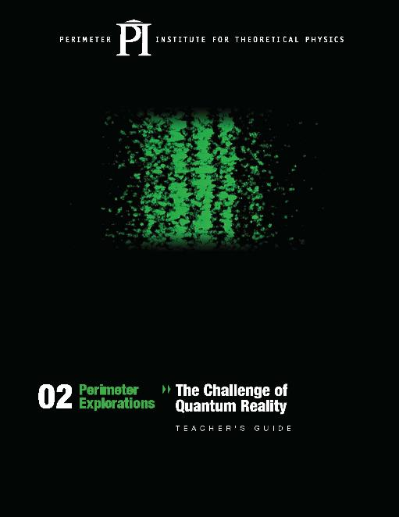
resources.perimeterinstitute.ca
Notes:
Let’s use this activity to test your model of an electron!

Slide 13
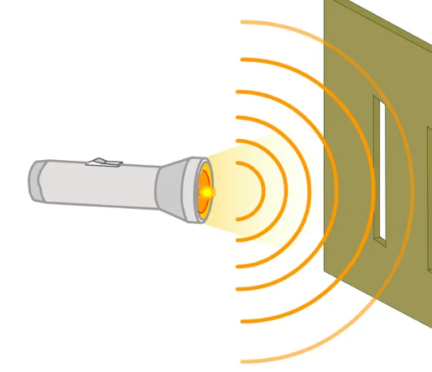

Let’s Use the Double Slit Experiment to Define “What is a Particle”
https://www.iflscience.com/light-interacts-with-itself-when-squeezed-through-slits-in-time-68282

Slide 14
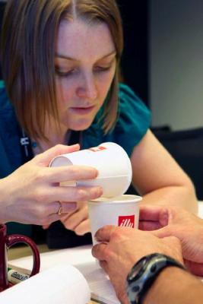
Double-slit Experiment with Classical Particles
Predict what pattern the sand will make on the paper.
Explain your prediction.

Slide 15
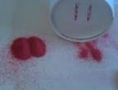
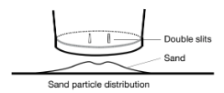
Double-slit Experiment with Classical Particles
Notes:
(15min)
Encourage the participants to perform the experiment several times to obtain several data sets. Identify and trouble shot systematic errors. The cup should sit flat on the table and the participants just need to tap the sides. See how the volume of sand used makes a difference.
After about 10 min, summarize the activity as a group (especially question #4). Develop the vocabulary as a class using the words from their whiteboards from earlier.
Develop a Particle Behaviour Model including vocabulary (collide, localized) and illustrations
Briefly talk about the effectiveness of the POE teaching strategy.

Slide 16
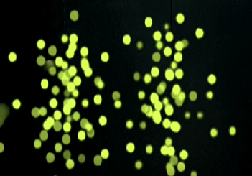
How would you describe a particle of sand?
Notes:
Here are the summaries of the built vocabulary.

Slide 17
Particle Model
Localized object
Particles are in one place at one time
Only one particle can hold a particular area at a time
Notes:
Here are the summaries of the built vocabulary.

Slide 18
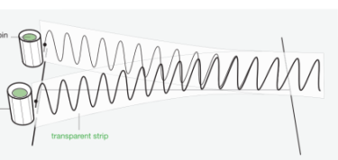
Double-Slit Experiment with Classical Waves
Predict what pattern you will observe along the line.
Explain your prediction.
Look along this line

Slide 19
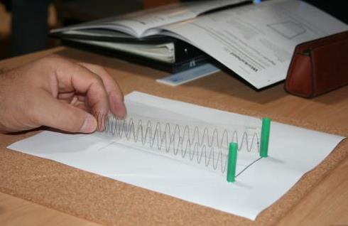
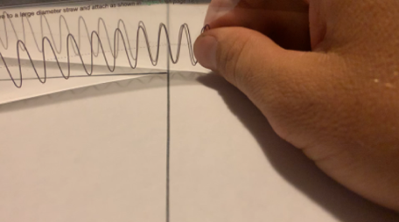
Double-Slit Experiment with Classical Waves

Slide 20

Notes:
Young’s double slit is often used to establish the Wave Nature of Light

Slide 21

How would you describe a wave?
Notes:
Explain the vocabulary above.

Slide 22
Wave Model
Non-localized
Spread out (no defined boundary or specific location)
Can occupy the same space as another wave at the same time
Notes:
Explain the vocabulary above.

Slide 23
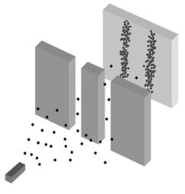
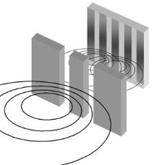
So What’s the Difference?
CLASSICAL PARTICLES
Localized
Collide with each other
No interference
CLASSICAL WAVES
Spread out (non-localized)
Don’t collide with other waves
Interference
Notes:
Summarize the two concepts. Recap the vocabulary.

Slide 24
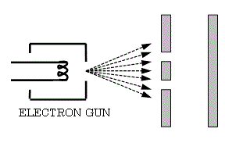
Let’s use this to define other objects… like an electron!
?
What happens when electrons go through the slits?
What will your students predict?
Notes:
(5min) Using the whiteboards, ask the participants to predict which model the electrons should adhere to. Get them to predict which pattern will result on the screen.

Slide 25
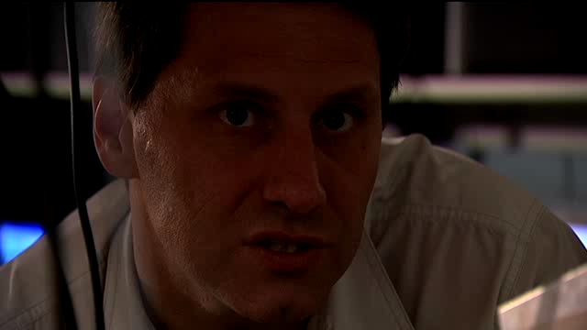
Electron Double-slit Experiment
Notes:
Video

Slide 26
Notes:
Video

Slide 27
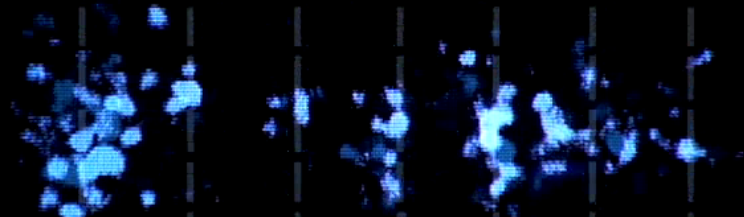
Observation
Notes:
Video

Slide 28
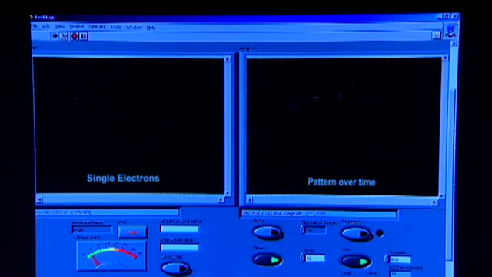
One Electron at a Time
Notes:
Is there any way to test the earlier models for the electrons? Be sure to relate the results to the vocabulary mentioned earlier. (Hopefully one person recommends passing the electrons through one at a time, to see if they are localized). After that recommendation, play the video, where only one electron is sent through at a time.

Slide 29
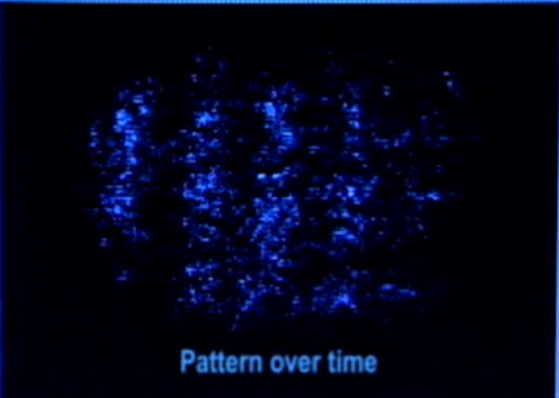

Slide 30

This is Wave-Particle Duality!!!!
Particle model explains each individual electron detection.
Wave model explains overall pattern
Notes:
(5 min) Summary of wave-particle duality.

Slide 31
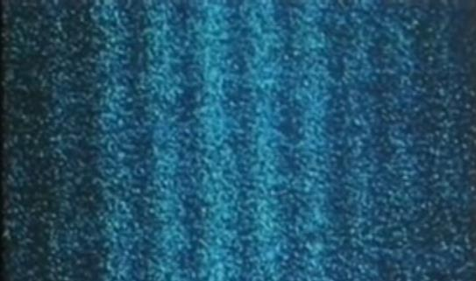

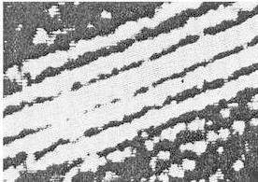
Other experiments have observed similar results
Jönsson 1961
Merli et al. 1976
Tonomura et al. 1989
Notes:
A Tonomura, J Endo, T Matsuda, T Kawasaki and H Ezawa 1989 Demonstration of single-electron build-up of an interference pattern American Journal of Physics57 117-120H
Pozzi et al. https://www.ncbi.nlm.nih.gov/pmc/articles/PMC4617474/
performed in 1961 by Claus Jönsson at the University of Tübingen in Germany. But while Jönsson’s work clearly illustrated that a beam of electrons can behave as a wave, it did not establish a crucial point of Feynman’s experiment – that an individual electron itself can behave like a wave.
Single-electron double-slit diffraction was first demonstrated in 1974 by Giulio Pozzi and colleagues at the University of Bologna in Italy,

Slide 32
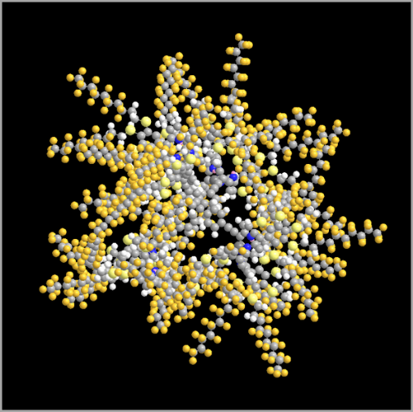
Wave-particle duality is widespread
Protons
Neutrons
Light
Atoms
Molecules
C₇₀₇H₂₆₀F₉₀₈N₁₆S₅₃Zn₄
mass = 25 000 amu
Notes:
The molecule mentioned is the heaviest object for which wave-particle has been observed as of May 2020. Reference; https://www.quantumnano.at/detailview-news/news/published-in-nature-physics/?tx_news_pi1%5Bcontroller%5D=News&tx_news_pi1%5Baction%5D=detail&cHash=e501b25b623fb79f80bcbcfdf04f8b6d
Image URL: same as above
There are many applications of wave particle duality. In fields like medical imaging, the wave-particle duality of electrons has played a role in the development of electron microscopes and other advanced imaging techniques that help us see the tiniest details of the microscopic world.

Slide 33
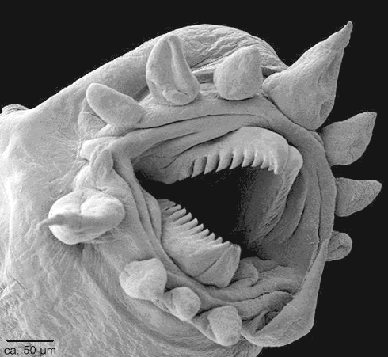
Can we use this duality?
YES!
Notes:
Then have them share with each other and then go to the next slide.

Slide 34

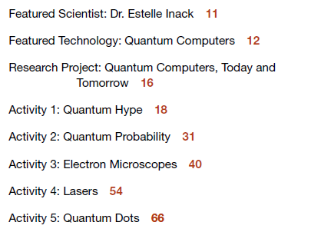
Notes:
Overall goal of resource is to provide a softer entry into quantum by looking at applications rather than interpretations.
Not an exhaustive list. Based on several standard lists (ex. NSTA)

Slide 35
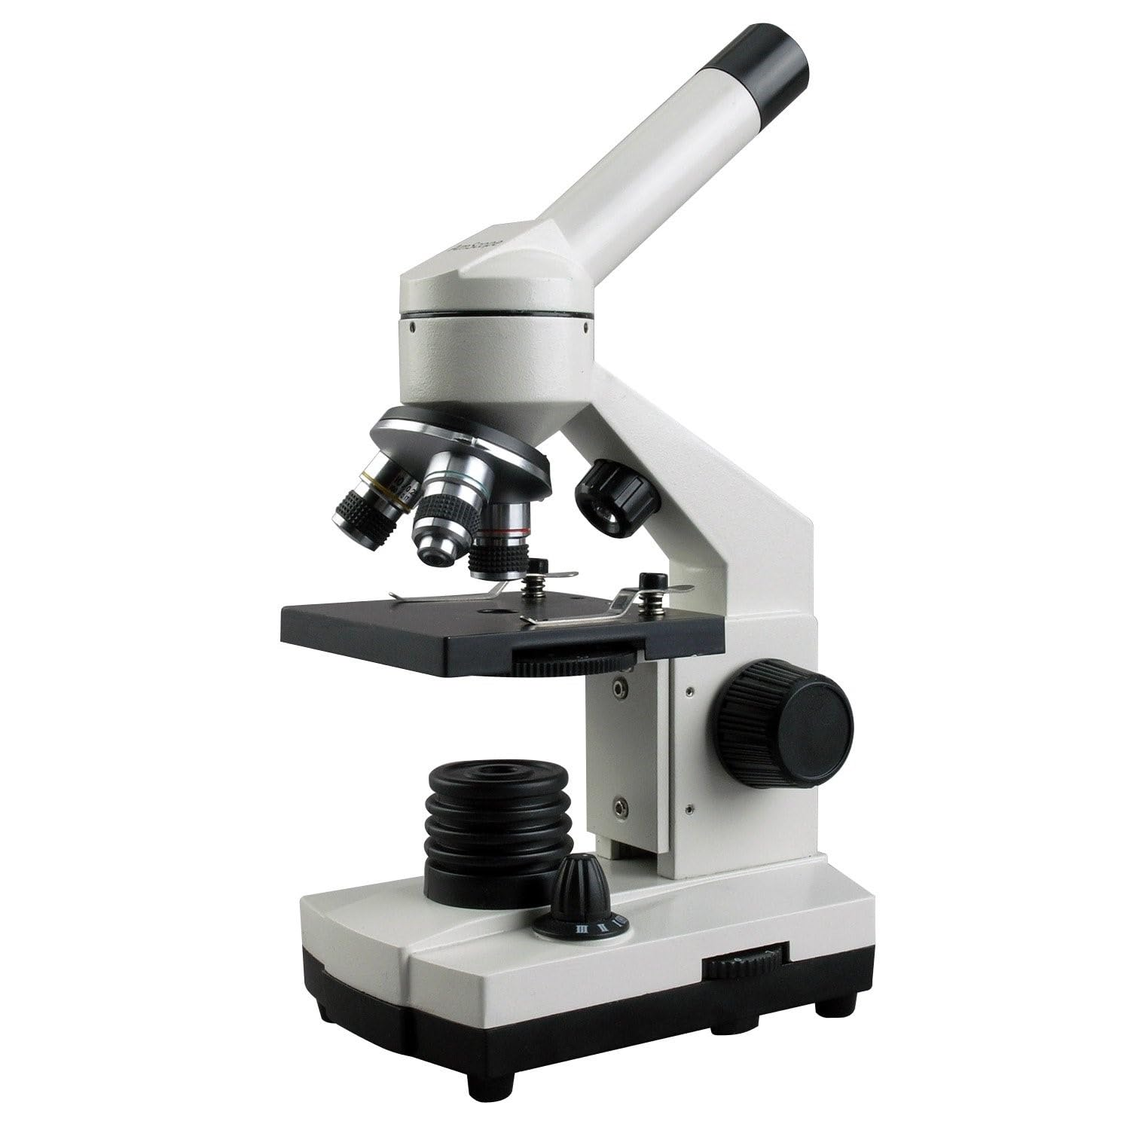
Microscopes
Magnify small objects so you can see more detail

Slide 36
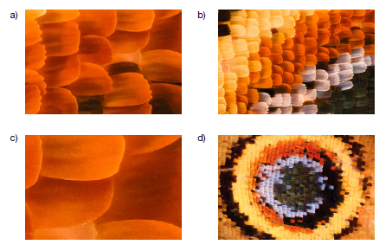
Magnification
Order the images from the smallest magnification to the largest.
What changes as the magnification increases?

Slide 37
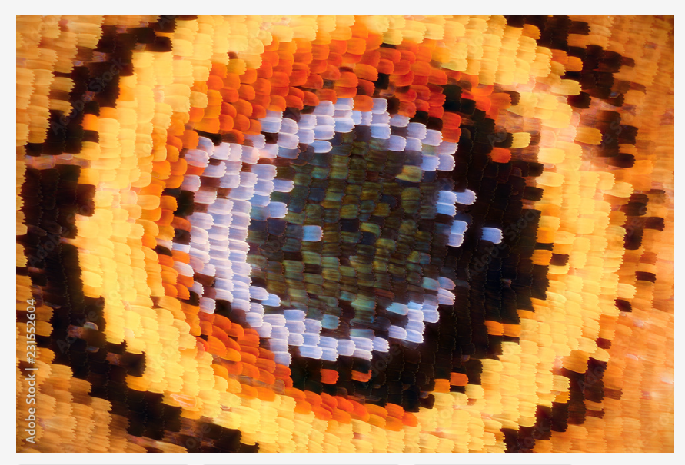
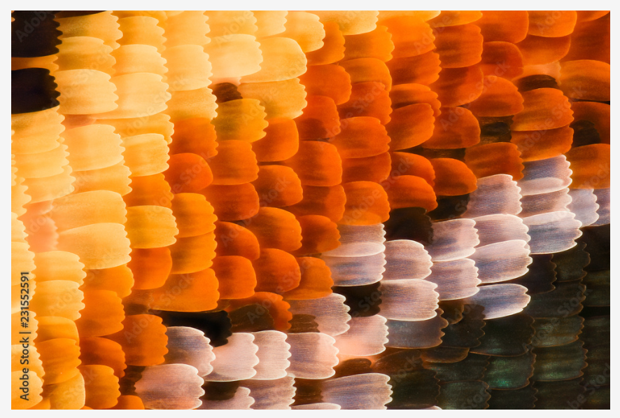
Magnification
d)
b)
a)
c)
Which image would you say provides the most detail?
Notes:
Answers will vary but image C does not provide more detail. It is a magnified blur.

Slide 38
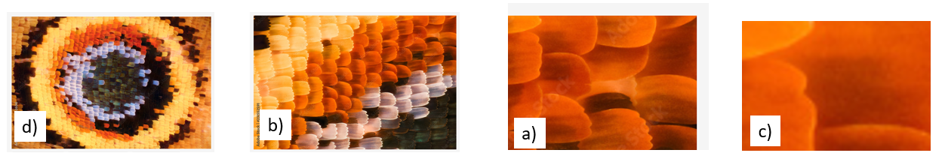
This is known as resolution
Ability to distinguish small features
One of the reasons resolution is limited is due to the diffraction and interference of light

Slide 39
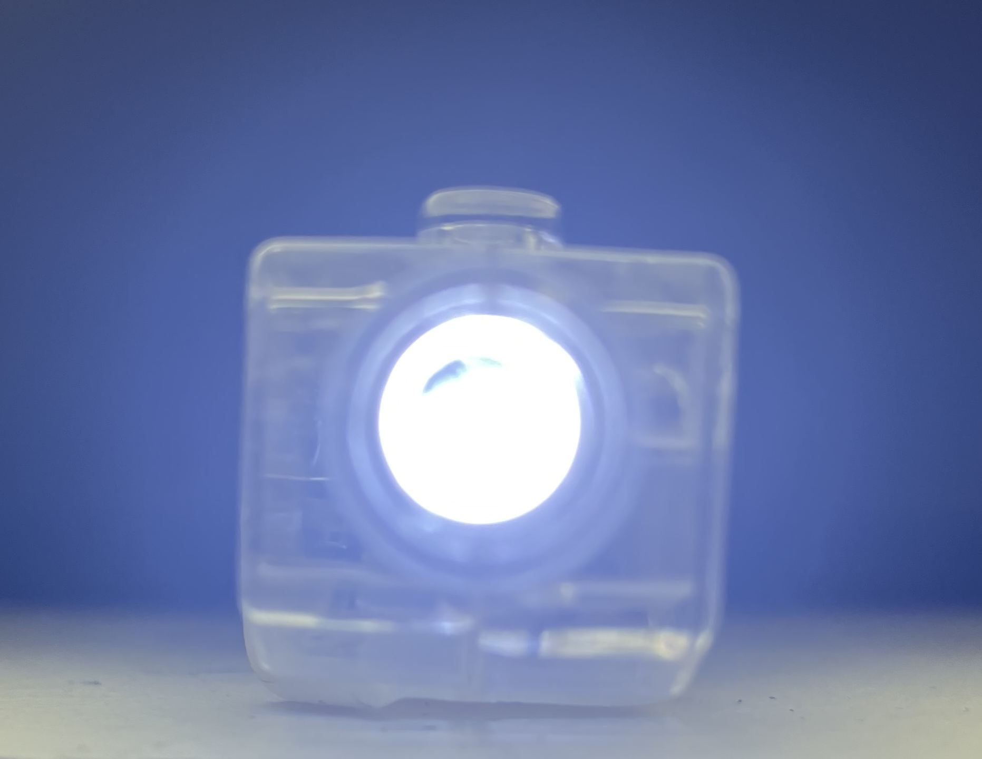

Optical microscopes have limited resolution

Slide 40
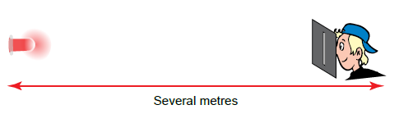
Let’s explore!

Slide 41
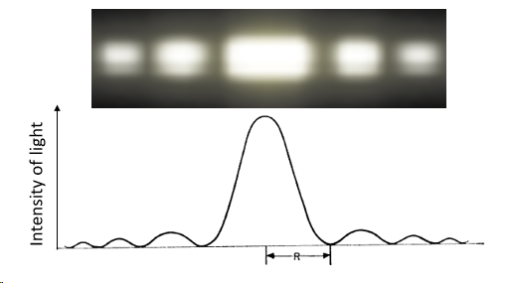
What do we see?

Slide 42
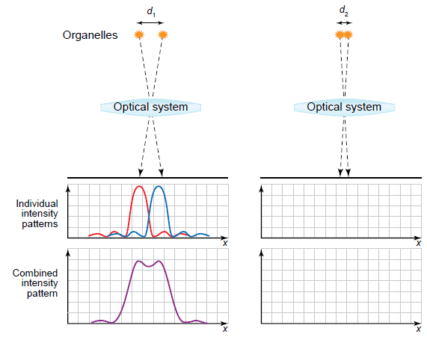
Distance and Size
How does separation distance affect the ability to resolve objects?

Slide 43
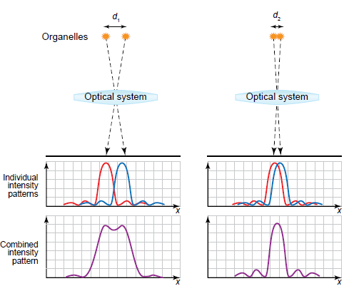
Distance and Size
As objects get closer together, they get harder to resolve.

Slide 44
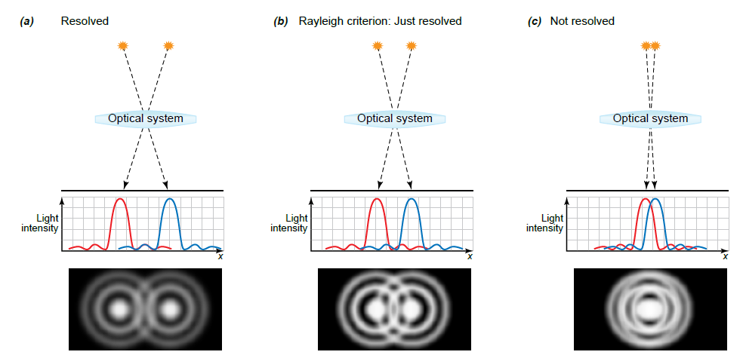
Rayleigh Criterion
Notes:
The Rayleigh criterion, named after Lord Rayleigh, defines the limit of resolution in optics, stating that two images are just resolvable when the center of the diffraction pattern of one is directly over the first minimum of the diffraction pattern of the other

Slide 45

How does the wavelength of light impact resolution?
What will you observe when you view pairs of red and blue lights through a narrow slit?

Slide 46


How does the wavelength of light impact resolution?

Slide 47


Slide 48

Some things to note…
You can only resolve an object if its size is greater than the wavelength of light being used, d ≥ λ.
E.g. The polio virus has a diameter of 25 nm. What type of light would be needed to resolve this virus?
Notes:
After determining x ray needed, ask What concerns might you have about using this type of light in a microscope?

Slide 49


Wave-Particle Duality to the Rescue!
An electron microscope uses the wave properties of electrons to “see” a sample.
de Broglie equation: $λ=\frac{h}{mv}$

Slide 50




The polio virus has a diameter of 25 nm.
Determine the speed of the electrons needed to resolve this virus.
$$λ=\frac{h}{mv}$$
$$h=6.626× {10}^{−34} \text{J}∙\text{s}$$
$$m_{e}=9.1×{10}^{−31} \text{kg}$$

Slide 51


The polio virus has a diameter of 25 nm.
Determine the speed of the electrons needed to resolve this virus.
$$v=\frac{h}{mλ}=\frac{6.626× {10}^{−34} \text{J}∙\text{s}}{(9.1×{10}^{−31} \text{kg})(25×{10}^{−9} \text{m})}$$
$$v=3 × {10}^{4} \text{m}\text{/}\text{s}$$

Slide 52

How do we control electrons?
Notes:
In an optical microscope, glass lenses like the one shown here are used to focus the light and magnify the image of the specimen.

Slide 53

Electrons are charged…
They respond to magnetic fields
Notes:
In an electron microscope, the beam of electrons also needs to be brought into focus, but glass lenses will not work. Instead, magnetic fields are used to change the path of electrons and act as a lens.
For each of the four magnetic fields, use a hand rule to determine the direction of the force on the electron beam when it enters the magnetic field. In each case, the force will change the path of the electron beam. If the magnetic field is pointing out of the page, the beam is deflected to the right. If the magnetic field is pointing into the page, the beam is deflected to the left.

Slide 54

Using Magnetic Lenses… Which arrangement will focus the beam of electrons?
A
B
C
D
Notes:
Which arrangement

Slide 55

Focusing a Beam of Electrons

Slide 56


Making an Image
Transmission Electron Microscope
Scanning Electron Microscope

Slide 57


Thank you

