Slide 1
Study Group 4
International High School Teacher Programme 2025

Slide 2
Wednesday, 9 July
SG Session 1

Slide 3
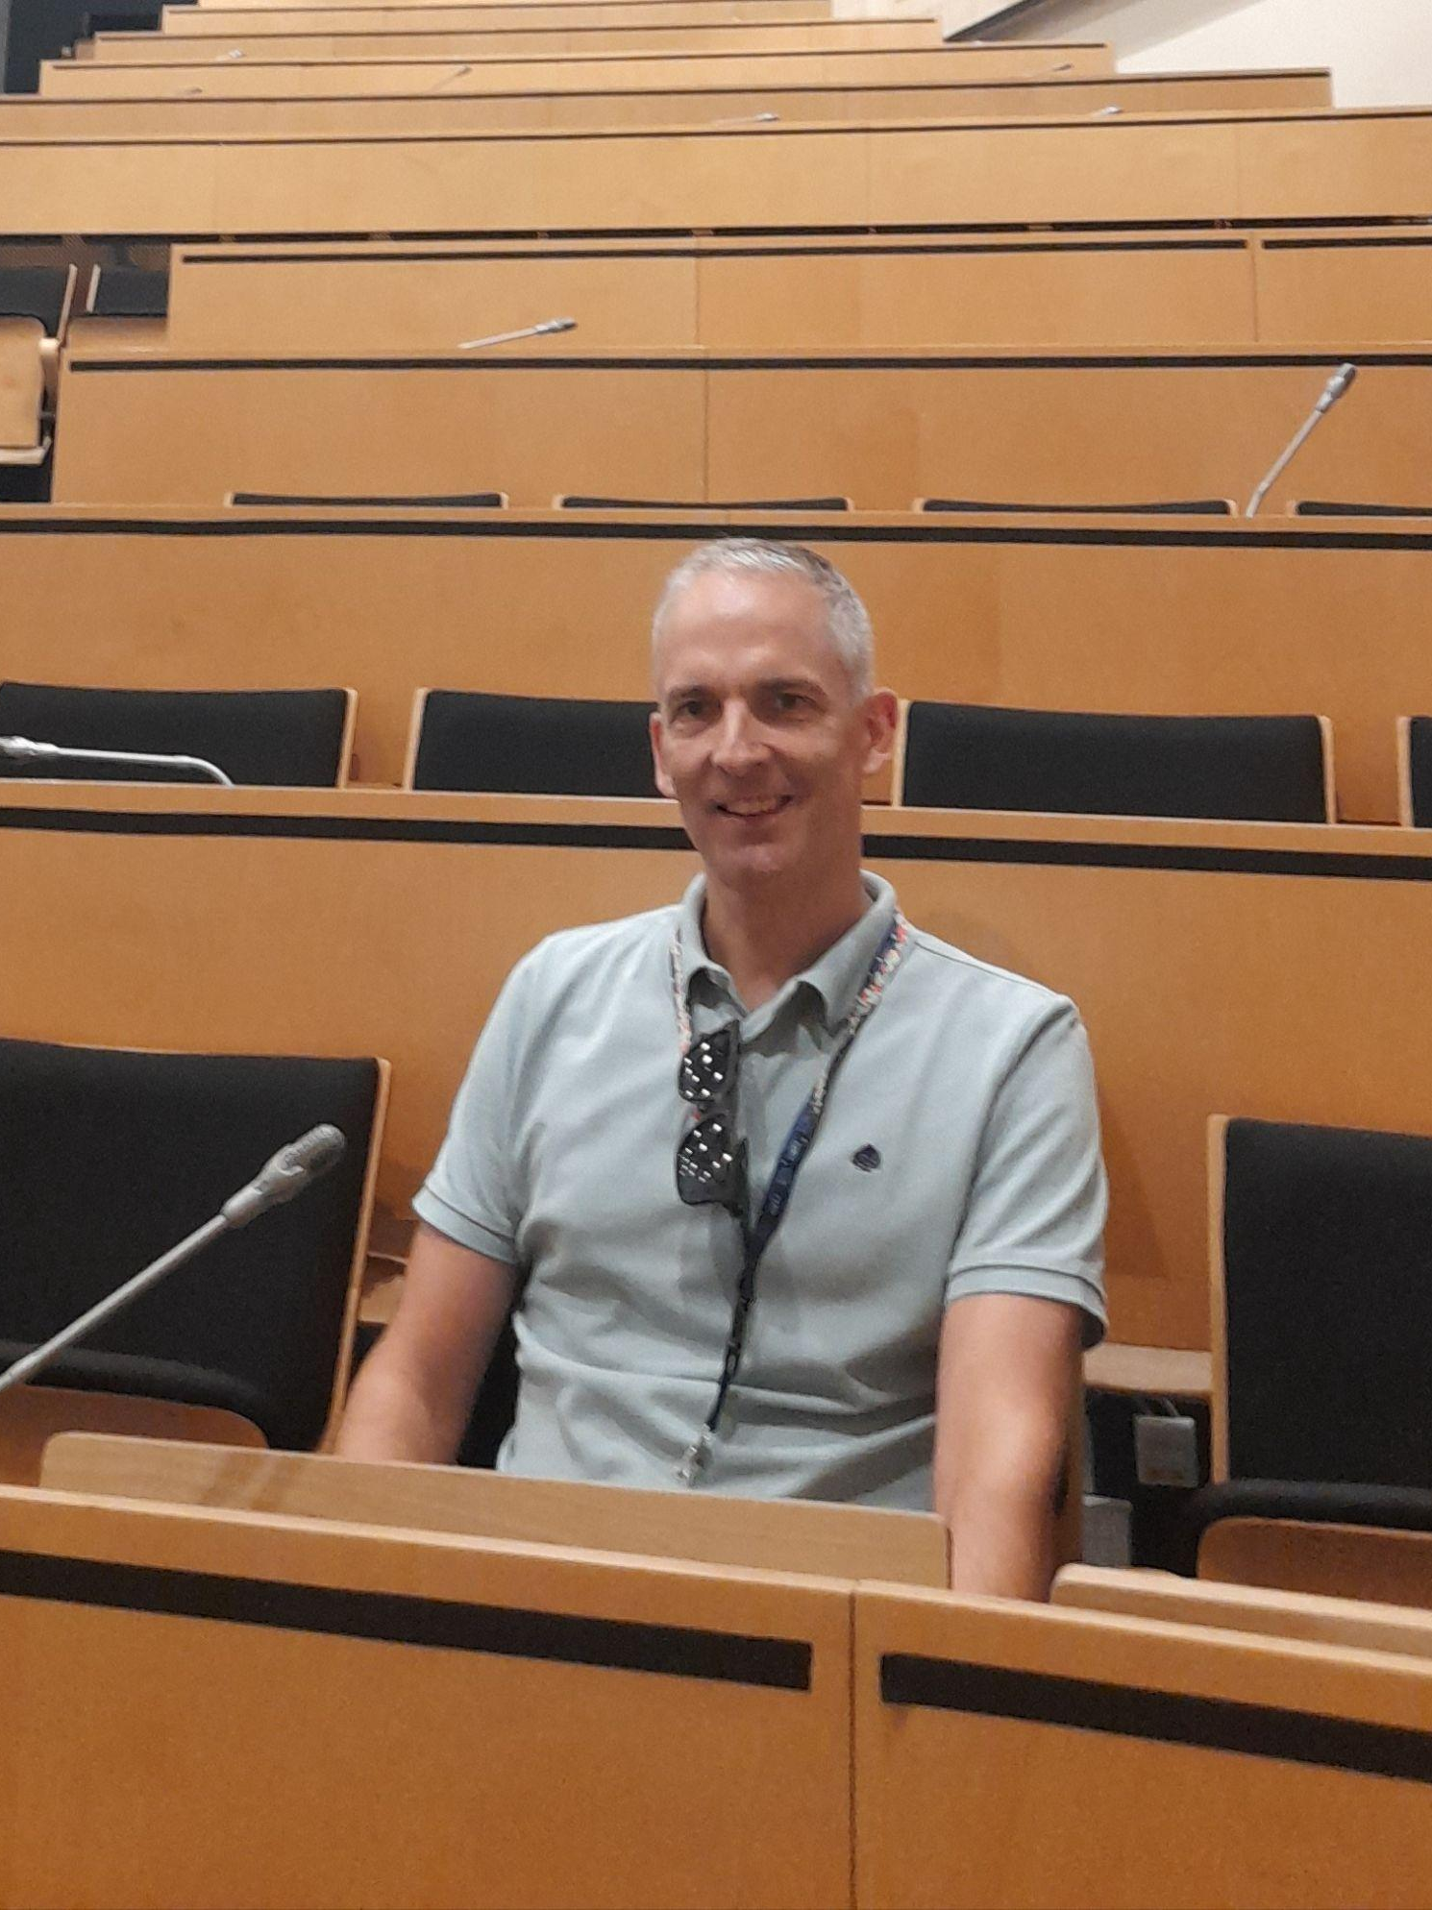

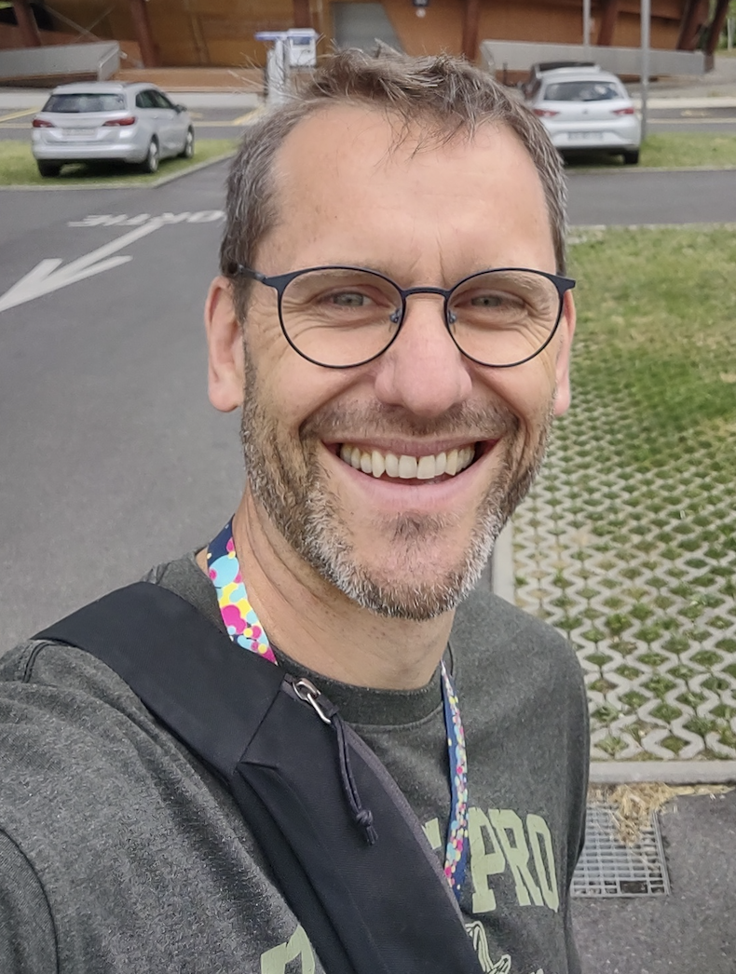
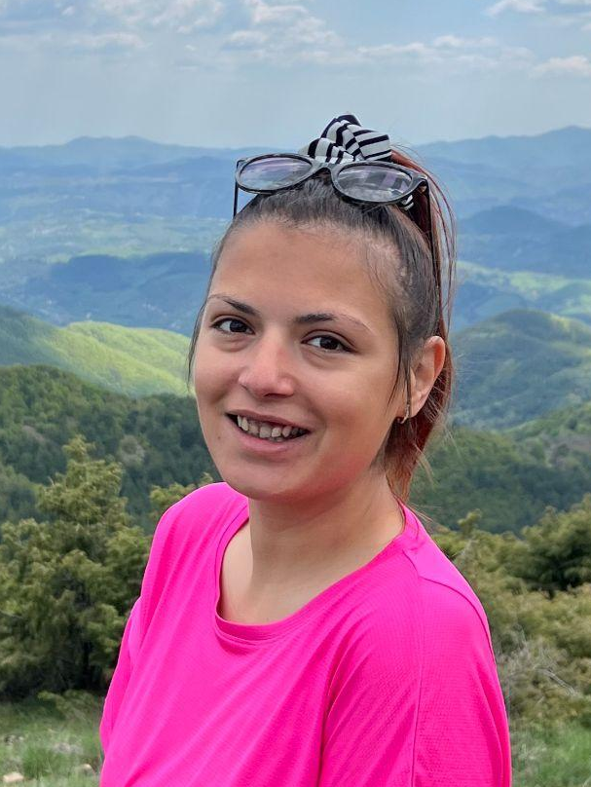

Study Group 4
Pedro Mourão
Portugal
Bad wake up (but I admit it) and I can write upside down.
Joni Albarico
Philippines
Has an unusual way of holding the pen when writing
Peter Olson
Germany
In a former life, I helped teachers integrate LEGO Mindstorms
Rozalina Nedyalkova
Bulgaria
During the week, I'm chased by questions; on the weekend – only echoes.
Barbara Hudovernik
Slovenia
At the moment I’m so afraid of bears…

Slide 4
Slide Conventions
Colour of Slide | Type of Work
 | Individual (your colour is indicated on the previous slide)
 | Group work
 | Report-out slides

Slide 5
Checklist for SG Session 1
# | Type of Task | Task | Deadline
1 | Individual | Fill in your section of the “Study Group 4” slide | Wednesday, 17:30
2 | Group | Fill in “Group Norms” slide | Wednesday, 17:30
3 | Individual | Fill in slides corresponding to your colour | Wednesday, 17:30
4 | Group | Fill in “Our Key Takeaways” and “Our Feedback” slides as a group. Make sure you all contribute to the discussion. | Wednesday, 17:30
5 | Group | Decide how you as a group will present your group slides if you are selected to present during the SG Report-Out. | Wednesday, 17:30

Slide 6
Group Norms
Instructions: Write on the right box your group norms and how you will work together. For example:
Who will manage the meetings?
Who will be the time-keeper?
Who will fill in group slides?
Anything else you think is important to coordinate for productive group work.
Peter - Manager
Pedro - Timekeep
Joni - Group slides

Slide 7
Particle
Physics
What are three adjectives that come to your mind when you think about particle physics?
To what extent is the topic of particle physics covered in your national curriculum?
difficult
mysterious
passionate
Only up to the core level in primary education and in secondary education up to the photoelectric effect and decay law.

Slide 8
Particle Accelerators
What are three key ideas about particle accelerators that you would like your students to know about?
What are potential challenges students might encounter when learning about particle accelerators?
Magnets
Importance of polarity
The need of vacuum
One challenge is the maths involves on it and the second one is the visualisation of events.

Slide 9
Particle
Detectors
What are three key ideas about particle detectors that you would like your students to know about?
What are potential challenges students might encounter when learning about particle detectors?
- Interaction particles with matter;
- Speed response of the electronics;
- Many questions without answers.
The multitude of effects and physical processes that can occur in a detector - that is, for each particle there is (or isn't) an effect on the material with which it interacts. Then there are the limitations of knowledge that may be enticing for some students but disappointing for others.

Slide 10
My Key Takeaways so far
Instructions: Write in the box any insights or things that you learned and that you want to remember after the HST2025 programme.
Magnets: what a world;
Collision process and the rate that it occurs.
CERN is not only for Physics.

Slide 11
Particle
Physics
What are three adjectives that come to your mind when you think about particle physics?
To what extent is the topic of particle physics covered in your national curriculum?
Interesting
Abstract
Challenging
Links to the Philippine Science High School (PSHS) System Curriculum
Chemistry 1 (Grade 8)
The structure of the atom
Physics 1 (Grade 8)
Conceptual introduction to forces (the four fundamental interactions)
Physics 3 (Grade 11): Extended Topics in Fundamental Physics
Relativity (Relativistic speed and energy)
Introduction to particle physics (fundamental concepts only)

Slide 12
Particle Accelerators
What are three key ideas about particle accelerators that you would like your students to know about?
What are potential challenges students might encounter when learning about particle accelerators?
Key Ideas
They are devices that enable particles to move at relatively high speeds through an external electric field.
They are instrumental in exploring the minute world of subatomic particles.
They come in different forms (i.e., linacs, circular accelerators).
Potential Challenges
Weak foundations of fundamental physics (knowledge of Newtonian mechanics and electromagnetism principles).
Lack of contextual knowledge of the use of particle accelerators (socio-scientific issues and practices)
Intimidation with the term or concept

Slide 13
Particle
Detectors
What are three key ideas about particle detectors that you would like your students to know about?
What are potential challenges students might encounter when learning about particle detectors?
Key Ideas
Particle detectors are devices that are used to observe and measure particles.
They act like cameras that can provide essential information about a particle, in terms of speed, energy, direction, and type.
Potential Challenges
Weak foundations of fundamental physics (knowledge of Newtonian mechanics and electromagnetism principles).
Students may associate particle detectors as devices that can trap particles.
Understanding how detectors work require interdisciplinarity of knowledge.

Slide 14
My Key Takeaways so far
Instructions: Write in the box any insights or things that you learned and that you want to remember after the HST2025 programme.
The CERN plays a pivotal role in constructing knowledge about the inner workings of the atom (the elementary particles).
Instrumental in understanding the existence, structure, and features of each elementary particle are the particle accelerators and detectors.
Science teachers should be effective purveyors of knowledge to effectively engage students in the abstract and mysterious world of elementary particle physics.

Slide 15
Particle
Physics
What are three adjectives that come to your mind when you think about particle physics?
To what extent is the topic of particle physics covered in your national curriculum?
Adjectives
  highly-technical
  inter-disciplinary (but not!)
  probing
National Curriculum
  US - No national curriculum
    Might address some modern physics topics, but typically not particle physics
    Not in AP curriculum, doesn't appear in NGSS - electromagnetism
    AP Physics will have topics of electromagnetism.
  Germany - BW
    Some concepts of electromagnetic interactions and fundamental particles

Slide 16
Particle Accelerators
What are three key ideas about particle accelerators that you would like your students to know about?
What are potential challenges students might encounter when learning about particle accelerators?
  Charged particles are accelerated by electric field.
  Limits of linear accelerators and circular accelerators needed for higher states.
  Significant amount of systems, engineering, and physics involved in the construction of these, even though they are built on basic principles.
  Understanding the acceleration is one component, understanding what they are used for is quite different!
  The particle accelerator is not very tangible.
  The particle accelerator is based on principles of chemistry, physics, and electricity - all working together.

Slide 17
Particle
Detectors
What are three key ideas about particle detectors that you would like your students to know about?
What are potential challenges students might encounter when learning about particle detectors?
Key ideas
  Detectors don't detect particles, rather the traces of how they interact with different materials.
  We can make observations of things that we cannot see by knowing the precise conditions of the initial momentum of the system.
  Detectors are arranged in a specific order, some that allow particles to pass through and some halt their progress (calorimeter).
Challenges:
  Seeing the sites are a tremendous benefit in understanding the specifics of what an accelerator and detector do, so not seeing them makes them abstract.
  There is a lot of information to digest to understand the search for fundamental particles. We've had three days of tours and lectures, and I'm starting to wrap my head around things.

Slide 18
My Key Takeaways so far
Instructions: Write in the box any insights or things that you learned and that you want to remember after the HST2025 programme.
I want to be able to explain clearly how and accelerator and detector work, even if my understanding is at a superficial level.
I want to be able to describe better the details of how accelerators confirm the predictions by the standard model.
I want to be able to explain to a layperson the importance of the science that is being done at CERN.

Slide 19
Particle
Physics
What are three adjectives that come to your mind when you think about particle physics?
To what extent is the topic of particle physics covered in your national curriculum?
Fundamental, abstract, microscopic
In Bulgaria, physics is taught in standard schools from 7th to 10th grade. At the end of 10th grade, the curriculum includes two lessons related to particle physics: “Elementary Particles” and “Fundamental Interactions in Nature.”

Slide 20
Particle Accelerators
What are three key ideas about particle accelerators that you would like your students to know about?
What are potential challenges students might encounter when learning about particle accelerators?
1)
What are particle accelerators?
How do accelerators work?
Why are particle accelerators important?
2)
Abstract and invisible object.
Difficult physical principles.
Why are we learning this?

Slide 21
Particle
Detectors
What are three key ideas about particle detectors that you would like your students to know about?
What are potential challenges students might encounter when learning about particle detectors?
1)
The detectors gather clues about the particles (speed, mass and charge).
Detectors are like giant scientific cameras made of layers, and each layer gives different information.
How do we measure these particles?
2)
complexity of detectors
abstract idea
technical vocabulary

Slide 22
My Key Takeaways so far
Instructions: Write in the box any insights or things that you learned and that you want to remember after the HST2025 programme.
I want to remember the excitement of being part of a global scientific community and sharing this passion with my students.

Slide 23
Particle
Physics
What are three adjectives that come to your mind when you think about particle physics?
To what extent is the topic of particle physics covered in your national curriculum?
fast
small
attractive
not at all
in national curriculum only relativity is optional
obligatory is only nucleus (nucleons, radioactive decay, fusion and fission, activity, binding energy, reaction energy)

Slide 24
Particle Accelerators
What are three key ideas about particle accelerators that you would like your students to know about?
What are potential challenges students might encounter when learning about particle accelerators?
Key ideas:
How do they operate? (electric and magnetic fields)
What is synchrocyclotron and what in cyclotron?
What particles are used to collide and what do we expect from colliding those particles?
Potential challenges:
They do not have much knowledge about strong force.
They do not know anything about standard model.
They do not know much about detectors.

Slide 25
Particle
Detectors
What are three key ideas about particle detectors that you would like your students to know about?
What are potential challenges students might encounter when learning about particle detectors?
Particle detectors
What are they used for (the whole idea)?
Why do we need different detectors?
How difficult it is to detect all events that are consequence of just one starting event.
Potential challenges:
the physics behind each sort of detector
they never saw (many also will not see) at least one single detector

Slide 26
My Key Takeaways so far
Instructions: Write in the box any insights or things that you learned and that you want to remember after the HST2025 programme.
what is done and what is not done in each part of CERN rings, accelerators, detectors
a variety of knowledge to make it all operate
the way we accelerate protons and nucleuses in more steps to finally give them the proper energy
some of the problems with beams (magnetic lenses and dumping)
how time and source consumpting is analyse of all data gathered

Slide 27
Study Group Discussion
Share your individual insights with your colleagues and identify shared themes.
Have some ice cream and don’t forget to
take notes :)
pedro.mourao@cjd.pt
barbara.hudovernik@gmail.com
rozi2642@gmail.com
peter.olson@bfacademy.de

Slide 28

Our Key Takeaways so far
Particle physics: challenging, abstract, compelling
Links to the National Curriculum:
atomic structure
the four fundamental interactions (iceberg analogy)
2. Particle accelerators: Why, how, and what? Operating mechanism
Prior knowledge to understand the mechanism
3. Particle detectors: Onion (analogy)
Why, how, and what of particle detectors
Technical knowledge associated with particle detectors
Interdisciplinarity of knowledge
4. The role of CERN
The critical role of teachers as conveyors of knowledge
Science is a collective enterprise.
Science is objective; it relies on empirical evidence (data).

Slide 29
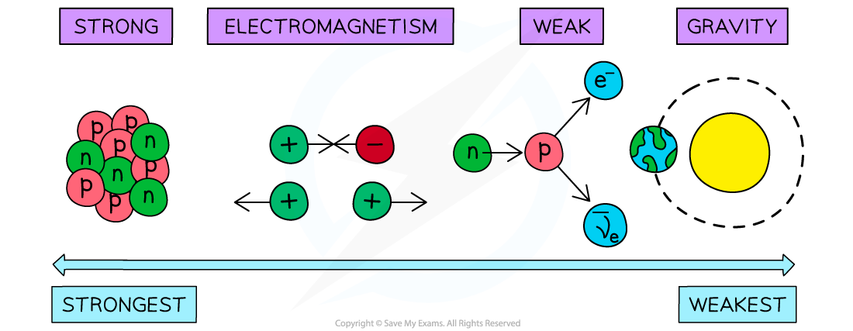
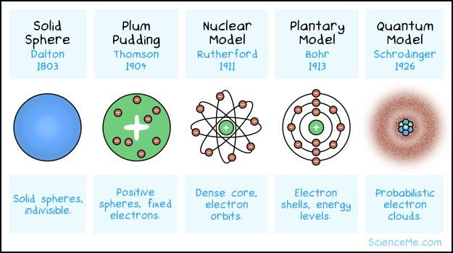

Our Key Takeaways so far
PARTICLE PHYSICS
Compelling | Abstract | Challenging
CURRICULUM CONNECTIONS
Fundamental interactions
Structure of the atom

Slide 30


Our Key Takeaways so far
Particle accelerators
Why are they important?
How do they work?
What are the basic principles behind the functioning of a particle accelerator?
Challenges
Students’ prior knowledge associated with particle accelerators
Contextual knowledge or background on the use of particle accelerators

Slide 31

Our Key Takeaways so far
Particle detectors
What are particle detectors?
How do they work?
Why are they important in particle physics?
Challenges
Technical knowledge associated with particle detectors
Interdisciplinarity of knowledge

Slide 32



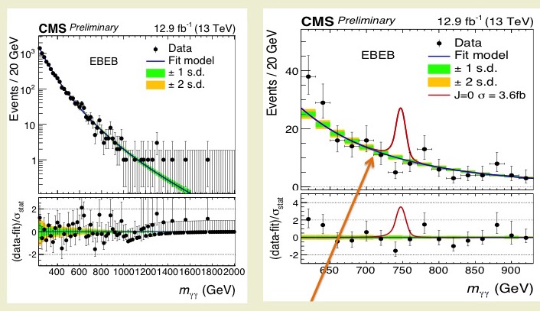
Our Key Takeaways so far
The role of CERN in advancing particle physics knowledge
The pivotal role of teachers as effective communicators and conveyors of knowledge
Science as a collaborative and collective enterprise.
Reliance of science on empirical evidence

Slide 33



Our Feedback
so far
Highlights?
What’s working?
What needs improvement?
Other comments?
Funny picture or meme?
Highlights
Interaction with teachers from all over the world.
Visiting the sites & lectures.
Enthusiasm all around.
Working
Sequencing and structure is very well planned. There is intentionality in each item on the schedule.
There is repetition of the key themes of particle physics. Another onion!
Improvement
Visits are somewhat rushed due to the time schedule.
Notes:
Highlight
Interaction with other Physics teachers from around the world. We start on common ground.
Sites & lectures
Enthusiasm all around - from presenters, Jeff, Milena & Team, from the participants.
Improvement - We've perhaps all chaperoned visits where you have to tell students that they can't leave until a certain time - here we have teachers

Slide 34
Thursday, 10 July
SG Session 2

Slide 35
Checklist for SG Session 2
# | Type of Task | Task | Deadline
1 | Individual | Fill in slides corresponding to your colour | Thursday, 18:00
2 | Group | Fill in “Our Key Takeaways” and “Our Feedback” slides as a group. Make sure you all contribute to the discussion. | Thursday, 18:00
3 | Group | Decide how you as a group will present your group slides if you are selected to present during the SG Report-Out. | Thursday, 18:00

Slide 36
Engineering
Which topic from the physics curriculum could you see yourself teaching in the context of Engineering at CERN?
Sketch out your idea and add links to suitable resources!
Electromagnetic effect and then superconductivity
a) Oersted experience https://www.youtube.com/watch?v=olijC0eIHWA
b) Faraday´s Law: https://phet.colorado.edu/sims/html/faradays-electromagnetic-lab/latest/faradays-electromagnetic-lab_all.html?locale=pt
c) And if the resistance were zero?
https://www.youtube.com/watch?v=sU3av6FqwHs

Slide 37
LHC
Which topic from the physics curriculum could you see yourself teaching in the context of the
Large Hadron Collider at CERN?
Sketch out your idea and add links to suitable resources!
Particle deflection (Lorentz Law)
Starting with the basic of the function of mass spectrometer and then get to the ciclotron

Slide 38
AI
What are three key ideas about AI that you would like your students to know about?
What are potential challenges students might encounter when learning about AI?
What are potential benefits students might encounter when learning with the help of AI?
- lots of information;
- only a small part of it are stored - trigger system
- maybe they miss important things
- Choose the correct parameters;
- Be in the (thin) line that separates what is legal from that is illegal
Speed in the choose and treatment of information

Slide 39
My Key Takeaways so far
Instructions: Write in the box any insights or things that you learned and that you want to remember after the HST2025 programme.
Magnets;
Superconductivity;
Big data;
Trigger system;
Luminosity.

Slide 40
Engineering
Which topic from the physics curriculum could you see yourself teaching in the context of Engineering at CERN?
Sketch out your idea and add links to suitable resources!
Magnetic phenomena
Energy in quantum physics
Concept of stress
The engineering design process: How to integrate the use of physics concepts and principles in proposing solutions
Teach Engineering: https://www.teachengineering.org/
Magnet Challenge (CERN Science Gateway): https://visit.cern/magnet-challenge
LHC Superconducting Magnets: https://home.cern/resources/video/engineering/lhc-superconducting-magnets

Slide 41
LHC
Which topic from the physics curriculum could you see yourself teaching in the context of the
Large Hadron Collider at CERN?
Sketch out your idea and add links to suitable resources!
Concept of electric fields
Mechanics of circular motion
Relativistic speed and energy
Magnetic phenomena

Slide 42
AI
What are three key ideas about AI that you would like your students to know about?
What are potential challenges students might encounter when learning about AI?
What are potential benefits students might encounter when learning with the help of AI?
There is an enormous amount of data produced when studying collisions in a particle accelerator.
AI can be harnessed to effectively and efficiently study experiments involving particle collisions.
AI becomes more effective and efficient when there is discernment.
Challenges
Technical knowledge (maths, probability, coding, data structures and algorithm, domain knowledge)
Ethical issues on the use of AI
Imposter syndrome
Benefits
Development of cognitive and analytical skills
Technical proficiency
Desire to pursue fields related to IT

Slide 43
My Key Takeaways so far
Instructions: Write in the box any insights or things that you learned and that you want to remember after the HST2025 programme.
The interdisciplinarity of STEM in actual research setting

Slide 44
Engineering
Which topic from the physics curriculum could you see yourself teaching in the context of Engineering at CERN?
Sketch out your idea and add links to suitable resources!
Engineering was specifically focused on magnet engineering. Building a product to accomplish a task no one has done before is fascinating.
Ties with some of the tasks of robotics design. Plan, test, refine.
I like the idea of building a quadrupole and dipole magnets using coils of wire. What is the educational gain here?
Notes:
Faraday Laws, superconducting, Faraday's law simulations.
Magnetic phenomena, unit electron volt, consequences of problem solving, engineering design problems - (how will you develop a plan to solution).Teach engineering representations. Magnet challenge, superconducting magnets at CERN.
Building items; rainbow in a box, prism, building blocks - what are detectors
How to repair beam - not easy to do. Magnetic lenses, dumpers, how to we get strong.

Slide 45
LHC
Which topic from the physics curriculum could you see yourself teaching in the context of the
Large Hadron Collider at CERN?
Sketch out your idea and add links to suitable resources!
Charges in an electric field
Create an electric field and show that particles are accelerated.
PHET - Electric Field Hockey Allows students to play with accelerating and steering a particle. Could this be modified to mimic accelerators or generate circular motion.
Circular motion
Analysis of circular motion of LHC
  What supplies force? What increases the energy of particle? What has to be counteracted?
  Students could compute centripetal force needed for a proton at velocities we would see.

Slide 46
AI
What are three key ideas about AI that you would like your students to know about?
What are potential challenges students might encounter when learning about AI?
What are potential benefits students might encounter when learning with the help of AI?
AI is a different looking to solve new problems in a faster way.
AI is mind bending. Training of algorithms and developing a solution approach that no one really understands is interesting.
AI might allow them to ask questions or refine questions that they have. Using how to use AI is a good learning process in itself.

Slide 47
My Key Takeaways so far
Instructions: Write in the box any insights or things that you learned and that you want to remember after the HST2025 programme.
The context for learning is key - we have a rich context from particle physics for us to consider and exploit.
New problems require new approaches or ways of thinking. CERN's need led them to developing technologies that others are now using.
Don't forget to do science

Slide 48
Engineering
Which topic from the physics curriculum could you see yourself teaching in the context of Engineering at CERN?
Sketch out your idea and add links to suitable resources!
Light and CERN (ATLAS detector)
(10 grade)
Students to build “rainbow in a box”
https://solvay-education-programme.web.cern.ch/rainbow-box-atlas-detector
“How can we detect something we can’t see?”
“Rainbow Box” is a hands-on model using everyday materials to simulate how detectors use light. While building, they explore key physics concepts like light propagation, reflection, refraction, and dispersion.
https://phet.colorado.edu/en/simulations/bending-light
https://www.youtube.com/watch?v=3cmrv2hCxWs

Slide 49
LHC
Which topic from the physics curriculum could you see yourself teaching in the context of the
Large Hadron Collider at CERN?
Sketch out your idea and add links to suitable resources!
When two bodies collide… Like at CERN
8 grade at the end of the Мechanics
Еveryone has seen a collision between two objects. A cart hits another cart. A football bounces off a wall. Two students bump into each other in the hallway.
Students observe how objects of different mass and speed behave when they collide. They realize that when one body acts on another, there is always an equal and opposite reaction. They see how momentum is transferred, and how direction or speed can change.
And then, we speak for CERN — the world’s largest physics laboratory. There, collisions happen too. But not between carts, rather between protons, moving nearly at the speed of light.
https://phet.colorado.edu/en/simulations/collision-lab
https://home.cern/resources/video/experiments/atlas-frequency-collisions-animation

Slide 50
AI
What are three key ideas about AI that you would like your students to know about?
What are potential challenges students might encounter when learning about AI?
What are potential benefits students might encounter when learning with the help of AI?
Machine learning helps us find complex solutions quickly.
Big data
Physics+intuition+calculation
difficult to prompt
possibility of false information

Slide 51
My Key Takeaways so far
Instructions: Write in the box any insights or things that you learned and that you want to remember after the HST2025 programme.
CERN Science Gateway is perfect place for the students and i want to go there with my students.
Cloud chamber
cern.ch/PER
decay/transformation

Slide 52
Engineering
Which topic from the physics curriculum could you see yourself teaching in the context of Engineering at CERN?
Sketch out your idea and add links to suitable resources!
If we already introduced some particle physics…
How do we know that we have what we want?
How do we repair our beam if something is wrong?
Is that easy to be done, how can it be done with all those systems involved?
magnetic lenses - analogy with ordinary lenses
dumpers
achieving high currents, low temperatures
materials

Slide 53
LHC
Which topic from the physics curriculum could you see yourself teaching in the context of the
Large Hadron Collider at CERN?
Sketch out your idea and add links to suitable resources!
It is not only protons we can collide.
What do we expect from larger particles in the collisions?
Larger particles, larger energies → new particles can be generated → new knowledge

Slide 54
AI
What are three key ideas about AI that you would like your students to know about?
What are potential challenges students might encounter when learning about AI?
What are potential benefits students might encounter when learning with the help of AI?
Way too much data to save all.
How do we decide if some data should be saved and which is not interesting?
How do we do it in that short time available?
Mathematical procedures…
How can we be sure that we did not throw away important events?
Helpful!
Can be used on many fields nowadays.

Slide 55
My Key Takeaways so far
Instructions: Write in the box any insights or things that you learned and that you want to remember after the HST2025 programme.
Many new aspects:
Accelerators (all kinds of)
Magnets and cooling
Materials - what a science in superconductivity
We have a beam, but it can not be perfect → what can we do (fix?, shut down?, how do we do it?)
We have collisions (they actually are rare!), but far too many data out of it
AI must be used → models according to our existing knowledge
People collaborate
80 % of time running tests

Slide 56
Study Group Discussion
Share your individual insights with your colleagues and identify shared themes.
Have some ice cream and don’t forget to
take notes :)
Superconductivity
Engineering design
Particle physics not being taught in schools; but can be integrated into the discussion of electromagnetic phenomena
Oxygen and proton collisions; Neon and proton collisions
Imposter syndrome
Big data
Speed in providing solutions
Development of analytical thinking skills through AI
Quick solutions using big data
Physics + Intuition + Calculation
Possibility of false information
Mathematical procedures and time

Slide 57
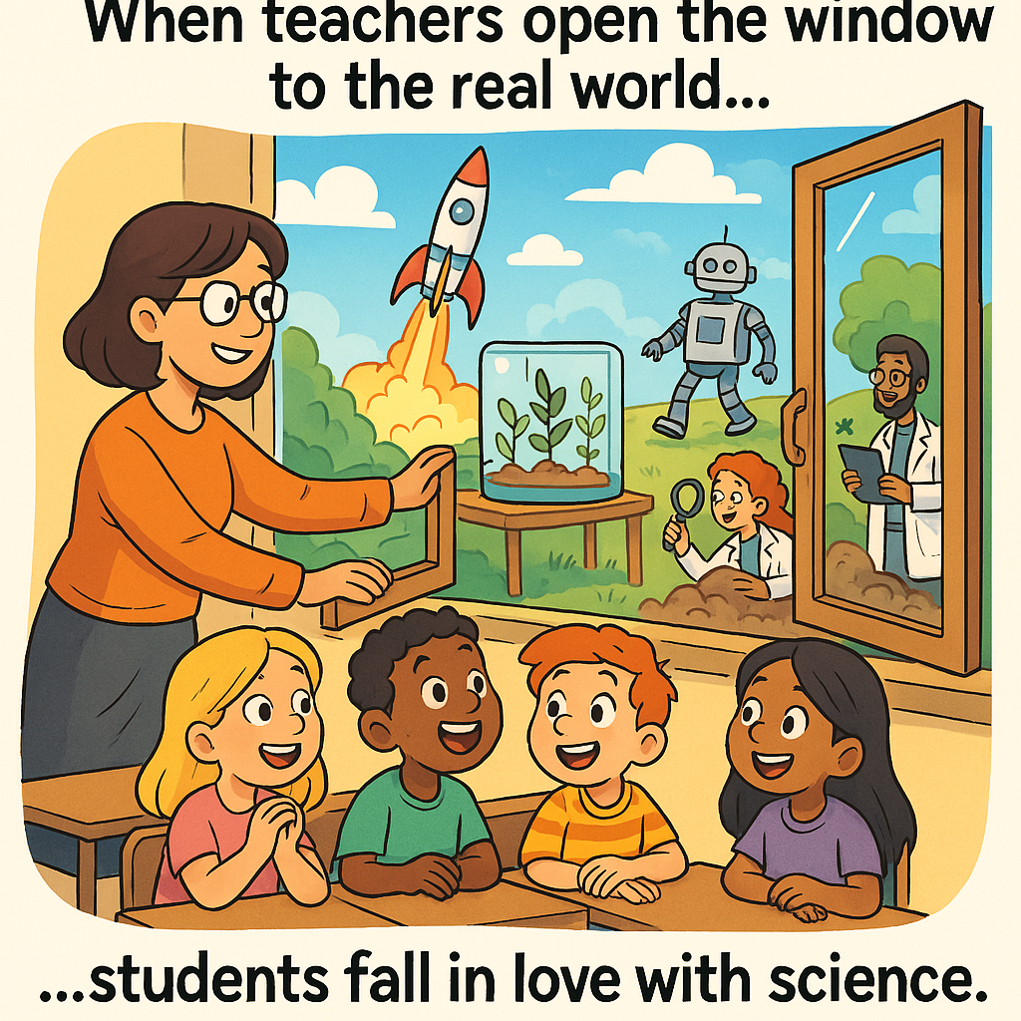
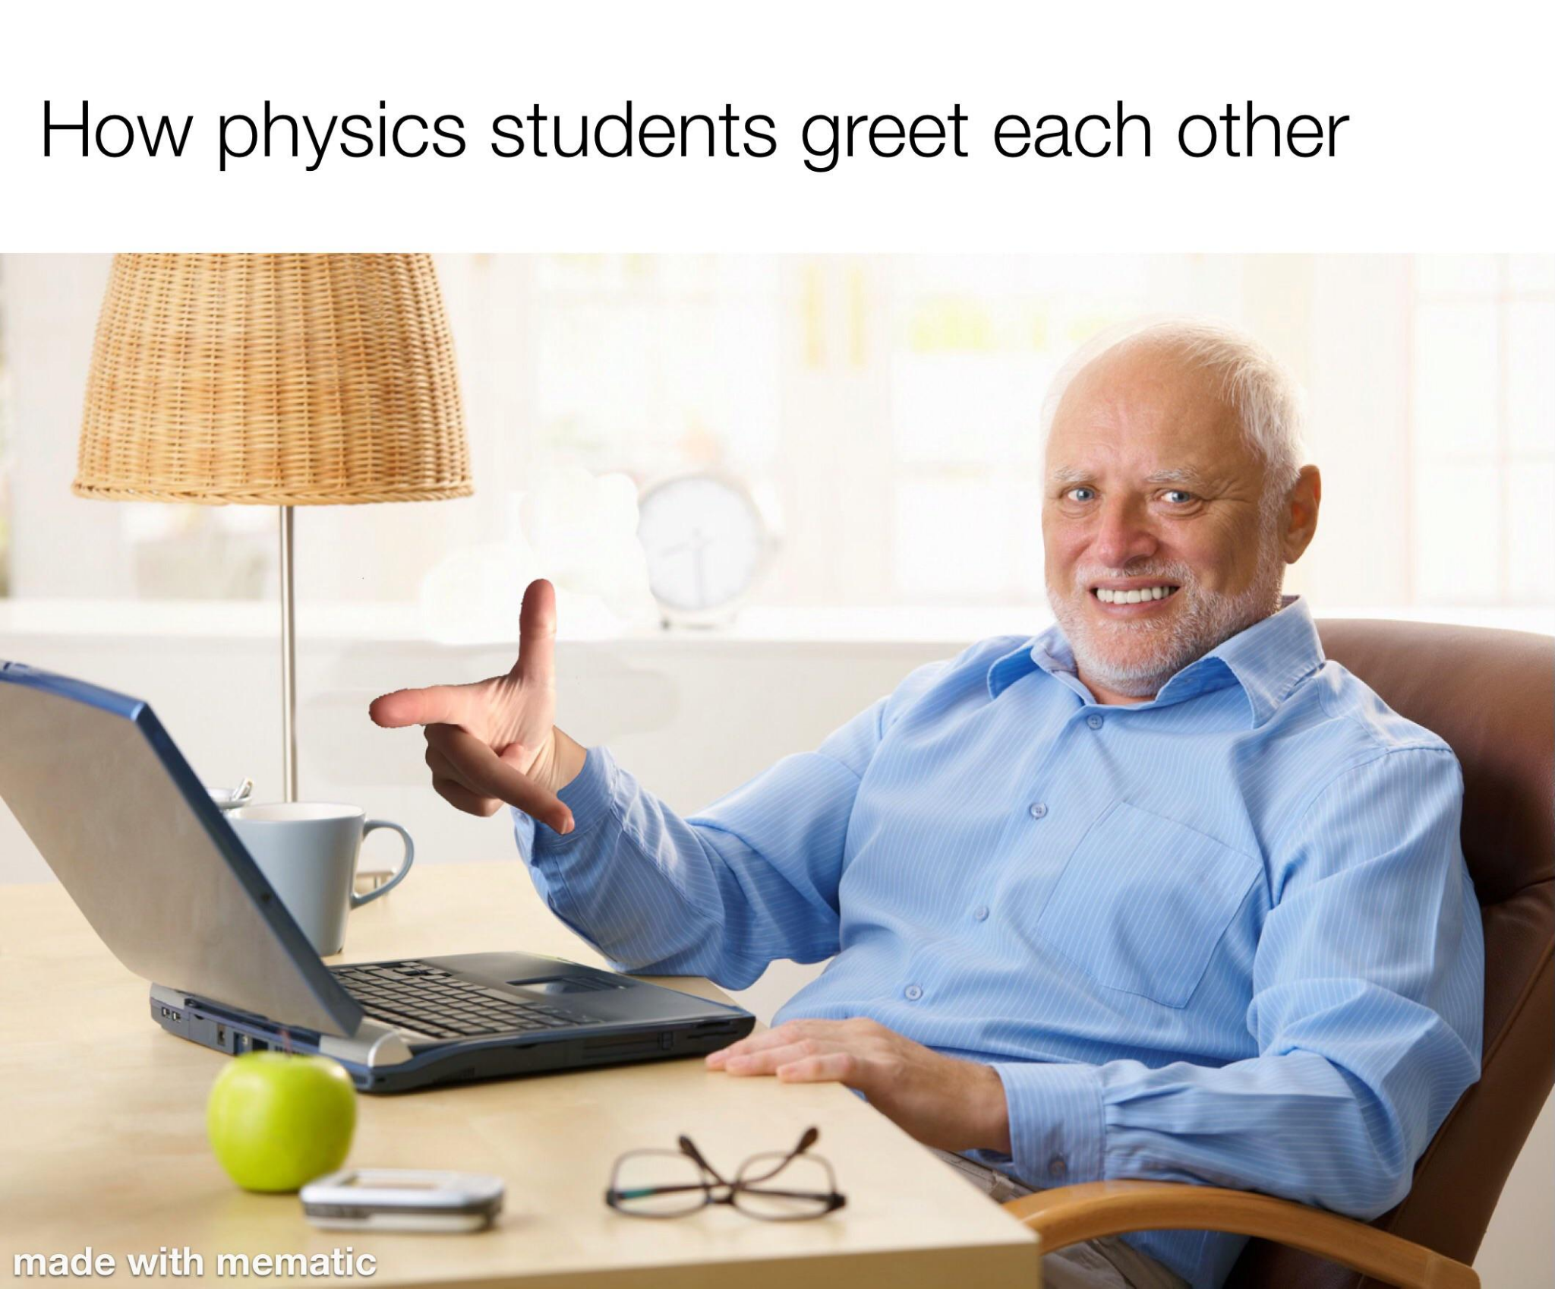
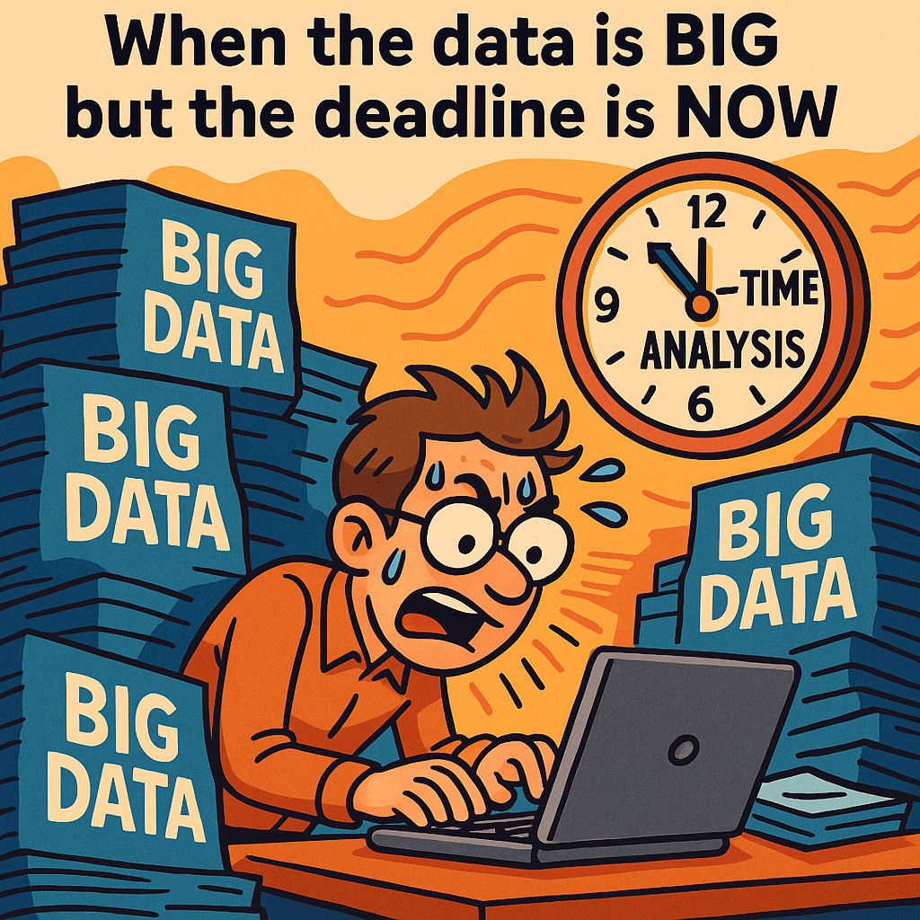

Our Key Takeaways so far
Notes:
1 Rosalina - role of teachers (The role of teachers to connect the classroom to the real world. Help develop a mindset to love science (science identity) (Historic moment: colision O/p & Ne/p)
2. Pedro - Magnets (Magnets & fields…CERN handshake)
3. Peter - Engineering Complex Machine (Engineering mindset development: - Complex machine
Collaboration needed to run the complex machine
4. Joni - AI
The role of big data and short time:
- trigger system
- Imposter syndrome

Slide 58
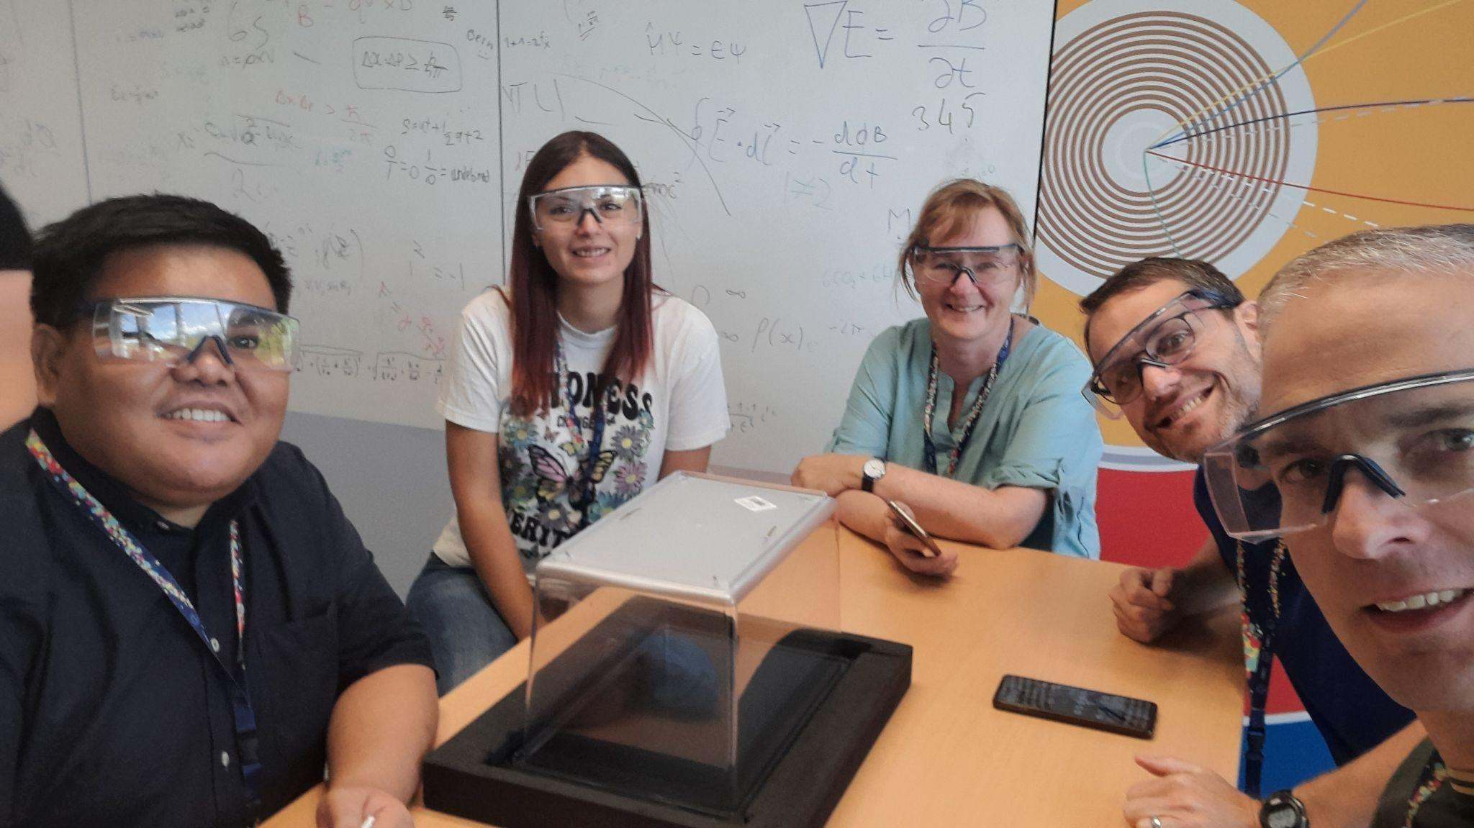
Our Feedback
so far
Highlights?
What’s working?
What needs improvement?
Other comments?
Funny picture or meme?
(Decide how you as a group will present them if you are selected to present during the SG Report-Out.)
Highlights
Interaction with teachers from all over the world.
Cloud Chambers, Close Encounters with CERN sites
Enthusiasm all around.
Working
Sequencing and structure is very well planned. There is intentionality in each item on the schedule.
There is repetition of the key themes of particle physics. Another onion!
Improvement
Visits are somewhat rushed due to the time schedule.

Slide 59
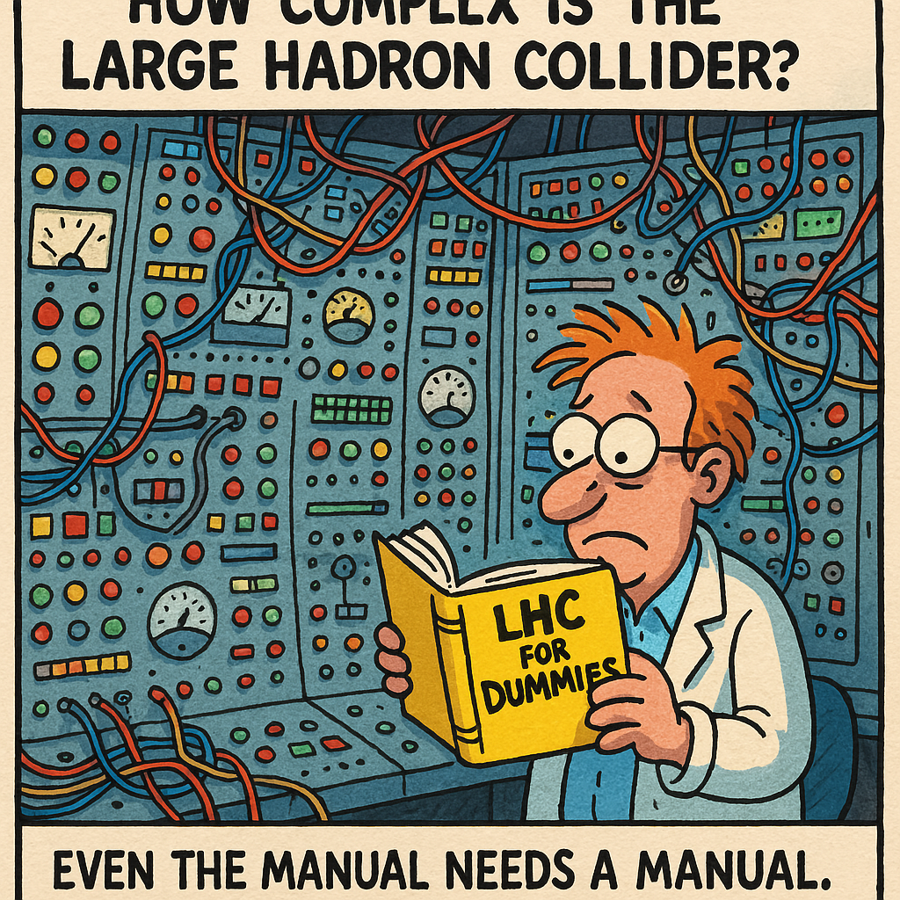

Slide 60
Tuesday, 15 July
SG Session 3

Slide 61
Checklist for SG Session 3
# | Type of Task | Task | Deadline
1 | Individual | Fill in slides corresponding to your colour | Tuesday, 17:30
2 | Group | Fill in “Our Key Takeaways” and “Our Feedback” slides as a group. Make sure you all contribute to the discussion. | Tuesday, 17:30
3 | Group | Decide how you as a group will present your group slides if you are selected to present during the SG Report-Out. | Tuesday, 17:30

Slide 62
Feynman
Diagrams
What would be a fun and creative way of introducing Feynman Diagrams in the classroom?
Which students’ conceptions would you expect to encounter and how would you address them?
Maybe turning students into particles, use rope or tape in the floor for the events and time, etc…
The idea of time is fundamental for the understating of the processes.

Slide 63
Computing
at CERN
What are three key ideas about computing and data analysis at CERN that you would like your students to know about?
What are potential challenges students might encounter when learning about computing and data analysis at CERN?
Big data; cyber attacks; collaboration
Computing language; how the data collected is transformed in physics; how to store more and more data and faster

Slide 64
Medical Applications
What are three key ideas about medical applications of particle physics that you would like your students to know about?
What are potential challenges students might encounter when learning about medical applications of particle physics?
High efficiency, accuracy, low side effects (known), lower dose;
Engineering challenges: make the machines smaller and cheaper

Slide 65
My Key Takeaways so far
Instructions: Write in the box any insights or things that you learned and that you want to remember after the HST2025 programme.
Medical applications: many challenges, but most of them political ones, because the physics of the processes are well determined.
Big problem with the data: too many data => HL-LHC

Slide 66
Feynman
Diagrams
What would be a fun and creative way of introducing Feynman Diagrams in the classroom?
Which students’ conceptions would you expect to encounter and how would you address them?
Visualization through role play?
The interactions that occur between particles.
It is seldom that schools teach the standard model to high school students (unless they have a special curriculum). It would be challenging for students to learn the topic when they have limited knowledge about the topic.

Slide 67
Computing
at CERN
What are three key ideas about computing and data analysis at CERN that you would like your students to know about?
What are potential challenges students might encounter when learning about computing and data analysis at CERN?
CERN banks on an enormous scale of data for analysis and these data are produced at an unprecedented speed. (Exabyte)
Computing makes analysis faster and more insightful.
Schools should consider computational thinking as a basic skill learned by students in basic education (jobs of the future).
Students may seem intimidated by the jargons and technicalities of computer science.
Students’ familiarity with the orders of magnitude in physics.
Splitting data into data centers for easy access and analysis (Divide and conquer)

Slide 68
Medical Applications
What are three key ideas about medical applications of particle physics that you would like your students to know about?
What are potential challenges students might encounter when learning about medical applications of particle physics?
Serendipity in science.
Particle accelerators and medical imaging technologies
The power of collaboration to produce more sophisticated knowledge and technologies to improve the quality of life
The physics behind smart medical technologies
Interdisciplinarity of knowledge has significant practical applications.
Students should have a sound understanding of how living systems interact with physical entities. (Conceptual complexity)
Technological familiarity; connections with physics concepts and principles; Contextualization issues

Slide 69
My Key Takeaways so far
Instructions: Write in the box any insights or things that you learned and that you want to remember after the HST2025 programme.

Slide 70
Feynman
Diagrams
What would be a fun and creative way of introducing Feynman Diagrams in the classroom?
Which students’ conceptions would you expect to encounter and how would you address them?
1)
Perhaps after a brief explanation, you could have students try to match diagrams with events or given a diagram, describe what it is trying to represent.
Physical manipulatives like Luiz had and trying to create a variety of "legal" shapes give students an idea on what the diagrams represent.
2) I think students will grapple with some of their understanding of chemistry and particle interactions.

Slide 71
Computing
at CERN
What are three key ideas about computing and data analysis at CERN that you would like your students to know about?
What are potential challenges students might encounter when learning about computing and data analysis at CERN?
Computing is massive! Central to the experiments are
  processing
  storage (also keep some of the "trash")
  collaborative computer grid
Physical understanding of networks and storage of information is an issue. Students might understand needing to make space for more data and the challenges associated with that. Working memory vs. long term storage.
Notes:
Maxima

Slide 72
Medical Applications
What are three key ideas about medical applications of particle physics that you would like your students to know about?
What are potential challenges students might encounter when learning about medical applications of particle physics?
Particle accelerators are key in medical imaging
Global disparity in access to medical imaging in LMIC
Exciting technologies associated with different accelerators (protons, carbon, FLASH)
Complexity of the topic. Finding their entry point into the field - is it as a practitioner, researcher, scientist, machine learning expert, etc.

Slide 73
My Key Takeaways so far
Instructions: Write in the box any insights or things that you learned and that you want to remember after the HST2025 programme.
CERN is pursuing specific science and is glad to share their expertise. There are a variety of applications that are not CERN's focus, but they are contributing to as they develop expertise
CERN is interdisciplinary at its core. There is collaboration at a massive scale!

Slide 74
Feynman
Diagrams
What would be a fun and creative way of introducing Feynman Diagrams in the classroom?
Which students’ conceptions would you expect to encounter and how would you address them?
1)
role-playing activity where students act as particles
I could assign each student a particle identity, and then simulate interactions physically in front of the class. Next, I will explain the rules for constructing and reading Feynman diagrams. This links the abstract diagram to something they experienced directly.
or changing roles teacher - student
https://www.youtube.com/watch?v=tkm0TNFzIeg&t=78s
using appropriate videos
2)
Misunderstanding the direction of arrows in diagrams
Difficulty distinguishing between different interaction types

Slide 75
Computing
at CERN
What are three key ideas about computing and data analysis at CERN that you would like your students to know about?
What are potential challenges students might encounter when learning about computing and data analysis at CERN?
1)
history of Computing at CERN
Мany technologies they use every day actually started in CERN (World Wide Web and touch screen).
The Worldwide LHC Computing Grid
2)
how data is generated, stored, and analyzed at such a massive scale
CERN’s work can feel intimidating
  e Worldwide LHC Computing Grid
  The Worldwide LHC Computing Grid

Slide 76
Medical Applications
What are three key ideas about medical applications of particle physics that you would like your students to know about?
What are potential challenges students might encounter when learning about medical applications of particle physics?
PET scan
Particle accelerators are used in cancer
Fundamental research drives innovation in medicine.
2)
Cancer sounds scary
Radiation and safety

Slide 77
My Key Takeaways so far
Instructions: Write in the box any insights or things that you learned and that you want to remember after the HST2025 programme.
how to create fast and beautiful concept maps on a computer
inspiring workshops

Slide 78
Feynman
Diagrams
What would be a fun and creative way of introducing Feynman Diagrams in the classroom?
Which students’ conceptions would you expect to encounter and how would you address them?
Particles can interact on 4 different ways.
But not all can do all 4 ways.
Use colored strips for each particle (blue - weak interaction, red - strong interaction …).
Particle has only the strips which it can interact on.
Then ask which strips and which particles will be used to present beta decay (for instance).

Slide 79
Computing
at CERN
What are three key ideas about computing and data analysis at CERN that you would like your students to know about?
What are potential challenges students might encounter when learning about computing and data analysis at CERN?
We must throw away most all data (10.000 stay out of 40 million).
What are the criteria?
How do we save data?
Are the criteria something that has to develop over time also? (understand feedback loop)
Some of data which do not pass criteria is also preserved. Why?

Slide 80
Medical Applications
What are three key ideas about medical applications of particle physics that you would like your students to know about?
What are potential challenges students might encounter when learning about medical applications of particle physics?
Not all methods are for the same purpose of treating?
Physicist can help! Where?
Challenges of unequal access to methods?
What is new? Flash is.
Maybe not challenges… but a beautiful way to expose how cancer can actually be killed with different particles and what is the cost on health tissues and how to minimise dammage on health tissue.

Slide 81
My Key Takeaways so far
Instructions: Write in the box any insights or things that you learned and that you want to remember after the HST2025 programme.
Practical use of knowledge that is achieved in CERN:
Medicine (are physicist pushing medicine further or contra?!)
Data analysis and storage capabilities (who is pushing to the limita: CERN or computer engineers?)

Slide 82
Study Group Discussion
Share your individual insights with your colleagues and identify shared themes.
Have some ice cream and don’t forget to
take notes :)
Active learning strategy (role play) to teach an abstract concept (Feynman diagram) - pedagogical content knowledge
Big data, speed, collaboration, cyber attacks, Computing language may not be easy, issues on data storage and warehousing, high luminosity LHC, criteria for choosing data for experiment
Radiation: dangerous but helpful (diagnostics and heallying);
Serendipity of science;
Particle therapy vs RT: less dose, high accuracy, low side effects;
FLASH: a new hope?;
Problem: economic and political issues;
Integrated lessons: physics, maths, biology, computing.
Notes:
Role play or manipulatives/models of some type help students visualize the interactions.

Slide 83
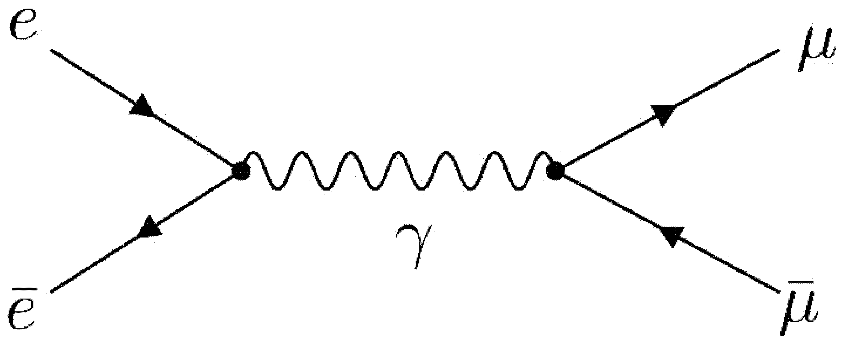
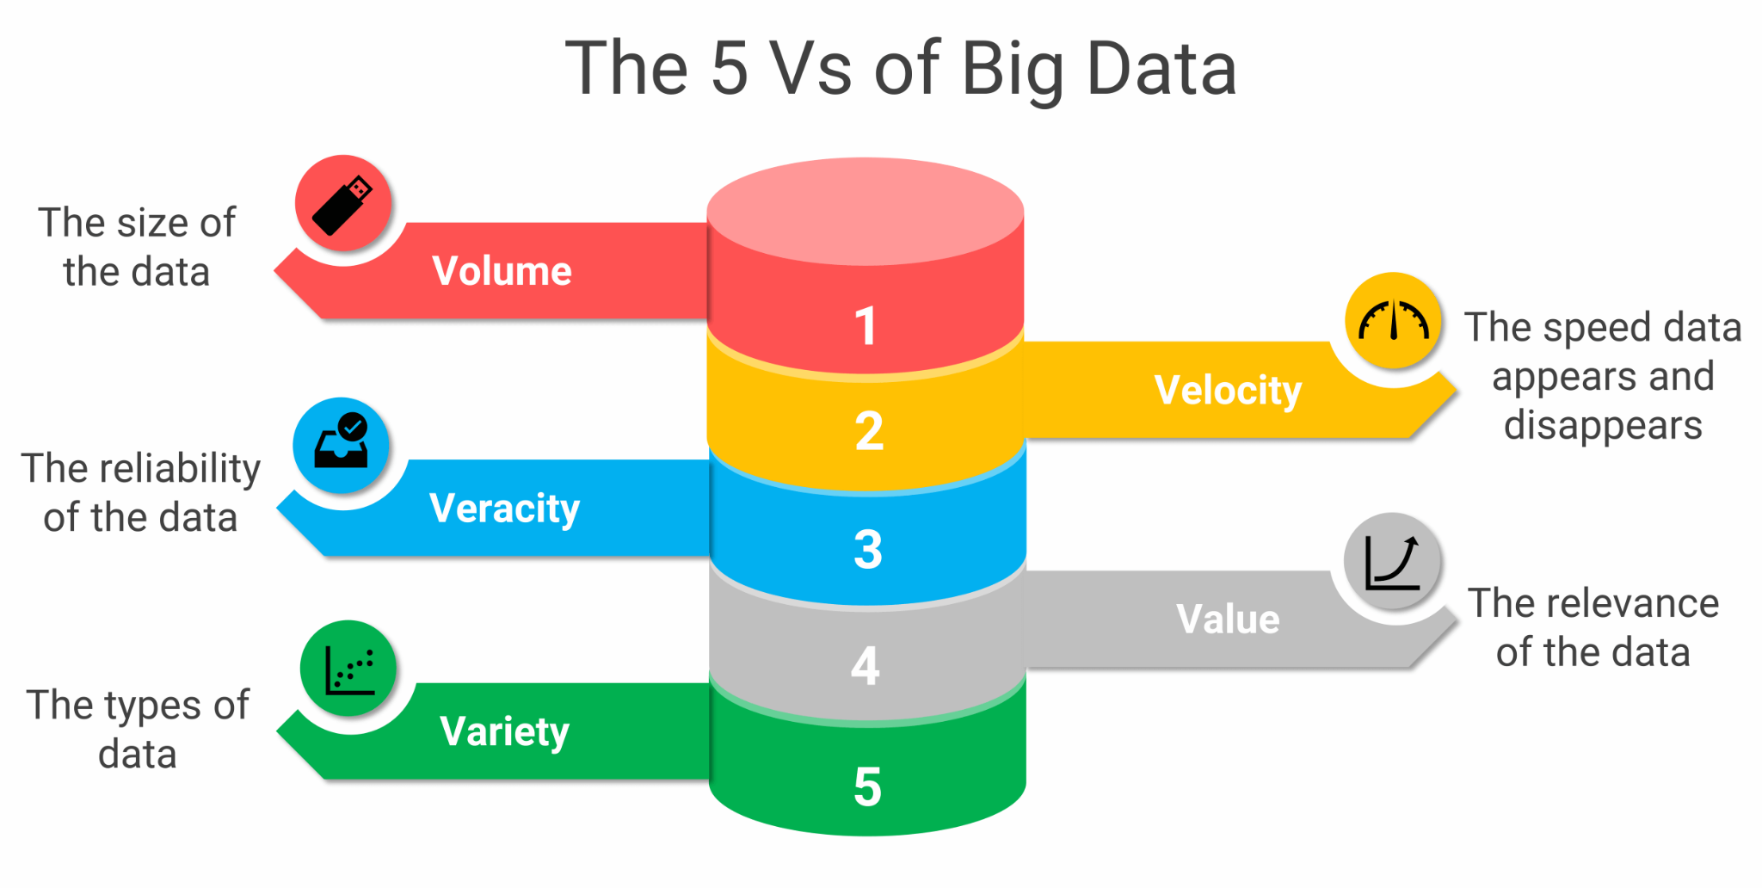
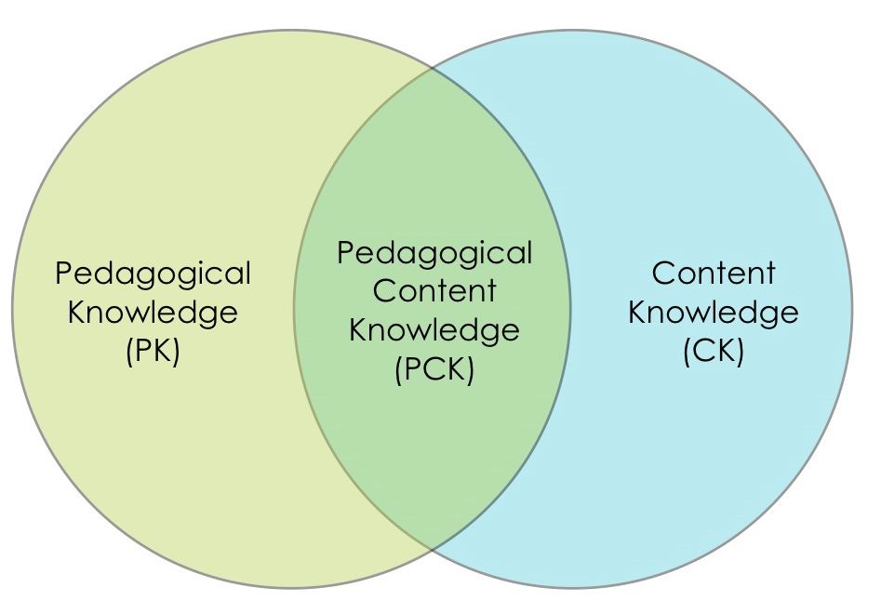
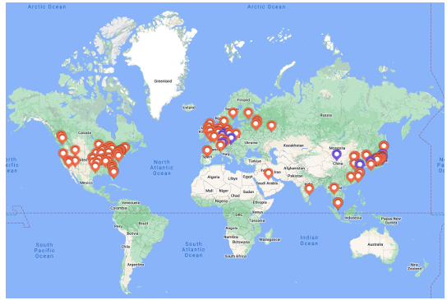
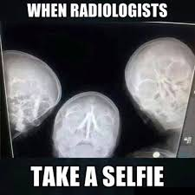
Our Key Takeaways so far
Instructions: Write in the box any insights, learnings and discussion outcomes.
(Decide how you as a group will present them if you are selected to present during the SG Report-Out.)
Notes:
Data:
Volume: Exabyte of information
Veracity: the data are confiable
Variety: there are some many types of data
Velocity: 40 millions of collisions per second
Value: the trigger takes a very important role and the physicists make the conversion

Slide 84

Our Feedback
so far
Notes:
Our Feedback in terms of the Accelerator Illustration:
Highlights?
Group of Teachers: Bunch of Protons (or this week Oxygen nuclei)
We start out moving in a circle, Lectures are like the RF chambers (we get a rapid acceleration and take off), then all of a sudden you hit a dipole and you change directions to visit a site visit (fantastic).
Fortunately there are straight sections of the LHC which are the times of the IHST week were we can coast in between intensive sessions.
Like the LHC, we see the evidence of intentionality in the planning and attention to detail in the program.
We appreciate the circular nature of the LHC - there is repetition of the key themes in particle physics from multiple perspectives…just in case you didn't get it on the first lap.
Obviously, there are collisions (rich teacher with teacher interactions…fortunately not at .999c)
Improvements
We don't know what the particle feels looping the LHC, but we remarked at some of the visitation sites we could feel rushed.
Highlights?
What’s working?
What needs improvement?
Other comments?
Funny picture or meme?

Slide 85
Thursday, 17 July
SG Session 4

Slide 86
Checklist for SG Session 4
# | Type of Task | Task | Deadline
1 | Individual | Fill in slides corresponding to your colour | Thursday, 14:30
2 | Group | Fill in the “Our Key Takeaways from HST2025” slide as a group. Make sure you all contribute to the discussion. | Thursday, 15:00
3 | Group | Discuss the topic that was assigned to your study group for the Final Presentation on Friday morning. Share and collect your individual experiences with this topic. | Thursday, 16:00
4 | Group | Prepare a detailed and entertaining presentation to share your results with your colleagues. Make sure that everyone plays an active role during the Final Presentation! | Thursday, 17:00

Slide 87
Antimatter
vs
Dark Matter
What are three key ideas about antimatter research at CERN that you would like your students to know about?
What would be a good approach to explain the difference between antimatter and dark matter to your students?

Slide 88
Future Particle Accelerators
What are five key ideas about future particle accelerators and acceleration technologies that you would like your students to know about?
What kind of career opportunities in particle physics are you definitely going to showcase to your students?

Slide 89
My Key Takeaways from HST2025
Instructions: Write in the box any insights or things that you learned and that you want to remember after the HST2025 programme.

Slide 90
Antimatter
vs
Dark Matter
What are three key ideas about antimatter research at CERN that you would like your students to know about?
What would be a good approach to explain the difference between antimatter and dark matter to your students?

Slide 91
Future Particle Accelerators
What are five key ideas about future particle accelerators and acceleration technologies that you would like your students to know about?
What kind of career opportunities in particle physics are you definitely going to showcase to your students?

Slide 92
My Key Takeaways from HST2025
Instructions: Write in the box any insights or things that you learned and that you want to remember after the HST2025 programme.

Slide 93
Antimatter
vs
Dark Matter
What are three key ideas about antimatter research at CERN that you would like your students to know about?
What would be a good approach to explain the difference between antimatter and dark matter to your students?

Slide 94
Future Particle Accelerators
What are five key ideas about future particle accelerators and acceleration technologies that you would like your students to know about?
What kind of career opportunities in particle physics are you definitely going to showcase to your students?

Slide 95
My Key Takeaways from HST2025
Instructions: Write in the box any insights or things that you learned and that you want to remember after the HST2025 programme.

Slide 96
Antimatter
vs
Dark Matter
What are three key ideas about antimatter research at CERN that you would like your students to know about?
What would be a good approach to explain the difference between antimatter and dark matter to your students?

Slide 97
Future Particle Accelerators
What are five key ideas about future particle accelerators and acceleration technologies that you would like your students to know about?
What kind of career opportunities in particle physics are you definitely going to showcase to your students?

Slide 98
My Key Takeaways from HST2025
Instructions: Write in the box any insights or things that you learned and that you want to remember after the HST2025 programme.

Slide 99
Antimatter
vs
Dark Matter
What are three key ideas about antimatter research at CERN that you would like your students to know about?
What would be a good approach to explain the difference between antimatter and dark matter to your students?

Slide 100
Future Particle Accelerators
What are five key ideas about future particle accelerators and acceleration technologies that you would like your students to know about?
What kind of career opportunities in particle physics are you definitely going to showcase to your students?

Slide 101
My Key Takeaways from HST2025
Instructions: Write in the box any insights or things that you learned and that you want to remember after the HST2025 programme.

Slide 102
Study Group Discussion
Share your individual insights with your colleagues and identify shared themes.
Have some ice cream and don’t forget to
take notes :)

Slide 103
Our Key Takeaways from HST2025

Slide 104
Final Presentation Guidelines
Presentation | 10 minutes + 5 minutes for Q&A
Style | Fun, entertaining & on time!
Contents | Curriculum & classroom connections Key ideas Potential students’ conceptions & challenges Helpful material and resources Best practice example
Final Slide | Key Takeaways & Goodbye messages

Slide 105
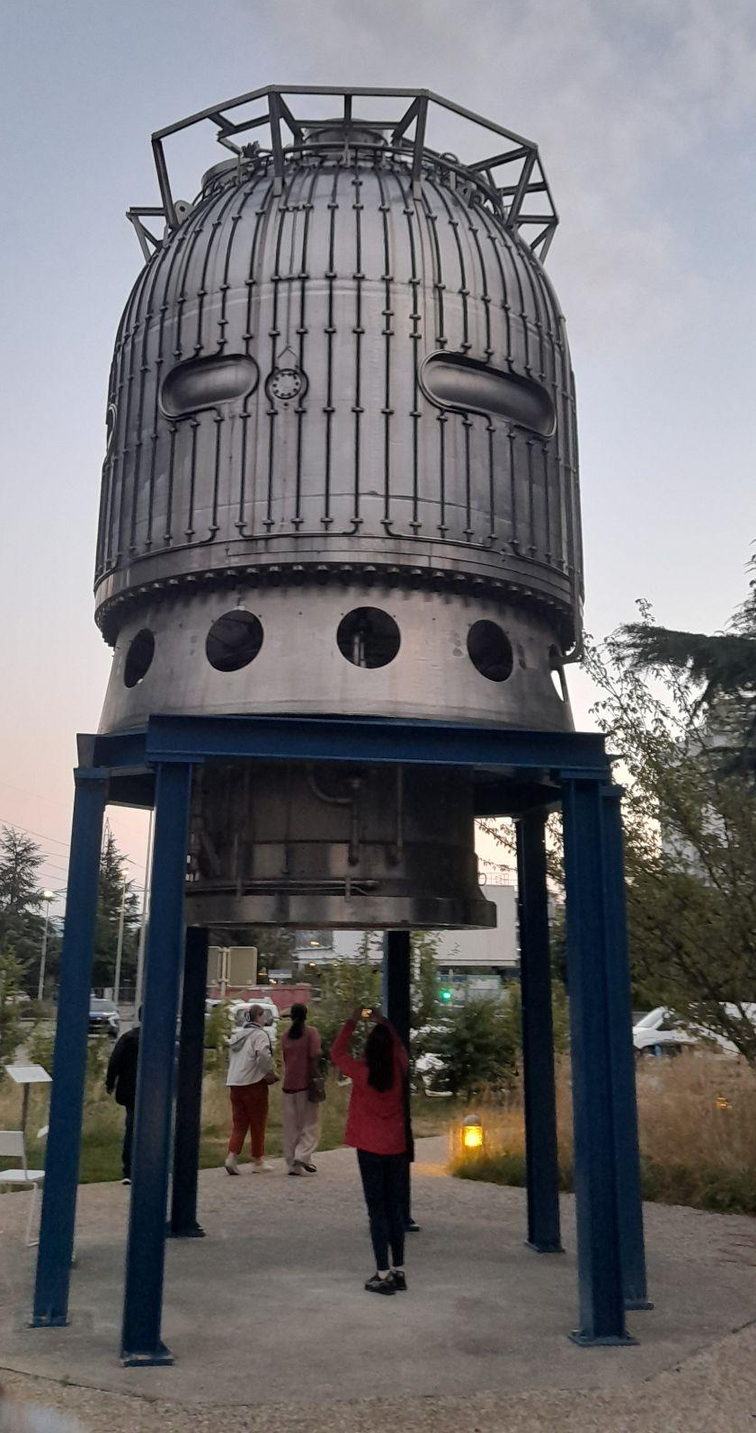
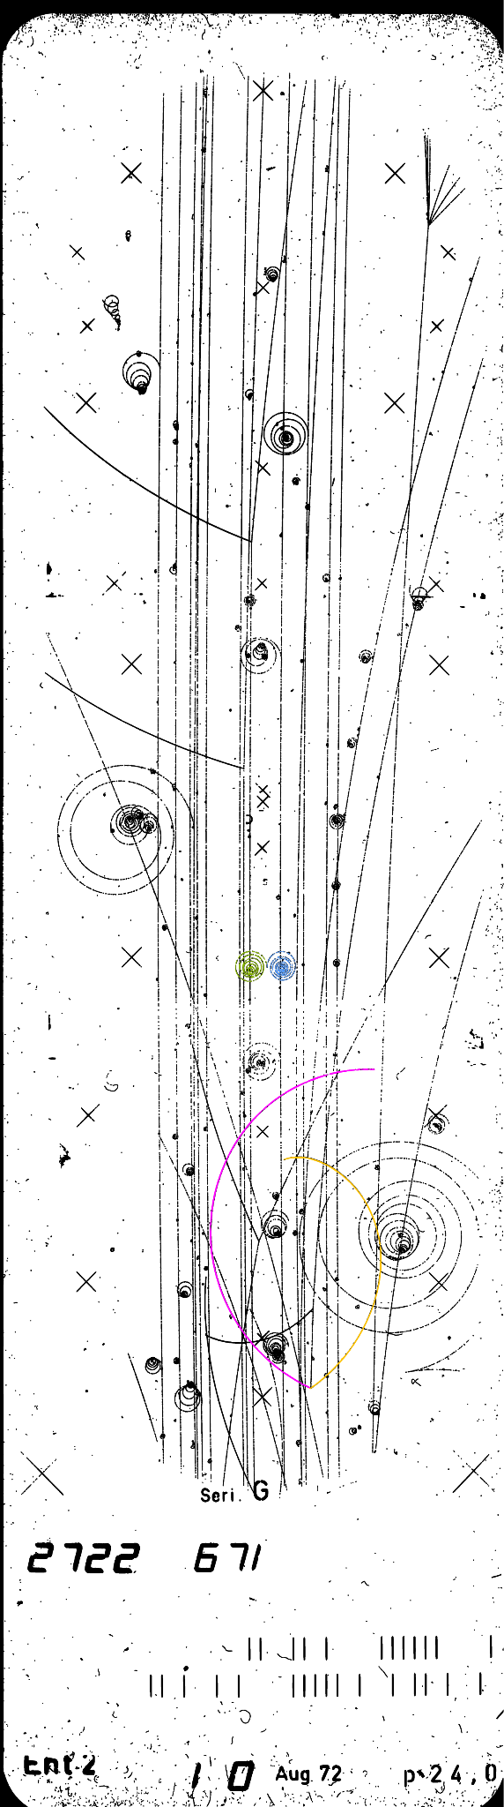

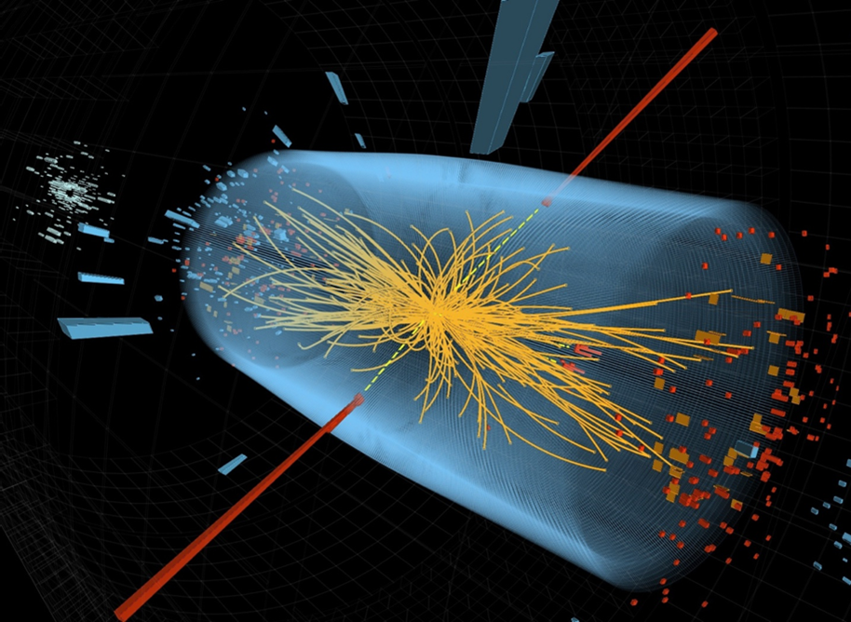
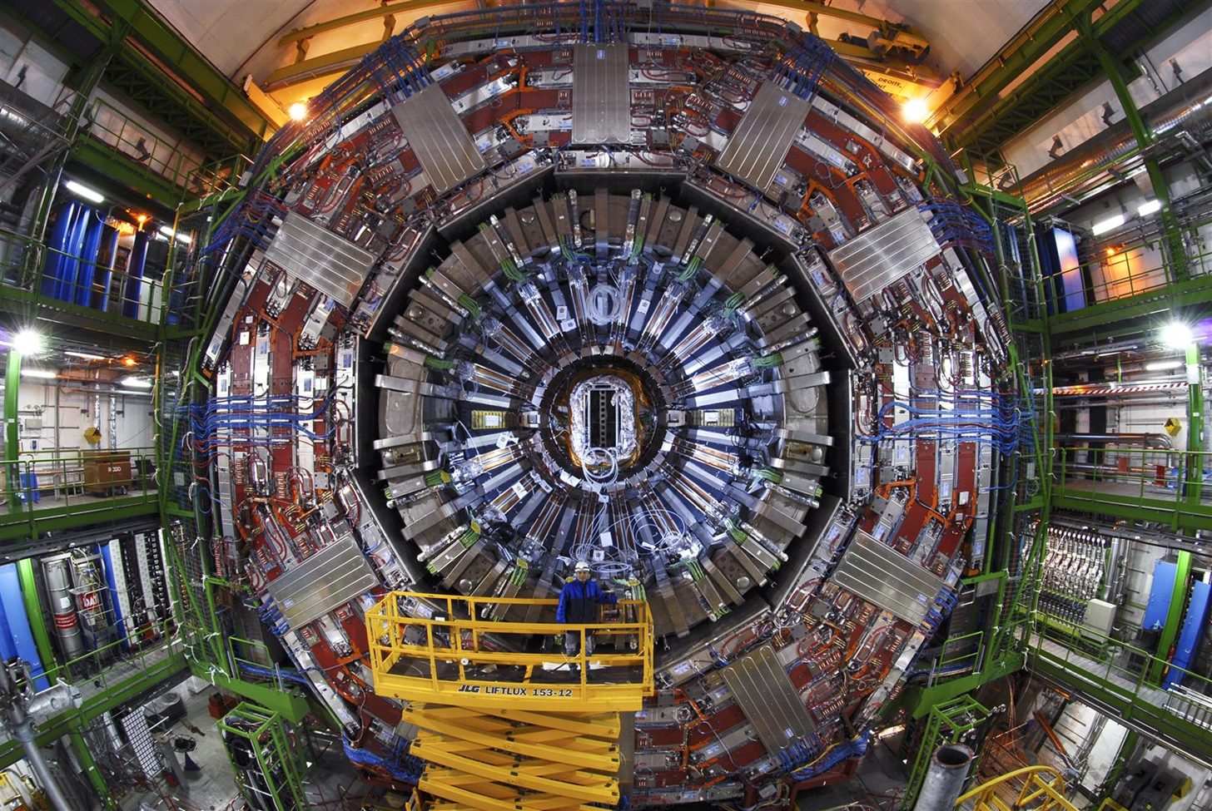
Particle Detectors
HST2025 Study Group 4
For Santa:
Notes:
Peter - introduction
What is the purpose of an Particle Accelerator if not for the Particle Detectors?
How do you find what you can't see? This is the challenge of particle detectors and they solve it by piecing together interactions in a space.
Even our youngest students have some experience in this task.
Detectors paint a timeline for us…bubble chambers to much larger and more detailed images.

Slide 106
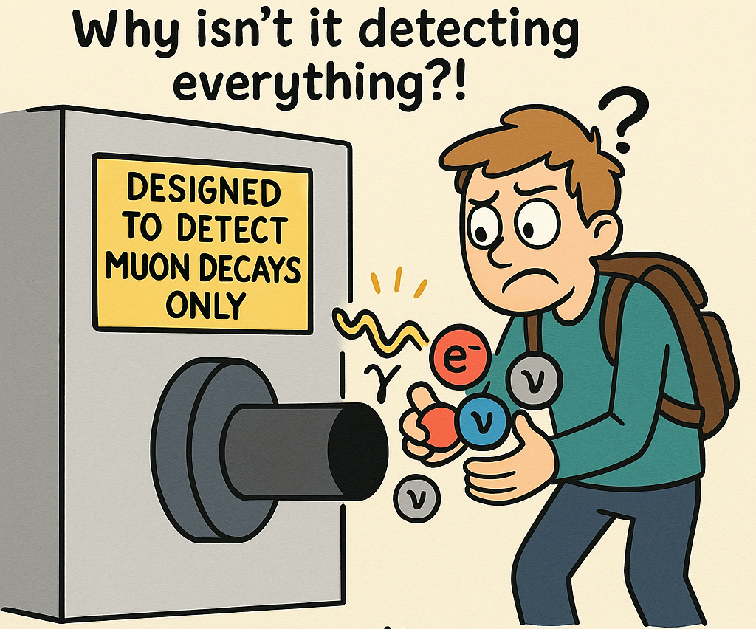
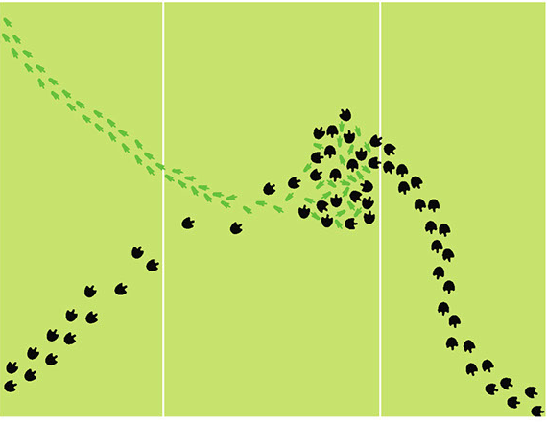
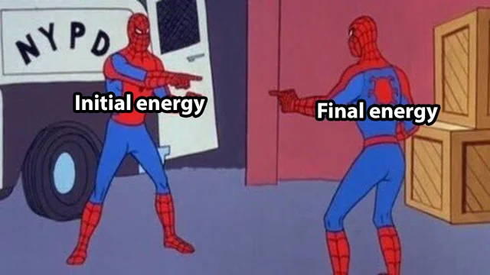
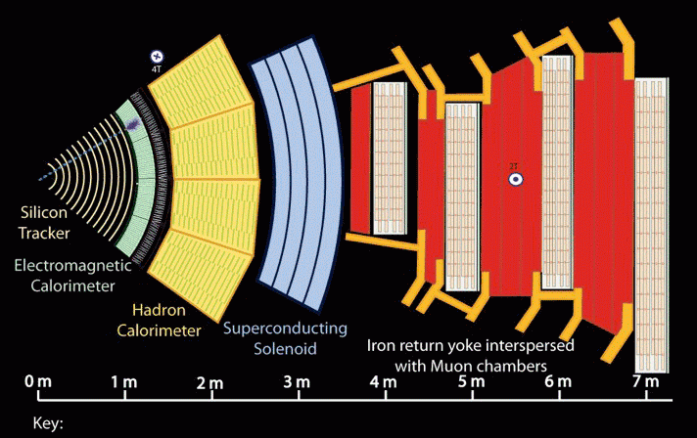
Key Ideas
Detectors are designed to look for certain decays
Layers and order of layers
We don’t detect particles; we look for trails
Conservation laws are observed.
Better and better measurements
Notes:
We don't detect particles, we detect interactions between particles and detector material (trails)
Designed the detectors to look for certain decays…they don't detect everything, but only what they were designed to detect.
Conservation laws
Layers & order of layers (trajectory & different particles)
better and better measurements

Slide 107
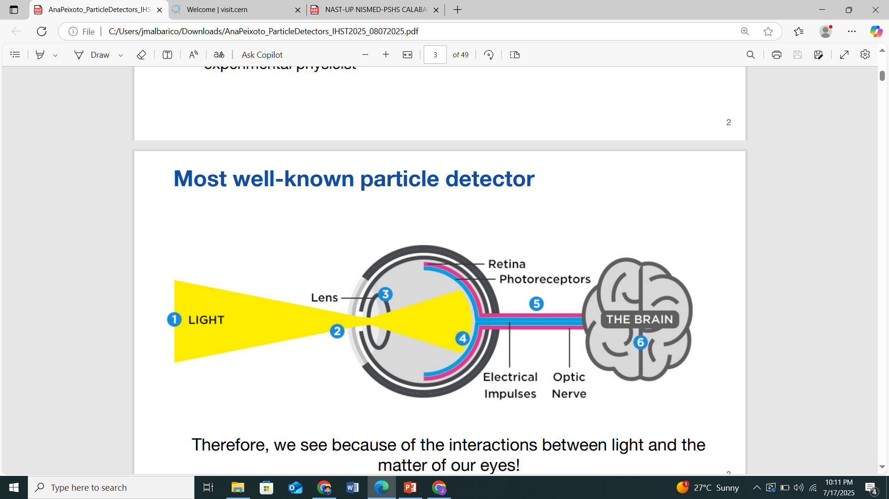
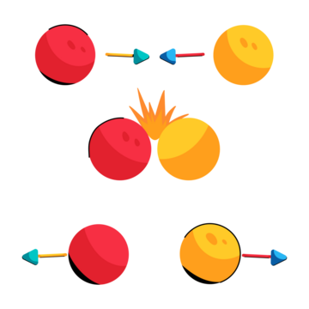
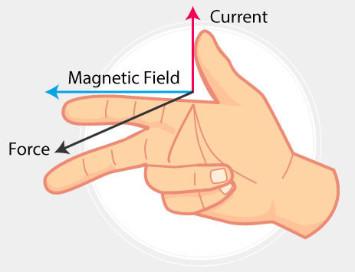
Curriculum & Classroom Connections
The eye as the first detector
Comparison of the collisions (conservation laws)
Evolution of atomic structure (hallmark experiments)
Lorentz law
Notes:
Eye - complicated detector
Conservation laws: energy, matter, momentrum + charge, barion number, lepton number
Cathode ray tube: deviation of particles with magnetic and electric field, Rutherford experiment with gold - the discovery of a nucleus

Slide 108
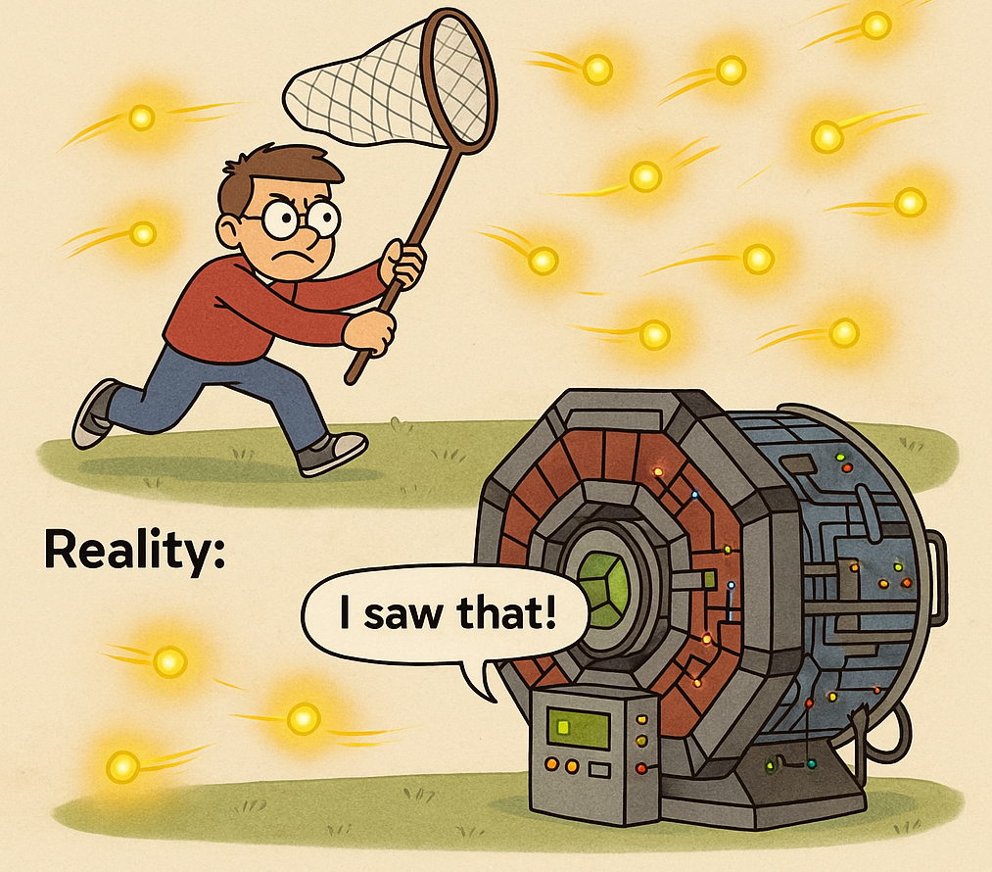
Potential Students’ Conceptions & Challenges
Misconception
Technical language
Abstract nature
Conceptual gaps
Notes:
Students may think that particle detectors can trap particles.
Jargons associated with particle detectors
Difficulty visualizing the phenomenon associated with particle detectors
Conceptual understanding how charges interact with a magnetic field; why and how particles interact with another particle

Slide 109
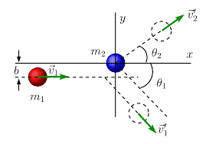
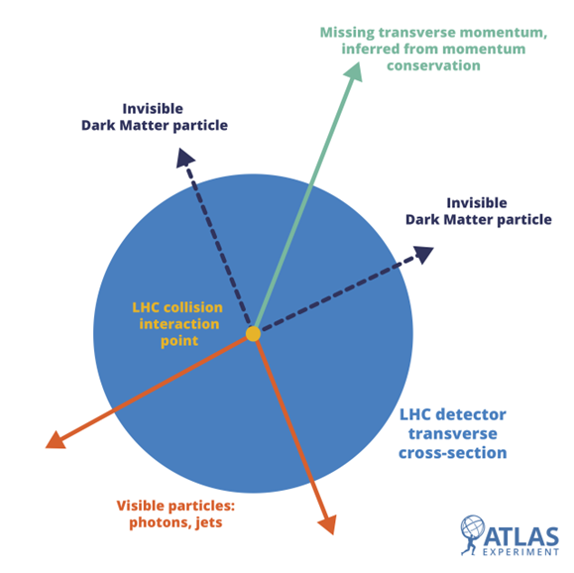
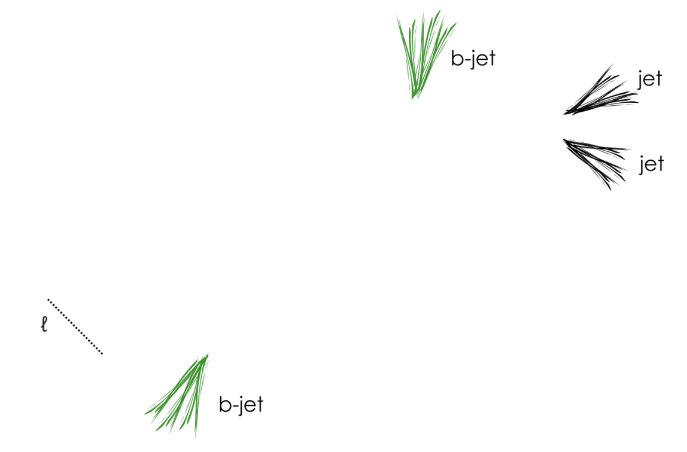
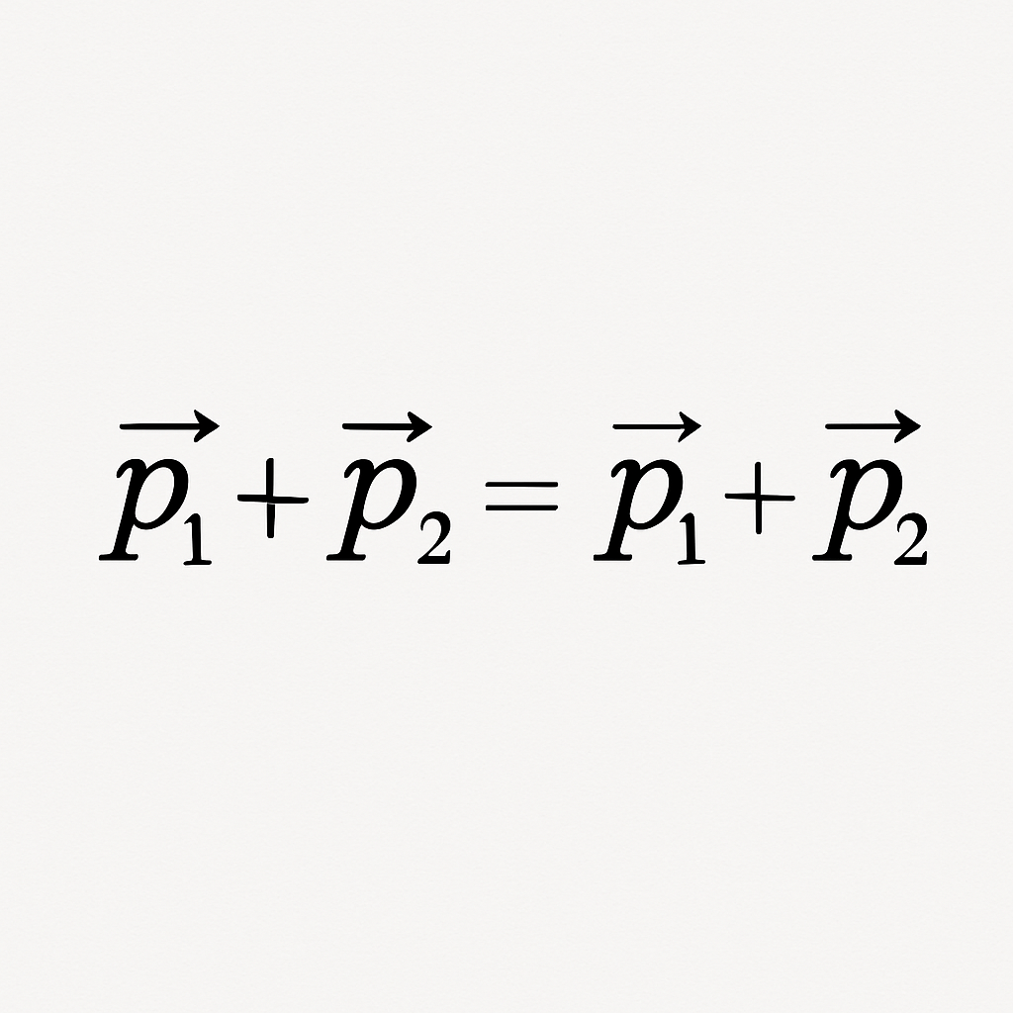
Best Practice Example
Conservation of momentum
Mechanic collision
Particle collision >> What we see?
Notes:
Collisions to activity could see starting with a picture…what do you see, what do you wonder? Perhaps of the end state of the jets in slide 41. I think students could begin to say things like…there must be a center, it looks like a collision, how do the pieces go together? How can we know what particles are? With the conservation of momentum we can know that total momentum must conserve, and with that we can know the mass/velocity/direction of particles and from where particles came from.
This could, then lead students to the dark matter research

Slide 110
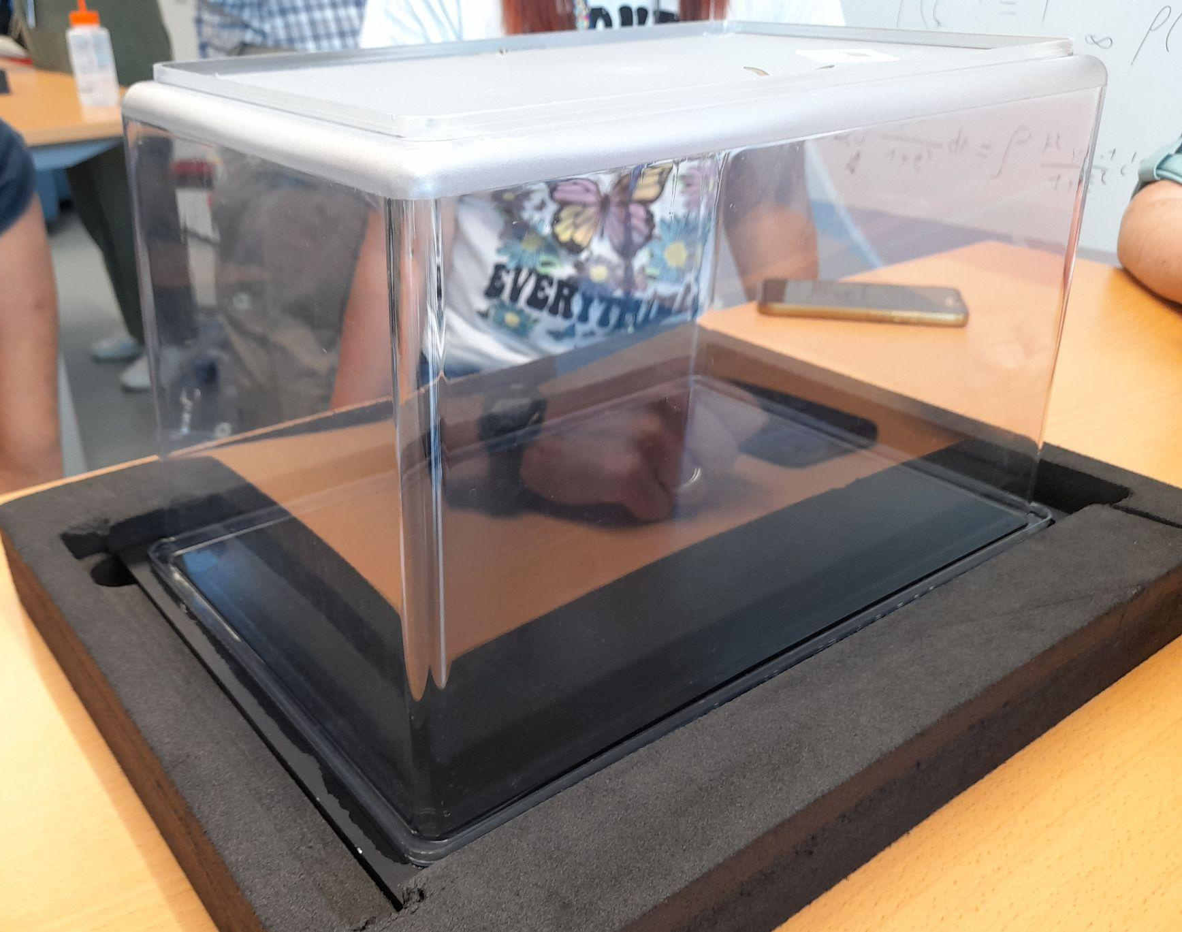
Useful Material & Resources
DIY - Particle detector
https://scoollab.web.cern.ch/diy-particle-detector
Bubble Chamber images
https://scoollab.web.cern.ch/bubble-chamber-pictures-classroom
Introducing modern particle detectors in the
classroom: a slice-by-slice overview
https://inspirehep.net/files/a9647e4e743e98f847ff0f5a4ab84c72
Notes:
This is a nice bubble chamber activity: https://www.scienceinschool.org/article/2019/track-inspection-how-spot-subatomic-particles/

Slide 111

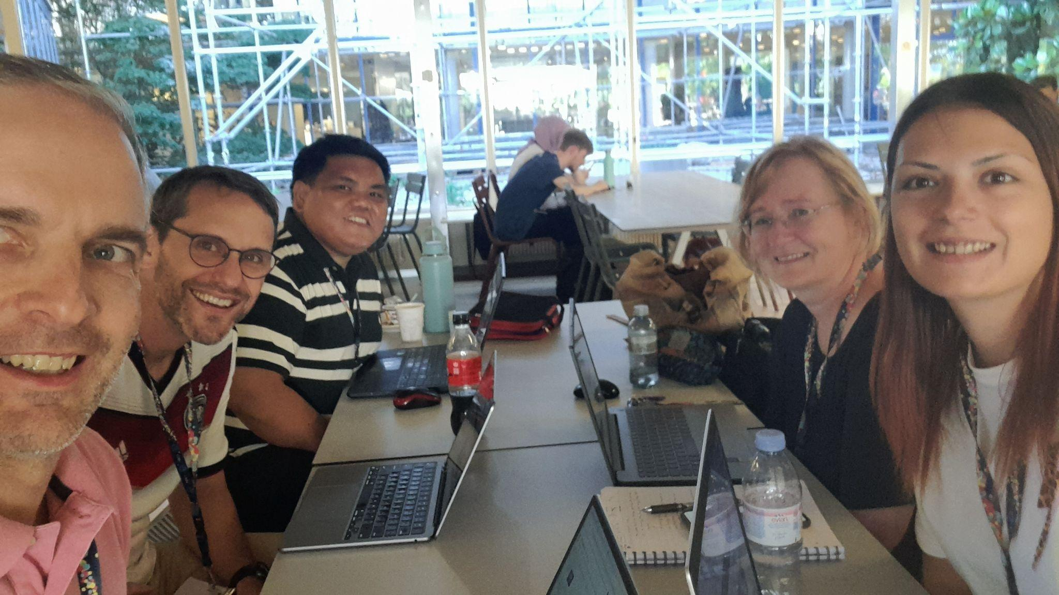
HST2025 Study Group 4
Barbara Hudovernik (Slovenia), Rozalina Nedyalkova (Bulgaria), Joni Albarico (Philippines), Peter Olson (Germany), Pedro Mourão (Portugal)
One way in which our thinking has changed…
Highlights, snapshots, farewell messages…
A better understanding of the big picture of CERN & LHC
  Cutting Edge Science
  International Collaboration
  Engineering Wonder
Seeing behind the scenes is a great way to generate enthusiasm.
Notes:
Peter
CERN is a big picture indeed - 27km.
Active cutting edge science, international collaboration, engineering complex machine…
Seeing behind the scenes - CERN does this with the "reveal" effect, but really we saw behind the scenes in each lecture, each site visit, that we had and for that we are grateful!

