Slide 1
Study Group 7
International High School Teacher Programme 2025

Slide 2
Wednesday, 9 July
SG Session 1

Slide 3
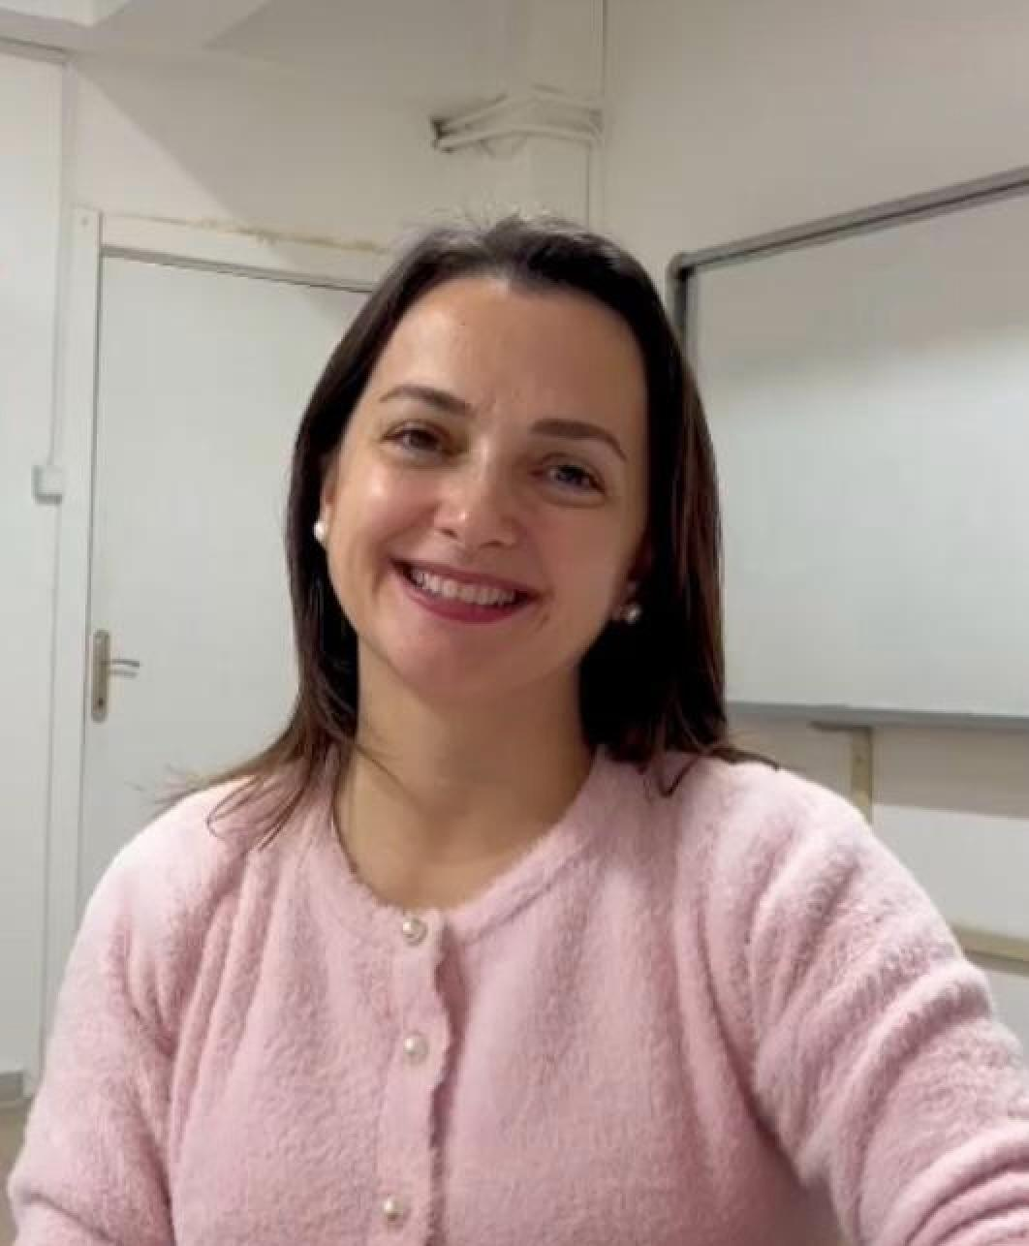
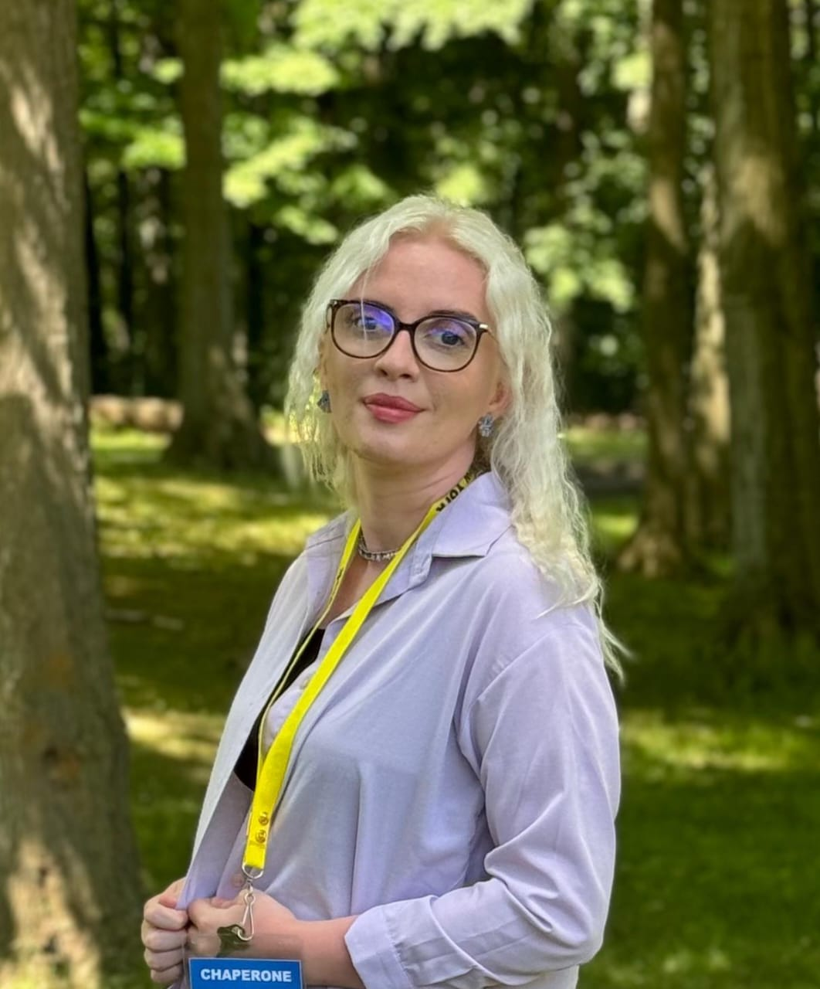
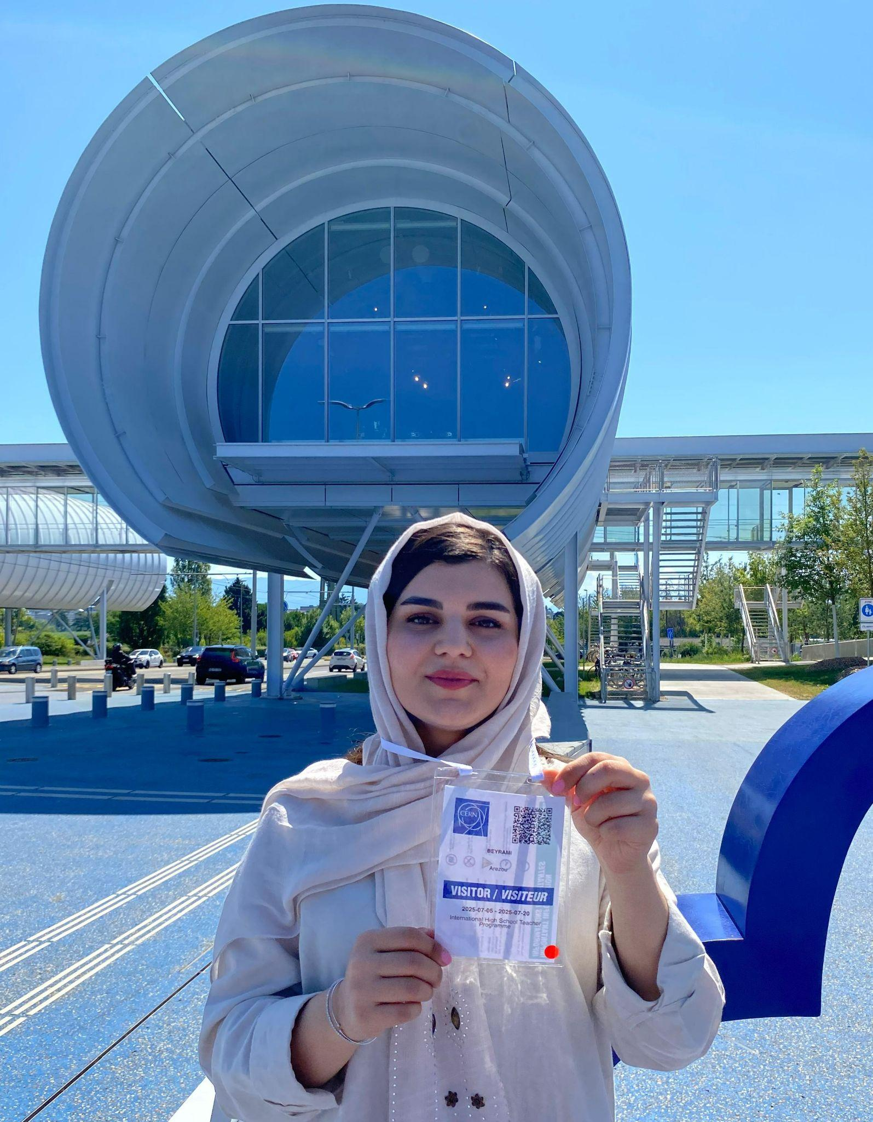
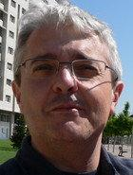





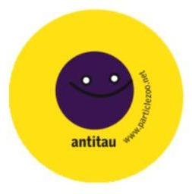
Study Group 7
Emel Özkök
Türkiye
Even being a time keeper, I cannot be on time for the group meetings:)
Albina Gerguri
Kosova
I just discovered I bowl way better with my left hand
Arezou Beyrami
Iran
I love taking lots of photos.
Oh! I’m the photographer of our group.
Víctor Curcó
España
I can’t distinguish between left and right hand
Matt Leach
USA
I have worked for Dwayne “The Rock” Johnson

Slide 4
Slide Conventions
Colour of Slide | Type of Work
 | Individual (your colour is indicated on the previous slide)
 | Group work
 | Report-out slides

Slide 5
Checklist for SG Session 1
# | Type of Task | Task | Deadline
1 | Individual | Fill in your section of the “Study Group 7” slide | Wednesday, 17:30
2 | Group | Fill in “Group Norms” slide | Wednesday, 17:30
3 | Individual | Fill in slides corresponding to your colour | Wednesday, 17:30
4 | Group | Fill in “Our Key Takeaways” and “Our Feedback” slides as a group. Make sure you all contribute to the discussion. | Wednesday, 17:30
5 | Group | Decide how you as a group will present your group slides if you are selected to present during the SG Report-Out. | Wednesday, 17:30

Slide 6
Group Norms
Instructions: Write on the right box your group norms and how you will work together. For example:
Who will manage the meetings?
Who will be the time-keeper?
Who will fill in group slides?
Anything else you think is important to coordinate for productive group work.
Matt is the note taker/English speaker/interrupter
Emel is timekeeper
Matt will manage and keep us organize
Arezou is photographer
Viktor will revise and think deep thoughts and moderate the discussion

Slide 7
Particle
Physics
What are three adjectives that come to your mind when you think about particle physics?
To what extent is the topic of particle physics covered in your national curriculum?

Slide 8
Particle Accelerators
What are three key ideas about particle accelerators that you would like your students to know about?
What are potential challenges students might encounter when learning about particle accelerators?
#1 Energy conservation
#2 Force applied on a charged particle in a magnetic field
#3 The use of an electric field to accelerate particles
They are lack of sufficient background to understand this interdisciplinar sub-topic. Because Electricity and Magnetism are their most challenging topic in physics.
They are unable to visualise the motion of a charged particle along the accelerator.

Slide 9
Particle
Detectors
What are three key ideas about particle detectors that you would like your students to know about?
What are potential challenges students might encounter when learning about particle detectors?
#1 Features of subatomic particles
#2 Matter and light interaction
#3 Interpreting the graphs
They

Slide 10
My Key Takeaways so far
Instructions: Write in the box any insights or things that you learned and that you want to remember after the HST2025 programme.

Slide 11
Particle
Physics
What are three adjectives that come to your mind when you think about particle physics?
To what extent is the topic of particle physics covered in your national curriculum?
1.Nucleus
2.Interactions
3.CERN
Students start to learn for the atom from 6th grade,step by step till 12 grade when they get deeper into particle Physics,,formulas, math and so on

Slide 12
Particle Accelerators
What are three key ideas about particle accelerators that you would like your students to know about?
What are potential challenges students might encounter when learning about particle accelerators?
1.What exactly are and their purpose
2.How do they work
3.Practical application
1.New concepts,especially while explaining how they work
2.Complexity of the machine might confuse them
3.Quantum proceses

Slide 13
Particle
Detectors
What are three key ideas about particle detectors that you would like your students to know about?
What are potential challenges students might encounter when learning about particle detectors?
1.How detectors look like
2.How it work
3.Types and application
1.Concepts
2.What is happening inside
3.Names, parts and visualisation

Slide 14
My Key Takeaways so far
Instructions: Write in the box any insights or things that you learned and that you want to remember after the HST2025 programme.
1.The accelerator work process and Physics inside it
2.I would like to be able to understand in that level that I can easly take analogies when I explain these things to the students
3.

Slide 15
Particle
Physics
What are three adjectives that come to your mind when you think about particle physics?
To what extent is the topic of particle physics covered in your national curriculum?
1- 1.life-saving 2.Infinite knowledge 3. Mysterious
2- In Iran, particle physics is not deeply integrated into the national high school curriculum. Students typically learn the basics of atomic structure, subatomic particles like protons, neutrons, and electrons, and a brief mention of quarks, but nothing beyond that. More advanced topics such as the Standard Model, particle accelerators, or quantum field theory are generally not covered at the school level. These subjects are usually introduced at the undergraduate level, especially for students majoring in physics or engineering. But overall, there is a real need to bring more modern physics topics into the classroom in Iran.

Slide 16
Particle Accelerators
What are three key ideas about particle accelerators that you would like your students to know about?
What are potential challenges students might encounter when learning about particle accelerators?
1.A particle accelerator is a machine that uses electromagnetic fields to propel charged particles to very high speeds and energies to contain them in well-defined beams.
2. They are used in medical treatments, Medical treatment like cancer treatment( especially in proton therapy and radiation therapy to target tumors with high precision) Medical imaging, Sterilization of medical equipment ,Material science and engineering, Food and agricultural industries, Security and cargo scanning ,Fundamental research in physics at places like CERN
3. How is it related to Physics
They will ask about the uses of this science. They may ask about the flow of protons that takes place in
Particle accelerators.

Slide 17
Particle
Detectors
What are three key ideas about particle detectors that you would like your students to know about?
What are potential challenges students might encounter when learning about particle detectors?
Detectors study the result of the collision of the beams that accelerators cause. Most particle detectors actually detect the light or electric charge the particle leaves behind.The size of the detectors
How they are located in CERN area
The people who work there
Isn’t it dangerous?

Slide 18
My Key Takeaways so far
Instructions: Write in the box any insights or things that you learned and that you want to remember after the HST2025 programme.
The big equipments under ground

Slide 19
Particle
Physics
What are three adjectives that come to your mind when you think about particle physics?
To what extent is the topic of particle physics covered in your national curriculum?
Adjectives
Hevy. Very heavy mathematics. Symmetry
High. High energy / Very small objects
Mess. Why supersymmetric particles don’t appear in LHC. What’s wrong
National Curriculum
At the age of 17-18 in one month we introduce basically, relationship between mass and energy, photoelectric effect, De Broglie wavelength, Heisemberg principle, mass defect, fission and fusion processes and the last topic is a basic exposition of standard model and associated particle physics

Slide 20
Particle Accelerators
What are three key ideas about particle accelerators that you would like your students to know about?
What are potential challenges students might encounter when learning about particle accelerators?
Key ideas
Huge facilities
Puhing the border of the technology
Inspire and share new ideas
Potencial challenges
Better understanding of electromagnetism
Curiosity to improve the curriculum knowledge
Relationships with other matters

Slide 21
Particle
Detectors
What are three key ideas about particle detectors that you would like your students to know about?
What are potential challenges students might encounter when learning about particle detectors?
Some kinds of detector
How a detector works
Do you want to make a detector?
Make a detector
Ask oneself questionsTake measurements
Take part in programs like Beamline for Schools, Quaknet, ADMIRA

Slide 22
Takeaways
Better understanding of CERN mission
Inspiring to improve my work teaching physics
My Key Takeaways so far
Instructions: Write in the box any insights or things that you learned and that you want to remember after the HST2025 programme.

Slide 23
Particle
Physics
What are three adjectives that come to your mind when you think about particle physics?
To what extent is the topic of particle physics covered in your national curriculum?
3 adjectives:
Complicated
Exciting
Unknown
To start, USA does not have a national curriculum, but instead has state standards. That being said, particle physics is NOT in the standards of Colorado. However, I use LOTS of particle physics examples to demonstrate conservation of energy and momentum, which is part of the standards.

Slide 24
Particle Accelerators
What are three key ideas about particle accelerators that you would like your students to know about?
What are potential challenges students might encounter when learning about particle accelerators?
3 key ideas
How charged particles feel a force and are accelerated by constant electric fields.
The need for AC controlled systems instead of DC.
The length variability of the gates (?) due to the increase in speed but constant frequency of AC signal
Potential challenges: Students will have a hard time visualizing what is happening between each part of the accelerator. They will struggle with the concept of “drift tubes” and the reason for the configuration of the accelerators.

Slide 25
Particle
Detectors
What are three key ideas about particle detectors that you would like your students to know about?
What are potential challenges students might encounter when learning about particle detectors?
3 key ideas
How we can only see when particles interact with matter, not the paths they take
The need for triggering mechanisms.
The need for collecting MANY trials and recording for long periods of time.
Potential challenges: not knowing certain key terms such as “Scintillator” or “Calorimeters” or “PMTs” will severely limit student understanding of how detectors work.

Slide 26
My Key Takeaways so far
Instructions: Write in the box any insights or things that you learned and that you want to remember after the HST2025 programme.
Making particles move in ways you want them to, collide with each other and be able to witness that collision is SUPER COMPLICATED!!!! Every step of the process feels like it’s a PhD paper and there’s thousands even MILLIONS of steps in the process!
That being said, it is nice that the topic is somewhat approachable, but the lack of math is definitely lacking.

Slide 27
Study Group Discussion
Share your individual insights with your colleagues and identify shared themes.
Have some ice cream and don’t forget to
take notes :)
Adjectives: Exciting/COOLEST!!! Very mysterious and lots of unknowns, which leads to excitement, and curiosity and questioning. TOP/BEST of all sciences
Accelerators:
  Key take aways: Practical purposes outside of research, the physics of how they work, how to use them in teaching simple ideas of E-fields and newton’s laws and energy.
  Challenges: Concepts of fields and particles interactions and their results. 3D visualization, Right Hand Rule (cross product).
Detectors:
  Key Concepts: Features of particles. We dont see the paths of the particles, only the spots of interaction. Matter and light interaction. BIG devices with LOTS of wire and very heavy.
  Challenges: Completing the puzzle. Their location and safety of them. Building “simple” detector and connecting the ideas to the BIG ones.

Slide 28


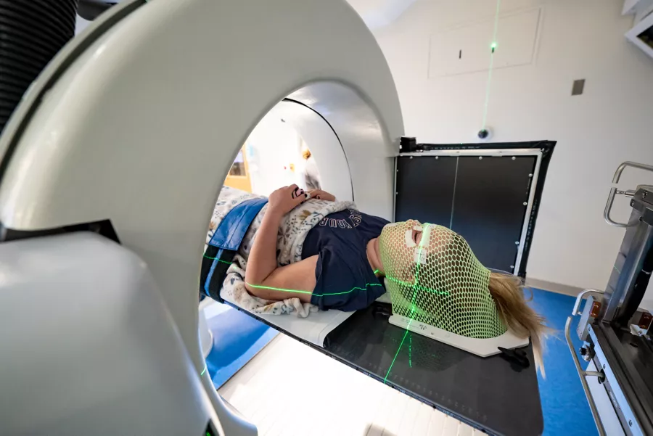
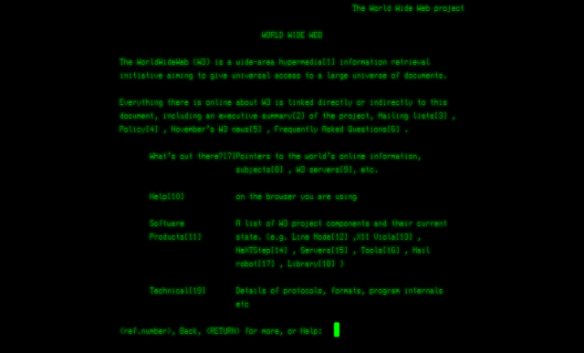
Group 7’s Key Takeaways
When thinking about ALL the aspects of the LHC
The SIZE of the detectors and the LHC
How far underground it all is
How complicated all the thousands of parts are
We feel:
2. CERN is not just about the LHC, but has developed other technologies that have changed the world!

Slide 29

Group 7’s Key Takeaways Continued
3. Inspiration for our teaching abilities.

Slide 30
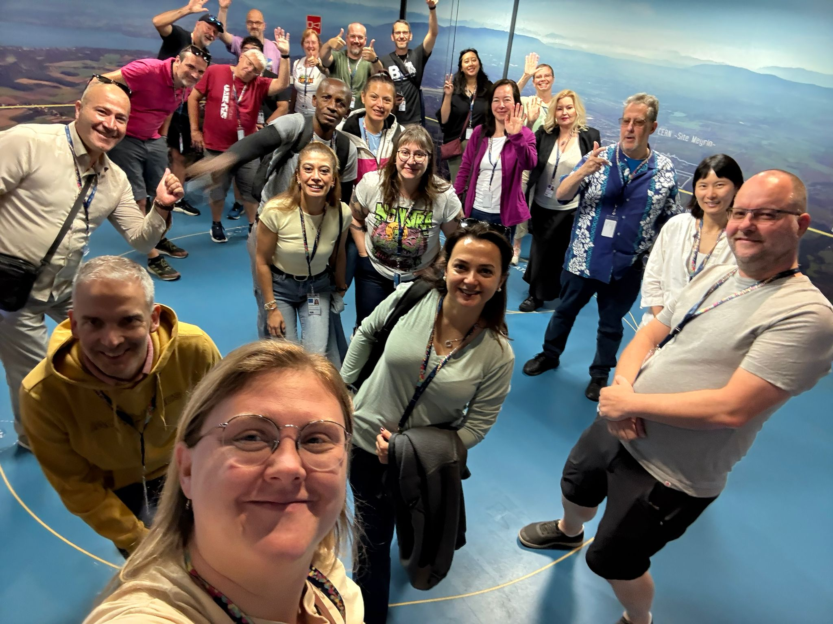
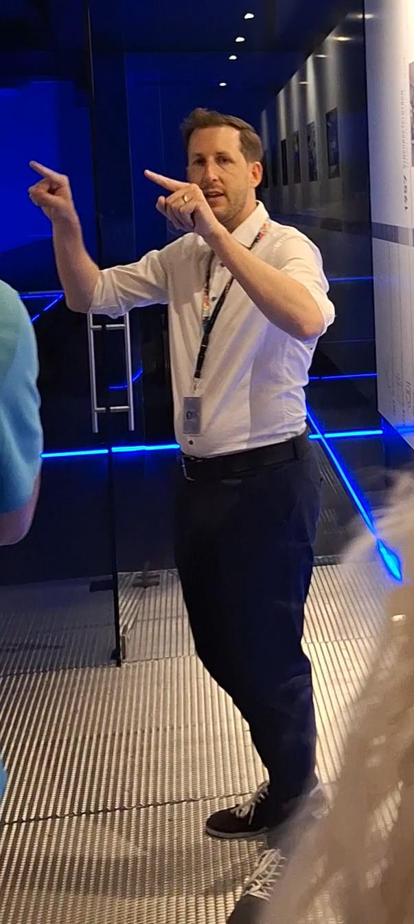
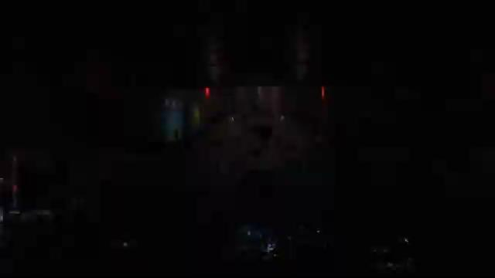
What has worked well:
The exchange of ideas with colleagues
Learning the theory before → visiting the site and seeing it in person!
Jeff has inspired us to lead people, kept our attention, and has make excellent analogies.

Slide 31

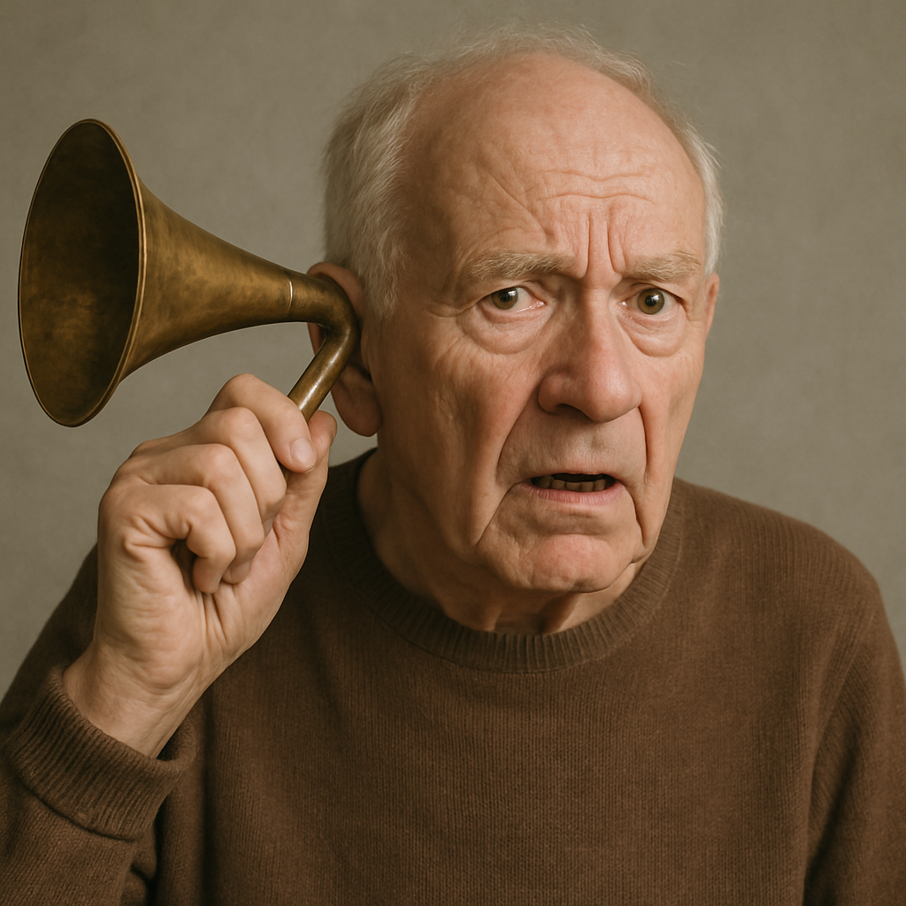

Ways to improve
Use of 3D simulations would be helpful for us.
Use of microphones, some have been hard to hear.
See some high level equation generation to try (and probably fail) to understand levels of physics at CERN

Slide 32
Thursday, 10 July
SG Session 2

Slide 33
Checklist for SG Session 2
# | Type of Task | Task | Deadline
1 | Individual | Fill in slides corresponding to your colour | Thursday, 18:00
2 | Group | Fill in “Our Key Takeaways” and “Our Feedback” slides as a group. Make sure you all contribute to the discussion. | Thursday, 18:00
3 | Group | Decide how you as a group will present your group slides if you are selected to present during the SG Report-Out. | Thursday, 18:00

Slide 34
Engineering
Which topic from the physics curriculum could you see yourself teaching in the context of Engineering at CERN?
Sketch out your idea and add links to suitable resources!
Particle accelerator
Particles are generated and prepared at the source.
They are then accelerated in the main ring using RF cavities and kept on course with magnets.
Finally, when particles collide or interact with targets, detectors capture data to study fundamental physics.
https://www.khanacademy.org/science/physics

Slide 35
LHC
Which topic from the physics curriculum could you see yourself teaching in the context of the
Large Hadron Collider at CERN?
Sketch out your idea and add links to suitable resources!
Superconductivity
Maglev trains
https://science.howstuffworks.com/transport/engines-equipment/maglev-train.htm

Slide 36
AI
What are three key ideas about AI that you would like your students to know about?
What are potential challenges students might encounter when learning about AI?
What are potential benefits students might encounter when learning with the help of AI?

Slide 37
My Key Takeaways so far
Instructions: Write in the box any insights or things that you learned and that you want to remember after the HST2025 programme.

Slide 38
Engineering
Which topic from the physics curriculum could you see yourself teaching in the context of Engineering at CERN?
Sketch out your idea and add links to suitable resources!
I would not like to teach engineering in my PHYSICS CLASS

Slide 39
LHC
Which topic from the physics curriculum could you see yourself teaching in the context of the
Large Hadron Collider at CERN?
Sketch out your idea and add links to suitable resources!
1..I would like to explain Physics behind LHC and I would like to teach it in a attractive way by using online simulation.
2.I like the idea of making student to build it either by using 3D printer or by LEGO
3.Detectors

Slide 40
AI
What are three key ideas about AI that you would like your students to know about?
What are potential challenges students might encounter when learning about AI?
What are potential benefits students might encounter when learning with the help of AI?
1.Ai learns from data
2.You can ask a lot of questions without limit
1.They might not know on how to use properly
1.Shape their ideas
Human ideas can be better but AI can shape almost perfectly

Slide 41
My Key Takeaways so far
Instructions: Write in the box any insights or things that you learned and that you want to remember after the HST2025 programme.
1.Explaining in simple terms by taking analogies
2. Being able to help students about different misconceptions that they might encounter
3.Doing more hands on experiments or use visual methods
4……

Slide 42
Engineering
Which topic from the physics curriculum could you see yourself teaching in the context of Engineering at CERN?
Sketch out your idea and add links to suitable resources!
Magnet designs
I will figure out and find some great simple experiments to make it easier.

Slide 43
LHC
Which topic from the physics curriculum could you see yourself teaching in the context of the
Large Hadron Collider at CERN?
Sketch out your idea and add links to suitable resources!
Accelerating protons - quench and how to prevent it
want to teach it using some videos showing what is happening inside.

Slide 44
AI
What are three key ideas about AI that you would like your students to know about?
What are potential challenges students might encounter when learning about AI?
What are potential benefits students might encounter when learning with the help of AI?
It is infinite - how does it work? - the safety of the information we give it.
The need for knowledge of math,computer science. Understanding how to analyze data
Career opportunities( jobs like machine learning engineer), future technological advances

Slide 45
My Key Takeaways so far
Instructions: Write in the box any insights or things that you learned and that you want to remember after the HST2025 programme.
The importance of the knowledge of magnets design.
Engineers at CERN design energy-efficient systems, power converters, and learn how to manage sudden power failures safely.Use of AI and automation in system diagnostics and failure prediction.Designing the LHC’s infrastructure required solving challenges like: Vibration control ,Radiation shielding, Tunneling deep underground

Slide 46
Engineering
Which topic from the physics curriculum could you see yourself teaching in the context of Engineering at CERN?
Sketch out your idea and add links to suitable resources!
1 Engineering
Electricity
Ohm Law / Superconducing
Termodynamics
States of matter
2. Simulations of PHET
You can fins a lot of simulations
https://phet.colorado.edu/en/simulations/filter?subjects=work-energy-and-power,heat-and-thermodynamics,quantum-phenomena,electricity-magnets-and-circuits&type=html

Slide 47
LHC
Which topic from the physics curriculum could you see yourself teaching in the context of the
Large Hadron Collider at CERN?
Sketch out your idea and add links to suitable resources!Lectro
LHC
Lorentz Force
Magnets
Electron trajectory in a magnetic field
https://www.ventusciencia.com/media/wysiwyg/Experimentos-de-fisica/10755_DESVIACION_DE_ELECTRONES.pdf

Slide 48
AI
What are three key ideas about AI that you would like your students to know about?
What are potential challenges students might encounter when learning about AI?
What are potential benefits students might encounter when learning with the help of AI?
AI
What do we understand as an AI algoritm
What are better programming languages
Where we can find libraries to practise
To become more efficient
To improve results and work
Boost (increase the time) imagination

Slide 49
My Key Takeaways so far
Instructions: Write in the box any insights or things that you learned and that you want to remember after the HST2025 programme.

Slide 50
Engineering
Which topic from the physics curriculum could you see yourself teaching in the context of Engineering at CERN?
Sketch out your idea and add links to suitable resources!
In all honesty, this lecture was completely over my head. I have no training as a materials engineer, so I could barely follow the lecture.
That being said, I think I could talk about the forces that the magnets experience, trying to pull it apart as the current flows in different directions. Maybe for a warm up question reviewing Lorentz force.

Slide 51
LHC
Which topic from the physics curriculum could you see yourself teaching in the context of the
Large Hadron Collider at CERN?
Sketch out your idea and add links to suitable resources!
Just how INCREDIBLY complicated the LHC is. And for me the big take away was how careful they have to be when the beam is active. It feels like they are trying to ride a wild bronco and having all the parts working perfectly balanced is very precarious.

Slide 52
Machine learning is necessary due to the time constraints of the LHC and detectors. I think that’s a big one.
  Based off of that I think a sub point is that hardware logic lines are necessary due to the quick (100 ns I think) constraint of data collection.
AI
What are three key ideas about AI that you would like your students to know about?
What are potential challenges students might encounter when learning about AI?
What are potential benefits students might encounter when learning with the help of AI?

Slide 53

My Key Takeaways so far
Instructions: Write in the box any insights or things that you learned and that you want to remember after the HST2025 programme.
With each new day and new lecture, the appreciation for the complexity of the LHC grows and grows.
With great complexity comes great opportunities for failure.
With great complexity
Comes great opportunities for failure.

Slide 54
Study Group Discussion
Share your individual insights with your colleagues and identify shared themes.
Have some ice cream and don’t forget to
take notes :)
Engineering:
using F = LIB equation and the fact that these are superconductors so current is 30,000 A, the forces are almost 2 MILLION Newtons!!!!!!
Extreme temperatures form 1.4 K up to 10,000 time hotter than sun.
Complex magnet design, a video of the process would have been useful.
Example of 2008 disaster can be used when teaching thermodynamics
If a small quench, it could take weeks to repair it. Similar in chemistry: erosion.
LHC:
Path deflection detectors using the cyclotron radiation was a clever idea and shows the problem with electron beams
Maybe use story of the LHC to teacher ideas of F = qE and F = qvB. And hoping to use simulation, and maybe 3D printing it. (cern.ch/PER)
AI:
Detectors: idea of walking around room with a person “particle” where they release energy

Slide 55
Group 7’s Key Takeaways
When thinking about ALL the aspects of the LHC…
💥 LHC – Where Tiny Particles Do Big Drama
🧊 Engineering: Super Cold and Supercharged
🤖 AI – The Fastest Nerd in the Room
We feel:
2. CERN is not just about the LHC, but has developed other technologies that have changed the world!

Slide 56
Group 7’s Key Takeaways Continued
3. New classroom ideas for bringing particle physics into our classroom:
Bubble Chamber
Decay vs transformation
Particles are NOT spheres
Post activity reflection time (exit ticket)

Slide 57
What has worked well:
The exchange of ideas with colleagues
Learning the theory before → visiting the site and seeing it in person!
Jeff has inspired us to lead people, kept our attention, and has make excellent analogies.

Slide 58
Ways to improve
Use of 3D simulations would be helpful for us.
Use of microphones, some have been hard to hear.
See some high level equation generation to try (and probably fail) to understand levels of physics at CERN

Slide 59
Tuesday, 15 July
SG Session 3

Slide 60
Checklist for SG Session 3
# | Type of Task | Task | Deadline
1 | Individual | Fill in slides corresponding to your colour | Tuesday, 17:30
2 | Group | Fill in “Our Key Takeaways” and “Our Feedback” slides as a group. Make sure you all contribute to the discussion. | Tuesday, 17:30
3 | Group | Decide how you as a group will present your group slides if you are selected to present during the SG Report-Out. | Tuesday, 17:30

Slide 61
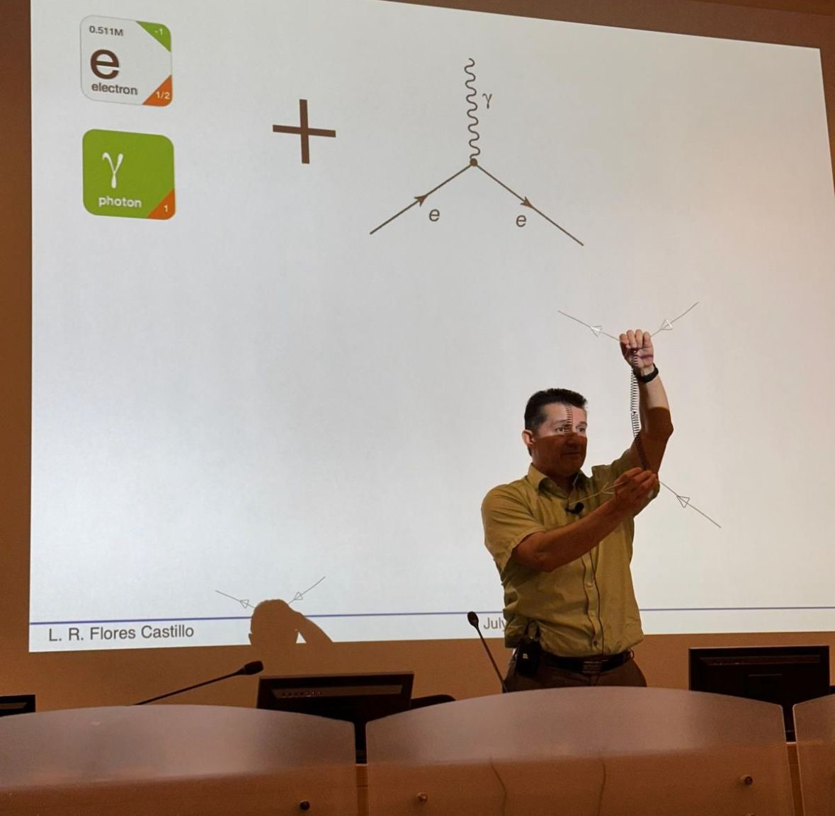
Feynman
Diagrams
What would be a fun and creative way of introducing Feynman Diagrams in the classroom?
Which students’ conceptions would you expect to encounter and how would you address them?
I think hands-on activities would work best for this. I liked the materials which Luis Roberto Flores Castillo. It was a fancy illustrations.

Slide 62
2) One common misconception is interpreting the diagrams as literal, spatial paths of particles, rather than abstract representations of interactions in spacetime. Students may think of the lines as particle trajectories similar to classical mechanics, which can obscure the quantum nature of the processes.
Another frequent issue is confusion around time ordering—especially in diagrams drawn with time on the vertical axis—leading to misunderstandings about particle-antiparticle creation and annihilation. Some students may also believe that virtual particles represented in internal lines are "real" particles that can be directly observed.
Some students may think Feynman Diagrams show actual particle paths, like in classical physics. Others might believe virtual particles are real or misunderstand the direction of time in diagrams.
To address this, I would explain that these diagrams are just calculation tools, not real pictures. I’d use simple examples, compare them with spacetime diagrams, and focus on teaching the rules clearly—like what each line and vertex represents. Encouraging students to discuss and draw diagrams themselves also helps clear up confusion.

Slide 63
Computing
at CERN
What are three key ideas about computing and data analysis at CERN that you would like your students to know about?
What are potential challenges students might encounter when learning about computing and data analysis at CERN?

Slide 64
Medical Applications
What are three key ideas about medical applications of particle physics that you would like your students to know about?
What are potential challenges students might encounter when learning about medical applications of particle physics?
Particle accelerators in cancer treatment (e.g., Proton Therapy)
Medical imaging technologies (PET Scans)
Detection and measurement techniques
Unfamiliar vocabulary, connecting physics to biology and medicine, scale and complexity of technology.

Slide 65
My Key Takeaways so far
Instructions: Write in the box any insights or things that you learned and that you want to remember after the HST2025 programme.

Slide 66
Feynman
Diagrams
What would be a fun and creative way of introducing Feynman Diagrams in the classroom?
Which students’ conceptions would you expect to encounter and how would you address them?
One way of best introducing Feyman diagram is by using models.Visual representation but before
,

Slide 67
Computing
at CERN
What are three key ideas about computing and data analysis at CERN that you would like your students to know about?
What are potential challenges students might encounter when learning about computing and data analysis at CERN?

Slide 68
Medical Applications
What are three key ideas about medical applications of particle physics that you would like your students to know about?
What are potential challenges students might encounter when learning about medical applications of particle physics?

Slide 69
My Key Takeaways so far
Instructions: Write in the box any insights or things that you learned and that you want to remember after the HST2025 programme.

Slide 70
Feynman
Diagrams
What would be a fun and creative way of introducing Feynman Diagrams in the classroom?
Which students’ conceptions would you expect to encounter and how would you address them?
I will start with an interesting question : if two particles are far from each other how can they speak with each other?
Then I will play a video to help them prepare for the explanations.
2)they will be confused about the horizontal and vertical axis of the diagram.
I will probably use flashcards and memes or give them some activities

Slide 71
Computing
at CERN
What are three key ideas about computing and data analysis at CERN that you would like your students to know about?
What are potential challenges students might encounter when learning about computing and data analysis at CERN?
It’s amazing to tell them that CERN invented world wide web.
Tell them about the data volumes and their resources.
The innovation and the changes that have accrued in the past 50-100 years is interesting
2)they may be curious about the computers and their abilities to compute lots of information
Where do they store these data?

Slide 72
My Key Takeaways so far
Instructions: Write in the box any insights or things that you learned and that you want to remember after the HST2025 programme.
I’ve learned not only about particle physics, but also its real-world applications.I discovered how CERN technologies are being used in medical fields, especially in cancer treatment and advanced imaging.
We explored how particle accelerators and detector technologies can support early diagnosis and therapy.I also learned about computing at CERN, including the Worldwide LHC Computing Grid and how big data is managed and analyzed.
Seeing how such huge amounts of data are processed in real time was eye-opening and exciting.This experience has given me a broader perspective on how science, technology, and society are deeply connected.

Slide 73
Medical Applications
What are three key ideas about medical applications of particle physics that you would like your students to know about?
What are potential challenges students might encounter when learning about medical applications of particle physics?
The history of discoveries would be really amazing
How are CERN’s activities really useful in real life?
How does x-ray imaging work?
They may ask about how do particles influence in tumor treatment?
How doesn’t it effect on healthy cells?

Slide 74
Feynman
Diagrams
What would be a fun and creative way of introducing Feynman Diagrams in the classroom?
Which students’ conceptions would you expect to encounter and how would you address them?
Feynman Diagrams
Time intrepretation . Paticles / Antiparticles
When rotate expression we have a valid expression
Student’s conceptions
Students don’t have knowledge about quantum physics

Slide 75
Computing
at CERN
What are three key ideas about computing and data analysis at CERN that you would like your students to know about?
What are potential challenges students might encounter when learning about computing and data analysis at CERN?
Key ideas
Volum of data and storage needs
Distributed computing
Security
Potencial challenges
Use computers and language programs in order to solve problems based on data
CERN OpenLab. Zeenodo (digital repository)

Slide 76
Medical Applications
What are three key ideas about medical applications of particle physics that you would like your students to know about?
What are potential challenges students might encounter when learning about medical applications of particle physics?
Key ideas
PET
Hadron therapy
Potencial challenges
To grab women to the technology a physics sciences because are very interested health science

Slide 77
My Key Takeaways so far
Instructions: Write in the box any insights or things that you learned and that you want to remember after the HST2025 programme.
Insights
Propierties of Feynman's diagram (Rotation)
Hadron therapy Bragg pic

Slide 78
Feynman
Diagrams
What would be a fun and creative way of introducing Feynman Diagrams in the classroom?
Which students’ conceptions would you expect to encounter and how would you address them?
Maybe we try designing our own diagrams? I mean the concept maps idea is kinda like a feynman diagram where we are identifying objects and showing their relationships between them?
Maybe having them act it out?
No longer part of my curriculum so not sure if I will teach it.

Slide 79
Computing
at CERN
What are three key ideas about computing and data analysis at CERN that you would like your students to know about?
What are potential challenges students might encounter when learning about computing and data analysis at CERN?
That the computer is NOT just at CERN, but part of the Worldwide LHC Computing Grid. Tiers 0, 1 and 2
Use fiberoptics for fast conecction (maybe calculate time of signal from CMS to Data Center?
The immense SIZE of the data that the detectors produce → filter → store.
I think it would be hard for students to wrap their heads around the numbers being SO large!

Slide 80
Medical Applications
What are three key ideas about medical applications of particle physics that you would like your students to know about?
What are potential challenges students might encounter when learning about medical applications of particle physics?
Very exciting future. Definitely want to share it with my students. Not sure how to implement into curriculum besides using it as an example problem in various units throughout the year maybe.

Slide 81
My Key Takeaways so far
Instructions: Write in the box any insights or things that you learned and that you want to remember after the HST2025 programme.
There have been a few demos and ideas that I want to implement right away:
Black box pipes and rope
Particles Identity Quiz to introduce particle physics
Electromagnetic Salt Water Propulsion inquiry lab. Give students the set up and have them create mini lab. Maybe as practice for IA.
Try to change practice problems across both years of physics to put in particle physics examples instead. Include medical examples as well.

Slide 82
Study Group Discussion
Share your individual insights with your colleagues and identify shared themes.
Have some ice cream and don’t forget to
take notes :)
Feynman diagrams would be better understood if students can physically manipulate them (legos, act it out, etc)
  Small activity before introducing.
  Funny questions/scenarios/models (post man necessary)
  Keep it simple (KISS method)
Computing:
  Evolution/history of the data storage was interesting.
  Collaboration with other networks to make the “Worldwide LHC Computing Grid”
  Storage SIZES!
  Videos should be shown to students:
    NOTE: videos are on links from schedule page
Mystery Boxes: Definitely use in class, maybe day 1 to introduce the idea of how science works. NEVER show the answer!!!!!
Medical Applications:
  Proton therapy very exciting.
  Used with radioactivity
  Masterclass from CERN brought in doctors, physicists, and then practical work. Used software “Matrad”
  Try to change some practice problems to add radiation therapy to inspire students.
  Need to inspire curiosity

Slide 83
Our Key Takeaways so far
Instructions: Write in the box any insights, learnings and discussion outcomes.
(Decide how you as a group will present them if you are selected to present during the SG Report-Out.)
SO many applications of the physics done here at CERN.
We can think big and change entire curriculum or add little things (like black boxes) for just 20 minutes MAX.

Slide 84
Our Feedback
so far
Highlights?
What’s working?
What needs improvement?
Other comments?
Funny picture or meme?
(Decide how you as a group will present them if you are selected to present during the SG Report-Out.)

Slide 85
Thursday, 17 July
SG Session 4

Slide 86
Checklist for SG Session 4
# | Type of Task | Task | Deadline
1 | Individual | Fill in slides corresponding to your colour | Thursday, 14:30
2 | Group | Fill in the “Our Key Takeaways from HST2025” slide as a group. Make sure you all contribute to the discussion. | Thursday, 15:00
3 | Group | Discuss the topic that was assigned to your study group for the Final Presentation on Friday morning. Share and collect your individual experiences with this topic. | Thursday, 16:00
4 | Group | Prepare a detailed and entertaining presentation to share your results with your colleagues. Make sure that everyone plays an active role during the Final Presentation! | Thursday, 17:00

Slide 87
Antimatter
vs
Dark Matter
What are three key ideas about antimatter research at CERN that you would like your students to know about?
What would be a good approach to explain the difference between antimatter and dark matter to your students?

Slide 88
Future Particle Accelerators
What are five key ideas about future particle accelerators and acceleration technologies that you would like your students to know about?
What kind of career opportunities in particle physics are you definitely going to showcase to your students?

Slide 89
My Key Takeaways from HST2025
Instructions: Write in the box any insights or things that you learned and that you want to remember after the HST2025 programme.

Slide 90
Antimatter
vs
Dark Matter
What are three key ideas about antimatter research at CERN that you would like your students to know about?
What would be a good approach to explain the difference between antimatter and dark matter to your students?

Slide 91
Future Particle Accelerators
What are five key ideas about future particle accelerators and acceleration technologies that you would like your students to know about?
What kind of career opportunities in particle physics are you definitely going to showcase to your students?

Slide 92
My Key Takeaways from HST2025
Instructions: Write in the box any insights or things that you learned and that you want to remember after the HST2025 programme.

Slide 93
Antimatter
vs
Dark Matter
What are three key ideas about antimatter research at CERN that you would like your students to know about?
What would be a good approach to explain the difference between antimatter and dark matter to your students?
Talk about the differences.
The importance of learning about it .
The important questions that we want to answer by studying and searching about them.
2) antimatter is like a hidden twin of matter that we can make and study.
Darkmatter is like a ghost it’s like a ghost it’s all around us we can’t see it but we feel its pull.

Slide 94
Future Particle Accelerators
What are five key ideas about future particle accelerators and acceleration technologies that you would like your students to know about?
What kind of career opportunities in particle physics are you definitely going to showcase to your students?
Powerful design - energy efficiency - the use in cancer therapy- improvement in data analysis- involve worldwide partnership
Engineer, data scientist . AI and machine learning , Technician

Slide 95
My Key Takeaways from HST2025
Instructions: Write in the box any insights or things that you learned and that you want to remember after the HST2025 programme.
The power of curiosity and collaboration
Teachers are not just educators. They have the responsibility to teach new scientists of world.
I now know physics is not just in books, it’s really useful to have a better life.

Slide 96
Antimatter
vs
Dark Matter
What are three key ideas about antimatter research at CERN that you would like your students to know about?
What would be a good approach to explain the difference between antimatter and dark matter to your students?

Slide 97
Future Particle Accelerators
What are five key ideas about future particle accelerators and acceleration technologies that you would like your students to know about?
What kind of career opportunities in particle physics are you definitely going to showcase to your students?

Slide 98
My Key Takeaways from HST2025
Instructions: Write in the box any insights or things that you learned and that you want to remember after the HST2025 programme.

Slide 99
Antimatter
vs
Dark Matter
What are three key ideas about antimatter research at CERN that you would like your students to know about?
What would be a good approach to explain the difference between antimatter and dark matter to your students?

Slide 100
Future Particle Accelerators
What are five key ideas about future particle accelerators and acceleration technologies that you would like your students to know about?
What kind of career opportunities in particle physics are you definitely going to showcase to your students?

Slide 101
My Key Takeaways from HST2025
Instructions: Write in the box any insights or things that you learned and that you want to remember after the HST2025 programme.

Slide 102
Study Group Discussion
Share your individual insights with your colleagues and identify shared themes.
Have some ice cream and don’t forget to
take notes :)

Slide 103
Our Key Takeaways from HST2025

Slide 104
Final Presentation Guidelines
Presentation | 10 minutes + 5 minutes for Q&A
Style | Fun, entertaining & on time!
Contents | Key ideas (Matt) Curriculum & classroom connections (Emel) Potential students’ conceptions & challenges (Albina) Helpful material and resources (Viktor) Best practice example (Arezou)
Final Slide | Key Takeaways & Goodbye messages

Slide 105
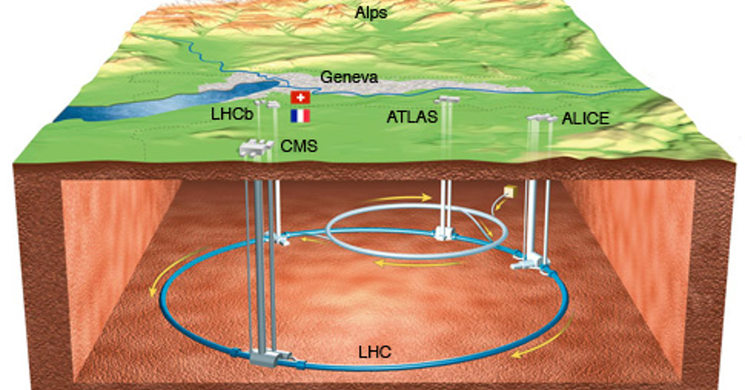
ATLAS, CMS, ALICE, LHCb
HST2025 Study Group 7
“Using the Right Tool for the Right Job”

Slide 106
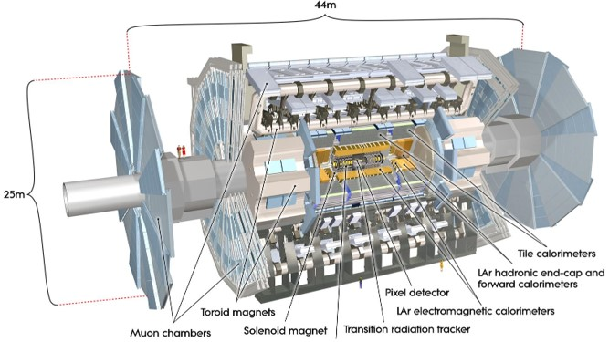
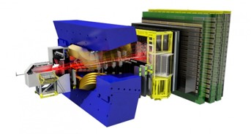
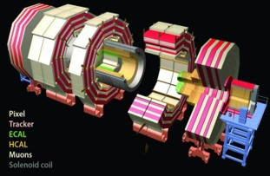
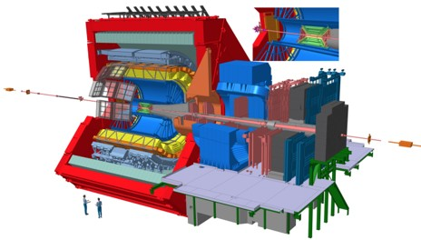
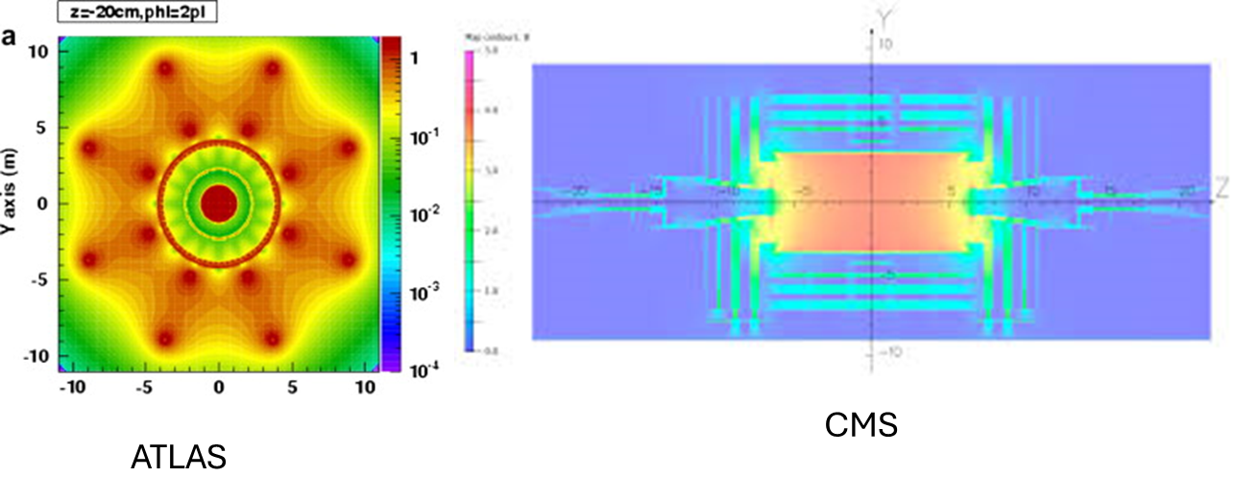
Key Ideas
The detectors are designed and differ due to their research goals.
Similarities:
  Silicon Trackers, EM & Hadron Calorimeters, MAGNETS MAGNETS MAGNETS!
  All are not “seeing” the particle but its interactions
Differences:
  Primary Job:
    CMS & ATLAS: General detectors for pp collision
    ALICE: Quark Gluon Plasma from heavy ion collision
    LHCb: Bottom Quark interactions
  Geometry:
    Magnetic Field Orientation
    Symmetric vs. Asymmetric
  Components

Slide 107

Curriculum & Classroom Connections
Potential Connections
Students have some closely related topics in Standart/High Level physics syllabus.
Forces and Momentum
Electric and Magnetic Fields
Structure of the Atom
Cosmic background microwave radiation
Radioactive decay

Slide 108
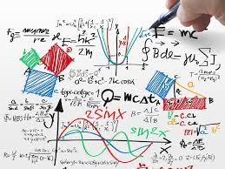
Curriculum & Classroom Connections
Missing or Weak Topics
Students have a conceptual foundation that can be built upon–especially when it comes to understanding how particles move and how they decay, so upon these we might build a knowledge for detectors as well.
Detailed subatomic particle physics
Detector technologies
Data acquisition/digitization
Role of superconducting magnets

Slide 109




Potential Students Misconceptions & Challenges
Size of the detectors
What they do

Slide 110


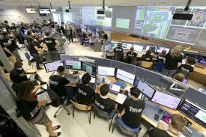
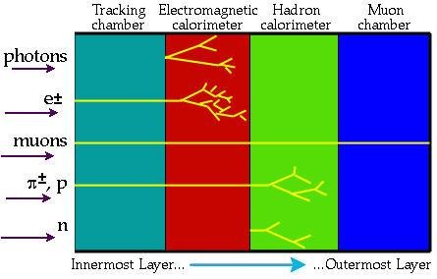
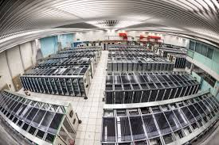
Potential Students Misconceptions & Challenges
Perception
Data Collections

Slide 111
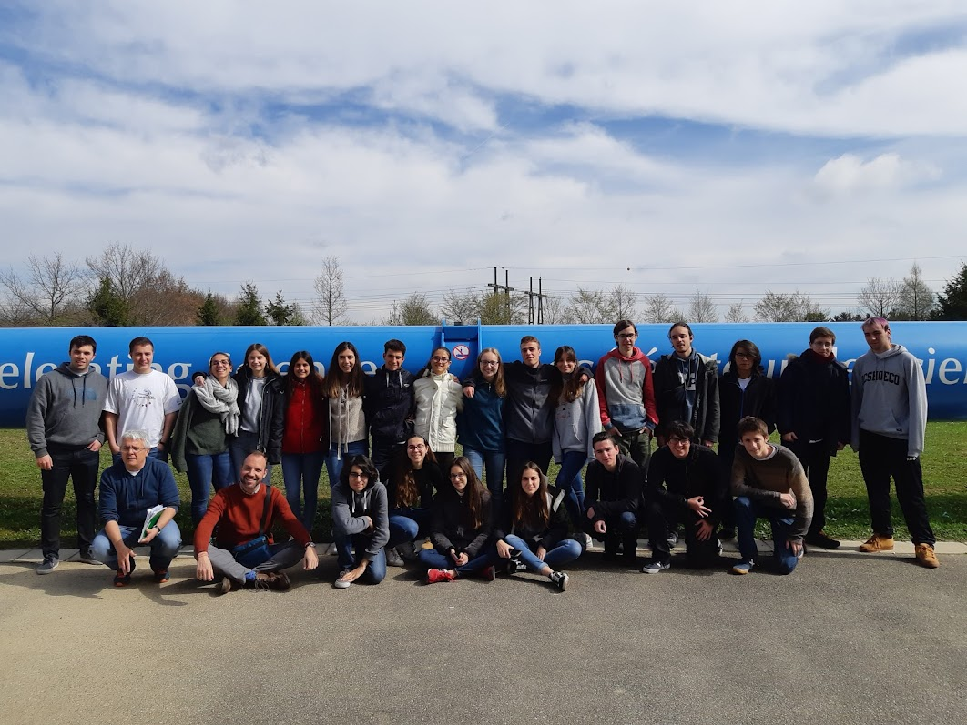
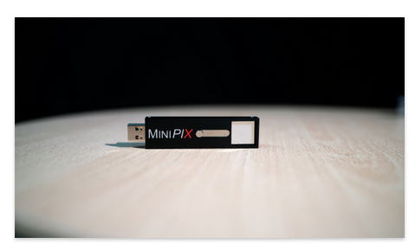
Useful Material & Resources
Physisc Eduction Research
Hands-on:
3D printable Atlas model
Atlas Open Data, CMS Event display
Cloud chamber activity
CERN Grupo visitors
Lab Workshops
Guided tours
Interactive exhibitions
Virtual tours CERN
Masterclasses particle physics International Physics
masterclasses
Quarknet
ICCUB (Institut of Cosmos Sciences of Barcelona University
Particle Physics
Reference any material that you find useful for your students and/or your colleagues

Slide 112

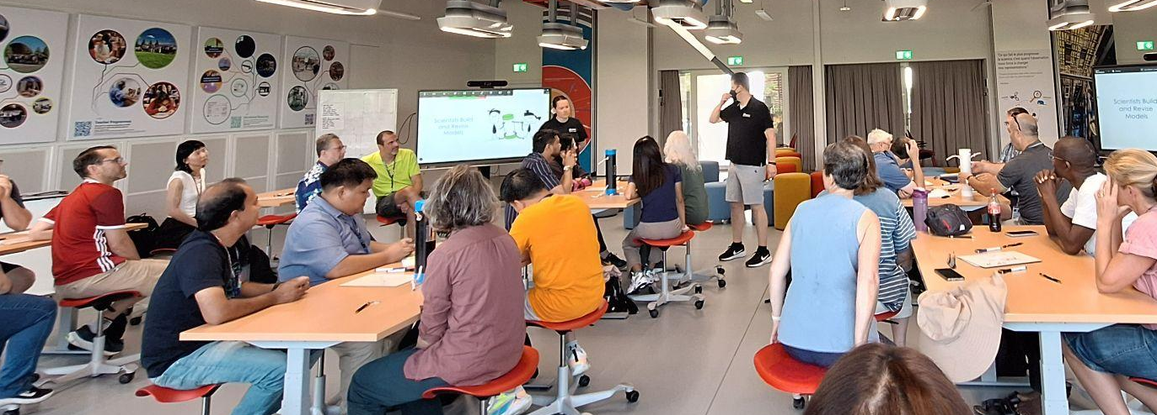
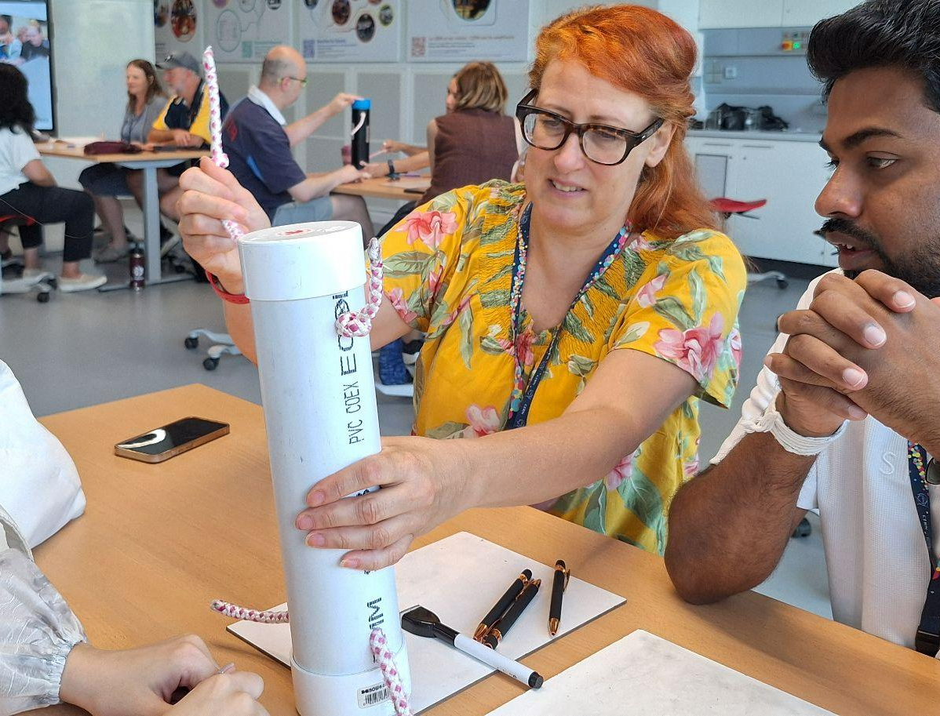
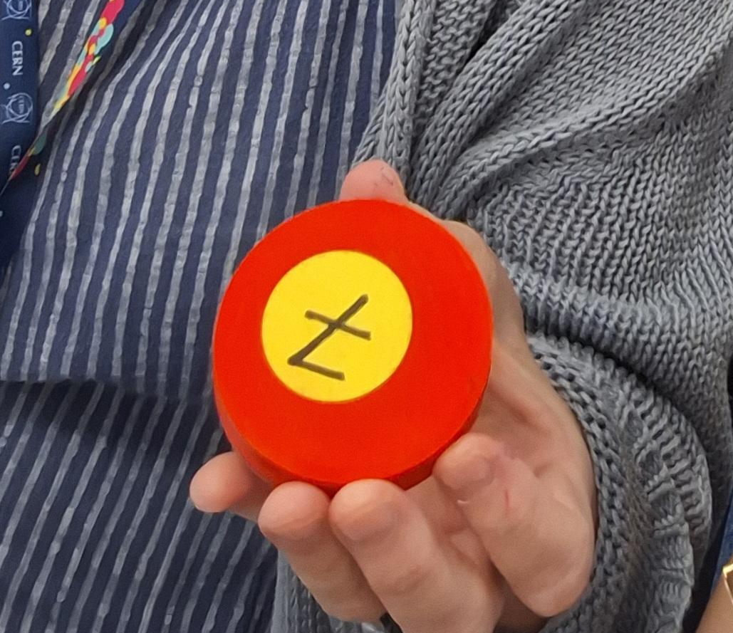
BEST PRACTICES EXAMPLE
As science teachers, we can transfer the inspiring experience of CERN into powerful classroom practices.
1. Start with a Challenge/Mystery
2. Facilitate Group Thinking
3. Deliver Key Concepts
4. Do a Hands-on Activity
5. Connect to the Real World
➡ We experienced this model at CERN and
I believe it can enrich our science teaching in our countries.

Slide 113


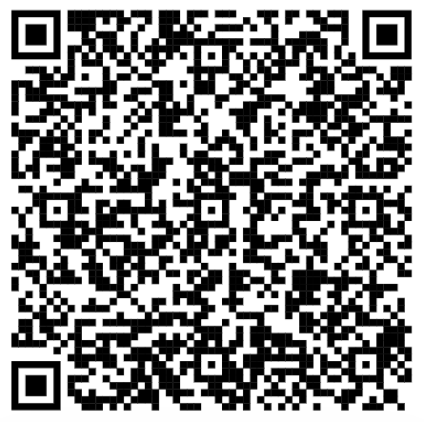


Now it is time to Choose
Results Summary

Slide 114
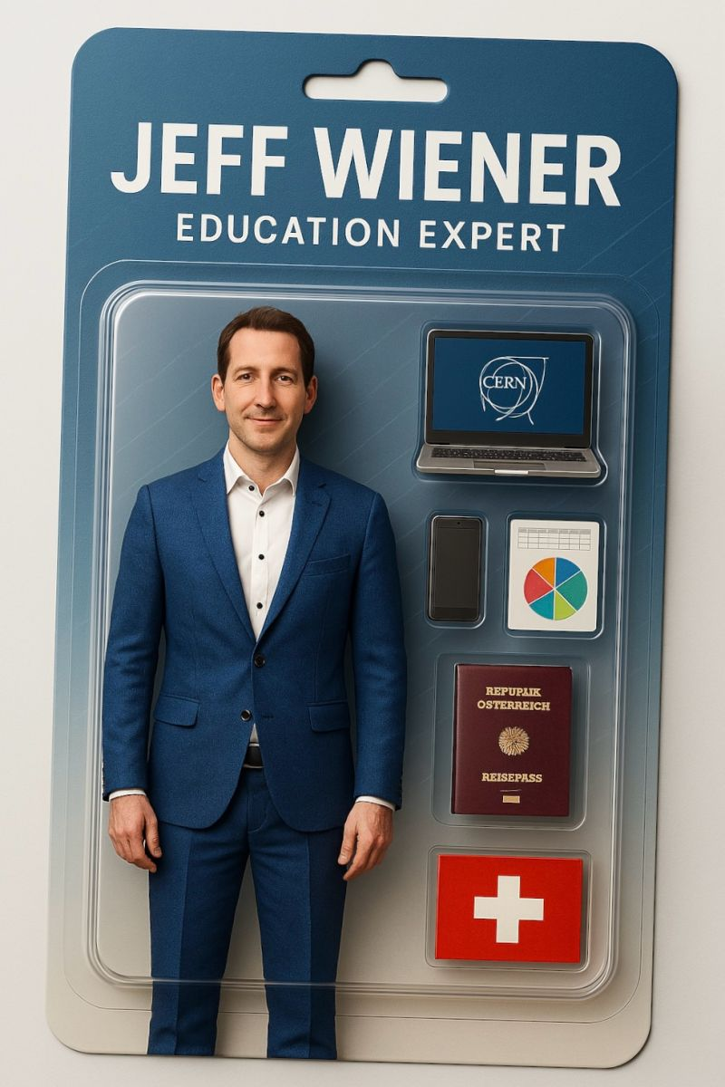

HST2025 Study Group 7
Matt (USA), Emel (Turkiye), Albina (Kosovo), Victor (Spain), Arezou (Iran)
One way in which our thinking has changed…
Highlights, snapshots, farewell messages…
How we feel when we think about the LHC
But now we can explain it more.
Thank you to Jeff and Milena who made this program the incredible experience it was.

