Slide 1
Study Group 6
International High School Teacher Programme 2025

Slide 2
Wednesday, 9 July
SG Session 1

Slide 3
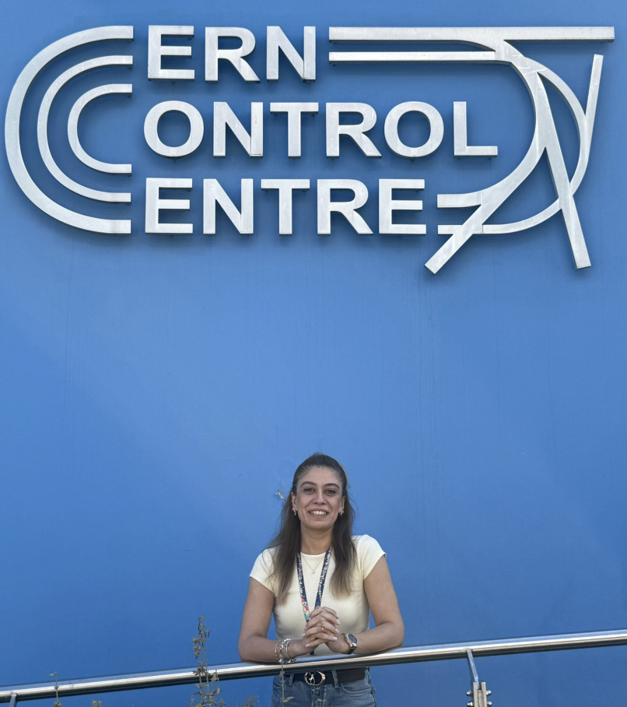
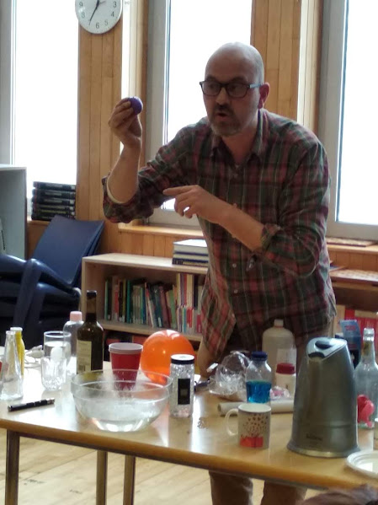
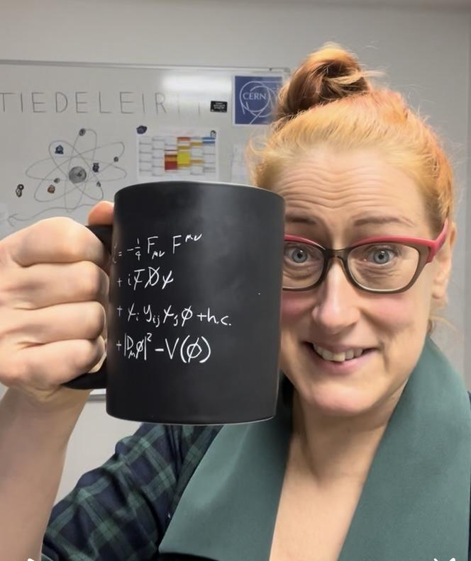
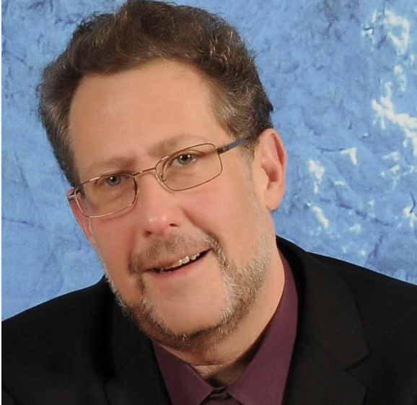

Study Group 6
https://www.rts.ch/play/tv/-/video/
Cansu Ece Aydınkal
Turkey
I once lost my voice during a physics lesson, but kept teaching by writing everything on the board — and my students said it was the best class ever.
Carlos Moreno
Andorra
I am a great basktetball player- Just look at my finger
Milla Unkuri
Finland
Still thinking about fun fact…. I am finnish after all…
Asanka Pushpa Kumara
Sri Lanka
Meaning of my name is unlimited.
Clıff Gerstman
Unıted States of Amerıca
One fun fact about myself Expert level Kazoo Player
Notes:
Asanka

Slide 4
Slide Conventions
Colour of Slide | Type of Work
 | Individual (your colour is indicated on the previous slide)
 | Group work
 | Report-out slides

Slide 5
Checklist for SG Session 1
# | Type of Task | Task | Deadline
1 | Individual | Fill in your section of the “Study Group 6” slide | Wednesday, 17:30
2 | Group | Fill in “Group Norms” slide | Wednesday, 17:30
3 | Individual | Fill in slides corresponding to your colour | Wednesday, 17:30
4 | Group | Fill in “Our Key Takeaways” and “Our Feedback” slides as a group. Make sure you all contribute to the discussion. | Wednesday, 17:30
5 | Group | Decide how you as a group will present your group slides if you are selected to present during the SG Report-Out. | Wednesday, 17:30

Slide 6
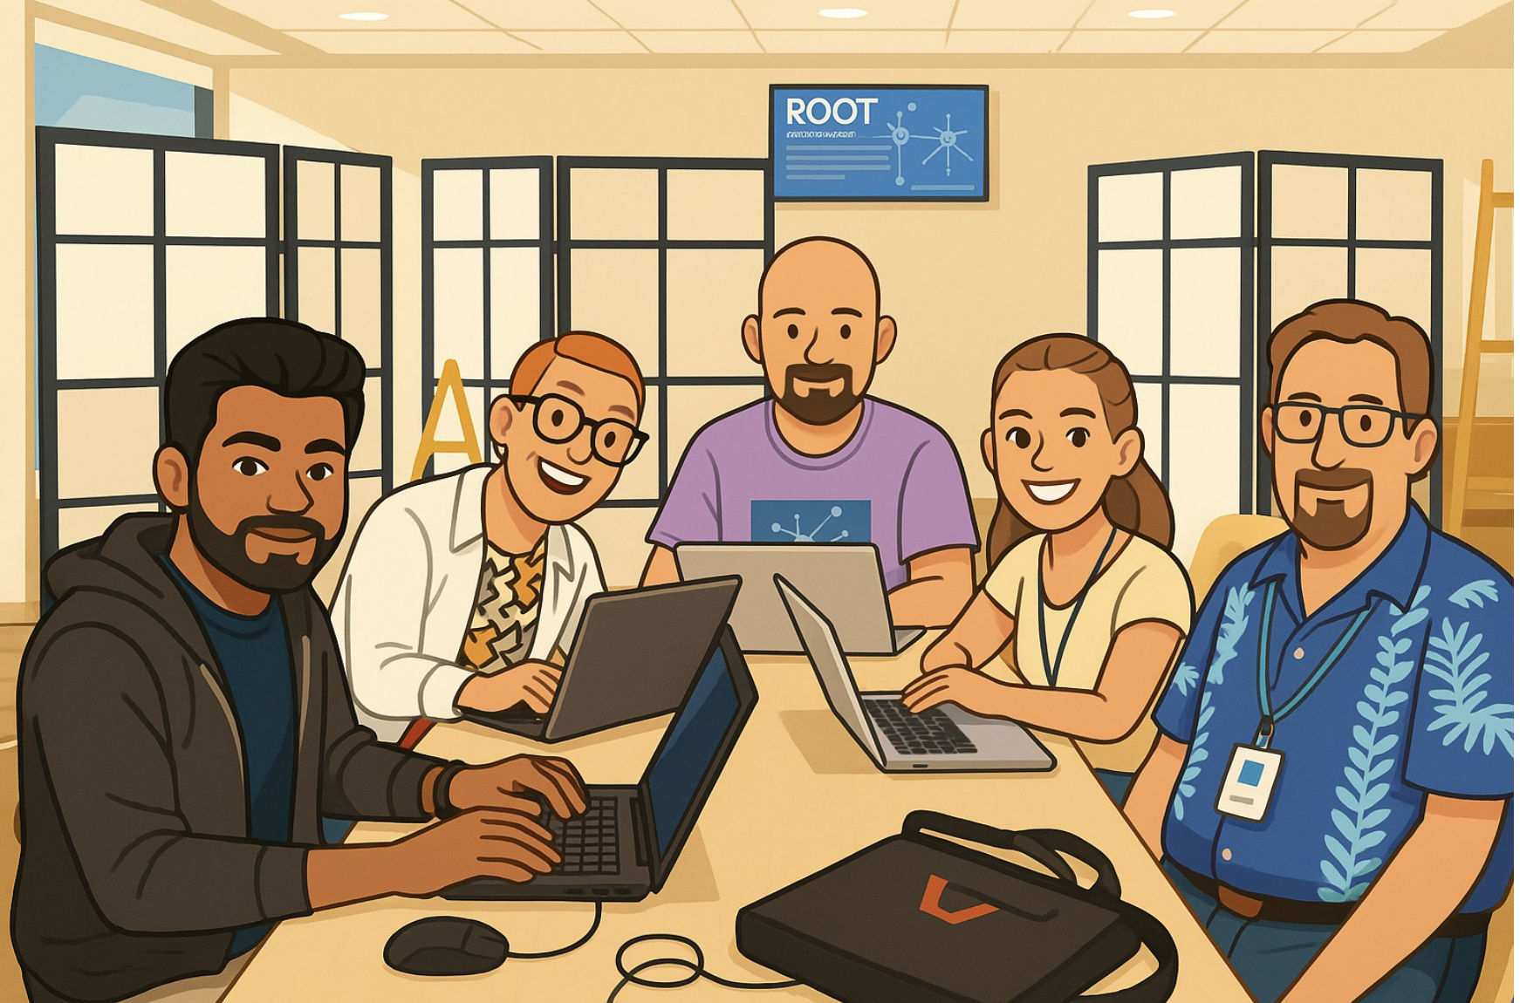

Slide 7
Group Leader
Time Keeper
Beauty of slides
Carlos
Asanka
Milla
Cansu
Cliff

Slide 8
Particle
Physics
What are three adjectives that come to your mind when you think about particle physics?
To what extent is the topic of particle physics covered in your national curriculum?
For me Particle Physics is..
🧱 Fundamental
→ Explores the deepest building blocks of reality.
🌀 Mysterious
→ So much is still unknown — like dark matter, quantum gravity, and more.
🌌 Transformative
→ Has revolutionized our understanding of the universe — from the Big Bang to the Higgs field.
🧪 Particle Physics in My Classes
Fundamental particles: quarks, leptons, gauge bosons
Structure of the Standard Model
Particle interactions and Feynman diagrams (not any more)
Conservation laws in particle interactions
Higgs boson (usually mentioned briefly)
Role of particle accelerators in discovery

Slide 9
Particle Accelerators
What are three key ideas about particle accelerators that you would like your students to know about?
What are potential challenges students might encounter when learning about particle accelerators?
⚛️ What Should Students Know About Particle Accelerators?
✅ Three Key Ideas
Tools for Discovery: Help uncover the building blocks of the universe, Recreate conditions just after the Big Bang
How They Work: Use electric fields and magnets to accelerate particles, Particles reach near-light speeds and collide
Real-World Applications : Technology used in cancer therapy, imaging, even touchscreen
Potential challenges
🔹 Abstract Concepts | Relativistic motion, magnetic fields, vacuum systems
🔹 Lack of Context | “Why does this matter?” can be unclear
🔹 Complex Vocabulary | Words like synchrotron, quench, cryogenics
🔹 Media Misconceptions | Sci-fi and headlines may distort student expectations

Slide 10
Particle
Detectors
What are three key ideas about particle detectors that you would like your students to know about?
What are potential challenges students might encounter when learning about particle detectors?
🔍What Should Students Know About Particle Detectors?
✅ 3 Key Ideas
1️⃣ Detectors Help Us “See” the Invisible
2️⃣ Different Detectors for Different Jobs
3️⃣ Collisions Turned into Data
⚠️ Potential Challenges in Learning
🔹 Too Much Complexity
Layered detector systems (like ATLAS/CMS) can overwhelm students
🔹 Unfamiliar Terminology
Words like muon chamber, calorimeter, trigger system can be intimidating
🔹 Scale and Speed Are Hard to Grasp
Detectors are massive in size and collect gigabytes of data per second — difficult to visualize

Slide 11
My Key Takeaways so far
Instructions: Write in the box any insights or things that you learned and that you want to remember after the HST2025 programme.
🌟 Insights & Takeaways from the HST2025 Programme
🧲 Engineering That Amazed Me
Superconducting magnets, cryogenics, and detector systems are far more complex and inspiring than I imagined.
The concept of “quench” and magnet training showed the precision behind large-scale experiments.
🌌 Big-picture connections
→ Particle physics links to quantum theory, cosmology, and medical tech.
🔬 Site visits made it real
→ Visiting the Synchrocyclotron, ATLAS Control Room, SM18 Magnet Test Hall, and the CERN Control Centre gave me a tangible sense of how complex concepts in particle physics come to life. These experiences connected theory to practice and gave me powerful stories and visuals to bring back to my classroom.
🎓 Personal impact
→ I leave with renewed motivation to nurture curiosity, critical thinking, and real-world links in my teaching.

Slide 12
Particle
Physics
What are three adjectives that come to your mind when you think about particle physics?
To what extent is the topic of particle physics covered in your national curriculum?
For me Particle Physics is …
Art
Collision
Energy
The Age 13 course begins with atomic models: Thomson, Rutherford, Bohr, and the structure of the atom.
At age 16, students are introduced to quantum mechanics, including the Bohr-Sommerfeld atomic model and the uncertainty principle.
In the final year (which is optional), we cover nuclear physics and relativity.

Slide 13
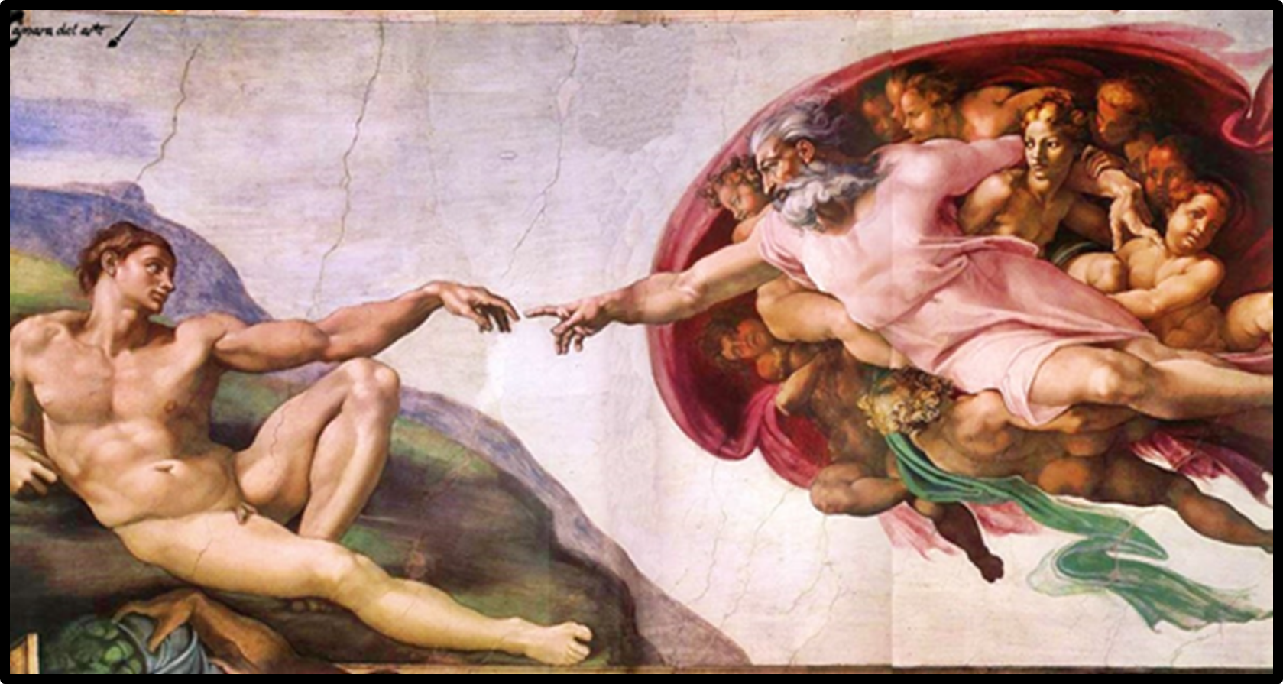
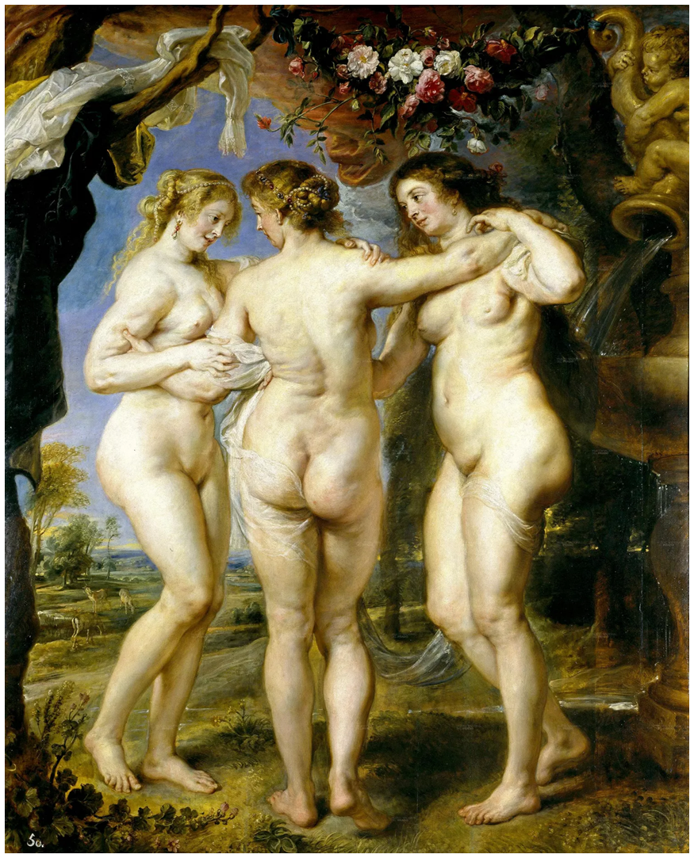

Particle Accelerators
What are three key ideas about particle accelerators that you would like your students to know about?
What are potential challenges students might encounter when learning about particle accelerators?
2. a) How find new energy and use it
b) why we need circular accelerator

Slide 14
Particle
Detectors
What are three key ideas about particle detectors that you would like your students to know about?
What are potential challenges students might encounter when learning about particle detectors?
A detector is like a giant camera, but for invisible particles
Imagine a camera… but instead of capturing light, it records subatomic particles. At the LHC, particles collide at nearly the speed of light, and detectors track what happens right after: which particles are created, how they move, and how much energy they carry.
2. They’re built in layers—like a technological onion
Detectors have concentric layers, and each one has a specific job:
Tracking: detects the path of charged particles.
Calorimeter: measures how much energy they carry.
Muon detector: catches particles that go through everything else.
3. The data they collect helps us understand the universe
Millions of collisions happen every second. Scientists look for the rarest ones—like those that led to the discovery of the Higgs boson. Thanks to these detectors, we can test theories, search for dark matter, and understand how matter came to be.

Slide 15
My Key Takeaways so far
Instructions: Write in the box any insights or things that you learned and that you want to remember after the HST2025 programme.
Is not possible to obtain an isolate quark
LHC is not a perfect circle.
How the Higgs field acts and how Higgs Bosson is a disturbation of the field
Construction of FFC
Colisons with oxigen first time. Difference and applications

Slide 16
Particle
Physics
What are three adjectives that come to your mind when you think about particle physics?
To what extent is the topic of particle physics covered in your national curriculum?
Futuristic, fundamental, interesting
*motion of a charged particle in a homogeneous electric and magnetic field
* quantization of energy in the interaction of matter and radiation
* photon as a quantum of electromagnetic radiation field
* structure of the atom, quantum states of atomic electrons and the principle of the wave-mechanical atomic model
* technology based on quantization: laser and quantum structures
* structure and changes of the atomic nucleus, radioactive decay
* nuclear reactions, mass and energy equivalence, nuclear binding energy
* nuclear power, fission and fusion
* decay law
* types and biological effects of ionizing radiation and application in medicine and technology
* standard model of particle physics
* development of the universe

Slide 17
Particle Accelerators
What are three key ideas about particle accelerators that you would like your students to know about?
What are potential challenges students might encounter when learning about particle accelerators?
Why are we doing this (this helps us understand matter and what we are and also create lots of new inventions.
Who are doing this (it is not just physicist, you need also engineers, programmers, technicians, etc.)
How they actually accelerate the particles (still learning this :)
CERN represents a collaborative effort among numerous nations, united by a shared commitment to advancing science. As such, it calls for setting aside political, religious, and ethical differences, fostering an environment of openness, mutual respect, and inclusivity.
The subject is entirely new and difficult to illustrate. The scales and magnitudes involved are also very different, and Newtonian physics may no longer fully apply to everything.

Slide 18
Particle
Detectors
What are three key ideas about particle detectors that you would like your students to know about?
What are potential challenges students might encounter when learning about particle detectors?
The structure of the detector.
How different particles can be detected.
How particles are actually collided in practice.
Since we cannot see the particles themselves, we can only study the effects resulting from their collisions and investigate from those what particles are produced or what events took place.

Slide 19
My Key Takeaways so far
Instructions: Write in the box any insights or things that you learned and that you want to remember after the HST2025 programme.

Slide 20
Particle
Physics
What are three adjectives that come to your mind when you think about particle physics?
To what extent is the topic of particle physics covered in your national curriculum?
Main objectives
Finding basic building units of the matter and fundamental forces
Discover the fundamental forces
Looking into the dark matter and dark energy
Extent of particle physics in my nationala curriculum
In ORDINARY LEVEL(O/L)
Atomic models and subatomic particles (Protons,neutrons,electrons)
In ADVANCED LEVEL(A/L)
Atomic models and subatomic particles further
electron neutrino,leptons and quarks
Fundamental forces
Particle accelerators

Slide 21
Particle Accelerators
What are three key ideas about particle accelerators that you would like your students to know about?
What are potential challenges students might encounter when learning about particle accelerators?
Key Ideas about particle accelerators
to accelerate charged particles
Use electric fields to increase particle speed and magnetic fields to steer or focus the beam
Two types - Linear Accelerators
Circular Accelerator
potential challenges students might encounter when learning about particle accelerators
Abstract concepts that are hard to understand
complex technology (superconducting magnets, cryogenics)
Unable to interact with accelerators to get hands on experience

Slide 22
Particle
Detectors
What are three key ideas about particle detectors that you would like your students to know about?
What are potential challenges students might encounter when learning about particle detectors?
key ideas about particle
Wok by detecting interactions between particles and the detector material—such as ionization, light flashes, or heat.
Different types of detectors, to measure specific properties of particles:
help us test theories in physics, explore new particles
potential challenges students might encounter when learning about particle detectors
Difficulty in understanding complex concepts
Difficulty in understanding data interpretation and analysis

Slide 23
My Key Takeaways so far
Instructions: Write in the box any insights or things that you learned and that you want to remember after the HST2025 programme.
Visiting ATLAS Control Room, SM18 Magnet Test Hall, and the CERN Control Centre gave me real experience to feel the particle physics experiments
Gave me an opportunity understand to present some ideas to students in a understandable way to our students.
Lectures and personnel involved in particle physics experiments inspired me to look into subject further and share with my students
Had a chance to know that two proton beams are made to collide with an angle rather that in a straight line in LHC

Slide 24
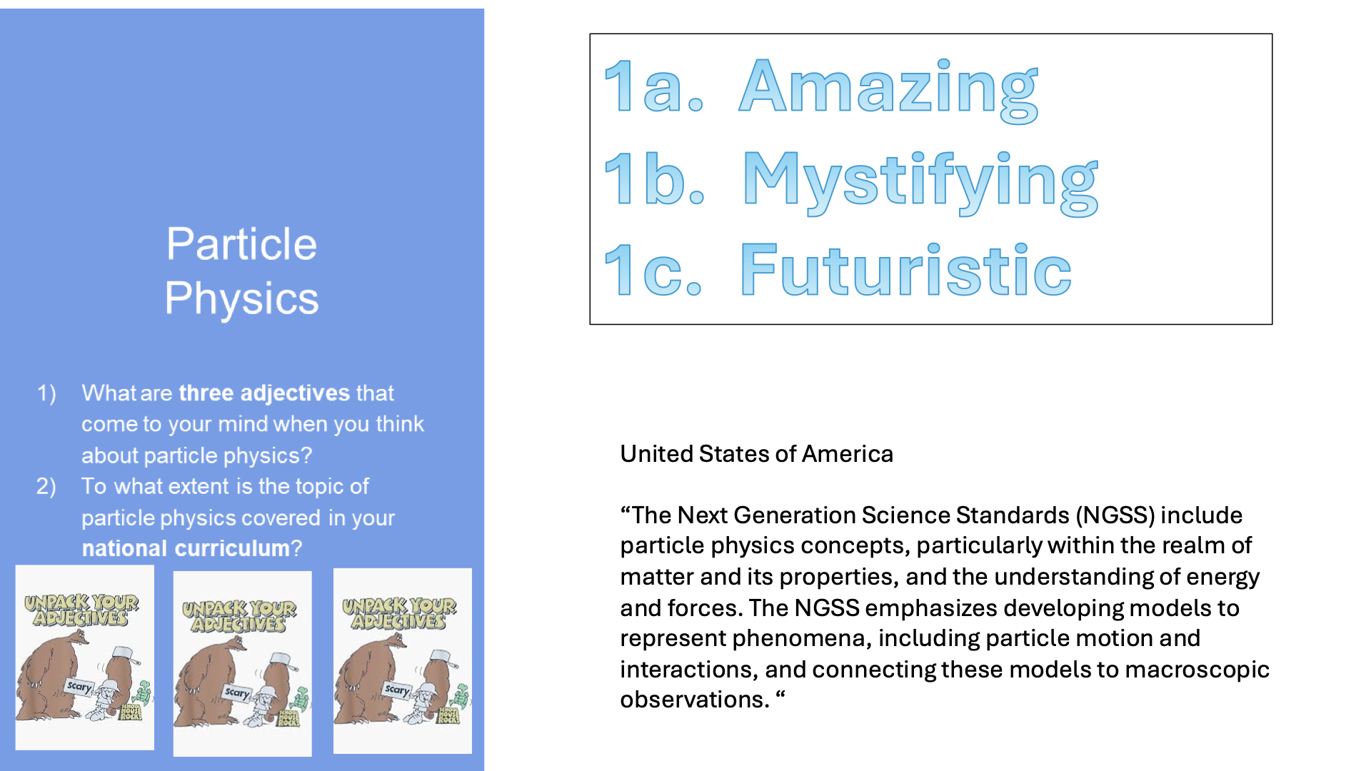
Particle
Physics
What are three adjectives that come to your mind when you think about particle physics?
To what extent is the topic of particle physics covered in your national curriculum?

Slide 25
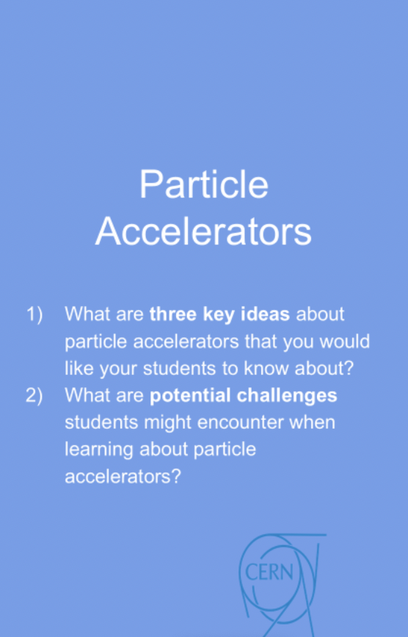
1a. Particles are accelerated
to 99.99999% the speed of light!
2a. It takes a lot of energy to break
particles into their parts!
3a. Accelerators need a lot of space to
accelerate particles.
2a. The VERY small nature of the particles.
2b. The confusing nature of the initial results
of a collision.

Slide 26
Particle
Detectors
What are three key ideas about particle detectors that you would like your students to know about?
What are potential challenges students might encounter when learning about particle detectors?

Slide 27
My Key Takeaways so far
Instructions: Write in the box any insights or things that you learned and that you want to remember after the HST2025 programme.

Slide 28
Study Group Discussion
Share your individual insights with your colleagues and identify shared themes.
Have some ice cream and don’t forget to
take notes :)
Individual Insights and Shared Themes
During our group discussion, several themes emerged that sparked both surprise and inspiration. Many of us were astonished by the physical and technical details of CERN’s experiments — from the impossibility of isolating a quark to the immense size of the beams and the extreme conditions such as temperature control and thermal expansion. The sheer number of magnets used and the principle of equal voting power for all member countries, regardless of population size, also stood out.
We were deeply inspired by the atmosphere at CERN and the people working here. Listening to experts who have been part of significant scientific discoveries — like the Higgs boson — was profoundly motivating. Jeff’s talk stood out for many of us, highlighting the importance of being a scientist in today’s world and how curiosity-driven learning can thrive when students are given a sense of purpose and community.
Notes:
cansu

Slide 29
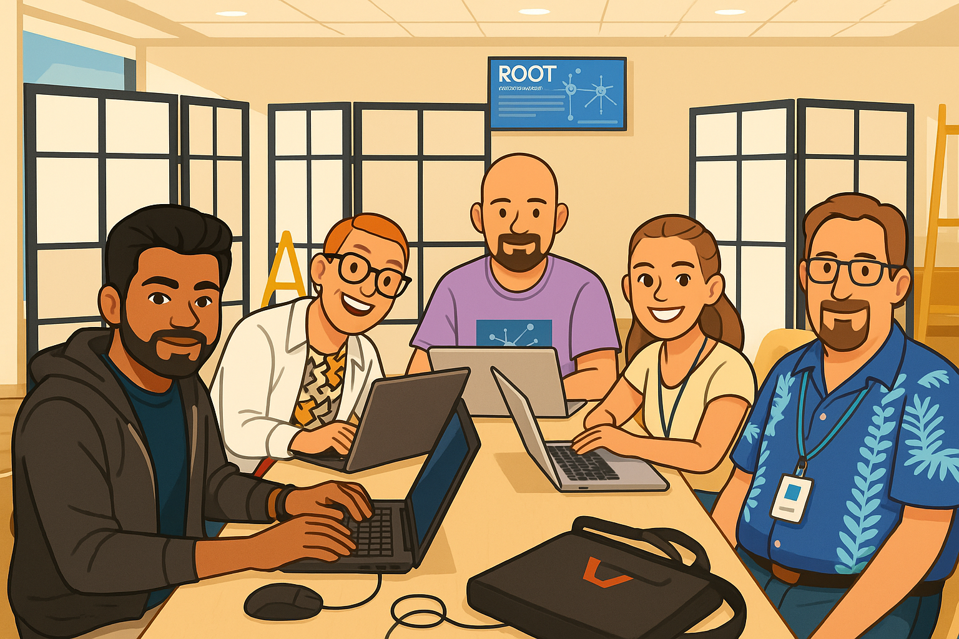
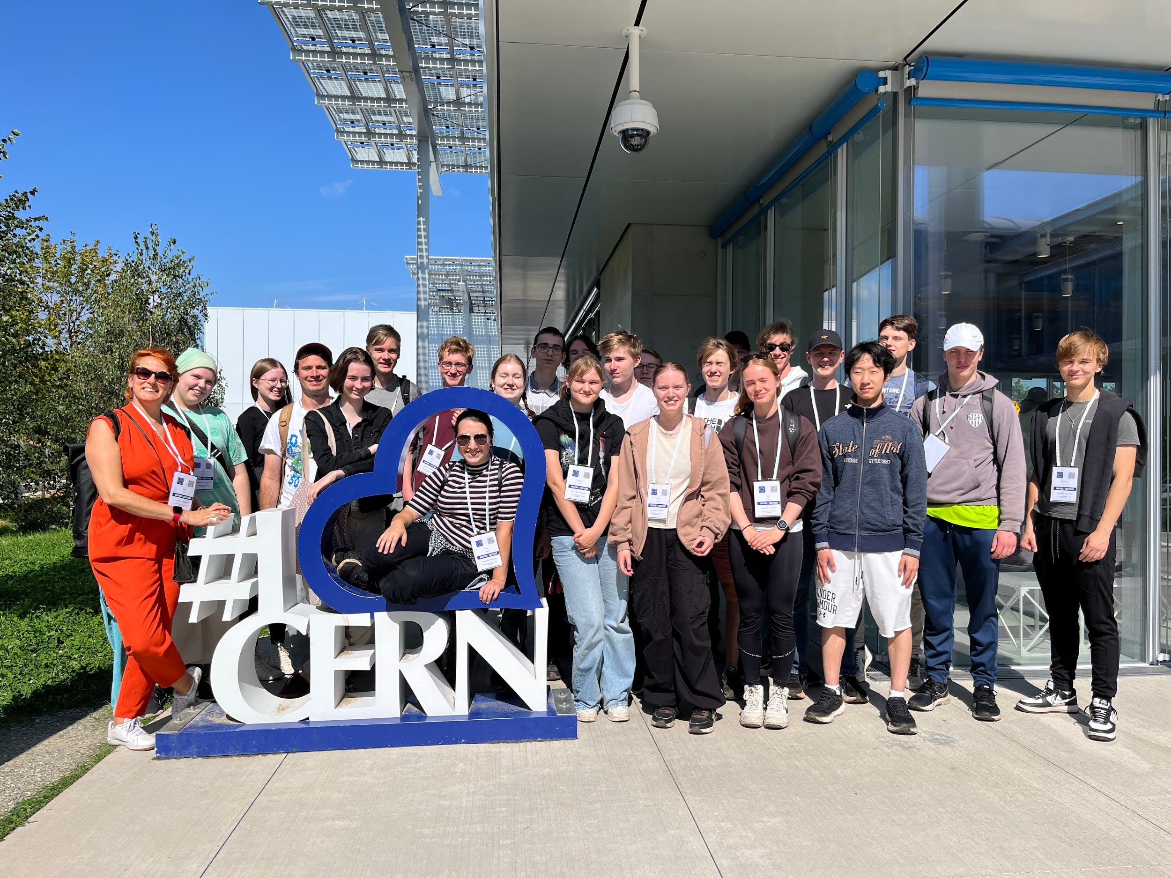
Our Key Takeaways so far
Instructions: Write in the box any insights, learnings and discussion outcomes.
(Decide how you as a group will present them if you are selected to present during the SG Report-Out.)
Our Key Takeaways
What inspired us the most:
Jeff’s presentations were not only informative but also deeply inspiring for all of us.
The collaborative and passionate atmosphere at CERN
Learning from top researchers who witnessed historic events like the Higgs boson discovery
Being surrounded by experts across physics and other fields
Shared reflection:
Bringing real-world science into our classrooms can spark curiosity, foster critical thinking, and show students the beauty and complexity of modern research.
Notes:
1. Humanizing Science
What struck me most was how these researchers spoke not just about data, but about emotion — the excitement, the doubt, the long nights, and the moment they realized history had been made. It reminded me that science is deeply human.
🧭 2. The Scale of Collaboration
I was amazed by how global and collaborative the discovery of the Higgs boson was — thousands of scientists working across continents, for years, to answer one question. That level of teamwork is something I want to bring into my classroom culture.
🧑‍🏫 3. Teaching Perspective
These stories gave me new ways to teach the scientific process — not as a clean method, but as a messy, real-world journey full of trial and error, skepticism, breakthroughs, and patience.
🔍 4. Connection to Broader Themes
The Higgs discovery isn’t just about physics — it’s about how far human curiosity can go when we invest in big questions. That message can inspire students beyond science, too.
🧠 5. Shift in Personal Thinking
I used to think of scientific discoveries as isolated “aha!” moments. But hearing how long and layered the Higgs journey was made me respect the process, not just the result.

Slide 30

Notes:
Cliff

Slide 31
Thursday, 10 July
SG Session 2

Slide 32
Checklist for SG Session 2
# | Type of Task | Task | Deadline
1 | Individual | Fill in slides corresponding to your colour | Thursday, 18:00
2 | Group | Fill in “Our Key Takeaways” and “Our Feedback” slides as a group. Make sure you all contribute to the discussion. | Thursday, 18:00
3 | Group | Decide how you as a group will present your group slides if you are selected to present during the SG Report-Out. | Thursday, 18:00

Slide 33
Engineering
Which topic from the physics curriculum could you see yourself teaching in the context of Engineering at CERN?
Sketch out your idea and add links to suitable resources!
Magnetic Fields and Electromagnetism Focus: Superconducting Magnets in Particle Accelerators
Direct application at CERN (LHC & SM18)
Real-world use of Ampere’s Law, Lorentz Force
Bridges theory and cutting-edge engineering
Learning activity: How to Bend a Beam: Engineering with Magnetic Fields https://www.youtube.com/watch?v=W3gtNioHLWc
Objective: Help students grasp how protons are accelerated, controlled, and focused in the LHC—using real CERN examples to bridge physics theory with engineering practice.
Prompt: “What systems and forces guide the protons through this massive accelerator?”
Define key terms: injection, acceleration, beam steering, and beam focusing.
Link these to curriculum topics such as Lorentz Force (F=qvBF=qvB) and magnetic beam optics (dipole & quadrupole magnets).
Option A (Simulation): Use PhET simulations to model charged particles traveling through magnetic fields.
Option B (Calculation): Provide beam momentum (e.g., 7 TeV/c), dipole magnet radius, and ask students to compute the required magnetic field strength using r=mvqBr=qBmv​.
Discuss why LHC uses superconducting magnets (NbTi) for efficient high-field steering.
Show real images/videos of SM18 magnet tests to illustrate quench risk and cryogenics.

Slide 34
LHC
Which topic from the physics curriculum could you see yourself teaching in the context of the
Large Hadron Collider at CERN?
Sketch out your idea and add links to suitable resources!
Selected Topic:
Fields: Electric and magnetic fields (SL/HL), Motion in electromagnetic fields (SL/HL)
These topics map directly to real engineering applications at CERN: steering and focusing particle beams in the LHC using superconducting magnets. It's a perfect example of taking textbook theory—like Lorentz force (F=qvB, F=qvB) and field strength–radius relationships (r=mv/qB​)—and applying it on a massive scale.
Show a CERN video of LHC beam steering highlighting magnet roles.
Derive Lorentz force and radius equation in class; identify key variables (charge, speed, B‑field, curvature).
Use PhET “Charged Particle in Magnetic Field” or similar to adjust q,v,Bq,v,B, and observe trajectories.
Provide LHC parameters — e.g. proton momentum ~7 TeV/c, B ≈ 8.3 T — and calculate beam curvature vs. the actual 27‑km ring.
Introduce superconducting magnet technology (NbTi, cryogenics, quench protection) and testing in SM18.
Design task: Students plan a mini-beamline—select beam energy, B-field, and lensing magnets for steering—and justify their design using IB theory.

Slide 35
AI
What are three key ideas about AI that you would like your students to know about?
What are potential challenges students might encounter when learning about AI?
What are potential benefits students might encounter when learning with the help of AI?
Neural networks, a core component of AI, are essentially functions capable of approximating any complex, smooth function
AI systems learn their tasks by analyzing examples rather than through predefined, explicit rules, which allows for more flexible problem-solving
AI systems learn their tasks by analyzing examples rather than through predefined, explicit rules, which allows for more flexible problem-solving
Potential Challenges for Students Learning About AI
Handling Big Data, Computational Limitations, Ensuring Generalization:
Benefits: Solving Complex Problems, Enhancing Discovery, Uncovering Anomalies and New Insights: AI enables "learning from anomalies" and "learning from data," allowing for the discovery of unexpected events and patterns that might be missed when only searching for predefined outcomes. This capability can open up entirely new avenues for scientific understanding and exploration.

Slide 36
My Key Takeaways so far
Instructions: Write in the box any insights or things that you learned and that you want to remember after the HST2025 programme.
Collaboration in Science
Great Ideas for Education
Physics and Experiments
The Human Side of Science
The Mission of Science Education

Slide 37
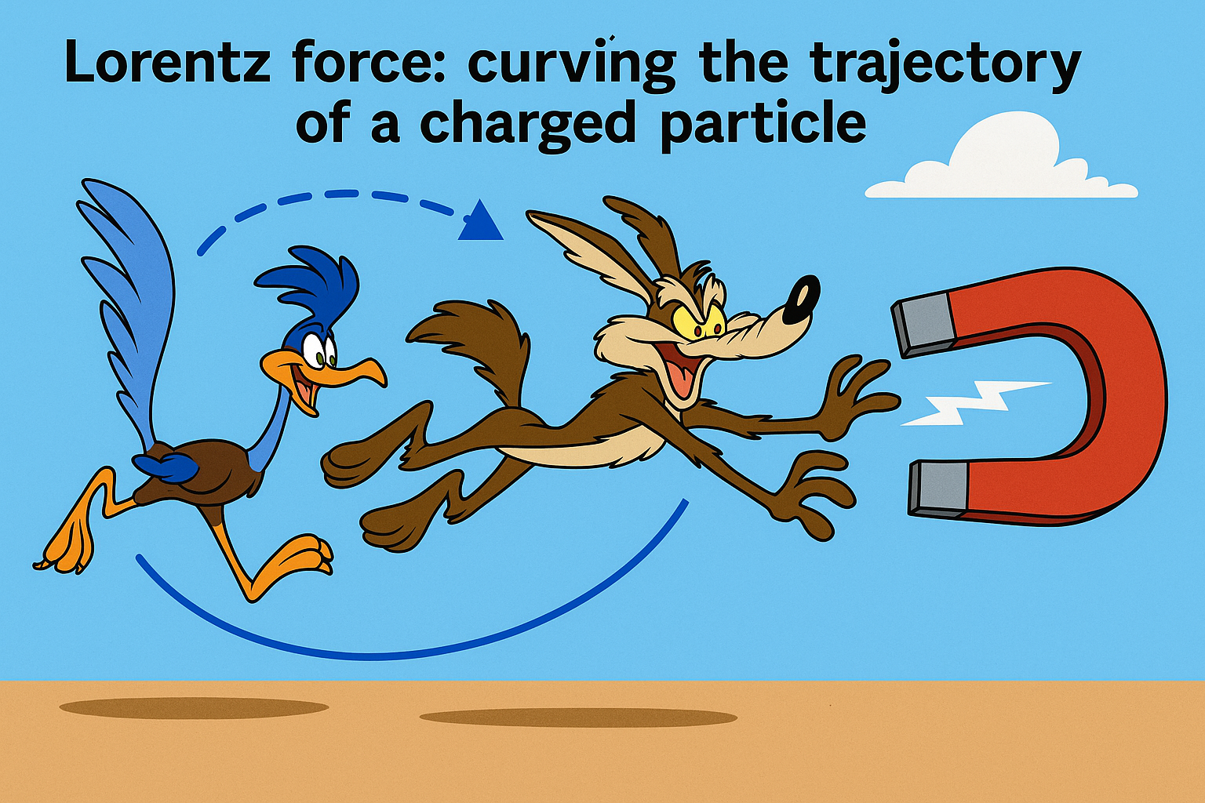
Engineering
Which topic from the physics curriculum could you see yourself teaching in the context of Engineering at CERN?
Sketch out your idea and add links to suitable resources!
At CERN, one of the most relevant physics topics I would teach within the context of engineering is the concept of electromagnetic fields, specifically how they are applied in guiding and accelerating charged particles using superconducting magnets.
Understand the Lorentz force and its effect on charged particles.
Explore the relationship between magnetic field strength and particle curvature.
Connect physics theory to real-world engineering at CERN
https://www.youtube.com/watch?v=orsMYomjwIw

Slide 38
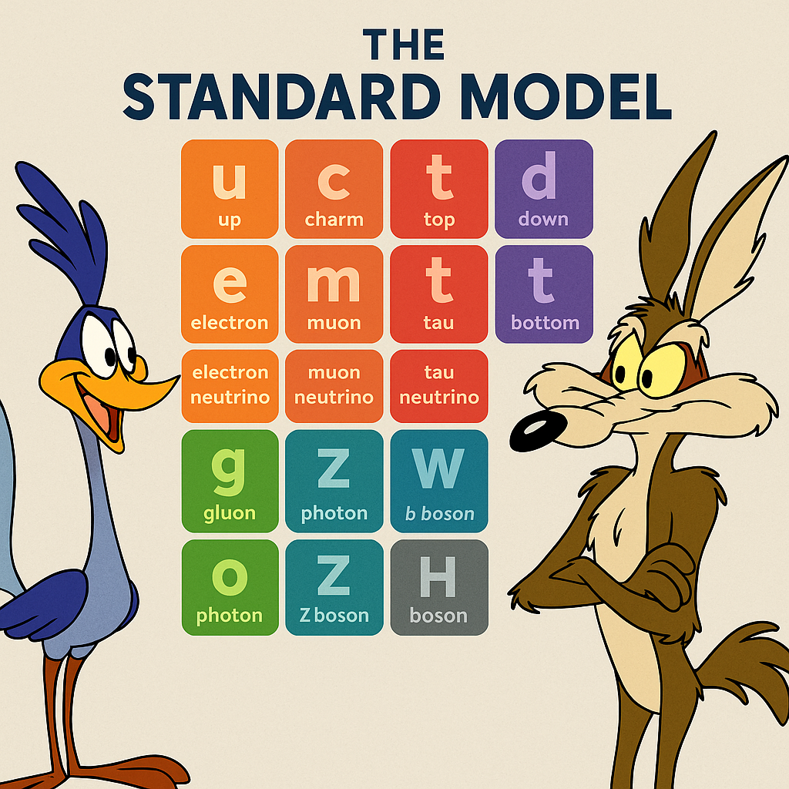
LHC
Which topic from the physics curriculum could you see yourself teaching in the context of the
Large Hadron Collider at CERN?
Sketch out your idea and add links to suitable resources!
What are we really made of?
Understand the structure of the Standard Model: fundamental particles and their interactions.
Identify how different particles (quarks, leptons, bosons) are detected and studied in high-energy collisions.
Connect how the LHC is used to test, confirm, or challenge the Standard Model, including the discovery of the Higgs boson

Slide 39
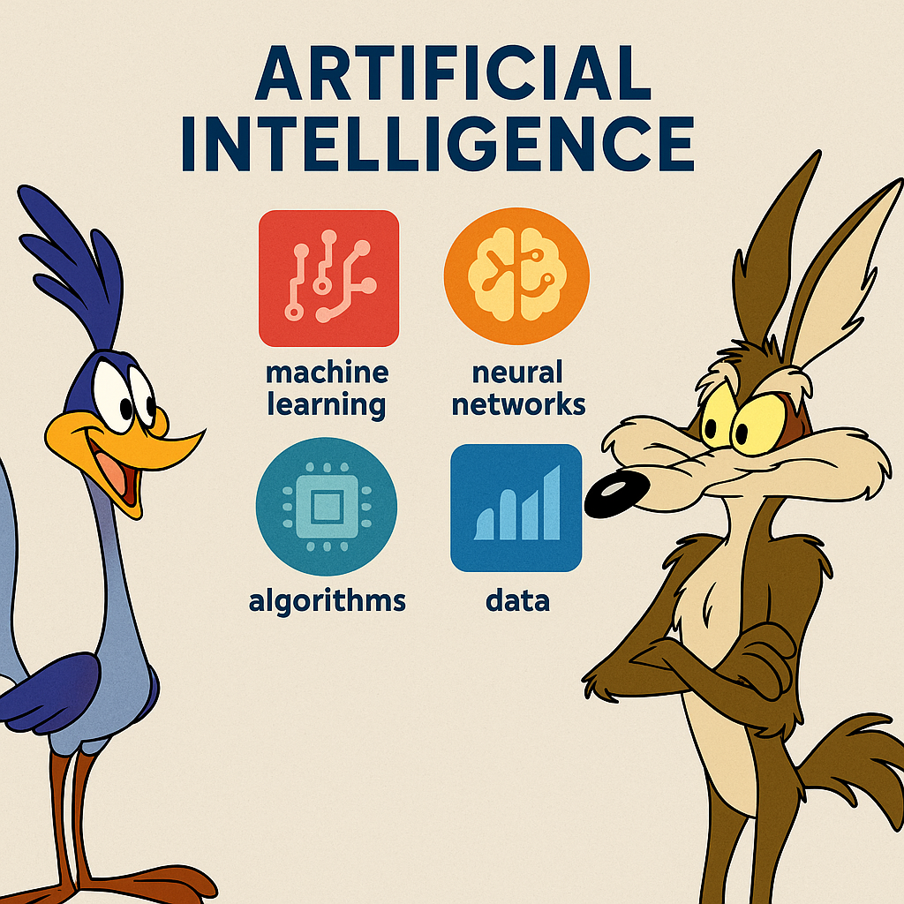
AI
What are three key ideas about AI that you would like your students to know about?
What are potential challenges students might encounter when learning about AI?
What are potential benefits students might encounter when learning with the help of AI?
AI is a tool, not a replacement
AI can support human creativity, analysis, and learning—but it doesn’t replace critical thinking, ethics, or human judgment. Teaching students to collaborate with AI is more valuable than fearing it.
Ethical concerns:
Personalized learning: AI tools can adapt to each student’s pace and level, helping them focus on areas they find challenging.

Slide 40
My Key Takeaways so far
Instructions: Write in the box any insights or things that you learned and that you want to remember after the HST2025 programme.
During the HST2025 programme, I learned that collaboration is at the heart of science. Seeing how physicists, engineers, chemists, computer scientists, and educators from all over the world work together at CERN was truly inspiring.
Great ideas for education in Jeff`’s lecture
I gained a deeper understanding of the Standard Model, particle accelerators, and the role of the Higgs boson in our universe. I also appreciated how complex concepts like the Lorentz force and time dilation are not just theory—they’re essential to real experiments at the LHC.
Beyond the physics, I will remember the human side of science: the conversations in the cafeteria, the international friendships, the curiosity, and the passion that unites us as teachers and learners.
Most of all, I take with me the idea that science education is a shared mission—and that by bringing these experiences back to our students, we help open the doors of discovery for the next generation.

Slide 41
Engineering
Which topic from the physics curriculum could you see yourself teaching in the context of Engineering at CERN?
Sketch out your idea and add links to suitable resources!
Accelerator has lot of engineering. We need to study
- circulate motion
- magnets
- electromagnets
- superconductive

Slide 42
LHC
Which topic from the physics curriculum could you see yourself teaching in the context of the
Large Hadron Collider at CERN?
Sketch out your idea and add links to suitable resources!
*motion of a charged particle in a homogeneous electric and magnetic field
* quantization of energy in the interaction of matter and radiation
* photon as a quantum of electromagnetic radiation field
* structure of the atom, quantum states of atomic electrons and the principle of the wave-mechanical atomic model
* structure and changes of the atomic nucleus, radioactive decay
* nuclear reactions, mass and energy equivalence, nuclear binding energy
* nuclear power, fission and fusion
* decay law
* standard model of particle physics
2)
Videos:
https://www.youtube.com/watch?v=pQhbhpU9Wrg
https://www.oxfordsparks.ox.ac.uk/videos/a-quick-look-around-the-lhc/
https://www.youtube.com/watch?v=328pw5Taeg0
https://www.oxfordsparks.ox.ac.uk/videos/a-quick-look-around-the-lhc/
Virtual tour: https://home.cern/resources/360-image/accelerators/virtual-tour-lhc
Simulation: https://huggingface.co/spaces/aiqtech/Particle-Accelerator-Simulation
https://phet.colorado.edu/sims/html/build-a-nucleus/latest/build-a-nucleus_all.html?locale=fi
For students, who want to know more: https://www.youtube.com/watch?v=xeJGWUO2M8g

Slide 43
AI
What are three key ideas about AI that you would like your students to know about?
What are potential challenges students might encounter when learning about AI?
What are potential benefits students might encounter when learning with the help of AI?
- AI needs lots of training to do even simple things
- And still it can make mistakes
- AI csan help students to understan physics. They can ask question to it but they should be aware of that it can be totally wrong. Critical thinking and fact-checking!
They shouldn’t let AI do thinking behalf of them. They should just using AI to help them. Like you should no what calculator do before you use it.
To speed up your work, but not in a way that AI does everything for you.
To explain things better and several times to them.

Slide 44
My Key Takeaways so far
Instructions: Write in the box any insights or things that you learned and that you want to remember after the HST2025 programme.
There is a vast amount of online material available to support the teaching of particle physics.
CERN requires experts from many different fields.
Due to the enormous amount of data, new methods are needed to process it. A cloud chamber can also be built in the classroom using simpler materials.
It is important to be careful when visualizing things like particles, to avoid giving students incorrect impressions or misconceptions.

Slide 45
Engineering
Which topic from the physics curriculum could you see yourself teaching in the context of Engineering at CERN?
Sketch out your idea and add links to suitable resources!
Topics from the physics curriculum could you see yourself teaching in the context of Engineering at CERN.
design and maintenance of particle accelerators like the Large Hadron Collider (LHC)
The design of magnets like dipole, quadrupole
Building models is needed in the classroom for giving engineering concepts understandable for students,
Example - 3D printed LINAC
https://scoollab.web.cern.ch/linac3D

Slide 46
LHC
Which topic from the physics curriculum could you see yourself teaching in the context of the
Large Hadron Collider at CERN?
Sketch out your idea and add links to suitable resources!
Topic from the physics curriculum could I see myself teaching in the context of the Large Hadron Collider at CERN
Linear accelerators
Circular accelerators
Large Hadron Collider at CERN
Particle detectors
Models of LHC should be available for students to understand the basic structure
Animations or other type visualization videos should be introduced to the classroom to give general idea about how LHC works
https://home.cern/resources?topic=1114
Large Hadron Collider at CERN

Slide 47
AI
What are three key ideas about AI that you would like your students to know about?
What are potential challenges students might encounter when learning about AI?
What are potential benefits students might encounter when learning with the help of AI?
AI systems are often only as good as the data they are trained on
can automate tasks and process information quickly
t doesn’t replace human creativity or decision-making
struggle with abstract concepts like machine learning algorithms, neural networks
students might lack access to the necessary resources or guidance
AI-powered tools can adapt to a student's learning style and it helps students learn more effectively and efficiently
can provide instant feedback allowing students to identify mistakes and correct them in real-time
making learning resources available whenever students need them

Slide 48
My Key Takeaways so far
Instructions: Write in the box any insights or things that you learned and that you want to remember after the HST2025 programme.
Interesting to know that particle beams are not collided in a straight way
Engineering at CERN to keep LHC safe
Neural systems
Typographic illustrations

Slide 49
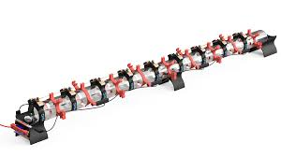
Engineering
Which topic from the physics curriculum could you see yourself teaching in the context of Engineering at CERN?
Sketch out your idea and add links to suitable resources!
Engineering is everywhere. I have my students do several engineering projects each year. One of the things I want to do is have them build scale models of CERN devices. We saw some of these In Jeff’s presentation earlier today. I think the students will get very excited about this.
2. Not only will I ba able to sneak in some particle physics lessons when the students build this, but adding a protractor will allow for projectile motion activities.

Slide 50
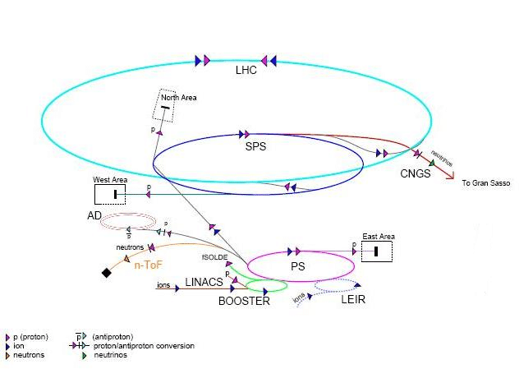
LHC
Which topic from the physics curriculum could you see yourself teaching in the context of the
Large Hadron Collider at CERN?
Sketch out your idea and add links to suitable resources!
The Large Hadron Collider has many curricular connections to Physics. Clearly acceleration is a major player here since that is what the LHC is all about. I can certainly build that into the lectures very appropriately.

Slide 51
AI
What are three key ideas about AI that you would like your students to know about?
What are potential challenges students might encounter when learning about AI?
What are potential benefits students might encounter when learning with the help of AI?
I would like my students to know that AI has potential uses far beyond cheating on a research paper. AI can be used to make correlations, and as we saw this morning it can be used to make judgements and decisions.
Students only know so far that AI can be used a research tool. What they will find out when they try to program further is that AI needs extremely specific instructions in very exact detail. Trial and error can work, but not easily and not on complex jobs.
AI is a tool and a timesaver and potentially a work saver. Students cannot get out more than they put in, and as such it is a work tool but not a learning tool.

Slide 52
My Key Takeaways so far
Instructions: Write in the box any insights or things that you learned and that you want to remember after the HST2025 programme.
Jeff’s presentation was absolutely brilliant this morning. His telling us about how to work CERN into a Physics curriculum was incredibly insightful and helpful on a fairly obscure topic. I will be downloading the slides are referring back to them. I will also be using some of the CERN resource 3D print activities into lessons.
So far, while some of the presentations apply to me more than others, all are great and I will want to refer back to them as well.

Slide 53
Study Group Discussion
Share your individual insights with your colleagues and identify shared themes.
Have some ice cream and don’t forget to
take notes :)
We've completed a fantastic study group! By bringing together our insights from the HST2025 program, we've had in-depth discussions on the importance of collaboration in science, and the real-world implications of advanced technologies like the LHC at CERN, engineering, and artificial intelligence. We've diligently documented our learnings and shared insights in our notes. We're filled with inspiration and new ideas to bring this experience back to our students.

Slide 54
Our Key Takeaways so far
Instructions: Write in the box any insights, learnings and discussion outcomes.
(Decide how you as a group will present them if you are selected to present during the SG Report-Out.)
Re The Large Hadron Collider: The beams cross four times as they travel 27 KM around the LHC. not only do they cross, but they cross at a small angle, allowing the collisions to be discrete and separate.
Jeff’s lecture connecting Education to CERN and Particle Physics was important, easy to apply and useful.
The cloud chamber allowed us to envision some of the particle we have been learning about, and it was fun to do and watch. It was exciting to see that different particles left different trails. Several of our group will build their own cloud chambers back at home.
The Exhibitions at the museum were exciting but we did not have time to see all of it.

Slide 55
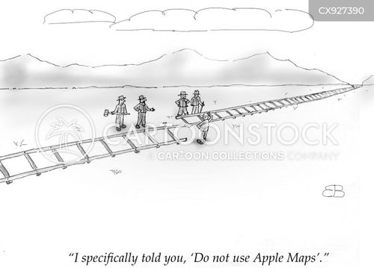
Our Feedback
so far
Highlights?
What’s working?
What needs improvement?
Other comments?
Funny picture or meme?
(Decide how you as a group will present them if you are selected to present during the SG Report-Out.)
Working: This is still an incredible experience and we are all glad to be here learning from each other.
Not working as well: The AI lecture demonstrated the amazing capabilities of what AI can do. The speaker was truly a master of his field. How ever, we all felt quite lost very early on as his specific application was far hard to follow.

Slide 56
Tuesday, 15 July
SG Session 3

Slide 57
Checklist for SG Session 3
# | Type of Task | Task | Deadline
1 | Individual | Fill in slides corresponding to your colour | Tuesday, 17:30
2 | Group | Fill in “Our Key Takeaways” and “Our Feedback” slides as a group. Make sure you all contribute to the discussion. | Tuesday, 17:30
3 | Group | Decide how you as a group will present your group slides if you are selected to present during the SG Report-Out. | Tuesday, 17:30

Slide 58
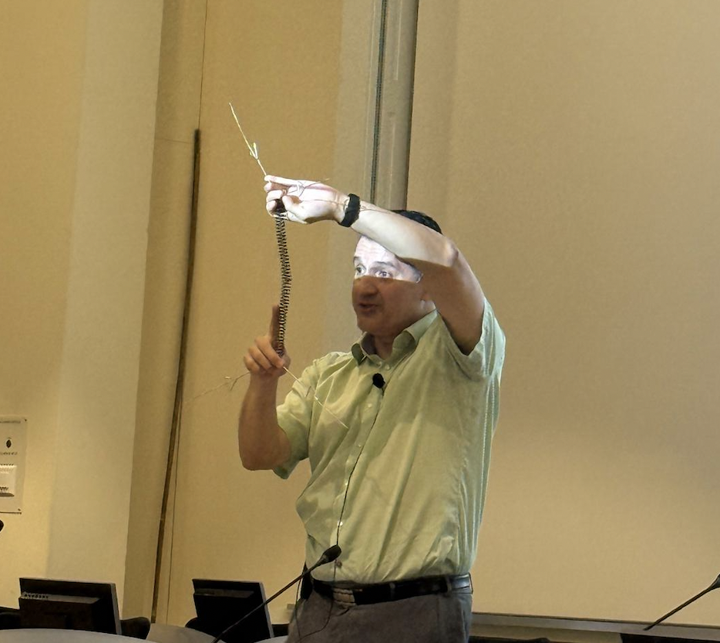
Feynman
Diagrams
What would be a fun and creative way of introducing Feynman Diagrams in the classroom?
Which students’ conceptions would you expect to encounter and how would you address them?
Fun and creative way of introducing Feynman:
Students draw diagrams for given interactions (e.g., electron-positron annihilation) and their peers guess the process.
Assign students as particles — they walk paths and interact, forming the diagram with ropes and labels.
I can use springs and metal wires and ask students to assemble them. Idea from Luis Roberto Flores Castillo
Students’ conceptions:
Clarify that Feynman diagrams are not physical paths but visual representations of probability amplitudes in quantum interactions.
Explain that orientation is a convention, and the key idea is the interaction, not spatial layout.
Help students understand that virtual particles are mathematical constructs, not particles we directly observe.

Slide 59
Computing
at CERN
What are three key ideas about computing and data analysis at CERN that you would like your students to know about?
What are potential challenges students might encounter when learning about computing and data analysis at CERN?
three key ideas
Unprecedented Scale of Data:
CERN handles exabytes of data from the LHC — about 1 petabyte/second is initially produced during collisions
The Worldwide LHC Computing Grid (WLCG):
CERN created a global distributed system (before the concept of cloud computing) to store, share, and analyze data across Tier 0, Tier 1, and Tier 2 centers.
Real-World Innovation from Necessity:
The World Wide Web, touchscreens, and open-source platforms like Zenodo and EOS were developed or accelerated at CERN to solve computing challenges
Potential challenges:
Abstract systems
Scale is hard to grasp
Technical vocab.

Slide 60
Medical Applications
What are three key ideas about medical applications of particle physics that you would like your students to know about?
What are potential challenges students might encounter when learning about medical applications of particle physics?

Slide 61
My Key Takeaways so far
Instructions: Write in the box any insights or things that you learned and that you want to remember after the HST2025 programme.

Slide 62
Feynman
Diagrams
What would be a fun and creative way of introducing Feynman Diagrams in the classroom?
Which students’ conceptions would you expect to encounter and how would you address them?
a) Present Feynman diagrams as comic strips where particles are characters that "meet," "talk," or "transform."
b) Using the idea of fractals as a iteraction and make his own fractal with software
Some students may believe the lines show real paths in space-time.
: Explain they are graphical tools to represent interactions, not literal paths

Slide 63
Computing
at CERN
What are three key ideas about computing and data analysis at CERN that you would like your students to know about?
What are potential challenges students might encounter when learning about computing and data analysis at CERN?
The Large Hadron Collider (LHC) produces petabytes of data per year, much of which must be filtered, selected, and analyzed in near real-time.
Students should understand that experiments like ATLAS and CMS detect millions of collisions per second, but only a fraction is stored — thanks to advanced data filtering systems (trigger systems).
2. Students may underestimate the complexity and quantity of data produced.
Use analogies (e.g., "more data per second than all the world’s social media combined").

Slide 64
Medical Applications
What are three key ideas about medical applications of particle physics that you would like your students to know about?
What are potential challenges students might encounter when learning about medical applications of particle physics?
Particle Accelerators in Cancer Treatment (Hadron Therapy)
Technologies from particle physics, like proton therapy and carbon ion therapy, are used to treat certain cancers with high precision.
These therapies allow targeting tumors while minimizing damage to surrounding healthy tissue — a direct application of accelerator physics.
Medical Imaging Technologies (PET, MRI, CT)
Techniques such as Positron Emission Tomography (PET) rely on principles of particle detection and antimatter (positrons).
The development of detectors and imaging technologies often stems from research in high-energy physics.
Radiation Detection and Safety
-Particle physics has contributed to advances in radiation detection and monitoring devices, crucial for both treatment and ensuring patient safety.
I

Slide 65
My Key Takeaways so far
Instructions: Write in the box any insights or things that you learned and that you want to remember after the HST2025 programme.
The value of making complex concepts accessible through creativity, storytelling, and hands-on activities
The human side of science: how passion, curiosity, and perseverance drive fundamental research, and how sharing this with students can make science more inspiring
The importance of international collaboration in both scientific research and education — how CERN's model of global teamwork can inspire classroom projects

Slide 66
Feynman
Diagrams
What would be a fun and creative way of introducing Feynman Diagrams in the classroom?
Which students’ conceptions would you expect to encounter and how would you address them?
Because my students have to everything with computer so this would be helpful:
https://youtu.be/xHS0eniDipk?feature=shared
Short Theory of Feynman diagram:
https://cds.cern.ch/record/2759490/files/Feynman%20Diagrams%20-%20ATLAS%20Cheat%20Sheet.pdf
Students may believe that the lines in the diagram represent the Real paths of the particles, but x-axes is presenting time.

Slide 67
Computing
at CERN
What are three key ideas about computing and data analysis at CERN that you would like your students to know about?
What are potential challenges students might encounter when learning about computing and data analysis at CERN?
A lot of data
WWW was invented in CERN

Slide 68
Medical Applications
What are three key ideas about medical applications of particle physics that you would like your students to know about?
What are potential challenges students might encounter when learning about medical applications of particle physics?

Slide 69
My Key Takeaways so far
Instructions: Write in the box any insights or things that you learned and that you want to remember after the HST2025 programme.
I finally got the answers to students questions about proton therapy which is mentioned in our studybook. There was not very much information about that.

Slide 70
Feynman
Diagrams
What would be a fun and creative way of introducing Feynman Diagrams in the classroom?
Which students’ conceptions would you expect to encounter and how would you address them?
a fun and creative way of introducing Feynman Diagrams in the classroom
Instructing students to Act Out an Interaction
Choose a simple interaction like:
Electron + Positron → Photon → Muon + Anti-muon
Student A and B walk toward each other (e⁻ and e⁺), meet in the middle and "annihilate" (shake hands and step aside).
Student C enters as a virtual photon, then “decays” into Student D and E (muon and anti-muon), who walk away from the interaction point.Ask students to freeze-frame at each step. Sketch the equivalent Feynman Diagram on the board in real time.
students’ conceptions would you expect to encounter and how would you address the
Students don’t apply conservation laws at vertices or misinterpret how they apply
Highlight each vertex as a checkpoint: “Every time particles meet, conservation rules must be obeyed.

Slide 71
Computing
at CERN
What are three key ideas about computing and data analysis at CERN that you would like your students to know about?
What are potential challenges students might encounter when learning about computing and data analysis at CERN?
three key ideas about computing and data analysis at CERN
Experiments at the LHC (Large Hadron Collider) produce petabytes of data per second, but only a small fraction can be stored and analyzed
CERN pioneered a global computing grid to store, share, and analyze data
machine learning to spot rare events and new physics in a sea of normal collisions
potential challenges students might encounter when learning about computing and data analysis at CERN
They might assume all data is saved or that it's easy to “just look at it.(Introduce the idea of trigger systems as digital “bouncers” that let only important events through)
The concept of the Worldwide LHC Computing Grid (WLCG) can be abstract(Compare it to familiar systems like Google Drive or online multiplayer games, where information and resources are shared globally)

Slide 72
Medical Applications
What are three key ideas about medical applications of particle physics that you would like your students to know about?
What are potential challenges students might encounter when learning about medical applications of particle physics?
Three key ideas about medical applications of particle physics
Medical tools like PET scans, CT scans, and MRI rely on principles and technologies developed in particle physics.
Accelerator technology from physics labs is used in radiation therapy, including proton therapy for treating tumors.
Techniques developed for analyzing particle collisions are now used in image reconstruction, diagnostics, and even AI-assisted diagnosis.
potential challenges students might encounter when learning about medical applications of particle physics
Struggling to See the Connection Between Abstract Physics and Real-World Medicine
Concepts like positron annihilation, gamma ray detection, or image reconstruction algorithms can feel abstract.

Slide 73
My Key Takeaways so far
Instructions: Write in the box any insights or things that you learned and that you want to remember after the HST2025 programme.
TRIGGERING SYSTEM OF DATA TO FILTER WHAT NEEDED
USING TAPES STILL TO STORE THE DATA
PET scans
FLASH Radiotherapy

Slide 74
Feynman
Diagrams
What would be a fun and creative way of introducing Feynman Diagrams in the classroom?
Which students’ conceptions would you expect to encounter and how would you address them?
A fun exciting way of introducing Feynman Diagrams would be to make them with items that our students will understand. An example might be cake and a bowl coming together to form flour and sugar and chocolate. They could easily reform, or remain as other items. Then once the students understand what the feynman diagram is and what it is not, we can talk about about the real things.
The biggest misconception, and the reason for my silly example is that students think of the diagrams as chemistry formulas rather then potentials and possibilities..

Slide 75
Computing
at CERN
What are three key ideas about computing and data analysis at CERN that you would like your students to know about?
What are potential challenges students might encounter when learning about computing and data analysis at CERN?
I want my students to be aware of the amazing power of computers that 40,000,000 collisions in 1 second can be scanned, correlated, and put into a meaningful form for human visualizations.
I want my students to understand the future of computer programming.as a career
Students will need to be very aware of not letting computers get the better of us. When they are fast enough to cover thousands or millions of calculations and processes in in a second, humans could well fall behind. That could lead to disaster.
One of the hugest challenges is telling particles apret while analyzing results. We know what many particle signatures look like, but check

Slide 76
Medical Applications
What are three key ideas about medical applications of particle physics that you would like your students to know about?
What are potential challenges students might encounter when learning about medical applications of particle physics?
I want my students to understand that there are new advances in modern nuclear medicine that will make it possible for new cancer treatments using new particle processes.
Money is still the limiting factor in dealing with illness as some can afford the new treatment and some cannot. This seems to insure that the more wealthy countries will restrict treatment from the other.
Modern medical particle treatments will need new students to study and become proficient in using these new and upcoming medical tools.
The biggest challenge to my students is money. Many of my students have the grades and the drive, but will be dependant on scholarships.

Slide 77
My Key Takeaways so far
Instructions: Write in the box any insights or things that you learned and that you want to remember after the HST2025 programme.
Perimeter has an excellent program, though their attitude did not match the high CERN standard I have experienced so far.
I was very impressed with the lecture on Medical Applications it made me wish I had reconsidered a career in modern medicine. She was very inspiring.
The computing power at CERN is incredible to handle 40 million collisions per second.

Slide 78
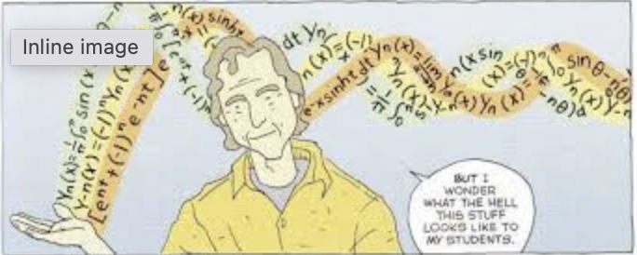
Study Group Discussion
Share your individual insights with your colleagues and identify shared themes.
Have some ice cream and don’t forget to
take notes :)
Feynman
Computing:
It takes a lot effort to handle a data
Filtering data
Still using the tapes and robot is used to retrieve requested archive material - CERN’s data center uses a mobile robotic system to move tapes in and out of the automated tape library.
Medical applications:
There are new particle cancer treatment every year
comics
Application for drawing Feynman diagrams

Slide 79
Our Key Takeaways so far
Instructions: Write in the box any insights, learnings and discussion outcomes.
(Decide how you as a group will present them if you are selected to present during the SG Report-Out.)
Collaboration - Big science needs big teams(Collaboration among different experts for a common goal)
The latest knowledge of particle science in medical applications.
Mysterybox, we are going to use them in our classes.
Motivate and encourage more students to choose medical physics field.
The value of making complex concepts accessible through creativity, storytelling, and hands-on activities

Slide 80
Our Feedback
so far
Highlights?
What’s working?
What needs improvement?
Other comments?
Funny picture or meme?
(Decide how you as a group will present them if you are selected to present during the SG Report-Out.)
Mystery box was great - It is an excellent start for scientific investigation. Lectures are great, visits are very useful to have the whole concept.
We hope that perimeter staff would honour our diffrent skills of english. We found it difficult to follow the content of the slides and proposed solutions in perimeter workshop, as they were not always clearly communicated or audible.

Slide 81
Thursday, 17 July
SG Session 4

Slide 82
Checklist for SG Session 4
# | Type of Task | Task | Deadline
1 | Individual | Fill in slides corresponding to your colour | Thursday, 14:30
2 | Group | Fill in the “Our Key Takeaways from HST2025” slide as a group. Make sure you all contribute to the discussion. | Thursday, 15:00
3 | Group | Discuss the topic that was assigned to your study group for the Final Presentation on Friday morning. Share and collect your individual experiences with this topic. | Thursday, 16:00
4 | Group | Prepare a detailed and entertaining presentation to share your results with your colleagues. Make sure that everyone plays an active role during the Final Presentation! | Thursday, 17:00

Slide 83
Antimatter
vs
Dark Matter
What are three key ideas about antimatter research at CERN that you would like your students to know about?
What would be a good approach to explain the difference between antimatter and dark matter to your students?

Slide 84
Future Particle Accelerators
What are five key ideas about future particle accelerators and acceleration technologies that you would like your students to know about?
What kind of career opportunities in particle physics are you definitely going to showcase to your students?

Slide 85
My Key Takeaways from HST2025
Instructions: Write in the box any insights or things that you learned and that you want to remember after the HST2025 programme.

Slide 86
Antimatter
vs
Dark Matter
What are three key ideas about antimatter research at CERN that you would like your students to know about?
What would be a good approach to explain the difference between antimatter and dark matter to your students?

Slide 87
Future Particle Accelerators
What are five key ideas about future particle accelerators and acceleration technologies that you would like your students to know about?
What kind of career opportunities in particle physics are you definitely going to showcase to your students?

Slide 88
My Key Takeaways from HST2025
Instructions: Write in the box any insights or things that you learned and that you want to remember after the HST2025 programme.

Slide 89
Antimatter
vs
Dark Matter
What are three key ideas about antimatter research at CERN that you would like your students to know about?
What would be a good approach to explain the difference between antimatter and dark matter to your students?

Slide 90
Future Particle Accelerators
What are five key ideas about future particle accelerators and acceleration technologies that you would like your students to know about?
What kind of career opportunities in particle physics are you definitely going to showcase to your students?

Slide 91
My Key Takeaways from HST2025
Instructions: Write in the box any insights or things that you learned and that you want to remember after the HST2025 programme.

Slide 92
Antimatter
vs
Dark Matter
What are three key ideas about antimatter research at CERN that you would like your students to know about?
What would be a good approach to explain the difference between antimatter and dark matter to your students?
Antimatter is Real—and Can Be Created and Trapped
Why is the universe made mostly of matter, not antimatter
it could hint at new physics beyond the Standard Model
Start with a Clear Analogy
Use a simple analogy that distinguishes the two:
"Antimatter is like your mirror image—it looks different but behaves in a predictable way. Dark matter is like a ghost—it’s invisible, but we know it’s there because of its effects on the world around it."

Slide 93
Future Particle Accelerators
What are five key ideas about future particle accelerators and acceleration technologies that you would like your students to know about?
What kind of career opportunities in particle physics are you definitely going to showcase to your students?
1). Future Accelerators Aim to Go Beyond the LHC
We’re Not Just Smashing Protons Anymore
New Acceleration Techniques Could Shrink Accelerators
Accelerators Have Applications Beyond Particle Physics
The Goal Is to Answer the Biggest Questions in Physics
2) Research Scientist in Academia or at Research Labs
Accelerator Physicist or Engineer
Medical Physicist
Data Scientist / Software Developer

Slide 94
My Key Takeaways from HST2025
Instructions: Write in the box any insights or things that you learned and that you want to remember after the HST2025 programme.
Production of Antihydrogen in the antimatter factory ar CERN
AWAKE (Advanced Wakefield Experiment)

Slide 95
Antimatter
vs
Dark Matter
What are three key ideas about antimatter research at CERN that you would like your students to know about?
What would be a good approach to explain the difference between antimatter and dark matter to your students?

Slide 96
Future Particle Accelerators
What are five key ideas about future particle accelerators and acceleration technologies that you would like your students to know about?
What kind of career opportunities in particle physics are you definitely going to showcase to your students?

Slide 97
My Key Takeaways from HST2025
Instructions: Write in the box any insights or things that you learned and that you want to remember after the HST2025 programme.

Slide 98
Study Group Discussion
Share your individual insights with your colleagues and identify shared themes.
Have some ice cream and don’t forget to
take notes :)

Slide 99
Our Key Takeaways from HST2025

Slide 100
Final Presentation Guidelines
Presentation | 10 minutes + 5 minutes for Q&A
Style | Fun, entertaining & on time!
Contents | Curriculum & classroom connections-Carlos Key ideas-Cansu Potential students’ conceptions & challenges-Asanka Helpful material and resources-Mila Best practice example-Cliff
Final Slide | Key Takeaways & Goodbye messages

Slide 101
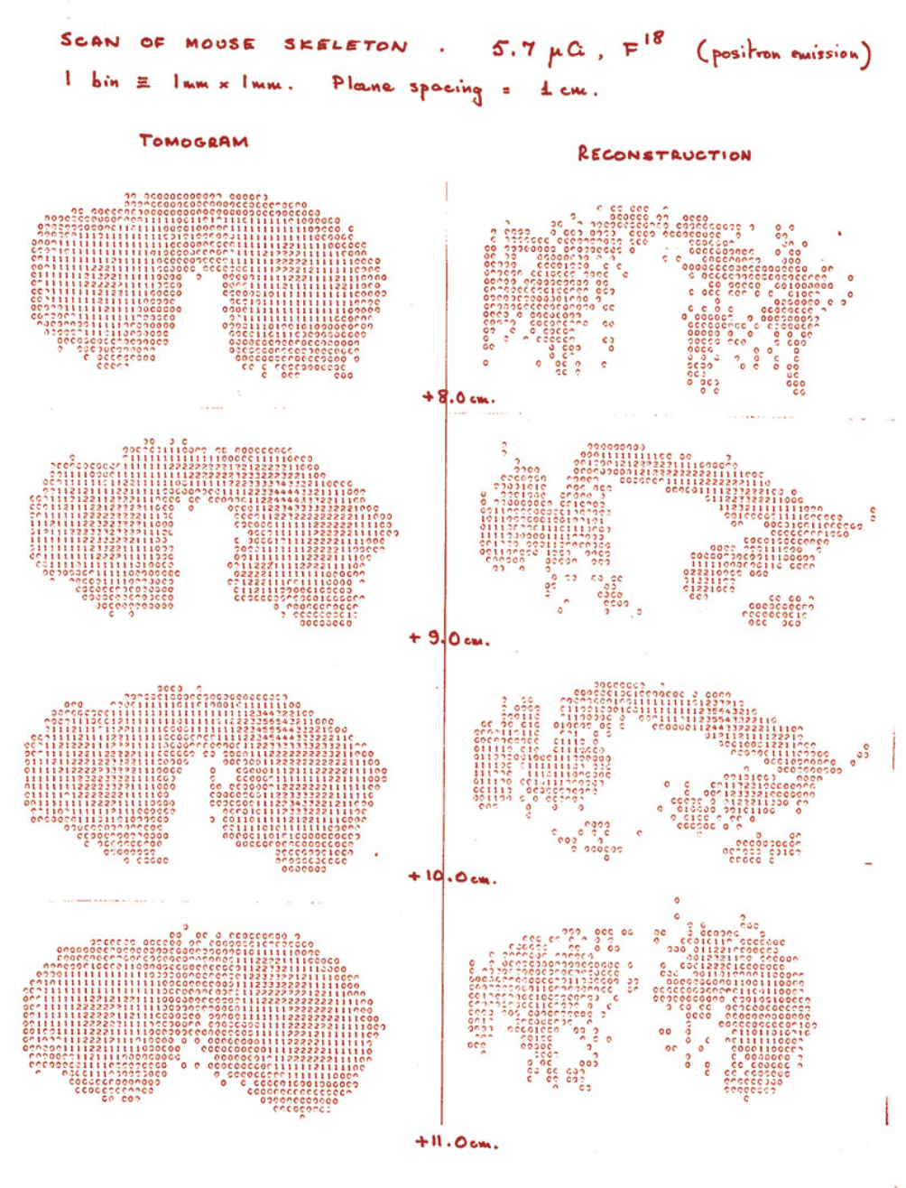
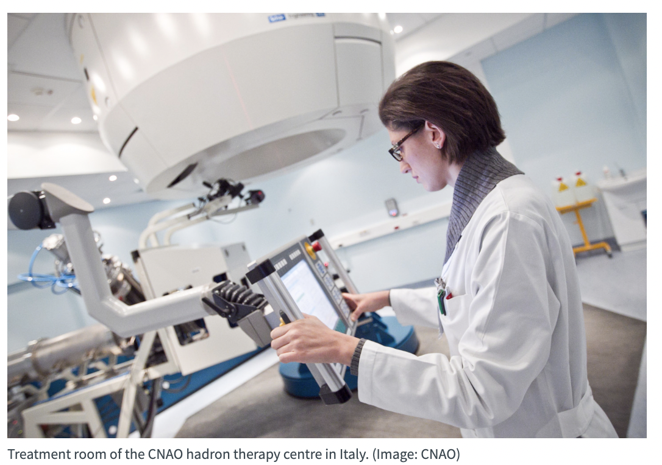
Medical Applications of Particle Physics
HST2025 Study Group 6
The first image of a mouse taken using positron emission tomography (PET) in 1977, when the technology began at CERN. (Image: CERN)

Slide 102
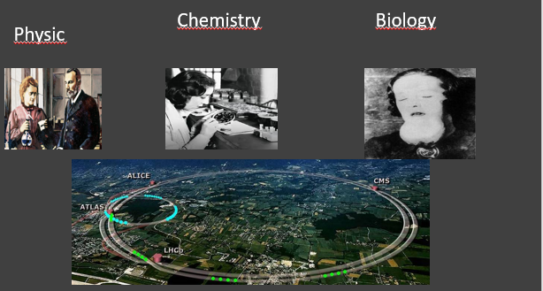
Curriculum & Classroom Connections
From lab to the hospital
The God(dam) particle
Radiation Therapy with Accelerators
Linear accelerators (LINACs) deliver precise radiation doses to tumors, sparing healthy tissue.
Particle therapy (protons, carbon ions) offers highly localized dose deliver
New accelerator-based methods like FLASH therapy are revolutionizing cancer care by delivering ultrahigh dose rates, potentially sparing healthy tissue.
Radiation induces DNA damage, leading to tumor control.
Particle therapy allows better control of deep-seated tumors with fewer side effects.
Cyclotrons and accelerators produce isotopes like ¹⁸F for PET scans, vital for early diagnosis and metabolic imaging.

Slide 103
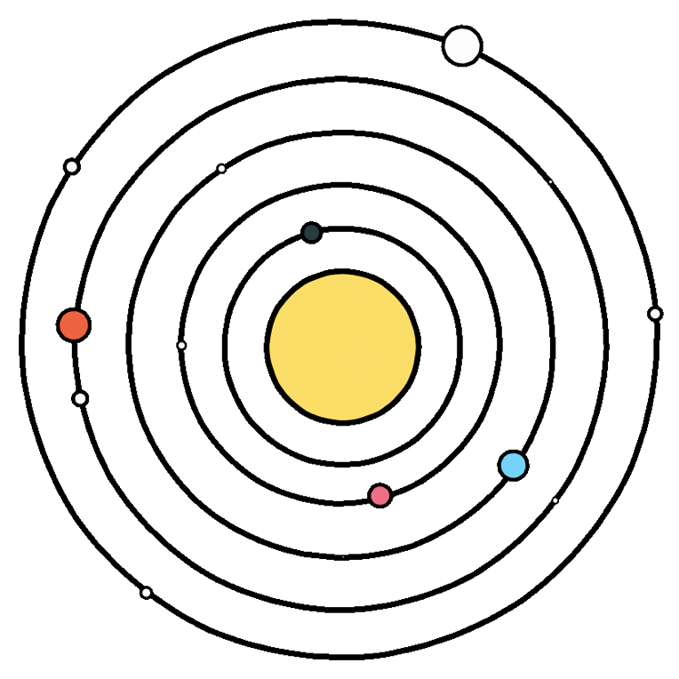





Key Ideas
SEEING (Advanced Imaging):
TREATING (Precise Delivery):
Precise "delivery" to ensure radiation goes where it should is key
Linear Accelerators (Linacs)
Hadron Therapy (Proton & Carbon Ion)
FLASH Therapy - CERN-CHUV collaboration is developing the first clinical Very High Energy Electron (VHEE) FLASH machine (DEFT),
The Global Challenge & Future Vision:
Groundbreaking technology for seeing and detecting tumors
to "see" the tumor with precision (imaging)
to "treat" it with targeted accuracy (delivery)
Effective treatment requires seeing the target. The field has evolved from basic X-rays to sophisticated methods like Computed Tomography (CT) for detailed 3D anatomical views and Positron Emission Tomography (PET) for visualizing metabolic activity. Multi-modality systems like PET-CT now offer a comprehensive understanding of a tumor's structure and function.
Despite these technological leaps, the most significant challenge is the vast gap in access to radiotherapy, particularly in low- and middle-income countries. Initiatives like Project STELLA are actively working to address this by developing more affordable, robust, and easier-to-operate radiotherapy systems, aiming to make these life-saving treatments a global reality.

Slide 104
Potential Students’ Conceptions & Challenges
elements of the topic that might obstruct a successful introduction in the classroom
🔬 1. Conceptual Complexity
understanding advanced physics,confused or disengaged if foundational knowledge is missing
🧪 2. Lack of Practical Demonstrations
Particle physics-based medical tools (ex.PET scanners),Teachers rely heavily on theoretical or multimedia explanations, which may not be engaging for all learners.
📚 3. Gaps in Curriculum or Teacher Training
not be part of the standard curriculum,teachers are not trained in high-energy physics or its medical uses
🧮 4. Mathematical Demands
involves calculations,without strong math skills may struggle to engage meaningfully
🤖 5. Technological Limitations
- Schools may lack the software, simulations, or internet access needed to support multimedia learning.,Limits student engagement and teacher flexibility

Slide 105
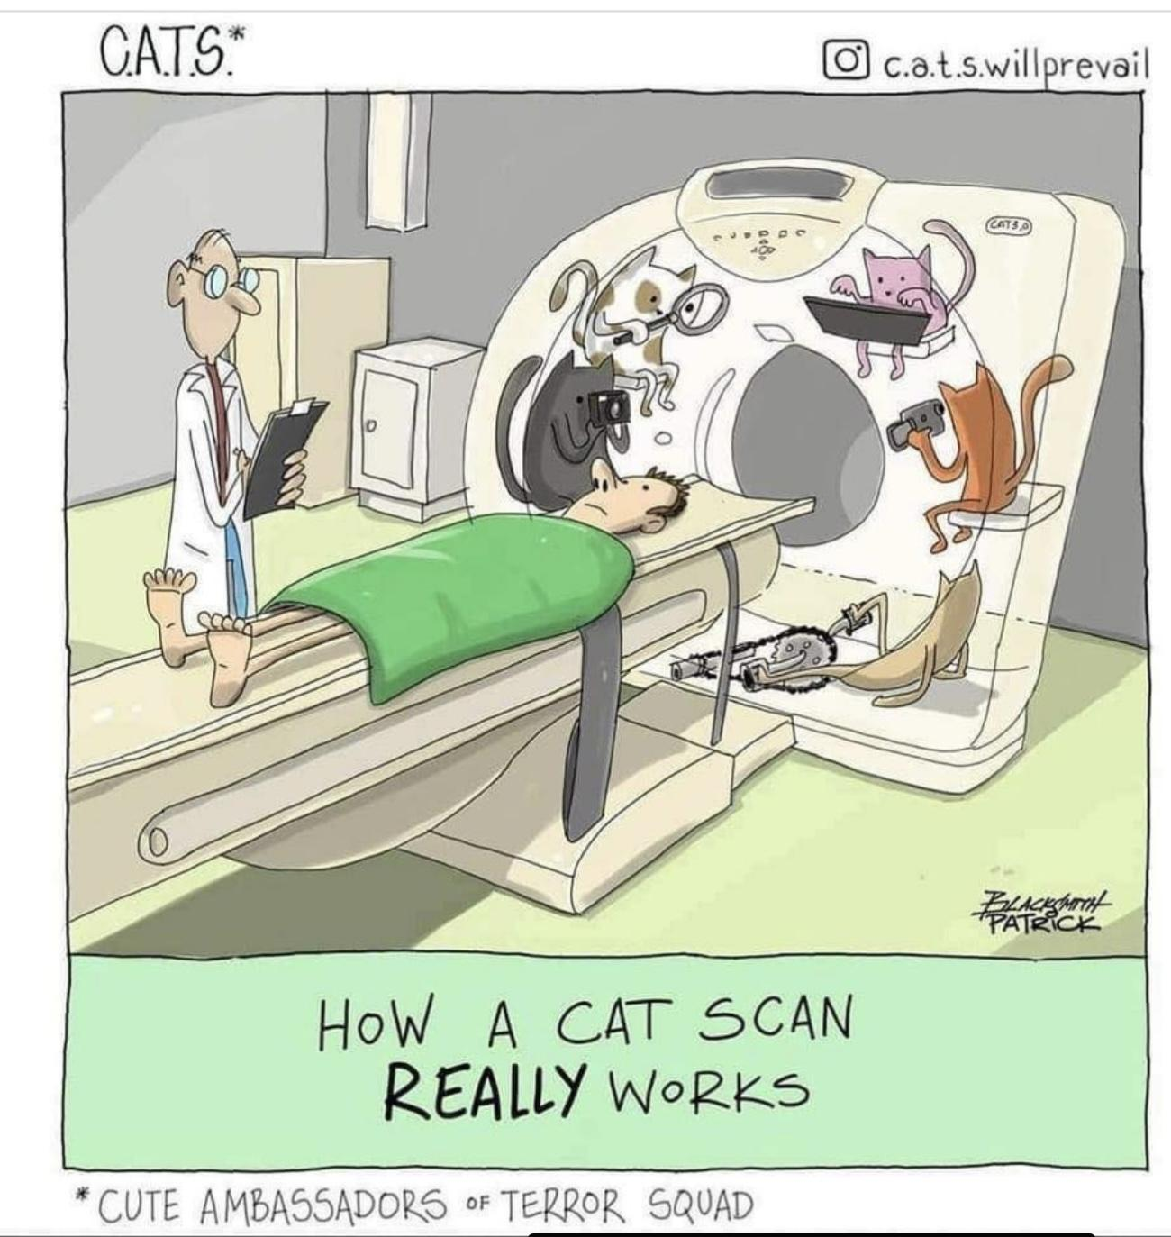
Useful Material & Resources
Phet-simulation of MRI
How to use simulation (Youtube)
110 questions and answers about Medical Imaging Modalities and Therapy
From particle physics to medicine (Video, CERN)
Nuclear medicine explained in two minutes(Youtube)
PET vs. SPECT (Youtube)
How CT work (Youtube)
How does proton radiation therapy works? (Youtube, Fermilab)
Video of FLASH (CERN)
X-rays, history, how they works etc. (Youtube, TED-Ed)
Using radioactive drugs to see inside your body (Youtube, TED-Ed)

Slide 106
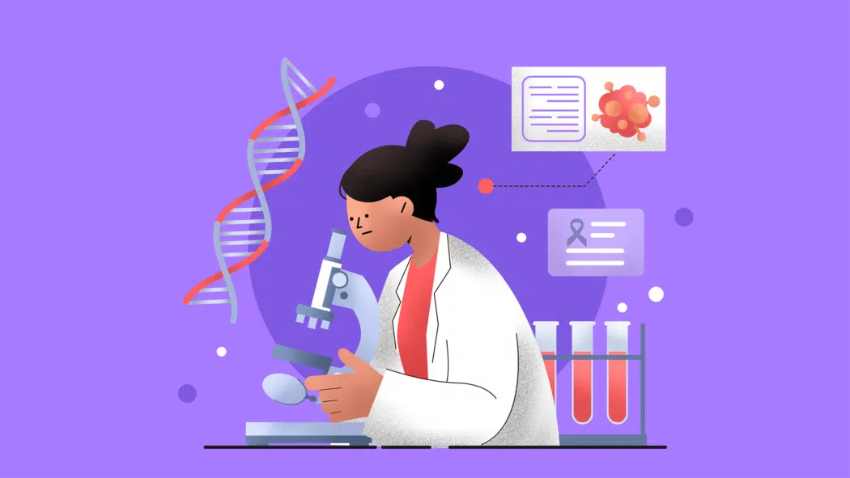
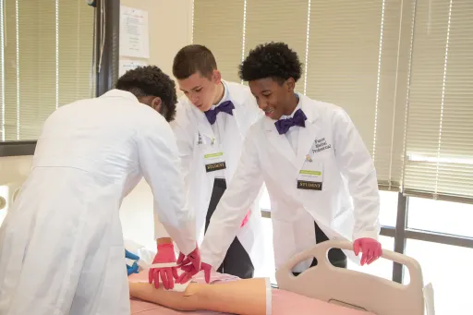
Best Practices:
Everyone knows someone who has battled or suffered with cancer
Cancer is a very sensitive subject for many people.
We need young people to enter the field of cancer treatment to keep up with the rising number of cases,
In the classroom:
Pre-med clubs can be a strong option
Guest speakers from hospitals and treatment centers can bring both inspiration and needed information.
Activities that study cancer treatment can keep students up to date before they even start college.

Slide 107
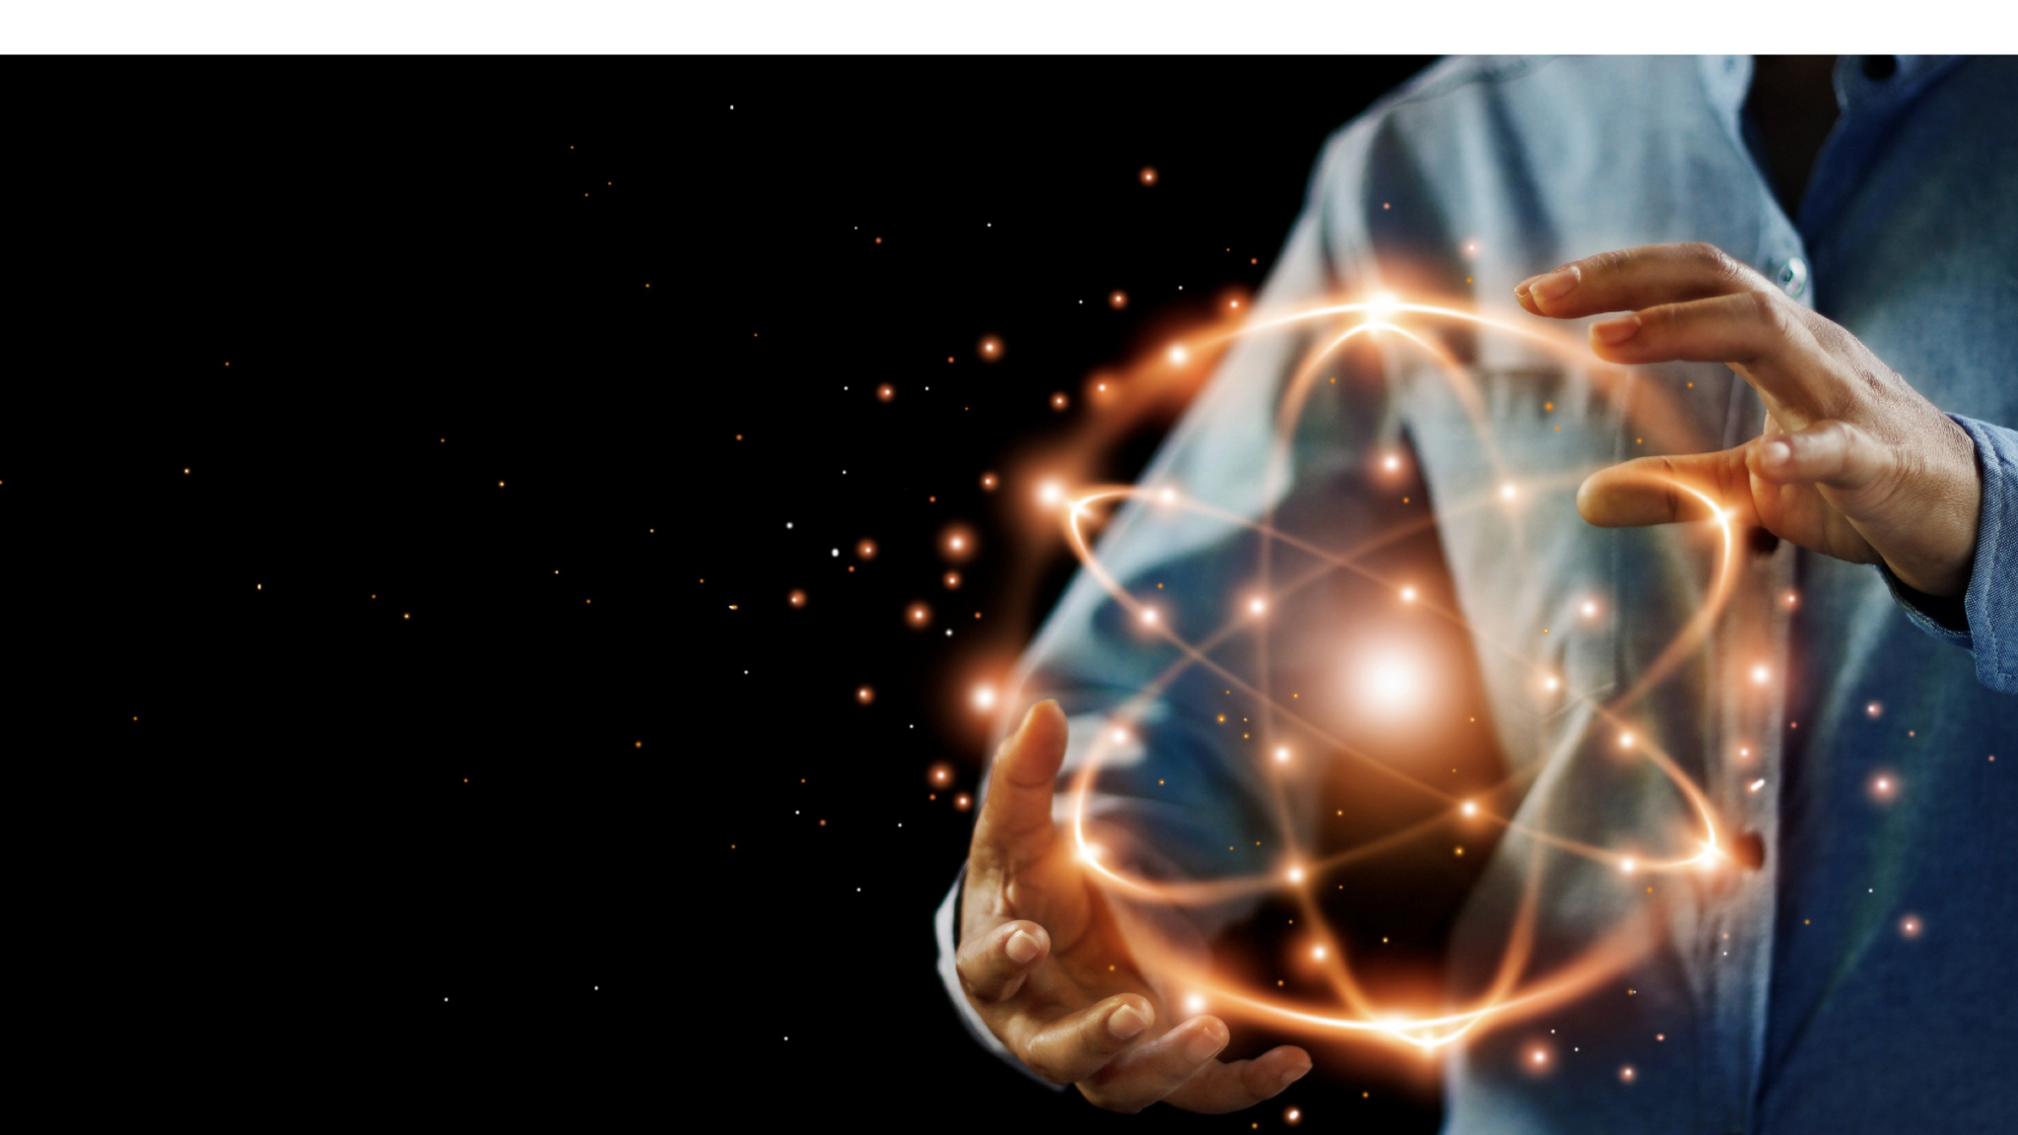
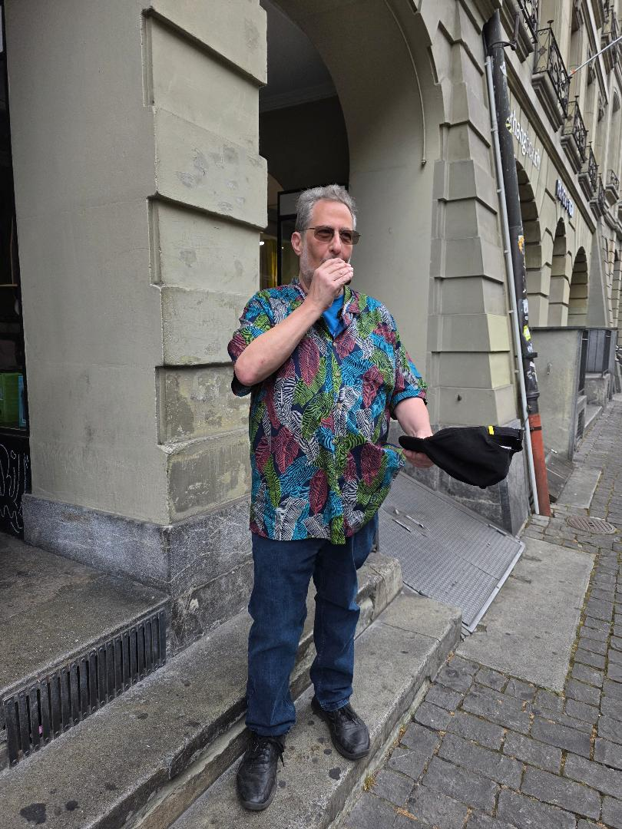
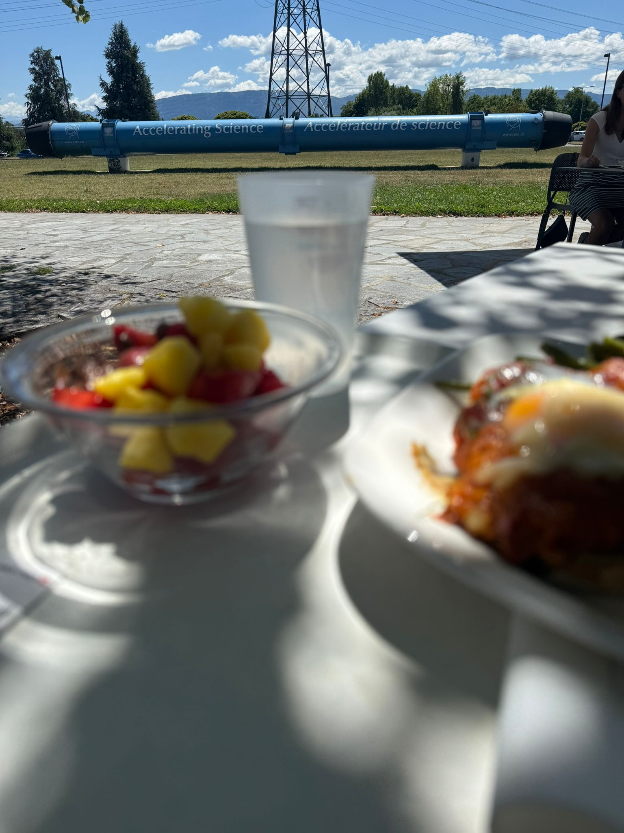
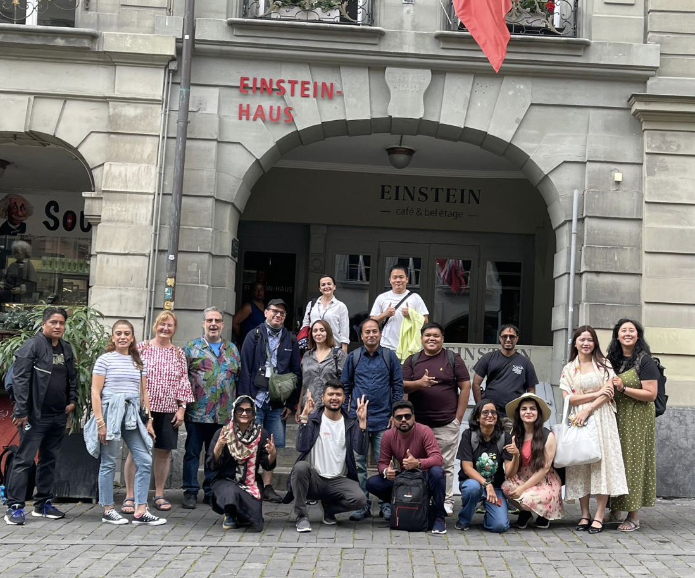
Best Practice Example
HST2025 Study Group 6
Cansu Aydinkal (Turkey), Carlos Borrallo (Andorra), Cliff Gerstman (USA), Asanka Kumara (Sri Lanka), Milla Unkuri (Finland)
One way in which our thinking has changed…
Almost everyone knows someone who has battled cancer, successfully or not.
Many high schools around the work have a preliminary pre-med program.
High school is the perfect time to get students interested in a potential medical career.
Today’s young people will inherit and create future technology, including new cancer treatments.
Because cancer is such a sensitive topic for everyone, we must keep the lessons in a very positive way.
A good way to start is a to get a nuclear oncologist to come to your school to give a talk.
Give the students a grid to fill out with types of cancer and the appropriate type of radiation therapy to use to treat it.
Follow this up with a matching card game. Only allow positive outcomes.
Use short videos to demonstrate how the treatment process works.
There are many articles written at the high school level that can be read in class and reported on in a number of ways.
A fine ending is to watch videos in which cancer patients who are now cancer free report on their conditions.
Visiting CERN gave us a much deeper appreciation for the role of scientists and revealed that particle physics is not just about research, but about global collaboration, interdisciplinary innovation, and inspiring the next generation through real-world applications that benefit society.
Highlights, snapshots, farewell messages…
It was so great to meet all of you! I hope I will see some of you again! Keep in touch!

