Slide 1
Study Group 2
International High School Teacher Programme 2025

Slide 2
Wednesday, 9 July
SG Session 1

Slide 3

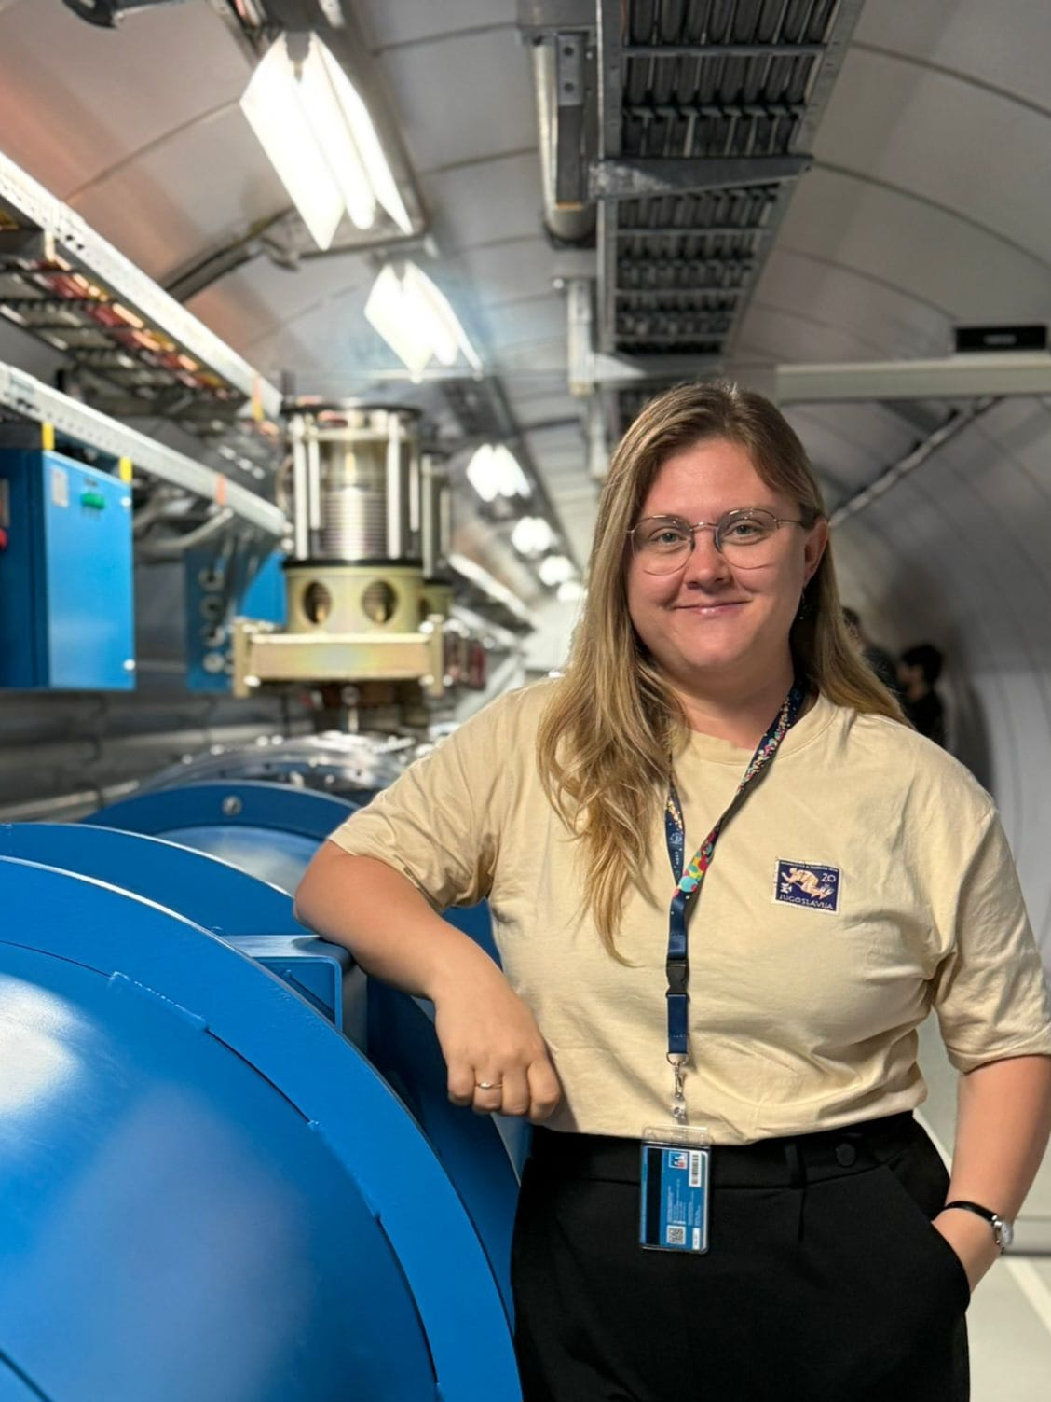
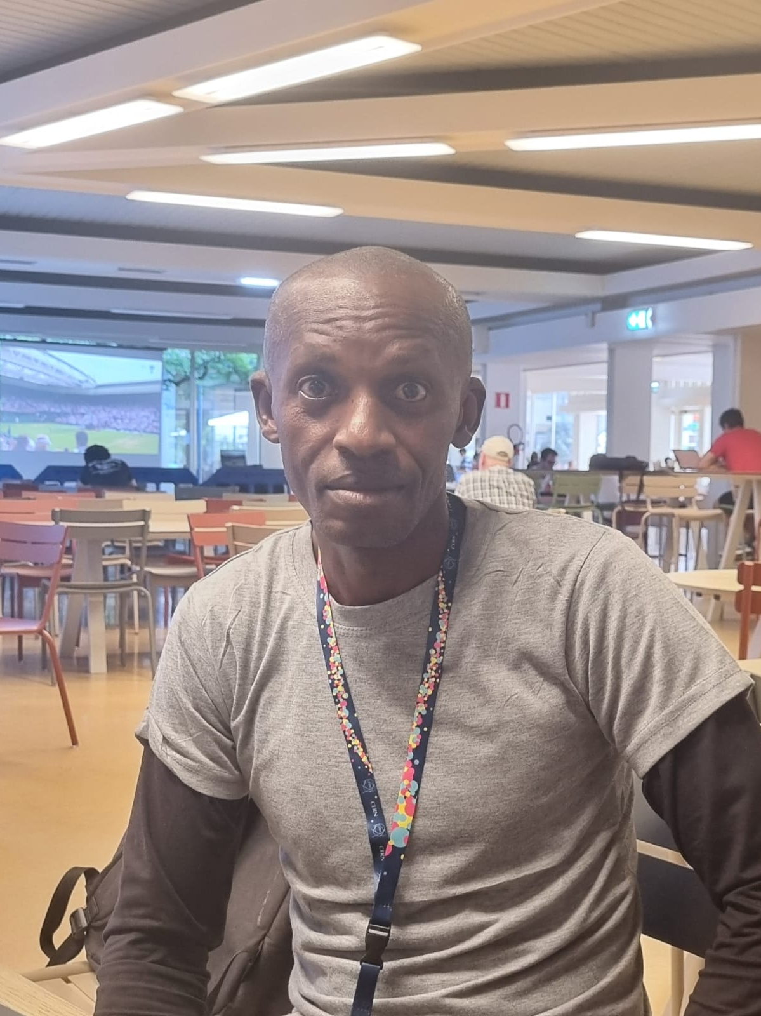
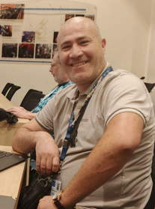

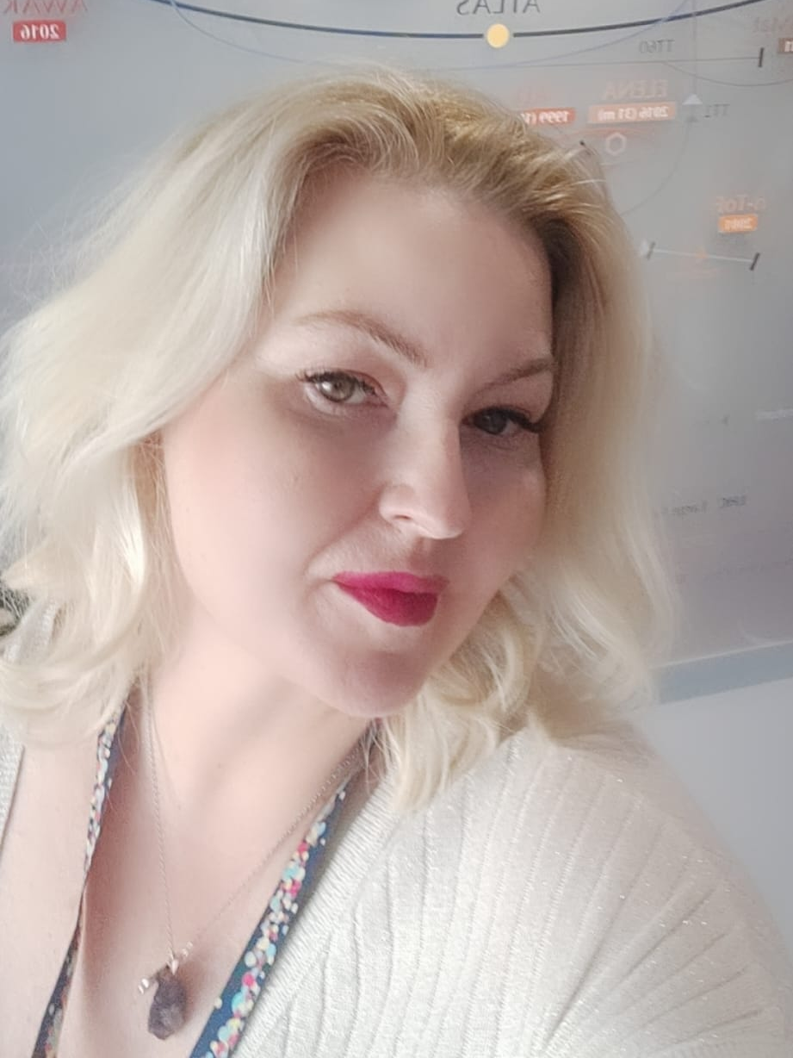

Study Group 2
Ed
Canada
I climbed Mont Blanc in 2006
Semra
Bosnia and Herzegovina
I am a mediocre tennis player
Akpa
Nigeria
I like laughing
Selim
Algeria
I am a time-keeper without a watch.
Quynh
Vietnam
No one gets my name right—not even Vietnamese people, and it’s a Vietnamese name!
Dragana
Serbia
My multitasking skills are amazing

Slide 4
Slide Conventions
Colour of Slide | Type of Work
 | Individual (your colour is indicated on the previous slide)
 | Group work
 | Report-out slides

Slide 5
Checklist for SG Session 1
# | Type of Task | Task | Deadline
1 | Individual | Fill in your section of the “Study Group 2” slide | Wednesday, 17:30
2 | Group | Fill in “Group Norms” slide | Wednesday, 17:30
3 | Individual | Fill in slides corresponding to your colour | Wednesday, 17:30
4 | Group | Fill in “Our Key Takeaways” and “Our Feedback” slides as a group. Make sure you all contribute to the discussion. | Wednesday, 17:30
5 | Group | Decide how you as a group will present your group slides if you are selected to present during the SG Report-Out. | Wednesday, 17:30

Slide 6
Group Norms
Instructions: Write on the right box your group norms and how you will work together. For example:
Who will manage the meetings?
Who will be the time-keeper?
Who will fill in group slides?
Anything else you think is important to coordinate for productive group work.
EditingWho will manage the meetings?
Semra
Who will be the time-keeper?
Salim
Who will enter information into group slides?
Quynh
Who will edit the presentation slides?
Ed
Who will be in charge of visual imagery?
Dragana
Who will bring the humour to the discussions/presentations (also add memes)?
Akpa

Slide 7
Particle
Physics
What are three adjectives that come to your mind when you think about particle physics?
To what extent is the topic of particle physics covered in your national curriculum?
Three Adjectives:
Fundamental
High-energy
Investigative (collaborative)
Provincial (Alberta, Canada) Curriculum:
Moderate coverage (Grade 12)
Evolution of Atomic Models (Thomson-Quantum Mechanical) including experimental evidence
Fundamental particles (fermions) first generation quarks/leptons
Force carriers (bosons)
Fundamental forces/interactions (SEWG)

Slide 8
Particle Accelerators
What are three key ideas about particle accelerators that you would like your students to know about?
What are potential challenges students might encounter when learning about particle accelerators?
Three Key Ideas:
Electric Fields accelerate particles
Magnetic Fields bend the particles so acceleration process can be repeated
Synchronization between electric and magnetic fields varies from relatively simple (linac) and complex (Synchotron)
Potential Challenges:
Understanding how a cyclotron works
Understanding the complex synchronization of electric and magnetic fields in synchotrons
Understanding the idea of how relativistic effects are accounted for in particle accelerator design

Slide 9
Particle
Detectors
What are three key ideas about particle detectors that you would like your students to know about?
What are potential challenges students might encounter when learning about particle detectors?
Three Key Ideas:
The use of magnetic fields to help identify charge of particles
The difference between charged and neutral particles in leaving motion tracks
How different detector types allow for the determination of class (lepton vs fermion vs photon)
Potential Challenges:
Understanding how individual detectors work (ie. calorimeters vs tracking)
Understanding that observers “see” only a small portion of the interactions from detectors and need to use computations/analysis to deduce possible sources
Understanding the limitations of detectors (and how detectors interact with and affect the particles they observe)

Slide 10
My Key Takeaways so far
Instructions: Write in the box any insights or things that you learned and that you want to remember after the HST2025 programme.
Key Takeaways:
How fundamental magnets are to the operation of the LHC (not just the obvious bending dipole magnets but the quadrupole magnets used for compressing/steering)
The complexity and interplay of the various stages of the acceleration process (linear accelerator to booster to PS to SPS to LHC)
The amazing engineering behind a cross-section of the LHC beamline (cryogenics, superconducting magnets, beam tubes, vacuum insulation, etc)
That the LHC is not a perfect circle (surprise!), and that there are straight sections with various curved sections layered with different types of magnets (dipoles, quadropoles, higher order magnets, etc)
The complexity of detector systems and ways of identifying the collision debris
investigation tools/techniques (statistical analysis) needed to identify mystery particles such as the Higgs Boson

Slide 11
Particle
Physics
What are three adjectives that come to your mind when you think about particle physics?
To what extent is the topic of particle physics covered in your national curriculum?
Particle Physics
Three adjectives that come to mind when thinking about particle physics:
  Complex
  Inspiring
  Exotic
The extent to which the topic of particle physics is covered in the national curriculum of Bosnia and Herzegovina?
  Particle physics is covered in the last year of high-school. The standard model and particles are thought but the depth of application examples is limited.

Slide 12
Particle Accelerators
What are three key ideas about particle accelerators that you would like your students to know about?
What are potential challenges students might encounter when learning about particle accelerators?
Particle Accelerators
Three key ideas about particle accelerators that I would like my students to know about?
  Cyclotron
  Synchrocyclotron
  Industrial applications of accelerators
Potential challenges students might encounter when learning about particle accelerators:
  Interaction between electromagnetic field and charged particle
  Relativity aspect of particle acceleration
  Chromaticity

Slide 13
Particle
Detectors
What are three key ideas about particle detectors that you would like your students to know about?
What are potential challenges students might encounter when learning about particle detectors?
Particle Detectors
Three key ideas about particle detectors that I would like my students to know about?
  The concept of a detector (eye analogy)
  Distinguishing among the particles
  CERN’s main experiments: ALICE, ATLAS, LHCb and CMS
Potential challenges students might encounter when learning about particle detectors:
  Being able to “see” without actually seeing
  Particle interactions and their various types
  Interaction bosons

Slide 14
My Key Takeaways so far
Instructions: Write in the box any insights or things that you learned and that you want to remember after the HST2025 programme.
Particle Physics
Particle physics offers answers to the great existential question: "What is the universe made of?" The Standard Model is a remarkable theory, one that has been built upon for centuries by countless scientists. As Newton said in 1675, "If I have seen further [than others], it is by standing on the shoulders of giants." Nearly 350 years later, particle physics stands as a prime example of how we must continually build upon the knowledge of those who came before us, pushing the boundaries of our understanding further with each discovery.
Particle Accelerators
Accelerators, which produce and collide beams of particles, are powerful tools in modern science. They require an enormous energy input—far beyond what we typically encounter in everyday life. Despite their high-tech nature, accelerators have practical applications that touch our daily lives. For example, technologies like MRI and PET scans rely on principles derived from particle physics and use low-energy particles for medical imaging and diagnostics. Beyond their everyday uses, particle accelerators play a crucial role in helping us uncover the fundamental secrets of the universe, from the structure of matter to the origins of the cosmos.
Particle Detectors
Particle detectors have a very hard job, because they need to detect particles through the interactions between the particles themselves and the matter of our detectors. Even with the best detectors, there are still many particles that we cannot detect (yet).

Slide 15
Particle
Physics
What are three adjectives that come to your mind when you think about particle physics?
To what extent is the topic of particle physics covered in your national curriculum?
High energy physics: Particles are accelerated at high speed near speed of light
Fundamental particles: Finite particle size
Collision: smashing of particle that move toward each other to create particles
National Curriculum connection
There is no connection to my curriculum

Slide 16
Particle Accelerators
What are three key ideas about particle accelerators that you would like your students to know about?
What are potential challenges students might encounter when learning about particle accelerators?
Quadrupole magnet: focus beam of magnet
Dipole magnets: bend beam of particle
Booster: Enhance and nudges particle to move forward
Challenges:
Understanding abstract concepts like magnetic field and electric field
Nature of particles and the scale of these machines.
The speed of the particles

Slide 17
Particle
Detectors
What are three key ideas about particle detectors that you would like your students to know about?
What are potential challenges students might encounter when learning about particle detectors?
Tracking: Determine the trajectory of charge particle
Identification: Sense the type of particle presence
Measurement: measure the energy of particles (Calorimeters)
Challenges:
Abstract nature of particles
The function of different detectors
Data analysis involved

Slide 18
My Key Takeaways so far
Instructions: Write in the box any insights or things that you learned and that you want to remember after the HST2025 programme.
High energy physics
Fundamental particle
Collision
Quadrupole magnet
Dipole magnets
Booster
Tracking
Identification
Measurement (Calorimeters)

Slide 19
Particle
Physics
What are three adjectives that come to your mind when you think about particle physics?
To what extent is the topic of particle physics covered in your national curriculum?
1 -
Spin Difference
  Fermions: Have half-integer spin (e.g., 1/2, 3/2)
  Bosons: Have integer spin (e.g., 0, 1, 2)
Role in Nature
  Fermions: Make up matter (e.g., electrons, protons, neutrons, quarks)
  Bosons: Carry forces (e.g., photons, gluons, W/Z bosons, Higgs)
Quantum Behavior
  Fermions: Obey the Pauli exclusion principle—no two identical fermions can occupy the same quantum state
  Bosons: Can occupy the same state—they “pile up” and enable phenomena like lasers and superconductivity
2 - In Algerian secondary education, students are introduced to key concepts about the infinitely small and the infinitely large. The curriculum covers the four fundamental forces of nature and includes topics such as the limits of Newtonian mechanics and an introduction to quantum mechanics.
At the university level, students can study elementary and mathematical particle physics, especially in Master’s and PhD programs.

Slide 20
Particle Accelerators
What are three key ideas about particle accelerators that you would like your students to know about?
What are potential challenges students might encounter when learning about particle accelerators?
Particle Accelerators:
a. What are they?
Machines that use electromagnetic fields to speed up charged particles (like protons or electrons) to very high energies and direct them into beams.
b. Why do we need them?
They allow us to explore the fundamental structure of matter by smashing particles together and observing the results—helping us answer big questions about the universe.
c. What are their applications?
Fundamental research in physics (e.g., discovering new particles)
Medicine (cancer therapy, medical imaging)
Industry (manufacturing semiconductors, sterilizing equipment)
Producing radioisotopes for research and diagnostics
potential challenges
Students may struggle with the abstract concepts and complex technology behind particle accelerators, as well as the challenge of connecting large-scale scientific machines to everyday experience and real-world applications
Specialized terminology and the multidisciplinary nature of accelerator science can also make the topic feel overwhelming for beginners

Slide 21
Particle
Detectors
What are three key ideas about particle detectors that you would like your students to know about?
What are potential challenges students might encounter when learning about particle detectors?
Three key ideas about particle detectors:
Particle detectors are devices that reveal, track, and identify subatomic particles by capturing the signals they produce when interacting with detector materials.
They measure important properties like energy, momentum, charge, and type of particle, using layers of different detection technologies.
Detectors are essential tools in experiments, making invisible particles visible and enabling discoveries in fundamental physics.
Potential challenges for students:
Grasping how invisible particles leave detectable signals and understanding the complex, layered structure of modern detectors can be difficult.
The technical vocabulary and statistical nature of detection (e.g., interpreting electrical signals, random processes) may feel abstract and overwhelming for beginners.

Slide 22
My Key Takeaways so far
Instructions: Write in the box any insights or things that you learned and that you want to remember after the HST2025 programme.
My Key Takeaways so far (HST2025):
I learned how particle detectors work, how they identify different particles through their interactions, and the fascinating structure of modern detectors.
I gained insight into the operation of the LHC, from accelerating particles to analyzing collision data.
I discovered how international collaboration at CERN unites countries for the advancement of science and the benefit of humanity.

Slide 23
Particle
Physics
What are three adjectives that come to your mind when you think about particle physics?
To what extent is the topic of particle physics covered in your national curriculum?
3 adjective:
- Modern
- Complex
- Cool - I always admire who good in particle physics :))
Topic of particle physics
- Atom structure (alpha particle scattering experiment, …)
- Movement of particle in electric and magnetic field
- Nuclear reaction

Slide 24
Particle Accelerators
What are three key ideas about particle accelerators that you would like your students to know about?
What are potential challenges students might encounter when learning about particle accelerators?
3 key ideas
It actually can be in any size (don’t have to be the huge one at CERN they see in book - the LHC)
The particle can be accelerated in linear or circular path and the way how it is accelerated. This can be an application to consolidate the concept of magnetic force)
Potential challenges
Can not image the real structure of the accelerators

Slide 25
Particle
Detectors
What are three key ideas about particle detectors that you would like your students to know about?
What are potential challenges students might encounter when learning about particle detectors?
potential challenges
3 key ideas
How the detectors get the result of the collisions (ionisation, photonemission,...)
The structure of the detector is like an onion, it has many layer (hadronic calorimeter, electromagnetic calorimeter, …) and each layer can detect each type of particle.
Potential challenges
Can not all understand about the principle under the dectection through photonemission, radiation
The field is highly interdisciplinary—blending physics, engineering, …

Slide 26
My Key Takeaways so far
Instructions: Write in the box any insights or things that you learned and that you want to remember after the HST2025 programme.
About particle physics: Some updated knowledge about Higgs Boson to students
About accelerator: the way how particle is accelerated linear or circular by magnet
About detector:
The structure of the detector is like an onion, it has many layer

Slide 27
Particle
Physics
What are three adjectives that come to your mind when you think about particle physics?
To what extent is the topic of particle physics covered in your national curriculum?
3 adjectives to describe partivle physics
Fascinating
Revolutionising
Expensive
In serbian national curriculum we teach particle physics at the end of the final year. Prior to that I can talk about superconductivity, magnets, Lorence force, electron and positron, collisions.

Slide 28
Particle Accelerators
What are three key ideas about particle accelerators that you would like your students to know about?
What are potential challenges students might encounter when learning about particle accelerators?
3 key ideas
The strong magnetic field is bending the protons trajectory
The protons are accelerated when passing RF cavities generating electromagnetic fields
Superfluid helium is used to achieve superconductivity
Challenges
Potential challenges for the students are RF cavities, right hand rule

Slide 29
Particle
Detectors
What are three key ideas about particle detectors that you would like your students to know about?
What are potential challenges students might encounter when learning about particle detectors?
3 key ideas
CERN detectors ATLAS and CMS detected Higgs particle
CERN detectors are put at the crossing points where particles in two beams are colliding
The detectors are multilayered in concentric circles with trackers, calorimeters, muon chambers to detect different particles after collisions
Challenges
Potential challenges are lessons not learned well enough like momentum conservation, energy conservation

Slide 30
My Key Takeaways so far
Instructions: Write in the box any insights or things that you learned and that you want to remember after the HST2025 programme.
I understand better how accelerators and LHC work in general, key physics and engineering concepts with some insider insights
I see how international collaboration can build something great
I like the atmosphere and work ethics here

Slide 31
Study Group Discussion
Share your individual insights with your colleagues and identify shared themes.
Have some ice cream and don’t forget to
take notes :)
Took the approach of breaking down into individual sections based on question prompts
Ie. 1. 3 Words
2. Approaches from high school curricula
3. Particle accelerator ideas
4. Particle accelerator challenges
5. Particle detector ideas
6. Particle detector challenges
3 words to describe particle physics
Approaches from high school curricula
Particle Accelerator ideas
Particle Accelerator Challenges
Particle detector ideas
Particle detector challenges

Slide 32
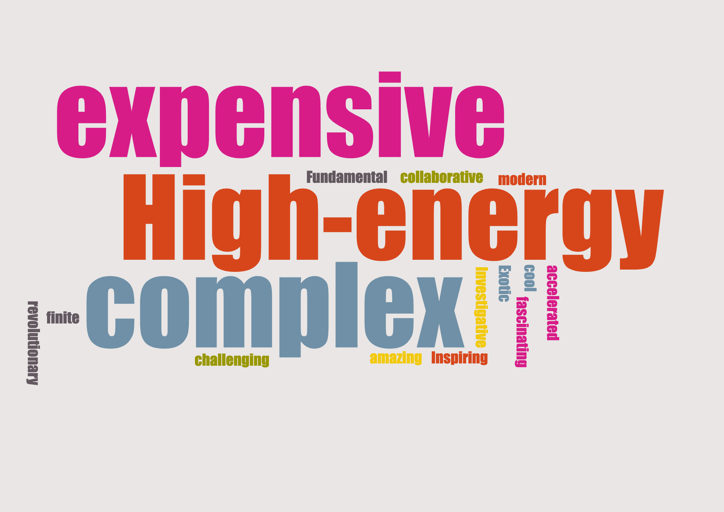
Our Key Takeaways so far
Instructions: Write in the box any insights, learnings and discussion outcomes.
(Decide how you as a group will present them if you are selected to present during the SG Report-Out.)
3 words for particle physics: The word cloud on the left.
High school levels of curricula vary wildly. Atomic physics seems to be prominent in national curricula, but standard model particle physics was either not present or introduced at a superficial level.
Magnetic field is used to steer and focus beam of particle. Oscillating electromagnetic field is used to accelerate beam of particle.
​Students may struggle with the abstract concepts and complex physics behind particle accelerators. The structure of particle accelerators can be difficult to imagine.​
Particle detectors are like layers of an onion with different complex physics technologies associated with each level
Students often find it hard to understand how we detect invisible particles using indirect clues, and how complex detectors with technical terms actually work.

Slide 33

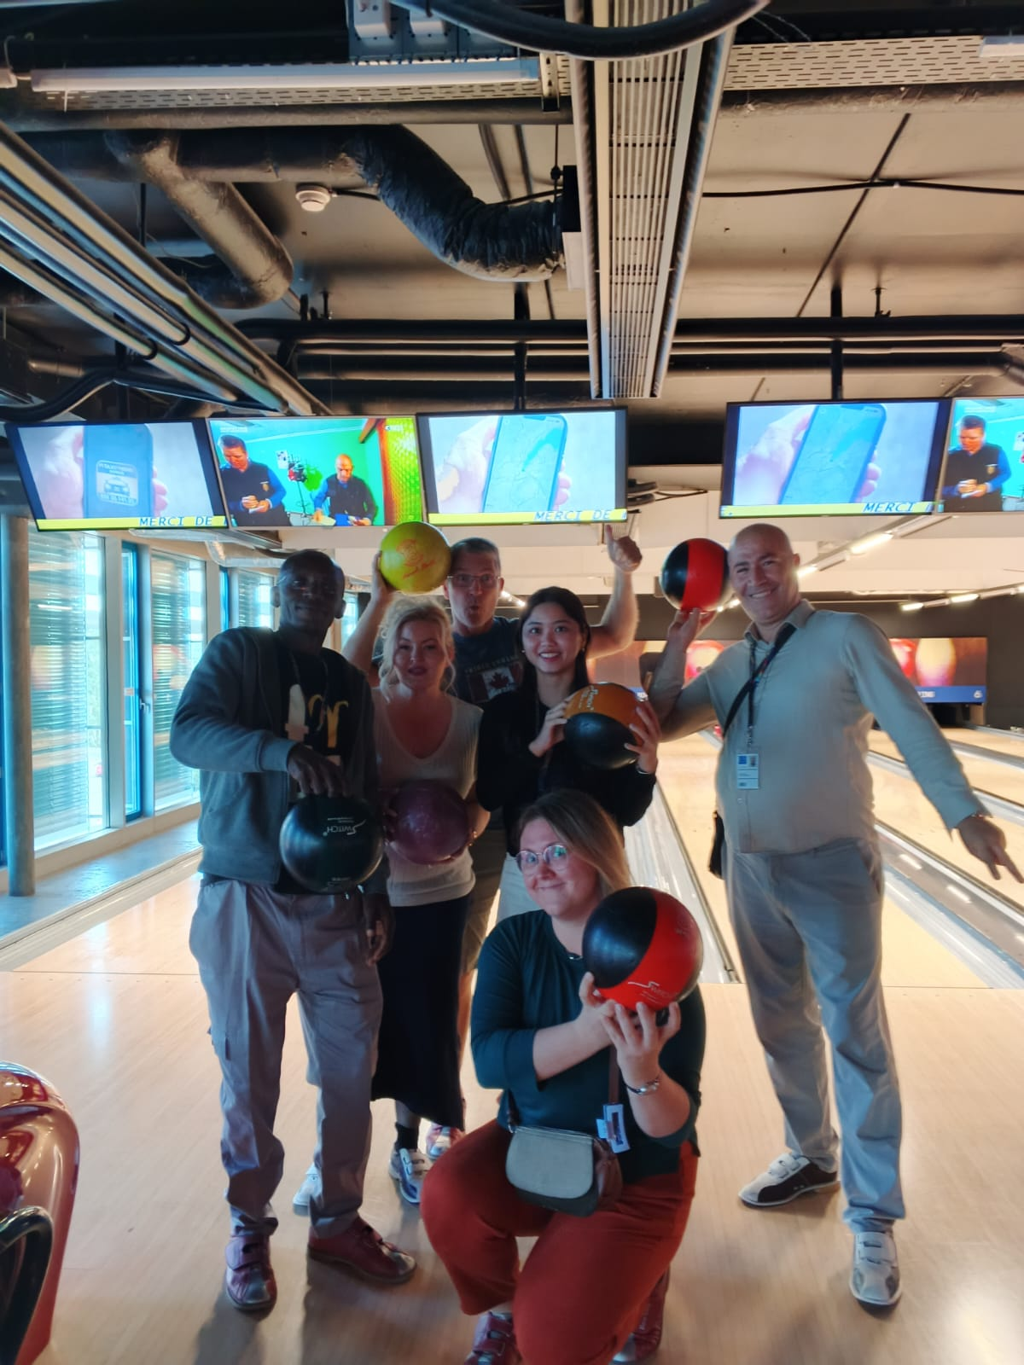
Our Feedback
so far
Highlights?
What’s working?
What needs improvement?
Other comments?
Funny picture or meme?
(Decide how you as a group will present them if you are selected to present during the SG Report-Out.)
On-site visits because it brings particle physics to life. Engaging lectures with very clear explanations.
It’s a good balance of work (between on-site visits and lectures) and play (relax time). Bowling
More interactive simulations related to various aspects of LHC operations. Hoped to get down in the LHC Tunnel…
Incredible meeting with and hearing stories from inspiring teachers from around the world

Slide 34
Thursday, 10 July
SG Session 2

Slide 35
Study Group 2
Ed
Canada
I climbed Mont Blanc in 2006
Semra
Bosnia and Herzegovina
I am a mediocre tennis player
Akpa
Nigeria
I like laughing
Selim
Algeria
I am a time-keeper without a watch.
Quynh
Vietnam
No one gets my name right—not even Vietnamese people, and it’s a Vietnamese name!
Dragana
Serbia
My multitasking skills are amazing

Slide 36
Checklist for SG Session 2
# | Type of Task | Task | Deadline
1 | Individual | Fill in slides corresponding to your colour | Thursday, 18:00
2 | Group | Fill in “Our Key Takeaways” and “Our Feedback” slides as a group. Make sure you all contribute to the discussion. | Thursday, 18:00
3 | Group | Decide how you as a group will present your group slides if you are selected to present during the SG Report-Out. | Thursday, 18:00

Slide 37
Engineering
Which topic from the physics curriculum could you see yourself teaching in the context of Engineering at CERN?
Sketch out your idea and add links to suitable resources!
Applied science of magnetism
-comparison of conventional vs superconducting magnets
-discussion of scale-up potential for a FCC or a higher energy collider
-discussion of forces between magnets and need for a collar or an aluminum outer casing to keep magnets from moving relative to each other
-discussion with students about the issues/mechanisms for keeping superconductors cold and the idea of quenching
-discussion with students about the dipole length of 15 m and why this was chosen, practical installation issues like using cranes to install due to heavy weights, need to curve pipe

Slide 38
LHC
Which topic from the physics curriculum could you see yourself teaching in the context of the
Large Hadron Collider at CERN?
Sketch out your idea and add links to suitable resources!
Acceleration, energy input and collision momentum
Discussion of boosting of energy of the respective rings, using electric and magnetic fields
Discussion of use of steering magnets to squeeze beam to narrow range to optimize / increase frequency of collisions
Discuss why particles not aimed straight-on but at a slight angle

Slide 39
AI
What are three key ideas about AI that you would like your students to know about?
What are potential challenges students might encounter when learning about AI?
What are potential benefits students might encounter when learning with the help of AI?
Idea of too much data resulting from collisions
Use of machine-learning to help process and filter data
Philosophical idea of using

Slide 40
My Key Takeaways so far
Instructions: Write in the box any insights or things that you learned and that you want to remember after the HST2025 programme.

Slide 41
Engineering
Which topic from the physics curriculum could you see yourself teaching in the context of Engineering at CERN?
Sketch out your idea and add links to suitable resources!
Engineering
Topics from the Physics curriculum that I can see myself teaching in the context of Engineering at CERN?
  Magnetism
  DC motor
  Properties of matter
I would teach it with:
  Showing them presentation and pictures of CERN
  Showing them videos and simulations of CERN

Slide 42
LHC
Which topic from the physics curriculum could you see yourself teaching in the context of the
Large Hadron Collider at CERN?
Sketch out your idea and add links to suitable resources!
LHC
Topics from the Physics curriculum that I can see myself teaching in the context of Large Hadron Collider at CERN?
  Thermal Physics (due to cryogenics)
  Energy resources (powering up CERN with nuclear energy)
I would teach it with:
  Showing them presentation and pictures of CERN
  Showing them videos and simulations of CERN

Slide 43
AI
What are three key ideas about AI that you would like your students to know about?
What are potential challenges students might encounter when learning about AI?
What are potential benefits students might encounter when learning with the help of AI?
AI
Three key ideas about AI:
  Big data
  Neural networks
  Machine learning
The potential challenges students might encounter when learning about AI:
  The scale of data
  Neural networks and machine learning
  Training process of AI
The potential benefits of students might encounter when learning with the help of AI:
  Faster learning
  More efficient learning

Slide 44
My Key Takeaways so far
Instructions: Write in the box any insights or things that you learned and that you want to remember after the HST2025 programme.
Engineering at CERN
P. Detectors
LHC
Accel. Particle acceleratore
AI
Pa). Machine learning

Slide 45
Engineering
Which topic from the physics curriculum could you see yourself teaching in the context of Engineering at CERN?
Sketch out your idea and add links to suitable resources!
1. Magnetism
Thermal energy
Detector
2. CERN resources
CERN animations
Pictures

Slide 46
LHC
Which topic from the physics curriculum could you see yourself teaching in the context of the
Large Hadron Collider at CERN?
Sketch out your idea and add links to suitable resources!
1 Magnetism
Particle nature of matter
Electricity
2. CERN Animation
CERN Pictures
Fluid

Slide 47
AI
What are three key ideas about AI that you would like your students to know about?
What are potential challenges students might encounter when learning about AI?
What are potential benefits students might encounter when learning with the help of AI?
1. Data Visualization
Machine learning
Data capturing
2. Linquistic accuracy
Neuron network algorithm
3. Instant information
Accuracy of information

Slide 48
My Key Takeaways so far
Instructions: Write in the box any insights or things that you learned and that you want to remember after the HST2025 programme.
1 Data visualization
Image mapping
2. Application of magnetism
3. Onsite-visit, lecture, picture and animation

Slide 49
Engineering
Which topic from the physics curriculum could you see yourself teaching in the context of Engineering at CERN?
Sketch out your idea and add links to suitable resources!
1 ) topic from the physics curriculum could I see myself teaching in the context of Engineering at CERN.
Magnetism
Particle acceleration and beam steering
Detectors
Conductivity and Superconductivity
2 )
Masterclasses can help teaching such topics
We can use CERN resources to simulate real physics facts

Slide 50
LHC
Which topic from the physics curriculum could you see yourself teaching in the context of the
Large Hadron Collider at CERN?
Sketch out your idea and add links to suitable resources!
1 ) Topic from the physics curriculum could I see myself teaching in the context of the Large Hadron Collider at CERN.
Magnetism
Particle acceleration and beam steering
Detectores
Conductivity and Superconductivity
2 )
Masterclasses can help teaching such topics
We can use CERN resources to simulate real physics facts

Slide 51
AI
What are three key ideas about AI that you would like your students to know about?
What are potential challenges students might encounter when learning about AI?
What are potential benefits students might encounter when learning with the help of AI?
1 ) key ideas.
Deep learning
Machine Learning
2 ) potential challenges
Understanding deep learning
Data analysis
3 ) potential benefits
Fast learning , Efficiency,

Slide 52
My Key Takeaways so far
Instructions: Write in the box any insights or things that you learned and that you want to remember after the HST2025 programme.
Machine Learning
Aceeletarors Technologies
Detectors

Slide 53
Engineering
Which topic from the physics curriculum could you see yourself teaching in the context of Engineering at CERN?
Sketch out your idea and add links to suitable resources!
Topic
Applications of magnets: maglev trains, MRI magnets
My idea
Relating to the current in metals, if the crystal lattices stop moving, free electrons are not hindered, the resistance will approach zero, the material becomes superconducting.

Slide 54
LHC
Which topic from the physics curriculum could you see yourself teaching in the context of the
Large Hadron Collider at CERN?
Sketch out your idea and add links to suitable resources!
Application of particle paths in accelerators to describe circular motion

Slide 55
AI
What are three key ideas about AI that you would like your students to know about?
What are potential challenges students might encounter when learning about AI?
What are potential benefits students might encounter when learning with the help of AI?
3 key ideas
Why AI is important in science: is because in experiments, such as particle collision experiments, it is necessary to collect a huge amount of data from collisions
Potential challenges
Need to understand algorithms and programming languages
Potential benefits
Students lose the ability to research because everything is already available

Slide 56
My Key Takeaways so far
Instructions: Write in the box any insights or things that you learned and that you want to remember after the HST2025 programme.
Some misunderstandings
About the particle path inside the tube, I thought the particles would collide with each other in the same direction.
The particle movement region has a smaller diameter than I thought
I thought the LHC was a completely circular tube.
I thought the magnet in the LHC was a single solid magnet, now I know it is made of coils made of many filament

Slide 57
Engineering
Which topic from the physics curriculum could you see yourself teaching in the context of Engineering at CERN?
Sketch out your idea and add links to suitable resources!
Topics from the physics curriculum related to the Engineering in CERN are
Applied magnetism, Magnetic field, electromagnets, DC current
Conductivity and Superconductivity, insulators
I would use https://solvay-education-programme.web.cern.ch/iron-screw-cern-electromagnets
https://solvay-education-programme.web.cern.ch/fridge-magnets-and-lhc
https://cds.cern.ch/record/2670942 for superconductivity

Slide 58
LHC
Which topic from the physics curriculum could you see yourself teaching in the context of the
Large Hadron Collider at CERN?
Sketch out your idea and add links to suitable resources!
Topic from the curriculum in the context of LHC
Lorentz force is applied at LHC
First, I would explain the Lorentz force and then ask students the following questions
How does Lorentz force explain why particles don’t fly straight at CERN?
How can we in general use the curvature of the subatomic particle to detect an invisible particle?
Explain how the magnetic field is responsible for plasma confinement in future fusion reactor?
I would use as resources
https://youtu.be/oWpy0SAAI6E?si=Str5sBdcD-hn9EG0

Slide 59
AI
What are three key ideas about AI that you would like your students to know about?
What are potential challenges students might encounter when learning about AI?
What are potential benefits students might encounter when learning with the help of AI?
3 key ideas about AI
-Large data analysis in various fields of our lives
-Neural networks for particle physics can speed up data analysis and filter the experimental results
-Machine Learning has a training process
Potential challenges
Students may rely too much on AI
Cheating has become easy
Potential benefits
AI can save research time and is accessible

Slide 60
My Key Takeaways so far
Instructions: Write in the box any insights or things that you learned and that you want to remember after the HST2025 programme.
My key takeaways so far
-How we collect data after collisions with the help of Machine Learning
-How is LHC working explained in details
-How to implement what we learned in our classrooms in various parts of our curriculum

Slide 61
Study Group Discussion
Share your individual insights with your colleagues and identify shared themes.
Have some ice cream and don’t forget to
take notes :)
Which topic from the physics curriculum could you see yourself teaching in the context of Engineering at CERN and LHC?
Magnetism, Superconductivity vs conductivity, Electricity, Currents, Lorentz force (Ed)
Sketch out your idea and add links to suitable resources!
Show simulations, animations and discussion - (Quynh)
What are three key ideas about AI that you would like your students to know about?
Machine learning, Big data, Visualization - (Akpa)
What are potential challenges students might encounter when learning about AI?
Language, complexity - (Semra)
What are potential benefits students might encounter when learning with the help of AI?
Efficient learning, Instant information, Inspirational, reducing routine - (Dragana)

Slide 62
Our Key Takeaways so far
Instructions: Write in the box any insights, learnings and discussion outcomes.
(Decide how you as a group will present them if you are selected to present during the SG Report-Out.)
Physics of Engineering at CERN and the LHC: Electric forces and fields, (conductivity vs superconductivity), Magnetic forces and fields (Lorentz Force))
I = Snve (Tôi (I) suy nghĩ về em)
Some misunderstandings: collision direction of particles; The shape of the LHC, …
AI: Machine learning, large data, data visualization.
Students may struggle with AI due to 🤯 complex terms, 🌀 abstract ideas, and ⚡ rapid developments. #PER
Benefits of AI Neural networks can speed up data analysis and filter the experimental results. AI is saving time in everyday life when working with large data.
Selim is NOT satisfied with Higgs Boson!

Slide 63
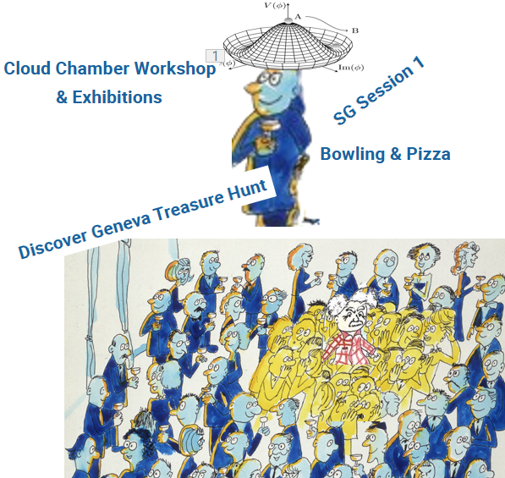
Our Key Takeaways so far
Instructions: Write in the box any insights, learnings and discussion outcomes.
(Decide how you as a group will present them if you are selected to present during the SG Report-Out.)

Slide 64
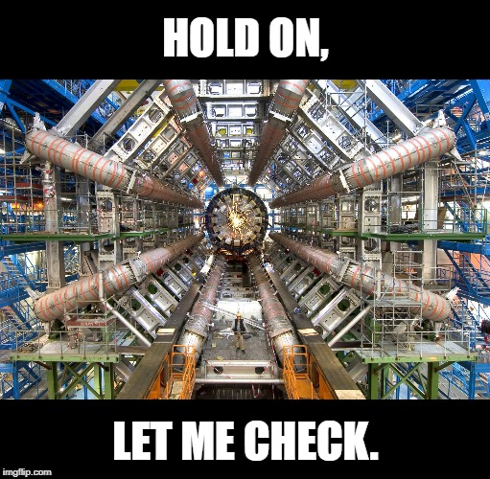
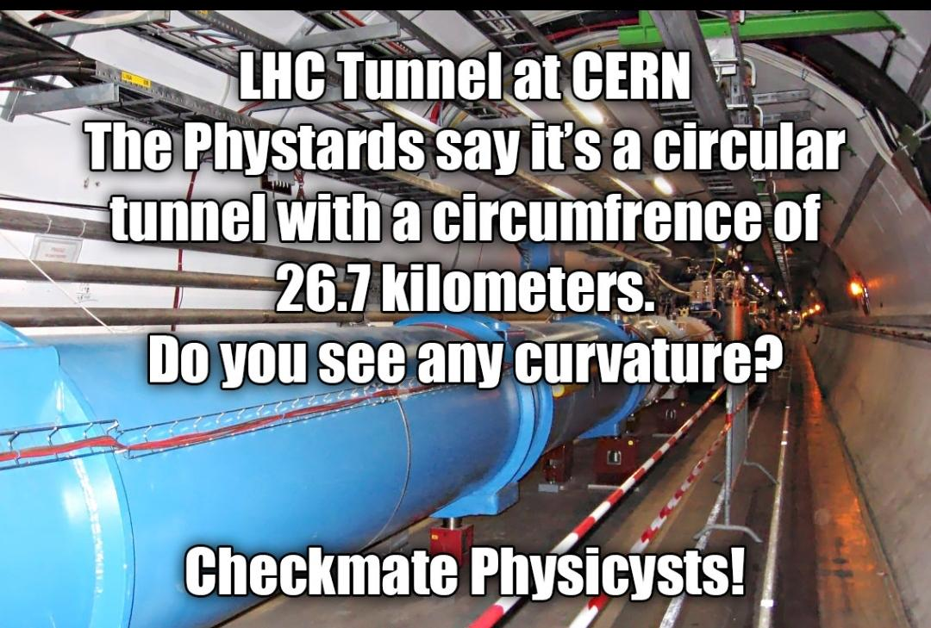
Our Feedback
so far
Highlights?
What’s working?
What needs improvement?
Other comments?
Funny picture or meme?
(Decide how you as a group will present them if you are selected to present during the SG Report-Out.)
On-site visits because it brings particle physics to life. Engaging lectures with very clear explanations.
It’s a good balance of work (between on-site visits and lectures) and play (relax time). Bowling!
EVERYTHING IS PERFECT! :) but please can you let us go down into the LHC tunnel…
Incredible meeting with and hearing stories from inspiring teachers from around the world

Slide 65
Tuesday, 15 July
SG Session 3

Slide 66
Checklist for SG Session 3
# | Type of Task | Task | Deadline
1 | Individual | Fill in slides corresponding to your colour | Tuesday, 17:30
2 | Group | Fill in “Our Key Takeaways” and “Our Feedback” slides as a group. Make sure you all contribute to the discussion. | Tuesday, 17:30
3 | Group | Decide how you as a group will present your group slides if you are selected to present during the SG Report-Out. | Tuesday, 17:30

Slide 67
Feynman
Diagrams
What would be a fun and creative way of introducing Feynman Diagrams in the classroom?
Which students’ conceptions would you expect to encounter and how would you address them?
Introduce the Feynman diagrams and ask students to brainstorm about what they think the diagrams represent. Ask them to see if they can identify patterns within the diagrams. Then, introduce some basic various rules for Feynman diagrams and get the students to further brainstorm about the meaning of the diagrams. Students share their thoughts.
Students would likely conceptualize the diagrams as a representation of physical movement in 2-dimensions and it would be necessary to talk about the nature of the time and distance axes. Students may struggle with reverse arrows for antiparticles and this will need discussion. Unusual symbols. I would try to get students to conceptualize and indicate how conservation laws are expressed within the diagrams.

Slide 68
Computing
at CERN
What are three key ideas about computing and data analysis at CERN that you would like your students to know about?
What are potential challenges students might encounter when learning about computing and data analysis at CERN?
The massive volume of data generated by the LHC and how it is filtered via “Triggers”. The necessity for shifting data to computing centres around the globe in order to manage the computing power required for data analysis (including at TRIUMF in Canada). Understanding the physical locations of the data (at LHC Computing centre locations and on “tape”)
Challenges may include students understanding the scale of computing required (ie. exabyte). Students understanding how the data is filtered in terms of triggers. Imagining the physical structure of the network and its various elements.

Slide 69
Medical Applications
What are three key ideas about medical applications of particle physics that you would like your students to know about?
What are potential challenges students might encounter when learning about medical applications of particle physics?
The key role of physics of accelerators beyond what occurs in particle accelerator labs (ie. at medical facilities). The different types of particles used to attack cancer. Cutting edge advancements such as as FLASH as a possibility for future therapy
Challenges may include understanding the differences between radiation types and optimizing the Bragg distance. Physical mechanisms in terms of DNA damage for how the radiation interacts with matter. The balancing of economics (expensive machines) with effectiveness (eradicating tumour)

Slide 70
My Key Takeaways so far
Instructions: Write in the box any insights or things that you learned and that you want to remember after the HST2025 programme.
The challenge of using Feyman effectively as a visual representation of interactions
Massive complexity of computing at CERN. How data is filtered, stored, and processed on an multinational scale
Historical evolution of radiation used in medical therapies
Key role of accelerators in medical physics (idea of HIT carbon ion beam, proton beam, and electron LINAC) and FLASH as a potential new therapy regimes.

Slide 71
Feynman
Diagrams
What would be a fun and creative way of introducing Feynman Diagrams in the classroom?
Which students’ conceptions would you expect to encounter and how would you address them?
Feynman Diagrams
🎭 “Particle Party” Role-Play
• Students act as particles (electron, positron, photon)
• Use props and movement to simulate interactions
• Sketch interactions as Feynman diagrams
🧠 Common Student (mis)Conceptions:
• Think diagrams show real paths
• Misunderstand time and particle direction
• Confuse virtual with real particles
Notes:
To make the abstract world of particle physics more accessible and fun, I start with a creative role-play activity I call a ‘Particle Party.’ Students act out interactions between particles using simple props. As they interact—say, an electron and positron annihilating into a photon—I draw the corresponding Feynman diagram on the board.
This activity not only sparks engagement but also reveals common misconceptions. For example, students often think these diagrams show literal paths through space, or that particles always move left to right. I use this moment to clarify that Feynman diagrams are symbolic tools for visualizing interactions and probabilities—not actual particle trajectories.
Addressing these early helps build a strong conceptual foundation for more complex quantum ideas

Slide 72
Computing
at CERN
What are three key ideas about computing and data analysis at CERN that you would like your students to know about?
What are potential challenges students might encounter when learning about computing and data analysis at CERN?
Computing at CERN
3 Key Ideas about computing:
  🌐 Huge Data Volumes – CERN generates petabytes of data from collisions.
  💻 Worldwide Grid Computing – Data is shared and analyzed globally.
  🧠 AI & Machine Learning – Used to sift through data and find meaningful patterns.
⚠️ Student Challenges:
  Abstract concepts (e.g. big data, distributed computing)
  Technical jargon
  Understanding how AI fits into physics research
Notes:
When introducing CERN’s computing and data analysis, I focus on three key ideas students should grasp:
First, the scale—CERN experiments produce petabytes of data per second, far beyond what a single computer can handle.
Second, CERN uses a Worldwide LHC Computing Grid—a global network of computers sharing the workload.
Third, AI and machine learning play a growing role, helping physicists identify patterns and rare events in the sea of data.
But students may find this challenging. The size of the data is hard to visualize, distributed computing is a new concept to many, and the role of AI in physics may seem abstract. I tackle this by using real-life analogies (e.g., streaming platforms for data flow, or facial recognition for pattern-finding) to make the concepts more relatable.

Slide 73
Medical Applications
What are three key ideas about medical applications of particle physics that you would like your students to know about?
What are potential challenges students might encounter when learning about medical applications of particle physics?
Medical Applications
✅ 3 Key Ideas about medical applications of particle physics:
🎯 Cancer Treatment – Proton therapy targets tumors precisely.
🔍 Imaging Techniques – PET scans use particle detectors to image the body.
⚛️ Technology Transfer – Innovations from particle physics improve medical tools.
⚠️ Student Challenges:
Connecting abstract physics to real-life medicine
Understanding how detectors apply outside the lab
Confusing radiation use in treatment vs. diagnostics
Notes:
When discussing the impact of particle physics beyond the lab, medical applications are a great way to connect science to real life.
First, particle accelerators are used in proton therapy, which targets cancer cells with incredible precision, minimizing damage to healthy tissue.
Second, PET scans rely on particle detectors to image the body from inside—this is a direct use of particle physics in diagnostics.
Third, many technological advances from physics labs, like detectors and imaging software, are now used in hospitals.
Students may struggle to see the connection between high-energy physics and healthcare. They might not realize that tools built for fundamental science can directly help save lives. It also helps to clarify the different roles of radiation: one for imaging, another for treatment. Using concrete examples and patient stories can make these ideas more engaging and meaningful.

Slide 74
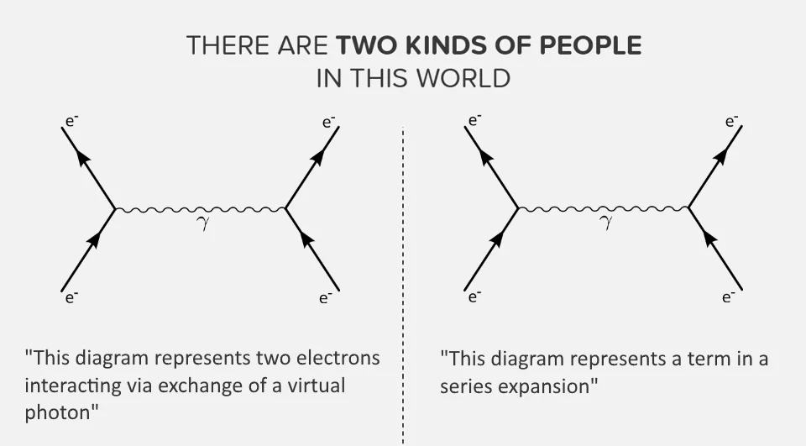
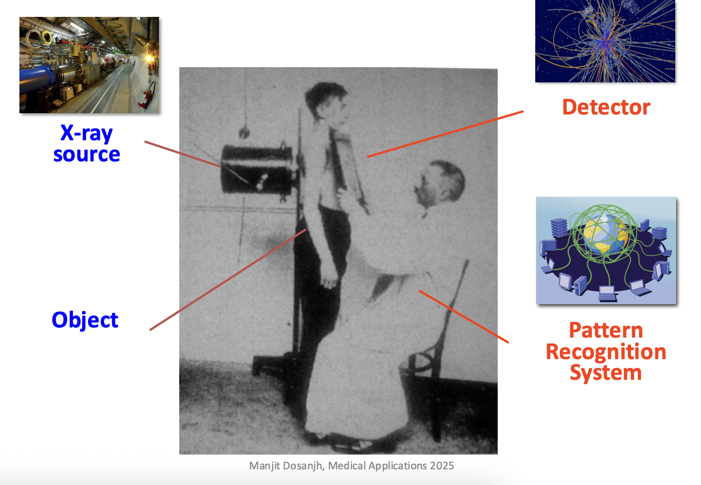
My Key Takeaways so far
Instructions: Write in the box any insights or things that you learned and that you want to remember after the HST2025 programme.
My Key Takeaways so far #3

Slide 75
Feynman
Diagrams
What would be a fun and creative way of introducing Feynman Diagrams in the classroom?
Which students’ conceptions would you expect to encounter and how would you address them?
Feynman Diagram
I will display a basic Feynman diagram on the board, I will allow students to draw Feynman diagram using graphic software like CorelDraw
Vertice, particle interaction (spring like)
To address the conception: I will use direct teaching to explain ideas about verice. Particle interaction

Slide 76
Computing
at CERN
What are three key ideas about computing and data analysis at CERN that you would like your students to know about?
What are potential challenges students might encounter when learning about computing and data analysis at CERN?
1
Large data Data storage
Data comes from event happening in the detector
Trigger: filter data of interest
2
Data is collected in real time event
Using data to make sense about particle of interest
Data is change into graph, plot and infographic

Slide 77
Medical Applications
What are three key ideas about medical applications of particle physics that you would like your students to know about?
What are potential challenges students might encounter when learning about medical applications of particle physics?
1
X-ray is used to treat cancer
Machines that accelerate particles for medical application
Side effect associated with particle in medical applications
2
Limited machines that demonstrate application of particle in medical application
Vocabulary/terminologies use
The mechanism of particle interacting with turmoil to detect and treat turmoil

Slide 78
My Key Takeaways so far
Instructions: Write in the box any insights or things that you learned and that you want to remember after the HST2025 programme.
Accelerated particles are used in medical application: eg. Detecting and treating cancer.
Data are collected in real time during smashing in a detector for analysis.

Slide 79
Feynman
Diagrams
What would be a fun and creative way of introducing Feynman Diagrams in the classroom?
Which students’ conceptions would you expect to encounter and how would you address them?
1- Creative Classroom Introduction: Feynman Diagrams
Start with a "Particle Exchange Game" using a soft ball tossed between students to represent exchange particles and visualize forces.
Show how the toss can be drawn as lines and vertices, leading naturally into the basics of Feynman diagrams.
Expect students to think the lines are real particle paths or virtual particles are "real."
Clarify diagrams are calculation tools, not literal paths, and virtual particles are representations, not observable particles.
Encourage students to build their own diagrams, labeling each part and checking for conservation laws.
2-
Address misconceptions directly with simple analogies and group challenges to reinforce correct concepts.

Slide 80
Computing
at CERN
What are three key ideas about computing and data analysis at CERN that you would like your students to know about?
What are potential challenges students might encounter when learning about computing and data analysis at CERN?
1- Three key ideas about computing and data analysis at CERN that students should know:
Massive Data Storage:
Powerful, Distributed Processing:
The Computing Grid:
2- Students learning about computing and data analysis at CERN may face several challenges:
Sheer complexity and data volume:
Understanding distributed computing:
Technical skills and software tools:

Slide 81
Medical Applications
What are three key ideas about medical applications of particle physics that you would like your students to know about?
What are potential challenges students might encounter when learning about medical applications of particle physics?
1- Three key ideas about the medical applications of particle physics that my students should know:
Cancer treatment breakthroughs:
Innovative medical imaging:
CERN’s ongoing impact:
2- Students might encounter several challenges when learning about medical applications of particle physics:
Difficulty connecting physics with real medical applications, as students often only know the basic concept of X-rays or radiation and may not see how advanced physics leads to modern diagnostics and treatments.
Understanding complex equipment and terminology such as “resonance,” “axial tomography,” or how MRI, PET, and CAT scans work, which involves new physics concepts and unfamiliar terms.
Grasping how different particles interact with matter and their biological effects, as well as the underlying principles applied in diagnosis and therapy

Slide 82
My Key Takeaways so far
Instructions: Write in the box any insights or things that you learned and that you want to remember after the HST2025 programme.
During the HST2025 programme, I learned how large-scale scientific research at CERN can be integrated into high school education to inspire students and make cutting-edge physics accessible. I gained practical skills in presenting complex ideas clearly, discovered new ways to use real particle physics data in the classroom, and saw firsthand the value of international collaboration in science education. I want to remember the impact that authentic scientific experiences and experiments can have on students, encouraging curiosity, critical thinking, and a passion for discovery.

Slide 83
Feynman
Diagrams
What would be a fun and creative way of introducing Feynman Diagrams in the classroom?
Which students’ conceptions would you expect to encounter and how would you address them?
Introducing Feynman Diagrams
Imagine two trolleys moving towards a point, they collide and bounce off each other, in what directions can they be pushed off. Draw a diagram using straight lines to represent the directions of the trolleys' movement and wavy lines to represent the position where they interact.
Students’ conceptions
Student can think the diagram show the real path of particle and it just has one possibility or all possibility are equally.
To address this problem, I will use the model to change some direction in the above diagram to show student that one interaction could have many possibilities.

Slide 84
Computing
at CERN
What are three key ideas about computing and data analysis at CERN that you would like your students to know about?
What are potential challenges students might encounter when learning about computing and data analysis at CERN?
How has the speed of data analysis improved over time to cope with the huge amount of data?
5PB
hard to lose data.
5PB
Data centres are not common in our area.

Slide 85
Medical Applications
What are three key ideas about medical applications of particle physics that you would like your students to know about?
What are potential challenges students might encounter when learning about medical applications of particle physics?
Fact about cancer
Therapy for treating cance
No access

Slide 86
My Key Takeaways so far
Instructions: Write in the box any insights or things that you learned and that you want to remember after the HST2025 programme.

Slide 87
Feynman
Diagrams
What would be a fun and creative way of introducing Feynman Diagrams in the classroom?
Which students’ conceptions would you expect to encounter and how would you address them?
Introducing Feynman’s Diagrams in the classroom in a fun and creative way:
Feynman used lines, squiggles and arrows to show how particles interact or change forms instead of using words.
We can show real physics processes like pair production and give 3 Feynman diagrams and the students should vote (secretly) which diagram shows a photon turning into an electron-positron pair.
Next level would be to use Feynman Diagram Generators
Students conceptions
“Feynman’s Diagrams are hard to understand !”
Well let’s give it a try with the simple example…

Slide 88
Computing
at CERN
What are three key ideas about computing and data analysis at CERN that you would like your students to know about?
What are potential challenges students might encounter when learning about computing and data analysis at CERN?
Three key ideas about computing and data analysis at CERN :
massive data storage is a challenge
-the computing grid all over the world
- electronic triggers are reducing the amount of data that needs to be processed
Potential challenges for students:
They should already know something about big data and distributed computing

Slide 89
Medical Applications
What are three key ideas about medical applications of particle physics that you would like your students to know about?
What are potential challenges students might encounter when learning about medical applications of particle physics?
Three key ideas about medical applications of particle physics :
-ever since the discovery of X-rays and radioactivity, physics is helping medicine to diagnose and treat patients
-radiation therapy is designed to damage the DNA of cancer cells
- LINACS are commonly used for beam radiation treatment but we are expecting heavy-particle accelerators from protons to carbon to improve the treatment results along with FLASH
Potential challenges for the students:
Misconceptions about ionising radiation and negative feelings about the disease

Slide 90
My Key Takeaways so far
Instructions: Write in the box any insights or things that you learned and that you want to remember after the HST2025 programme.
CERN is using tape for long-term big data storage because it is more cost-effective and secure.
Triggers drastically reduce data – only interesting events are kept for analysis.
Feynman diagrams show interactions between particles.and are not so difficult to use
Perimeter institute
Radiation therapy is powerful but under utilized
FLASH therapy could be life saving in the future

Slide 91

Study Group Discussion
Share your individual insights with your colleagues and identify shared themes.
Have some ice cream and don’t forget to
take notes :)
Surprised that main data storage mechanism is “tape”
The role of triggers in reducing the amount of data that needs to be processed
Feynman diagrams as a representation of interactions that can be rotated in multiple directions
Possible misconception: diagram representation the actual particle trajectory (in reality multiple possibilities each with a different probability)
Radiation therapy is very effective and underused
Challenge of balancing effective radiation therapy with availability/cost of technology
FLASH at the cutting edge of potential exciting new treatment regime (with less effect on healthy cells)

Slide 92
Our Key Takeaways so far
Instructions: Write in the box any insights, learnings and discussion outcomes.
(Decide how you as a group will present them if you are selected to present during the SG Report-Out.)
💾 CERN still relies on tape for long-term data storage – it’s secure and cost-effective.
⚡ Triggers drastically reduce data – only interesting events are kept for analysis.
🔄 Feynman diagrams show interactions, not paths – and can be rotated depending on conventions.
☢️ Radiation therapy is powerful but underutilized – due to access and cost limitations.
🚀 FLASH therapy offers promising future – targets tumors while sparing healthy cells.

Slide 93
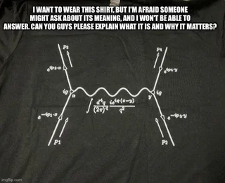
Our Feedback
so far
Highlights?
What’s working?
What needs improvement?
Other comments?
Funny picture or meme?
(Decide how you as a group will present them if you are selected to present during the SG Report-Out.)
-Magnetohydrodynamic propulsion (PI) activity
-Mystery box activity with Jeff
-Perimeter gave many valuable demonstrations and interactive activities but was delivered a bit too rapidly (delivery technique did not resonate with everyone)
- Content overview (one-pager) could have resulted in less feeling of confusion and more efficient intake of information we learned in the PI workshop.
-The level of organization for this course has been superb, and the expectations have been very high (which led to a bit of criticism of the method of facilitator interaction from the Perimeter workshop)

Slide 94
Thursday, 17 July
SG Session 4

Slide 95
Checklist for SG Session 4
# | Type of Task | Task | Deadline
1 | Individual | Fill in slides corresponding to your colour | Thursday, 14:30
2 | Group | Fill in the “Our Key Takeaways from HST2025” slide as a group. Make sure you all contribute to the discussion. | Thursday, 15:00
3 | Group | Discuss the topic that was assigned to your study group for the Final Presentation on Friday morning. Share and collect your individual experiences with this topic. | Thursday, 16:00
4 | Group | Prepare a detailed and entertaining presentation to share your results with your colleagues. Make sure that everyone plays an active role during the Final Presentation! | Thursday, 17:00

Slide 96
Antimatter
vs
Dark Matter
What are three key ideas about antimatter research at CERN that you would like your students to know about?
What would be a good approach to explain the difference between antimatter and dark matter to your students?
The difference linguistically between antiparticles and antimatter
The idea of combining positron and electron to make antihydrogen

Slide 97
Future Particle Accelerators
What are five key ideas about future particle accelerators and acceleration technologies that you would like your students to know about?
What kind of career opportunities in particle physics are you definitely going to showcase to your students?
Different approaches to accelerator design
Financial and political considerations
Reasoning about why to go linear vs circular
Wakefield acceleration as a potential mechanism

Slide 98
My Key Takeaways from HST2025
Instructions: Write in the box any insights or things that you learned and that you want to remember after the HST2025 programme.
Incredible task to make the FCC

Slide 99
Antimatter
vs
Dark Matter
What are three key ideas about antimatter research at CERN that you would like your students to know about?
What would be a good approach to explain the difference between antimatter and dark matter to your students?

Slide 100
Future Particle Accelerators
What are five key ideas about future particle accelerators and acceleration technologies that you would like your students to know about?
What kind of career opportunities in particle physics are you definitely going to showcase to your students?

Slide 101
My Key Takeaways from HST2025
Instructions: Write in the box any insights or things that you learned and that you want to remember after the HST2025 programme.

Slide 102
Antimatter
vs
Dark Matter
What are three key ideas about antimatter research at CERN that you would like your students to know about?
What would be a good approach to explain the difference between antimatter and dark matter to your students?

Slide 103
Future Particle Accelerators
What are five key ideas about future particle accelerators and acceleration technologies that you would like your students to know about?
What kind of career opportunities in particle physics are you definitely going to showcase to your students?

Slide 104
My Key Takeaways from HST2025
Instructions: Write in the box any insights or things that you learned and that you want to remember after the HST2025 programme.

Slide 105
Antimatter
vs
Dark Matter
What are three key ideas about antimatter research at CERN that you would like your students to know about?
What would be a good approach to explain the difference between antimatter and dark matter to your students?

Slide 106
Future Particle Accelerators
What are five key ideas about future particle accelerators and acceleration technologies that you would like your students to know about?
What kind of career opportunities in particle physics are you definitely going to showcase to your students?

Slide 107
My Key Takeaways from HST2025
Instructions: Write in the box any insights or things that you learned and that you want to remember after the HST2025 programme.

Slide 108
Antimatter
vs
Dark Matter
What are three key ideas about antimatter research at CERN that you would like your students to know about?
What would be a good approach to explain the difference between antimatter and dark matter to your students?

Slide 109
Future Particle Accelerators
What are five key ideas about future particle accelerators and acceleration technologies that you would like your students to know about?
What kind of career opportunities in particle physics are you definitely going to showcase to your students?

Slide 110
My Key Takeaways from HST2025
Instructions: Write in the box any insights or things that you learned and that you want to remember after the HST2025 programme.

Slide 111
Antimatter
vs
Dark Matter
What are three key ideas about antimatter research at CERN that you would like your students to know about?
What would be a good approach to explain the difference between antimatter and dark matter to your students?

Slide 112
Future Particle Accelerators
What are five key ideas about future particle accelerators and acceleration technologies that you would like your students to know about?
What kind of career opportunities in particle physics are you definitely going to showcase to your students?

Slide 113
My Key Takeaways from HST2025
Instructions: Write in the box any insights or things that you learned and that you want to remember after the HST2025 programme.

Slide 114
Study Group Discussion
Share your individual insights with your colleagues and identify shared themes.
Have some ice cream and don’t forget to
take notes :)

Slide 115
Our Key Takeaways from HST2025

Slide 116
Final Presentation Guidelines
Presentation | 10 minutes + 5 minutes for Q&A
Style | Fun, entertaining & on time!
Contents | Curriculum & classroom connections Key ideas Potential students’ conceptions & challenges Helpful material and resources Best practice example
Final Slide | Key Takeaways & Goodbye messages

Slide 117
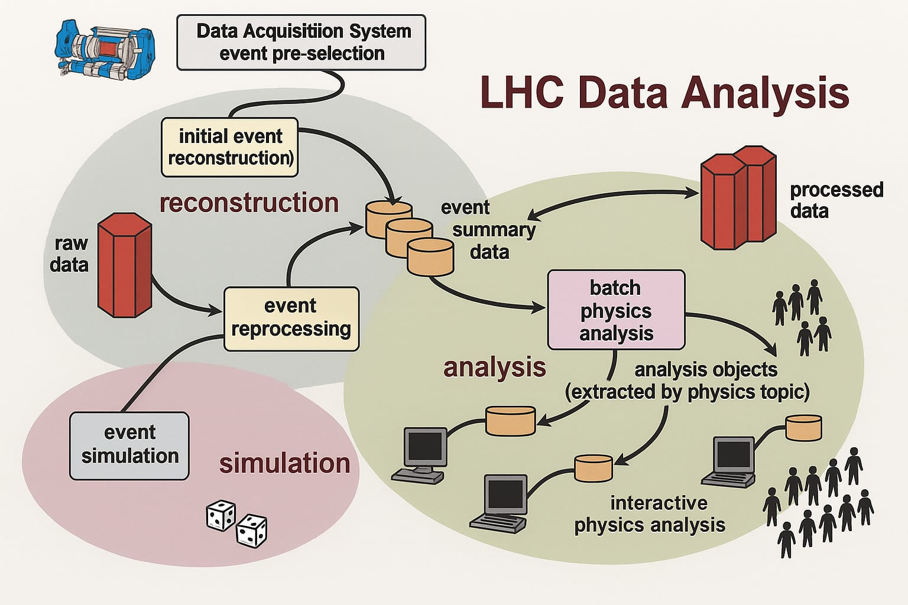
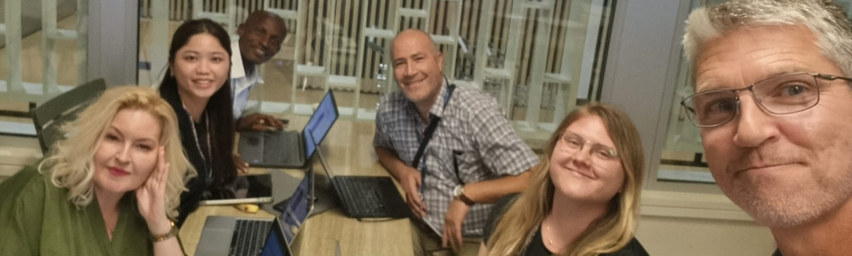
Computing at CERN
HST2025 Study Group 2

Slide 118

Key Ideas (Ed)
Showcase the most important aspects of the topic that you consider to be key for a meaningful instruction
Massive volume of data (orders of magnitude)
Critical role of trigger algorithms in filtering the data for further analysis without losing key information. (future AI and machine learning networks proposed for use in HL-LHC)
Importance of international computing power and international collaboration to analyze and also facilitate sharing of data (CERN freely shares)
Computing (as part of science) is evolving and constantly innovating (10x computing power gap to the HL-LHC)
Electricity, electrical systems, and tape storage systems used to support computing grid (physics of computing)

Slide 119
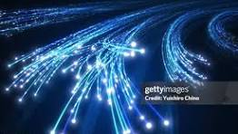
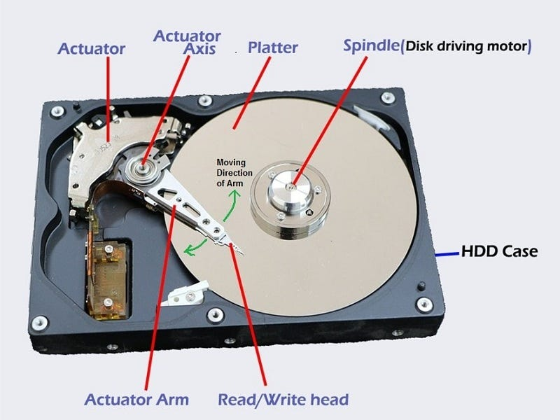
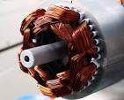
Curriculum & Classroom Connections (Akpa)
Electricity: flow of charges is use to power computer
Optics: the concept of total internal reflection is used in optical cable to transmit data in a computer network
Magnet: principle of magnetic field is used in the operation of storage devices such as flash, hard disk, tape to store and retrieve large amount of digital data
Electromagnetic: concept of electromagnet is used in computer motor to spin storage device (Hard disk) that store data
Laboratory work: Use Excel to analyse data as well as produce graph.
Notes:
Computer at CERN provides powerful context that can bridge the gap between concepts in physics and practical application which deepen students understanding

Slide 120
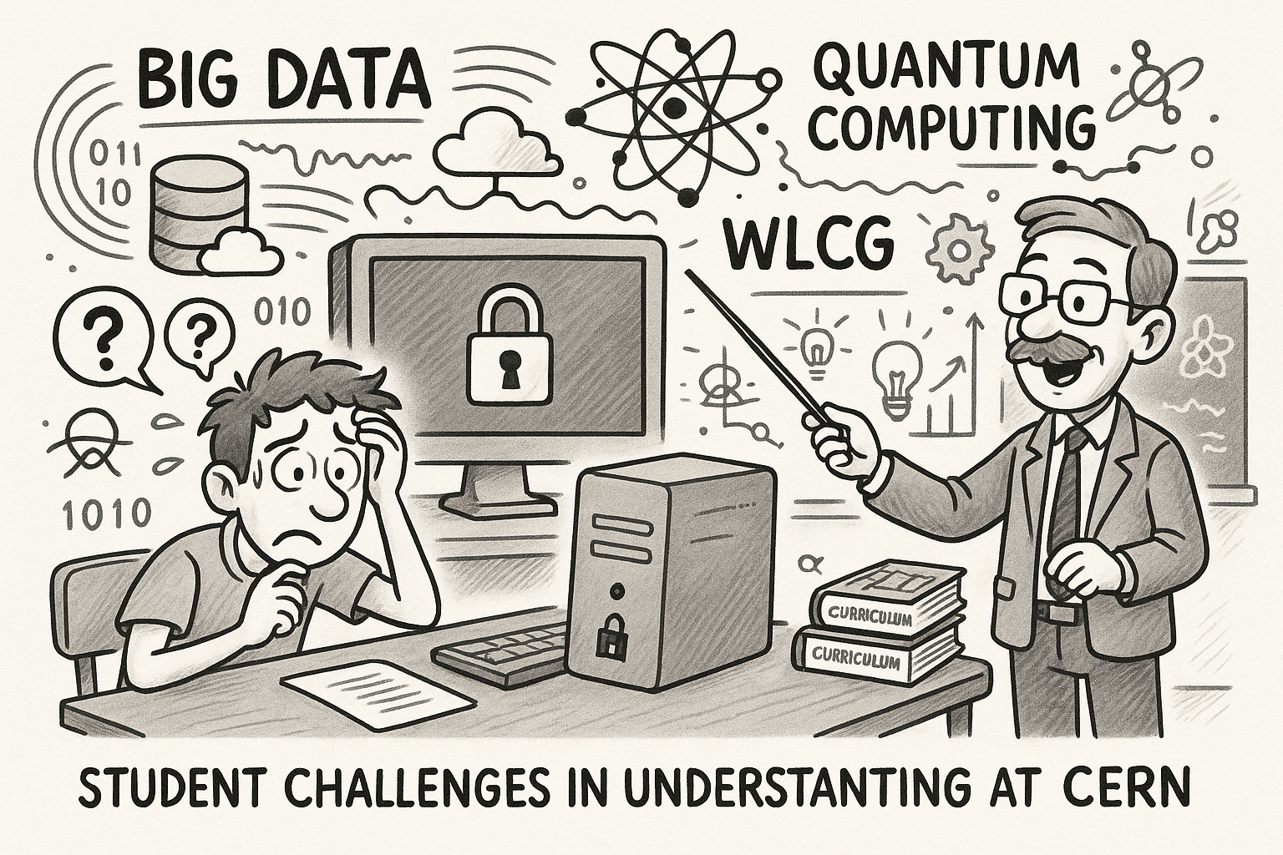

Potential Students’ Conceptions & Challenges
Key ideas : data storage, processing, exchange, and cryptography.
Challenges : the concepts are abstract and filled with intimidating jargon.
analogies, practical activities, and real-life examples
Ilclassroom

Slide 121
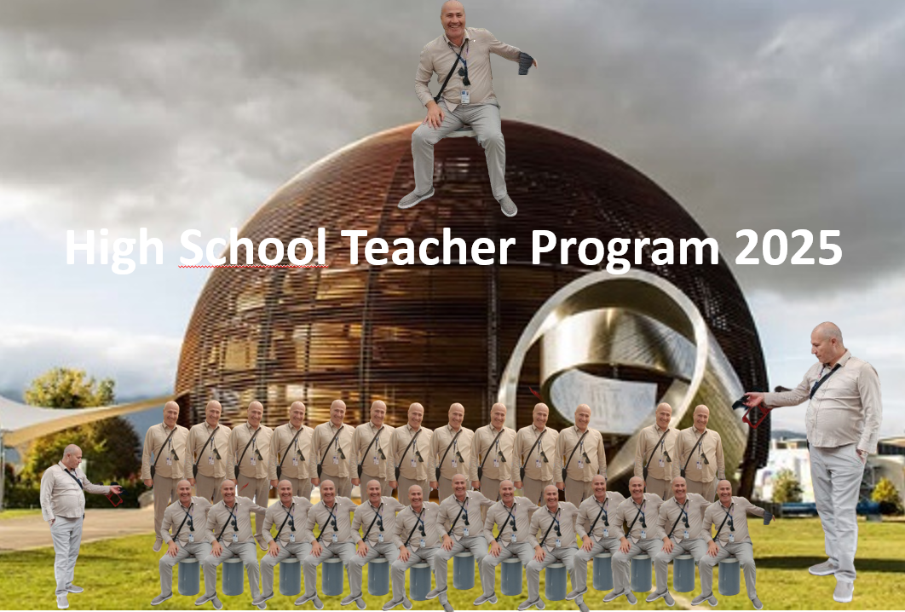

Slide 122
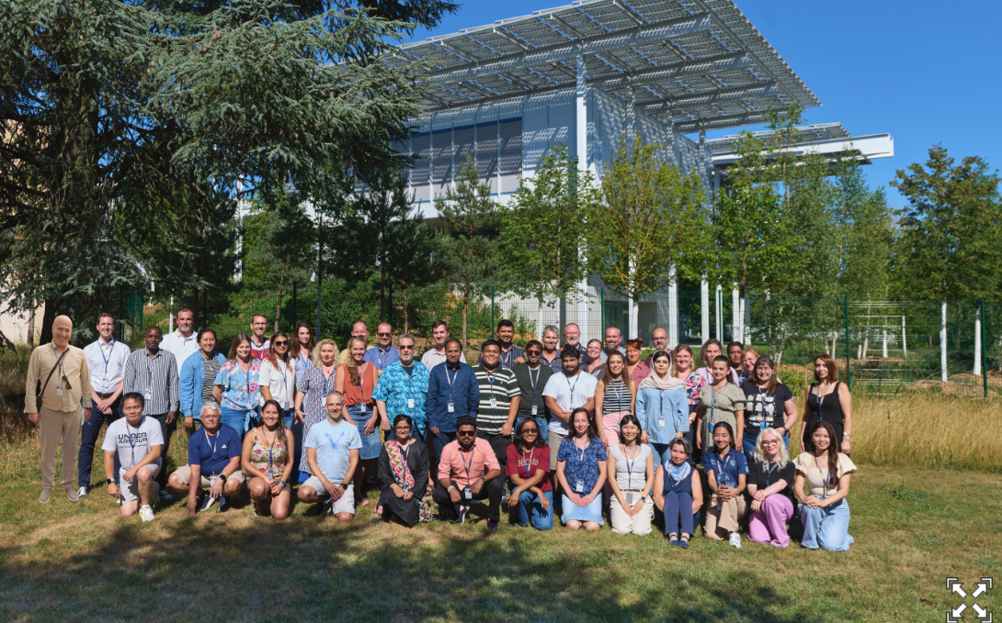

Slide 123

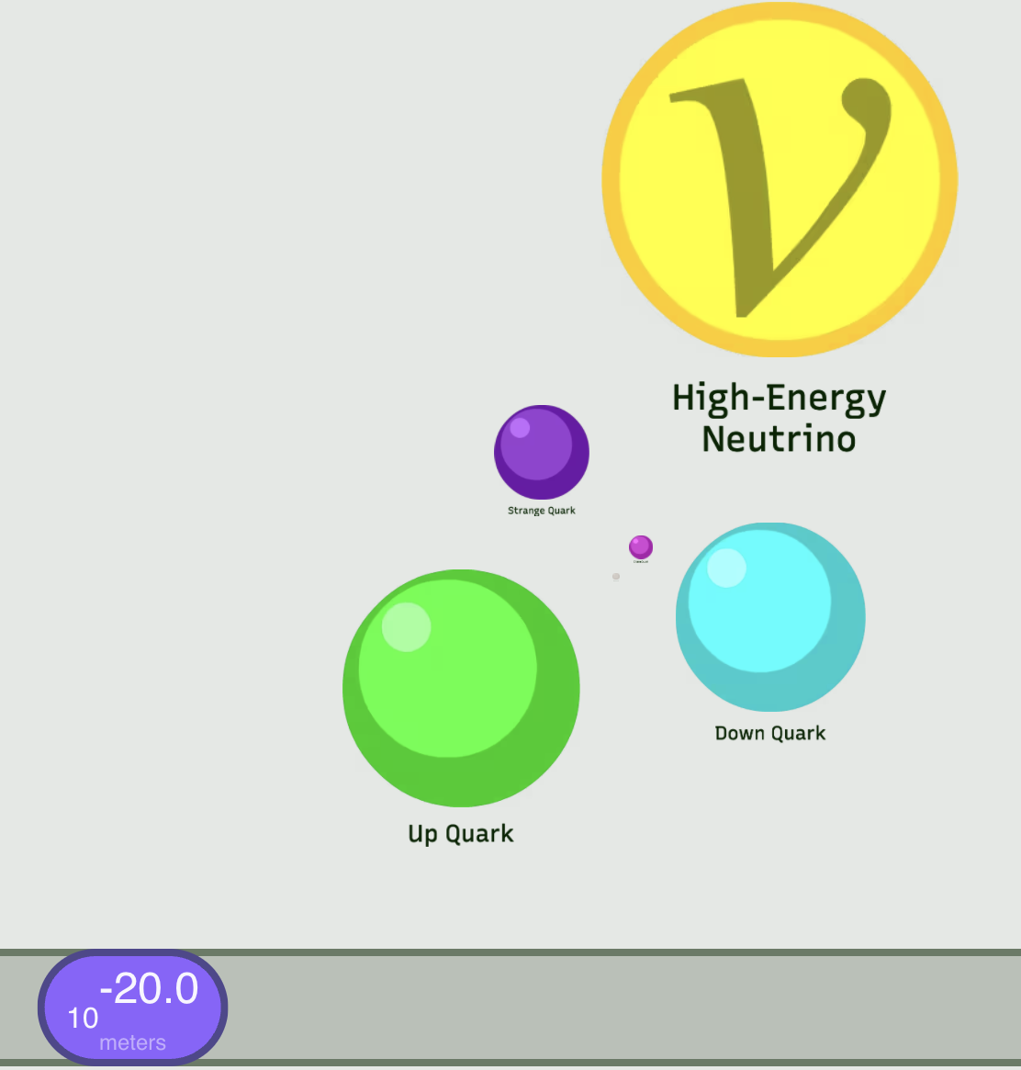






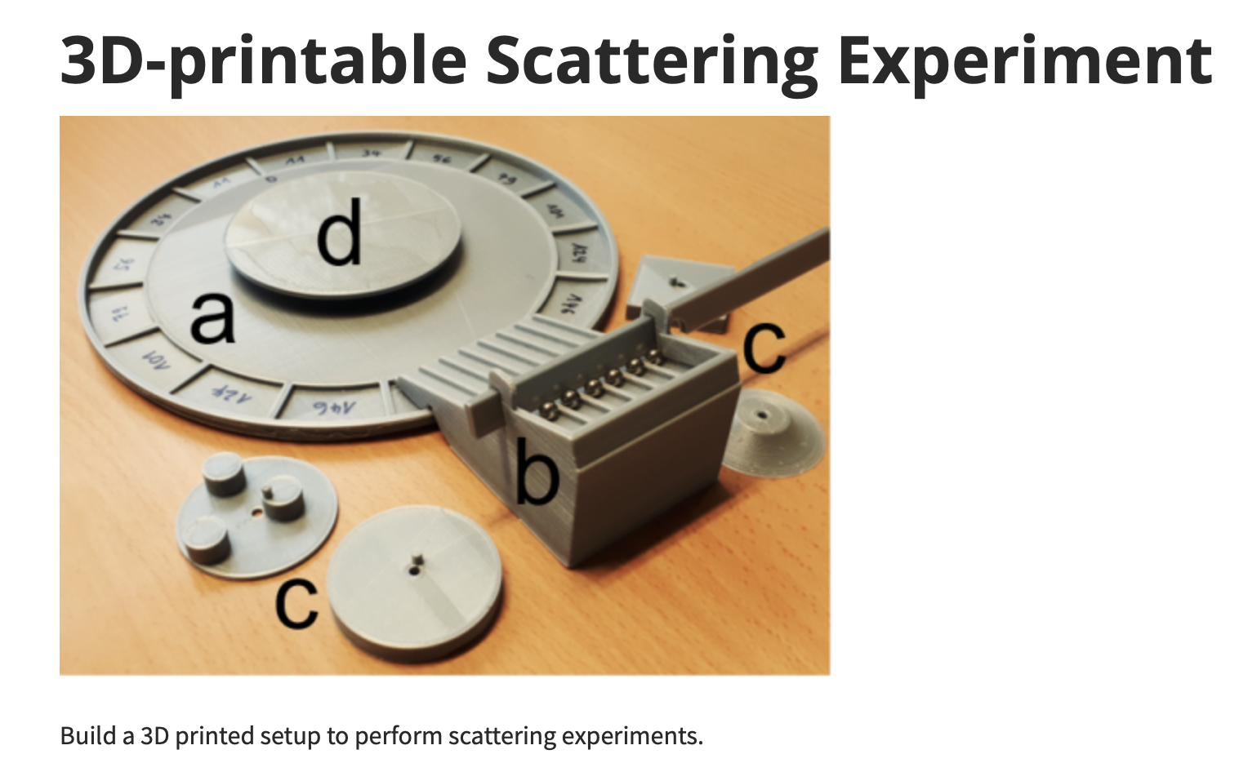
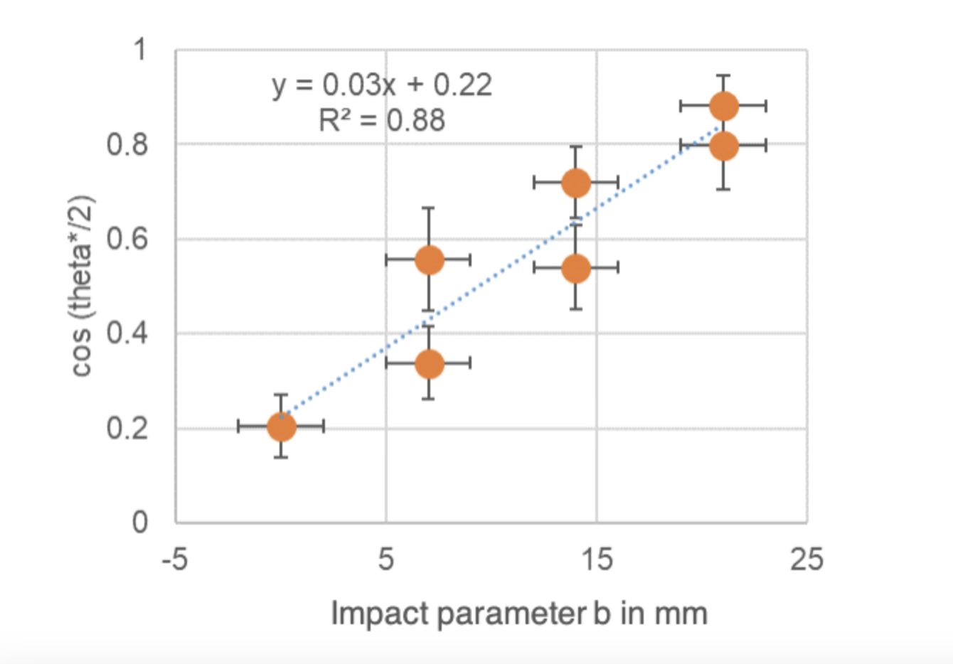
Useful Material & Resources (Quynh)
1. Interactive simulations
https://phet.colorado.edu
https://www.myphysicslab.com
https://scaleofuniverse.com/en
2. Measuring physics quantities: Physics Toolbox, Phyphox
3. Open source hardware and software: Arduino
4. Modeling or data analysis
https://per.web.cern.ch/

Slide 124
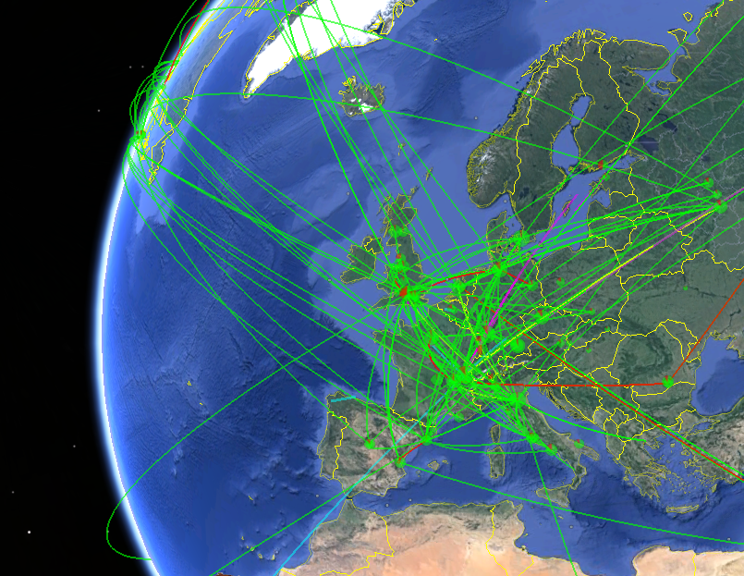
Best Practice Example (Dragana blending fundamental science with computing)
The Worldwide LHC Computing Grid (WLCG)
We start by introducing CERN and LHC to students and then we connect it with the role of computing, data collection, storing Big Data, analysis with the use of Machine Learning (ML). Our goal is to explain the importance of computing in physics with meaningful, real data from CERN.
Grid Computing
Example of the Worldwide LHC Computing Grid to work with Big Data and distributed computing
Teach with open data https://opendata.cern.ch/
Combining educationals datasets (smaller and simplified for classroom use) from CERN Open Data Portal and analysing it with available software (Jupyter Notebook example that uses Python)
Track a particle, identify a particle like in a masterclass
Analyse hits from a detector, classify particle tracks with the help of ML, reconstruct particles using decay products (look for Higgs via 4 muons or look for Z boson ). Possible use of dimensionality reduction techniques like PCA, or UMAP to visualize event distribution
Simulations with Geant 4 or ROOT to help visualisation https://geant4.web.cern.ch/support/training
Demonstration only for high school because coding is complex
Use of toolkit for simulations of collisions and the passage of particles through detectors and possible talk about energy, momentum, charge.

Slide 125
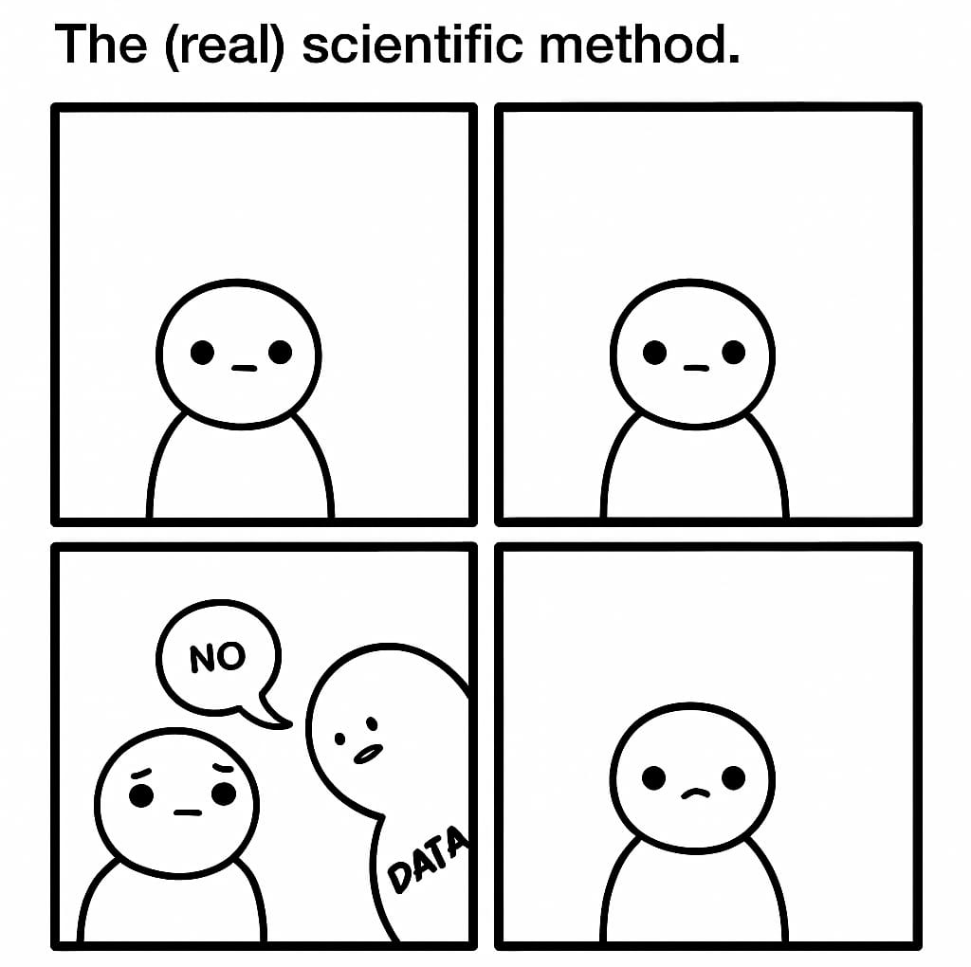
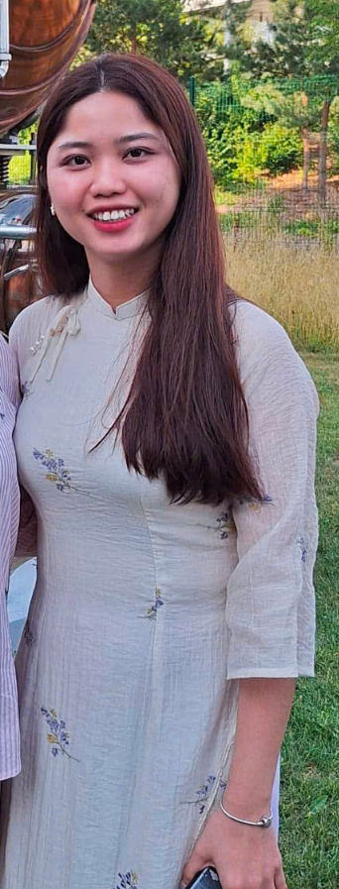
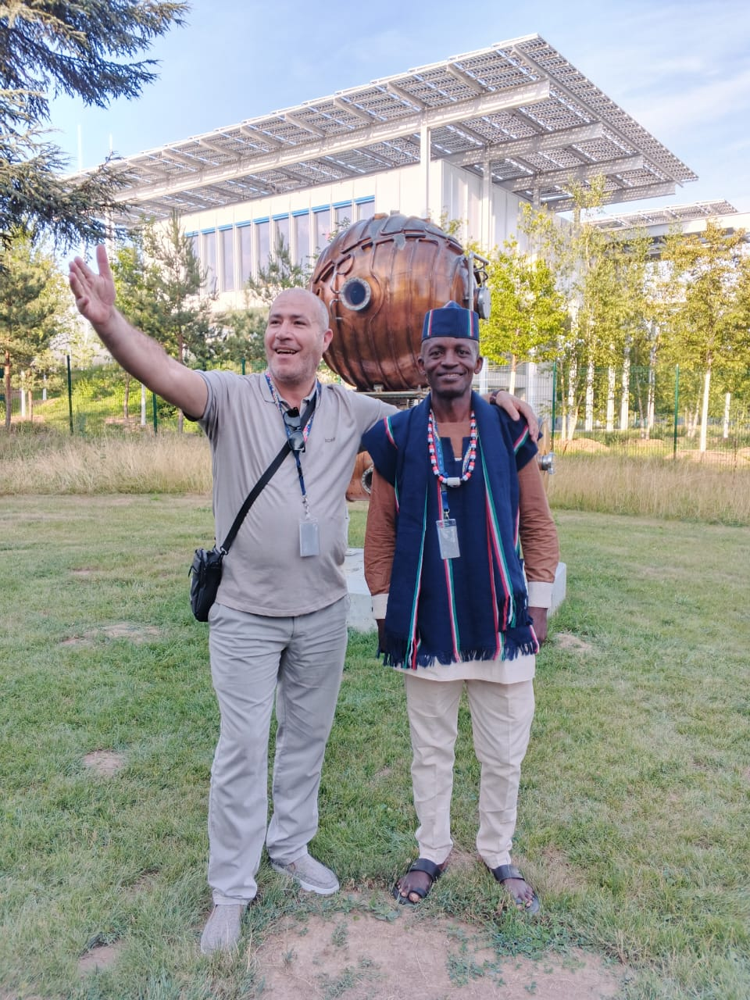
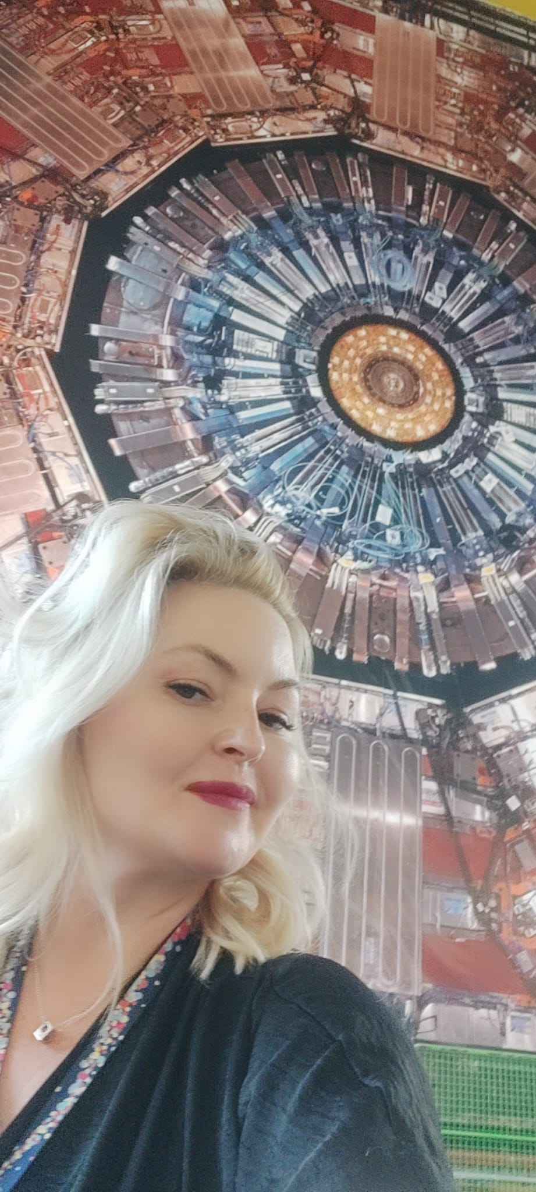
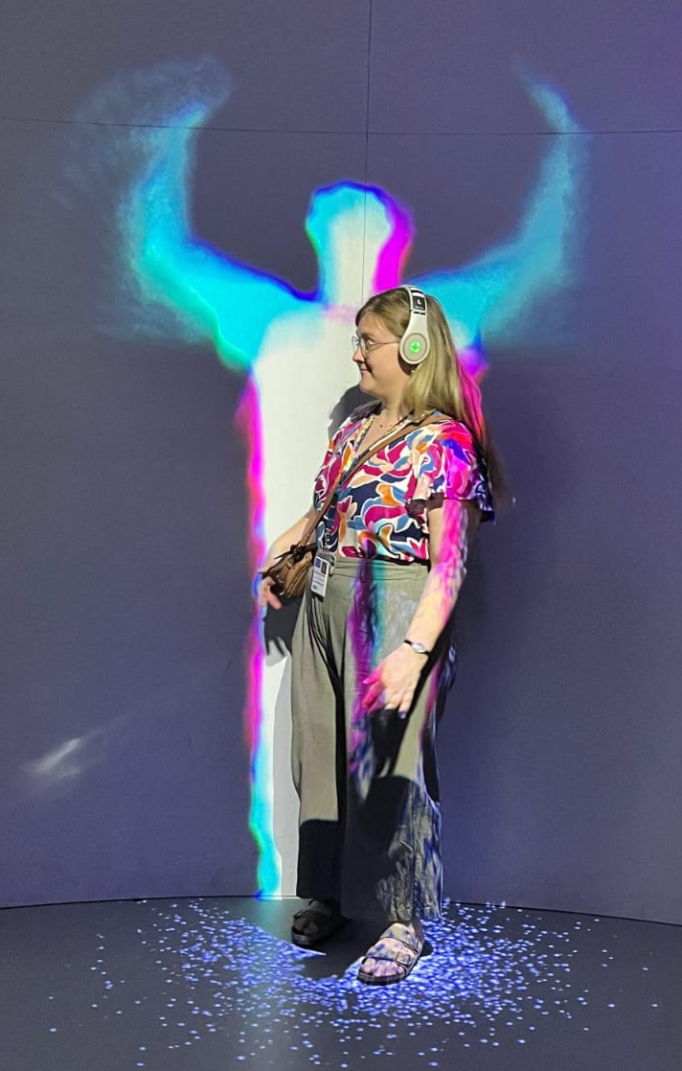
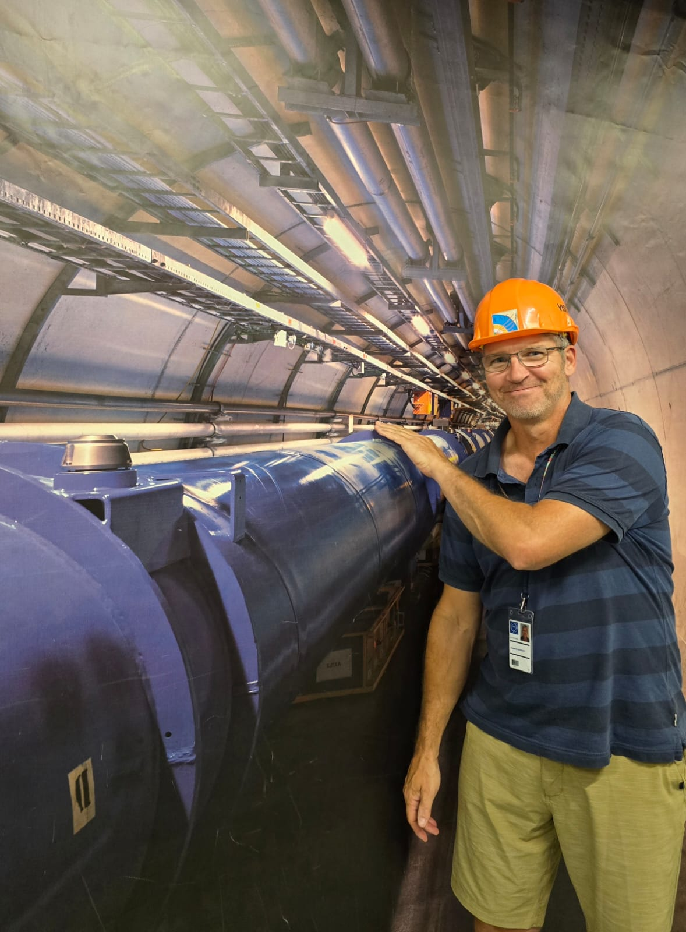
HST2025 Study Group 2
Semra (Bosnia-Herzegovina), Ed (C-eh-N-eh-D-eh), Quiynh (Vietnam), Salim (Algeria), Akpo (Nigeria), Dragana (Serbia)
One way in which our thinking has changed…
Highlights and snapshots:
Notes:
One way in which our thinking has changed is in how we view the work being done at CERN. Initially, we may have seen it as simply high-level particle physics research, but our understanding has deepened into a more complex and multifaceted outlook. We now recognize CERN as not just a scientific institution, but as a hub of collaborative effort, where physicists, engineers, and thinkers from around the world unite in pursuit of knowledge and peace—science for peace.
This multifocal approach to problem-solving, blending theory, experimentation, engineering, and international cooperation, has reshaped how we think about science itself. It's not just about the results, such as exam scores or even discoveries, but also about qualities like innovativeness, initiative, and resilience. These are the traits that truly define success as a physicist, especially in a research environment as challenging and dynamic as CERN.
What is CERN?
not just as a center for high-level particle physics, but as a multifocal, collaborative space where science serves a broader purpose.
We've come to see it as a real-world example of how the scientific approach, driven by international cooperation and shared values, can promote peace and global progress.

Slide 126
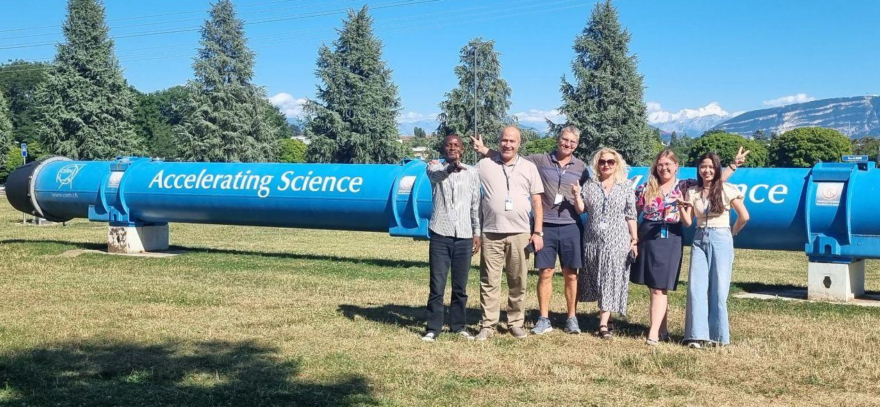
HST2025 Study Group 2
Semra (Bosnia-Herzegovina), Ed (C-eh-N-eh-D-eh), Quynh (Vietnam), Salim (Algeria), Akpo (Nigeria), Dragana (Serbia)
Our farewell message:
It's not annihilation — just a temporary separation. We'll collide again soon.
Study group #2
Notes:
One way in which our thinking has changed is in how we view the work being done at CERN. Initially, we may have seen it as simply high-level particle physics research, but our understanding has deepened into a more complex and multifaceted outlook. We now recognize CERN as not just a scientific institution, but as a hub of collaborative effort, where physicists, engineers, and thinkers from around the world unite in pursuit of knowledge and peace—science for peace.
This multifocal approach to problem-solving, blending theory, experimentation, engineering, and international cooperation, has reshaped how we think about science itself. It's not just about the results, such as exam scores or even discoveries, but also about qualities like innovativeness, initiative, and resilience. These are the traits that truly define success as a physicist, especially in a research environment as challenging and dynamic as CERN.

Slide 128
