Slide 1
Study Group 9
International High School Teacher Programme 2025

Slide 2
Wednesday, 9 July
SG Session 1

Slide 3
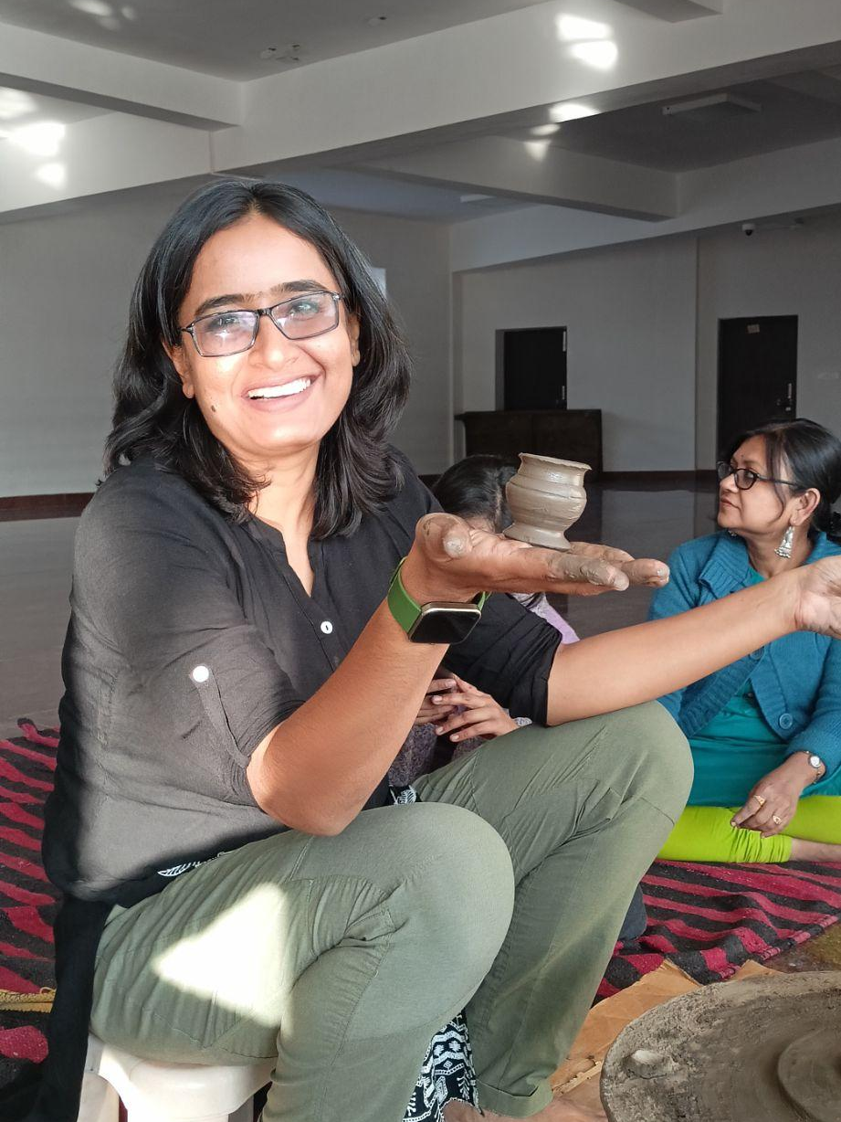
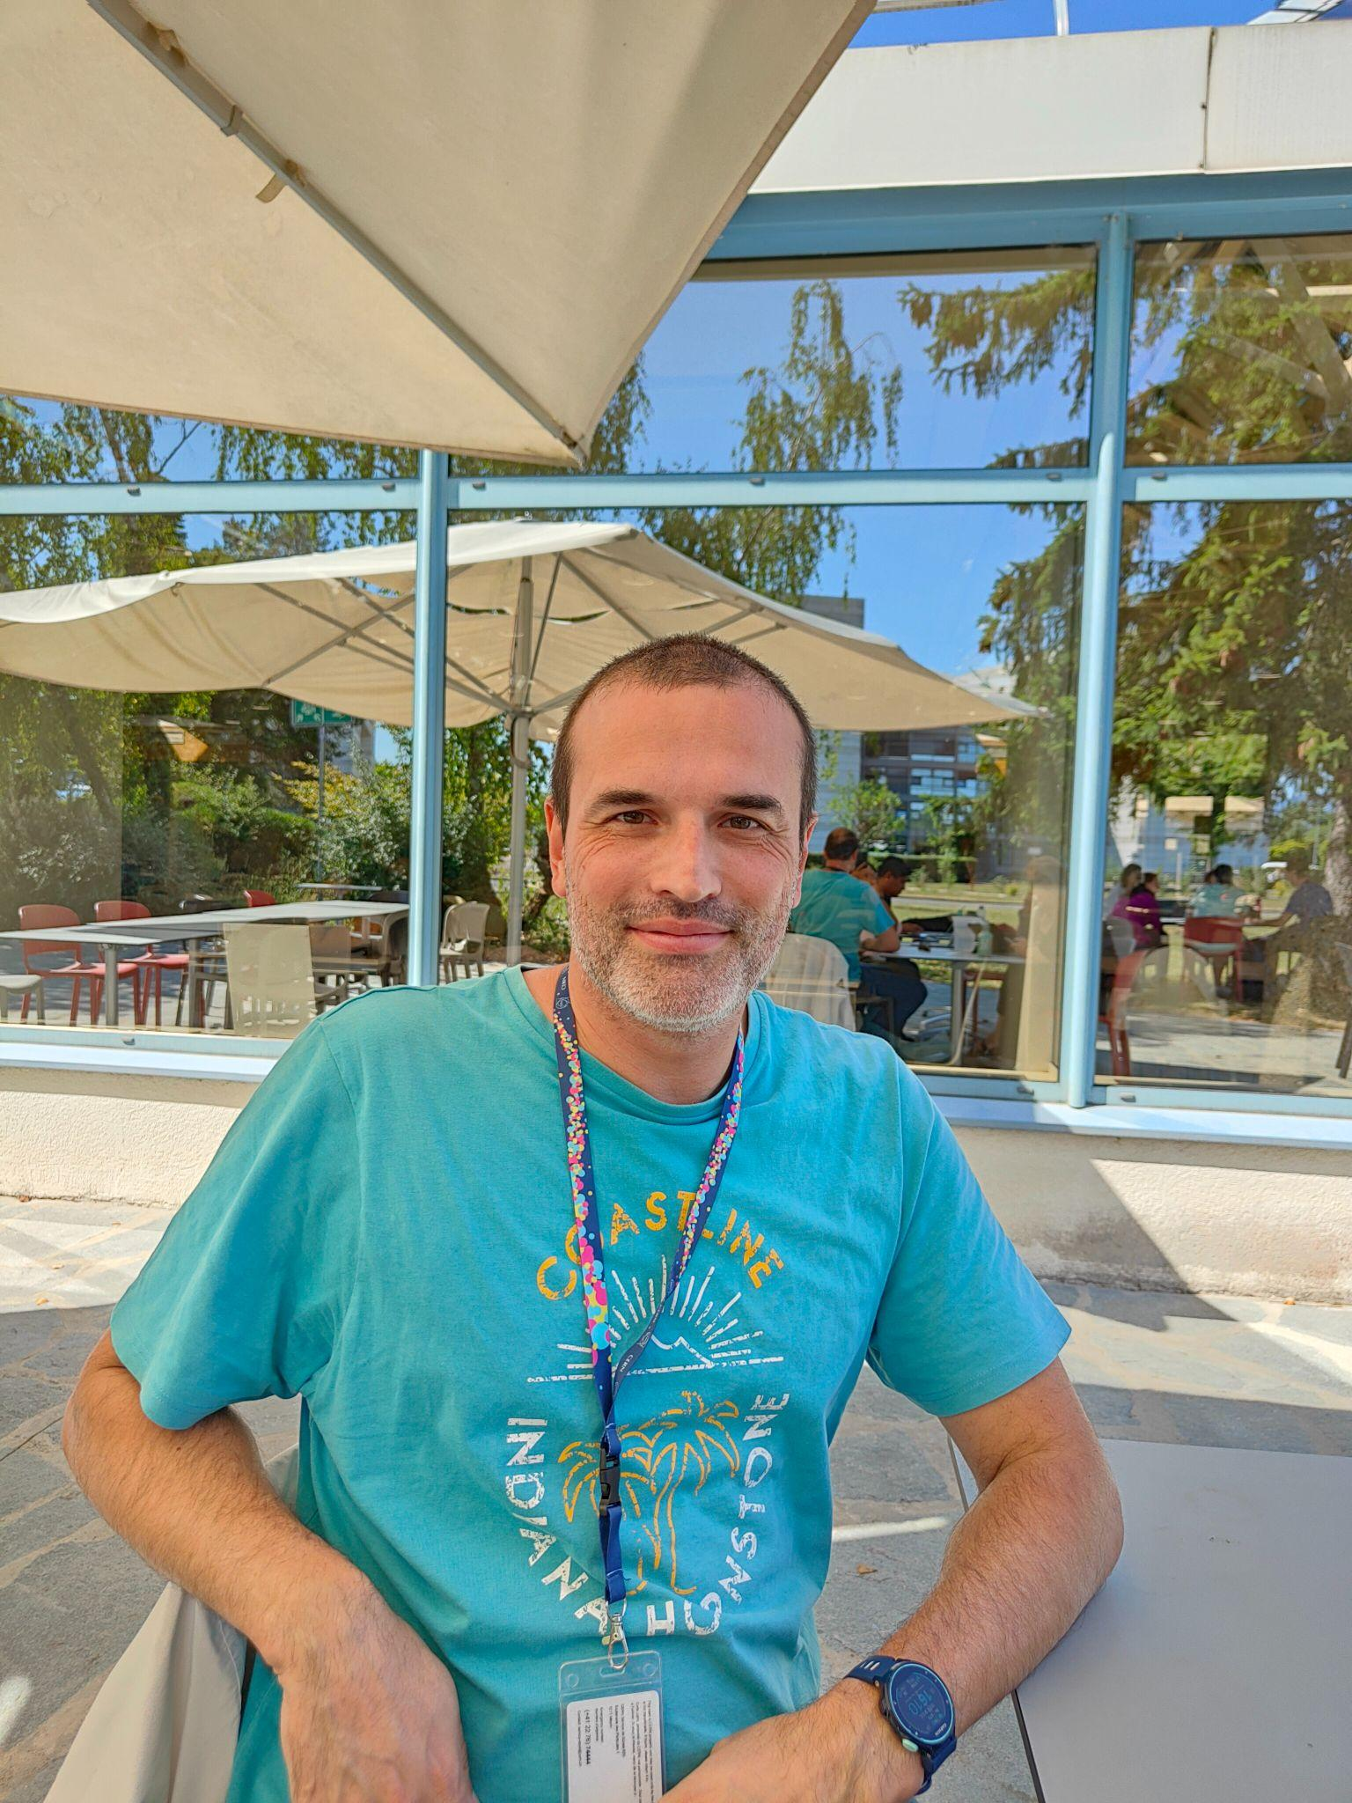

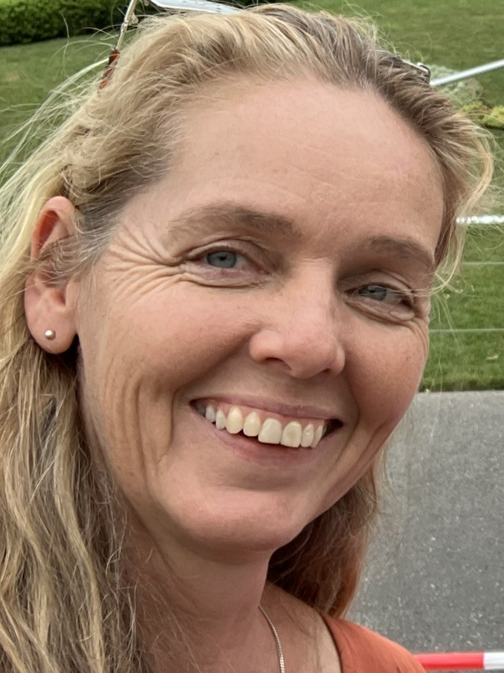

Study Group 9
Tanusree Goswami
India
I love to trek in Himalayas
George
Greece
I like complex board games
Job Lino
México
I like running and explore the nature
Suzanne
Australia
I am learning to play cello
Susanne
Germany
I own n+1 bikes

Slide 4
Slide Conventions
Colour of Slide | Type of Work
 | Individual (your colour is indicated on the previous slide)
 | Group work
 | Report-out slides

Slide 5
Checklist for SG Session 1
# | Type of Task | Task | Deadline
1 | Individual | Fill in your section of the “Study Group 9” slide | Wednesday, 17:30
2 | Group | Fill in “Group Norms” slide | Wednesday, 17:30
3 | Individual | Fill in slides corresponding to your colour | Wednesday, 17:30
4 | Group | Fill in “Our Key Takeaways” and “Our Feedback” slides as a group. Make sure you all contribute to the discussion. | Wednesday, 17:30
5 | Group | Decide how you as a group will present your group slides if you are selected to present during the SG Report-Out. | Wednesday, 17:30

Slide 6
Group Norms
Instructions: Write on the right box your group norms and how you will work together. For example:
Who will manage the meetings?
Who will be the time-keeper?
Who will fill in group slides?
Anything else you think is important to coordinate for productive group work.
Suzanne
George
Tanusree
To remind everyone of their jobs -Susanne

Slide 7
Particle
Physics
What are three adjectives that come to your mind when you think about particle physics?
To what extent is the topic of particle physics covered in your national curriculum?
Adjectives
Knowing about the universe
To accelerate the concept of particle physics
Mystery of the universe
National Curriculum
Upto photoelectric effect and uncertainty principle in higher secondary level

Slide 8
Particle Accelerators
What are three key ideas about particle accelerators that you would like your students to know about?
What are potential challenges students might encounter when learning about particle accelerators?
Key Ideas
Accelerates
Collides
Breaks
Potential Challenges
The laboratory doesn't have particle accelerators or advanced computer simulations to make these concepts clear to the students.

Slide 9
Particle
Detectors
What are three key ideas about particle detectors that you would like your students to know about?
What are potential challenges students might encounter when learning about particle detectors?
Key ideas
It can detect new subatomic particles.
It may also be able to detect dark matter and dark energy in the future.
The particle's presence can be detected by deviations in the graph.
Potential Challenges
The school laboratories don't have particle accelerators or advanced computer simulations to make these concepts clear to the students.

Slide 10
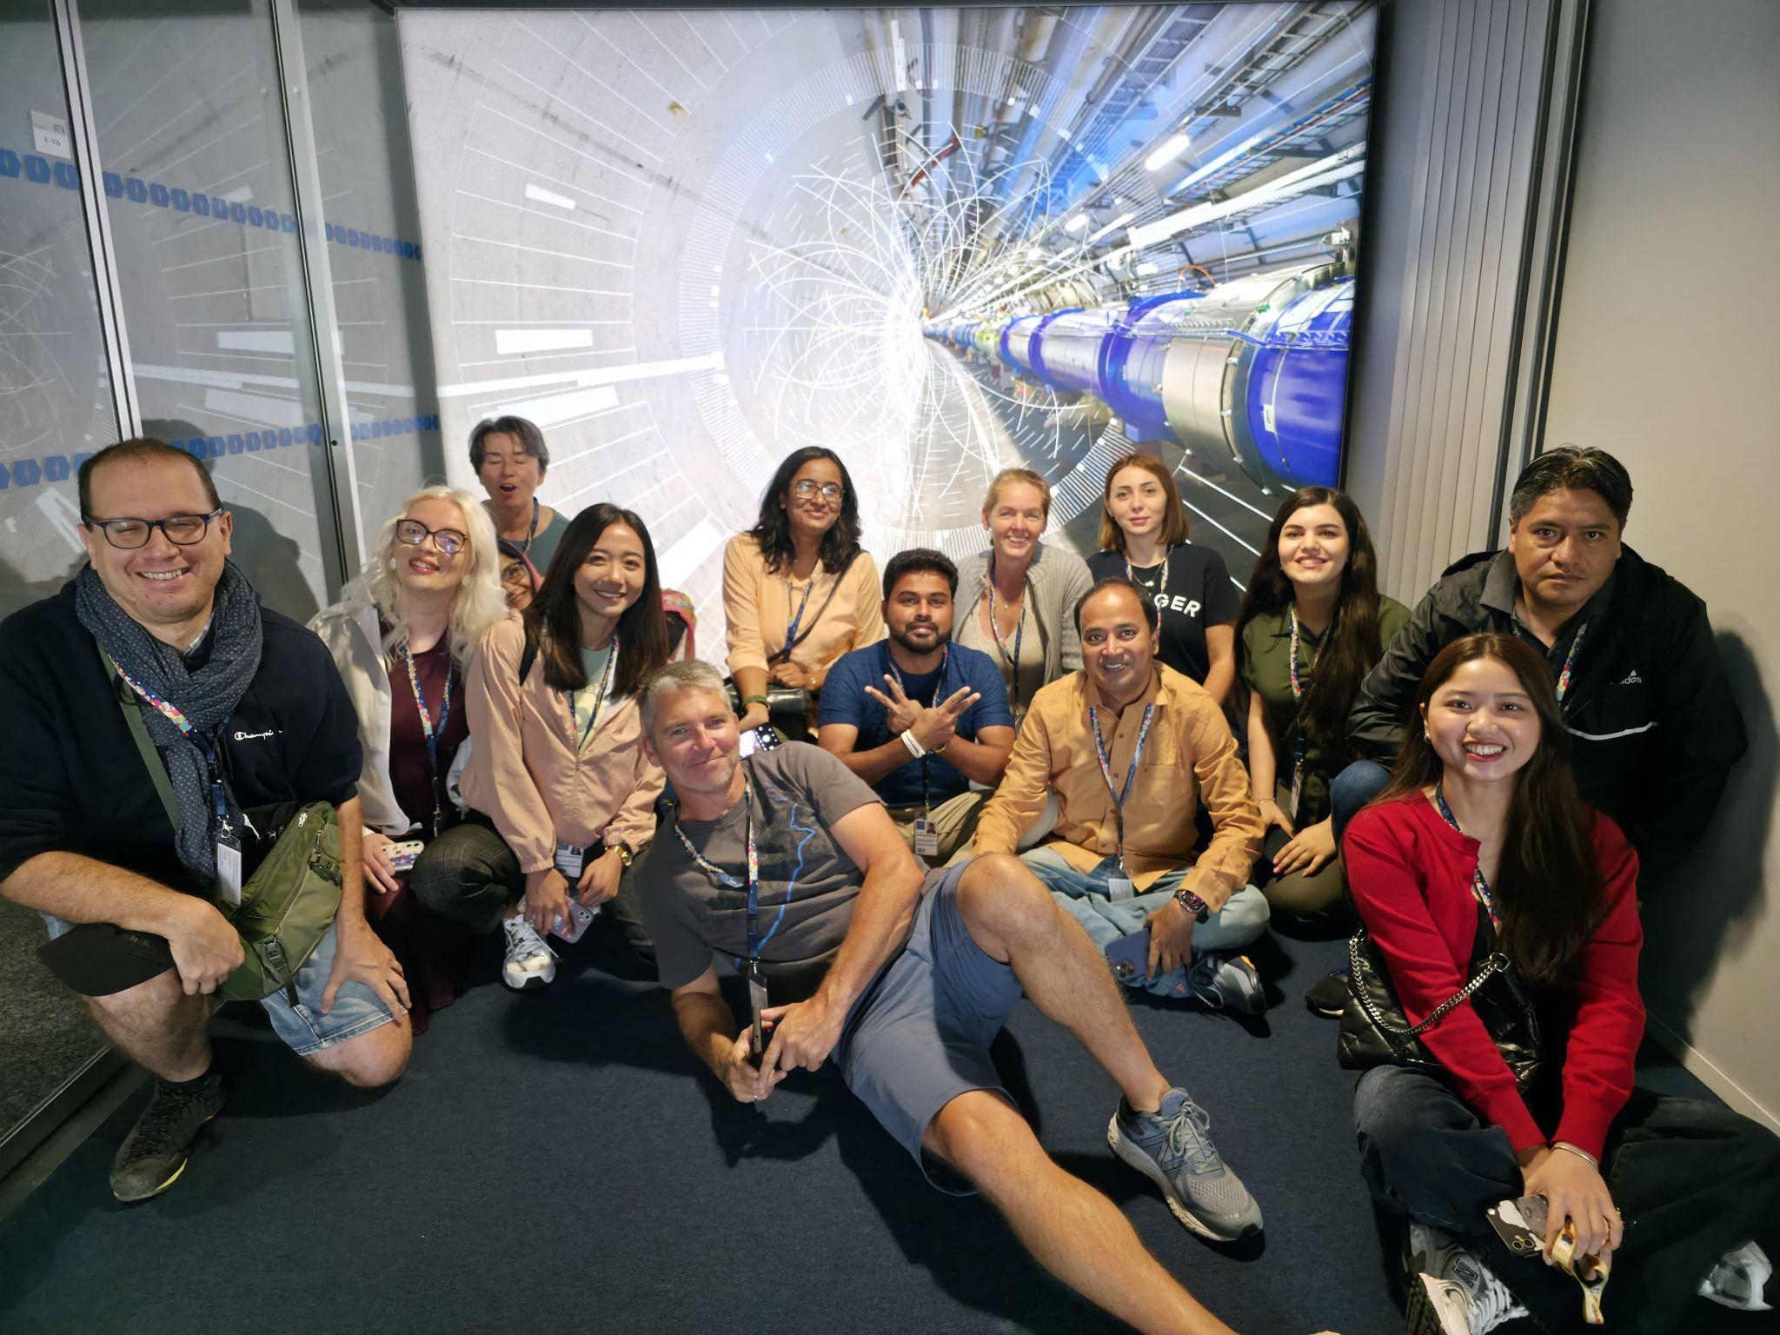
My Key Takeaways so far
Instructions: Write in the box any insights or things that you learned and that you want to remember after the HST2025 programme.
Key takeaways
It always needs hands-on experiments to better understand any subject. The concepts of colliders and their mechanism were never so clear before seeing the laboratory firsthand.

Slide 11
Particle
Physics
What are three adjectives that come to your mind when you think about particle physics?
To what extent is the topic of particle physics covered in your national curriculum?
1)
Complex
Fascinating
Dynamic
2) It is covered briefly and superficially (nothing about the Standard Model, only electrons, protons, neutrons, and some parts of quantum mechanics).
There is no emphasis on modern discoveries or on how large experiments work.

Slide 12
Particle Accelerators
What are three key ideas about particle accelerators that you would like your students to know about?
What are potential challenges students might encounter when learning about particle accelerators?
1)
Accelerating particles in high energies
Collision of accelerated particles
Deriving fundamental results for understanding the world
2)
The complexity of the technology used in the accelerators
The complexity of the mathematics used in the models
The connection of energy and mass in a subatomic level

Slide 13
My Key Takeaways so far
Instructions: Write in the box any insights or things that you learned and that you want to remember after the HST2025 programme.
The perfect outcome relies on the simultaneous cooperation of different scientists

Slide 14
Particle
Detectors
What are three key ideas about particle detectors that you would like your students to know about?
What are potential challenges students might encounter when learning about particle detectors?
1)
Visualizing things that we can not see
Multiple levels of detectors, depending on what do you want to catch (myon, glyon, etc)
Neutrinos belong to a category of their own. They do whatever they want
2)
The complexity of different levels of detectors
We don't actually see particles, but we trace their trajectory
The reason that the room detector is so big

Slide 15
Particle
Physics
What are three adjectives that come to your mind when you think about particle physics?
To what extent is the topic of particle physics covered in your national curriculum?
1. Invisible to the aye
2. Small
3. Misterius
In general, the physics courses in Mexico do not cover the topics about particle physics. However, others fundamental concepts of the classical mechanics can be related.

Slide 16
Particle
Detectors
What are three key ideas about particle detectors that you would like your students to know about?
What are potential challenges students might encounter when learning about particle detectors?
Lorentz force.
Particle delay.
Sensor Motion
Estudents hearts about radioactivity and electromagnetism
To do the invisible, visible

Slide 17
Particle Accelerators
What are three key ideas about particle accelerators that you would like your students to know about?
What are potential challenges students might encounter when learning about particle accelerators?
Types of detectors
Conservation laws and symmetries
3. Simulations
Ideas about of engineering

Slide 18
Particle
Physics
What are three adjectives that come to your mind when you think about particle physics?
To what extent is the topic of particle physics covered in your national curriculum?
- Tiny
- Beautiful
- Fundamental
The NSW syllabus covers the standard model of matter, defining hadrons, leptons and bosons. It also identifies that particle accelerators require electric fields to accelerate charges and magnetic fields to guide them.

Slide 19
My Key Takeaways so far
Instructions: Write in the box any insights or things that you learned and that you want to remember after the HST2025 programme.
The amazing learning environment. The level of collaboration among people from so many different countries.
Talking about physics, and seeing how scientists are genuinely passionate about education and see how they are interested in the High School Students.

Slide 20
Particle Accelerators
What are three key ideas about particle accelerators that you would like your students to know about?
What are potential challenges students might encounter when learning about particle accelerators?
- Definition including everyday examples.
- Purpose of physics research that requires a particle accelerator.
- Relativity is significant at speeds close to the speed of light which is the absolute maximum in the Universe.
- Challenges because they cannot see them!
- Finding out how the universe was formed may not be a priority for them at this stage in their development!

Slide 21
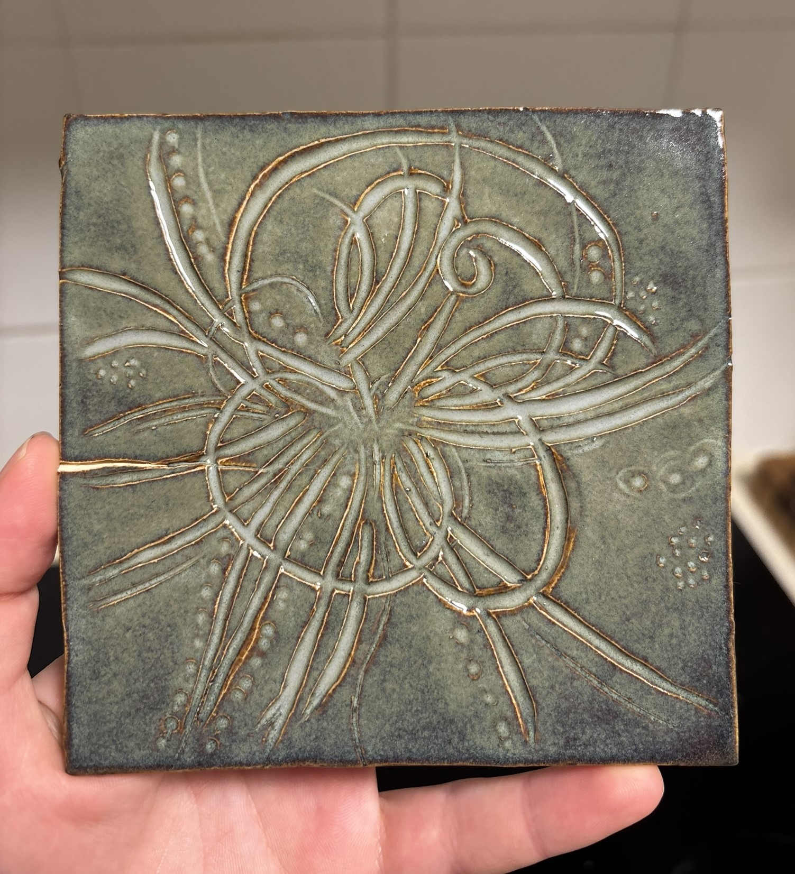
Particle
Detectors
What are three key ideas about particle detectors that you would like your students to know about?
What are potential challenges students might encounter when learning about particle detectors?
- Interactions are needed to detect anything!
- That the products of such a collision is not the parts of the whole, weird quantum stuff happens
- This is because E=mc^2
- Understanding Quantum stuff is hard!
- Again you cannot “see” the “debris” so clever ways have to be employed to infer the presence of particles by understanding their properties and behaviours

Slide 22
My Key Takeaways so far
Instructions: Write in the box any insights or things that you learned and that you want to remember after the HST2025 programme.
The key is in the details. A general overview is misleading and makes it difficult to overcome misconceptions.However it is important to keep hold of the big picture in order to really engage students on a level that allows them to make informed decisions about the future of scientific research in particle physics.

Slide 23
Particle
Physics
What are three adjectives that come to your mind when you think about particle physics?
To what extent is the topic of particle physics covered in your national curriculum?
Fast
Precise
cern-ish
No particle physics; just decay, currents, lorentz force

Slide 24
Particle Accelerators
What are three key ideas about particle accelerators that you would like your students to know about?
What are potential challenges students might encounter when learning about particle accelerators?
Magnets
Lorentz force
Bending, squeezing, the beam
Do you know something about..
different particles, their properties, magnetic fields or even the (maybe) four elementary forces?

Slide 25
Particle
Detectors
What are three key ideas about particle detectors that you would like your students to know about?
What are potential challenges students might encounter when learning about particle detectors?
Only sensitive to special particle properties
Your eye is a particle detector
(for photons)
Trekking is key to gain knowledge
Do you know something about..
different particles, their properties, magnetic fields or even the (maybe) four elementary forces?

Slide 26
My Key Takeaways so far
Instructions: Write in the box any insights or things that you learned and that you want to remember after the HST2025 programme.
Takeaway… food … food is good … good timekeeping … how is Jeff a person… Milena is always there! … Is she writing a paper? … paper … knowledge transfer … was there a paper about the teacher summer school? … summer … summer is coming … weekend … plans … exchange with the other teachers … exchange ideas … energy … particles … collision … trajectory … information about energy, charge, momentum … momentum in the program … shifting … letting hair down … finding people to connect … never spoken to some … why? … a lot of people … large cross-section … we should focus the group to form more interactions of small probability happening … languages… I would love to here everyone's voice in their own language … and I am done. Time is up. For now. ;)

Slide 27
Study Group Discussion
Share your individual insights with your colleagues and identify shared themes.
Have some ice cream and don’t forget to
take notes :)
Colleagues from across the world, seating together and discussing about the same thing is quite fascinating with having some ice cream.
After reading each others comments there are some common thread emphasising the scale and enigmatic nature of particle physics.
In our syllabuses particle physics is dealt with on very superficial level. Some content on accelerators but none on detectors.
Schrodinger and Heisenberg principles are only mentioned. But there is no such introductions of quantum mechanics.
Limitations ranging from complexity to lack of hands on experiences.

Slide 28
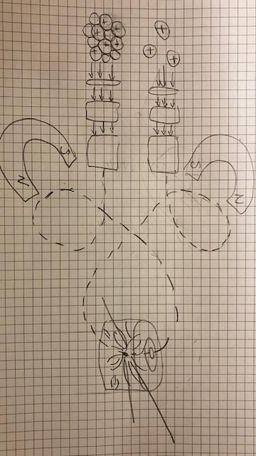
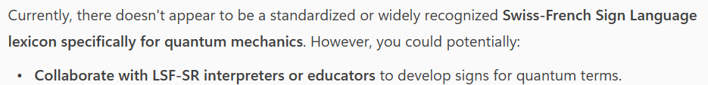
Our Key Takeaways so far
Instructions: Write in the box any insights, learnings and discussion outcomes.
(Decide how you as a group will present them if you are selected to present during the SG Report-Out.)
Complex and difficult to visualize
Not enough content in Syllabi
Can be sorted out by discussing with the educators
across the world
Big picture thinking
Cutting edge technology development from research changing the world!

Slide 29
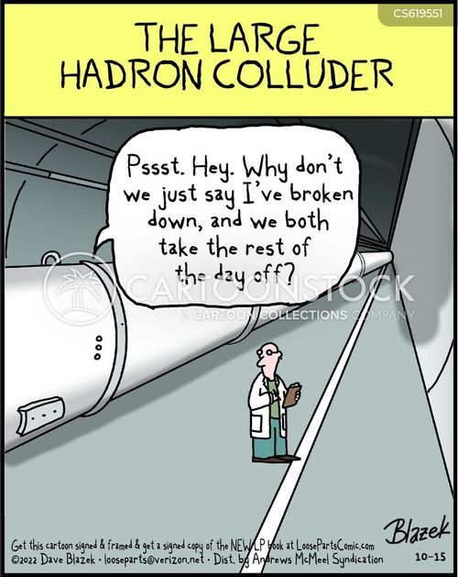
Our Feedback
so far
Highlights?
What’s working?
What needs improvement?
Other comments?
Funny picture or meme?
(Decide how you as a group will present them if you are selected to present during the SG Report-Out.)
Humour is essential! Well done
The program is well-designed!
The people!
What is working:
Presenters using the microphones is wonderful! :)
Could need improvement:
We don’t know the names of all the participants.
Questions are -sometimes- too quiet.

Slide 30
Thursday, 10 July
SG Session 2

Slide 31
Slide Conventions
Colour of Slide | Type of Work
 | Individual (your colour is indicated on the previous slide)
 | Group work
 | Report-out slides

Slide 32
Checklist for SG Session 2
# | Type of Task | Task | Deadline
1 | Individual | Fill in slides corresponding to your colour | Thursday, 18:00
2 | Group | Fill in “Our Key Takeaways” and “Our Feedback” slides as a group. Make sure you all contribute to the discussion. | Thursday, 18:00
3 | Group | Decide how you as a group will present your group slides if you are selected to present during the SG Report-Out. | Thursday, 18:00

Slide 33
Engineering
Which topic from the physics curriculum could you see yourself teaching in the context of Engineering at CERN?
Sketch out your idea and add links to suitable resources!
For teaching physics in the context of engineering at CERN, I would choose Electromagnetism and its Applications in Particle Accelerators, with a focus on Superconducting Magnets.

Slide 34
LHC
Which topic from the physics curriculum could you see yourself teaching in the context of the
Large Hadron Collider at CERN?
Sketch out your idea and add links to suitable resources!
One fantastic topic from the physics curriculum that I could definitely see myself teaching in the context of the Large Hadron Collider at CERN is Conservation of Energy and Mass-Energy Equivalence (E=mc2).

Slide 35
AI
What are three key ideas about AI that you would like your students to know about?
What are potential challenges students might encounter when learning about AI?
What are potential benefits students might encounter when learning with the help of AI?
Key ideas:
AI is a tool driven by algorithms and data.
Data quality is paramount.
AI is transforming industries and society, demanding critical thinking and adaptability.
Potential challenges:
Abstract and Complex Concepts
Rapidly Evolving Field
Ethical and Societal Implications
Potential benefits:
Personalized Learning Experiences
Immediate Feedback and Support
Cost Reduction

Slide 36
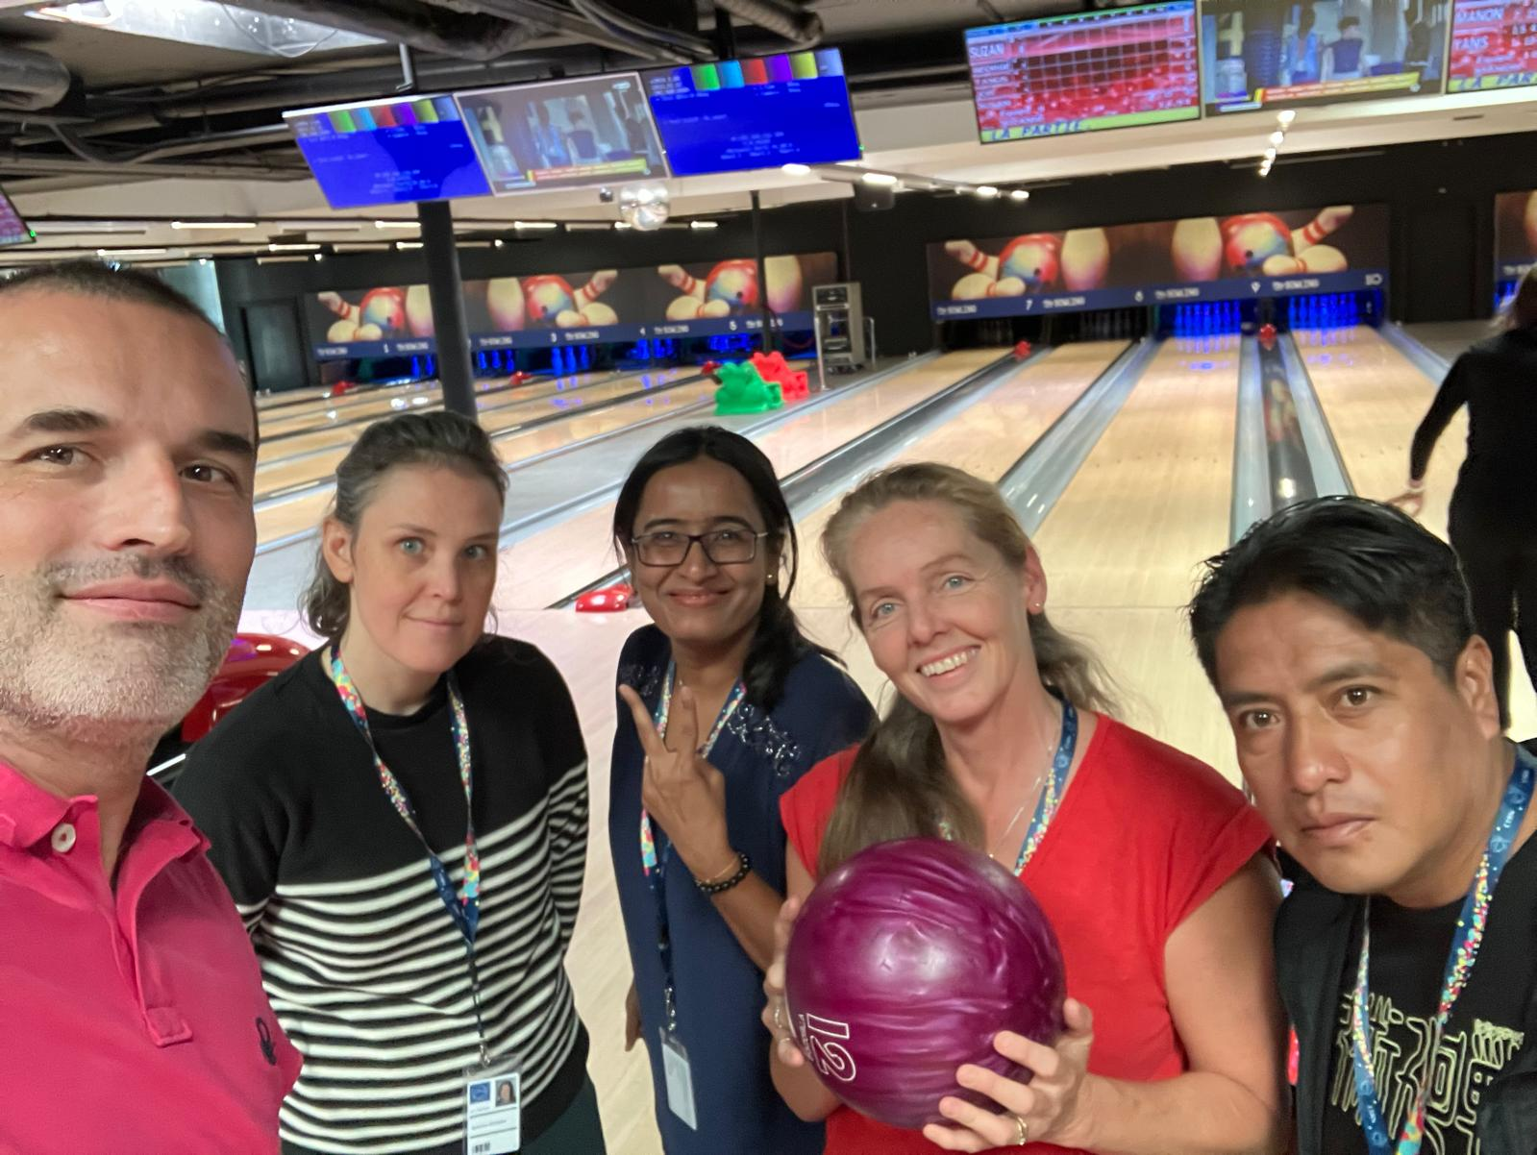
My Key Takeaways so far
Instructions: Write in the box any insights or things that you learned and that you want to remember after the HST2025 programme.
Key Takeaways:
I won't ever forget the bowling and pizza party we had, especially since it was my first time ever bowling. Everyone patiently showed me how to play, and that's how our bond as global particle physics educators truly solidified. It was a fantastic way to connect beyond the classroom and build a strong collaborative spirit.

Slide 37
Engineering
Which topic from the physics curriculum could you see yourself teaching in the context of Engineering at CERN?
Sketch out your idea and add links to suitable resources!
Linear accelarators
Alternate currents
Lorentz force
https://www.seilias.gr/index.php?option=com_content&task=view&id=729&Itemid=63

Slide 38
LHC
Which topic from the physics curriculum could you see yourself teaching in the context of the
Large Hadron Collider at CERN?
Sketch out your idea and add links to suitable resources!
Magnetic and electric fields
Particle physics
Modern physics
Use the schematics of CERN’s school lab https://scoollab.web.cern.ch/linac3D to build a linear accelarator

Slide 39
AI
What are three key ideas about AI that you would like your students to know about?
What are potential challenges students might encounter when learning about AI?
What are potential benefits students might encounter when learning with the help of AI?
AI does not replace human thinking, it complements it.
Use AI wisely in order to fill the gaps
Use AI as a tool to check your results
Relying on AI without understanding basic principles
Sometimes gives you wrong results
It's not a human being, just a machine that you can talk
It's quicker than other internet sources, in order to search for something
Make short physics simulations, for example in html form, i.e. for the circular motion

Slide 40
My Key Takeaways so far
Instructions: Write in the box any insights or things that you learned and that you want to remember after the HST2025 programme.
The procedure of keeping the appropriate amount of data after the collisions
The huge difference in temperature between the cooling system and the beam temperature
There is no way to clearly define particle
The trails in the cloud chamber and their match to corresponding particles
Socializing

Slide 41
Engineering
Which topic from the physics curriculum could you see yourself teaching in the context of Engineering at CERN?
Sketch out your idea and add links to suitable resources!
Mechanics: Work
Electricity: Current and Voltage
2 ) For example, I want to link this with problems related to how move and build the ATLAS detector.
CERN uses an enormous amount of energy, about 200 kW at peak. Electrical engineers manage everything from high-voltage down to standard 230 V systems. Its is real problem that can be used in classroom to solve with students.
Some resources can be obtained from the next links:
Home.cern
Use Simulation

Slide 42
LHC
Which topic from the physics curriculum could you see yourself teaching in the context of the
Large Hadron Collider at CERN?
Sketch out your idea and add links to suitable resources!
Mechanics: circular motion
Electromagnetism: Lorentz force
For example, Lorentz force can easily explain to students without a strong background. and circular motion can be analyzed.
Resources
Use visuals, simulations, and analogies to build mental models
Home.cern
Miniature Accelerator for Cancer Treatment

Slide 43
AI
What are three key ideas about AI that you would like your students to know about?
What are potential challenges students might encounter when learning about AI?
What are potential benefits students might encounter when learning with the help of AI?
Data analysis, Probability, Simulations
They could understand AI through knowledge of Math such as: statistics, probability, linear algebra, and calculus, and use this tool to solve real physics problems. The challenges are new for the teachersl, because is a new tool.
Students get critical thinking because they analice output data from IA.

Slide 44
My Key Takeaways so far
Instructions: Write in the box any insights or things that you learned and that you want to remember after the HST2025 programme.
Everything is important, I can not exclude some knowledge.

Slide 45
Engineering
Which topic from the physics curriculum could you see yourself teaching in the context of Engineering at CERN?
Sketch out your idea and add links to suitable resources!
Engineering topic I would include is the design of the magnets to contain the charged particles
Dipoles and quadrupole magnets
Also superconductors so only takes 16V! Therefore not a huge drain on the grid.
Look at the CERN resources to do this. I have accompanied students on excursion to demonstrate electromagnetism wit great engagement but they have removed it from the syllabus.

Slide 46
LHC
Which topic from the physics curriculum could you see yourself teaching in the context of the
Large Hadron Collider at CERN?
Sketch out your idea and add links to suitable resources!
We do cover particle accelerators in the NSW syllabus as it links to electromagnetism topic.
Also the standard model of matter as need to define Hadron if you are going to talk about the LHC.
Also the discovery of the higgs boson.
There is an interactive I use that is really fun for the students. However I use it earlier in the electromagnetism topic Here is the link https://phet.colorado.edu/en/simulations/electric-hockey

Slide 47
AI
What are three key ideas about AI that you would like your students to know about?
What are potential challenges students might encounter when learning about AI?
What are potential benefits students might encounter when learning with the help of AI?
Machine learning is something the student already know more about than me, but they may not be aware of how much it is used.
- It’s everywhere! From ads tailored to you, to netflix suggestion.
- That it needs to be trained. With data where you know the answer before you can trust the output.
- It can be used effectively to make decisions much more quickly than a human but with human imposed parameters (that is why it need training! And testing)
Preconceived ideas, whatever these may be, including that AI offers shortcuts to effort and people use it to cheat!
It’s the way of the future, they need to become literate in how AI can be used as a tool.

Slide 48
My Key Takeaways so far
Instructions: Write in the box any insights or things that you learned and that you want to remember after the HST2025 programme.
I can sneak in more content on particle accelerators now that I know more myself more about exactly how it works. Teacher fluency and experience is really giving me the opportunity to do this confidently.
I want to understand the graph better where with the bump that is the evidence for the higgs boson and explain it in terms that students can understand. (You should consider including it in the visitor centre info, people believe graphs even if they don’t understand it)
Rubber duck! It worked! I answered my own question about RF cavity. Thanks people!

Slide 49
Engineering
Which topic from the physics curriculum could you see yourself teaching in the context of Engineering at CERN?
Sketch out your idea and add links to suitable resources!
Engineering - preparation of magnets; show them as an example for magnets
(year 1 of physics)
Eg dipole magnet (foto: superconducting, electromagnet)
→ students are building their own electromagnet (similar to the PER linked by Jeff)

Slide 50
LHC
Which topic from the physics curriculum could you see yourself teaching in the context of the
Large Hadron Collider at CERN?
Sketch out your idea and add links to suitable resources!
Collaboration is key
→ Introducing group work, dividing up tasks, setting checkpoints, ….
Emulation of the Control center
Aim: do a group presentation
method: divide group work up
Identify projects
Work in different projects
Raise green “flag” if the next step is a go
Stop, if process is on the wrong way (beam dump)
Go and take data :) meaning, start working on the presentation
OR
Acceleration by adding force
OR
(what I did) explain the difference of AC/DC and using the example of a LINAC (manually switching the field would be quite annoying)

Slide 51
AI
What are three key ideas about AI that you would like your students to know about?
What are potential challenges students might encounter when learning about AI?
What are potential benefits students might encounter when learning with the help of AI?
a) Importance of using neural networks (use training data and let the clustering go on its own)
→ also used in social media
b) Those ARE neural networks
c) Learning from nature
They might think everything “is done automatically”
Understanding the world around them; how automatized decisions are made

Slide 52
My Key Takeaways so far
Instructions: Write in the box any insights or things that you learned and that you want to remember after the HST2025 programme.
Use MODELS, we don’t know what a particle is, just how it is interacting
Higgs-field reminds me of the Ether-theory (Photons are moving in a soup of some sort) which got proven wrong
There is such a thing as information pilling up and the need to sort them differently.

Slide 53
Study Group Discussion
Share your individual insights with your colleagues and identify shared themes.
Have some ice cream and don’t forget to
take notes :)
After discussing the engineering aspects, we have collectively decided that we want to teach about magnetic fields, electromagnetism, and superconductivity.
While there are many topics we could cover regarding the LHC, our aim is to guide students through the learning process much like the LHC accelerates particles: by accelerating their thinking, detecting their challenges, and then boosting their understanding.
AI does not replace human thinking; rather, it learns from nature and can reduce human effort. Furthermore, it can be used effectively to make decisions. However, students may risk over-relying on AI without first learning basic principles.

Slide 54
Our Key Takeaways so far
Instructions: Write in the box any insights, learnings and discussion outcomes.
(Decide how you as a group will present them if you are selected to present during the SG Report-Out.)
Engineering and LHC science have similar links to electricity and magnetism, but also need to teach standard model.
Also superconductors so only takes 16V! Therefore not a huge drain on the grid.
Student misunderstand AI (does not replace human thinking) and need to realise how it works to make decisions and become a useful tool. It is a challenge for teachers too.
Copilot Here’s a more relaxed and student-friendly version of the paragraph, linking AI to the LHC: In the HST programme, learning about AI gets way more exciting when you see how it’s used in real science—like at the Large Hadron Collider (LHC). The LHC creates a massive amount of data from particle collisions, and AI helps scientists sort through it all super fast to find the really interesting stuff, like rare particles or signs of new physics. It’s like trying to find a needle in a haystack, but with smart tools that learn what to look for. This shows students how AI isn’t just tech buzz—it’s a powerful tool that helps solve real-world problems and push the boundaries of what we know. Would you like this turned into a short activity or discussion prompt for students?

Slide 55
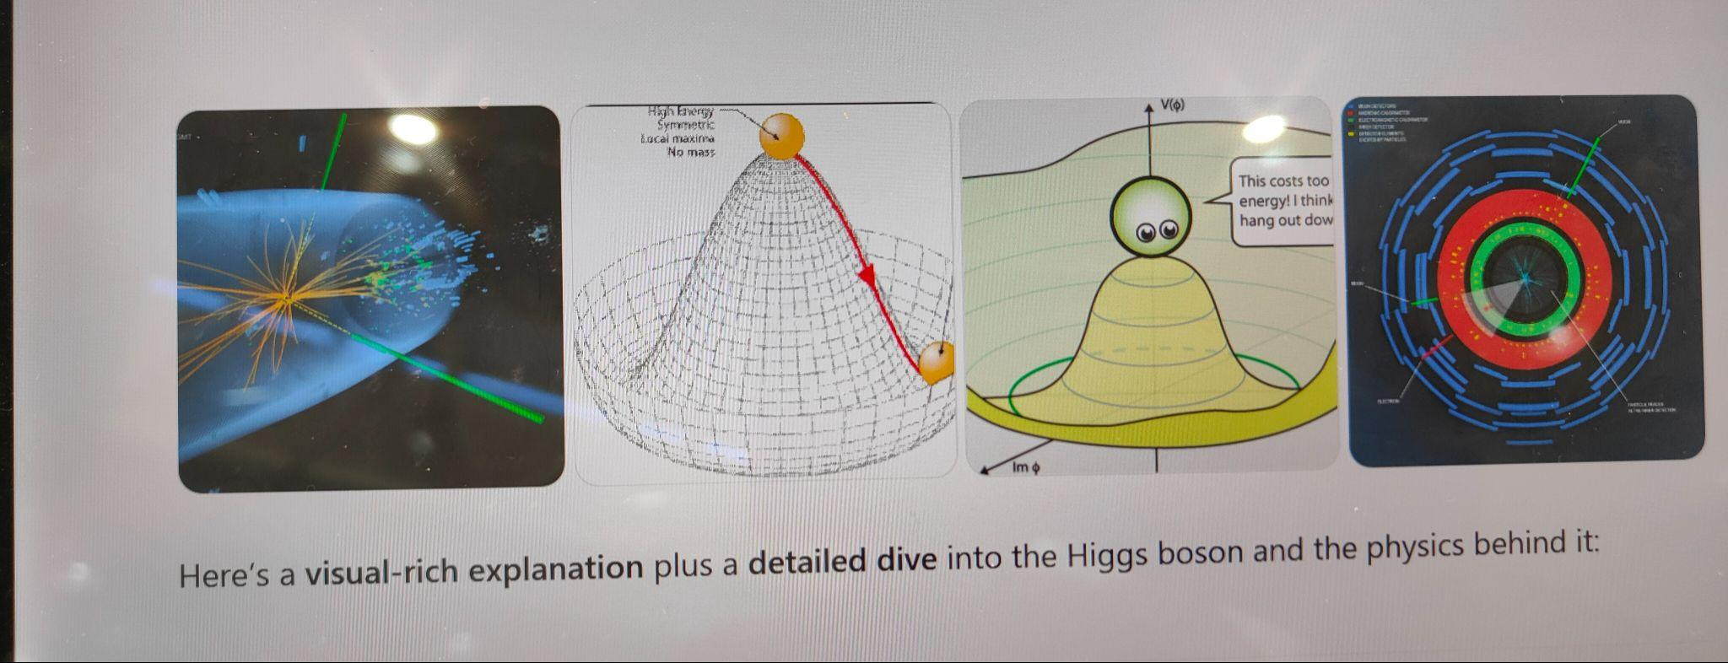
Our Feedback
so far
Highlights?
What’s working?
What needs improvement?
Other comments?
Funny picture or meme?
(Decide how you as a group will present them if you are selected to present during the SG Report-Out.)
The is no suitable definition of particle.
We are all becoming confident experts!
Labels on the inside of the parts of the collider in the exhibit (eg liquid Helium, beam 1, beam 2, magnet…)
Phones on Silent
Our cloud chamber was
the best!

Slide 56
Tuesday, 15 July
SG Session 3

Slide 57
Checklist for SG Session 3
# | Type of Task | Task | Deadline
1 | Individual | Fill in slides corresponding to your colour | Tuesday, 17:30
2 | Group | Fill in “Our Key Takeaways” and “Our Feedback” slides as a group. Make sure you all contribute to the discussion. | Tuesday, 17:30
3 | Group | Decide how you as a group will present your group slides if you are selected to present during the SG Report-Out. | Tuesday, 17:30

Slide 58
Feynman
Diagrams
What would be a fun and creative way of introducing Feynman Diagrams in the classroom?
Which students’ conceptions would you expect to encounter and how would you address them?
To make learning about Feynman Diagrams engaging, transform my classroom into a "particle collider" using everyday props. Start by explaining how subatomic particles interact by exchanging "messengers," like people talking or high-fiving. Prepare simple props: students or labeled objects for particles, and throwable items like beanbags for force carriers (e.g., photons, gluons).

Slide 59
Computing
at CERN
What are three key ideas about computing and data analysis at CERN that you would like your students to know about?
What are potential challenges students might encounter when learning about computing and data analysis at CERN?
Key Ideas
Unprecedented Data Volume
Global Distributed Computing
Advanced Software and Algorithms
Abstractness
Specialized Tools and Programming
Conceptual Understanding of Data Analysis
Can’t connect with the complexity

Slide 60
Medical Applications
What are three key ideas about medical applications of particle physics that you would like your students to know about?
What are potential challenges students might encounter when learning about medical applications of particle physics?
Key Ideas
Imaging through particle interactions
About different types of cancer therapy
About the new research in cancer treatment with Hadron
Potential Challenges
Understanding the relation between physics and biology
Understanding to much engineering
Understanding the concept of particle imaging

Slide 61
My Key Takeaways so far
Instructions: Write in the box any insights or things that you learned and that you want to remember after the HST2025 programme.
CERN isn't just focused on resolving the mysteries of the universe's origins and composition; it also significantly contributes to human well-being. Through its collaborations with medical institutes, CERN plays a vital role in advancing cancer treatment.

Slide 62
Feynman
Diagrams
What would be a fun and creative way of introducing Feynman Diagrams in the classroom?
Which students’ conceptions would you expect to encounter and how would you address them?
Build diagrams with springs, pencils, pens or markers.
Jokes about of annihilation of matter and antimatter.
2) Students conceptions
Students confuse time with space
Students believe that the diagrams shows the trajectories of the particles.

Slide 63
Computing
at CERN
What are three key ideas about computing and data analysis at CERN that you would like your students to know about?
What are potential challenges students might encounter when learning about computing and data analysis at CERN?
Huge amount of data that produced everyday. Filtering is a crucial issue before the analysis of the data.
Data are stored in disks in order to reduce energy consumption
2)
The huge amount of data (Exabytes) and the way they stored.
Data analysis uses complex algorithms and machine learning.

Slide 64
Medical Applications
What are three key ideas about medical applications of particle physics that you would like your students to know about?
What are potential challenges students might encounter when learning about medical applications of particle physics?
Different types and sizes of cancer can be treated depending on their location
Accelerators are not only used for research purposes, but also for cancer treatment.
There will be cancer therapies in the future that won't destroy the health tissue along with tumour.
2)
Complex engineering
Considerations about safety, for example radiation exposure

Slide 65
My Key Takeaways so far
Instructions: Write in the box any insights or things that you learned and that you want to remember after the HST2025 programme.
Feynmann diagrams are particle physics language
Research involving particle collisions is not the most common use of particle accelerators. Medical applications are actually among the most common use of particle accelerators.
Mystery boxes is a fantastic pedagogical technique. Students has to investigate by observing, listening, shaking to figure out what's inside or how it works.

Slide 66
Feynman
Diagrams
What would be a fun and creative way of introducing Feynman Diagrams in the classroom?
Which students’ conceptions would you expect to encounter and how would you address them?
Show some geometric exercises that relate to the invariance under rotations that a figure can have.
Show the Feyman game to students (R. Harlander,
2020, FeynGame Webpage)
Paths of particles in space
Types of interaction between particles

Slide 67
Computing
at CERN
What are three key ideas about computing and data analysis at CERN that you would like your students to know about?
What are potential challenges students might encounter when learning about computing and data analysis at CERN?
Manage massive amounts of data, Data analysis and processing , Simulations about Particle Physics using Monte Carlo.
Learn specific mathematical tool and computational tools to be applied to physics.
Observe measure experiment Collect real life data Theory and real life.

Slide 68
Medical Applications
What are three key ideas about medical applications of particle physics that you would like your students to know about?
What are potential challenges students might encounter when learning about medical applications of particle physics?
Know History of radioactivity.
Learn about technology: Accelerators, detectors, X-ray tubes.
Learn about cancer Therapy: Radiation therapy, particle therapy with proton beams.
Understand how leptons and quarks are the smallest known particles

Slide 69
My Key Takeaways so far
Instructions: Write in the box any insights or things that you learned and that you want to remember after the HST2025 programme.
Everything I have seen I have liked, but I especially want to highlight the experiments shown by those from the Perimetral Institute, and what was presented at the Data Center.

Slide 70
Feynman
Diagrams
What would be a fun and creative way of introducing Feynman Diagrams in the classroom?
Which students’ conceptions would you expect to encounter and how would you address them?
Through art. Have some diagrams on card available to circulate through the classroom and some displayed on the walls. Have available some pencils or markers and paper, or chalk and chalkboards, or mini whiteboards. The students then individually copy some of the samples and produce their own alongside it by trying to figure out patterns or rules of the diagrams. Then the students can work in groups to come up with rules of the diagrams.
Direction or orientation of the diagram. ANy work of art is still art even if you hang it upside down. It is a the discretion of the artist. Have a couple of framed images and ask them to decide which way up they should be. This is more difficult with abstract art, but portraits or landscapes have built in bias.

Slide 71
Computing
at CERN
What are three key ideas about computing and data analysis at CERN that you would like your students to know about?
What are potential challenges students might encounter when learning about computing and data analysis at CERN?
- the www was invented and developed by CERN to deal with the enormous amount of data produced and analysed at CERN
- 1 Petabyte of data per second is produced by the 40 million collisons, this is way too much and more than any system can handle. So trigger daq are used to filter the data and only keep 0.01% of the data on magnetic tapes in the basement (eventually).
- The kept data is analysed in computing centres all over the world and eventually is an open data source that anyone including them has access to to do your own analysis.
Understanding the units, what is a byte anyway? Comparing to the number of all of netflix data processed in a second per event might be useful to give them a sense of scale of operation! Aslo maybe what exactly the data is because it required some understanding of detectors first.

Slide 72
Medical Applications
What are three key ideas about medical applications of particle physics that you would like your students to know about?
What are potential challenges students might encounter when learning about medical applications of particle physics?
- Radiotherapy for cancer treatment can be done with particle accelerators and this is called radiotherapy.
- Flash Therapy. I would like them to know there is n collateral damage and it is not understood how or why this occurs as every other method also damages DNA of healthy cells as well as the cancer cells.
- The money problem. Radiotherapy is very effective but is not widely used enough because it is expensive and required maintenance by skilled technicians.
- students may have knowledge of treatments from personal experience and will try to reconcile what they know with radiotherapy using particle accelerators.

Slide 73
My Key Takeaways so far
Instructions: Write in the box any insights or things that you learned and that you want to remember after the HST2025 programme.
Overall I have a couple of points that are very interesting to note:
The LHC only requires 16 Volts because superconductors are used
That copper is used as an insulator because it is not a superconductor
Big data science and open source data that can be used in the classroom
Trigger daq used to select the data to target what you are searching for.
The Higgs data to 5 sigma graph is really helpful to understand to explain the significance.
International collaboration extends to students! The Average age of those who work at CERN is 27! Make sure the student know it is attainable and not an impossible other people thing to do.

Slide 74
Feynman
Diagrams
What would be a fun and creative way of introducing Feynman Diagrams in the classroom?
Which students’ conceptions would you expect to encounter and how would you address them?
Wear a dress with the pattern of Feyman diagrams. Might the coffee mug 2.0 ;)
In math: using graphics to symbolize equations
Could be done in algebra when we introduce graphs or diagrams in general
→ aim: choose a representative which helps to clarify the problem one is trying to solve
2) “Understanding” the Lagrangian is quite challenging. For me, it is more: solving the equation, try to understand what the solution is standing for, and the middle part is “trusting in math”.
Multiple path are possible! Question of probability.

Slide 75
Computing
at CERN
What are three key ideas about computing and data analysis at CERN that you would like your students to know about?
What are potential challenges students might encounter when learning about computing and data analysis at CERN?
“Making sense” of the data alone is impossible, to solve them internationally is a challenge but doable.
Tapes are the past (and for CERN) the future.
→ no additional energy is needed to store data
Grasping the concept of the dimensions
→ I would need analogies they understand!

Slide 76
Medical Applications
What are three key ideas about medical applications of particle physics that you would like your students to know about?
What are potential challenges students might encounter when learning about medical applications of particle physics?
FLASH as for now: attacking only canorous cells; keeping non-canorous cells alive
Bragg peek (energy deposition localized)
Medicine is able to introduce Physics quite fast
Broad basic concepts have to be taught:
Different kinds of radiation
Imaging
Acceleration
Detectors
…

Slide 77
My Key Takeaways so far
Instructions: Write in the box any insights or things that you learned and that you want to remember after the HST2025 programme.
Think globally
Medicine
Computing (grids)
Multilayer > single layer
? introduce that idea into teaching?
Give a broad overview and dive down to more specific questions and more accurate answers.

Slide 78
Study Group Discussion
Share your individual insights with your colleagues and identify shared themes.
Have some ice cream and don’t forget to
take notes :)
1)Create a Feynman diagram using wires, strings, a pencil, and markers.
Then make the classroom a Particle Collider. Dress up the students with a drawing of a Feynman diagram and have one student represent a single particle.
Then, provide them with the basic idea.
Play the game using the link below.
FeynGame Webpage
2) CERN possesses a vast amount of data, which it shares globally for research purposes. However, students often find it challenging to conceptualize the sheer scale of these data measurements.

Slide 79

Our Key Takeaways so far
Instructions: Write in the box any insights, learnings and discussion outcomes.
(Decide how you as a group will present them if you are selected to present during the SG Report-Out.)
About Feynman diagrams
Not in the syllabus, may not help students get a better understand of particle physics without the context of fractals but:- reducing complex problems to simple representations that can be manipulated to solve problems is a great concept in theoretical physics concept
About Computing CERN
Huge amount of data that must be filtered using triggers and stored (on magnetic tapes!) and international collaboration of computing centers. Conceptual understanding of how much data that is can be challenge! What exactly is an exabyte?
Medical applications
Flash therapy is amazing!
How does it work?

Slide 80
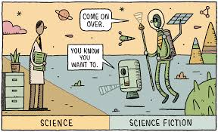

Our Feedback
so far
Highlights?
What’s working?
What needs improvement?
Other comments?
Funny picture or meme?
(Decide how you as a group will present them if you are selected to present during the SG Report-Out.)
Mystery boxes are a fantastic pedagogical technique. Students has to investigate by observing, listening, shaking to figure out what's inside or how it works.
Suggestion for the method of delivery of the perimeter project, perhaps run it like a world expo with stations set up with the various awesome classroom activities. And maybe an actual escape room which would be fun for all the participants.
CERN isn’t just focused on resolving the mysteries of the universe’s origins and composition: it also significantly contributes to human-being. Through collaboration with medical institutes, CERN plays a vital role in advancing cancer treatment.

Slide 81
Thursday, 17 July
SG Session 4

Slide 82
Checklist for SG Session 4
# | Type of Task | Task | Deadline
1 | Individual | Fill in slides corresponding to your colour | Thursday, 14:30
2 | Group | Fill in the “Our Key Takeaways from HST2025” slide as a group. Make sure you all contribute to the discussion. | Thursday, 15:00
3 | Group | Discuss the topic that was assigned to your study group for the Final Presentation on Friday morning. Share and collect your individual experiences with this topic. | Thursday, 16:00
4 | Group | Prepare a detailed and entertaining presentation to share your results with your colleagues. Make sure that everyone plays an active role during the Final Presentation! | Thursday, 17:00

Slide 83
Antimatter
vs
Dark Matter
What are three key ideas about antimatter research at CERN that you would like your students to know about?
Key ideas:
CERN experiments like ALPHA and BASE are studying antimatter's properties (e.g., gravitational effect, spectral lines) to see if it behaves differently from matter
CERN's antimatter research has found no significant difference in fundamental properties between matter and antimatter so far.
Difference between dark matter and the antimatter
Antimatter is like regular matter's "opposite twin" – same mass, opposite charge. If they meet, they annihilate into pure energy.
Dark matter is totally invisible and doesn't interact with light or regular matter at all, except through gravity.
So the good approach to introduce the difference to

Slide 84
Future Particle Accelerators
What are five key ideas about future particle accelerators and acceleration technologies that you would like your students to know about?
What kind of career opportunities in particle physics are you definitely going to showcase to your students?
Key takeaways
Higher collision energies and luminosities.
New acceleration techniques (e.g., plasma, laser).
Use of advanced superconducting materials and magnet
Development of muon colliders.
May be discovered the dark matter
Career opportunities
Research field
Engineering field
Machine learning field

Slide 85
My Key Takeaways from HST2025
Instructions: Write in the box any insights or things that you learned and that you want to remember after the HST2025 programme.
My Key Takeaways
The "Mystery Box Experiment" is a hands-on learning activity where students use senses other than sight (shaking, tilting, weighing, tapping) to deduce the contents of a sealed box.
Nurtures creativity, problem-solving, critical thinking, observation, communication, and experiential learning by focusing on the process of discovery.

Slide 86
Antimatter
vs
Dark Matter
What are three key ideas about antimatter research at CERN that you would like your students to know about?
What would be a good approach to explain the difference between antimatter and dark matter to your students?
Imagine matter and antimatter going into a bar.
Matter: can we talk?
Antimatter: sure why n…
The antimatter study will result to a Nobel prize in the future.
Particles and antiparticles
The same mass, opposite charges except for neutrinos

Slide 87
Future Particle Accelerators
What are five key ideas about future particle accelerators and acceleration technologies that you would like your students to know about?
What kind of career opportunities in particle physics are you definitely going to showcase to your students?
Plasma Wakefield acceleration
Sustainability
Medical applications
New fundamental discoveries
New collaborations
Medical physicist
Data science
Researcher
Engineering

Slide 88
My Key Takeaways from HST2025
Instructions: Write in the box any insights or things that you learned and that you want to remember after the HST2025 programme.
Geneva is a very beautiful and very expensive city. But France is near. Vive la France!
Cern is a great place to work
The program is well-designed
Social events and CERN visits were the highlight of this program
CERN creates knowledge and gives answers to fundamental questions about our existance and universe

Slide 89
Antimatter
vs
Dark Matter
What are three key ideas about antimatter research at CERN that you would like your students to know about?
What would be a good approach to explain the difference between antimatter and dark matter to your students?
Annihilation and pair production
Beta decay
Trapping Antimatter
Create Graphical representation of Anticolor charge

Slide 90
Future Particle Accelerators
What are five key ideas about future particle accelerators and acceleration technologies that you would like your students to know about?
What kind of career opportunities in particle physics are you definitely going to showcase to your students?
Plasma Wakefield
Laser Acceleration
Cost & Efficiency
Environmental Impact
Global Collaboration
Physics particles can be abstract and intimidating. Terms like synchrotron radiation, plasma waves, or Lorentz force can easily overwhelm students who learn without a strong background. To realize this task is necessary, use visuals, simulations, and analogies to build mental models and make it fun and relatable.

Slide 91
My Key Takeaways from HST2025
Instructions: Write in the box any insights or things that you learned and that you want to remember after the HST2025 programme.
The practice related to robot programming.
Also collaboration between teachers

Slide 92
Antimatter
vs
Dark Matter
What are three key ideas about antimatter research at CERN that you would like your students to know about?
What would be a good approach to explain the difference between antimatter and dark matter to your students?
-Antimatter is real matter and is not the opposite of matter!
-Every type of matter has its antimatter equivalent with opposite properties (opposite charge)
- Scientists don’t know why the is more matter than antimatter in the universe and are using particle accelerator to research how this has occurred in order to understand how we came to be.
Antimatter is well define (see above) whereas DArk matter is so called because we are in the dark about it! We do not even know if it exists! But we can see some effects that cannot be explained without this concept. Something else may be responsible for the observations but we don’t know what.

Slide 93
Future Particle Accelerators
What are five key ideas about future particle accelerators and acceleration technologies that you would like your students to know about?
What kind of career opportunities in particle physics are you definitely going to showcase to your students?
- International collaboration in terms of technologies and funding are complicated BUT essential to proceed with future particle accelerators
- The LH- LHC is next and why it will give us more opportunities to test theories
- The FCC plan and why build it.
- Plasma accelerators could be used in medicine and industry and has advantages of increasing acceleration rapidly so a linear accelerator can be used which would limit loss due to synchrotron radiation.
- Spokespeople are needed to educate people and convince politicians to involve Australia more into these projects.
Engineering, research in physics, applied physics to make the experiments happen, computer science specialists and education and outreach for international collaboration.

Slide 94
My Key Takeaways from HST2025
Instructions: Write in the box any insights or things that you learned and that you want to remember after the HST2025 programme.
The LHC only requires 16 Volts because superconductors are used
That copper is used as an insulator because it is not a superconductor
Big data science and open source data that can be used in the classroom
Trigger daq used to select the data to target what you are searching for.
The Higgs data to 5 sigma graph is really helpful to understand to explain the significance.
International collaboration extends to students! The Average age of those who work at CERN is 27! Make sure the student know it is attainable and not an impossible other people thing to do.
Particle accelerators, particle detector work with charged particles but don’t forget the neutral particles!
Plasma and antimatter experiments are the coolest!
My Theory explored - What if the universe has a ‘membrane’ like a soap bubble outside the observable universe, made of matter that exert gravitational attraction may explain expanding rate of universe

Slide 95
Antimatter
vs
Dark Matter
What are three key ideas about antimatter research at CERN that you would like your students to know about?
What would be a good approach to explain the difference between antimatter and dark matter to your students?
Antimatter /= Antiparticles
Dark Matter is UNknown matter (maybe)
Mirror-image as presented by Ina to explain antimatter
Dark matter - I would show a video because I could not speak about it.
I dont know how to explain the concepts, I could do name dropping but that would help no one.

Slide 96
Future Particle Accelerators
What are five key ideas about future particle accelerators and acceleration technologies that you would like your students to know about?
What kind of career opportunities in particle physics are you definitely going to showcase to your students?
Collaboration + competition =collapetition
Circle vs linear ideas
Introducing new ideas (e.g. explain AWAKE) in order to spark curiosity
Phd
Summer programm
I might organize a trip to CERN… I would ask at the Uni in Munich.

Slide 97
My Key Takeaways from HST2025
Instructions: Write in the box any insights or things that you learned and that you want to remember after the HST2025 programme.
Culture (of Geneve, the HST, cern)
Science
Big questions of mankind are posed here
From cosmology to particle (largest structures to smallest)
Fundamental science IS leading to real live applications
Living (CERN is a colourful, research driven, marvolous place)
People of the programm (organization!! And other participants)
Teaching physics
Might take snippets of the cern an incorporate that
Use “normal” curriculum to sneak in particle physics
…

Slide 98
Study Group Discussion
Share your individual insights with your colleagues and identify shared themes.
Have some ice cream and don’t forget to
take notes :)
Key ideas:
CERN experiments like ALPHA and BASE are studying antimatter's properties (e.g., gravitational effect, spectral lines) to see if it behaves differently from matter
CERN's antimatter research has found no significant difference in fundamental properties between matter and antimatter so far.
Imagine matter and antimatter going into a bar.
Matter: can we talk?
Antimatter: sure why n…
The antimatter study will result to a Nobel prize in the future.
Annihilation and pair production
Beta decay
Trapping Antimatter

Slide 99
Our Key Takeaways from HST2025
The mystery box illustrates the investigation well and engage students to switch on their critical thinking skills.
CERN is a great place to work, the programme is well designed and the social events are important for future collaboration, and CERN visits give teacher enthusiasm and first hand experience
Robot programming is also very important skill to weave into education as it is the future.
Many technologies have come from CERN as creative new developments are made to solve problems and advance scientific understanding.The new learning and details of operation for us as teachers shared to dispel the notion of it’s “magic”.

Slide 100
Final Presentation Guidelines
Presentation | 10 minutes + 5 minutes for Q&A
Style | Fun, entertaining & on time!
Contents | Curriculum & classroom connections Key ideas Potential students’ conceptions & challenges Helpful material and resources Best practice example
Final Slide | Key Takeaways & Goodbye messages

Slide 101
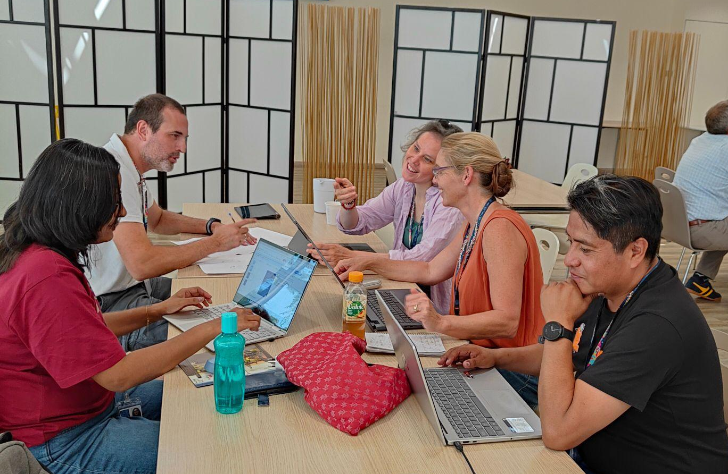
Engineering at CERN
HST2025 Study Group 9

Slide 102
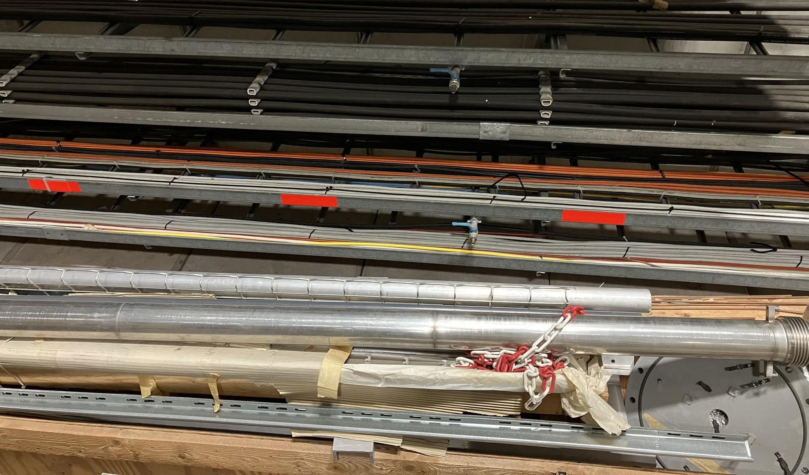

Slide 103
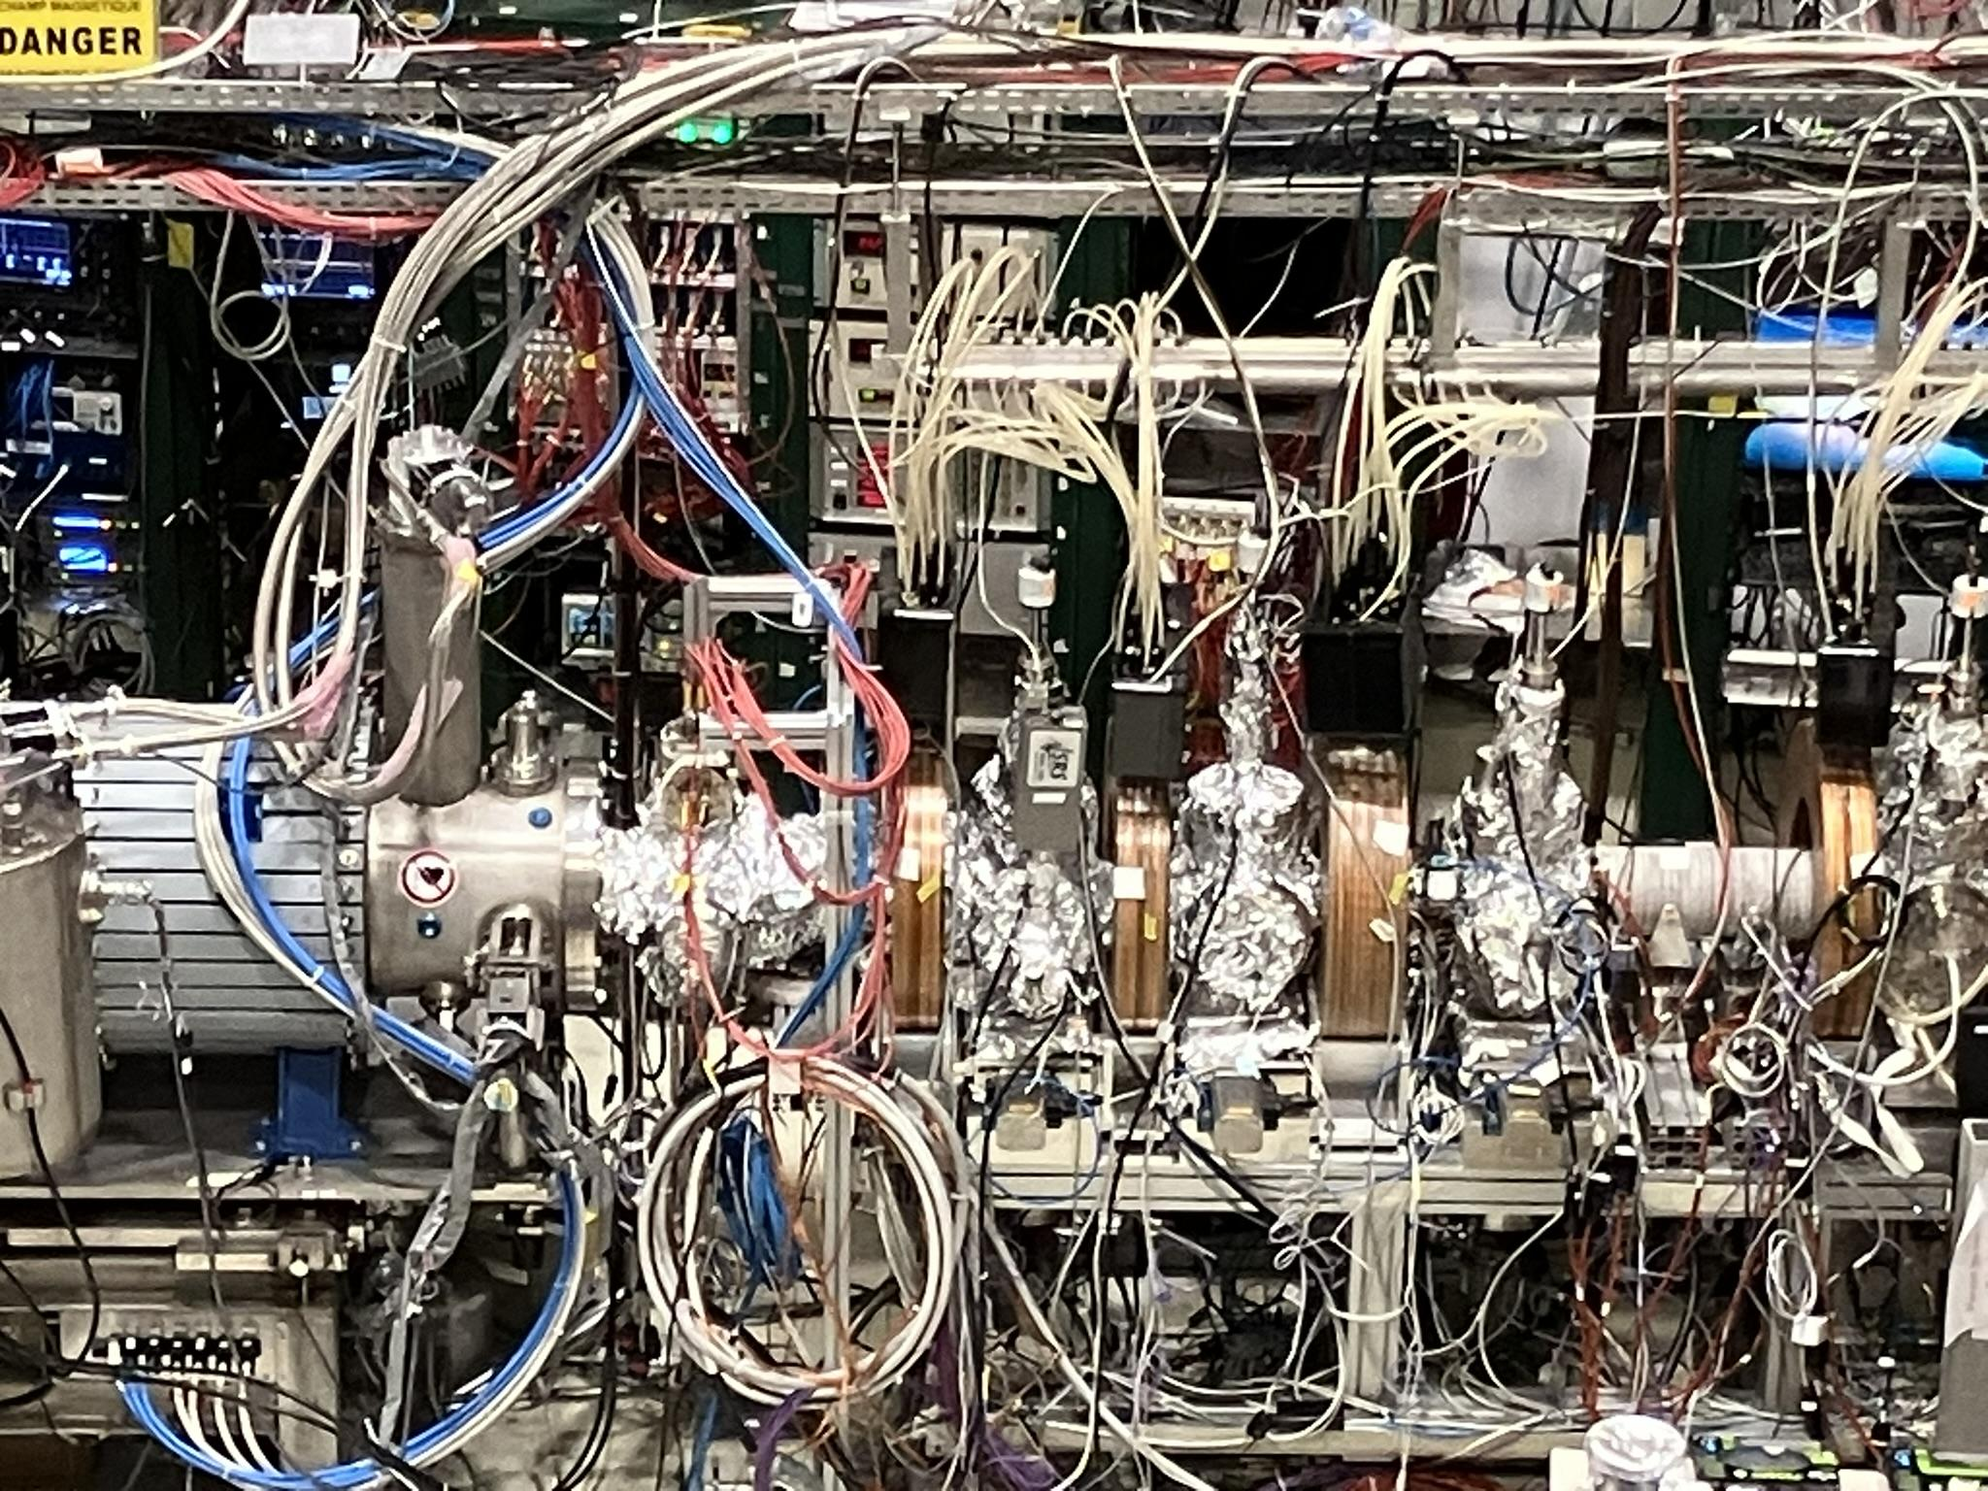

Slide 104
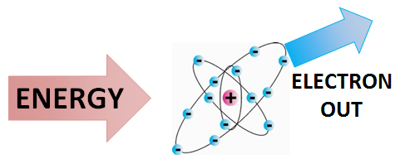
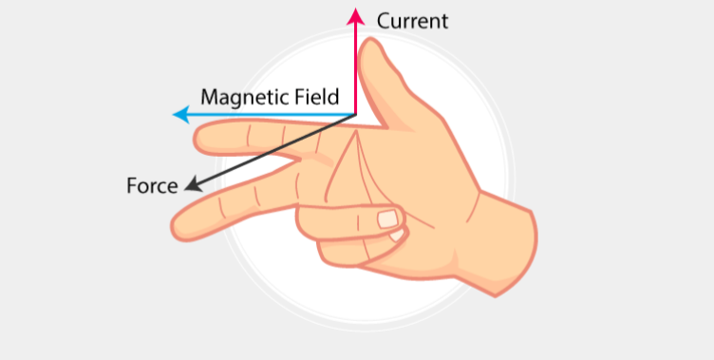
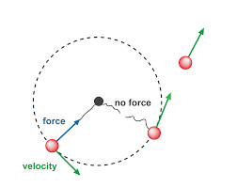
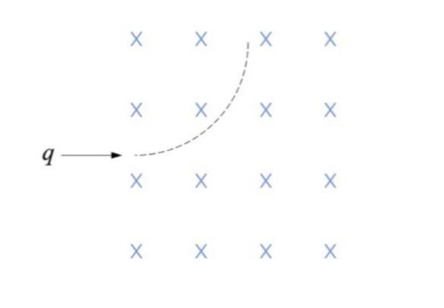
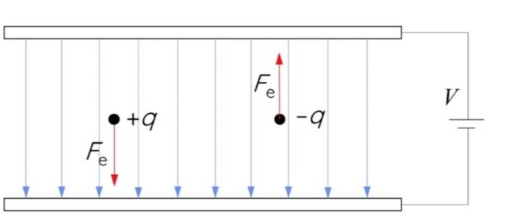
Curriculum & Classroom Connections (1/2)
Ionization
Lorentz force
Linear and circular motion
Electric/magnetic field

Slide 105
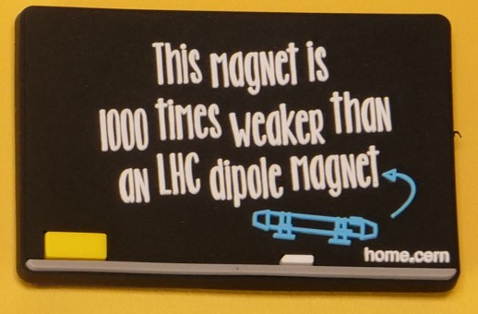
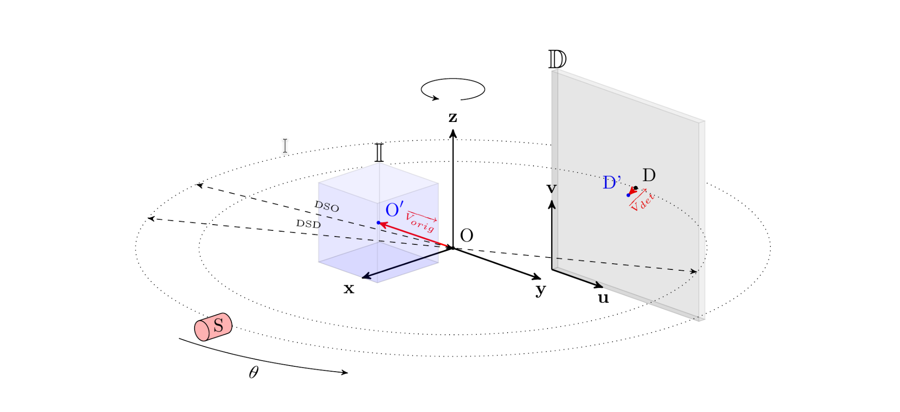
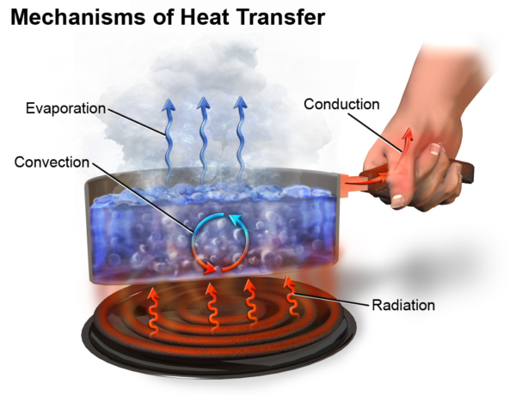
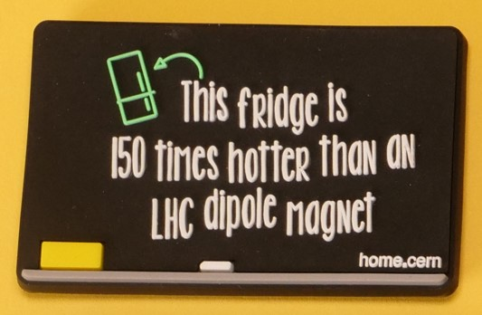
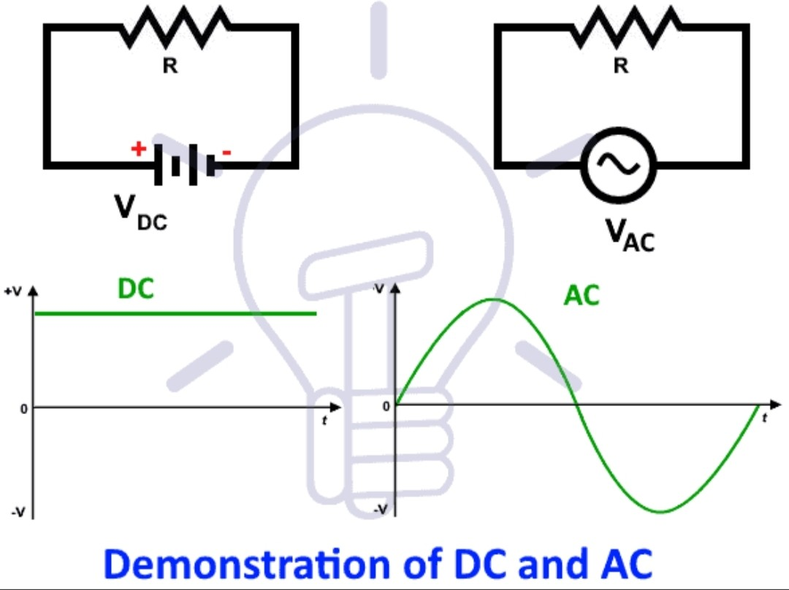
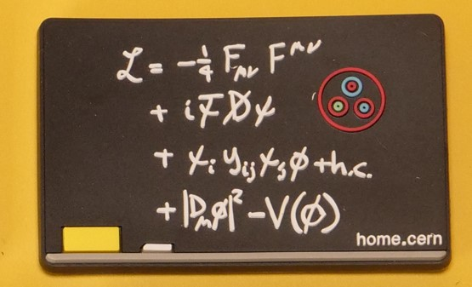
Curriculum & Classroom Connections (2/2)
Heat conduction
Solid Geometry
Electrical circuits (AC/DC)

Slide 106

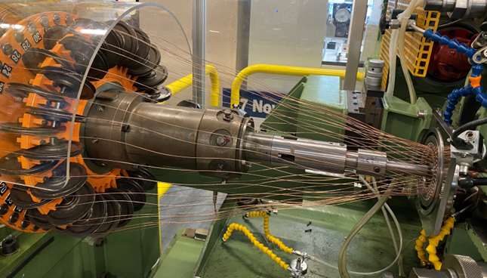
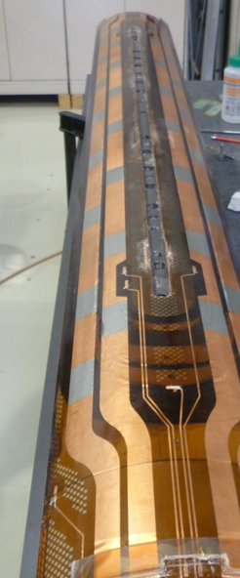
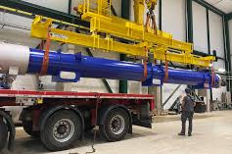

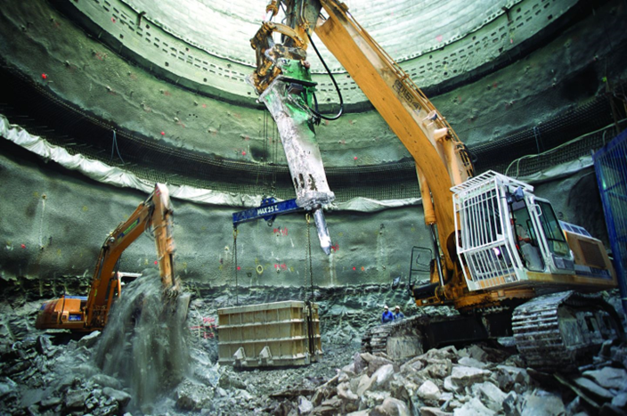
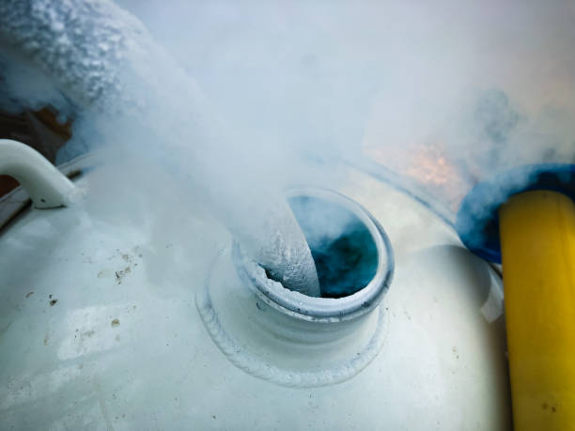
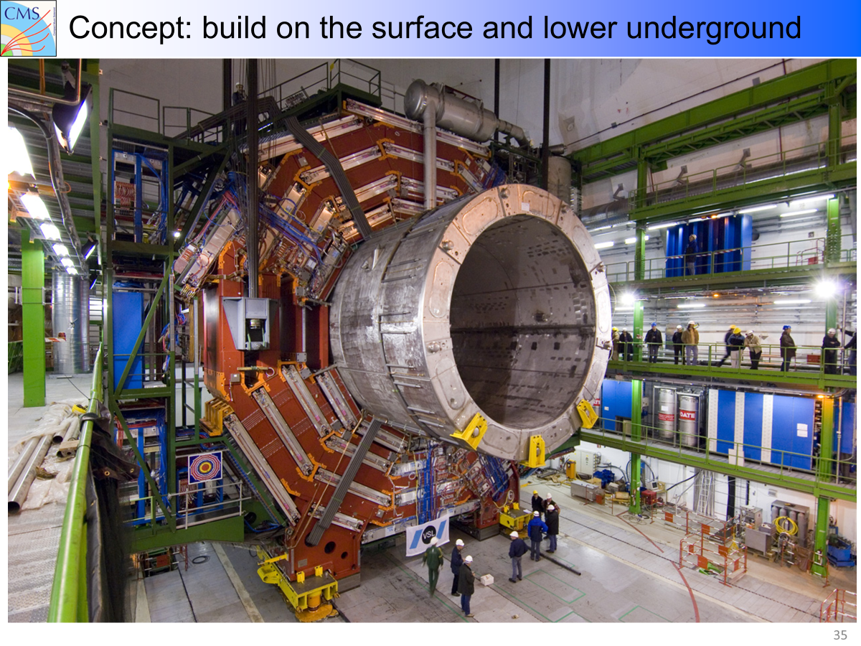
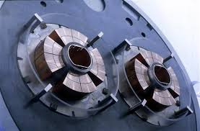
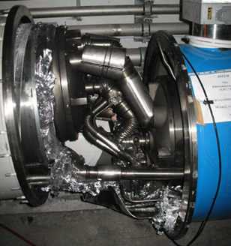
Key Ideas
Copper is not a superconductor! The material used are Niobium and Titanium alloy, or a brittle compound of Niobium and tin.
Structural construction of the LHC e.g. bent 1cm over 15m to transport on trucks and join together to construct LHC
Superconductors requires cryogenics
Engineering at CERN
Dipole and quadrupole magnets used to guide beam
Excavate access tunnel through water table by freezing water first.
Quenching of electromagnet

Slide 107
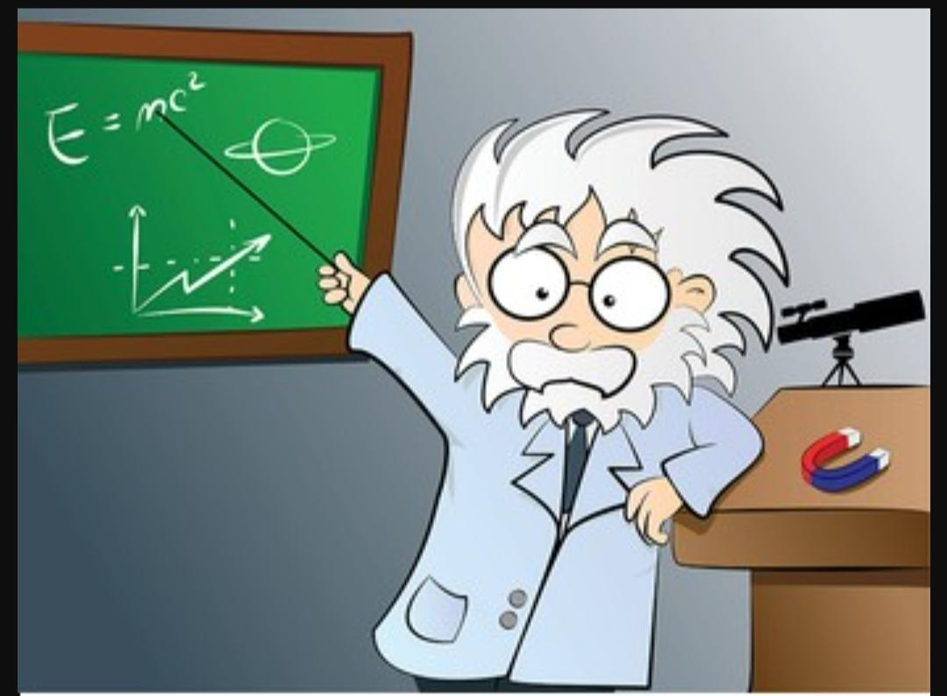
Potential Students’ Conceptions & Challenges
For teachers and students to simplify sufficiently without sacrificing accuracy
Scale - Thinking about 10^-15 size of a particle or an exabyte of data, or a 27 km underground pipe
Differences between science and engineering
Process optimization for tasks related to the efficient use of resources and energy.

Slide 108
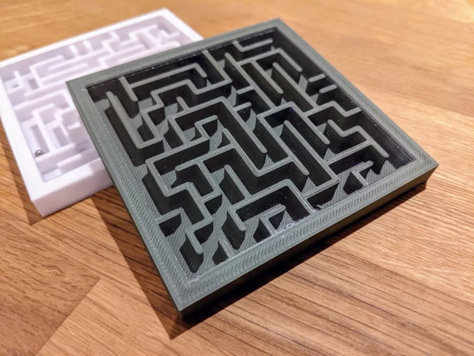
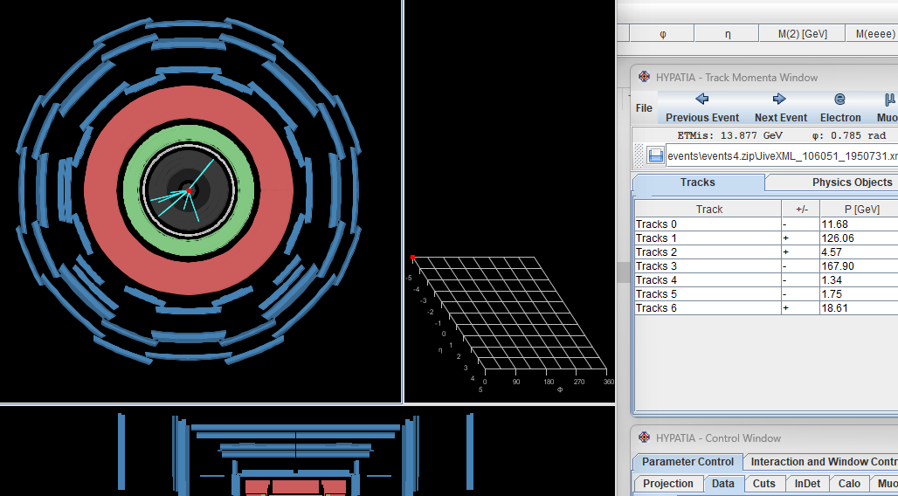

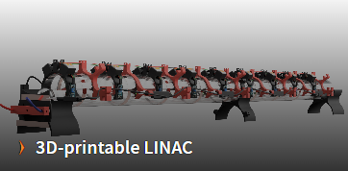

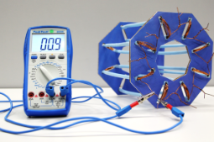

Useful Material & Resources
Basic experiments to make inferences
Design a tilted labyrinth with physical materials (cardboard, string, sticky tape limit them or have to “purchase”) and magnets. In this case the accelerator is gravity. While the ball bearing is guided by physical and magnetic materials.
Bending Limits: From Straws to the LHC: Use paper straws to make a circle without breaking them. What is the minimum size circle you can make without breaking them.The pieces of the pipe of the LHC are bent by just 1 cm over 15m so they can be joined to make a circle. (15 m so they fit on a truck!)
Build Models in 2D and 3D
Buid models and mockups using teplate for 3D printers for ATLAS Magnet, LINAC model and cuadrupole.
(https://schoollab.web.cern.ch).
Data analysis and simulations.
Using simulators with data stored in the ATLAS detector (hypatia.vog.gr)
Teaching guide
Classroom Resource from PI: Beyond the Atom. Activity 4. Purpose: To analyze real scientific data.

Slide 109
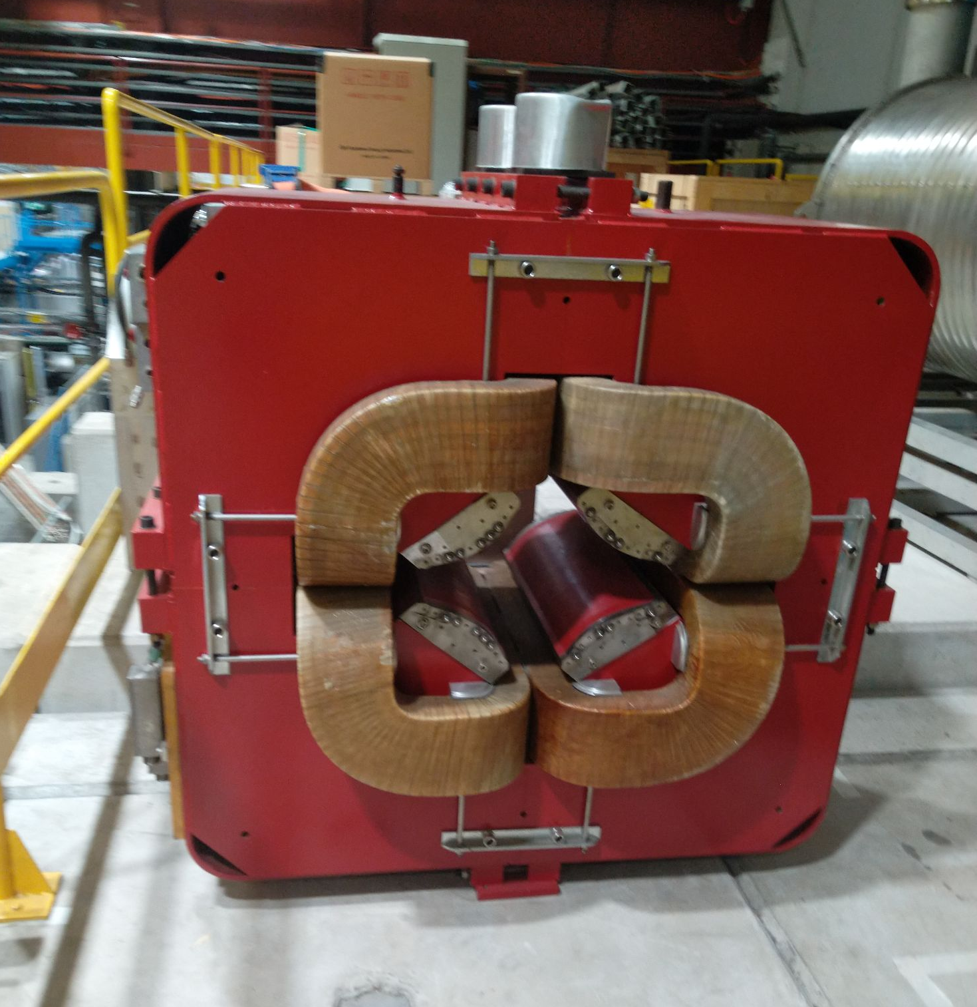
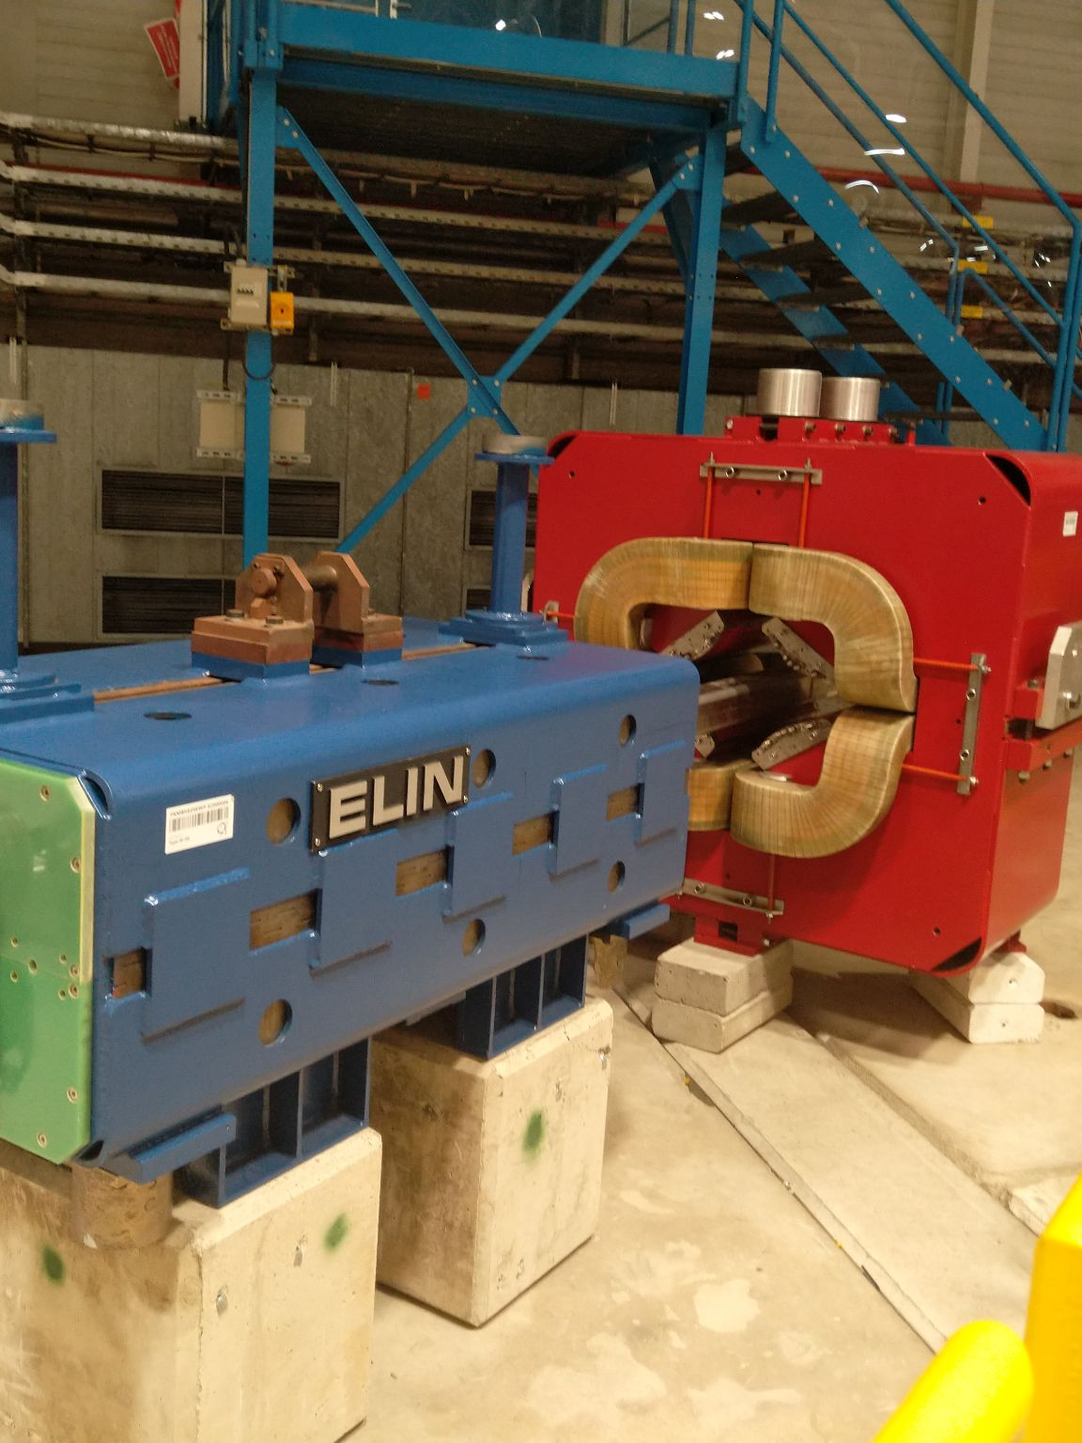
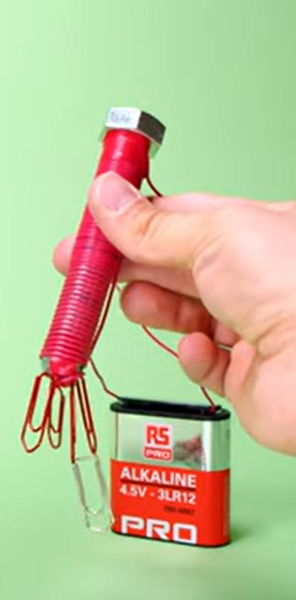
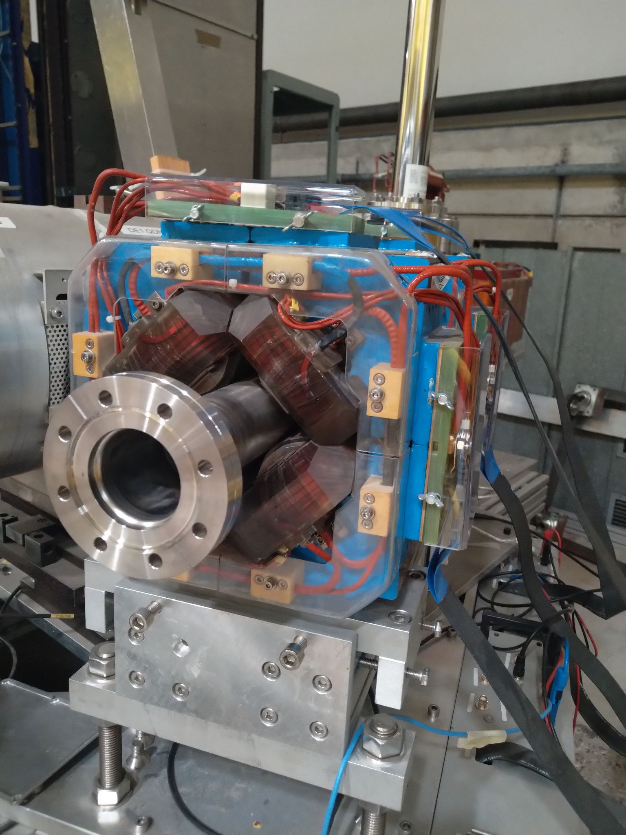
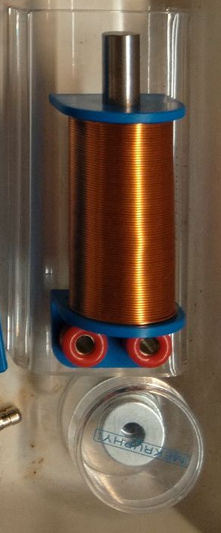

From CERNs electromagnets → engineering an electromagnet
Build electromagnet
[1]
Taken at Antimatter factory!
[1] https://solvay-education-programme.web.cern.ch/iron-screw-cern-electromagnets

Slide 110
From CERNs electromagnets → engineering an electromagnet
Cable
diameter
groupwork
Cable
length
Optimized product
engineering
vary
Build electromagnet
[1]
Cable
material
core material
[1] https://solvay-education-programme.web.cern.ch/iron-screw-cern-electromagnets

Slide 111

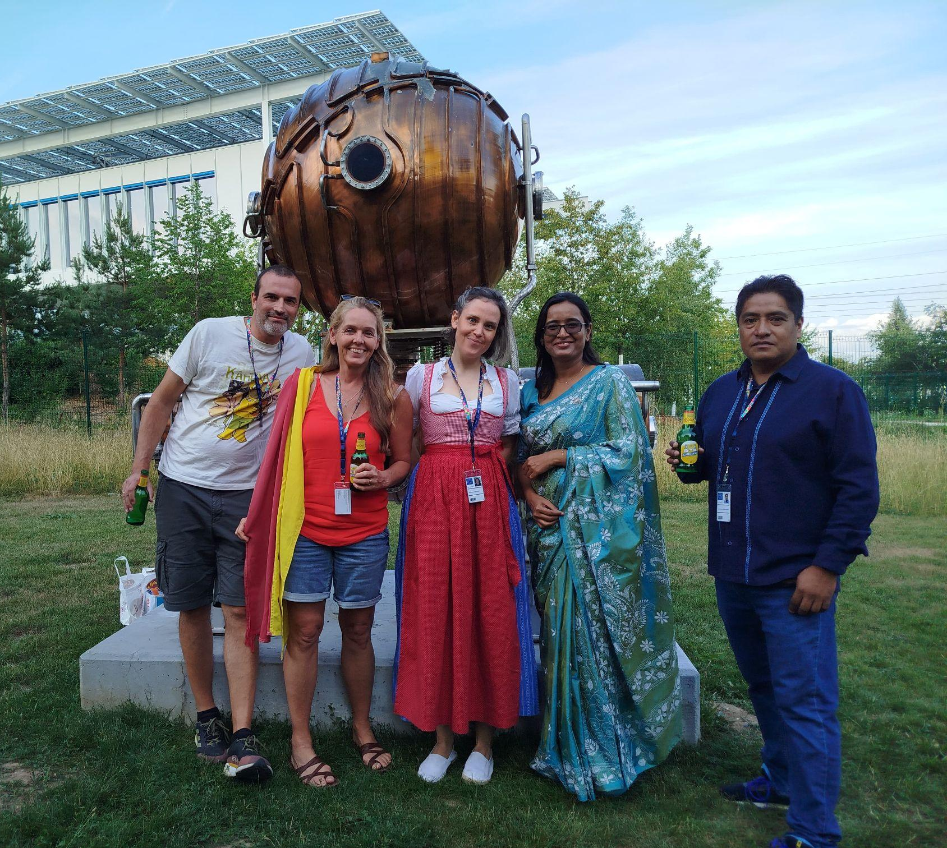
HST2025 Study Group 9
George (Greece), Job (Mexico), Susanne (Germany), Suzanne (Australia), Tanusree (India)
One way in which our thinking has changed…
simultaneous cooperation → ideal outcome
Socializing is crucial
Visualization is important
From global idea to the learning snippet
A better understanding how CERN works and how attainable it is to be involved. It is not magic!

