Slide 1
Study Group 5
International High School Teacher Programme 2025

Slide 2
Wednesday, 9 July
SG Session 1

Slide 3
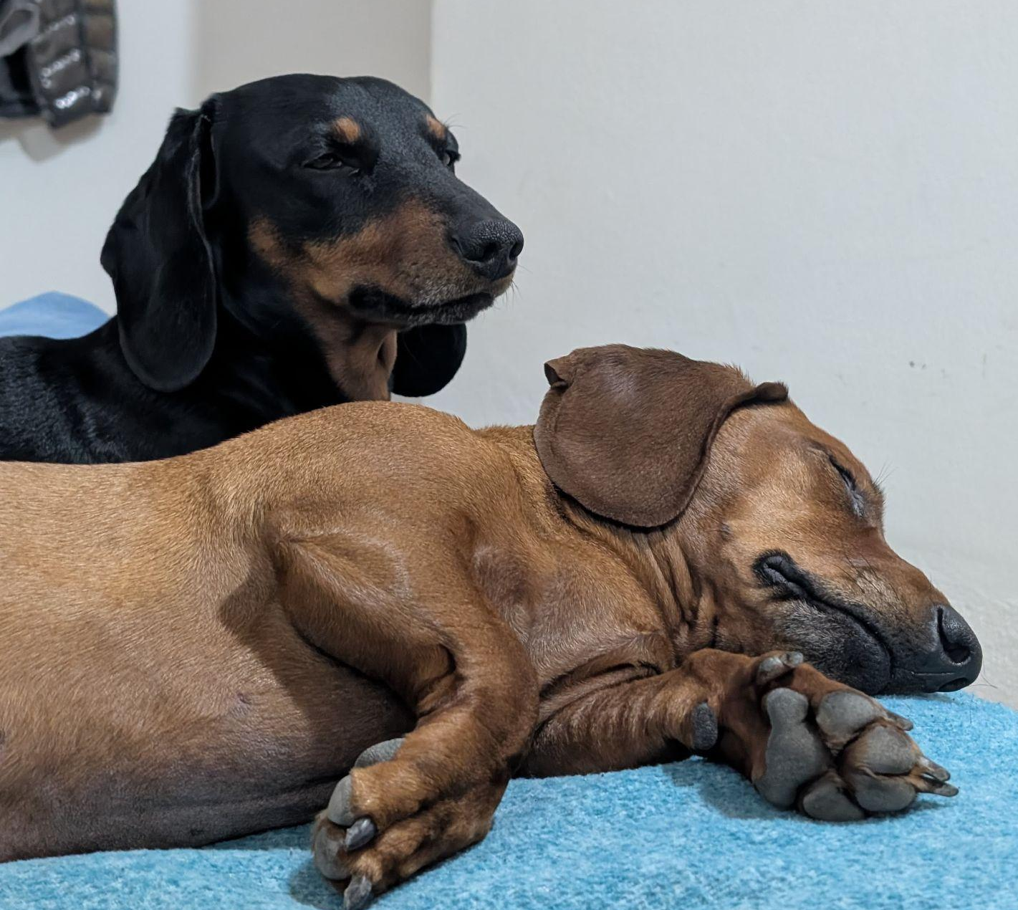

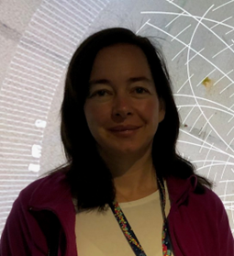


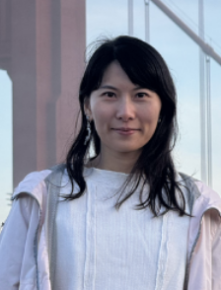

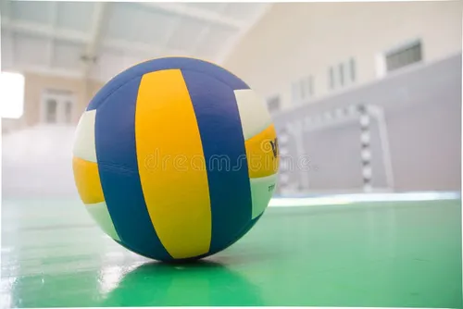
Study Group 5
Georg
Austria
I like to troll my students.
Wanyi Huang
China
I am a rated saber fencer
Sabina Lehocká
Slovakia
I’m into sports. When I was a teen, I did karate, and at university Aikido.
Stacey Floyd
USA
I love to use big power-tools!
Esteban Riquelme
Argentina
I drink more mate than water, and I have 2 wiener dogs.

Slide 4
Slide Conventions
Colour of Slide | Type of Work
 | Individual (your colour is indicated on the previous slide)
 | Group work
 | Report-out slides

Slide 5
Checklist for SG Session 1
# | Type of Task | Task | Deadline
1 | Individual | Fill in your section of the “Study Group 5” slide | Wednesday, 17:30
2 | Group | Fill in “Group Norms” slide | Wednesday, 17:30
3 | Individual | Fill in slides corresponding to your colour | Wednesday, 17:30
4 | Group | Fill in “Our Key Takeaways” and “Our Feedback” slides as a group. Make sure you all contribute to the discussion. | Wednesday, 17:30
5 | Group | Decide how you as a group will present your group slides if you are selected to present during the SG Report-Out. | Wednesday, 17:30

Slide 6
Group Norms
Instructions: Write on the right box your group norms and how you will work together. For example:
Who will manage the meetings?
Who will be the time-keeper?
Who will fill in group slides?
Anything else you think is important to coordinate for productive group work.
Wanyi will be our time-keeper.
Everyone will be ontime.
Everyone contributes equally.
We will support each other.
We will be respectful.
No FIGHTING!!
Everyone comes with a Dad joke or Meme/day!
We try to be aware of deadlines.
We shouldn’t leave the meeting with unresolved questions.
Stay on task - with priorities.

Slide 7
Particle Physics
What are three adjectives that come to your mind when you think about particle physics?
To what extent is the topic of particle physics covered in your national curriculum?
Elementary - Pointlike - Entertaining
Austrian Curriculum:
Unterstufe: barely at all
Oberstufe: Moderne Physik, Kernphysik - embedded vaguely as “modern physics”

Slide 8
Particle Accelerators
What are three key ideas about particle accelerators that you would like your students to know about?
What are potential challenges students might encounter when learning about particle accelerators?
a) (Only charged) Particles can be accelerated with DC or with particles can be accelerated with AC - in a straight line if the length of the dipoles get larger.
b) Particle accelerators are present in our daily lifes.
c) Acceleration means more speed, that means more mass which sets a limit to the reachable speed.
Missing knowledge of electrostatics
They might think that the length of the dipoles has to get larger
Mistaking accelerators and electromagnets

Slide 9
Particle Detectors
What are three key ideas about particle detectors that you would like your students to know about?
What are potential challenges students might encounter when learning about particle detectors?
a) They don’t detect particles, but indirectly via their traces.
b) they can measure different quantities - like the path or the energy.
c) It helps to know what is NOT detected.
a) Particles are not detected directly.
b) Difficulties in understanding the way particles can deposit their energy

Slide 10
My Key Takeaways so far
Instructions: Write in the box any insights or things that you learned and that you want to remember after the HST2025 programme.
The relativistic mass must not be ignored.
More massive particles can be created from particles of less mass.
The amount of corrections in order to run the accelerator and detector are enormous.
It broadened my horizon in so far as that now I know more that i don’t know.
The origin of mass.

Slide 11
Particle Physics
What are three adjectives that come to your mind when you think about particle physics?
To what extent is the topic of particle physics covered in your national curriculum?
Explain how theoretical particle physics (standard model)
Explain experimental particle physics (CERN - particle accelerators and detectors)
Explain why particle physics is essential in the study of Cosmology
Particle physics is not included in the California Next Generation Science Standards (NGSS).

Slide 12
Particle Accelerators
What are three key ideas about particle accelerators that you would like your students to know about?
What are potential challenges students might encounter when learning about particle accelerators?
The advantages and drawbacks of different accelerators: LINAC, Synchrocyclotron, Cyclotron, Synchrotron
The role Dipole, Quadrupole, Sextupole play in the accelerator
How accelerators need to account for relativity
Vocabulary
Prior knowledge on relativity, Electromagnetism, Right hand rule, optics

Slide 13
Particle Detectors
What are three key ideas about particle detectors that you would like your students to know about?
What are potential challenges students might encounter when learning about particle detectors?
Particles are detected with with different layers of detectors
Target particles are not directly detected by the detector instead scientists need to work backward by studying the trace particles
The significance of discovery of higgs boson
Prior knowledge of electromagnetism, standard model
Vocabulary
Hard time to understand abstract concepts

Slide 14
My Key Takeaways so far
Instructions: Write in the box any insights or things that you learned and that you want to remember after the HST2025 programme.
Multiple accelerators(psb, ps, sps, LHC) work together to boost particle to the targeted energy.
Collaborations between different specialists(engineers, physicists, operators, admins… )make CERN successful.
It takes multiple key components (4 experiments-CMS, ALICE, ATLAS, LHCb, collimator, proton dump, correctors) working accurately and synchronously together to discover Higgs Boson
It’s all about INTERACTION!!!!!

Slide 15
Particle Physics
What are three adjectives that come to your mind when you think about particle physics?
To what extent is the topic of particle physics covered in your national curriculum?
Exciting, easy-to-understand, interesting
It is a part of study for students who choose physical seminar (one or two lectures)

Slide 16
Particle Accelerators
What are three key ideas about particle accelerators that you would like your students to know about?
What are potential challenges students might encounter when learning about particle accelerators?
I)
We can accelerate only charged particles.
We use electrical field to accelerate them and magnetic field to curve them.
There are two main types of accelerators - linear and circular (colliders)
II)
If they haven’t enough time, they can’t get deeper to this topic.
Understanding the boosting particles in the radio-frequency cavity.
Grasp luminosity and how can be increased.

Slide 17
Particle Detectors
What are three key ideas about particle detectors that you would like your students to know about?
What are potential challenges students might encounter when learning about particle detectors?
I.
There are different detectors that can detect different particles due to their interaction with matter.
At LHC they are shaped as an onion.
Some particle cannot be detect, but we know about them because of lost energy (momenta)
II.
Understanding basic process of interaction with matter - ionisation.
How calorimeters work. What is the difference between electromagnetic and hadronic calorimeter.
How to count invariant mass and then the lost energy.

Slide 18
My Key Takeaways so far
Instructions: Write in the box any insights or things that you learned and that you want to remember after the HST2025 programme.
CERN -> International Collaboration
Education
Fundamental Research
New Technology

Slide 19
Particle Physics
What are three adjectives that come to your mind when you think about particle physics?
To what extent is the topic of particle physics covered in your national curriculum?
A. Inspiring
B. Lego 1x1s - ish
C. Worthwhile
Particle physics is not covered heavily in our curriculum. It is only mentioned as part of the wave-particle duality of light.

Slide 20
Particle Accelerators
What are three key ideas about particle accelerators that you would like your students to know about?
What are potential challenges students might encounter when learning about particle accelerators?
A. It would be good for the students to know that the accelerators use magnetic fields to create the centripetal forces necessary to direct the particles.
B. I would like the students to know that the quantity of particles and huge number of collision events needed to be monitored by and evaluated by the aging legacy detector arrays can help the students to understand both the idea of sample selection, as well as the idea of experimental errors due to limitations.
C. I want the students to know that research opportunities are abundant and that they can still help to answer unanswered questions.
Potential challenges for students include the fact that they won’t have a lot of time to understand these topics, as well as the fact that they may feel slightly overwhelmed by these very new topics.

Slide 21
Particle Detectors
What are three key ideas about particle detectors that you would like your students to know about?
What are potential challenges students might encounter when learning about particle detectors?
A. They need to know that detectors come in many forms, including our eyes, items in nature, bubble chambers, scintillators and more.
B. I’d like to show them how to use a few detectors, including a gas chamber (made of dry ice), and maybe some phosphorescent paper, an arduino photoresistor sensor, etc.
C. I’d like them to know how important detectors are in the discovery of new science discoveries.
A potential challenge that the students will encounter are budget limitations. It will be difficult to have all of the equipment that they need to explore detectors.

Slide 22
My Key Takeaways so far
Instructions: Write in the box any insights or things that you learned and that you want to remember after the HST2025 programme.
I have enjoyed learning about the stacked accelerators.
I have enjoyed learning about the oldest types of accelerators and detectors (like the objects in the garden behind the cafeteria)
I have also enjoyed getting to know some of these teachers from so many places. They all seem just amazing and their efforts to learn all about physics and also a language as difficult as English is so cool!

Slide 23
Particle Physics
What are three adjectives that come to your mind when you think about particle physics?
To what extent is the topic of particle physics covered in your national curriculum?
3 ADJECTIVES:
Small,
Fast &
Evolving
Just this year (2025) they included particle physics as a high school curriculum theme at the province I work in (Neuquen). In university it really varies, in my case it was an elective course.

Slide 24
Particle Accelerators
What are three key ideas about particle accelerators that you would like your students to know about?
What are potential challenges students might encounter when learning about particle accelerators?
3 KEY IDEAS:
They work with magnets
Any charged particle could work in it
We have “particle accelerators” at home in a daily basis (microwave), and all work with the same physical principles.
POTENTIAL CHALLENGES:
They should know what acceleration is.
They should know basic electromagnetic stuff.
It is really difficult to make an experiment, so it would be convenient to think on analogies.

Slide 25
Particle Detectors
What are three key ideas about particle detectors that you would like your students to know about?
What are potential challenges students might encounter when learning about particle detectors?
3 KEY IDEAS:
Without them a particle accelerator is useless.
With them we can discover new particles.
With them we can differentiate known particles.
POTENTIAL CHALLENGES:
Some of them are really complicated systems, but the general idea can be learnt with a homemade bubble chamber.
Due to the previous challenge, the first way I see students learning about this is conceptual.

Slide 26
My Key Takeaways so far
Instructions: Write in the box any insights or things that you learned and that you want to remember after the HST2025 programme.
MY KEY TAKEAWAYS SO FAR:
I have learnt the basics of a particle accelerator and a particle detector, enough so i can explain it to someone and evolve my understanding.
Because in the curriculum of my province particle physics wasn't included, they only teached me the basics, but not really the standard model, so I will be learning more about this in the future.
I want to remember common misconceptions my students had about particle physics in general.
More to come…

Slide 27
Study Group Discussion
Share your individual insights with your colleagues and identify shared themes.
Have some ice cream and don’t forget to take notes :)
Particle accelerators are present in the daily life (e.g. microwave, TV tube, ..)

Slide 28
Our Key Takeaways so far
Instructions: Write in the box any insights, learnings and discussion outcomes. (Decide how you as a group will present them if you are selected to present during the SG Report-Out.)
Particle accelerators are objects of our daily life. (Esteban)
Connections to curriculum (Stacey)
Particle accelerators (Wanyi)
Particle detectors (Georg)
Teaching particle physics
Potential challenges for teachers and students (Sabina)

Slide 29
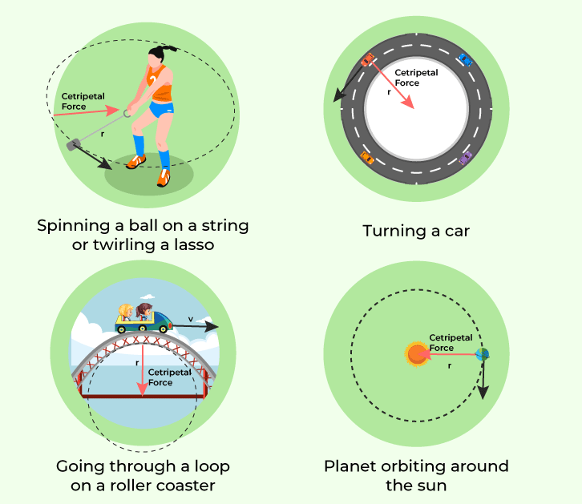
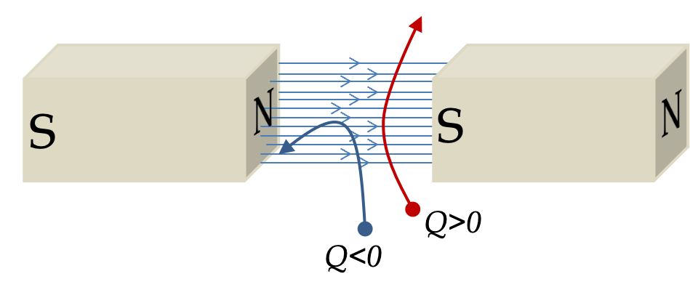
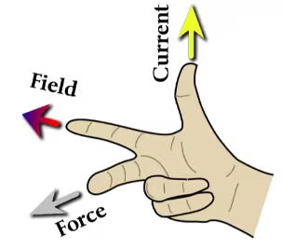
Connections to curriculum
Secret Handshake!
Notes:
One of the key takeaways from our time here at CERN so far is the fact that there are so many ways to integrate the interesting topics of particle accelerators and detectors with our regular physics content. Even when the state and national standards don’t always specifically include particle physics, we can use concepts.

Slide 30
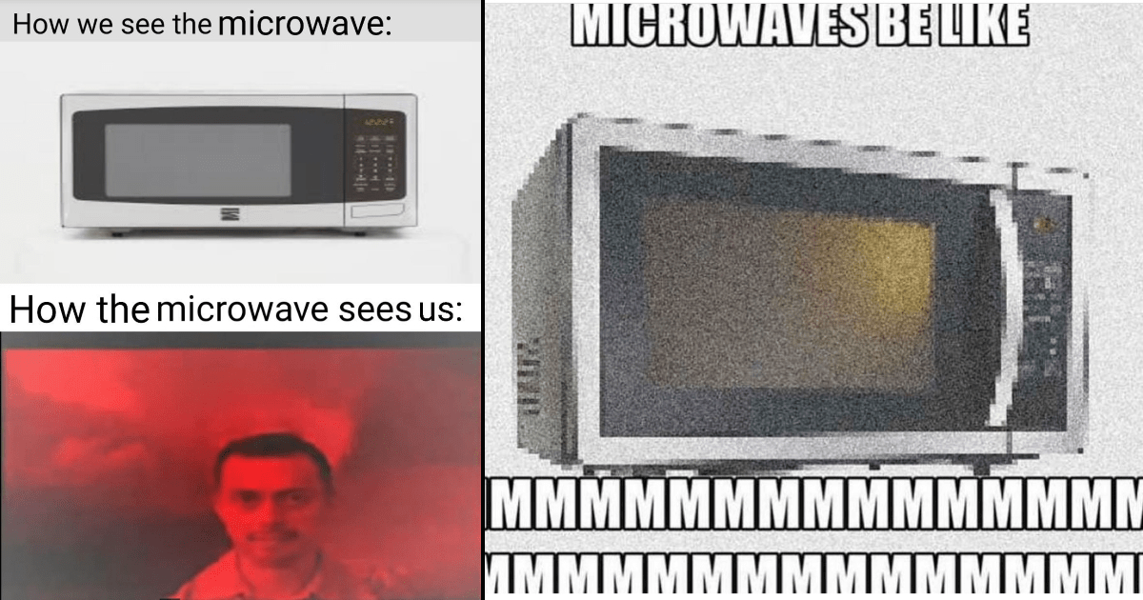

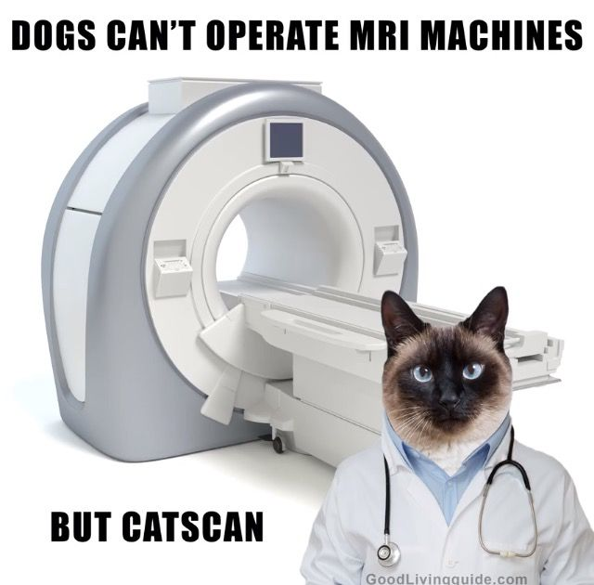
Particle accelerators are objects of our daily life!

Slide 31
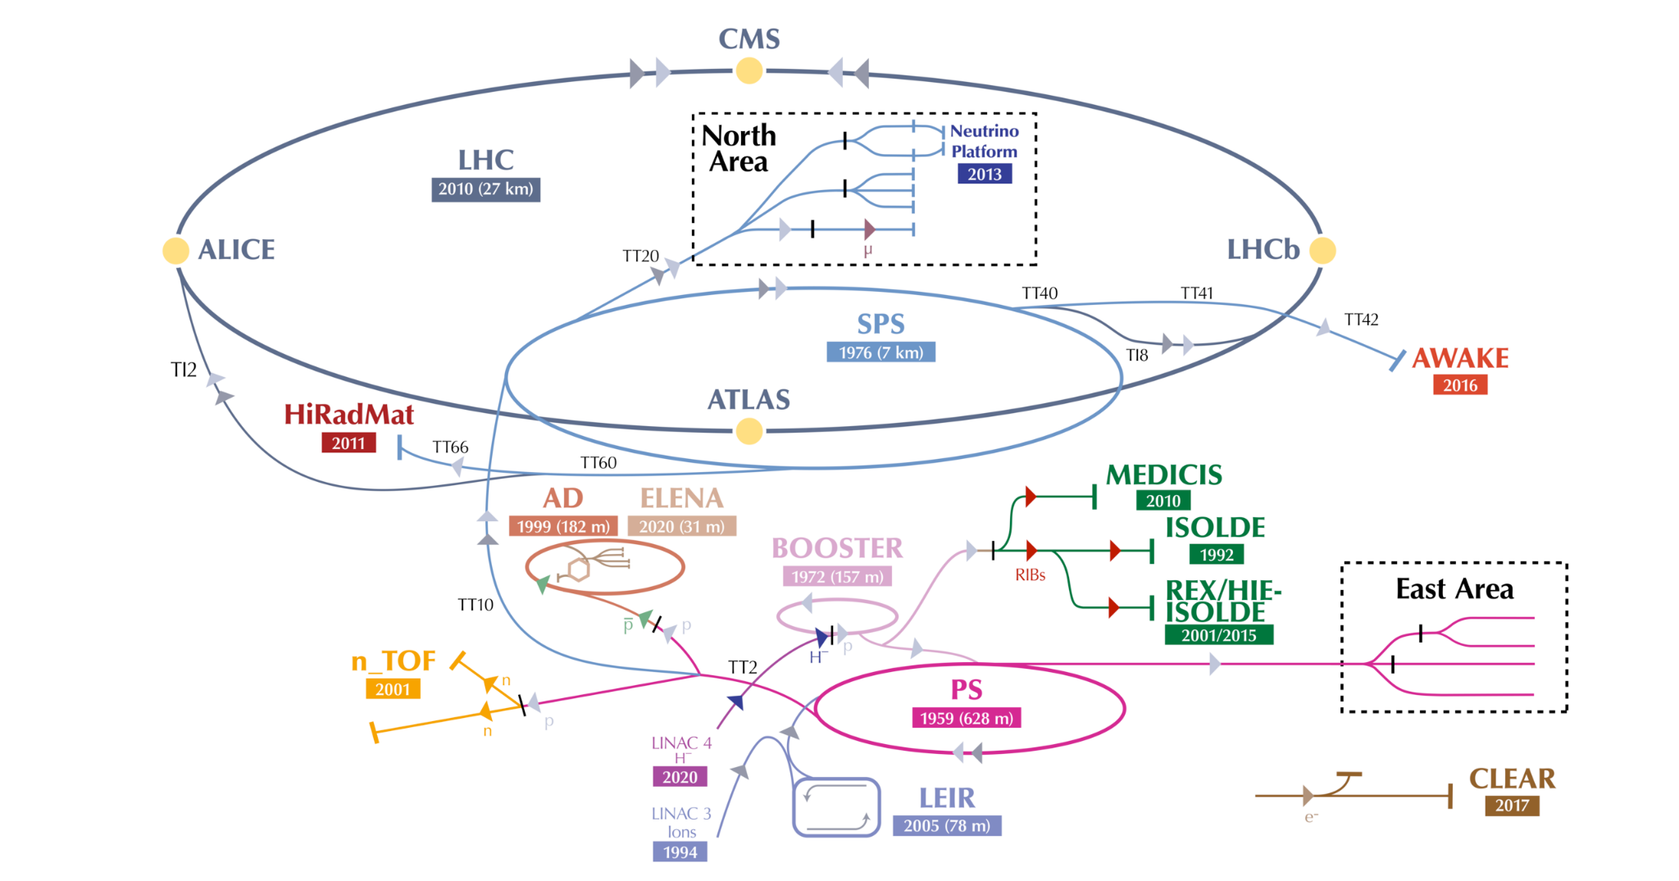
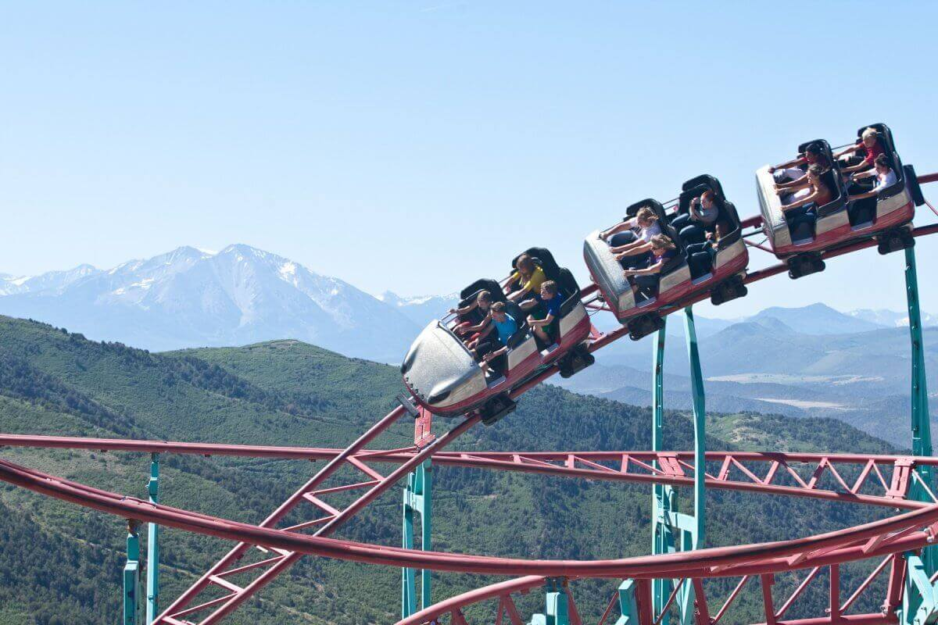
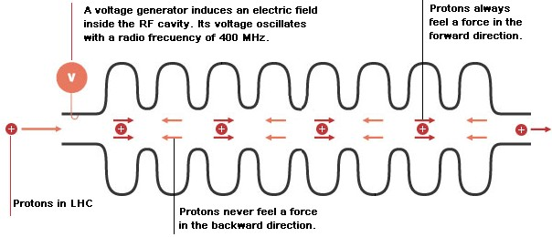
Particle Accelerator
1.2s
LINAC ~50 MeV, PSB ~2GeV, PS ~25GeV, SPS ~450 GeV, LHC ~6.8 TeV
Box car - each injection - groups of proton bunches
riders - proton bunches
Each box car is made of bunches spaced 25 ns apart
Notes:
400 MHz - 2.5 ns

Slide 32

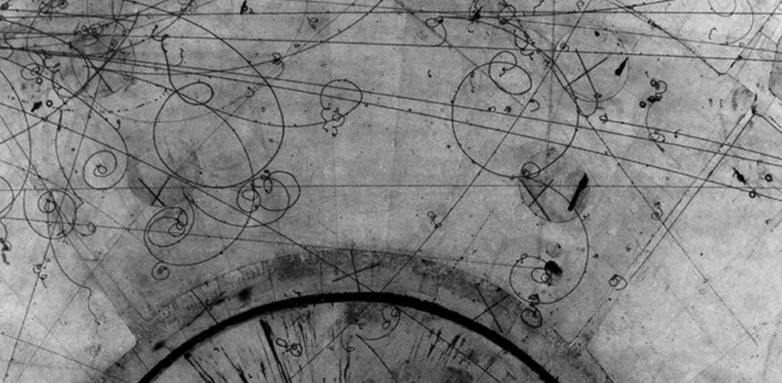
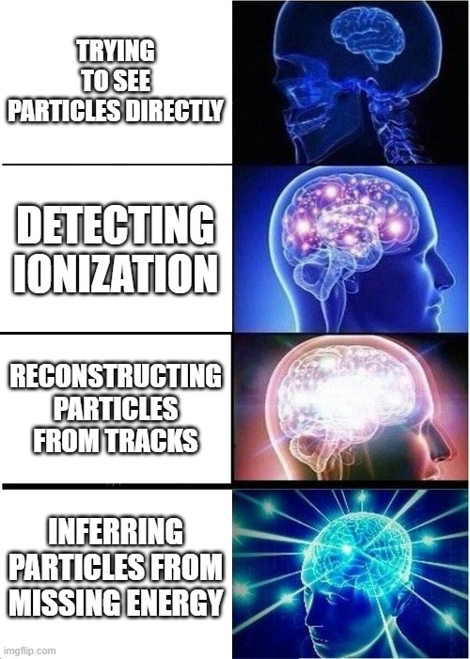
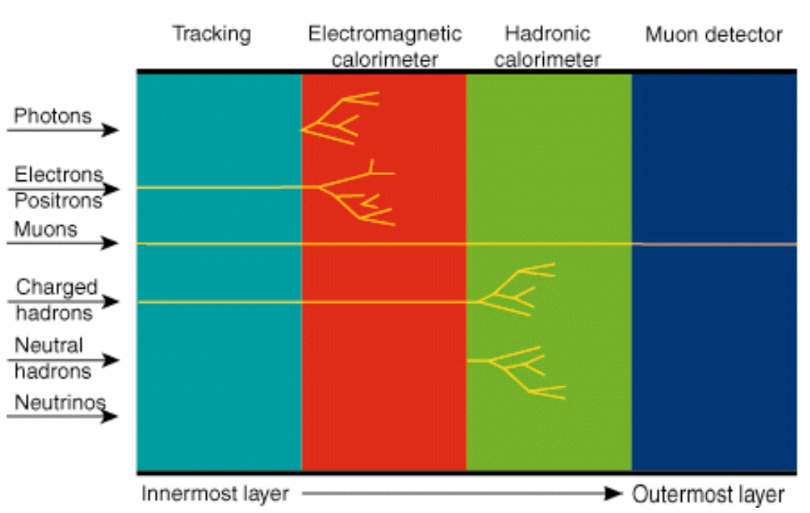
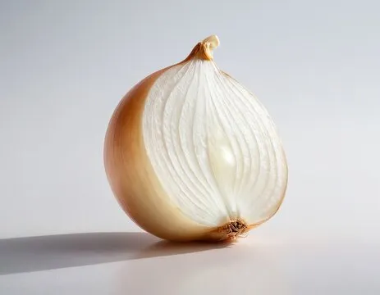
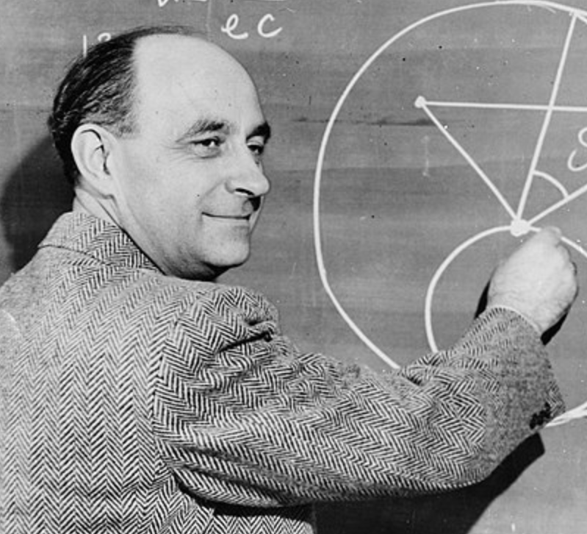
Particle Detectors

Slide 33
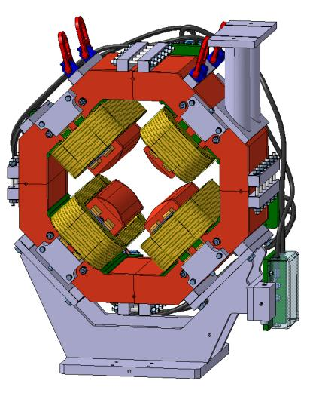
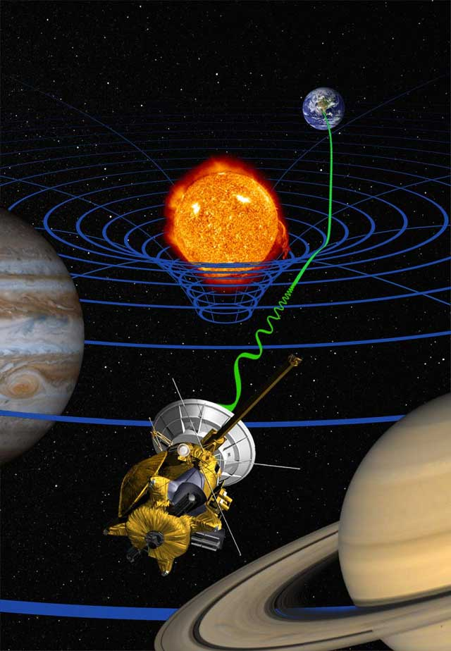

Potential challenges
for teachers
and students
We need to prior knowledge of:
Electrostatic
Electromagnetism
Optics
RELATIVITY
It’s really difficult to make an experiment in classroom, so it would be convenient to think in analogies.
Students won’t have a lot of time to understand this topics deeply and they may feel slightly overwhelmed by these very new topics.
Students may have problems with understanding:
basic processes of interaction with matter
the way particles can deposit their energy
boosting particles in the radio-frequency cavity

Slide 34
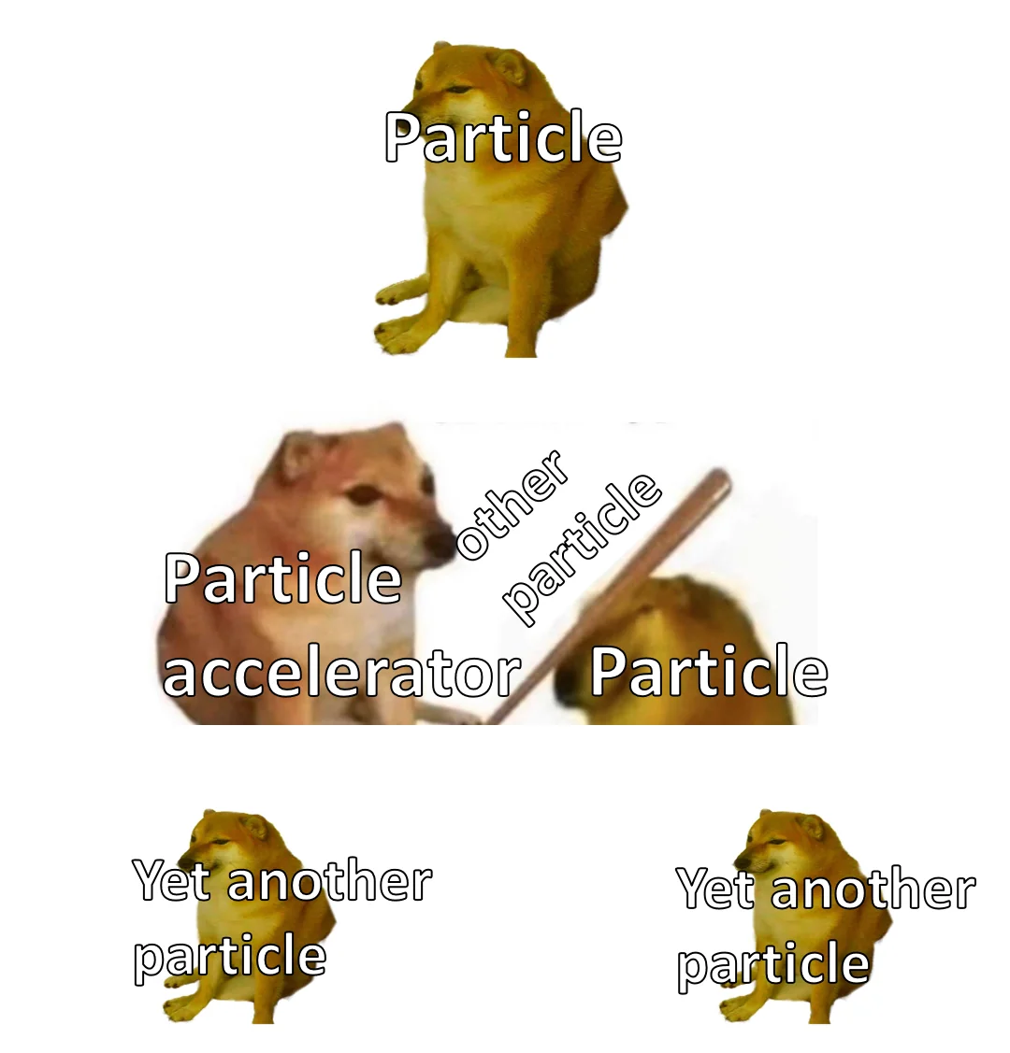
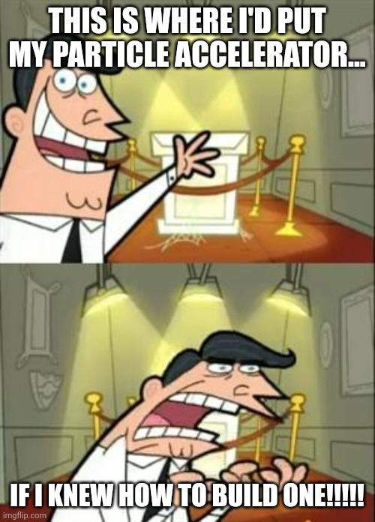

Our Feedback so far
Highlights?
What’s working?
What needs improvement?
Other comments?
Funny picture or meme?
Highlights:
Interactive Contents,
visits,
passionate speakers,
questions,
socials…

Slide 35
Thursday, 10 July
SG Session 2

Slide 36
Checklist for SG Session 2
# | Type of Task | Task | Deadline
1 | Individual | Fill in slides corresponding to your colour | Thursday, 18:00
2 | Group | Fill in “Our Key Takeaways” and “Our Feedback” slides as a group. Make sure you all contribute to the discussion. | Thursday, 18:00
3 | Group | Decide how you as a group will present your group slides if you are selected to present during the SG Report-Out. | Thursday, 18:00

Slide 37
Engineering
Which topic from the physics curriculum could you see yourself teaching in the context of Engineering at CERN?
Sketch out your idea and add links to suitable resources!
Electricity - resistance
Quantum physics - superconductivity
2) superconductivity and its applications - hyperloop

Slide 38
LHC
Which topic from the physics curriculum could you see yourself teaching in the context of the Large Hadron Collider at CERN?
Sketch out your idea and add links to suitable resources!
Conservation laws (energy, electric charge)
Thermodynamics (how to maintain the cold)
The LHC is run every day 24/7
A lot of safety systems are in action to prevent the beam from damaging sensors and more

Slide 39
AI
What are three key ideas about AI that you would like your students to know about?
What are potential challenges students might encounter when learning about AI?
What are potential benefits students might encounter when learning with the help of AI?
- Deeplearning is needed to deal with big amounts of data
- without AI, much more storage would be needed
- every detector needs its own AI
Very spezialized topic
Computer background dependant on computer science class
Realizing the all day applications of AI - netflix, youtube, …

Slide 40
My Key Takeaways so far
Instructions: Write in the box any insights or things that you learned and that you want to remember after the HST2025 programme.

Slide 41
Engineering
Which topic from the physics curriculum could you see yourself teaching in the context of Engineering at CERN?
Sketch out your idea and add links to suitable resources!
Mechanical
Forces
Energy and power
Electricity
Thermodynamics
Kinematic
Optics
Electromagnetism

Slide 42
LHC
Which topic from the physics curriculum could you see yourself teaching in the context of the Large Hadron Collider at CERN?
Sketch out your idea and add links to suitable resources!
Mechanical
Forces
Energy and power
Electricity
Thermodynamics
Kinematic
Optics
Electromagnetism
Modern physics

Slide 43
AI
What are three key ideas about AI that you would like your students to know about?
What are potential challenges students might encounter when learning about AI?
What are potential benefits students might encounter when learning with the help of AI?
We can use AI to train model to make
Over reliance on AI tool
Pragerism
Lack of critical thinking
Simulation
Feedback
Clarification of understanding

Slide 44
My Key Takeaways so far
Instructions: Write in the box any insights or things that you learned and that you want to remember after the HST2025 programme.
Material science
→superconductors & insulator & conductors!
→quenching (removing heat)
Recycling
PS→SPS→LHC? (CHECK)
Advancing
SC→PS→SPS→LHC→LH+LHC & FCC
Teaching
AI
MACHINE LEARNING
Bias

Slide 45
Engineering
Which topic from the physics curriculum could you see yourself teaching in the context of Engineering at CERN?
Sketch out your idea and add links to suitable resources!
Electricity and magnetism

Slide 46
LHC
Which topic from the physics curriculum could you see yourself teaching in the context of the Large Hadron Collider at CERN?
Sketch out your idea and add links to suitable resources!
Magnetism
2)

Slide 47
AI
What are three key ideas about AI that you would like your students to know about?
What are potential challenges students might encounter when learning about AI?
What are potential benefits students might encounter when learning with the help of AI?

Slide 48
My Key Takeaways so far
Instructions: Write in the box any insights or things that you learned and that you want to remember after the HST2025 programme.

Slide 49
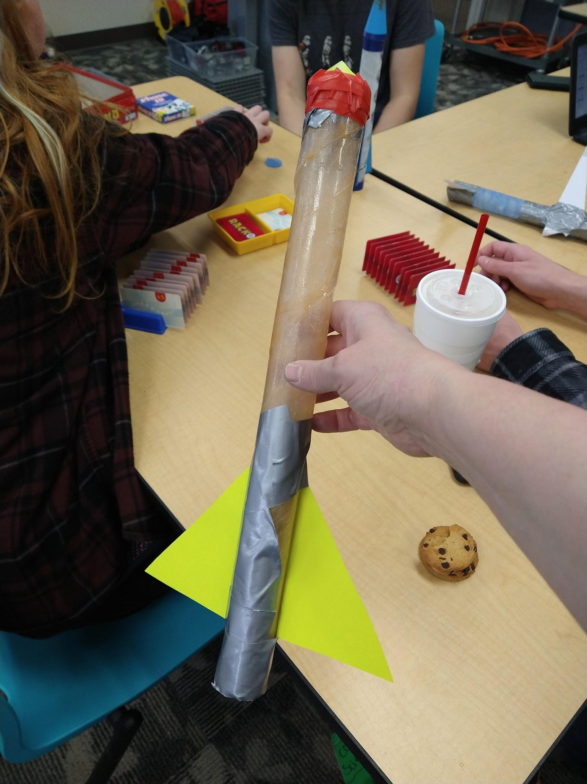
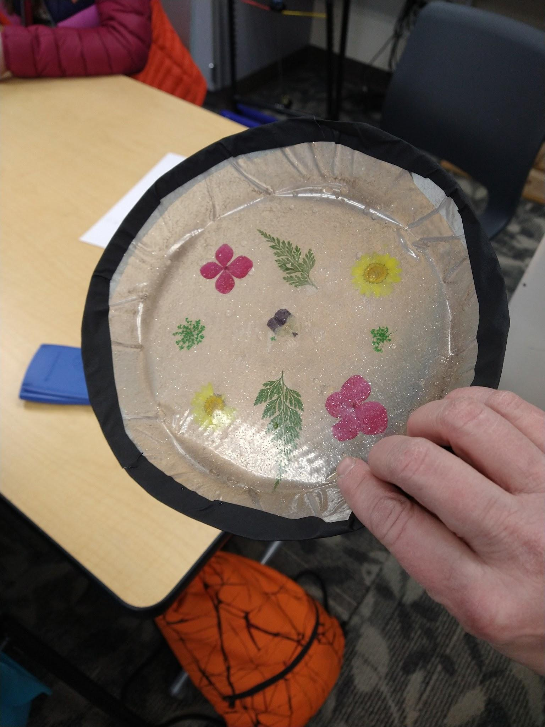
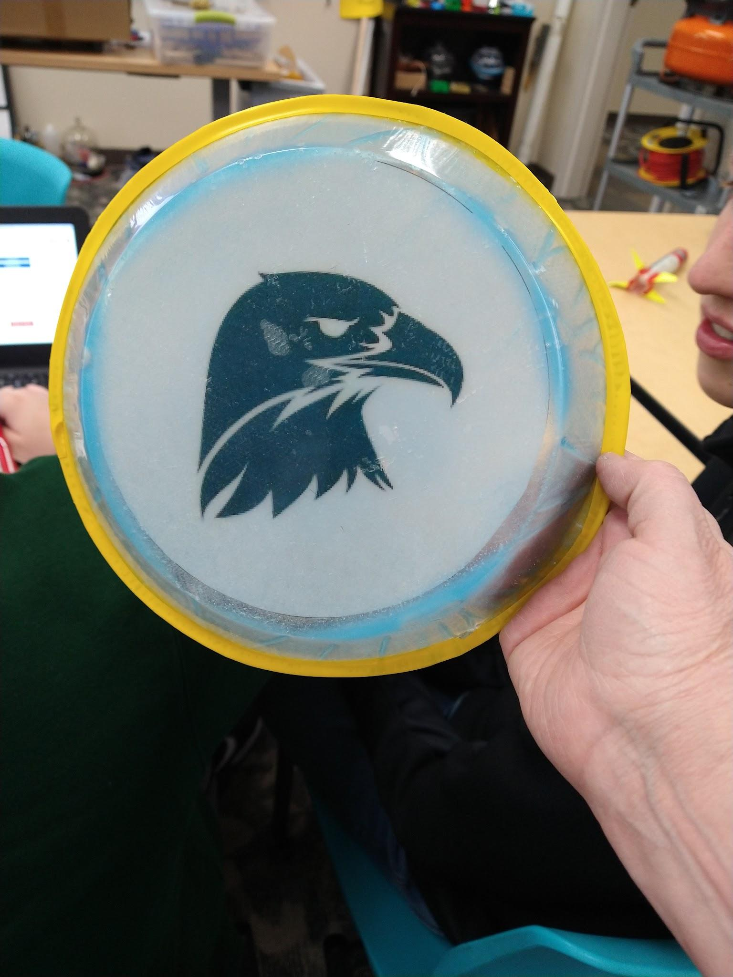
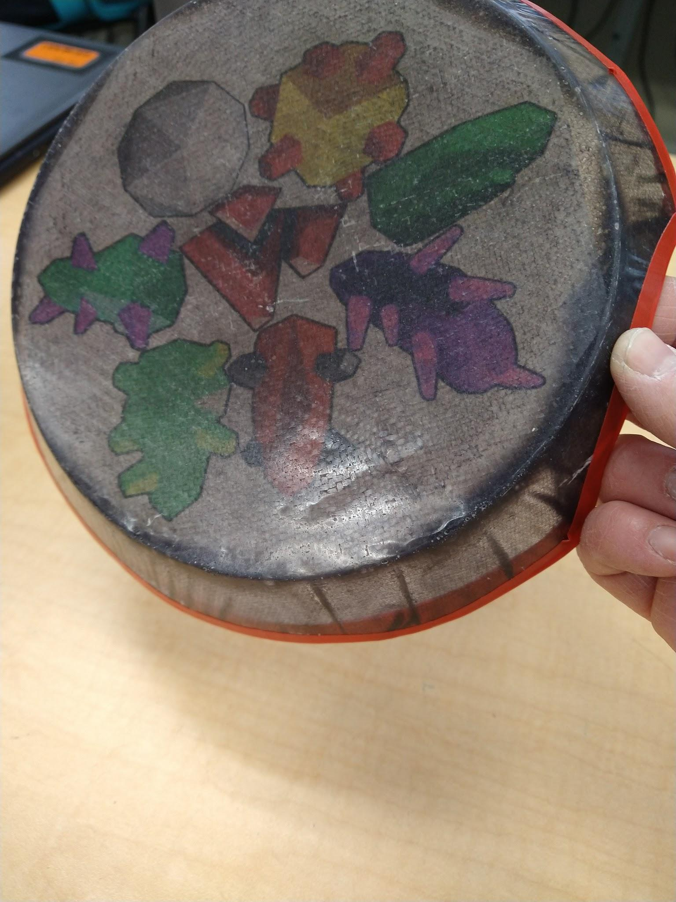
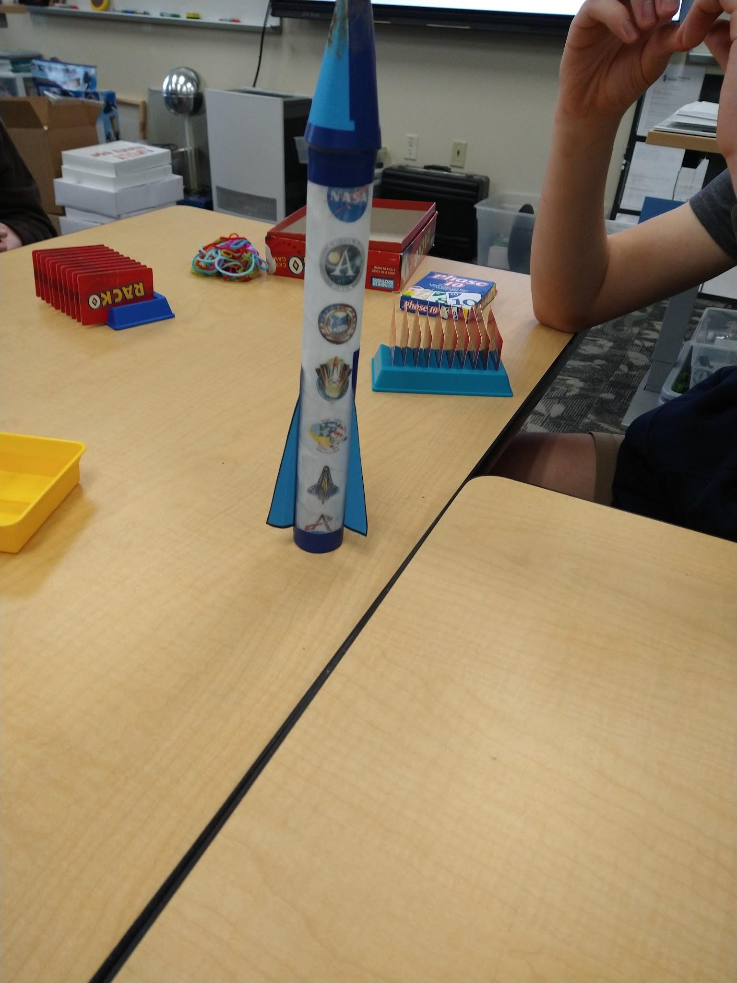
Engineering
Which topic from the physics curriculum could you see yourself teaching in the context of Engineering at CERN?
Sketch out your idea and add links to suitable resources!
Principles of Engineering
Digital Electronics
Materials Science
I loved the discussion about the coils in the matrix. I would use that as an example of composites in a materials sciences section of a physics and engineering course.
https://docs.google.com/presentation/d/1RYJQ4-56G8apIcai-C94q_CO6tH9HecQ6DW94jFyzqU/edit?usp=sharing

Slide 50
LHC
Which topic from the physics curriculum could you see yourself teaching in the context of the Large Hadron Collider at CERN?
Sketch out your idea and add links to suitable resources!
Centripetal Forces
EM Spectrum

Slide 51
AI
What are three key ideas about AI that you would like your students to know about?
What are potential challenges students might encounter when learning about AI?
What are potential benefits students might encounter when learning with the help of AI?
That it is a tool
That it takes a ton of math skills to create and configure.
That there are possible dangers and errors.
They may think that it substitutes thinking for oneself.
They may be able to find help with processes, or ideas of how to create something.

Slide 52
My Key Takeaways so far
Instructions: Write in the box any insights or things that you learned and that you want to remember after the HST2025 programme.
I want to remember all of it! Maybe especially the idea of collaboration and the concept of working with and really appreciating people from all over the world.

Slide 53
Engineering
Which topic from the physics curriculum could you see yourself teaching in the context of Engineering at CERN?
Sketch out your idea and add links to suitable resources!
CERN ENGINEERING TOPICS
Superconductors (conceptually)
Magnets as a electromagnet
Optics (lenses, colors)
Collisions and momentum conservation
SKETCHING & RESOURCES
Superconductors (conceptualy)
Magnets as a electromagnets Imanes y Electroimanes - Campo Magnético | Imanes | Electroimanes - Simulaciones Interactivas PhET
Color charge Visión del color - Fotones | Luz Monocromática | Luz Blanca - Simulaciones Interactivas PhET

Slide 54
LHC
Which topic from the physics curriculum could you see yourself teaching in the context of the Large Hadron Collider at CERN?
Sketch out your idea and add links to suitable resources!
I COULD SEE ME TEACHING
Superconductors (conceptually)
Magnets as a electromagnet
Optics (lenses, colors)
Collisions and momentum conservation

Slide 55
AI
What are three key ideas about AI that you would like your students to know about?
What are potential challenges students might encounter when learning about AI?
What are potential benefits students might encounter when learning with the help of AI?
3 IA KEI IDEAS
They are present in all major apps.
They use it at CERN to analyze big data trough machine learning.
Machine learning can be…
POTENTIAL CHALLENGES
Outdated/incorrect sources of information.
(mis)conceptions
Using this as them only source of information.
POTENTIAL BENEFITS
Fast answers
Different sources comparison

Slide 56
My Key Takeaways so far
Instructions: Write in the box any insights or things that you learned and that you want to remember after the HST2025 programme.

Slide 57
Study Group Discussion
Share your individual insights with your colleagues and identify shared themes.
Have some ice cream and don’t forget to take notes :)

Slide 58
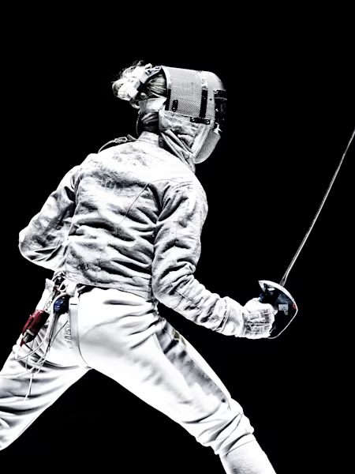
Study Group 5
Georg
Austria
I like ice swimming.
Wanyi Huang
China
I am a rated saber fencer
Sabina
Slovakia
I’m into sports. When I was a teen, I did karate, and at university Aikido.
Stacey Floyd
USA
I love to use big power-tools!
Esteban
Argentina
I drink more mate than water, and I have 2 sausage dogs.

Slide 59

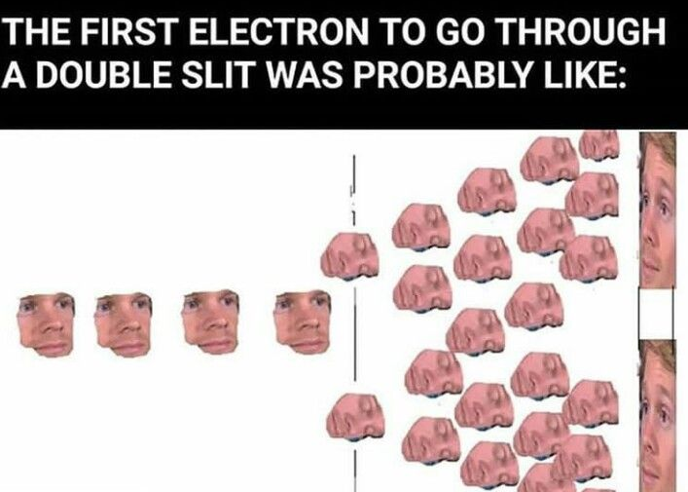


Our Feedback so far
HIGHLIGHTS
Cloud chambers
Links to educational resources
IMPROVEMENT
Hands-on
RESPONSES LINK
Notes:
WE WILL START WITH THE FEEDBACKS!!!!!!!!!!!!!!!!!!!!!!!!!!!!!!!!!

Slide 60
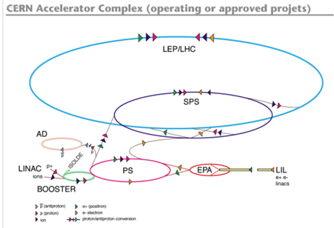
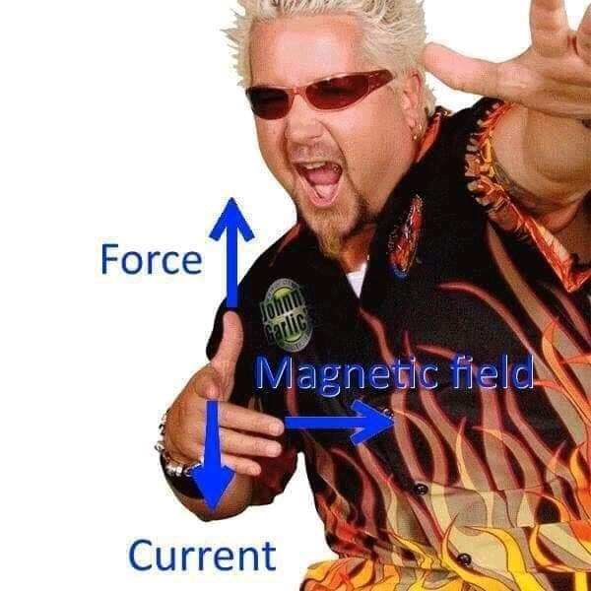
Our Key Takeaways so far
Instructions: Write in the box any insights, learnings and discussion outcomes.
Material science
→superconductors & insulator & conductors!
→quenching (removing heat)
Recycling
PS→SPS→LHC
Advancing
SC→PS→SPS→LHC→LH+LHC & FCC
Teaching
AI
MACHINE LEARNING
Bias

Slide 61
Tuesday, 15 July
SG Session 3

Slide 62
Checklist for SG Session 3
# | Type of Task | Task | Deadline
1 | Individual | Fill in slides corresponding to your colour | Tuesday, 17:30
2 | Group | Fill in “Our Key Takeaways” and “Our Feedback” slides as a group. Make sure you all contribute to the discussion. | Tuesday, 17:30
3 | Group | Decide how you as a group will present your group slides if you are selected to present during the SG Report-Out. | Tuesday, 17:30

Slide 63
Feynman Diagrams
What would be a fun and creative way of introducing Feynman Diagrams in the classroom?
Which students’ conceptions would you expect to encounter and how would you address them?
“An image says more than a thousand words.”
Draw a x axis representing time.
Create a puzzle or feynman diagram bingo - pupils have to look at the events, while getting a legend for the symbols.
Rotation symmetry
They may take it too literally.
Particles move along the lines.
Collision - interaction
Trajectory

Slide 64
Computing at CERN
What are three key ideas about computing and data analysis at CERN that you would like your students to know about?
What are potential challenges students might encounter when learning about computing and data analysis at CERN?
Computers may be human or a machine
Computing = action or an instance of calculating
An enormous amount of dara are being produced.
The data at CERN need a big storage place.
CERN creates software for the greater good
It is
Event selection and filtering at CERN is difficult
All data is stored and analyzed later
Computer finds the higgs particle directly
Computer does all the work
Scientits lool at the data one by one.
Internet = web

Slide 65
Medical Applications
What are three key ideas about medical applications of particle physics that you would like your students to know about?
What are potential challenges students might encounter when learning about medical applications of particle physics?
- You need a source (possibly an accelerator), an object you want to study (diagonisis/therapy) and a detector and a computer.
- it would be easy to treat all cancer patients in the world if more money way put into radiotherapy field
- New technologies for medicine arose out of CERN research - PT, CT and newer versions of diagnosis and radiotherapy
They might get confused between the difference of diagnosis and therapy (I do myself)
X-ray are no particles
Knowledge of cells
Radioactivity = harmful (positive side neglected)
Why would radium be helpful if it burns skin

Slide 66
My Key Takeaways so far
Instructions: Write in the box any insights or things that you learned and that you want to remember after the HST2025 programme.
Feynman Diagrams
Computing at CERN
Medical Applications

Slide 67
Feynman Diagrams
What would be a fun and creative way of introducing Feynman Diagrams in the classroom?
Which students’ conceptions would you expect to encounter and how would you address them?
I like the way Luise introduced Feynman diagram. A story, a video, and a proof.
Feynman diagram is used to predict unknown particles and their interactions.
Some students might have heard of it and thought they are diagrams that represent the physical properties of the particles.
I would use a story, a video, and a proof to show how Feynman diagrams are used to represent the iteration and mathematical relationships of the particles.
Students might think the arrows show the direction of the movement

Slide 68
Computing at CERN
What are three key ideas about computing and data analysis at CERN that you would like your students to know about?
What are potential challenges students might encounter when learning about computing and data analysis at CERN?
A huge data network is used to process the data produced by LHC. 1 Gb per collision.
There are 3 tiers for data storage
Students might think computer does everything and discover Higg boson.

Slide 69
Medical Applications
What are three key ideas about medical applications of particle physics that you would like your students to know about?
What are potential challenges students might encounter when learning about medical applications of particle physics?
CT, PET, x ray, Carbon, Gamma ray knife, FLASH
A lot of research is going into how to target tumor precisely minimizing the normal cell damage.
Particle therapy is more precise and less damaging than chemo.
Emotional distress

Slide 70
My Key Takeaways so far
Instructions: Write in the box any insights or things that you learned and that you want to remember after the HST2025 programme.
One of the takeaway came from particle fever. In it, David Kaplan said he had no idea what the financial benefit of running LHC was and that basic science with big breakthroughs needs to occur at a lever where we don’t ask what the economic return is, but ask what we do not know, and where we can make progress.

Slide 71
Feynman Diagrams
What would be a fun and creative way of introducing Feynman Diagrams in the classroom?
Which students’ conceptions would you expect to encounter and how would you address them?
3D model of the vertex with strings
Using a mathematic approach - how count approximately
Fly backwards = antiparticle

Slide 72
Computing at CERN
What are three key ideas about computing and data analysis at CERN that you would like your students to know about?
What are potential challenges students might encounter when learning about computing and data analysis at CERN?
Huge amount of data at the beginning
We need use trigger
Grid
None, it can be incorporate into the computer programing lessons, I think

Slide 73
Medical Applications
What are three key ideas about medical applications of particle physics that you would like your students to know about?
What are potential challenges students might encounter when learning about medical applications of particle physics?
Collaboration between physics, biology, chemistry and engineering
Historical evolution
New machines, new therapy
II. knowledge of particle physics

Slide 74
My Key Takeaways so far
Instructions: Write in the box any insights or things that you learned and that you want to remember after the HST2025 programme.
Hands out activities with Perimeter people, which I can incorporate into my lessons
Nice 3D model of vertex during lesson about Feynman diagrams

Slide 75
Feynman Diagrams
What would be a fun and creative way of introducing Feynman Diagrams in the classroom?
Which students’ conceptions would you expect to encounter and how would you address them?
It would be fun to work with the students with the most basic structures of the diagrams, but also in conjunction with the puzzles on CERN’s website. They are helpful to me to understand the very most basic constructions.
The different charges, spins, colors, etc. can be very challenging, so I think, at this level, I would briefly explain what they are, and how they work, but not expect perfect understanding at this level.

Slide 76
Computing at CERN
What are three key ideas about computing and data analysis at CERN that you would like your students to know about?
What are potential challenges students might encounter when learning about computing and data analysis at CERN?
I think the quantity of data is important to understand.
It is also important to help the students to understand the delay time on technology upgrades, when there are 40 something sites used to store the data.
It would also be good to understand a little about the internet and how the connectivity works.
Often, the students have never seen any wired ethernet. Wifi and 5G data plans are kings in their worlds, so comprehension of a connected, wired internet can sometimes be difficult to understand.

Slide 77
Medical Applications
What are three key ideas about medical applications of particle physics that you would like your students to know about?
What are potential challenges students might encounter when learning about medical applications of particle physics?

Slide 78
My Key Takeaways so far
Instructions: Write in the box any insights or things that you learned and that you want to remember after the HST2025 programme.

Slide 79
Feynman Diagrams
What would be a fun and creative way of introducing Feynman Diagrams in the classroom?
Which students’ conceptions would you expect to encounter and how would you address them?
With something sustancial, as an experiment with springs and arrows, similar to Luis presentation
(Mis)/conceptions
Time direction
Collisions vs interaction
Trajectories
Anti-particles
Model

Slide 80
Computing at CERN
What are three key ideas about computing and data analysis at CERN that you would like your students to know about?
What are potential challenges students might encounter when learning about computing and data analysis at CERN?
IDEAS
Not everything is saved, they use filters
Big Data, 2 ExaBytes
Machine Learning, New technologies
1 Higgs per 1 billion collision
CHALLENGES
Technical terms (it's also a challenge for me)
Scales of data M,G,T,E bytes
Data analysis takes timeeeeee
New Technologies improves time and data analysis, so to be better we need to improve data storage and sensing
Synchronous upgrades

Slide 81
Medical Applications
What are three key ideas about medical applications of particle physics that you would like your students to know about?
What are potential challenges students might encounter when learning about medical applications of particle physics?
IDEAS
FLASH!
There are other medical technologies besides PET, like Carbon, but they are more expensive
Everything is about money
CHALLENGES
Emotional management / sensitive topic
Physics/Biology/Chem specifics

Slide 82
My Key Takeaways so far
Instructions: Write in the box any insights or things that you learned and that you want to remember after the HST2025 programme.

Slide 83
Study Group Discussion
Share your individual insights with your colleagues and identify shared themes.
Have some ice cream and don’t forget to take notes :)
Feynman Diagrams - The wired (coat hanger wire and springs) diagrams could be awesome to build.
Misconceptions - the students may think that the arrows are the directions.
Puzzles of some kind. Models are limited. There is math behind it, which they don’t need to understand all of at this level.
Not everything is saved, filters are used. 90% of data is discarded.
Technologies developed for this work, has been offered to the world.
Collecting the data, sorting and filtering the data, and storing the data is just the beginning. Then people must analyse the data.
Discussion of cancer treatment requires emotional management (because it is sensitive), but also biology, chemistry and physics. Accessibility is a huge issue in development countries.
David Kaplan said that he didn’t know what the financial benefit of running the LHC.
Difference between tools for diagnosis and for treatment.
Comparison between LHC and high energy particle therapy.
Damaging and healing of radioactivity

Slide 84
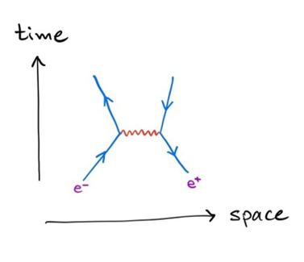
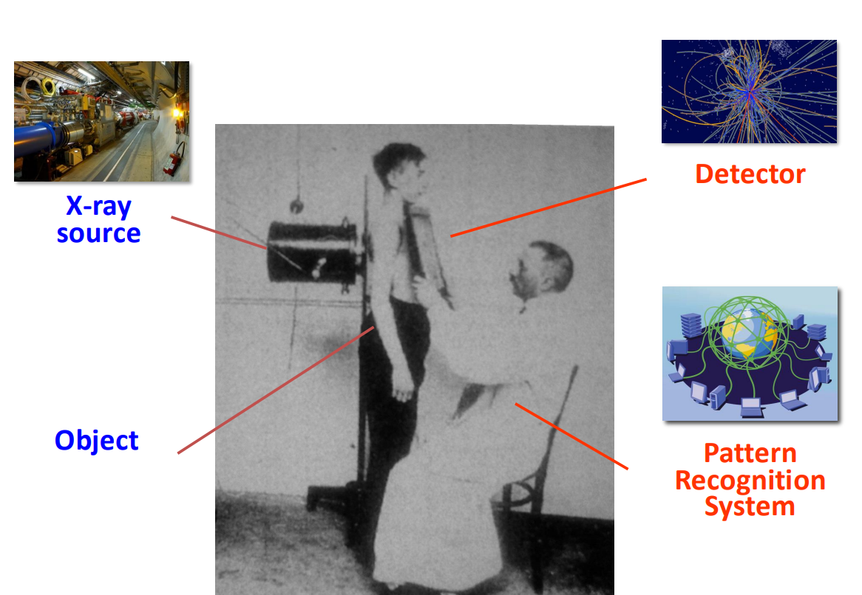
Our Key Takeaways so far
Feynman Diagrams → Hands on manipulatives can help the students to understand.
Particle Fever → David Kaplan said that he didn’t know what the financial benefit of running the LHC was.
Perimeter Institute → amazing applications; Building a model
Computing → Collection, filtering, storage and analysis of HUGE data sets.
Medical Application → Diagnosis (PET), Treatment (Radio Therapy)
Notes:
Sabina-Wanyi-Stacey-Esteban-Georg

Slide 85




Our Feedback so far
Highlights?
What’s working?
What needs improvement?
Other comments?
Funny picture or meme?
Fantastic lectures, visits (CMS), movie night, treasure hunt, official dinner (fondue!), perimeter workshop
Jeff - working with the material online
Teacher collaboration.
Age groups instead of grades level (students)

Slide 86
Thursday, 17 July
SG Session 4

Slide 87
Checklist for SG Session 4
# | Type of Task | Task | Deadline
1 | Individual | Fill in slides corresponding to your colour | Thursday, 14:30
2 | Group | Fill in the “Our Key Takeaways from HST2025” slide as a group. Make sure you all contribute to the discussion. | Thursday, 15:00
3 | Group | Discuss the topic that was assigned to your study group for the Final Presentation on Friday morning. Share and collect your individual experiences with this topic. | Thursday, 16:00
4 | Group | Prepare a detailed and entertaining presentation to share your results with your colleagues. Make sure that everyone plays an active role during the Final Presentation! | Thursday, 17:00

Slide 88
Antimatter vs Dark Matter
What are three key ideas about antimatter research at CERN that you would like your students to know about?
What would be a good approach to explain the difference between antimatter and dark matter to your students?
Antimatter exists in everyday life: lightning, PET scans, even bananas.
So far, the only difference between particles and antiparticles is their electric charge.
It can be created through radioactive decay (positrons) or by firing protons at heavy atoms (e.g. iridium).
Antimatter must be trapped, since it annihilates on contact with normal matter.
Explaining Antimatter vs. Dark Matter to Students
Both are real and made of “something,” but not the same!
Antimatter: Part of the Standard Model, interacts with matter, visible through annihilation.
Dark matter: Not in the Standard Model, invisible, doesn’t interact with light, only seen through gravity.
Antimatter is studied in labs (like at CERN), dark matter hasn’t been directly detected yet.
Dark matter surrounds galaxies in halos; no large sources of antimatter found in space.

Slide 89
Future Particle Accelerators
What are five key ideas about future particle accelerators and acceleration technologies that you would like your students to know about?
What kind of career opportunities in particle physics are you definitely going to showcase to your students?
AWAKE:
Plasma wakefield acceleration is a new method to accelerate charged particles.
It offers a very high accelerating gradient, allowing for more compact accelerators.
AWAKE at CERN is the world’s only proton-driven wakefield acceleration experiment.
The experiment could enable future particle physics applications.
The next objective is to achieve high beam quality over long plasma distances.
The ultimate goal is to design a high-quality, high-energy electron accelerator based on this research.
Physicists explore the fundamental laws of nature.
Engineers design and build complex detectors and accelerators.
Computer scientists handle massive data and develop advanced algorithms.

Slide 90
My Key Takeaways from HST2025
Instructions: Write in the box any insights or things that you learned and that you want to remember after the HST2025 programme.
It's worth exploring physics even without full understanding — nobody knows everything (not even what the Higgs really is).
Science builds models to describe the world — not absolute truth, but useful and powerful.
CERN is about the future of understanding the universe.
Big questions are fun to think about!
Teaching: always watch out for misconceptions.
Learned a lot about magnets, superconductivity, detectors, and accelerators.

Slide 91
Antimatter vs Dark Matter
What are three key ideas about antimatter research at CERN that you would like your students to know about?
What would be a good approach to explain the difference between antimatter and dark matter to your students?
Every fundamental particle has its antiparticle counterpart
CERN is the only place where antimatter is produced
Matter and antimatter annihilate when they come in contact.

Slide 92
Future Particle Accelerators
What are five key ideas about future particle accelerators and acceleration technologies that you would like your students to know about?
What kind of career opportunities in particle physics are you definitely going to showcase to your students?
Collider is advancing with difficulty
AWAKE can be the future of the next generation collider
Funding is limited

Slide 93
My Key Takeaways from HST2025
Instructions: Write in the box any insights or things that you learned and that you want to remember after the HST2025 programme.
Electric fields: explain electric charge, including opposite charges of particles and antiparticles; relate to Millikan experiment and charge conservation
Radioactivity: introduce beta-plus decay producing positrons (antimatter); show natural and medical examples like PET scans
Modern physics: present antimatter as part of the Standard Model;
Special Relativity: E=mc^{2,} antimatter bomb
Electromagnetic field to control antimatter - Dynamics
Elena laser cooling - conservation of momentum
Particles - Atomic structure
G-Bar - Projectile motion

Slide 94
Antimatter vs Dark Matter
What are three key ideas about antimatter research at CERN that you would like your students to know about?
What would be a good approach to explain the difference between antimatter and dark matter to your students?
Antimatter can be created only in CERN
But it is difficult to catch it because it is neutral
We use decelerator: AD, ELENA
II)
to discuss the spectra of hydrogen and anti-hydrogen
(no difference in behaviour between antimatter and matter?)
The presence of antimatter can be detecting by interaction with matter by measuring photons - PET
Antimatter disappeared early after Big Bang. No any anti-worlds in Universe.
But Dark Matter makes up about 27% of the Universe

Slide 95
Future Particle Accelerators
What are five key ideas about future particle accelerators and acceleration technologies that you would like your students to know about?
What kind of career opportunities in particle physics are you definitely going to showcase to your students?
Trapping the antiparticles and neutral anti-matter: nice idea of anti-hygrogen with two positrons (GBAR exp.)
Composed state of anti-matter, where anti-nuclei is surrounded by anti-proton - is stable?
Plasma Wakefield Acceleration - great idea how to use waves in plasma to accelerate particles without magnetic field
HL-LHC - reality in few years (update of LHC to HiLumi)
FCC/CLIC - who knows - everything is about preferences and of course about money, it depends on so many variables
II.)
Experimental Physicist
Theoretical Physicist
Engineer, Researcher in Chemistry and Medicine
Computer Scientist
Mathematician
University Professor in Collaboration with some CERN experiment

Slide 96
My Key Takeaways from HST2025
Instructions: Write in the box any insights or things that you learned and that you want to remember after the HST2025 programme.
AWAKE
realistic future of particle physics
interesting idea of accelerating particles
the plasma is still very rare vaccum
No need of magnets (cheap?)

Slide 97
Antimatter vs Dark Matter
What are three key ideas about antimatter research at CERN that you would like your students to know about?
What would be a good approach to explain the difference between antimatter and dark matter to your students?
Antimatter interacts with regular matter and dark matter does not interact in a way that is currently detectable.
Antimatter particles are discoverable in simple ways, such as a cloud chamber and a magnetic field.
Anti-matter is only stable at CERN. It has never been discovered anywhere else.
Maybe discussing the fact that students can see, with their eyes, some types of particles, even interactions of sub-atomic particles with matter can be seen with the naked eye.
Dark matter, and dark energy is not visible because it doesn’t interact with what we think of as matter, nor with any of the current types of detectors. I would probably show the students the remote control for the television and ask them if they can see the IR light. Then talk to them about sensors. We simply do not currently have sensors that can detect dark matter.

Slide 98
Future Particle Accelerators
What are five key ideas about future particle accelerators and acceleration technologies that you would like your students to know about?
What kind of career opportunities in particle physics are you definitely going to showcase to your students?
They should know about
Plasma waves
Surfing particles
The decrease in required distances for acceleration.
World-wide efforts at newer technologies
Physicists
Mathematicians
Computer Scientists
Chefs!

Slide 99

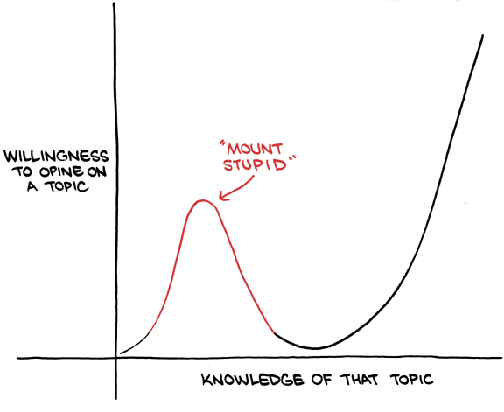
My Key Takeaways from HST2025
Instructions: Write in the box any insights or things that you learned and that you want to remember after the HST2025 programme.
My key take-aways include the fact that I am still lacking a lot of knowledge, as far as particle physics goes. I have learned a lot during HST 2025, and it will help me to maybe summit Mt. Stupid in order to see the peak behind it (It looks like Monte Blanc!)

Slide 100
Antimatter vs Dark Matter
What are three key ideas about antimatter research at CERN that you would like your students to know about?
What would be a good approach to explain the difference between antimatter and dark matter to your students?
KEY IDEAS
Matter and Antimatter have the same mass but opposite internal properties.
Antimatter is present in everyday life, bananas, our body
APPROACH
Ionizing radiations
Coulomb Force

Slide 101
Future Particle Accelerators
What are five key ideas about future particle accelerators and acceleration technologies that you would like your students to know about?
What kind of career opportunities in particle physics are you definitely going to showcase to your students?

Slide 102
My Key Takeaways from HST2025
Instructions: Write in the box any insights or things that you learned and that you want to remember after the HST2025 programme.

Slide 103
Study Group Discussion
Share your individual insights with your colleagues and identify shared themes.
Have some ice cream and don’t forget to take notes :)

Slide 104
Our Key Takeaways from HST2025

Slide 105
Final Presentation Guidelines
Presentation | 10 minutes + 5 minutes for Q&A
Style | Fun, entertaining & on time!
Contents | Curriculum & classroom connections Key ideas Potential students’ conceptions & challenges Helpful material and resources Best practice example
Final Slide | Key Takeaways & Goodbye messages

Slide 106
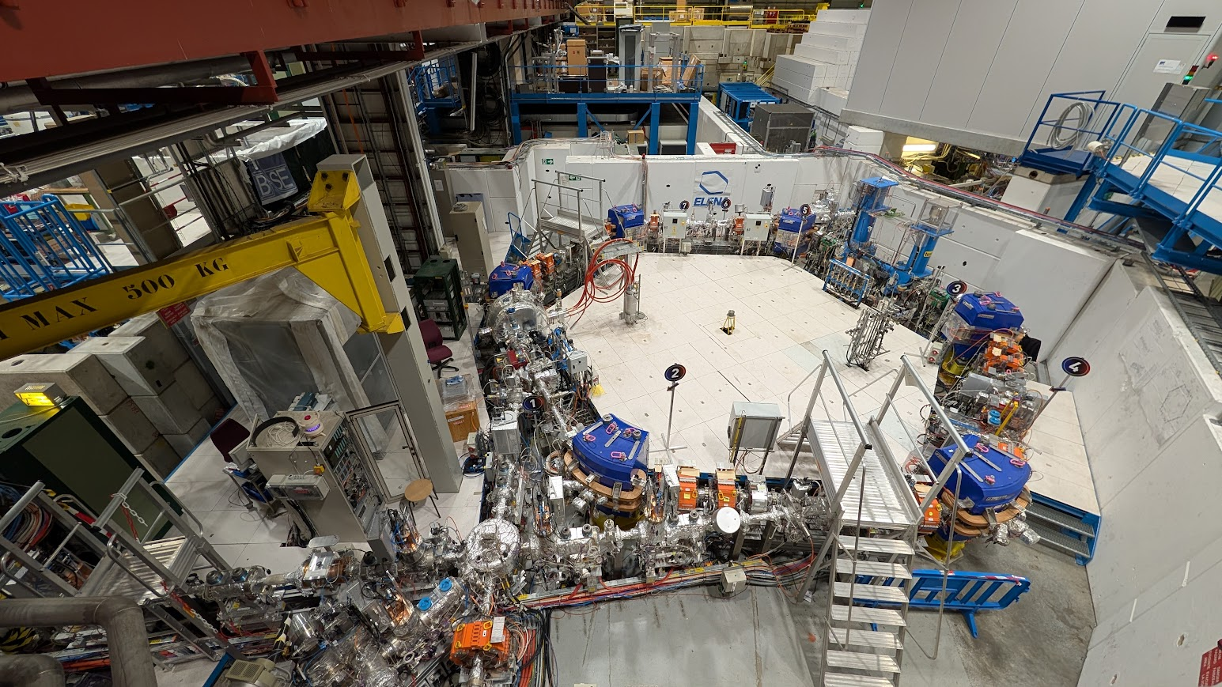
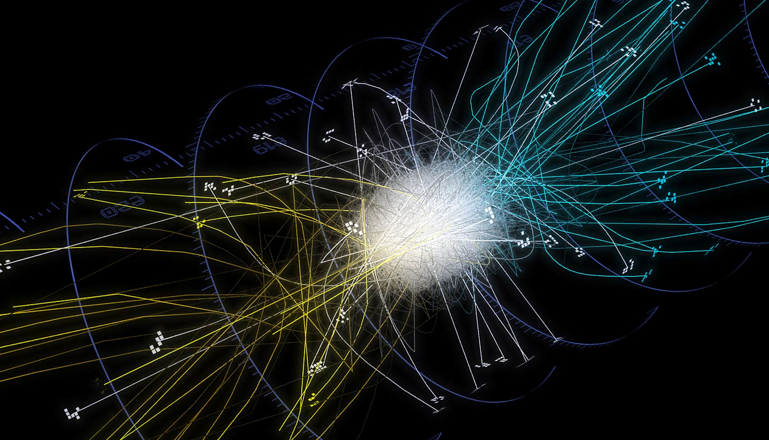
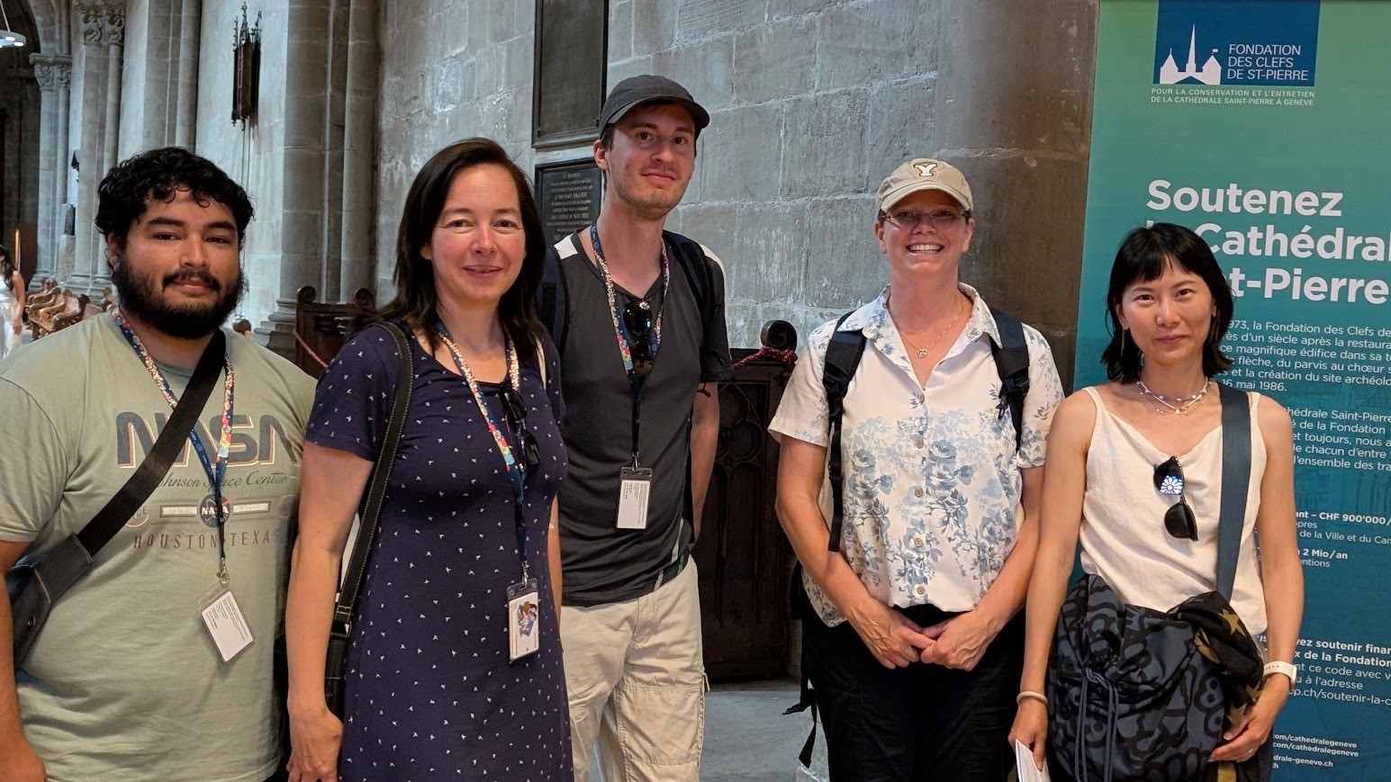
Antimatter Research
HST2025 Study Group 5

Slide 107
Curriculum & Classroom Connections
⚡Electric Fields
Antiparticles = same mass, opposite charge
Millikan: charge is quantized
➤ Use: charge conservation
☢️ Radioactivity
Beta⁺ decay → positrons
Used in PET scans
🕰️ Relativity
E = mc² → energy creates antimatter ➤ Antimatter bomb (thought experiment)
💡 Quantum & Spectroscopy
Charge = quantum number
Antihydrogen has same spectrum
Laser cooling (ELENA) via momentum
🧬 Science Process
First predicted, then discovered
Dirac: theory → positron found in 1932
🧲 Electromagnetism
Trapped by magnetic/electric fields
Lorentz force → same path, reversed charge

Slide 108



Do not edit
How to change the design
In what context would you treat Antimatter the most likely?
Presenting with animations, GIFs or speaker notes? Enable our Chrome extension
Notes:
📣 This is Slido interaction slide, please don't delete it. ✅ Click on 'Present with Slido' and the poll will launch automatically when you get to this slide.

Slide 109
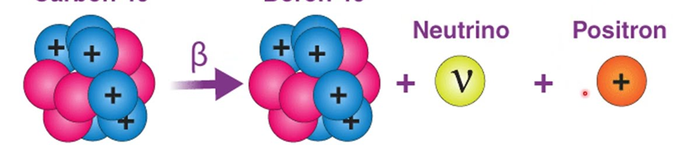
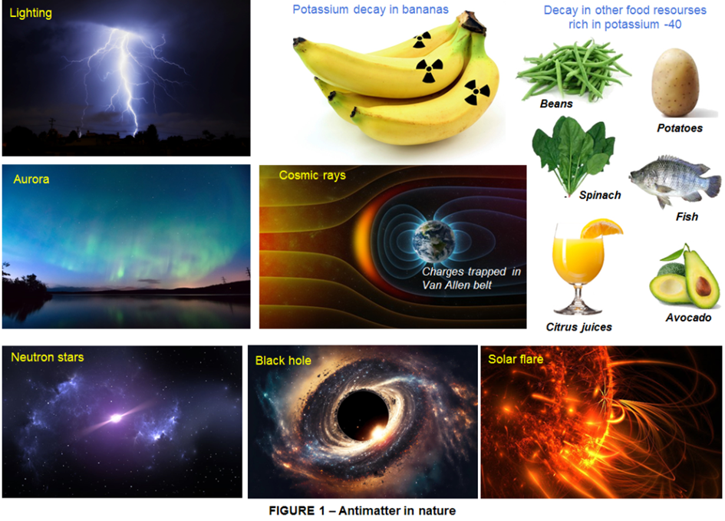
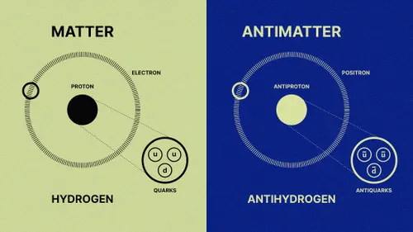
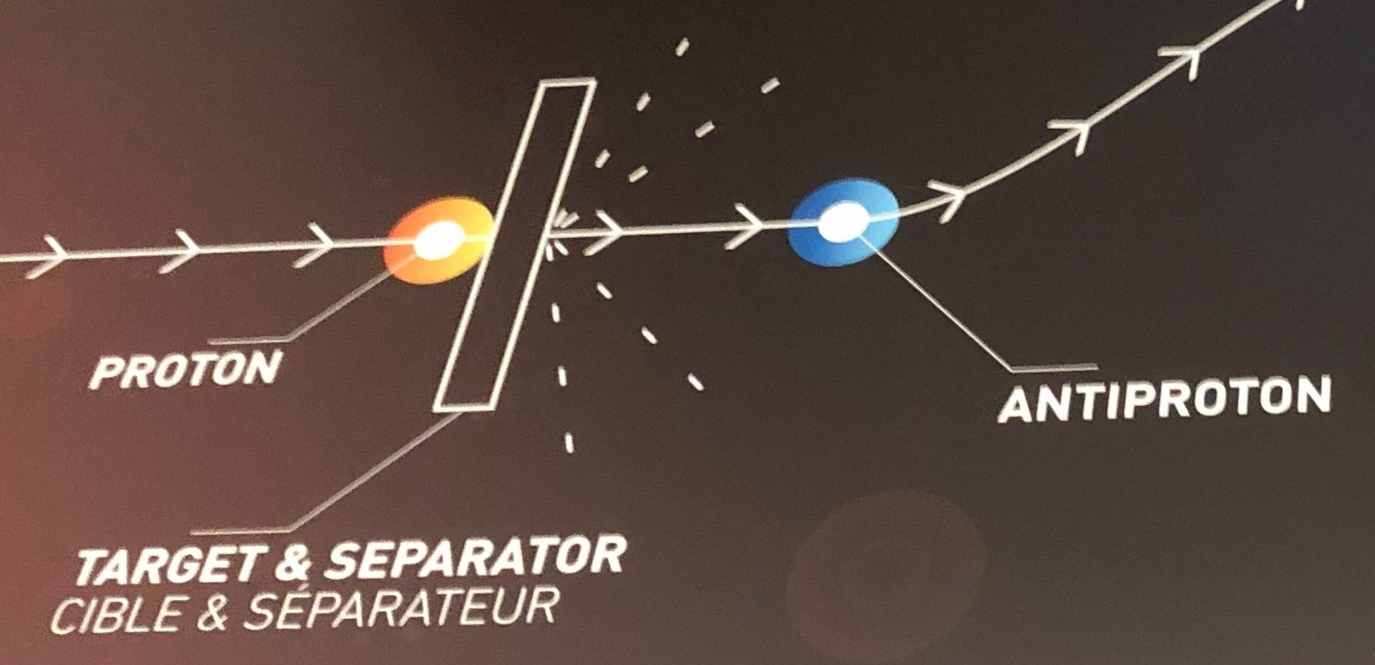
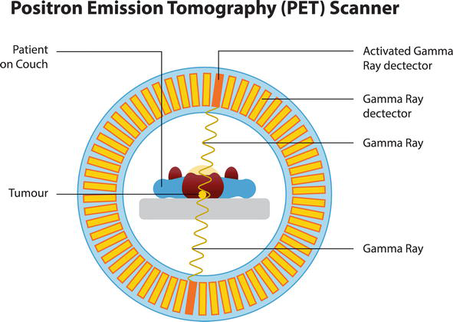
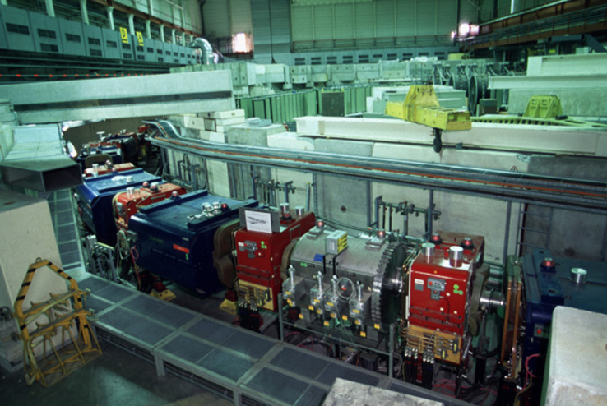
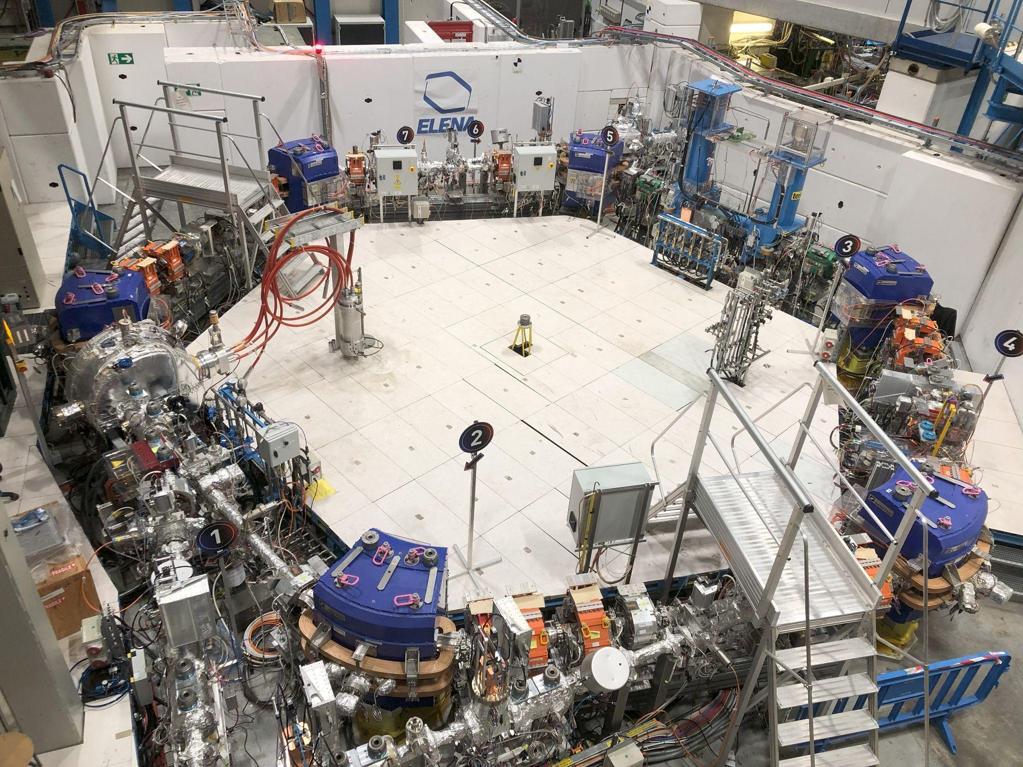
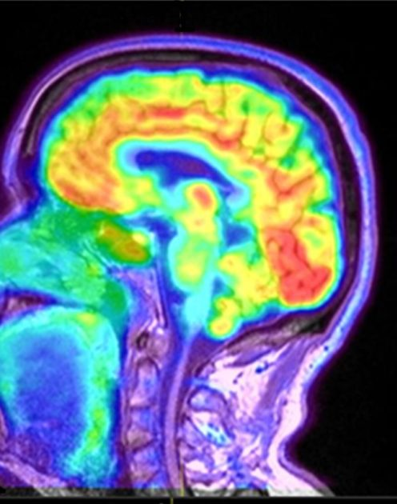
Key Ideas
AD
ELENA

Slide 110
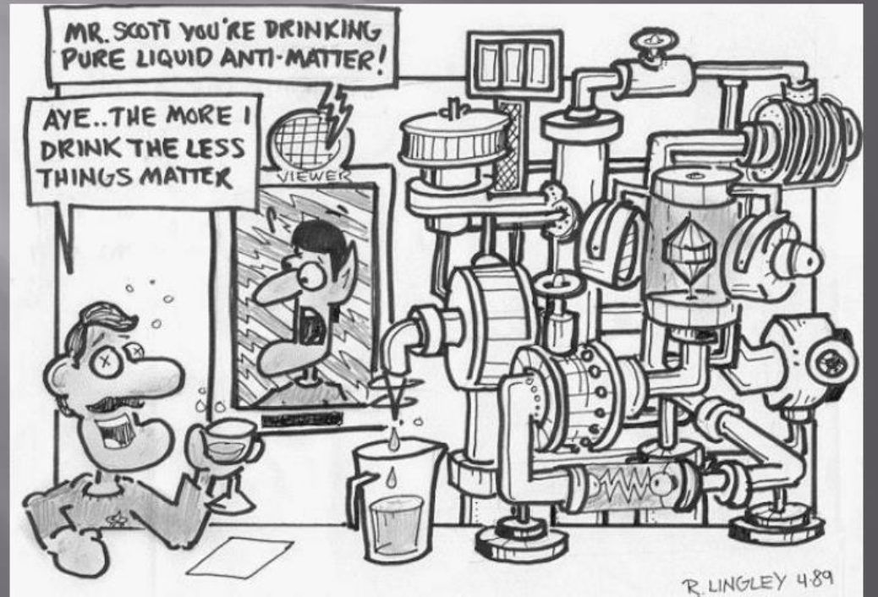
Potential Students’ Conceptions & Challenges
Conceptions | Challenges
Both are positive, so students assume they're the same.
“Positron = Proton”
“There are antimatter bombs”
Movies like Angels & Demons suggest it.
“Antimatter is just science fiction”
Influenced by media; it's unfamiliar.
“E=mc² means you can turn energy into mass”
Misinterpreting the equation direction.
“The universe should’ve annihilated”
They learn matter + antimatter annihilates.
Notes:
Bananas naturally emit positrons due to potassium-40 decay.
PET scans (Positron Emission Tomography) use positrons in hospitals every day.
Cosmic rays produce antimatter when they hit the Earth's atmosphere.

Slide 111


Best Practice Example
In class survey
Brief outline of an instructional strategy
Prior Knowledge
Cloud chamber
Movies
Introduction
Activation/Engage
YT Videos
Brainstorm/quiz on antimatter beliefs.
Explanation/Enquiry
Visuals
Application
Gamification*/Simulation. i.e: Puzzle Challenge
Closure
Medical Facility
PET Scan
*Game with cards for each matter particle and antimatter particle. Rules: they choose one person and see if they form a particle with it or annihilate
References: Open Access proceedings Journal of Physics: Conference series
Notes:
ESTEBAN

Slide 112
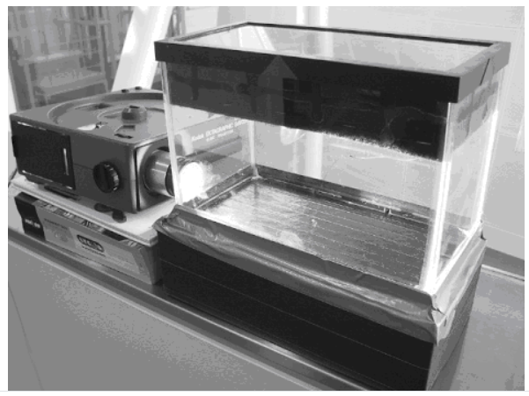
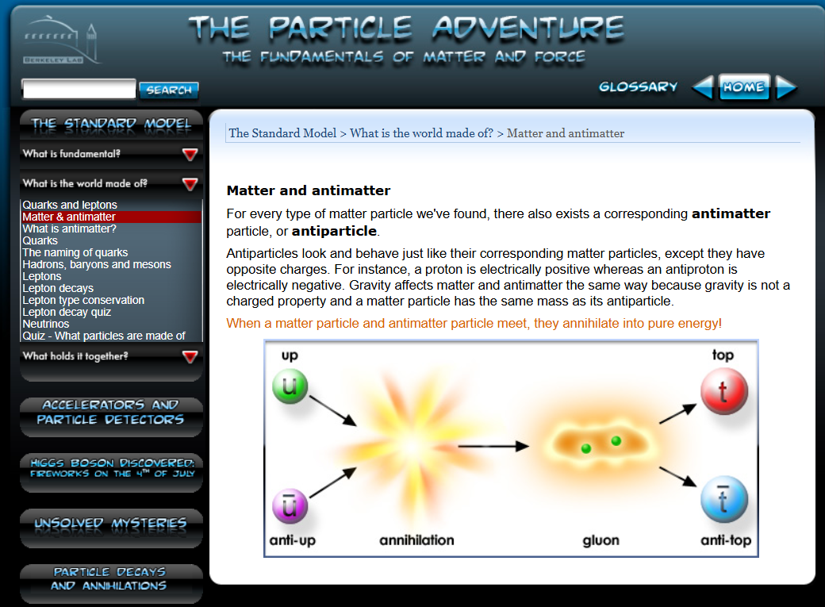
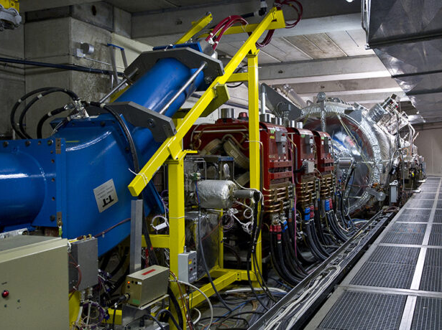
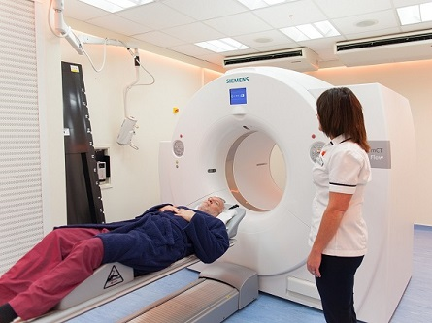
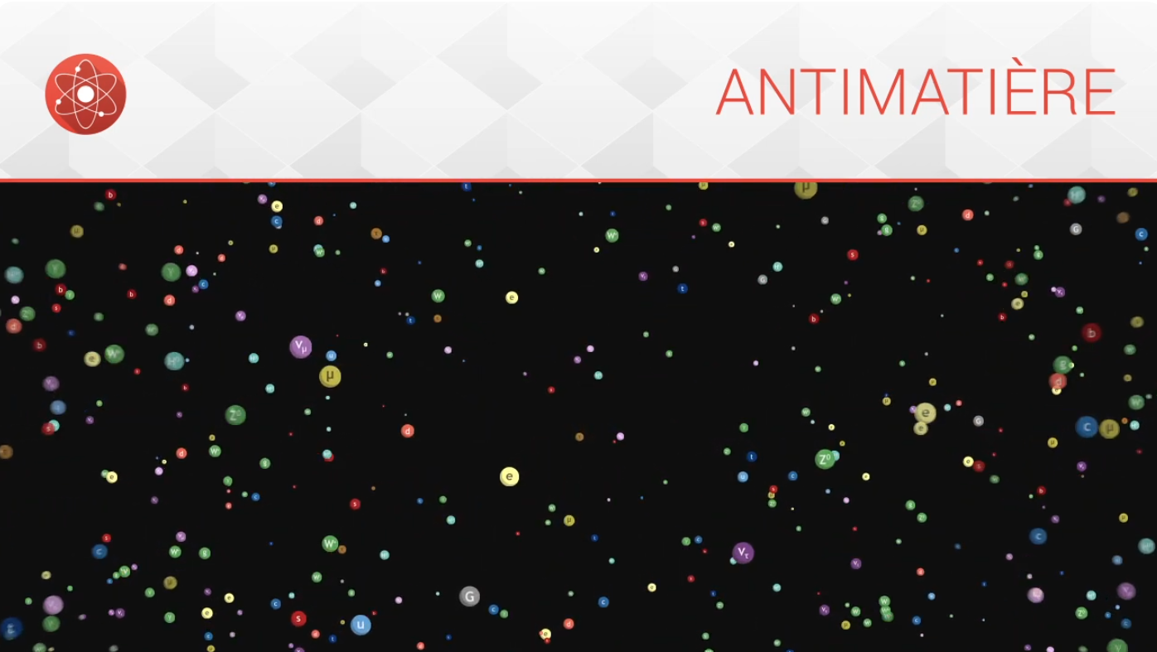



Useful Material & Resources
For Student and Teacher Understanding
For Real Applications
Introduction Activities
Design with Magnet

Slide 113


HST2025 Study Group 5
Stacey (USA), Georg (Austria), Wanyi (USA/China),
Sabina (Slovakia), Esteban (Argentina)
One way in which our thinking has changed…
Highlights, snapshots, farewell messages…
Particle physics is easier than I thought to incorporate into other physics topics
Understanding of what we don’t know has increased
Knowing about the insight in the microcosmos of CERN
CERN is the only place where antimatter can be created
CERN is so much more than just a collider
Nobody actually understands gravity
The World is made up of many amazing countries and people.
Lectures, Lectures, Lectures
Tour, Tour, Tour
Fun, Fun, Fun
Thank you, Thank you, Thank you!

