Slide 1
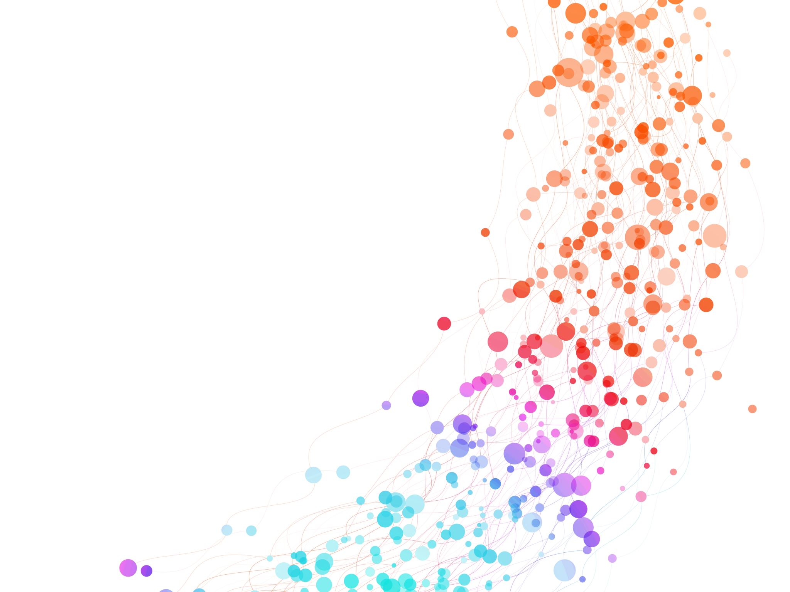


Concept Maps
Session 3
Milena Vujanović
University of Leeds (UK) & CERN (Switzerland)
International High School Teacher Programme 2025
18th July 2025

Slide 2
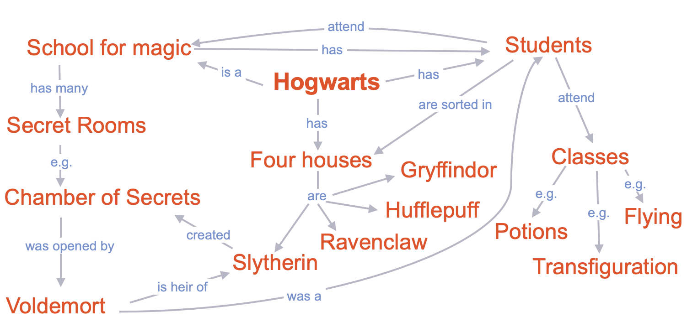

How to Construct a Concept Maps
Use linking words
2. Connect all the concepts
Milena loves to read.
Milena loves to read.
Milena loves to read.
Start your map from beginning please ☺

Slide 3
How to Construct Your Code
                First letter of your first name (e.g. Colin = C)
                Second letter of your mother’s name (e.g. Kathy = A)
                A
                C
                3
                1
                T
                7
                Last two digits of your phone number
                (e.g. 012 268 537 = 37)
                Third letter of your mother’s name (e.g. Kathy = T)
                Last digit of your year of birth (e.g. 1961 = 1)

Slide 4
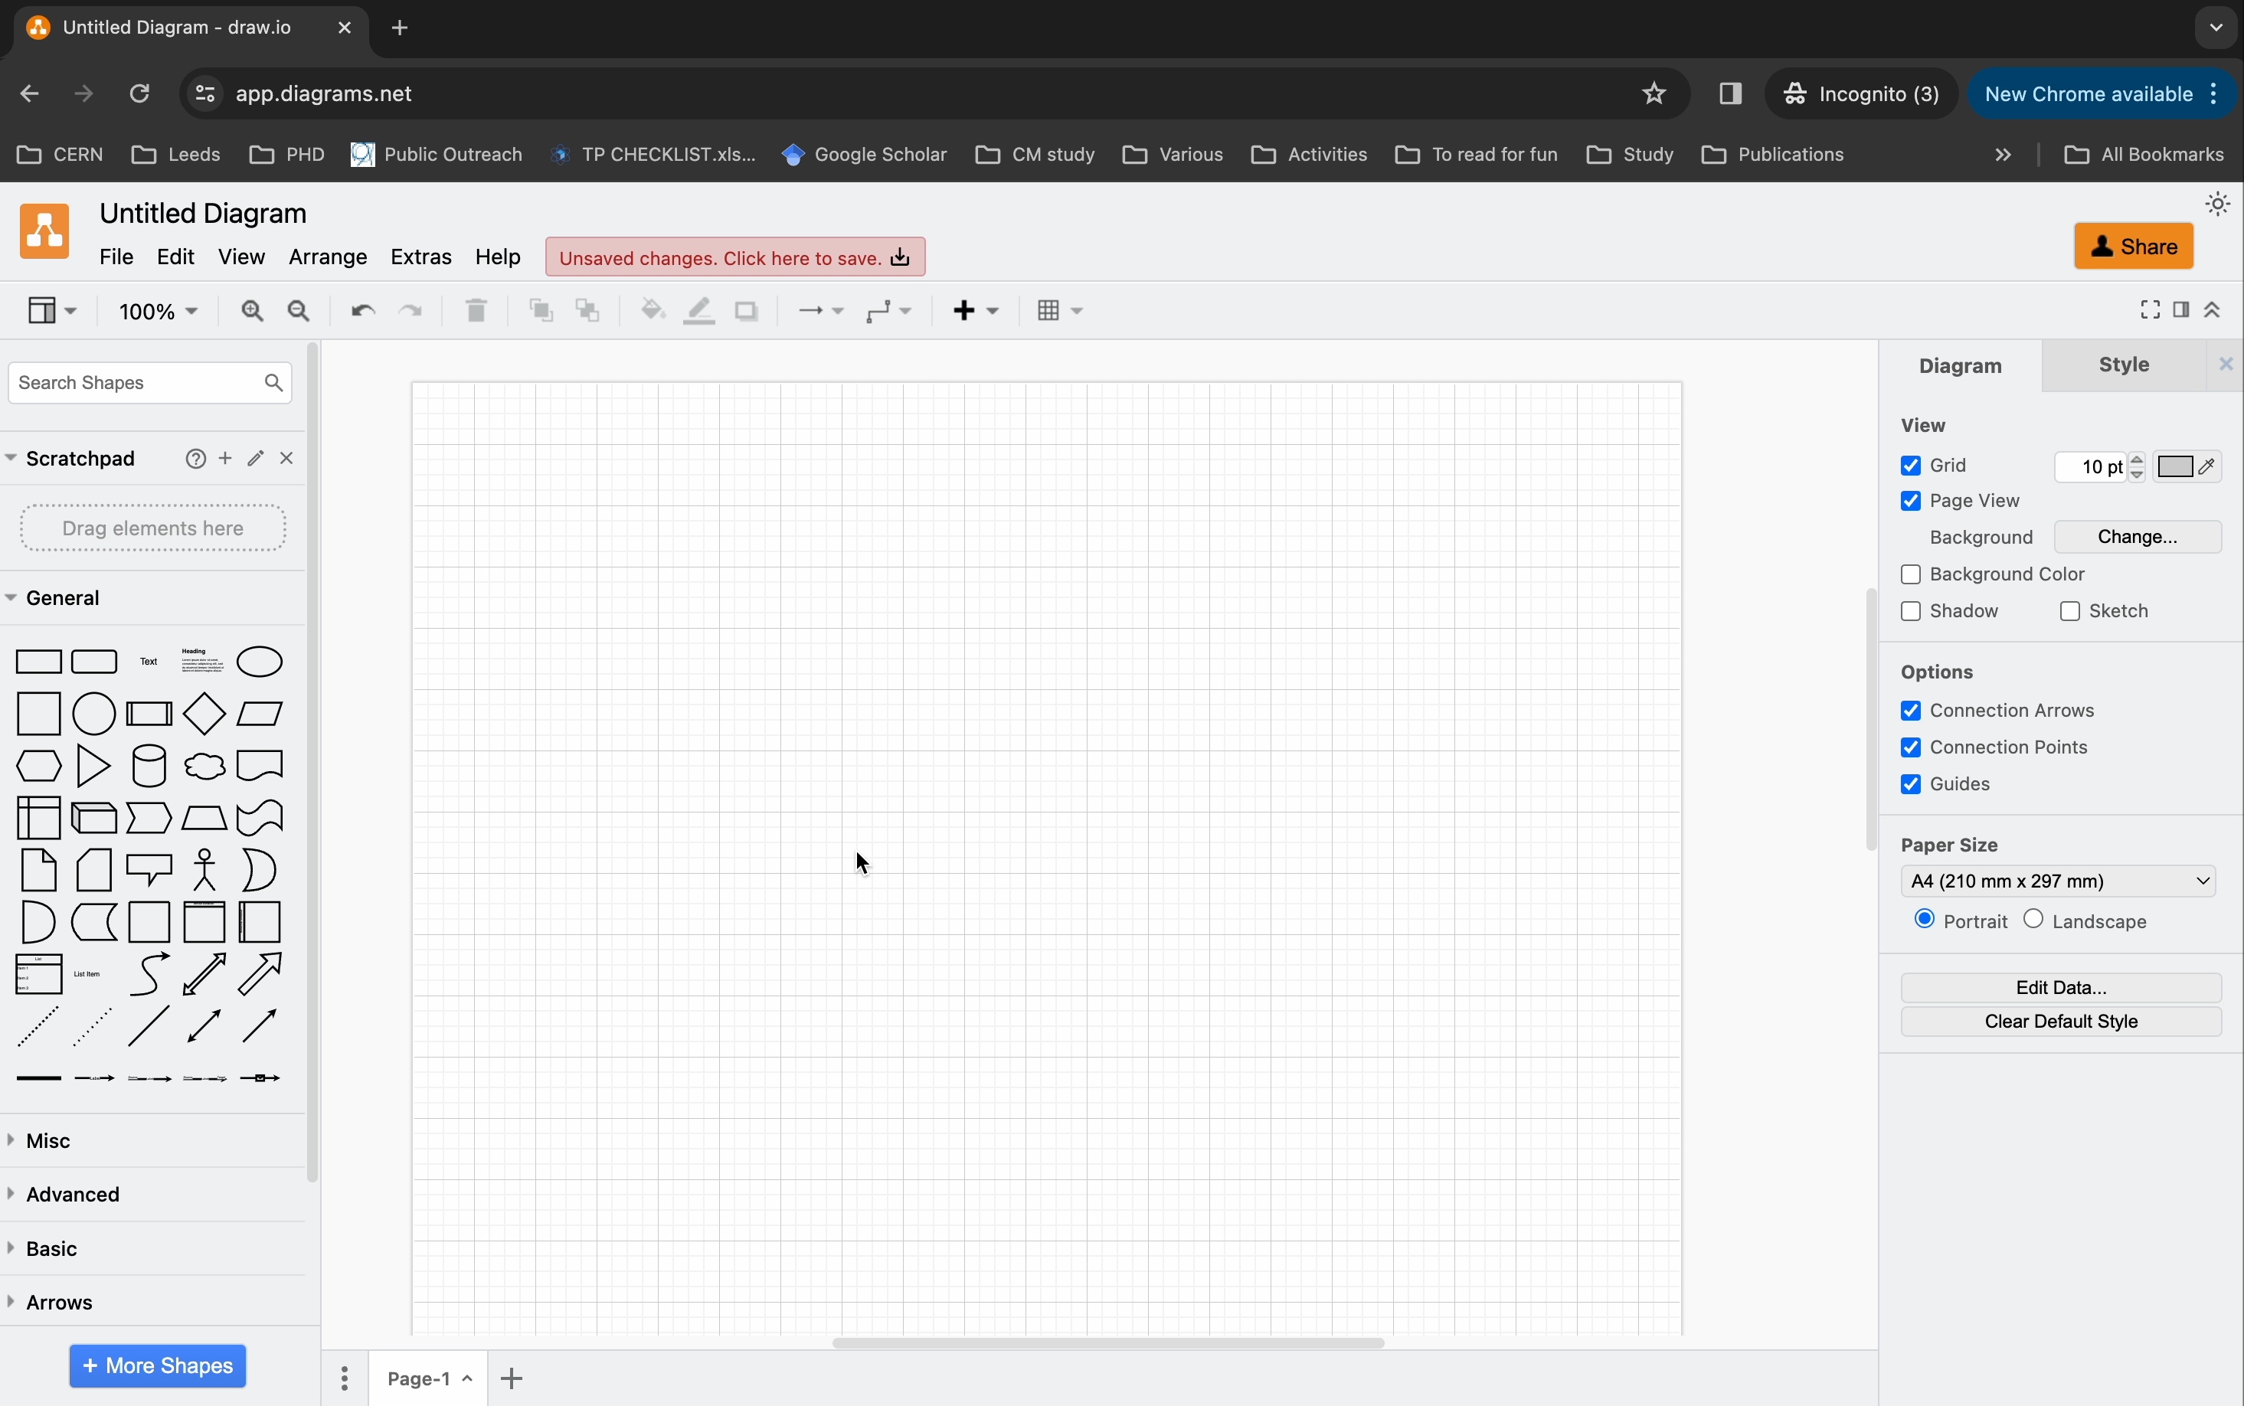

Slide 5
A choice to make!
Paper & Pen
Software (Laptop)

Slide 6
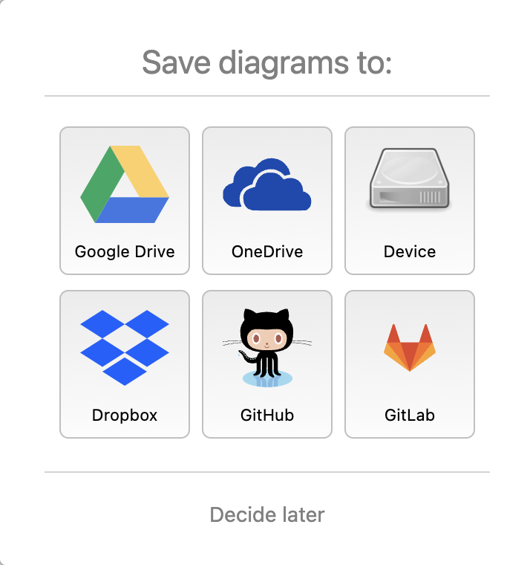
Now, it is your turn!
You will get A3 paper. Please do not flip the paper!
Personal Laptop:
CERN Laptop:
Open your laptop
Open an internet browser
Type: www.draw.io
Open the laptop in front of you
Enter the password: Tsp@2023
Open an internet browser
Type: www.draw.io
Milena loves to read.
Milena loves to read.
Milena loves to read.

Slide 7
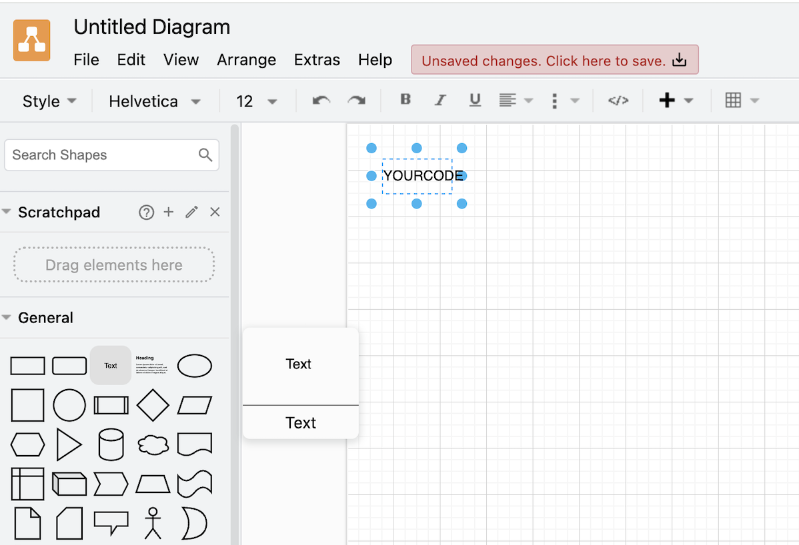
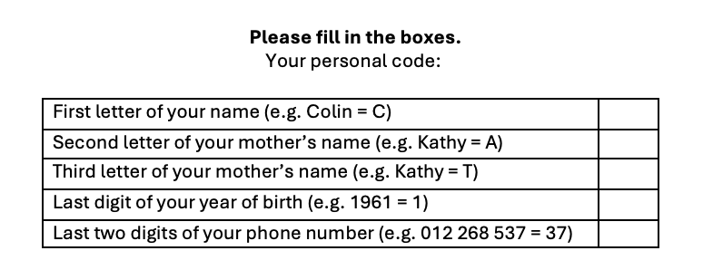
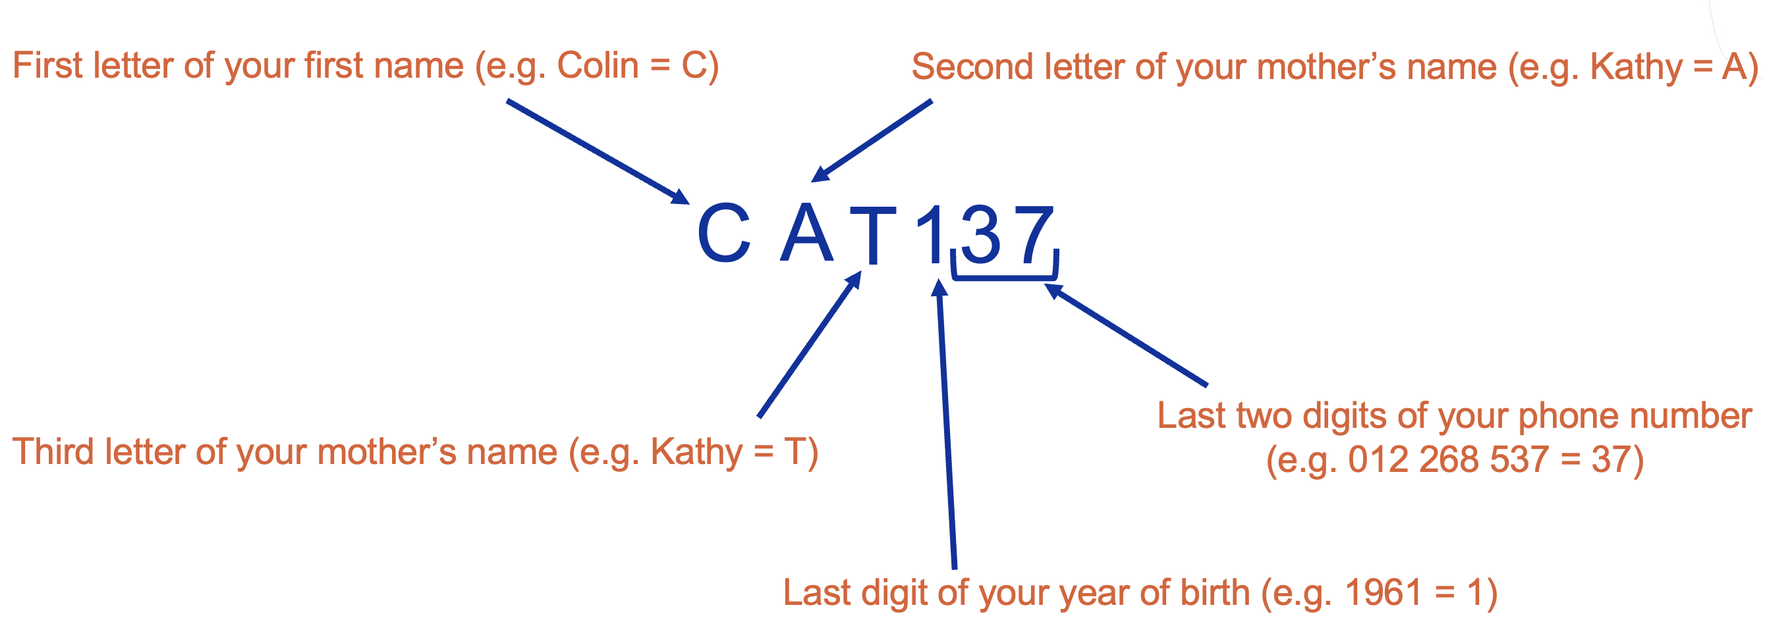
1. Drag and drop the text icon anywhere
2. Double click on the text icon to write your personal code:
If you have the paper, just enter your code!

Slide 8
Stop and think about the focus question
2. Chose your starting concept
3. Then chose 2 – 5 key concepts to start your map
What would you like your students to know about
PARTICLE PHYSICS and CERN?
4. Connect concepts with arrowed lines and linking words
5. Expand
Milena loves to read.
Milena loves to read.
Milena loves to read.
20 minutes
Please do not delete your maps!

Slide 9
Milena loves to read.
Milena loves to read.
Milena loves to read.
QUESTIONS?

Slide 10
Questions?
Milena loves to read.
Milena loves to read.
Milena loves to read.
QUESTIONS?

Slide 11
What would you like your students to know about Particle Physics and CERN?
Stop and think about the focus question
2. Chose your starting concept
3. Then chose 2 – 5 key concepts to start your map
4. Connect concepts with arrowed lines and linking words
5. Expand

Slide 12
Your time is up!
Please do not delete your concept map!
Milena loves to read.
Milena loves to read.
Milena loves to read.
QUESTIONS?

Slide 13
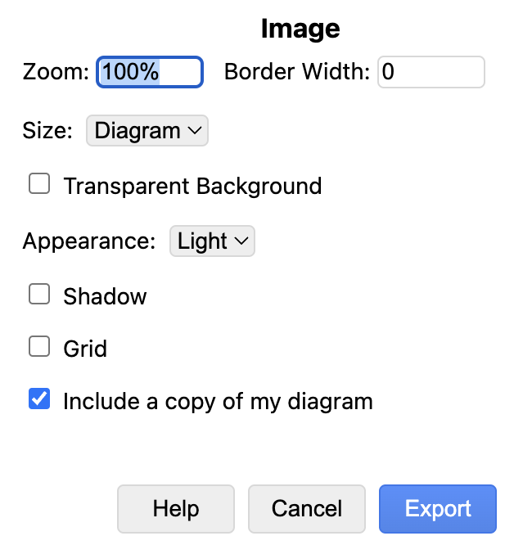
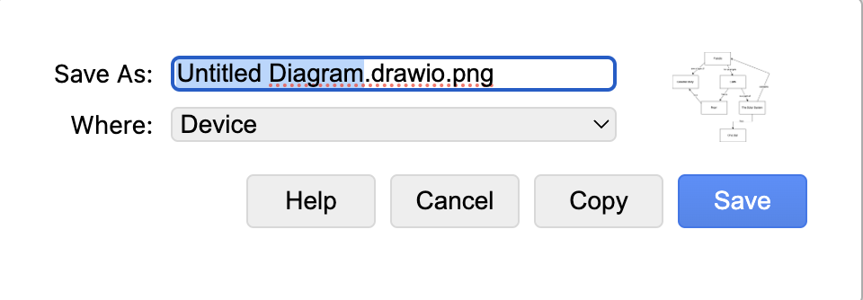
It is time to save your work!
1. Go to File and click Export as
2. Chose PNG
3. Tick ‘Include a copy of my diagram’ and then Export
4. Instead of ‘Untitled Diagram’, write your Personal Code
5. Chose ‘Device’ or ‘Downloads’ in dropdown menu for ‘Where’
6. Click Save

Slide 14

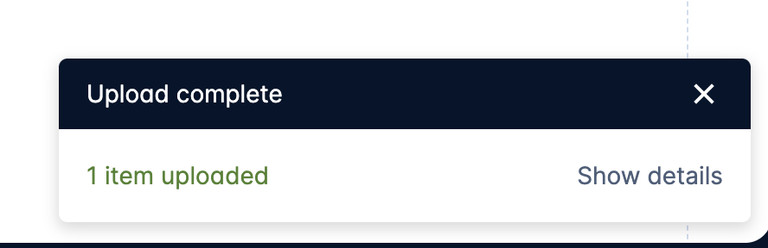
1. Go to: cern.ch/conceptmap
2. Upload your saved concept map by clicking this
Make sure to ADD your NEW Map!
3. Chose your file from the computer

Slide 15
Let’s talk!

Slide 16
How can concept maps be used in a classroom?
Teaching new concepts/topics
Teaching new concepts/topics
Assessment of your students’ understanding

Slide 17

Teaching new concepts/topics
and shares with class
1. Teacher creates a map
with students’ help
2. Your students create a map
individually
in a small group
Maps can be made using a software or a paper and pen.

Slide 18
Paper & Pen
Software
Speed and simplicity
Editability and Scalability
Aid memory and cognitive processing
Polish and Professional Presentation
Actual knowledge without distractions
Accessibility Features
Low tech, high accessibility
Integration and Storage

Slide 19
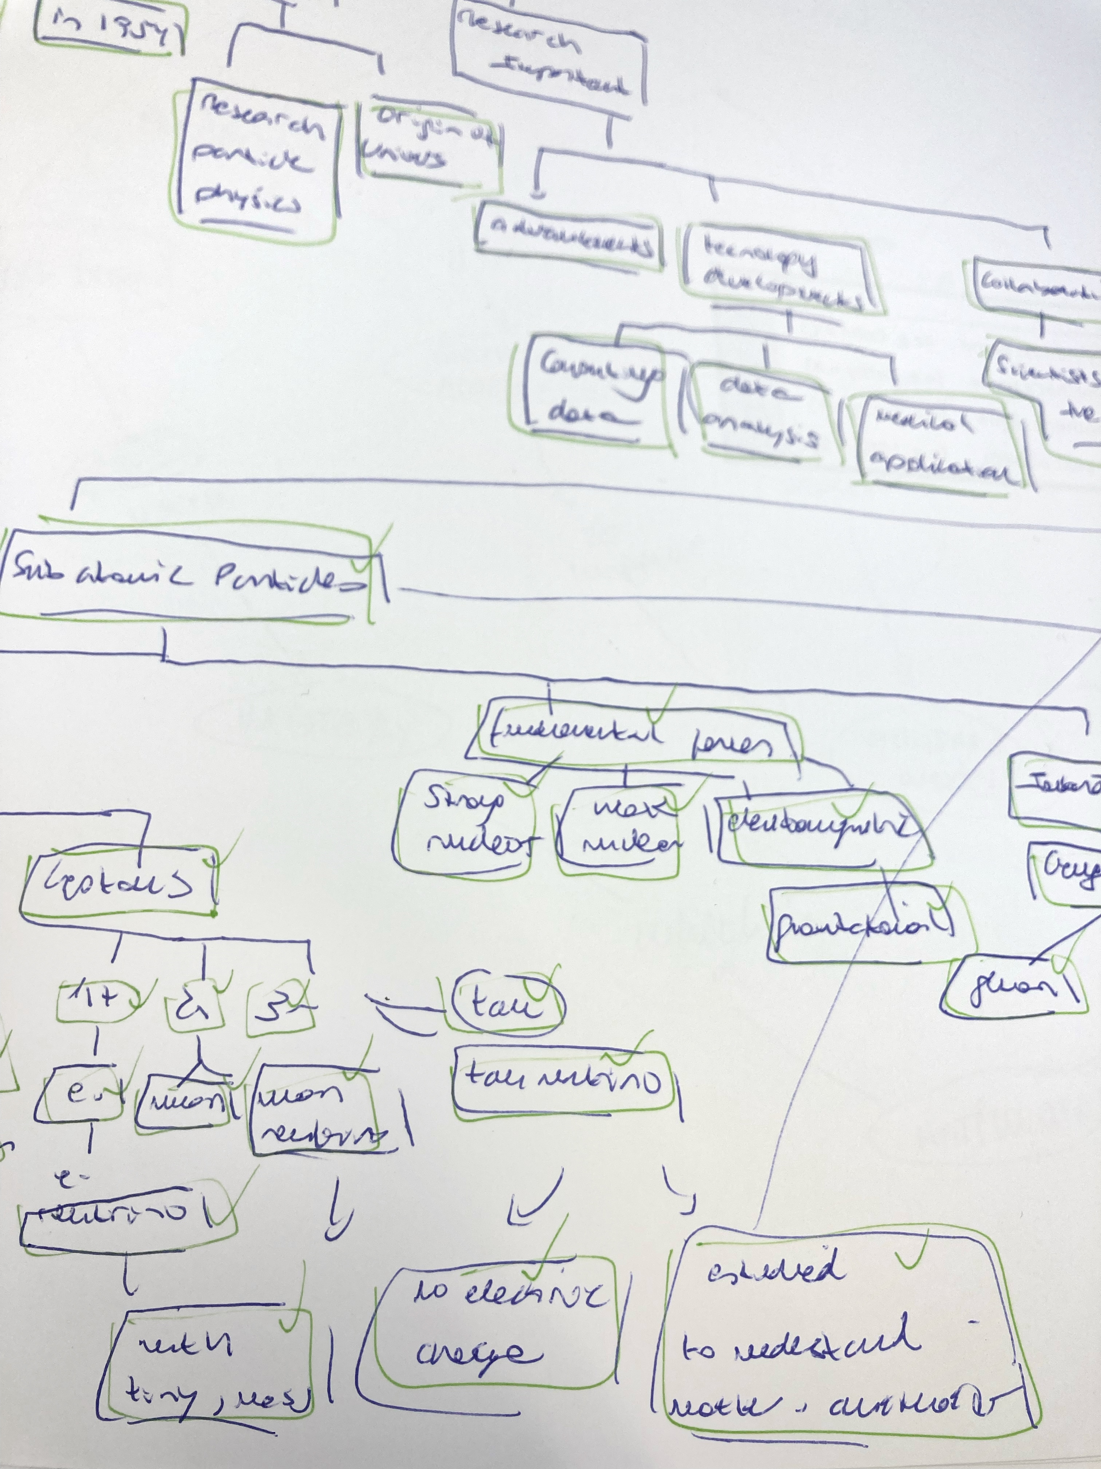
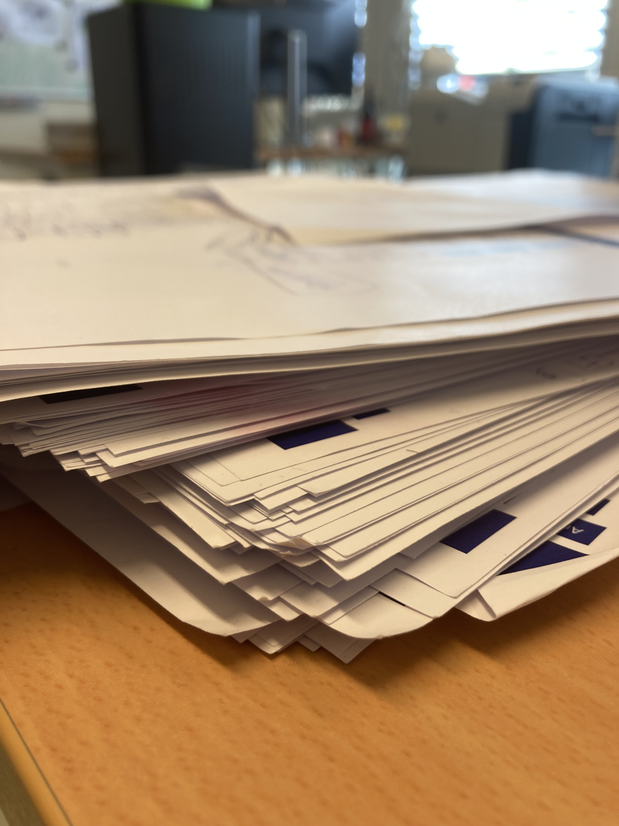
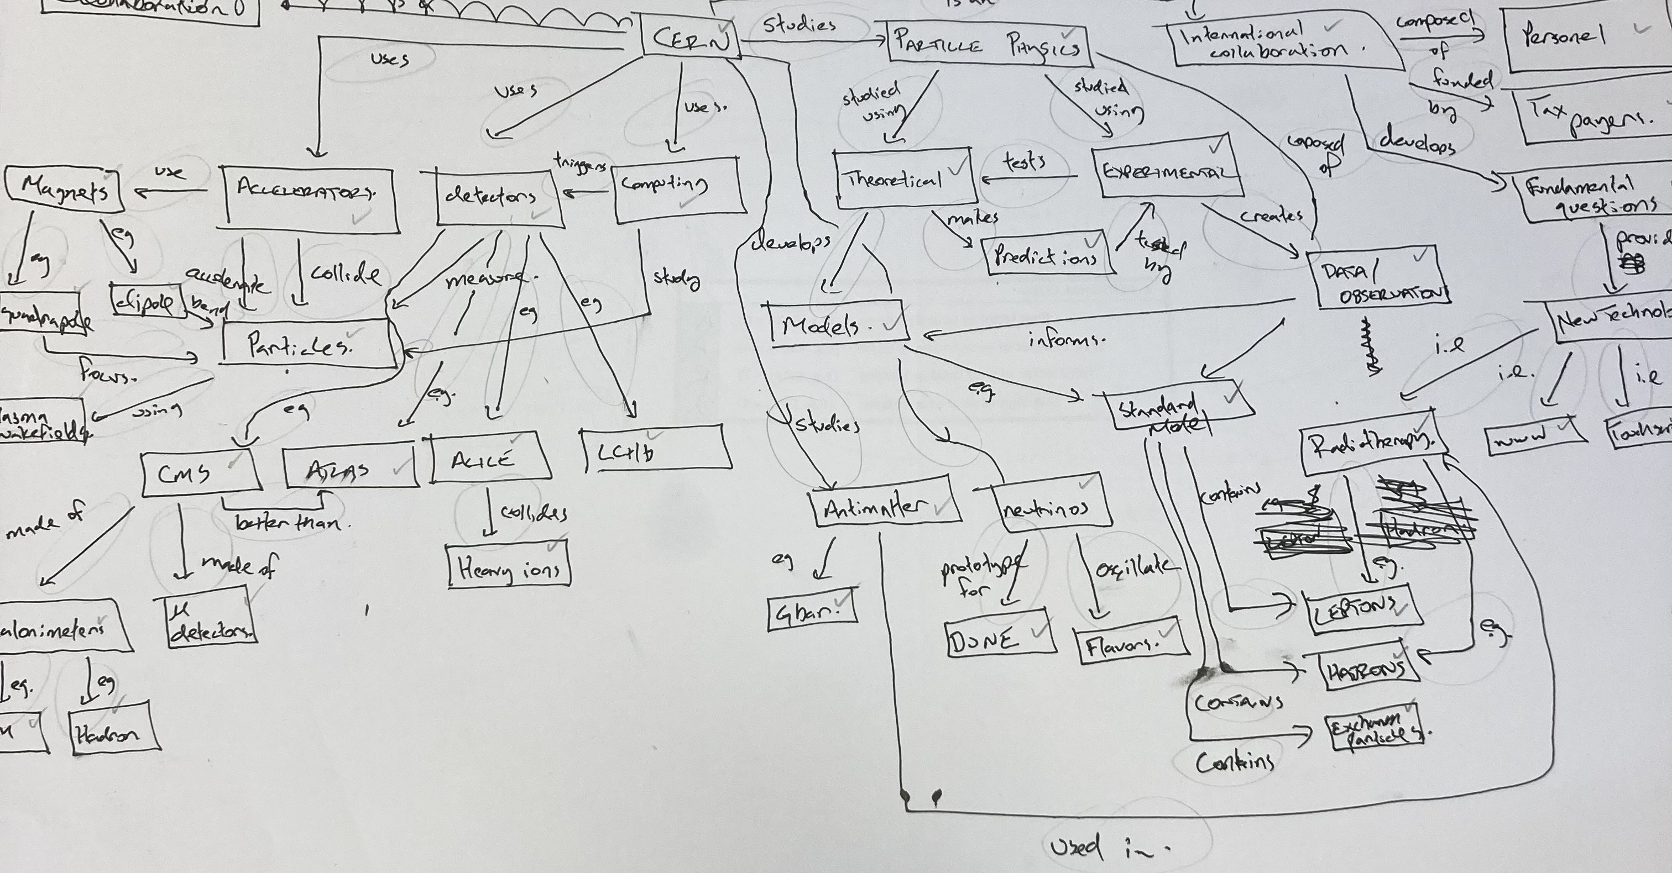

Slide 20
Parking Lot Method
Blank Paper Method
Fill-In Method

Slide 21
How can concept map be used in a classroom?
Teaching new concepts/topics
Assessment of your students’ understanding
Assessment of your students’ understanding

Slide 22
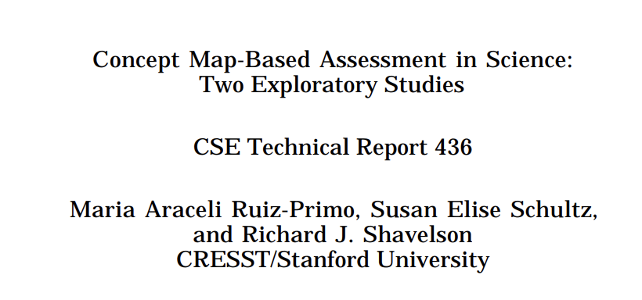
Assessment of your students’ understanding
Validity
Misconceptions

Slide 23
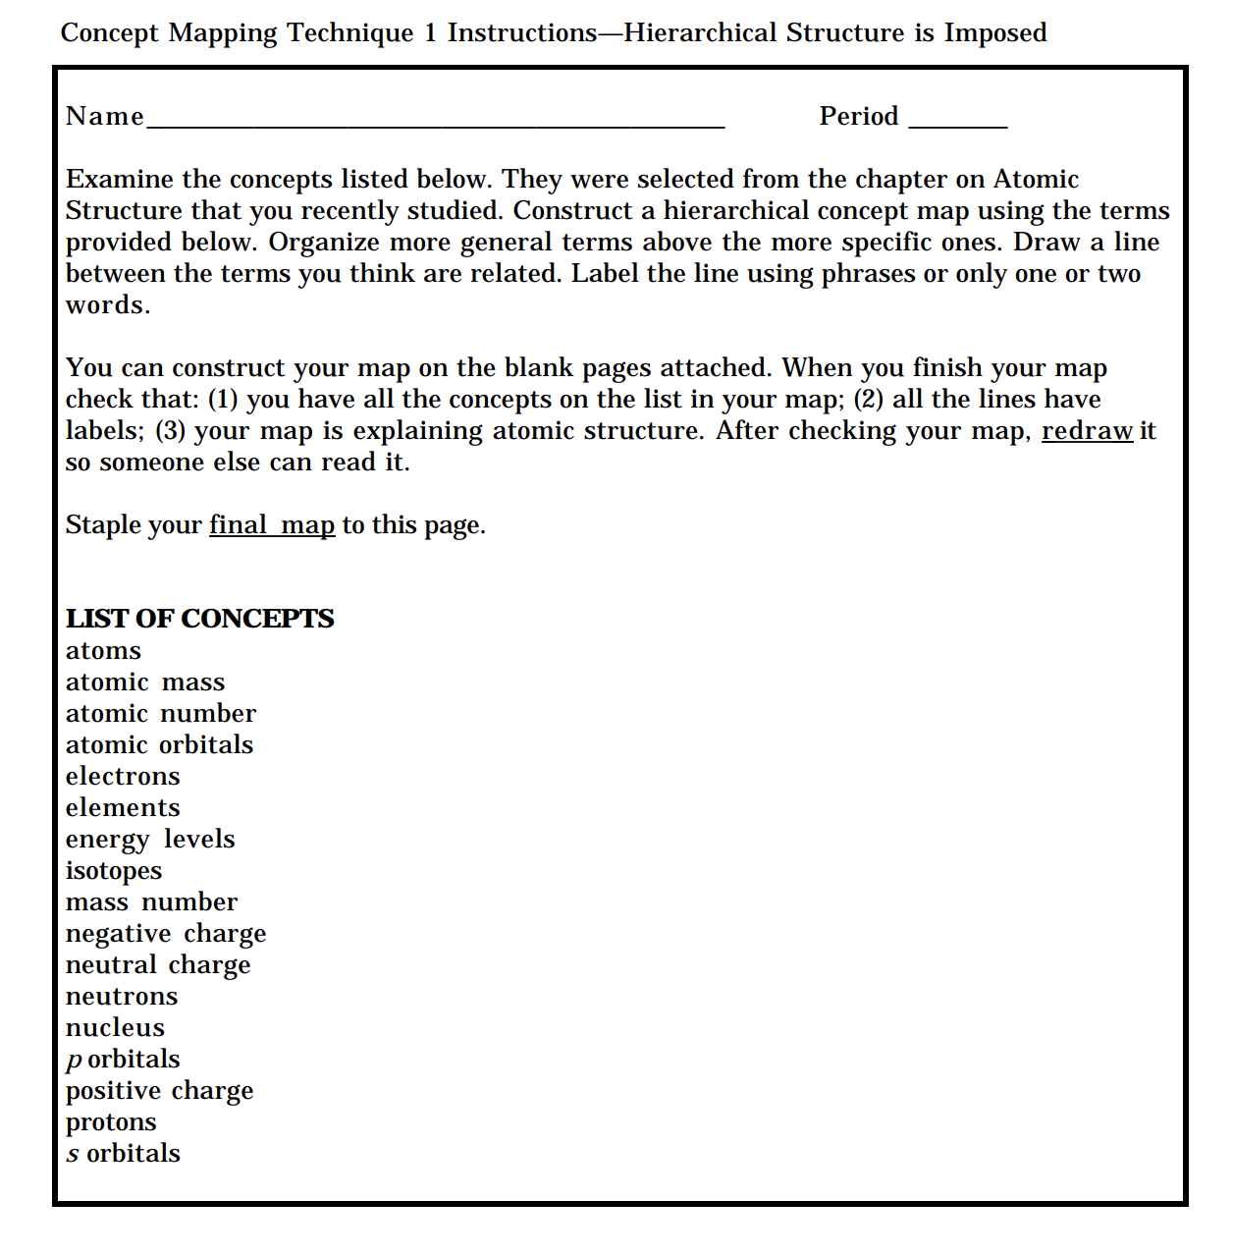

Slide 24
How Milena evaluates your concept maps
Milena loves to read.
Milena loves to read.
Milena loves to read.

Slide 25
How Milena evaluates your concept maps
Concepts (and Chunks)
Concept knowledge
Density
= L / T
L = links; T = total number of concepts
Integration of knowledge
Propositions
Higher number = higher accuracy
Milena loves to read.
Milena loves to read.
Accuracy of knowledge
Milena loves to read.
25

Slide 26
Expert Concept Map

Slide 27



Thank you for your participation!
milena.vujanovic@cern.ch
Nariel_137

