Slide 1


AWAKE and Plasma Wakefield Acceleration
Marlene Turner
Go to vevox.app
Enter the session ID: 131-113-101
Or scan the QR code

Slide 2
Join the Vevox session
Go to vevox.app Enter the session ID: 131-113-101 Or scan the QR code

Slide 3

What do you think plasma wakefield acceleration is?
##/##
Join at: vevox.app
ID: 131-113-101
Question slide
A way to speed up plasma flow in natural lightning.
0%
A method of accelerating particles using waves created in plasma.
0%
A technique for heating plasma to generate energy.
0%
A way to slow down fast-moving ions in a laboratory.
0%
A method of propelling spacecrafts using solar plasma.
0%
Go to vevox.app
Enter the session ID: 131-113-101
Or scan the QR code

Slide 4
What do you think plasma wakefield acceleration is?
##/##
Join at: vevox.app
ID: 131-113-101
Preparing Results
A way to speed up plasma flow in natural lightning.
0%
A method of accelerating particles using waves created in plasma.
0%
✓
A technique for heating plasma to generate energy.
0%
A way to slow down fast-moving ions in a laboratory.
0%
A method of propelling spacecrafts using solar plasma.
0%
RESULTS SLIDE

Slide 5




Outline
Introduction
What’s next?
Summary
Physics of plasma wakefields
AWAKE Experiment
State of the Art

Slide 6



Outline
Introduction
What’s next?
Summary
Physics of plasma wakefields
AWAKE Experiment
State of the Art

Slide 7
To accelerate a charged particle, you need…
0/0
Join at: vevox.app
ID: 131-113-101
Question slide
A magnetic field only.
0%
A electric field only.
0%
A magnetic and electric field.
0%
All four fundamental forces: strong, weak, gravitational and electromagnetic.
0%

Slide 8
To accelerate a charged particle, you need…
0/0
Join at: vevox.app
ID: 131-113-101
Preparing Results
A magnetic field only.
0%
A electric field only.
0%
✓
A magnetic and electric field.
0%
All four fundamental forces: strong, weak, gravitational and electromagnetic.
0%
RESULTS SLIDE

Slide 9
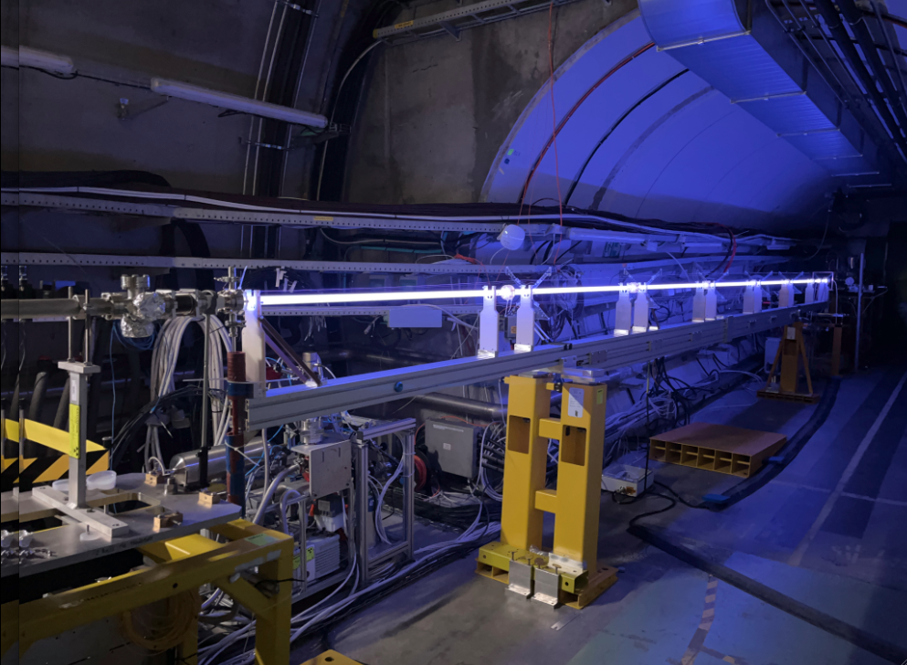


Why Plasma Wakefield Acceleration?
→ New way to accelerate charged particles
Goal: Build smaller, cheaper, or more energetic particle accelerators.
$$\overset{⃑}{E}$$
e⁻
100 MV/m
Acceleration gradient: e.g. 100 MeV/m,…
Static field is not ideal
Better:
Field travels together with the beam
e-

Slide 10
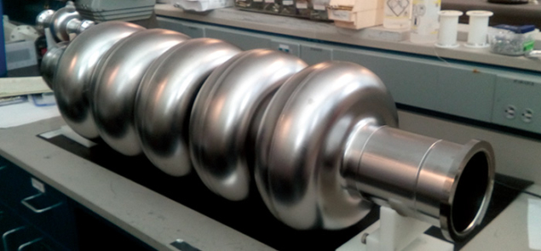
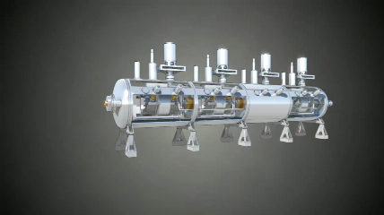

Current State-of-the-Art Acceleration Technology
Metallic radiofrequency (RF) cavities
Source: https://cerncourier.com/a/cern-thinks-bigger/
Metallic cavities
Limited to ~100 MV/m due to electric breakdowns (ionization).
Operate typically around 30 MV/m
To overcome this limit → change the medium

Slide 11

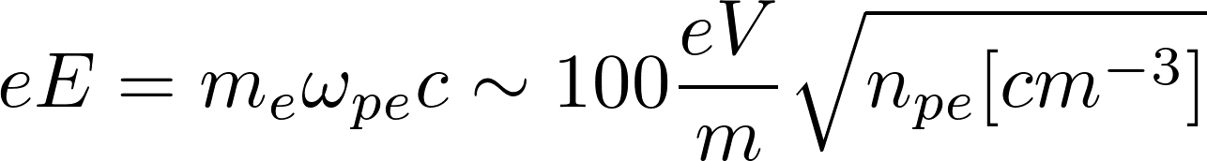
Plasma Wakefield Acceleration
Plasmas are not limited by electrical breakdown.
i.e.: ~1 GeV/m for a plasma electron density of n_{pe} = 10¹⁴ cm⁻³
~100 GeV/m for a plasma electron density of n_{pe} = 10¹⁸ cm⁻³
(Cold plasma wavebreaking limit)
10 GeV = 100 MeV/m x 100 m
10 GeV = 100 GeV/m x 0.1 m
11

Slide 12
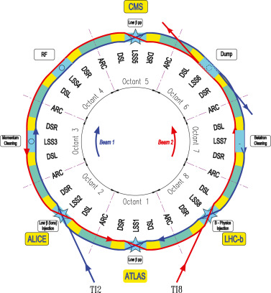
Circular and Linear Accelerators
Circular accelerators
Image from P. Arpaia et al., NIMA 985, 164652 (2021)
r
Synchrotron radiation loss

Slide 13
Synchrotron Radiation
Field left behind
Synchrotron radiation is caused by leaving part of fields behind
when the beam moves along the curve.
∝ E⁴/(r²m⁴)
v = c
v < c
Bending
radius
Mass of the particle
Particle
energy
Field lines
→ Needs to be taken into account when accelerated charged particles are deflected in the radial direction.

Slide 14
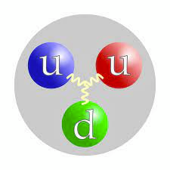
Circular and Linear Accelerators
Circular accelerators
Image from P. Arpaia et al., NIMA 985, 164652 (2021)
Advantage: beam passes accelerating section many times
Disadvantage: synchrotron radiation losses
r
LHC tunnel:
p+p+ → 14 TeV → limited by magnets
e+e- → 209 GeV → limited by SR
Max. energy (E) limited by synchrotron radiation (SR) losses ∝ E⁴/(r²m⁴)
9.1 × 10⁻³¹ kg
1.67 × 10⁻²⁷ kg
r → bending radius
m → mass of the particle
e-
e-

Slide 15
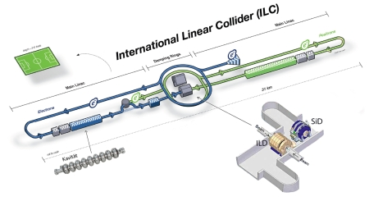
Circular and Linear Accelerators
Circular accelerators
Linear accelerators
Image from P. Arpaia et al., NIMA 985, 164652 (2021)
r
Beam passes acceleration section multiple times.
Max. energy (E) limited by synchrotron radiation losses ∝ E⁴/(r²m⁴)
Beam passes acceleration section multiple times.
Negligible synchrotron radiation losses
Accelerator length and accelerating gradient define final beam energy.

Slide 16

Plasma
Wakefield Acceleration
Plasma ?
Wakefield ?
Acceleration ?

Slide 17
Definition of Plasma and Plasma Wakefield
Plasma
Plasma: ionised gas (4th state of matter)
Quasi-neutrality: the overall charge of a plasma is about zero.
Collective effects: Charged particles must be close enough together that each particle influences many nearby charged particles.
Electrostatic interactions dominate over collisions or ordinary gas kinetics.
Rb+
Rb+
Rb+
Rb+
e-
e-
e-
e-
Rb+
e-
Rb+
Rb+
Rb+
e-
e-
e-
e-
Rb+
Rb+
Rb+
Rb+
e-
e-
e-
Rb+
e-
Rb+
Rb+
e-
Rb+
e-
e-

Slide 18
How much plasma is out there in the visible universe?
##/##
Join at: vevox.app
ID: 131-113-101
Question slide
About 99% of the visible universe consists of plasma
0%
Less than 10% — it’s mostly solid and liquid
0%
Around 50%, evenly mixed with gases
0%
Only in stars — so 1% or less
0%

Slide 19
How much plasma is out there in the visible universe?
##/##
Join at: vevox.app
ID: 131-113-101
Preparing Results
About 99% of the visible universe consists of plasma
0%
✓
Less than 10% — it’s mostly solid and liquid
0%
Around 50%, evenly mixed with gases
0%
Only in stars — so 1% or less
0%
RESULTS SLIDE

Slide 20
Definition of Plasma and Plasma Wakefield
Plasma
Plasma: ionised gas (4th state of matter)
Quasi-neutrality: the overall charge of a plasma is about zero.
Collective effects: Charged particles must be close enough together that each particle influences many nearby charged particles.
Electrostatic interactions dominate over collisions or ordinary gas kinetics.
Rb+
Rb+
Rb+
Rb+
e-
e-
e-
e-
Rb+
e-
Rb+
Rb+
Rb+
e-
e-
e-
e-
Rb+
Rb+
Rb+
Rb+
e-
e-
e-
Rb+
e-
Rb+
Rb+
e-
Rb+
e-
e-
Plasma Wakefields
Plasma Wakefields:
are the fields created/sustained by collective motion of plasma particles.
Rb+
Rb+
Rb+
Rb+
Rb+
Rb+
Rb+
Rb+
Rb+
Rb+
e-
e-
e-
e-
e-
e-
e-
e-
e-
e-
e-
e-
e-
e-
e-
e-
e-
e-
Rb+
e-
Rb+
Rb+
Rb+
Rb+
Rb+
Rb+
Rb+
Rb+
Rb+
e-
e-
e-
e-
e-
e-
e-
e-
Rb+
Rb+
e-
e-
Rb+
Rb+
Rb+
Rb+
Rb+
Rb+
Rb+
Rb+
Acceleration
e-
e-
e-
e-
e-
e-
e-
e-
e-
e-
e-
e-
e-
e-
e-
Rb+
e-
e-
e-
e-
Rb+
Rb+
Rb+
Rb+
Rb+
e-
Rb+
Rb+
Rb+
Rb+
e-
e-
e-
e-
e-
Electric field

Slide 21
Let Us Repeat…
We quantify the acceleration process using the acceleration gradient
Plasma wakefields allow to accelerate charged particles with ~ 1-100 GeV/m
High gradients are important when using linear accelerators (e.g. for light particles) to minimize synchrotron radiation losses
For linear accelerators, their length defines the final beam energy

Slide 22

Outline
Introduction
What’s next?
Summary
Physics of plasma wakefields
AWAKE Experiment
State of the Art

Slide 23
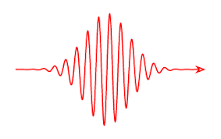
How to Create Plasma Wakefields?
Two ingredients
Plasma
(Medium)
Relativistic charged particle beam or
Short intense laser pulse
(Energy source)
Rb+
Rb+
Rb+
Rb+
e-
e-
e-
e-
Rb+
e-
Rb+
Rb+
Rb+
e-
e-
e-
e-
Rb+
Rb+
Rb+
Rb+
e-
e-
e-
Rb+
e-
Rb+
Rb+
e-
Rb+
e-
e-

Slide 24

Image from https://revbalance.com/improving-balance-for-wakesurfing/

Slide 25

Energy Source: The Driver
At rest:
Relativistic charged particle bunches or laser pulses
→ Relativistic charged particle bunches carry almost purely transverse electric fields
What we need → longitudinal electric field to accelerate charged particles
Trick:
Use plasma to convert the transverse electric field of the proton bunch into a longitudinal electric field in the plasma.
e- bunch
v ~<c
Rb+
Rb+
Rb+
Rb+
e-
e-
e-
e-
Rb+
e-
Rb+
Rb+
Rb+
e-
e-
e-
e-
Rb+
Rb+
Rb+
Rb+
e-
e-
e-
Rb+
e-
Rb+
Rb+
e-
Rb+
e-
e-

Slide 26
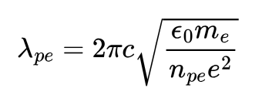
How to Drive a Plasma Wave
Rb+
Rb+
Rb+
Rb+
Rb+
Rb+
Rb+
Rb+
Rb+
Rb+
e-
e-
e-
e-
e-
e-
e-
e-
Important to understand
Rb ions are heavy and do not move significantly on the timescale of the electrons
Wakefield is moving with the particle bunch (v~c)
Plasma electron motion is mostly transverse
Electrons do not move significantly longitudinally
e-
e-
e-
e-
e-
e-
e-
e-
e-
e-
Rb+
e-
Rb+
Rb+
Rb+
Rb+
Rb+
Rb+
Rb+
Rb+
Rb+
e-
e-
e-
e-
e-
-- - - - -
e-
e-
e-
Rb+
Rb+
e-
e-
Rb+
Rb+
Rb+
Rb+
Rb+
Rb+
Rb+
Rb+
e-
e-
e-
e-
e-
e-
e-
e-
e-
e-
e-
e-
e-
e-
e-
Rb+
e-
e-
e-
e-
Rb+
Rb+
Rb+
Rb+
Rb+
e-
Rb+
Rb+
Rb+
Rb+
e-
e-
e-
e-
e.g. ~3 mm for n_{pe} = 10¹⁴ cm⁻³ ~30 μm for n_{pe} = 10¹⁸ cm⁻³

Slide 27

How to Drive a Plasma Wave
Rb+
Rb+
Rb+
Rb+
Rb+
Rb+
Rb+
Rb+
Rb+
Rb+
e-
e-
e-
e-
e-
e-
e-
e-
Charge separation → electric field
(longitudinal and transverse)
e-
e-
e-
e-
e-
e-
e-
e-
e-
e-
Rb+
e-
Rb+
Rb+
Rb+
Rb+
Rb+
Rb+
Rb+
Rb+
Rb+
e-
e-
e-
e-
e-
e-
e-
e-
Rb+
Rb+
e-
e-
Rb+
Rb+
Rb+
Rb+
Rb+
Rb+
Rb+
Rb+
e-
e-
e-
e-
e-
e-
e-
e-
e-
e-
e-
e-
e-
e-
e-
Rb+
e-
e-
e-
e-
Rb+
Rb+
Rb+
Rb+
Rb+
e-
Rb+
Rb+
Rb+
Rb+
e-
e-
e-
e-
Rb+
Rb+
Rb+
Rb+
Rb+
Rb+
Rb+
Rb+
Rb+
Rb+
e-
e-
e-
e-
e-
e-
e-
e-
e-
e-
e-
e-
e-
e-
e-
e-
e-
Where should we place an electron bunch to be accelerated?
e-
Rb+
e-
Rb+
Rb+
Rb+
Rb+
Rb+
Rb+
Rb+
Rb+
Rb+
e-
e-
e-
e-
e-
e-
e-
e-
Rb+
Rb+
e-
e-
Rb+
Rb+
Rb+
Rb+
Rb+
Rb+
Rb+
Rb+
e-
e-
e-
e-
e-
e-
e-
e-
e-
e-
e-
e-
e-
e-
e-
Rb+
e-
e-
e-
e-
Rb+
Rb+
Rb+
Rb+
Rb+
e-
Rb+
Rb+
Rb+
Rb+
e-
e-
e-
e-

Slide 28
Plasma Wakefields
Accelerating for negatively charged particles
Decelerating for negatively charged particles
Rb+
Rb+
Rb+
Rb+
Rb+
Rb+
Rb+
Rb+
Rb+
Rb+
e-
e-
e-
e-
e-
e-
e-
e-
e-
e-
e-
e-
e-
e-
e-
e-
e-
e-
Rb+
e-
Rb+
Rb+
Rb+
Focusing for negatively charged particles
Rb+
Rb+
Rb+
Rb+
Rb+
Rb+
e-
e-
e-
e-
e-
e-
e-
e-
e-
e-
e-
e-
Rb+
e-
Rb+
Rb+
Rb+
Rb+
Rb+
Rb+
Rb+
Rb+
Rb+
e-
e-
e-
e-
e-
e-
e-
e-
e-
e-
e-
Defocusing for negatively charged particles
e-
e-
e-
e-
Rb+
e-
e-
e-
e-
Rb+
Rb+
Rb+
Rb+
Rb+
e-
Rb+
Rb+
Rb+
Rb+
e-
e-
e-
e-

Slide 29

Plasma Acts As a Transformer Driver deposits energy, witness gains energy
Acceleration distance typically limited by either
witness
driver
Depletion: The drive bunch/pulse running out of energy. Solution: couple in a new driver or use a more energetic driver
witness
driver
Dephasing: The witness bunch outruns the driver. Solution: couple in a new driver or shape the plasma density
witness
driver
Diffraction: Drive beam evolution. Solution: Guiding or use a more rigid driver

Slide 30
Let Us Repeat…
Driving plasma wakefields requires plasma, energy source (driver)
Place a particle beam (witness) to be accelerated
Plasma acts as a transformer
Drive beam energy is transferred to the witness bunch
What limits the energy gain:
Depletion: Driver runs out of energy
Dephasing: Accelerating bunch outruns the driver
Diffraction: Driver no longer intense enough

Slide 31
Outline
Introduction
What’s next?
Summary
Physics of plasma wakefields
AWAKE Experiment
State of the Art

Slide 32
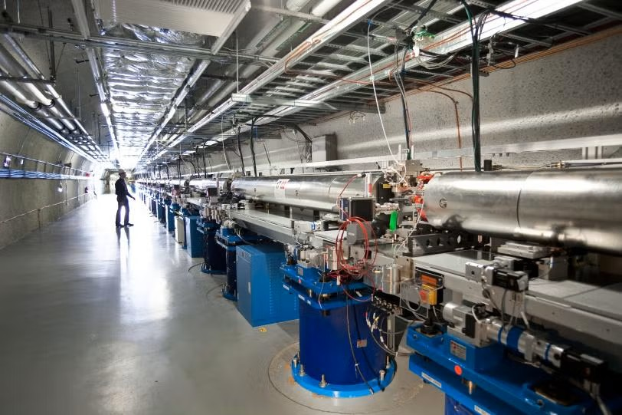
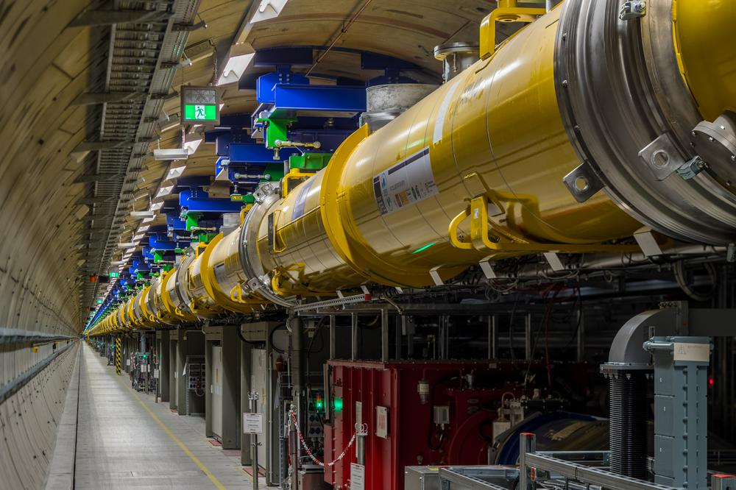
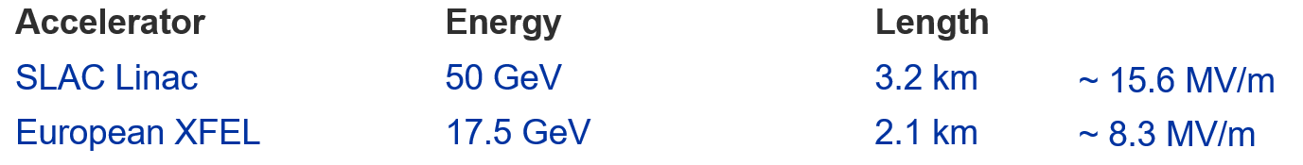
Reference:

Slide 33
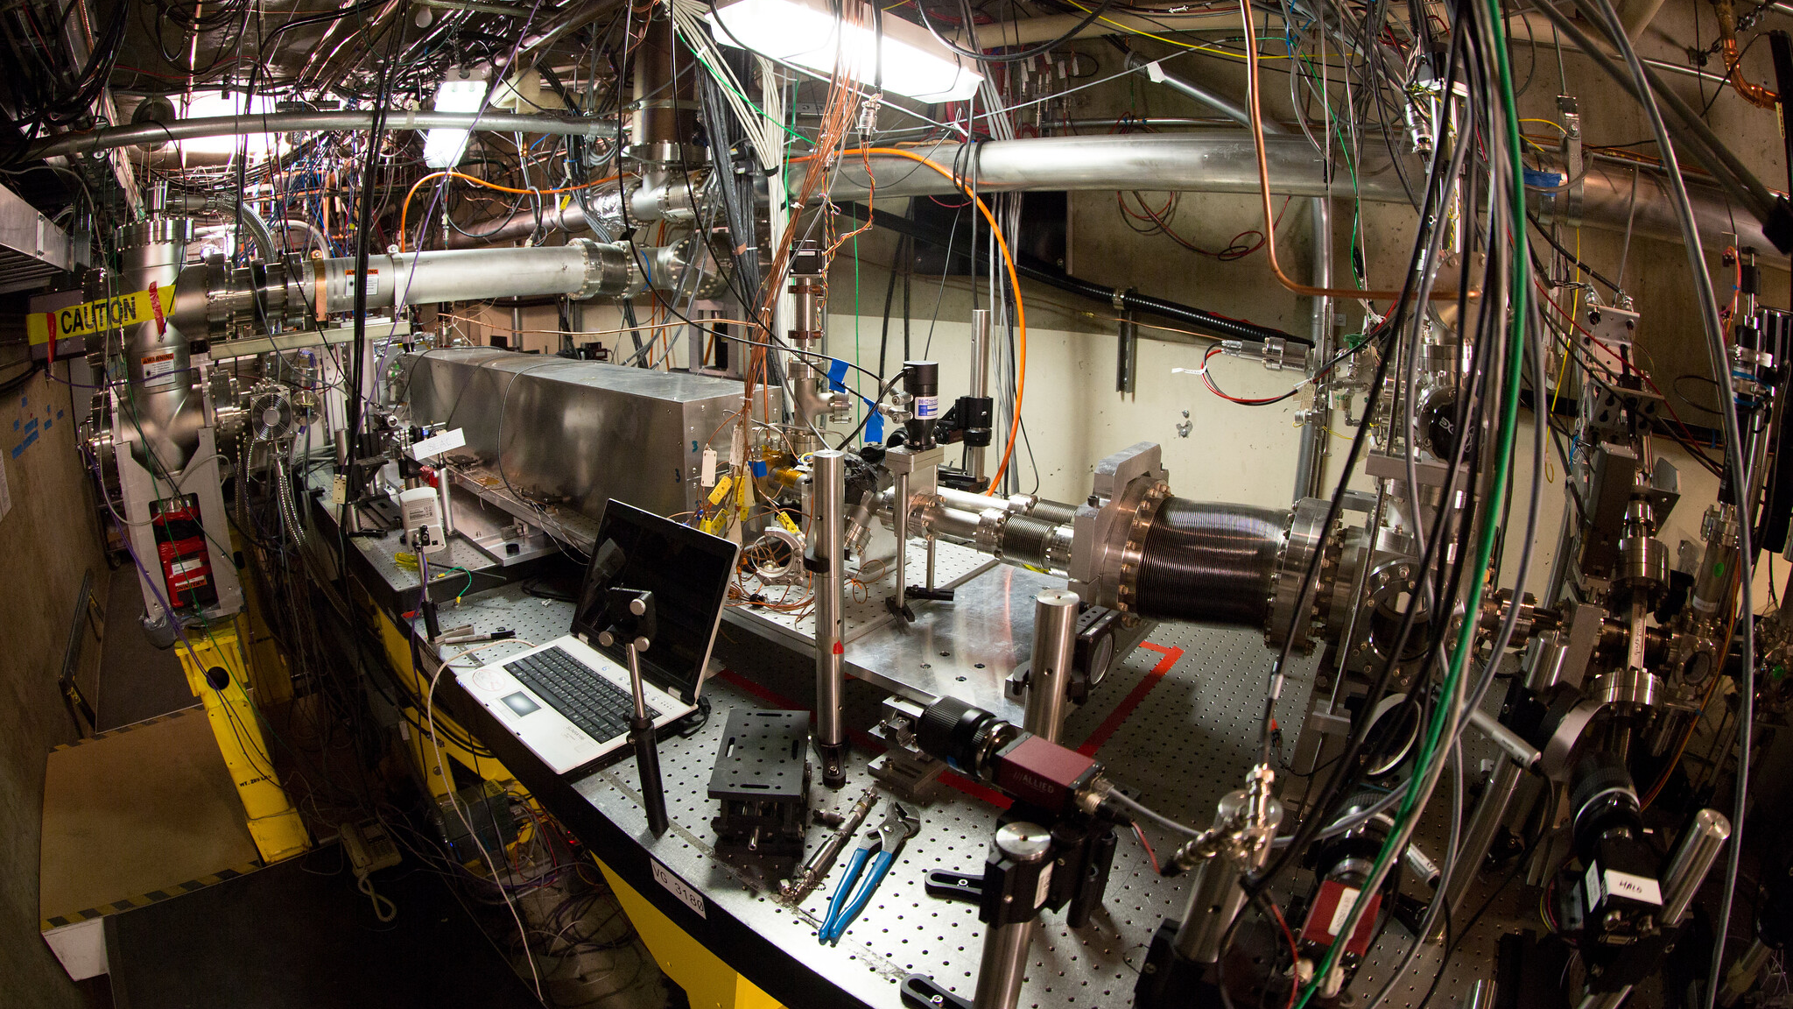

Slide 34
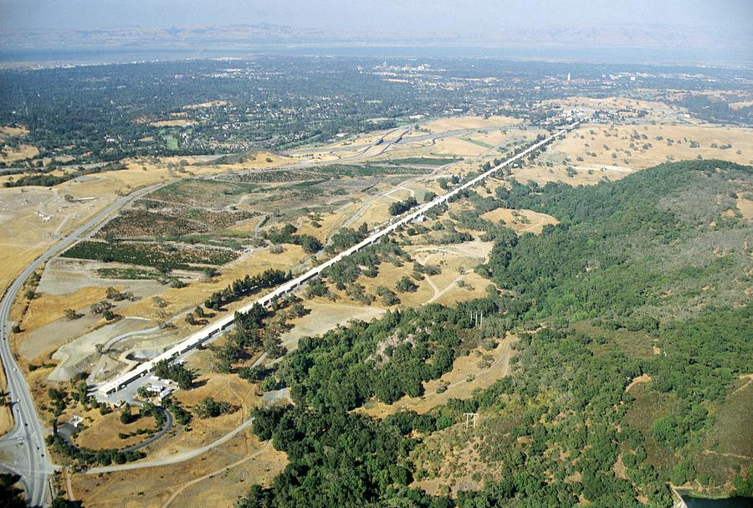
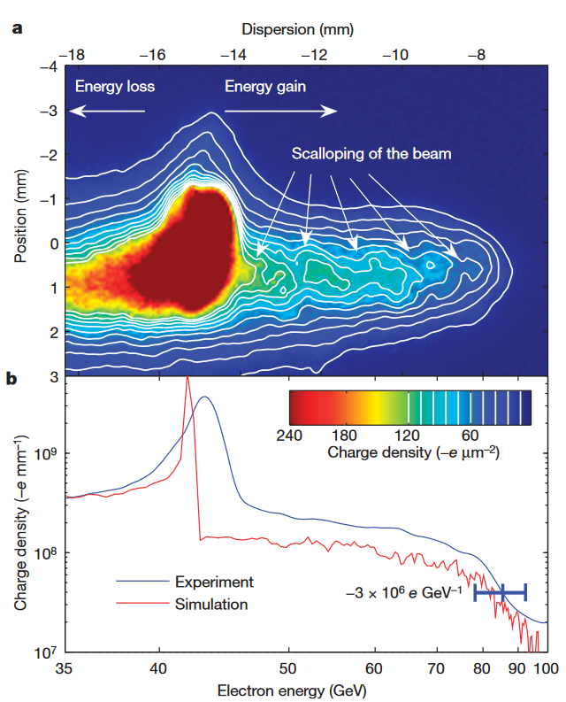
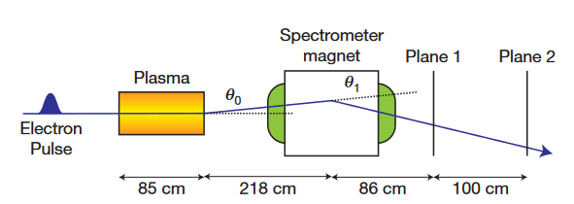
State-of-the-Art Results Beam-Driven
SLAC (Stanford, California)
Rb+
Rb+
Rb+
Rb+
e-
e-
e-
e-
e-
e-
e-
Rb+
Rb+
Rb+
Rb+
3.2 km
e-
e-
e-
e-
e-
42 GeV energy gain
in 85 cm of plasma
~ 50 GeV/m
e-
e-
Rb+
Rb+
Rb+
Rb+
e-
e-
e-
e-
e-
e-
e-
e-
e-
Rb+
Rb+
Rb+
e-
Rb+
Blumenfeld, I., Clayton, C., Decker, FJ. et al. Energy doubling of 42 GeV electrons in a metre-scale plasma wakefield accelerator. Nature 445, 741–744 (2007).

Slide 35
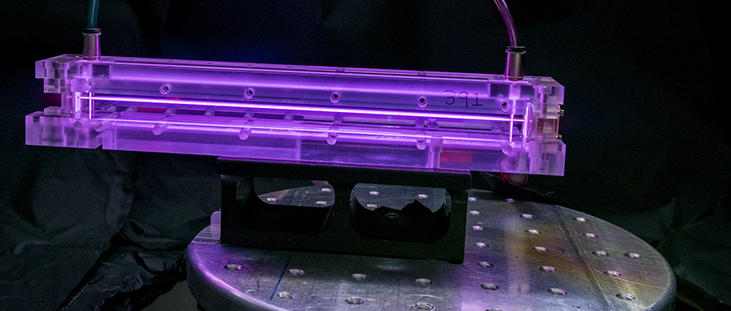
Capillary Discharge Plasma
20 cm

Slide 36
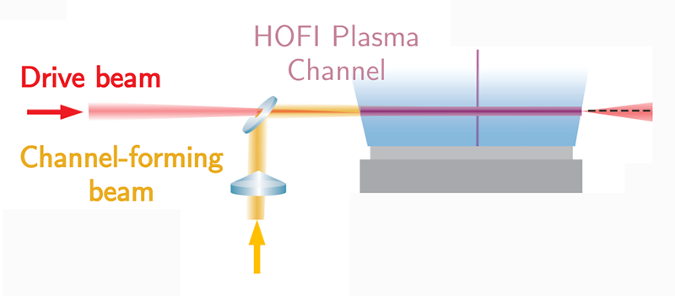
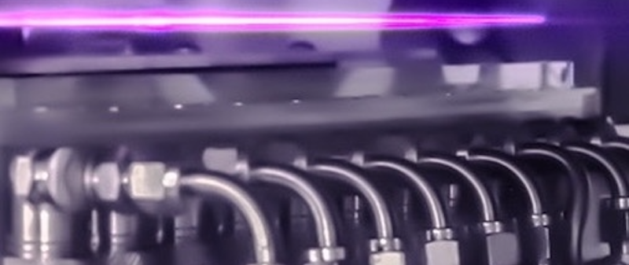
Slit Jet

Slide 37
Why is the plasma purple/pink?
0/0
Join at: vevox.app
ID: 131-113-101
Question slide
Because it was photoshopped to look good.
0%
Because of the very high temperature.
0%
Because Hydrogen was used to create the plasma.
0%
Because plasma absorbs all colors except pink.
0%

Slide 38
Why is the plasma purple/pink?
0/0
Join at: vevox.app
ID: 131-113-101
Preparing Results
Because it was photoshopped to look good.
0%
Because of the very high temperature.
0%
Because Hydrogen was used to create the plasma.
0%
✓
Because plasma absorbs all colors except pink.
0%
RESULTS SLIDE

Slide 39
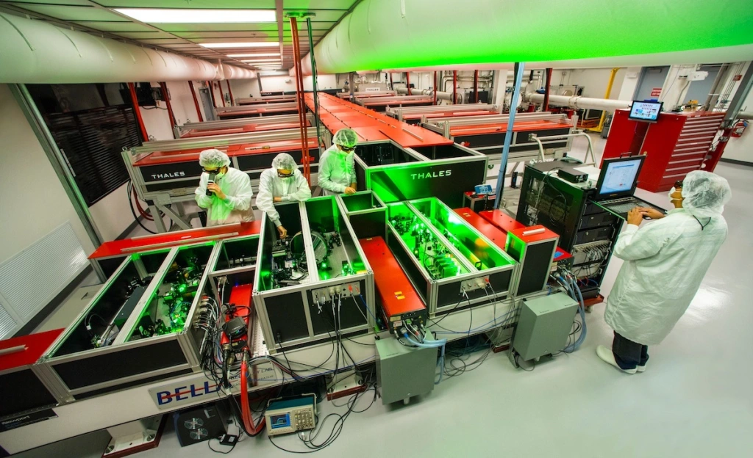
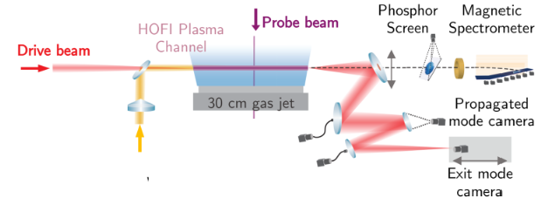
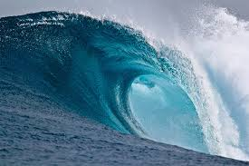
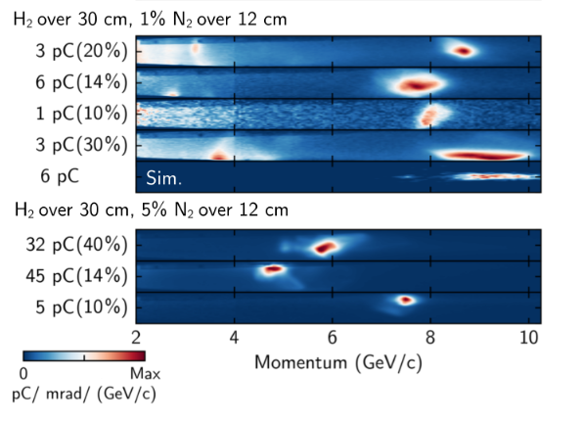
State-of-the-Art Results Laser-Driven
Laser System
Wave-breaking
9.2 GeV in 30 cm of plasma
→ 30.6 GeV/m
BELLA PW (Berkeley, California)
40 J, 30 fs → 1.2 PW
Focused to σ_{r} = 50 μm
Phys. Rev. Lett. 133, 255001 (2024).
39

Slide 40
Let Us Repeat…
Plasma wakefields acceleration has been demonstrated experimentally:
~10 GeV in 30 cm of plasma → ~30 GV/m
42 GeV in 85 cm of plasma → ~50 GV/m

Slide 41

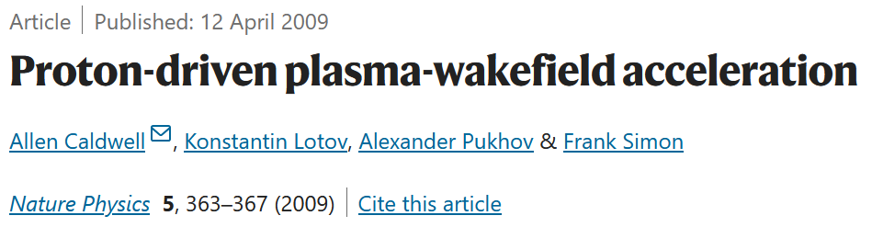

How to Reach Even Higher Energies?
Staging
More energetic
drivers
Driver 1
→ AWAKE experiment
Refocus
Acc. Stage 1
Acc. Stage 2
Driver 2
Goal: Keep interstage distance short
41

Slide 42
Outline
Introduction
What’s next?
Summary
Physics of plasma wakefields
AWAKE Experiment
State of the Art

Slide 43
The AWAKE Experiment @CERN

Slide 44
What does AWAKE stand for?
0/0
Join at: vevox.app
ID: 131-113-101
Question slide
Applied Wakefield Acceleration of Kinetic Electrons
0%
Active Wakefield Acceleration via Kinetic Electrodynamics
0%
Advanced Wakefield Experiment
0%
Angry Wizards And Kryptonite Everywhere
0%

Slide 45
What does AWAKE stand for?
0/0
Join at: vevox.app
ID: 131-113-101
Preparing Results
Applied Wakefield Acceleration of Kinetic Electrons
0%
Active Wakefield Acceleration via Kinetic Electrodynamics
0%
Advanced Wakefield Experiment
0%
✓
Angry Wizards And Kryptonite Everywhere
0%
RESULTS SLIDE

Slide 46
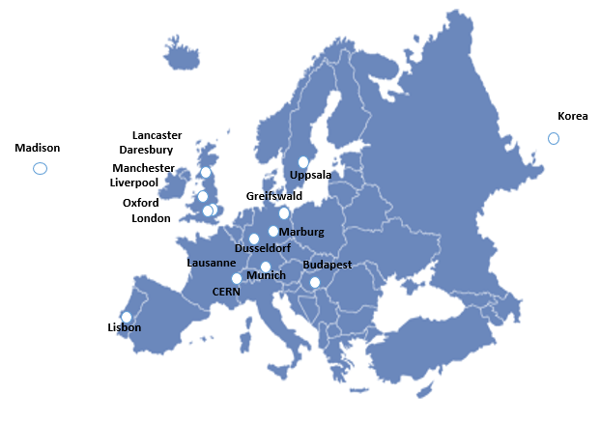

AWAKE: Advanced Wakefield Experiment International Collaboration
19 Institutes Worldwide:
CERN, Geneva, Switzerland
University of Manchester, Manchester, UK
Cockcroft Institute, Daresbury, UK
Lancaster University, Lancaster, UK
Oxford University, UK
Max Planck Institute for Physics, Munich, Germany
Max Planck Institute for Plasma Physics, Greifswald, Germany
UCL, London, UK
UNIST, Ulsan, Republic of Korea
Philipps-Universität Marburg, Marburg, Germany
Heinrich-Heine-University of Düsseldorf, Düsseldorf, Germany
University of Liverpool, Liverpool, UK
ISCTE - Instituto Universitéario de Lisboa, Portugal
GoLP/Instituto de Plasmas e Fusão Nuclear, Instituto Superior Técnico, Universidade de Lisboa, Lisbon, Portugal
Technical University Munich, Munich, Germany
University of Wisconsin, Madison, US
Uppsala University, Sweden
Wigner Institute, Budapest
Swiss Plasma Center group of EPFL, Lausanne, Switzerland
Experiment @
46
46

Slide 47
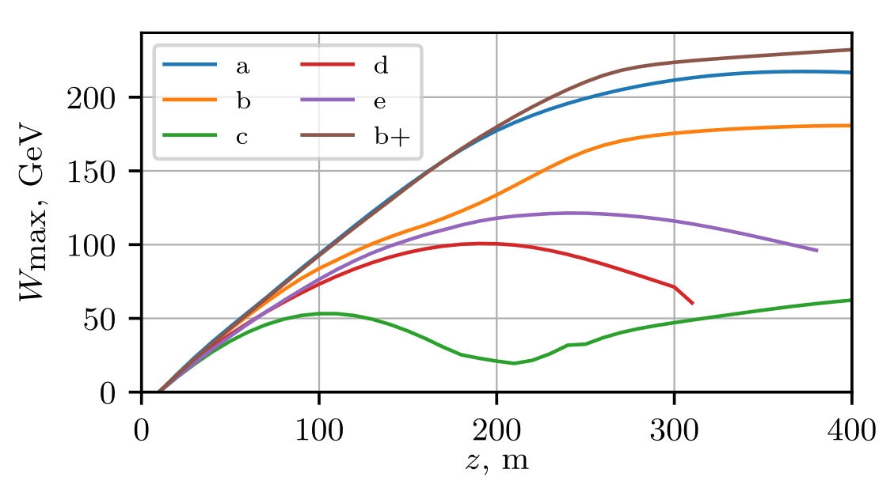
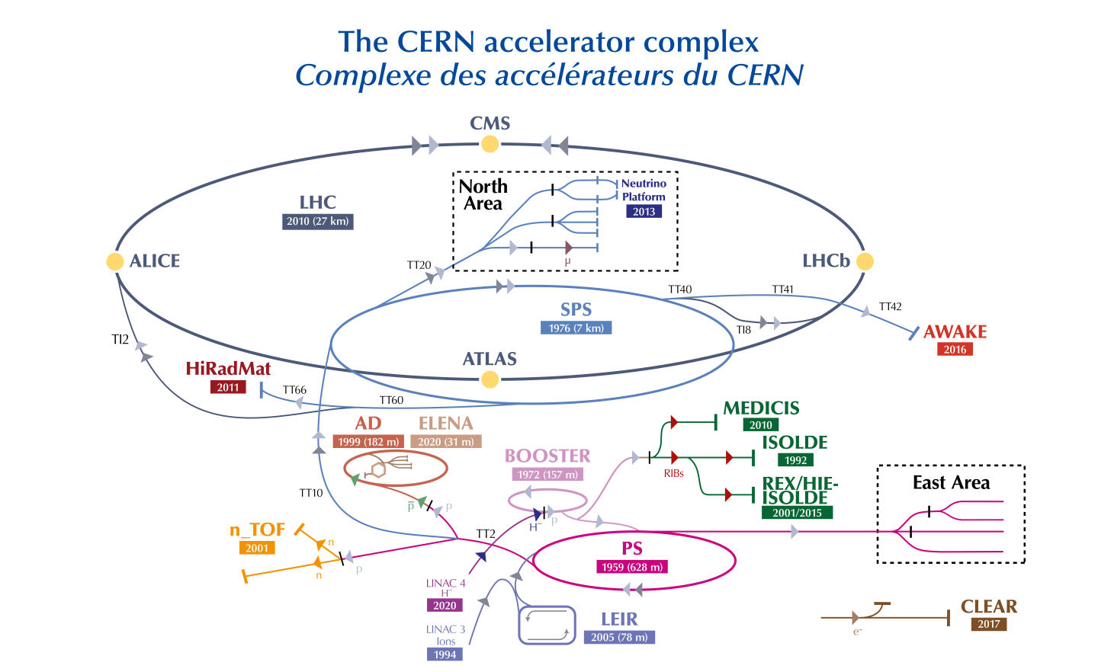
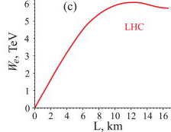
AWAKE is Unique in Using Proton Drivers
Highly-relativistic, highly-energetic (hundreds of kJ) bunches are available at CERN
Accelerating externally-injected electrons (e⁻) to GeV (SPS) or TeV (LHC) energy scale
P. Tuev, K. V. Lotov, PPFC 63, 125027 (2021)
SPS Driver (19 kJ):
~ 200 GeV in ~200 m
~ 10⁹ e⁻
A. Caldwell, K. V. Lotov, Phys. Plasmas 18, 13101 (2011)
LHC Driver (112 kJ):
~ 5 TeV in ~7 km
~ 10⁹ e⁻
47

Slide 48
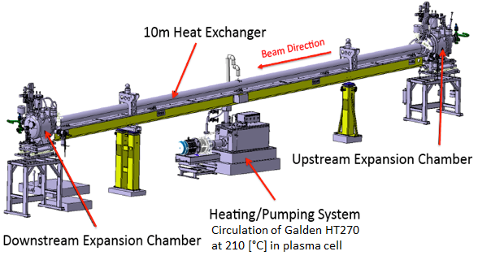
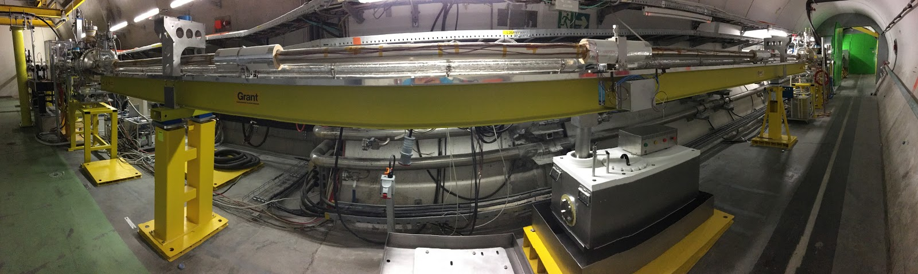
The AWAKE Plasma
Rubidium vapour cell.
The laser ionizes the outermost electron of each rubidium atom.
Desired plasma density: ~1-10x10¹⁴ electrons/cm³.

Slide 49
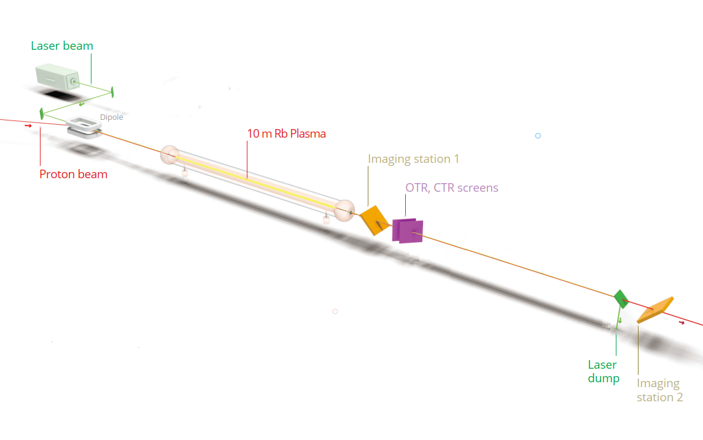

Slide 50
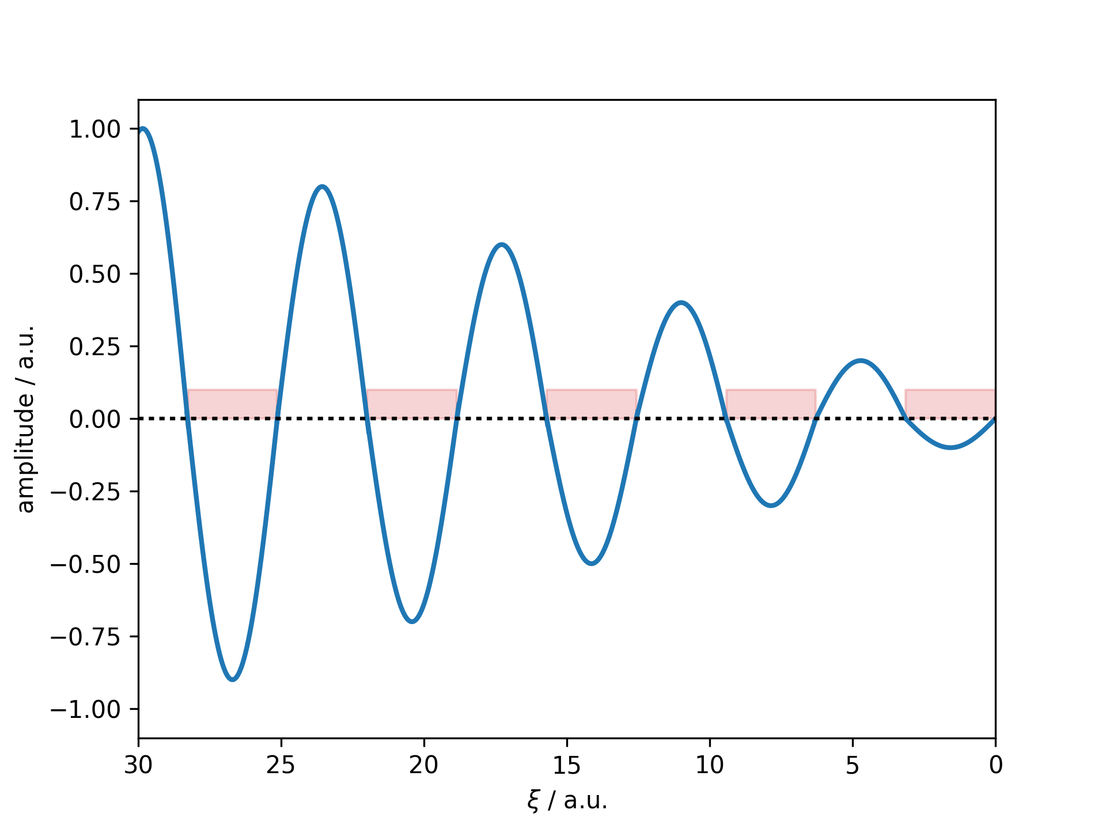
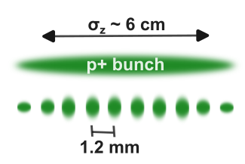
AWAKE Requires Microbunching of p⁺ Bunch
To effectively excite wakefields:
The drive bunch length has to be on the order of the plasma wavelength
For AWAKE → mm-scale bunch length
CERN SPS proton bunch length is ~6 cm
⇒ Plasma process: Self-Modulation Instability (SMI)
Resonant excitation
Wakefields driven resonantly to large amplitude
Self-modulation necessary to drive ~GV/m accelerating fields in 10¹⁴ cm⁻³ density plasma
(7x10¹⁴ cm⁻³)

Slide 51
Self-Modulation in Plasma Wakefields
Accelerating for negatively charged particles
Decelerating for negatively charged particles
Rb+
Rb+
Rb+
Rb+
Rb+
Rb+
Rb+
Rb+
Rb+
Rb+
e-
e-
e-
e-
e-
e-
e-
e-
e-
e-
e-
e-
e-
e-
e-
e-
e-
e-
Rb+
e-
Rb+
Rb+
Rb+
Focusing for negatively charged particles
Rb+
Rb+
Rb+
Rb+
Rb+
Rb+
e-
e-
e-
e-
e-
e-
e-
e-
Rb+
Rb+
e-
e-
Rb+
Rb+
Rb+
Rb+
Rb+
Rb+
Rb+
Rb+
e-
e-
e-
e-
e-
e-
e-
e-
e-
e-
e-
Defocusing for negatively charged particles
e-
e-
e-
e-
Rb+
e-
e-
e-
e-
Rb+
Rb+
Rb+
Rb+
Rb+
e-
Rb+
Rb+
Rb+
Rb+
e-
e-
e-
e-
Rb+
Rb+
Rb+
Rb+
Rb+
Rb+
Rb+
Rb+
Rb+
Rb+
e-
e-
e-
e-
e-
e-
e-
e-
e-
e-
e-
e-
e-
e-
e-
e-
e-
e-
Rb+
e-
Rb+
Rb+
Rb+
Rb+
Rb+
Rb+
Rb+
Rb+
Rb+
e-
e-
e-
e-
e-
e-
e-
e-
Rb+
Rb+
e-
e-
Rb+
Rb+
Rb+
Rb+
Rb+
Rb+
Rb+
Rb+
e-
e-
e-
e-
e-
e-
e-
e-
e-
e-
e-
e-
e-
e-
e-
Rb+
e-
e-
e-
e-
Rb+
Rb+
Rb+
Rb+
Rb+
e-
Rb+
Rb+
Rb+
Rb+
e-
e-
e-
e-

Slide 52
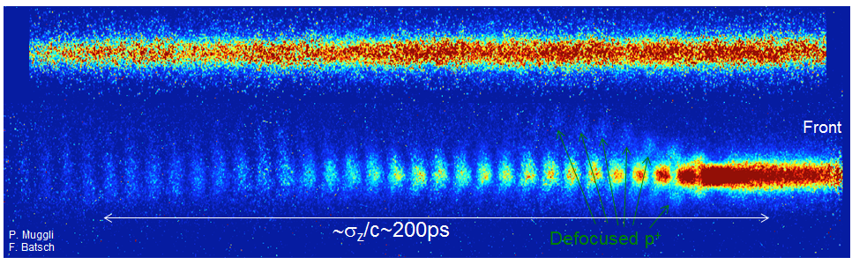
Self-Modulation Measurement Results
Plasma off:
Plasma on:
Plasma off:

Slide 53
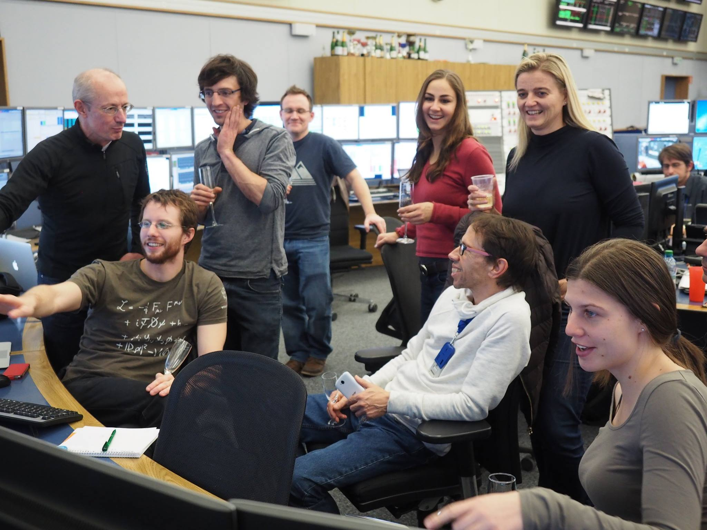
Shortly after we have observed the Seeded-Self Modulation for the first time!

Slide 54
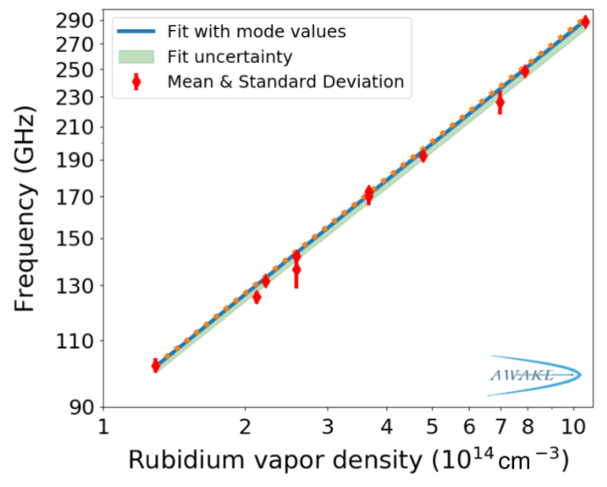
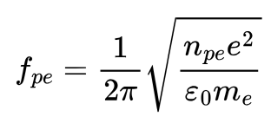
Frequency of Self-Modulation
Prediction:
Spacing of the microbunches → Plasma electron wavelength
Varied in the
experiment
Excellent agreement between prediction and measurement
Now used as a tool to measure plasma density→ only method at the % level
AWAKE Collaboration, Phys. Rev. Lett. 122, 054802 –2019
54

Slide 55
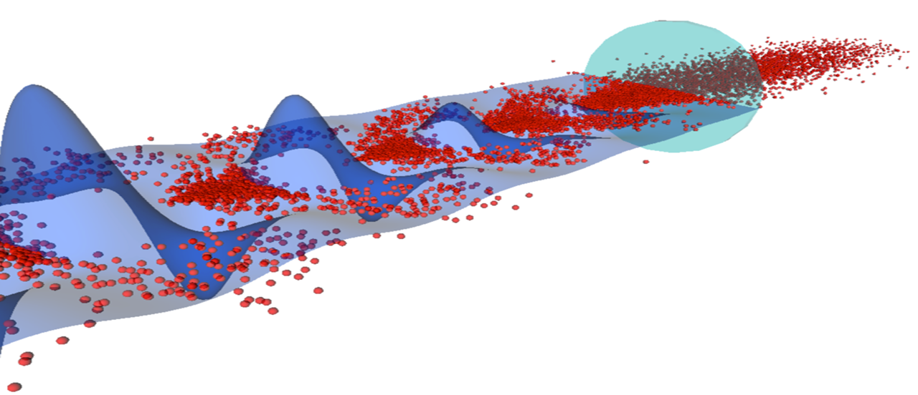
Wakefield (blue)
Protons (red)
e⁻
Gaussian proton beam distribution
Laser (green)
Defocused protons
Focused micro-bunch

Slide 56
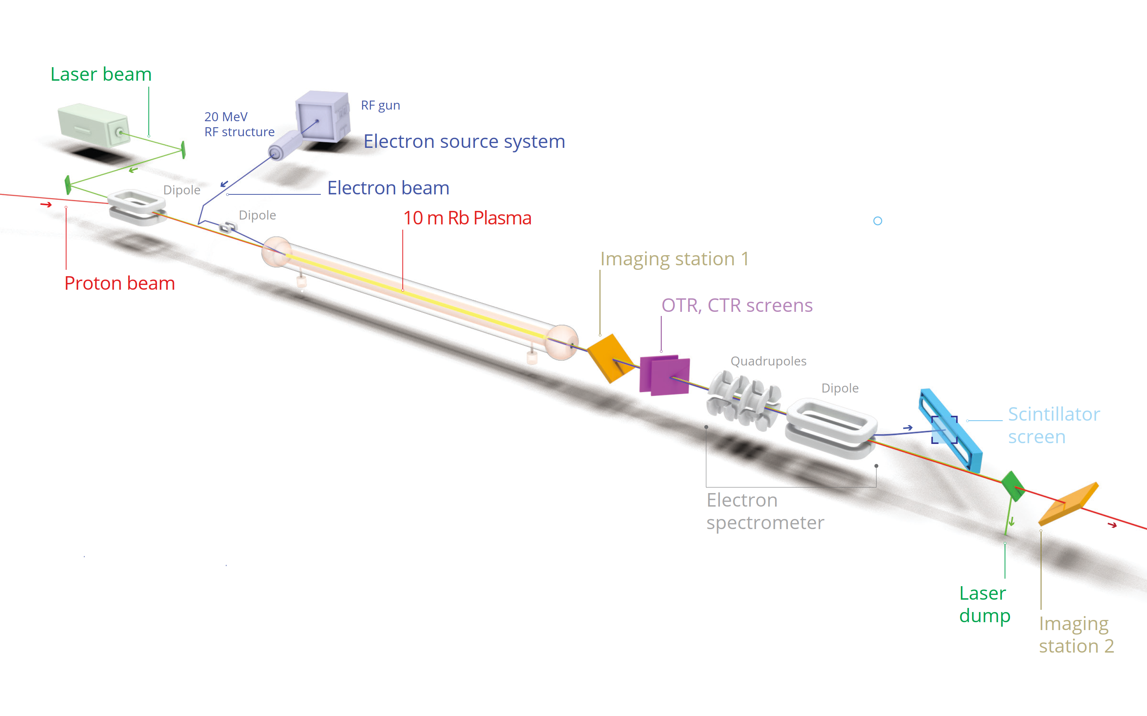

Slide 57
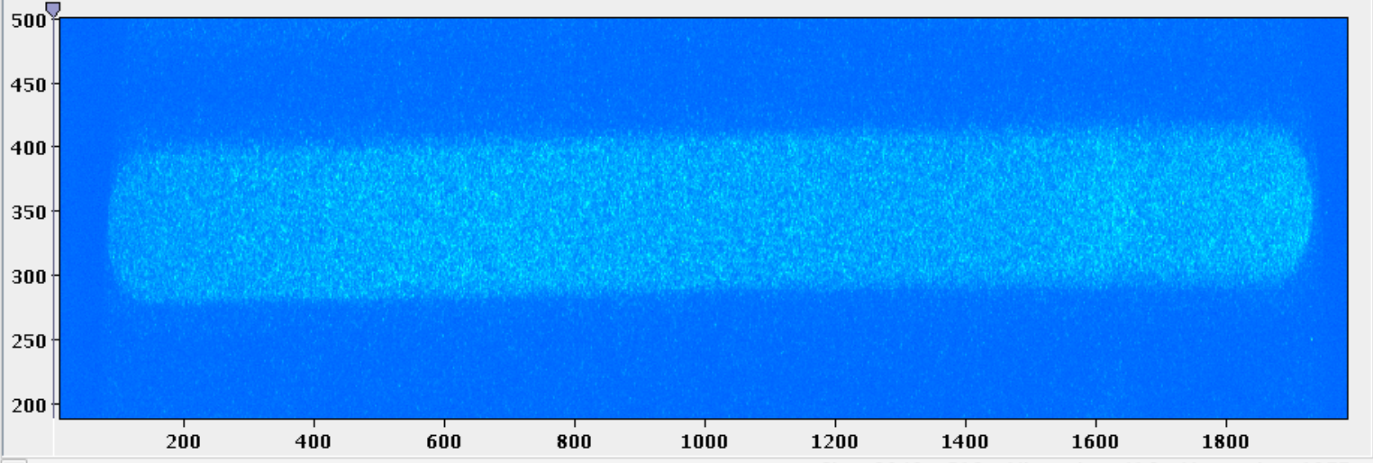
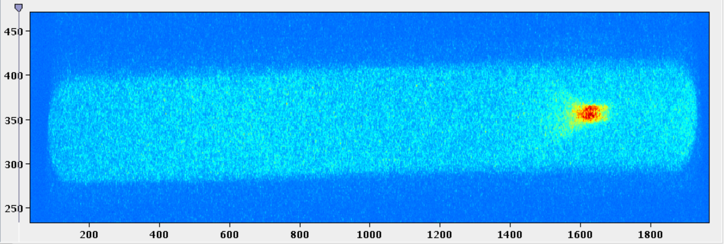
First Electron Acceleration
No electrons accelerated.
Accelerated electrons.

Slide 58
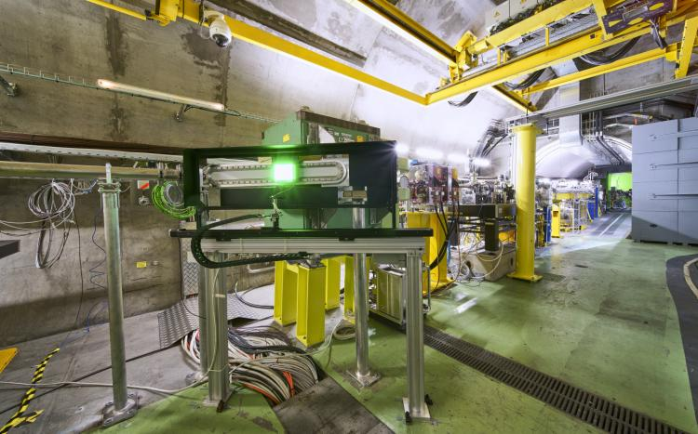
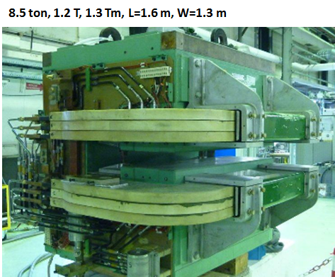
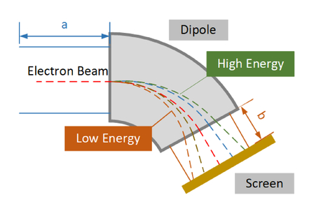
Image from: Yan Shen et alIE 11909, Tenth International Symposium on Ultrafast Phenomena and Terahertz Waves (ISUPTW 2021), 119090T (2021);

Slide 59
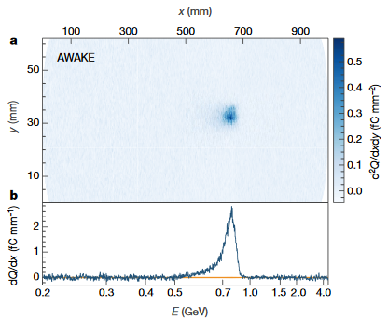
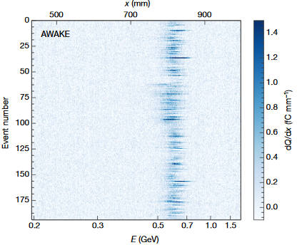
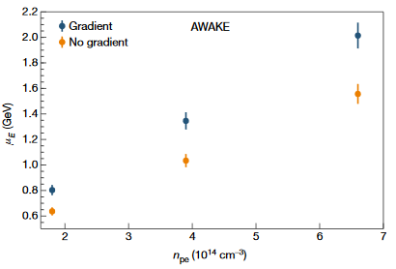
Electron Acceleration Results
AWAKE Collaboration, Nature volume 561, pages 363–367 (2018)

Slide 60
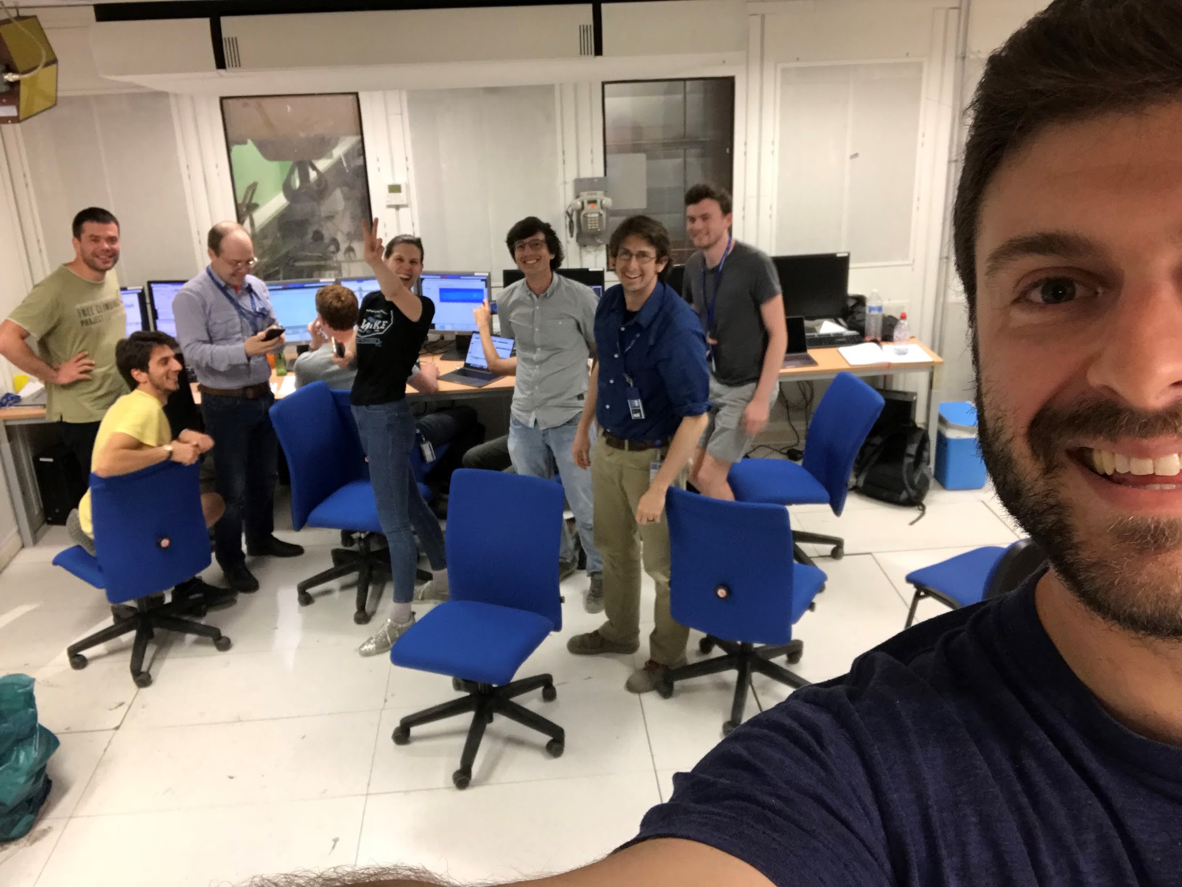
Shortly after we have observed electron acceleration for the first time!

Slide 61
Let Us Repeat…
To realize the AWAKE experiment at CERN, we need:
Plasma (vapor source + laser)
Proton bunch (wakefield driver)
Electron bunch (witness – to be accelerated)
AWAKE was able to show that:
Proton bunches do self-modulate and drive high-amplitude wakefields
Electrons can be accelerated in these wakefields to GeV energies

Slide 62
Outline
Introduction
What’s next?
Summary
Physics of plasma wakefields
AWAKE Experiment
State of the Art

Slide 63
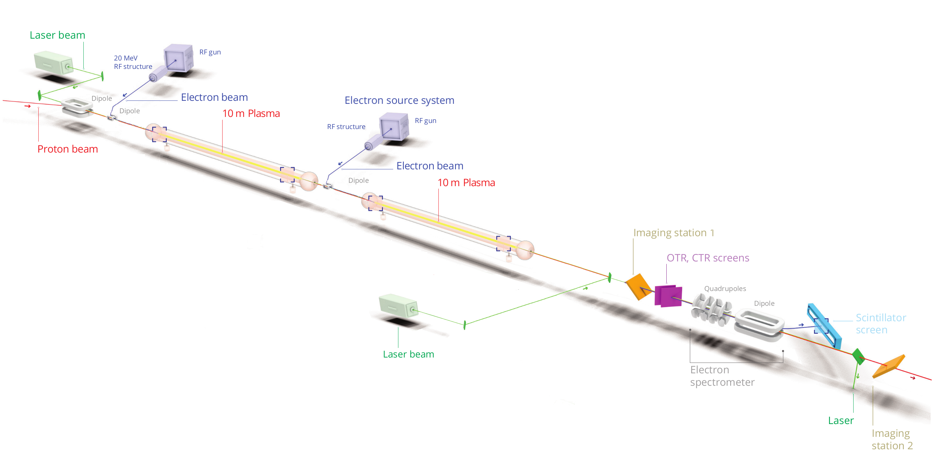
Next: Two Plasmas
Separate Self-Modulation from acceleration to accelerate bunches with quality
Experiments starting in 2029
Expected parameter reach:
ε_{N} = (2-30) mm-mrad
Q = 100 pC, N_{e-}~6x10⁹ e-
∆E/E = 5-8%
Run 2c: E ~ 4-10 GeV, 10m
63

Slide 64
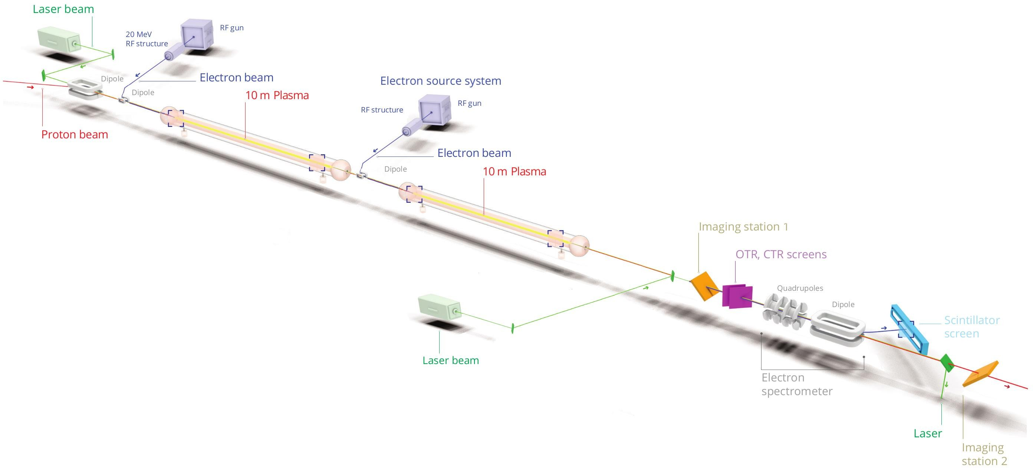
Next Next: Demonstration of Scalability Use Scalable Plasma Source for Acceleration
→Experiments starting in 2030s
scalable
Expected parameter reach:
ε_{N} = (2-30) mm-mrad
Q = 100 pC, N_{e-}~6x10⁹ e-
∆E/E = 5-8%
Run 2c: E ~ 4-10 GeV, 10m
Run 2d: E >10 GeV, 10+m, scalable
64

Slide 65



Scalable Plasma Source Development
Laser ionization does not scale to long plasma lengths (100m-1km): laser pulse energy depletion!
Plasma source development laboratory as part of AWAKE
Helicon source: magnetized RF discharge
Pulsed discharge
Buttenschön, PPFC 60(7), 075005 (2018)
Torrado, IEEE-TPS 51(12) (2023)

Slide 66

Most Recently: New Plasma Source Technology

Slide 67


Xe
Xe
A = 131

Slide 68
Ar
Ar
(A=40)

Slide 69

He
He
(A=4)

Slide 70
Motion of Ions Leads to Decoherence of Plasma Electron Motion
Rb+
e-
e-
Rb+
Rb+
Rb+
e-
e-
e-
e-
Rb+
Rb+
Rb+
Rb+
Rb+
Rb+
Rb+
Rb+
Rb+
Rb+
e-
e-
e-
e-
e-
e-
e-
e-
Rb+
Rb+
Rb+
Rb+
Rb+
Rb+
e-
e-
e-
e-
e-
e-
e-
e-
e-
e-
e-
e-
e-
e-
e-
Rb+
e-
Rb+
Rb+
Rb+
e-
Rb+
Rb+
Rb+
Rb+
Rb+
Rb+
e-
e-
e-
e-
e-
e-
e-
e-
e-
e-
e-
Rb+
e-
Rb+
Rb+
e-
e-
e-
e-
Rb+
Rb+
e-
Rb+
Rb+
e-
e-
e-
Rb+
Rb+
e-
e-
Rb+
Rb+
Rb+
Rb+
Rb+
Rb+
Rb+
Rb+
Rb+
Rb+
Rb+
e-
Rb+
e-
Rb+
e-
e-
e-
e-
e-
e-
Rb+
Rb+
e-
e-
Rb+
e-
e-
Rb+
Rb+
Rb+
Rb+
Rb+
Rb+
e-
e-
e-
e-
e-
e-
e-
e-
e-
e-
e-
e-
Rb+
e-
e-
e-
Rb+
e-
e-
Rb+
Rb+
Rb+
Rb+
e-
Rb+
Rb+
Rb+
Rb+
e-
e-
e-
e-
e-
e-
e-
e-
e-
e-
e-
e-
e-
e-
Rb+
e-
Rb+
Rb+
e-
Rb+
e-
e-
e-
Rb+
Rb+
e-
e-
e-
e-
Rb+
Rb+
Rb+

Slide 71

tail

Slide 72
Outline
Introduction
What’s next?
Summary
Physics of plasma wakefields
AWAKE Experiment
State of the Art

Slide 73
What’s next?
Plasma wakefield acceleration is a developing concept → trying to make it a technology
For colliders: high risk, high reward

Slide 74

The next collider will need
Number of collisions are produced (per cm² and per second).
E
L
Collision energy defines
what can you discover
Luminosity defines
how likely you are to discover
⇒ Cross section: probability of that a particular event occurs
Notes:
A lot of opinions and a lot of discussion out there on what is the right thing to do and why,
We are accelerator physicist and we have to build a machine

Slide 75
What’s next?
Plasma wakefield acceleration is a developing concept → trying to make it a technology
For colliders: high risk, high reward
Next steps
Produce also high-quality beams (with high charge)
Start using them for first applications: medical accelerators, FELs, radiation generation,…

Slide 76
Summary and Conclusions
Plasma wakefield acceleration is a novel technique to accelerate charged particles
Advantage: Very high accelerating gradient, compact accelerators
Proof of principle acceleration is demonstrated
AWAKE is an accelerator R&D experiment at CERN:
Only proton-driven wakefield acceleration experiment worldwide
The experiment opens a pathway towards particle physics applications
Next step: aim for high beam quality in long plasmas→ first applications
Final Goal: Design high quality & high energy electron accelerator based on acquired knowledge.

Slide 78
Leaderboard
Position
Participants
Score
🏆
Total participants: 0
Average Score: - / 5

Slide 79
Join the Vevox session
Go to vevox.app Enter the session ID: 131-113-101 Or scan the QR code

